Slide 1
Barrick (1979)

Slide 2
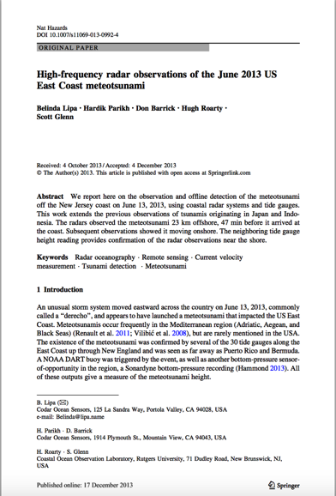
Meteotsunami June 2013

Slide 3
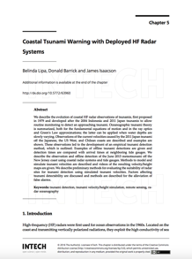
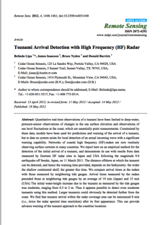
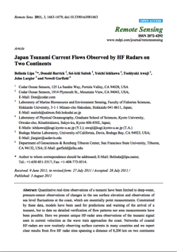
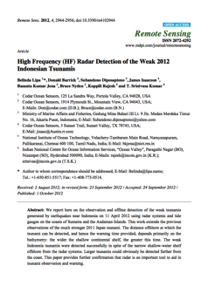
Japan (2011) Indonesia (2012)

Slide 4
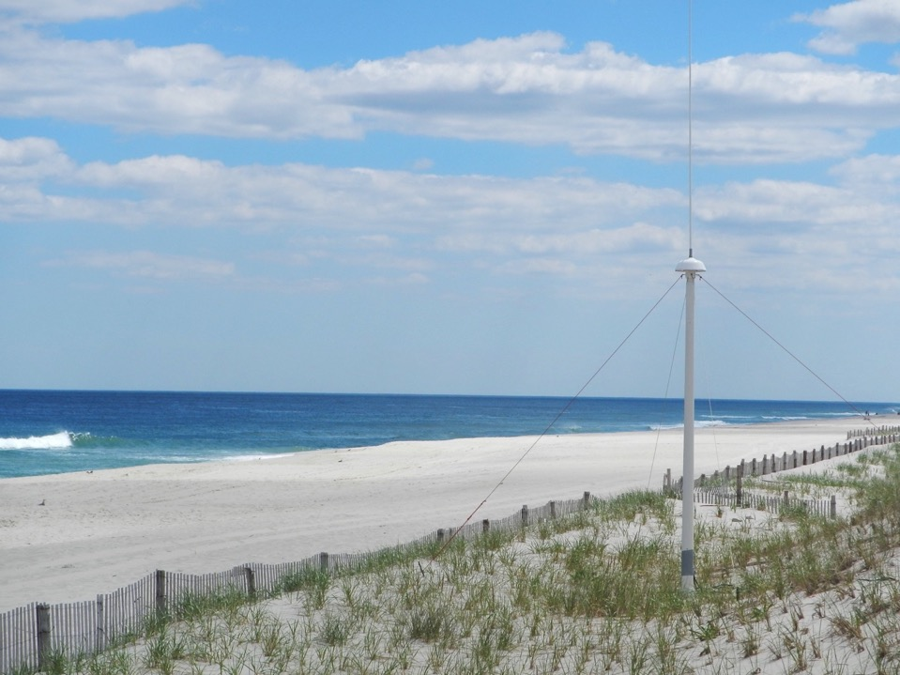
HF Radar Network Operation
Hugh Roarty
Rutgers University MARACOOS

Slide 5
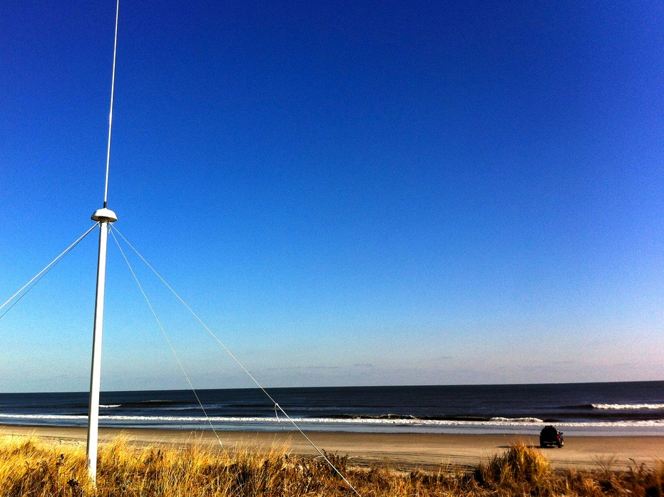
Outline
Introduction to HF Radar
Past Results
Network Operation
Hurricane Sandy
Storm Resiliency
Antenna Calibration

Slide 6
Introduction to High Frequency Radar
INTRODUCTION TO HF RADAR

Slide 8
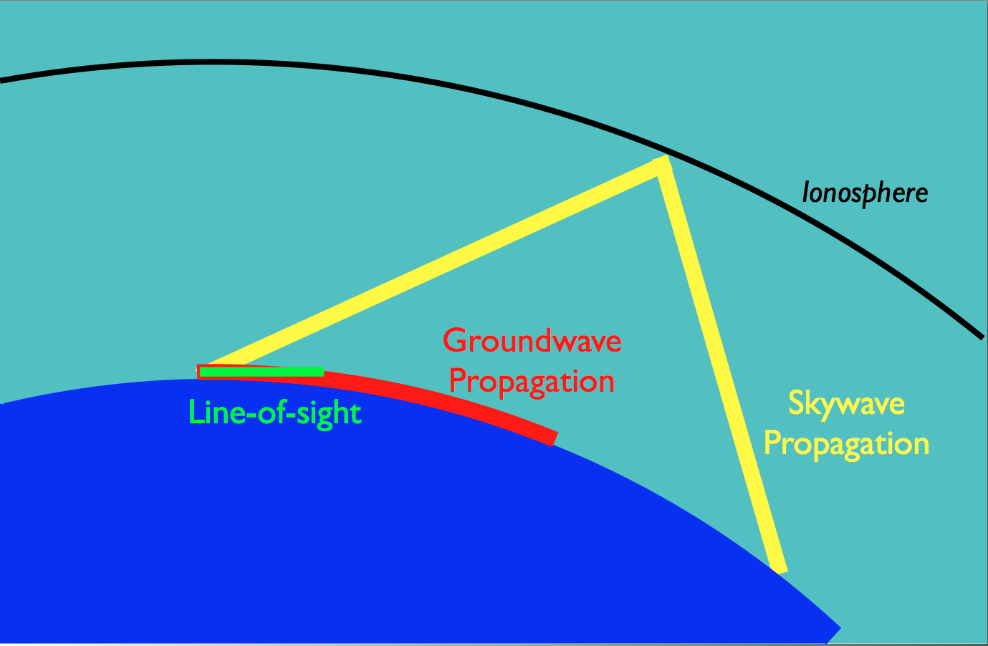
“The benefits of
HF radar are over the horizon measurements and
persistent surveillance”
Radar measures roughness and motion

Slide 9
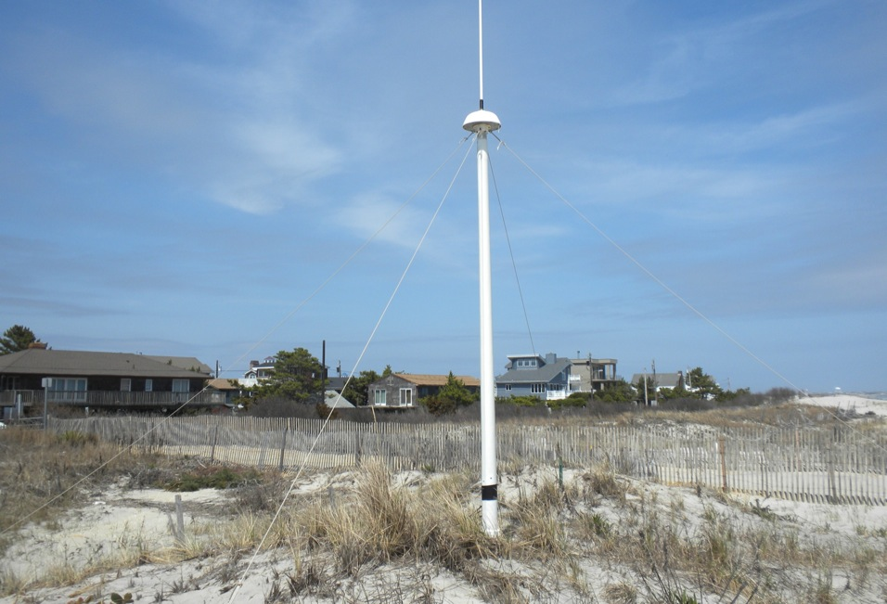
13 MHz Transmit and Receive Antenna
4 meters

Slide 11
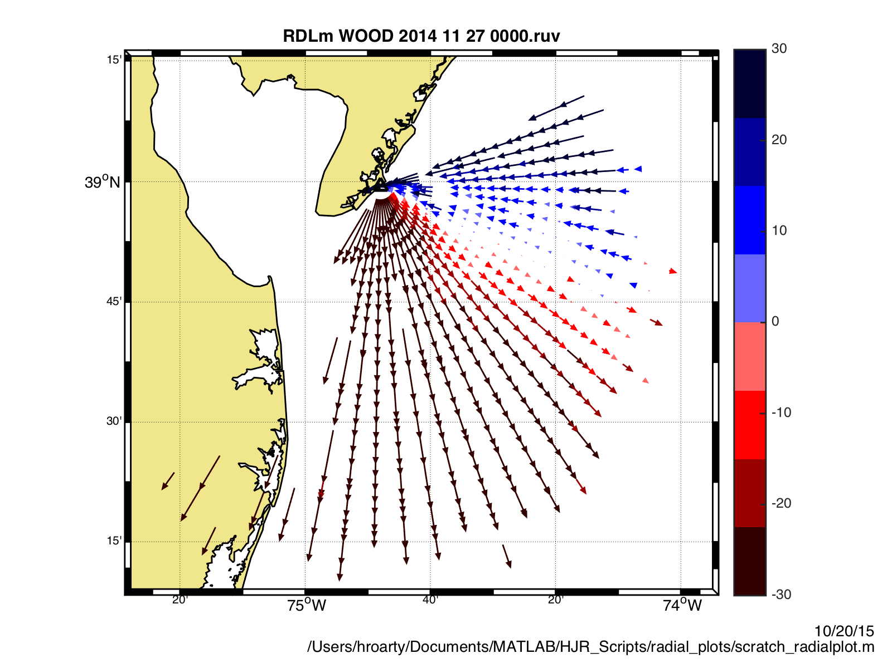
Radial Surface Currents

Slide 12
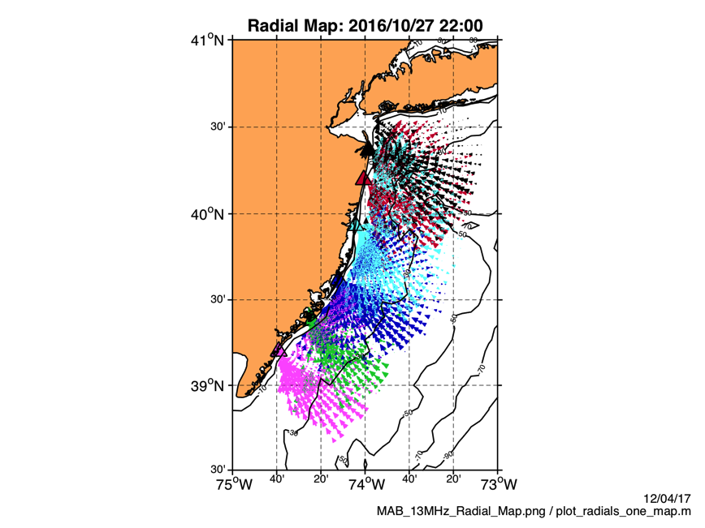

Slide 13
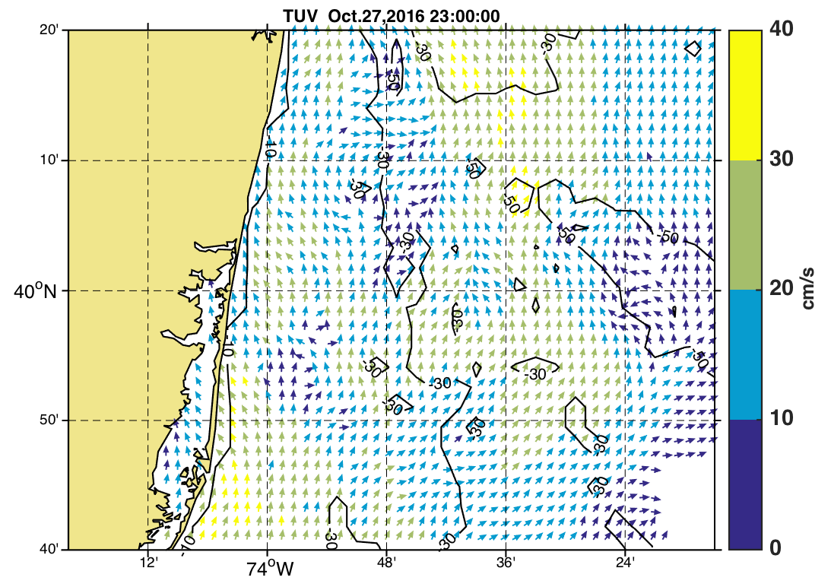
Total Vector Surface Currents: October 27, 2016 23:00 GMT
Long Branch

Slide 15
Previous Results

Slide 16
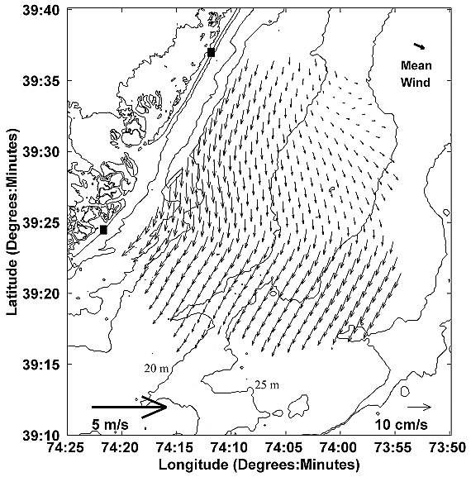
Seasonal current variability on the New Jersey inner shelf
Journal of Geophysical Research: Oceans Volume 109, Issue C7, C07S07, 31 JUL 2004 DOI: 10.1029/2003JC001963 http://onlinelibrary.wiley.com/doi/10.1029/2003JC001963/full#jgrc9416-fig-0004
May 1999 to May 2000
Notes:
Annual mean currents measured between May 1999 and May 2000 with the HF radar system. The mean wind measured at the marine field station (upper right), the current scale (lower right), and wind scale (lower left) are also shown.
IF THIS IMAGE HAS BEEN PROVIDED BY OR IS OWNED BY A THIRD PARTY, AS INDICATED IN THE CAPTION LINE, THEN FURTHER PERMISSION MAY BE NEEDED BEFORE ANY FURTHER USE. PLEASE CONTACT WILEY'S PERMISSIONS DEPARTMENT ON PERMISSIONS@WILEY.COM OR USE THE RIGHTSLINK SERVICE BY CLICKING ON THE 'REQUEST PERMISSIONS' LINK ACCOMPANYING THIS ARTICLE. WILEY OR AUTHOR OWNED IMAGES MAY BE USED FOR NON-COMMERCIAL PURPOSES, SUBJECT TO PROPER CITATION OF THE ARTICLE, AUTHOR, AND PUBLISHER.

Slide 17
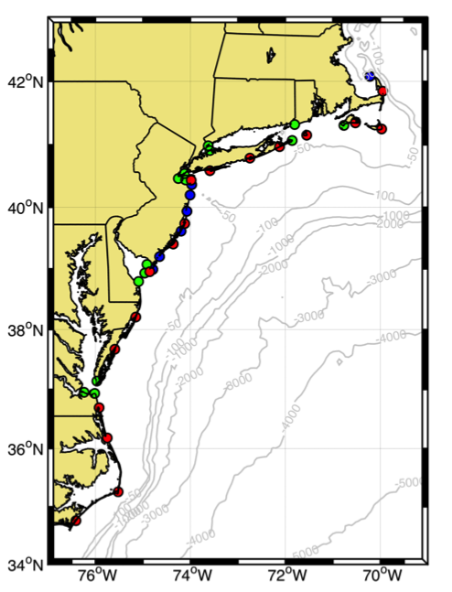

Slide 18
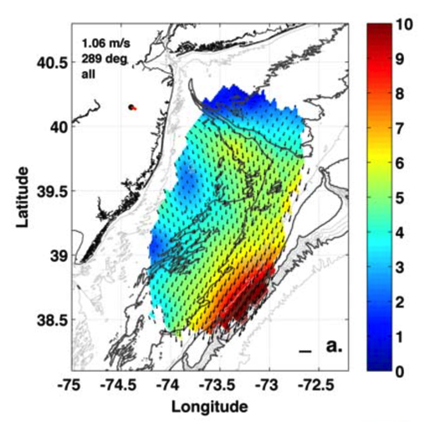
Seasonal Climatology of Wind-Driven Circulation on the New Jersey Shelf
Journal of Geophysical Research: Oceans Volume 115, Issue C4, C04006, 3 APR 2010 DOI: 10.1029/2009JC005520 http://onlinelibrary.wiley.com/doi/10.1029/2009JC005520/full#jgrc11438-fig-0003

Slide 21
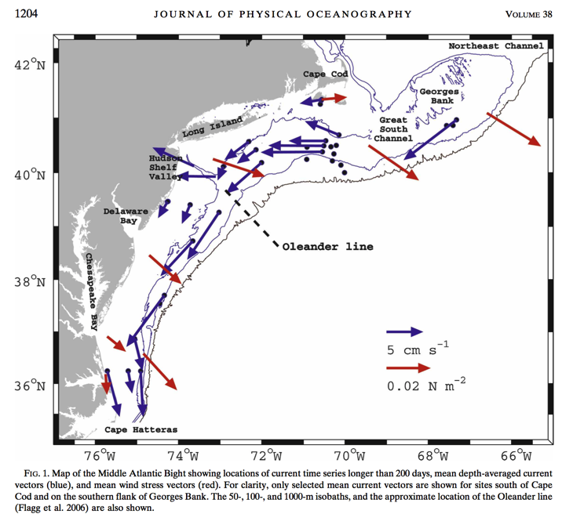
Lentz (2008)

Slide 22
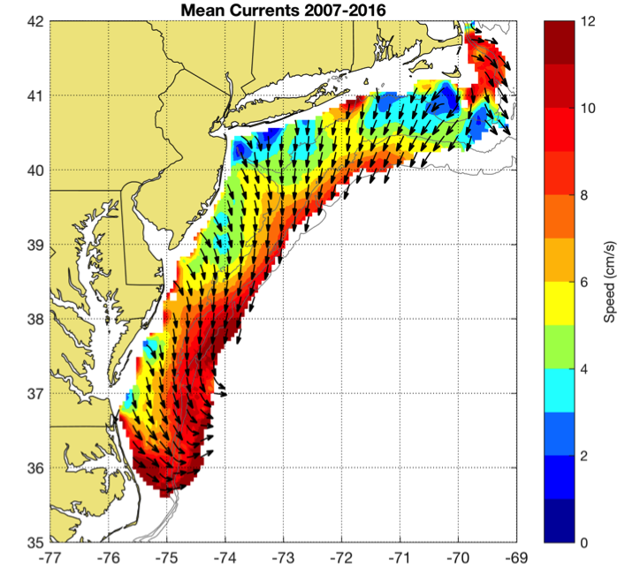
Decadal Mean
Detided using t_tide
30 hour low pass filter applied
50% temporal coverage required

Slide 23
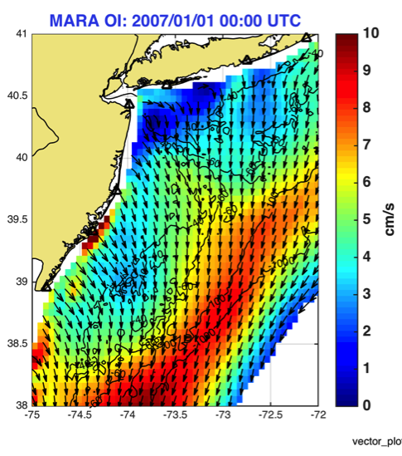
Gong et al. 2009
2002-2007
Roarty et al. (In Prep)
2007-2016

Slide 24
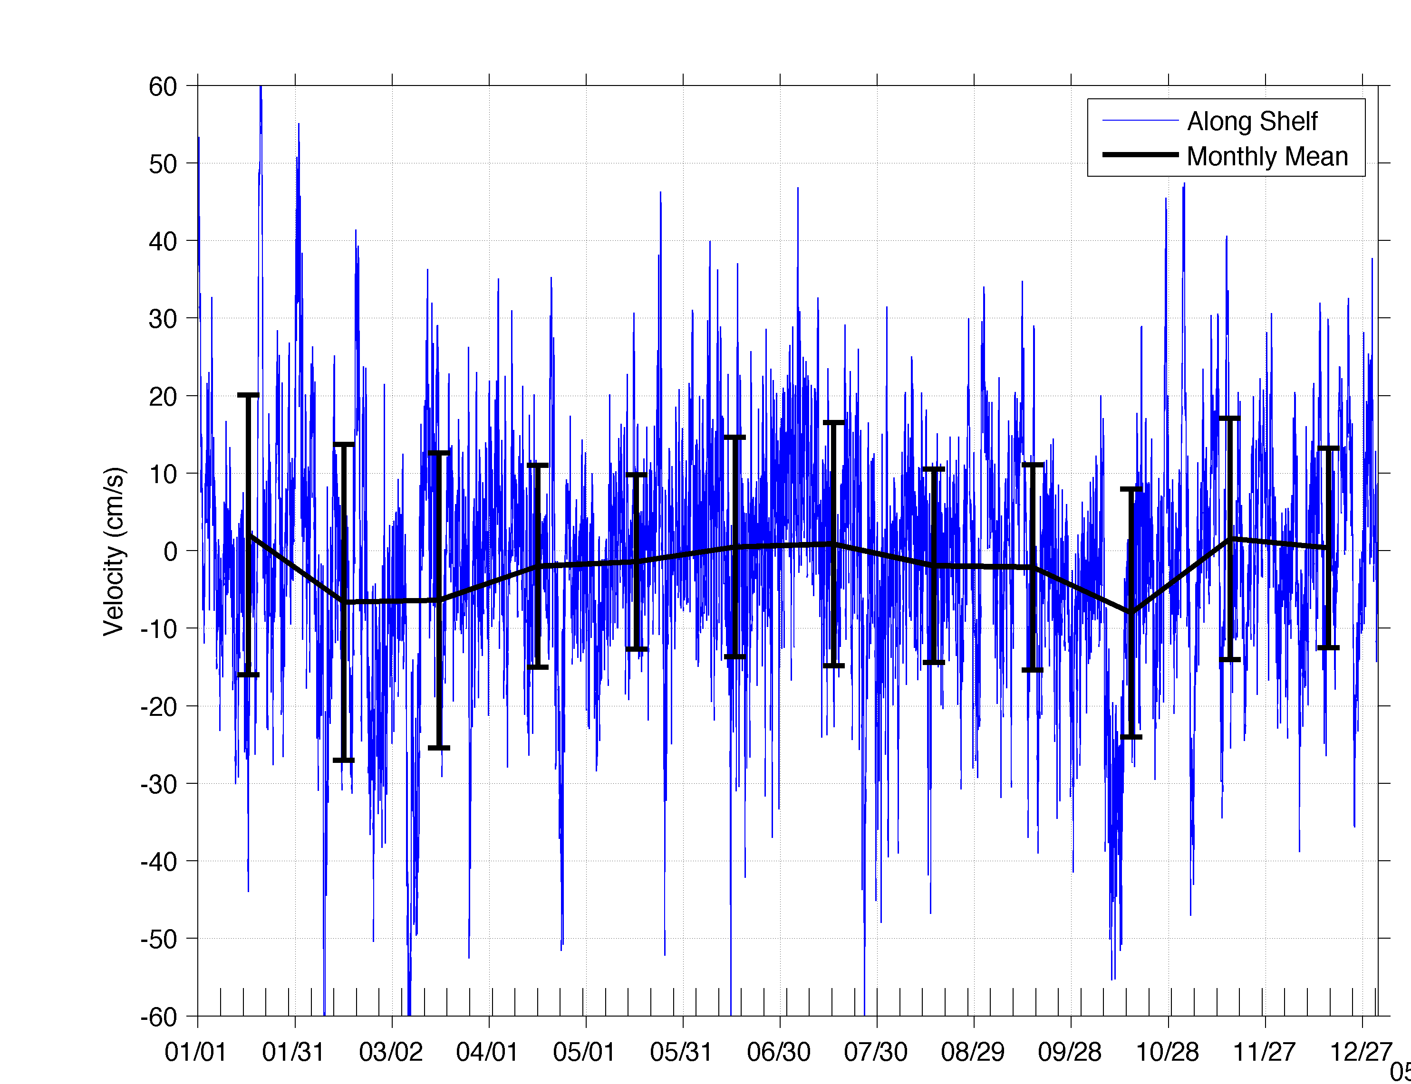
Hourly Along Shelf Mean Currents 2013

Slide 25
NETWORK OPERATION

Slide 26
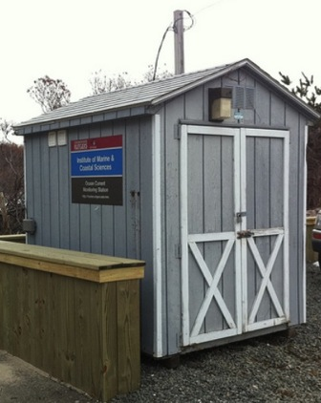
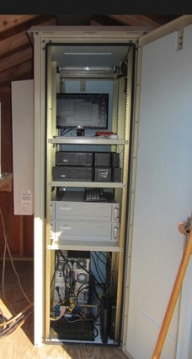
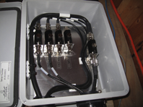
Standard CODAR Shore Site: Shed, Enclosure, Tx/Rx, Comms, Power, GPS, AIS
monitor
computer & external hard drive
A.C. unit
UPS system
transmitter
receiver
Two lines of Communication
Shed
Enclosure
Lightning Protection

Slide 27
MARACOOS HF RADAR NETWORK
 | 5 MHz | 13 MHz | 25 MHz
U Mass
WHOI
U Conn
URI
Rutgers
ODU
UNC
Total | 17 | 8 | 16
41 Stations in Total

Slide 28
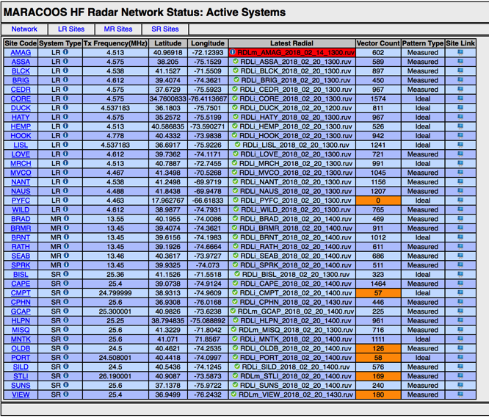
Central Monitoring

Slide 29
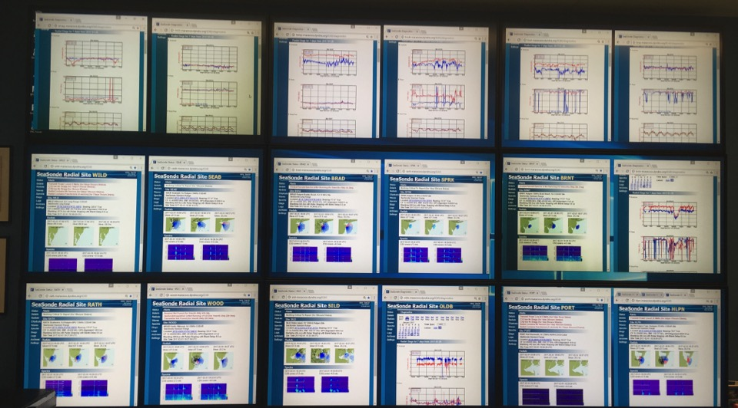
Central Monitoring

Slide 30
Hurricane Sandy October 2012
Hurricane Sandy 2012

Slide 31
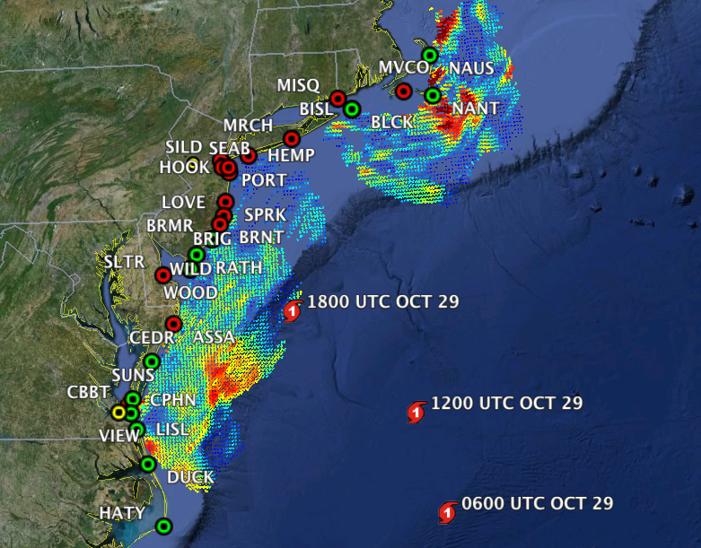

Slide 32
Seaside park
Seaside Park, NJ

Slide 33
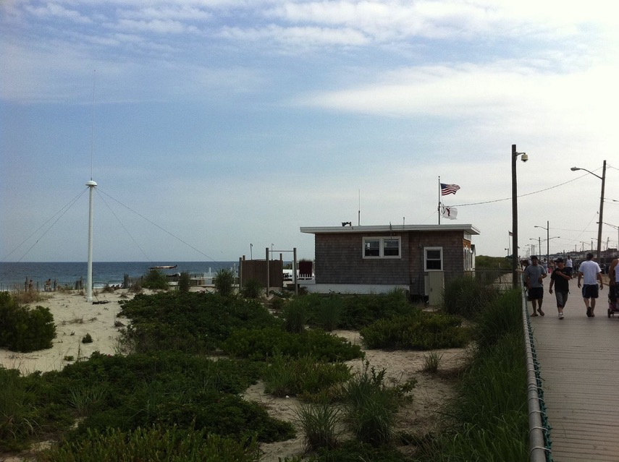

Slide 34
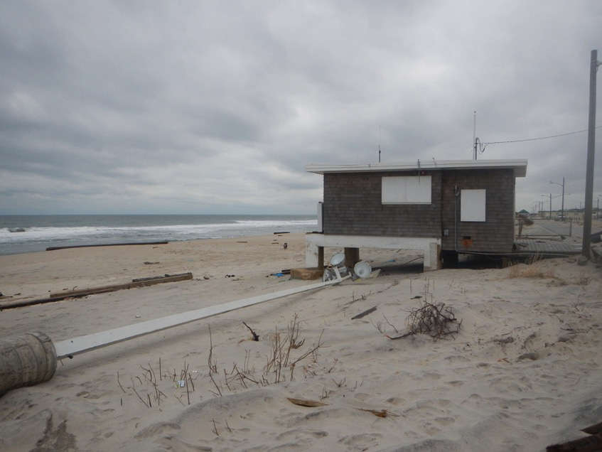

Slide 36
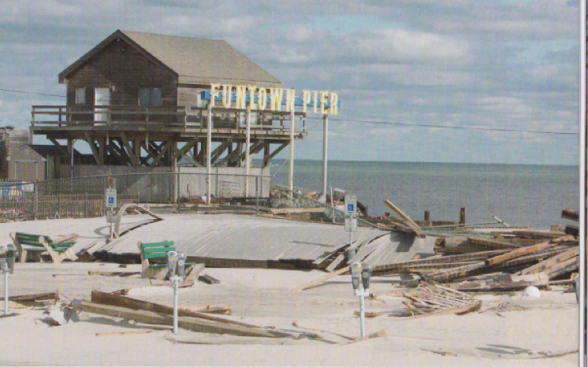

Slide 37
RESILIENCY & Hardening
Resiliency

Slide 38
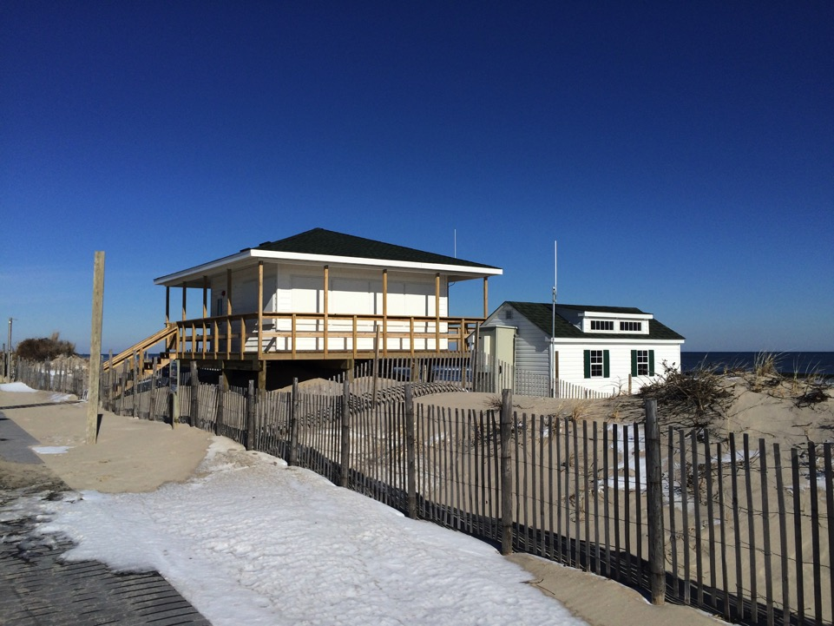

Slide 39
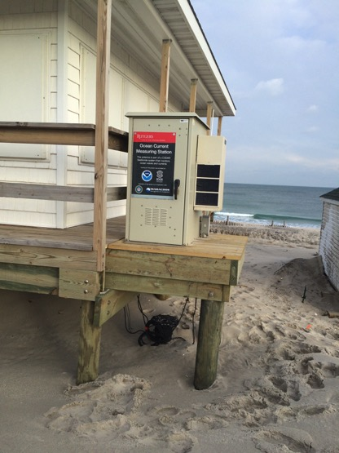
Seaside Park, NJ

Slide 40
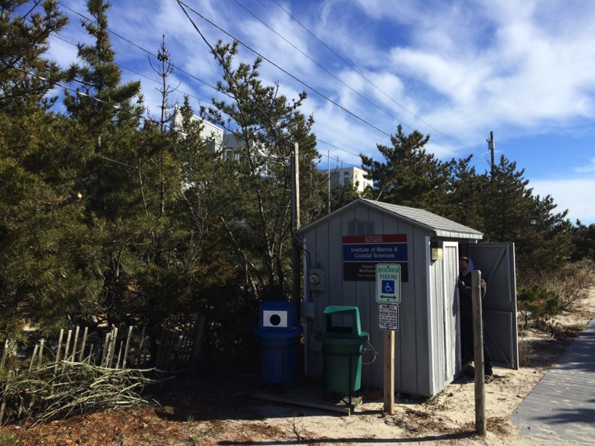

Slide 41
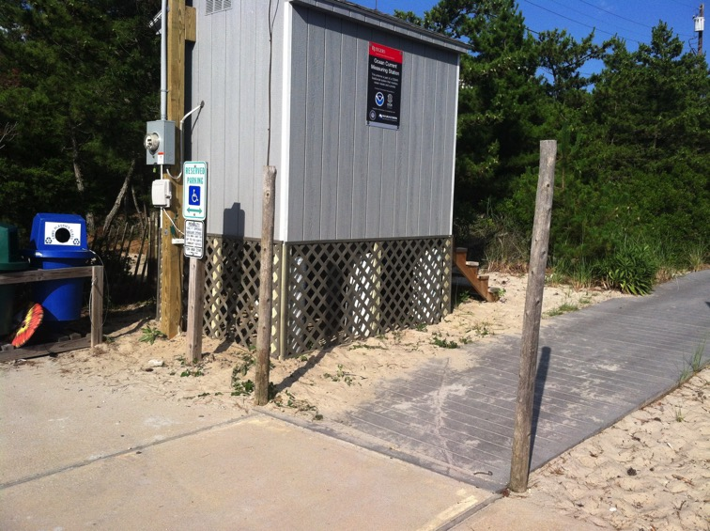
Loveladies, NJ

Slide 42
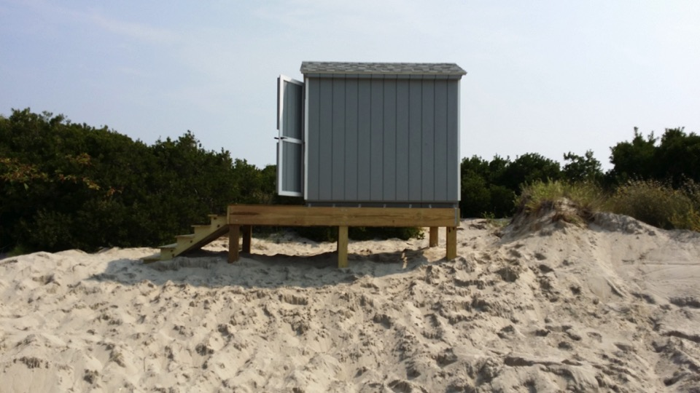
Brigantine, NJ

Slide 43
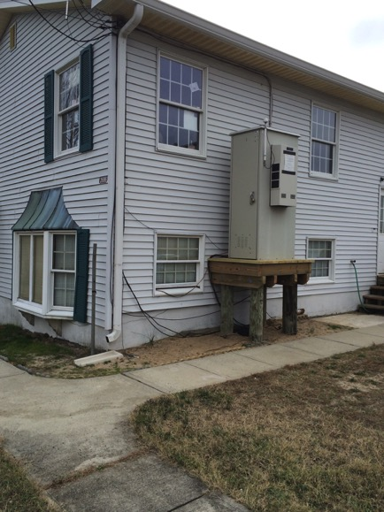
Port Monmouth, NJ

Slide 44
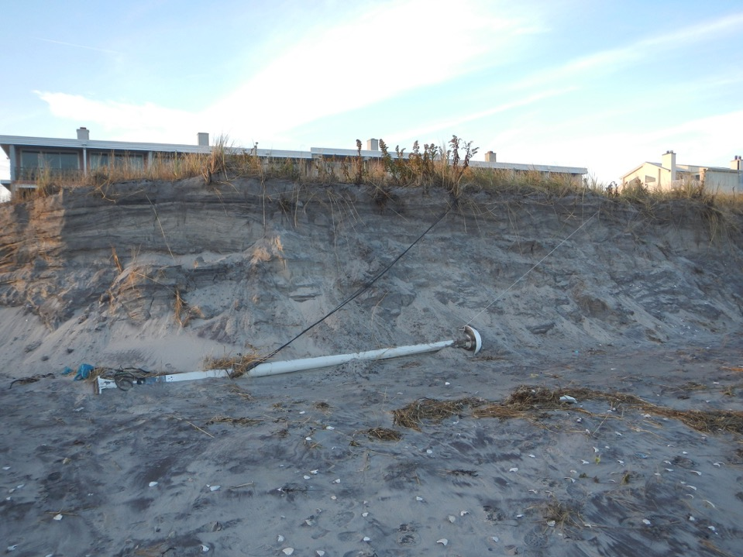

Slide 45
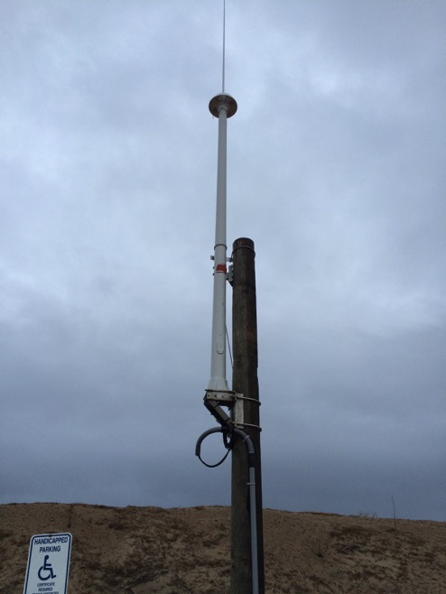

Slide 46
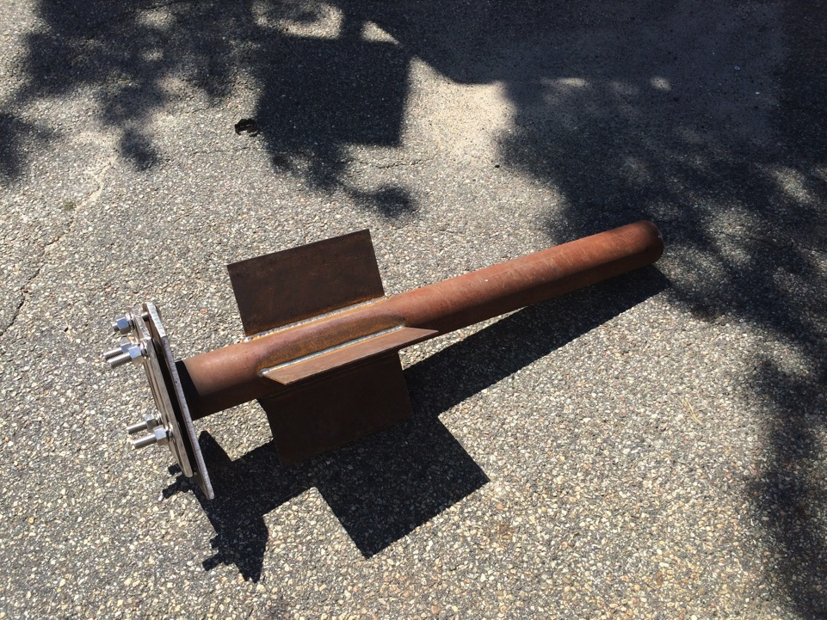
Antenna Base

Slide 47
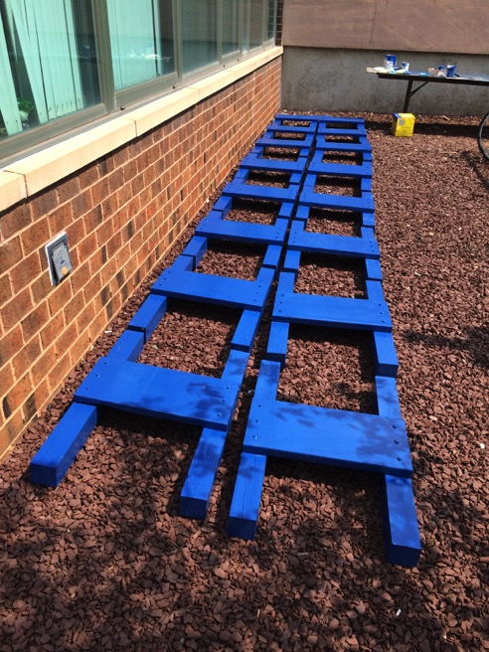
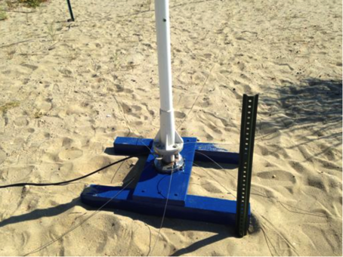

Slide 48
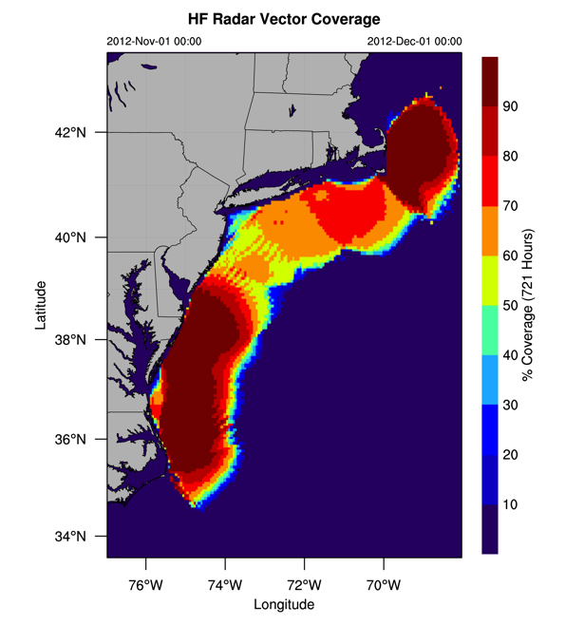
Data Coverage November 2012

Slide 49
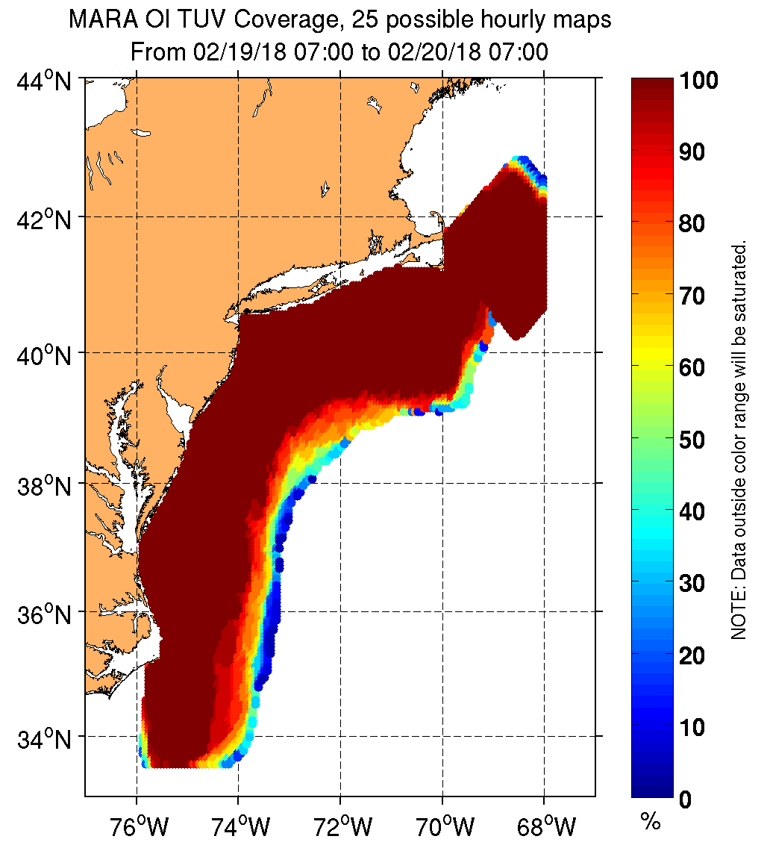
Data Coverage February 20, 2018

Slide 50
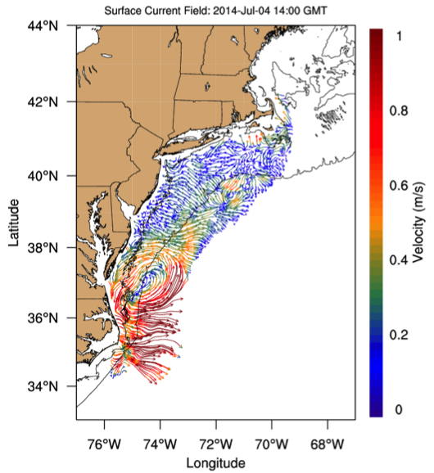
Hurricane Arthur 2014

Slide 51
Antenna Calibration

Slide 52
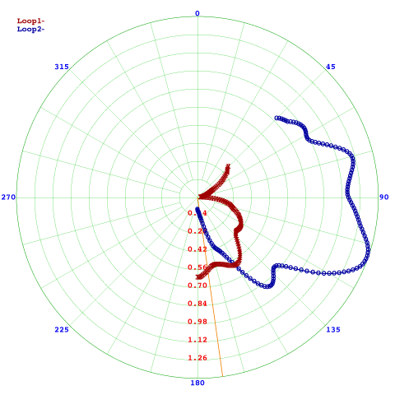
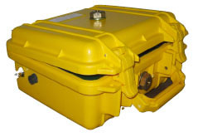
Antenna Pattern Procedure
BRNT 2017_11_20

Slide 53
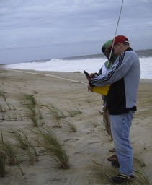
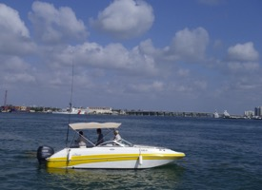
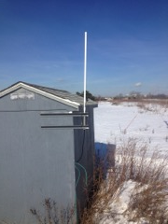
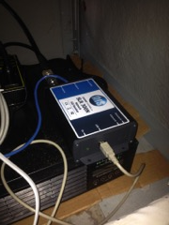
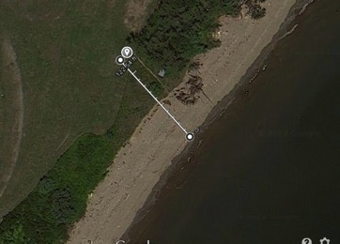
Pattern Methods
Walking
Boat
AIS
- 25 MHz system = ~12 m wavelength
- Rule of thumb suggested by CODAR is to be more than 1 wavelength away from the antenna (and other objects) during pattern calibration
~35 m

Slide 54
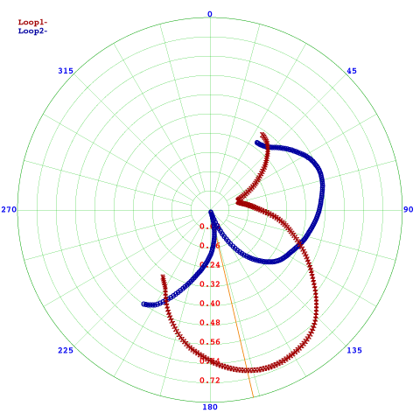
Pattern Results
Walking – 10º smooth
Boat – 10º smooth
AIS – 12º smooth

Slide 55
Outline
Introduction to HF Radar
Past Results
Network Operation
Hurricane Sandy
Storm Resiliency
Antenna Calibration

Slide 56
HF Radar Network Operation
THANK YOU

