Slide 1
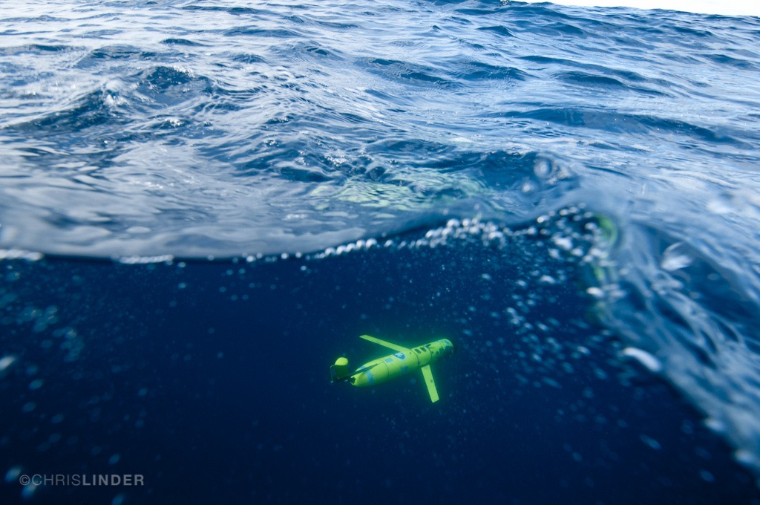

Dawn in the age of robotic oceanography
Oscar Schofield on behalf of many!!!
Take home messages
We have new ways of doing oceanography
Platforms are mature, we need sensors
Sensor webs, no longer about one technology
New directions

Slide 2
This morning session is about thinking big and how can we do things differently
Spanning the scales: Multi-platform approaches for integrated studies of biogeochemistry and physics (Craig Lee, APL/UW)
Stretching the scales of surface ocean observing systems: Biogeochemical observations from the Saildrone USV (Jessica Cross, NOAA/PMEL)
Robotic systems for survey and sampling of the mesopelagic (Dana Yoerger, WHOI)
My biased timeline on how much has changed in my career in ocean robotics (people) that inspired me
Pliestocene
Late 1980’s
Early 1990’s
Early 2000’s
Early 2000’s
AOSN and LEO-15 alternating coastal experiments
Ray Smith measuring UV under ice with an ROV
Late 1990’s
Late 2000’s
Early 2000’s
Dad (JPL scientist)
built me Star Trek consul
and watched bad TV
ARGO begins to be deployed
Stommel’s backyard neighbor Doug Webb realizes Henry’s vision
Stommel’s Bold Vision
In TOS
Chris von Alt & Jim Bellingham building AUVs

Slide 3
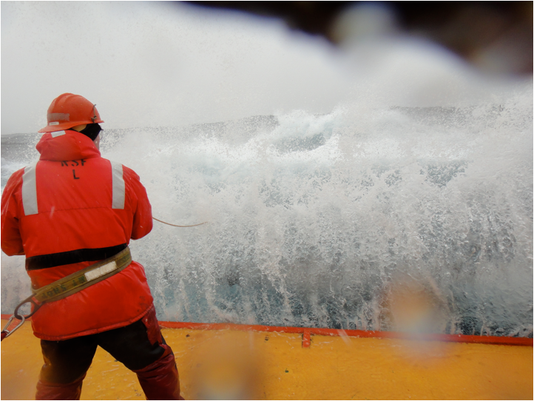
WHY?
-Humans at sea have limits
-Sustain a presence at sea

Slide 4
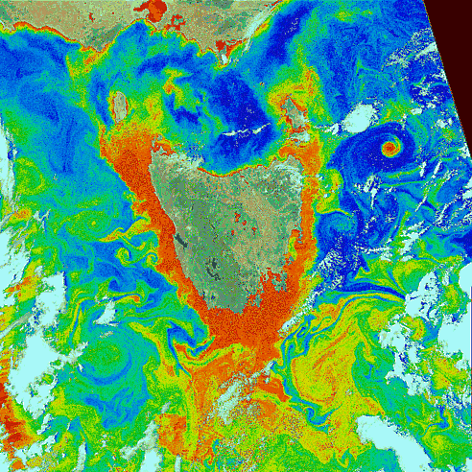
WHY?
-Sampling Space
-Cost Effective
GSFC, NASA (thanks Tommy Dickey)
Schofield et al. 2007
Sample this with a ship……..
Scalable technology……..

Slide 5
A small group can have a big footprint as the platforms are robust
Rutgers COOL deployments
As of June 28th

Slide 6
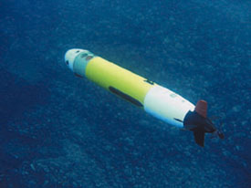
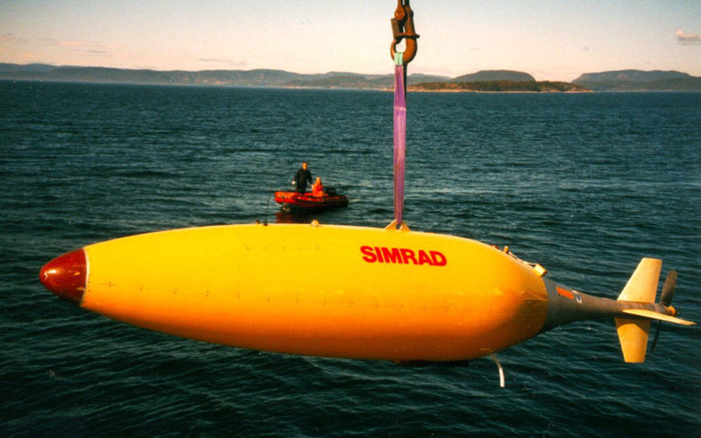
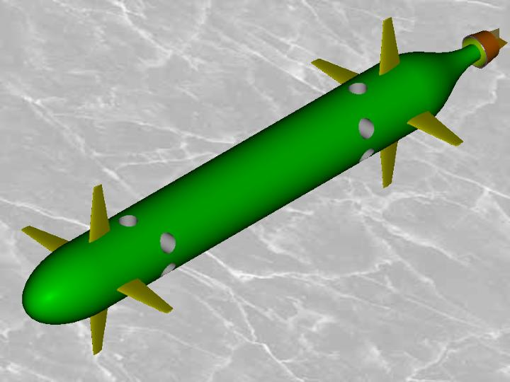
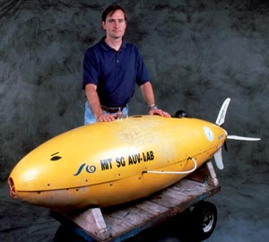
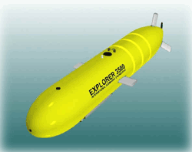
Propeller Systems Diverse highly varied and we can sample the ocean interior
Highly capable of studying boundary problems, high resolution sampling, and in general capable of collecting a wider range of data

Slide 7
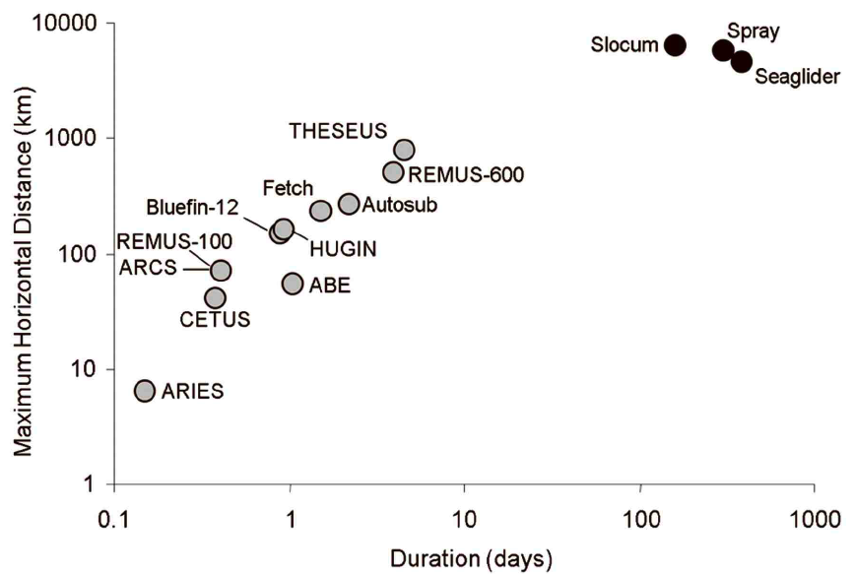
Waveglider
Moline & Schofield 2009
Moline et al. 2009
Moline et al. 2009
Moline et al. 2009
Moline et al. 2009

Slide 8
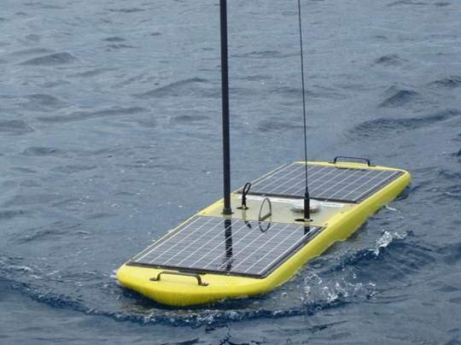
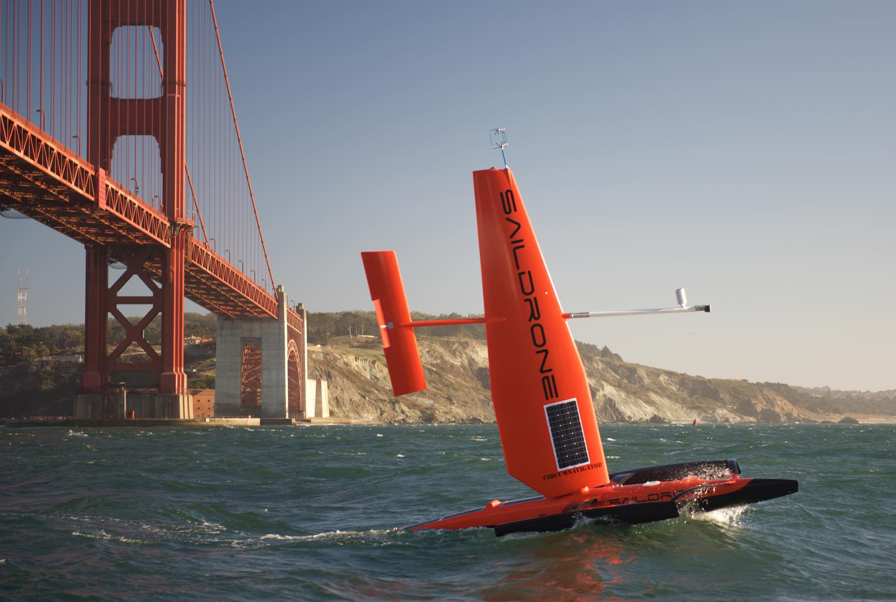
Surface vehicles rapidly maturing! We can sample the interface
Wave Glider
Sail Drone

Slide 9
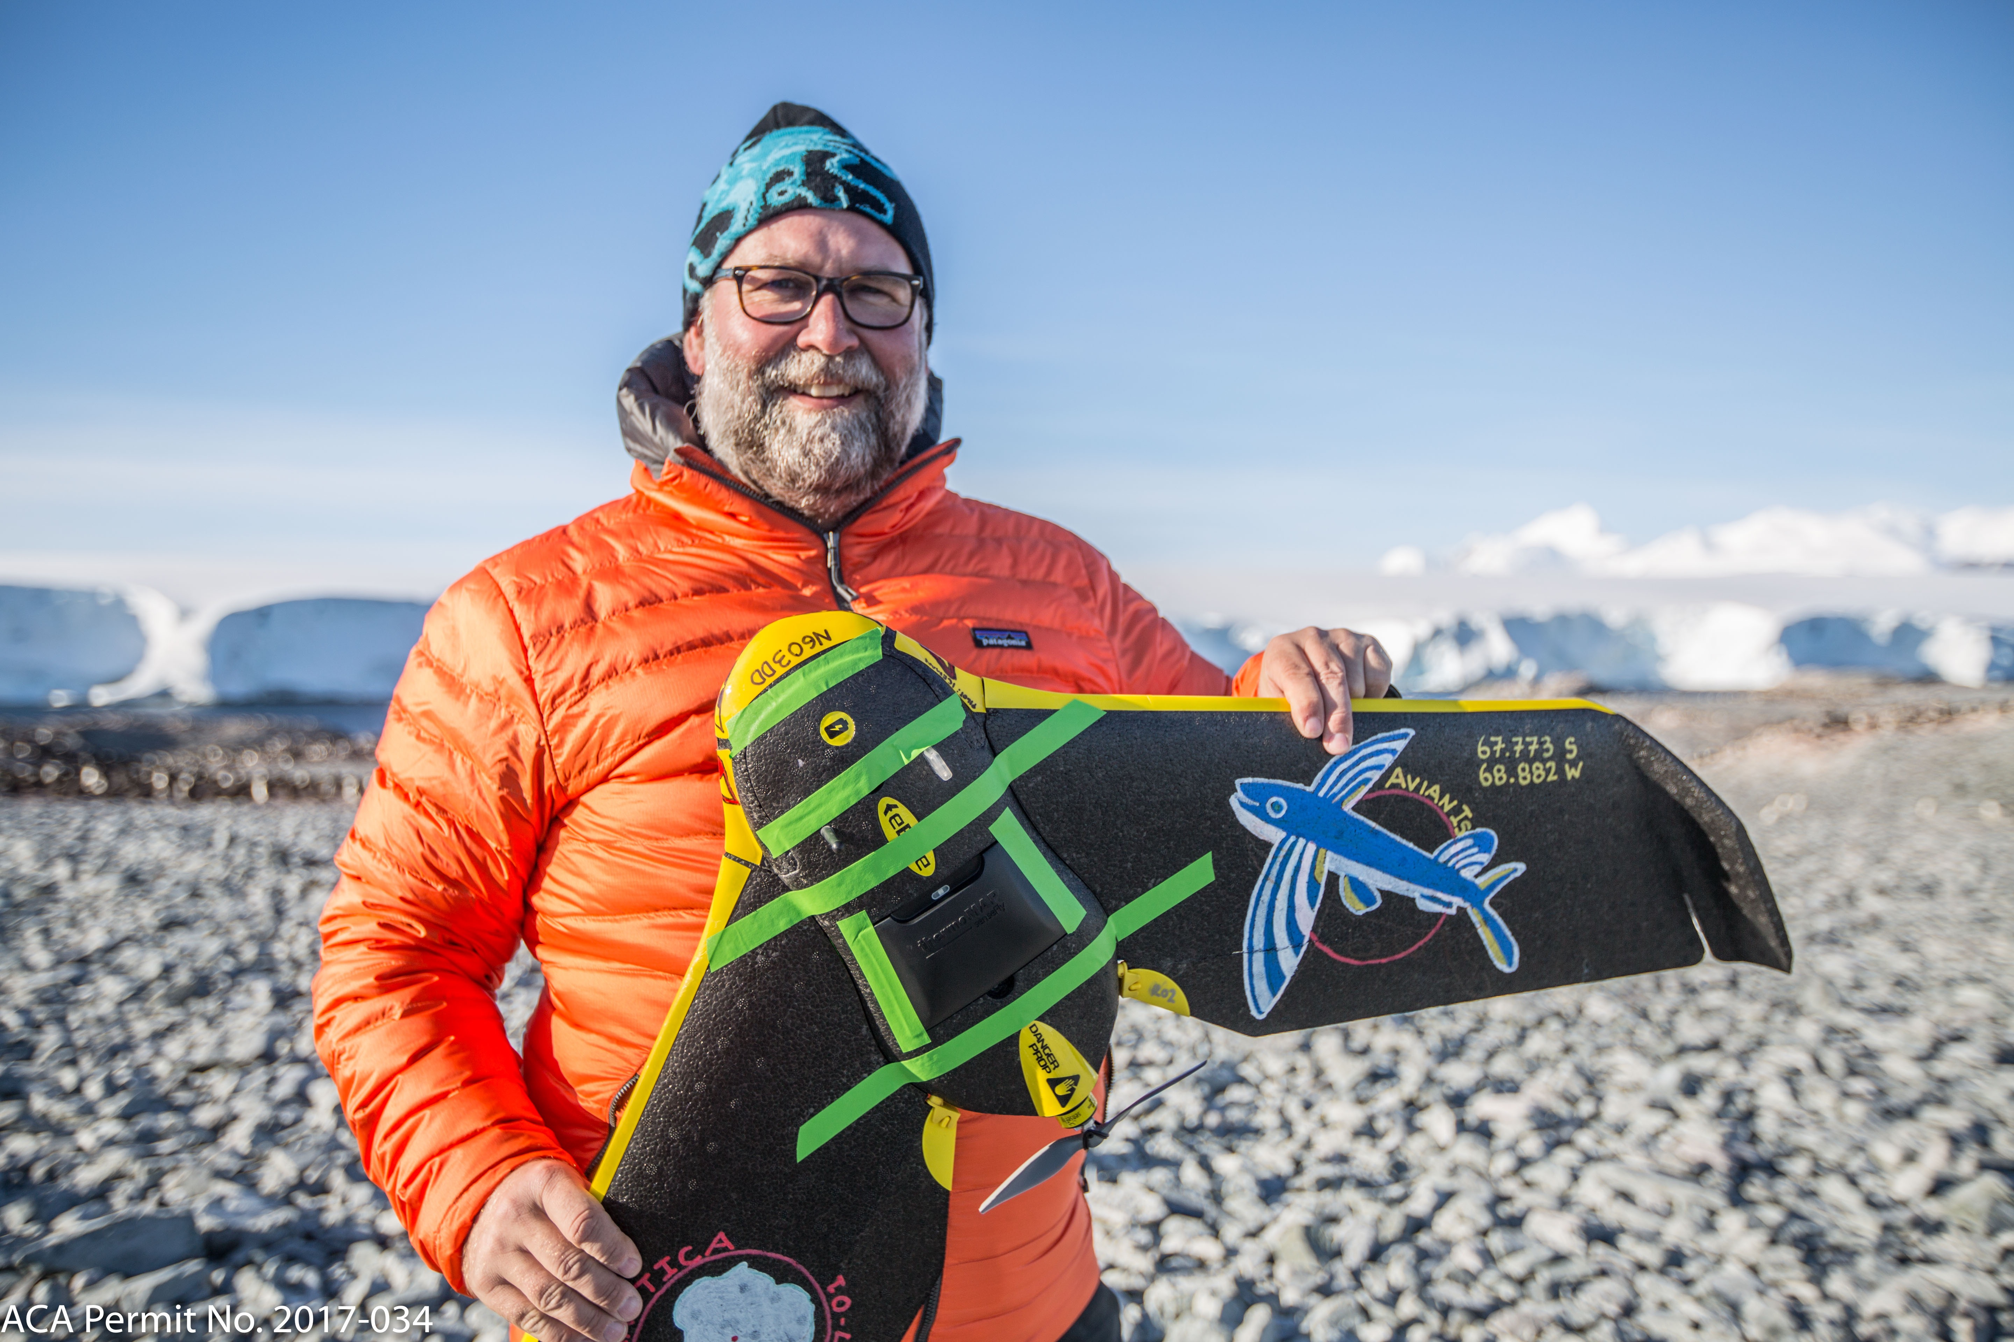
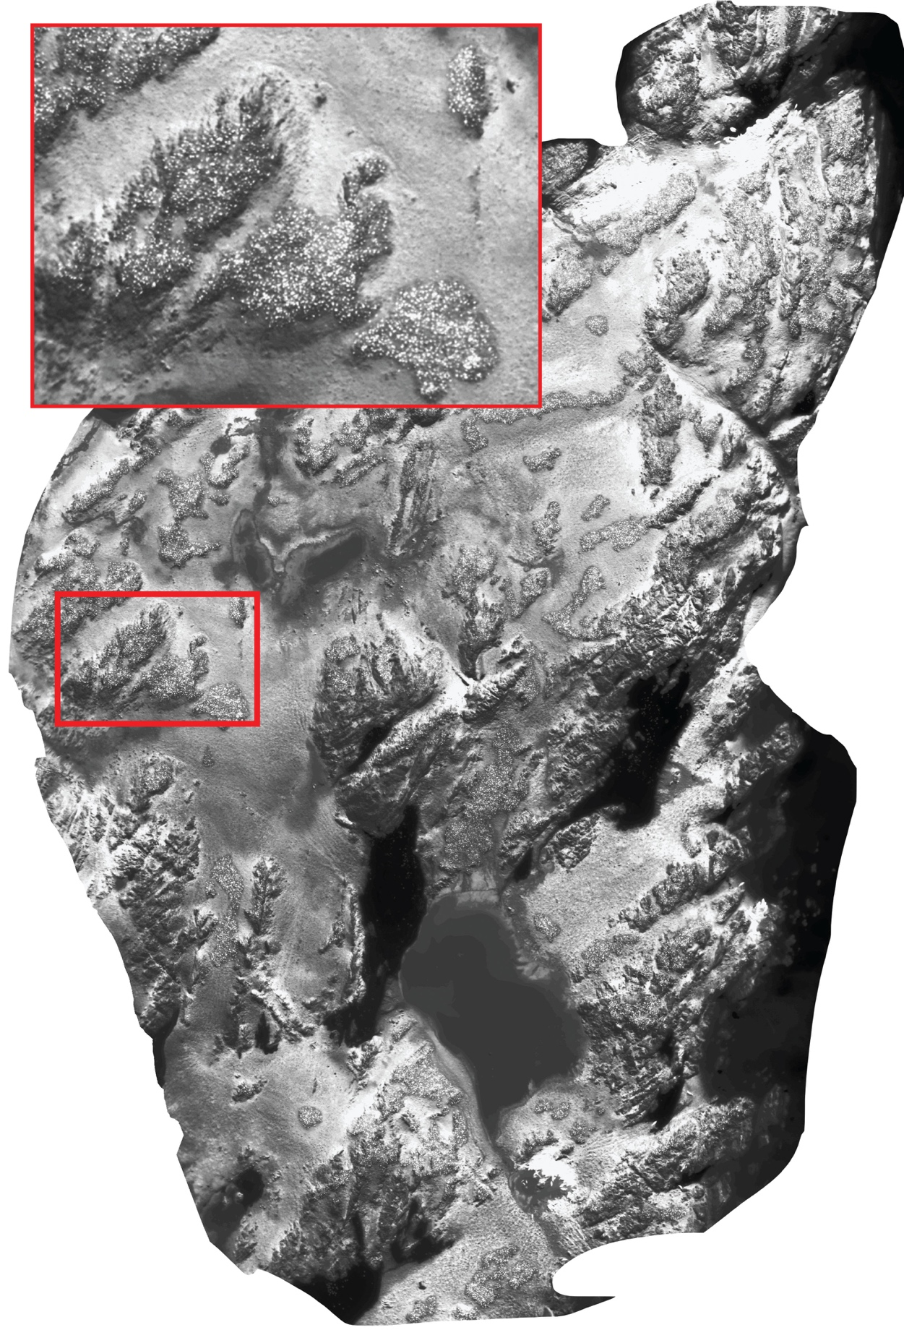
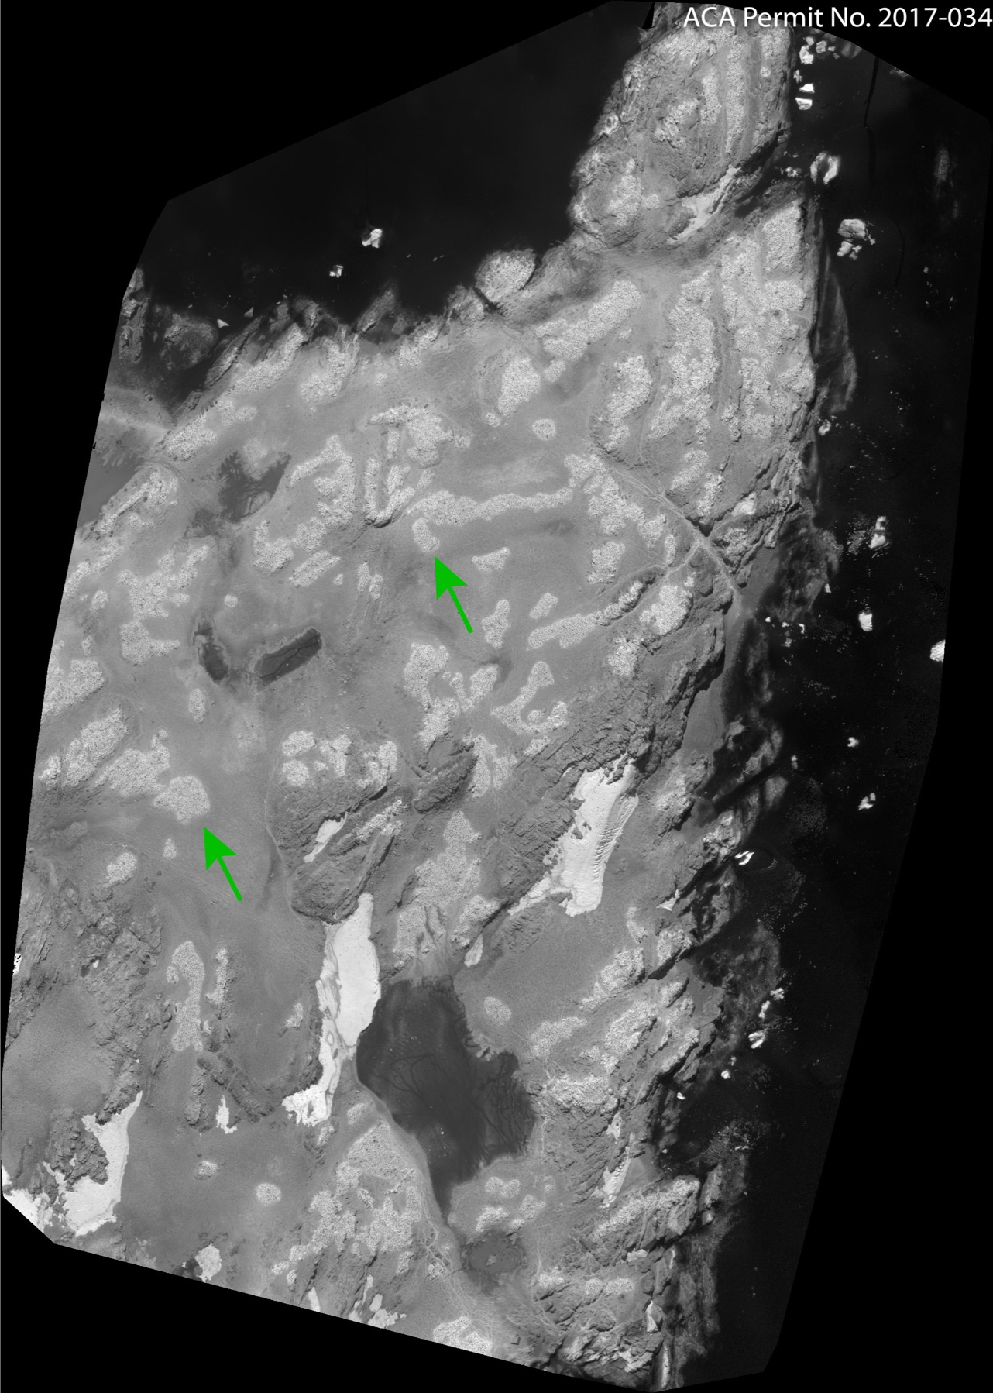
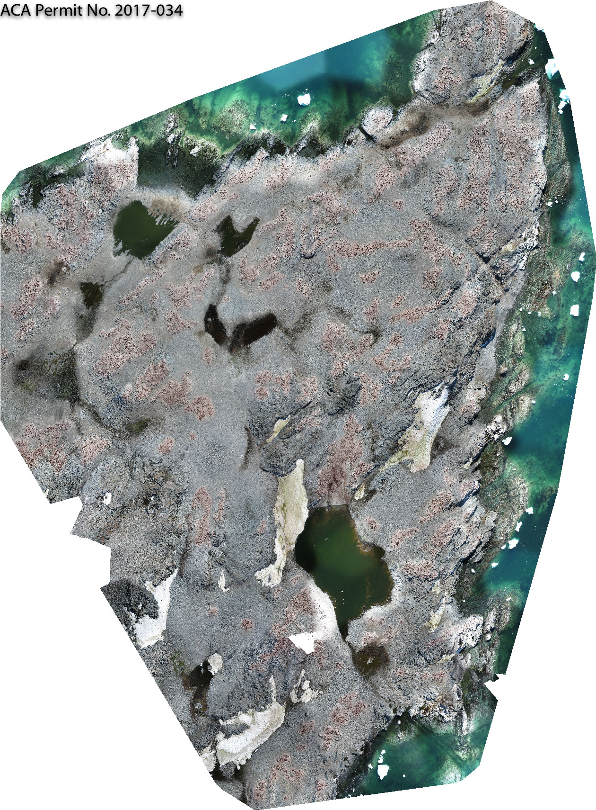
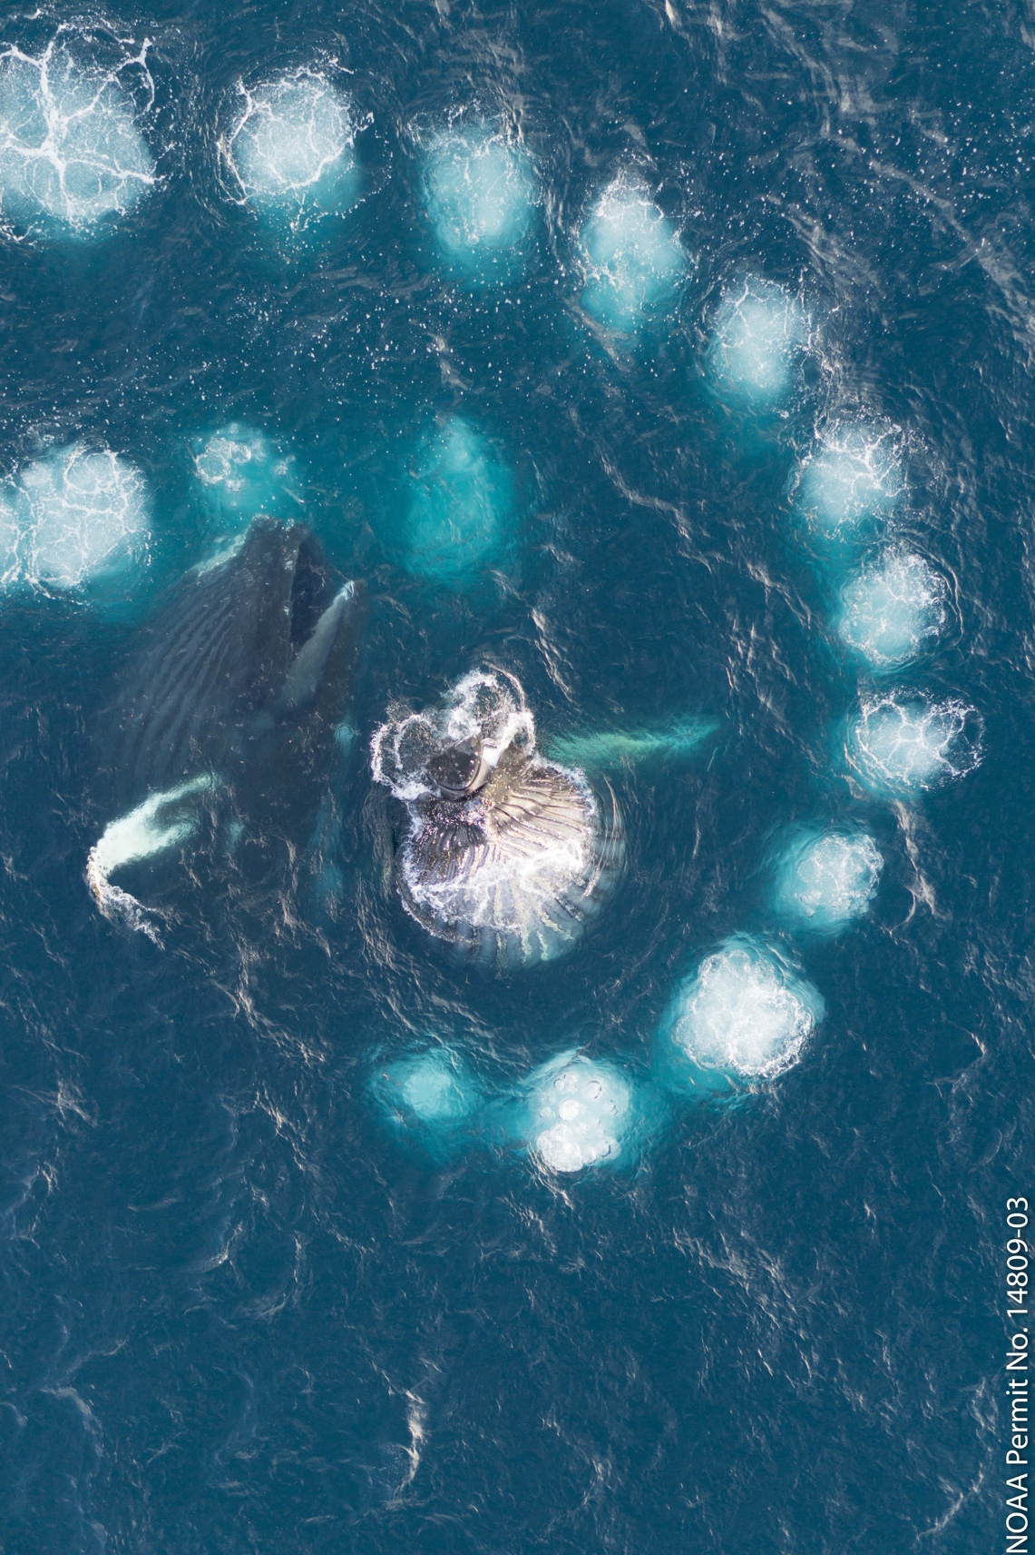
UAV technology rapidly maturing! We can sample lower atmosphere of ocean surface
Multispectral sensors-cheap (relatively speaking)
Ability to repeat surveys frequently
Range of duration and stabilities
Dave Johnson, Duke University
RGB image
Thermal image
False color

Slide 11

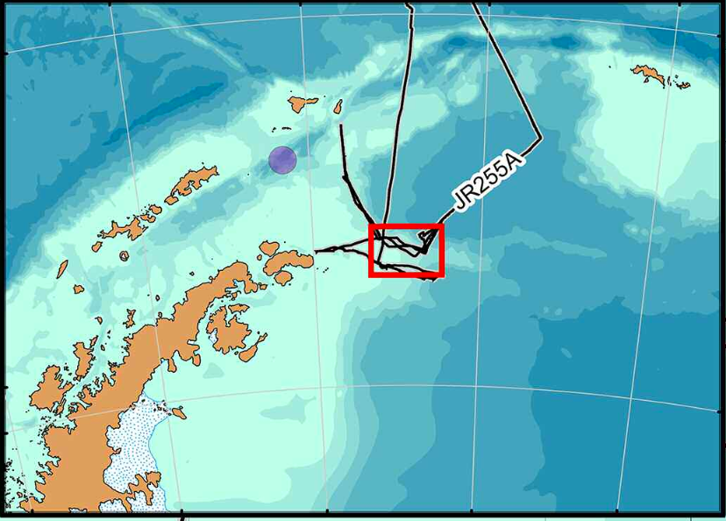
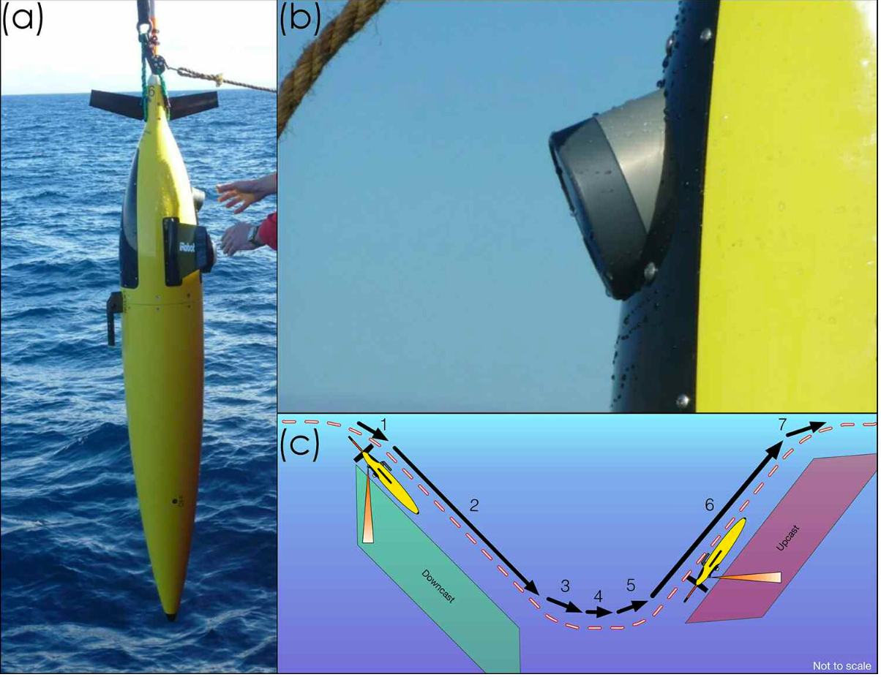
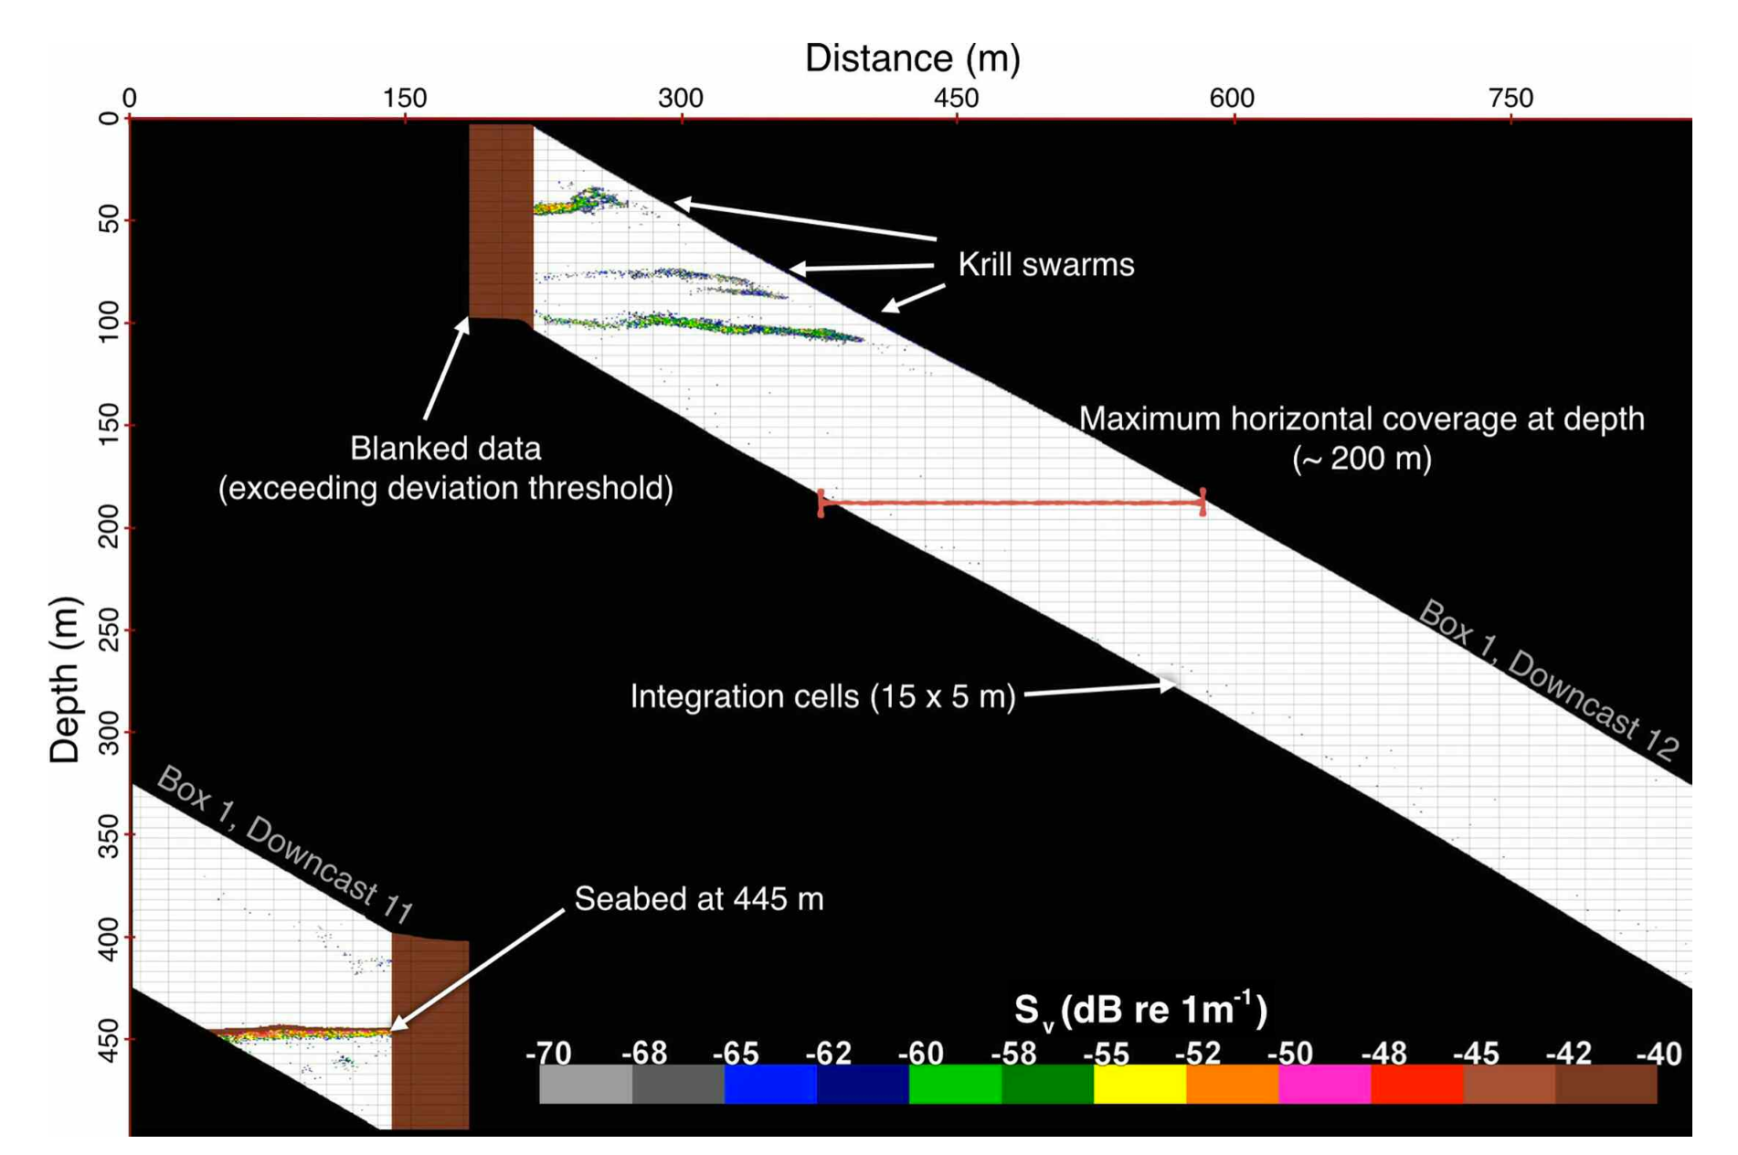
Active acoustics to map macro-zooplankton community and concentration
Guihen et al. 2014

Slide 12
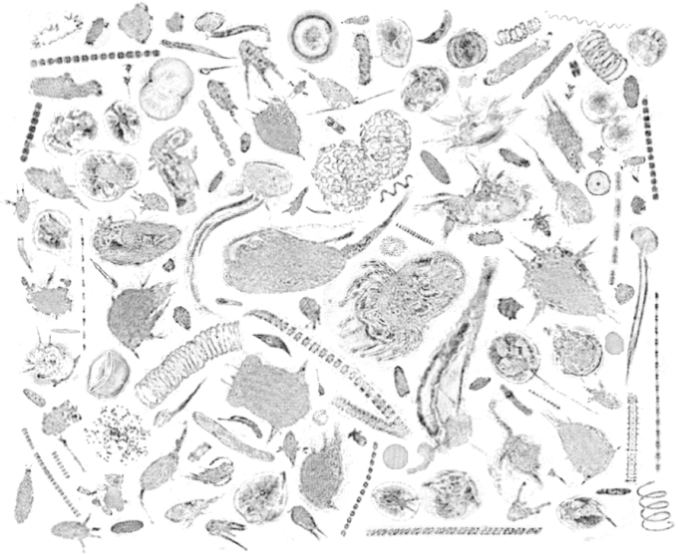
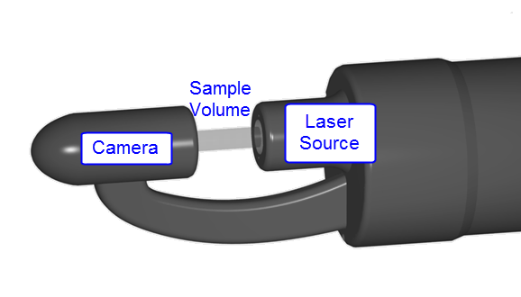
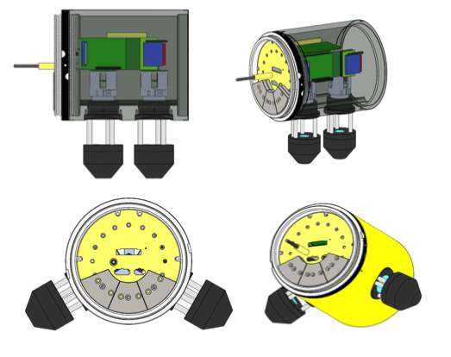
Coming soon (2-4 years) micro- and small zooplankton imaging
Holographic images from Monterey
by an AUV
Design strategies are underway
Thanks to James Bellingham (WHOI)

Slide 13
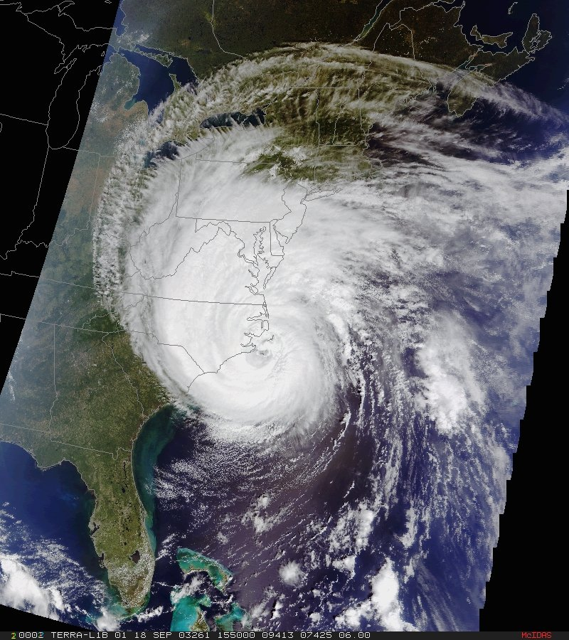
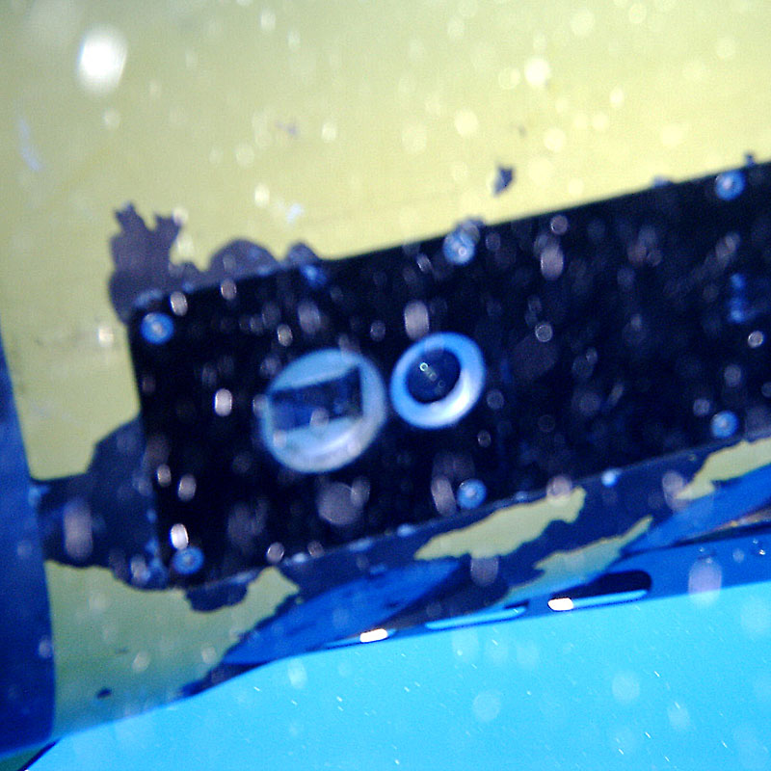
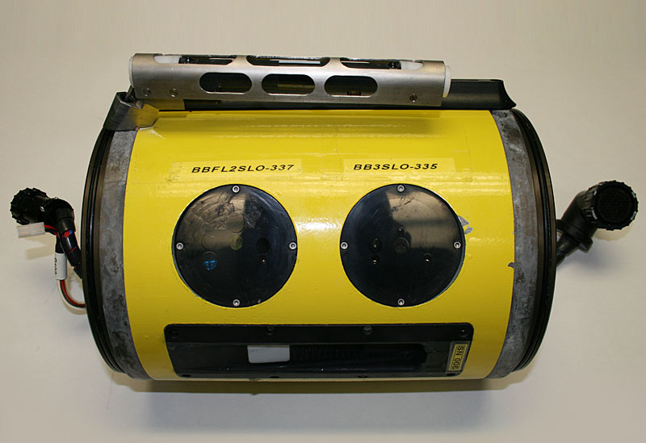
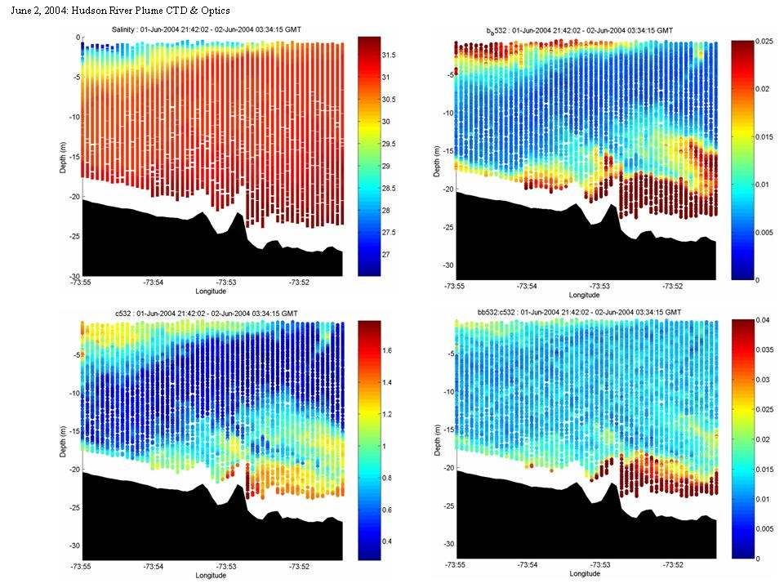
Glider’s provide insight into the nature of phytoplankton composition
c_{b650}
C_{b650}/b_{b650}
Empirical algorithms
%Mineral (in situ)
salinity
b_{b650}

Slide 14
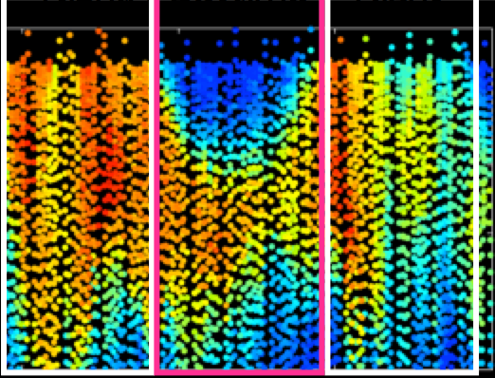
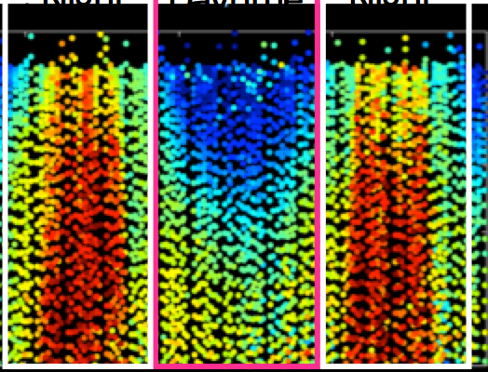
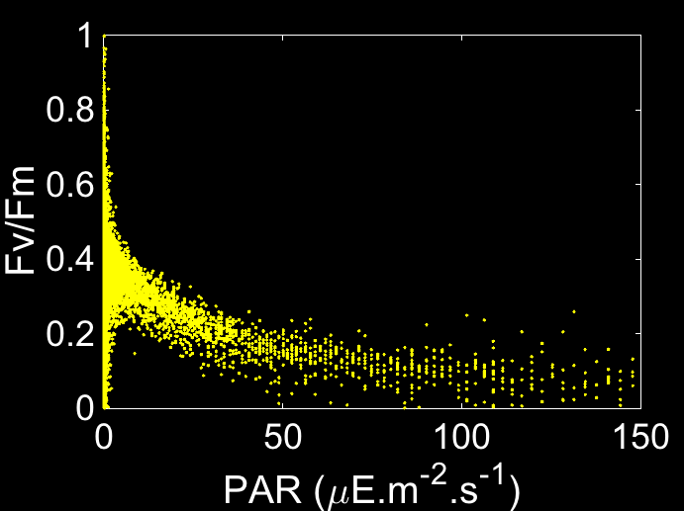

The ability to look at phytoplankton physiology and rate processes
PROXY FOR BIOMASS
HEALTH
Night
Daytime
Night
Night
Daytime
Night
0
0
25
25
50
50
02/20
02/21
02/20
02/21
Time (month/day)
Time (month/day)
0
4000
8000
0
0.3
0.6
Biomass Proxy (Fm)
Quantum Yield of Photosynthesis (Fv/Fm)

Slide 15
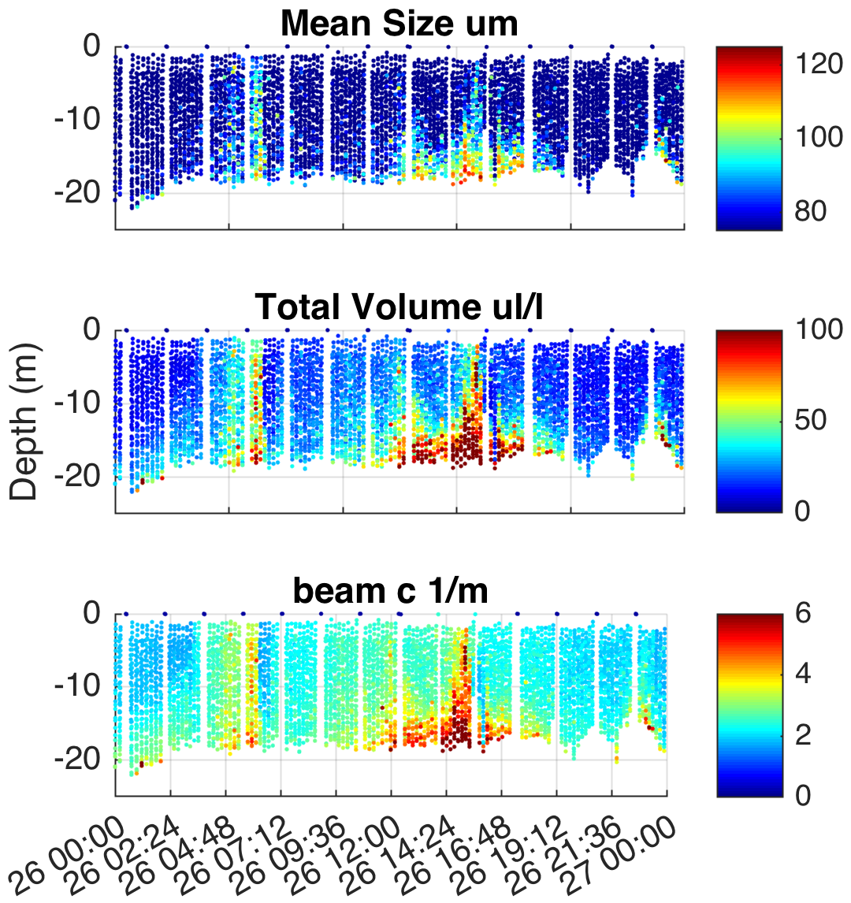
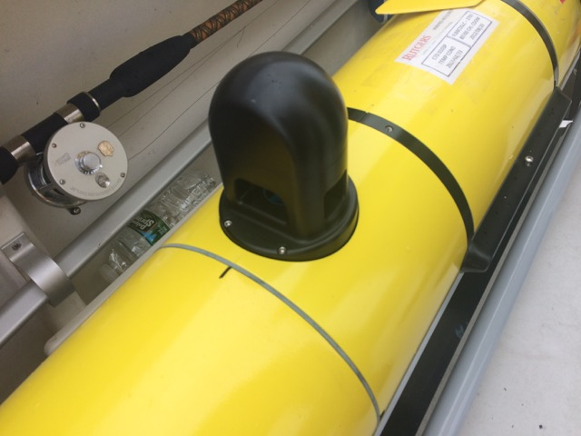



LISST Glider Integration
Thanks to Travis Miles

Slide 16
Rutgers and WHOI collaboration: September deployment being tested

Slide 17
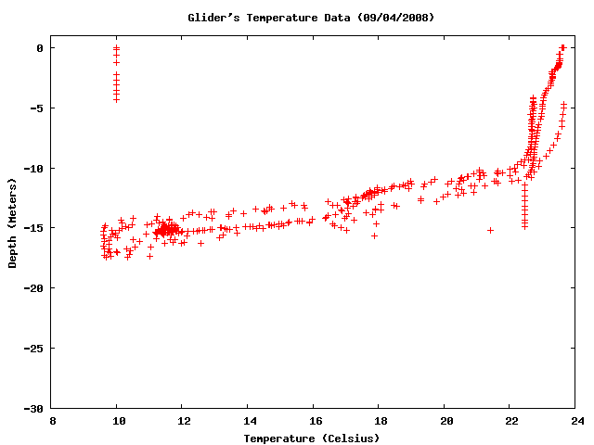
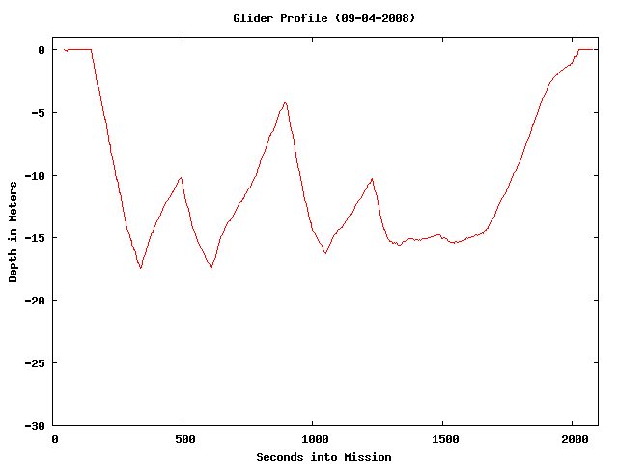
MAKE YOUR AUVS SMARTER
Currently porting over a NVIDIA Jetson TX-1 is an embedded system with
256 CUDA cores, 8 regular cores, with a performance of 1 Tflop
Thanks Uli Kremer (Energy Efficiency Laboratory at Rutgers)

Slide 18
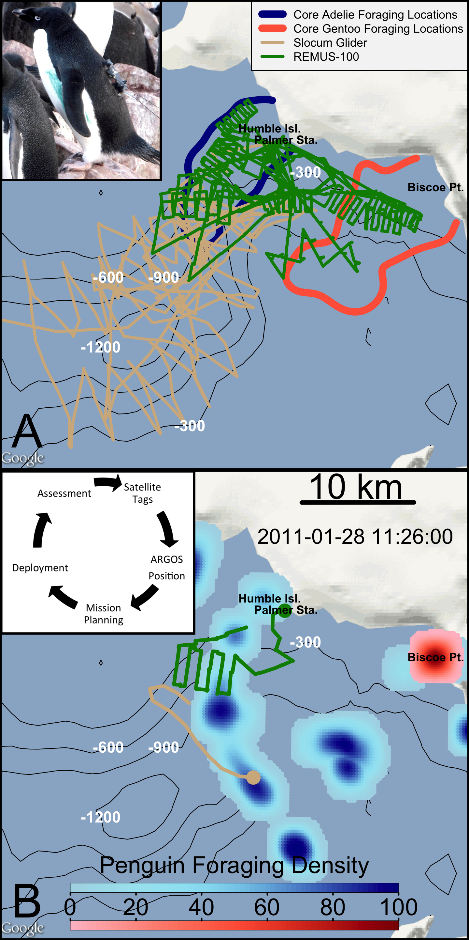
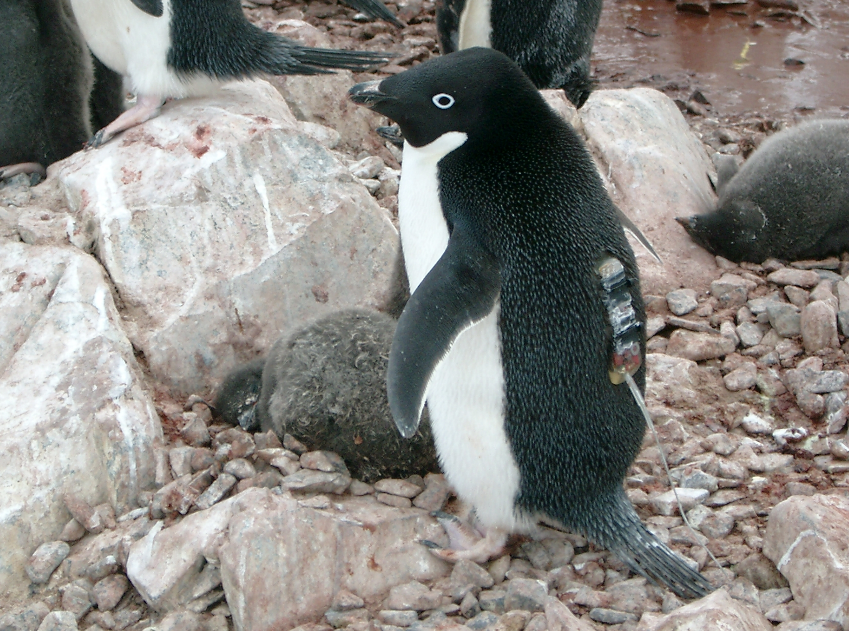
Multi-Platform dynamic analysis of penguin foraging in space
climatologies
Real-time

Slide 19
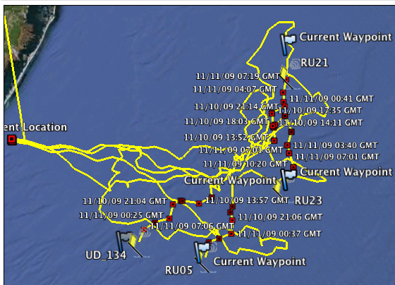
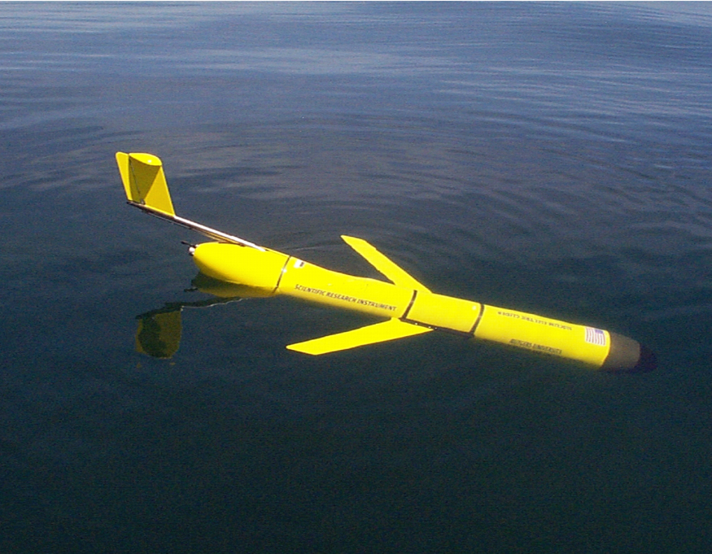
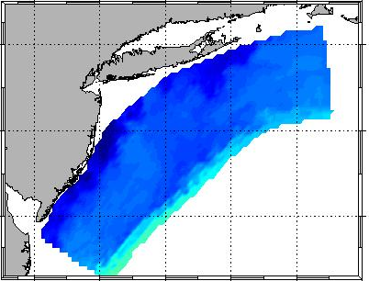
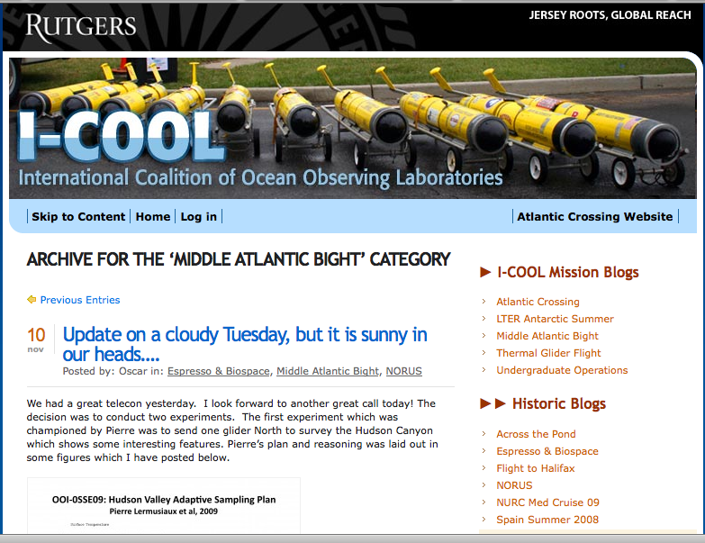
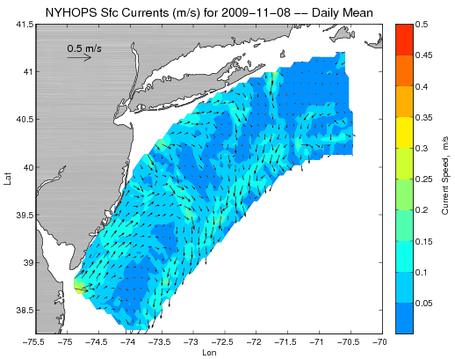
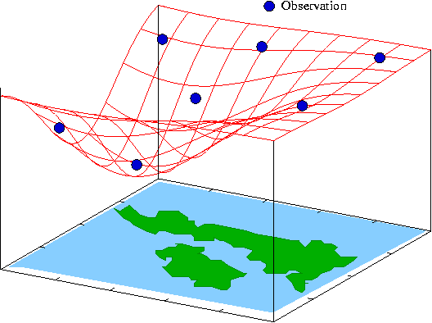
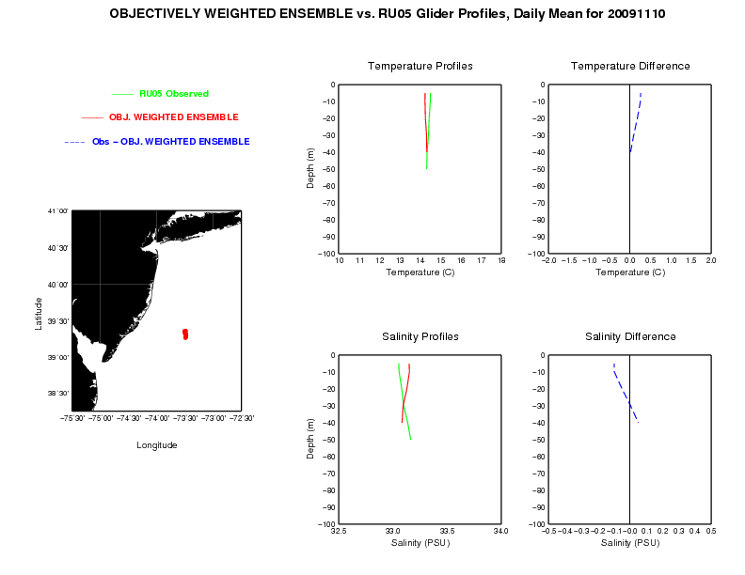
FUTURE: MACHINE TO MACHINE NETWORKS (TEST NOV. 2009)
Design, Testing and Deploy
Observatory (simulated) data
Models
Sensor &
Platform
~3 km
~100 m
Virtual Ocean
Data Assimilation
Data
Analysis
Science Questions & Drivers
Data Synthesis: Nowcast & Data Impact
Schofield et al. 2009

Slide 20
5 ocean numerical models run in forecast mode:2 versions of ROMS, 2 versions of HOPs, 1 version of POM

Slide 23
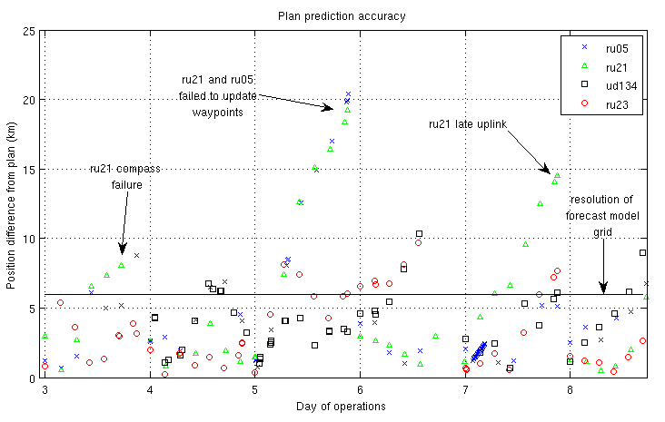
FUTURE: MACHINE TO MACHINE NETWORKS (TEST NOV. 2009)
DID IT WORK?
Increase model resolution
Reduce forecast error

Slide 24
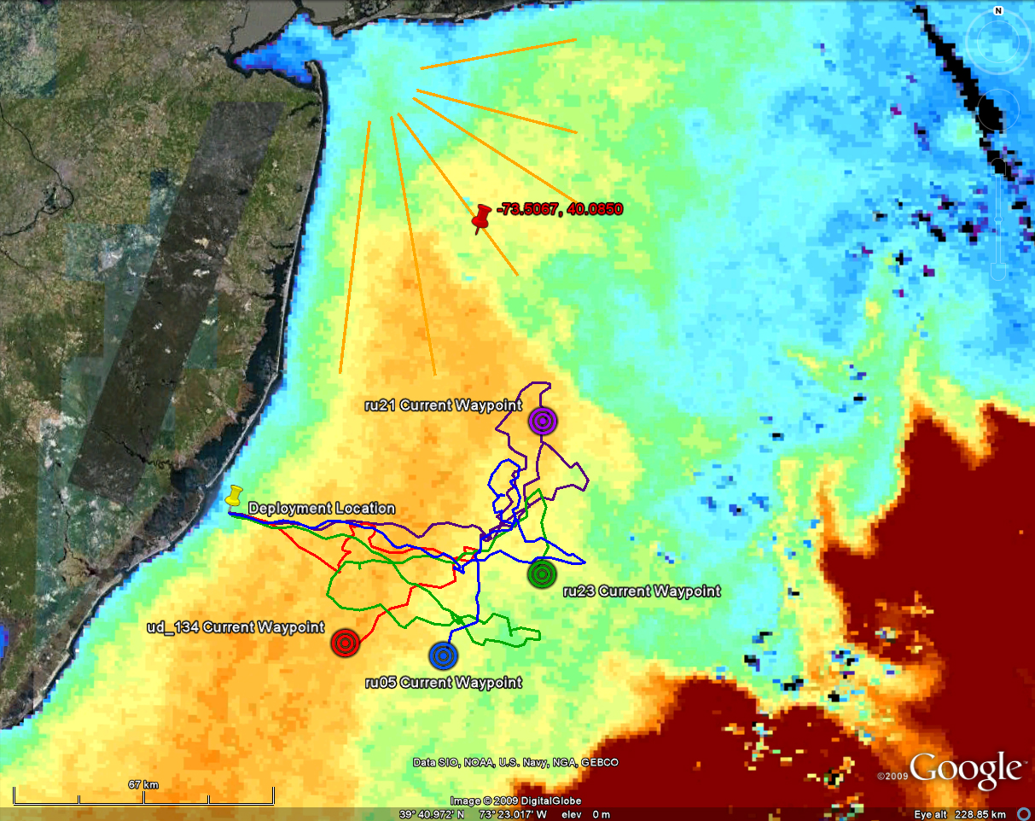
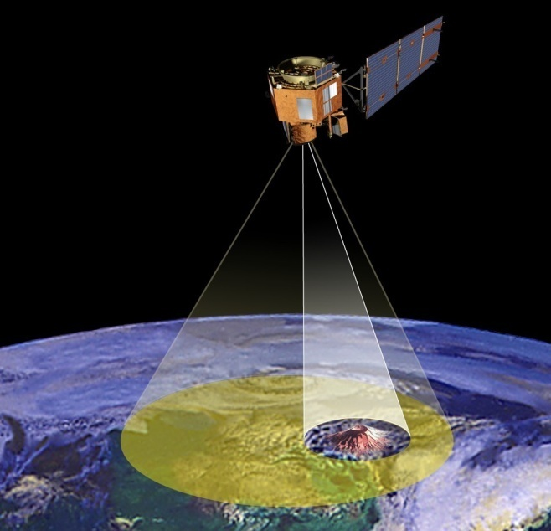
Science Alerts
Scientists
Science Campaigns
Science
Agents
Science Event Manager
Processes alerts and
Prioritizes response observations
EO-1 Flight Dynamics
Tracks, orbit, overflights,
momentum management
Observation
Requests
ASPEN
Schedules observations on EO-1
Hyperion
on EO-1
Updates to onboard plan
24

Slide 25
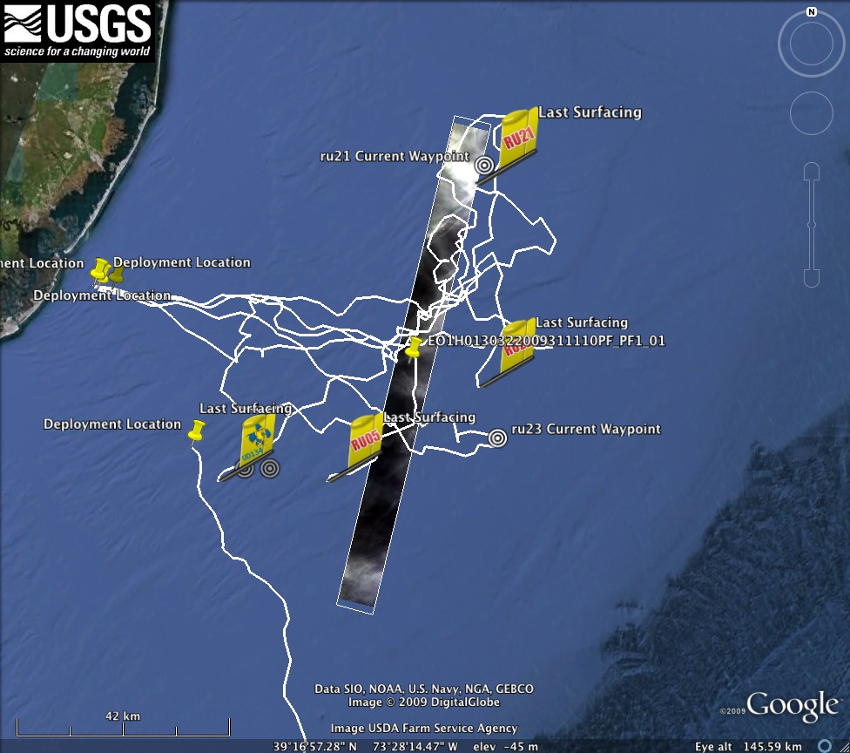

Slide 26
Community data sets coming together through national aggregation efforts

Slide 27
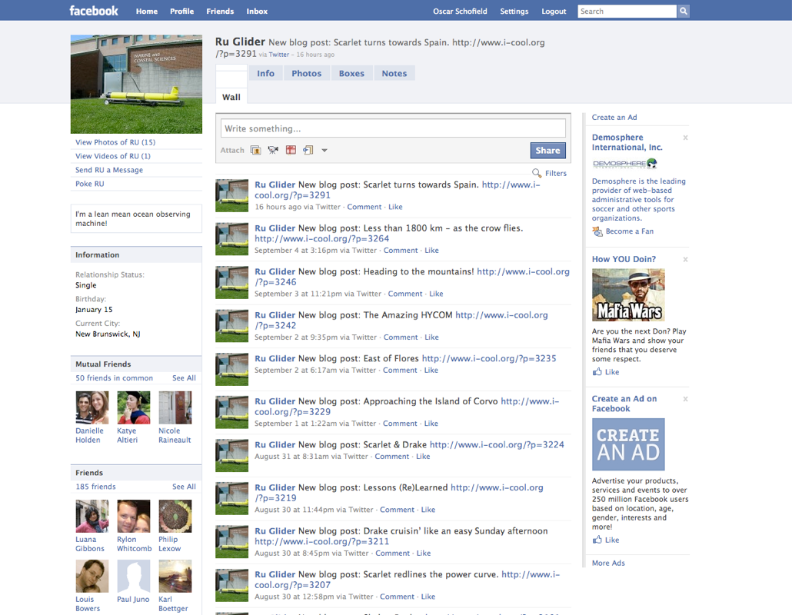
OUTREACH OUR ROBOTS ARE JUST AS COOL

Slide 28
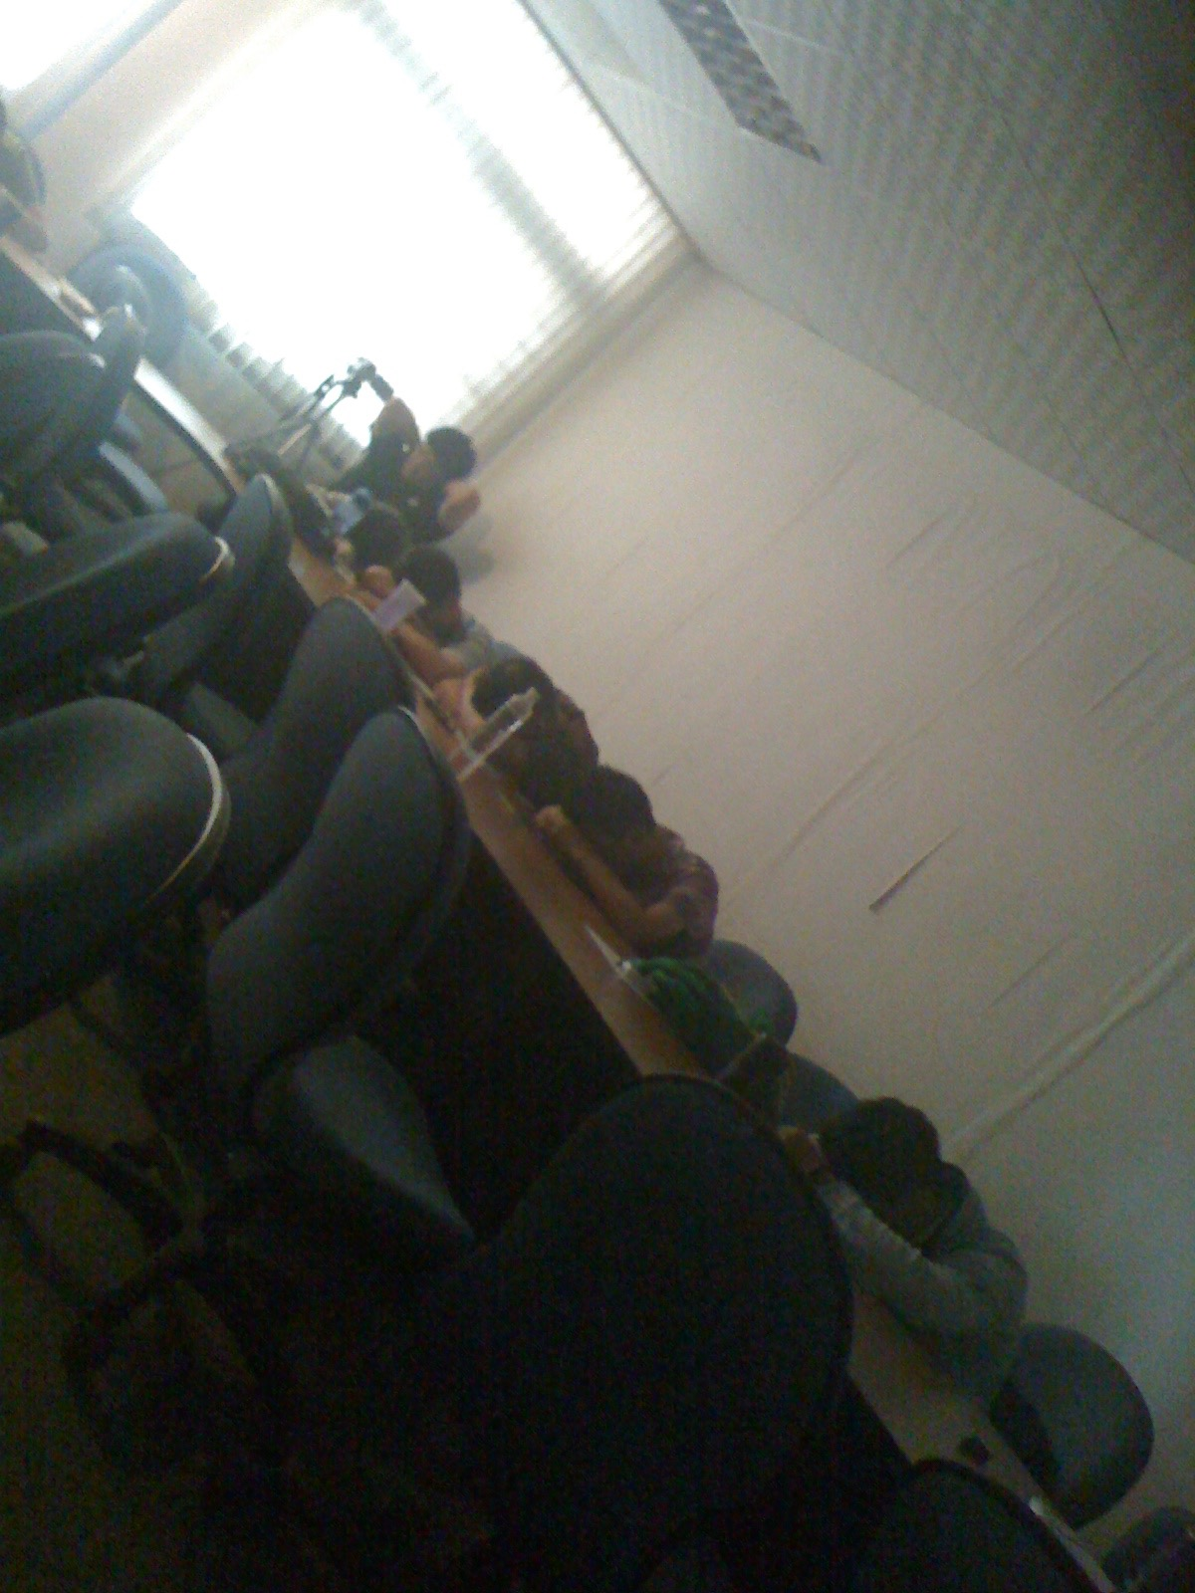
Sometimes traditional lectures and pontification do not inspire as we wish
How is science teaching perceived by many?
Oct 2010
Kaohsiung, Taiwan
These will be great tools to convey the excitement of what we do.

Slide 29
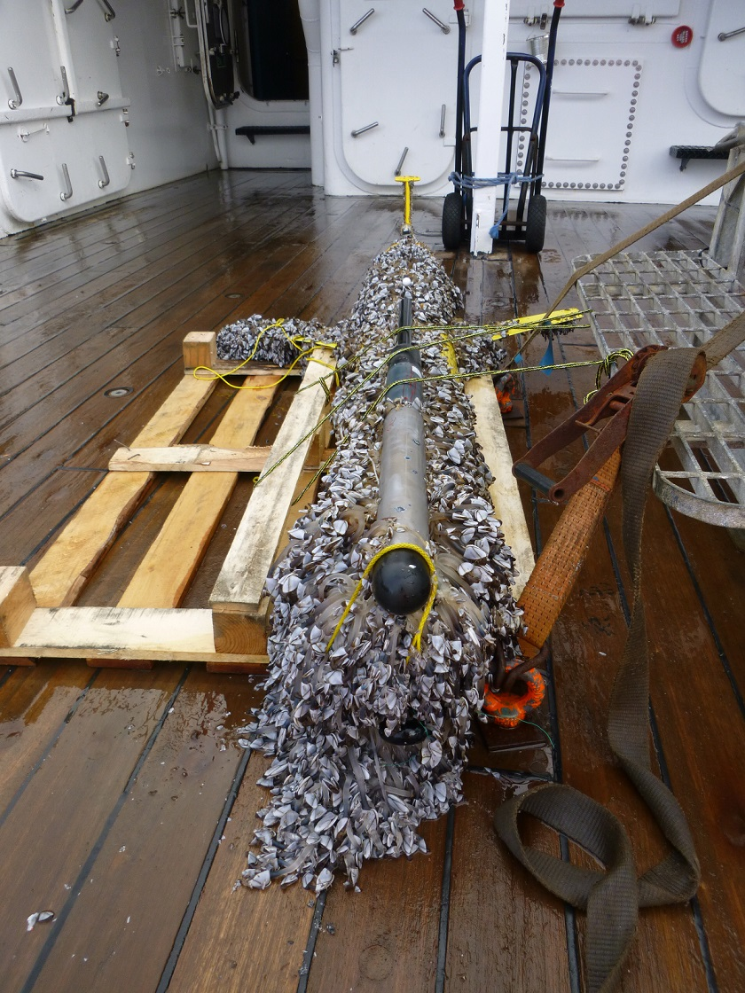
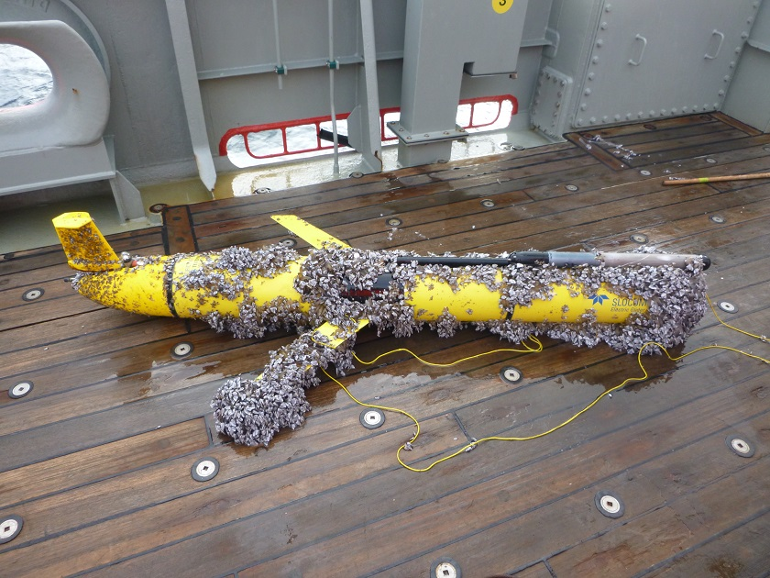
Hurdles: Substrates for formation of artificial reefs
Hurdles: Biofouling (see below), pace of sensor integration, slow but accelerating rate of standardization (Calibration, Qa/Qc, etc)
NSF OOI Glider Argentinean Basin

