Slide 1



78 Million People (1/4 of U.S.)
1000 km Cape to Cape
U..
Middle Atlantic
Regional Association
Coastal
Ocean Observing System
Cape
Cod
Stratified
Coastal Ocean Interactions with
Tropical Cyclones
Sandy
Irene
Barry
Arthur
Scott Glenn, Travis Miles,
Greg Seroka, Robert Forney,
Hugh Roarty, Oscar Schofield, Josh Kohut (Rutgers),
Yi Xu (China) & Fei Yu (China)
Nature Communications (2016)
Hermine
Cape
Hatteras
Notes:
1

Slide 2
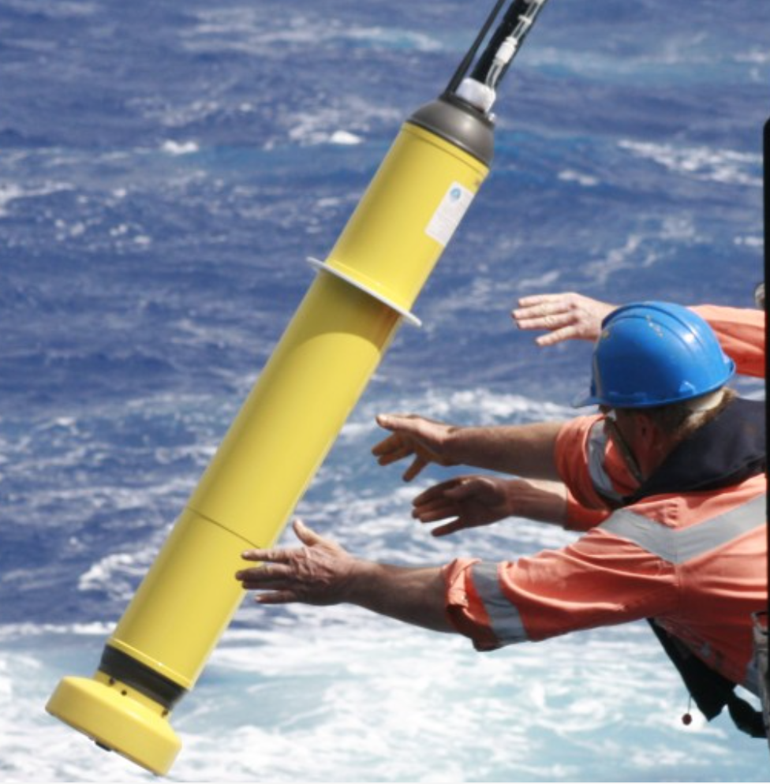
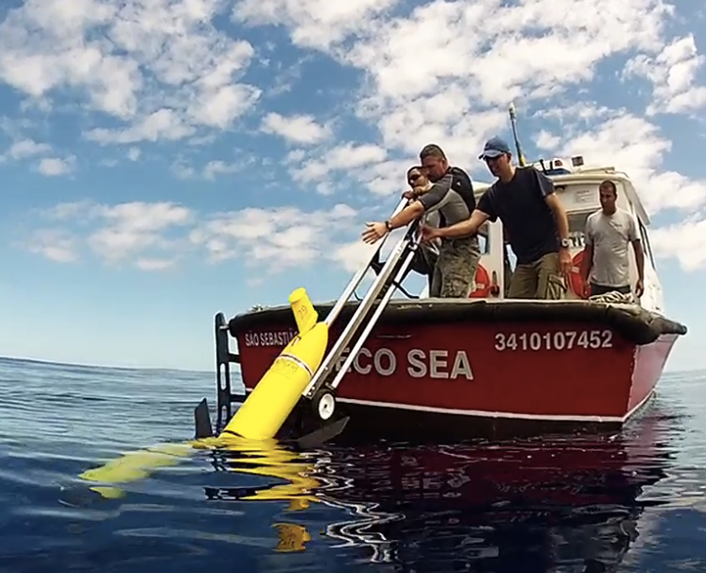
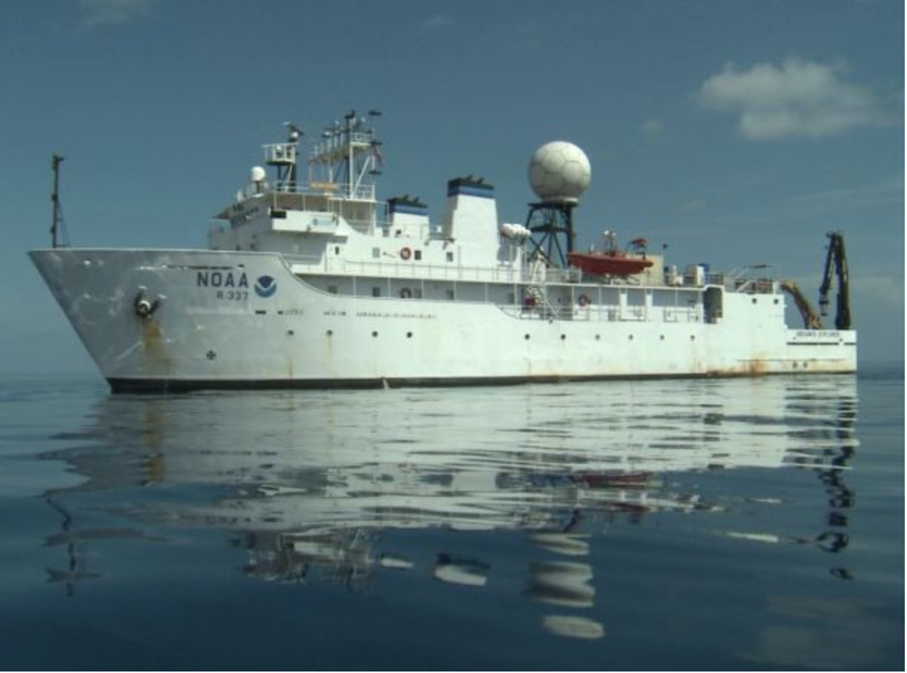
Mobile Subsurface Sampling Capabilities
Drifters
Gliders
Ships
Increasing Control, Capacity & Cost
Decreasing Endurance & Risk Tolerance

Slide 3
Key Storm Glider Reference List
Glenn, Jones, Twardowski, Bowers, Kerfoot, Kohut, Webb, Schofield, 2008. Glider observations of sediment resuspension in a Middle Atlantic Bight fall transition storm. Limnology and Oceanography 53(5, Part 2): 2180-2196.
Miles, Glenn, Schofield, 2013. Temporal and spatial variability in fall storm induced sediment resuspension on the Mid-Atlantic Bight. Continental Shelf Research 63, Supplement: S36-S49.
Miles, Seroka, Kohut, Glenn, 2015. Glider observations and modeling sediment transport in Hurricane Sandy. JGR Oceans, DOI: 10.1002/2014JC010474
Glenn, Miles, Seroka, Xu, Forney, Yu, Roarty, Schofield, Kohut, 2016. Stratified coastal ocean interactions with tropical storms, Nature Communications, DOI:10.1038/ncomms10887.
Seroka, Miles, Xu, Kohut, Schofield & Glenn, 2016. Hurricane Irene Sensitivity to Stratified Coastal Ocean Cooling, Monthly Weather Review, 144(9) 3507-3530.
Seroka, Miles, Xu, Kohut, Schofield & Glenn, 2017. Rapid shelf-wide cooling response of a stratified coastal ocean to hurricanes. JGR-Oceans: Special Section on Ocean Responses and Feedbacks to Tropical Cyclones, DOI:10.1002/2017JC012756.
Miles, Seroka, Glenn, 2017. Coastal ocean circulation during Hurricane Sandy, J. Geophysical Res. - Oceans, accepted.
Sea-Bottom Interface
Air-Sea Interface

Slide 4
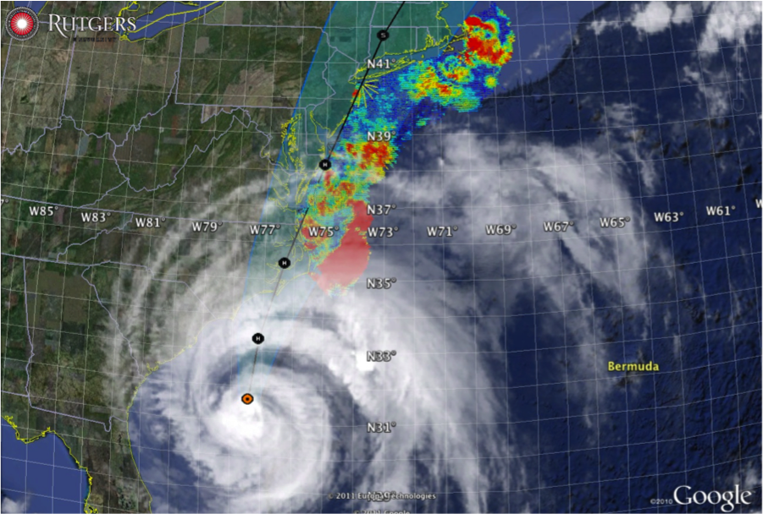

Hurricane Irene
August 28, 2011
NOAA/NHC Damage:
#7 with >$16 Billion.
Track Accurate;
Intensity Over-predicted.
Avila & Cangialosi, 2012, Tropical Cyclone Report
Hurricane Sandy
October 29, 2012
NOAA/NHC Damage:
#2 with >$68 Billion.
Track Accurate;
Surge Under-predicted.
Georgas et al., 2014, J. of Extr. Even.
Colle et al., 2015, J. Mar. Sci. & Engr.

Slide 5

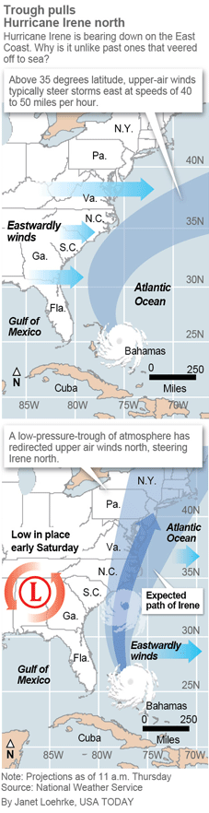
Pre-Irene Storm Warnings
Over 2 million people ordered to “flee the storm’s path”.
President Obama: Shaping up to be a “historic hurricane” and urged residents to “be prepared for the worst”. “Don’t wait. Don’t delay.”
New Jersey Governor Christie: Ordered evacuation of 1 million people - “Get the hell off the beach”. “Do not waste any more time working on your tan”.
New York Mayor Blumberg: “Staying behind is dangerous, staying behind is foolish, and its against the law”. “The time to leave is right now”. The bridges, streets and subways were nearly empty ahead of a nearly unprecedented mass transit shutdown.

Slide 6
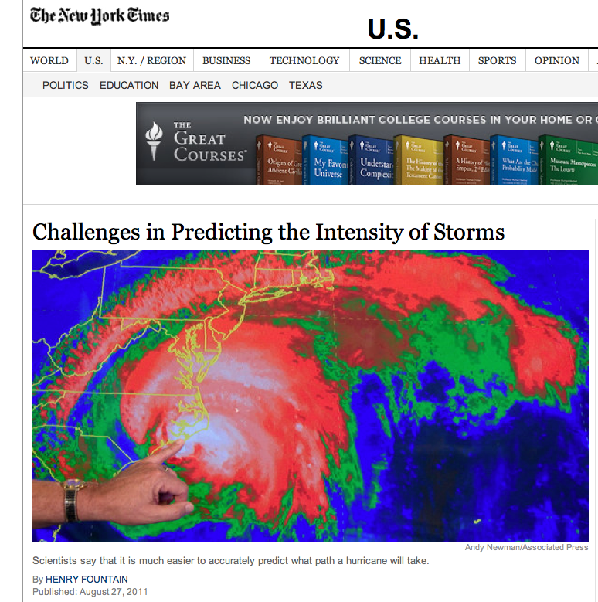
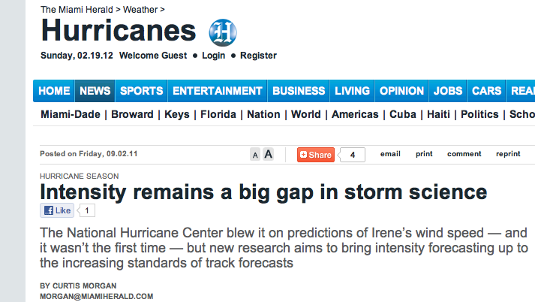
Post-Irene Analysis:
Track accurately forecast
days in advance.
Intensity (wind speed), and the resulting impacts, were over-predicted.
Close the Intensity Science Gap!

Slide 7
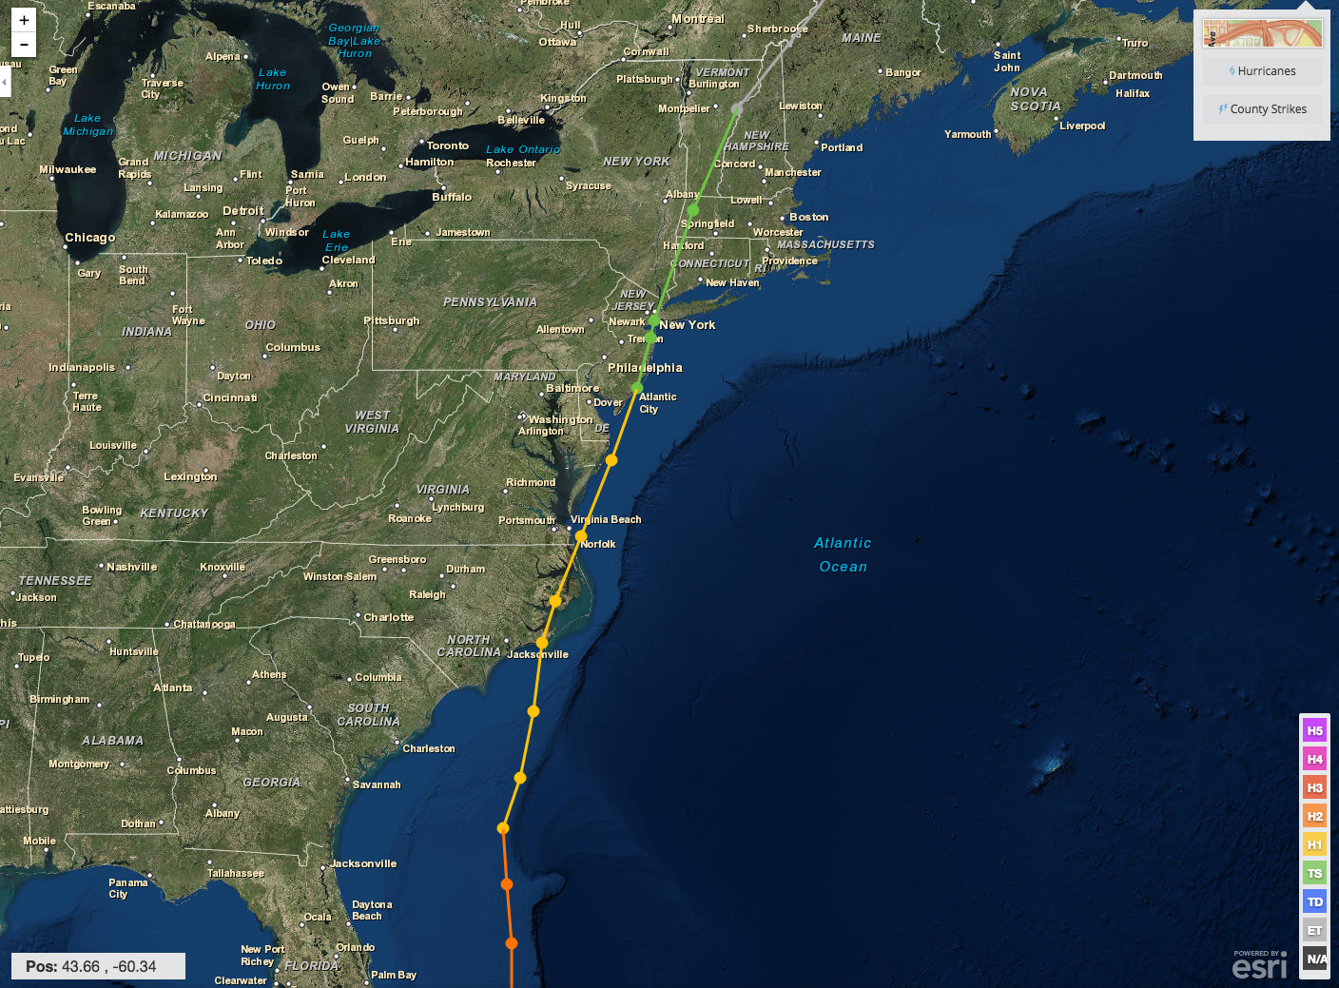
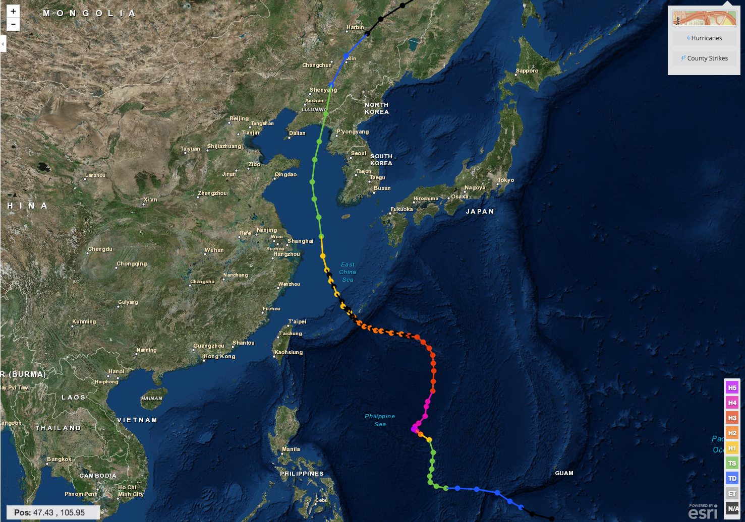
Hurricane Irene & Super-Typhoon Muifa:
What do these summer of 2011 storms have in common?
Hurricane Irene
26-29 August 2011
Super-Typhoon Muifa
26 July - 9 August 2011

Slide 8
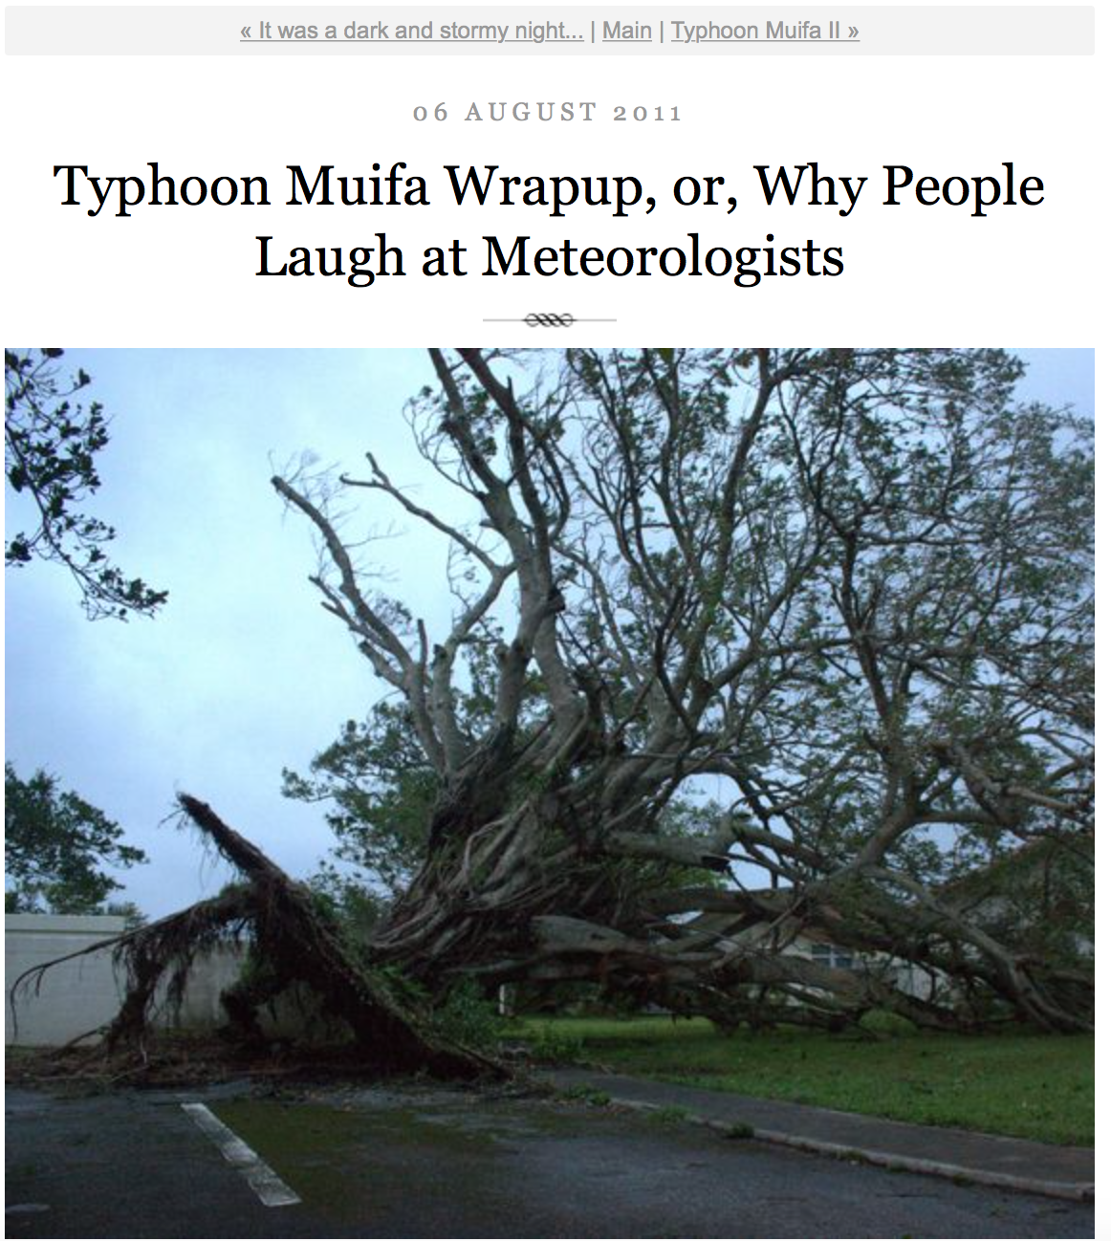
Pre-Muifa preparation:
SHANGHAI Aug 6 (Reuters) - Chinese authorities evacuated more than 200,000 residents from eastern Zhejiang province and cancelled more than 200 flights, as the region braced itself for a typhoon that could be the worst in the area in years.
Post-Muifa Blog entry:
As Muifa moved toward us over the week, at first it looked like we were literally going to take a direct hit from a category 4 typhoon … gradually was downgraded to a 2, it started to seem like no big deal … Basically we started out worried and got less and less so as it moved toward us and were mostly grateful for the 4-day weekend…

Slide 9
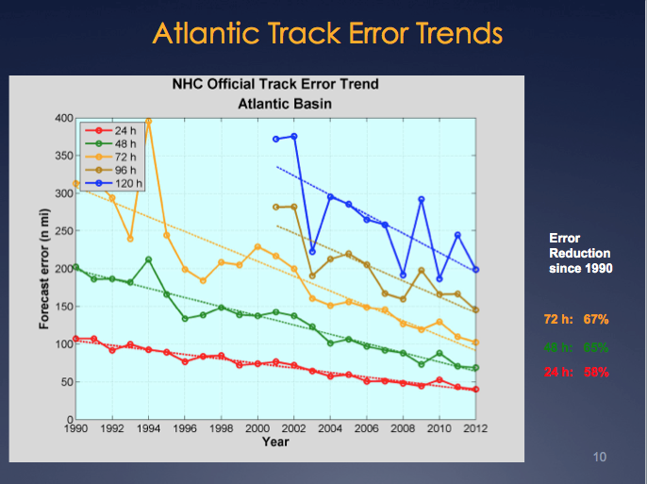
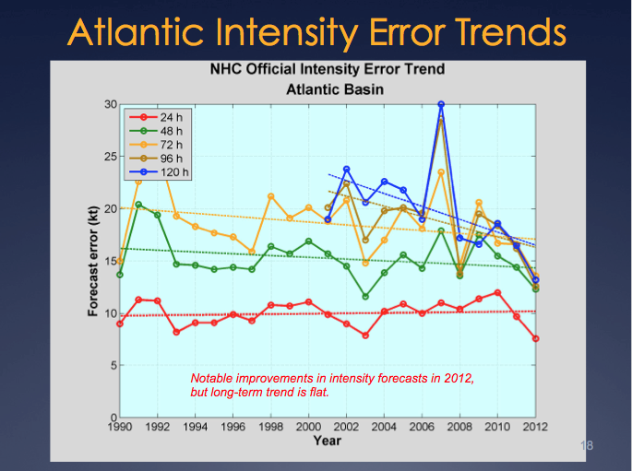
Motivation: Research to Operations to Research (R2O2R)
Track Error: Decreases in 20-Year Trend Intensity Error: - “Long-term trend is flat”
Track: Improvements attributed to Global Forecast Models & the Super-Ensemble.
Intensity: “…upper-ocean thermal structure can affect the evolution of storm intensity, …Unfortunately, the paucity of subsurface measurements limits our ability to assess the effect of upper-ocean variability on tropical cyclone intensity evolution.”
– Emanuel et al., (2004)
Production Suite Review: December 4, 2012

Slide 10
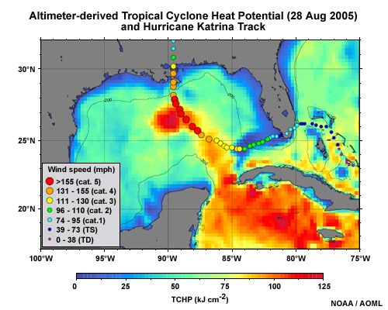

Hurricane Intensity is modulated by upper ocean heat content
Rapid intensification of Hurricane Katrina over warm ocean water

Slide 11
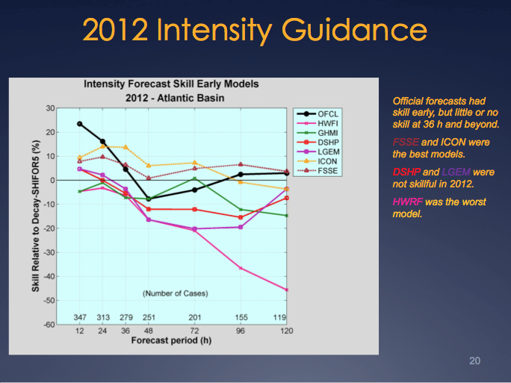
National Hurricane Center: Intensity Skill in 2012
But
adding the ocean model reduces forecast skill.
WE NEED A BETTER OCEAN!

Slide 12
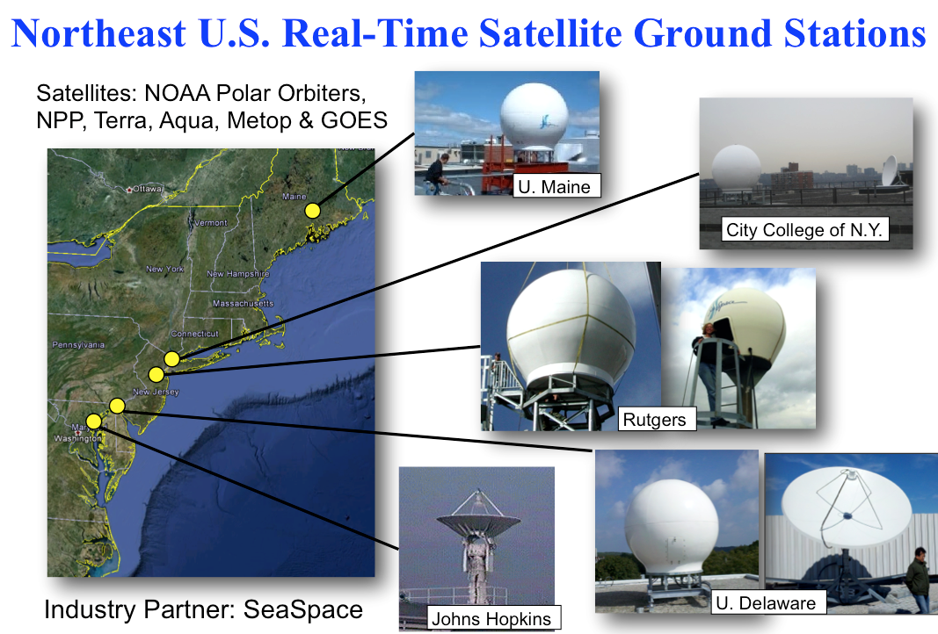
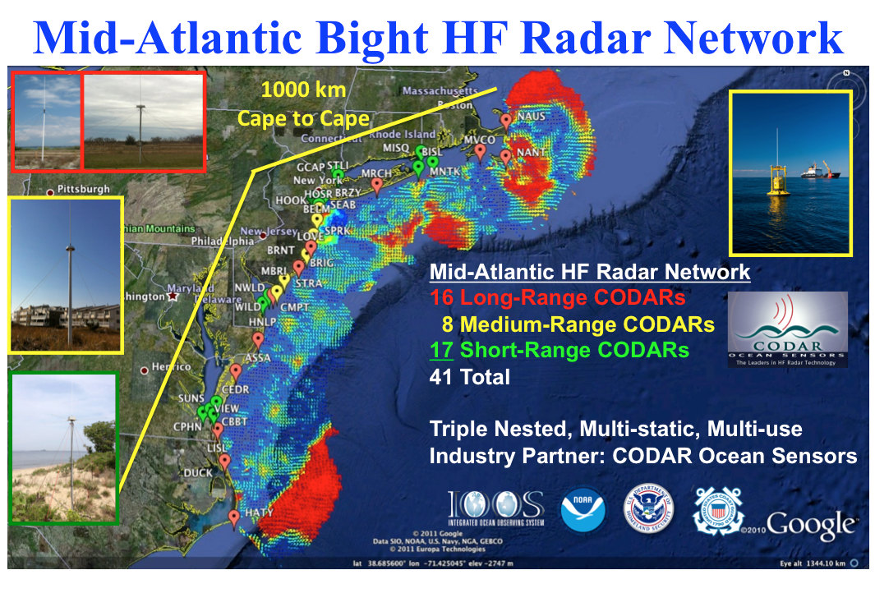
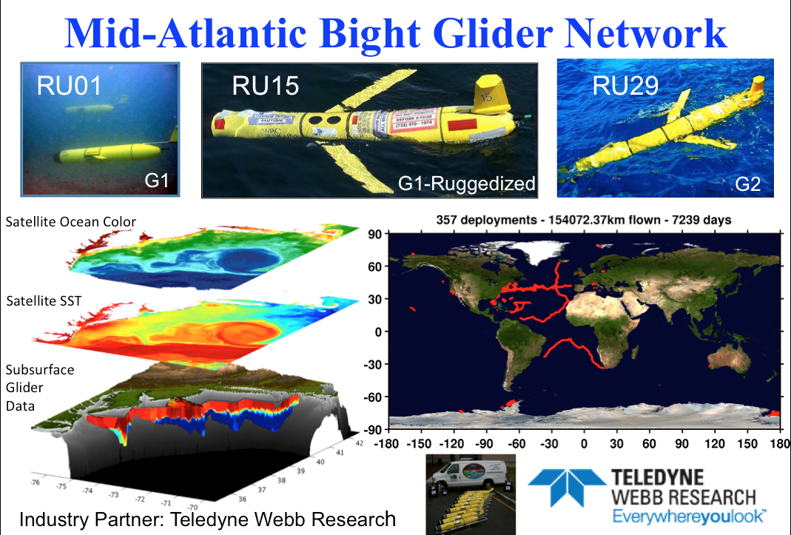
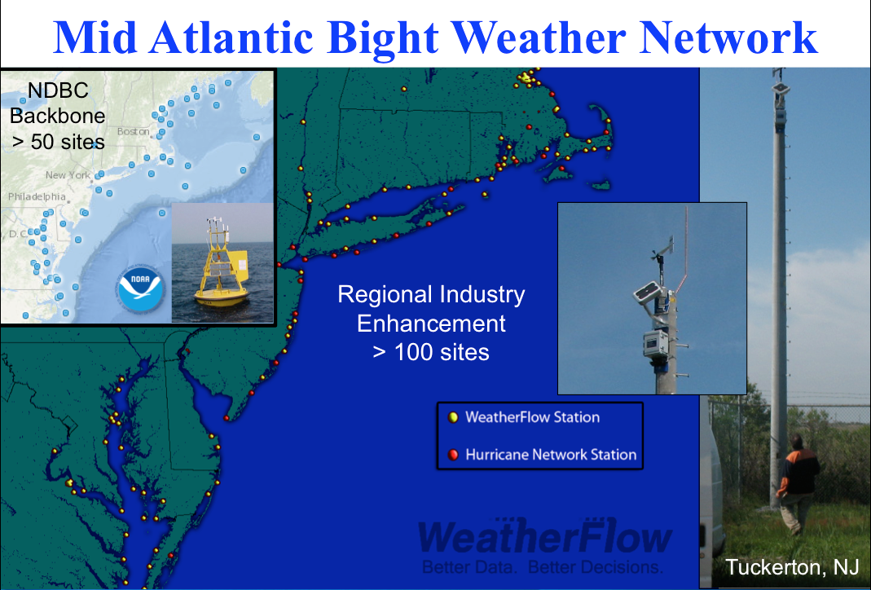
Mid-Atlantic Regional-Scale Observation Network

Slide 13
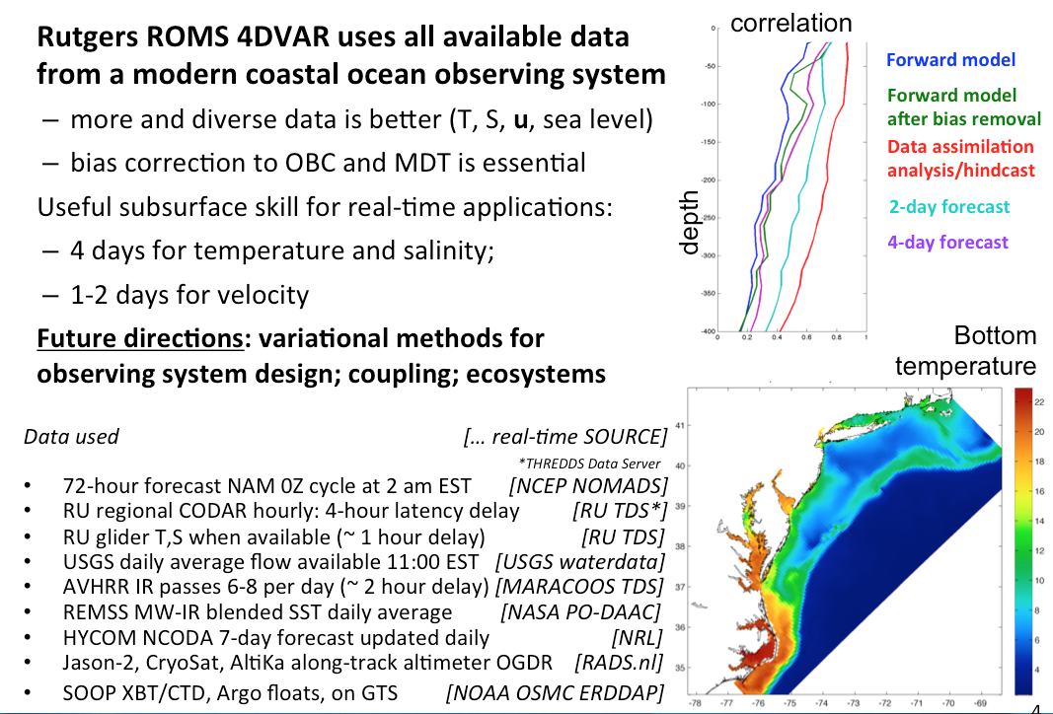
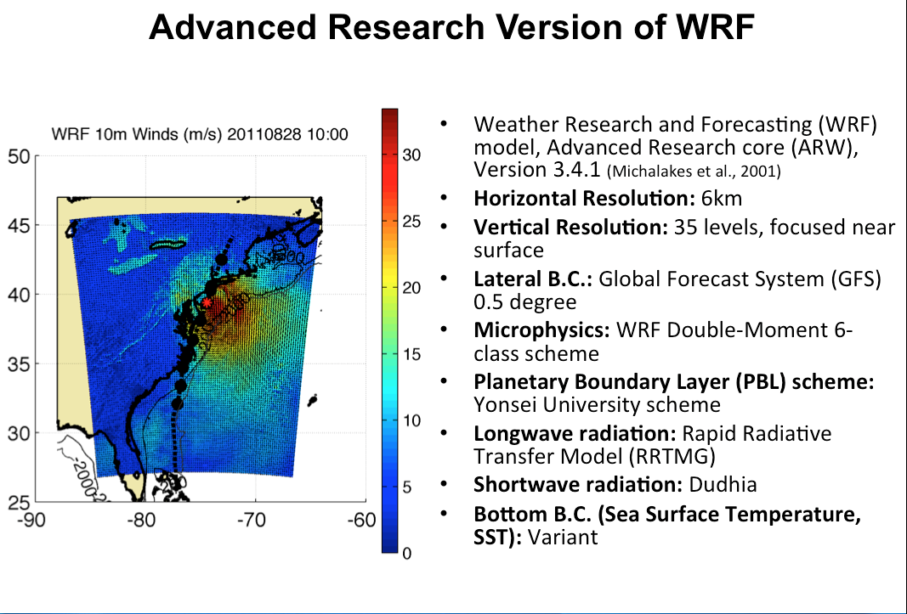

Mid-Atlantic Ensemble of Forecast Models Include:
Mid-Atlantic Operations Center @

Slide 14
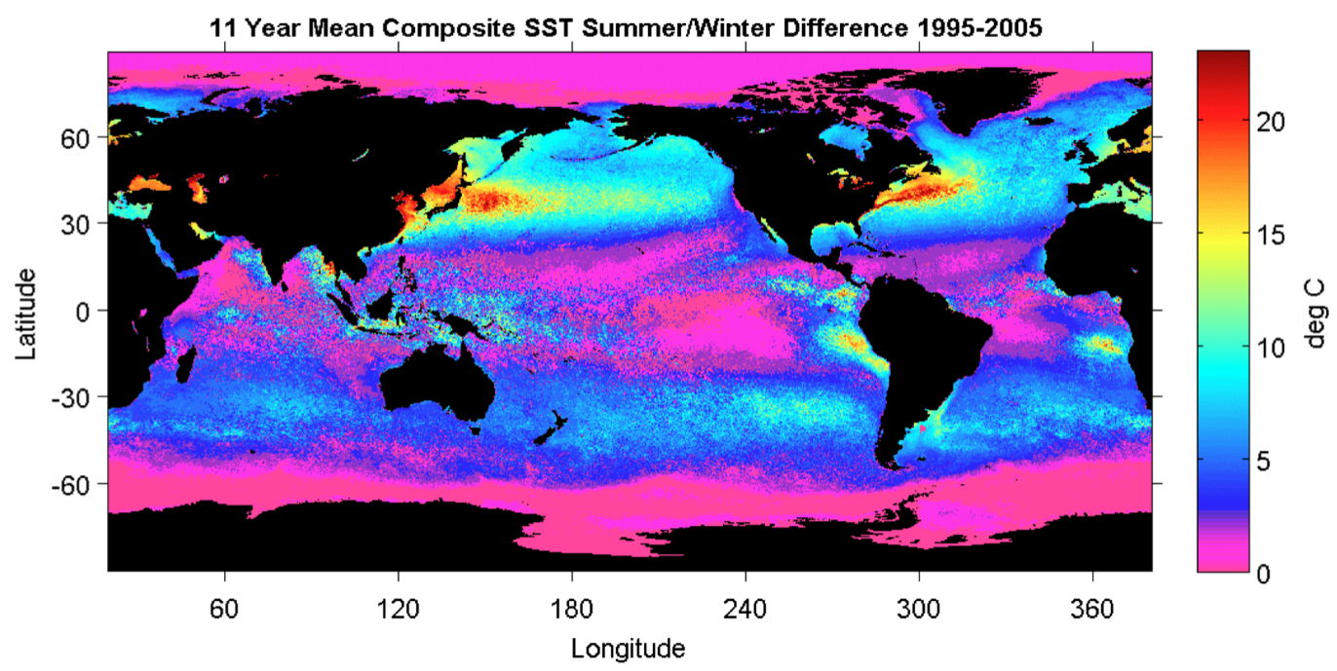
Earth’s northern mid-latitude sea surface temperatures (SSTs) undergo large seasonal cycles.
Summer-Winter SST Difference (1995-2005)
Schofield et al. 1998
Notes:
Earth’s northern mid-latitudes undergo large seasonal cycles, not only in the atmosphere but also in the ocean.
Within the ocean, this seasonal cycle is especially pronounced over the western continental boundaries often characterized by broad continental shelves and proximity to coastal population centers [Schofield et al., 2008].
Figure 1. Global ocean temperature contrast between winter and summer months, which were designated based on the mean seasonal temperatures
measured with the AVHRR satellite. Data were taken between 1995 and 2005. The grey shades on the land masses indicate human
populations (dark grey = high human populations).

Slide 15
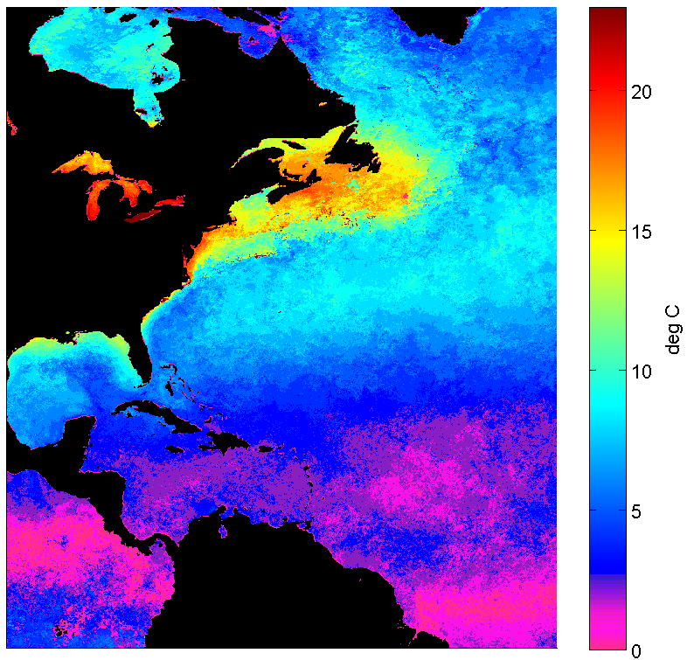
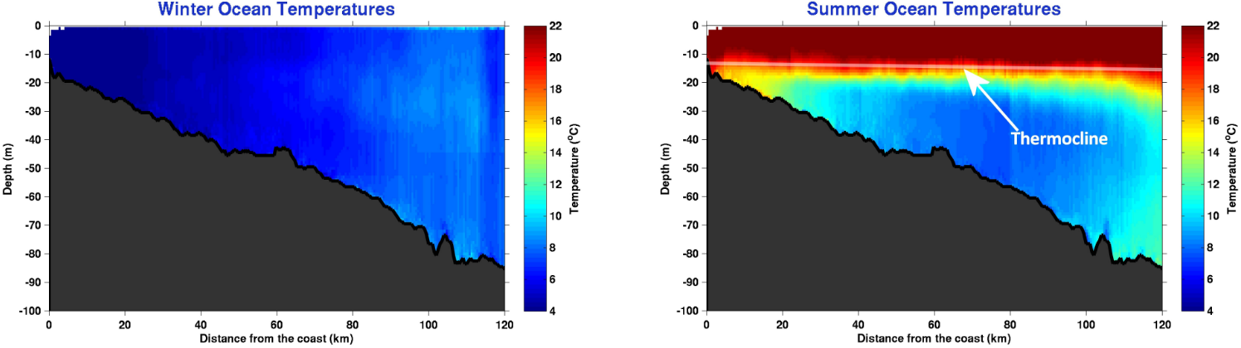
The U.S. Mid-Atlantic summer ocean is one of the most stratified in the world.
Summer-Winter SST Difference
Cold Pool
Winter (1-layer)
Summer (2-layers)
COSEEnow.net
Notes:
-1-slab moving in wind in winter, 2-layer moving in wind in summer- slippery surface layer
-SST seasonality and nearly constant bottom cold water results in 1-layer winter and 2-layer summer
The Mid-Atlantic Bight (MAB) of the eastern U.S. is located on one such broad continental shelf, with a large 20°C seasonal SST cycle.
This seasonality in the surface ocean results in a well-mixed and cold coastal ocean in the winter and a highly-stratified warm surface and cold bottom coastal ocean in the summer [Castelao et al., 2008], due to the presence of the summertime MAB Cold Pool at the bottom of the shelf water [Houghton et al., 1982].

Slide 16


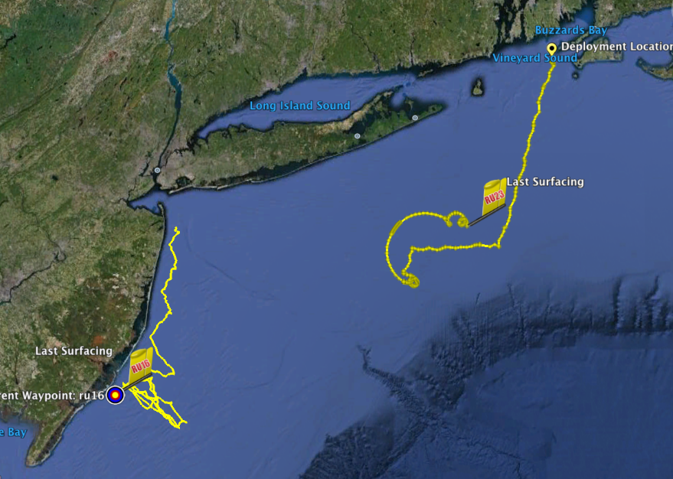
Hurricane Irene
August 27-28, 2011
NOAA/NHC:
Damage >$16B ( #7)
Track Accurate
Intensity Over-predicted
Two Gliders Deployed

Slide 17
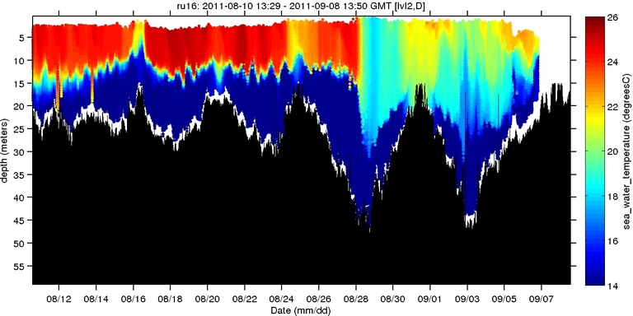
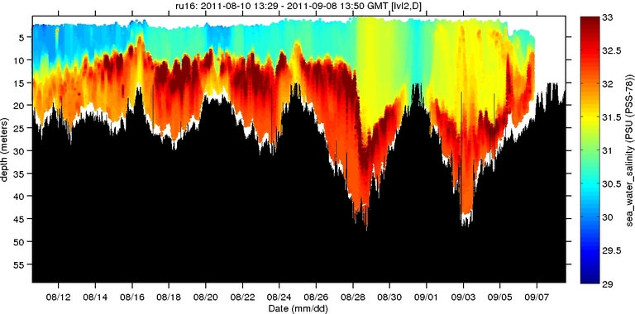
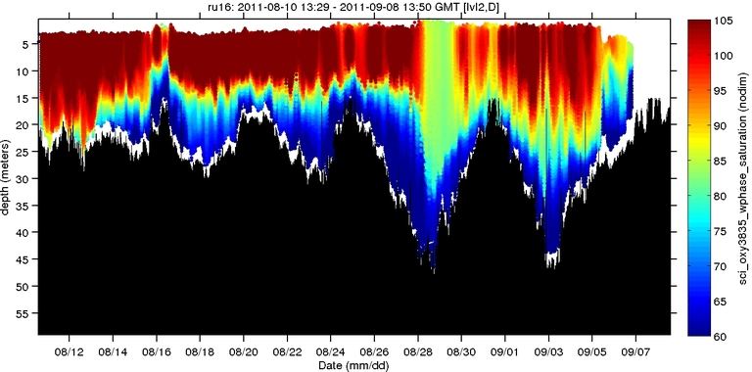
Hurricane Irene
August 27-28, 2011
NOAA/NHC:
Damage >$16B ( #7)
Track Accurate
Intensity Over-predicted
Hurricane Irene
0
26
depth
temperature
55
14
0
33
depth
salinity
55
29
0
105
depth
% oxygen
Two Gliders Deployed
55
60
8/12
date
9/07

Slide 18
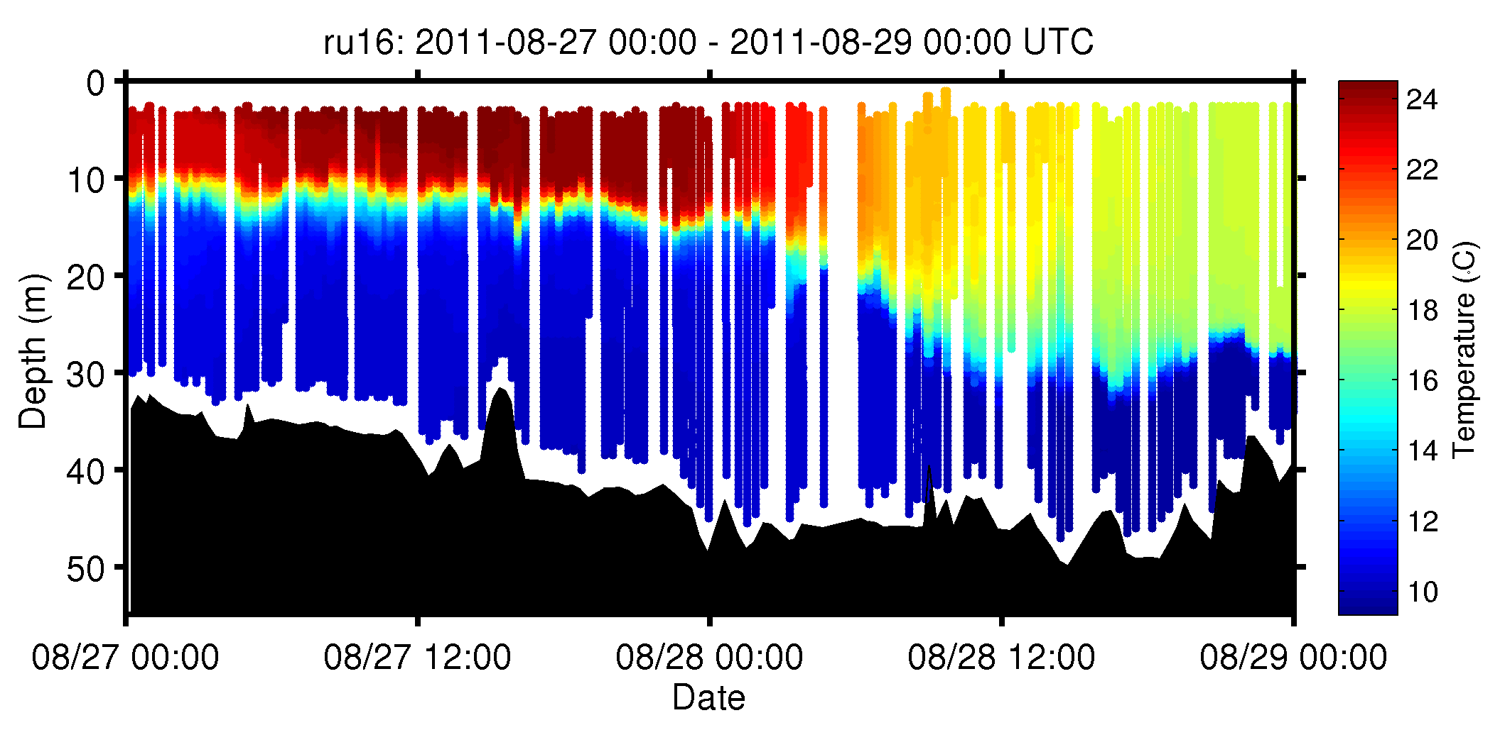
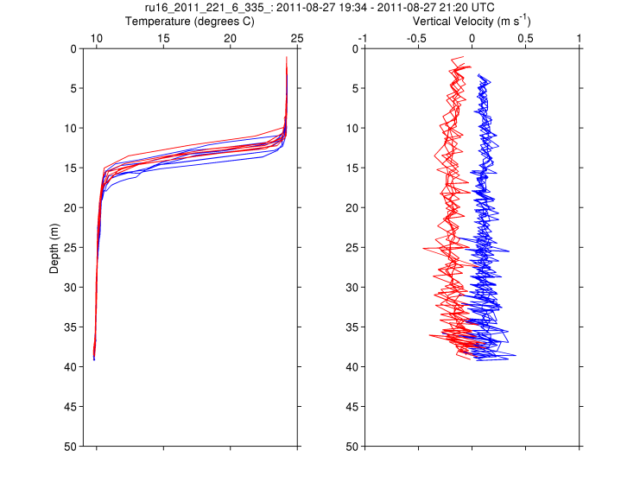
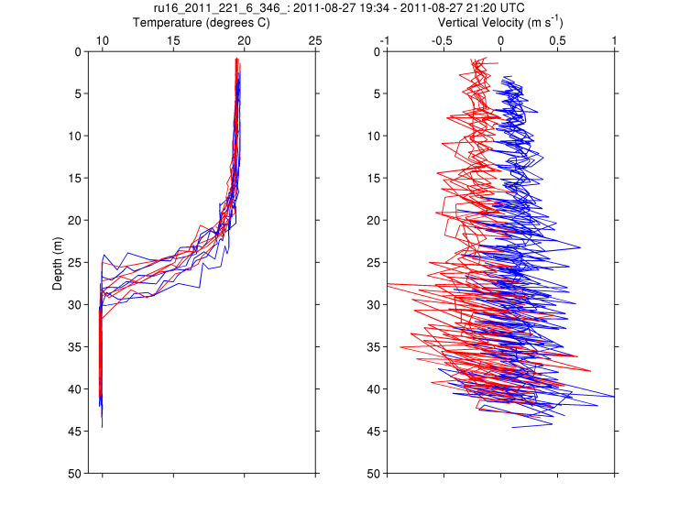
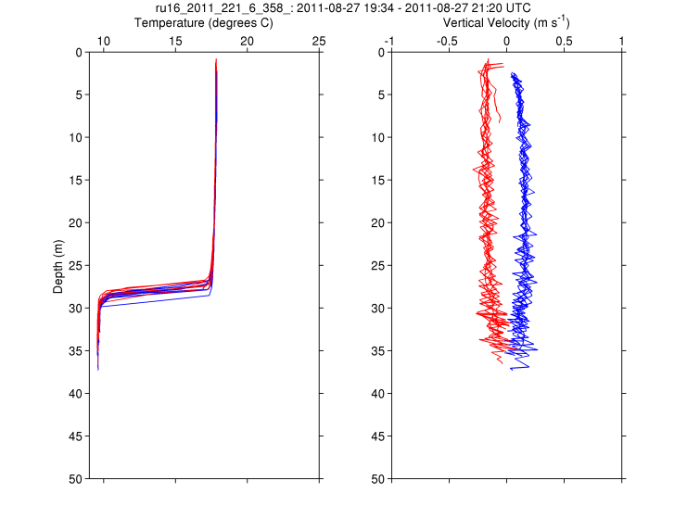
RU16
Temp.
Section
Upcast
Downcast
Temp. Vert. Vel.
Temp. Vert. Vel.
Temp. Vert. Vel.

Slide 19
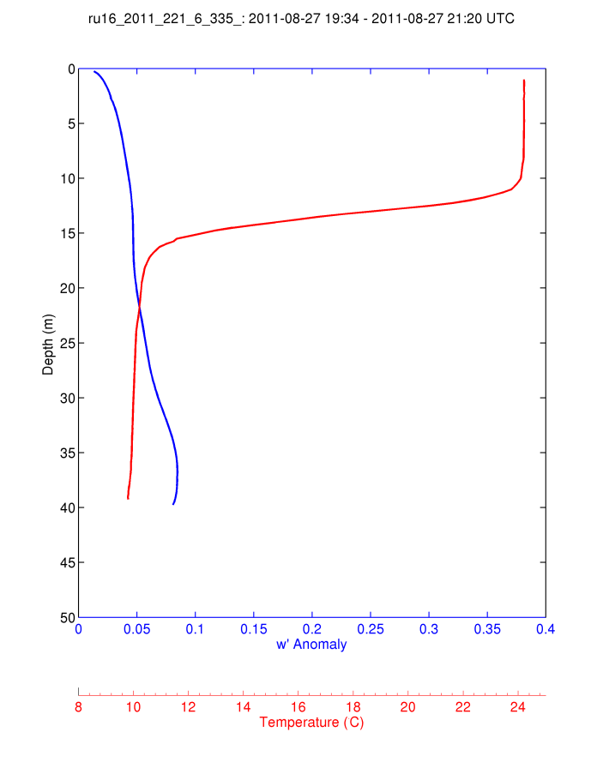
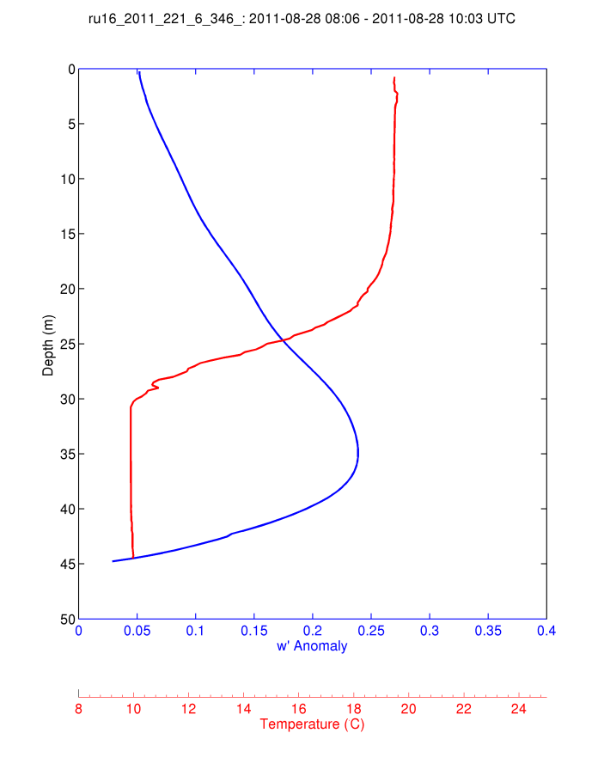
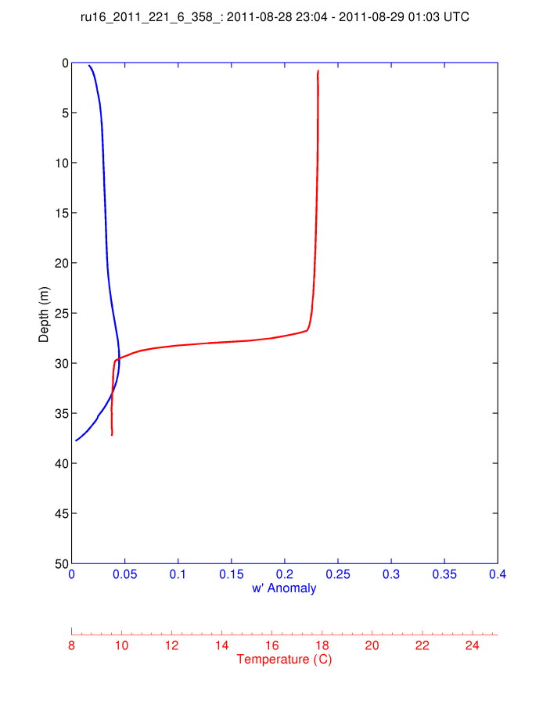
For Each 2-hour Segment:
1) Calculate the Average Temperature Profile
2) Calculate the Vertical Velocity Standard Deviation Profile and Smooth Vertically.
Temp
S.D. w’
During Irene
Pre-Irene
Post-Irene

Slide 20
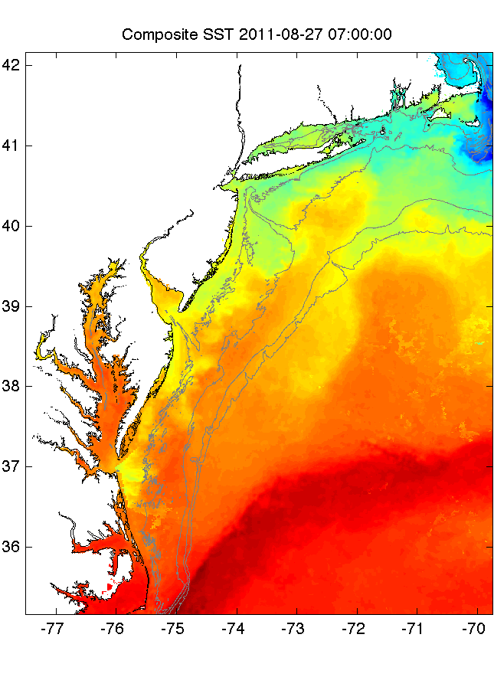
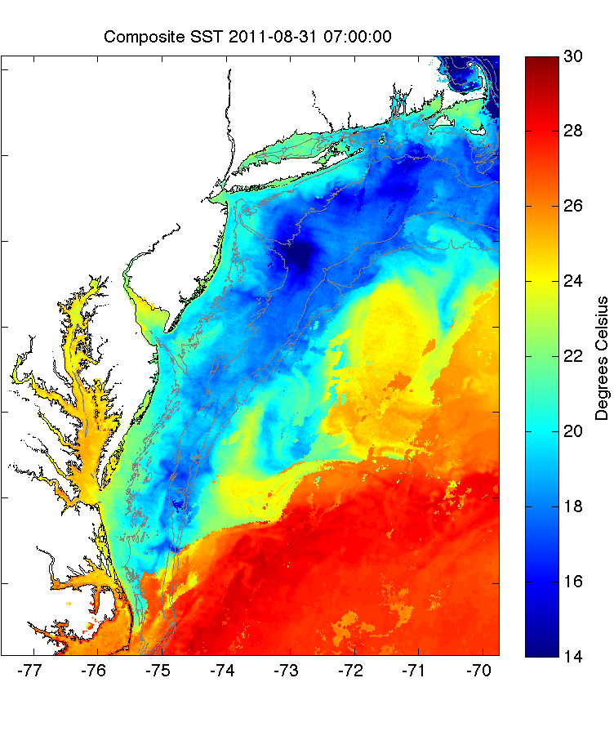
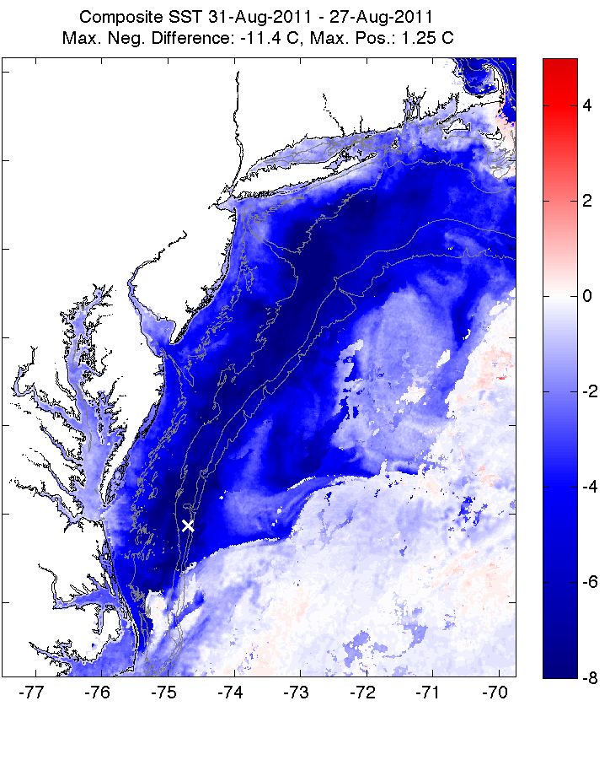
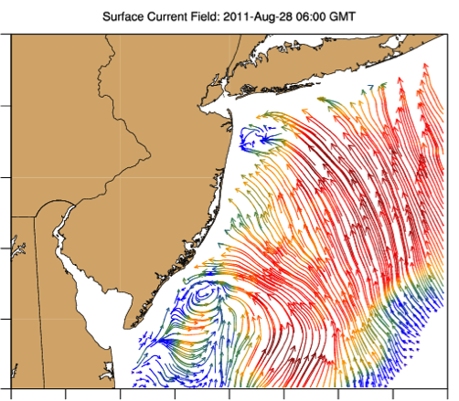
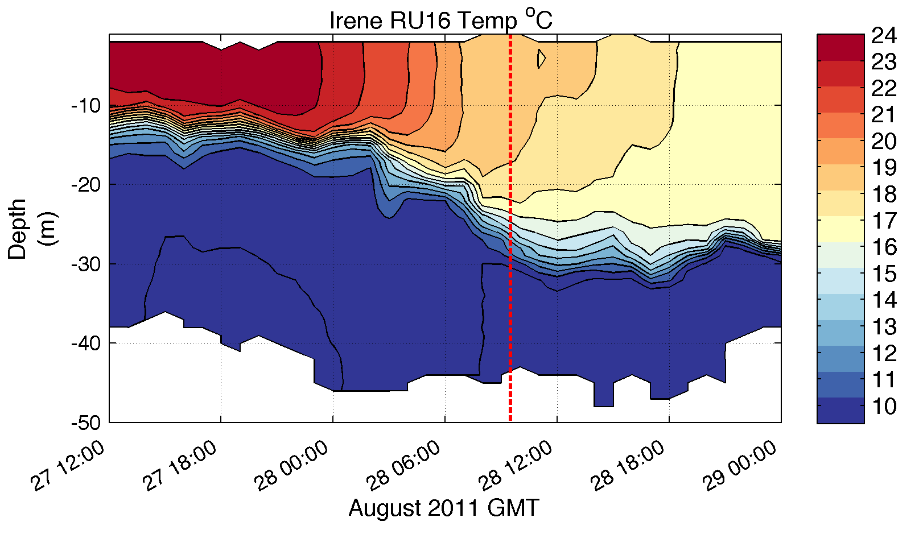
Pre-Irene
Post-Irene
Difference
11C max Cooling
WHAT?
Satellite
SST
WHEN? Glider Temperature
WHY?
HF Radar
Currents
Eye Passage
?

Slide 21
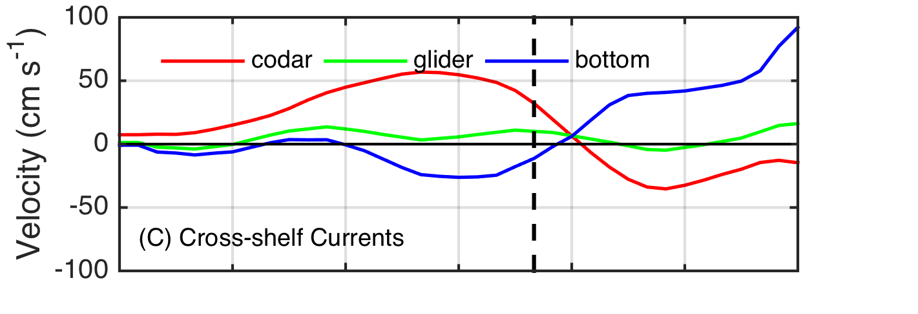
Pre-Irene
Post-Irene
Difference
11C max Cooling
WHAT?
Satellite
SST
WHEN? Glider Temperature
WHY?
HF Radar
Currents
Eye Passage

Slide 22
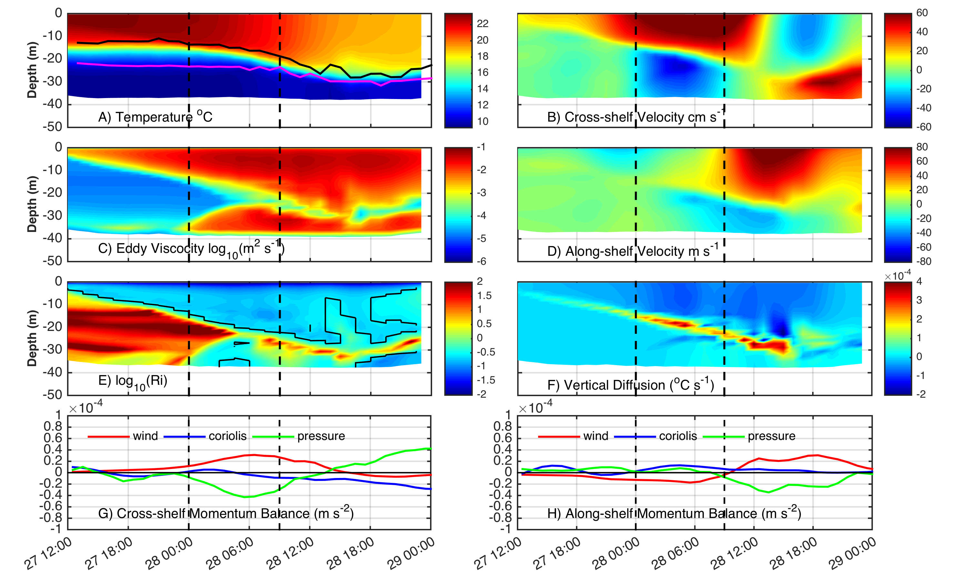
ROMS Model Results at Glider Location
Coastal Baroclinic Circulation Enhances Mixing & Cooling

Slide 23
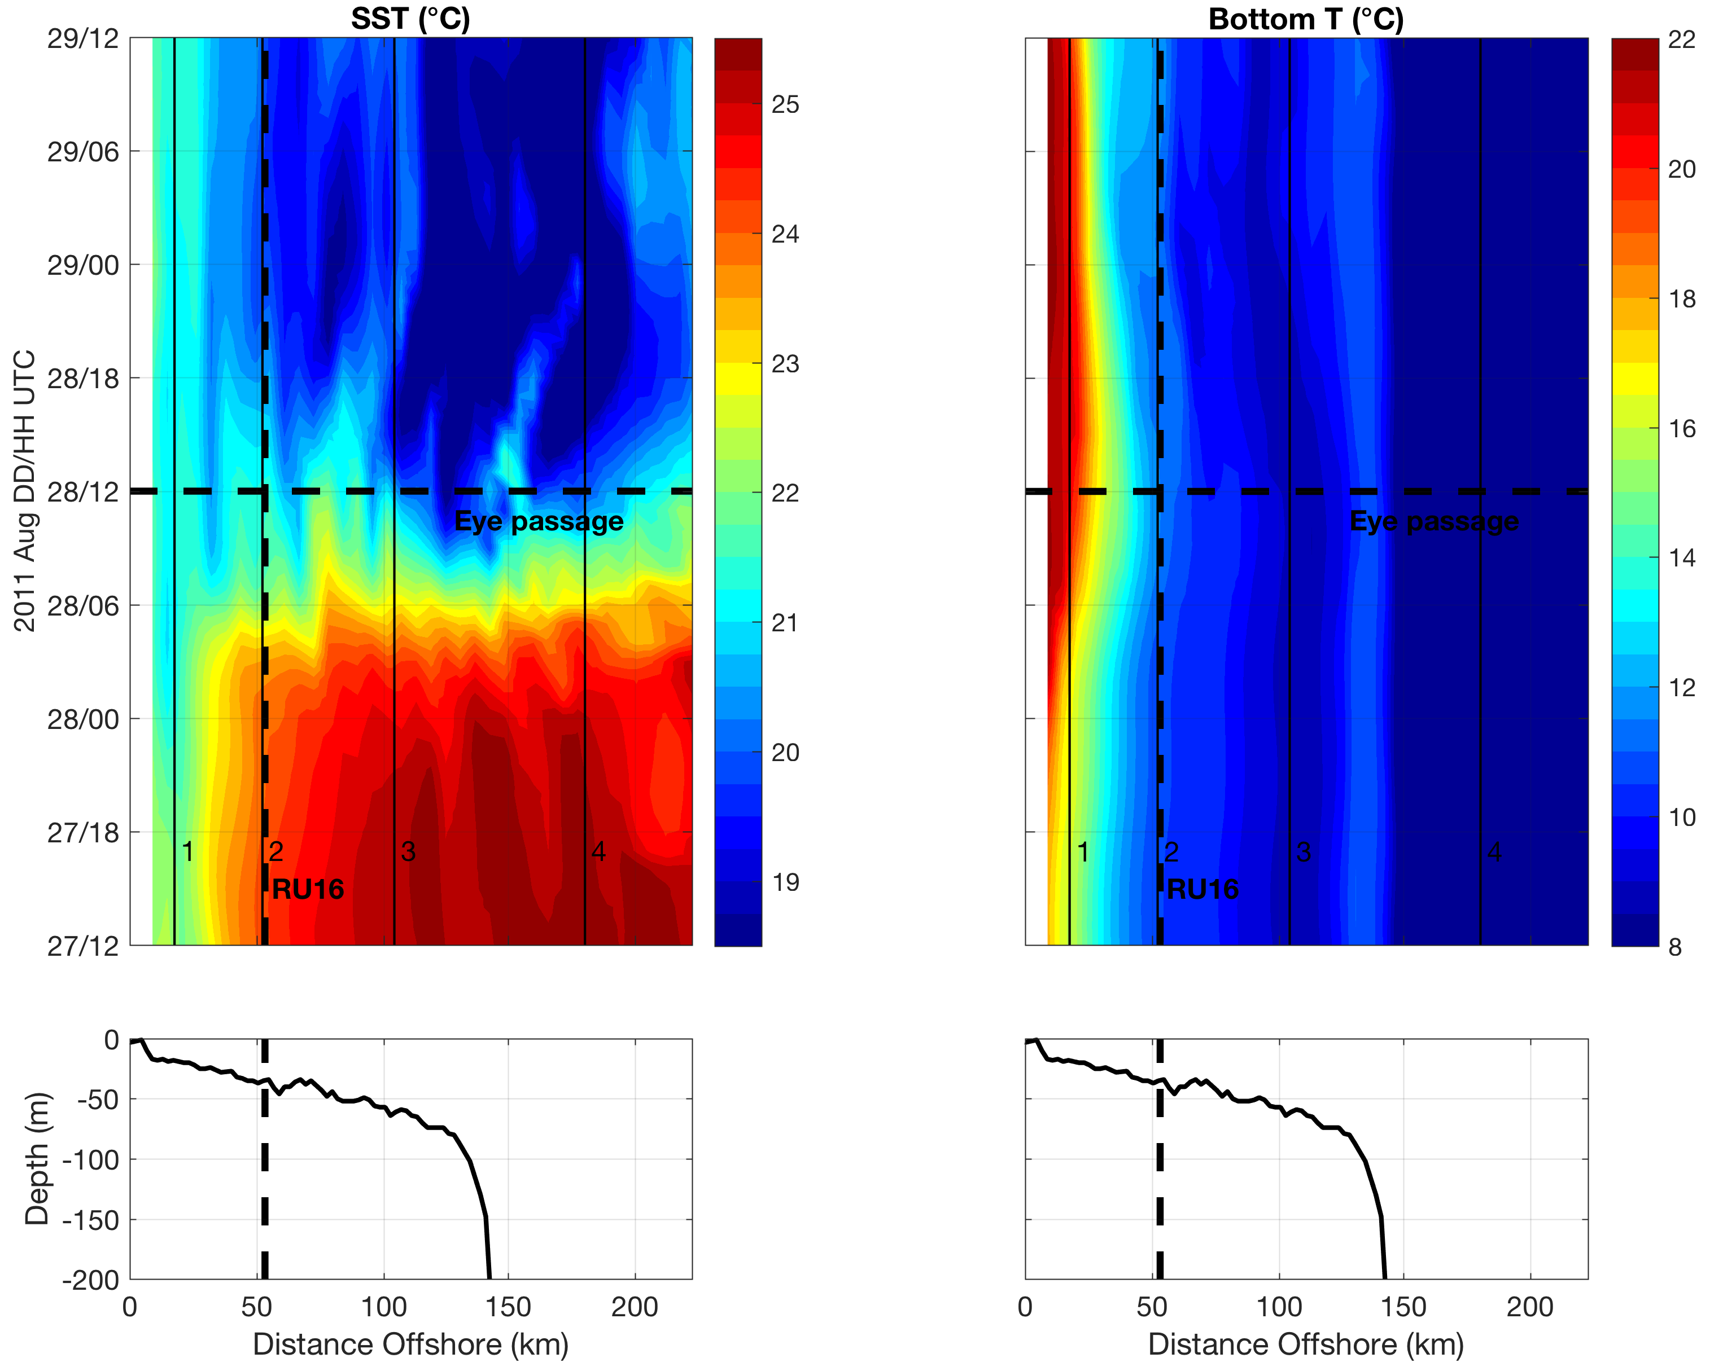
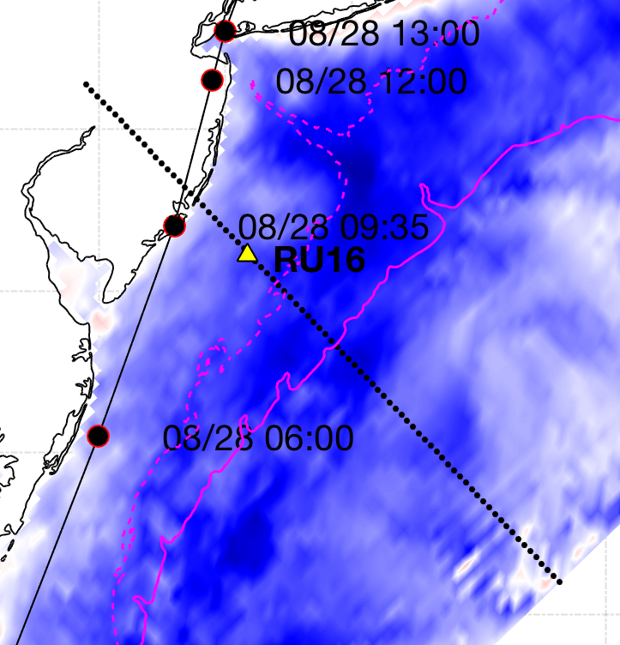
ROMS Model Cross-shelf Section: SST cooling, downwelling bottom T
AOEC SST cooling
Downwelling
Upwelling
Seroka et al. in prep.
Notes:
10

Slide 24
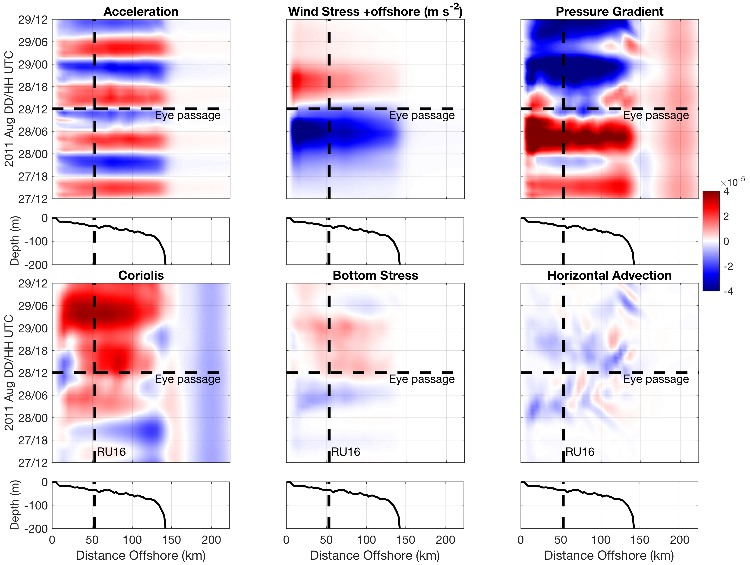
ROMS Model Cross-shelf Section: onshore WS vs. offshore PG
+offshore
m s⁻²
-onshore
Seroka et al. in prep.
Notes:
15

Slide 25
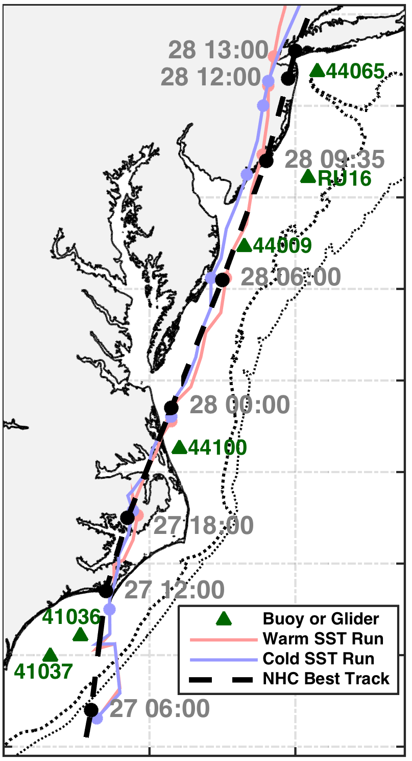
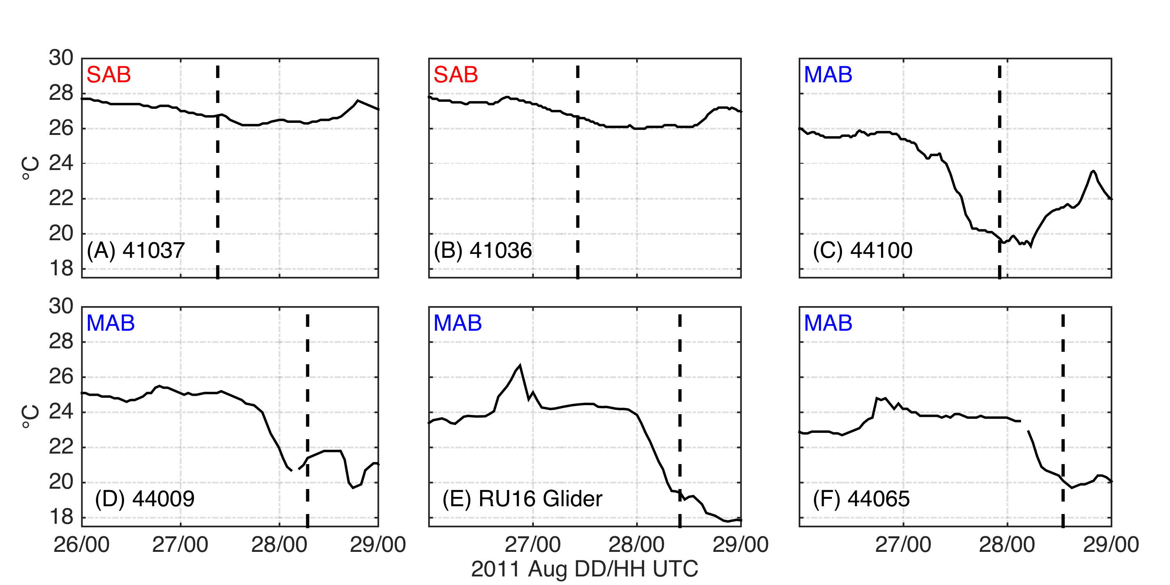
Alongshelf Buoy Array
Ahead-of-eye-center (AOEC) cooling signal in Irene
South
Eye passage
98%
SST
SST
82%
76%
90%
North
Seroka et al. 2016

Slide 26
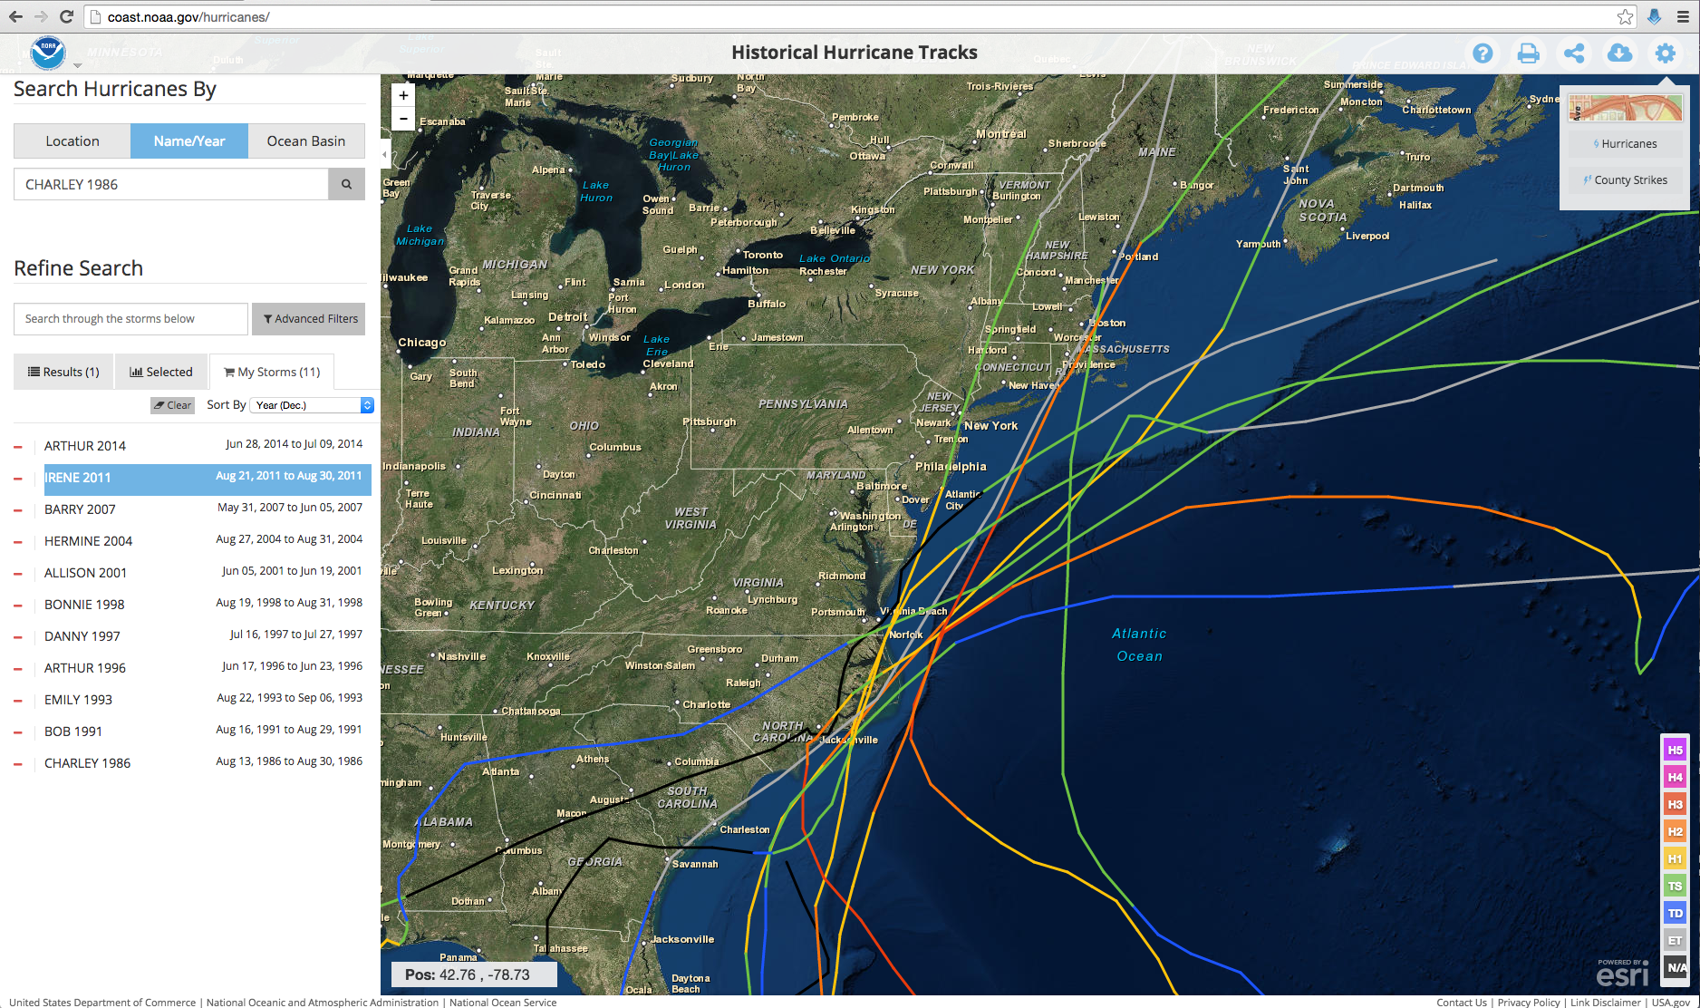
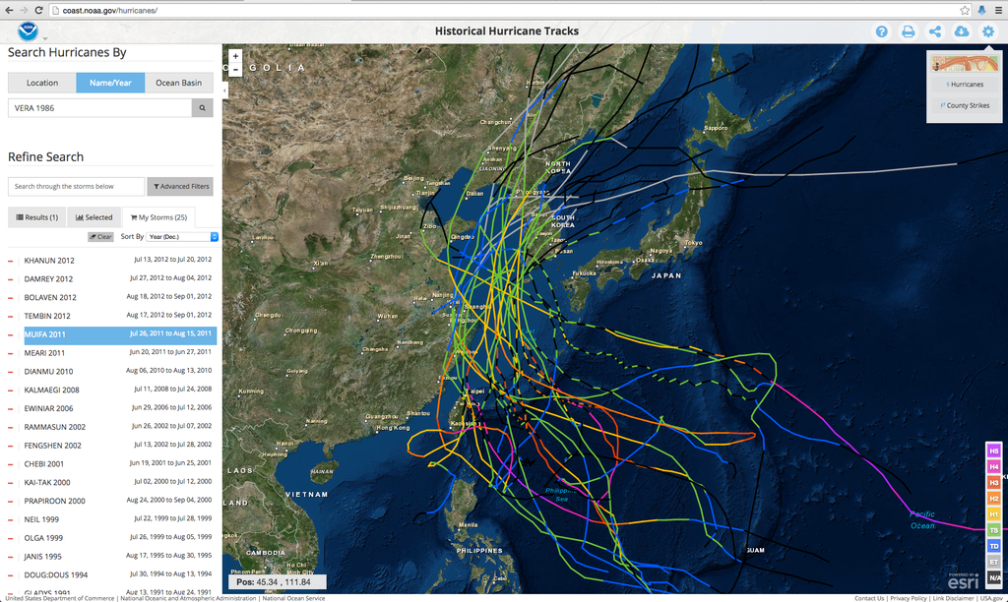
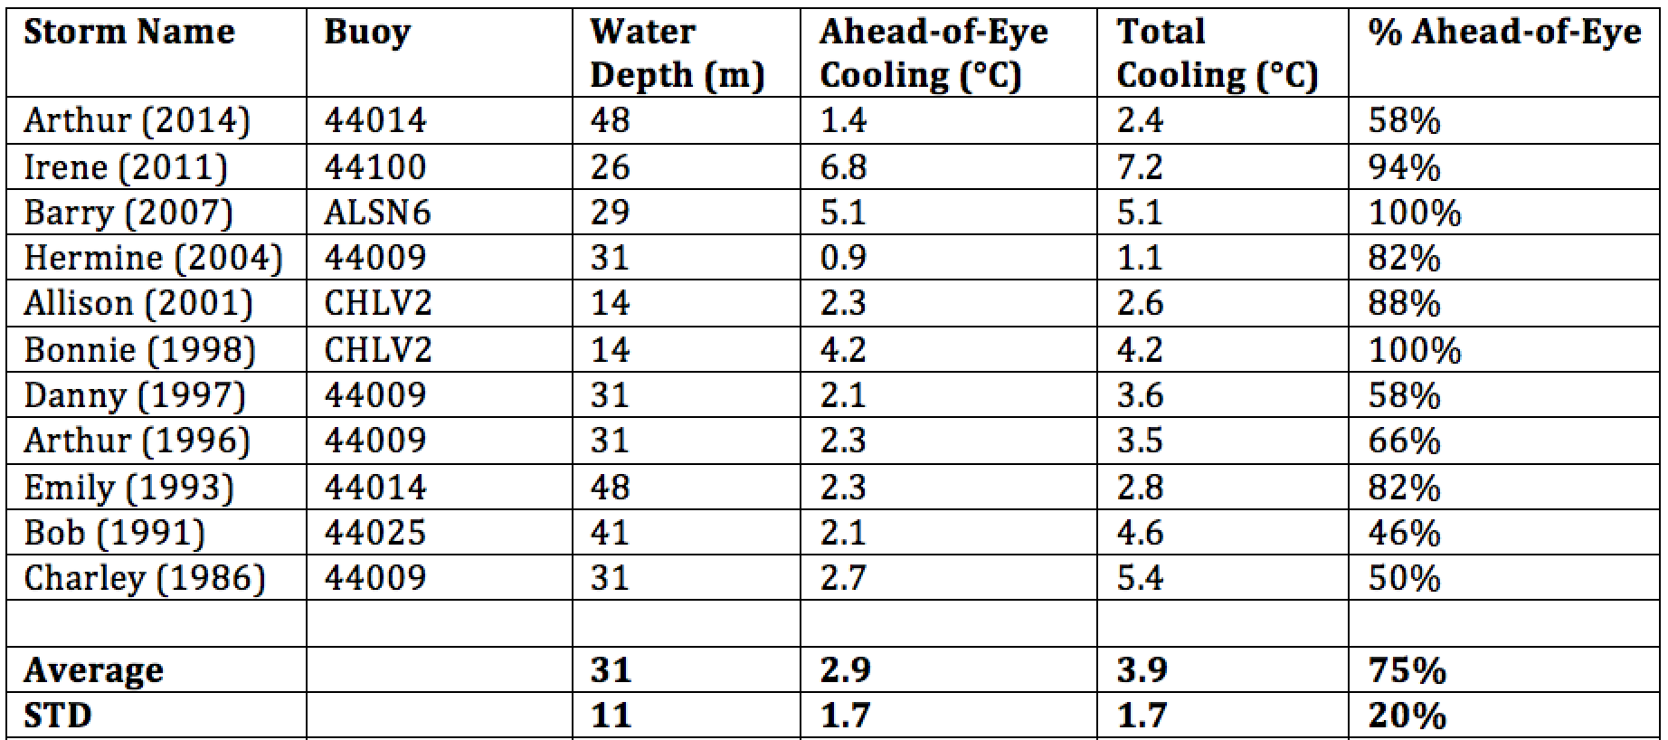
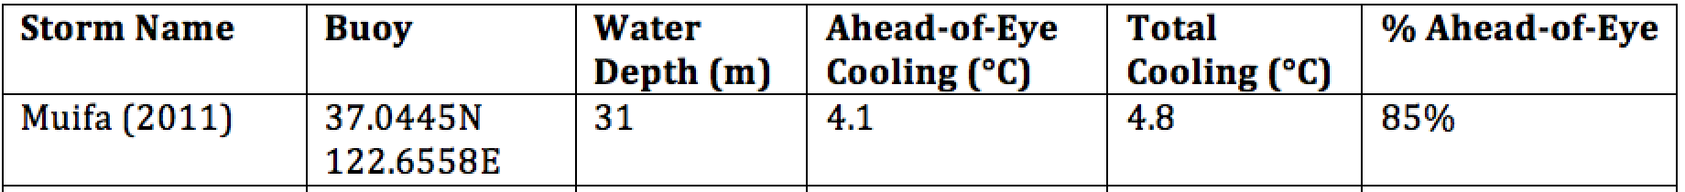
Ahead of Eye Center Cooling
Left: U.S. Mid-Atlantic
Right: East China & Yellow Seas
11 Hurricanes since 1985
26 Typhoons since 1985
AOE Center Cooling in Buoy Record:
Mid Atlantic Average: 75%
Super-typhoon Muifa: 85%
See Glenn et al., Nature Comms, 2016

Slide 27






Rutgers Atmospheric Forecast Sensitivity Study
Warm Ocean
Boundary Condition
Cat 1 Hurricane
Tropical Storm
Cold Ocean
Boundary Condition
IMPACT?
>10 knots reduction in peak wind speed

Slide 28


SST within 25 km of eye & impact on air-sea heat flux
Warm
Cold
Northern Buoy
26C
Central Buoy

Slide 29




NARR
WARM SST
COLD SST
WRF Heat Flux Comparison to
North American Regional Reanalysis
Wind
Latent heat flux
Sensible heat flux

Slide 30


WRF 250-850 hPa Wind Shear
NARR
WARM SST
COLD SST
August 28
00:00 Z
August 28
12:00 Z

Slide 31


WRF Dry air intrusion (700 mb specific humidity)
NARR
WARM SST
COLD SST
August 28
00:00 Z
August 28
12:00 Z
Notes:
SST sensitivity is not affecting or not being affected by humidity

Slide 32

WRF Model Sensitivity Study
Over 130 model runs
Paired to compare sensitivities
Central pressure & max wind
Sensitivity to SST greatest
Seroka, Miles, Xu, Kohut, Schofield & Glenn,
Hurricane Irene Sensitivity to Stratified Coastal Ocean Cooling, Monthly Weather Review, 2016

Slide 33









Improved satellite SST product revealed ahead-of-eye cooling was not captured by:
standard satellite product
ocean models used for forecasting hurricane intensity
MARACOOS SST
RTG HR SST
NAM model
HWRF-POM
low res
HWRF-HYCOM
medium res
BEFORE IRENE
AFTER IRENE
Notes:
Caveats: different atmospheric forcing, etc.
Rutgers SST: 2km, RTG: 1/12 deg, ~9 km, HWRF-POM: 18km, HWRF-HYCOM: 1/12 deg, ~9km

Slide 34






HWRF Cross-shelf Transects
HWRF-POM
Before
HWRF-HYCOM
Before
Before
After
HWRF-POM
After
HWRF-HYCOM
After
RU16 Glider
Thank you to Hyun-Sook Kim and Zhan Zhang for providing HWRF data
Observed bathymetry from NOAA National Geophysical Data Center, U.S. Coastal Relief Model, Retrieved date goes here, http://www.ngdc.noaa.gov/mgg/coastal/crm.html

Slide 35




Hurricane Hermine Response: CINAR/MARACOOS Glider Fleet Launched, 9/2016
Glider
HYCOM
RTOFS

Slide 36
Hurricane Irene Track August 27-28, 2011
Summary:
Summer Storm
Strong Stratification
Coastal Response
Mixing Cooled Surface
Limited Intensity

Slide 37



Slide 38


JCOMM Global
OceanGlider Network:
Tropical Cyclone Task team
MARACOOS/CINAR
UMaine
WHOI
UMass
Rutgers
UMaryland
VIMS
NCEP
KIOST
2nd IO
SKLECR
IOrucool_global_map_black_axis (1)
USM
NRL
BIOS
NTU
CariCOOS
UPRM
UVI
TWR
AOML
BMKGA
UCT
UWA
USP
Selected EGO Goals from Pierre Testor, Slide 4:
Coordination of ongoing research, and the conception of future research
Build Capacity to operate fleets of gliders at international level

