Slide 1



Stratified coastal ocean interactions with tropical cyclones:
Coastal ocean circulation during Hurricane Sandy
Travis Miles, Scott Glenn (Rutgers), and Greg Seroka (NOAA NOS)
NPOMS-5, Tianjin
July 5th 2017
Journal of Geophysical Research (Accepted)

Slide 2
Key Storm Glider Reference List
Glenn, Jones, Twardowski, Bowers, Kerfoot, Kohut, Webb, Schofield, 2008. Glider observations of sediment resuspension in a Middle Atlantic Bight fall transition storm. Limnology and Oceanography 53(5, Part 2): 2180-2196.
Miles, Glenn, Schofield, 2013. Temporal and spatial variability in fall storm induced sediment resuspension on the Mid-Atlantic Bight. Continental Shelf Research 63, Supplement: S36-S49.
Miles, Seroka, Kohut, Glenn, 2015. Glider observations and modeling sediment transport in Hurricane Sandy. JGR Oceans, DOI: 10.1002/2014JC010474
Glenn, Miles, Seroka, Xu, Forney, Yu, Roarty, Schofield, Kohut, 2016. Stratified coastal ocean interactions with tropical storms, Nature Communications, DOI:10.1038/ncomms10887.
Seroka, Miles, Xu, Kohut, Schofield & Glenn, 2016. Hurricane Irene Sensitivity to Stratified Coastal Ocean Cooling, Monthly Weather Review, 144(9) 3507-3530.
Seroka, Miles, Xu, Kohut, Schofield & Glenn, 2017. Rapid shelf-wide cooling response of a stratified coastal ocean to hurricanes. JGR-Oceans: Special Section on Ocean Responses and Feedbacks to Tropical Cyclones, DOI:10.1002/2017JC012756.
Miles, Seroka, Glenn, 2017. Coastal ocean circulation during Hurricane Sandy, J. Geophysical Res. - Oceans, accepted.
Sea-Bottom Interface
Air-Sea Interface
Notes:
The paper that this work is coming from was the most recent in what's become a series of works focused on coastal storms

Slide 3

Hurricane Irene August 26-29 2011
#8 with >$15B damage
Track Accurate
Intensity Over-predicted

Slide 4
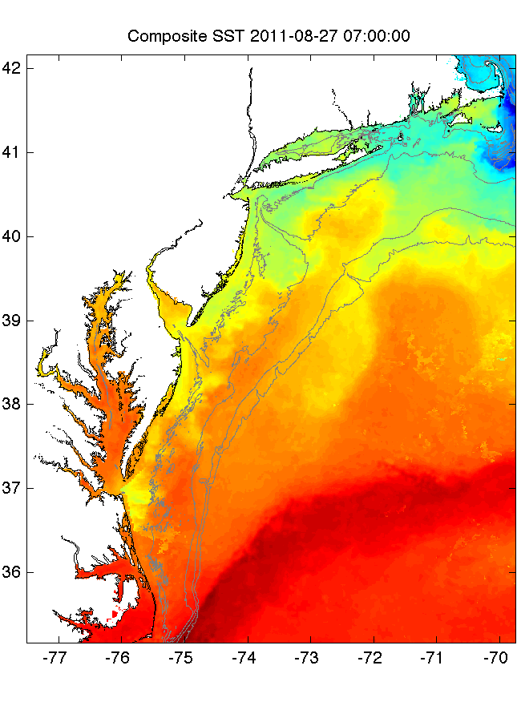
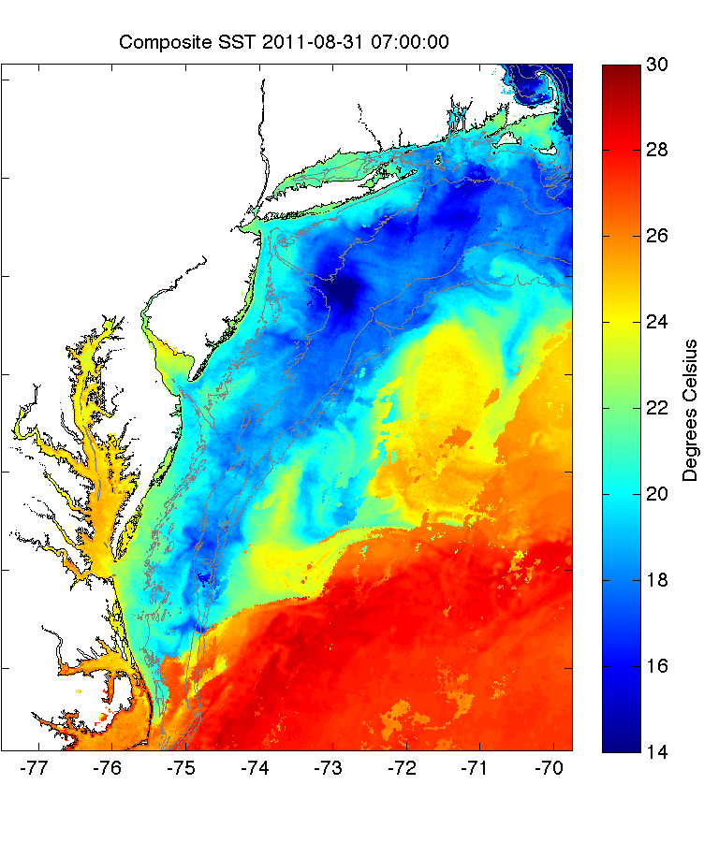
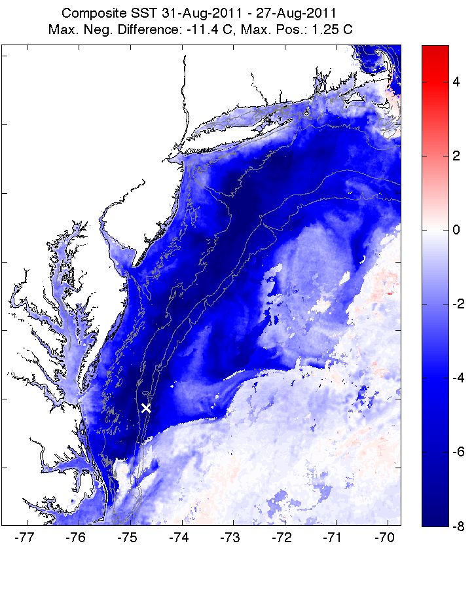
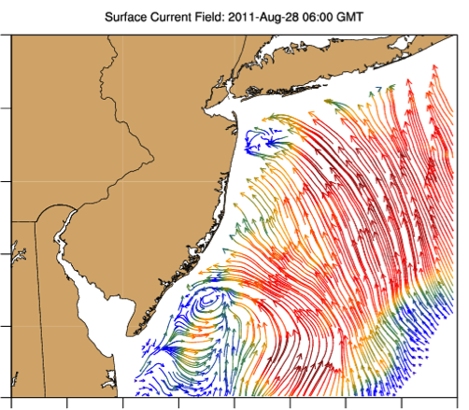
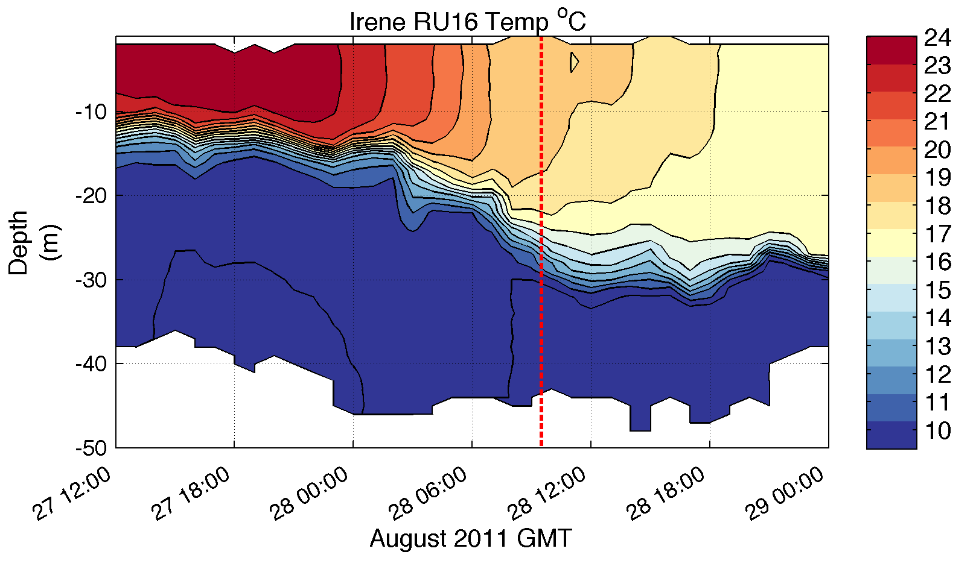
Pre-Irene
Post-Irene
Difference
11C max Cooling
WHAT?
Satellite
SST
WHEN? Glider Temperature
WHY?
HF Radar
Currents
Eye Passage
?

Slide 5
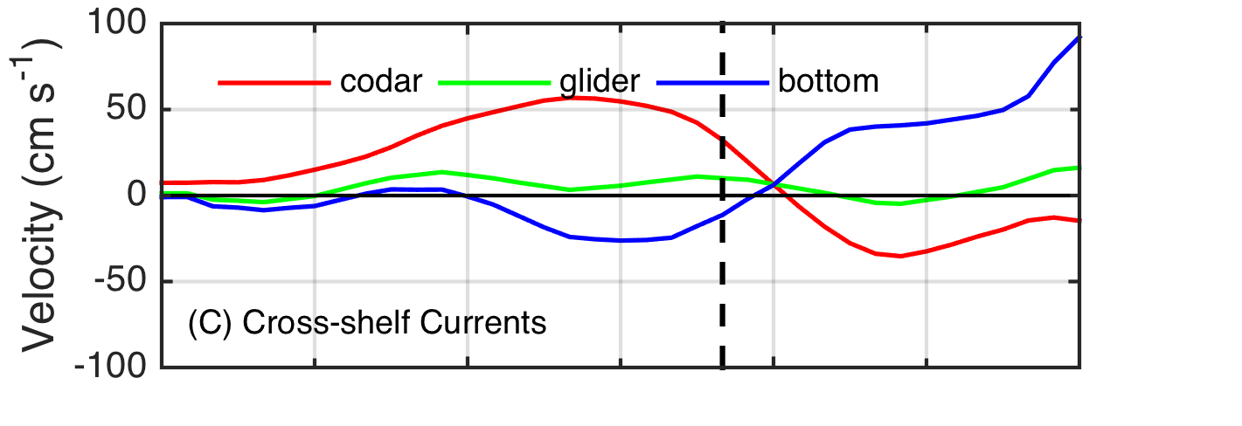
Pre-Irene
Post-Irene
Difference
11C max Cooling
WHAT?
Satellite
SST
WHEN? Glider Temperature
WHY?
HF Radar
Currents
Eye Passage

Slide 6
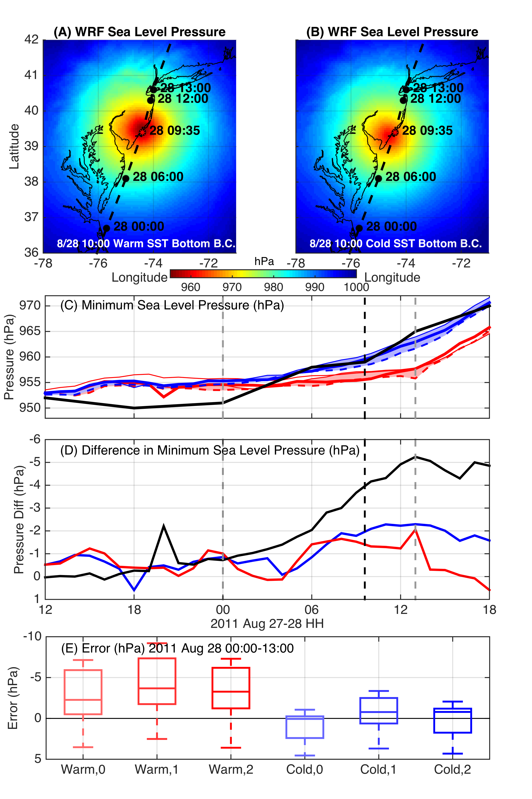
Irene WRF Model Sensitivity Study
Over 130 model runs
Paired to compare sensitivities
Central pressure & max wind
Sensitivity to SST greatest
Seroka, Miles, Xu, Kohut, Schofield & Glenn,
Hurricane Irene Sensitivity to Stratified Coastal Ocean Cooling, Monthly Weather Review, 2016

Slide 7
Hurricane Sandy
October 29, 2012
NOAA/NHC Damage:
#2 with >$60 Billion.
Minimum pressure – 948 mb
Storm surge over –14 ft. in NYC

Slide 8
Zambon et al. (2014)

Slide 9
Zambon et al. (2014)

Slide 10
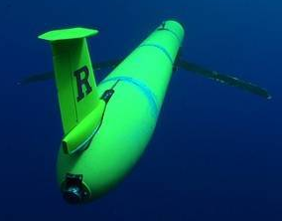

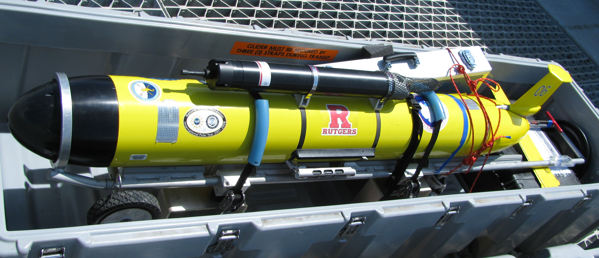

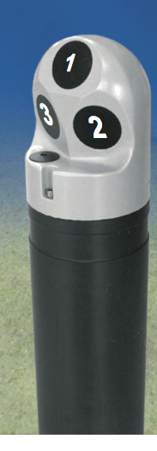
What does a storm glider look like?
Irene Glider Of Opportunity:
RU16 1st Generation TWR Slocum Glider
Alkaline batteries
30 day deployment
Requires re-ballast post-deployment
Seabird un-pumped (CTD)
Temperature, Conductivity. Depth
Aandera Optode
O₂ Saturation and Concentration
Depth Averaged Velocity
Storm Glider v1
RU23 1st Generation TWR Slocum Glider
Rechargeable Batteries
20-30 day deployment
Recharge but no re-ballast (rapid prep)
Nortek Aquadopp Current Profiler
  Water Column Shear
  Inverse solution for absolute velocities
Wet Labs Eco-puck BB3 (470, 532, 660 nm) – optical backscatter

Slide 11
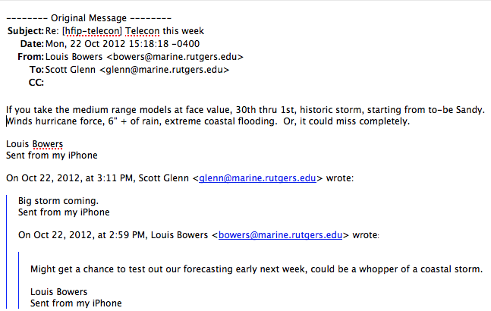
First Warning for Hurricane Sandy:
Monday, Oct 22, 1-week prior to landfall

Slide 12
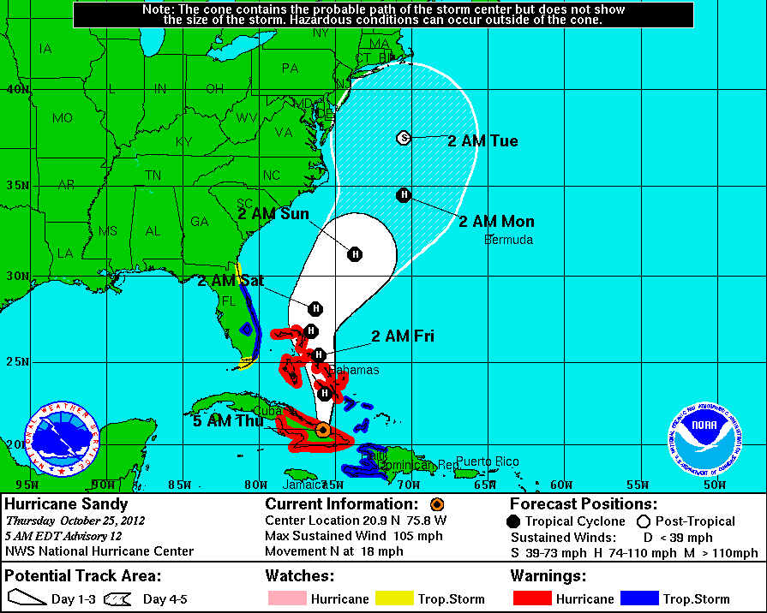

Slide 13
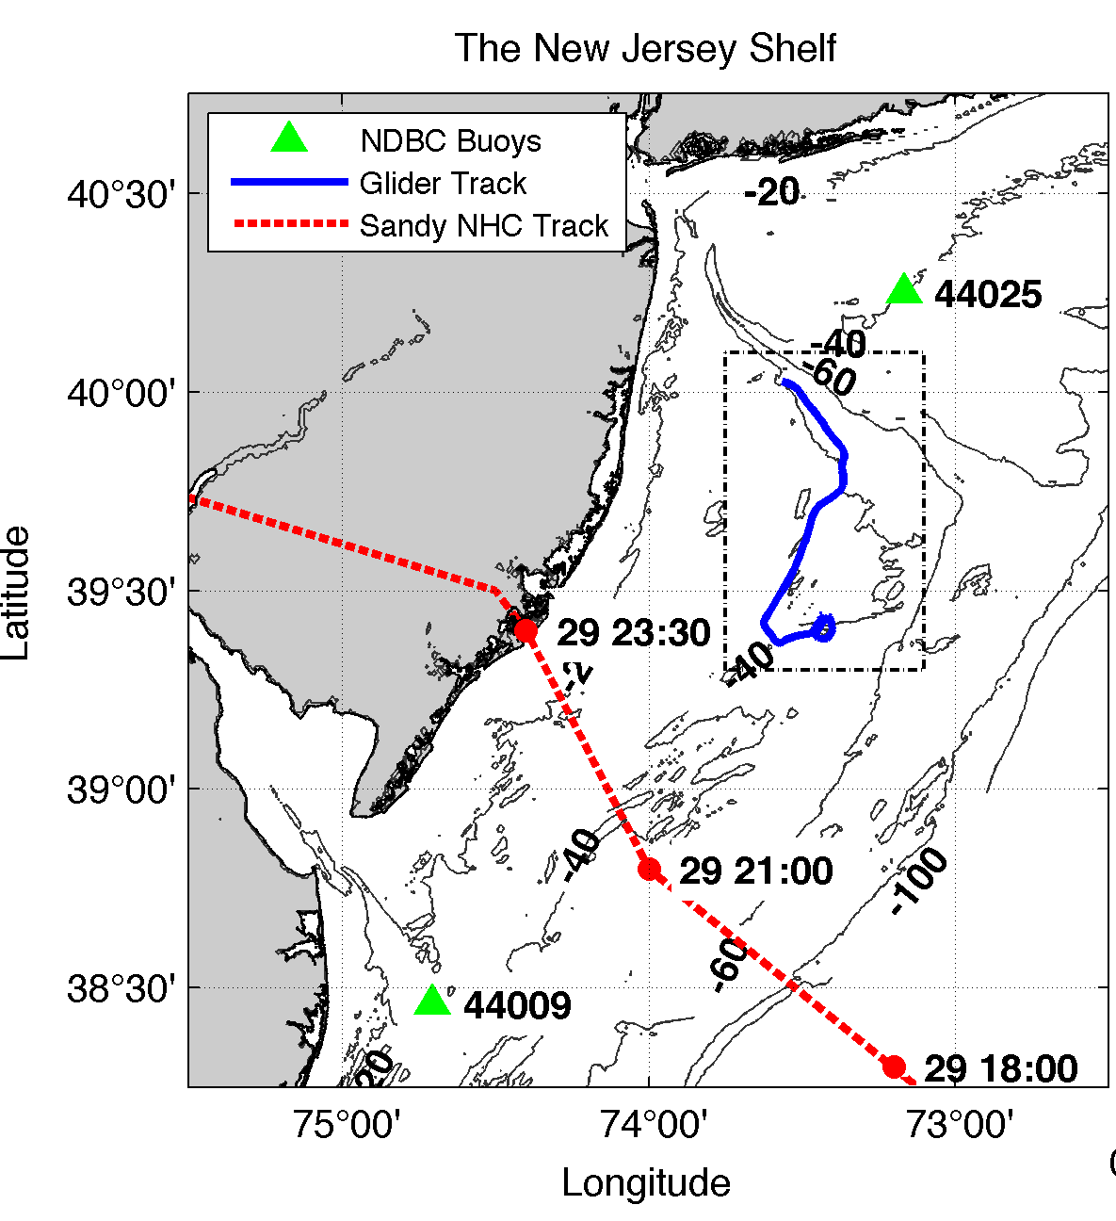
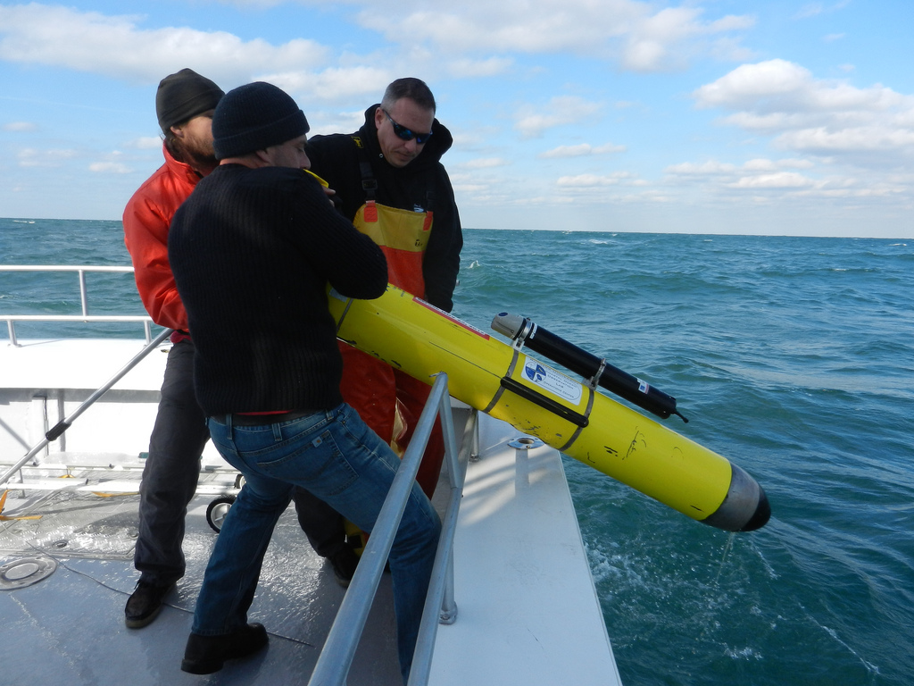
RU23 deployed in rapid response
RU23 Deployed on October 25th
Transited southeast along 40 meter isobath (southern flank of Hudson Shelf Valley)
During storm advected southwestward.
Within ~100 km of storm center NE quadrant (strongest winds/waves).
Notes:
Describe piloting strategy

Slide 14
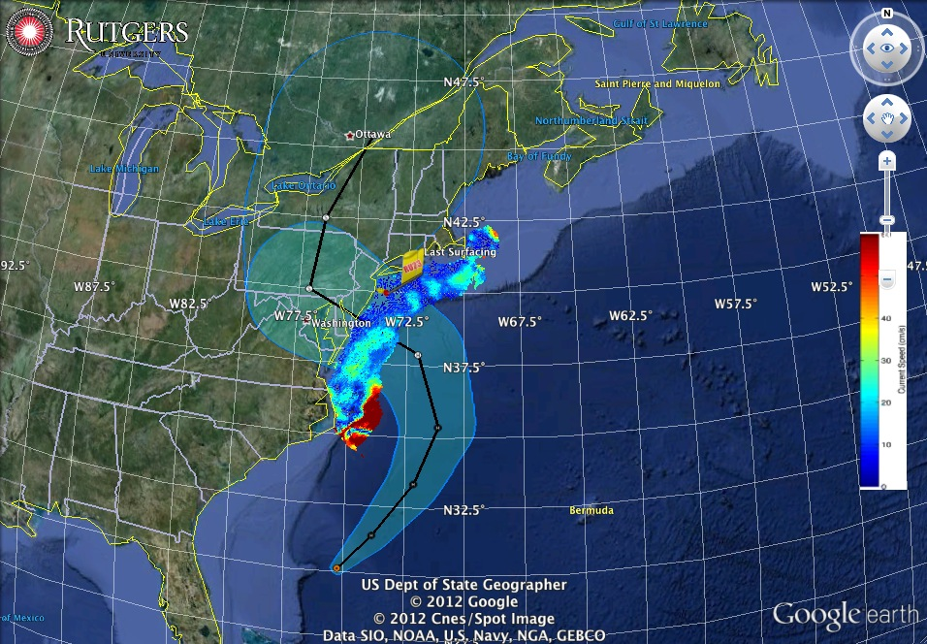
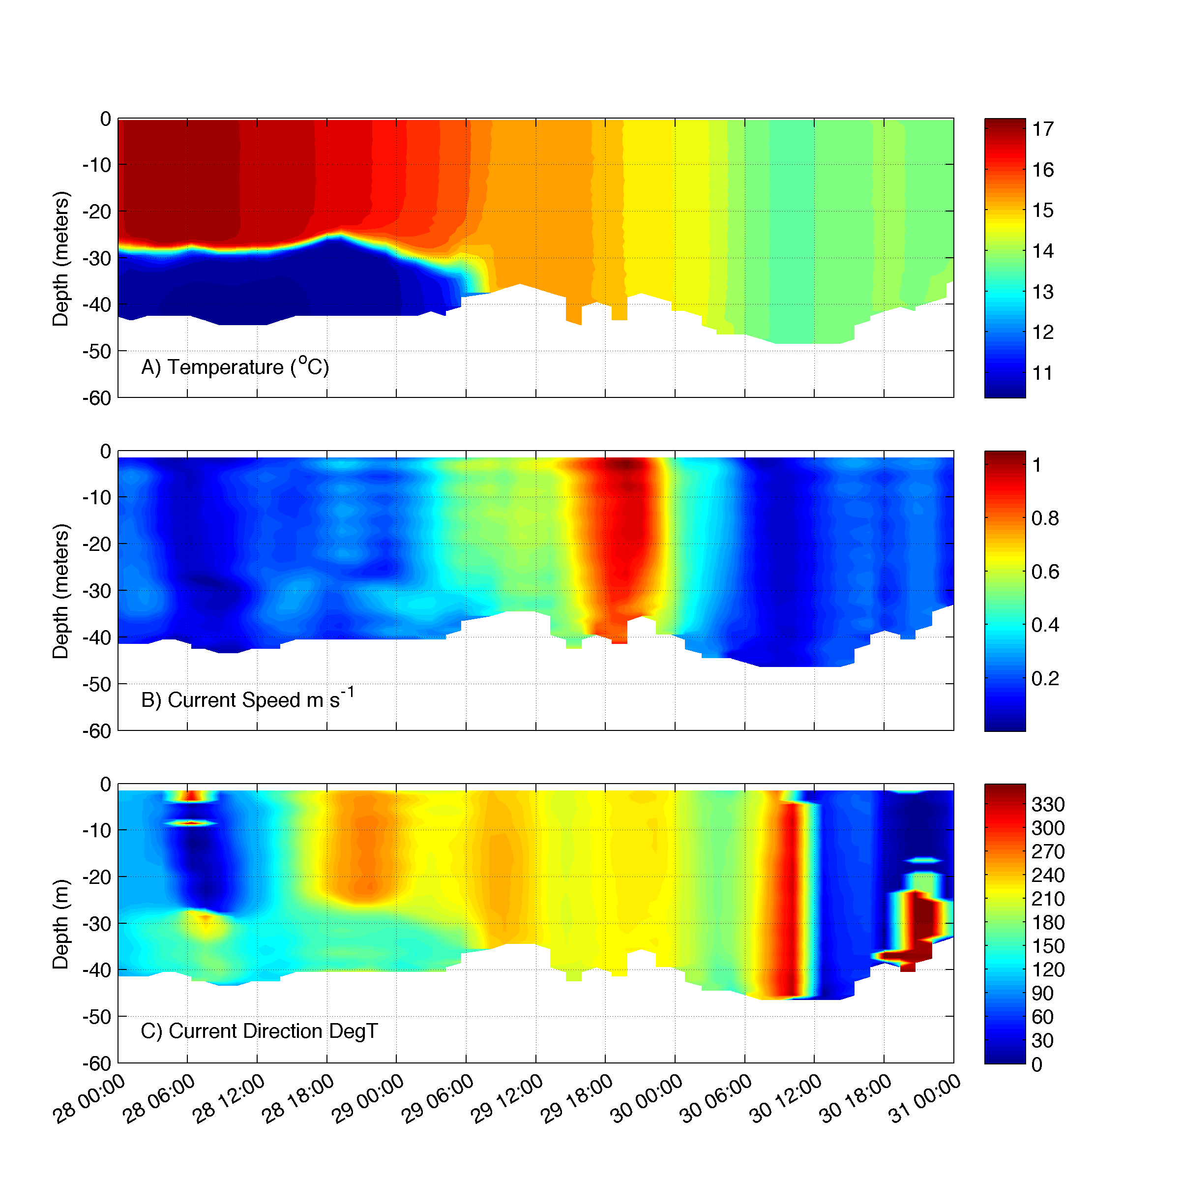
Superstorm Sandy: 2 Days Before Landfall

Slide 15
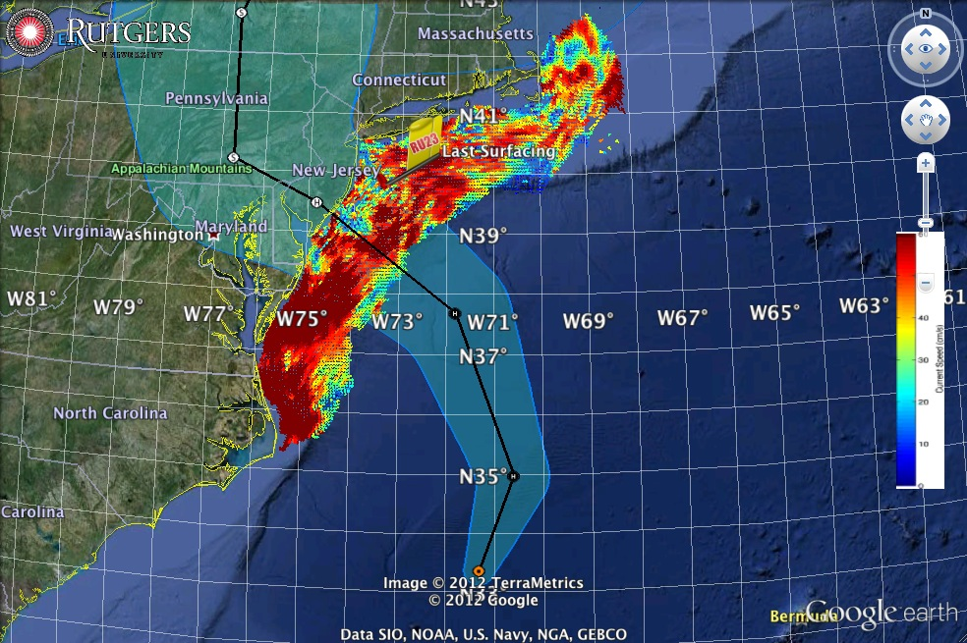
Superstorm Sandy: 1 Day Before Landfall

Slide 16
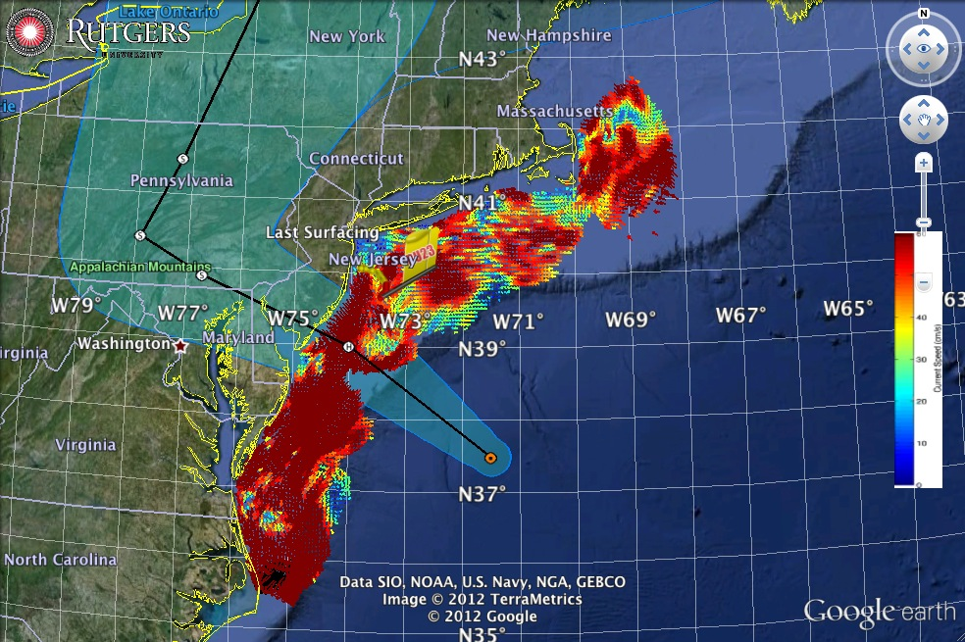
Superstorm Sandy: Morning Before Landfall

Slide 17
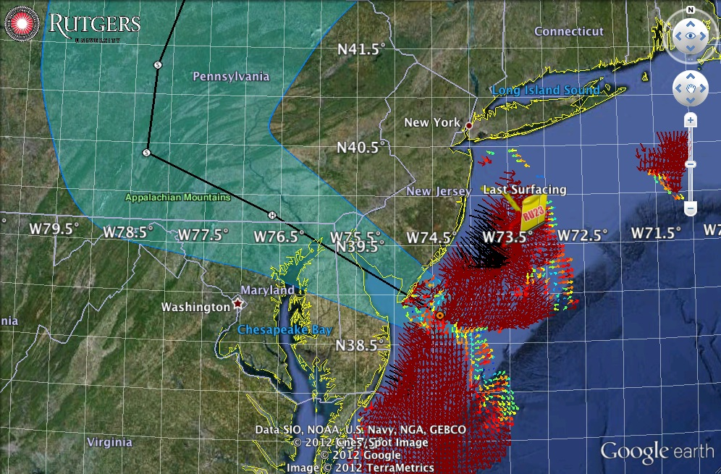
Superstorm Sandy: Landfall (20:00 Local)
Notes:
Insert Comment on recent rebuild/hurricane hardened HF Radar stations?

Slide 18
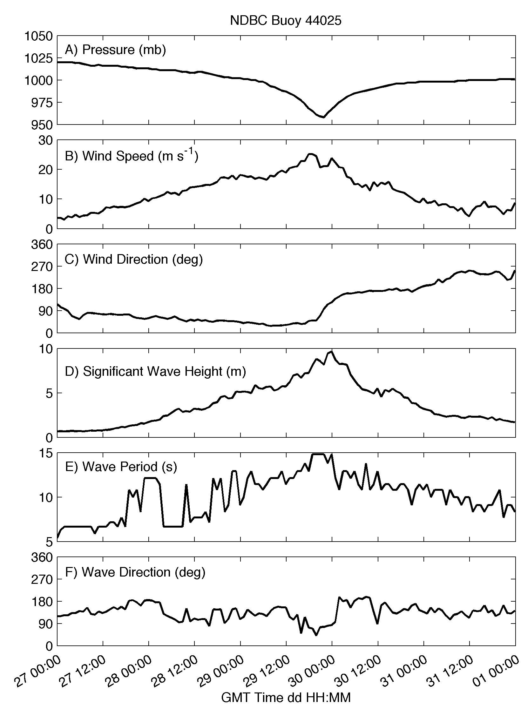
Notes:
Identify what’s on the map and describe Piloting strategy

Slide 19
Along-shore

Slide 20
Along-shore
Onshore
Notes:
Include 44009 comparisons? Not helpful

Slide 21
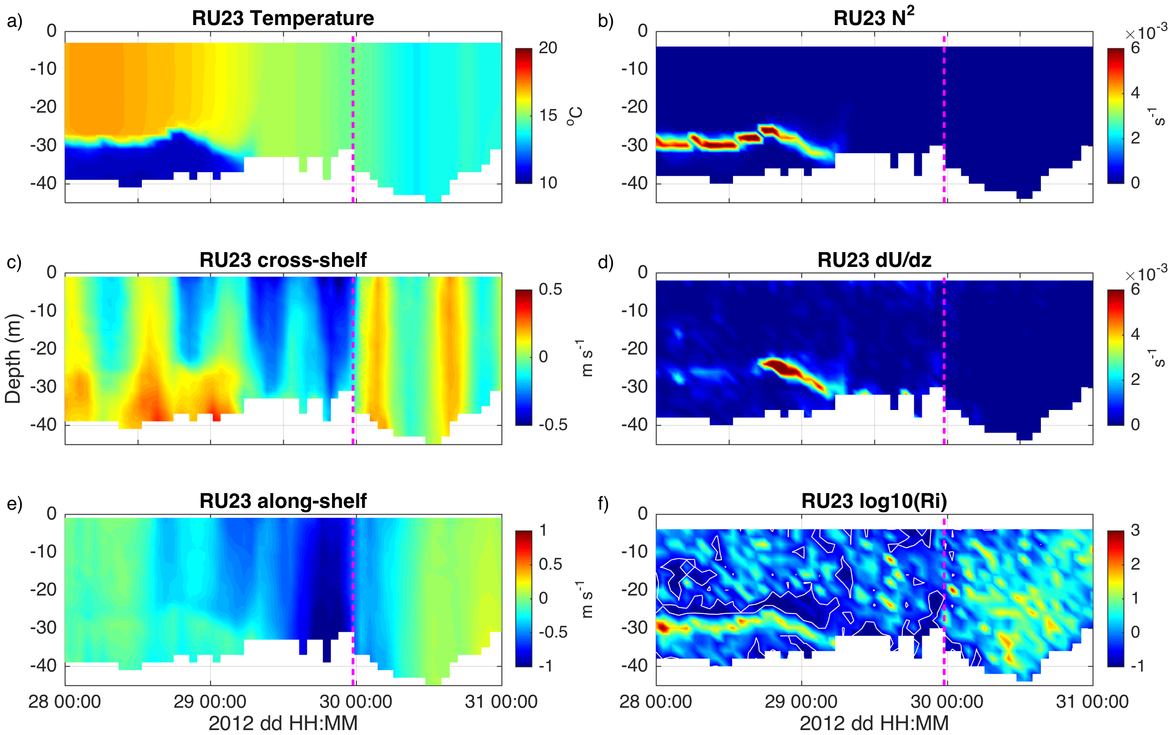

Slide 22
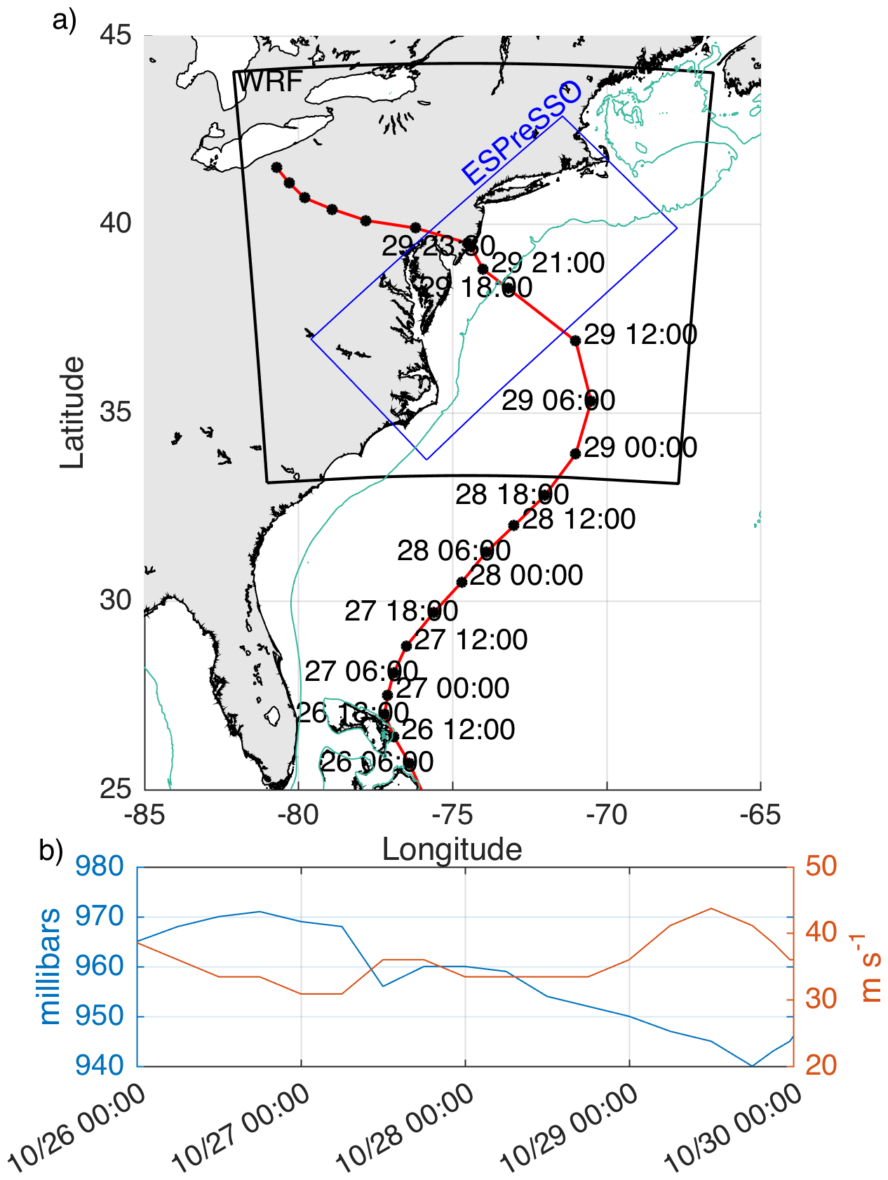
Rutgers ROMS on the ESPreSSO domain
http://www.myroms.org/espresso/
    Cape Hatteras to Cape Cod
36 vertical Levels, ~5 km horizontal resolution, output hourly
Tides at boundary from ADCIRC
HYCOM-NCODA Boundary Conditions
  Cahill et al., 2008, Haidvogel et al., 2008, Hoffman et al., 2008, Zhang et al., 2009a,b, Wilkin and Hunter, 2013
Rutgers Weather Research and Forecasting (RUWRF) Model
WRF Advanced Research core (ARW) version 3.4.1
35 vertical levels, ~6 km resolution
Global Forecast System (GFS) boundary condition
AVHRR fixed sea surface temperature bottom boundary condition.

Slide 23
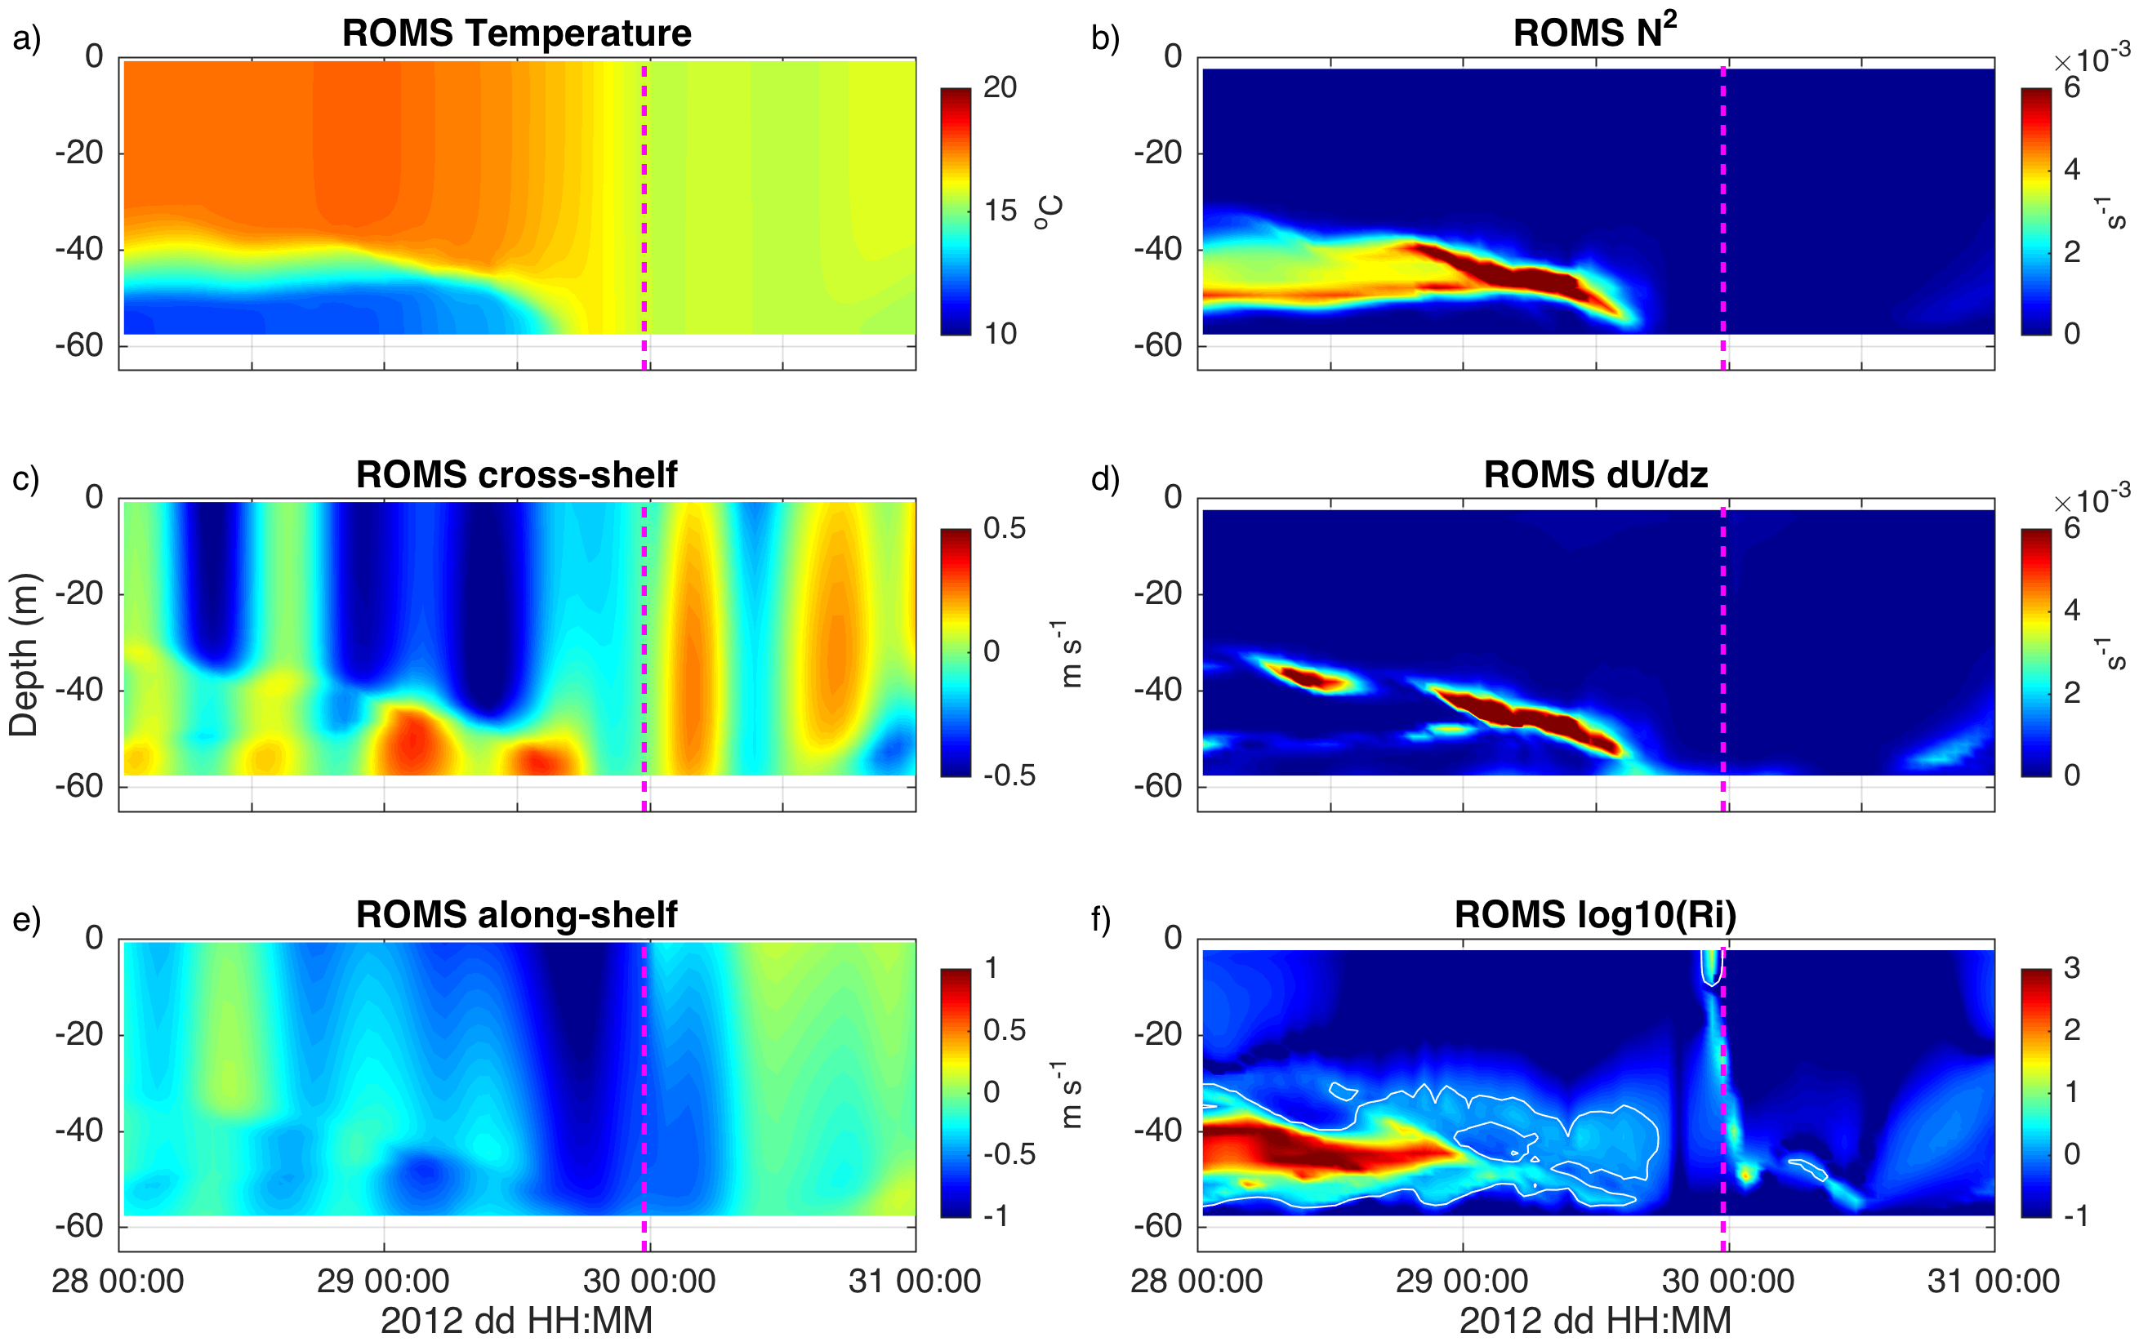

Slide 24
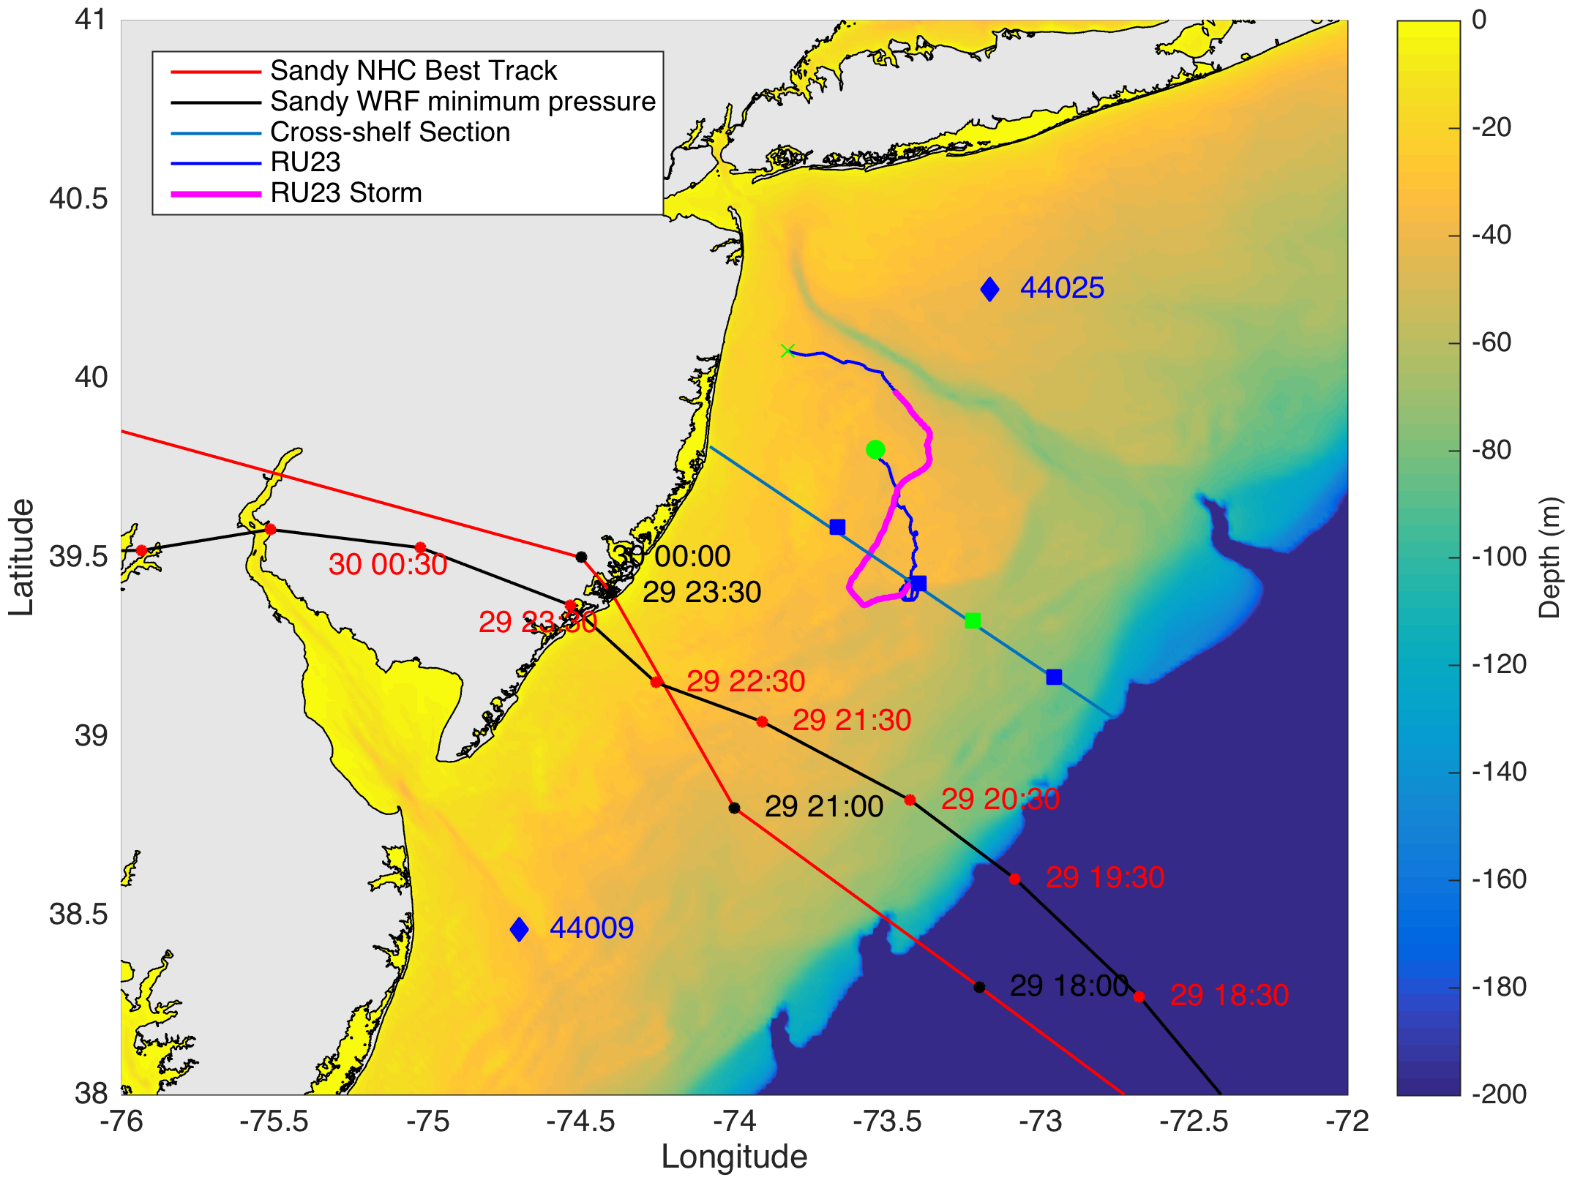

Slide 25
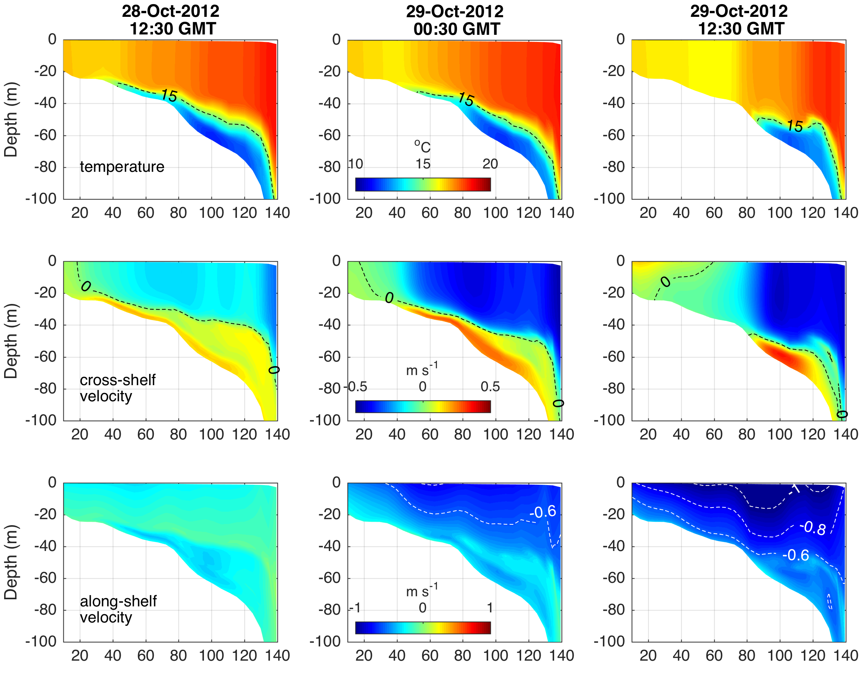
32 Hrs
Pre-Landfall
20 Hrs
Pre-Landfall
8 Hrs
Pre-Landfall
Temperature
Cross-shelf
Velocity
Along-shelf
Velocity
Distance Offshore (km)

Slide 26
32 Hrs
Pre-Landfall
20 Hrs
Pre-Landfall
8 Hrs
Pre-Landfall
Temperature
Cross-shelf
Velocity
Along-shelf
Velocity
Distance Offshore (km)

Slide 27
32 Hrs
Pre-Landfall
20 Hrs
Pre-Landfall
8 Hrs
Pre-Landfall
Temperature
Cross-shelf
Velocity
Along-shelf
Velocity
Distance Offshore (km)

Slide 28
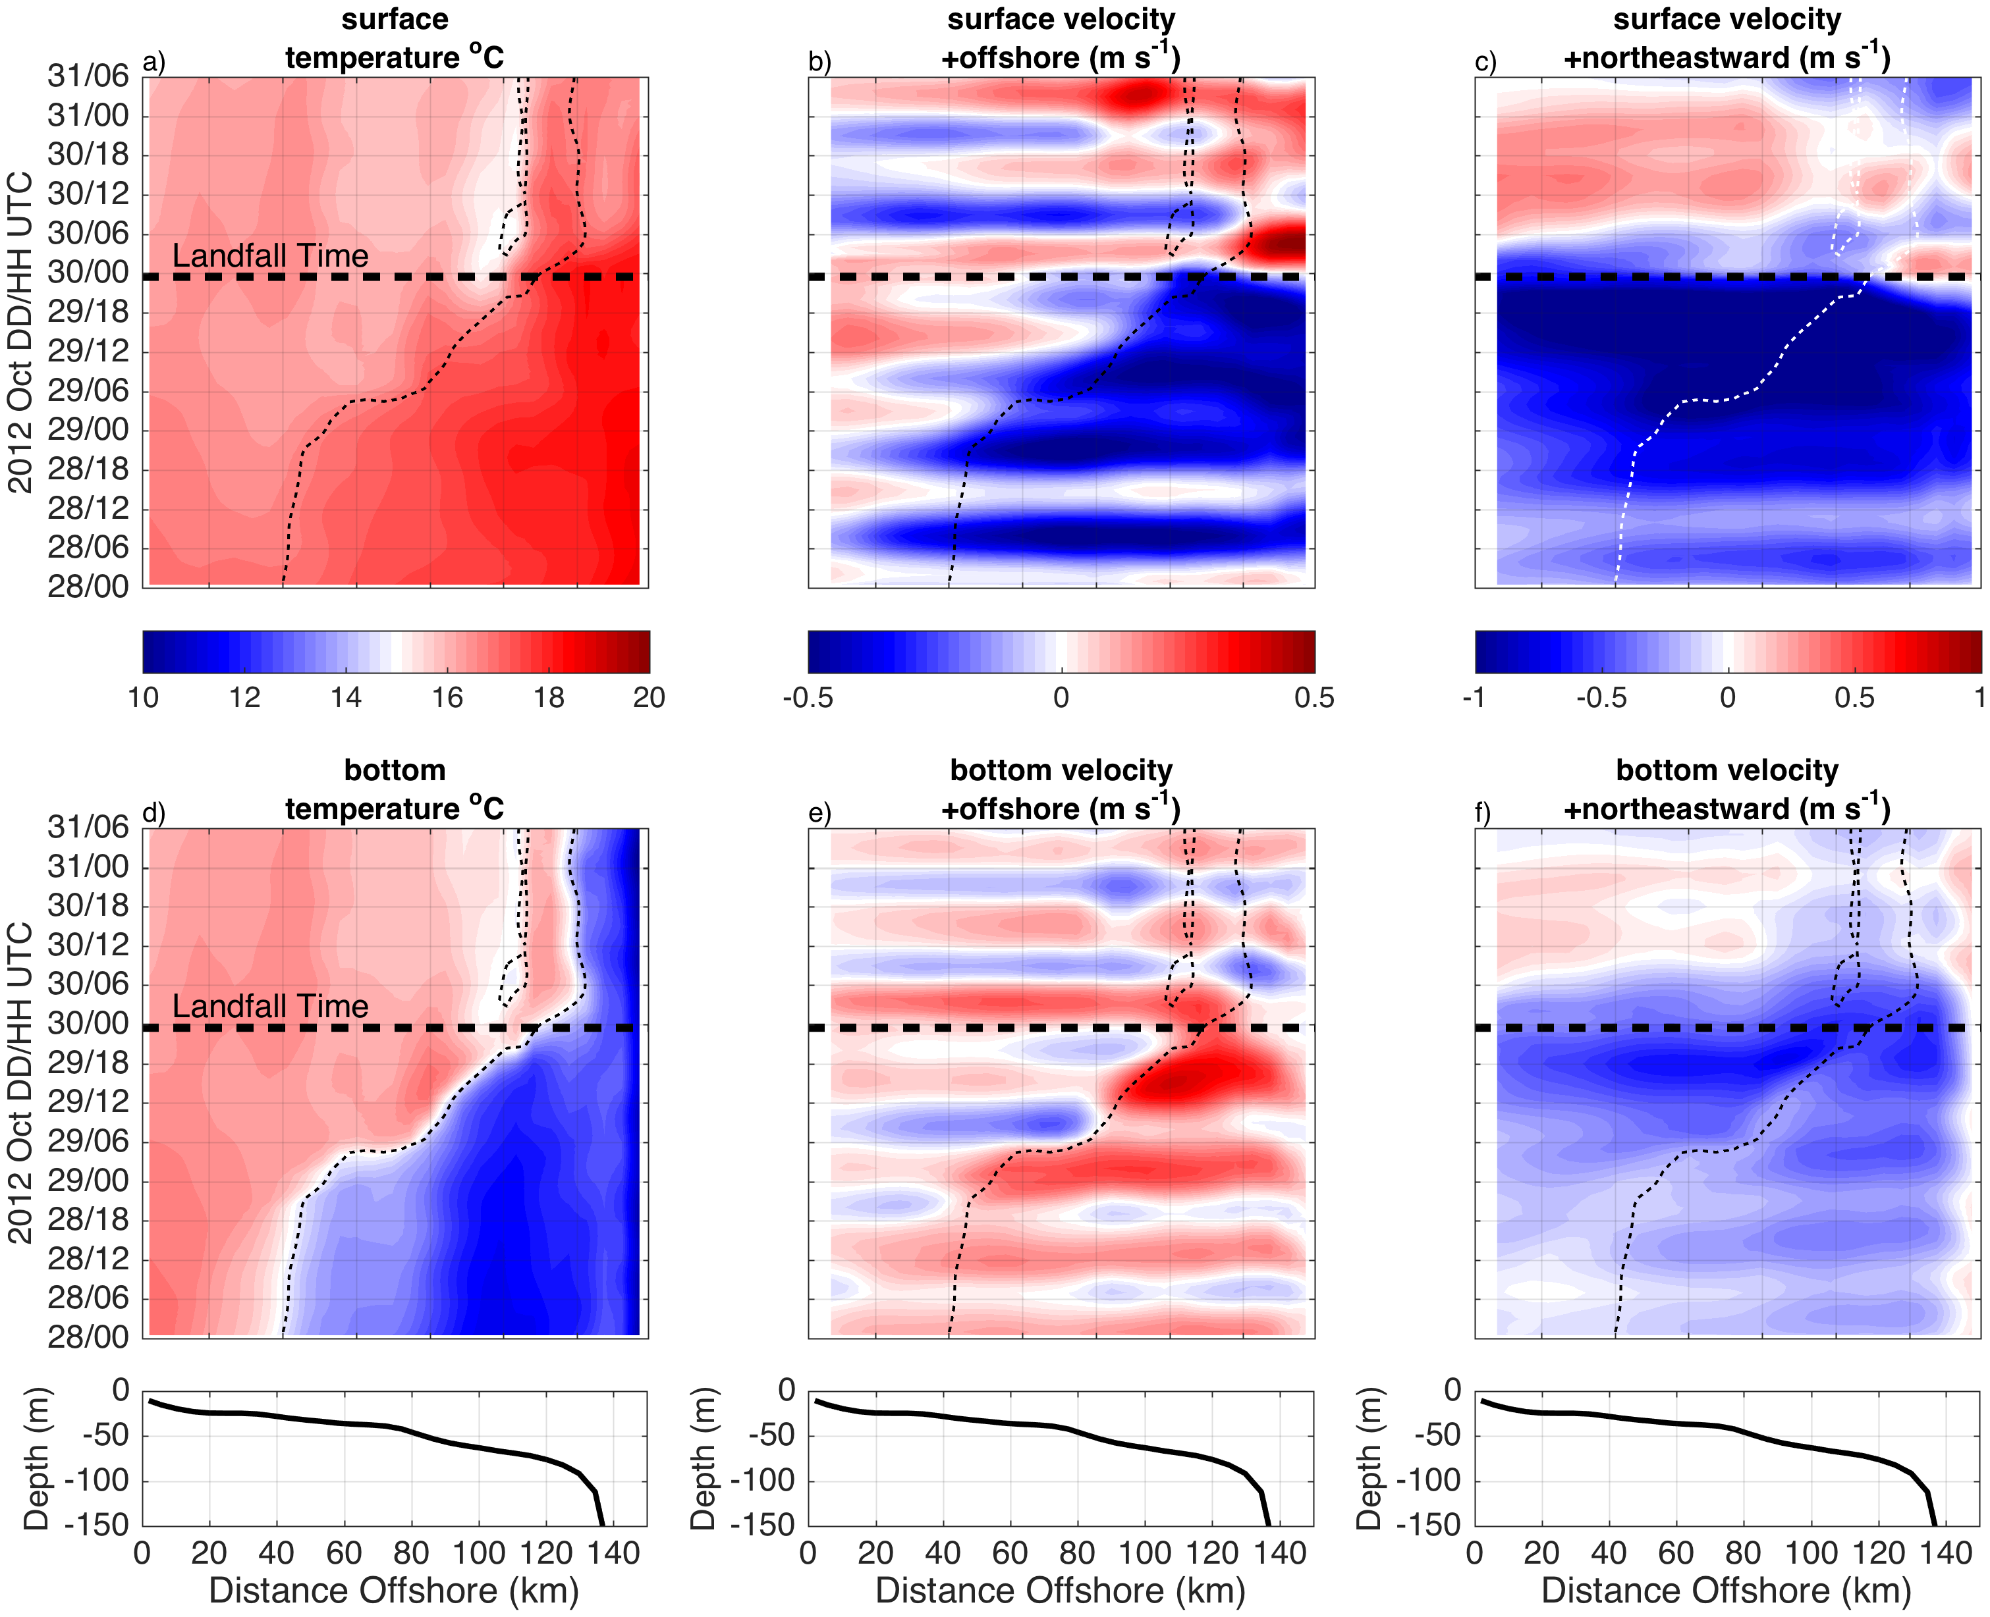

Slide 31
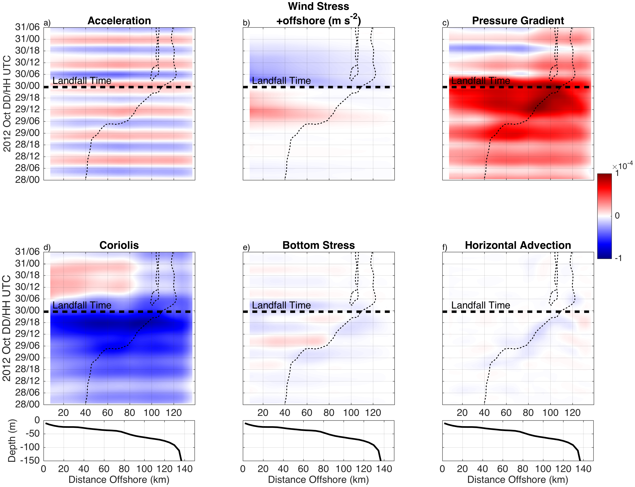
Cross-shelf Force Balance

Slide 32
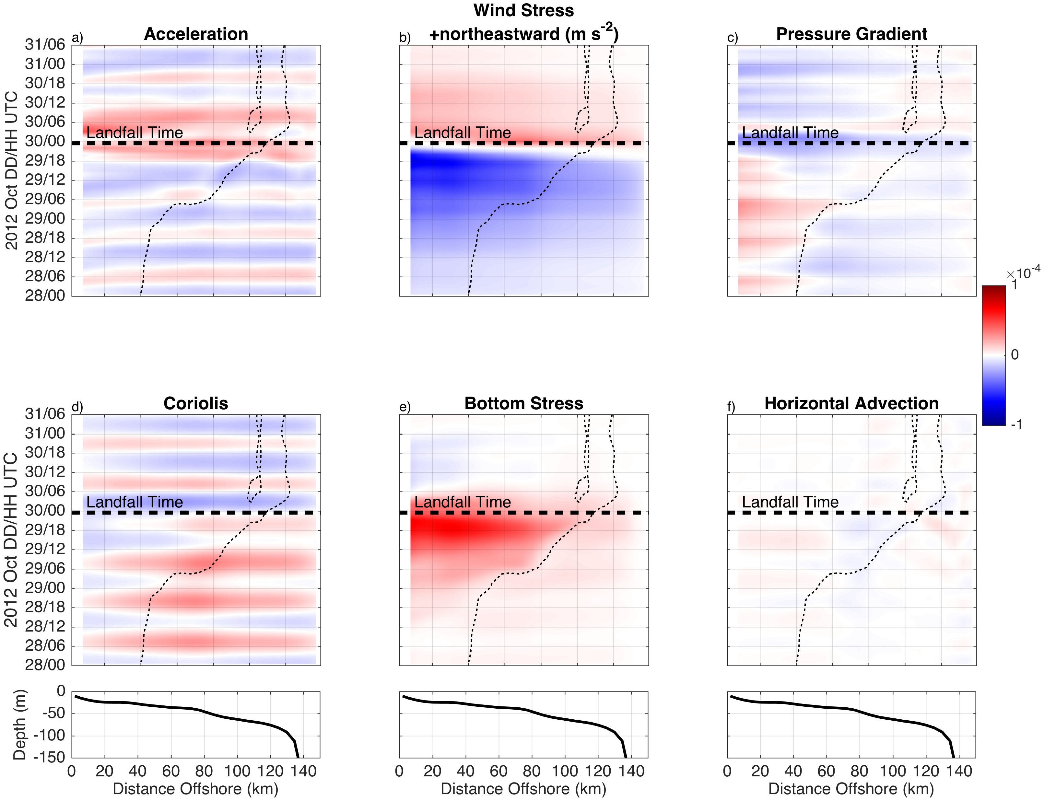
Cross-shelf Force Balance
Along-shelf Force Balance

Slide 33
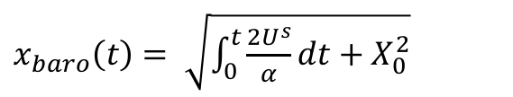
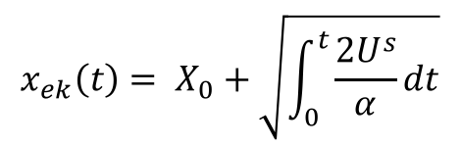
$x_{baro}\left(t\right)= \sqrt{\int_{0}^{t}{\frac{2U^{s}}{α}dt}+X_{0}^{2}}$
First Inertial Period
$$x_{ek}\left(t\right)= X_{0}+\sqrt{\int_{0}^{t}{\frac{2U^{s}}{α}dt}}$$
After Bottom Boundary layer Spin-up

Slide 34
$x_{baro}\left(t\right)= \sqrt{\int_{0}^{t}{\frac{2U^{s}}{α}dt}+X_{0}^{2}}$
First Inertial Period
Inertial Periods
$$x_{ek}\left(t\right)= X_{0}+\sqrt{\int_{0}^{t}{\frac{2U^{s}}{α}dt}}$$
After Bottom Boundary layer Spin-up

Slide 35
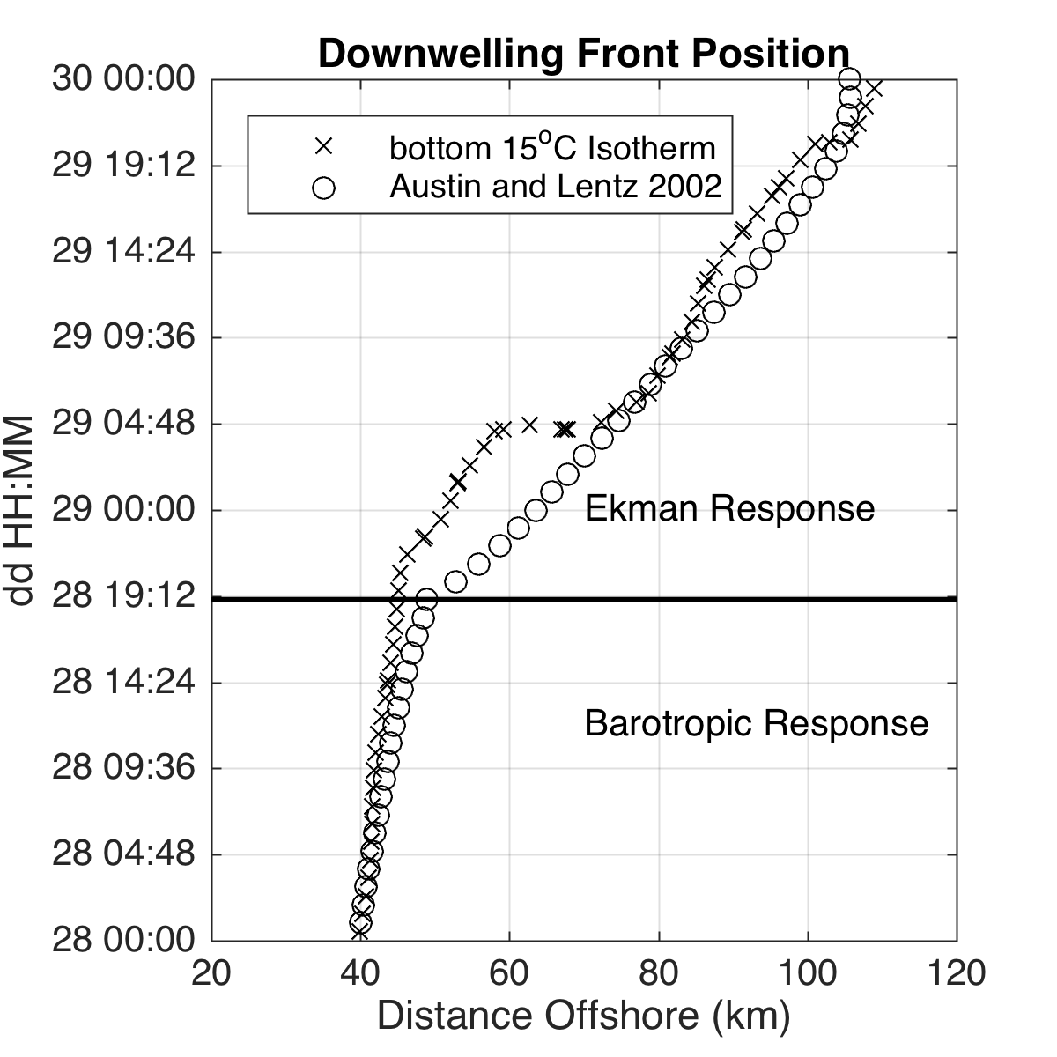
$x_{baro}\left(t\right)= \sqrt{\int_{0}^{t}{\frac{2U^{s}}{α}dt}+X_{0}^{2}}$
First Inertial Period
$$x_{ek}\left(t\right)= X_{0}+\sqrt{\int_{0}^{t}{\frac{2U^{s}}{α}dt}}$$
After Bottom Boundary layer Spin-up

Slide 36
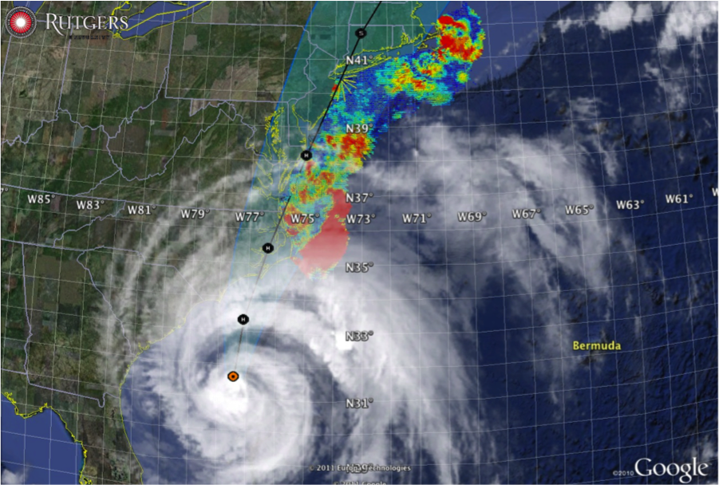
Hurricane Irene
August 26, 2011
Strong Stratification
Fast moving storm
Mixing cooled surface
Limited intensity
Hurricane Sandy
October 29, 2012
Weak/deep stratification
Slow moving storm
Perpendicular track
Coastal downwelling response
Single layer ocean

Slide 37



78 Million People (1/4 of U.S.)
1000 km Cape to Cape
U..
Middle Atlantic
Regional Association
Coastal
Ocean Observing System
Cape
Cod
Thank You!
Sandy
Irene
Barry
Arthur
Hermine
Cape
Hatteras
Notes:
37

Slide 38
Thank You
Hurricane Sandy Oct 28 - 30 2012
Fall transition storm
Deep surface mixed layer
Perpendicular track
Coastal downwelling response
Offshore advection of Cold Pool

Slide 39
$x_{baro}\left(t\right)= \sqrt{\int_{0}^{t}{\frac{2U^{s}}{α}dt}+X_{0}^{2}}$
First Inertial Period
$$x_{ek}\left(t\right)= X_{0}+\sqrt{\int_{0}^{t}{\frac{2U^{s}}{α}dt}}$$
After Bottom Boundary layer Spin-up

Slide 40
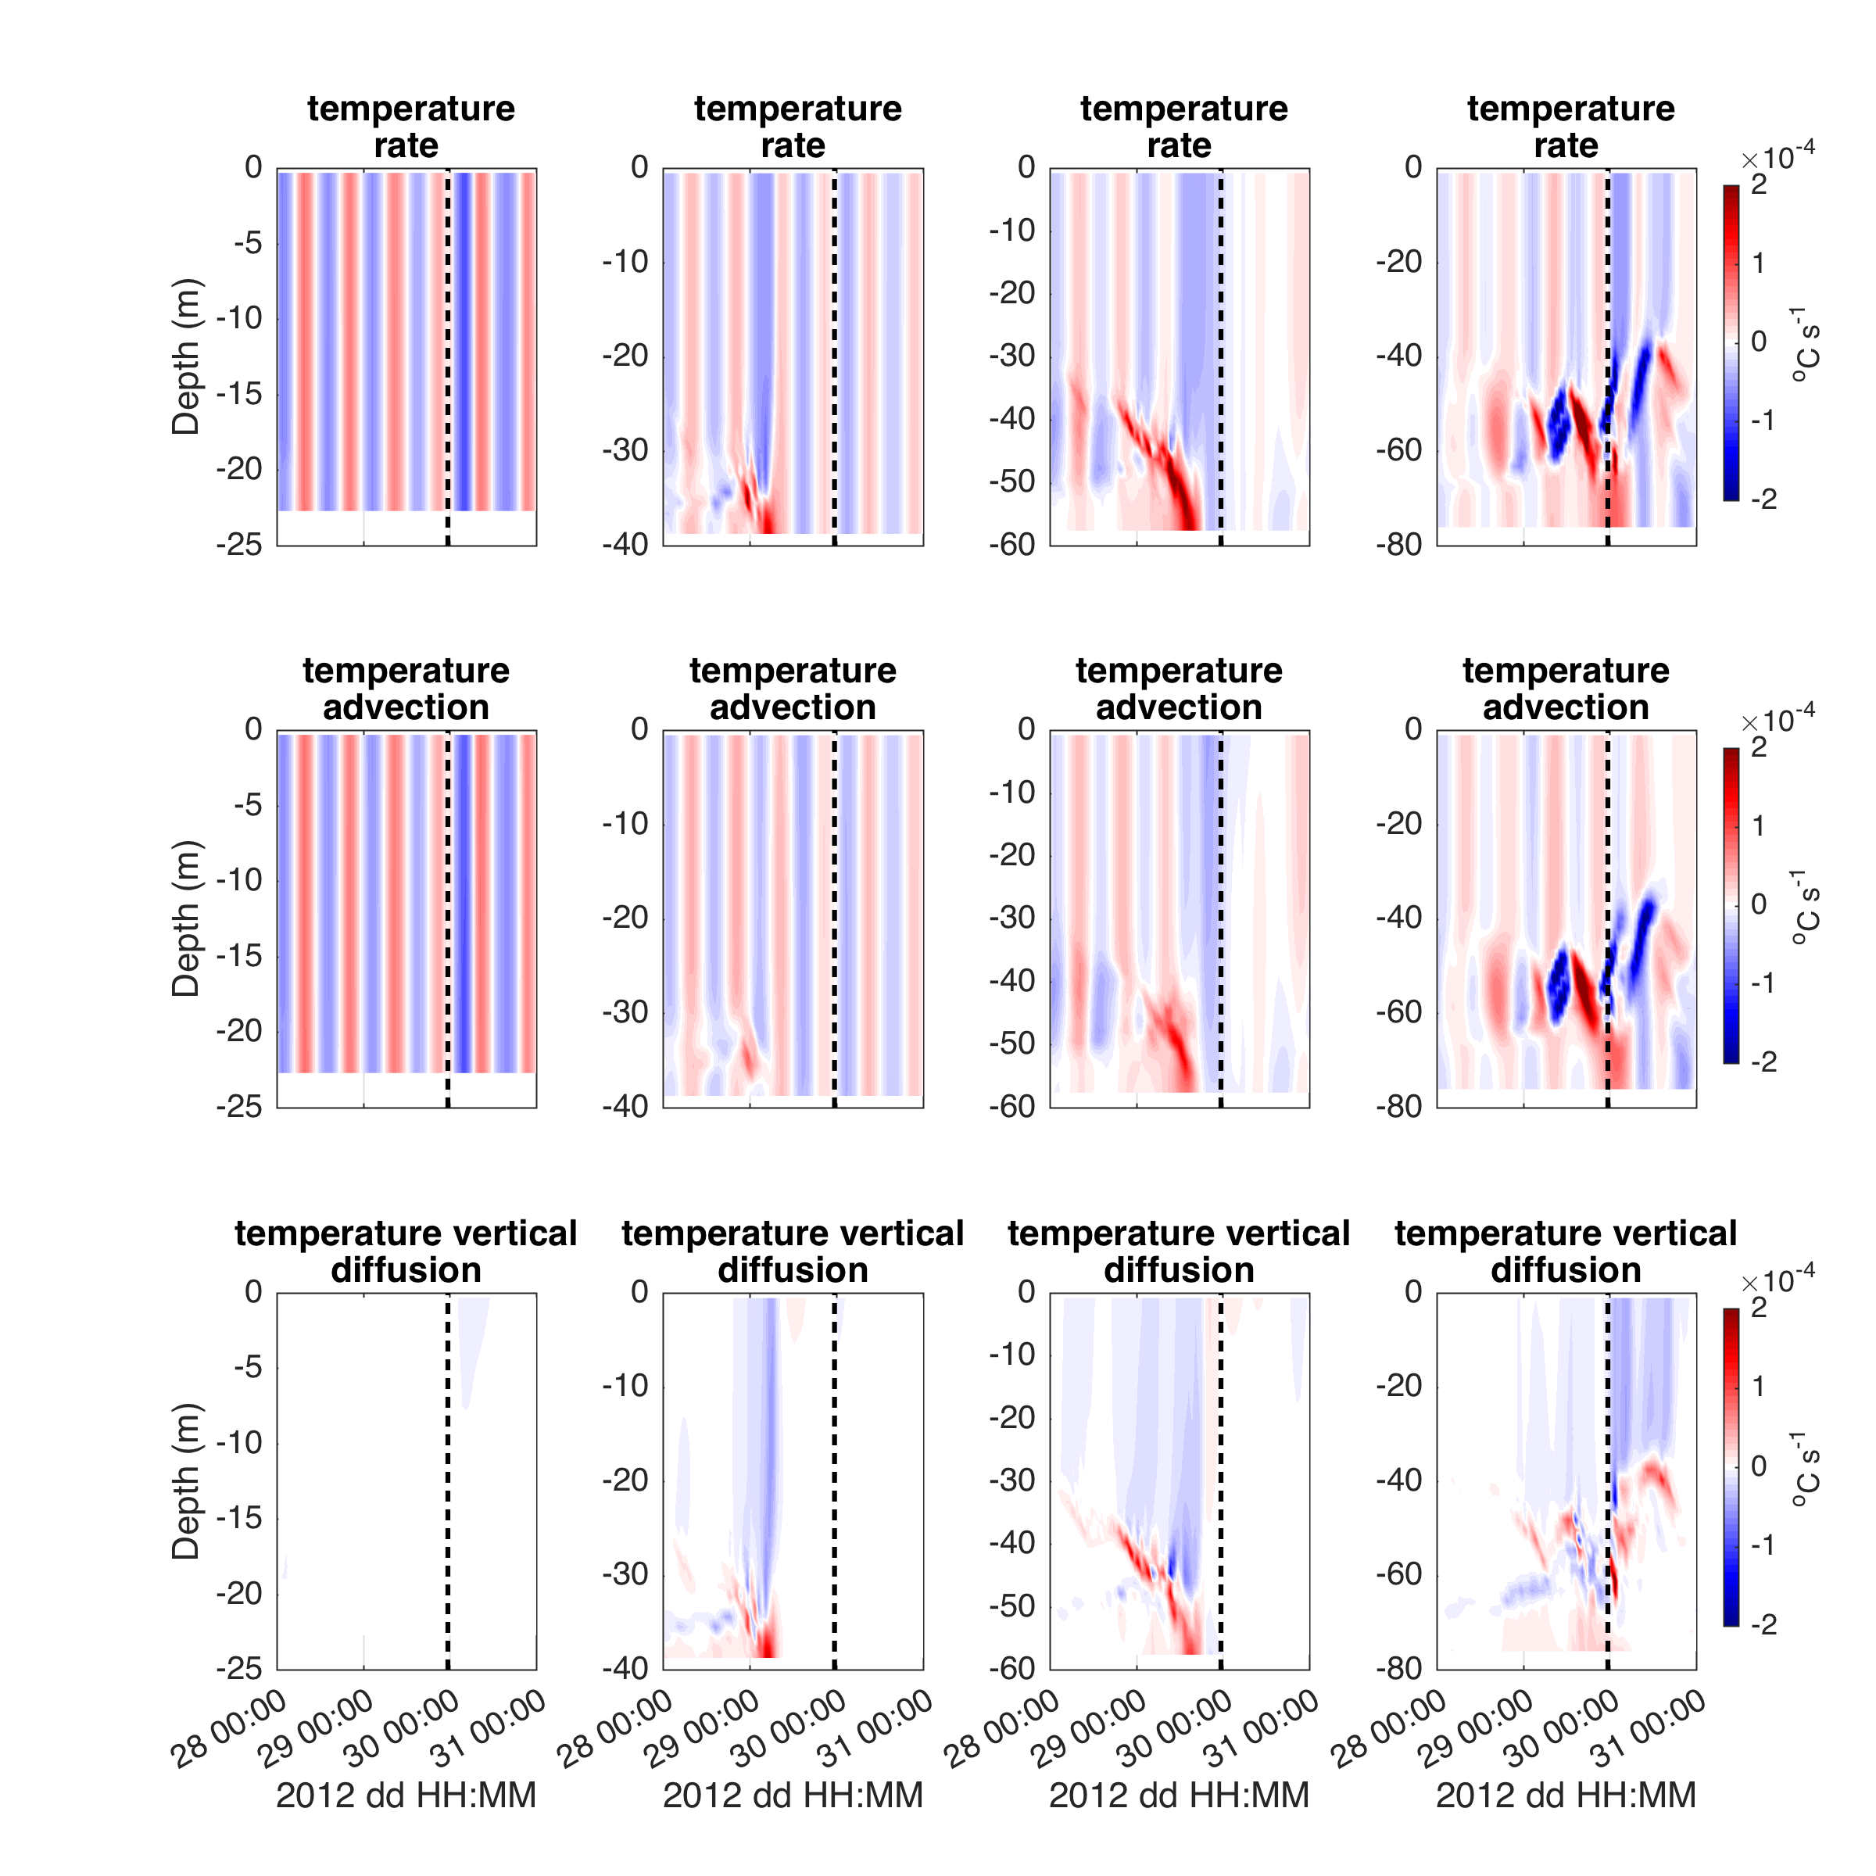

Slide 41

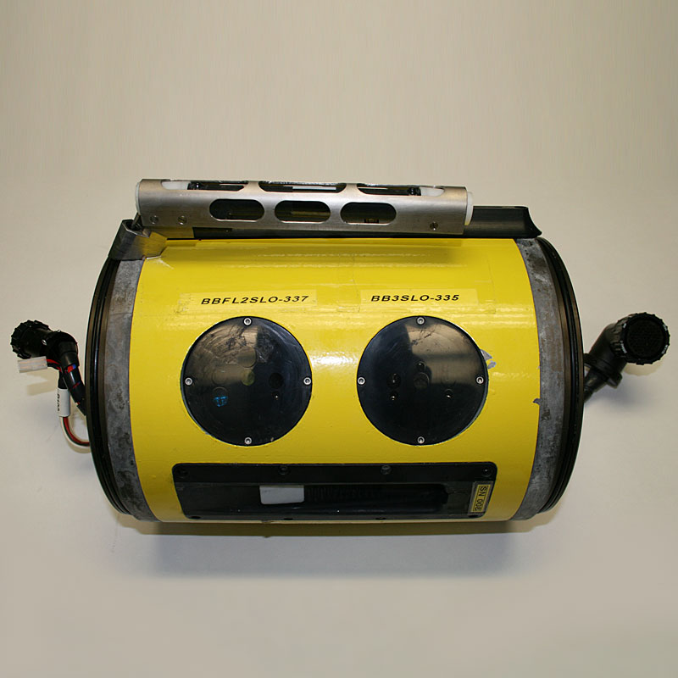
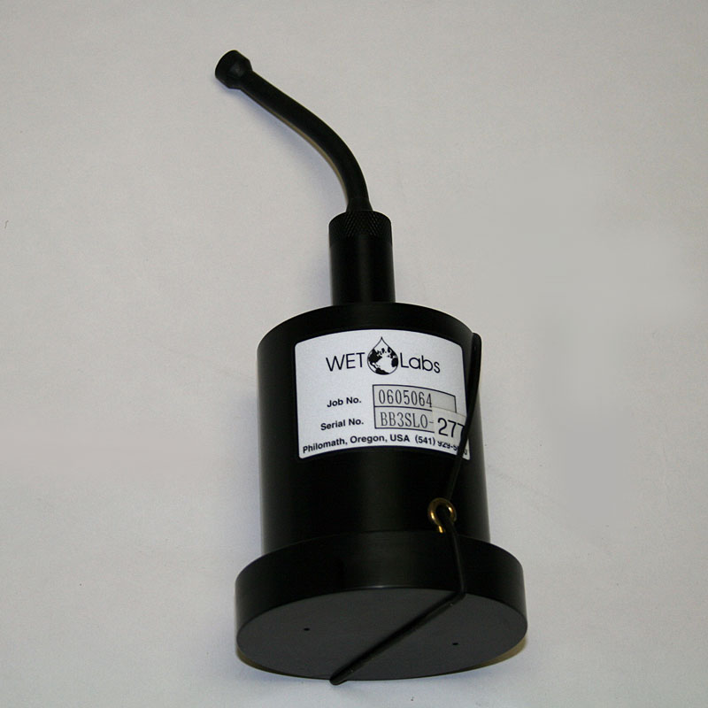
What Does a Storm Glider Look Like?
Irene Gliders: 1st Generation TWR Slocum Glider with Alkaline batteries, Seabird Conductivity Temperature Depth (CTD) and Aandera Optode
Storm Glider (v1)
Seabird Conductivity Temperature Depth (CTD), Wetlabs ECOpuck, Aandera Optode, Nortek Aquadopp, rechargeable batteries, optical backscatter.
1) Acoustic Backscatter/Currents: Nortek Aquadopp Current Profiler (2 MHz head, 1 meter bins, internally logging, 30 days)
2) Optical Backscatter: Wet Labs Eco-puck BB3 (470, 532, 660 nm) – Smaller particles

Slide 44
Hurricane Sandy
October 29, 2012
NOAA/NHC Damage:
#2 with >$60 Billion.
Minimum pressure – 948 mb
Storm surge over –14 ft. in NYC

