Slide 1
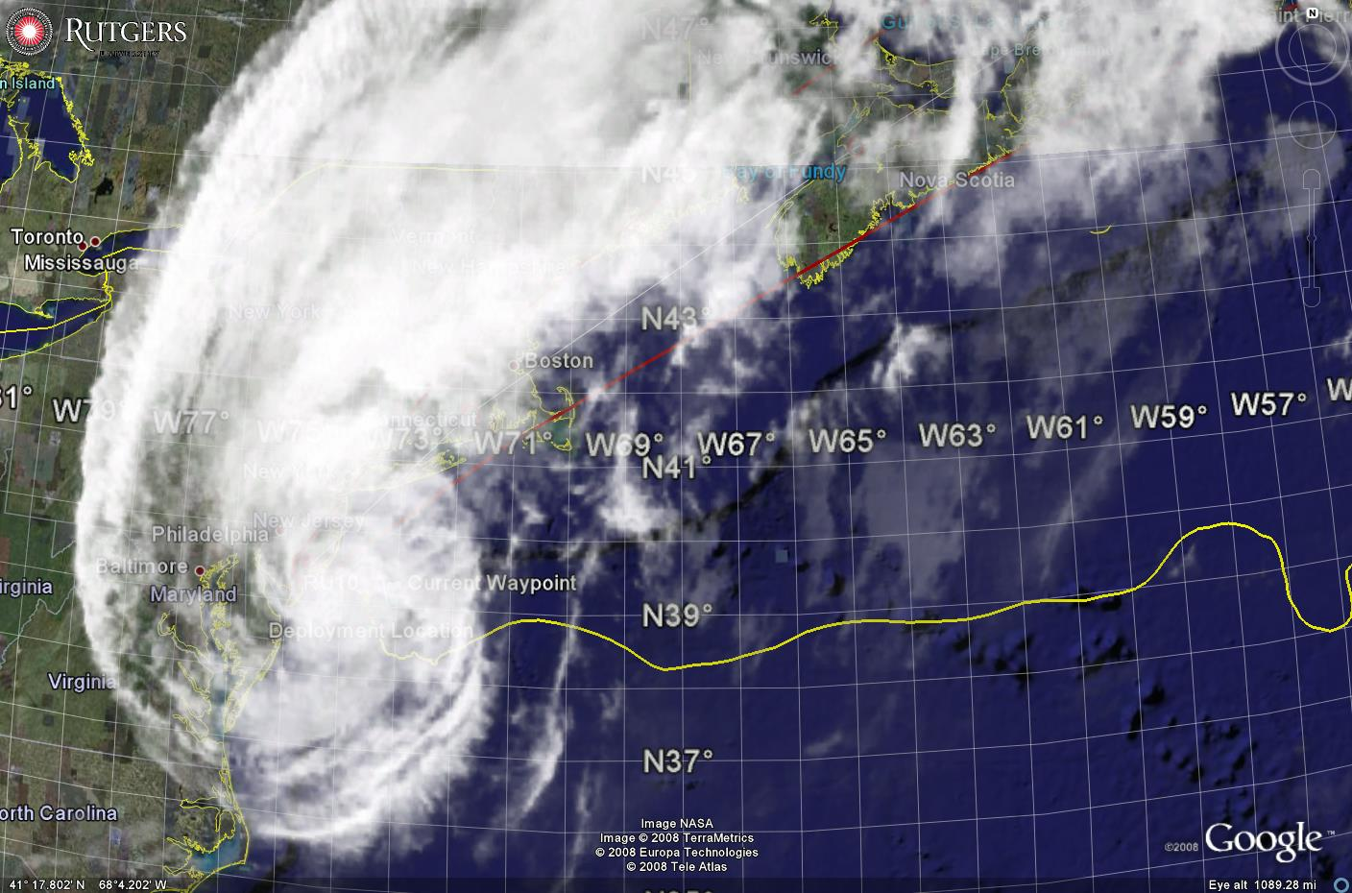
Glider Observations of Sediment Transport
Travis Miles, Oscar Schofield, Josh Kohut, and Scott Glenn
Rutgers University
NPOMS-5
Tianjin, China
July 6, 2017
Notes:
Sediment – Pollutants, benthic habitat, coastal change, interpret historical sediment record for climate studies

Slide 2
Key Storm Glider Reference List
Glenn, Jones, Twardowski, Bowers, Kerfoot, Kohut, Webb, Schofield, 2008. Glider observations of sediment resuspension in a Middle Atlantic Bight fall transition storm. Limnology and Oceanography 53(5, Part 2): 2180-2196.
Miles, Glenn, Schofield, 2013. Temporal and spatial variability in fall storm induced sediment resuspension on the Mid-Atlantic Bight. Continental Shelf Research 63, Supplement: S36-S49.
Miles, Seroka, Kohut, Glenn, 2015. Glider observations and modeling sediment transport in Hurricane Sandy. JGR Oceans, DOI: 10.1002/2014JC010474
Glenn, Miles, Seroka, Xu, Forney, Yu, Roarty, Schofield, Kohut, 2016. Stratified coastal ocean interactions with tropical storms, Nature Communications, DOI:10.1038/ncomms10887.
Seroka, Miles, Xu, Kohut, Schofield & Glenn, 2016. Hurricane Irene Sensitivity to Stratified Coastal Ocean Cooling, Monthly Weather Review, 144(9) 3507-3530.
Seroka, Miles, Xu, Kohut, Schofield & Glenn, 2017. Rapid shelf-wide cooling response of a stratified coastal ocean to hurricanes. JGR-Oceans: Special Section on Ocean Responses and Feedbacks to Tropical Cyclones, DOI:10.1002/2017JC012756.
Miles, Seroka, Glenn, 2017. Coastal ocean circulation during Hurricane Sandy, J. Geophysical Res. - Oceans, accepted.
Sea-Bottom Interface
Air-Sea Interface

Slide 3
Why Study Sediment Transport?
  Important for understanding sedimentation and erosion around structures [Fredsøe and Deigaard, 1992].
  Development of continental Margin morphology [Nittrouer and Wright, 1994]
  Sediment resuspension can have a significant impact on benthic habitat and overlying primary productivity [Pilskaln et al., 1998; Fanning et al., 1982], resuspension and replenishment of nutrients.
  Understanding fate of sediments can aid with understanding and predicting the fate of pollutants introduced at the coast [Biscaye et al., 1988]
  Winter storms responsible for 92% of New Jersey inner shelf suspended sediment transport, and 38% of bedload transport, during a 2 year study period [Styles and Glenn 2005].

Slide 4
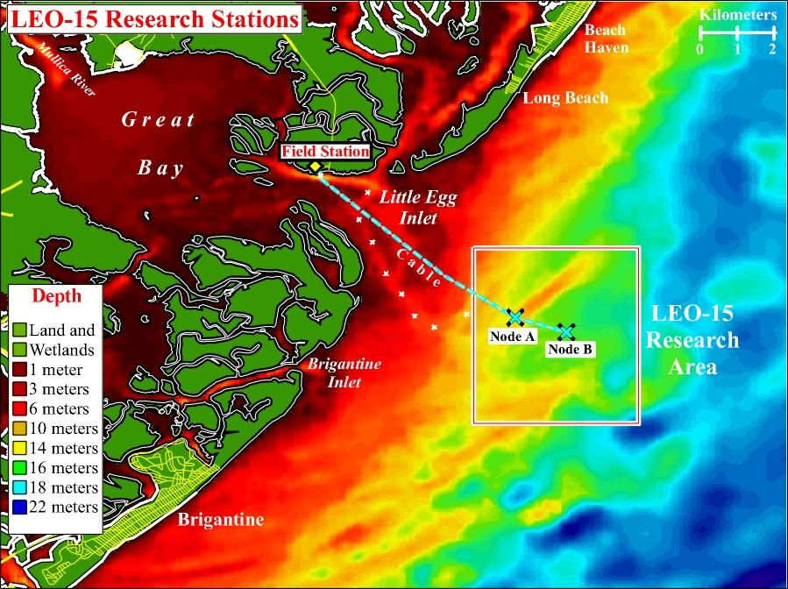
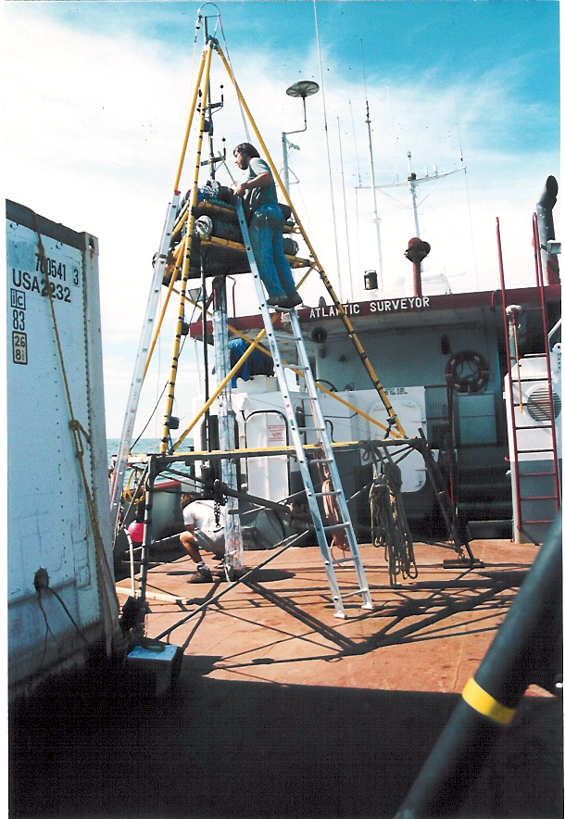
Sediment Transport Studies at LEO Site –early 1990’s
Benthic Acoustic Stress Sensor (BASS) Tripod
Notes:
BASS sensor, ADCPS, Optical instruments, LISSTs
Very good at resolving wave bottom boundary layer
Provides high temporal resolution at a single location
Instrumental in developing one-dimenisional bottom boundary layer models coupled to Regional Ocean Modeling System
New technologies needed for regional model validation

Slide 5
Notes:
COAWST – Developed by USGS for sediment transport (Cross-disciplinary leveraged research support)

Slide 6
Regional models
Primary validation is post storm surveys and limited point measurements.
Need for new technologies for regional in situ validation

Slide 7
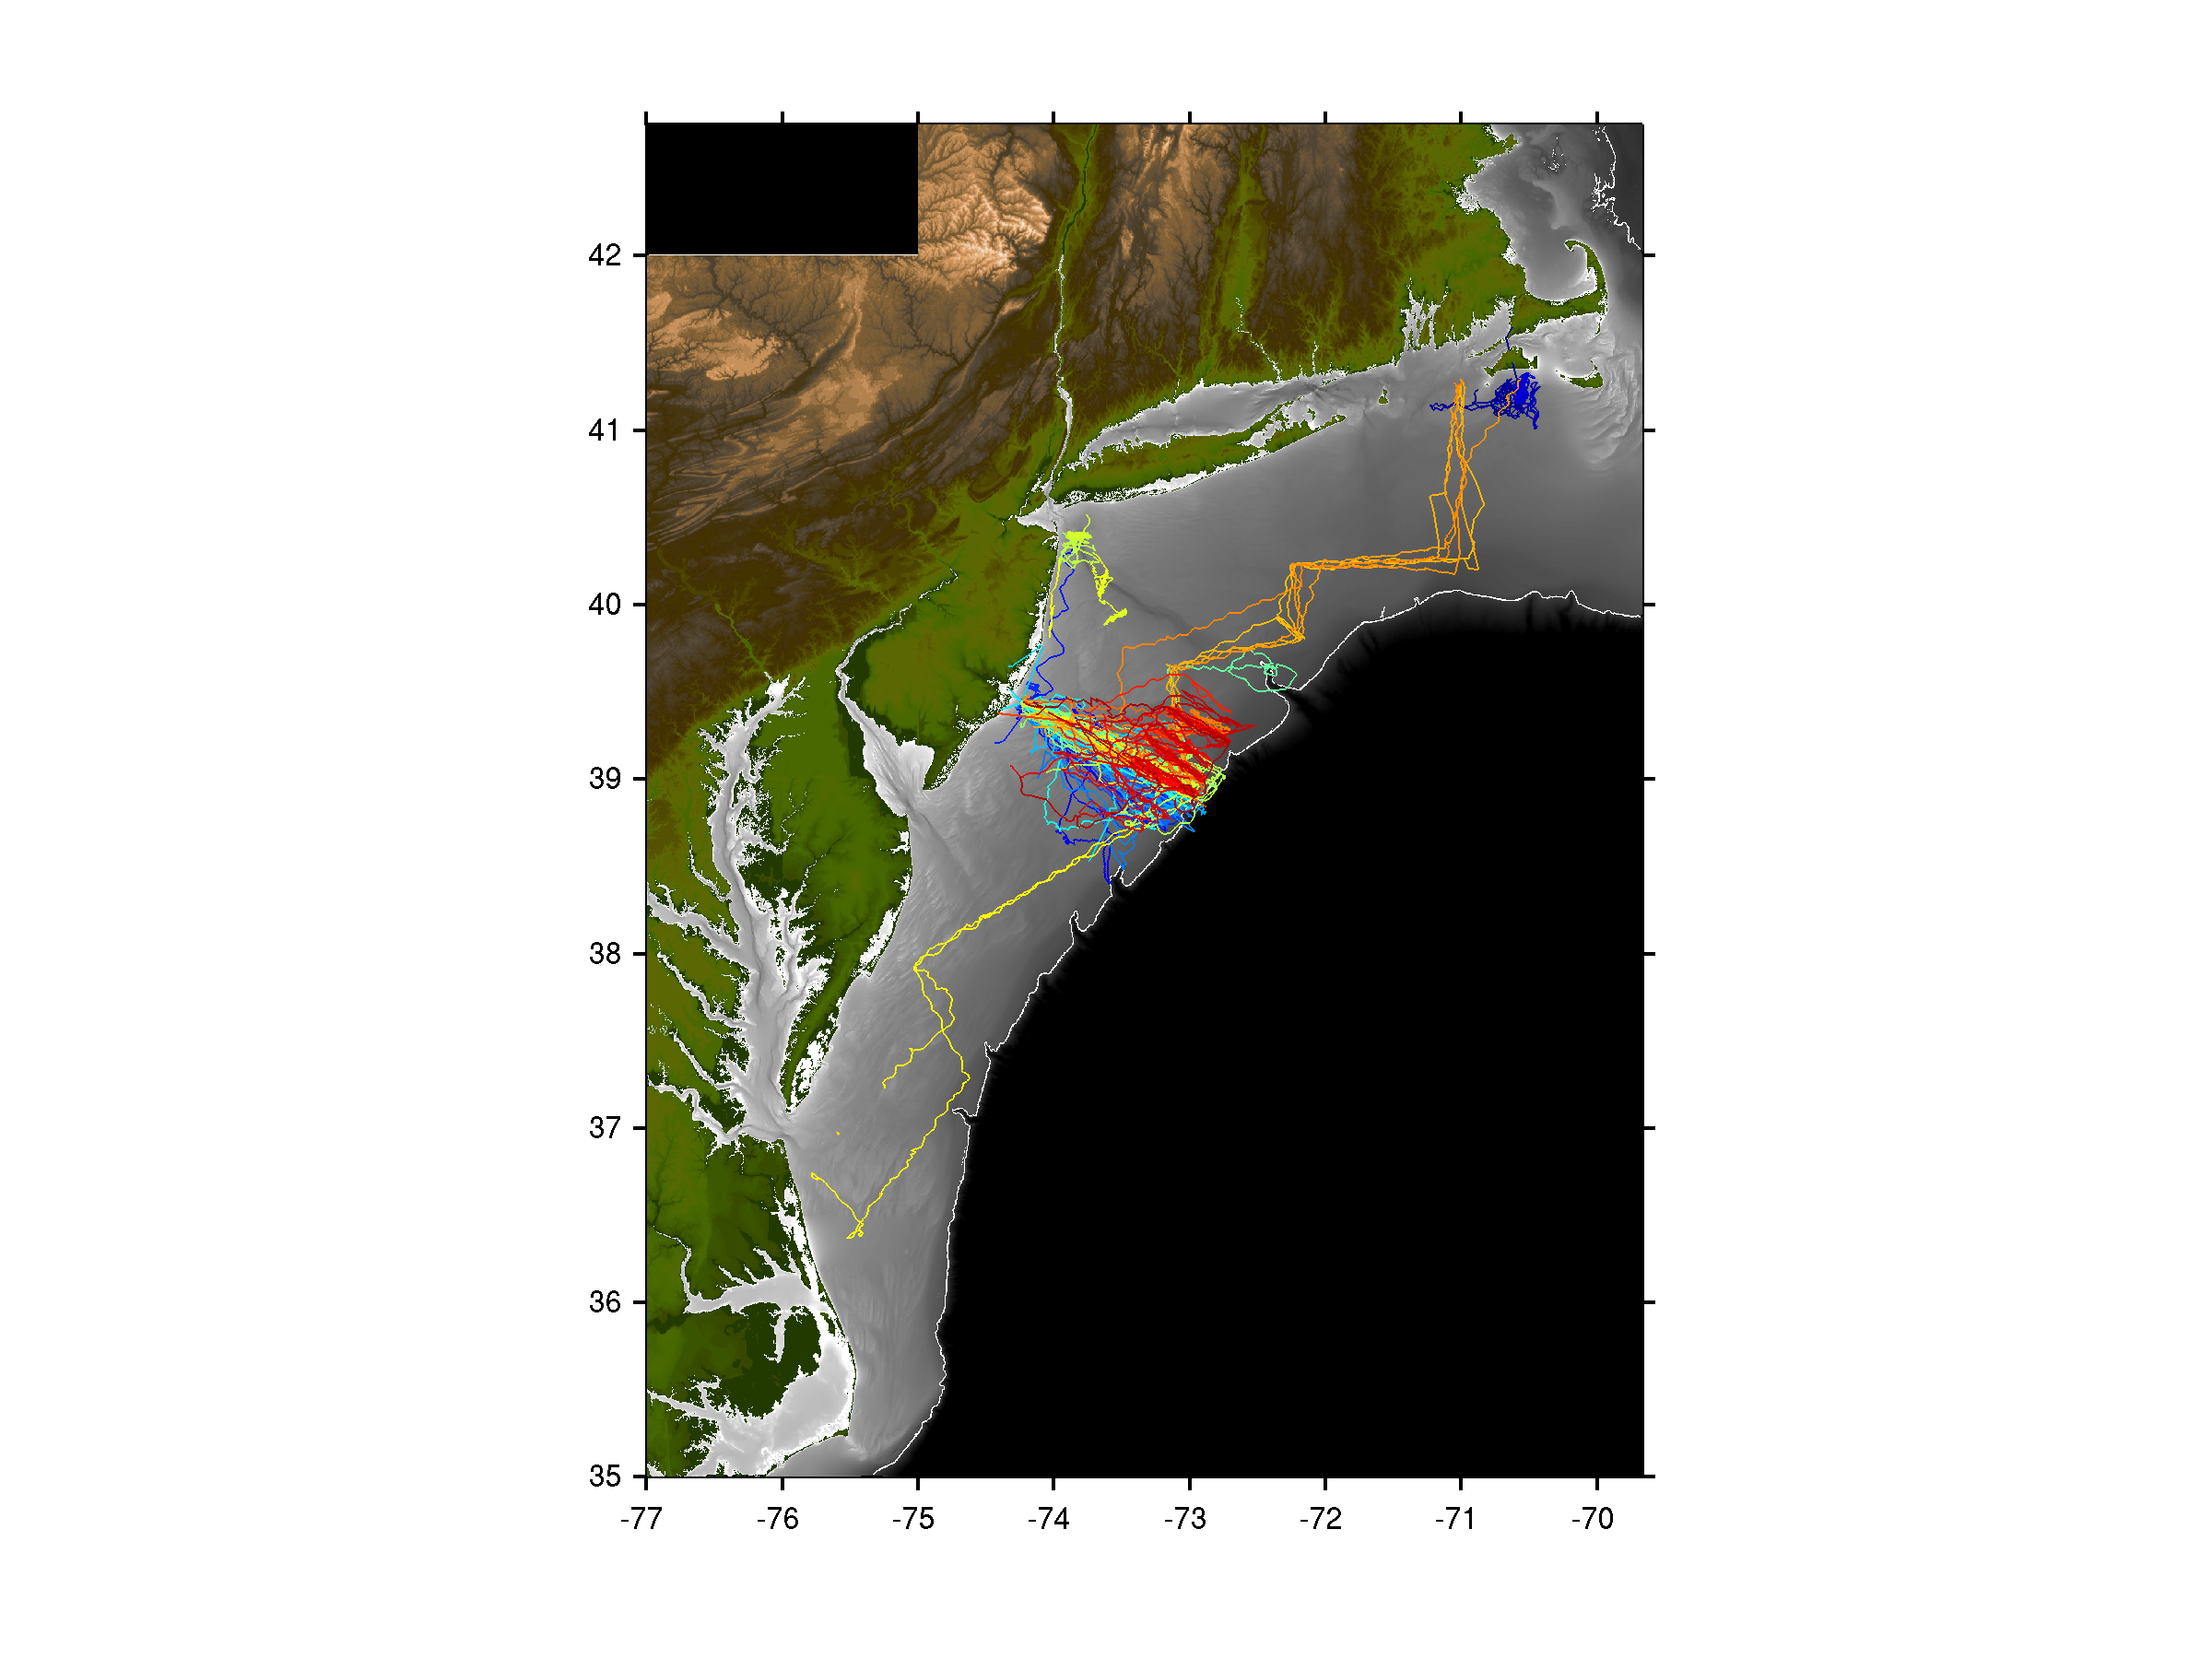

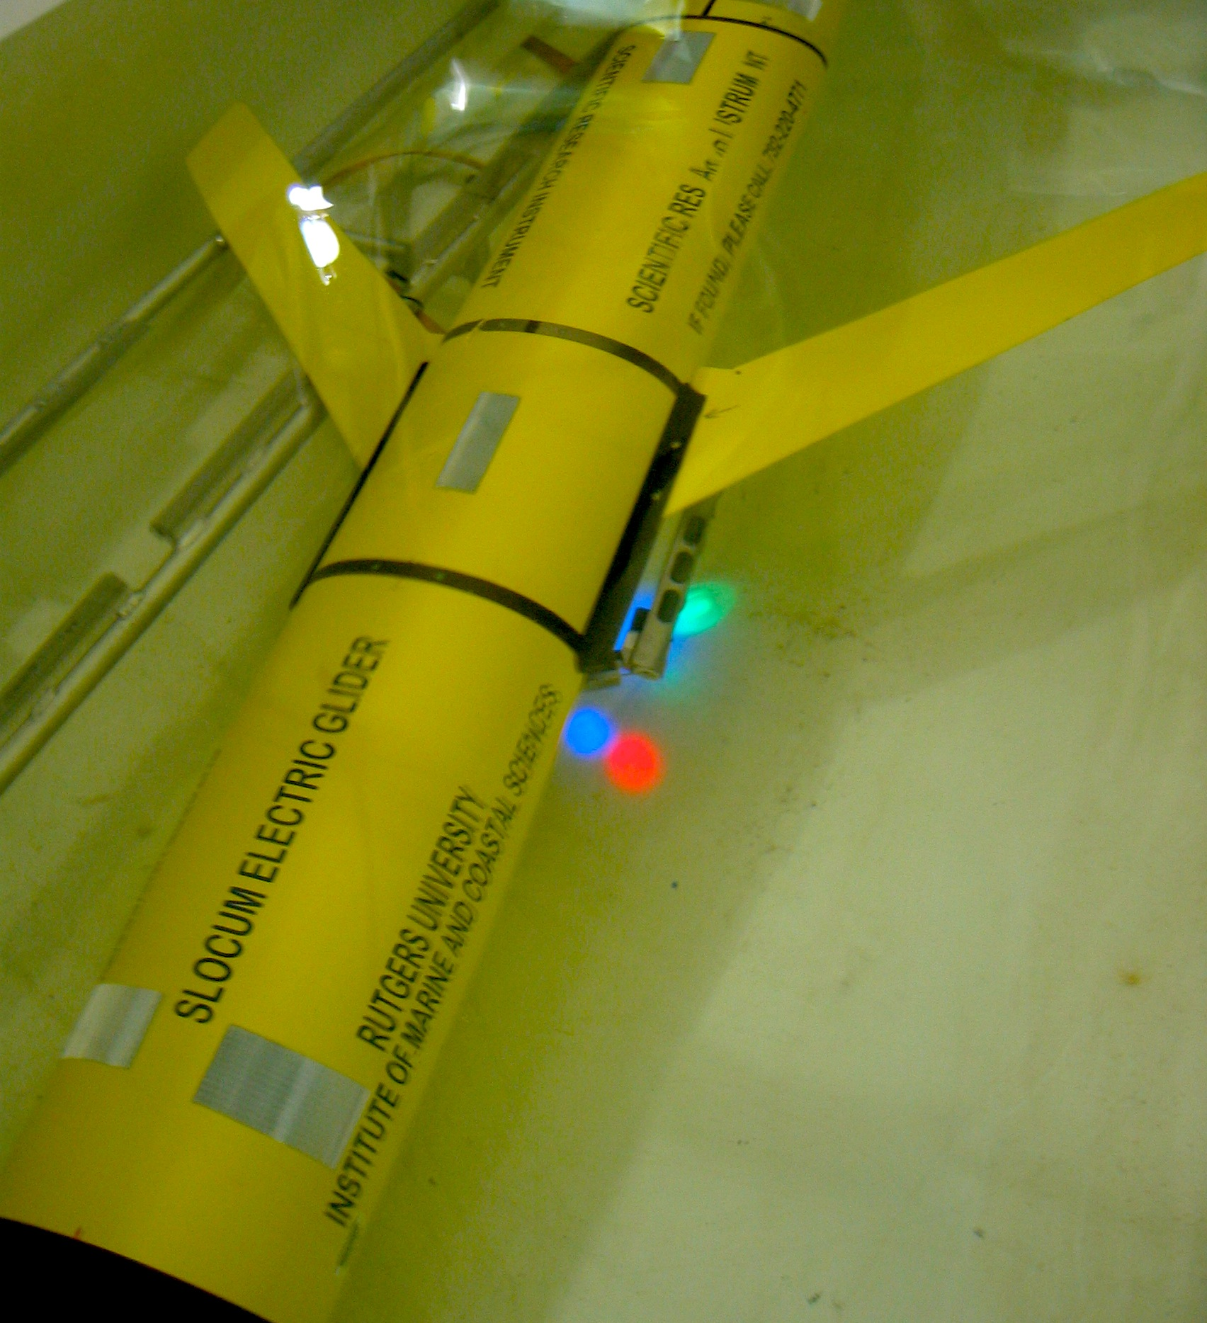
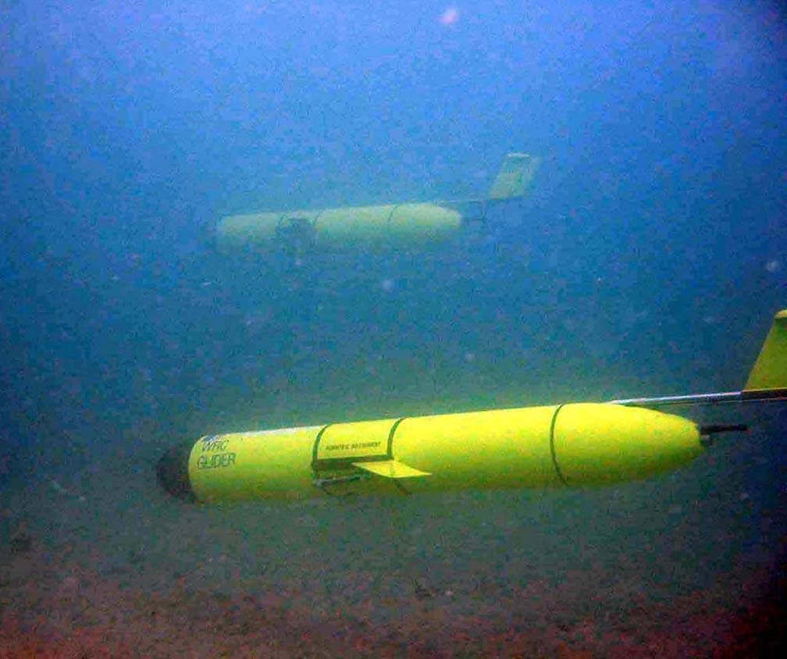
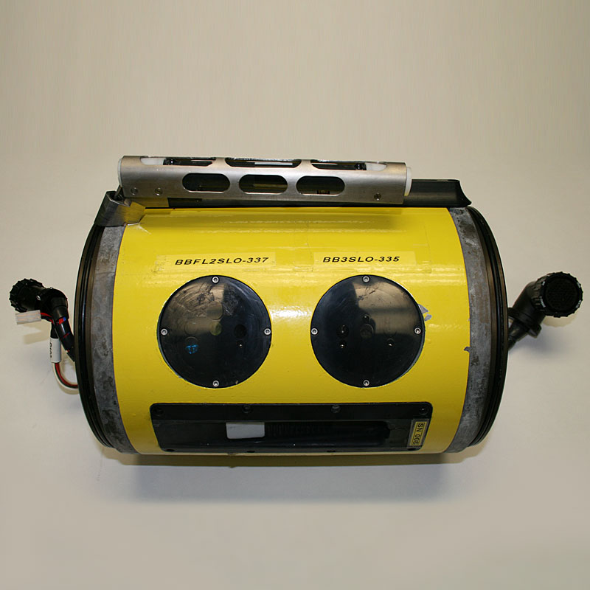
Glider Observations of Sediment Resuspension in a Middle Atlantic Bight Fall Transition Storm (Glenn et al., 2008)
Temperature
Optical
Sensors
Notes:
One of the first studies to demonstrate this capability in gliders was Glenn et al. 2008
- Here you see a Teledyne-Webb Slocum glider equipped with a Wetlabs BB3 Optical Backscatter sesnosr

Slide 8

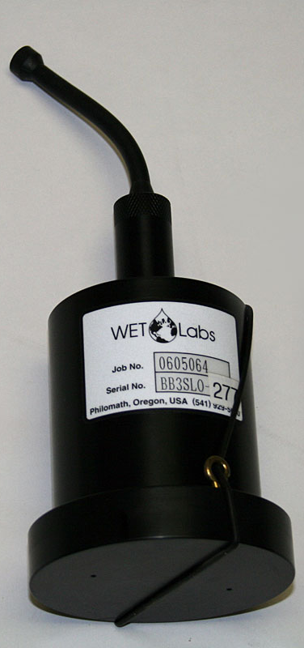

Storm Glider Development
Storm Response Glider (v1)
Un-pumped Seabird Conductivity Temperature Depth (CTD), Wetlabs ECOpuck (CDOM, Chlorophyll, Backscatter), Aandera Optode (Oxygen).

Slide 9
Notes:
Two storms were sampled and presented in this study during unstratified and stratified conditions
Here you see Temperature and optical backscatter during a fall transition storm on the left
The water column is vertically well mixed and you can see full water column sediment resuspension from the bed to the surface at nearly 40 meters depth
A deployment on a similar line in Summer of 2004 shows the highly stratified continental shelf, and sediment resuspended, but limited by the stable thermocline (likely not visible from satellite etc.)

Slide 10
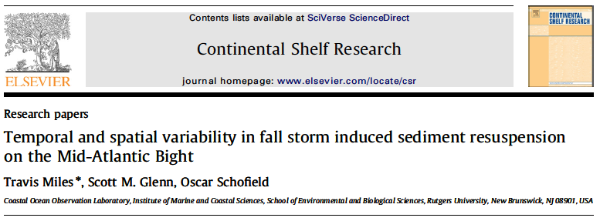
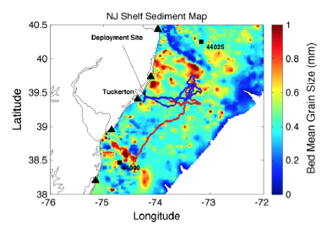
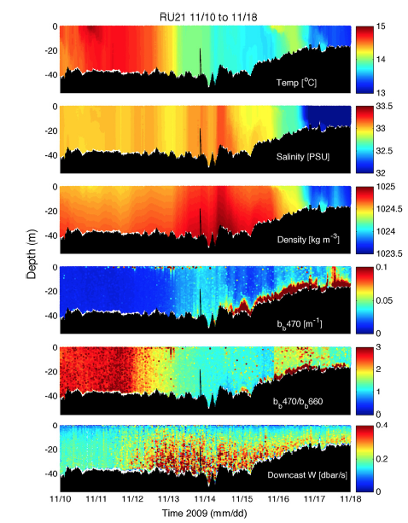
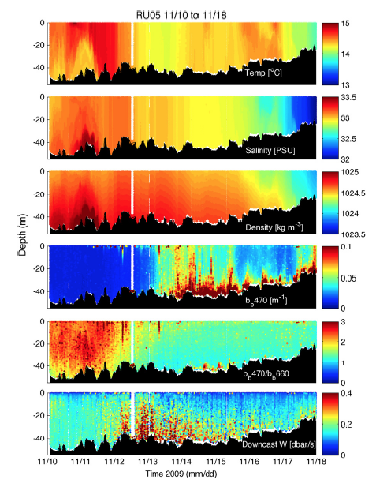
Notes:
In 2009 during the first few months of my PhD we opportunistically had 4 gliders deployed on the NJ shelf for an OSSE experiment, when a hurriacane that transitioned into an extra-tropical cyclone came through the region
Two of these G1 Slocum gliders had optical backscatter pucks and we used them to investigate spatial variability in shelf-wide sediment resuspension
They showed differences of about an order-of-magnitude largely due to order 10 km > differences in sediment meant grain size

Slide 11
Storm Glider Development
Storm Response Glider (v1)
Un-pumped Seabird Conductivity Temperature Depth (CTD), Wetlabs ECOpuck (CDOM, Chlorophyll, Backscatter), Aandera Optode (Oxygen).

Slide 12
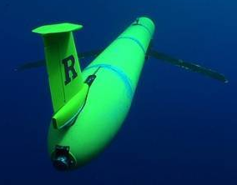
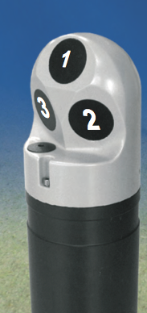
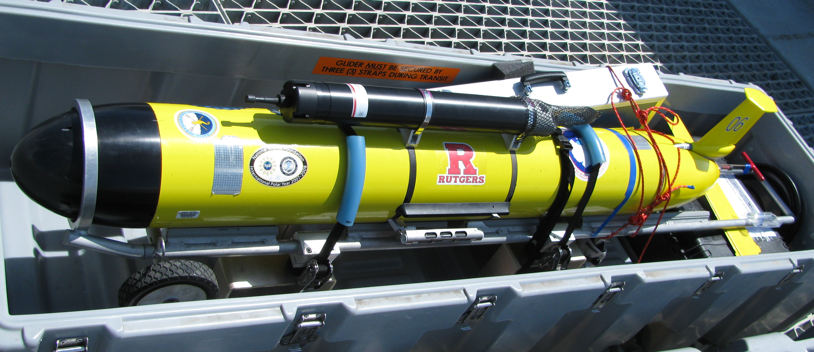
RU23: Shallow G1 Slocum Glider 100 meter pump:
Conductivity Temperature
and Depth (CTD) (Seabird)
Optical Backscatter: Wet Labs Eco-puck BB3 (470, 532, 660 nm) – Smaller particles
Acoustic Backscatter/Currents: Nortek Aquadopp Current Profiler (2 MHz head, 1 meter bins, internally logging, 30 days) – medium sands
Storm Glider v1
Notes:
After these two studies we wanted to design a glider deployment specifically to compare with a realistic ROMS run with sediment parameters
Added a Nortek Aquadopp Current Profiler to be able to estimate transport
Also add acoustic backscatter measurements in order to target both smaller grain size particles (with optics) and larger grain sizes with acoustics.
Glider we put together was the first version of a ‘storm glider’

Slide 13
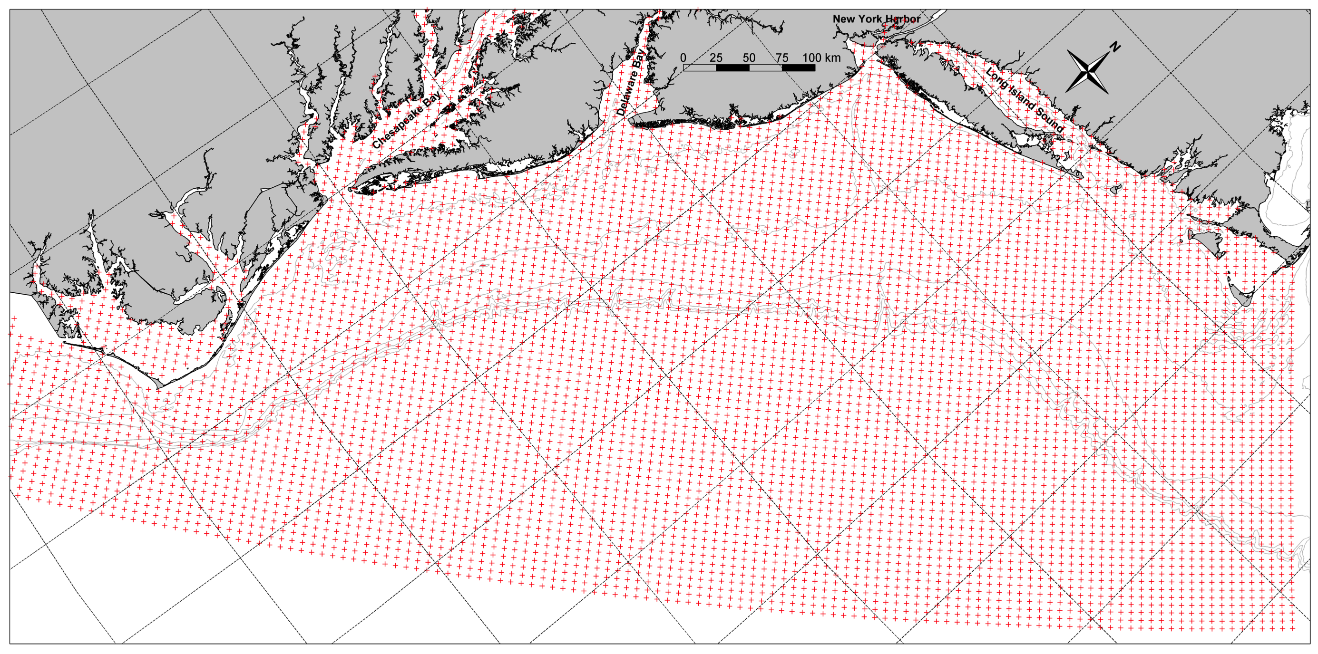
Rutgers ROMS ver. 645 on the ESPreSSO domain
  Detailed at : http://www.myroms.org/espresso/
    Cape Hatteras to Cape Cod
    36 Vertical Levels, 5 km resolution, output hourly
    Tides at boundary from ADCIRC
    HYCOM-NCODA Boundary Conditions
    NCEP North American Mesoscale (NAM) 12km – 3 hourly Wind forcing
  (Cahill et al., 2008, Haidvogel et al., 2008, Hoffman et al., 2008, Zhang et al., 2009a,b, Wilkin and Hunter, 2013)
Notes:
Don’t get hung up!

Slide 14
Rutgers ROMS ver. 645 on the ESPreSSO domain
  Detailed at : http://www.myroms.org/espresso/
    Cape Hatteras to Cape Cod
    36 Vertical Levels, 5 km resolution, output hourly
    Tides at boundary from ADCIRC
    HYCOM-NCODA Boundary Conditions
    NCEP North American Mesoscale (NAM) 12km – 3 hourly Wind forcing
  Replaced NAM with Weather Research Forecast Model 6 km – hourly
  Coupled Bottom Boundary Layer (SSW_BBL) included in ROMS checkout
  Wave Height, Wave Period, and Wave Direction from NOAA NCEP Wavewatch III 3-hourly (http://polar.ncep.noaa.gov/waves/)
  Idealized Sediment from the Community Sediment Transport Model
    Version Included in ROMS Trunk
    Two Non-Cohesive size-classes 0.1 mm and 0.4 mm
      Fall Velocities 5.7 mm/s and 52 mm/s, 0.14 and 0.23 Critical Shear Stress ,respectively
    Spatially uniform for entire Domain
  (Warner et al., 2008, Madsen 1994, Styles and Glenn 2000, Wiberg and Harris 1994, Harris and Wiberg 2001)
Notes:
Don’t get hung up!

Slide 15
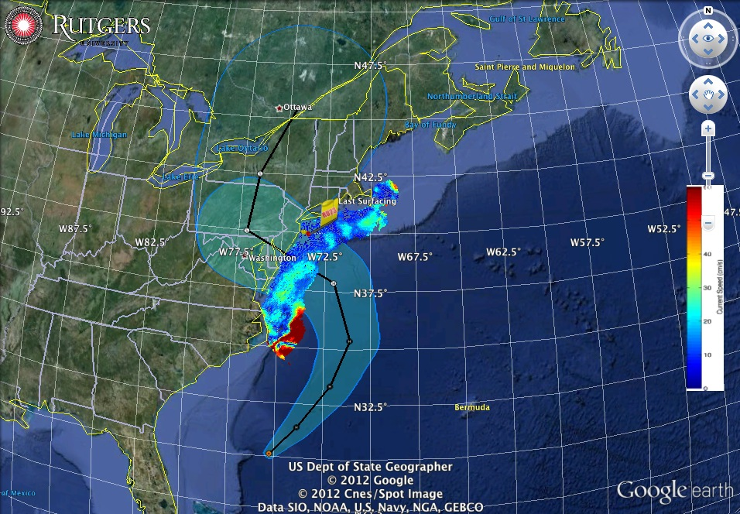
Superstorm Sandy: 2 Days Before Landfall

Slide 16
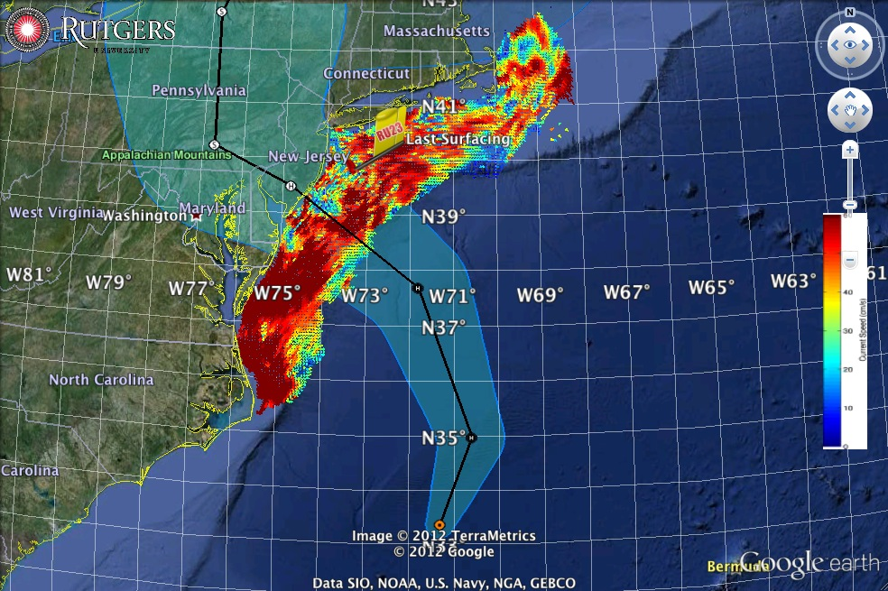
Superstorm Sandy: 1 Day Before Landfall

Slide 17
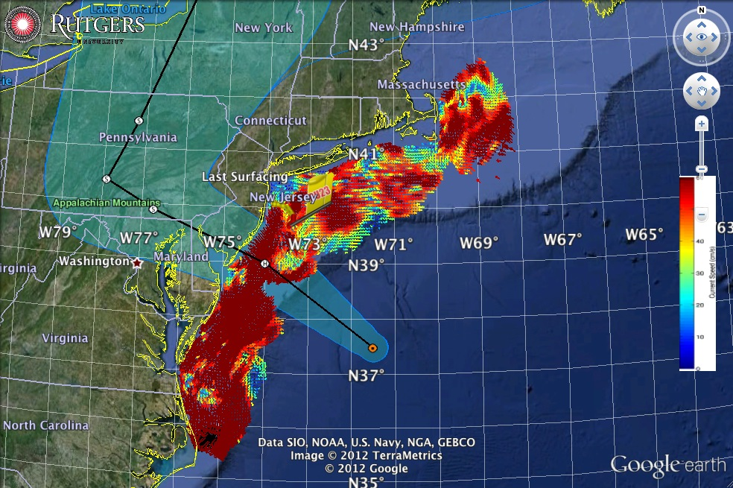
Superstorm Sandy: Morning Before Landfall

Slide 18
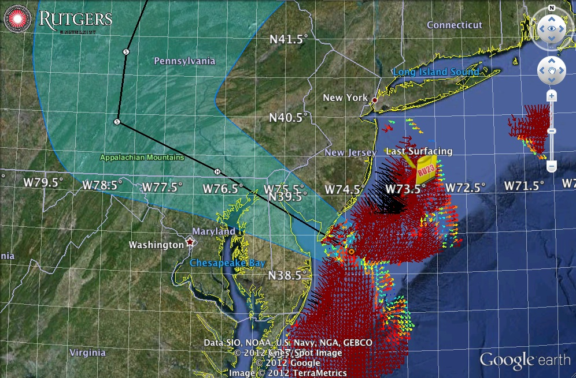
Superstorm Sandy: Landfall (20:00 Local)

Slide 19
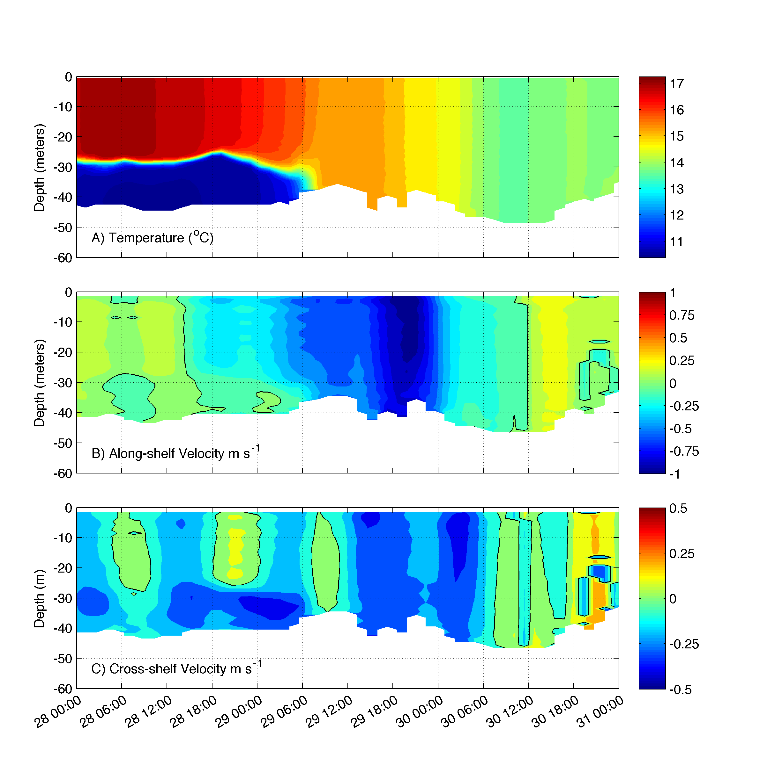
Temperature, transitions from 2-layer to well-mixed on the 29th at 06:00 GMT 18 hrs before landfall
Strong one-layer flow just prior to landfall > 1 m/s
Weak Two-layer flow while stratified: Onshore surface, offshore bottom ~0.3 m/s
Shear least-squares method: Visbeck et al. (2002) and Todd et al. (2011)
Notes:
Need to update this with New Results

Slide 20
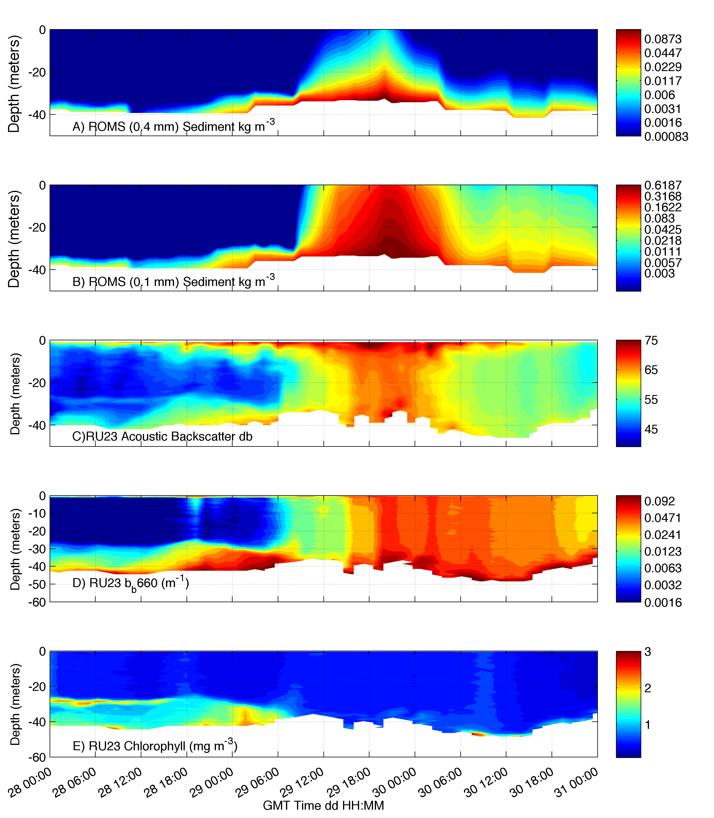
ROMS 0.4 mm sediment
concentration
ROMS 0.1 mm sediment
concentration
Acoustic Backscatter
db
Optical Backscatter
1/m
Chlorophyll Concentration
mg m⁻³

Slide 21
ROMS 0.4 mm sediment
concentration
ROMS 0.1 mm sediment
concentration
Acoustic Backscatter
db
Optical Backscatter
1/m
Chlorophyll Concentration
mg m⁻³

Slide 22
ROMS 0.4 mm sediment
concentration
ROMS 0.1 mm sediment
concentration
Acoustic Backscatter
db
Optical Backscatter
1/m
Chlorophyll Concentration
mg m⁻³
Notes:
Surface signal is likely bubbles (upward looking system)

Slide 23
ROMS 0.4 mm sediment
concentration
ROMS 0.1 mm sediment
concentration
Acoustic Backscatter
db
Optical Backscatter
1/m
Chlorophyll Concentration
mg m⁻³
Notes:
Need to work on calibration of acoustics for sediment

Slide 24
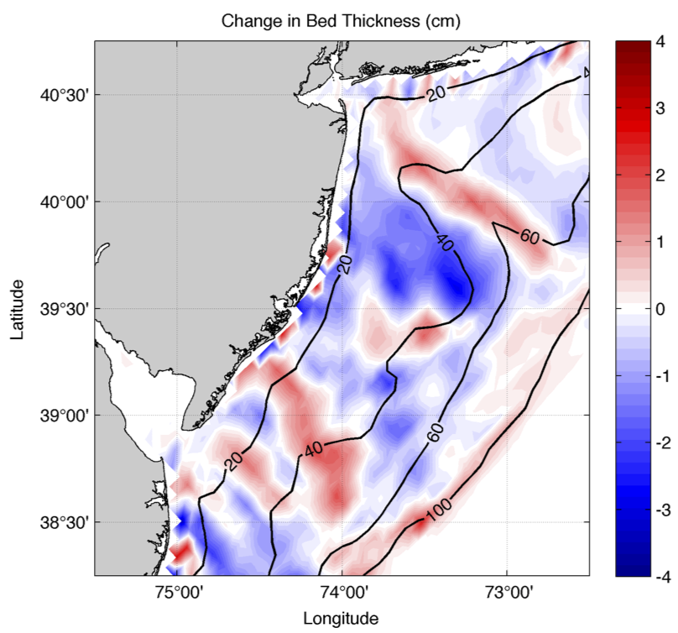

Slide 25
erosion
deposition

Slide 26
erosion
Storm track
deposition

Slide 27
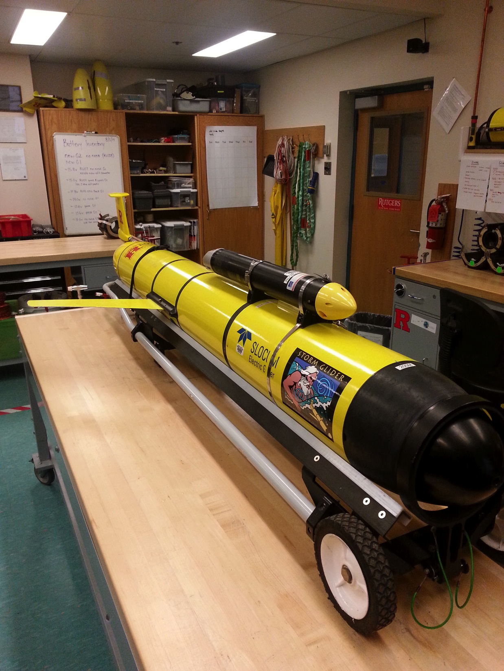
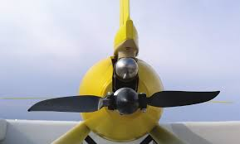
Storm Glider Development
Rapid Response Glider (v1)
Un-pumped Seabird Conductivity Temperature Depth (CTD), Wetlabs ECOpuck (CDOM, Chlorophyll, Backscatter), Aandera Optode (Oxygen).
Rapid Response Glider (v2)
Pumped CTD, Externally mounted Nortek Aquadopp Current Profiler, integrated accelerometer, extended battery bay, Thruster G1.

Slide 28
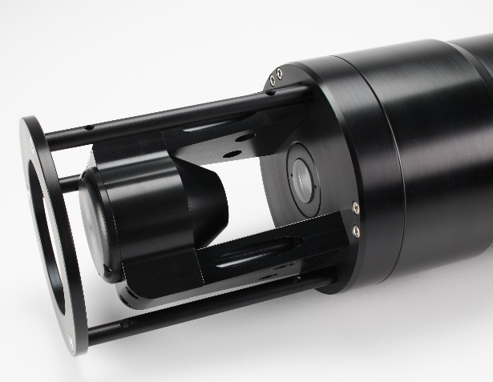

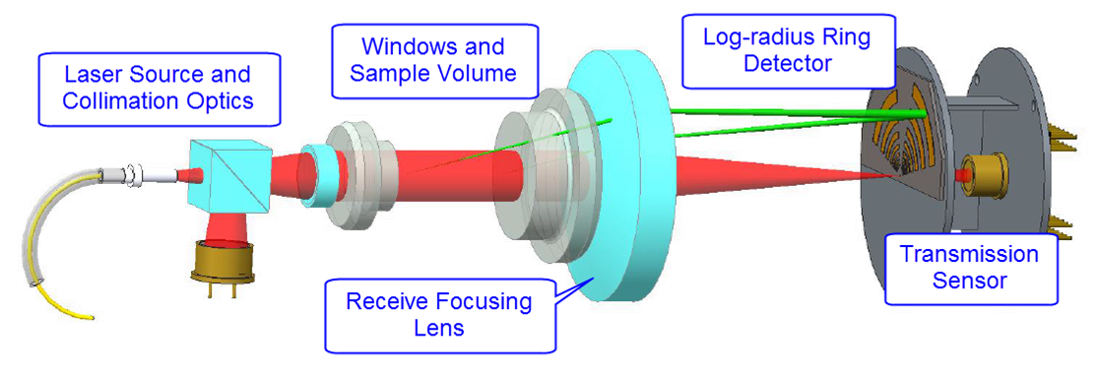

LISST-200X
Primary purpose is measurement of particle size distribution and concentration of particles
2.50-500 µm size range (32 size bins)
Particles measured include sediment, biological particles, flocs, oil-droplets and air bubbles.
It also measures the small angle forward scattering of light known as the Volume Scattering Function (VSF)

Slide 29
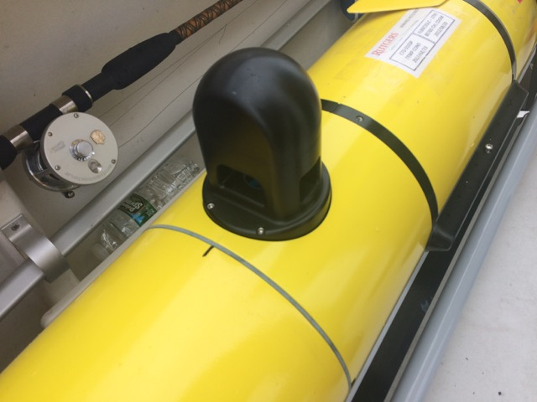
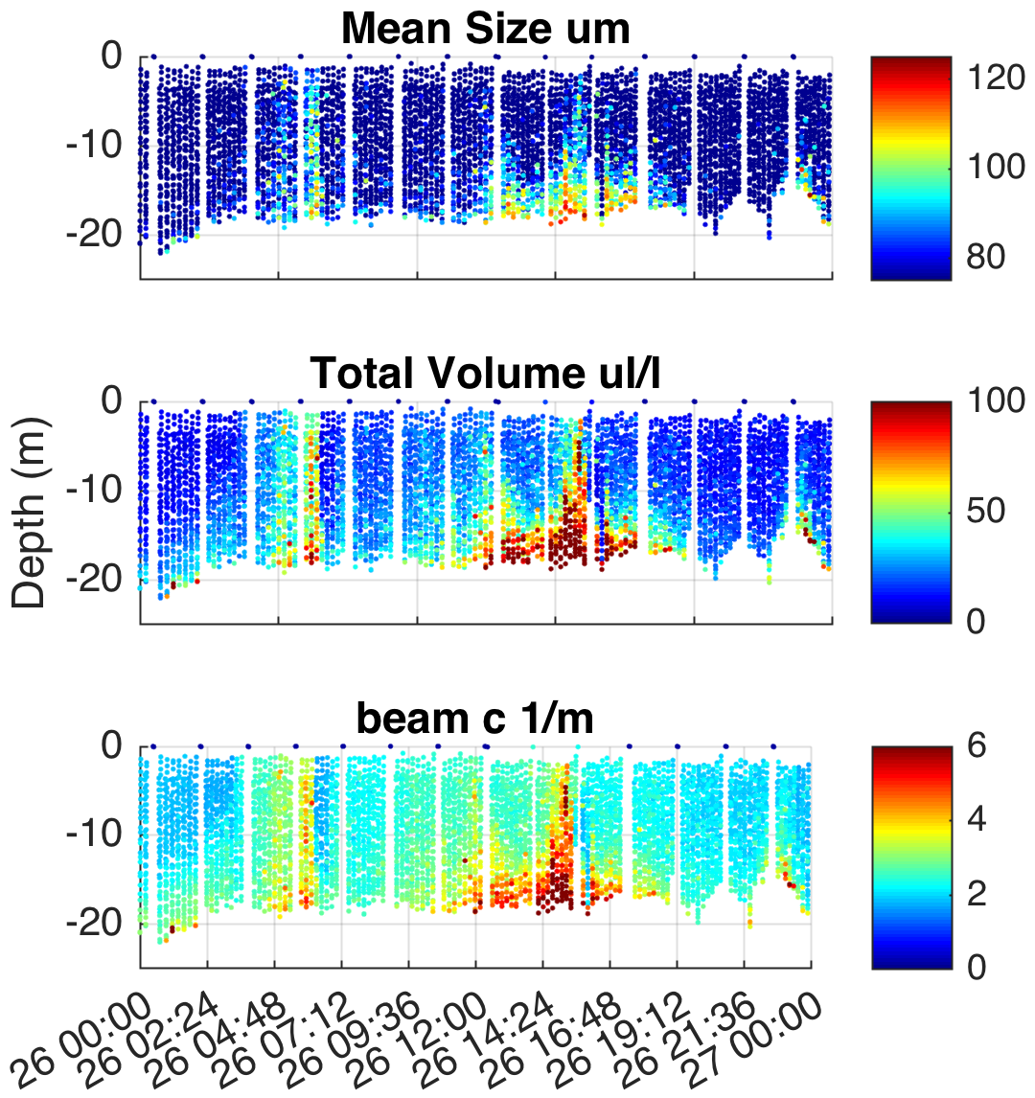
LISST Glider Integration

Slide 30
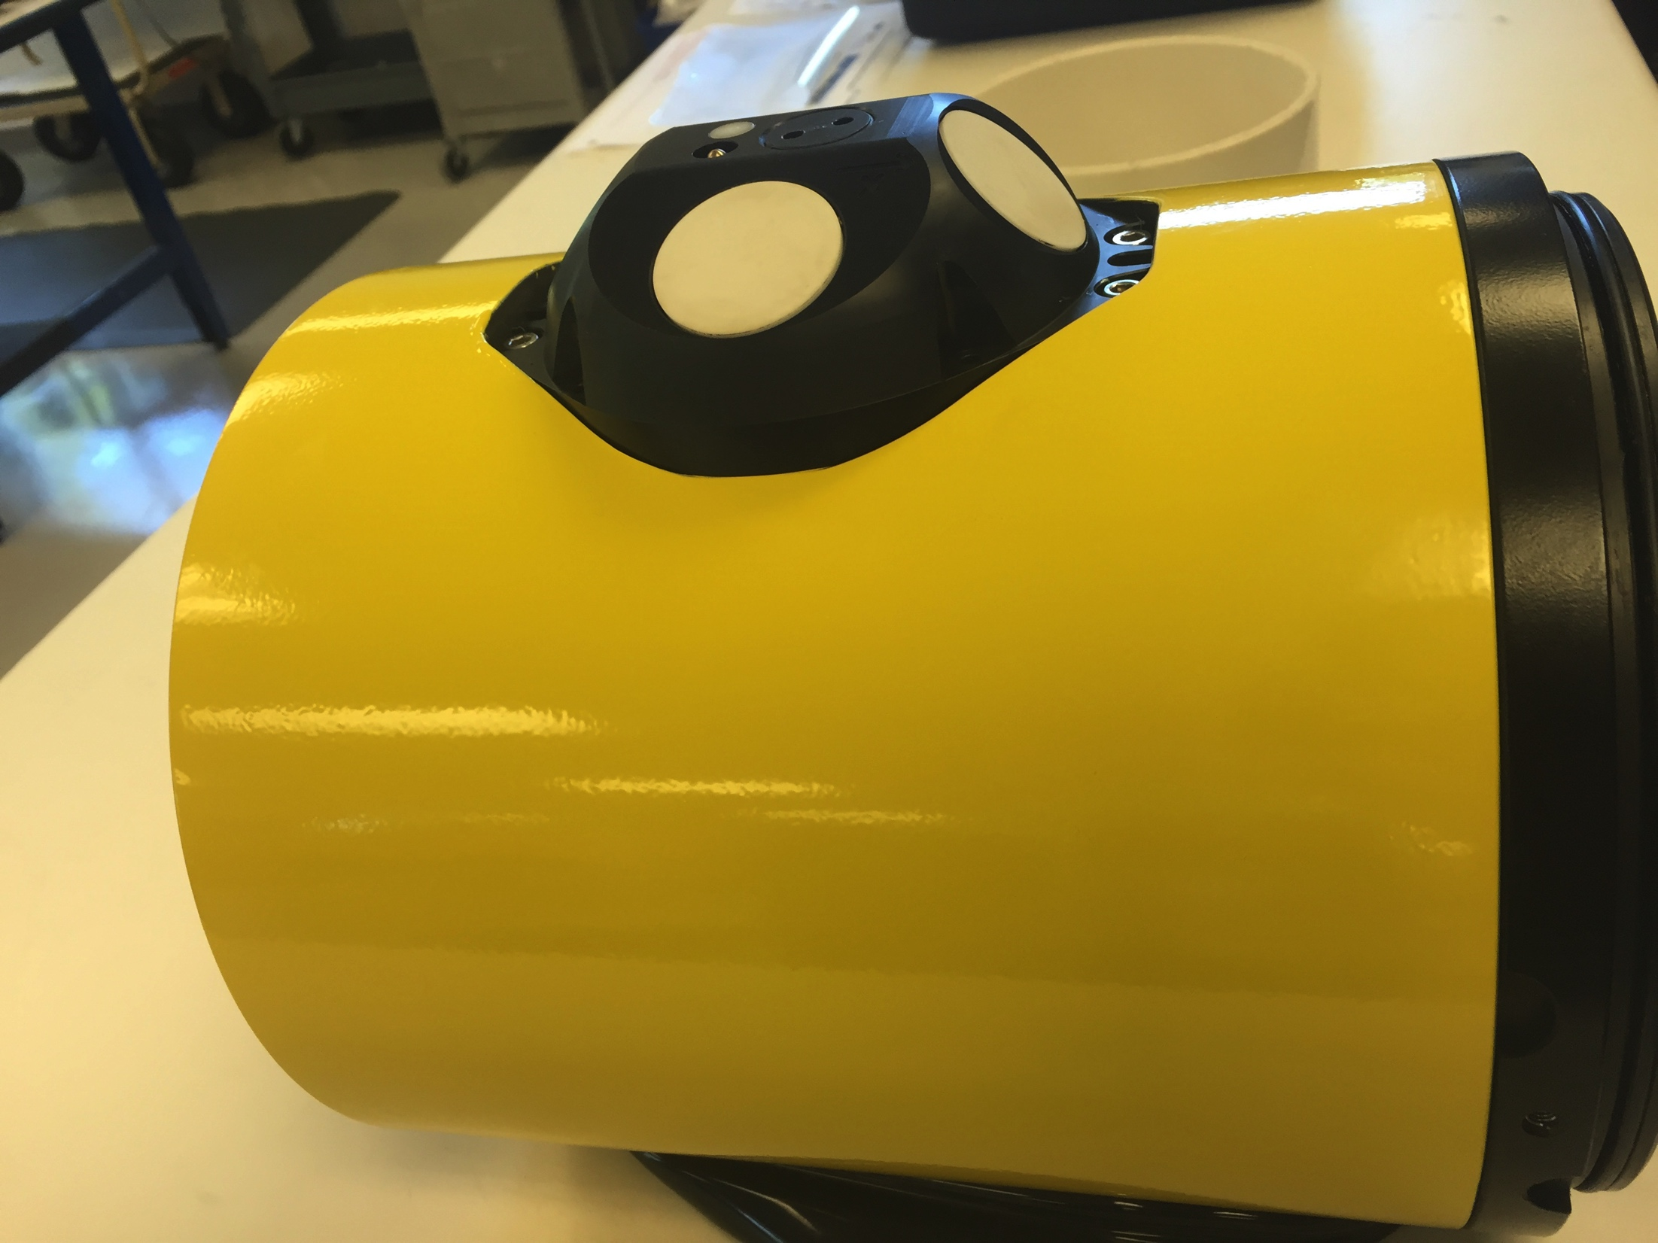
Storm Glider Development
Rapid Response Glider (v1)
Un-pumped Seabird Conductivity Temperature Depth (CTD), Wetlabs ECOpuck (CDOM, Chlorophyll, Backscatter), Aandera Optode (Oxygen).
Rapid Response Glider (v2)
Pumped CTD, Externally mounted Nortek Aquadopp Current Profiler, integrated accelerometer, extended battery bay, Thruster G1.
Rapid Response Glider (v3)
Integrated current profilers, expanded capacity buoyancy pumps, thruster G2, integrated LISST-200X particle sizer (sediment, oil droplet, phytoplankton, etc.).

Slide 31
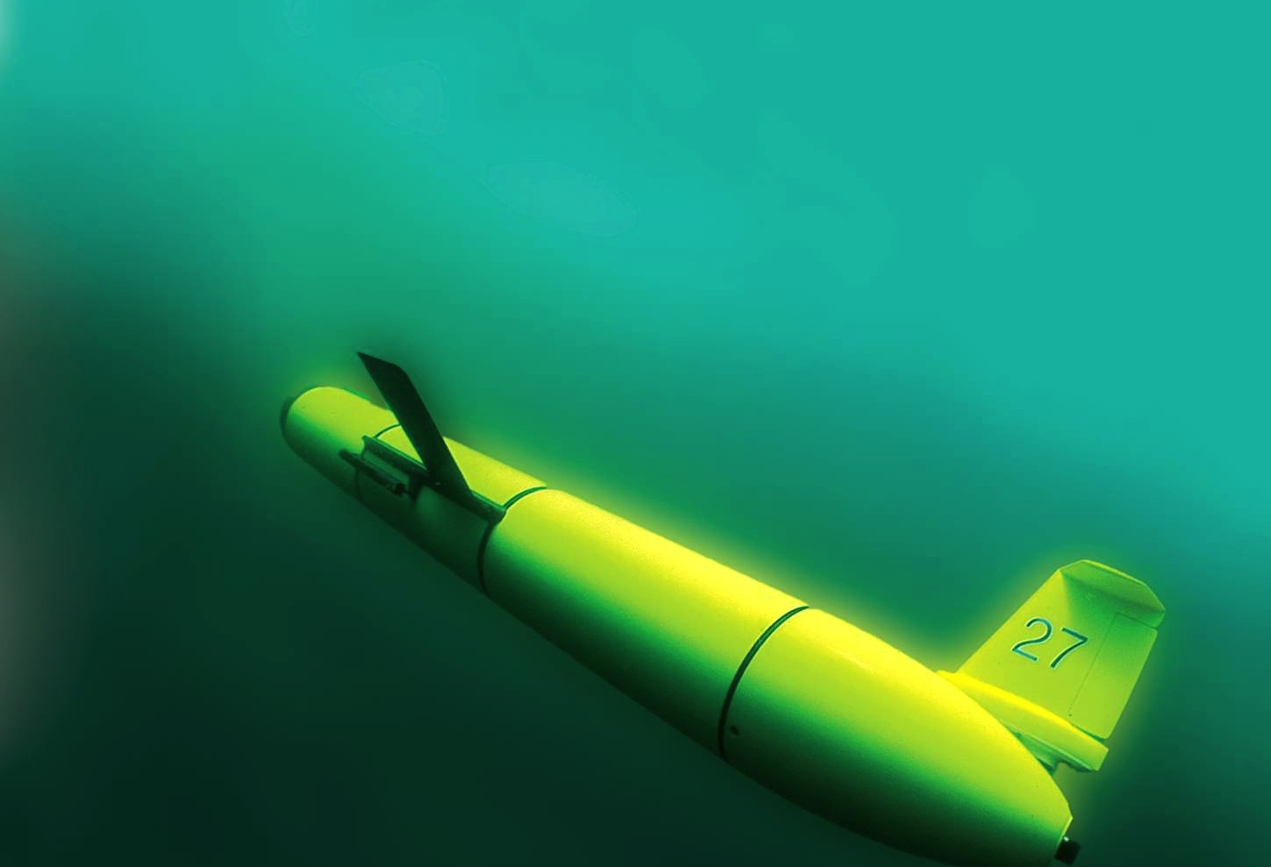
Conclusions
Leverage Tools
Leverage Expertise
Focus on Impacts
Collaboration

Slide 32



Thank You
NOAA NOS - U.S. IOOS - MARACOOS
NOAA OAR – CINAR (Disaster Recovery Act)
NOAA NCEP – OPC/EMC
EPA/NJ DEP
NJ BPU
Teledyne Webb Research
ONR
RUCOOL
Questions?

Slide 33
Key Storm Glider Reference List
Glenn, Jones, Twardowski, Bowers, Kerfoot, Kohut, Webb, Schofield, 2008. Glider observations of sediment resuspension in a Middle Atlantic Bight fall transition storm. Limnology and Oceanography 53(5, Part 2): 2180-2196.
Miles, Glenn, Schofield, 2013. Temporal and spatial variability in fall storm induced sediment resuspension on the Mid-Atlantic Bight. Continental Shelf Research 63, Supplement: S36-S49.
Miles, Seroka, Kohut, Glenn, 2015. Glider observations and modeling sediment transport in Hurricane Sandy. JGR Oceans, DOI: 10.1002/2014JC010474
Glenn, Miles, Seroka, Xu, Forney, Yu, Roarty, Schofield, Kohut, 2016. Stratified coastal ocean interactions with tropical storms, Nature Communications, DOI:10.1038/ncomms10887.
Seroka, Miles, Xu, Kohut, Schofield & Glenn, 2016. Hurricane Irene Sensitivity to Stratified Coastal Ocean Cooling, Monthly Weather Review, 144(9) 3507-3530.
Seroka, Miles, Xu, Kohut, Schofield & Glenn, 2017. Rapid shelf-wide cooling response of a stratified coastal ocean to hurricanes. JGR-Oceans: Special Section on Ocean Responses and Feedbacks to Tropical Cyclones, DOI:10.1002/2017JC012756.
Miles, Seroka, Glenn, 2017. Coastal ocean circulation during Hurricane Sandy, J. Geophysical Res. - Oceans, accepted.
Sea-Bottom Interface
Air-Sea Interface

Slide 34
Thank You
NOAA NOS - U.S. IOOS - MARACOOS
NOAA OAR – CINAR (Disaster Recovery Act)
NOAA NCEP – OPC/EMC
EPA/NJ DEP
NJ BPU
Teledyne Webb Research
ONR
RUCOOL
Questions?

Slide 35
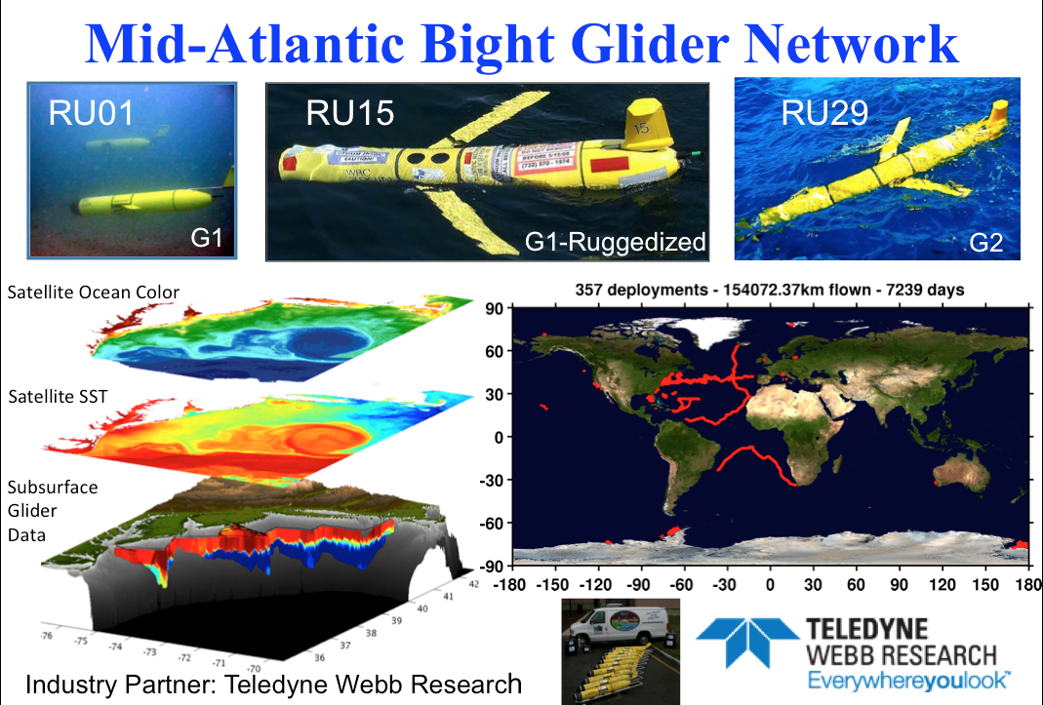
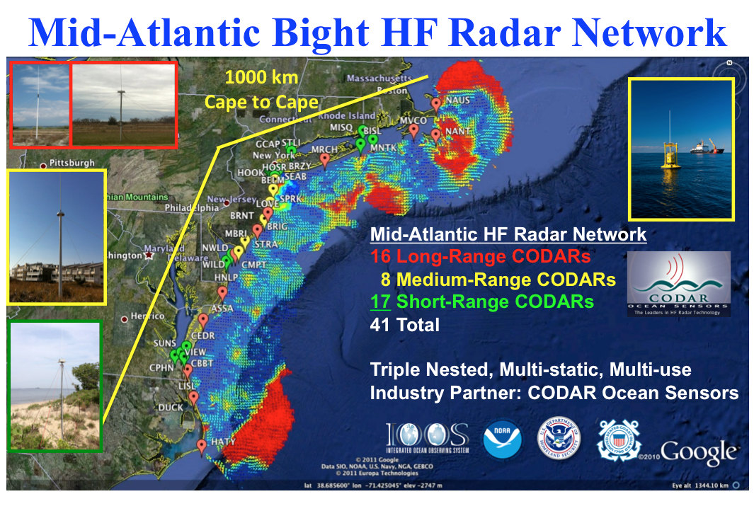
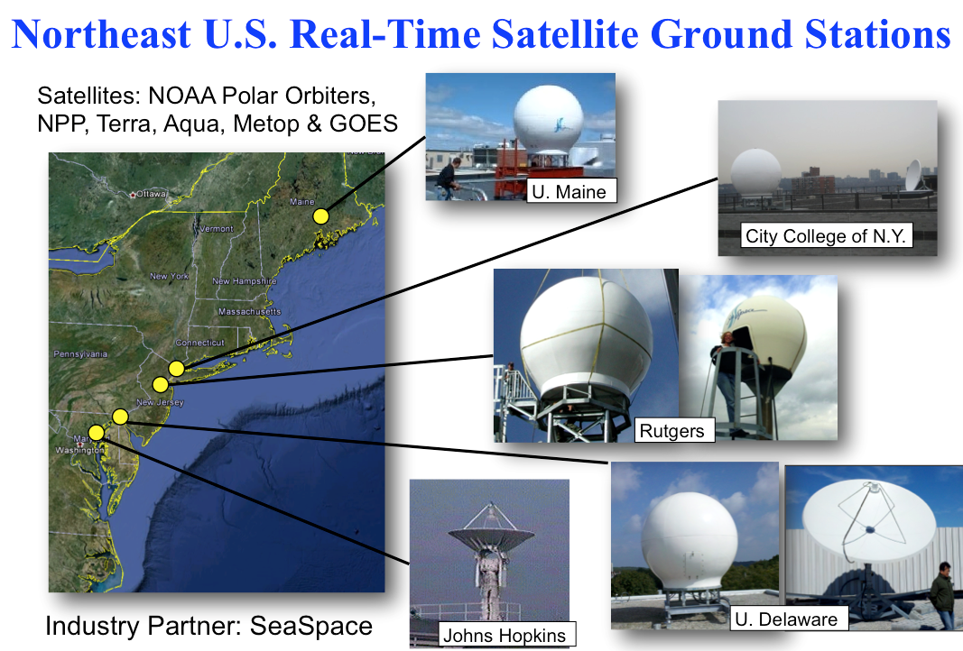
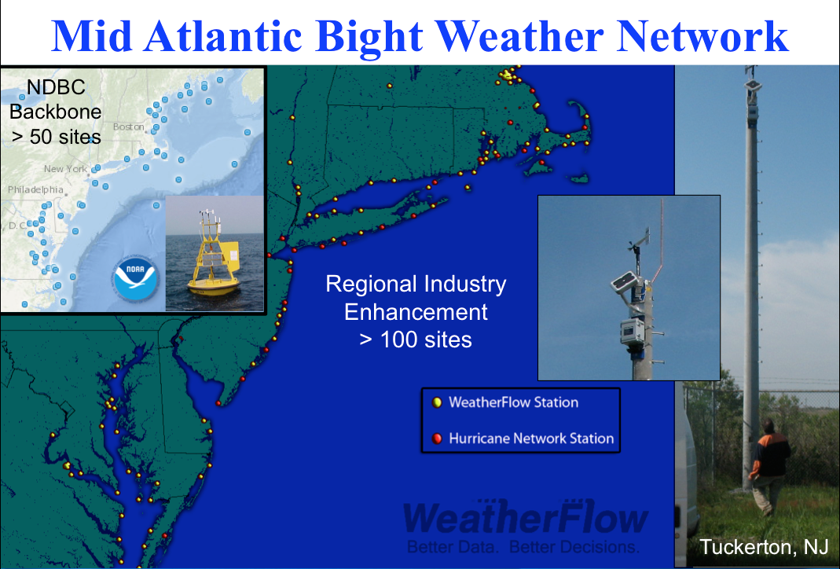
Mid-Atlantic Regional-Scale Observation Network
Notes:
What can we add for the final 24 hours before landfall?

Slide 36
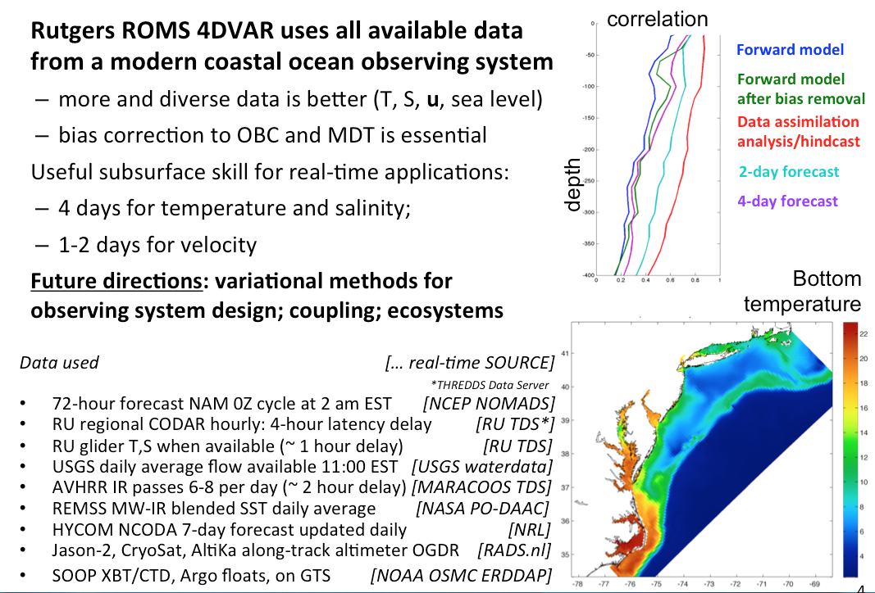
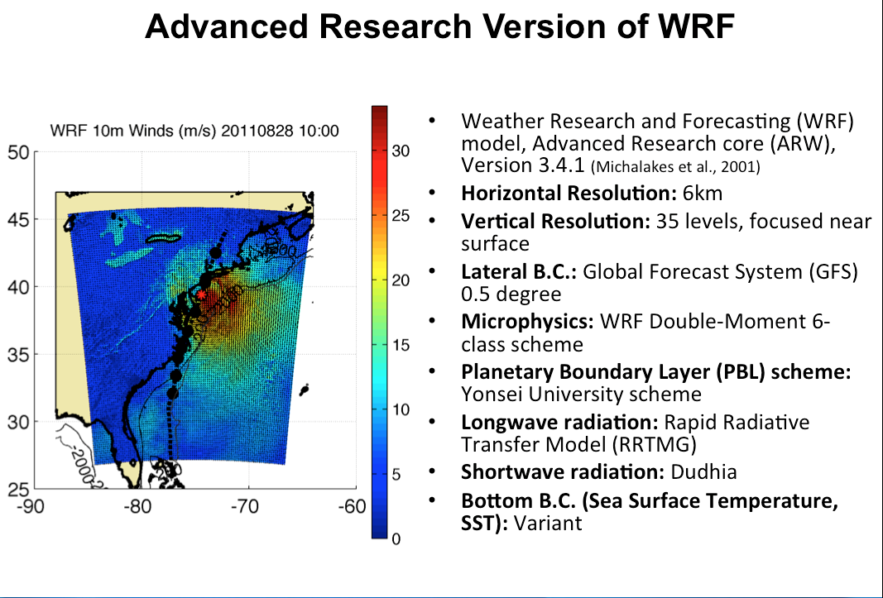


Mid-Atlantic Ensemble of Forecast Models Include:
Rutgers University Coastal Ocean Observing Lab

Slide 37
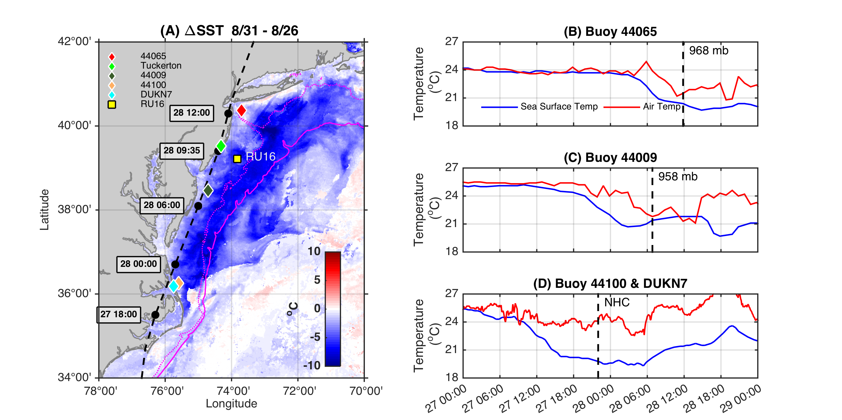
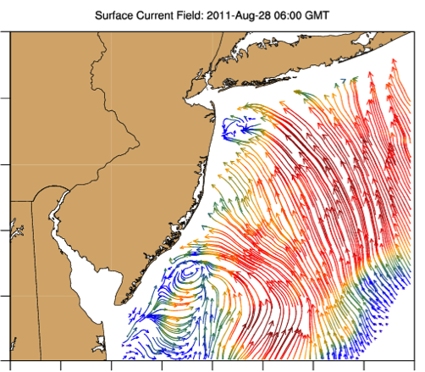
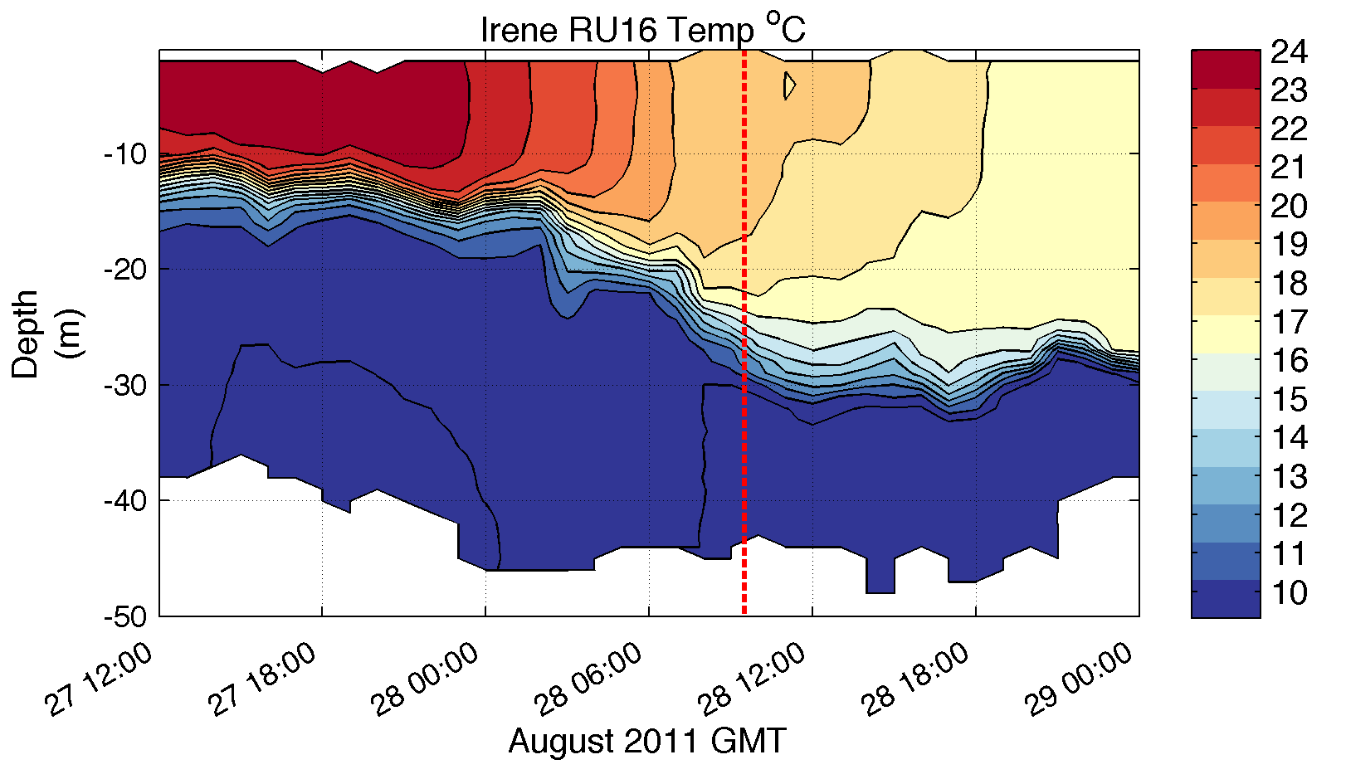
Mid-Atlantic Regional-Scale Observation Network

Slide 38
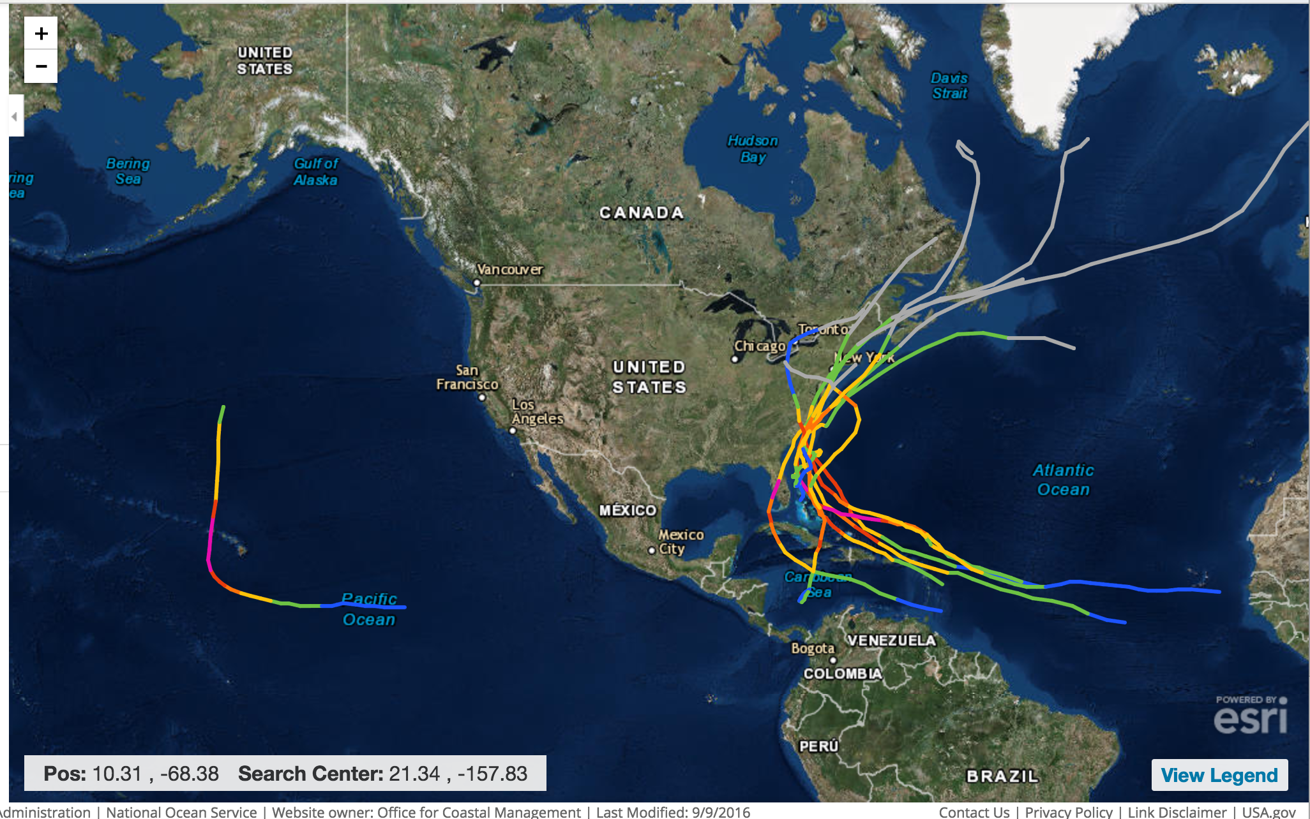
Notes:
Last major storm to impact Hawaii Iniki-1992
Floyd, Fran, Bertha, Bonnie, and Hugo in North Carolina
Sandy and Irene in New Jersey

Slide 39
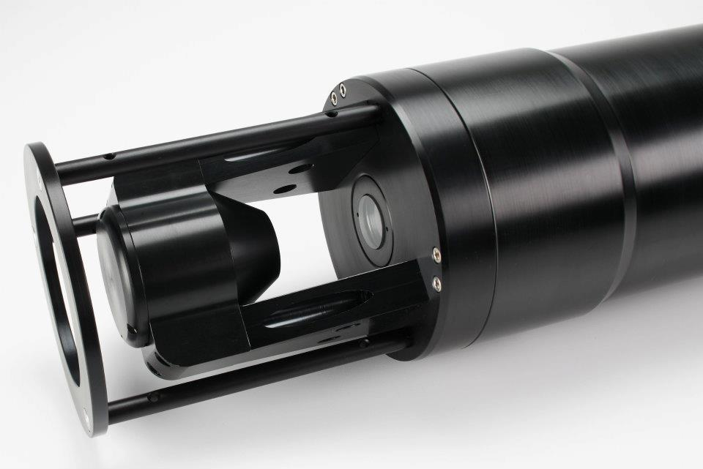
Rapid Response Glider Development
Rapid Response Glider (v1)
Un-pumped Seabird Conductivity Temperature Depth (CTD), Wetlabs ECOpuck (CDOM, Chlorophyll, Backscatter), Aandera Optode (Oxygen).
Rapid Response Glider (v2)
Pumped CTD, Externally mounted Nortek Aquadopp Current Profiler, integrated accelerometer, extended battery bay, Thruster G1.
Rapid Response Glider (v3)
Integrated current profilers, expanded capacity buoyancy pumps, thruster G2, integrated LISST-200X particle sizer (sediment, oil droplet, phytoplankton, etc.).
Notes:
Need ONR and GoMRI

Slide 40
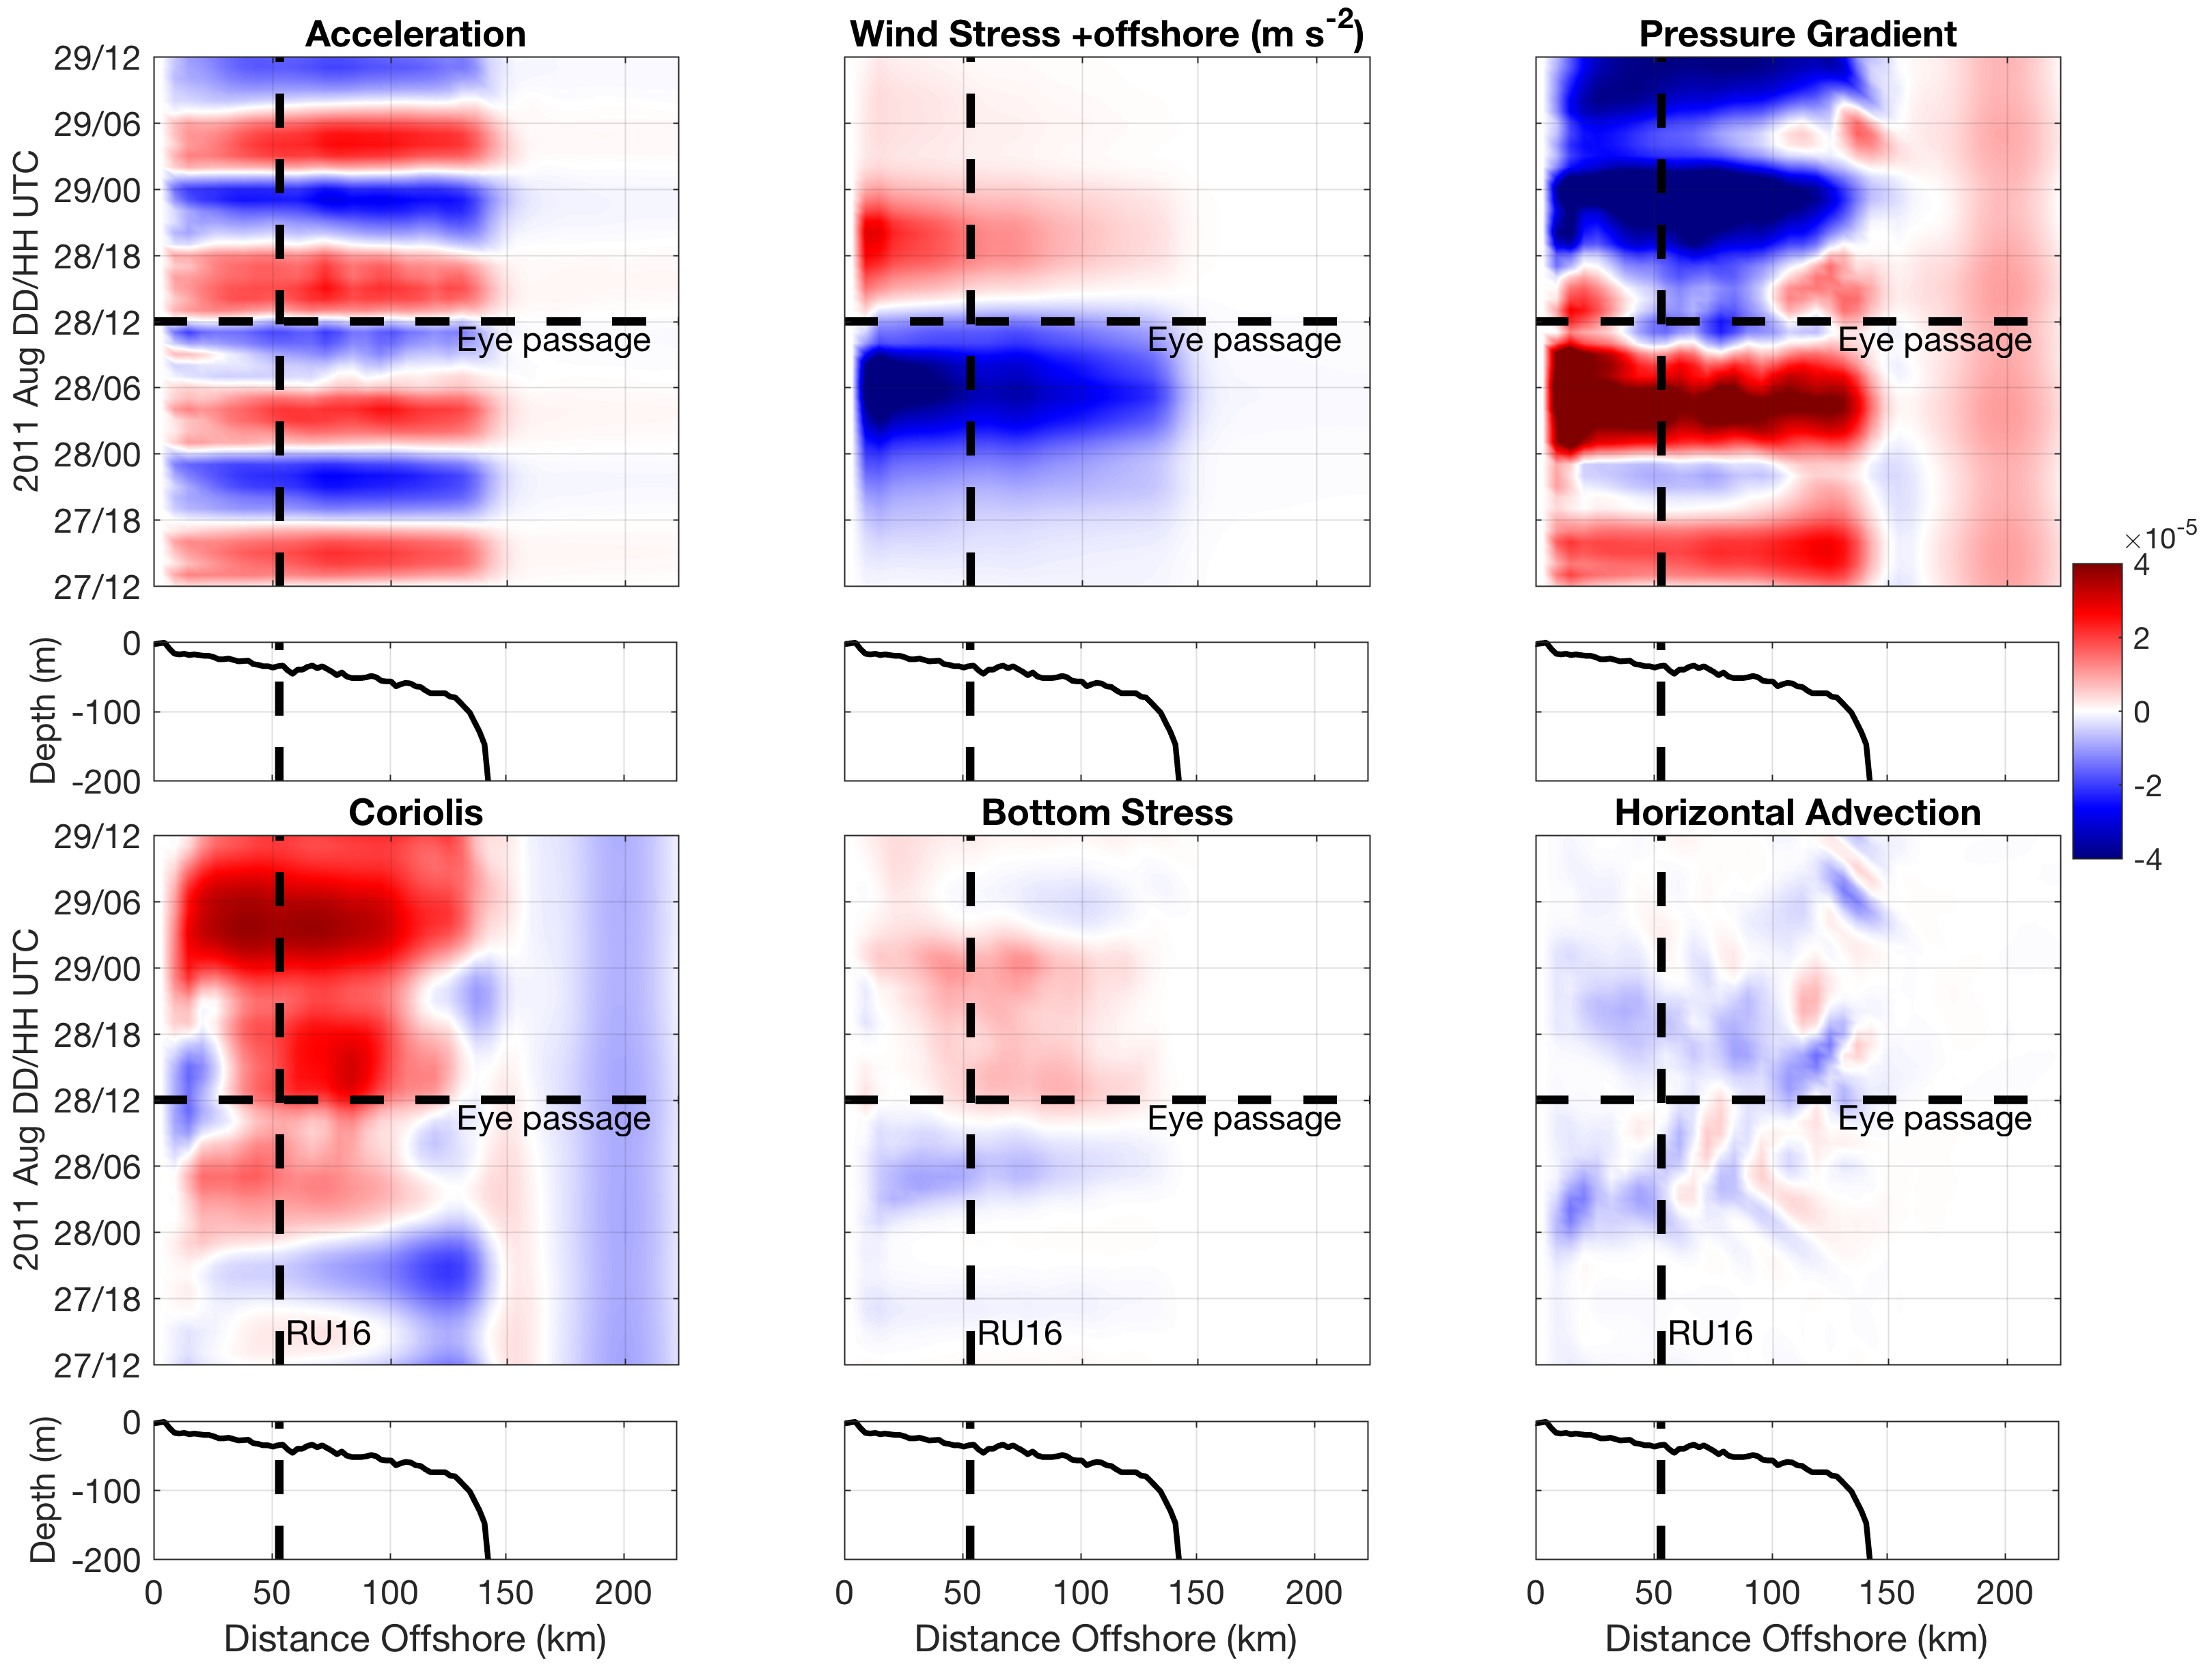
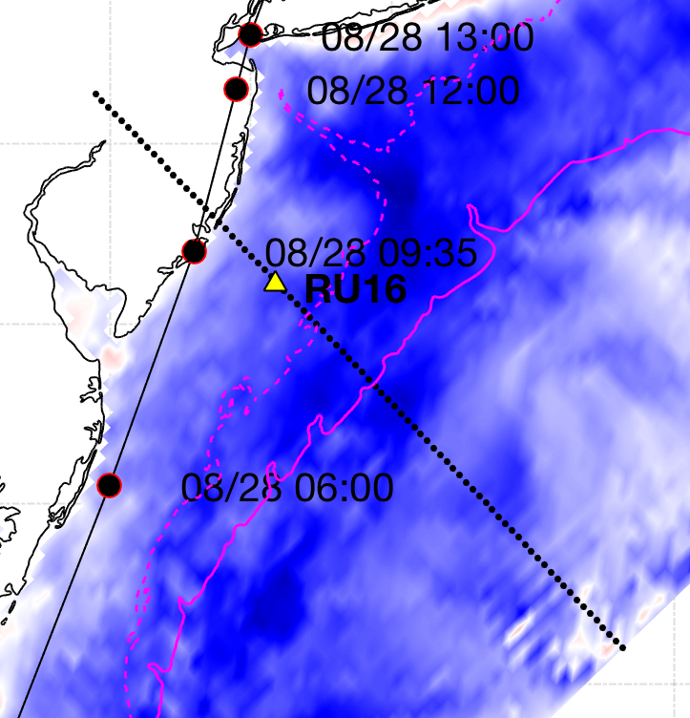
+offshore
m s⁻²
-onshore
Seroka et al. in prep.
Notes:
15

Slide 41
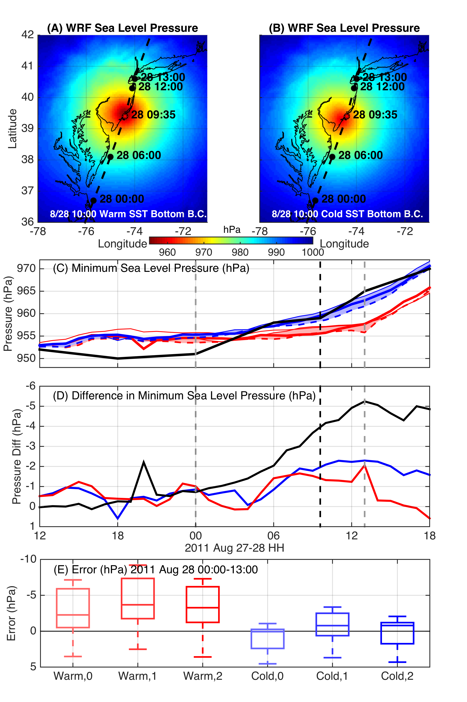
WRF Model Sensitivity Study
Over 140 model runs
Paired to compare sensitivities
Central pressure & max wind
Sensitivity to SST greatest
Seroka, Miles, Xu, Kohut, Schofield & Glenn,
Hurricane Irene Sensitivity to Stratified Coastal Ocean Cooling, In Review, Monthly Weather Review

Slide 42
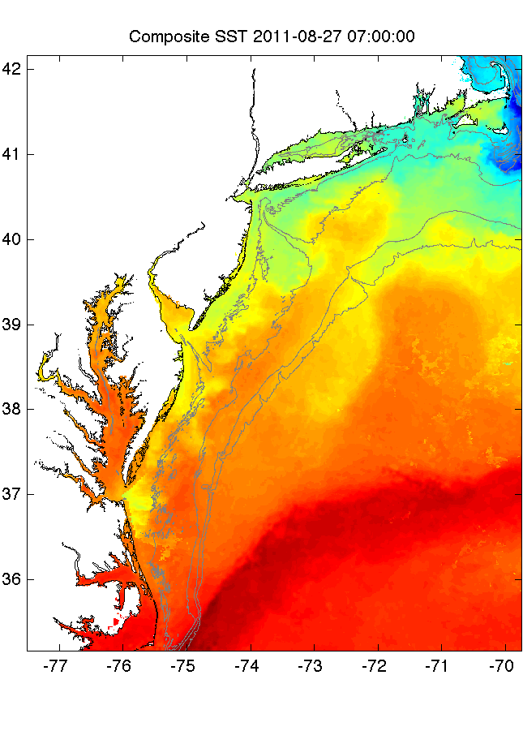
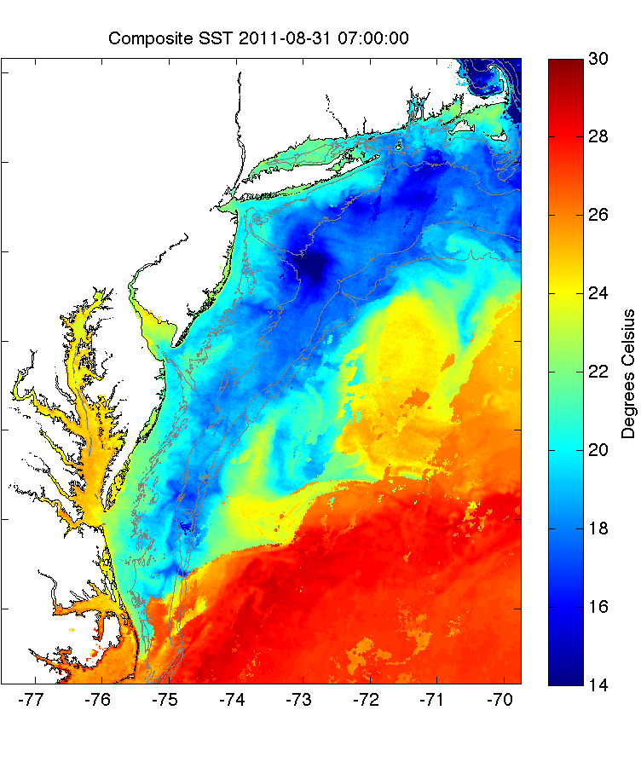
Warm Ocean
Boundary Condition
Cold Ocean
Boundary Condition
Notes:
Need a better figure to setup our model experiment

Slide 43
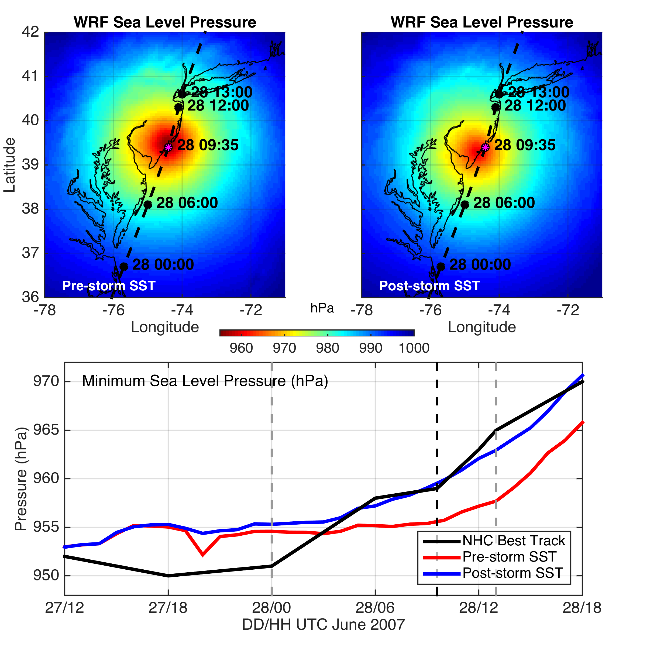

Slide 44

Specific humidity includes Sea Surface Temperature and air temperature

Slide 45
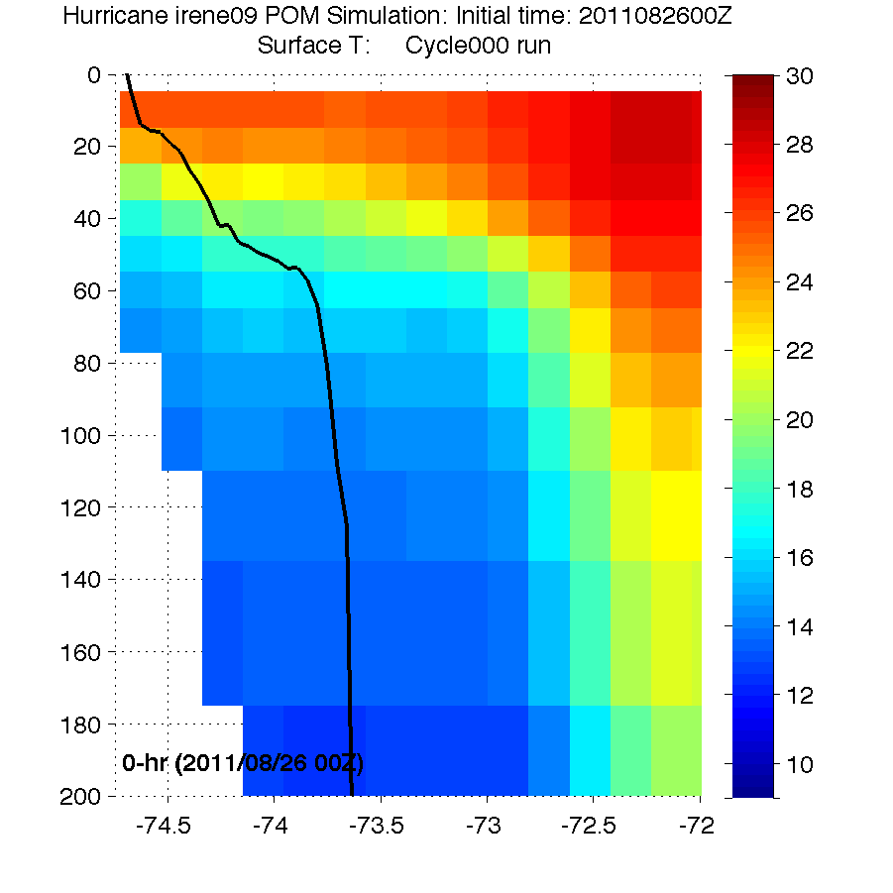
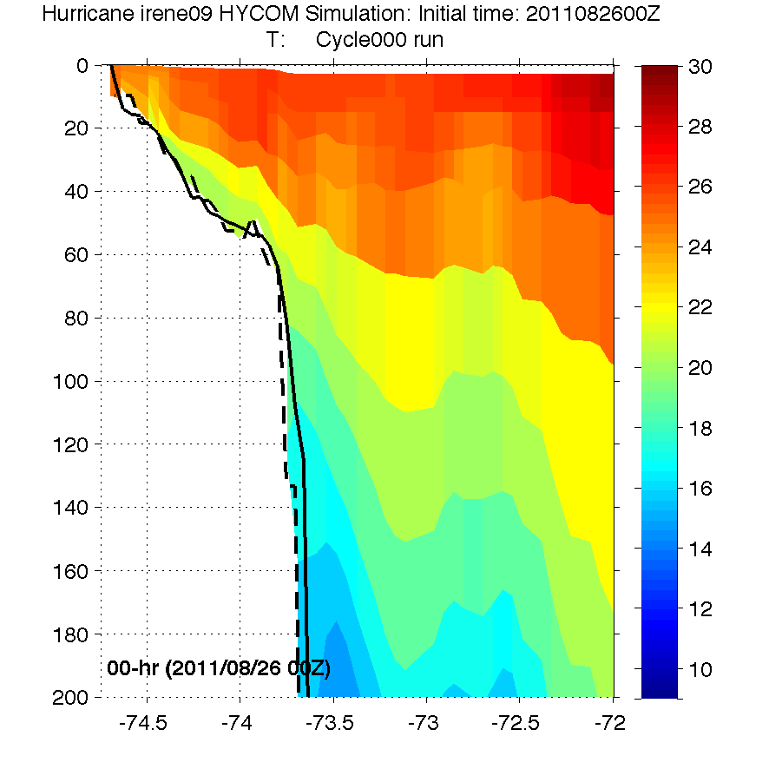


HWRF Cross-shelf Transects
HWRF-POM
Before
HWRF-HYCOM
Before
Before
RU16 Glider
RU16 Glider
Thank you to Hyun-Sook Kim and Zhan Zhang for providing HWRF data
Observed bathymetry from NOAA National Geophysical Data Center, U.S. Coastal Relief Model, Retrieved date goes here, http://www.ngdc.noaa.gov/mgg/coastal/crm.html

Slide 46


HWRF Cross-shelf Transects
HWRF-POM
Before
HWRF-HYCOM
Before
Before
After
HWRF-POM
After
HWRF-HYCOM
After
RU16 Glider
Thank you to Hyun-Sook Kim and Zhan Zhang for providing HWRF data
Observed bathymetry from NOAA National Geophysical Data Center, U.S. Coastal Relief Model, Retrieved date goes here, http://www.ngdc.noaa.gov/mgg/coastal/crm.html

Slide 47




Modeled Deepwater Cooling Processes in Hurricane Irene
Air-Sea Fluxes Only
1-D Mixing
3-D PWP (Upwelling)
Storm-induced cooling in deep water is often equally distributed between the front and back half of the storm (Price et al., 1981)
Notes:
Describe each mode clearly

