Slide 1
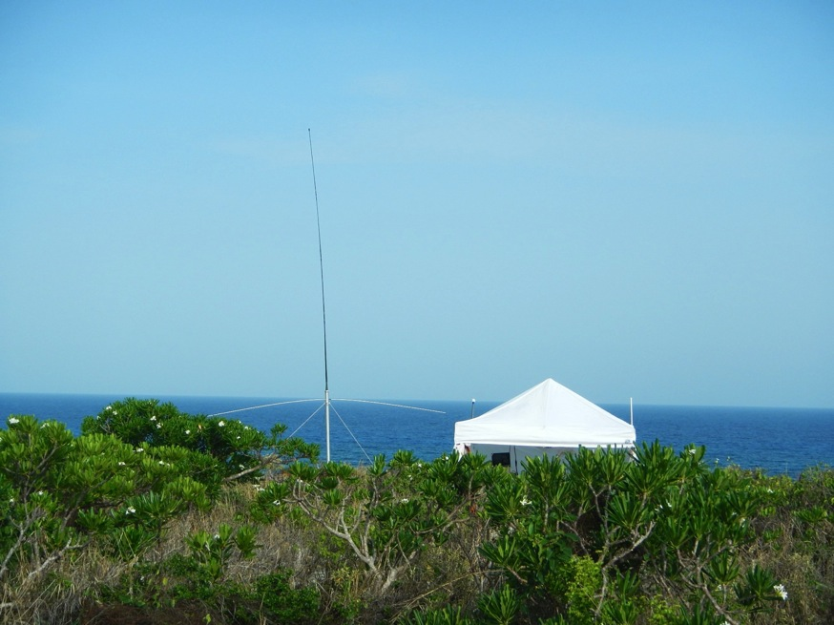
Globalizing Lessons Learned
from Regional-scale
Ocean Observatories:
Promoting Partnerships for Research, Education and
Service to Society
Scott Glenn,
Oscar Schofield, Josh Kohut,
Grace Saba & Travis Miles
Rutgers University,
New Brunswick, New Jersey, USA
CODAR HF Radar on
Mona Island, Puerto Rico

Slide 2
Conclusions up front:
Integrated Approach
Enabled by New Technologies
Requires Partnerships
Training is Key
CODAR HF Radar on
Mona Island, Puerto Rico

Slide 3
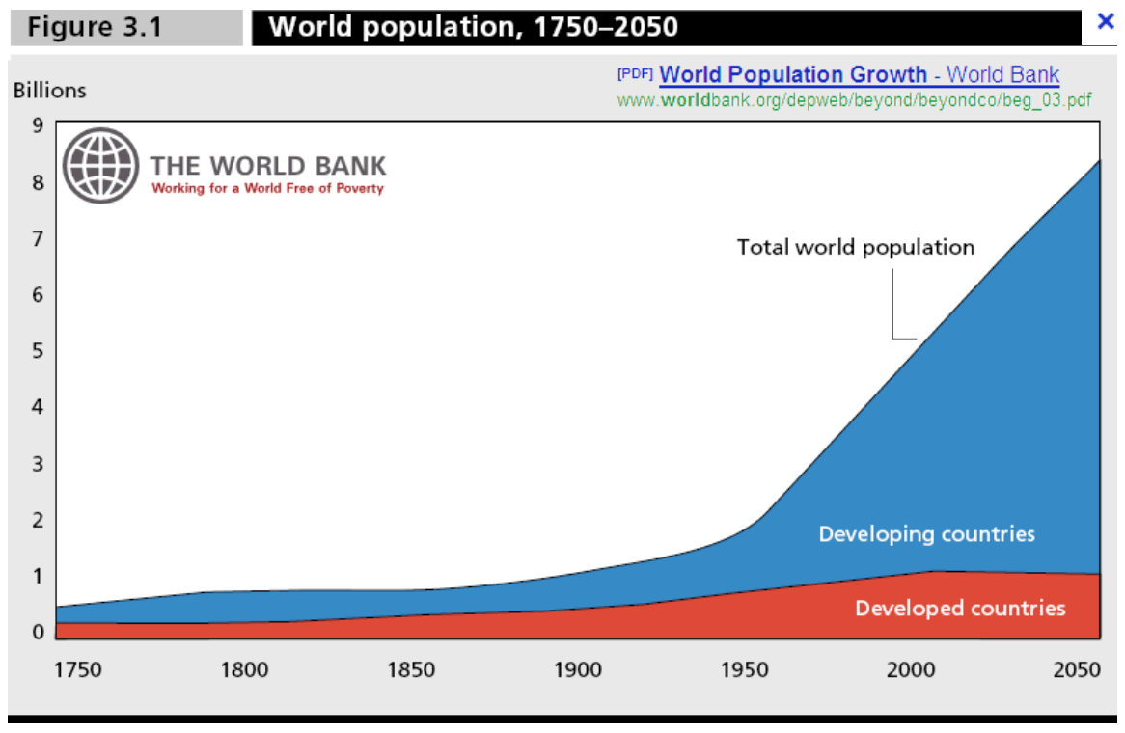

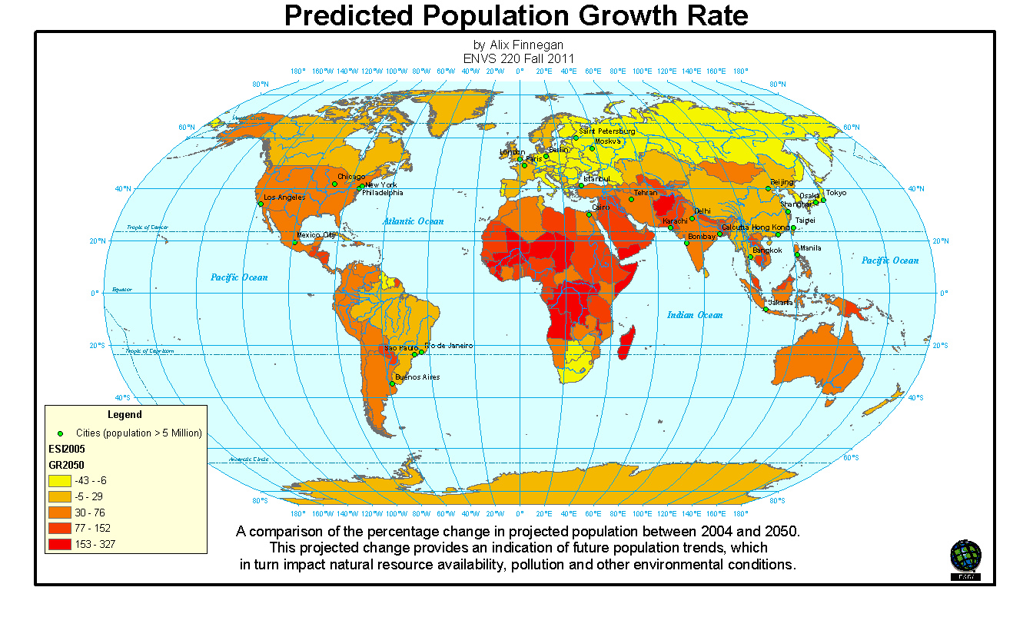
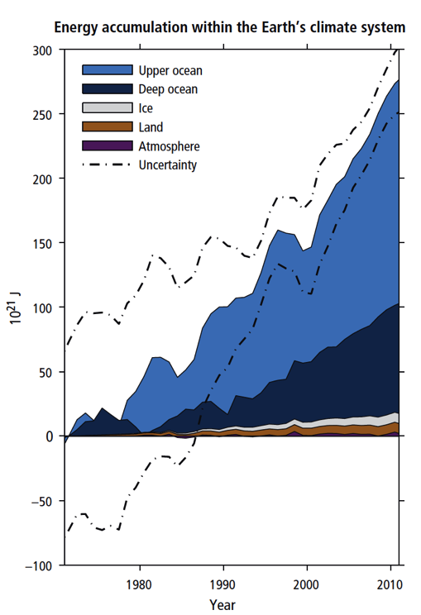

Slide 4
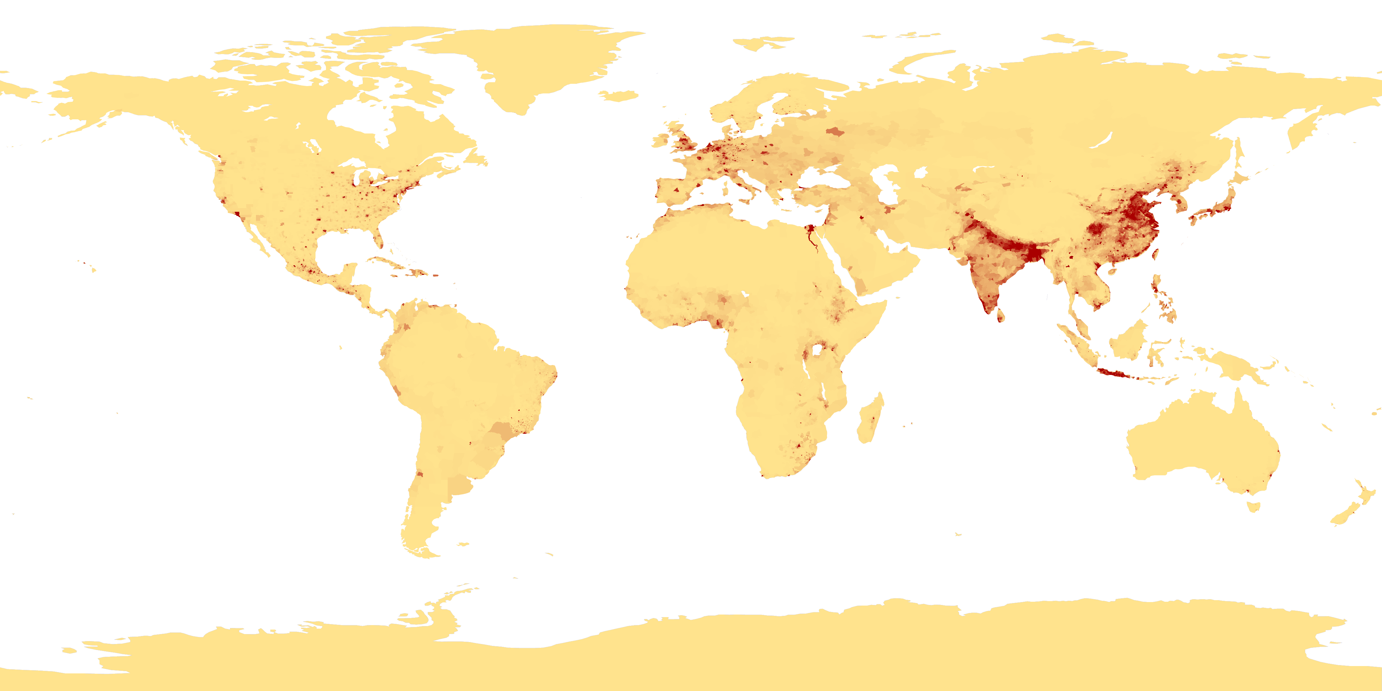
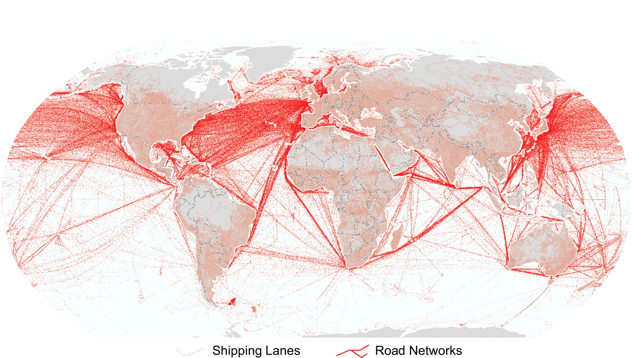
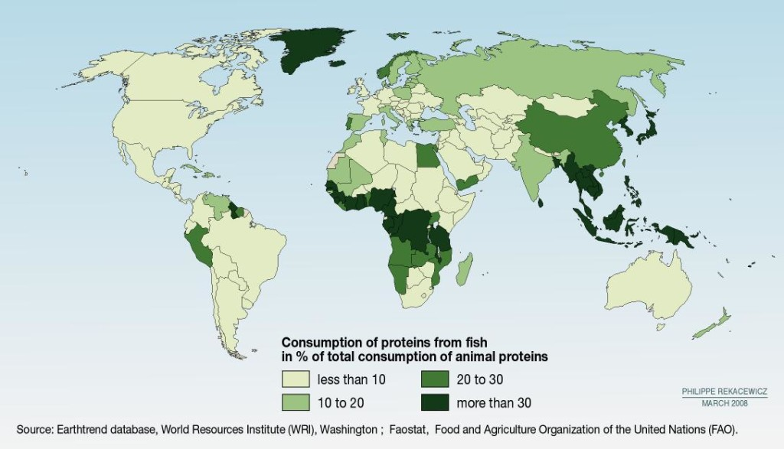
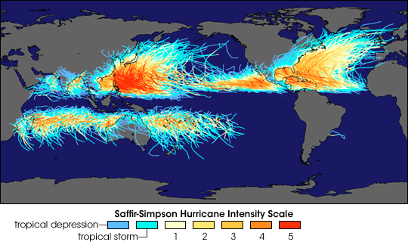
Societal Drivers for Ocean Research and Monitoring
Coastal Population Centers
International Commerce
Fish Consumption
Tropical Cyclones

Slide 5
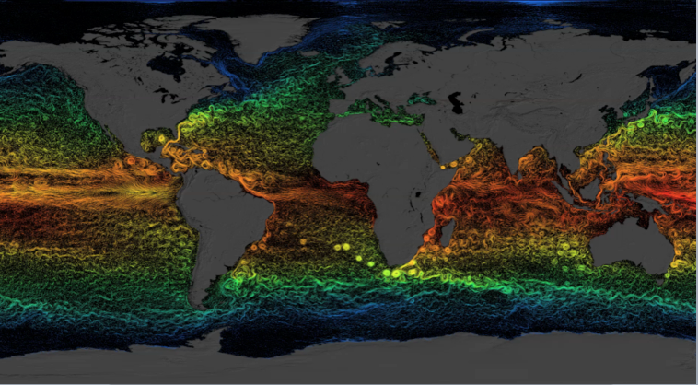
The Ocean is Physically Complex & Biologically Diverse
Global circulation dominated by the Mesoscale
61 Large Marine Ecosystems
Dominated by Coastal Regions

Slide 6
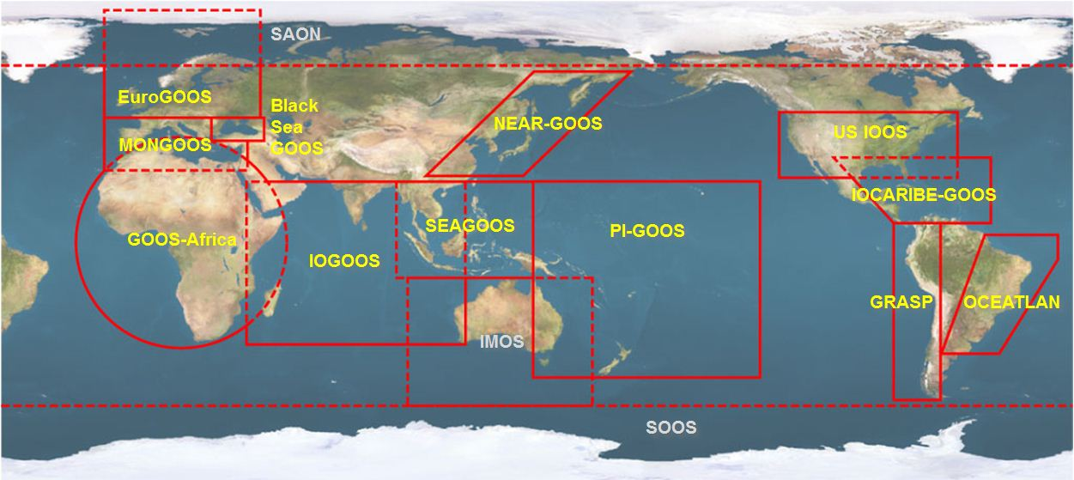

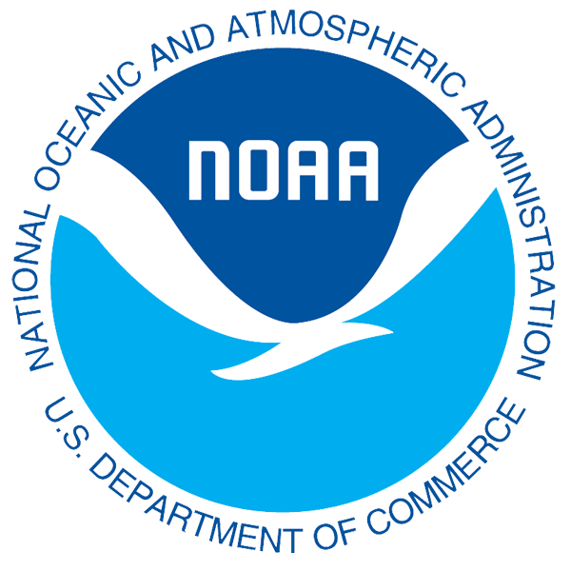



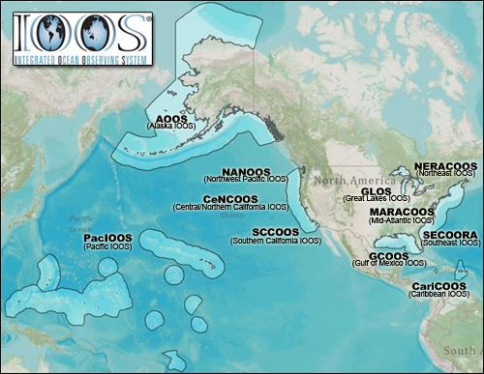


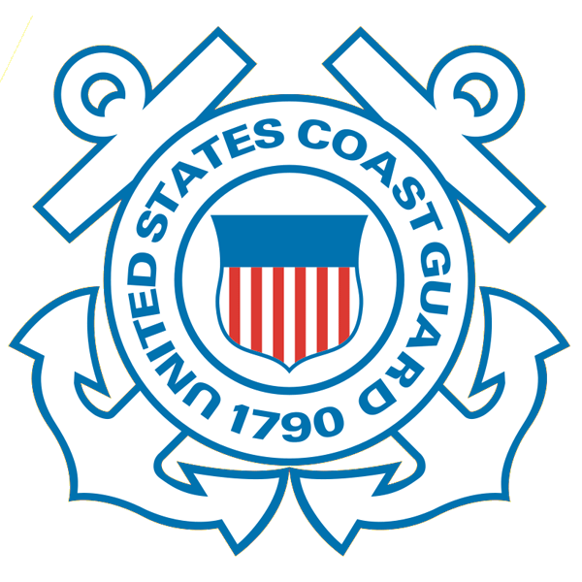










Global Ocean Observing System (GOOS) & U.S. IOOS Model
Global Component
National Component
Regional Component
15 Regional Alliances in GOOS
Vessels -
Satellite
Satellite
CODAR
Ships/ Vessels
Glider
REMUS
Data Vis.
Modeling
Security
Leadership
Education
11 Regional Associations
17 U.S. Federal Agencies
Serving Society & Science
http://ioos.gov

Slide 7
















RI
U..
Middle Atlantic
Regional Association
Coastal
Ocean Observing System
10 States - 76 Million People
1000 km Cape to Cape
CT
Cape
Cod
MA
NY
PA
NJ
MARACOOS:
An Integrated & Sustained Real-time Observation and Forecast System
DE
>40 PIs
>20 Institutions
>50 Members
>2000 Contacts
MD
VA
NC
Cape
Hatteras
Notes:
7

Slide 8
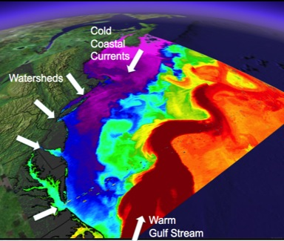
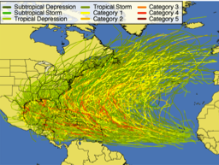
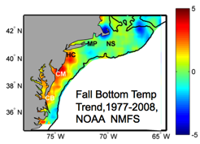
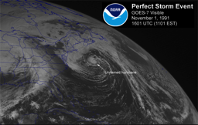
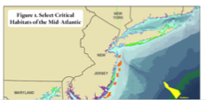
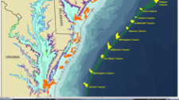
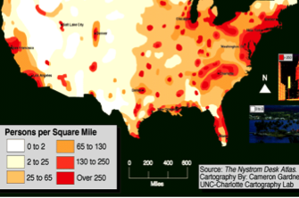
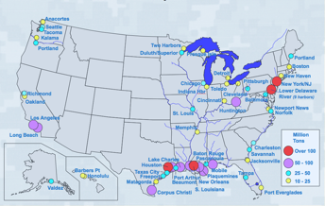
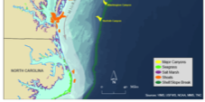
MID-ATLANTIC REGIONAL DRIVERS
Tropical Storms
Climate Change
Ocean Circulation
Critical Habitat
Northeasters
Population
Ports

Slide 9
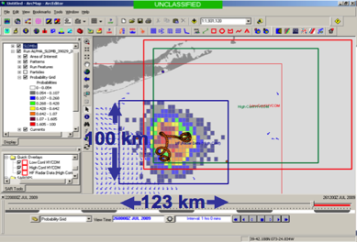
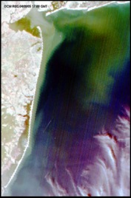
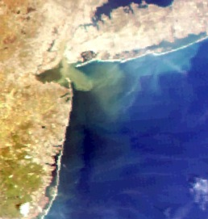
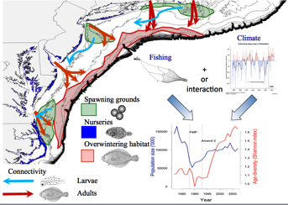
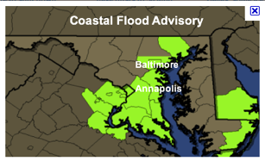
MARACOOS REGIONAL THEMES
1) Maritime Operations – Safety at Sea
3) Water Quality – a) Floatables, b) Hypoxia, c) Nutrients
2) Ecosystem Decision Support - Fisheries
5) Energy – Offshore Wind
4) Coastal Inundation - Flooding

Slide 10
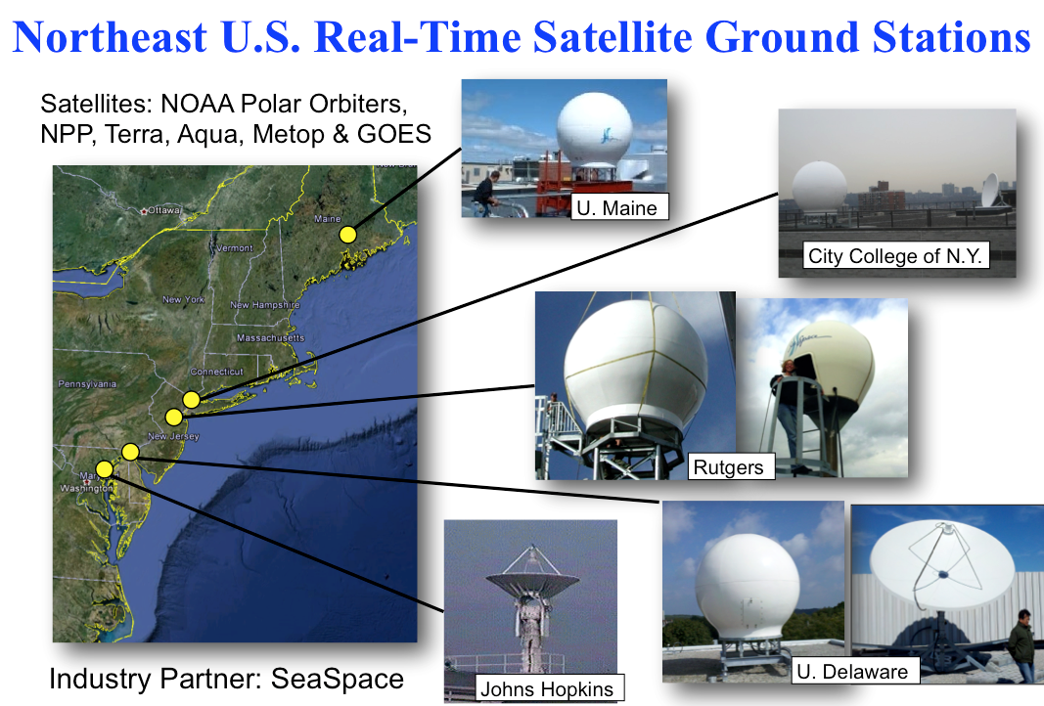
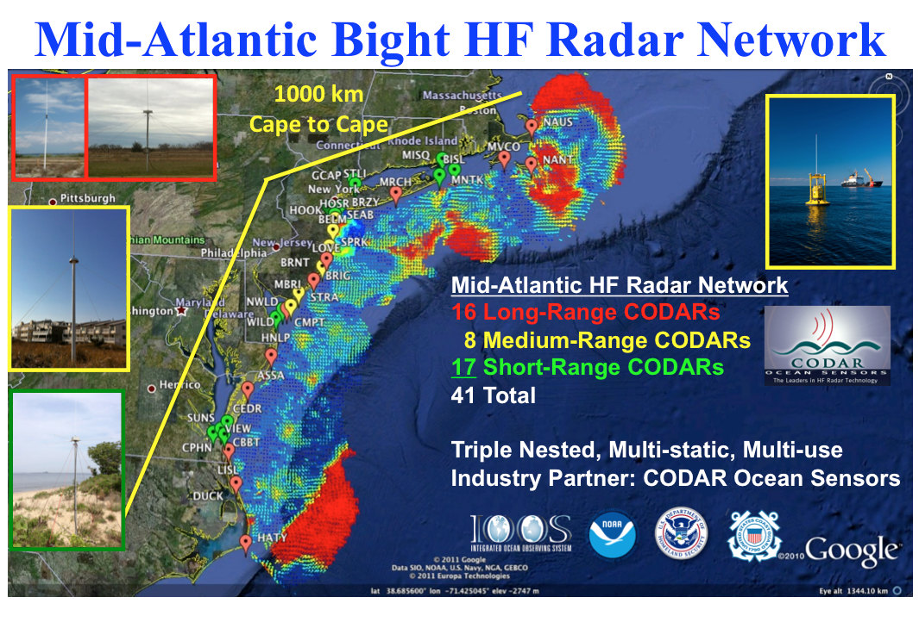
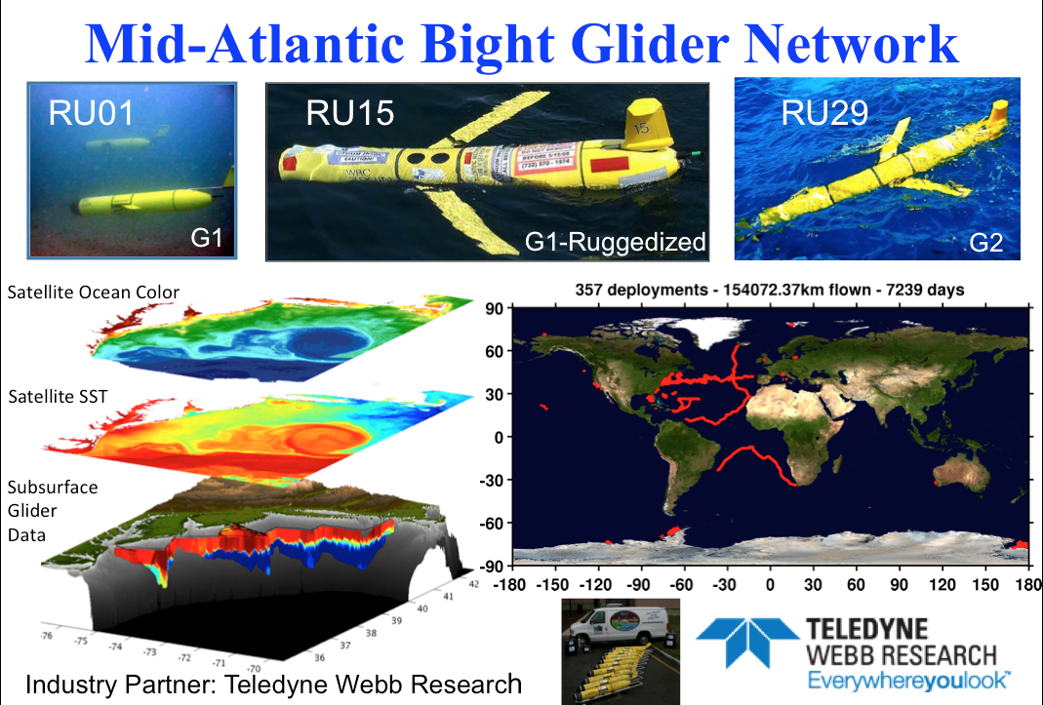
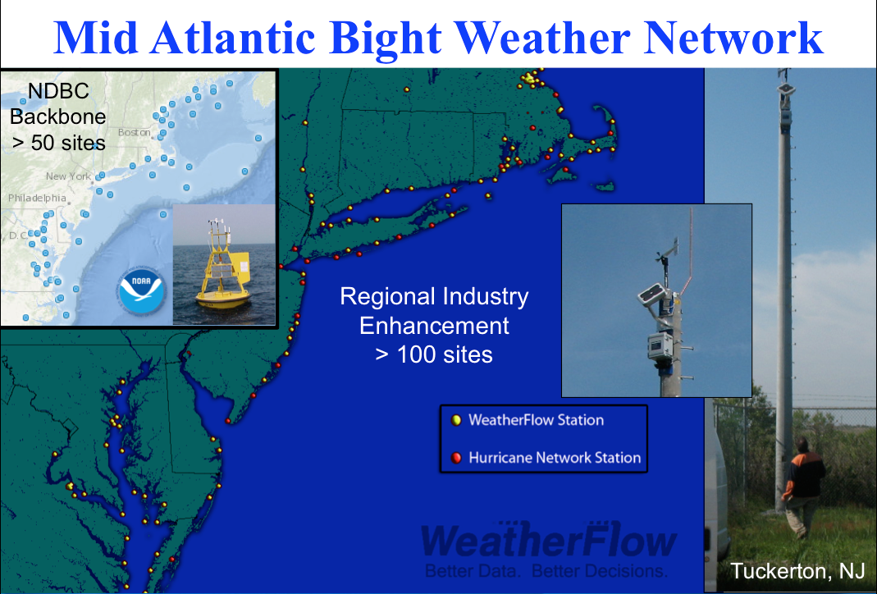
Mid-Atlantic Regional-Scale Observation Network

Slide 11
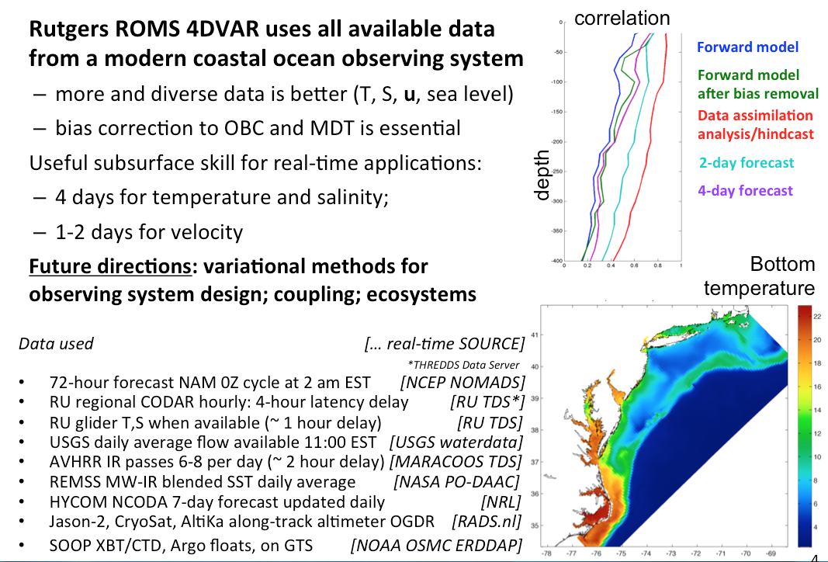
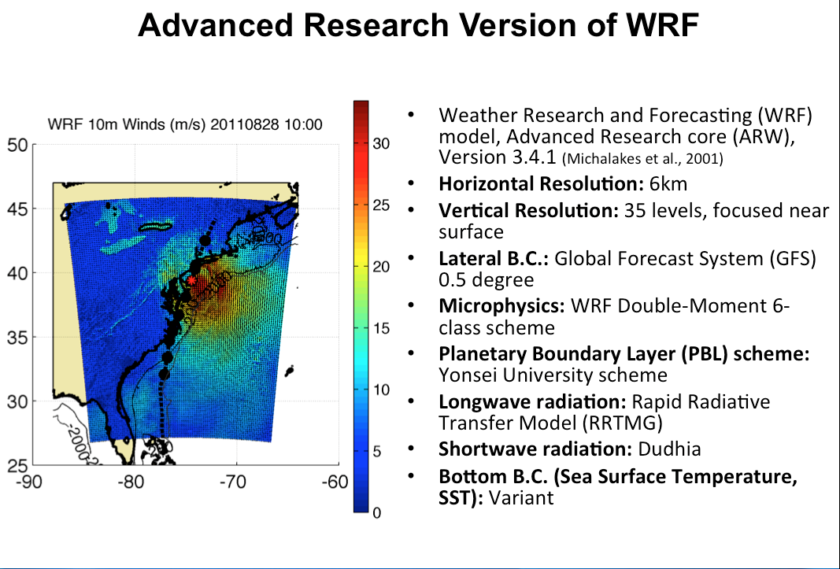

Mid-Atlantic Ensemble of Forecast Models Include:
Mid-Atlantic Operations Center @

Slide 12






Integrating Data, Products and Services for Societal Goals
Regional Priority Themes | Regional Observation & Modeling Capabilities
 | Weather Mesonet | HF Radar Network | Statistical STPS | Satellite Imagery | Glider Surveys | Dynamical Ocean Forecasts
Theme 1. Maritime Safety | Operational Input to USCG SAROPS | Operational input to USCG SAROPS | Operational input to USCG SAROPS | SST for survivability planning | Assimilation dataset for forecast models | Surface currents for SAROPS
Theme 2. Ecological Decision Support | Weather forecast ensemble validation | Circulation and divergence maps for habitat |  | SST & Color for habitat | Subsurface T & S for habitat | 3-D fields of T, S, circulation for habitat
Theme 3. Water Quality | Winds for transport, river plumes, & upwelling | Surface currents for floatables, bacteria, spill response | Surface currents for floatables, bacteria, spill response | Ocean color for river plumes | Nearshore dissolved oxygen surveys | Surface currents for floatables, bacteria, spill response
Theme 4. Coastal Inundation | Weather forecast ensemble validation | Current forecast model validation |  | SSTs assimilation into forecast models | Assimilation dataset for forecast models | Nested forecast ensembles
Theme 5. Offshore Energy | Historical analysis & wind model validation | Historical current analysis & wind model validation |  | Historical analysis surface fronts & plumes for siting | Historical analysis of subsurface fronts & plumes | Coupled ocean-atmosphere models for resource estimates

Slide 13
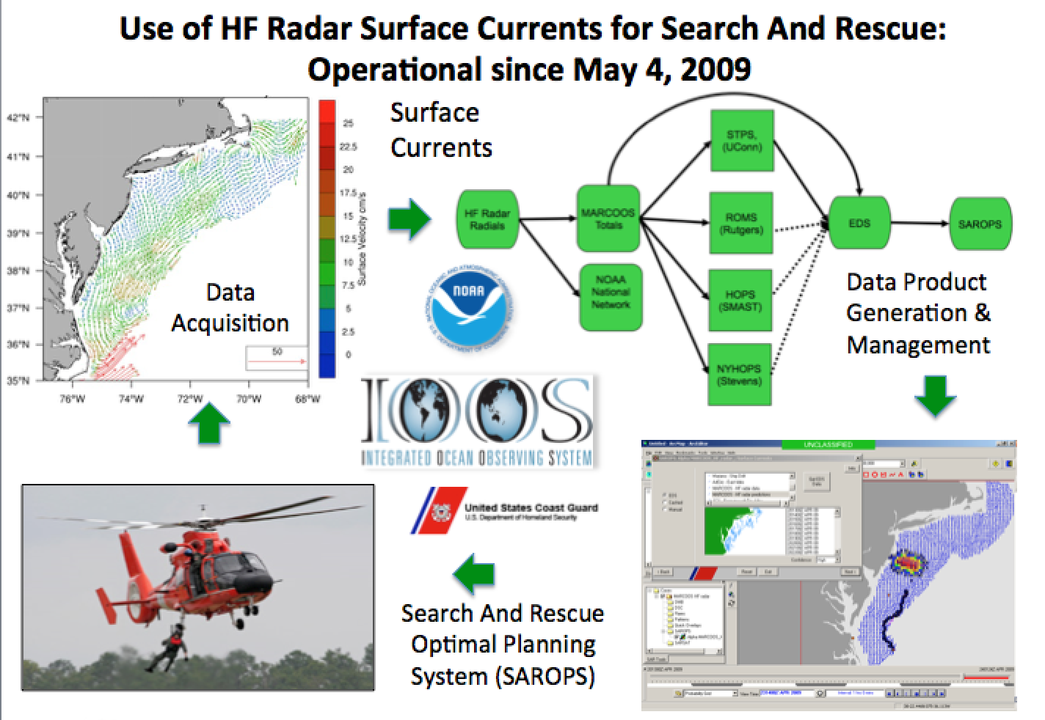
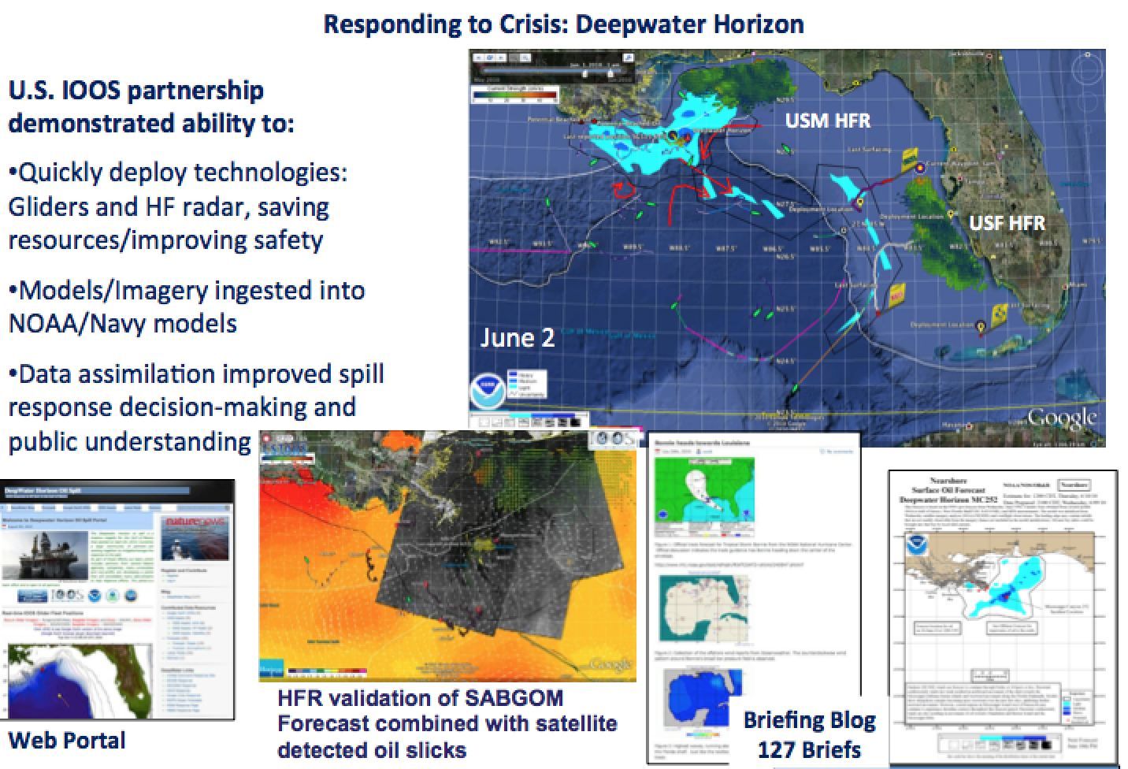
Integration Matrix
Success Stories
Theme 1: Safety at Sea HF Radar operational in USCG Search And Rescue Optimal Planning System
Theme 3: Water Quality
HF Radar network used to respond to the Gulf of Mexico Oil Spill
61 Large Marine Ecosystems

Slide 14
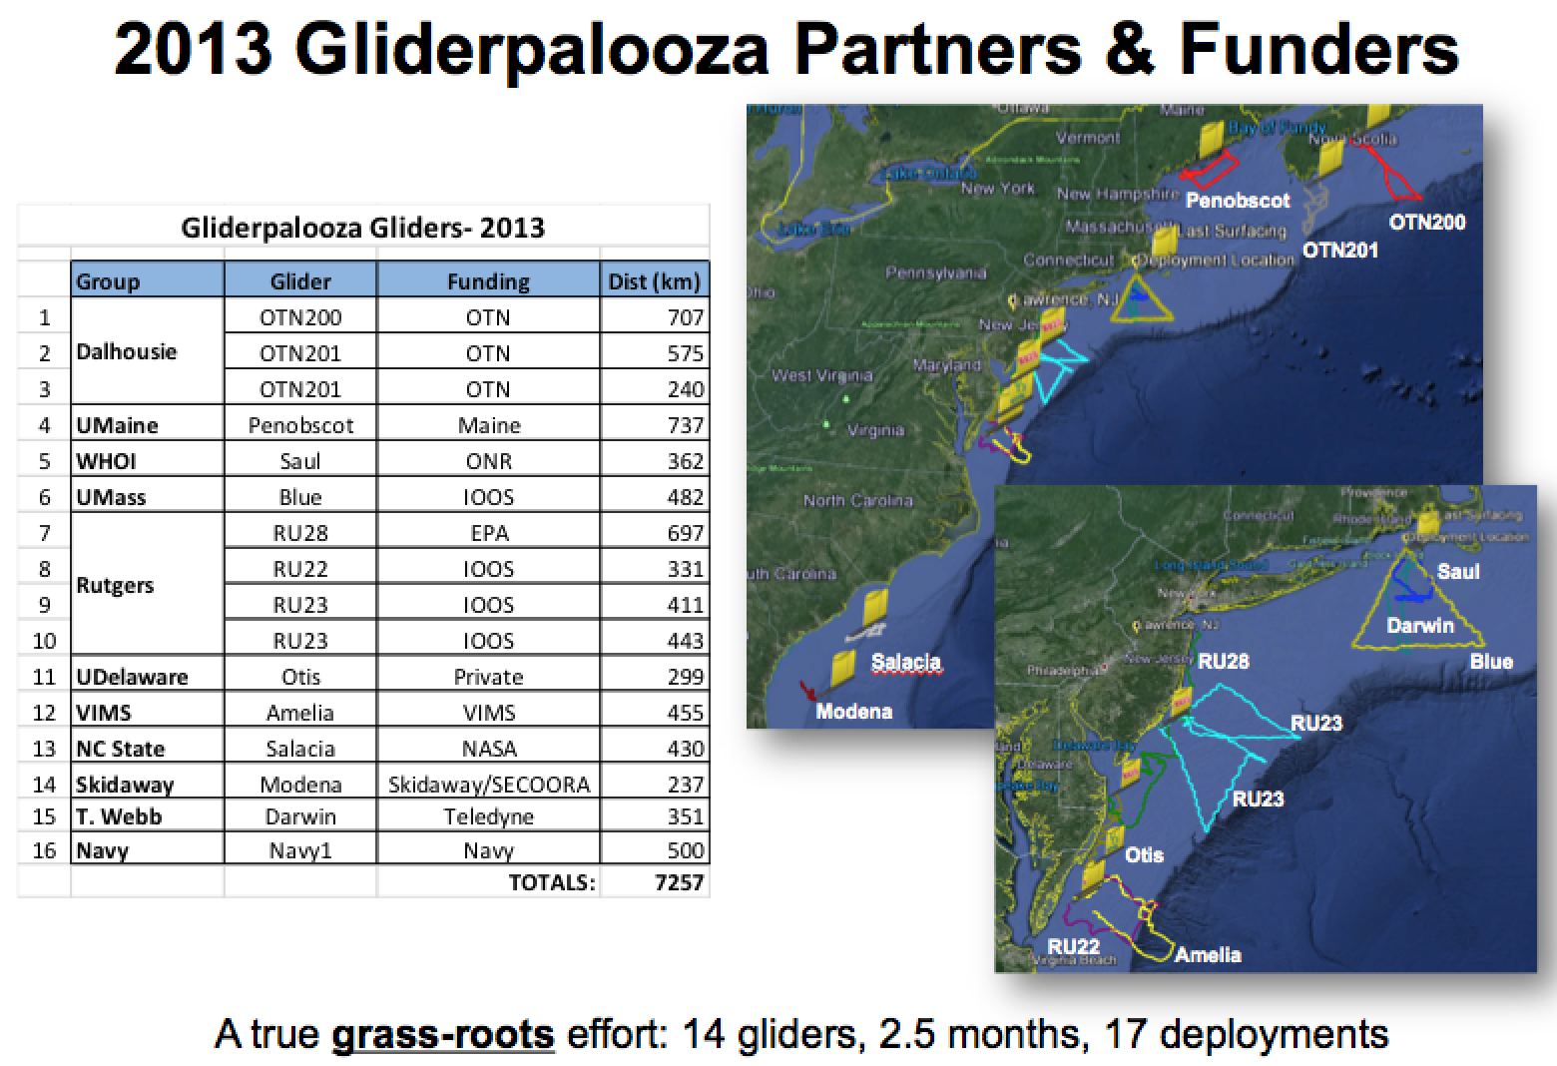
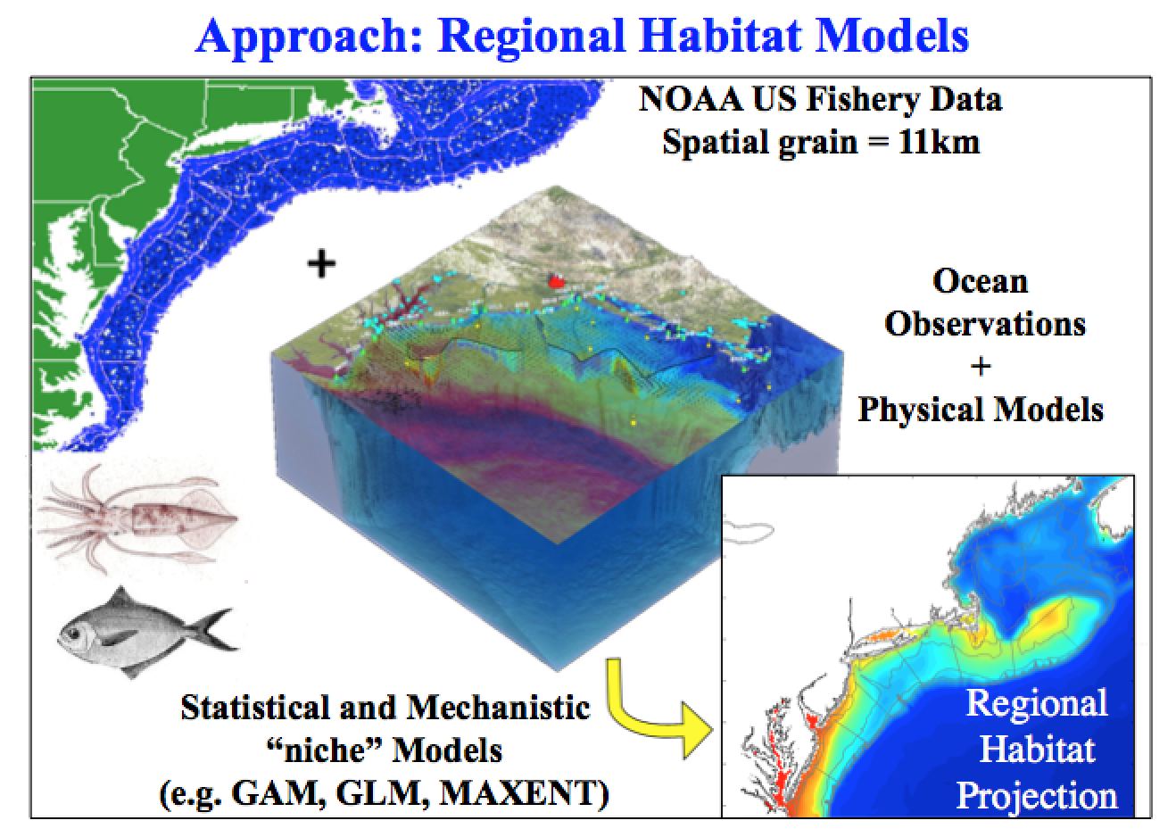
Integration Matrix
Success Stories
Theme 3: Integration
Safety at Sea HF Radar operational in USCG Search And Rescue Optimal Planning System
Theme 2: Ecological Decision Support
4D Data Assimlative Model used to create a new fishery worth $30 M annually

Slide 15
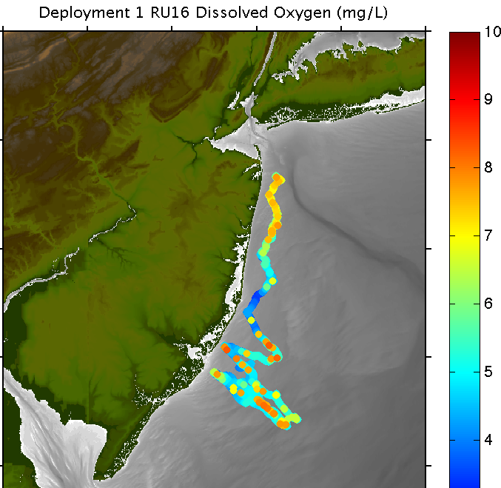
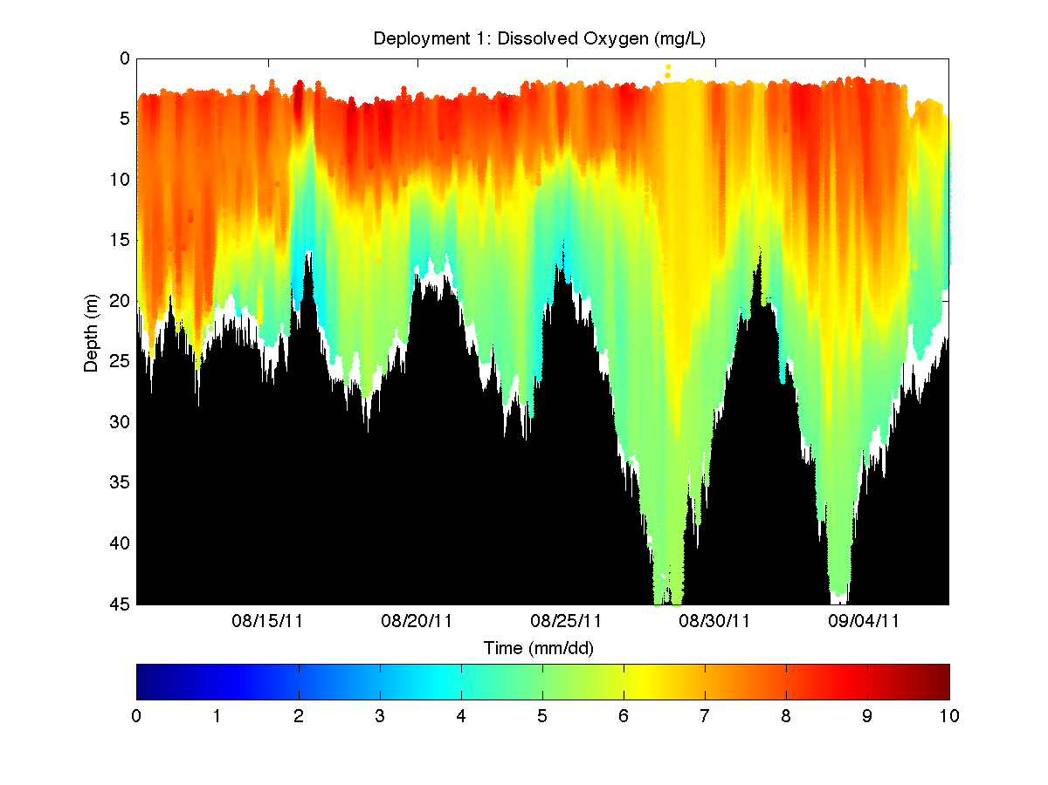

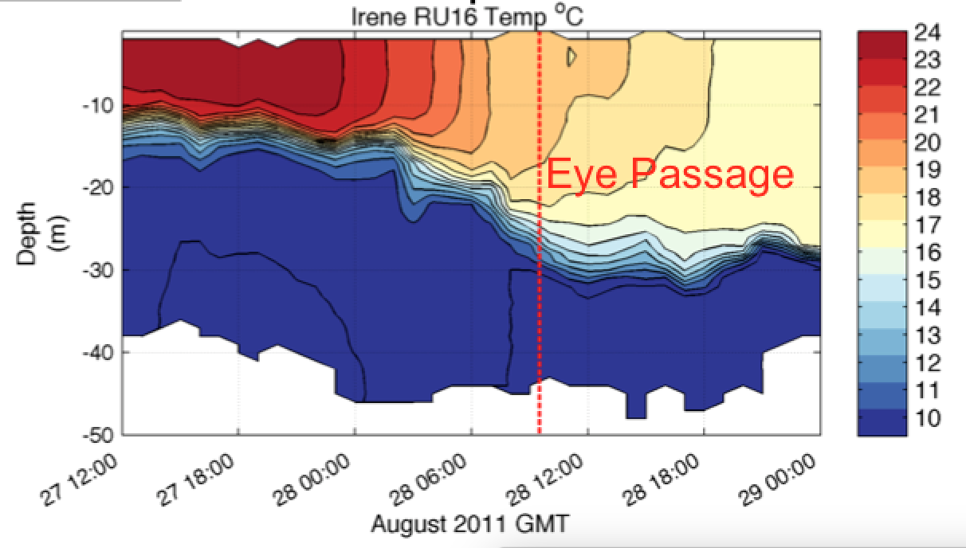
Integration Matrix
Success Stories
Theme 4: Water Quality
EPA Glider used to monitor bottom Dissolved Oxygen
Hurricane Irene Track August 26-29 2011
Theme 4: Coastal Innundation
Gliders used to discover ahead-of-eye cooling processes in Hurricane Irene

Slide 16
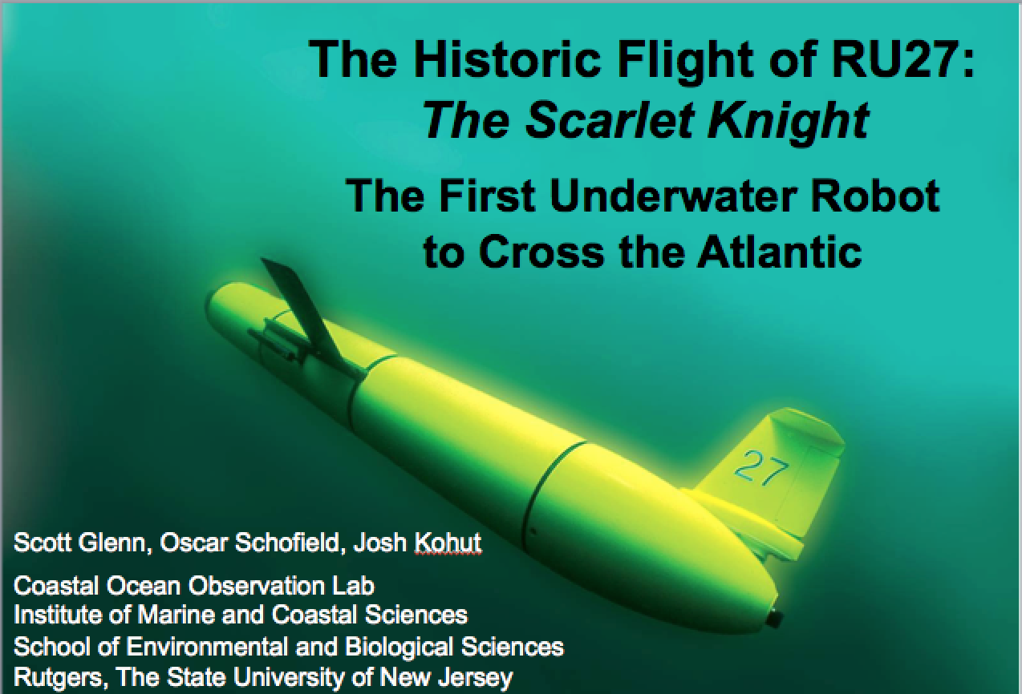
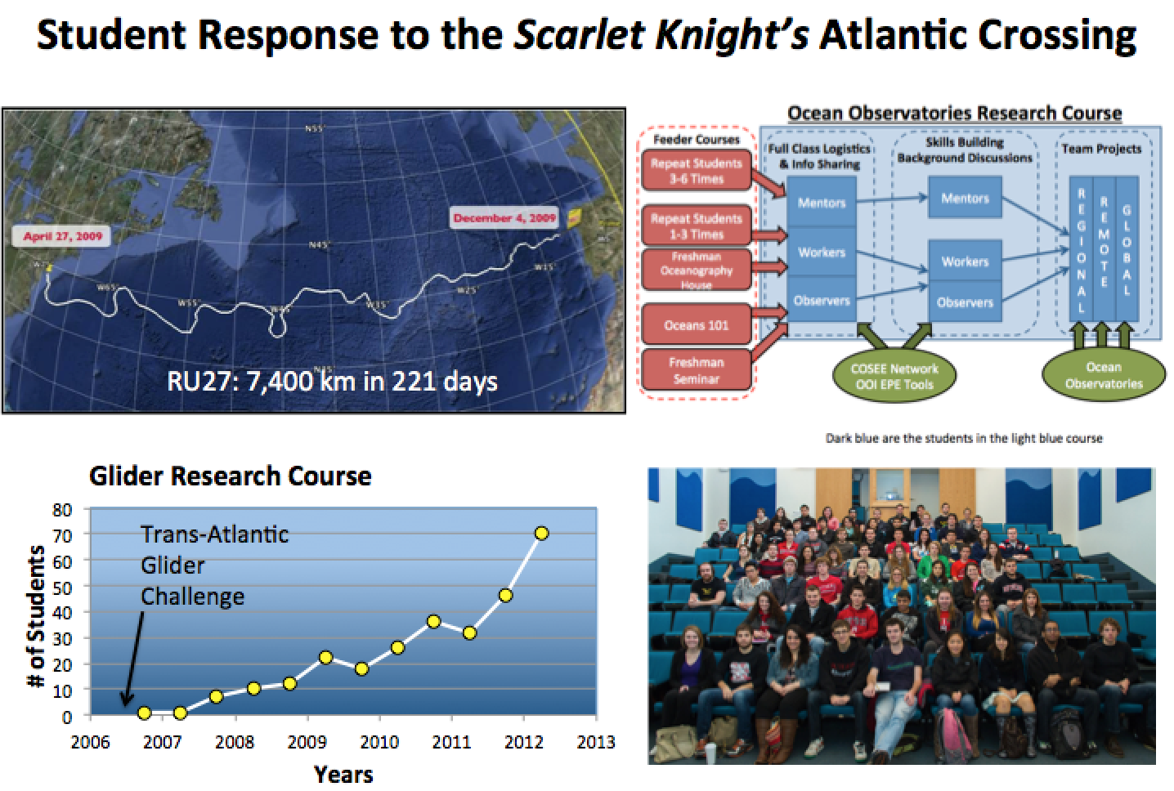

Slide 17
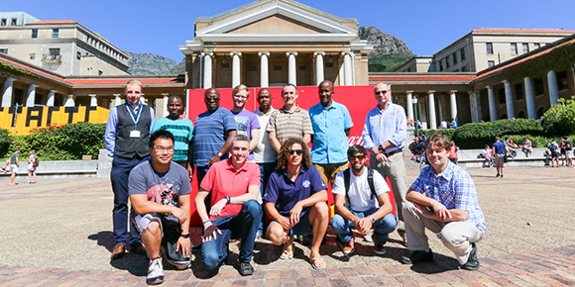
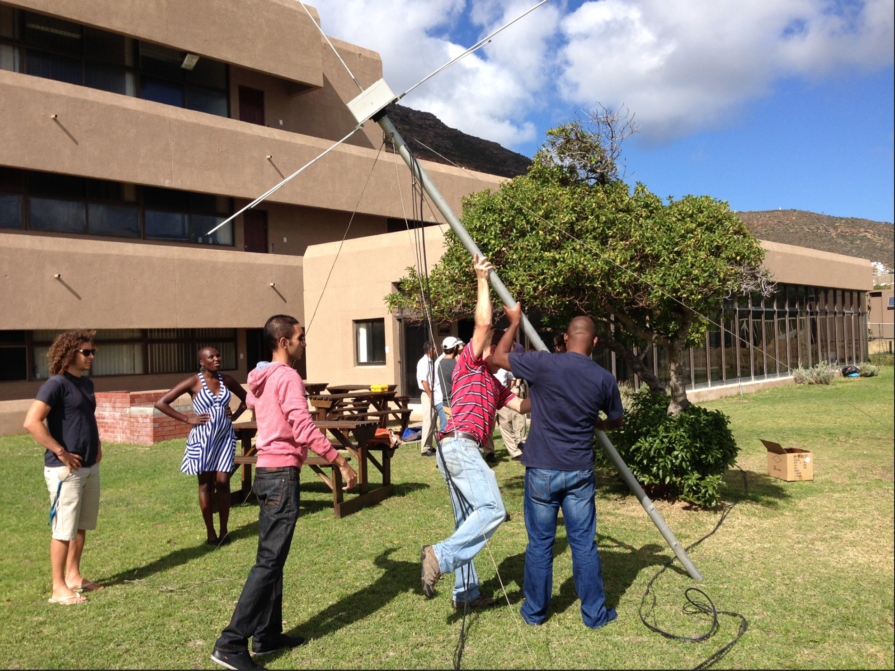
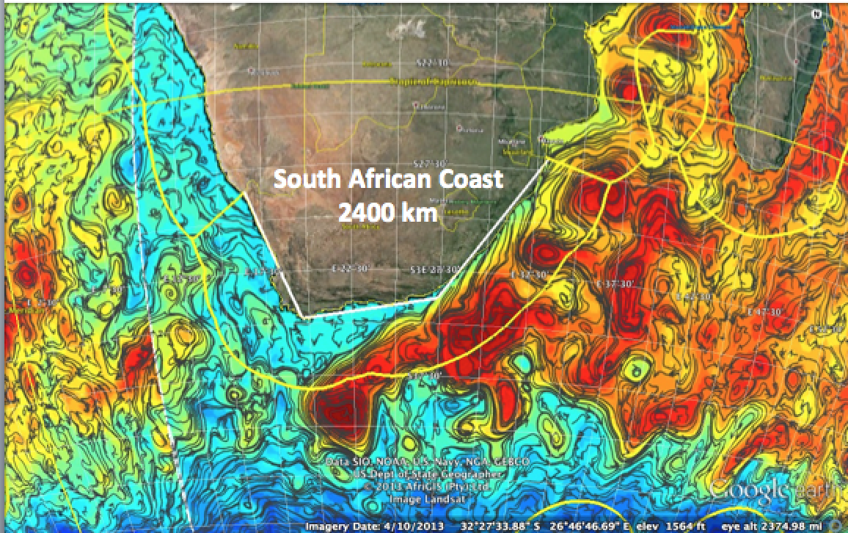
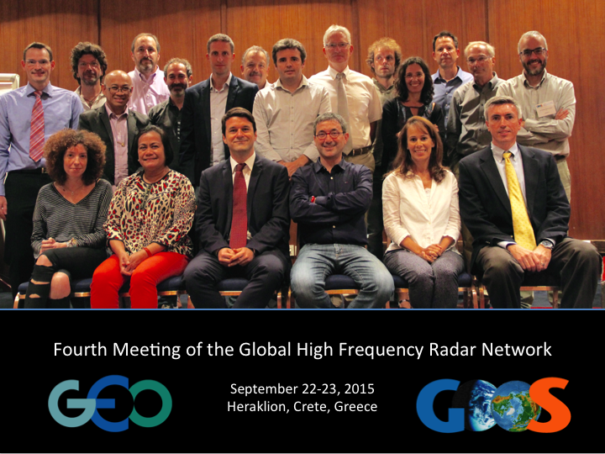

Slide 18
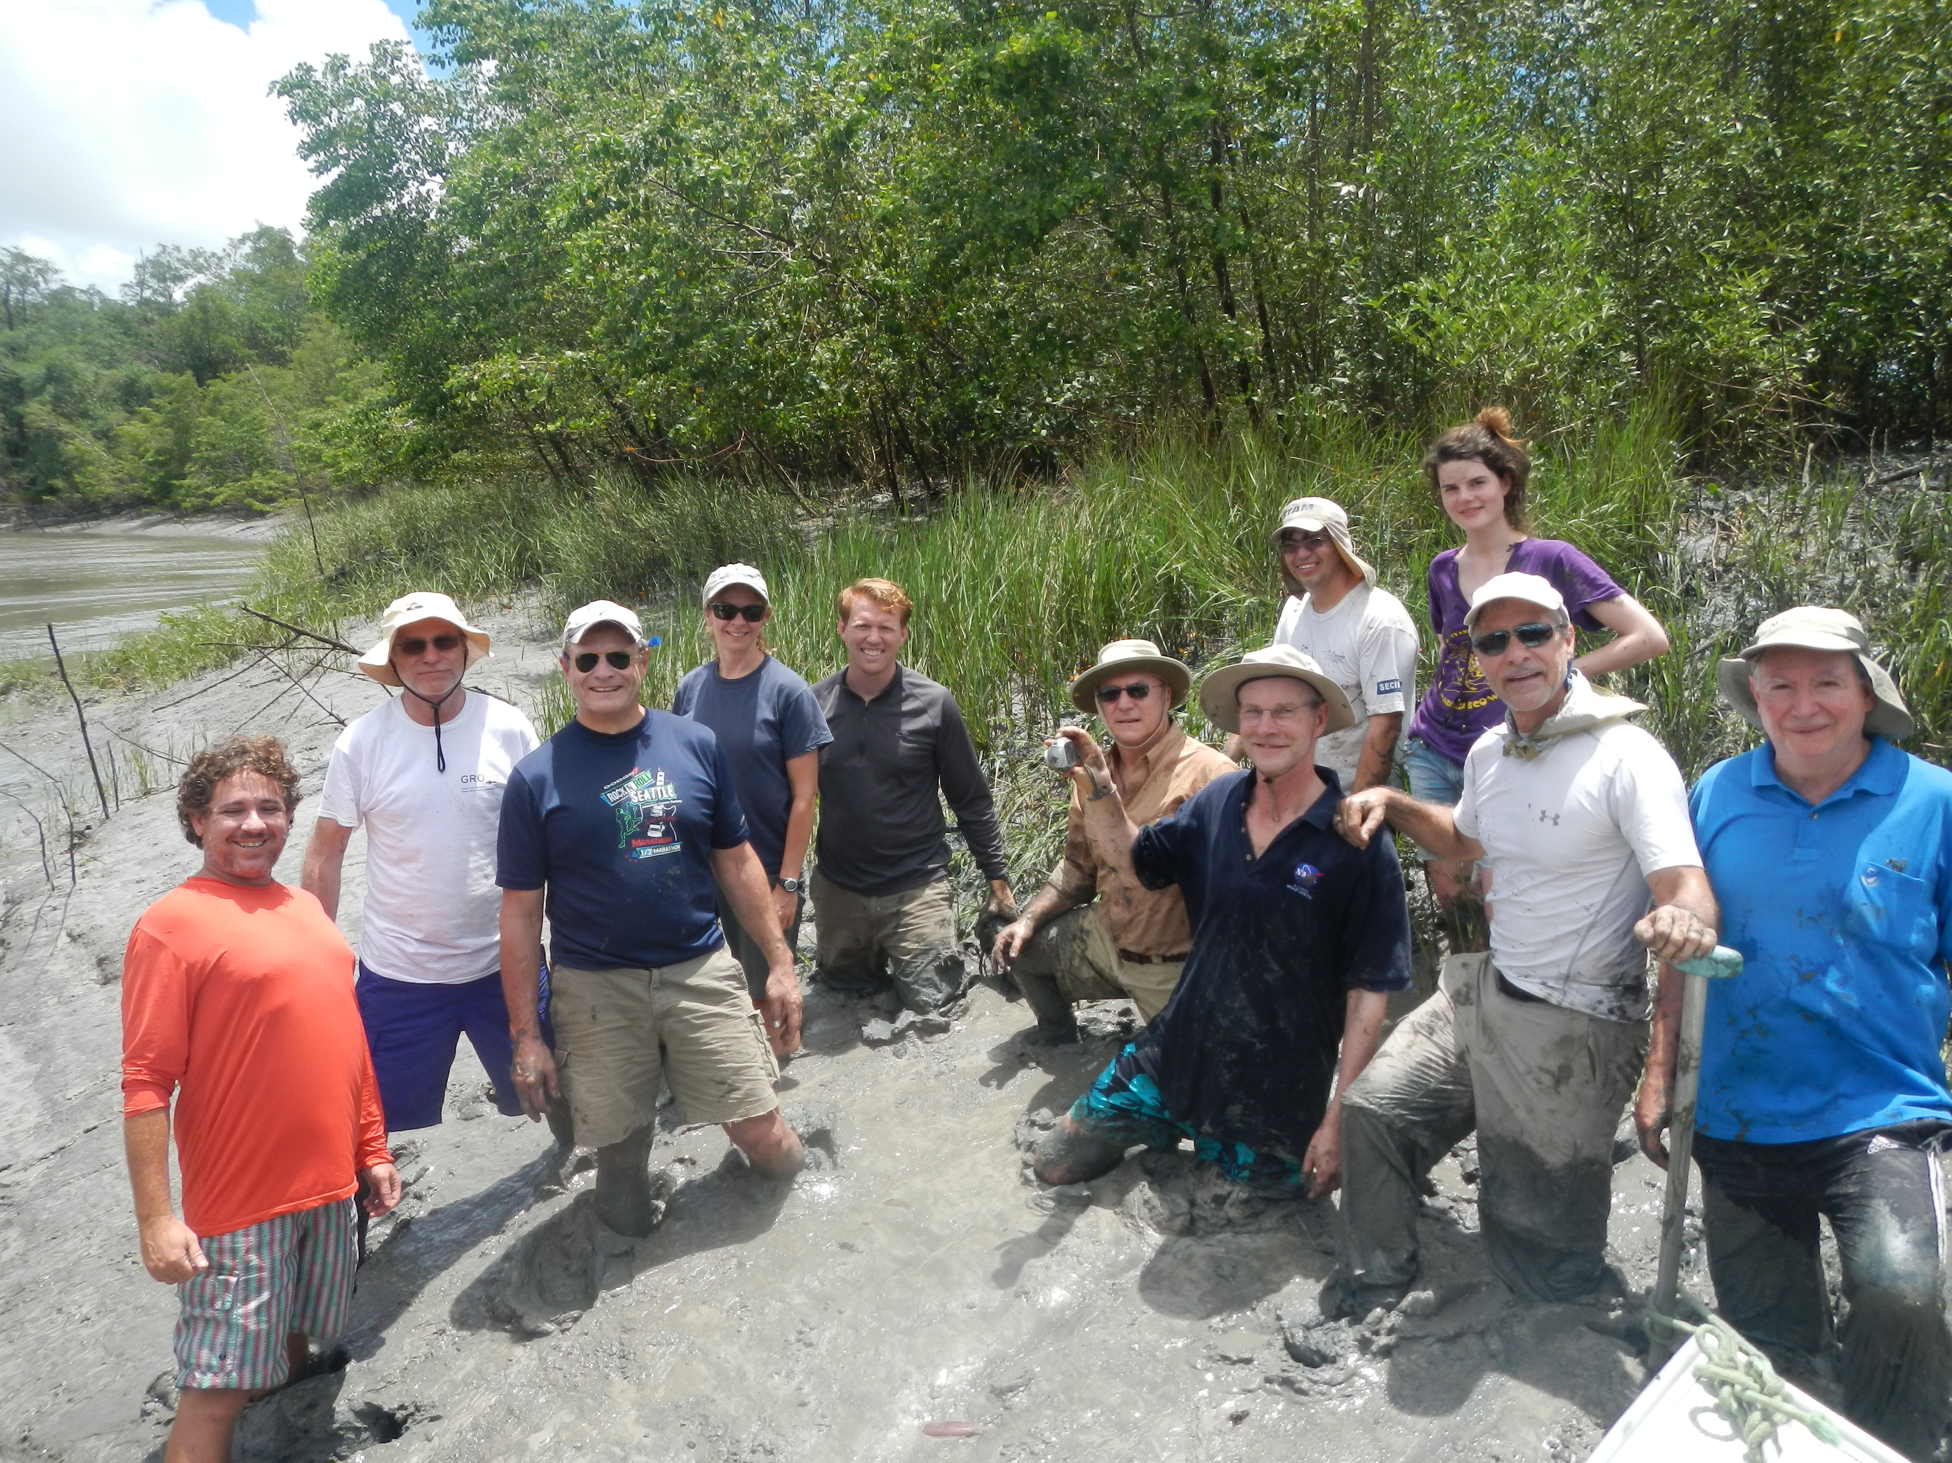
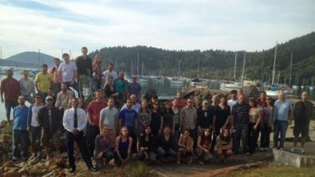
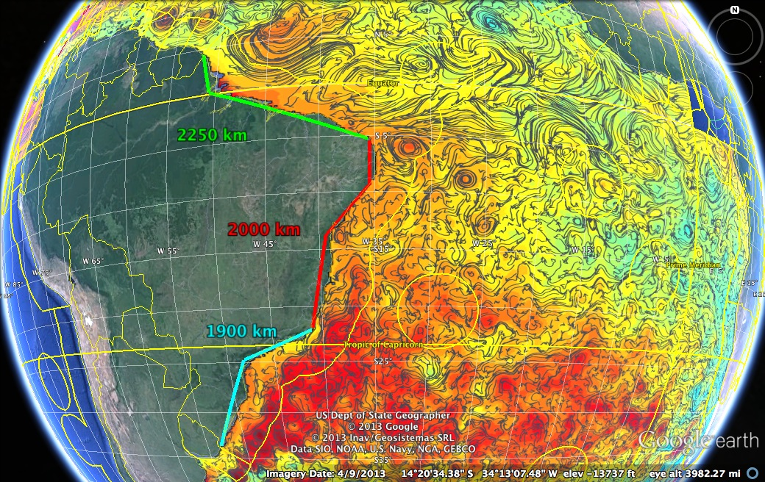


Slide 19
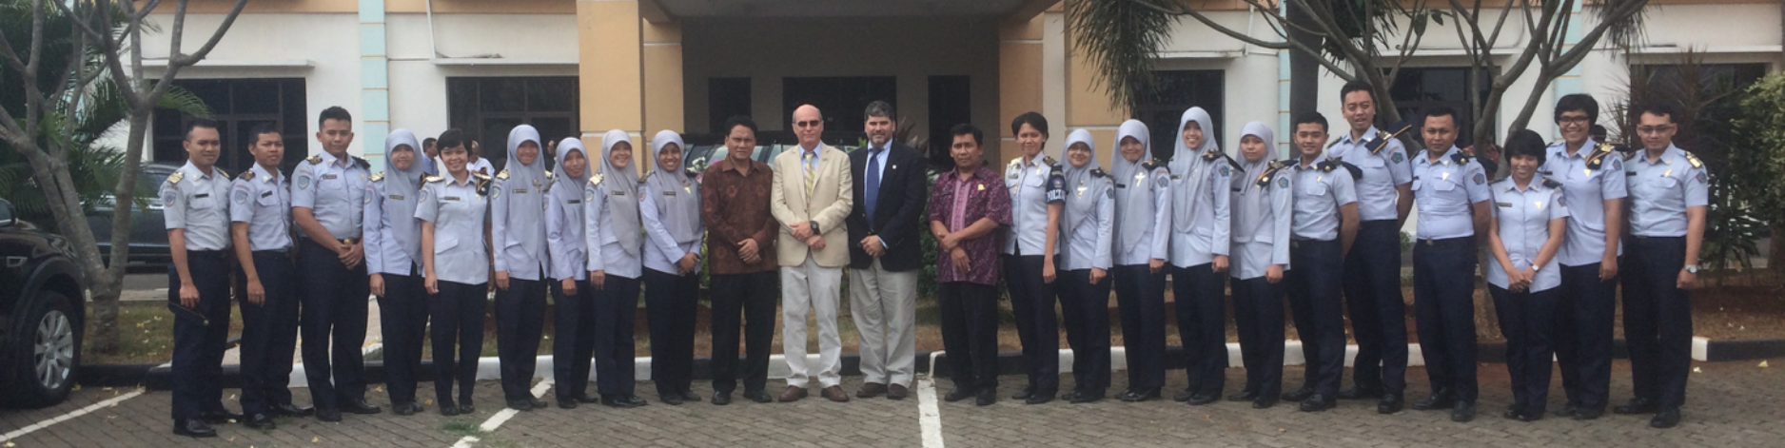



Slide 20
Conclusions:
Integrated Approach
Enabled by New Technologies
Requires Partnerships
Training is Key
CODAR HF Radar on
Mona Island, Puerto Rico

