Slide 1
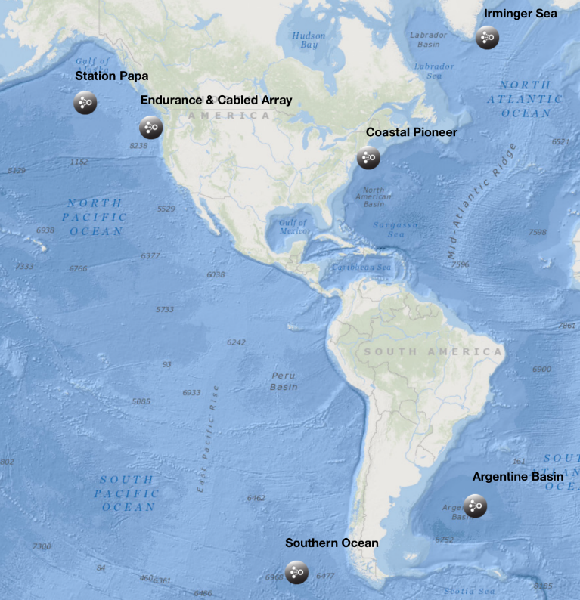
The Ocean Observatories Initiative: Data, Data and More Data
Michael F Crowley, M. Vardaro, L. Belabbassi, M. Smith, L. Garzio, F. Knuth, J. Kerfoot, S. Glenn, O. Schofield, S. Lichtenwalner..
Rutgers University, Dept. of Marine & Coastal Sciences, New Brunswick, NJ

Slide 2
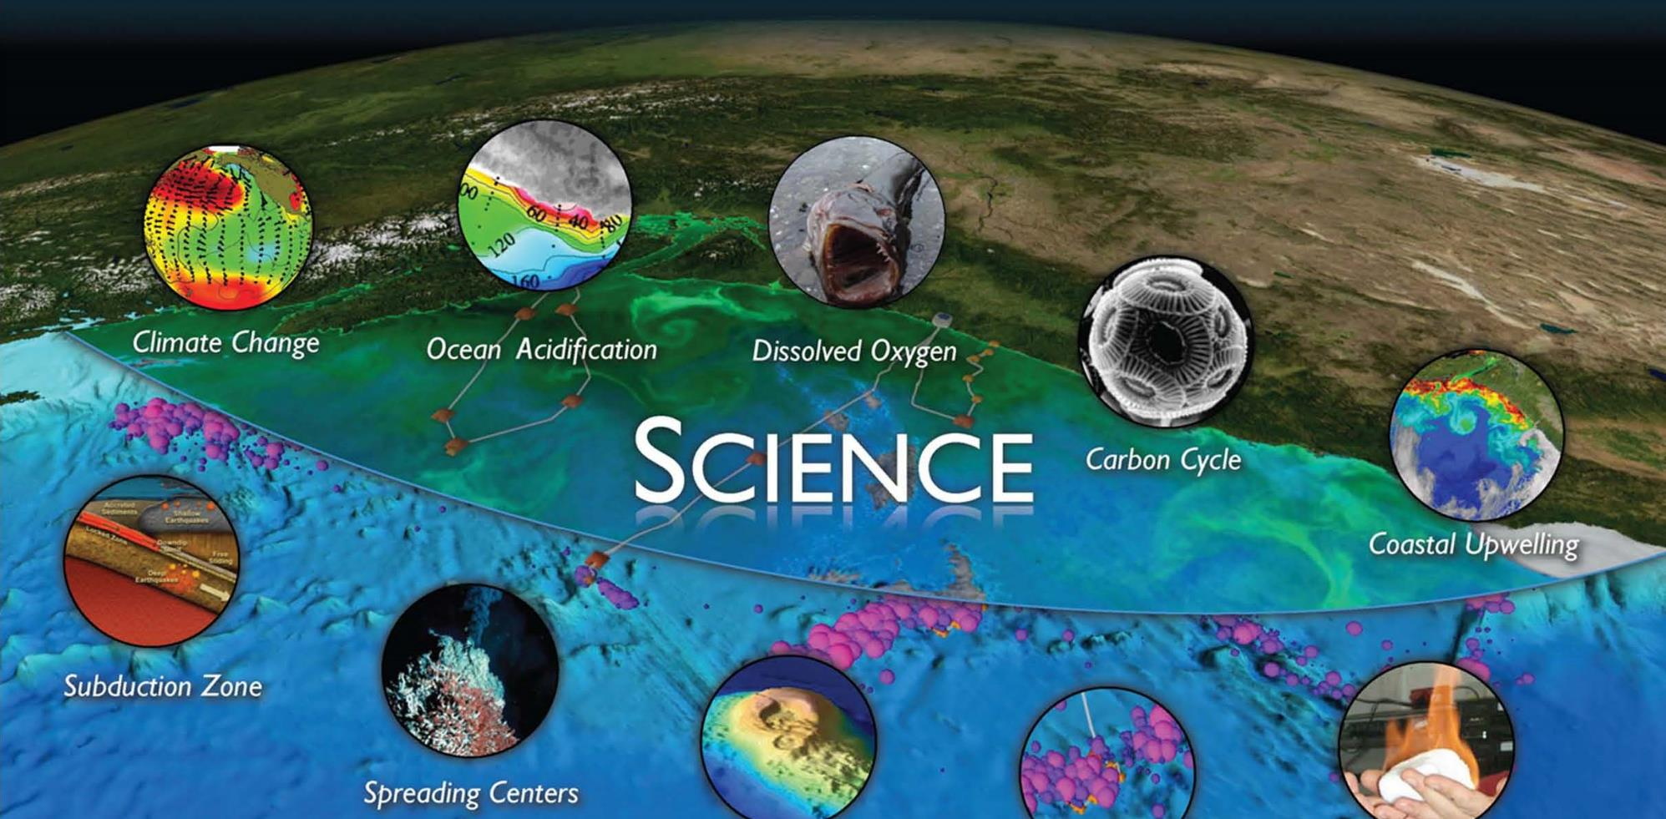
WHY?
UW CEV Graphics
Global Biogeochemistry and Carbon Cycling Ocean-Atmosphere Exchange
Ocean Circulation, Mixing and Ecosystems Climate Variability and Ecosystems
Coastal Ocean Dynamics and Ecosystems - Hypoxia on Continental Shelves
Coastal Ocean Dynamics and Ecosystems - Shelf/Slope Exchange

Slide 3
The Observatory

Slide 4
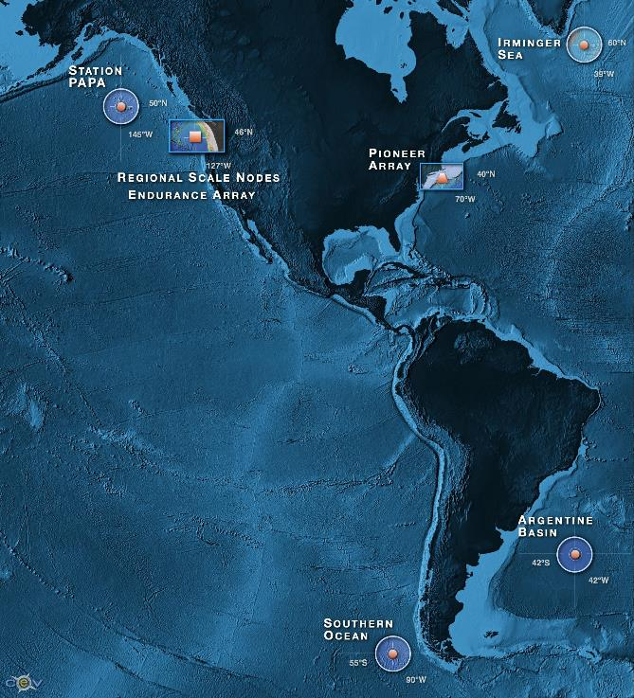
OOI By the Numbers
7
50
33
833
>2500
>100K
Arrays
4 Global, Pioneer, Endurance, Cabled
Sites
Moorings, Profilers, Nodes
Mobile Assets
Gliders, AUVs
Instruments
Science Data Products
Science/Engineering Data Products

Slide 5
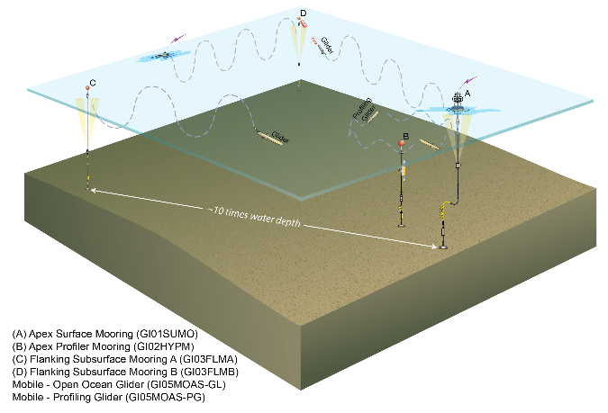
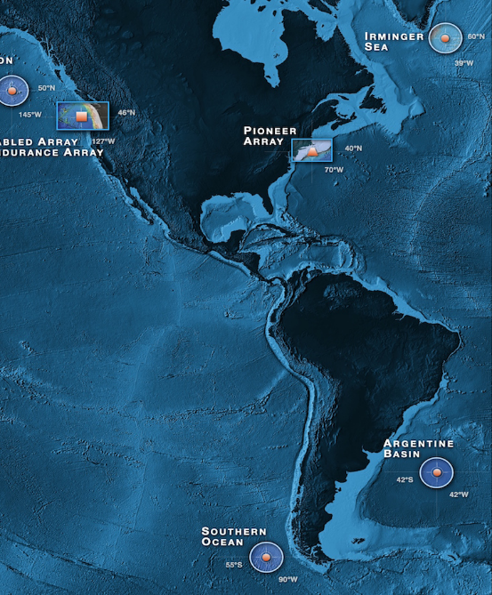
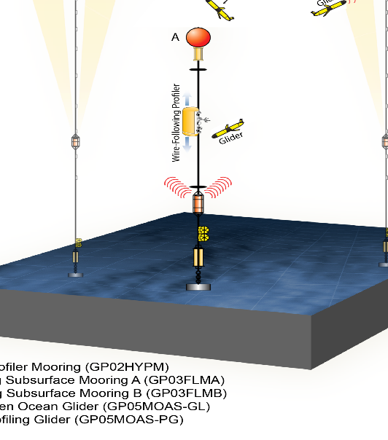
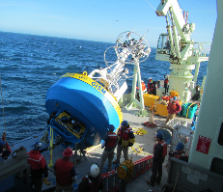
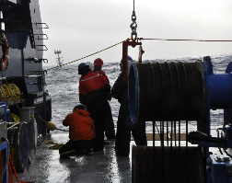
OOI Components: Global Array
Four Global Sites
Flanking Moorings
Profiler Mooring
Surface Mooring
Gliders (5)
Bio-Acoustics
Telemetered & recovered data

Slide 6
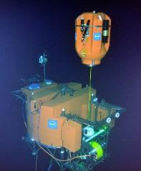
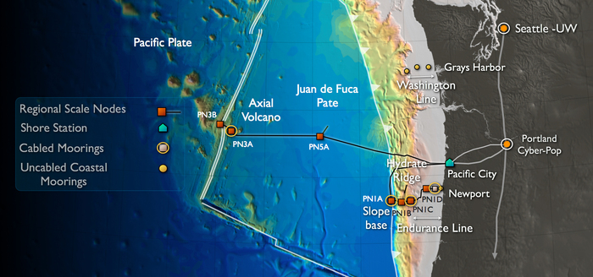
OOI Components: Cabled Array
Cable allows for high frequency sampling and quick delivery
Moorings
Profilers
HD Video
Hydrophones
Seismic

Slide 7
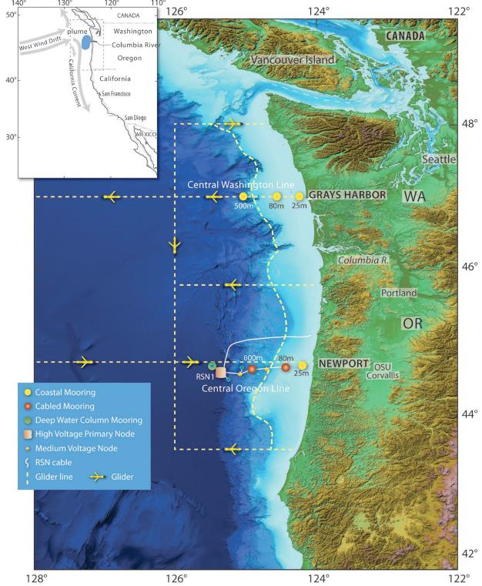
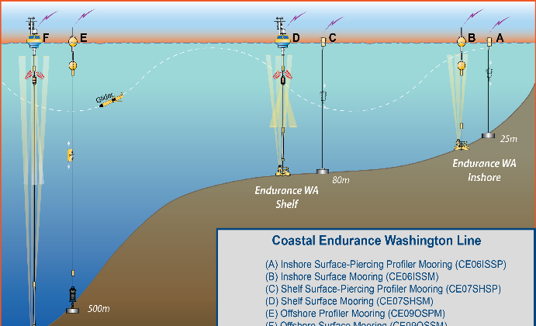
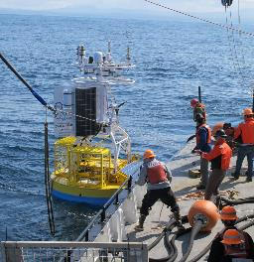
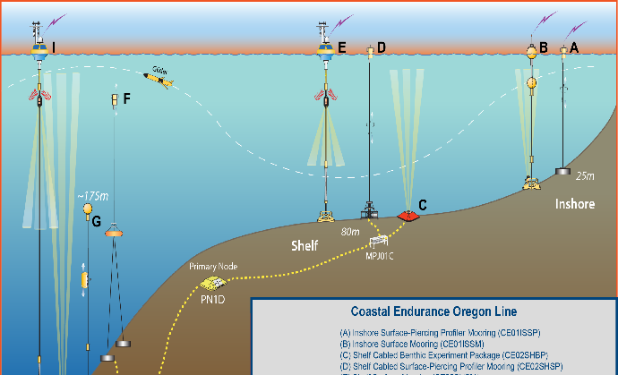
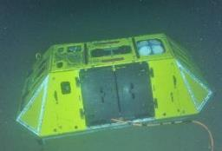
OOI Components: Endurance Array
Glider AUVs
Moorings
Profilers
Met Data
Telemetered & recovered
7

Slide 8
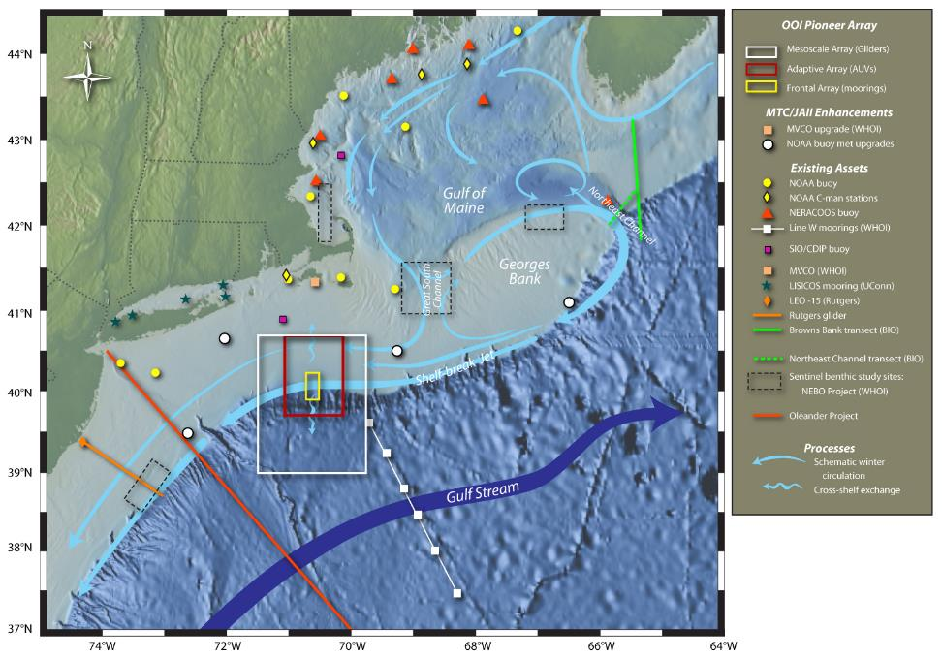
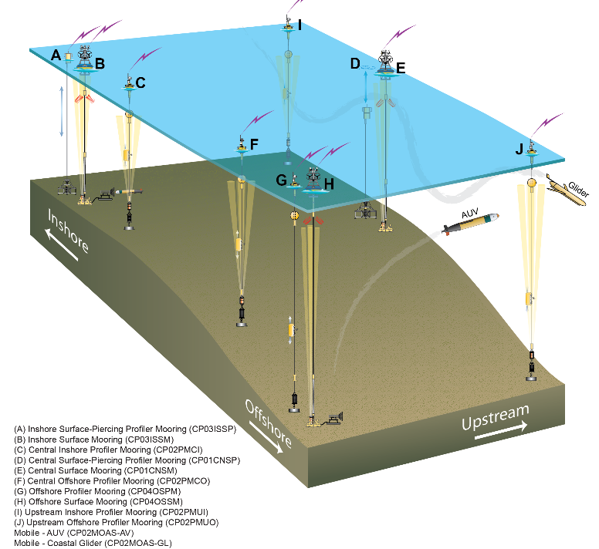
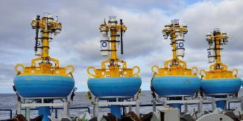
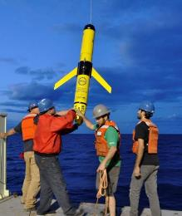
OOI Components: Pioneer Array
Glider AUVs
Moorings
Profilers
Met Data
REMUS AUV (late 2016)
Telemetered & recovered

Slide 9
Web Access:
Oceanobservatories.org
Ooinet.oceanobservatories.org
Education.oceanobservatories.org

Slide 10
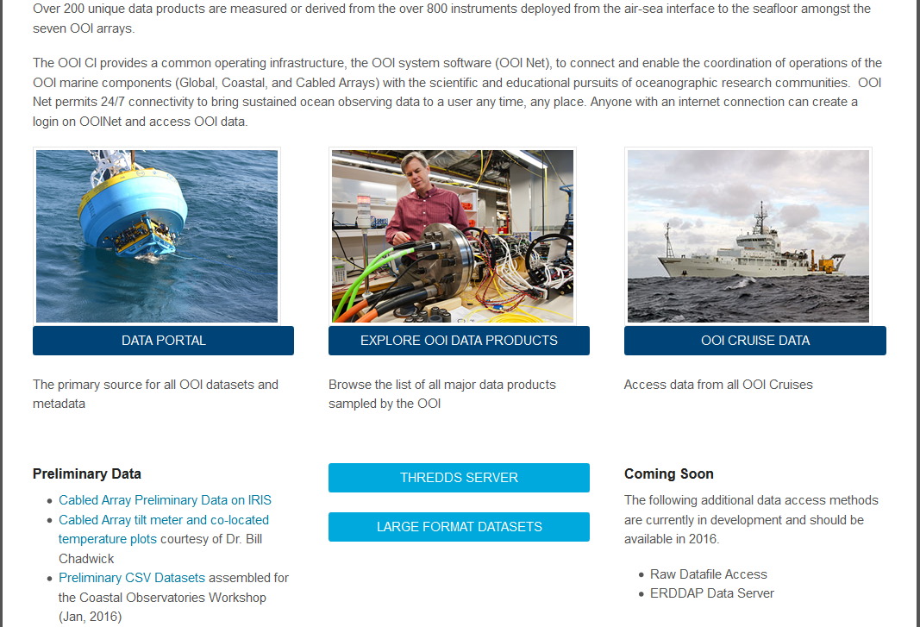
What Data Tools Exist? – oceanobservatories.org
Array & Platform Info
Instrument &Data Product Info
Stream Status
Data Portal
Asynchronous download (imminent)
THREDDS Server
Access to aggregated data products
Cruise Data
Direct Pass to community sites
ERDDAP (Spring 2016)
Raw Data (Spring 2016)
Educational tools

Slide 11
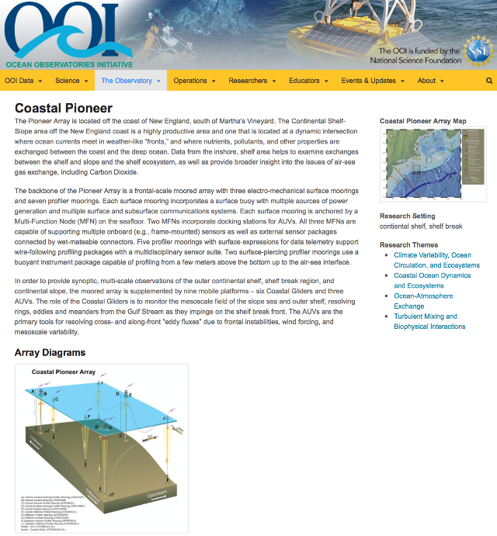
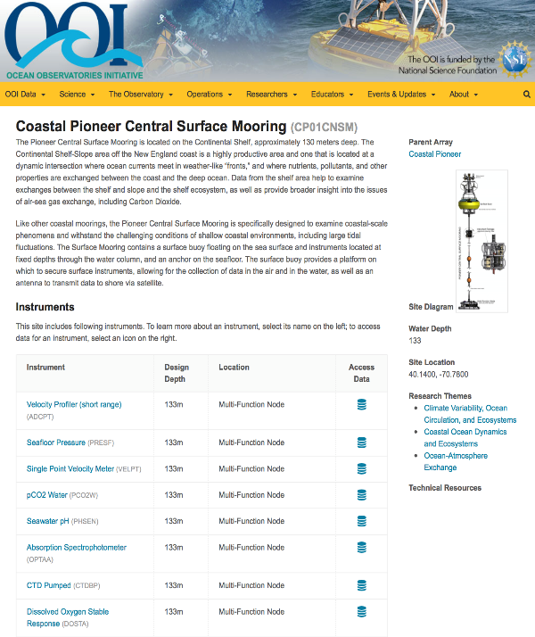
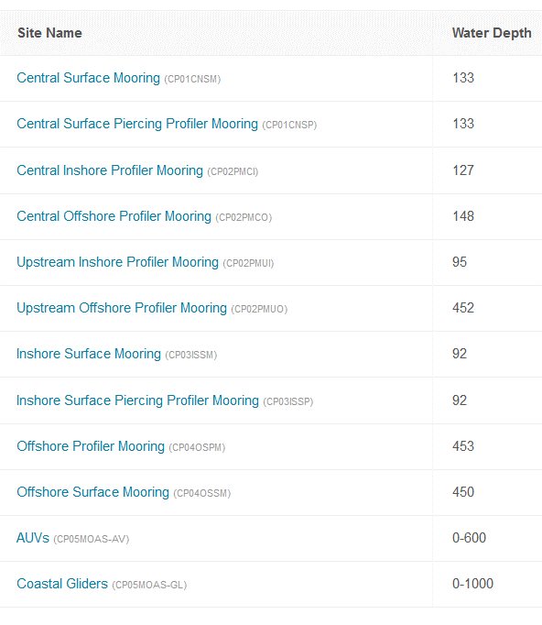
Array, Platform & Instrument Info…
Array
Platforms
Instruments

Slide 12
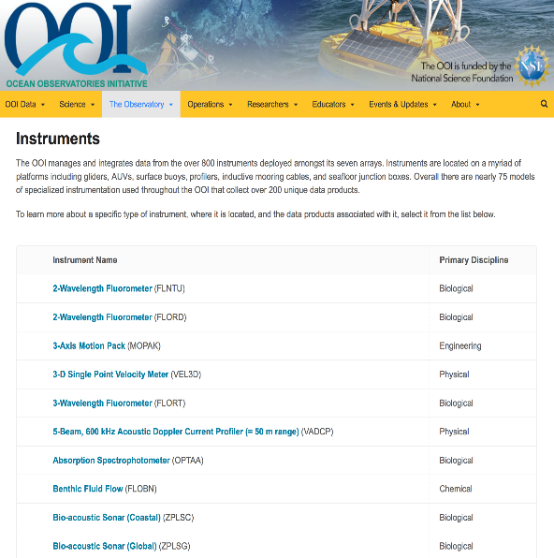
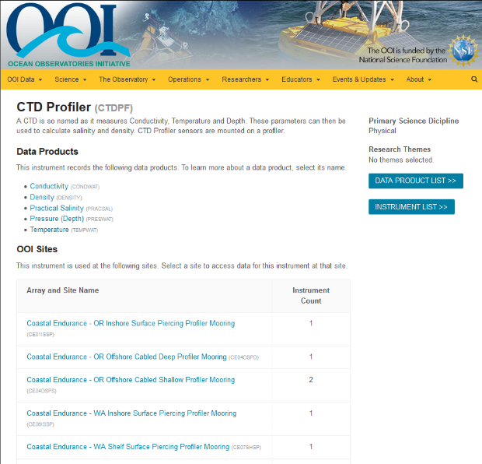
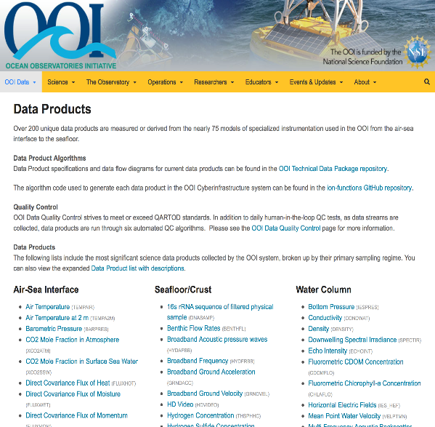
….Instruments & Data Products
Instruments Description Data Products

Slide 13
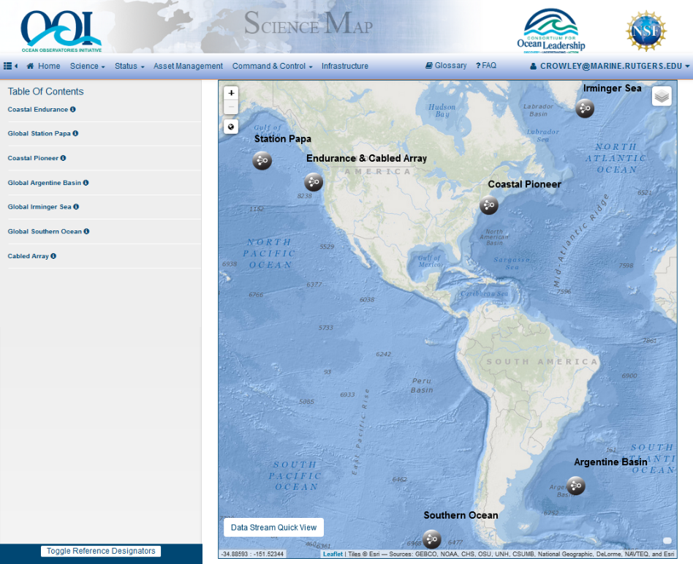
Data Portal: ooinet.oceanobservatories.org
Data Plotting
Annotation of data
QA/QC
Calendars of deployments
Asynchronous download (imminent)

Slide 14
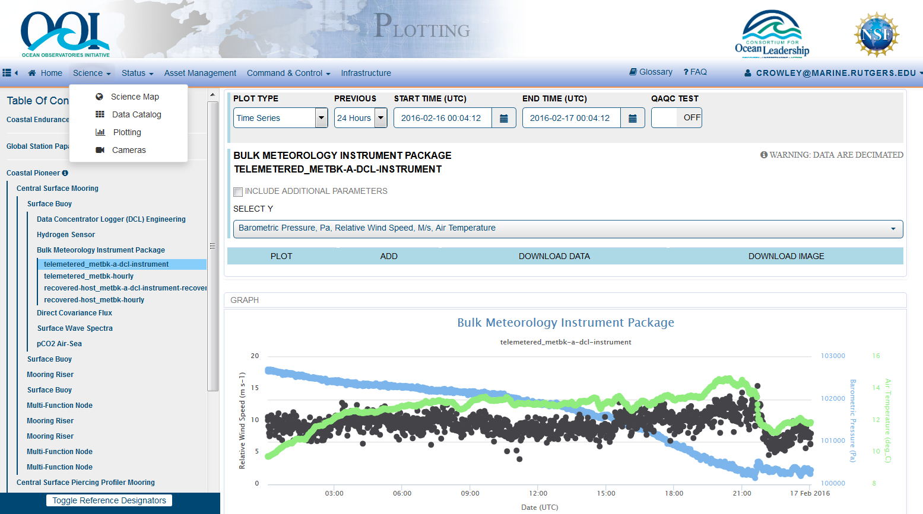
Data Plotting
Plots: Time series, T/S, profiles, quiver, rose, 3D colored
Data soon available through web services for automatic download
Event information as well

Slide 15
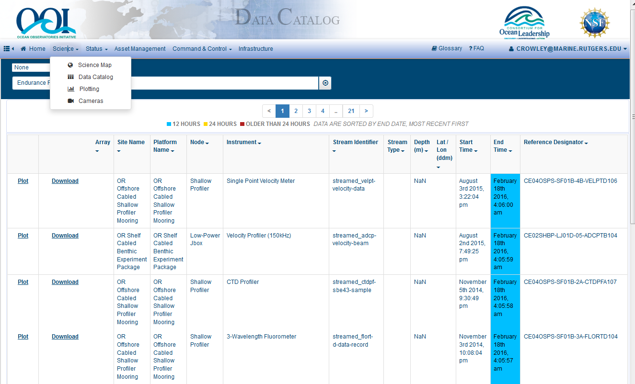
Data Catalog: Asynchronous Download
Available very soon
Searchable by array, platform, instrument, data product, etc.
Data request populates a web based directory for download
Users are informed via email
NetCDF, JSON & CSV
Large data format (eg. Cameras & hydrophones) available now!

Slide 16
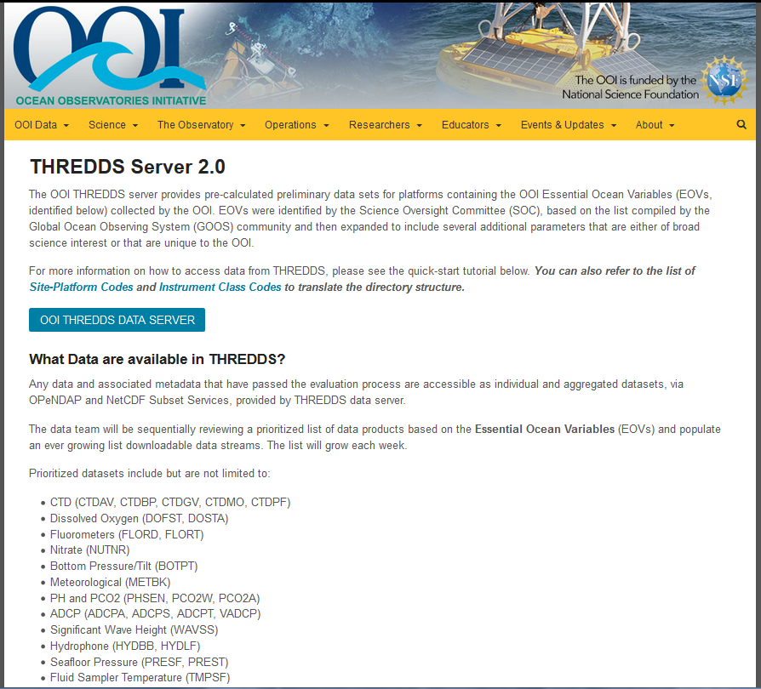
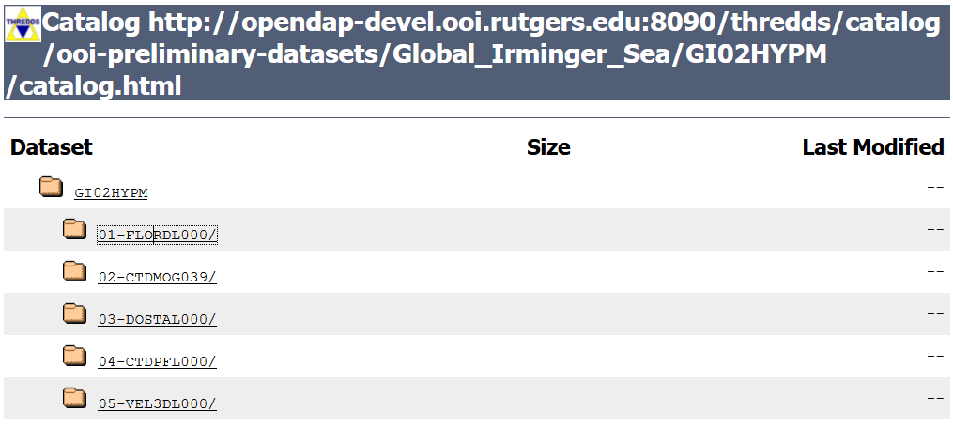
THREDDS Data Access
Currently a reasonability check is performed
Tutorial of how to use THREDDS included

Slide 17
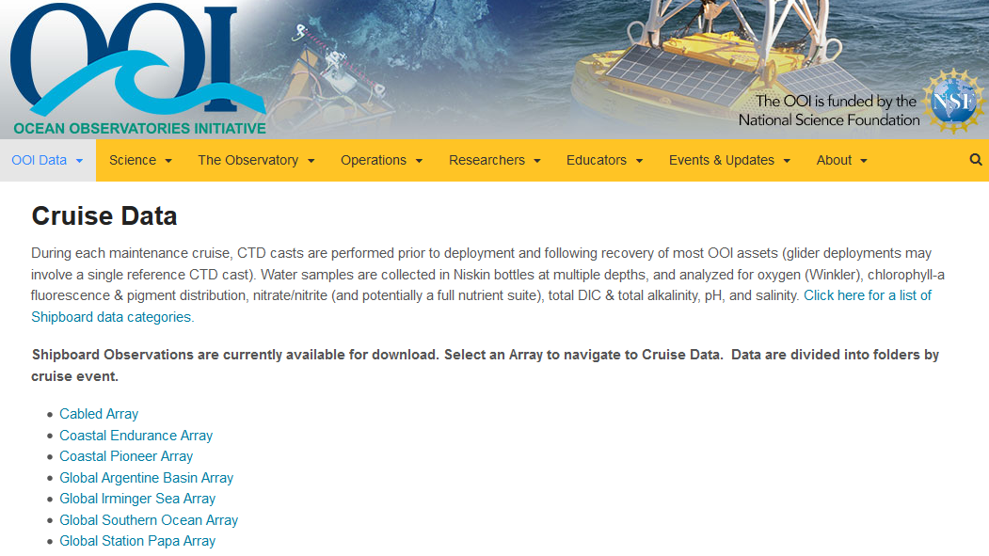
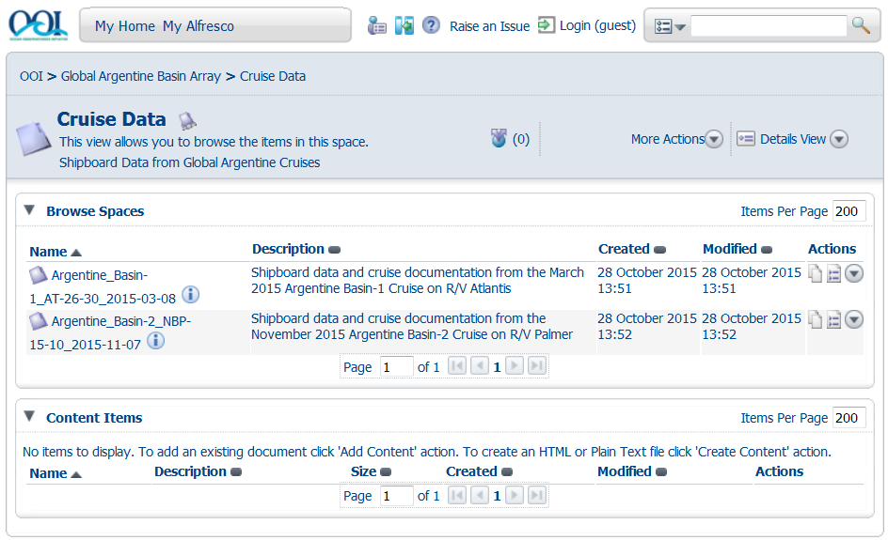
Cruise Data
Still populating cruise data

Slide 18
External Data Sources
Example: IRIS

Slide 19
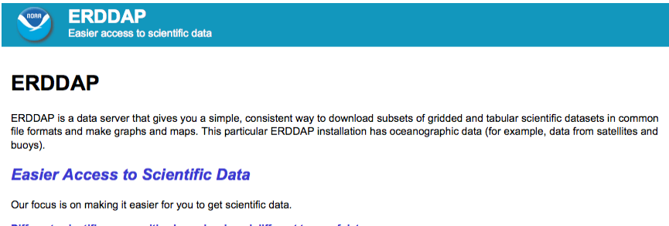
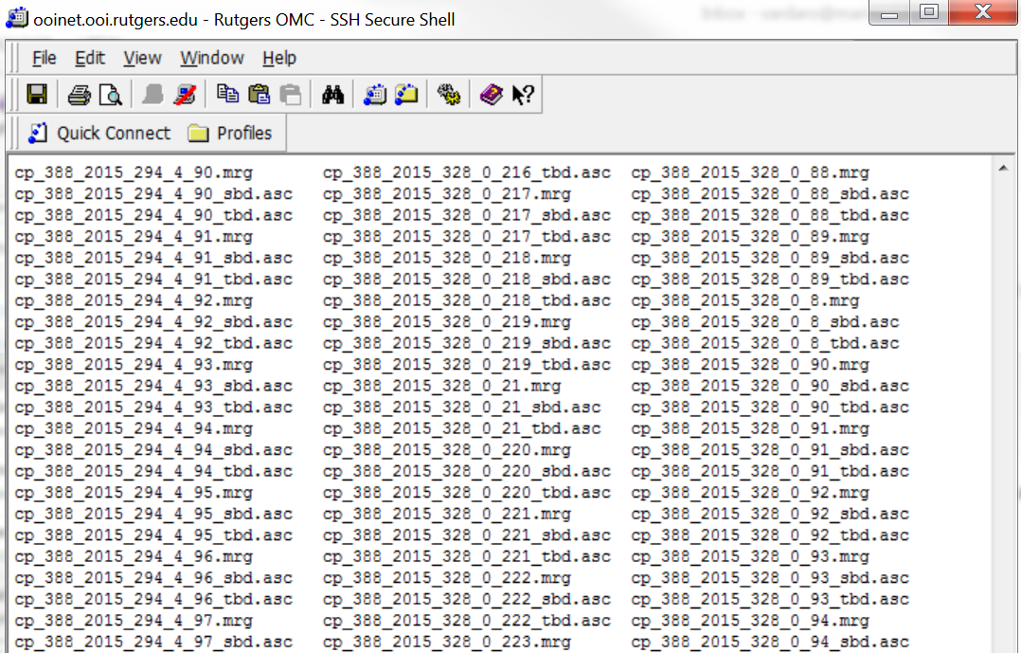
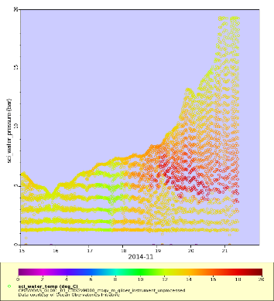
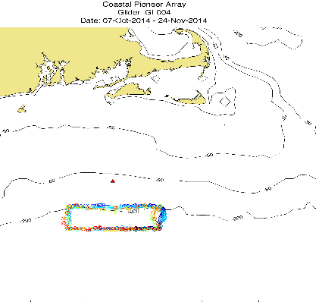
ERDDAP & Raw Data: Spring 2016
Searchable by date, location, type and downloadable in multiple formats
Raw Data: Example using gliders

Slide 20
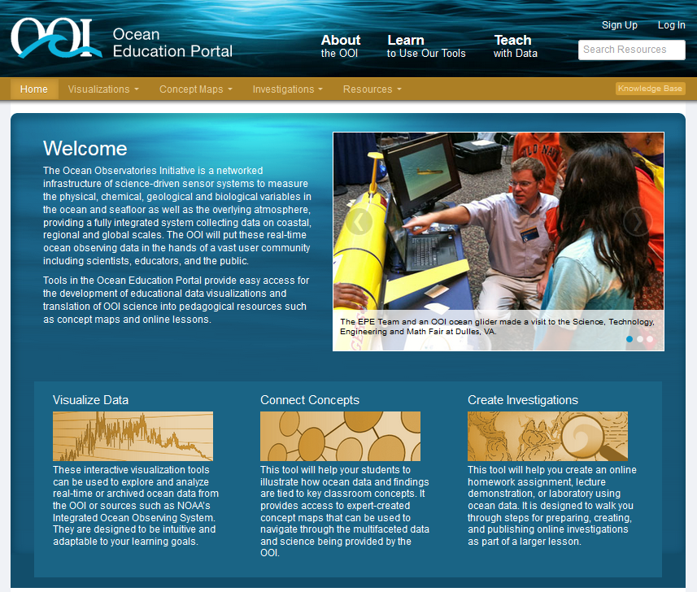
Education Web Site Education and Public Engagement (EPE) Team Education.oceanobservatories.org Enable professors to build focused, easily understood science lessons using OOI data and share them with the community

Slide 21
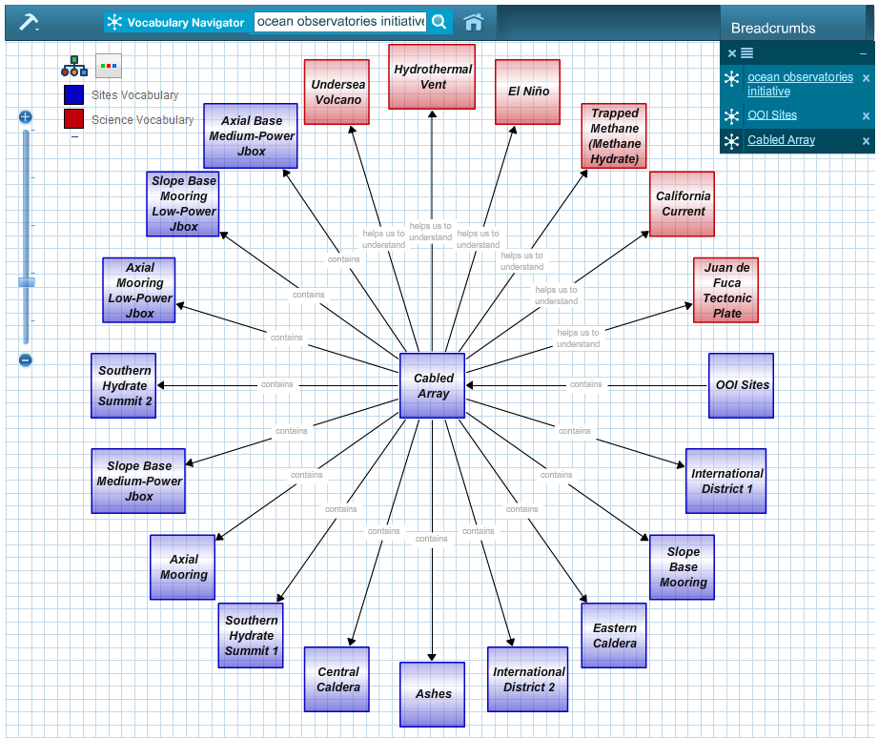
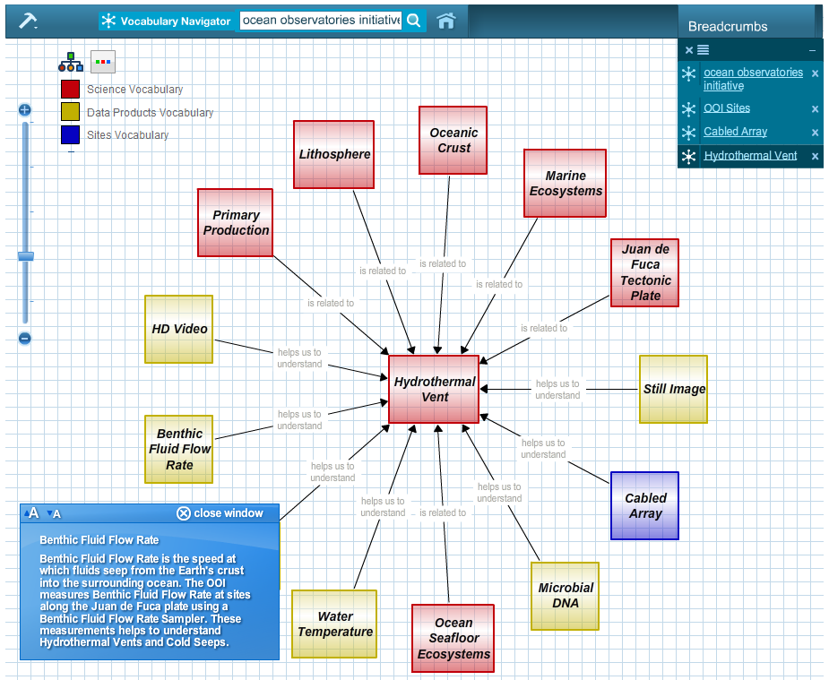
Concept Mapper: OOI Vocabulary Navigator
Concept Map Builder (create & edit) and Viewer
Concept & linking phrase suggestions (ontologies)
Embedded content resources such as descriptions, data visualizations, photos & videos from OOI & outside resources

Slide 22
HELP!

Slide 23
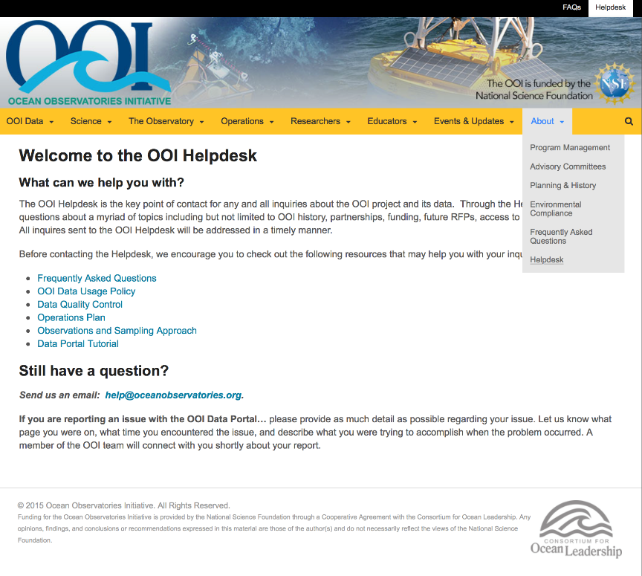
Help Desk
Questions about data, data access, and instrumentation:
help@oceanobservatories.org
All inquiries are tracked in a ticketing system

Slide 24
OOI at Oceans 2016
Presentations: Mike Vardaro coming up in 30 mins
Posters Today at 4pm
OD14A-2394 - The Ocean Observatories Initiative: Data Access and Visualization via the Graphical User Interface, Lori Garzio
OD14A-2397 - The Ocean Observatories Initiative: Unprecedented access to real-time data streaming from the Cabled Array through OOI Cyberinfrastructure, Friedrich Knuth
OD14A-2396 - The Ocean Observatories Initiative: Data Acquisition Functions and Its Built-In Automated Python Modules, Mike Smith
OD14A-2399 The Ocean Observatories Initiative: Data pre-Processing: Diagnostic Tools to Prepare Data for QA/QC Processing, Leila Belabbassi
Poster Thursday 4pm
ED44B-1728: The OOI Ocean Education Portal: Enabling the Development of Online Data Investigations, Sage Lichtenwalner
TOWN HALL TOMORROW AT 12:45pm - Rooms 220-221

Slide 25
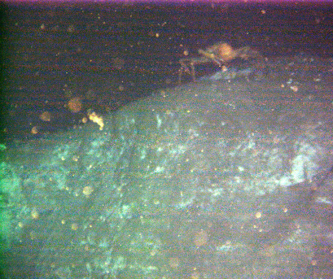
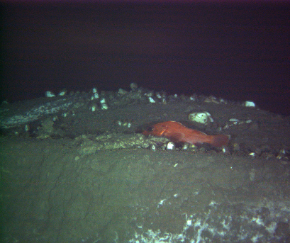
See you this week
OOI Main Web site: http://oceanobservatories.org
Data Portal: http://ooinet.oceanobservatories.org
Mike Crowley, PM, OOI CI Data Team
crowley@Rutgers.edu
Acknowledgements: NSF, COL, Rutgers U., U. Washington, WHOI, Oregon State U., Applied Science Assoc., Raytheon, U. Maine, Scripps,

