Slide 1
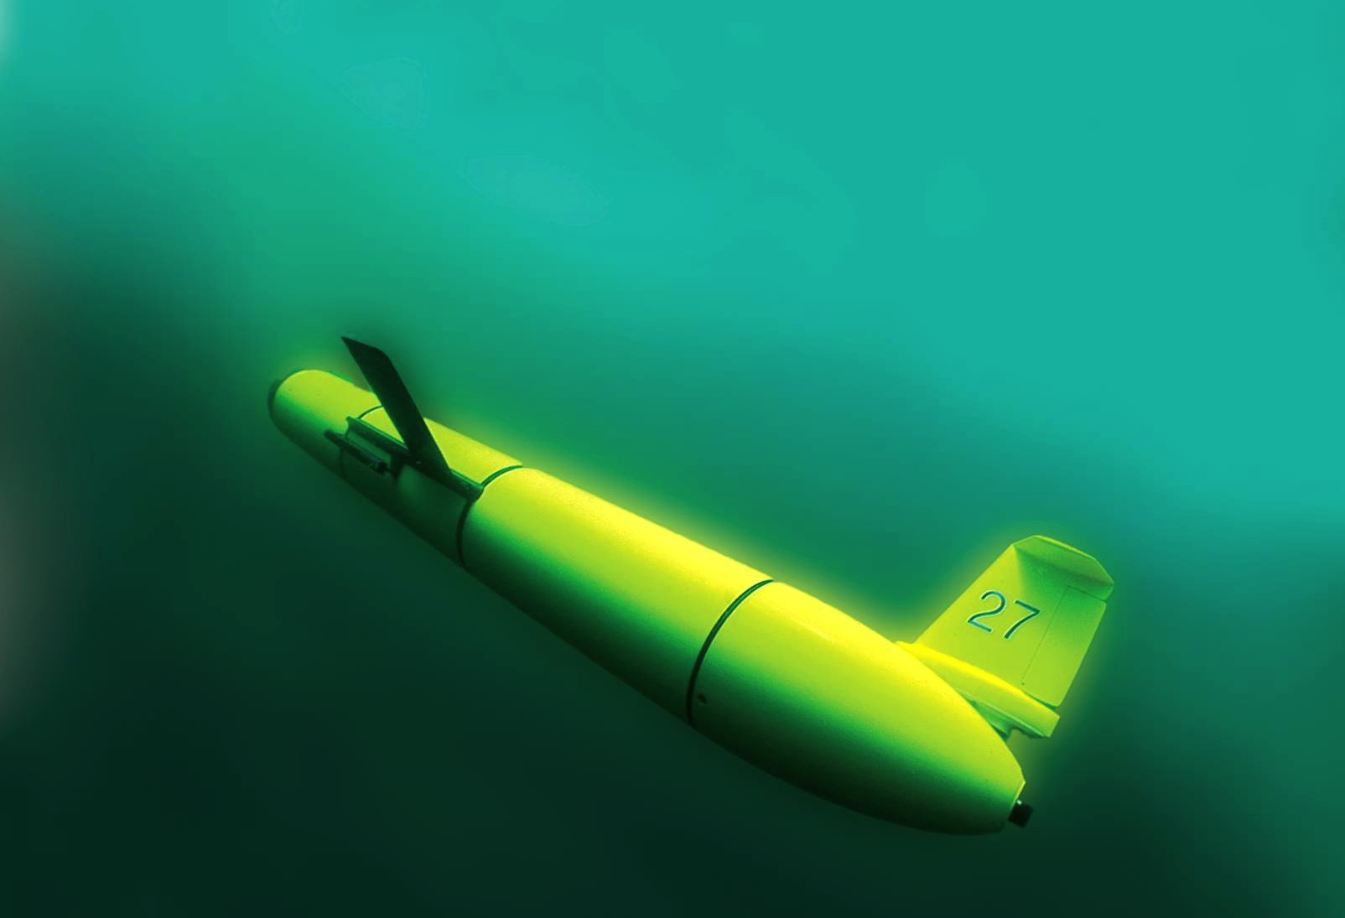
RU COOL’s scalable focus on immersing society in the ocean through observing systems
Oscar Schofield,
Scott Glenn,
Josh Kohut &
Janice McDonnell
Rutgers University
“The Ocean is Our Classroom”

Slide 2
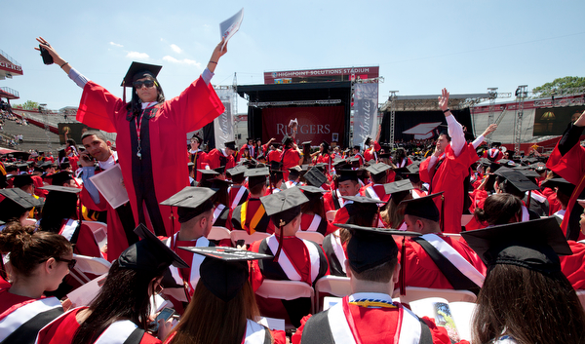
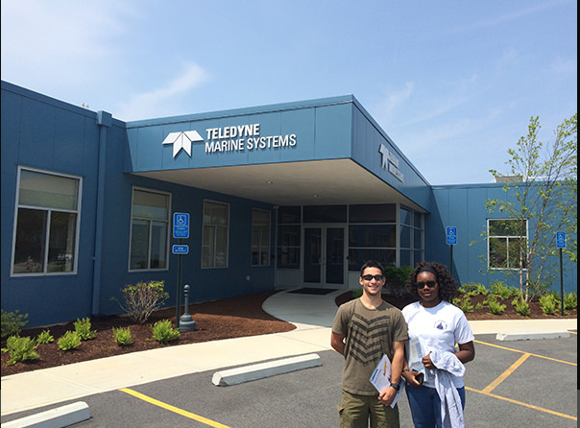
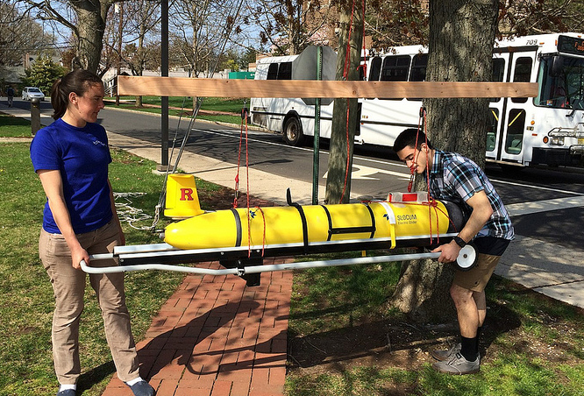
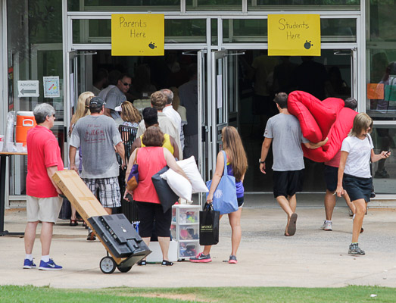
LOOKING AT A TYPICAL MARINE SCIENCE MAJOR
Seniors (focused on completion)
Earth Systems, PO, CO, BO ….
Advanced courses
Research in Lab
Marine Dynamics, Oceanographic Methods and Data Analysis
Core Courses (Theory)
Choose a major
Grad School
(MS or PhD)
English, Inorganic Chem, Calculus, Intro Oceanography ….
Intro Courses, Requirements across the ivory towers
Freshmen (maybe focused)

Slide 3
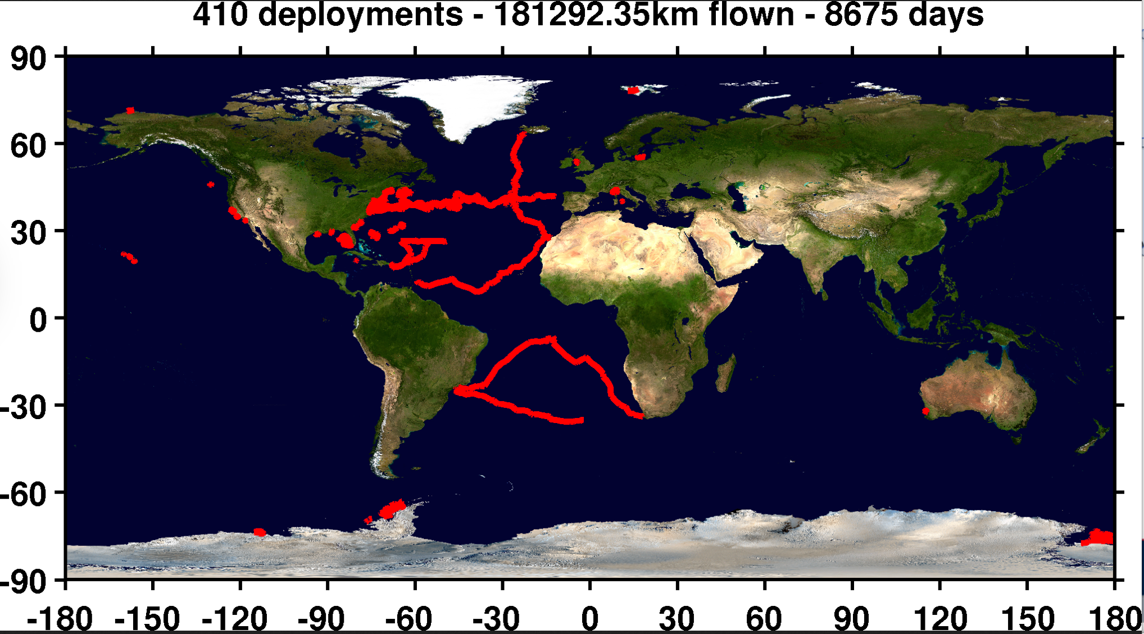
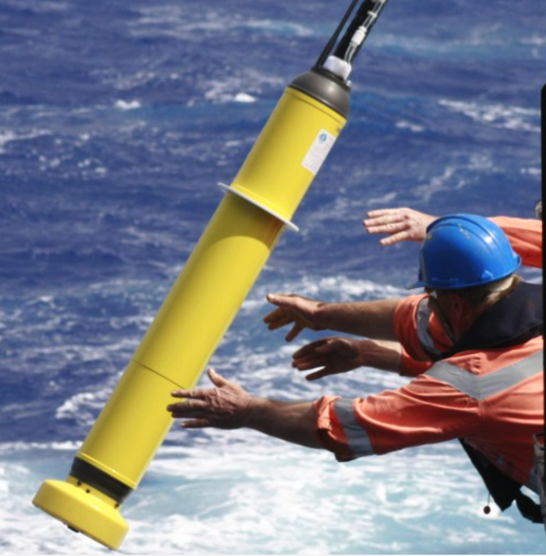
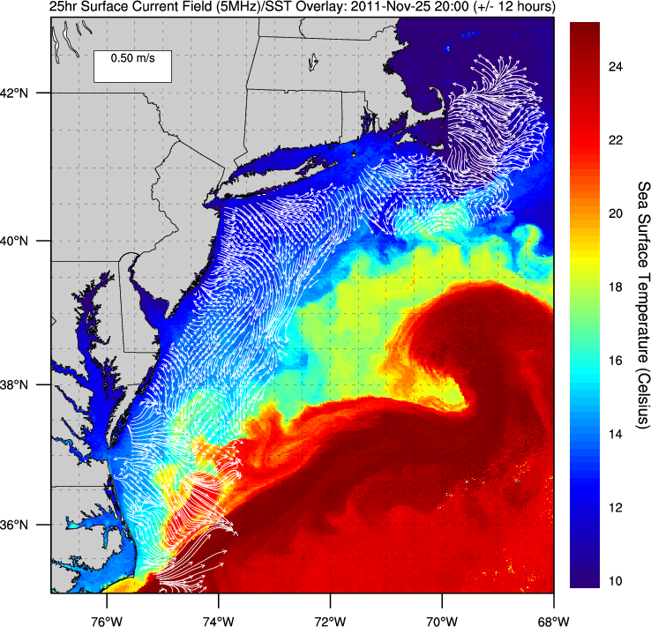
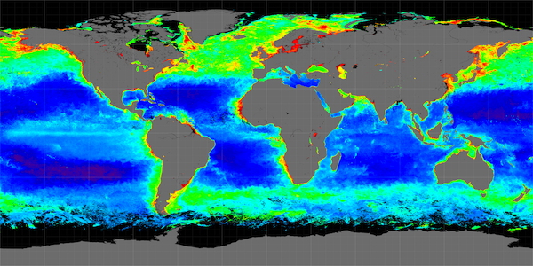
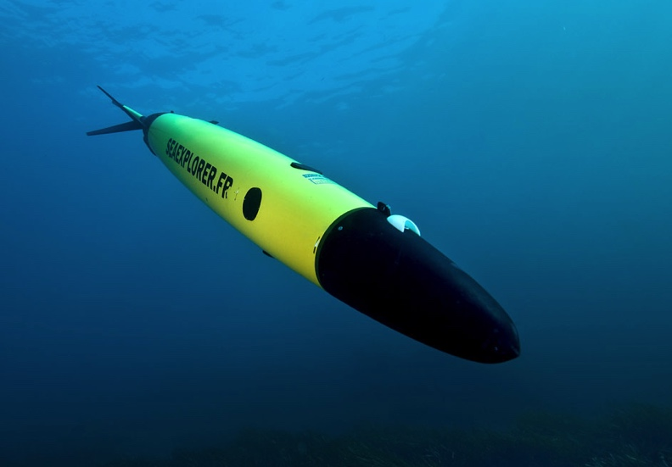
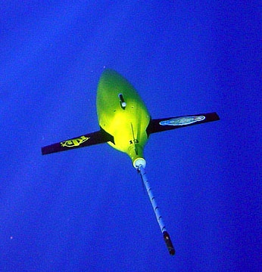
What has changed that might evolve our approach?
We can take our classrooms into the ocean everyday

Slide 4
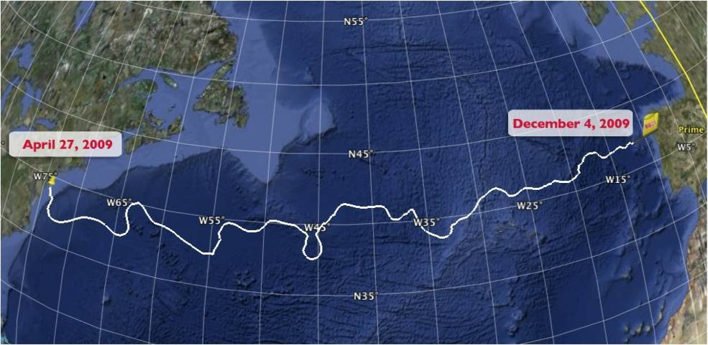
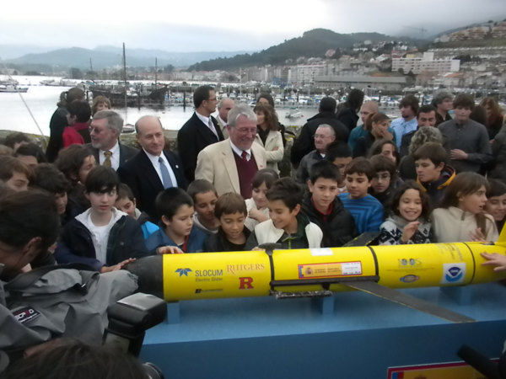
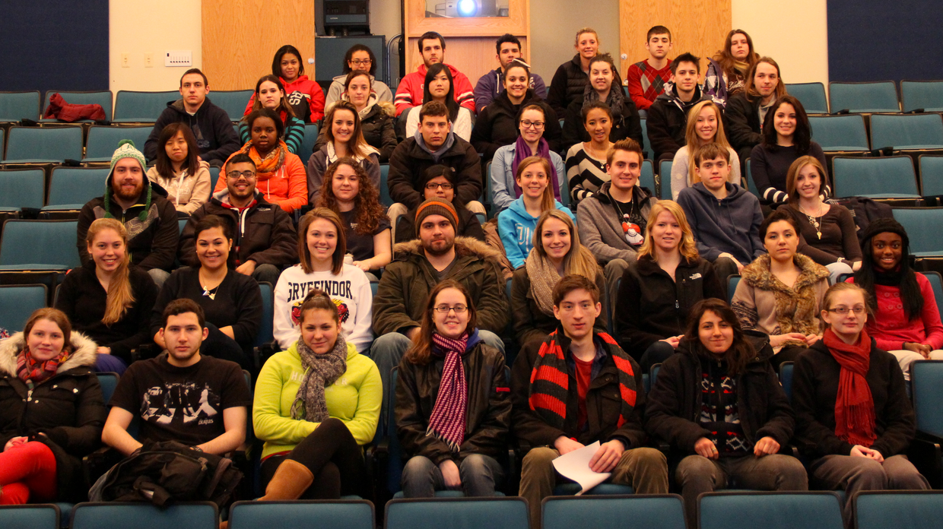
The Trans-Atlantic Glider Challenge
December 9, 2009 – Baiona, Spain
RU27: 7,400 km in 221 days
Trans-Atlantic Glider Challenge
Notes:
Letters from students to Spanish schools
Watch one, do one teach one. Borrowed best practices from COSEE, used data from ocean observatories. Increased students by over 400% with between 50 and 100 undergrads involved in the lab and research on a consistent basis. Reached carrying capacity.

Slide 5
Public Experiment
Vicarious Adventure
Traditional
Research
Traditional Research
Number of Marine Science Majors at Rutgers
female
male
Year

Slide 6
Beyond the Increase in the Numbers, a Change in the Diversity
Trans-Atlantic
Flight
Percent non-Caucasian
Year

Slide 7
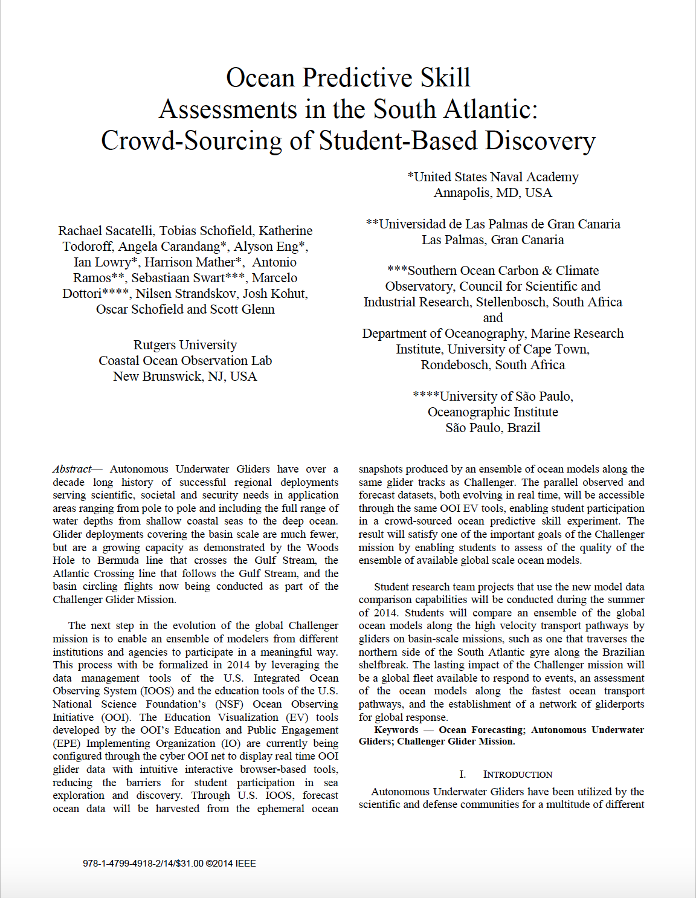
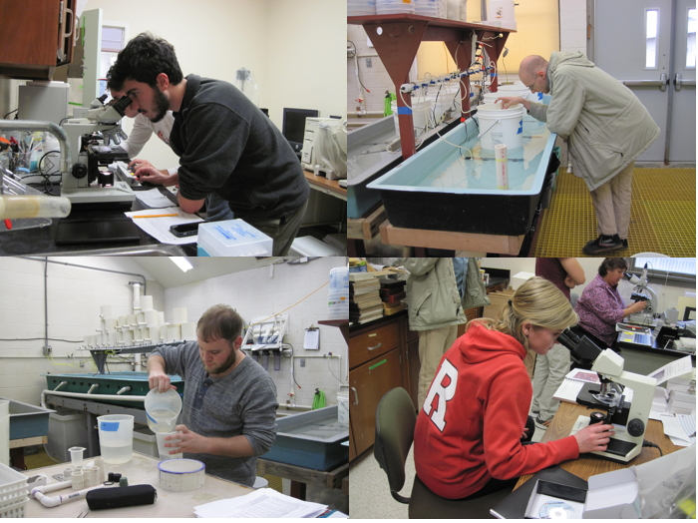
The Challenger Did Have a Lasting Impact For Those in the Major
(Improved Culture of Undergraduate Research, Many start in the Ocean Obs Class)
Works out to be
~1 student per
faculty per year
Undergraduate Independent Research
Problem Enrollment (Research Intensive)
Trans-Atlantic
Flight
Year

Slide 8
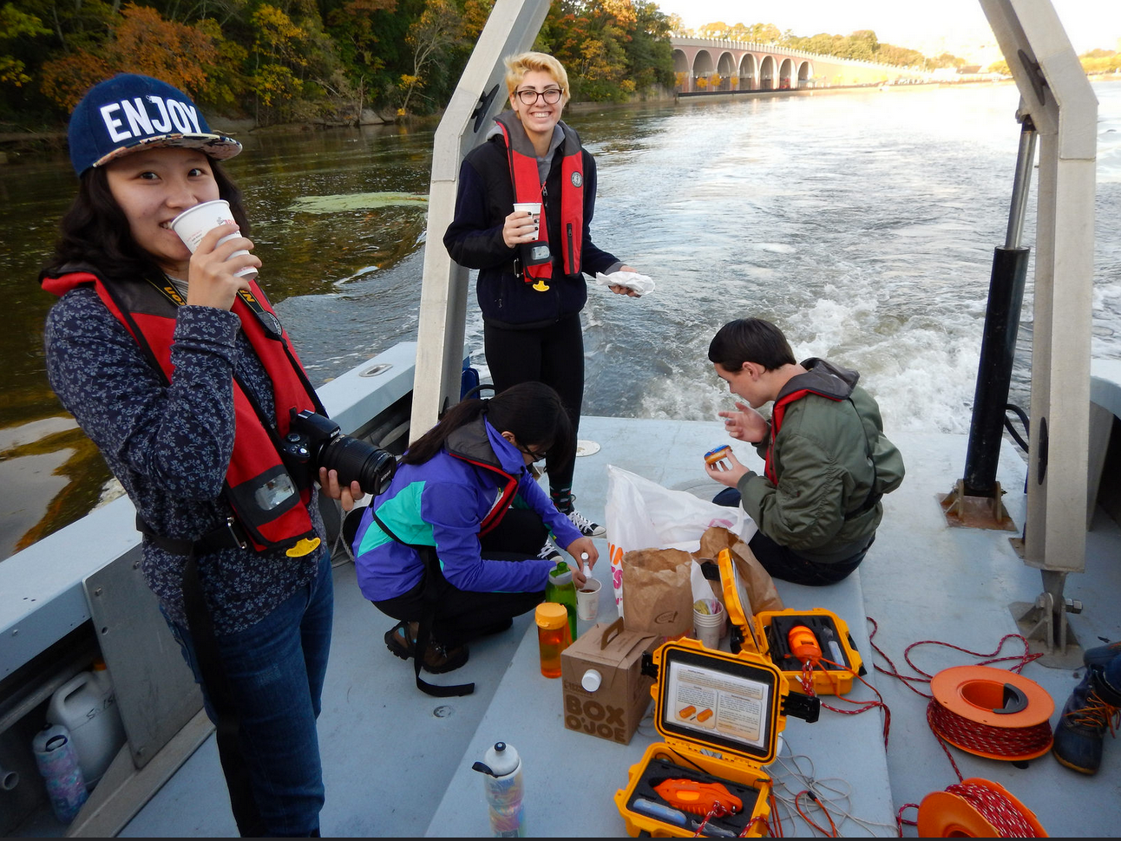
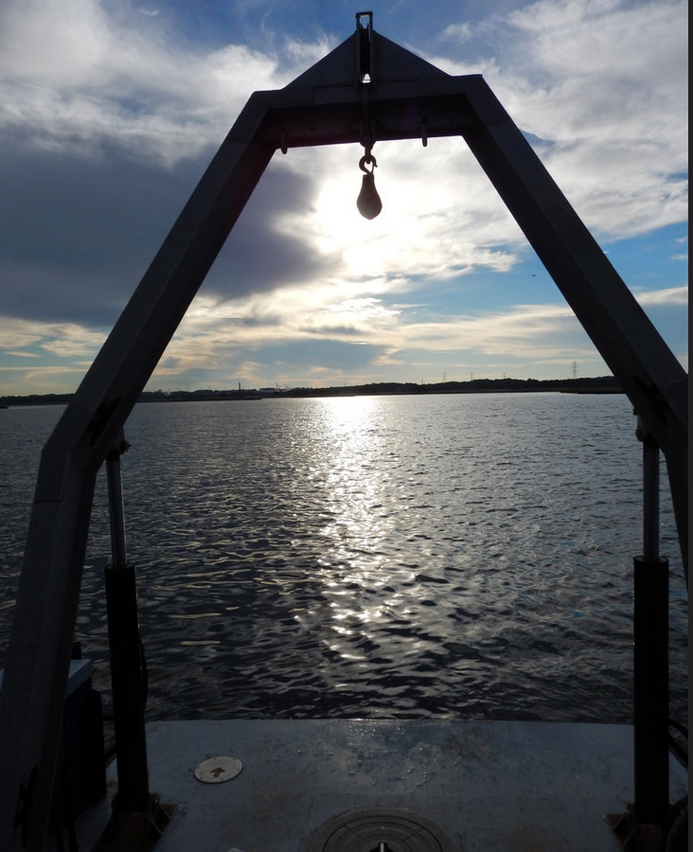
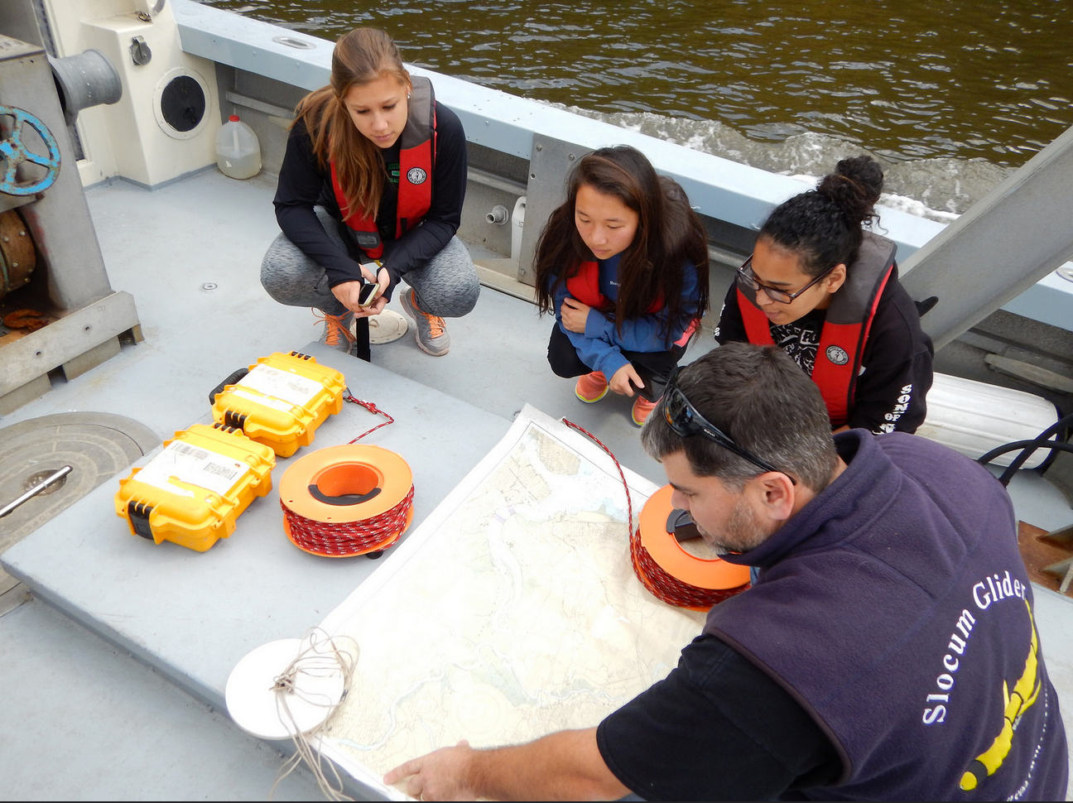
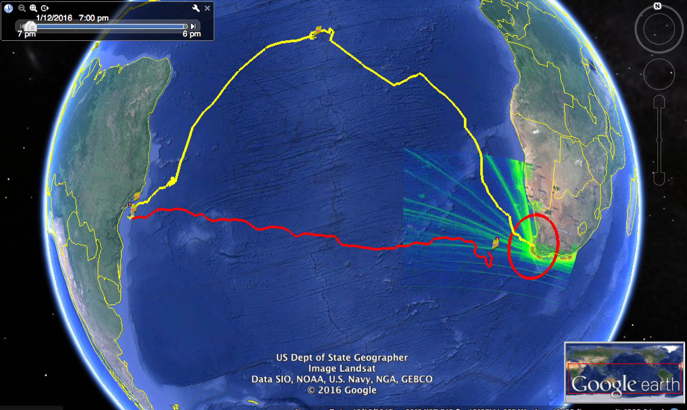
Entraining the students early
Oceanography House
(A first term freshmen learning community)
First quarter on campus, introduce them to opportunities at a research University, how to collect data, how look at data, 2nd term transition to the ocean observatory course

Slide 9
What is next? 4:1 programs
4-year undergraduate degree coupled to a 1-years Masters in Operational Oceanography. Focus on rounding undergraduate program with hands-on experience that includes running numerical models, preparing gliders-moorings-floats, Quartod standards for Qa/Qc, and applied research products.
Masters of Operational Oceanography
Research in National Research Labs

