Slide 1
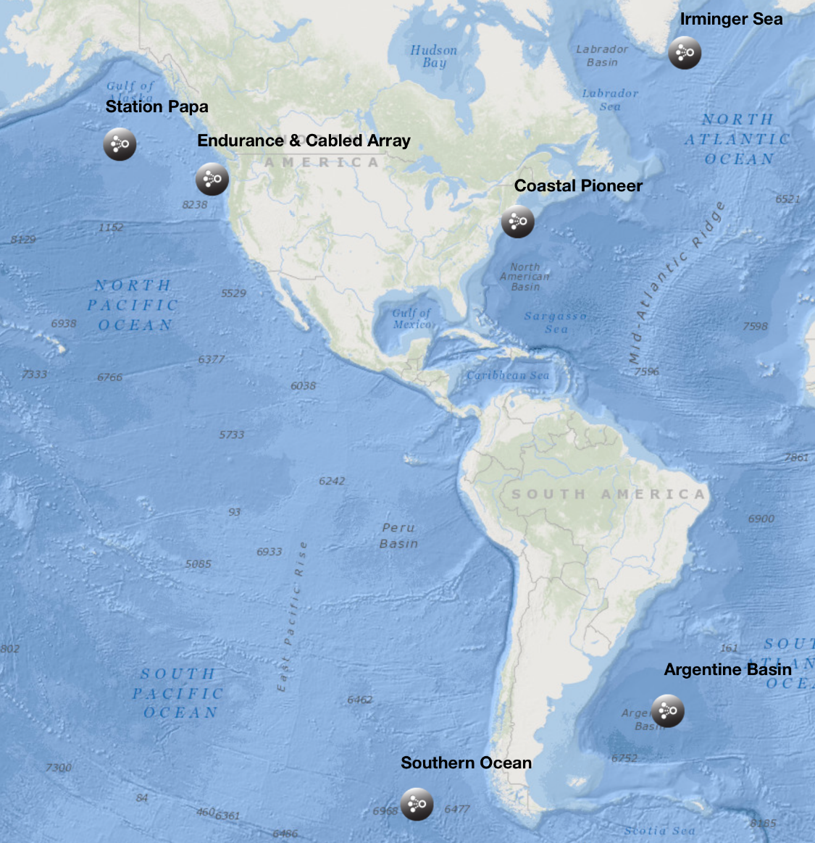
The OOI Coastal Workshop: OOI Net Status Overview
Manish Parashar, Scott Glenn & Oscar Schofield
Rutgers University Cyberinfrastucture (CI)
www.oceanobservatories.org

Slide 2
Summary Up Front
Much has been accomplished
Significant assets have been deployed at sea
All data coming ashore is being stored
OOI Net with Asset Management is deployed on the Production Server!
Access points to the vast number of data products are growing
OceanObservatories.org website updated & continues to evolve
Graphical User Interface (GUI) with plotting enabled & continues to evolve
Essential Ocean Variables (EOVs) are being downloaded & stored for easy access
Data Access will accelerate
Software Team is in place with a rapid feedback environment established
Data Evaluation Team is in place and seasoned
We seek community input – mechanisms are in place
We welcome community contributions – software, data, scientific synthesis

Slide 3
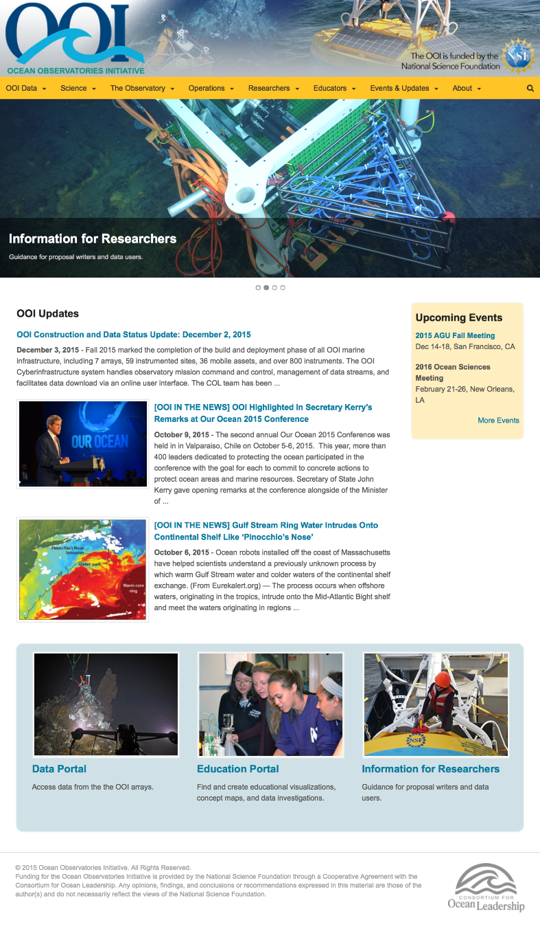
What has been deployed at sea?
4 Global Arrays
Cabled Array
Coastal Endurance Array
Coastal Pioneer Array
Information at www.oceanobservatories.org

Slide 4
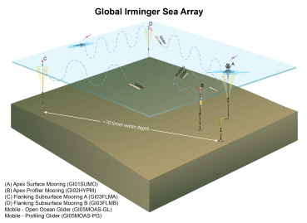
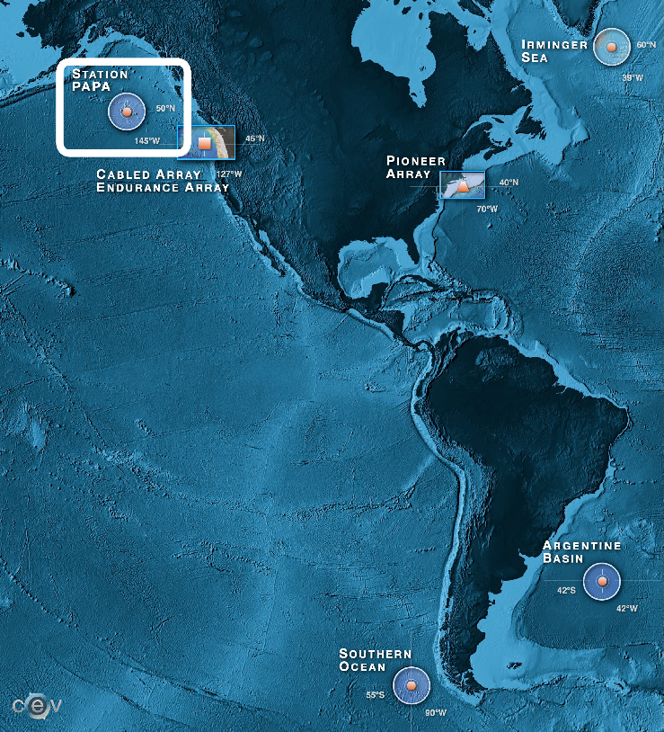
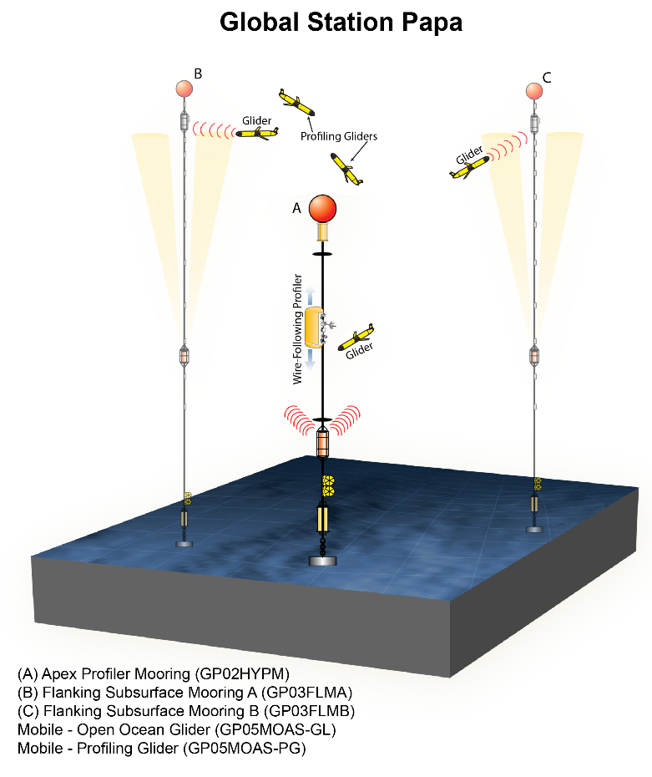
Global Arrays

Slide 5
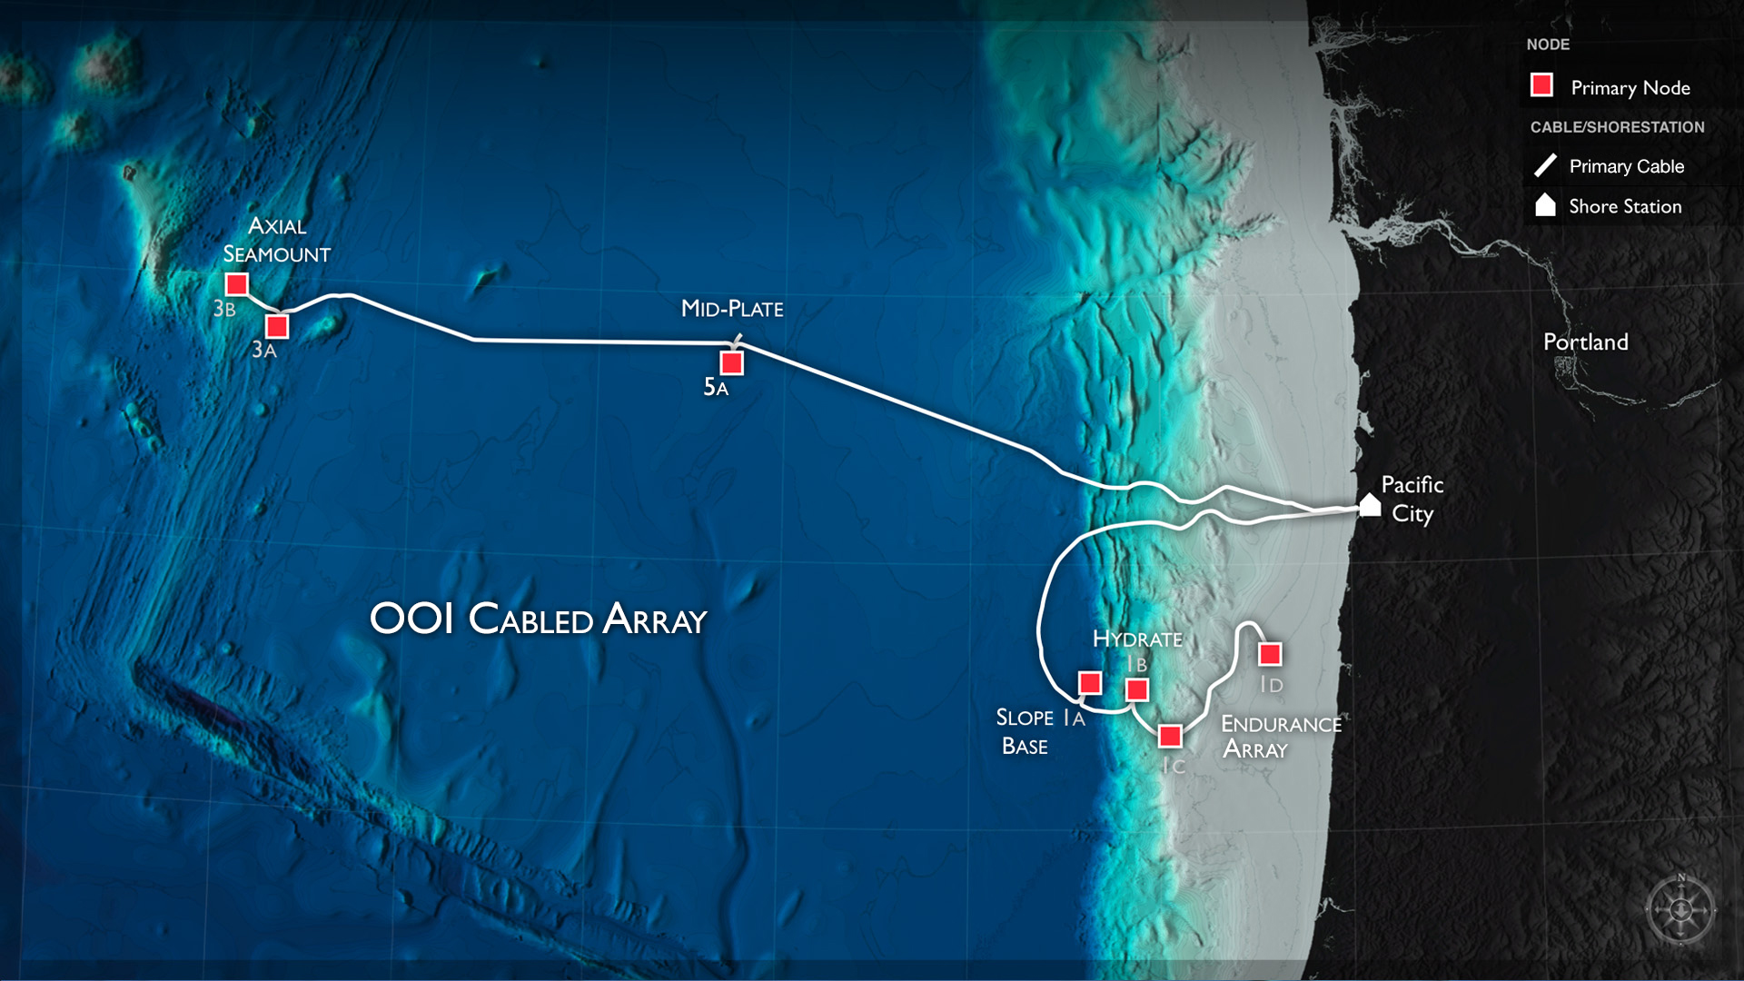
Cabled Array

Slide 6
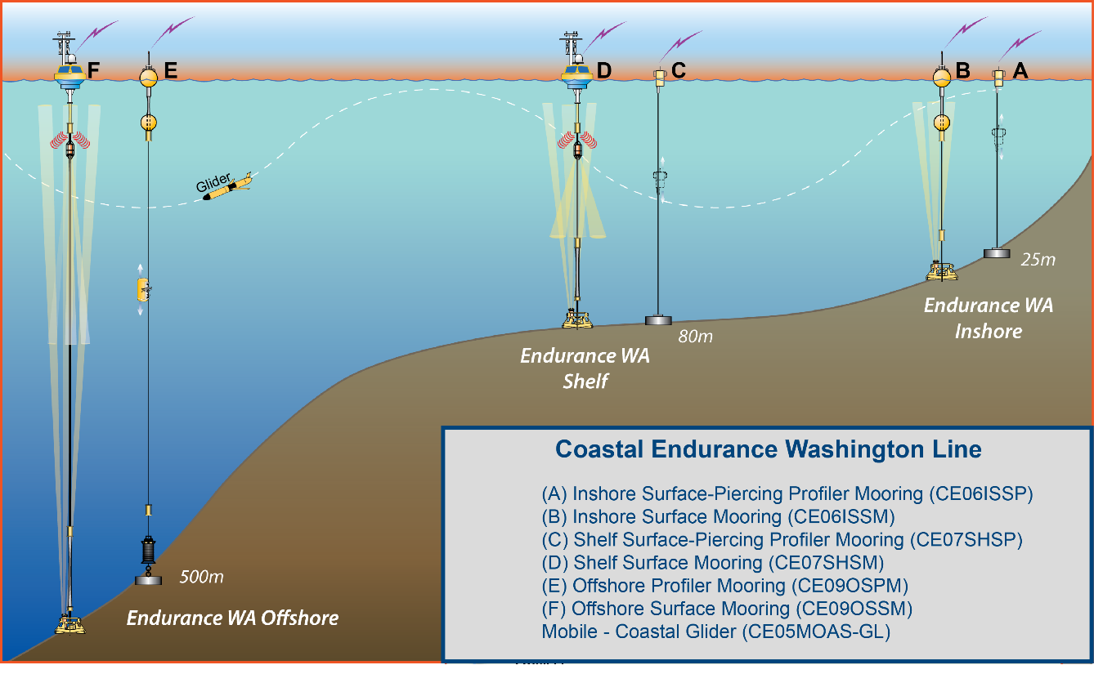
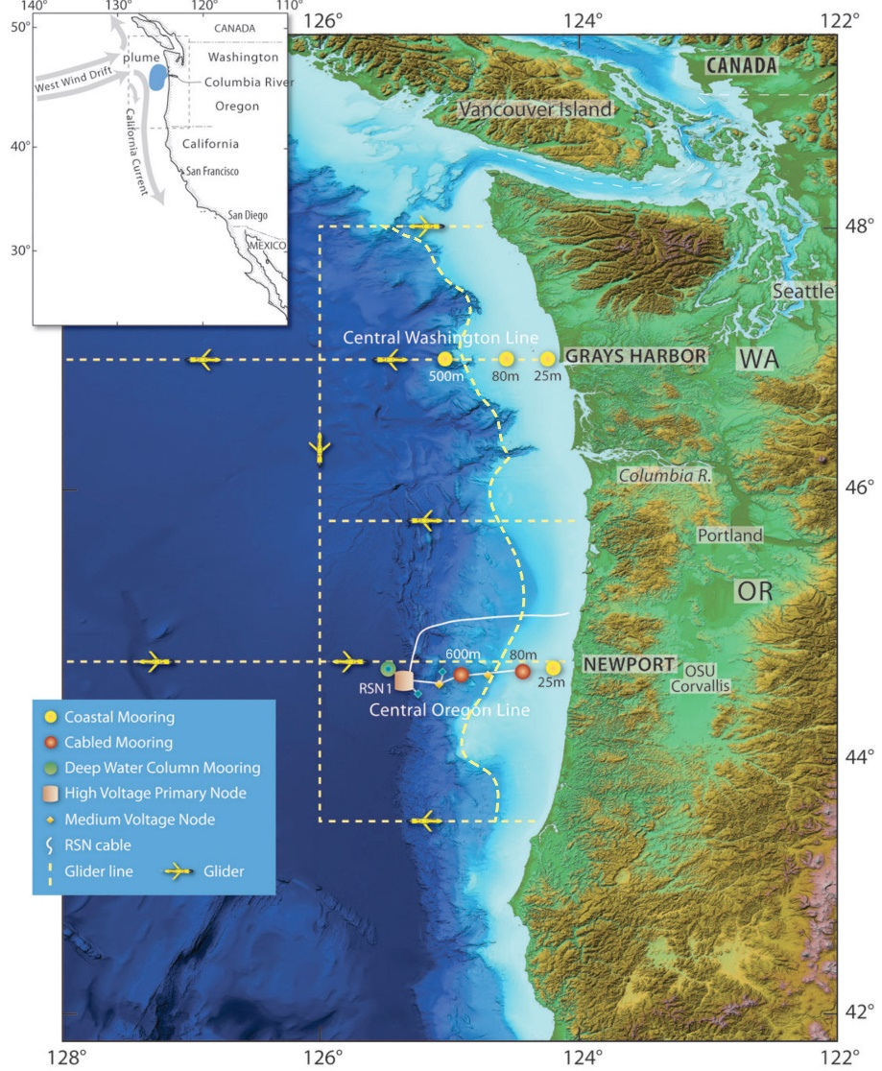
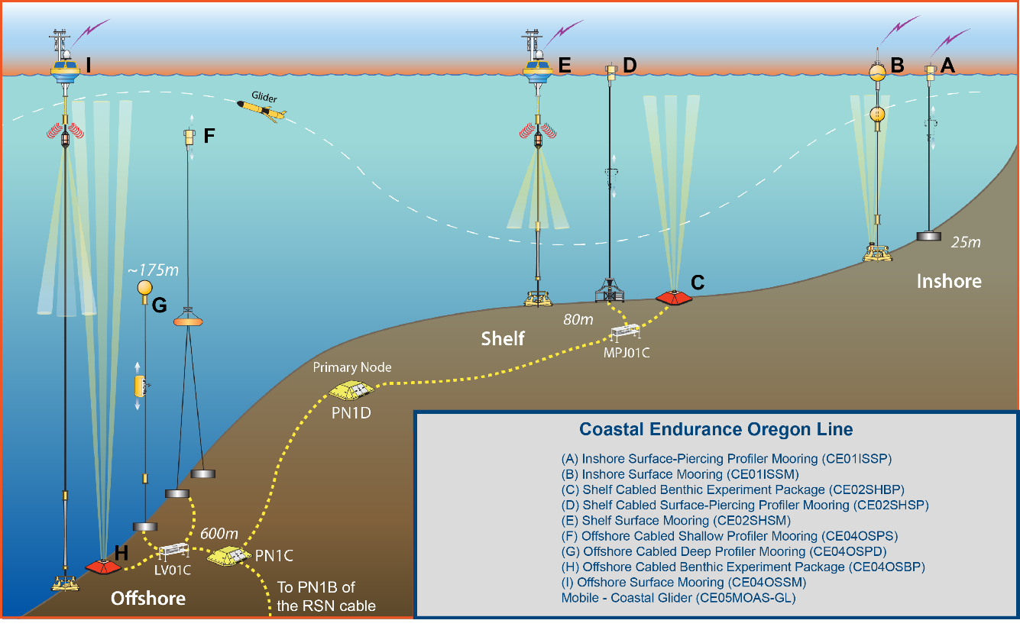
Endurance Array

Slide 7
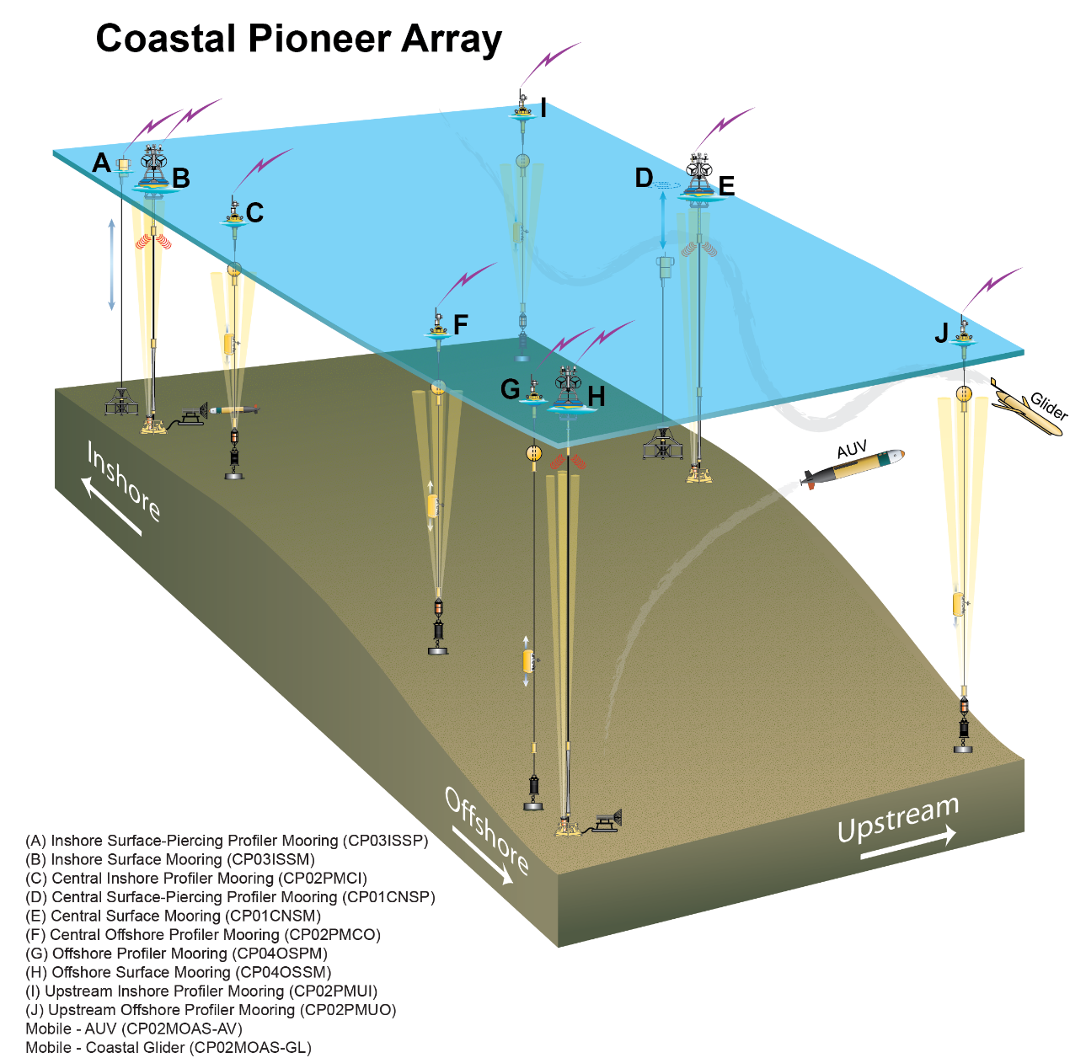
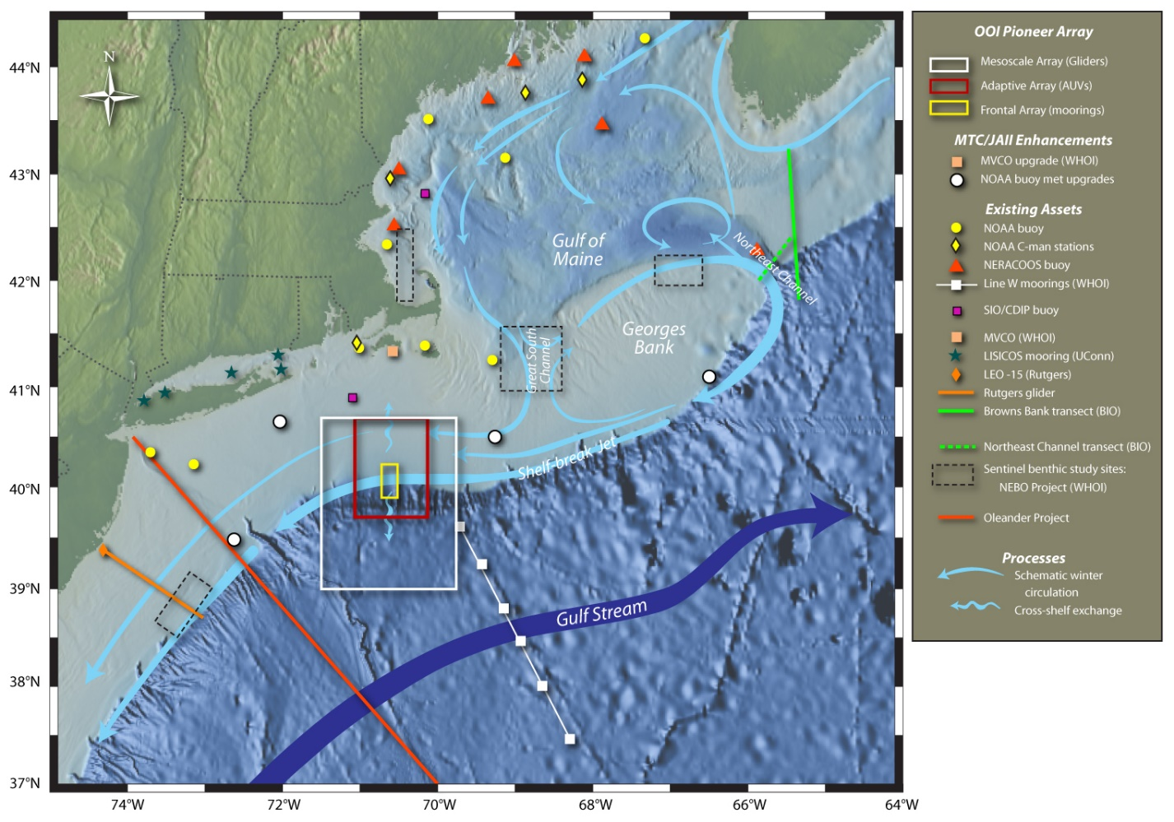
Pioneer Array

Slide 8
Data Hierarchy
Array
Data Product
Data Stream
Node
Platform
Instrument
All tracked in Asset Management

Slide 9
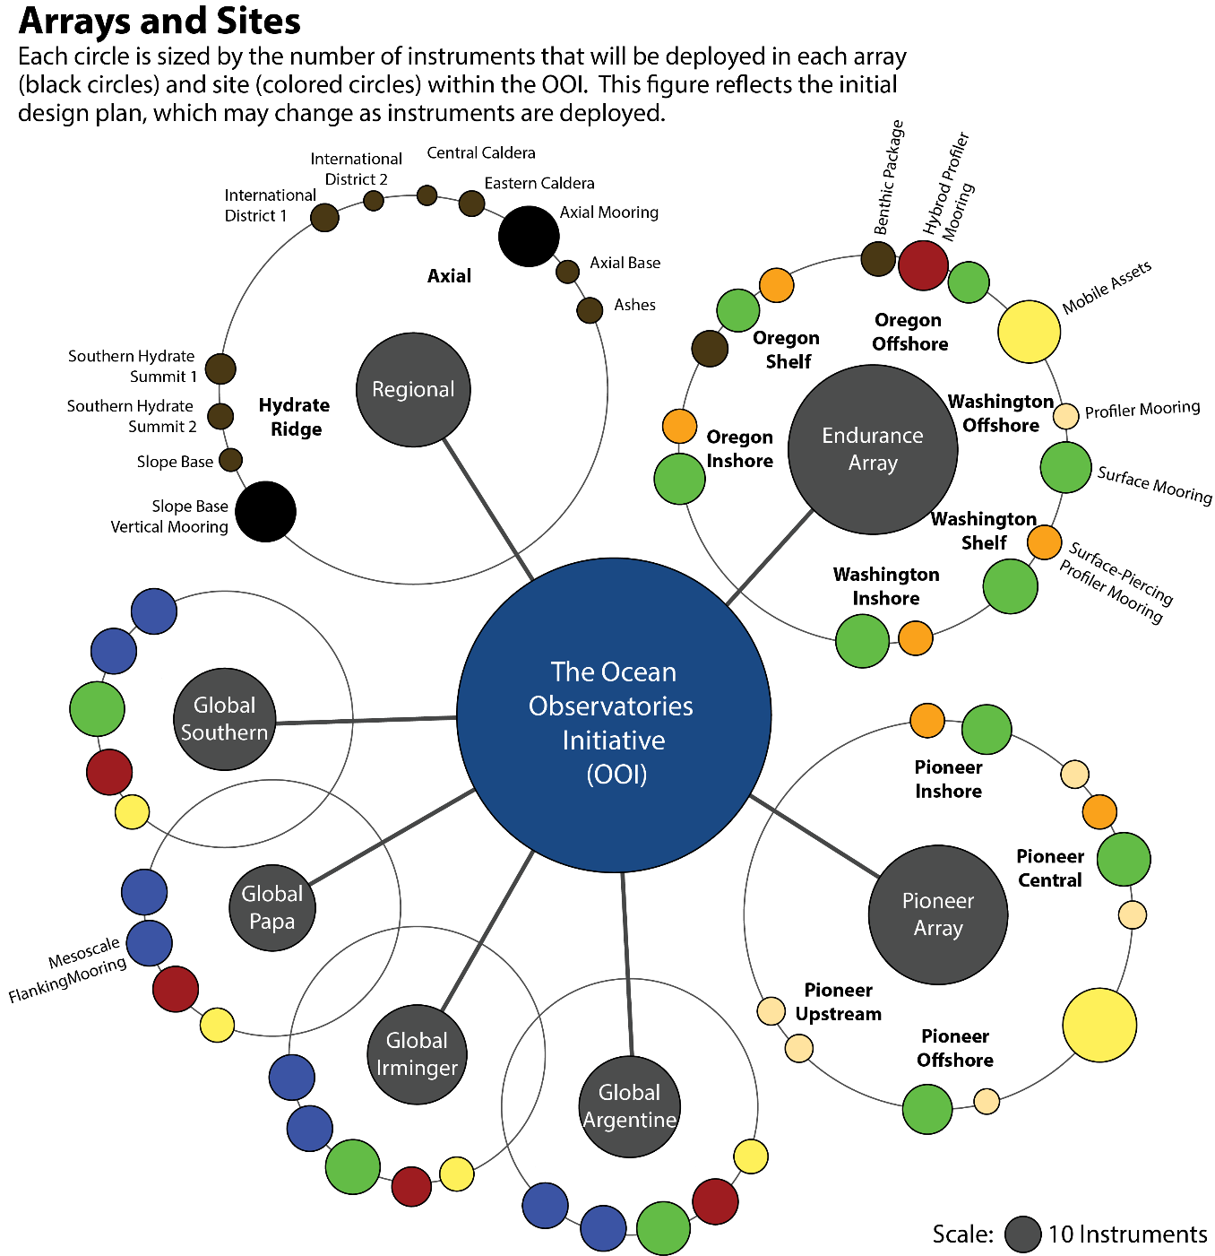
7
50
33
856
2848
>100K
Arrays
Sites
Moorings, Profilers, Nodes
Mobile Assets
Gliders, AUVs
Instruments
Science Data Products
Science/Engineering Data Products

Slide 10
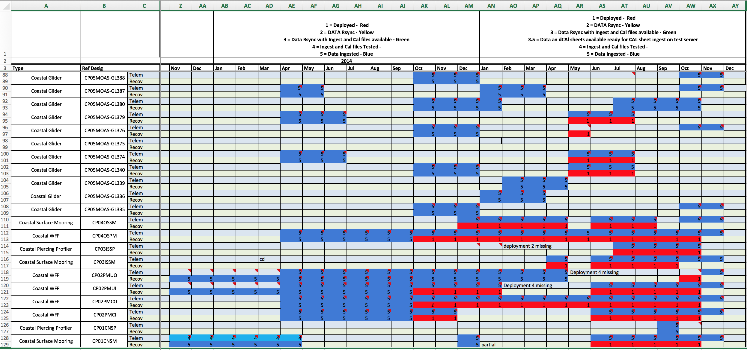
Pioneer Site & Mobile Asset Deployment Times

Slide 11
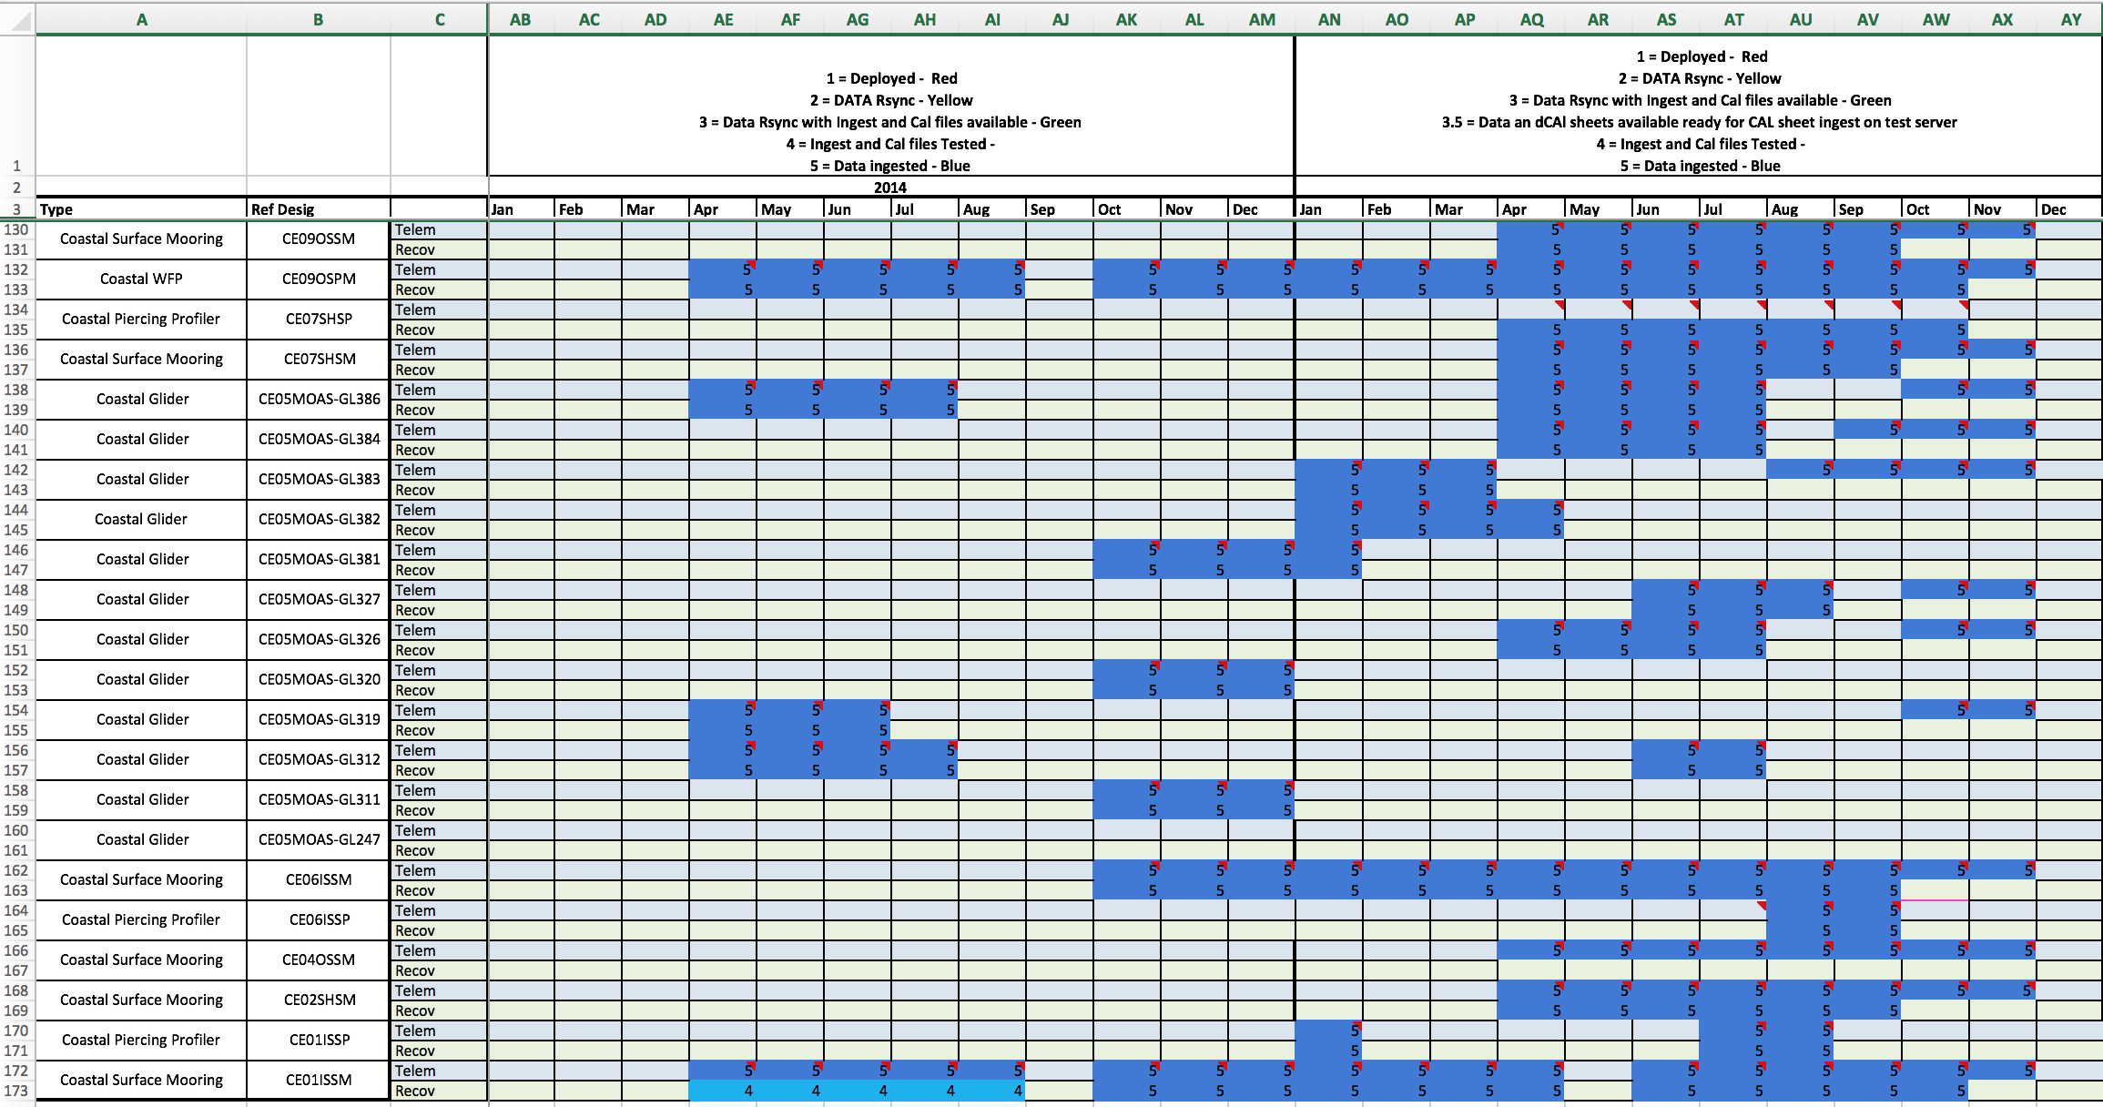
Endurance Site & Mobile Asset Deployment Times

Slide 12
What is being deployed on land?
Nationally Distributed Computer Network
Rapidly evolving Service Oriented Architecture (SOA) Software for data processing, distribution & archiving
Information at www.oceanobservatories.org

Slide 13
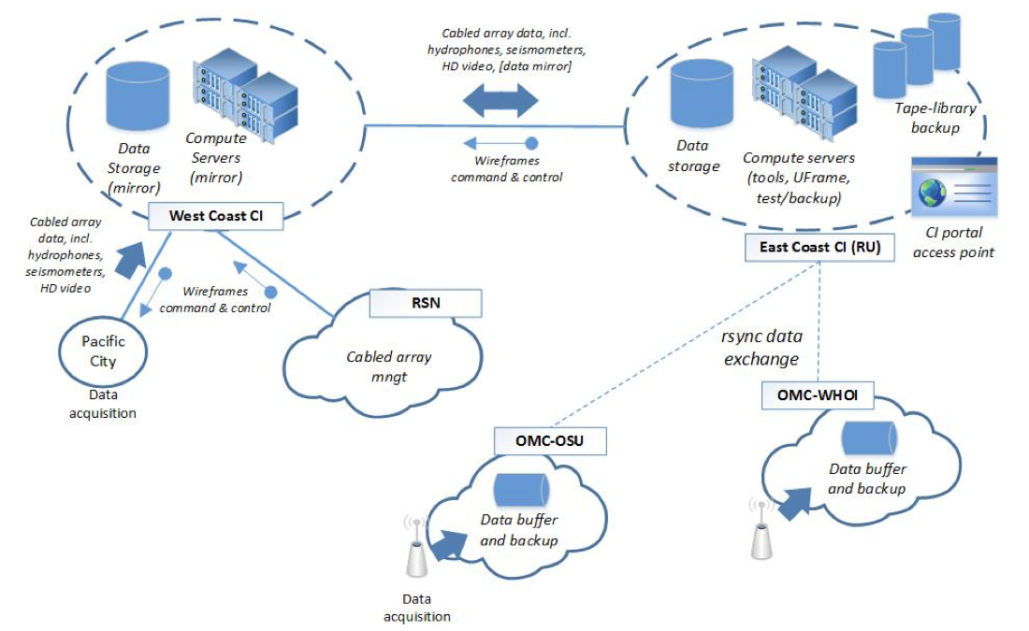
Overall CI Architecture – Functional View
Commercial
Internet

Slide 14
OOINet Deployment
Cassandra cluster
~50TB
“Fat” nodes:
16 Xeon cores
128GB DRAM
2T RAID (disk)
1/10G interconnect
UFrame server
10G
“Thin” nodes:
16 Xeon cores
64GB DRAM
2x4TB local disk + SSD
4x1G interconnect
10G
2x1G
networks
UFrame server
10G
…
…
2 cassandra networks:
data
Gossip
+ management network
UFrame server
10G
faster
10G (multiple)
1PB SAN
Up to 5PB
Internet 2 link to mirror
in West Coast CI
10G
Internet link to OMCs
1G
3.75PB raw
Tape Library
Up to >10PB
larger
Information Lifecycle Management
System (replicated at West Coast)

Slide 15
OOI-Net Software Build & Upgrade Team
Integration Lead – COL
Universal Framework (uFrame) SOA Core - Raytheon Omaha
Dataset Agent Drivers – Parsers for ingest - Raytheon San Diego
Data Product Algorithms – Oregon State University
Graphical User Interface (GUI or UI) – Applied Science Associates
Additional Data Delivery – Community Protocols
Operator - Rutgers

Slide 16
Data Flow Example: Pioneer Profiler
CTDPF
DOFST
FLORT
PARAD
VEL3D
Profiler Controller
Inductive Modem
Ocean
WHOI
Instrument
Platform Controller
Telemetry
Iridium
OMC Platform Shore Server
rsync
OMC Data Server
MOPAK RTE
Inductive Modem
ADCPS/T
Rutgers
Data Files from CGSN
User
RU Acquisition Point Server
Dataset Agent
Driver
uFrame Database
Data Product Algorithm
GUI

Slide 17
OOI Net Server Configurations
Code Testing
Integration
Testing
Load
Testing
Development Server
Test
Server
Production
Server
Development Server
Development Server
Increasing Computer Capabilities

Slide 18
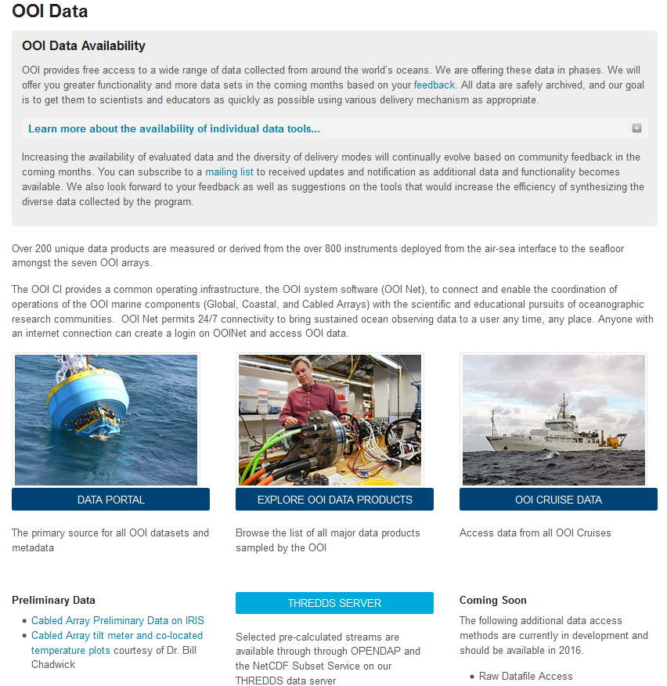
Data Access Points
Data Portal (GUI)
THREDDS Server
Access to aggregated data products in NetCDF and CSV
ERDDAP (Spring 2016)
Raw data files (Spring 2016)
Shipboard Data
Large Format Data
Still Camera & HD Video
Seismic
Hydrophone
Bioacoustic Sonar
Direct Pass to community organizations (ex: seismic to IRIS)

Slide 19
Evolving OOI Net Dataset Access
Plotting
GUI
Asynchronous Download
NetCDF
EOV - 1
Production Server
CSV
EOV - 2
NetCDF
CSV
NetCDF
EOV - 3
CSV

Slide 20
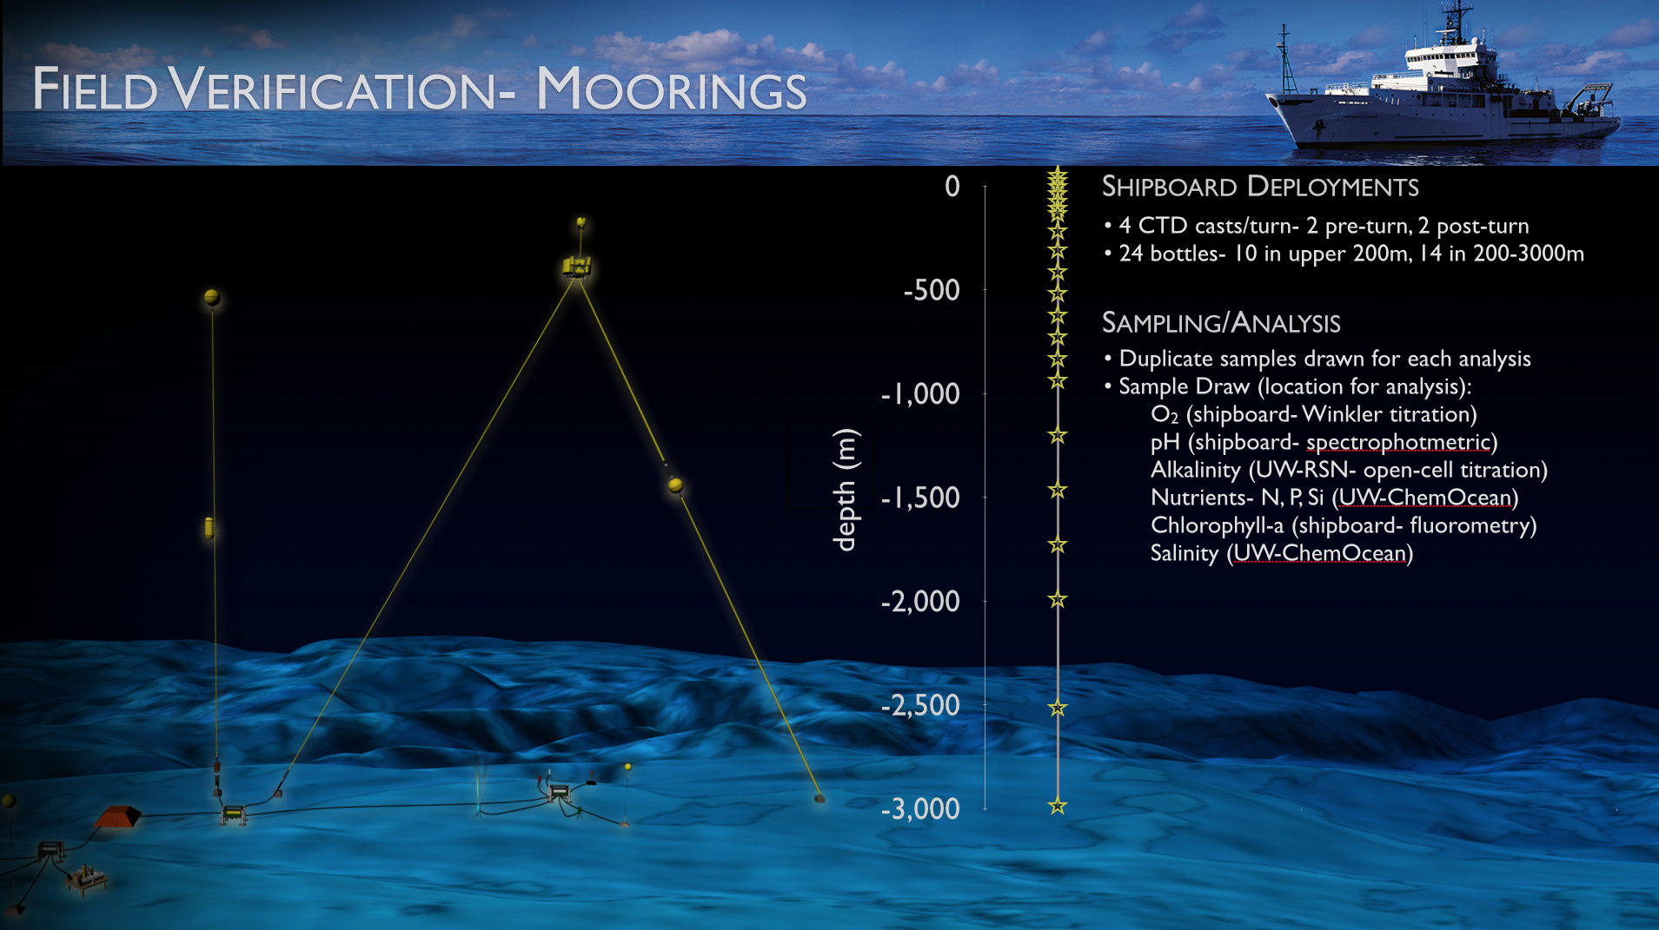
Ship and Shore-based sensor verification

Slide 21
At-sea Data QA procedures
Pre- & Post-deployment procedures
Deployment documentation
Pre-deployment checklists [CP02PMUI-00001_checklist.pdf]
Mooring deployment logs [CP02PMUI-00001_deployment-log.pdf]
Post-deployment assessments
Adjacent CTD cast(s) (temp,sal,oxy,chl,turb) [see quick look report]
Shipboard systems (met, surface t-sal, ADCP) [SCS_WSPD.gif, SCS_WDIR.gif]
Water samples and lab analysis (sal,oxy,chl,etc) [Pioneer1_salinity_oxygen.xlsx]
Quick-look report [3204-00023_Poineer_1_Quick_Look_Cruise_Report.pdf]
Lessons learned [internal working documents]

Slide 22
Data QC
Automated QC Algorithms
Global Range Test
Local Range Test
Spike Test
Gradient Test
Trend Test
Stuck Value Test
Manual QC Tests
Quick Looks
Deep Dives
Alert Diagnoses

Slide 23
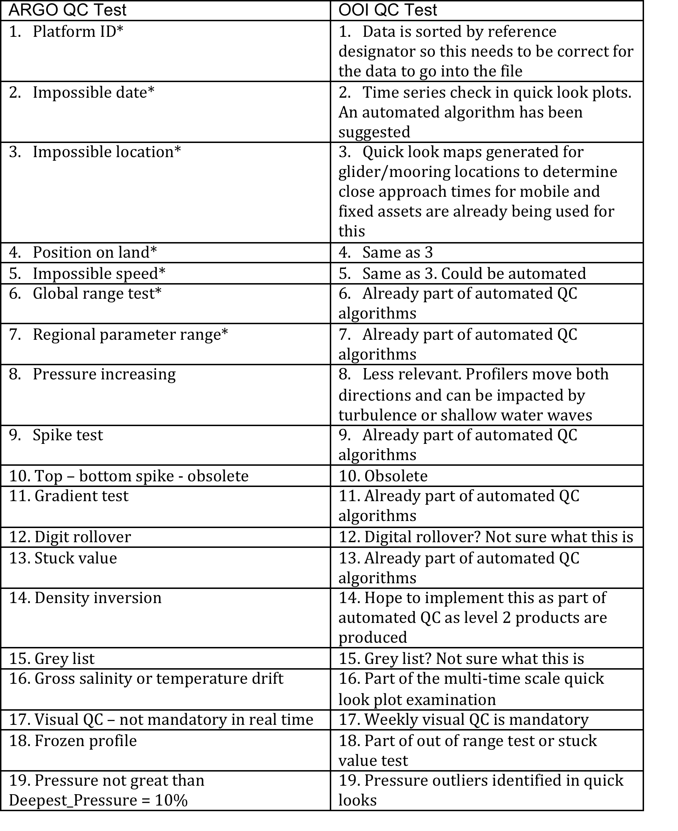
Data QC aligned with accepted community standards

Slide 24
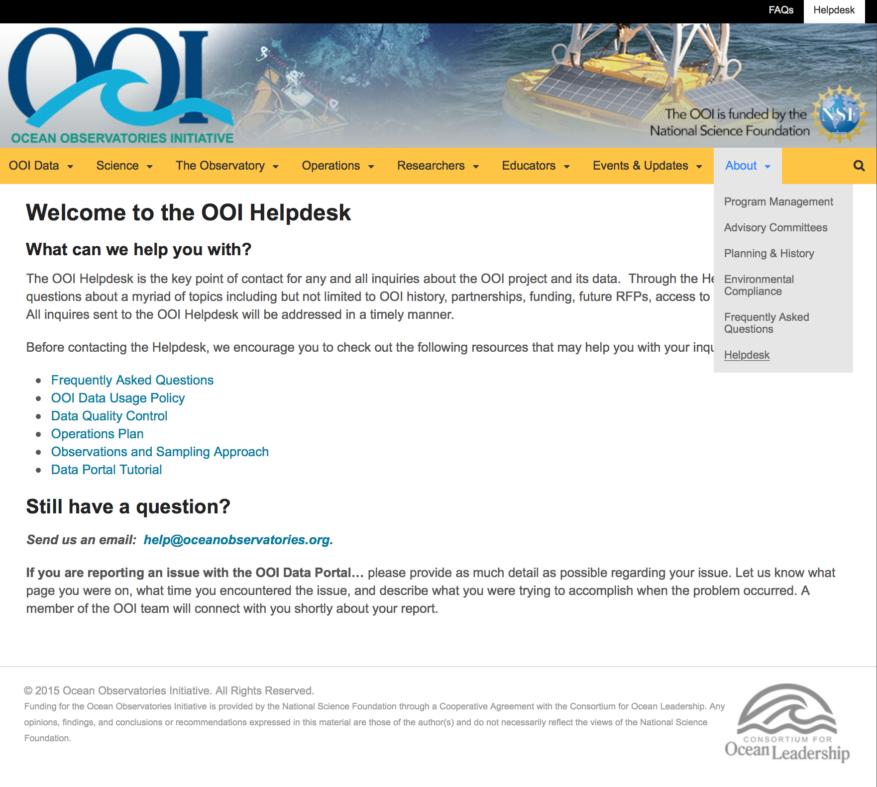
Helpdesk
Questions about data, data access, and instrumentation:
help@oceanobservatories.org

Slide 25
Summary Review
Much has been accomplished
Significant assets have been deployed at sea
All data coming ashore is being stored
OOI Net with Asset Management is deployed on the Production Server!
Access points to the vast number of data products are growing
OceanObservatories.org website updated & continues to evolve
Graphical User Interface (GUI) with plotting enabled & continues to evolve
Essential Ocean Variables (EOVs) are being downloaded & stored for easy access
Data Access will accelerate
Software Team is in place with a rapid feedback environment established
Data Evaluation Team is in place and seasoned
We seek community input – mechanisms are in place
We welcome community contributions – software, data, scientific synthesis

