Slide 1
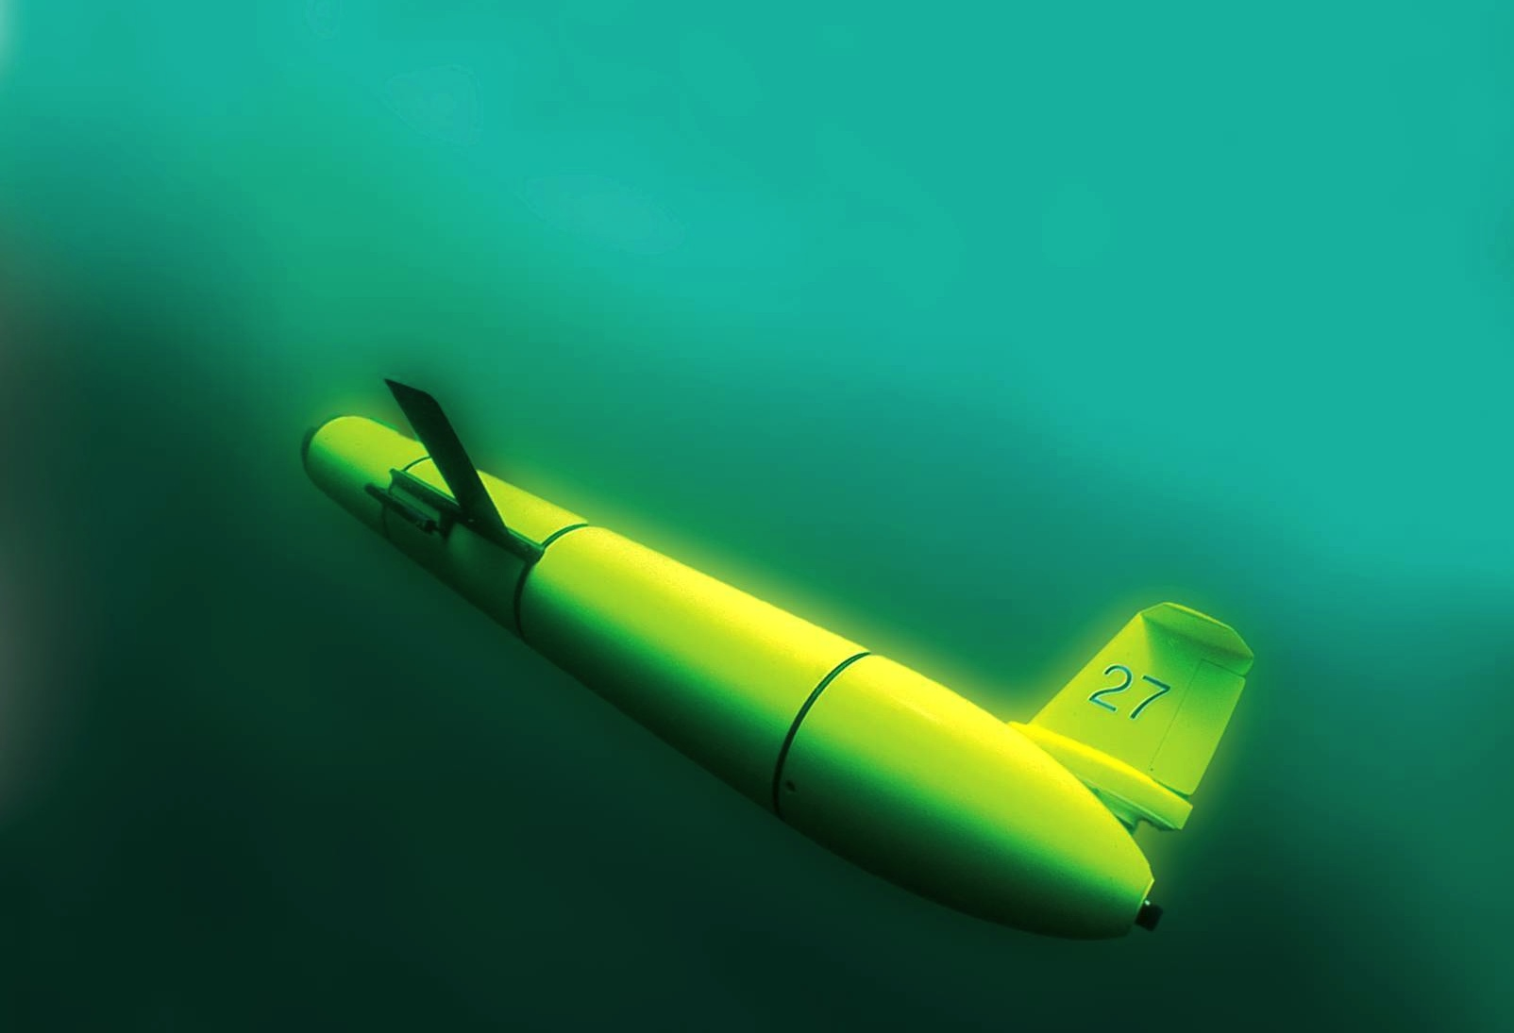
Overview of the U.S. National HF Radar Network and Its Application
Scott Glenn,
Oscar Schofield,
Josh Kobut &
Hugh Roarty
Rutgers University
Coastal Ocean Observation Lab
http://rucool.marine.rutgers.edu/

Slide 2
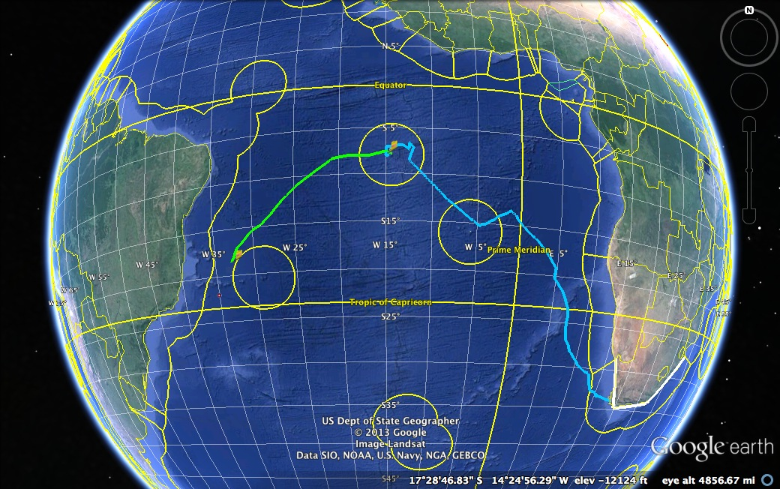
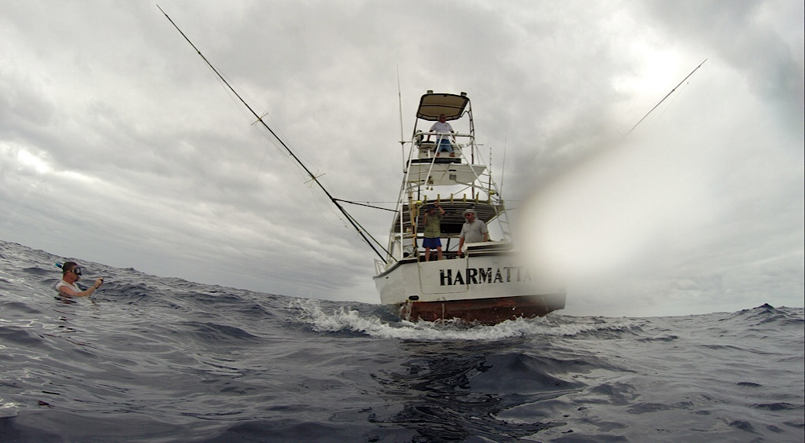

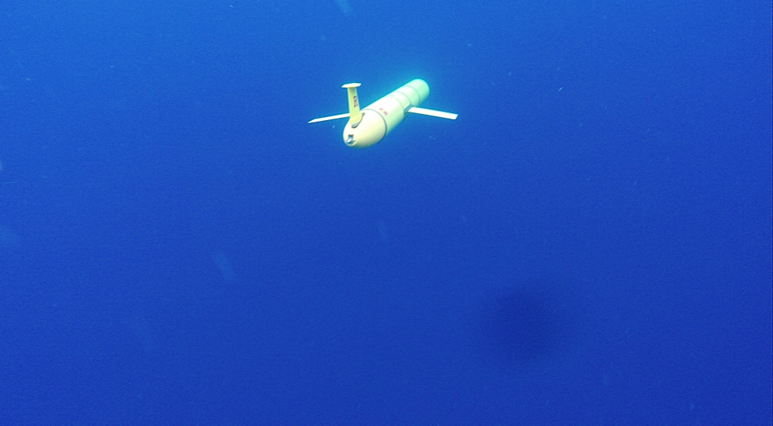
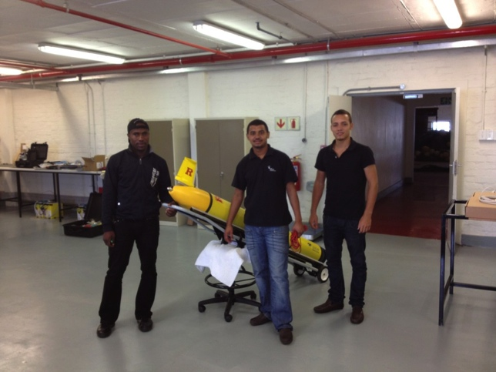

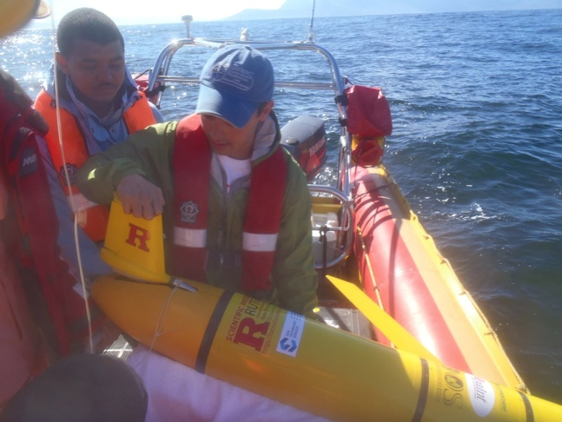

Glider RU29: Launched from Cape Town 11 Jan 2013, flown >8,125 km
South African Coast
2400 km

Slide 3
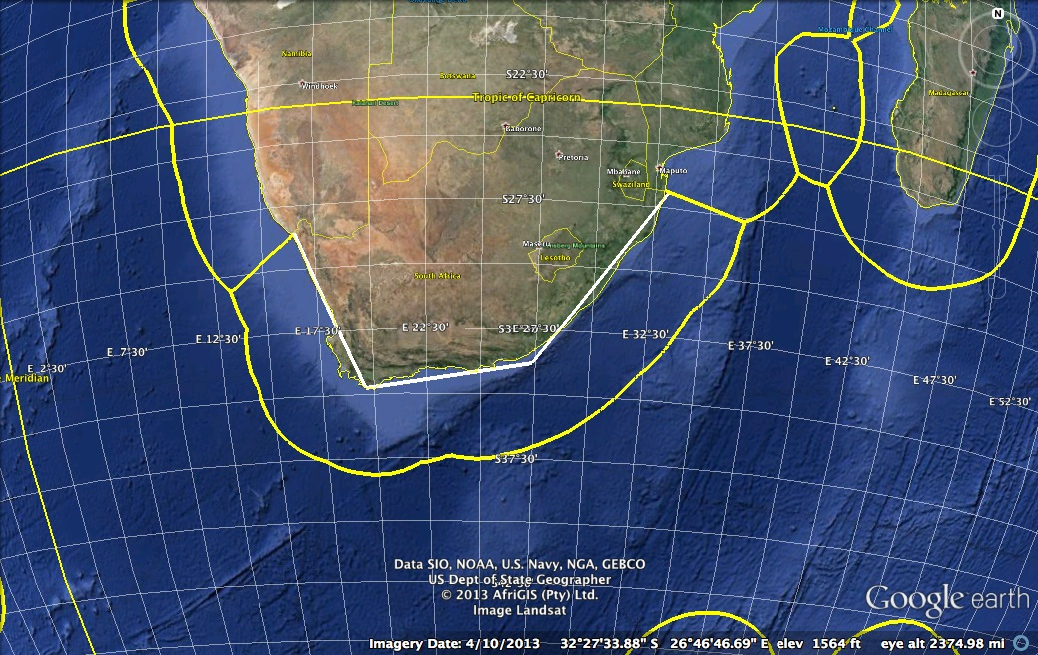
South African Coast with Bathymetry
South African Coast
2400 km

Slide 4
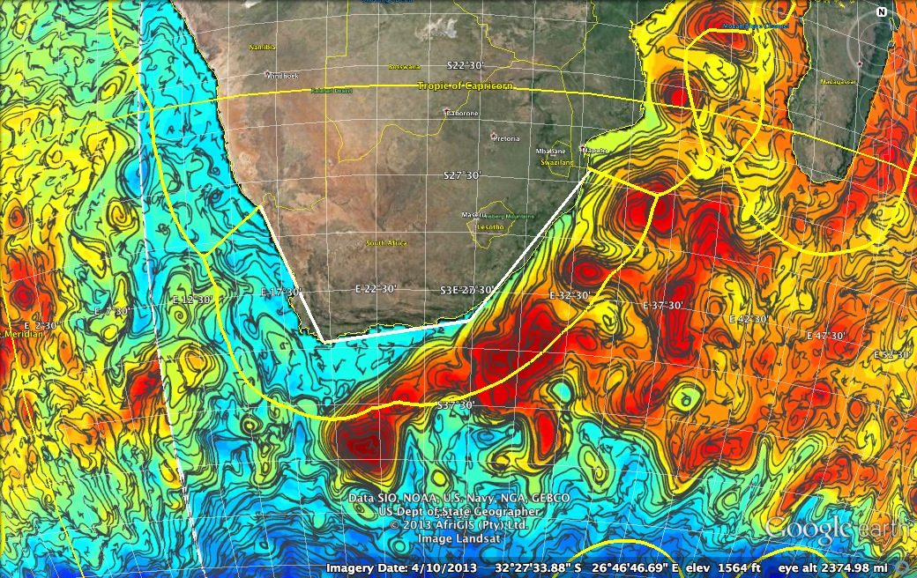
South African Coast with Global Ocean Model
South African Coast
2400 km

Slide 5
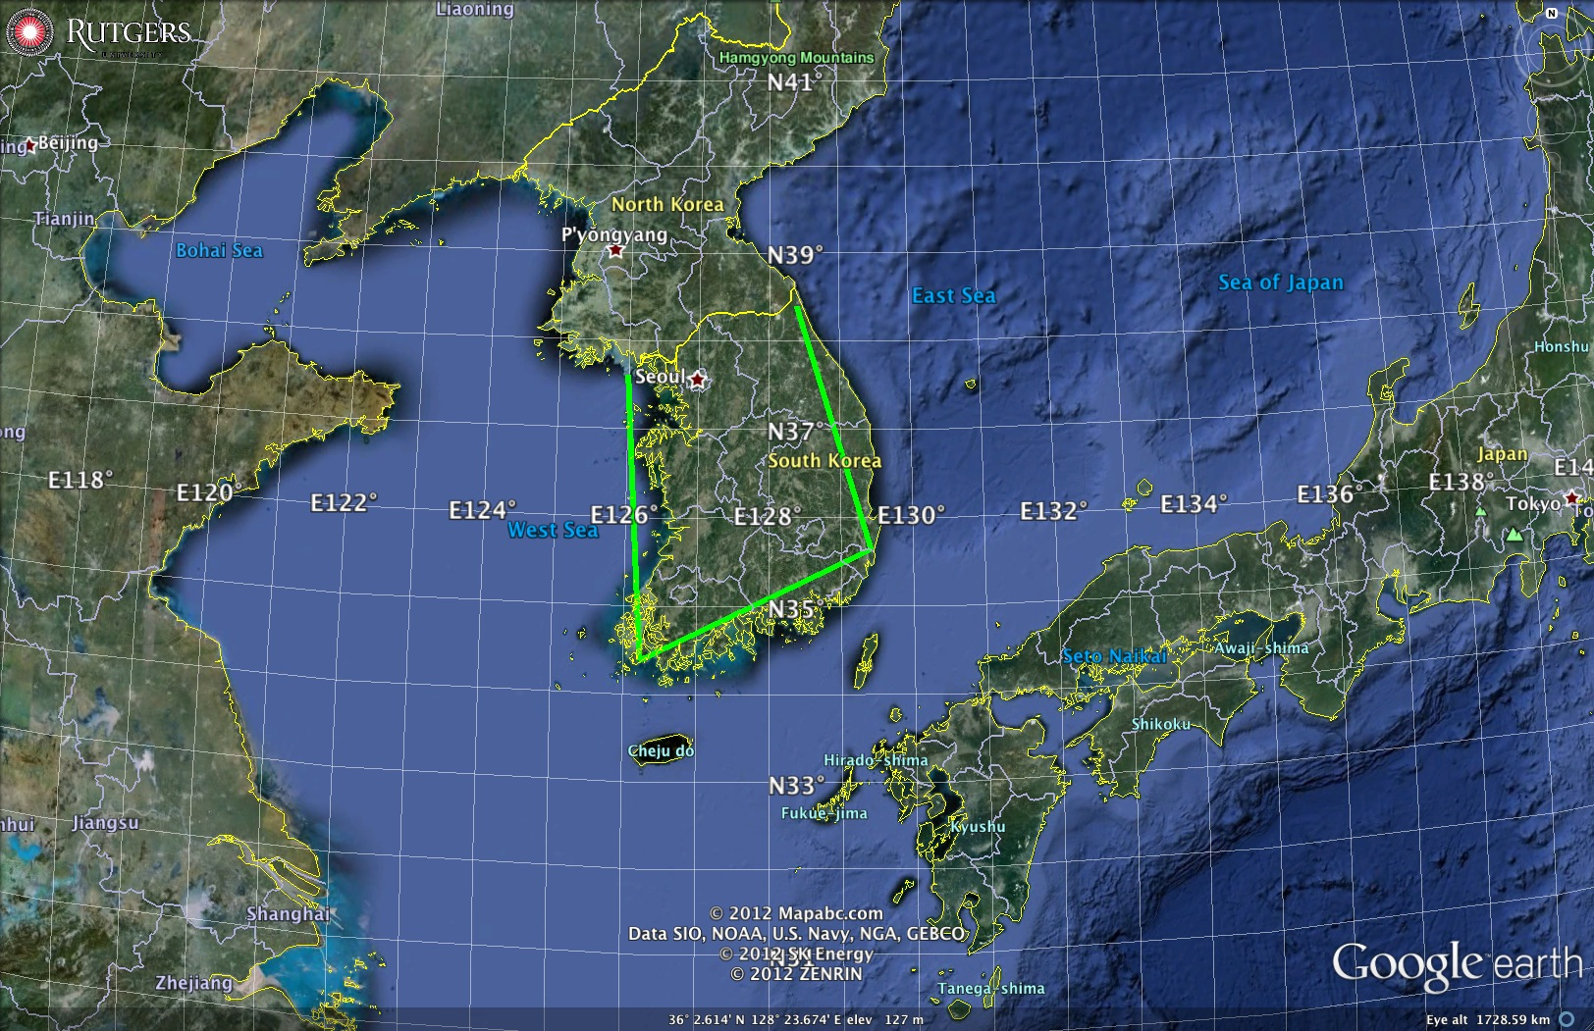
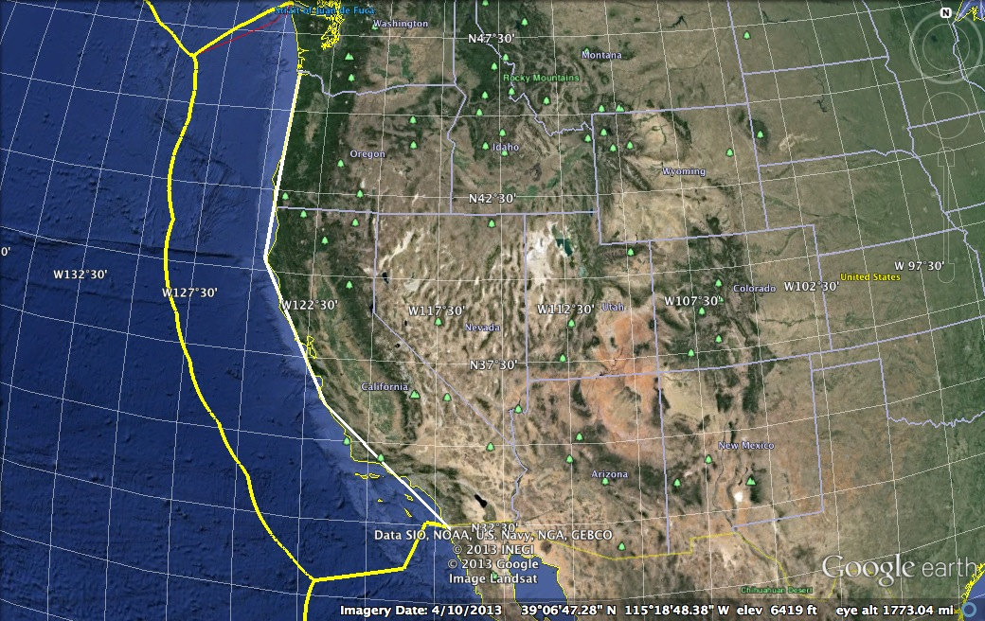
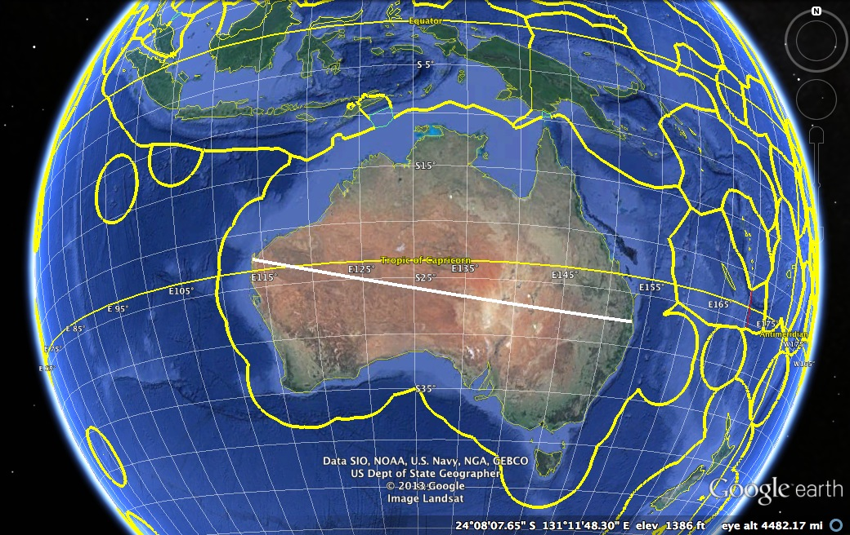
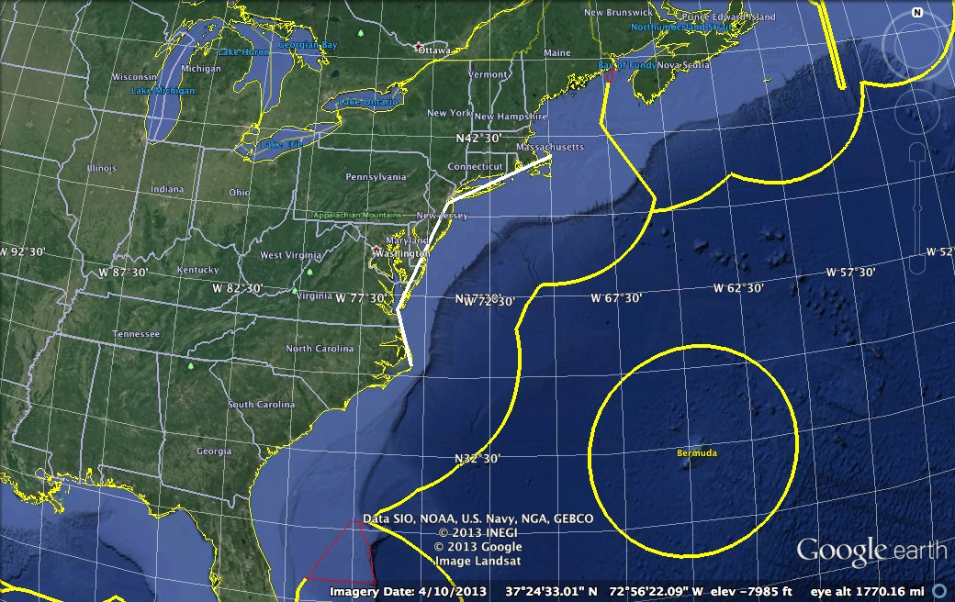
Similar HF Radar Networks
California + Oregon
1800 km
South Korea
1000 km
Australia
Pi x 4000 km
Mid-Atlantic
1000 km

Slide 6
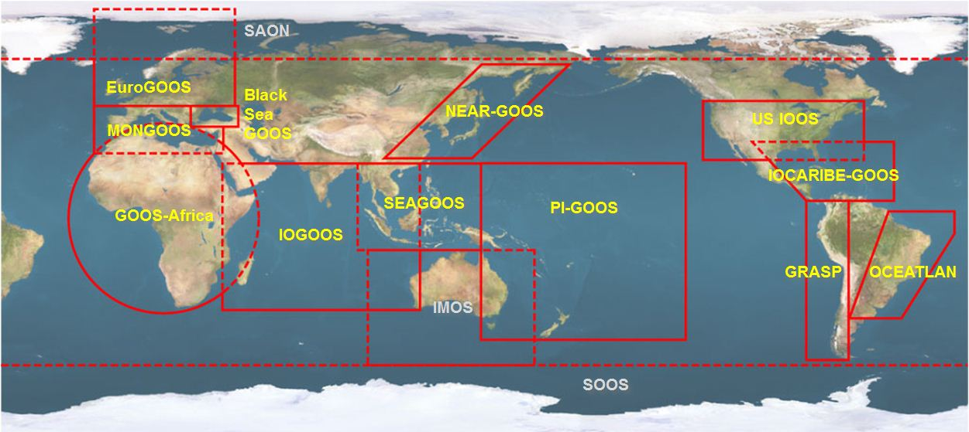





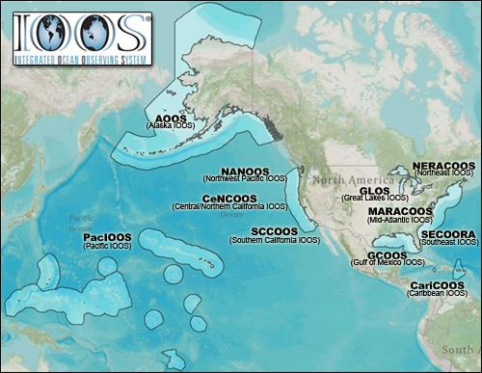


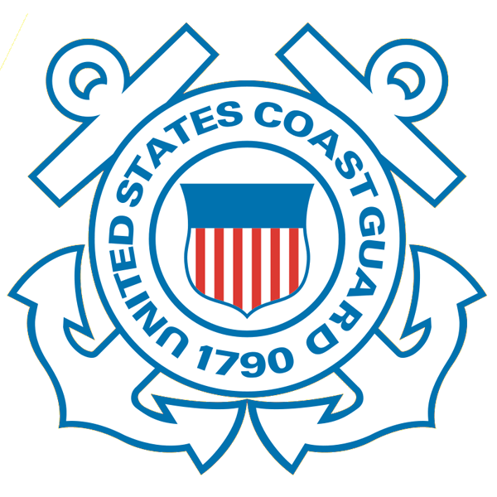










U.S. Integrated Ocean Observing System (IOOS)
Global Component
National Component
Regional Component
15 Regional Alliances in GOOS
Vessels -
Satellite
Satellite
CODAR
Ships/ Vessels
Glider
REMUS
Data Vis.
Modeling
Security
Leadership
Education
11 Regional Associations
17 U.S. Federal Agencies
http://ioos.gov

Slide 7
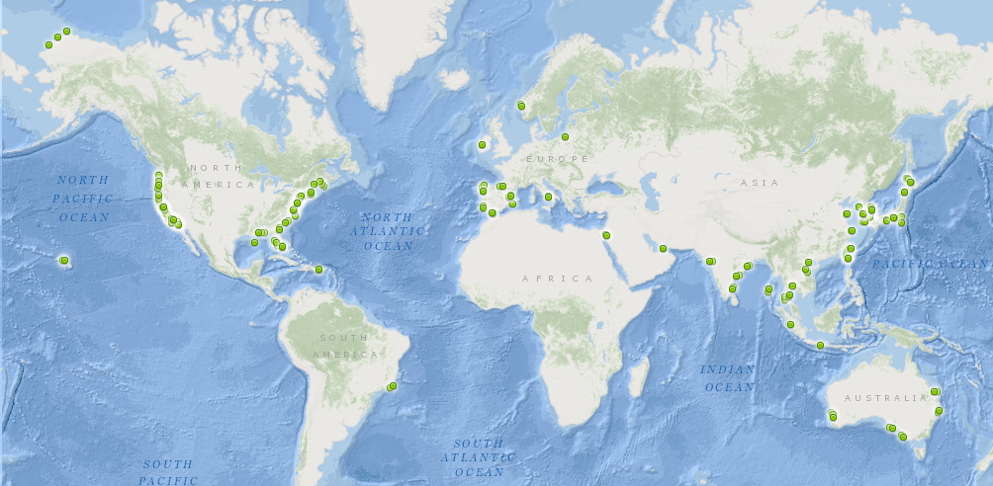
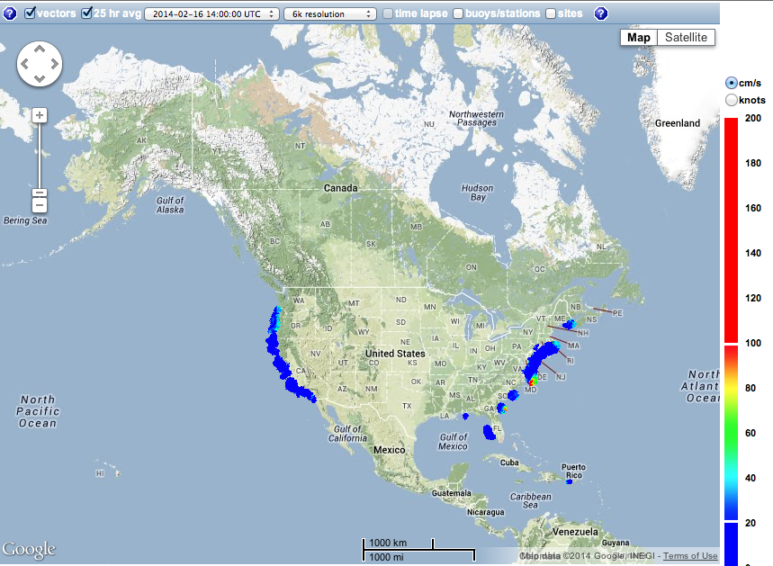
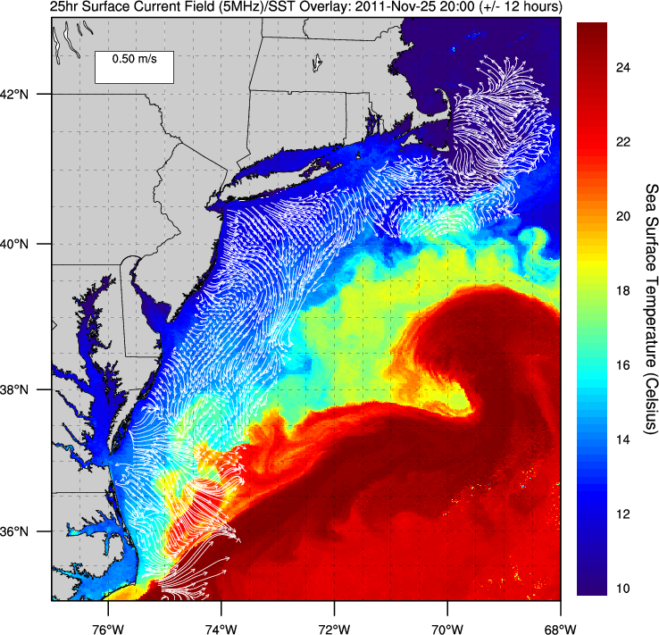
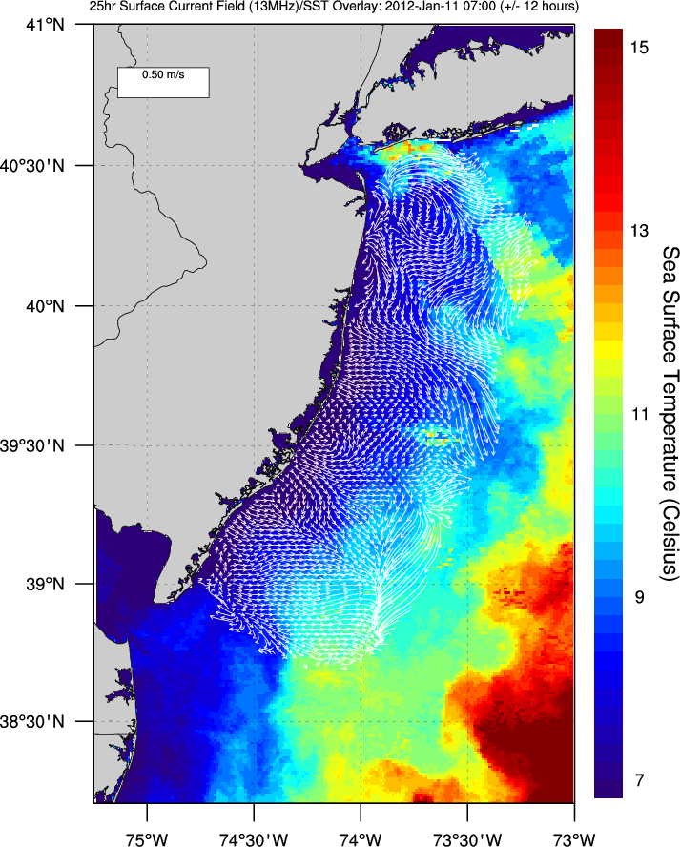
U.S. Integrated Ocean Observing System (IOOS)
Global Component
National Component
Regional Component
Positions
Global HF Radar Network
Vessels -
Satellite
Multistatic
Nested
Monostatic
Mid-Atlantic HF Radar Network
U.S. National HF Radar Network
http://ioos.gov

Slide 8














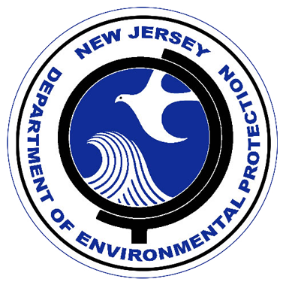


RI
U..
Middle Atlantic
Regional Association
Coastal
Ocean Observing System
10 States - 76 Million People
1000 km Cape to Cape
CT
Cape
Cod
MA
NY
PA
NJ
MARACOOS:
A Sustained Real-time Observation & Forecast System
DE
MD
>40 PIs
>20 Institutions
>50 Members
>2000 Contacts
Scott Glenn + Many
VA
NC
Cape
Hatteras
Notes:
8

Slide 9
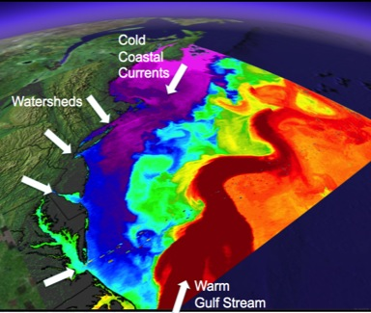
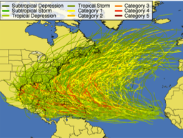
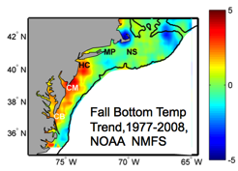
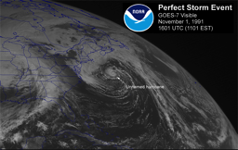
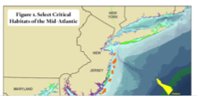
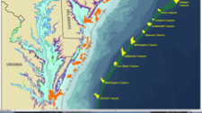
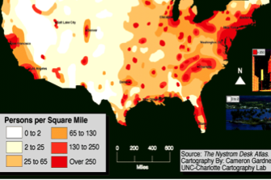
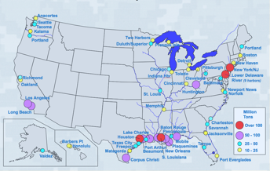
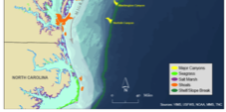
MID-ATLANTIC REGIONAL DRIVERS
Tropical Storms
Climate Change
Ocean Circulation
Critical Habitat
Northeasters
Population
Ports

Slide 10
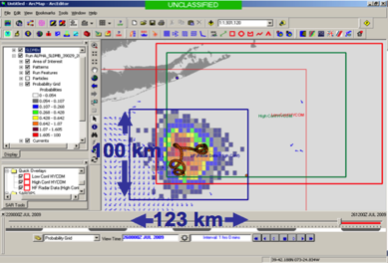
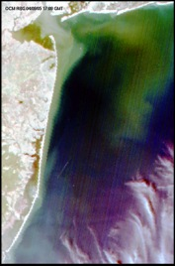
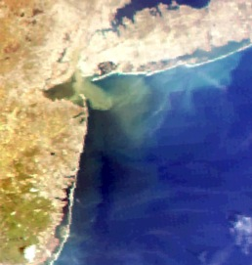
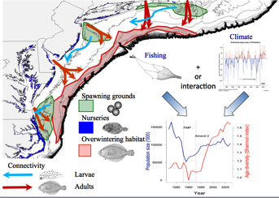
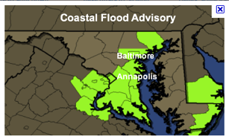
MARACOOS REGIONAL THEMES
1) Maritime Operations – Safety at Sea
3) Water Quality – a) Floatables, b) Hypoxia, c) Nutrients
2) Ecosystem Decision Support - Fisheries
5) Energy – Offshore Wind
4) Coastal Inundation - Flooding

Slide 11
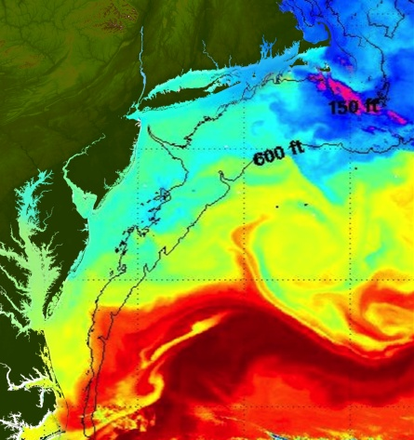
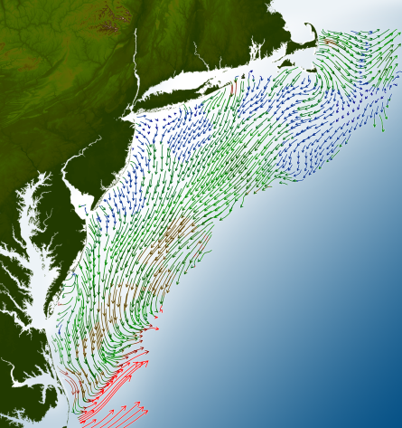
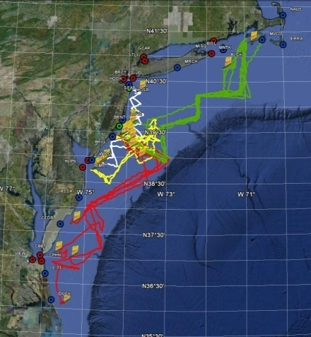
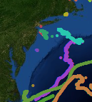
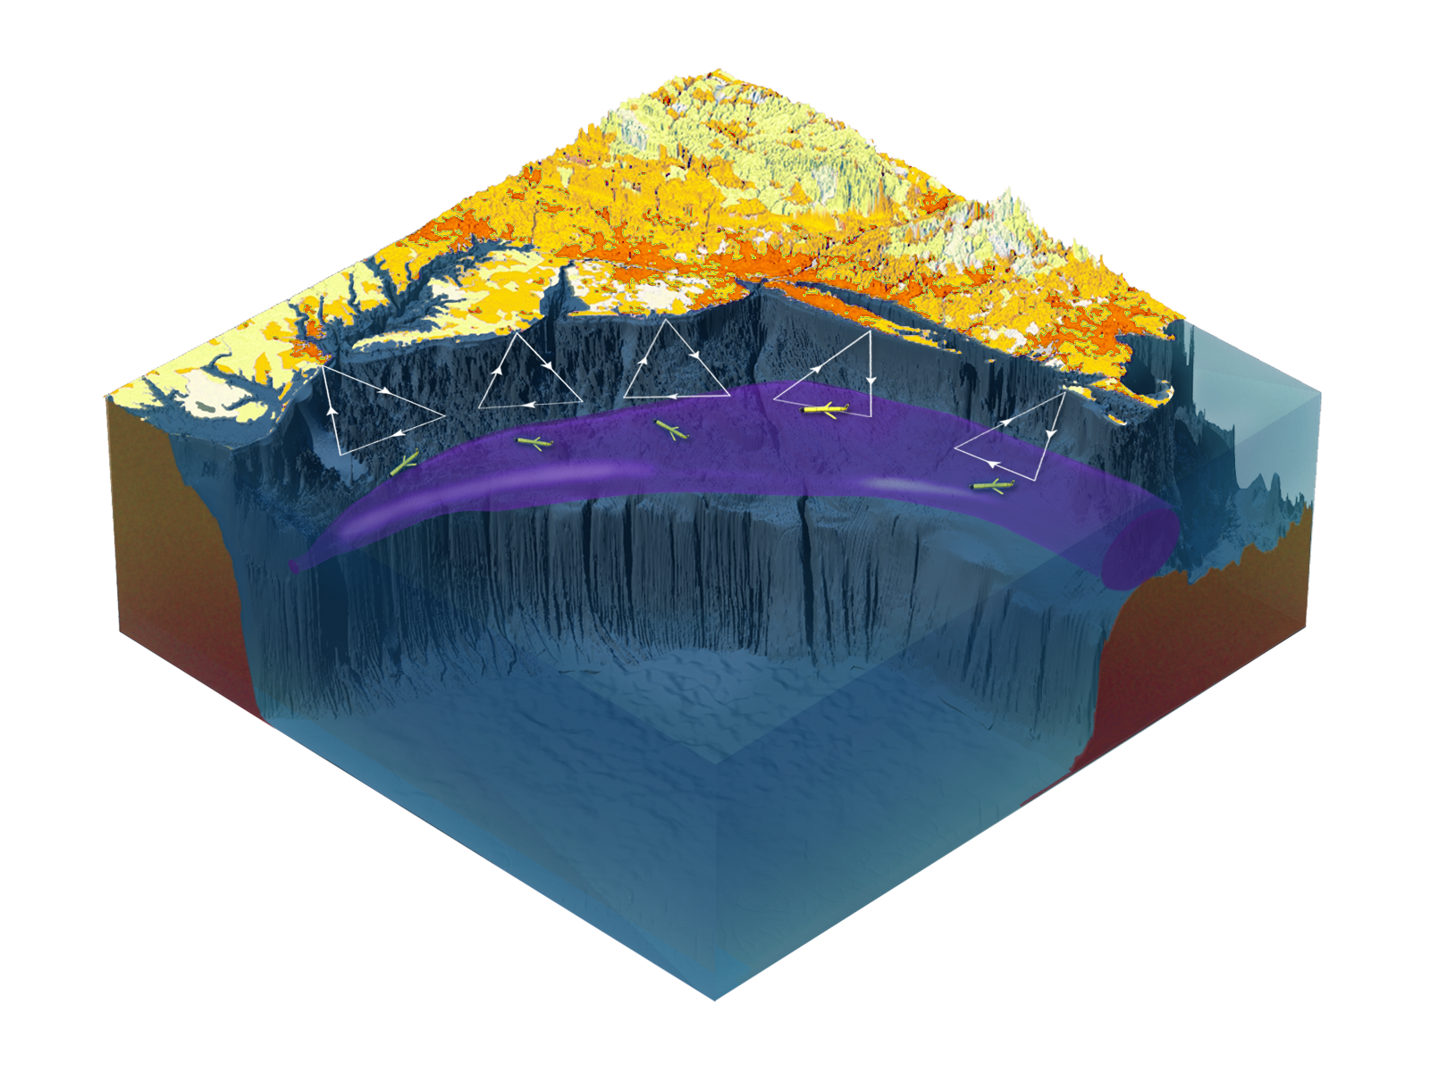

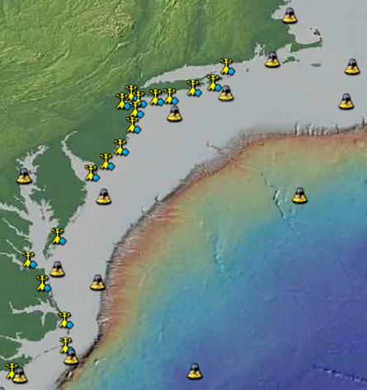
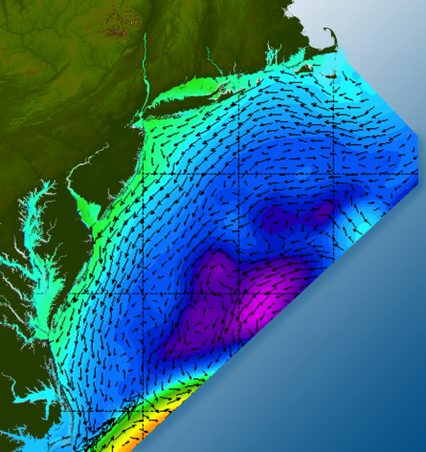

Satellites
HF-Radar
Gliders
Drifters
Population Density
To seek, discover & apply
new knowledge & understanding
of our coastal ocean
Weather Stations
Ocean Forecast Ensemble
Notes:
Need to cut off cold pool in south and bend offshore
Need to experiment with dulling down the colors in the pop density. Maybe orange/tan to white like the box I put in?
Put gliders just below the lines in 3 of them, and increase their angles facing up and down randomly. I stuck in cheesy examples
I already put the shadow and 80% clear line around the two new maps in the upper right, so we are good there.

Slide 12
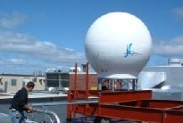
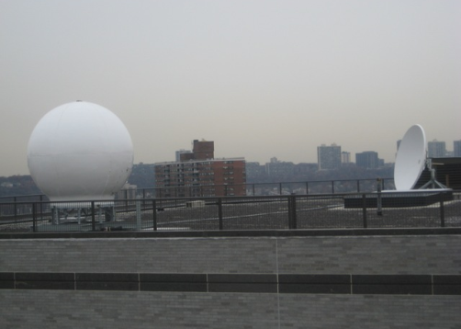
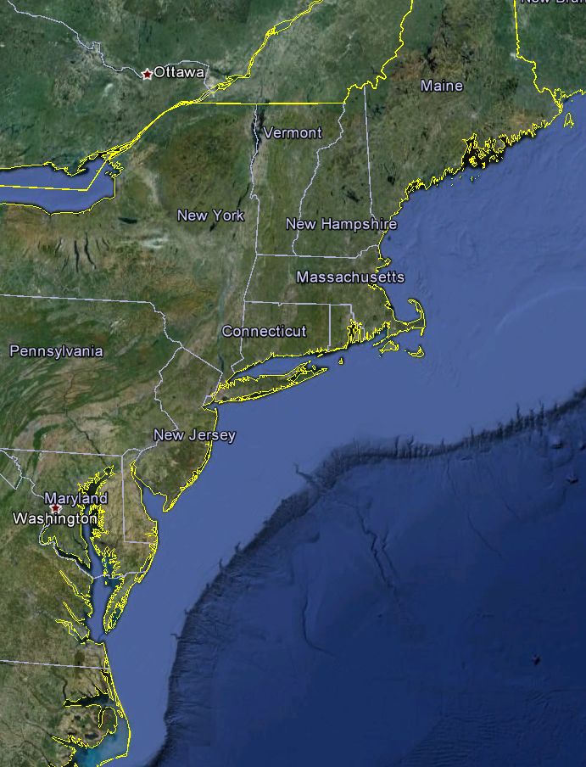
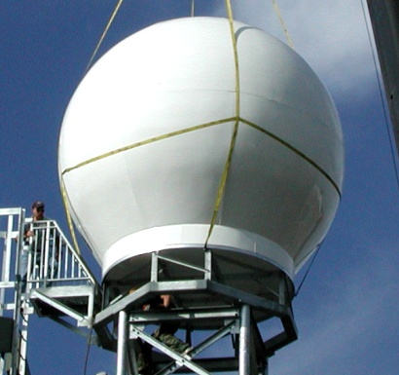
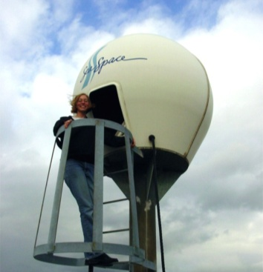
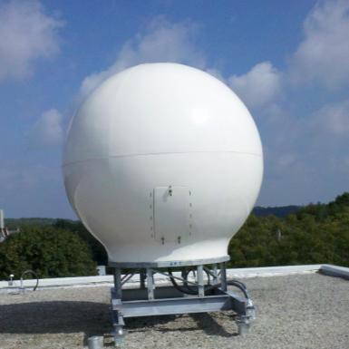
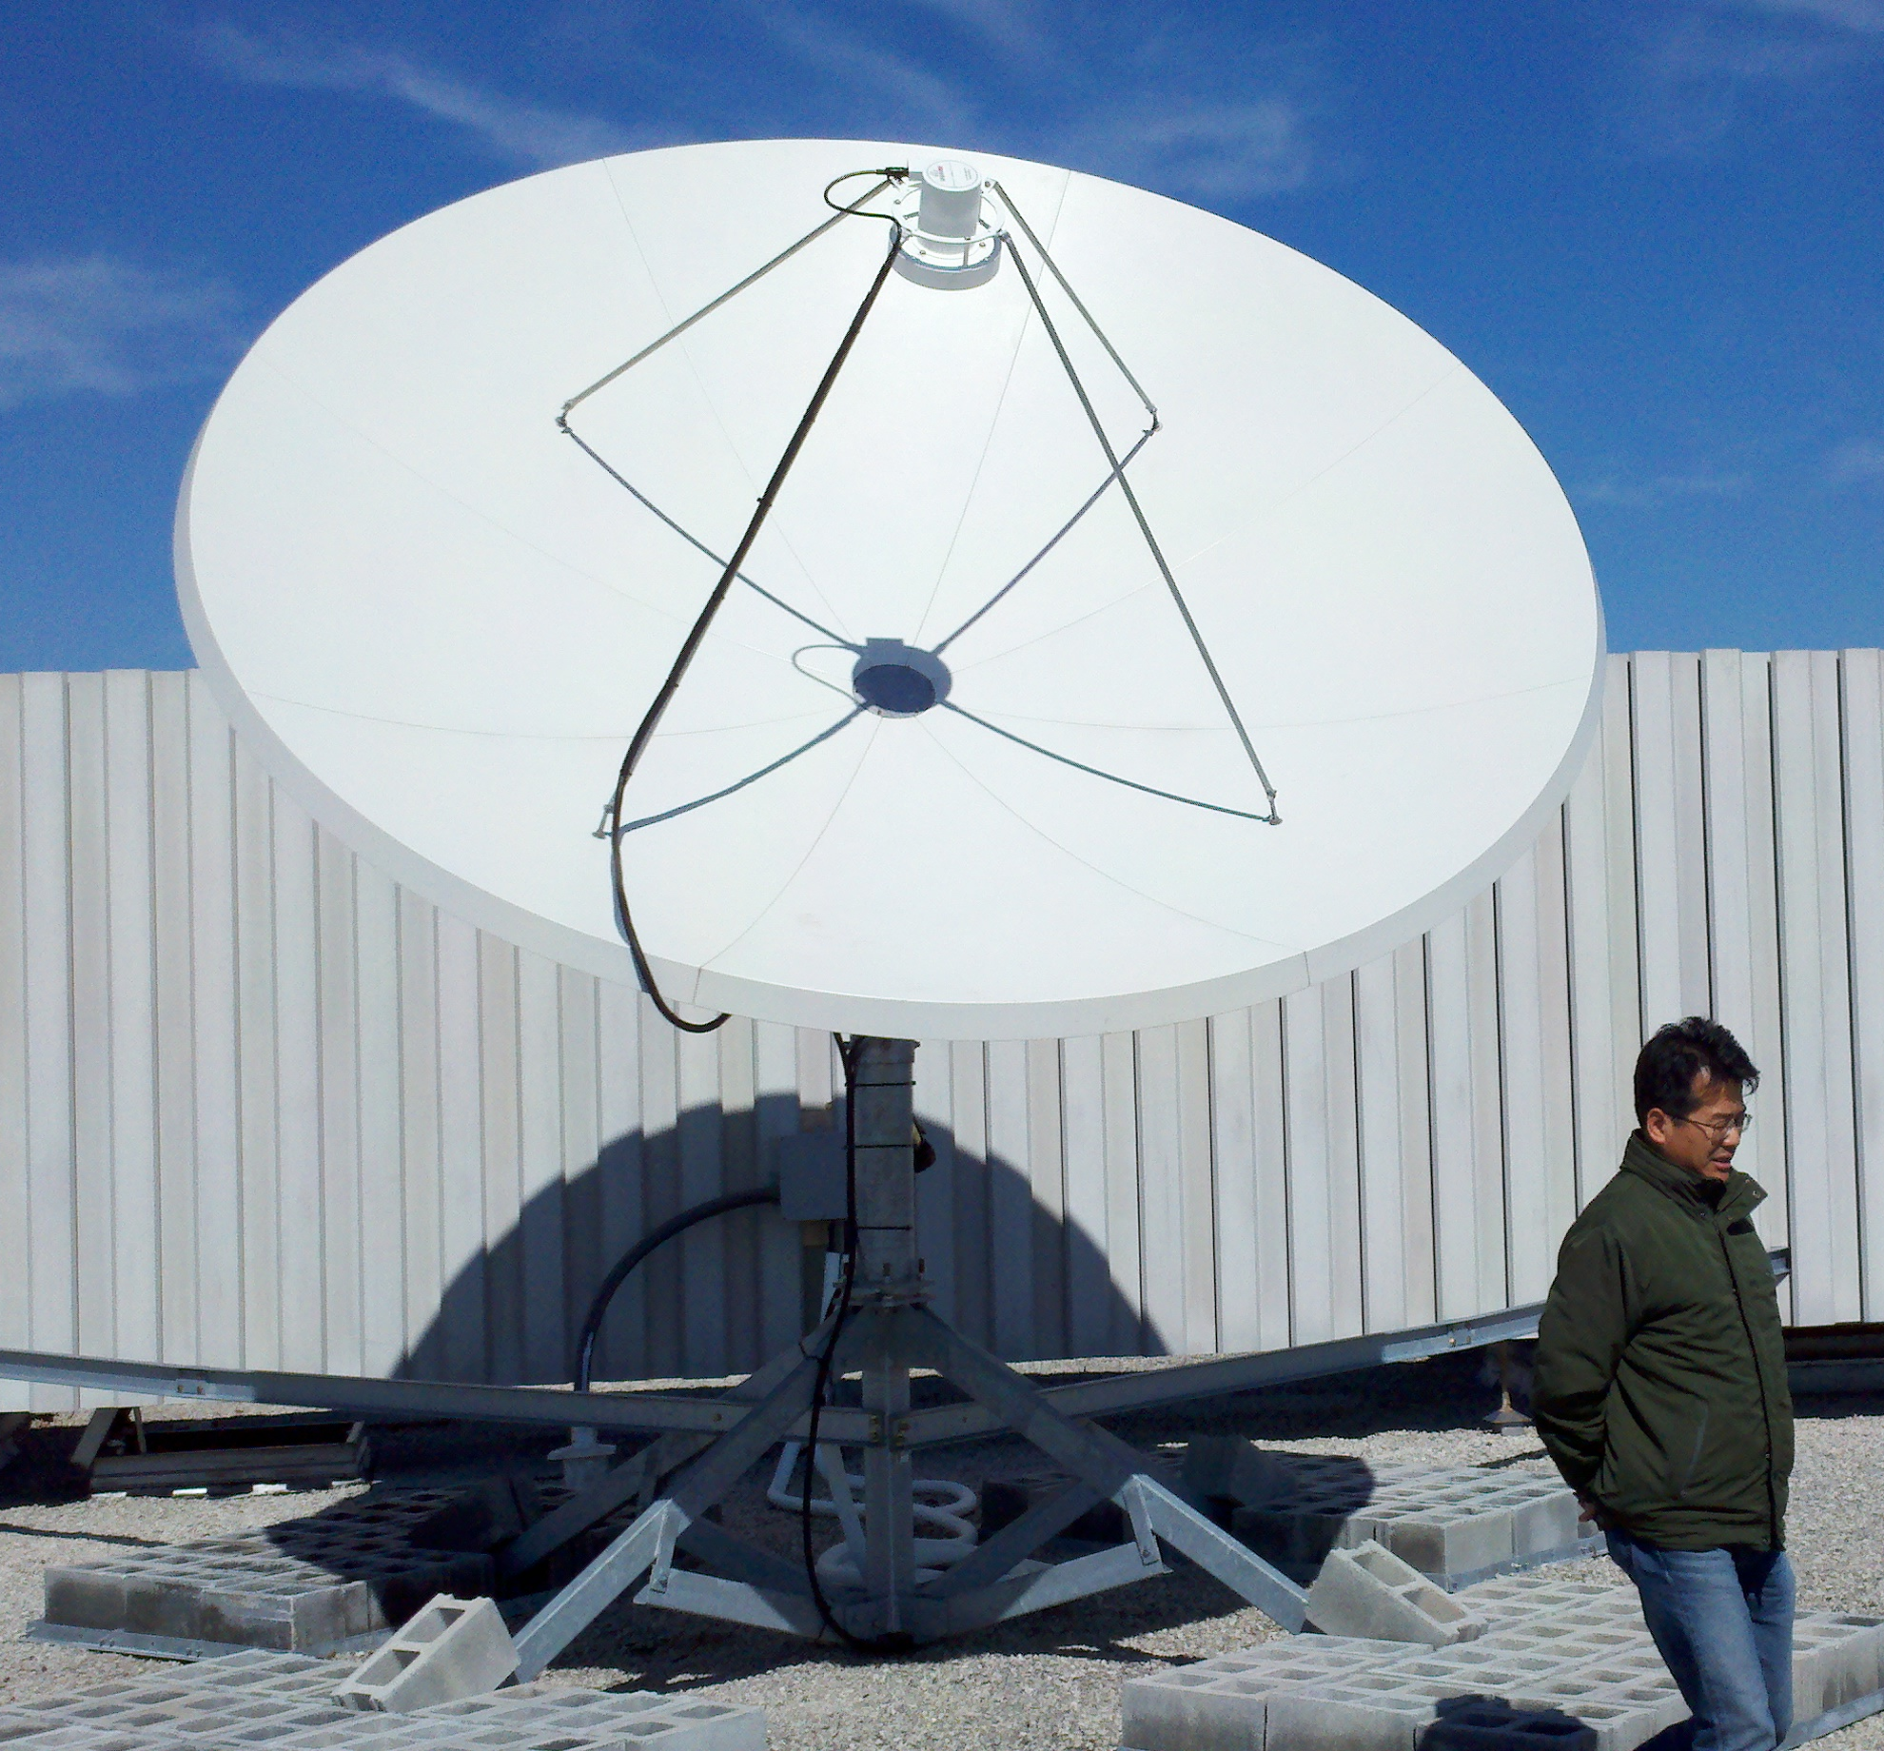
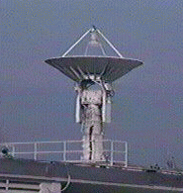
Real-Time Satellite Ground Stations in the Northeast U.S.
Satellites: NPP, Terra, Aqua, NOAA Polar Orbiters, Metop & GOES
U. Maine
City College of N.Y.
Rutgers
U. Delaware
Johns Hopkins

Slide 13
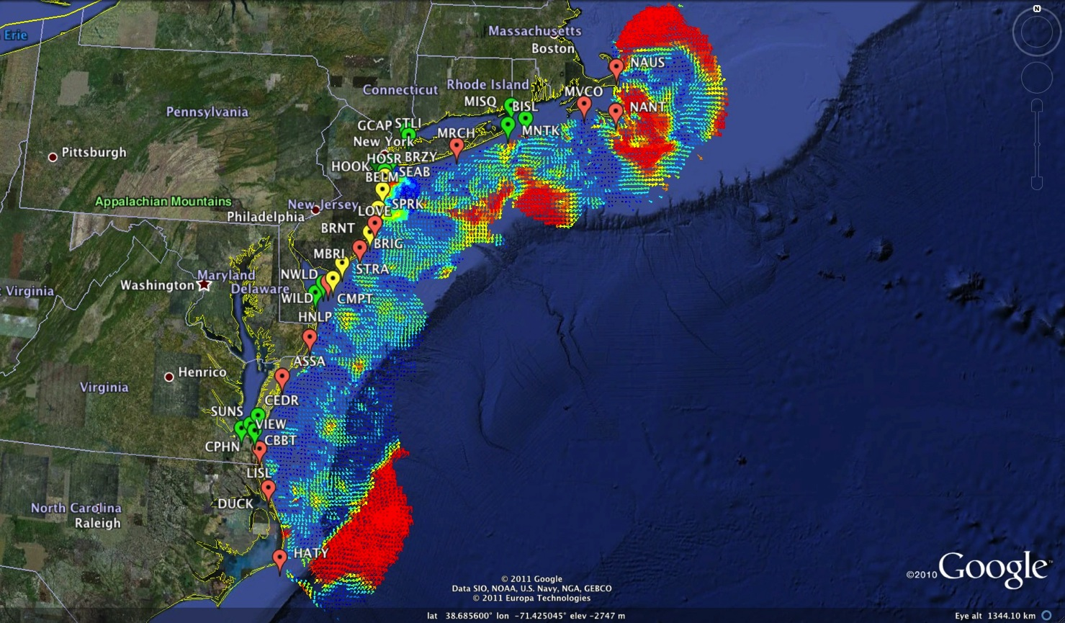






Mid-Atlantic Bight HF Radar Network
1000 km
Cape to Cape
Mid-Atlantic HF Radar Network
16 Long-Range CODARs
8 Medium-Range CODARs
17 Short-Range CODARs
41 Total (Pre-Sandy)
Triple Nested, Multi-static, Multi-use
Industry Partner: CODAR Ocean Sensors

Slide 14







Mid-Atlantic Bight Glider Network
RU01
RU15
RU29
G1
G1-Ruggedized
G2
Satellite Ocean Color
Satellite SST
Subsurface
Glider
Data
Industry Partner: Teledyne Webb Research

Slide 15




MARACOOS Weather Network
NDBC
Backbone
> 50 sites
Regional Industry
Enhancement
> 100 sites

Slide 16

MARACOOS Weather Network
NDBC
Backbone
> 50 sites
MARACOOS
Weather Ensemble
3-7 Members
Verified with Coastal Observations

Slide 17

Advanced Research Version of WRF
Weather Research and Forecasting (WRF) model, Advanced Research core (ARW), Version 3.4.1 (Michalakes et al., 2001)
Horizontal Resolution: 6km
Vertical Resolution: 35 levels, focused near surface
Lateral B.C.: Global Forecast System (GFS) 0.5 degree
Microphysics: WRF Double-Moment 6-class scheme
Planetary Boundary Layer (PBL) scheme: Yonsei University scheme
Longwave radiation: Rapid Radiative Transfer Model (RRTMG)
Shortwave radiation: Dudhia
Bottom B.C. (Sea Surface Temperature, SST): Variant

Slide 18




Improved Predictive Modeling and Data Assimilation
1) STPS
U. Connecticut
2) NYHOPS
Stevens Institute of Technology
3) ROMS
Rutgers University
4) HOPS
U. Massachusetts, Dartmouth

Slide 19

Rutgers ROMS 4DVAR uses all available data
from a modern coastal ocean observing system
  more and diverse data is better (T, S, u, sea level)
  bias correction to OBC and MDT is essential
Useful subsurface skill for real-time applications:
  4 days for temperature and salinity;
  1-2 days for velocity
Future directions: variational methods for
observing system design; coupling; ecosystems
correlation
Forward model
Forward model
after bias removal
Data assimilation
analysis/hindcast
depth
2-day forecast
4-day forecast
Bottom temperature
Data used [… real-time SOURCE]
*THREDDS Data Server
72-hour forecast NAM 0Z cycle at 2 am EST [NCEP NOMADS]
RU regional CODAR hourly: 4-hour latency delay [RU TDS*]
RU glider T,S when available (~ 1 hour delay) [RU TDS]
USGS daily average flow available 11:00 EST [USGS waterdata]
AVHRR IR passes 6-8 per day (~ 2 hour delay) [MARACOOS TDS]
REMSS MW-IR blended SST daily average [NASA PO-DAAC]
HYCOM NCODA 7-day forecast updated daily [NRL]
Jason-2, CryoSat, AltiKa along-track altimeter OGDR [RADS.nl]
SOOP XBT/CTD, Argo floats, on GTS [NOAA OSMC ERDDAP]

Slide 20


Global Models & the Mid- Atlantic Shelf
Glider Data compared to Global Model Forecasts
Summer 2013: Current
Mid-Atlantic
Temperature

Slide 21






MARACOOS Operations Center
Rutgers University - Coastal Ocean Observation Lab
Satellite Data Acquisition Stations
CODAR Network
Glider Fleet
3-D Forecasts

Slide 22






Leveraging Data & Products for Societal Goals
Regional Priority Themes | Regional Observation & Modeling Capabilities
 | Weather Mesonet | HF Radar Network | Statistical STPS | Satellite Imagery | Glider Surveys | Dynamical Ocean Forecasts
Theme 1. Maritime Safety | Operational Input to USCG SAROPS | Operational input to USCG SAROPS | Operational input to USCG SAROPS | SST for survivability planning | Assimilation dataset for forecast models | Surface currents for SAROPS
Theme 2. Ecological Decision Support | Weather forecast ensemble validation | Circulation and divergence maps for habitat |  | SST & Color for habitat | Subsurface T & S for habitat | 3-D fields of T, S, circulation for habitat
Theme 3. Water Quality | Winds for transport, river plumes, & upwelling | Surface currents for flotables, bacteria, spill response | Surface currents for flotables, bacteria, spill response | Ocean color for river plumes | Nearshore dissolved oxygen surveys | Surface currents for floatables, bacteria, spill response
Theme 4. Coastal Inundation | Weather forecast ensemble validation | Current forecast model validation |  | SSTs assimilation into forecast models | Assimilation dataset for forecast models | Nested forecast ensembles
Theme 5. Offshore Energy | Historical analysis & wind model validation | Historical current analysis & wind model validation |  | Historical analysis surface fronts & plumes for siting | Historical analysis of subsurface fronts & plumes | Coupled ocean-atmosphere models for resource estimates

Slide 23
Leveraging Data & Products for Societal Goals
Regional Priority Themes | Regional Observation & Modeling Capabilities
 | Weather Mesonet | HF Radar Network | Statistical STPS | Satellite Imagery | Glider Surveys | Dynamical Ocean Forecasts
Theme 1. Maritime Safety | Operational Input to USCG SAROPS | Operational input to USCG SAROPS | Operational input to USCG SAROPS | SST for survivability planning | Assimilation dataset for forecast models | Surface currents for SAROPS
Theme 2. Ecological Decision Support | Weather forecast ensemble validation | Circulation and divergence maps for habitat |  | SST & Color for habitat | Subsurface T & S for habitat | 3-D fields of T, S, circulation for habitat
Theme 3. Water Quality | Winds for transport, river plumes, & upwelling | Surface currents for flotables, bacteria, spill response | Surface currents for flotables, bacteria, spill response | Ocean color for river plumes | Nearshore dissolved oxygen surveys | Surface currents for floatables, bacteria, spill response
Theme 4. Coastal Inundation | Weather forecast ensemble validation | Current forecast model validation |  | SSTs assimilation into forecast models | Assimilation dataset for forecast models | Nested forecast ensembles
Theme 5. Offshore Energy | Historical analysis & wind model validation | Historical current analysis & wind model validation |  | Historical analysis surface fronts & plumes for siting | Historical analysis of subsurface fronts & plumes | Coupled ocean-atmosphere models for resource estimates

Slide 24









Development of the
Mid-Atlantic,
U.S. National & Global
HF Radar Networks
Rutgers
CODAR
Group:
Scott Glenn &
Josh Kohut (Fac).
Hugh Roarty (Lead).
Ethan Handel &
Colin Evans (HW).
Mike Smith (SW).
8 Universities + 2 Techs contribute to MARACOOS HF Radar Network

Slide 25


Surface Current Mapping Capability
25 MHz
Radar λ: 12 m Ocean λ: 6 m
Range: 30 km Resolution: 1 km
13 MHz
Radar λ: 23 m Ocean λ: 12 m
Range: 80 km Resolution: 3 km
05 MHz
Radar λ: 60m Ocean λ: 30 m
Range: 180 km Resolution: 6 km

Slide 26





LONG RANGE NETWORK
2010
2003
2007
2003
2001
2003
2000
2001
2001
2006
2006
2009
Fourteen
5 MHz
CODAR
SeaSondes
2003
2003

Slide 27
LONG RANGE NETWORK
2010
2003
2007
2003
2001
2003
2000
2001
2001
2006
2006
2009
Fourteen
5 MHz
CODAR
SeaSondes
2003
2003

Slide 28




Nested Standard Range Network
Fourteen
24 MHz
CODAR
SeaSondes

Slide 29





U.S. National HF Radar Network
June 2004
U.S. IOOS
HF Radar Data Flow
For US Coast Guard
Search And Rescue
Since 2007

Slide 30



Success Stories – Making a Difference
Optimizing HF Radar for SAR using USCG Surface Drifters
Art Allen
U.S. Coast Guard
Scott Glenn
Rutgers University
Mid-Atlantic Regional Association
Coastal Ocean Observing System

Slide 31





Transition Objective –
Operational Use of HF Radar Surface Currents for Search And Rescue
Surface Currents
Data Acquisition
Data Product Generation & Management
Search And Rescue Optimal Planning System (SAROPS)

Slide 32



5000 Virtual Drifters –
24 Hours Into Search
HYCOM
Low Confidence
CODAR
High Confidence
Notes:
HYCOM, (low Conf) 24 hrs

Slide 33


5000 Virtual Drifters –
48 Hours Into Search
HYCOM
Low Confidence
CODAR
High Confidence
Notes:
HYCOM, (low Conf) 24 hrs

Slide 34


5000 Virtual Drifters –
72 Hours Into Search
HYCOM
Low Confidence
CODAR
High Confidence
Notes:
HYCOM, (low Conf) 24 hrs

Slide 35


5000 Virtual Drifters –
96 Hours Into Search
HYCOM
Low Confidence
CODAR
High Confidence
Notes:
HYCOM, (low Conf) 24 hrs

Slide 36


5000 Virtual Drifters –
Search Area After 96 Hours
154 km
100 km
232 km
123 km
HYCOM
36,000 km²
CODAR
12,000 km²
Notes:
HYCOM (Low Conf) 48 hours

Slide 37

May 4, 2009: After a year of testing, NOAA Announces on
U.S. Department of Commerce Website that
MARACOOS CODAR is Operational in SAROPS
Present Activity:
Bring all
sustained regional-scale HFR networks up to operational status in USCG SAROPS
3 West Coast Regions for
California & Oregon are ready.

Slide 38


U.S. National HF Radar Network
Table 4: Full 5-Year Buildout. Estimated acquisition & maintenance costs.
Technician fully encumbered salary is
estimated at $130,000;
Purchase and deployment for DF HFRs,
LPA HFRs are $160,000 and $300,000,
respectively.
Two technicians for each 7 DF HFRs,
4 LPA HFRs, respectively.
September 2009
http://www.ioos.gov/hfradar/
Notes:
100 people for DF, 175 people for LPA.

Slide 39


2010 Deepwater Horizon Oil Spill
Oil Transport Questions: Will the oil….
Come ashore in Louisiana?
Spread east to Texas or west to Mississippi, Alabama and Florida pan handle in the wind-driven coastal currents?
Enter the Loop Current and be transported downstream?
Hit the Florida Shelf and be driven shoreward by winds?
Ride the Loop Current south and hit the Florida Keys?
Be transported out of the Gulf of Mexico by the Gulf Stream and impact the East Coast?
Gulf of Mexico

Slide 40

Oil Spill Trajectory Forecasting
Ingested & distributed by IOOS national HF radar data servers at Scripps & NOAA/NDBC
Collected using CODAR SeaSonde® HF radar systems (USM, USF)
Chronology
2006
2007
20 Apr
30 Apr
2 May
2 May – Cap of DWH Well
Safe Seas Exercise
HFR support to COSCO Busan
Data received by IOOS National Servers & NOAA/OR&R/ERD
HFR used daily for trajectory forecasting
USM: radars restored
2 of 3 USM radars: not operational, scheduled maintenance

Slide 41





Responding to Crisis: Deepwater Horizon
U.S. IOOS partnership demonstrated ability to:
Quickly deploy technologies: Gliders and HF radar, saving resources/improving safety
Models/Imagery ingested into NOAA/Navy models
Data assimilation improved spill response decision-making and public understanding
USM HFR
USF HFR
June 2
HFR validation of SABGOM Forecast combined with satellite detected oil slicks
Briefing Blog
127 Briefs
Web Portal
HFR data informed NOAA
trajectory forecasts

Slide 42




Deepwater Horizon Oil Spill Response: Near Field Environmental Analyses
Oil response to a major wind shift
July 3
June 29
July 4
July 7

Slide 43




Deepwater Horizon Oil Spill Response: Far Field Environmental Analyses
June 6
June 6
June 6
June 6

Slide 44


Deepwater Horizon Oil Spill Response: Approach to West Florida Shelf
Close Approach to
West Florida Shelf
June 3
June 4

Slide 45

18 July 2010 Blog Entry - 2010-2020: The Ocean Forecasting Decade

Slide 46





July, 2009
Deepwater Horizon
Response: East Coast Assessments of Risk
July 6
August, 2009
September, 2009
June 25

Slide 47
Feedback from the Deepwater Horizon
Incident Command Center
Composite of Satellite Observed Oil Spill Locations
“All - Greetings from Unified Area Command in New Orleans. I couldn't agree more - the IOOS community has acquitted itself very well during this entire incident. Not only has everyone provided valuable information - you have done it without getting in the way of the ongoing operations. It's been a pleasure to represent IOOS here and see all the great contributions from the larger IOOS community. “
- Sam Walker (IOOS representative to Deepwater Horizon Unified Command Center), June 18, 2010
“… AWESOME JOB - that call that we had last week was a very good thing. You are taking a huge burden off of the team here who is trying to simply capture the deluge of assets now being deployed. “
- Sam Walker (IOOS representative to Deepwater Horizon Unified Command Center), July 2, 2010
“…Thanks to everyone for all of your efforts to support the Response and the very professional and competent manner in which you have executed your efforts. IOOS has played a huge role in informing the modeling teams and the Unified Command through your extraordinary service. “
- Sam Walker (IOOS representative to Deepwater Horizon Unified Command Center), August 6, 2010

Slide 48
Feedback from the Deepwater Horizon
Incident Command Center
Composite of Satellite Observed Oil Spill Locations
“All - Greetings from Unified Area Command in New Orleans. I couldn't agree more - the IOOS community has acquitted itself very well during this entire incident. Not only has everyone provided valuable information - you have done it without getting in the way of the ongoing operations. It's been a pleasure to represent IOOS here and see all the great contributions from the larger IOOS community. “
- Sam Walker (IOOS representative to Deepwater Horizon Unified Command Center), June 18, 2010
We did not get in the way
“… AWESOME JOB - that call that we had last week was a very good thing. You are taking a huge burden off of the team here who is trying to simply capture the deluge of assets now being deployed. “
- Sam Walker (IOOS representative to Deepwater Horizon Unified Command Center), July 2, 2010
We reduced the burden
“…Thanks to everyone for all of your efforts to support the Response and the very professional and competent manner in which you have executed your efforts. IOOS has played a huge role in informing the modeling teams and the Unified Command through your extraordinary service. “
- Sam Walker (IOOS representative to Deepwater Horizon Unified Command Center), August 6, 2010
We informed modeling teams & leadership

Slide 49

From Page 10:
Also in support of oil spill response, NOAA requests a $5.0 million increase to implement the U.S. Integrated Ocean Observing System (IOOS®) Surface Current Mapping Plan using high frequency (HF) radar surface current measurements. HF radar provides information vital to oil spill response, national defense, homeland security, search and rescue operations, safe marine transportation, water quality and pollutant tracking, and harmful algal bloom forecasting.
www.legislative.noaa.gov/Testimony/Lubchenco033111.pdf

Slide 50


U.S. National HF Radar Network
Summer
2011 Coverage
131 Radars

Slide 51

U.S. National HF Radar Network
Status:
Feb 16, 2014
111 of 137 registered sites
reporting
AOOS &
PACIOOS
Not Reporting
http://hfradar.ndbc.noaa.gov/

Slide 52



Total Vectors Combined from Sites at
Palmer Station (P313) and Wauwerman Islands (WAUW)
1 Frequency at Palmer (13 MHz), 2 consecutive hours

Slide 53

National HF Radar Technical Steering Team Meeting: July 19-20, 2011
Steering Team members
Project Manager:
Jack Harlan, NOAA IOOS
Federal Partners:
Bill Birkemeier, USACE
Pat Burke, NOAA CO-OPS
Bill Burnett, NOAA-NDBC
Ming Ji, NOAA NWS OPC
Rich Patchen, NOAA CSDL
Elected by RAs:
Larry Atkinson, Old Dominion
Pierre Flament, U Hawaii
Scott Glenn, Rutgers
Jeff Paduan, Naval Postgrad
Nick Shay, U Miami
Eric Terrill, Scripps
Technical Experts:
Don Barrick, COS
Mike Kosro, Oregon State
http://hfradar.ndbc.noaa.gov/

Slide 54
National HF Radar Technical Steering Team
Addressing Research Topics
  Use of HF radar over fresh water
  Wave measurements with HFR
  Model assimilation of HFR data
Addressing Programmatic Topics
  Establishing budget line for National HFR network

Slide 55



Radiowave Operators Working Group
ROWG 2014

Slide 56




Rutgers Course for High Frequency Radars
Course 11:628:312

Slide 57


Slide 58


Slide 59


Slide 60


Slide 61


Slide 62


Slide 63


Slide 64

Grid Points for USCG 80-80 Metric

Slide 65

2009
2010
2008

Slide 66



Standard CODAR Shore Site:
Shed, Enclosure, Tx/Rx, Comms, Power, GPS, AIS
monitor
computer & external hard drive
A.C. unit
UPS system
transmitter
receiver
Two lines of Communication
Shed
Enclosure
Lightning Protection

Slide 67
Loveladies Power Configuration
Electricity Grid Power
SeaSonde Transmitter
SeaSonde Receiver
Macintosh Computer
Load 1
TrippLite Surge Strip
AIS Receiver
TrippLite UPS
Linksys Router
Power Stone
Cable Modem
Load 2
Monitor
Air Conditioner
External Hard Drive
Roarty et al. (2010) MTS Journal

Slide 68
Loveladies Communication Configuration
Tripp LIte UPS
Cable Modem
Linksys Router
AIS Receiver
Internet
Macintosh Computer
SeaSonde Receiver
SeaSonde Transmitter
Telephone Network
Power Stone
Telephone
Ethernet
USB
Serial
Roarty et al. (2010) MTS Journal

Slide 69

Acquisition & Installation and
Annual Technician Support cost
estimates based on the U.S.
National HF Radar Network
design parameters.
Active Spares Approach
Spares used to fill the largest gaps, improving the quality of the data when all are running and improving the resiliency of the network when one site goes down.
HFR Network Design Example:
1000 km / ( 75 km/segment )
= 13 Segments of Coast
Segment Color Key
Red > 90 km
90 km > Orange > 70 km
70 km > Green

Slide 70

Through Improved Site Resiliency & An Active Spares Approach, MARACOOS has exceeded the USCG’s 80-80 Coverage Target with 1/3 of the Recommended Technician Support

Slide 71


Monostatic
Radials
Bistatic
Ellipticals

Slide 72

Total Surface Currents
Three Weeks
August 30 – September 20, 2013
6 Radial Stations

Slide 73

Total Surface Currents
Three Weeks
August 30 – September 20, 2013
6 Radial Stations
&
5 Elliptical Pairs

Slide 74



Dual Transmitter Test
25% Increase
Transmitter Installed
234 km
187 km

Slide 75

Global High Frequency (HF) Radar
Surface Current Mapping
GEO Task
Co-Chairs
Jack Harlan (USA)
Lucy Wyatt (Australia)
Enrique Alvarez-Fanjul (Spain)

Slide 76
GEO Work Plan 2012-2015
Endorses a task to plan a Global HF Radar Network for data sharing and delivery and to help expand HF radar networks for surface current and wave measurements.
This GEO task is mentioned under
  IN-01 Earth Observing Systems
  SB-01 Oceans and Society: Blue Planet

Slide 77
GEO – Quick Facts:
There are 89 entities in the Group on Earth Observations
72 countries have a salty coast
35 of those countries have High Frequency Radars on their coastline
Approximately 410 operating radars worldwide

Slide 78

Global HF Radar Network
Established in March 2012 at Oceanology International in London
Goals of this effort:
  Increase the number of radars
  Ensure HF radar data is available in a single standardized format
  Develop worldwide quality standards
  Assimilate the data into ocean models
  Develop standard product suite and advance the emerging applications

Slide 79
Number of HF Radar Stations
Identified in Each Country
35 Countries with HF Radar for oceanographic purposes

Slide 80
Accomplishments
Two International Meetings
  (London 2012, Bergen 2013)
Dedicated Web Page
  http://www.ioos.noaa.gov/globalhfr/welcome.html
Established Three Working Groups
  1. Data Management - Scripps
  2. Applications - Rutgers
  3. Deployment - James Cook
Held Two Webinars
  1. Data management (April 2013)
  2. Applications (June 2013)

Slide 81
Type of Applications
63 stories can be found at:
https://docs.google.com/spreadsheet/ccc?key=0ApJVYVXQvIe0dDBPcWFGZll0UTRBS3VaMERYUXhKT2c#gid=0
Please send us more stories!

Slide 82
2nd GEO Global HF Radar Meeting - Bergen 2013
~30 Attendees from 14 nations
  Australia
  Canada
  France
  Germany
  Indonesia
  Ireland
  Korea
  Malta
  Morocco
  Norway
  Saudi Arabia
  Spain
  United Kingdom
  USA
All 3 topics discussed
Additional discussion of international radio frequency management (ITU Working Party 5B, May 2013)

Slide 83
Synergies & Challenges
Synergies
  WRC frequency allocations
  Data file formats
Challenges
  Data distribution and exchange
  Data assimilation into operational models
  Frequency synchronization

Slide 84


Slide 85

3rd GEO Global HF Radar Meeting
Kaohsiung, Taiwan, April, 2014

Slide 86
Selected Recent Publications
HF Radar for Surface Current Mapping:
Roarty, Glenn, Kohut, Gong, Handel, Rivera, Garner, Atkinson, Brown, Jakubiak, Muglia, Haines, Seim, (2010). Operation and Application of a Regional High-Frequency Radar Network in the Mid-Atlantic Bight, Marine Technology Society Journal, V. 44, No. 6, p. 1-13.
Corredor, J. E., Amador, A., Canals, M., Rivera, S., Capella, J.E., Morell, J.M., Glenn, S.M., Roarty, H.J., Handel, E., Rivera, E. (2011) “Optimizing and Validating High Frequency Radar Surface Current Measurements in the Mona Passage” Marine Technology Society Journal, Vol. 45, No. 3, 49-58
Teague, C.C., Barrick, D. E., Lilleboe, P.M., Roarty, H., Holden, D., Goldinger, D. (2011) “Extended-Range RiverSonde Operation on the Hudson River, Current, Waves and Turbulence Measurements (CWTM), 2011 IEEE/OES 10th, 78-80, doi 10.1109/CWTM.2011.5759529
Harlan, J., Allen, A., Howlett, E., Glenn, S.M., Kohut, J.T., Roarty, H., O’Donnell, J., Fake, T., Terrill, E., Kim, S.Y., Otero, M. (2011) “National IOOS HF Radar Search and Rescue Project”, Oceans 2011 MTS/IEEE – Kona

Slide 87
Selected Recent Publications
HF Radar for Surface Current Mapping:
Kohut, Roarty, Randall-Goodwin, Glenn, Lichtenwalner (2012) Evaluation of Two Algorithms for a Network of Coastal Radars in the Mid Atlantic Bight, Ocean Dynamics, Vol. 62, p. 953-968
Roarty, H.J., Riscica, J., Palamara, L., Bowers, L. , Seroka, G., Kohut, J., Glenn, S., Dunk, R. (2012) “Analysis of the Wind Resource off New Jersey for Offshore Wind Energy Development”, Oceans 2012 MTS/IEEE – Hampton Roads
Roarty, H.J., Smith, M., Kerfoot, J., Glenn S. (2012) “Automated Quality Control of High Frequency Radar Data”, Oceans 2012 MTS/IEEE – Hampton Roads
Roarty, H.J., Smith, M., Handel, E., Barrick, D. and Glenn S. (2012) “ Expanding the Coverage of HF Radar Through the Use of Wave Powered Buoys” Oceans 2012 MTS/IEEE – Hampton Roads
Evans, C.W., Roarty, H.J., Kohut, J.T., Glenn, S.M. (2012) ‘Examination of the SeaSonde Wave Processing Settings and the Effects of Shallow Water on Wave Measurements” Oceans 2012 MTS/IEEE – Hampton Roads

Slide 88
Selected Recent Publications
HF Radar for Surface Current Mapping:
Seroka, G, Dunk, R., Glenn, S., Bowers, L., Kerfoot, J., Crowley, M., Roarty, H.J., Palamara, L., Kohut, J., (2012) “Rutgers University Coastal Ocean Observation Laboratory (RU-COOL) Advanced Modeling System Developed to Cost-Effectively Support Offshore Wind Energy Development and Operational Applications” Oceans 2012 MTS/IEEE – Hampton Roads
Schofield, O., Roarty, H., Saba, G., Yi, X., Kohut, J., Glenn, S., Manderson, J., Oliver, M. (2012) “ Phytoplankton Dynamics and Bottom Water Oxygen During a Large Bloom in the Summer of 2011”, Oceans 2012 MTS/IEEE – Hampton Roads
Glenn, Schofield, Kohut, Dunk, Titlow, Roarty, Kerfoot, Palamara, Bowers, Seroka, Miles, Xu, Crowley (2012) “Impact of Ocean Observations on Hurricane Forecasts in the Mid Atlantic”, Oceans 2012 MTS/IEEE – Hampton Roads

Slide 89
Selected Recent Publications
HF Radar for Vessel Tracking:
Roarty, H.J., D. E. Barrick, J. T. Kohut, S. M. Glenn (2010) “Dual-Use of Compact HF Radars for the Detection of Mid and Large Size Vessels” Turkish Journal of Electrical Engineering and Computer Sciences, Vol. 18, No. 3, 373-388
Roarty, Lemus, Handel, Glenn, Barrick, Issacson, (2011). “Performance Evaluation of SeaSonde High-Frequency Radar for Vessel Detection”, Marine Technology Society Journal, V. 45, No. 3, p. 14-24.
Newton, D. (2012) "Observations and Analysis of the Target Detection Performance of the CODAR HF Surface Wave Radar," The Proceedings of the 2012 MSS Tri-Service Radar Conference, Boulder, CO; 18-22 June 2012.
Roarty, Smith, Glenn, Barrick, Whelan, Statscewich, Weingartner (2013) “Expanding Maritime Domain Awareness Capabilities in the Arctic: High Frequency Radar Vessel-tracking” IEEE Radar Conference, Ottawa Canada
Roarty, Glenn, Barrick (2013) “Real-Time Beyond the Horizon Vessel Detection” Radar Sensor Technology XVII, SPIE Paper 8714-36

Slide 90
Selected Recent Publications
Education:
Glenn + 27 Researches + 57 Students, Jan-Feb 2011. The Trans-Atlantic Slocum Glider Expeditions: A Catalyst for Undergraduate Participation in Ocean Science & Technology, Marine Technology Society Journal, V. 45, No. 1, p. 52-67.
International Talks
Spain, Norway, Sweden, Poland, Brazil, United Kingdom, South Korea, China, South Africa

Slide 91
Conclusions:
South African Coast
2400 km
1) We welcome South Africa to the Global HF Radar Community
2) How can we help?
3) What can we do together?

