Slide 1




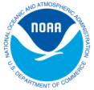

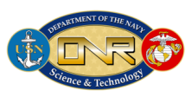

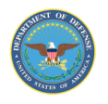


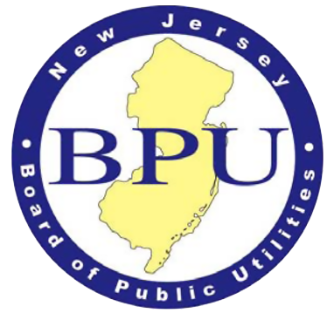
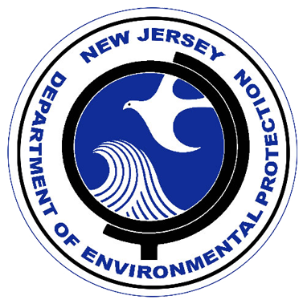


Ocean Observatories
Scott Glenn, Josh Kohut, Oscar Schofield
Rutgers University’s Coastal Ocean Observation Lab

Slide 2
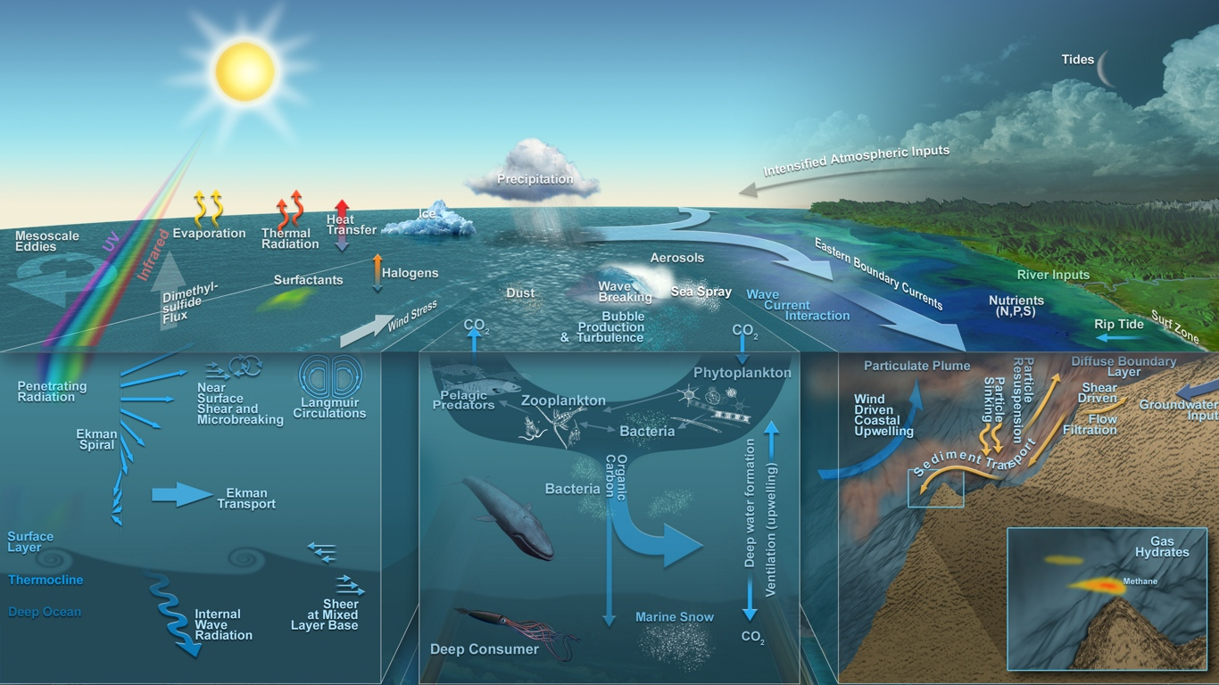
The Earth system is complex
Thanks to Neptune, John Delaney, and Mark Stoermer

Slide 3
Ocean System is Changing (Physics)

Slide 4
Ocean System is Changing (Chemistry)

Slide 5
Ocean System is Changing (Biology)

Slide 6
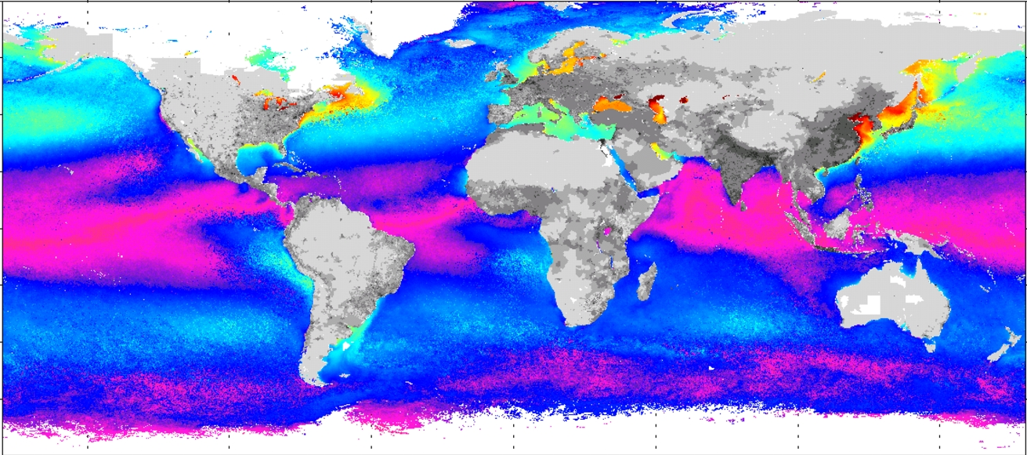
Ocean system is central to global commerce and is
home to the majority of humans living at the coasts
Grey is human population density
Colors represent the interannual temperature change

Slide 7
Given the challenges we need to:
Improve technologies to observe and model ocean systems
Deploy multi-use omnipresent networks throughout the world’s oceans
Develop an event response capability
Integrated data networks to allow for data fusion and selective crowd sourcing
Development new training pipeline for the future workforce, scientists and engineers
The community is maturing through international collaboration, national operational and science investments, and new teaching programs

Slide 8
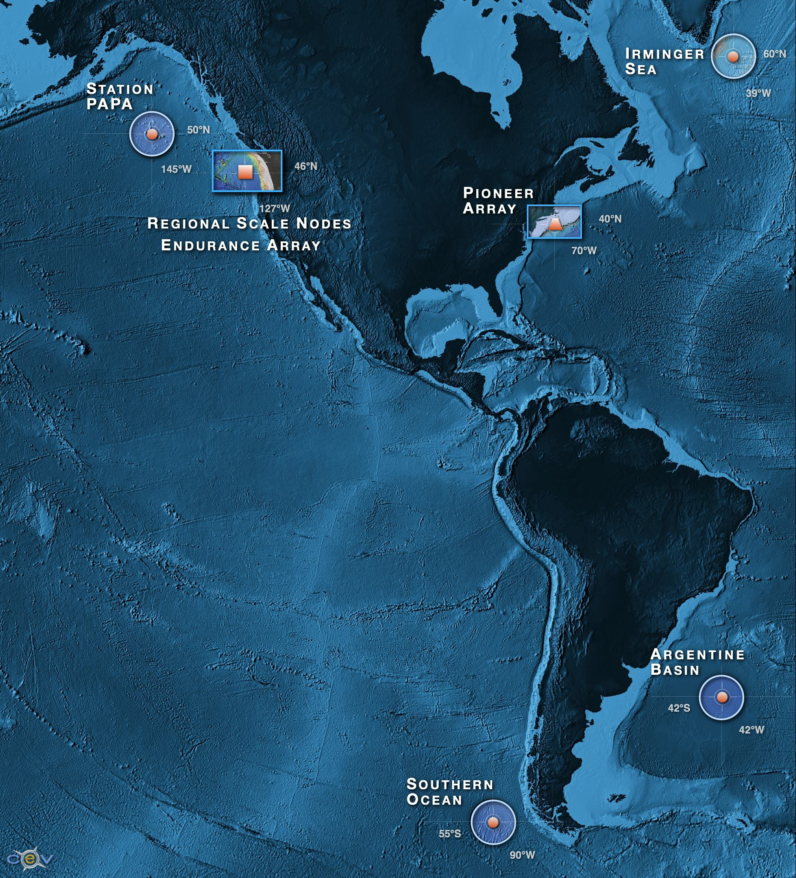
1) Developing new technologies
(National Science Foundation Ocean Observatory Initiative)
Overarching Science Drivers
Forcing and exchanges at the boundaries
    Ocean-atmosphere exchange
    Fluid-rock interactions
Dynamics of the boundary regimes
    Coastal ocean dynamics and ecosystems
    The subseafloor biosphere
    Plate-scale, ocean geodynamics
Four Global high latitude sites
Station Papa
Irminger Sea
Argentine Basin
Southern Ocean
Two Coastal Arrays
Endurance Array
Pioneer Array
Cabled Array
Meso-scale,
Plate Scale network
Dynamics and variability of the ocean volume
    Climate variability
    Ocean circulation
    Turbulent mixing and biophysical interactions
    Ecosystems
Across the boundaries and in the interior
    Carbon cycling, ocean acidification, ecosystem health

Slide 9
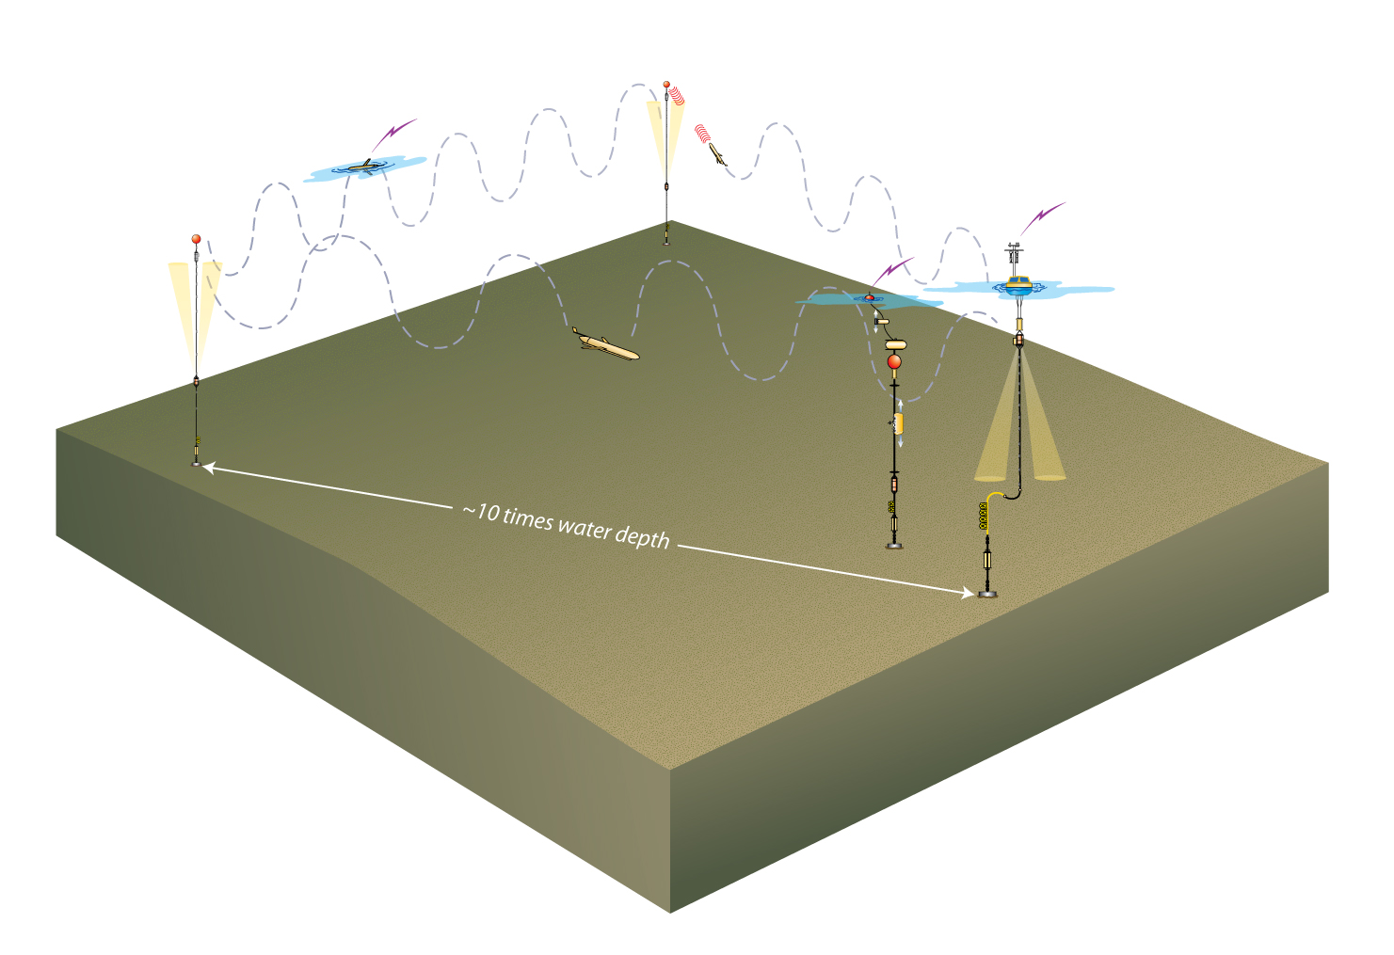
Global Scale Nodes
Subsurface
flanking
moorings
Observation Need: Adaptive spatial data sampling
of water column that can be sustained for a year
Gliders
• Paired surface and profiler moorings cover full water column
• 3 gliders to observe evolution of ocean properties on sections
• 2 gliders to track/survey features, also commandable as spares
• 2 subsurface moorings with fixed depth sensors complete triangular moored array
• telemetry via gliders
Paired surface and
profiler mooring

Slide 10
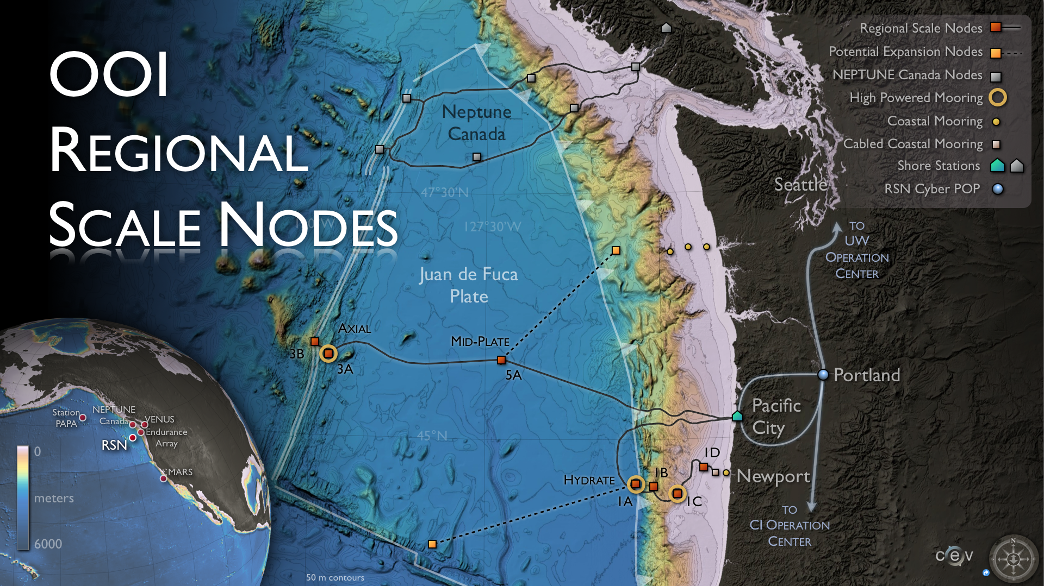
Regional Cabled Network
An 800 km Electro-optical Backbone Provides Scientists with Multiple Subsea Power and Communications Nodes. Each node provides 8 kW and 10 Gb/s.
.

Slide 11
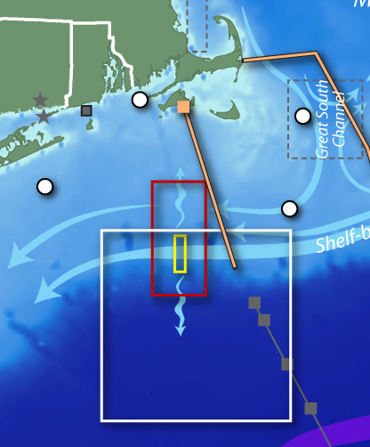
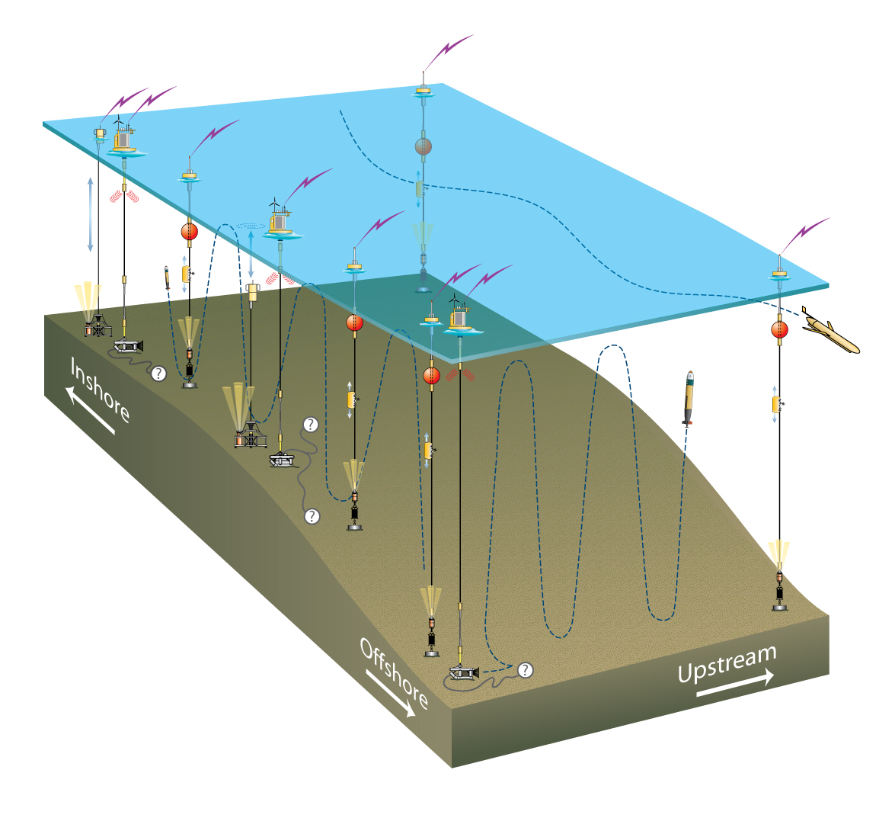
Coastal Node: Pioneer Array
Engineering Design: Multi-element, multi-scale, fixed and mobile assets, relocatable, reconfigurable to resolve processes Network consists of surface profiling floats, subsurface floats, coastal gliders, and docking AUVs

Slide 12
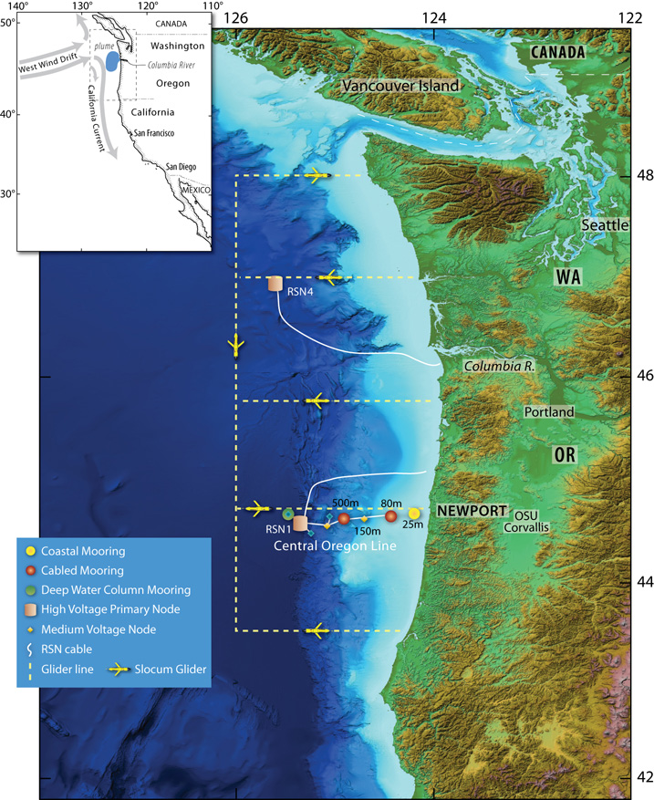
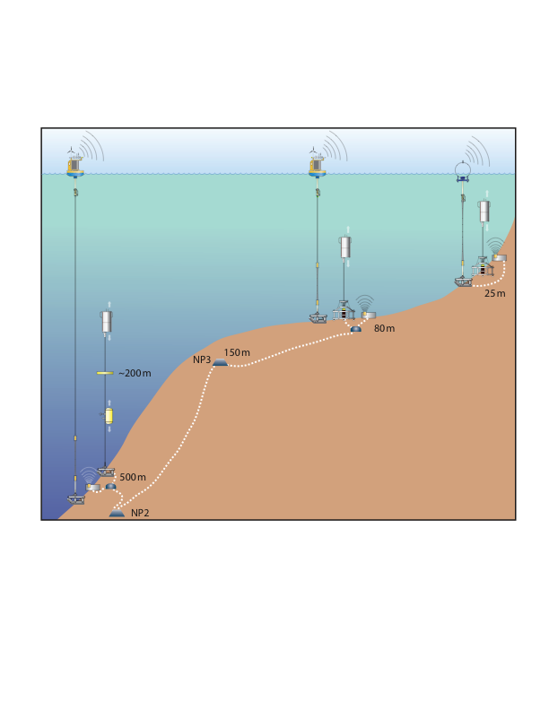
Coastal Endurance Arrays
Engineering Design: Multi-element, multi-scale cabled, high power and bandwidth Fixed and mobile assets deployed for long term sustained time series. Network consists of surface profiling floats, subsurface floats, coastal gliders, and subsurface electro-optical cable.
60 km
500 km
500 m
25 m
125 km

Slide 13
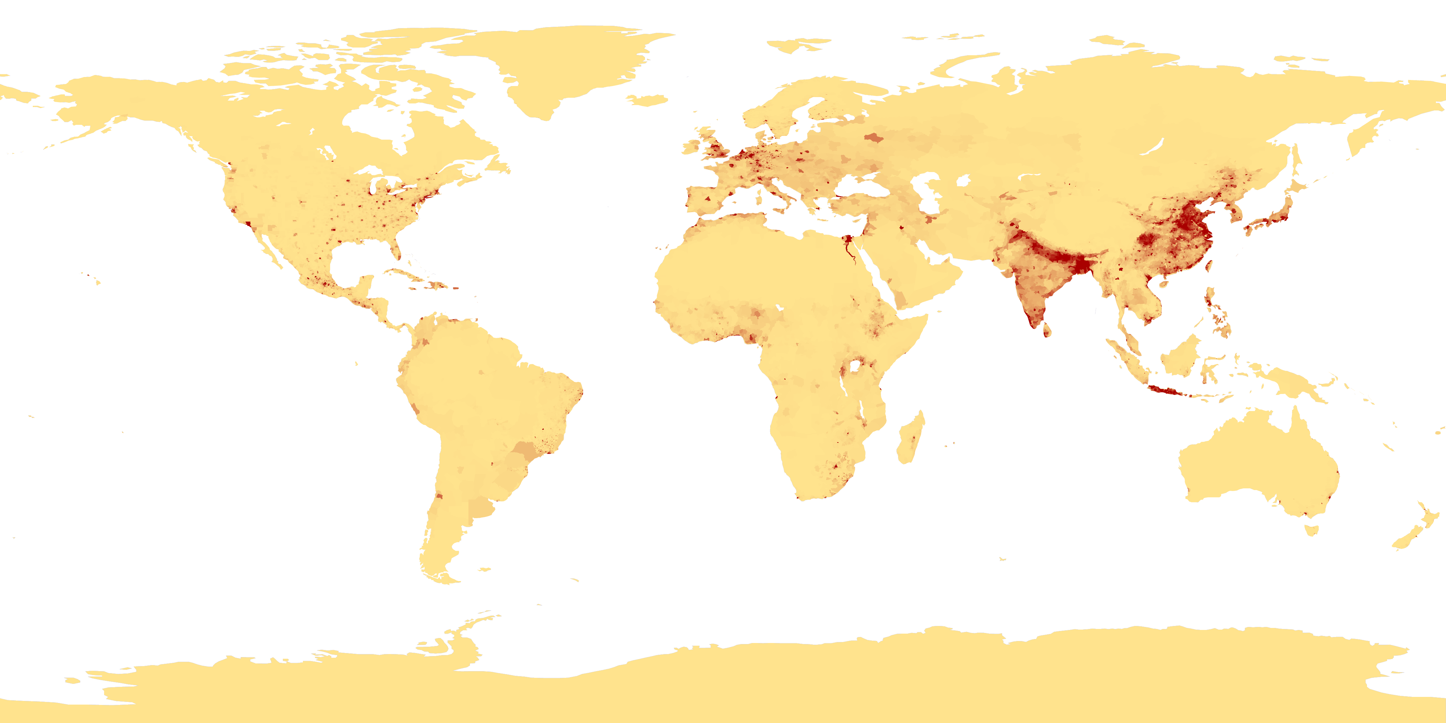
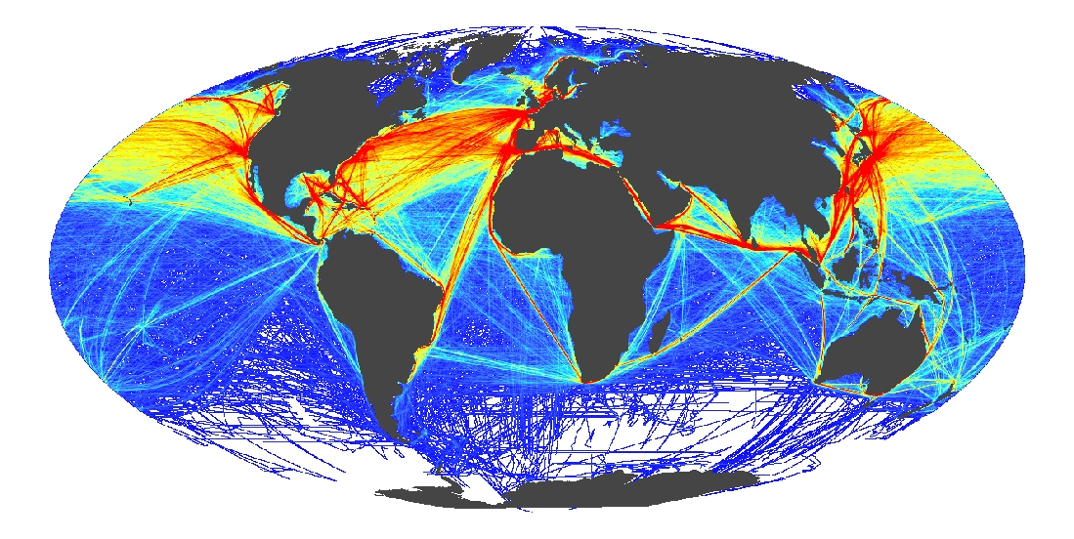
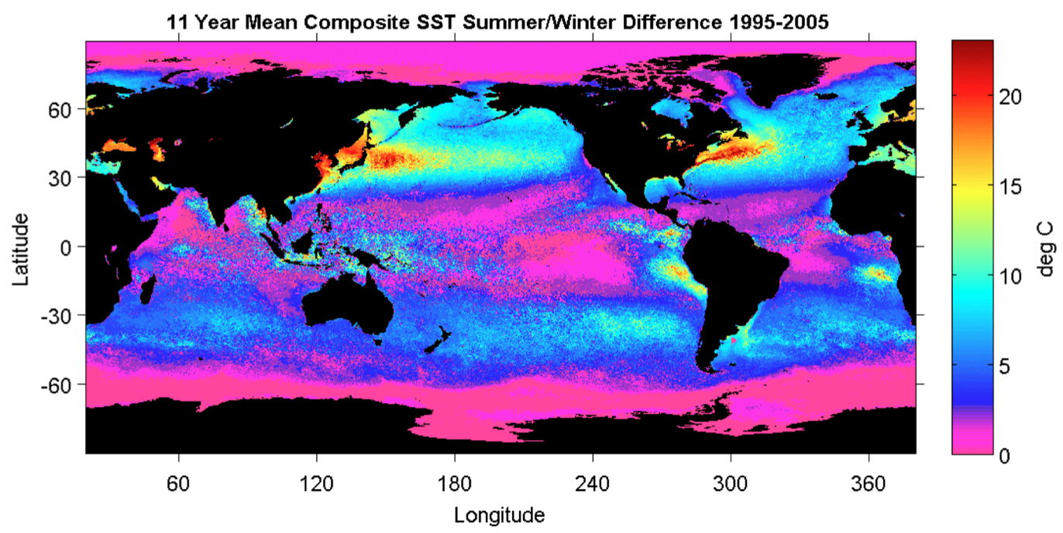
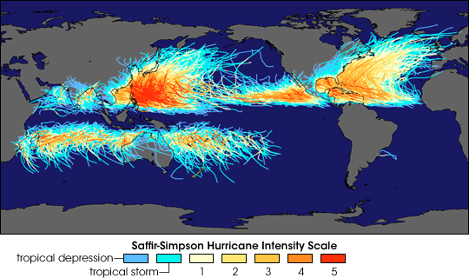
Global Drivers
Coastal Population Centers
International Commerce
Ocean Seasonality
Tropical Cyclones

Slide 14
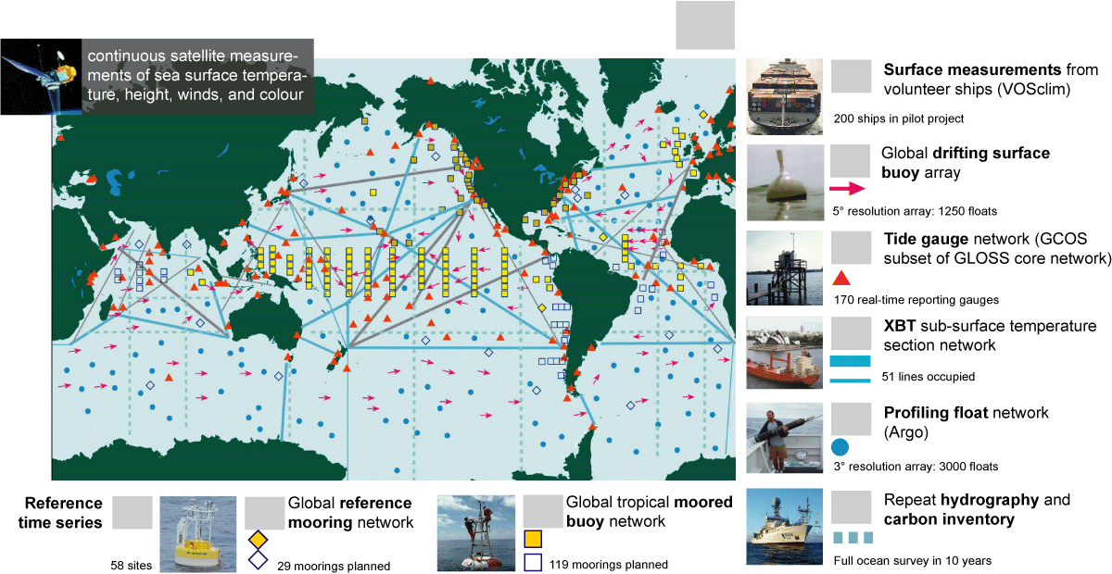


2) Developing operational networks (GOOS)
Global Ocean Observing System for Climate
Total in situ networks
61%
87%
100%
59%
81%
100%
48%
34%
73%
62%

Slide 15
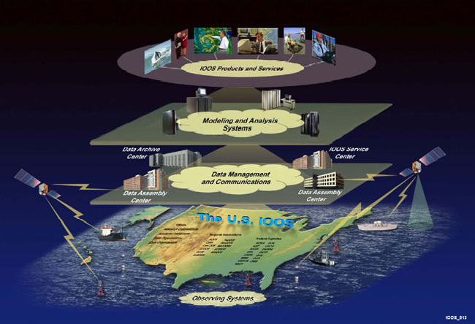
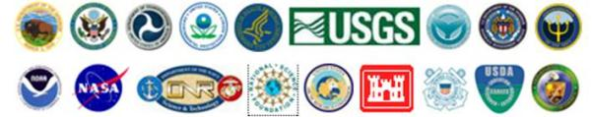
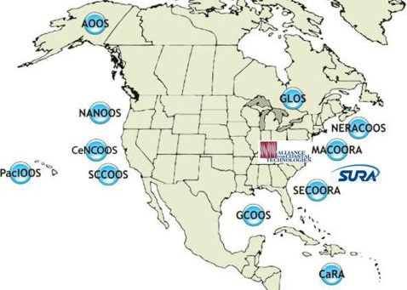
U.S. IOOS
Global Component
Coastal Component (EEZ to the head of tide)
12
        7 Goals, 1 System
      Improve predictions of climate change and weather
      Improve the safety and efficiency of maritime operations
      Improve forecasts of natural hazards
      Improve homeland security
      Minimize public health risks
      Protect and restore healthy coastal ecosystems
      Sustain living marine resources
Enhances science and improves decision making
Notes:
IOOS is a partnership for Lives and Livelihoods.
IOOS® is a solution to increasing observing assets, to coordinating and connecting scattered ocean, coastal and Great Lakes data so that information is comprehensive, clear, usable, and available to inform decision making.
Organizationally we have two components:
Global and Coastal
The logos and the Map you see are the who of US IOOS. First our National Agencies, followed by our Regional entities and 2 national functional enties I will go into more detail later in the presentation.
The what of US IOOS: 6 subsystems:
Observing, Data Management and Communications (or as I say supply chain management of all oceanographic data); Modeling/Analysis/Products/Services. Underpinned by Research and development and Education and Outreach. Over that we have a governance and management schema
US IOOS is about providing the right information in the right format across 7 societal goals through a single system. The 7 societal goals are listed here

Slide 16
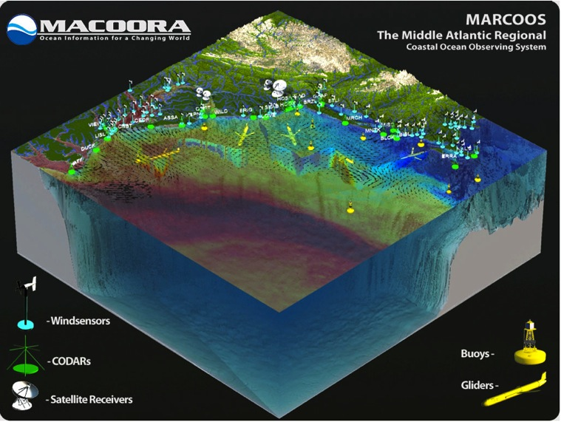
Mid-Atlantic Regional Association Coastal Ocean Observing System
Merged 2011: >40 Co-PIs, >20 Institutions, 10 States (&DC),
25% of US population, 25% of US GDP, 111 Congr. districts
MARACOOS’ MISSION: To seek, discover, share, and
apply new knowledge & understanding of our coastal ocean
Sustained regional observing networks a
Societal priorities drive development
MARACOOS supports the R&D continuum throughout the region

Slide 17
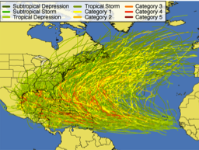
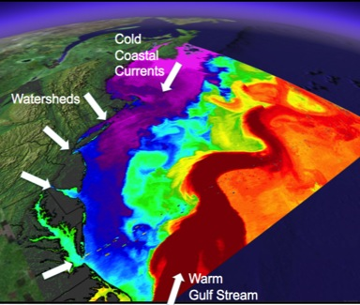
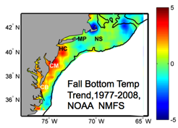
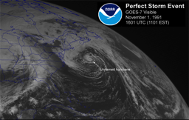
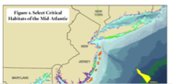
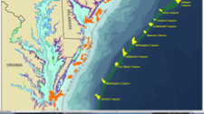
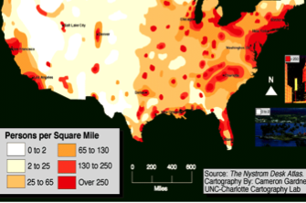
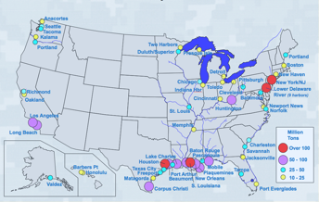
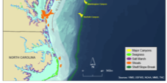
MID-ATLANTIC REGIONAL DRIVERS
Tropical Storms
Climate Change
Ocean Circulation
Critical Habitat
Northeasters
Population
Ports

Slide 18
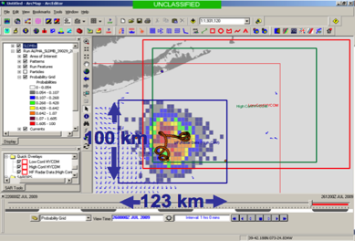
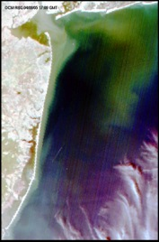
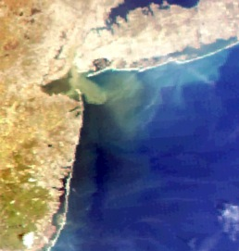
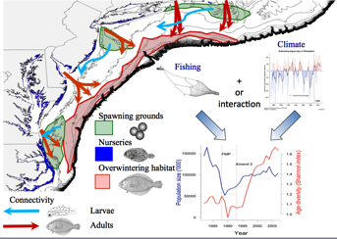
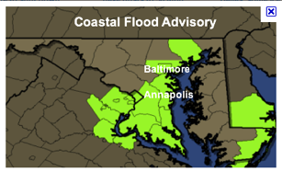
MARACOOS REGIONAL THEMES & SUCCESS STORIES
1) Maritime Operations – Safety at Sea
3) Water Quality – a) Floatables, b) Hypoxia, c) Nutrients
2) Ecosystem Decision Support - Fisheries
5) Energy – Offshore Wind
4) Coastal Inundation - Flooding

Slide 19
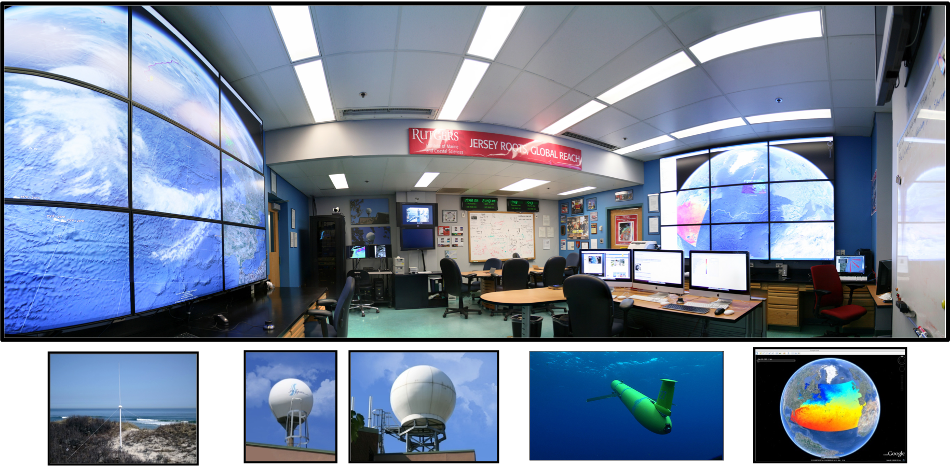
Coordinated through command centers
Rutgers University’s Coastal Ocean Observation Lab (RU COOL)
CODAR
Satellites
Gliders
Models

Slide 20
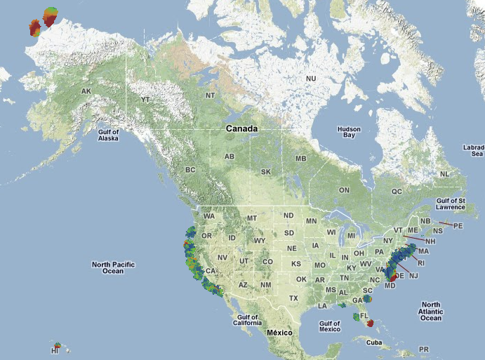
US HF Radar Network
Operated by > 30 institutions
Used by > 40 government/private entities
Industry Partner: US-based CODAR Ocean Sensor
Uses:
+ Coast Guard : Search &Rescue: Oil spill + Water Quality; Criminal Forensics
+ Commercial marine navigation + Off Shore Energy
+ Water Quality: Harmful algal blooms + Marine fisheries
+Waves and Nearshore currents (Rip) + Emerging – Tsunami

Slide 21
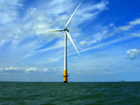
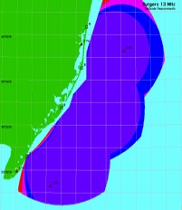
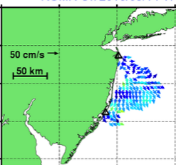
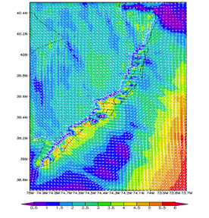
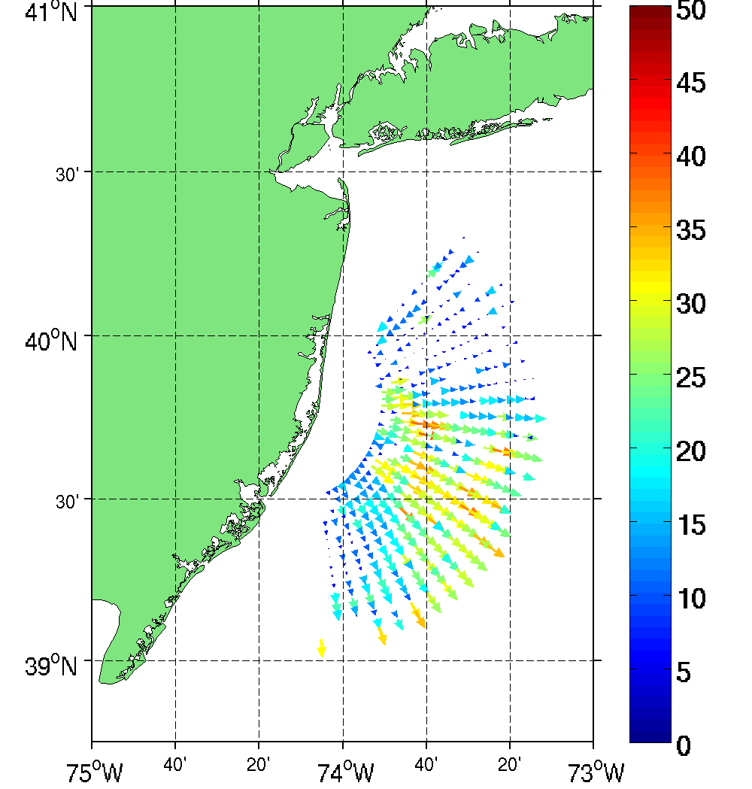
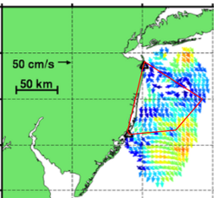
National system providing Multi-Use Offshore Wind Energy
High Resolution Atmospheric Forecast validated with HF radar
Additional Radar Sites
Spatial validation of Atmospheric Model with 13 MHz Multi-static
HF Radar Array
2-Site Mono-static Coverage
High Resolution Wind Resource
670 m horizontal resolution
Bi-static Geometries
2-Site Multi-static Coverage

Slide 22
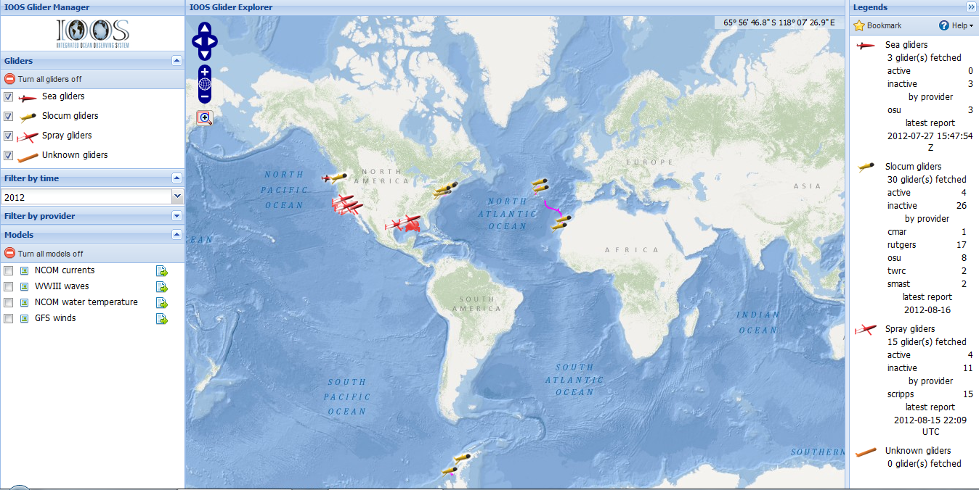
US Glider Network (Under Design)
Uses:
+ Ecosystem management + Plume dispersal
+Eddy detection + Ocean Forecasting
+Storm Intensity + Harmful Algal Bloom detection

Slide 23
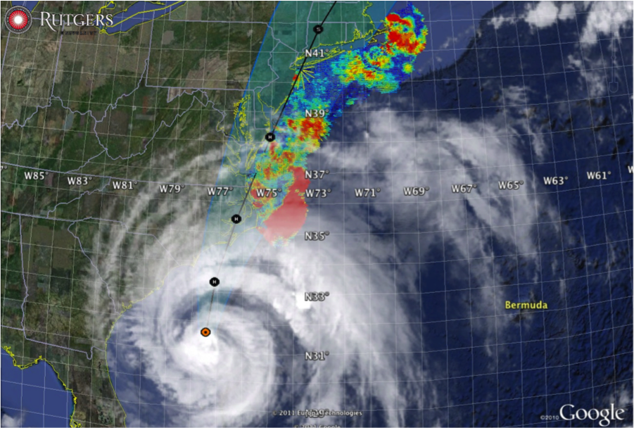

Hurricane Irene
August 26, 2011
NOAA/NHC Damage:
#8 with >$15 Billion.
Track Accurate;
Intensity Over-predicted.
Hurricane Sandy
October 29, 2012
NOAA/NHC Damage:
#2 with >$60 Billion.
Track Accurate;
Intensity Under-predicted.

Slide 24
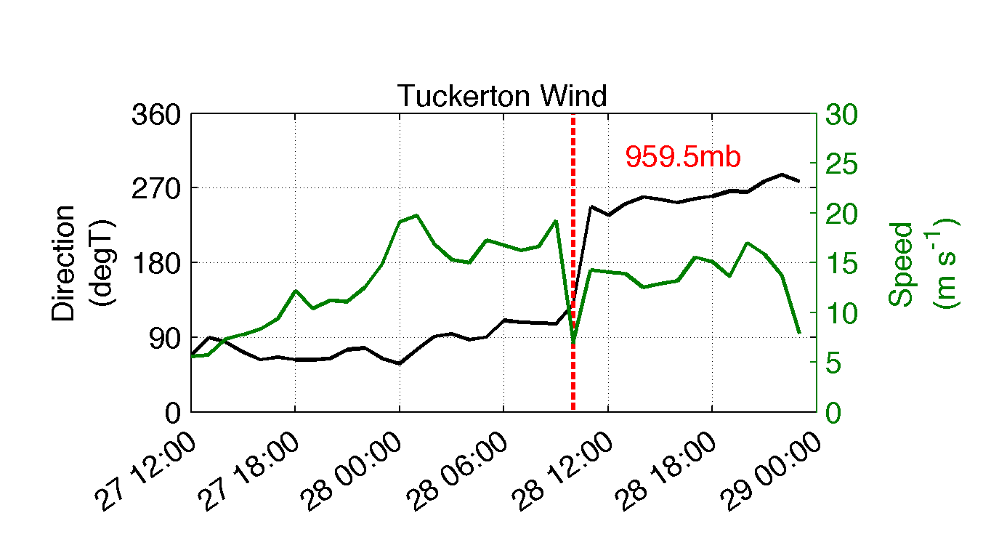
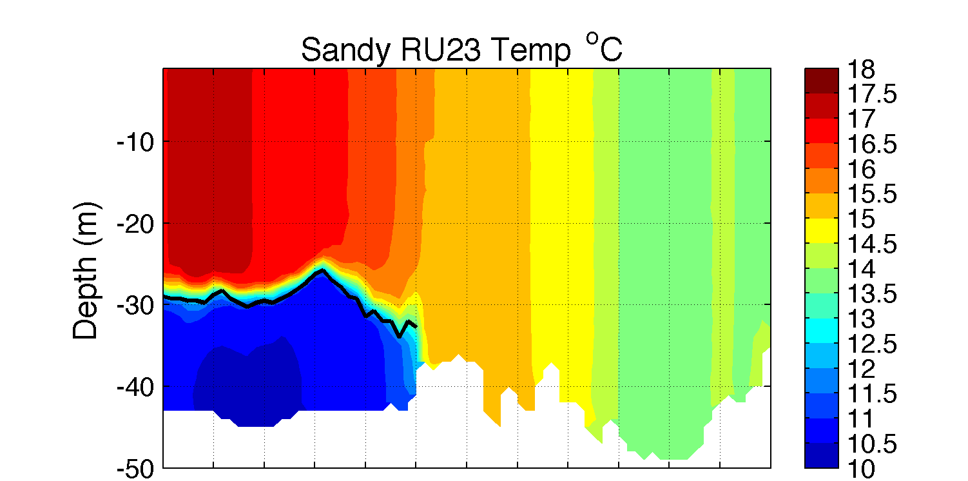
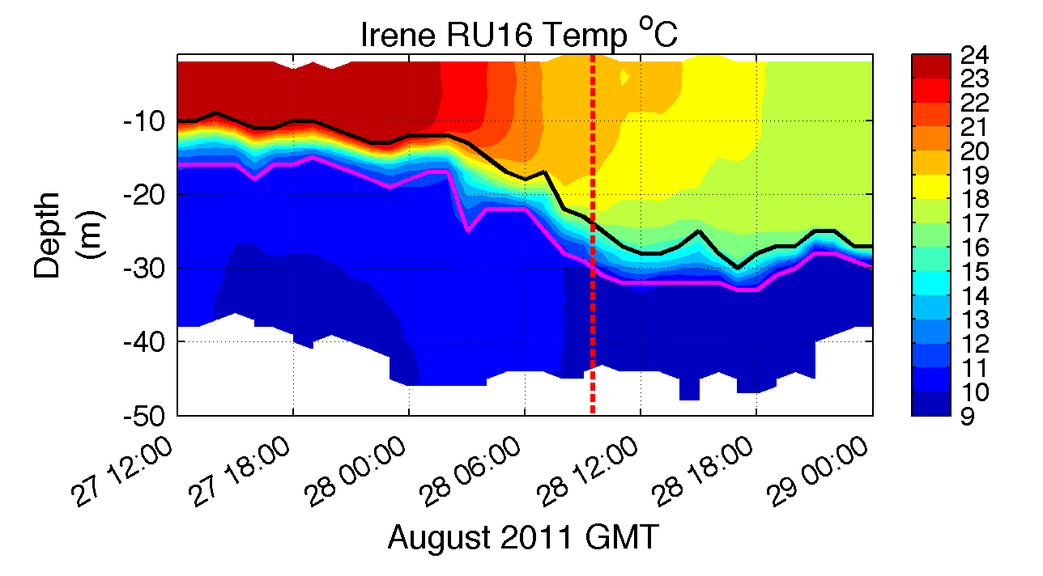



National system serving many needs: Storm Physics
Hurricane Irene
Hurricane Sandy
Hurricane Sandy
glider measurements

Slide 25




The future is coupled observation & modeling networks
=
+
Remote Sensing
Gliders
3-D Nowcasts
+
=
Nested Models
Data Assimilation
4-D Forecasts

Slide 26




MARACOOS Ocean Forecast Models
NY-HOPS
Stevens
Institute
Technology
Short Term
Prediction System
U. Connecticut
ROMS
ESPRESSO
Rutgers
HOPS
U Massachusetts

Slide 27


Penobscot
To Date:
13 Gliders,
11 Participants,
11 Funding Sources
OTN201
OTN200
Darwin
Saul
RU28
Blue
Otis
RU23
RU22
VIMS
Salacia
Gliderpalooza
Sept-Oct 2013
Deployments
Modena
Multiple Goals:
1) provide a unique assimilation dataset for ocean models
2) provide standardized dataset over ecological scales
3) provide information on fish/mammal migrations
4) provide a 3-D snapshot of the MAB cold pool,
5) demonstrate a community surge capacity through the peak fall storms & hurricanes
6) demonstrate data flow from Academics to IOOS to NDBC to GTS via DMAC, and
7) engage undergraduates in ocean observing efforts.

Slide 28



3) Event response capability
Deepwater Horizon Oil Spill: Coordinated Rapid Response
Contributed Assets:
HF Radar Networks
USF, USM
Gliders
iRobot, Mote, Rutgers,
SIO, UDel, USF, Navy
Drifters & Profilers
Horizon Marine, Navy
Satellite Imagery
CSTARS, UDel, Rutgers
Ocean Forecasts
Navy, NCSU
Data/Web Services
ASA, Rutgers, SIO
Tropical Storm Bonnie crosses the Gulf of Mexico
USM HFR
TS Bonnie
USF HFR
USM HFR validation of SABGOM Forecast
in region with satellite detected oil slicks
HFR used for Oil Slick Forecasts by NOAA/NOS/OR&R

Slide 29



Deepwater Horizon Information Flow
Tools developed for education during the trans-Atlantic mission of RU27 adapted to coordinate response to the oil spill:
Collaborative web portal established as an aggregation center for information
Google Earth data/model interactive interface used for environmental analysis & glider path planning
Blog established to share analyses and provide comments – 127 briefs posted
Google Earth
Interactive Interface
Web Portal
Briefing Blog

Slide 30

Feedback from the Deepwater Horizon
Incident Command Center
Composite of Satellite Observed Oil Spill Locations
“All - Greetings from Unified Area Command in New Orleans. I couldn't agree more - the IOOS community has acquitted itself very well during this entire incident. Not only has everyone provided valuable information - you have done it without getting in the way of the ongoing operations. It's been a pleasure to represent IOOS here and see all the great contributions from the larger IOOS community. “
- Sam Walker (IOOS representative to Deepwater Horizon Unified Command Center), June 18, 2010
“… AWESOME JOB - that call that we had last week was a very good thing. You are taking a huge burden off of the team here who is trying to simply capture the deluge of assets now being deployed. “
- Sam Walker (IOOS representative to Deepwater Horizon Unified Command Center), July 2, 2010
“…Thanks to everyone for all of your efforts to support the Response and the very professional and competent manner in which you have executed your efforts. IOOS has played a huge role in informing the modeling teams and the Unified Command through your extraordinary service. “
- Sam Walker (IOOS representative to Deepwater Horizon Unified Command Center), August 6, 2010

Slide 31
Feedback from the Deepwater Horizon
Incident Command Center
Composite of Satellite Observed Oil Spill Locations
“All - Greetings from Unified Area Command in New Orleans. I couldn't agree more - the IOOS community has acquitted itself very well during this entire incident. Not only has everyone provided valuable information - you have done it without getting in the way of the ongoing operations. It's been a pleasure to represent IOOS here and see all the great contributions from the larger IOOS community. “
- Sam Walker (IOOS representative to Deepwater Horizon Unified Command Center), June 18, 2010
We did not get in the way
“… AWESOME JOB - that call that we had last week was a very good thing. You are taking a huge burden off of the team here who is trying to simply capture the deluge of assets now being deployed. “
- Sam Walker (IOOS representative to Deepwater Horizon Unified Command Center), July 2, 2010
We reduced the burden
“…Thanks to everyone for all of your efforts to support the Response and the very professional and competent manner in which you have executed your efforts. IOOS has played a huge role in informing the modeling teams and the Unified Command through your extraordinary service. “
- Sam Walker (IOOS representative to Deepwater Horizon Unified Command Center), August 6, 2010
We informed modeling teams & leadership

Slide 32


4) Integrated data networks offering potential crowd sourcing and innovation for workforce development
Increase in Number & Scope of Research Internships
Locations: Australia, Antarctica, Svalbard, Spain, Canaries, Azores, California, Florida, New Jersey
Sponsors: NSF, DHS, Alumni
Trans-Atlantic Glider Challenge
Spring 2012 Course: >70 Students
Number of Marine Science Majors

Slide 33





Undergraduates can do real research, with right tools
RTOFS and MERCATOR
Temperature and Current Maps at 200 m
IEEE, MTS Oceans ‘13
(San Diego, USA)
RTOFS 200m temperature and currents on April 18th, 2013. The glider position is marked by the red dot.
MyOcean 200m temperature and currents on April 18th, 2013. The Gliders position is marked by a red dot.

Slide 34






Expanding the model
Developing tools to increase the crowd sourcing & educational opportunities with OOI Education and Public Engagement team (EPE)
Concept Maps
Data Visualization Tools
Lab Lesson Builder

Slide 35




4) Integrated data networks offering potential crowd sourcing and innovation for workforce development
Example: Challenger Mission
Current countries: USA, Canada, Australia, UK, Japan, Indonesia, Korea, Brazil, Spain, Portugal, South Africa, Ireland, Norway

Slide 36

Conclusions:
Nested Ocean Observation & ensemble Forecasting Systems have matured and now meet science, commercial, and management needs.
They are revolutionizing science education.
These networks are consortia of academic, government, and commercial partners.
New disruptive technologies will enhance global observations & forecasts
Challenger Glider Mission can kick-start global science education
(http://challenger.marine.rutgers.edu)
Oceanography will rise to meet growing global needs

