Slide 1
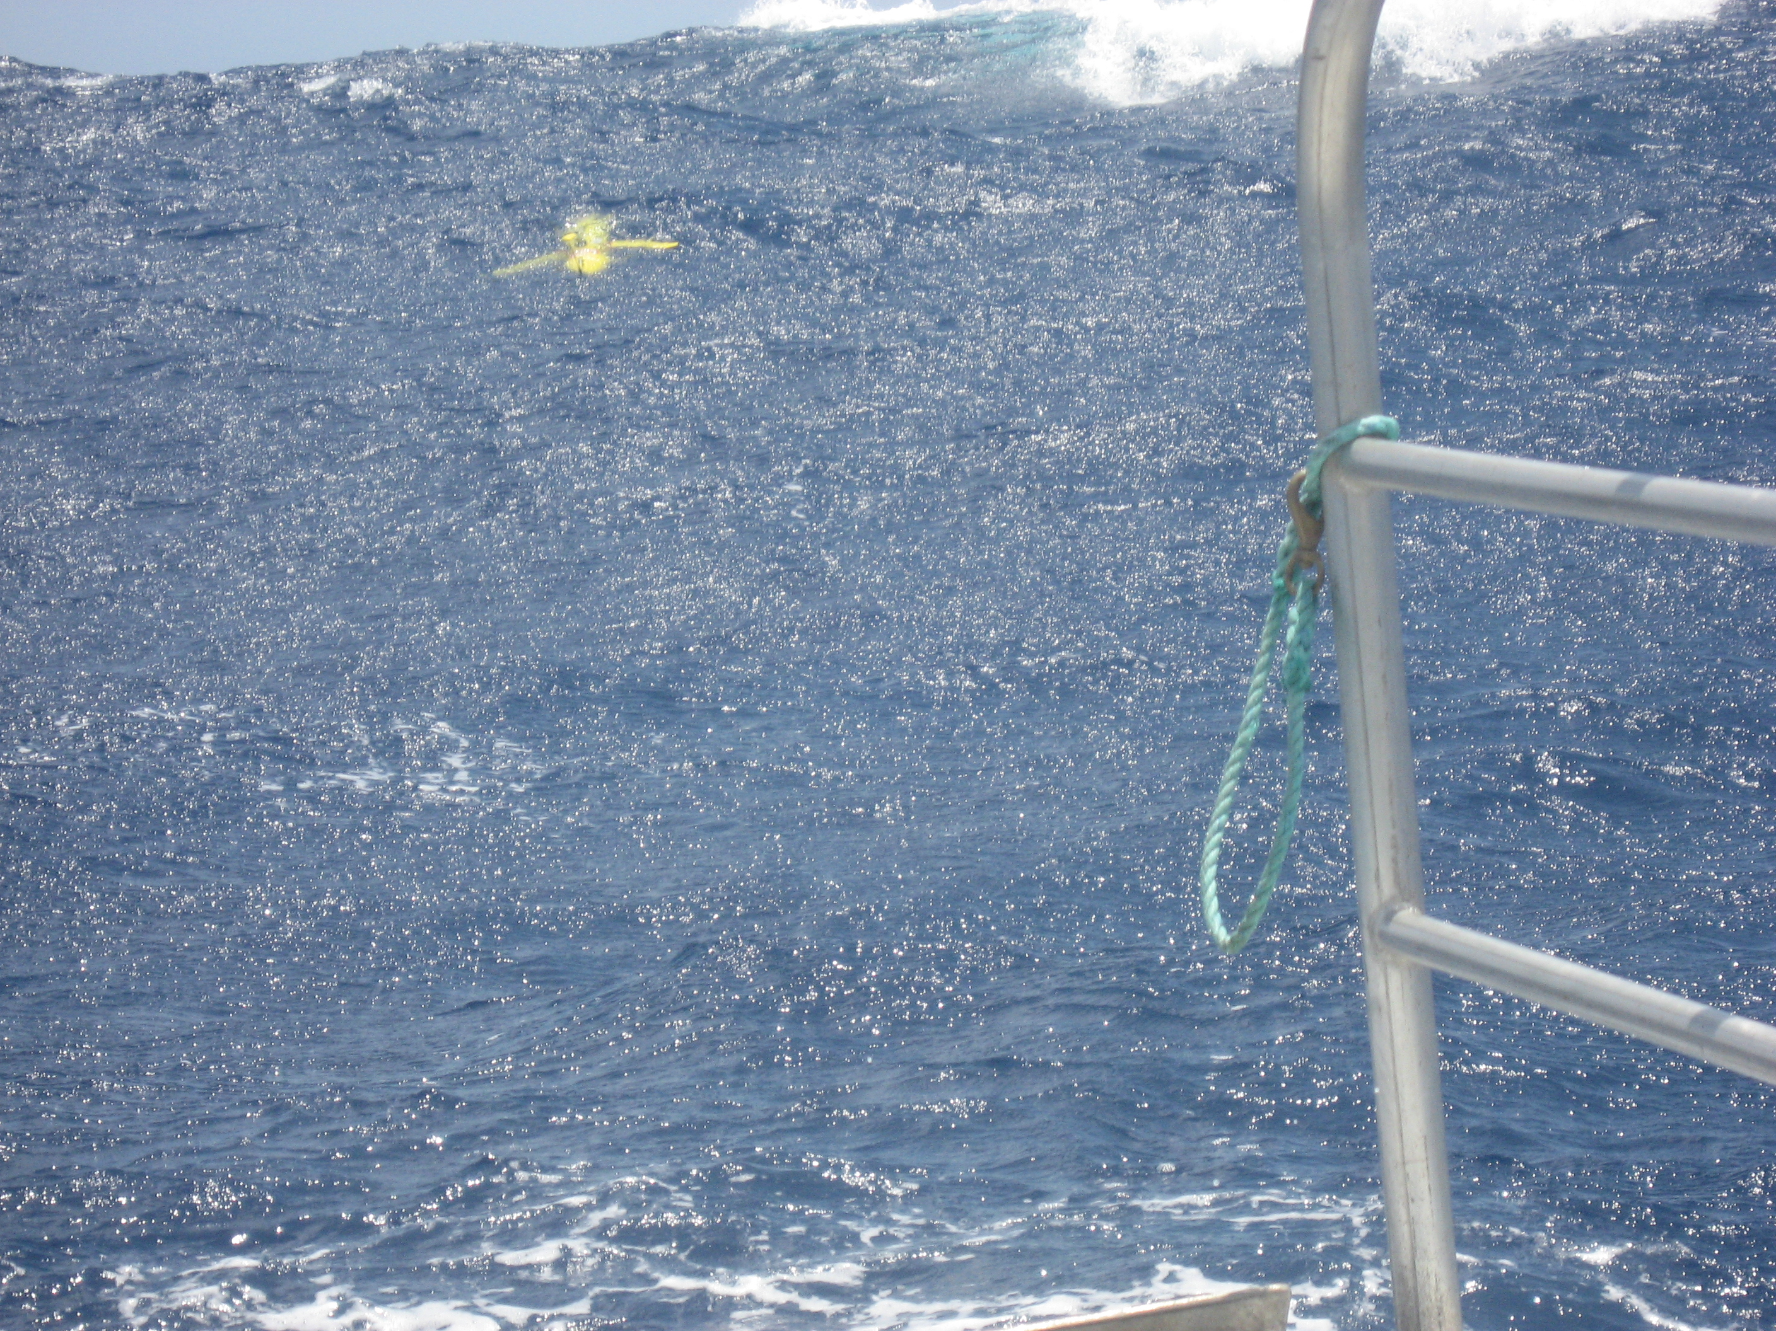

Using gliders to characterize storm resuspension processes on continental shelves
Oscar Schofield, Travis Miles, Scott Glenn
Rutgers University Costal Ocean Observation Lab
&
Michael Twardowski
WetLabs

Slide 2
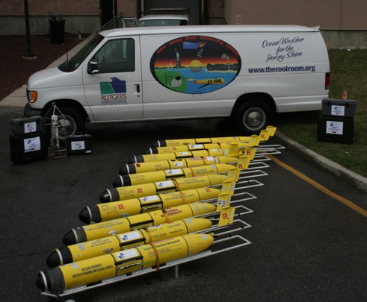
Our ultimate goal is to provide a complete environmental monitoring system for physics and optics for sustained operations. From Navy perspective, these integrated platforms need to be flexible to fulfill a variety of needs (such as ASW and MCM).
Our teams goals for ONR OASIS efforts:
l Implementing optical sensors onto Web gliders.
l Deploy gliders during coastal storms to study storm induced
bottom resuspension
l Assess the variability between storms resuspension efficiencies

Slide 3
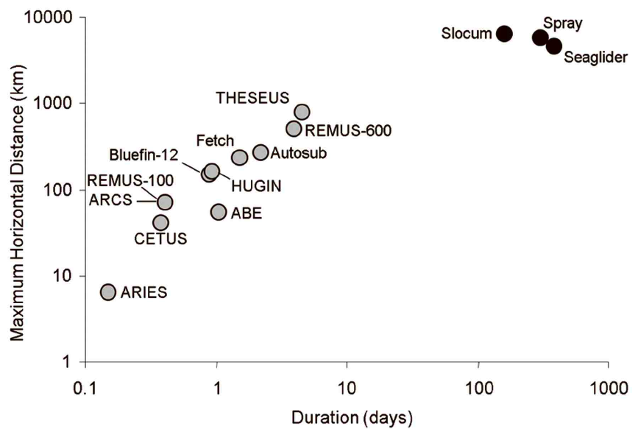
Sustained presence in oceans is a reality
Moline & Schofield 2009 J. Atm Oce Tech

Slide 4
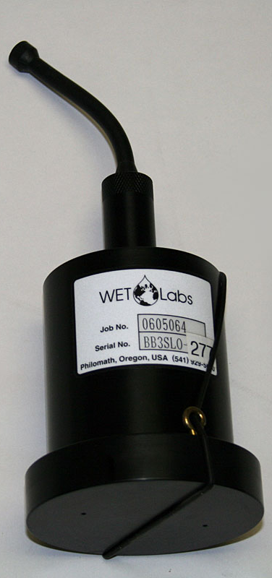
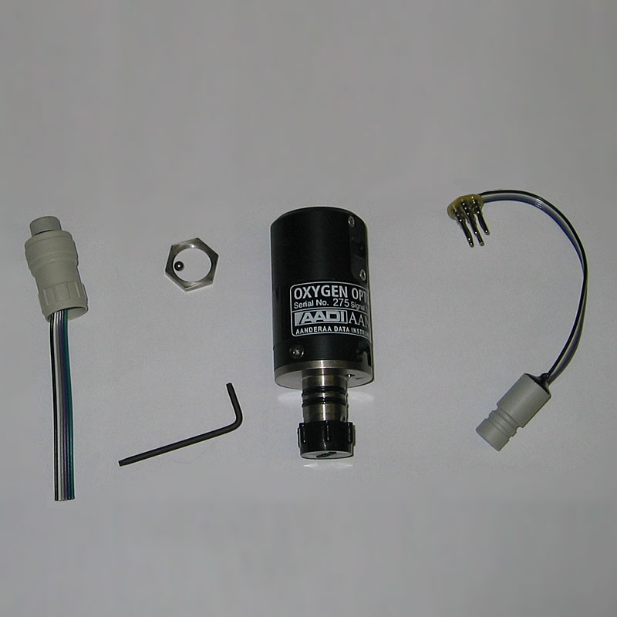
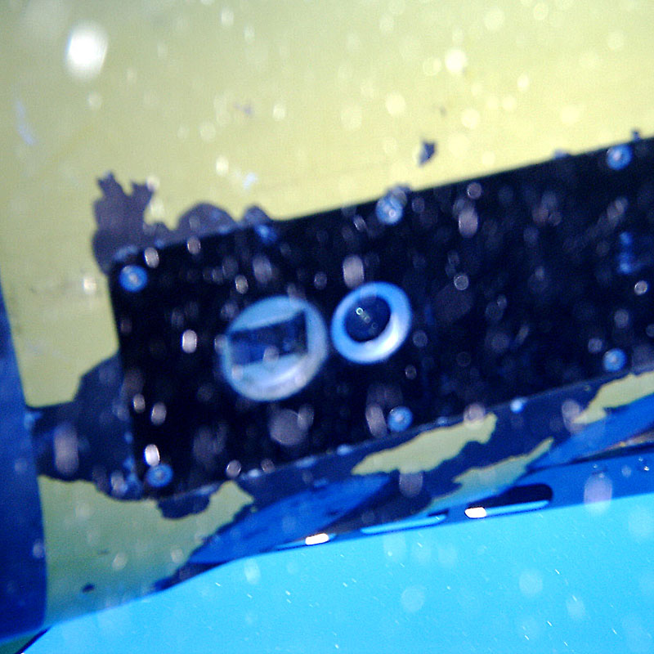
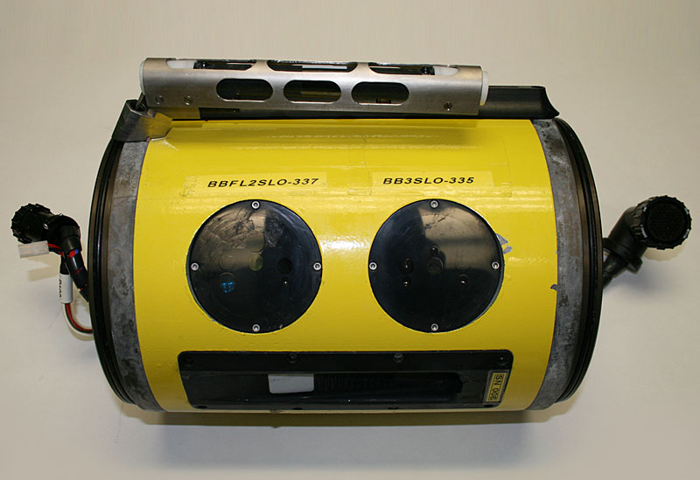
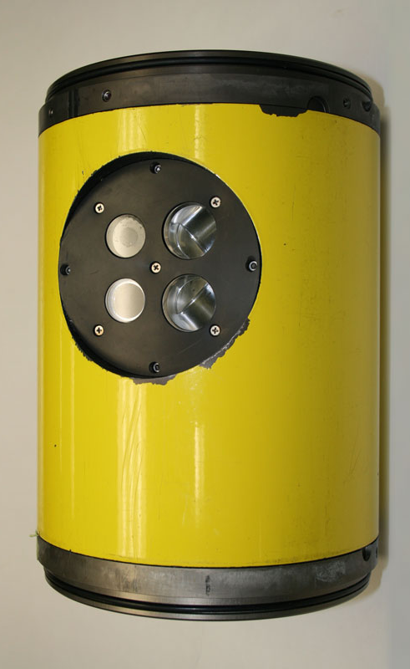
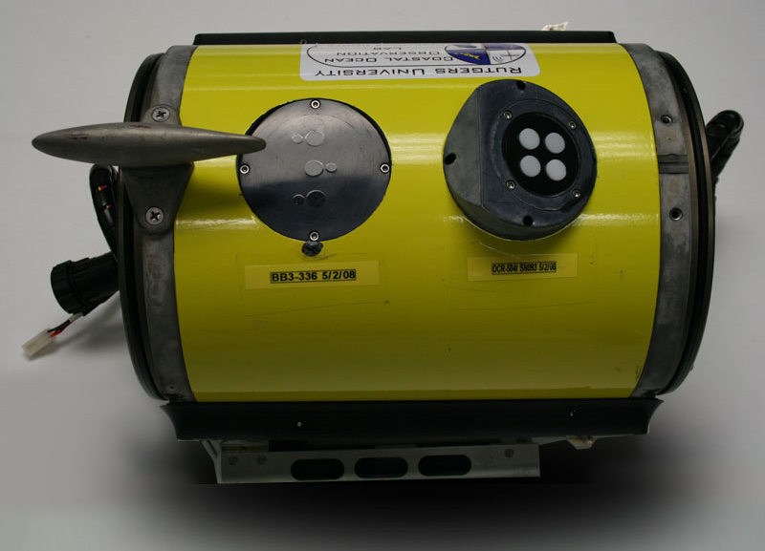
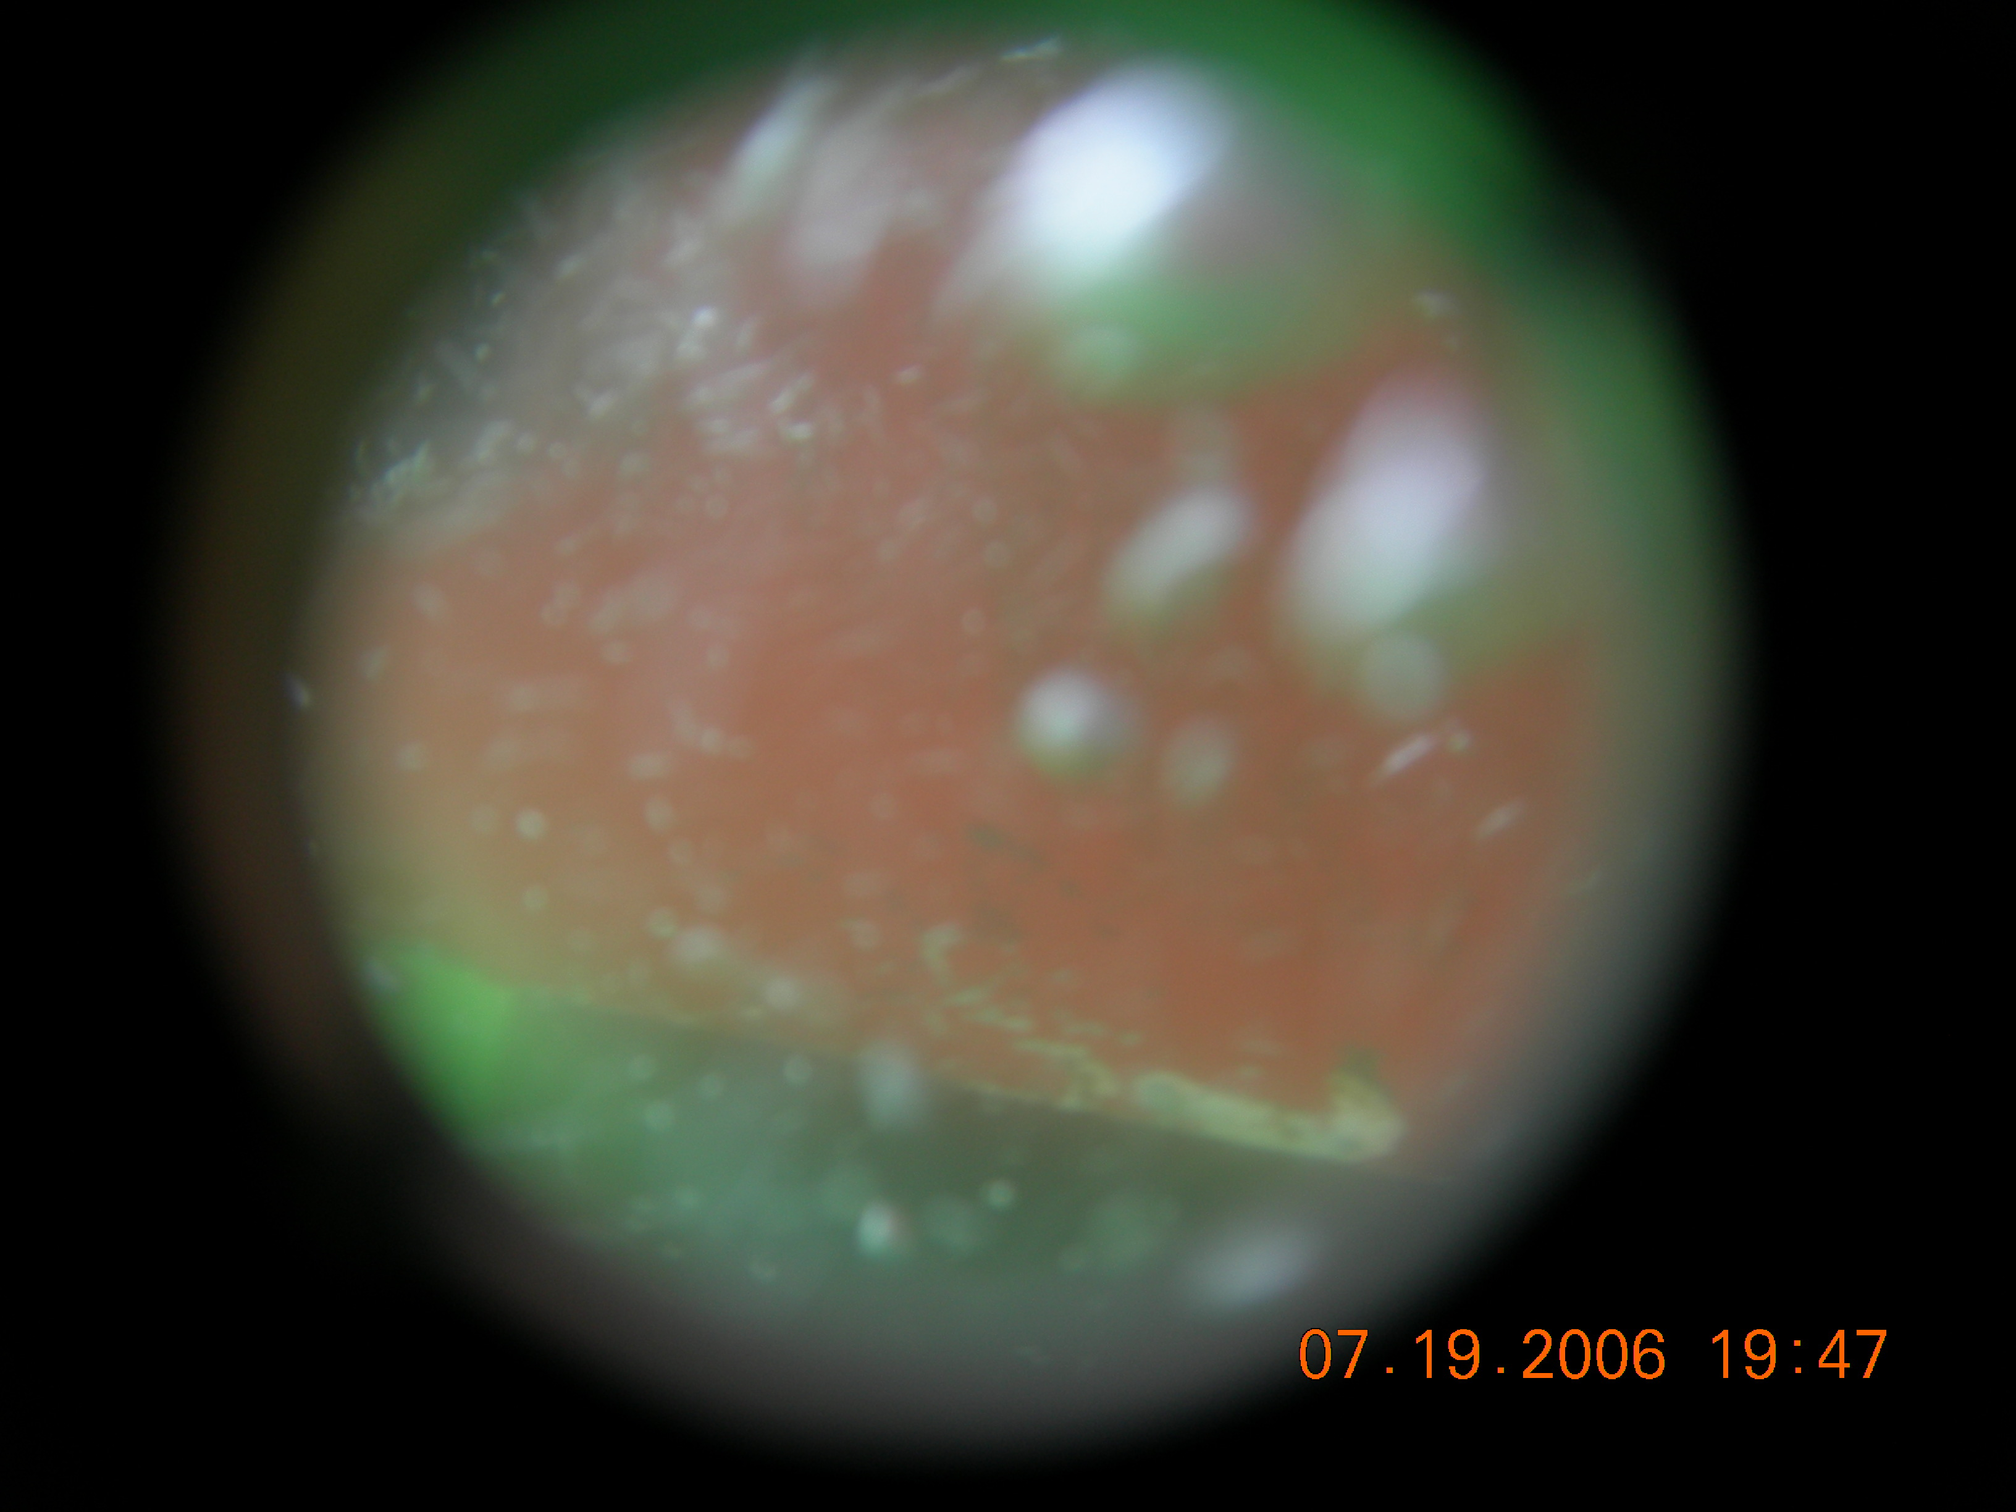
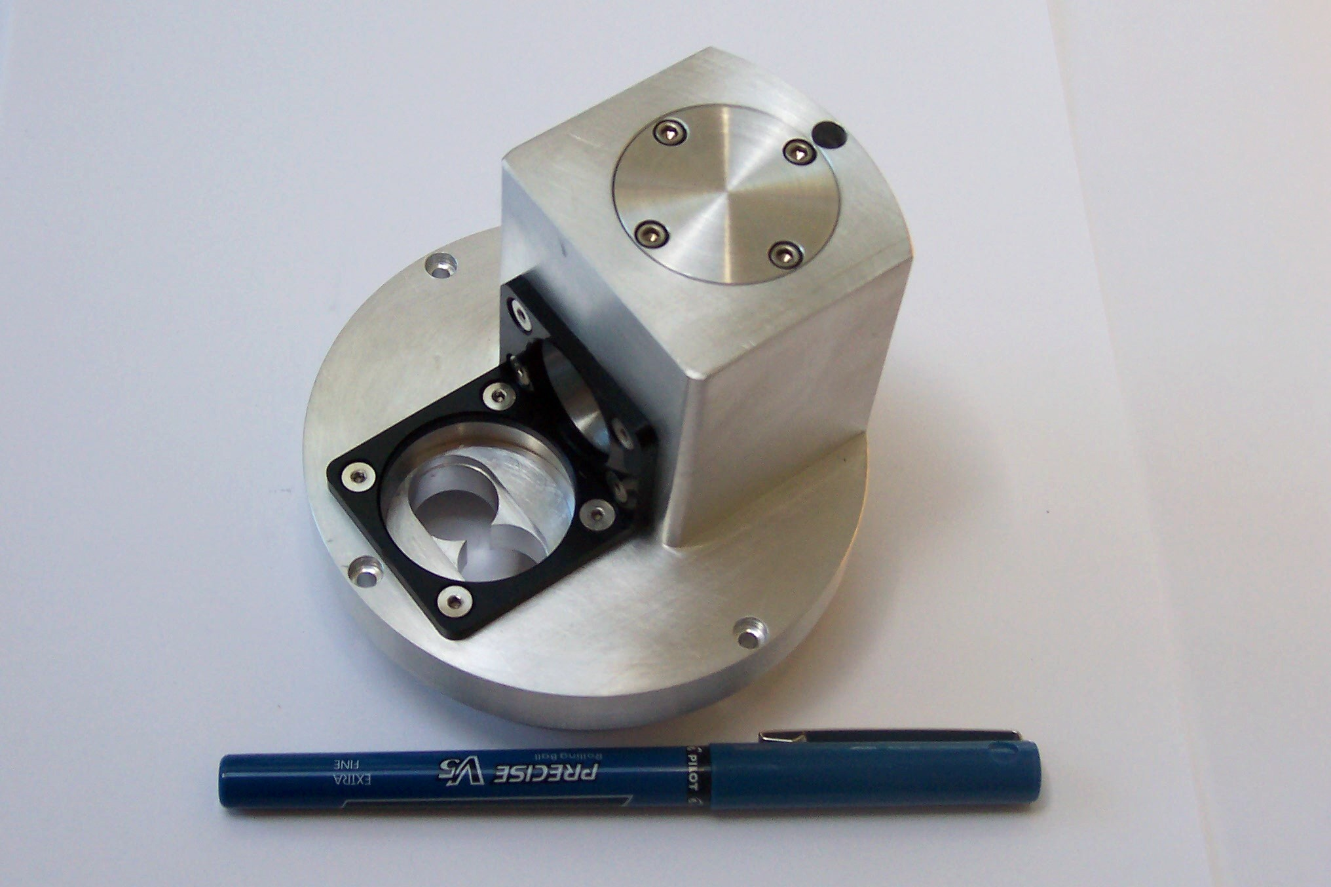
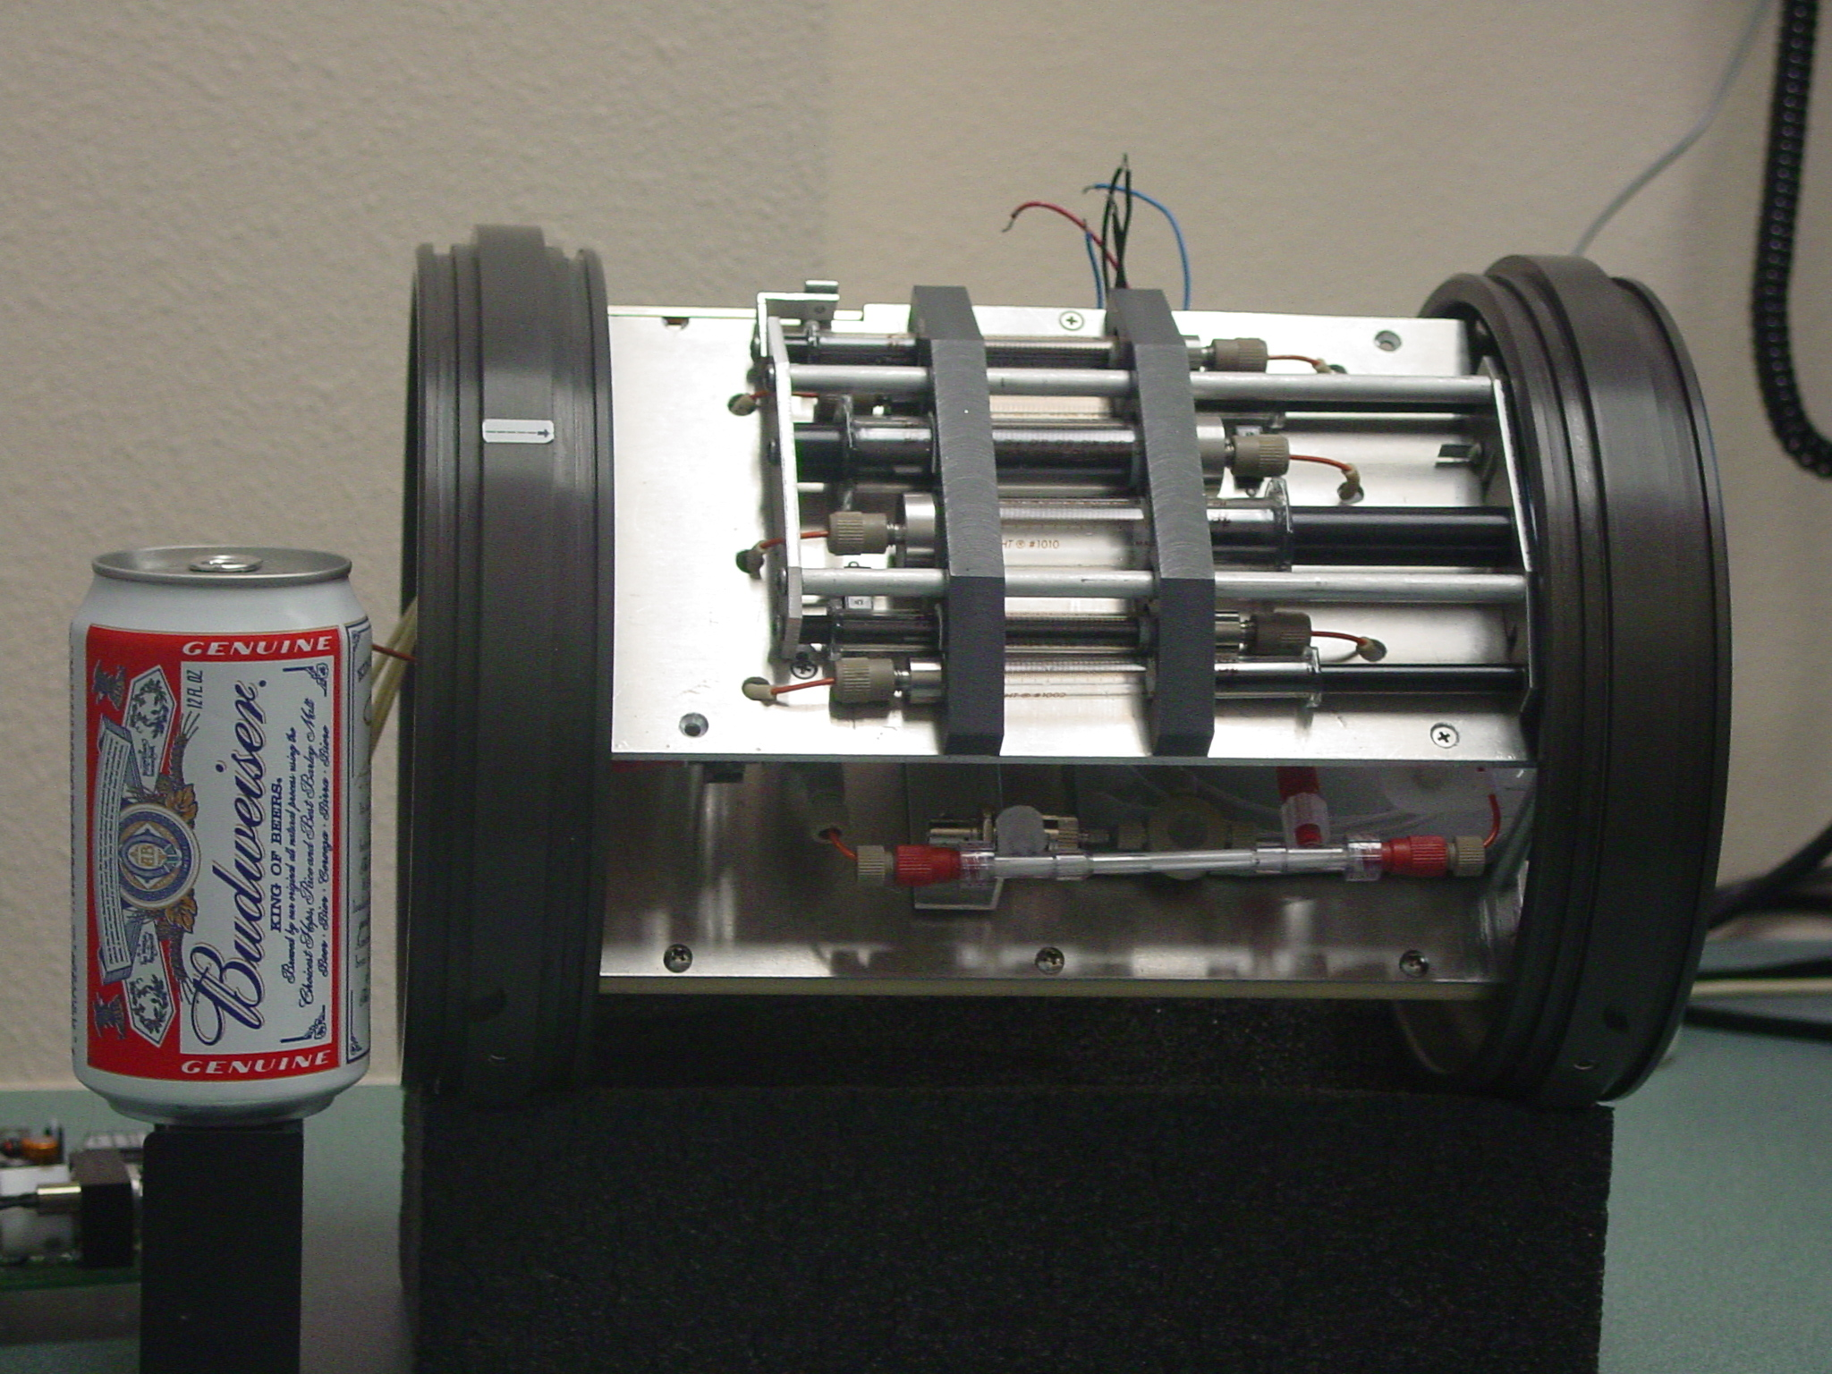
Sensor integration is accelerating as close collaborations with WetLabs, Satlantic and Teledyne Webb Research
ONR Optics and OASIS facilitated the integration sensors to measure:
spectral irradiance, spectral backscatter,
spectral attenuation, spectral scatter
camera, spectral absorption, chlorophyll fluorescence, and fast repetition fluorometry

Slide 5
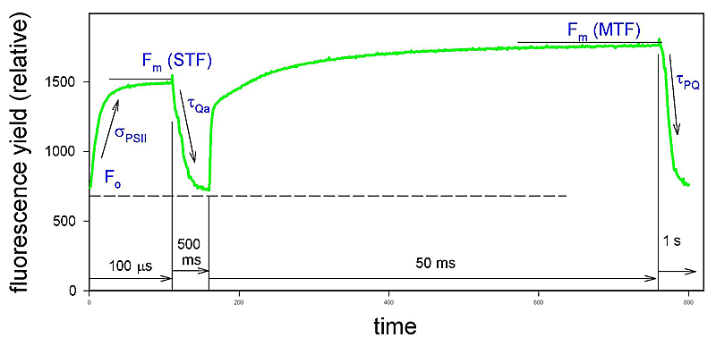

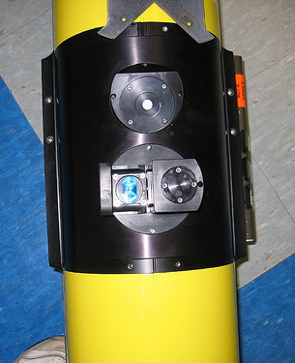

Going after biological rates: Phytoplankton photosynthesis and physiological state
Week of July 10, 2009 FIRe glider demonstrated in NJ test bed
2000
Light
(μmol photons m⁻² s⁻¹)
0
0.8
Fv/Fm
(PSII quantum yield)
0
0
Days
9
Fv/Fm
Light

Slide 6
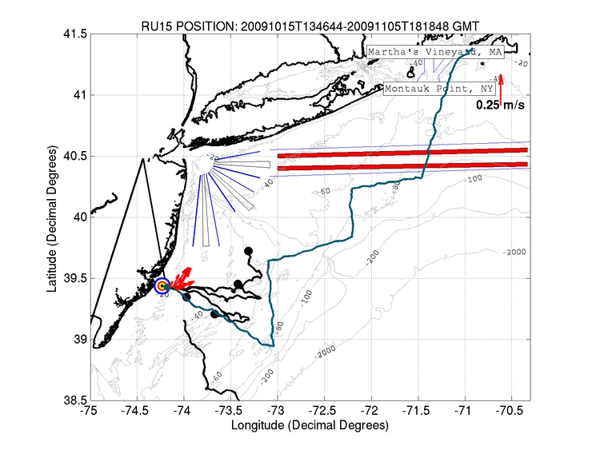
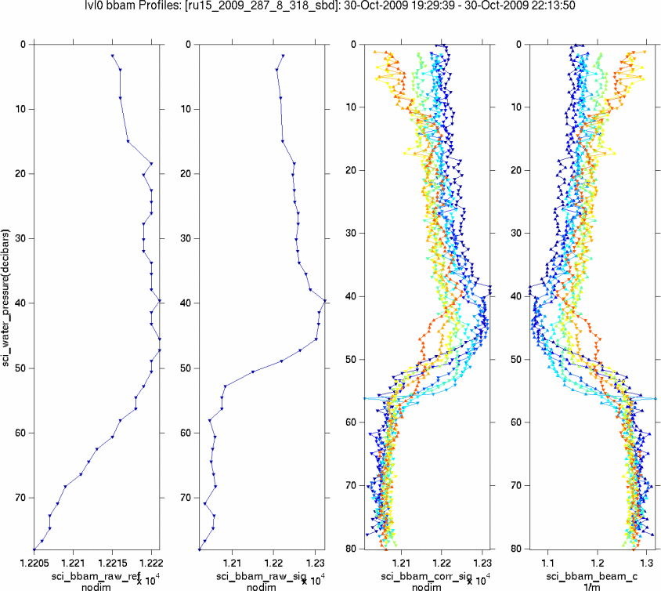
First in situ glider BAM data, part of the LBSFG buy,
growing out the OASIS/RIMPAC ONR efforts.
October 2009

Slide 7
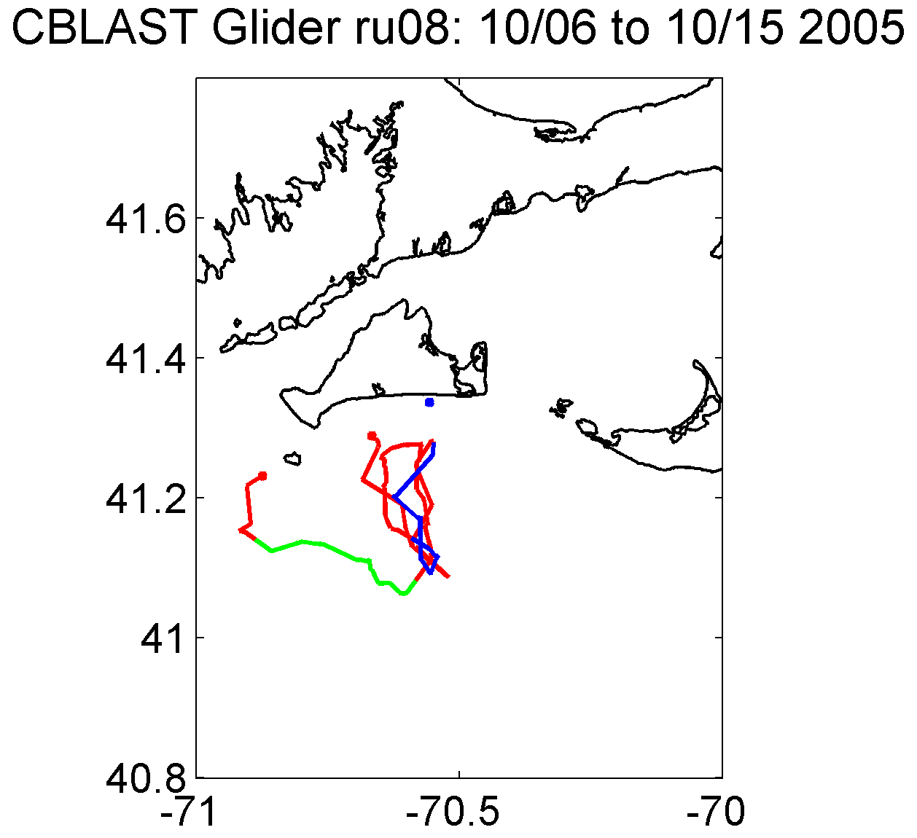

Gliders deployed as part of OASIS during late summer/ early
Fall as part of OASIS at MVCO
MVCO
Storm 1
Storm 1

Slide 8
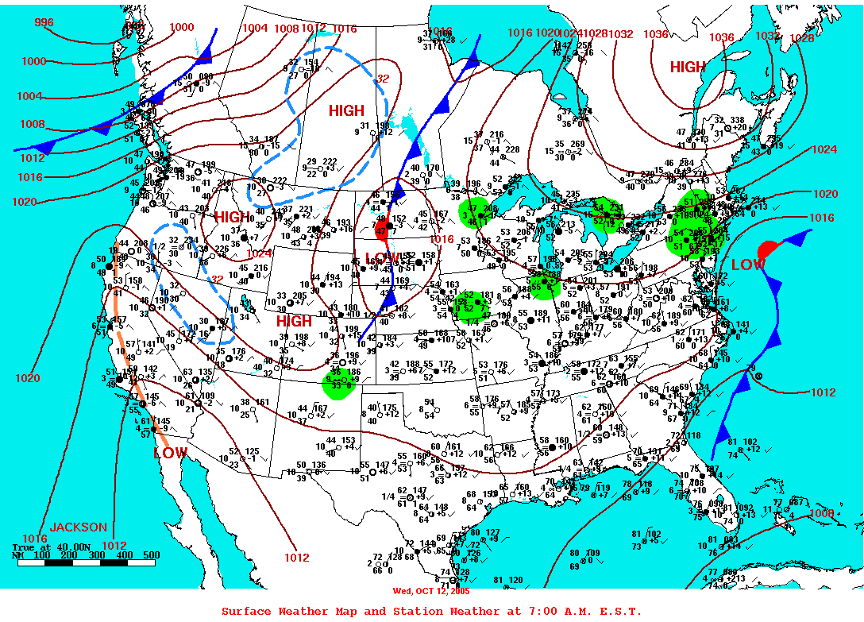
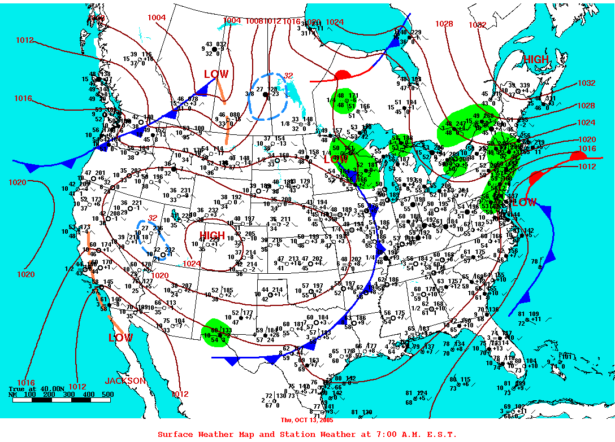
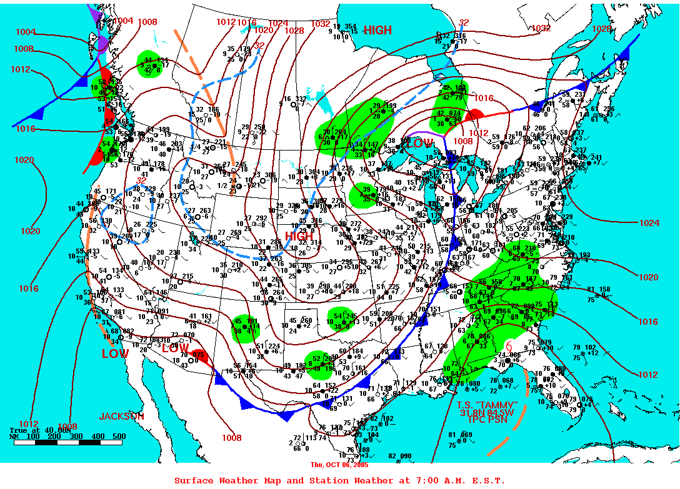
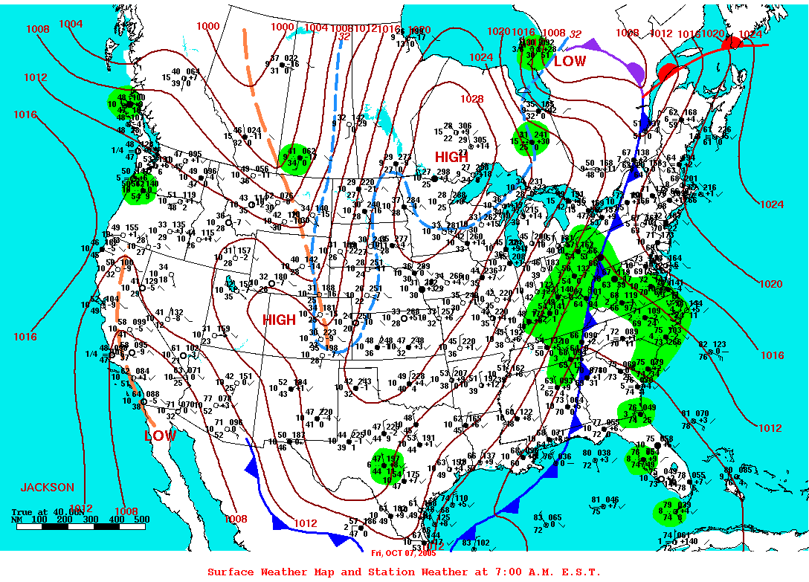
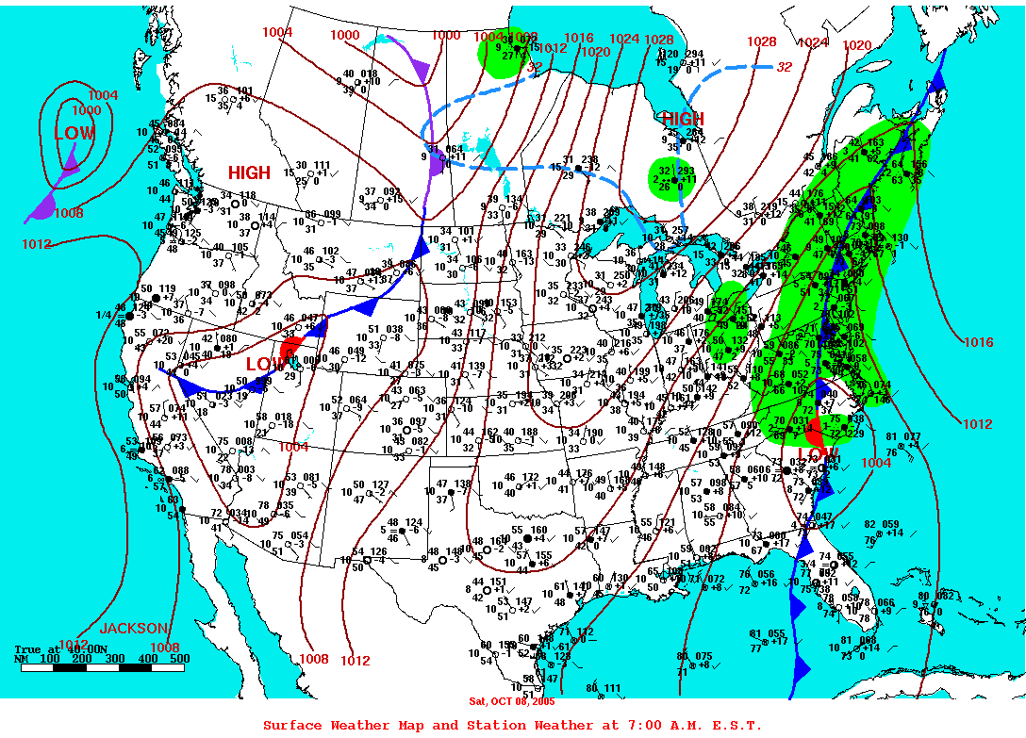
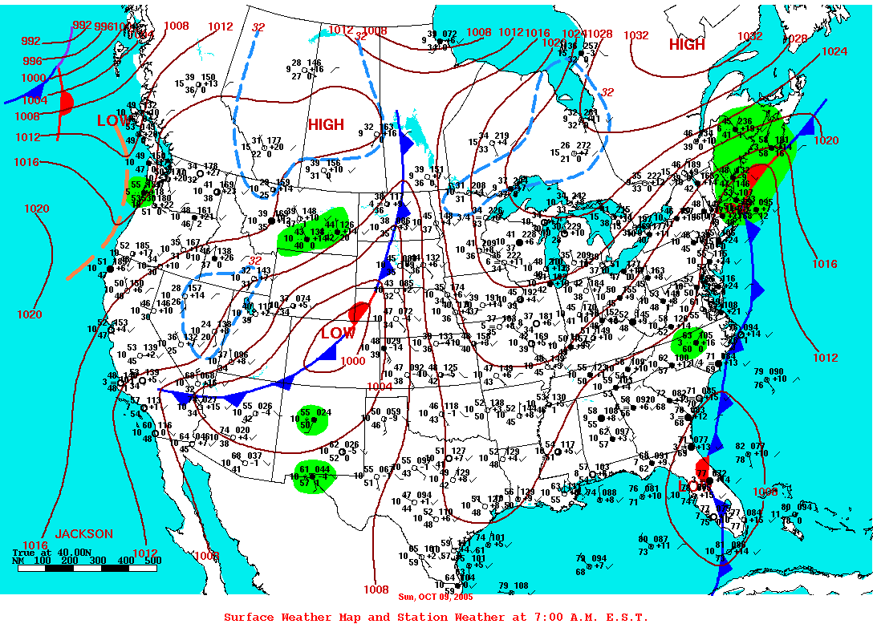
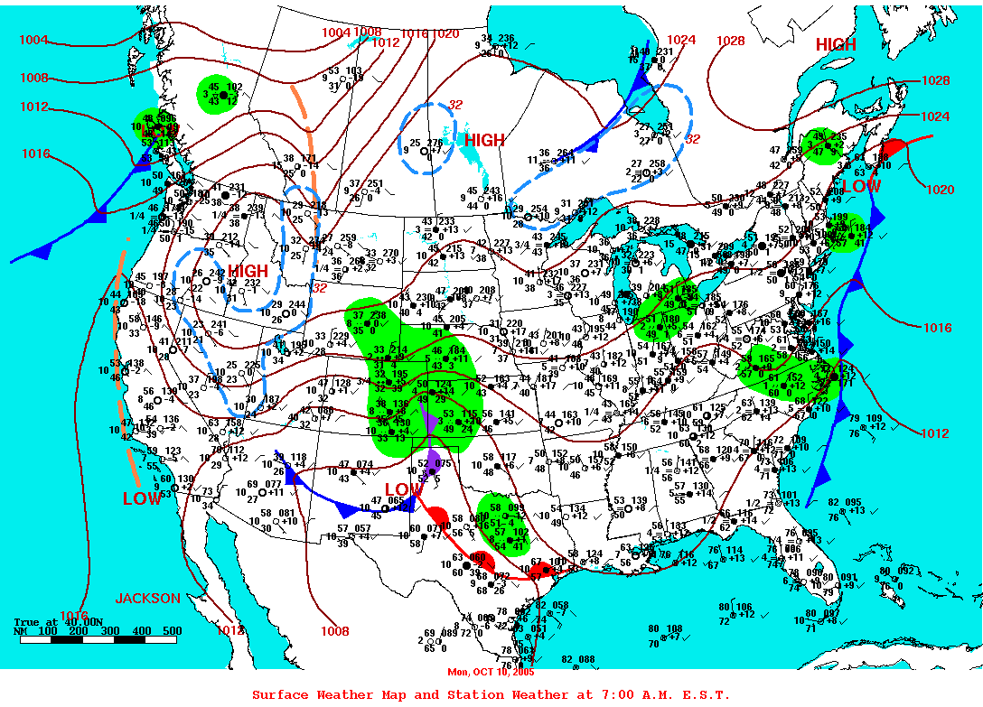
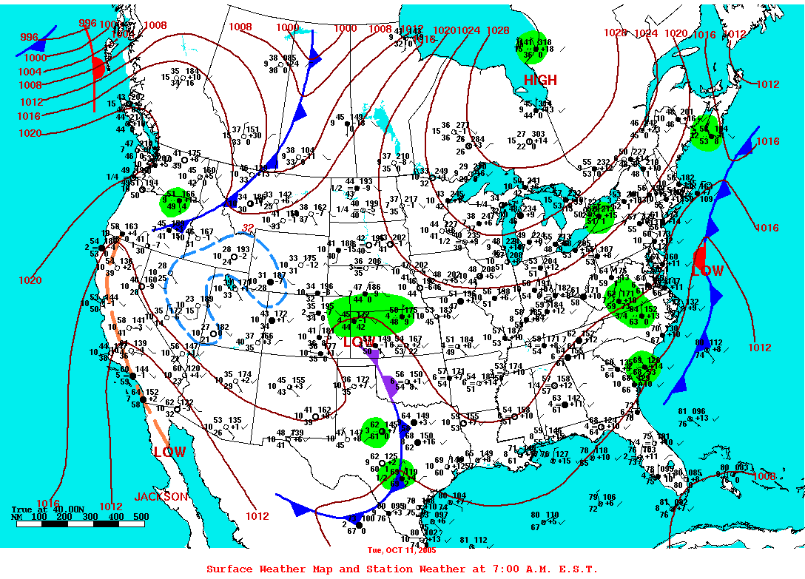
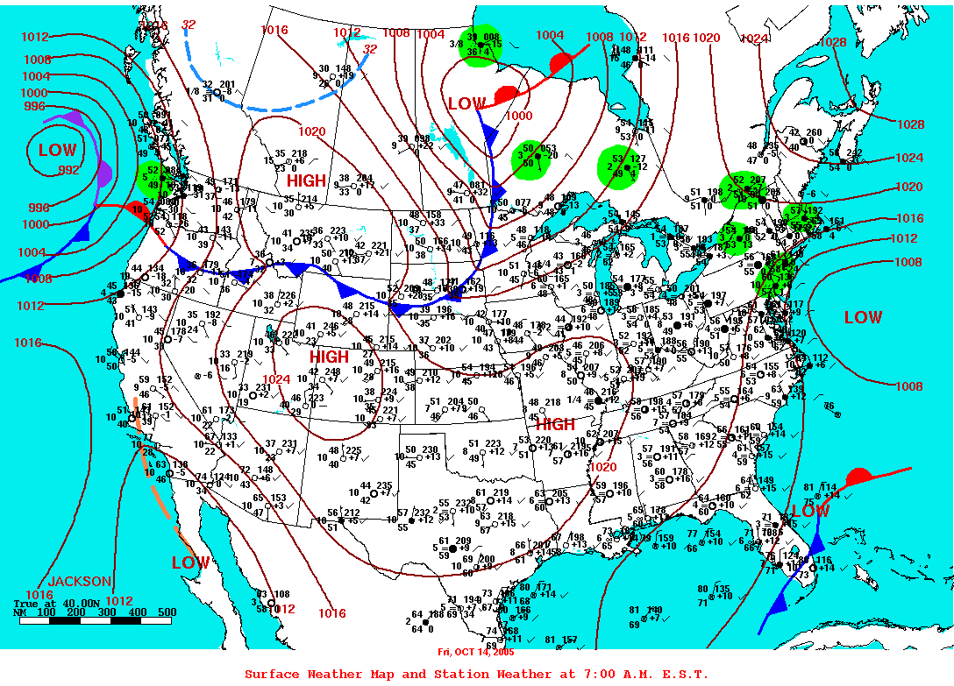
Storms systems during the OASIS deployment in 2005 at MVCO

Slide 9
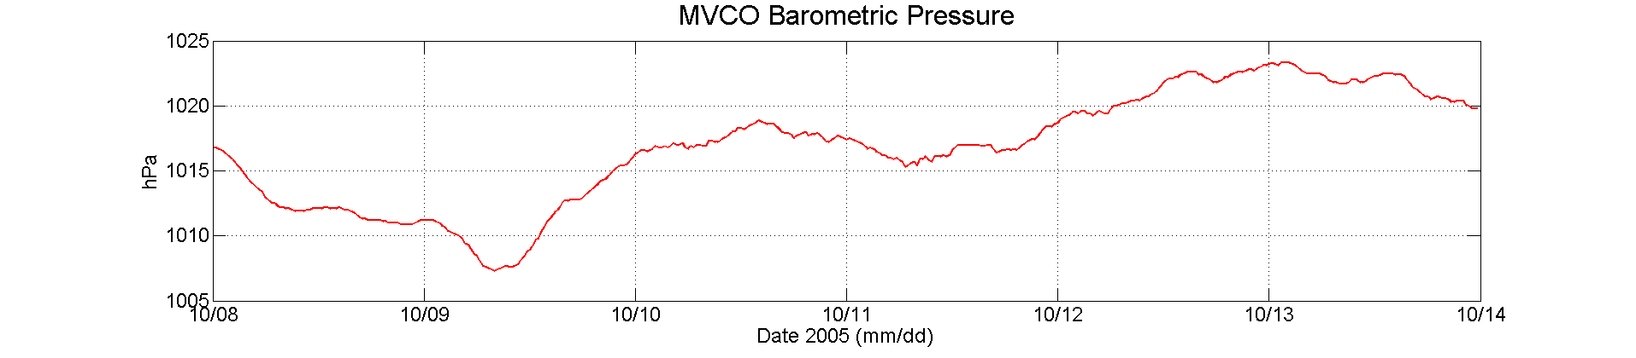
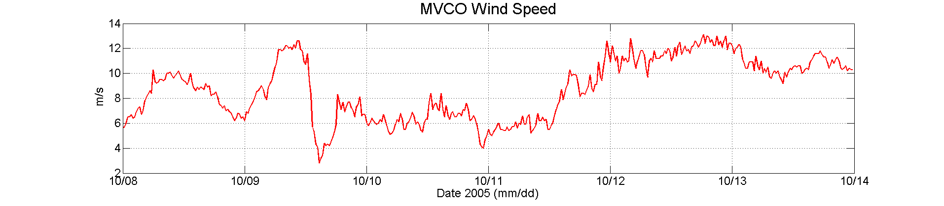
MVCO data from storms during OASIS
Storm 1
Storm 2

Slide 10
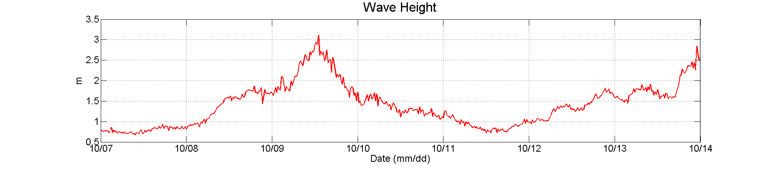
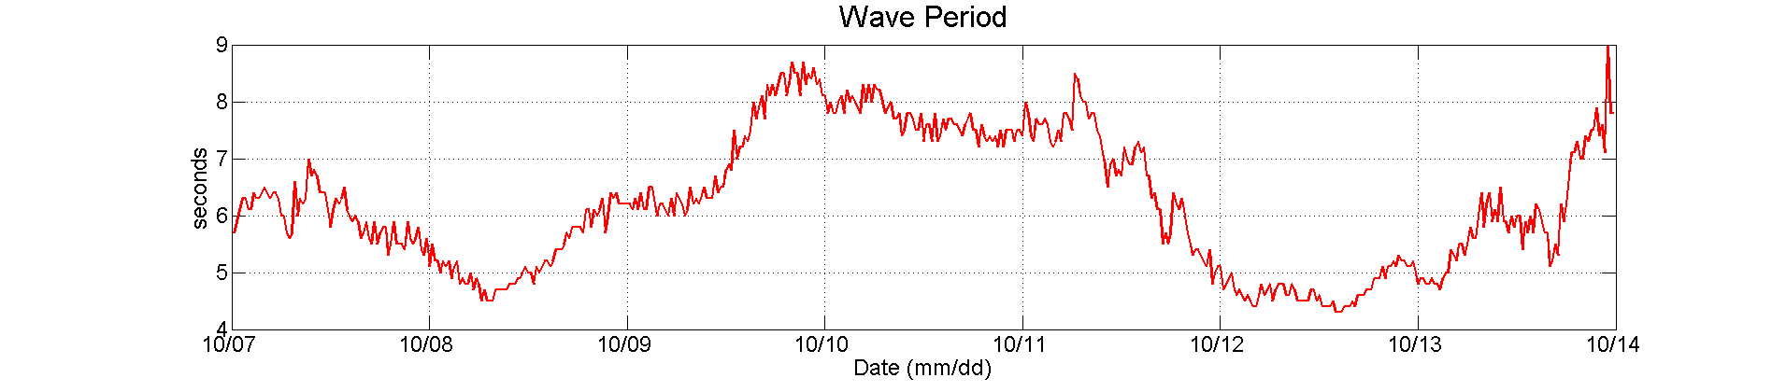
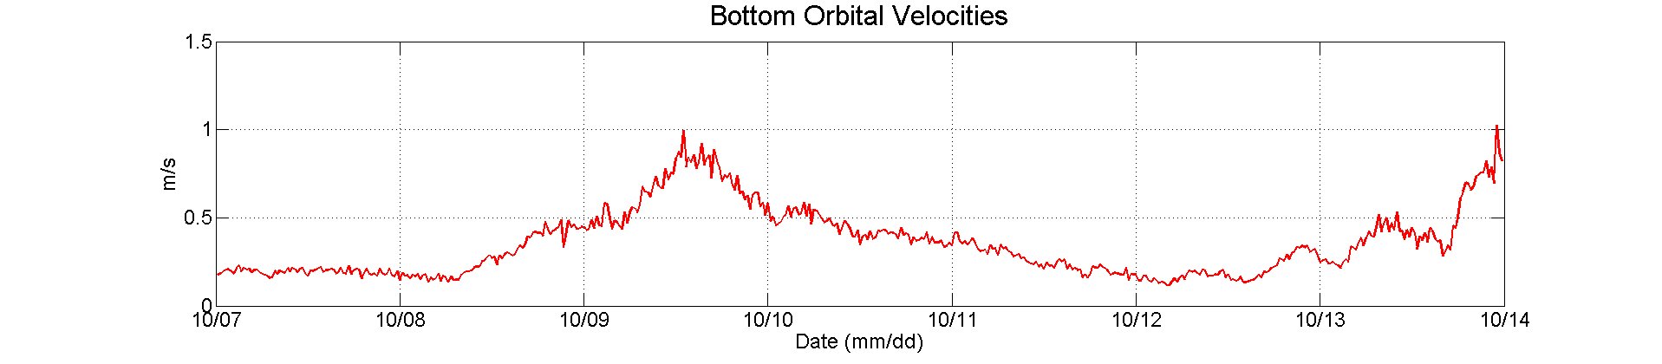
MVCO data from storms during OASIS
Storm 1
Storm 2

Slide 11
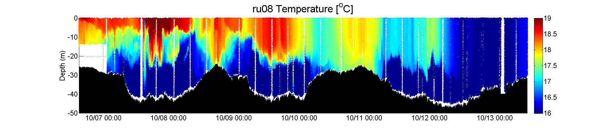
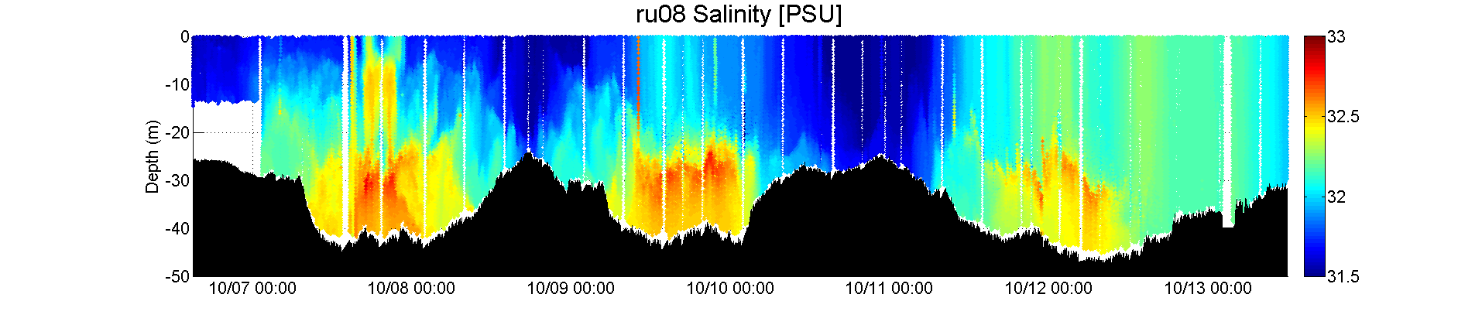
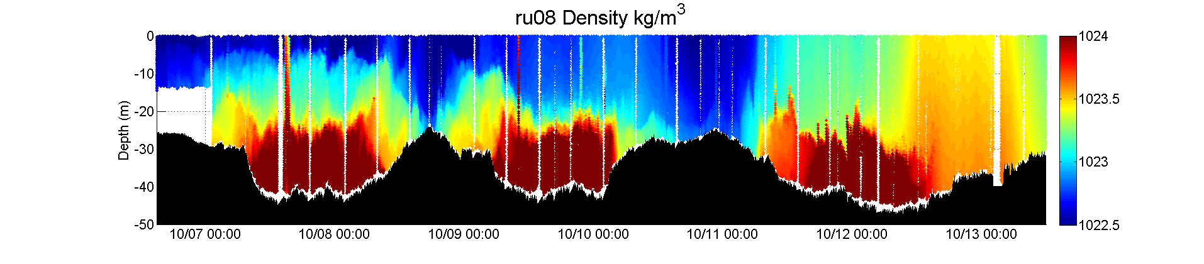
The glider showed a transition in the hydrography between the storms. During storm 1, system was stratified. This stratification was eroded by the second storm.
Storm 1
Storm 2

Slide 12
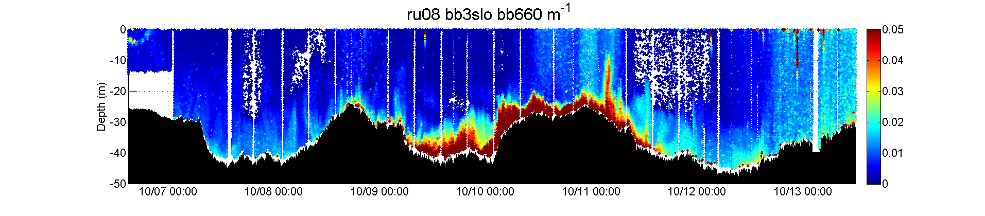
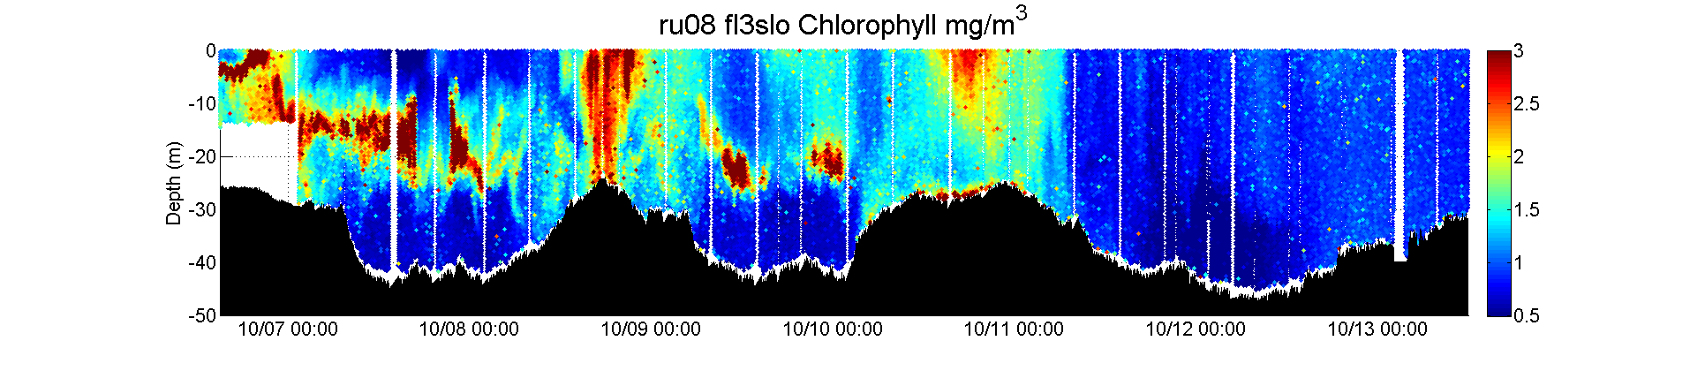
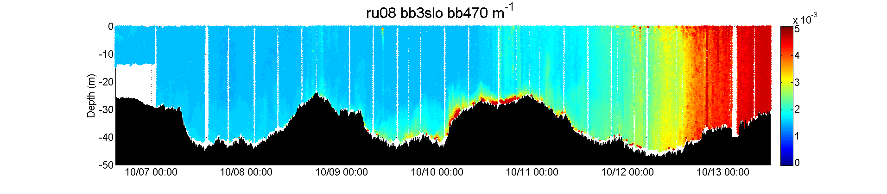
Storm 1, resuspension, none of the material penetrates through the weak stratification. Long period waves keep matter suspended.
Storm 2, resuspension, throughout the water column, during both storms chlorophyll is not a major constituent.

Slide 13
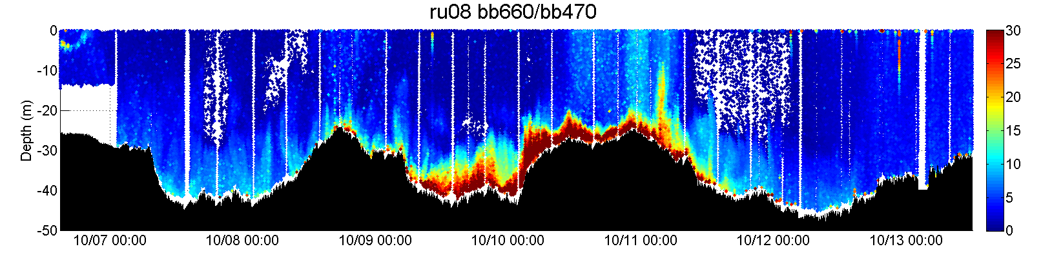
Resuspension has unique and detectable optical properties.
Distinct differences between the two storms. The long period wave storm shows
Storm 1
Storm 2
1.5
0

Slide 14
Conservation of Sediment Mass
Closure - Constant Stress Layer, No Stratification
Suspended Sediment Concentration Profile
Fall Velocity / Shear Velocity Ratio
In terms of the Normalized Backscatter
Plot vs. & Find Slope

Slide 15
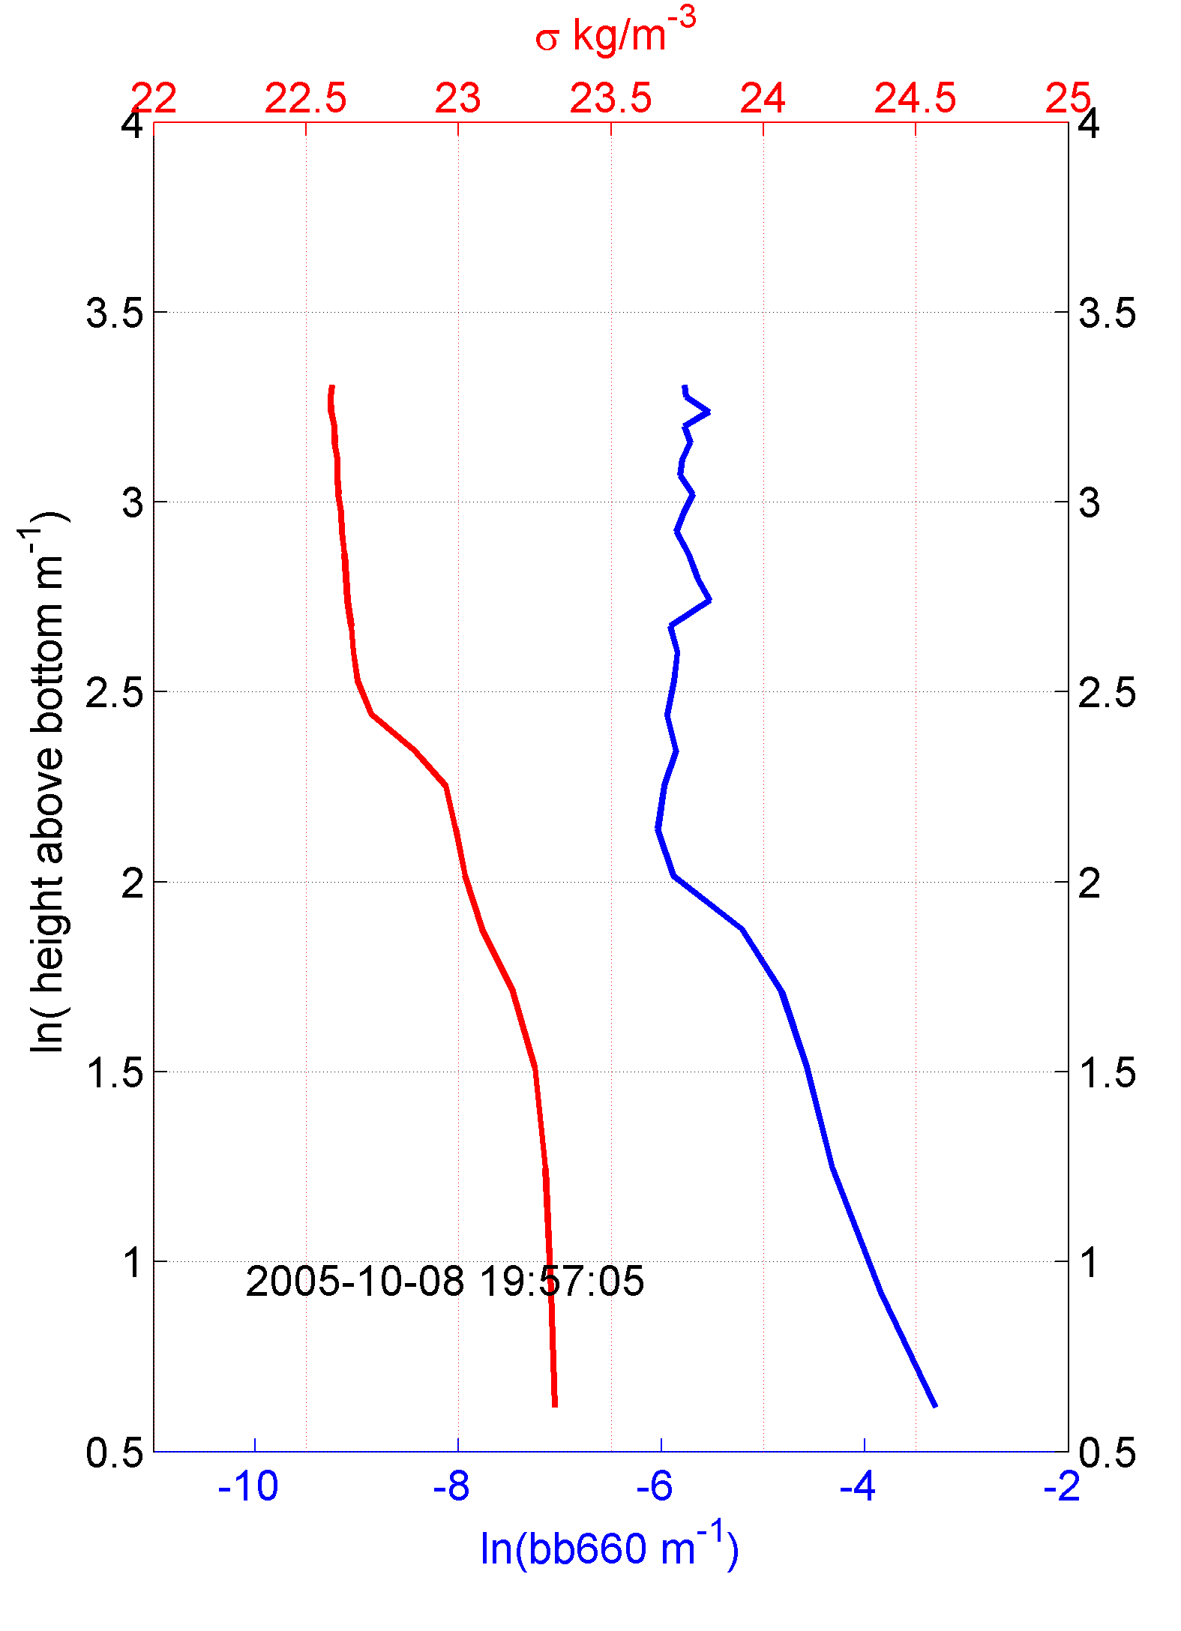
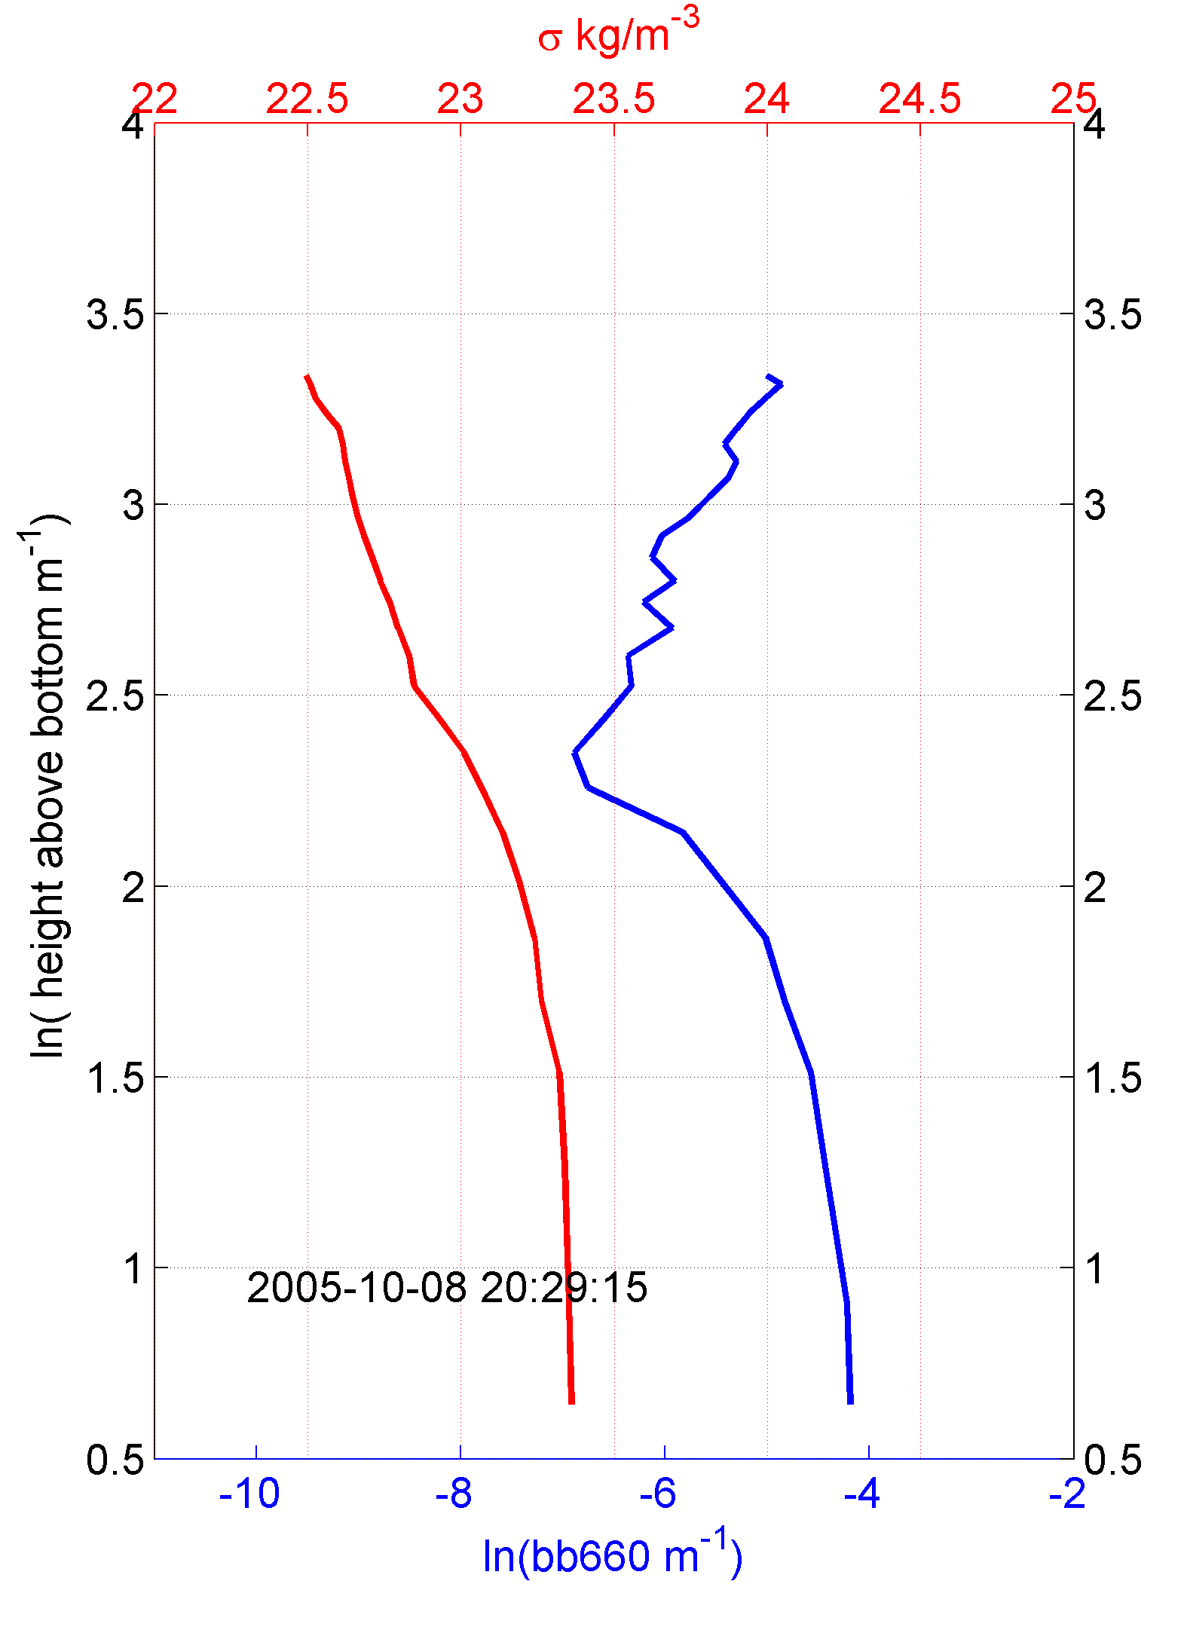
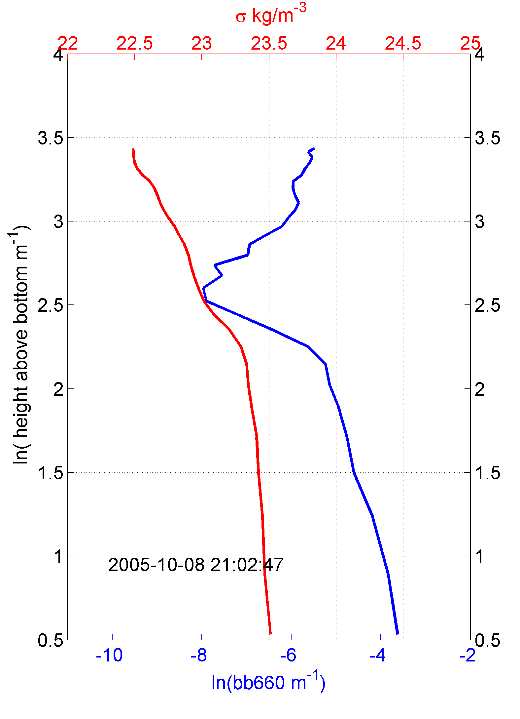
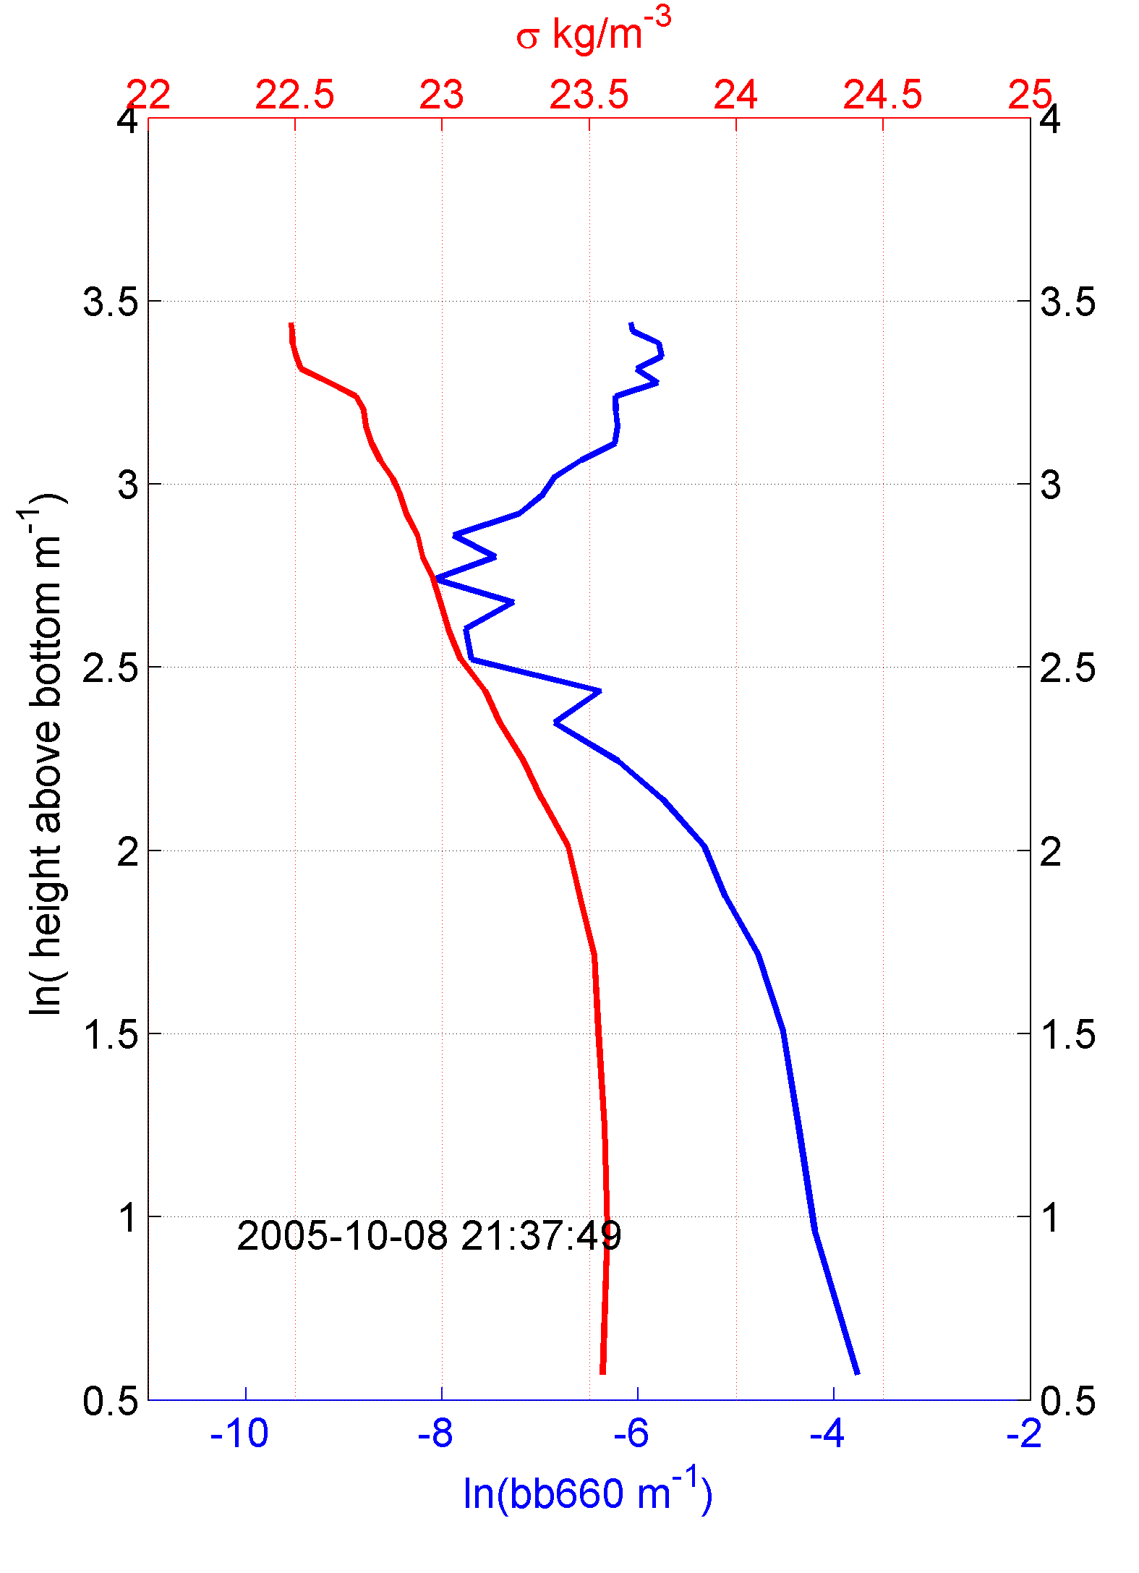
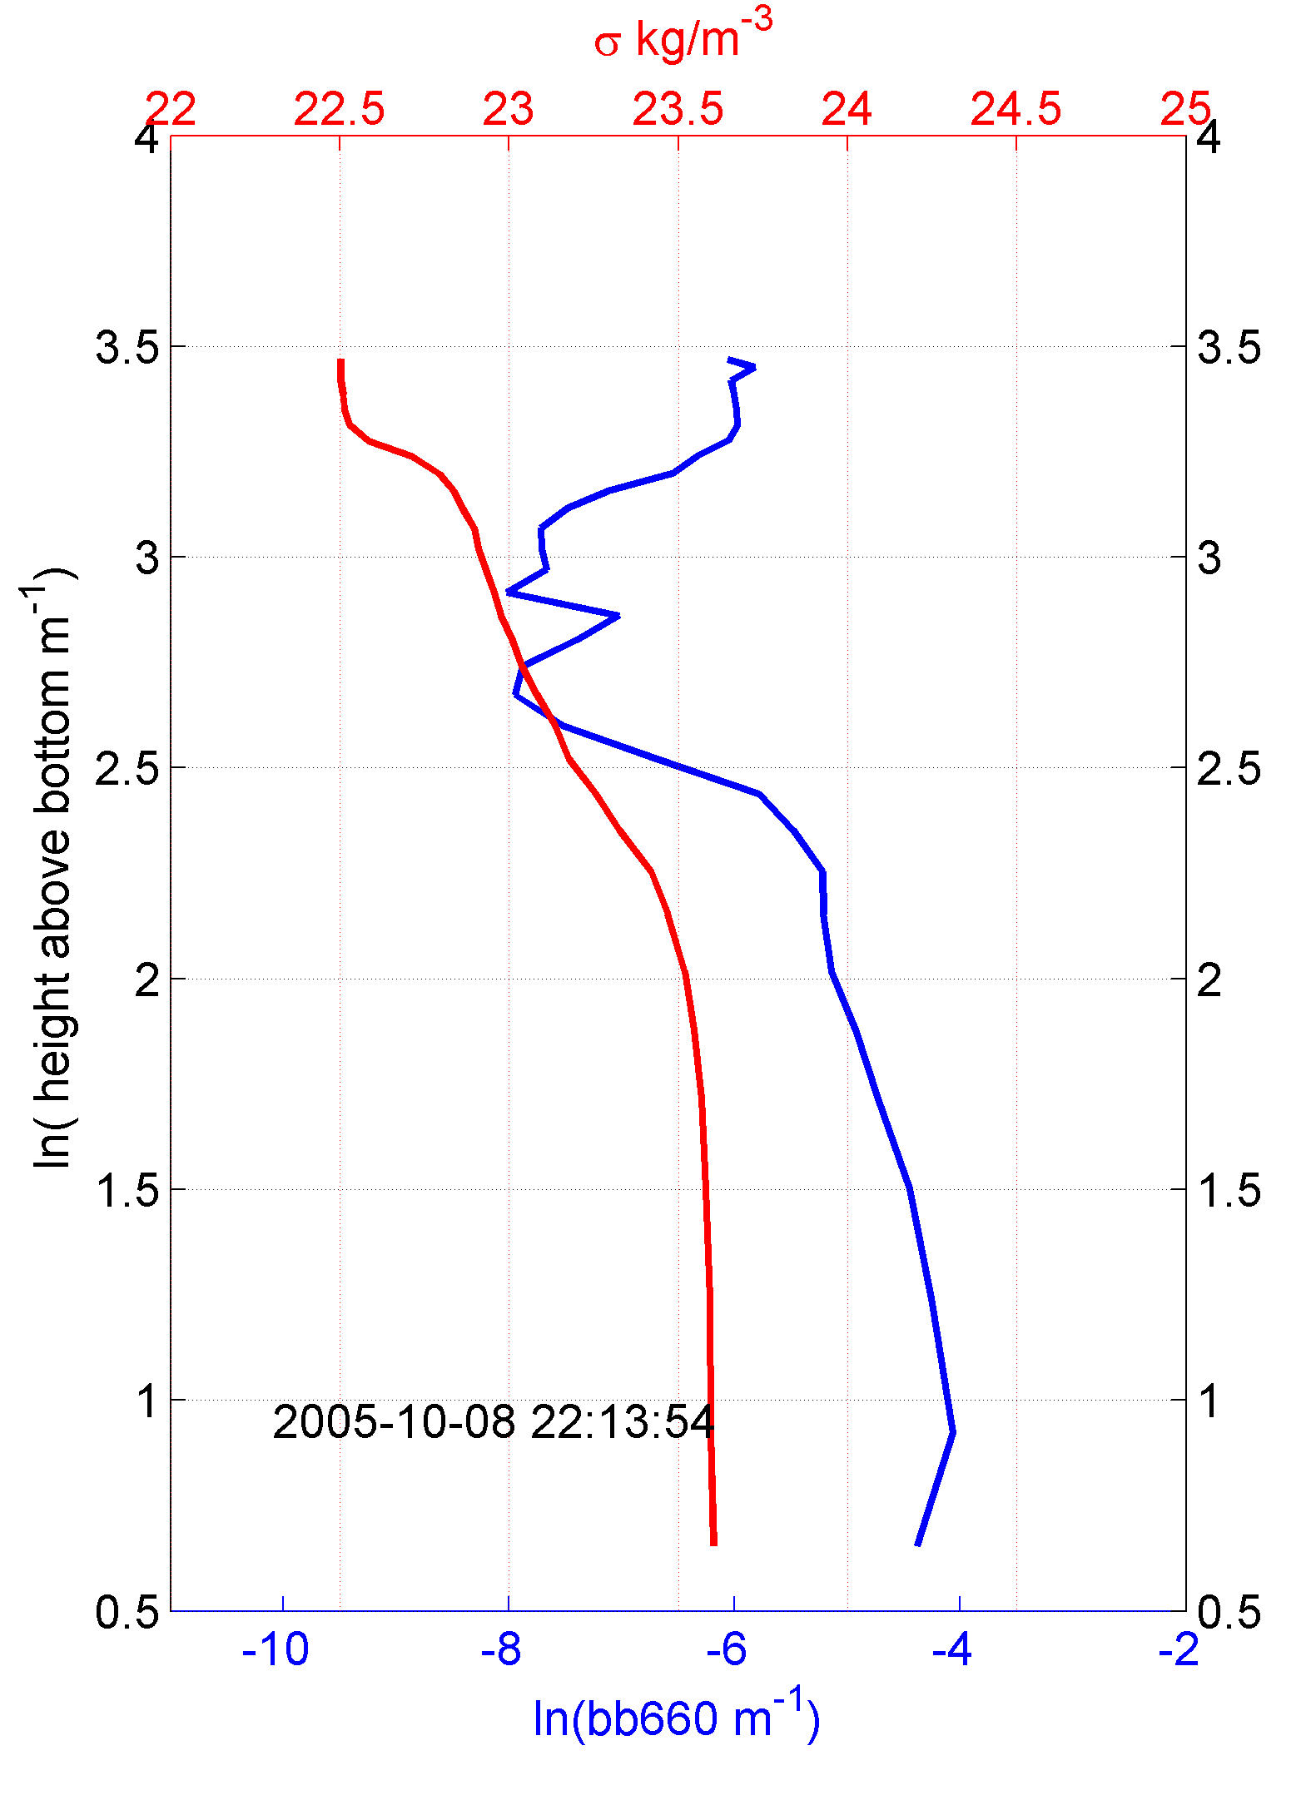
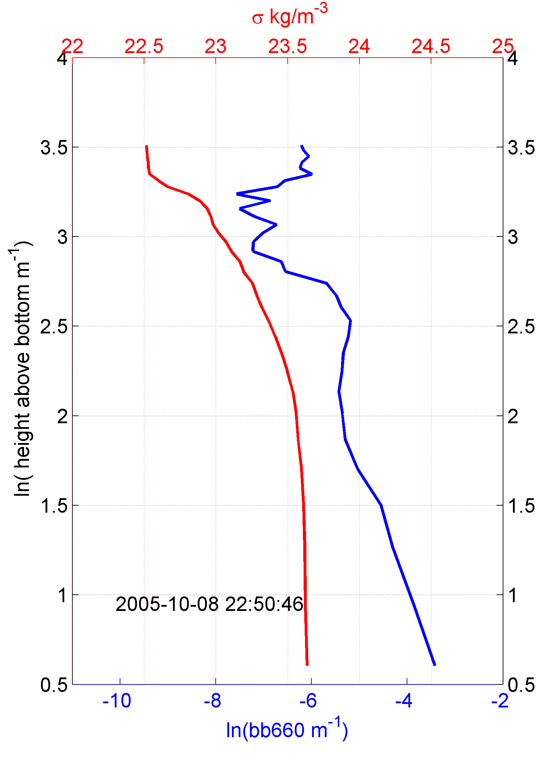
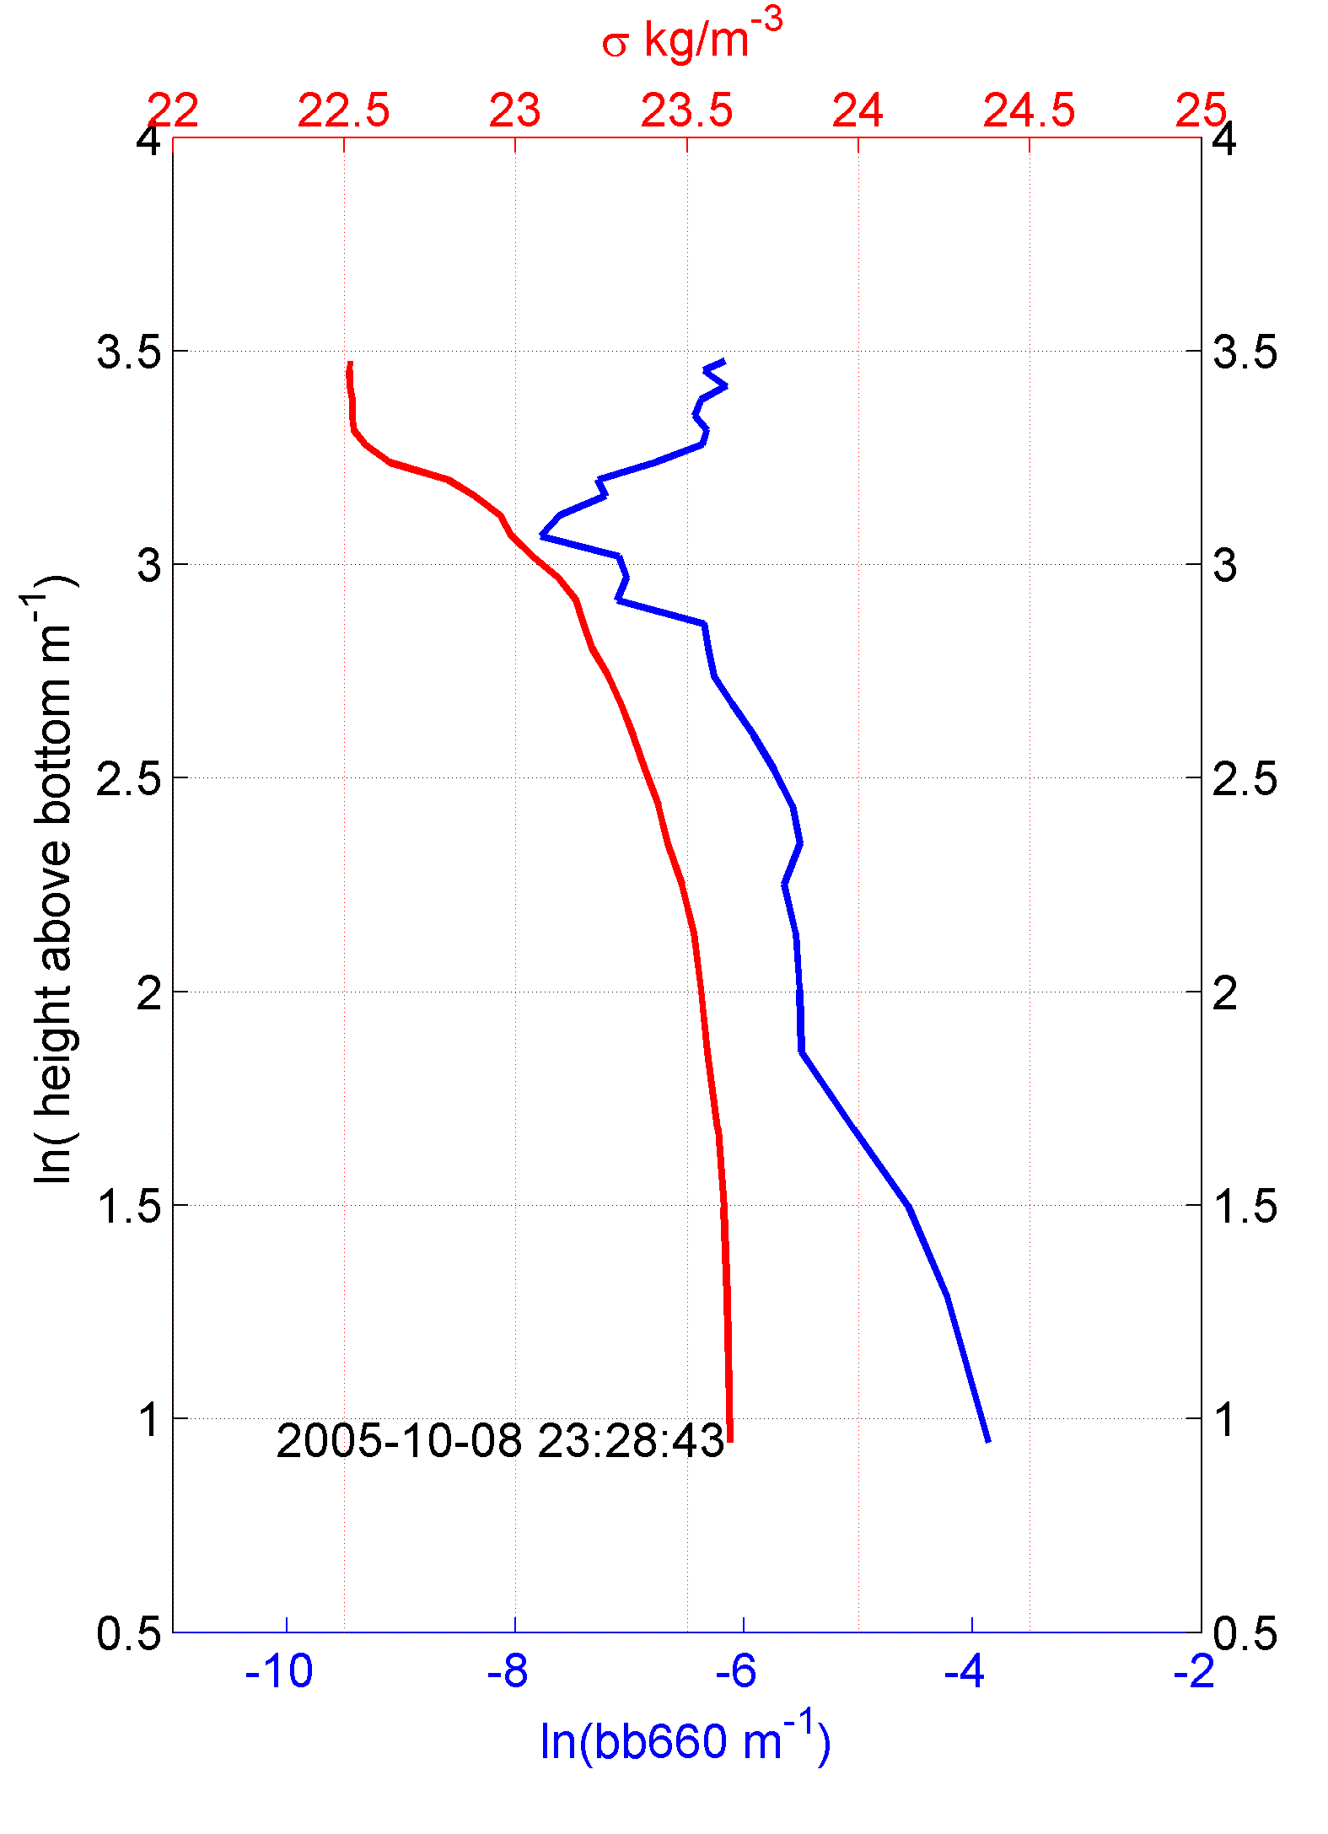
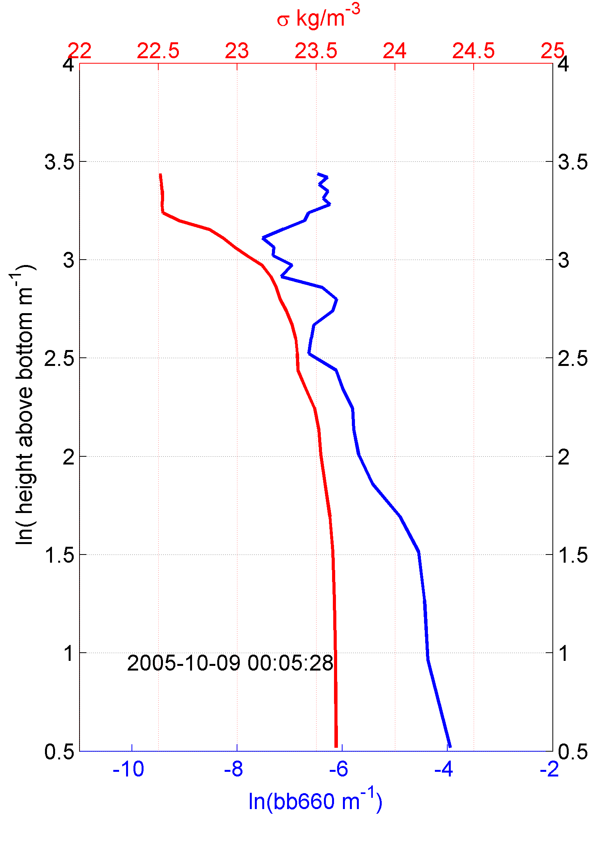
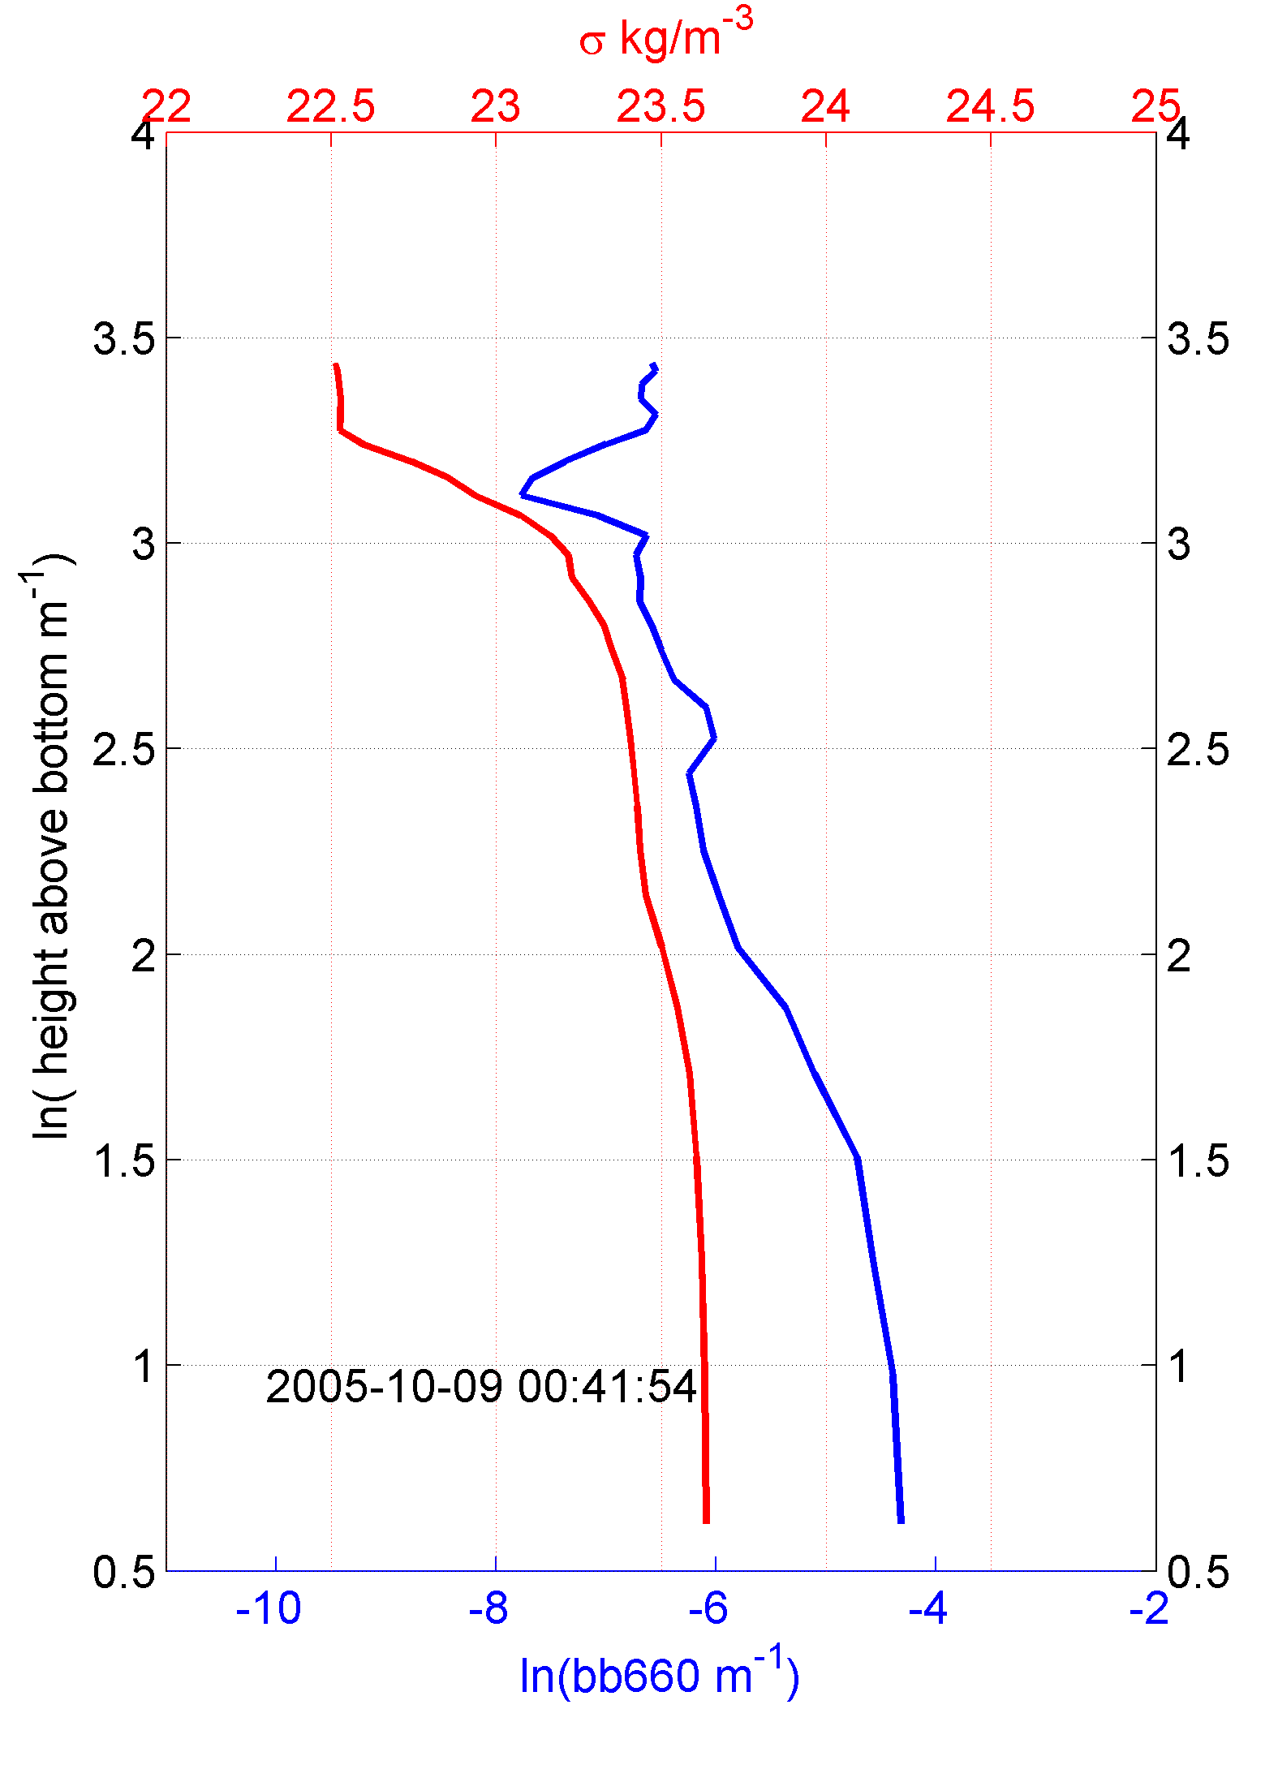
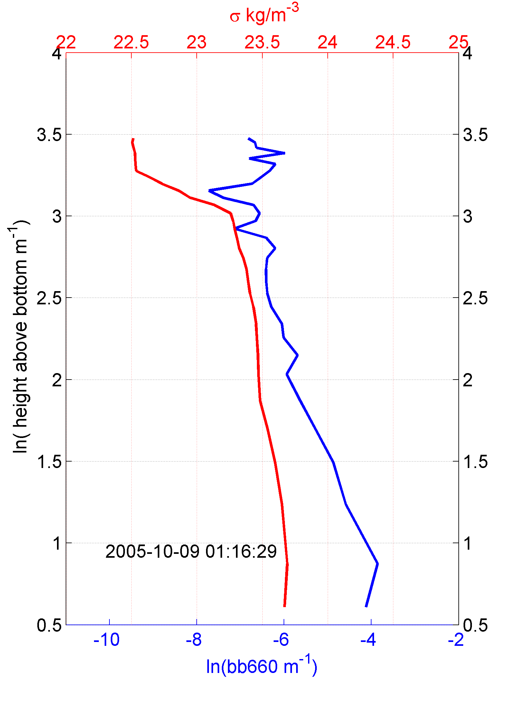
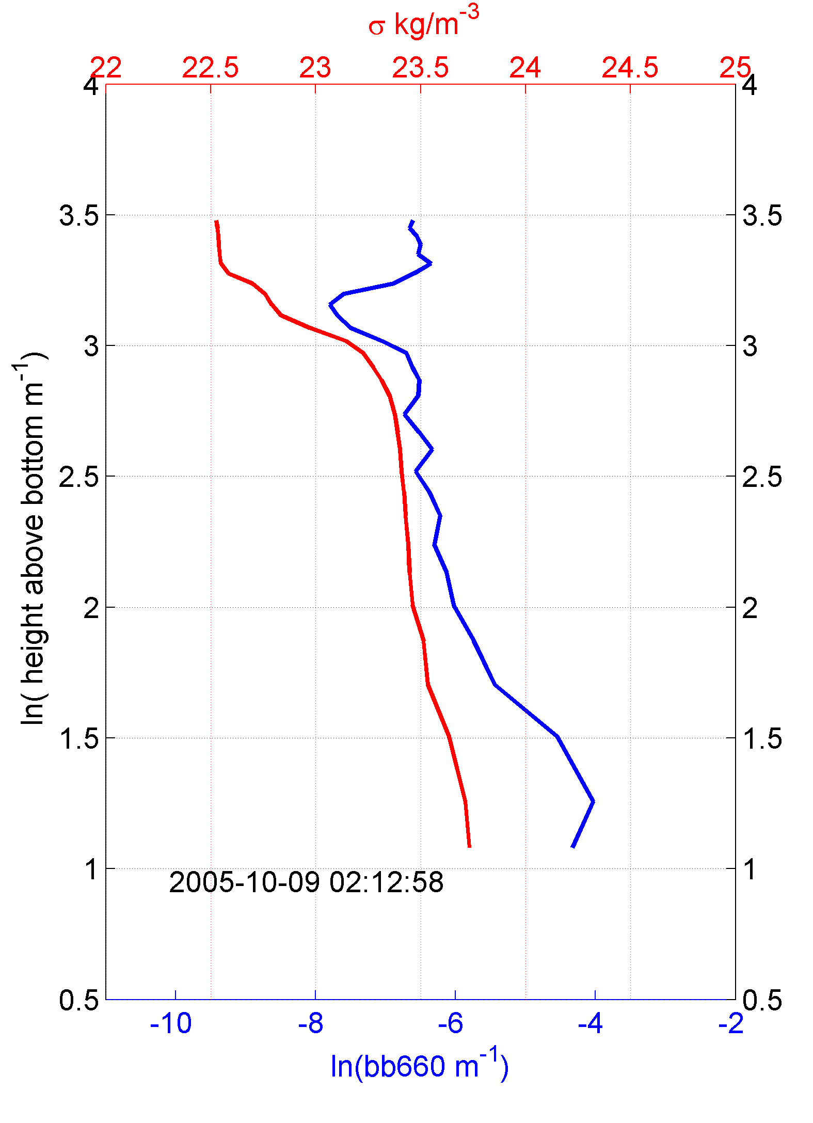
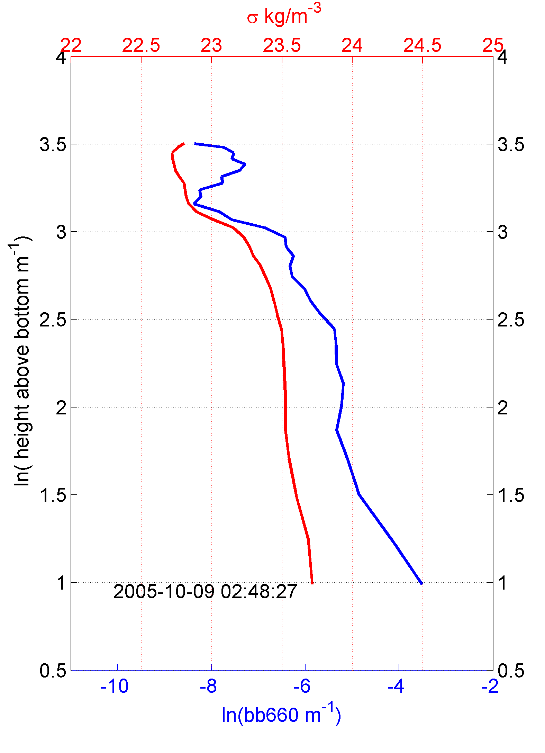


















Slide 16






























Slide 17



Derived currents from glider.

Slide 18



Slide 19






MURI, IOOS, ONR, OOI Observing System Experiment (OSE)
Design, Testing and Deploy
Observatory (simulated) data
Models
Sensor &
Platform
~3 km
~100 m
Virtual Ocean
Data Assimilation
Data
Analysis
Science Questions & Drivers
Data Synthesis: Nowcast & Data Impact

Slide 20





Nor’ Easter during the exercise
Storm
NOAA buoy

Slide 21



Nice big storm, with 6m waves with 7s periods

Slide 22



Large storm erodes stratification rapidly as the water column had already been “preconditioned” with seasonal cooling
storms

Slide 23



The storm lifts material throughout the water column as stratification erodes,
chlorophyll contributes significantly to the resuspension signal

Slide 24



Downcast mean velocity
Extremely strong currents, currents also strong in the vertical, which is detectable in the gliders motion!
Downcast mean velocity residual

Slide 25







October 2003 Fall Transition Storm - Northeaster
Fall Transition
BBL Growth
Rapid Increase in u* as stratification is lost
Mixing throughout watercolumn
1 2 3 4 5
RMS
Before Transition
After Transition
wf/u*
October 30, 2003

Slide 26
October 2003 Fall Transition Storm - Northeaster
1 2 3 4 5
Total
Load
Current
Speed
Net
Trans-
port
October 30, 2003

Slide 27

Regional-Scale Conclusions
Gliders are Proven Storm Sampling Platforms
2) Existing Optical Sensors Produce Unique Sediment Transport Results – Regionally Distributed Fleets Possible Now – Spatial Patterns
3) New Sensors Will Further Enable New Storm Science
- Turbulent Closure & Mixing
torms

