Slide 1
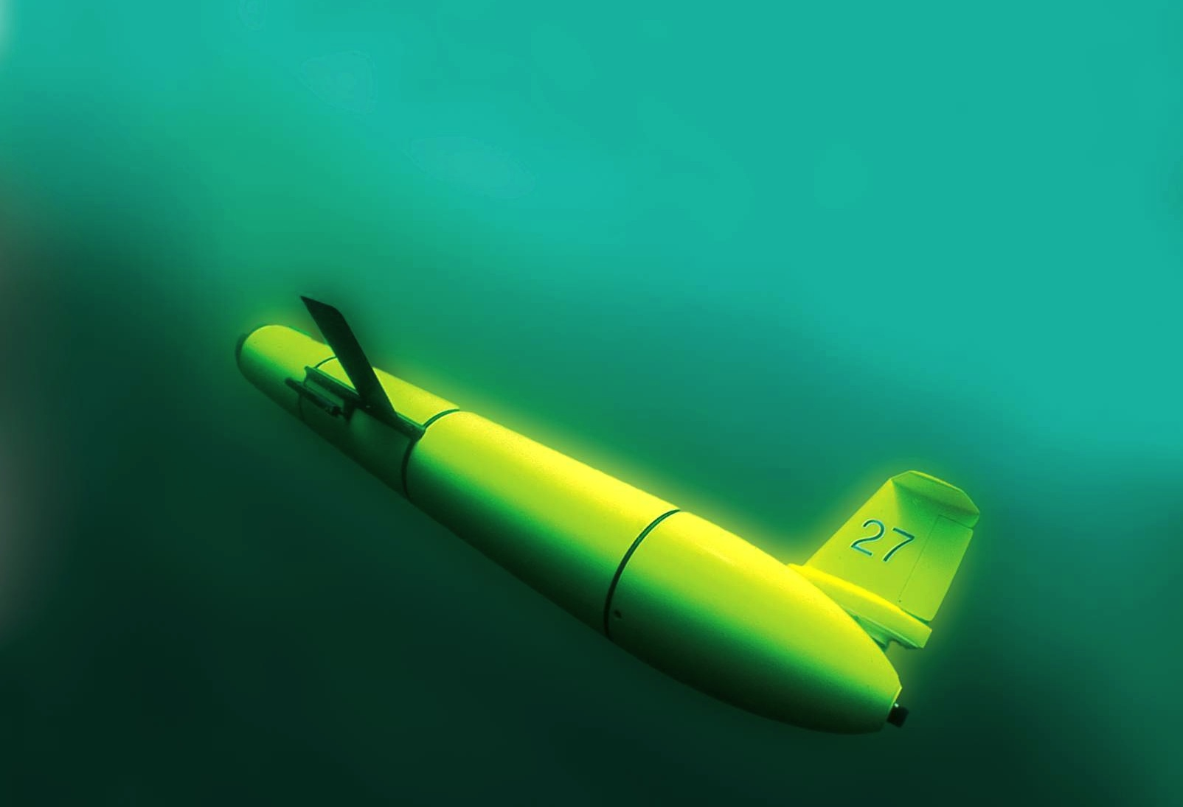
RU COOL’s scalable focus on immersing society in the ocean through observing systems
Oscar Schofield,
Scott Glenn,
Josh Kohut &
Janice McDonnell
Rutgers University
“The Ocean is Our Classroom”

Slide 2
Conclusions:
Observatories a new tool for education and engagement
Near-peer teams critical to the possible scale and sustainability of teaching
Opportunity to break barriers between academic departments is critical

Slide 3
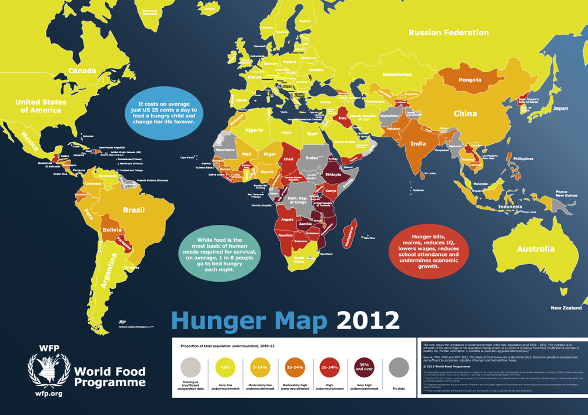
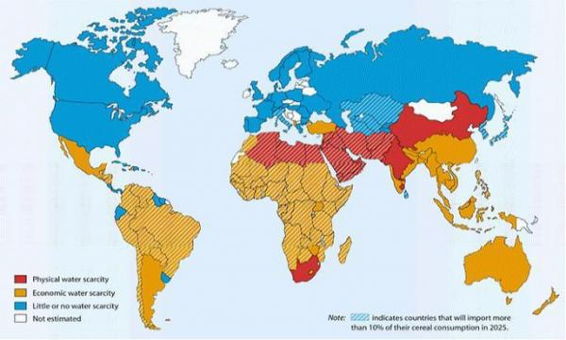
Changes in the Earth system is impacting humanity today. These affects will increase in the future.
The question is no longer if there will be change but on how to live with the change.
Living with the change will require a full societal response therefore there is an urgent need to entrain wide segments throughout society.
So how do we entrain students throughout an entire University?
Water Scarcity

Slide 4
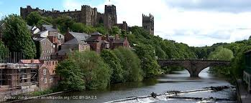
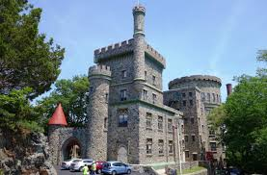
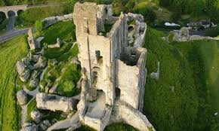
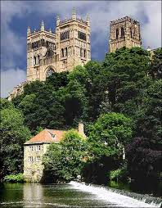
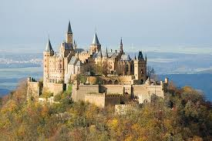
But our Universities still largely remain full of ivory tower fiefdoms with limited integration across majors
Physics (we are the smartest)
Engineering (we matter)
History (we have the long view)
Art
(we have soul)
Marine Science (we explore)

Slide 5
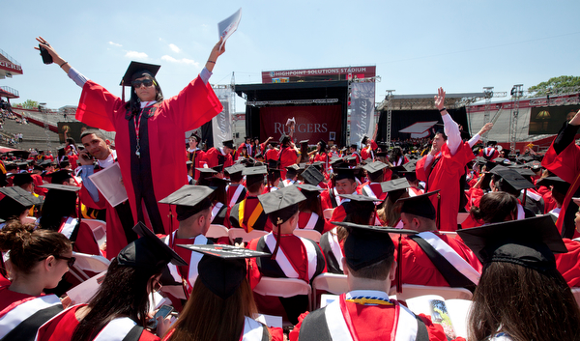
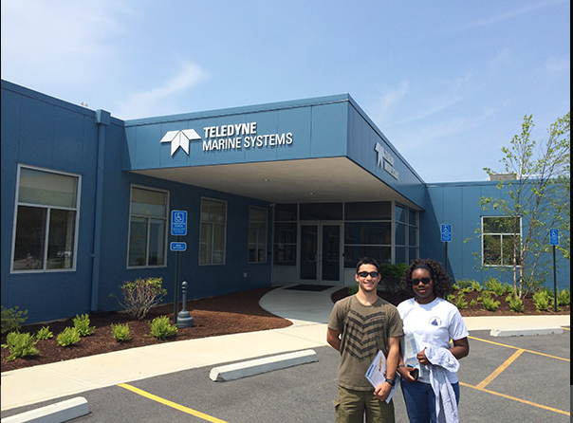
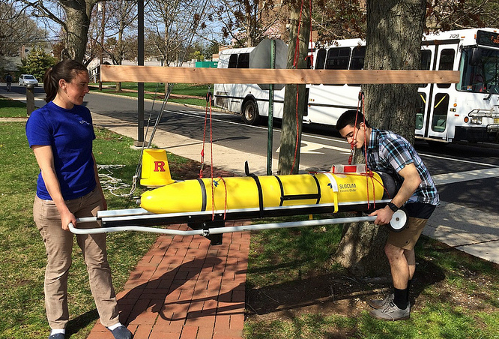
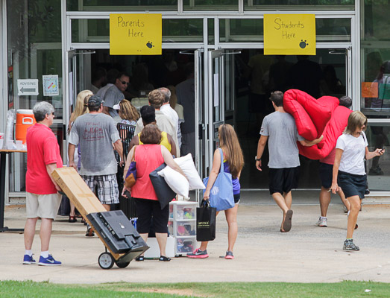
LOOKING AT OUR MARINE SCIENCE MAJOR
Seniors (focused on completion)
Earth Systems, PO, CO, BO ….
Advanced courses
Research in Lab
Marine Dynamics, Oceanographic Methods and Data Analysis
Core Courses (Theory)
Choose a major
Grad School
(MS or PhD)
English, Inorganic Chem, Calculus, Intro Oceanography ….
Intro Courses, Requirements across the ivory towers
Freshmen (maybe focused)

Slide 6

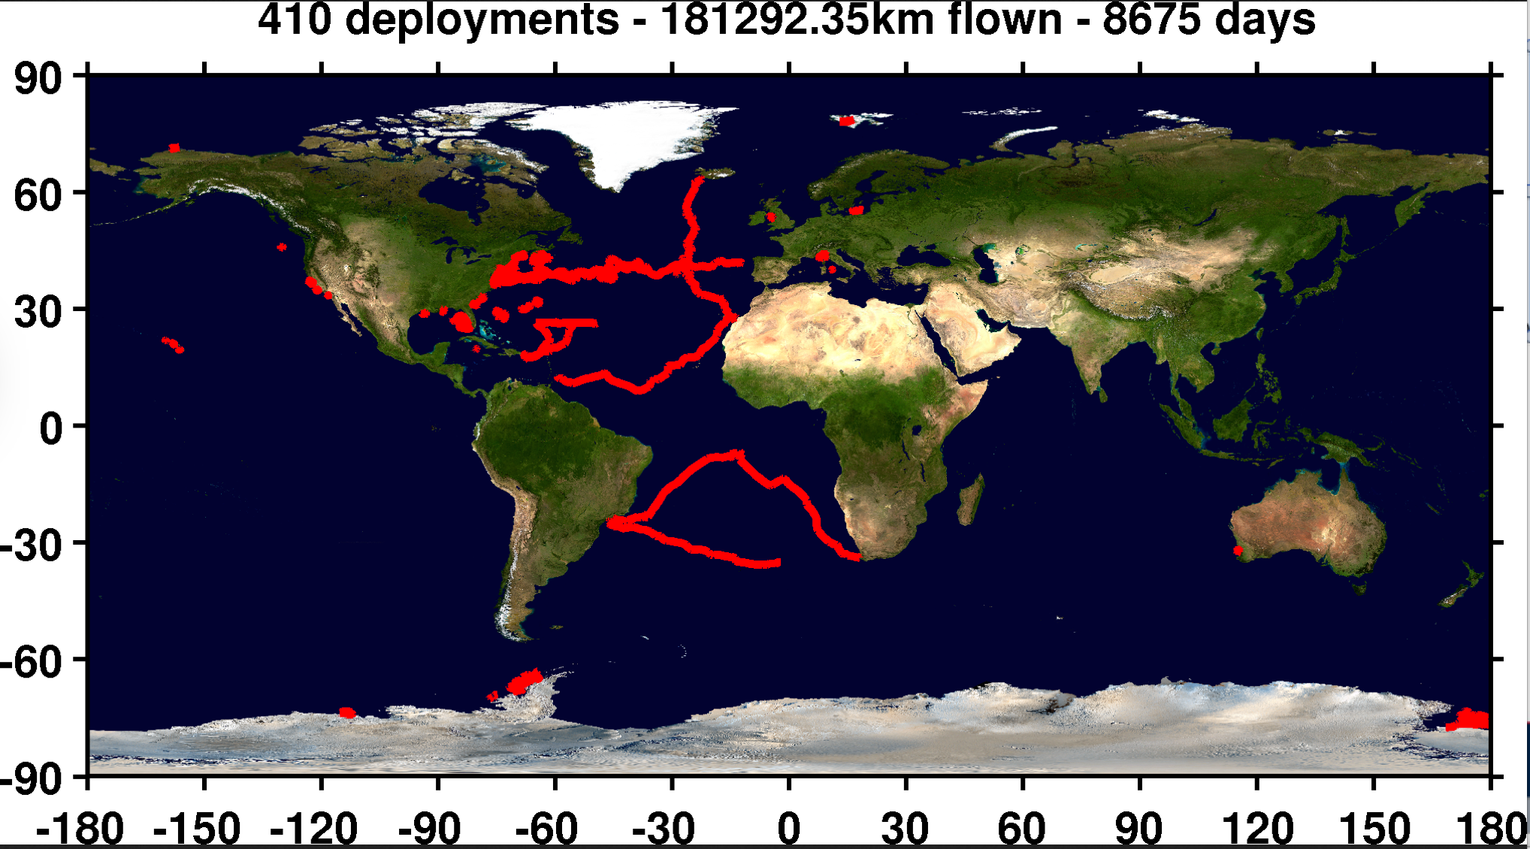
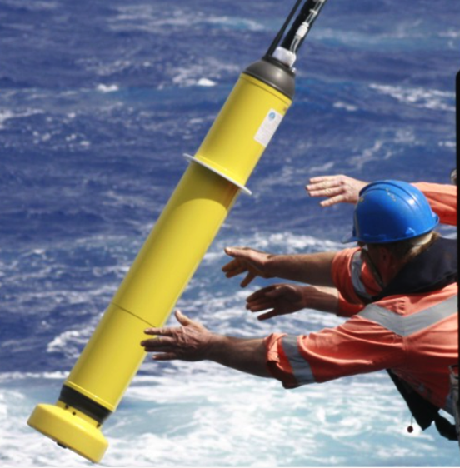
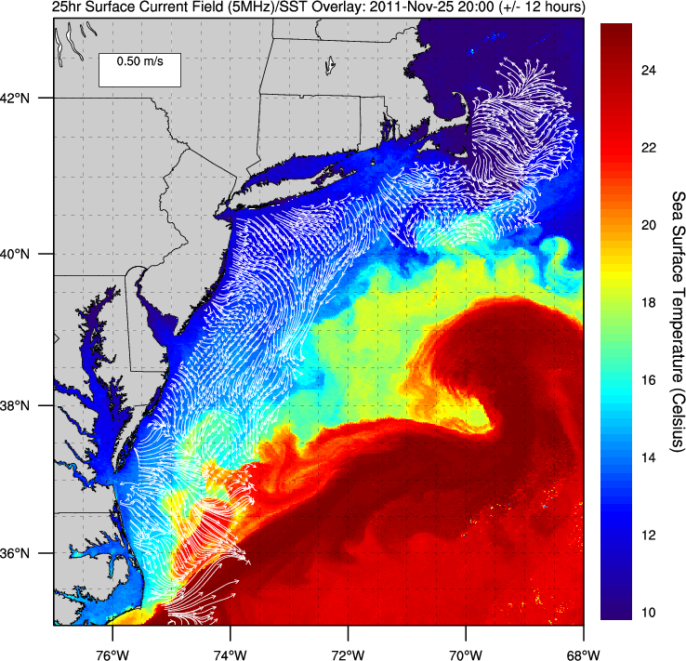
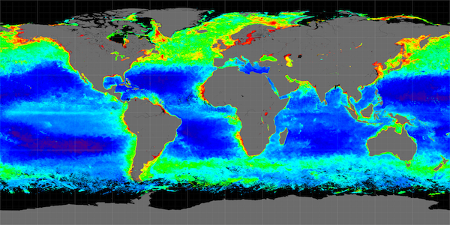
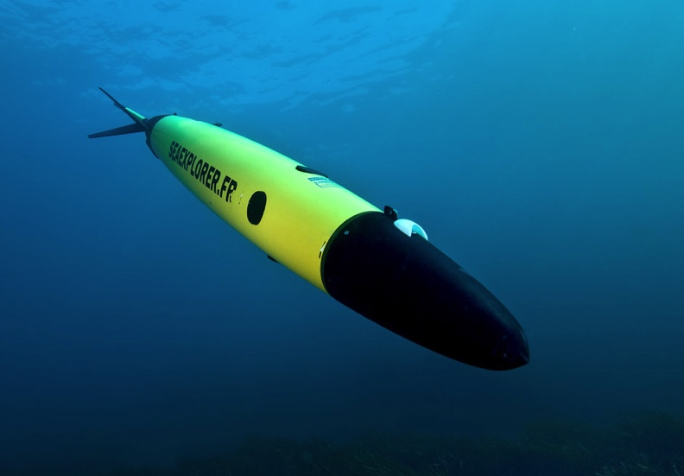
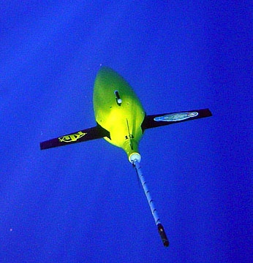
What has changed that might evolve our approach?
We can take our classrooms into the ocean everyday

Slide 7

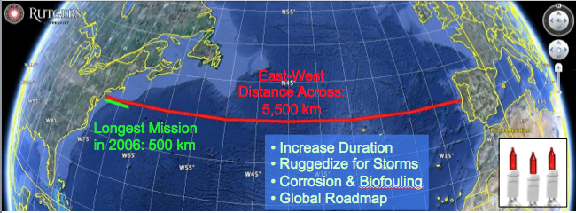
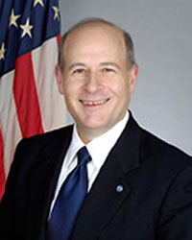
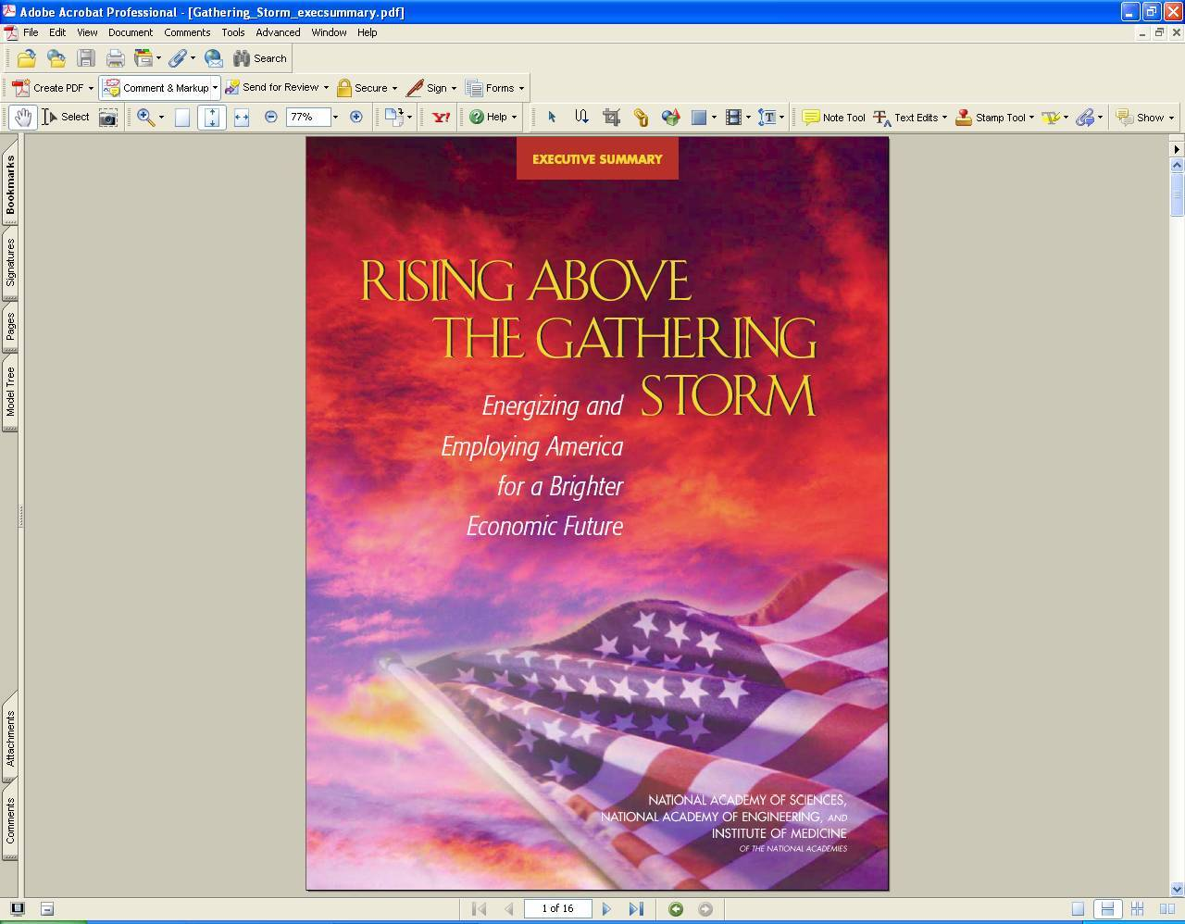
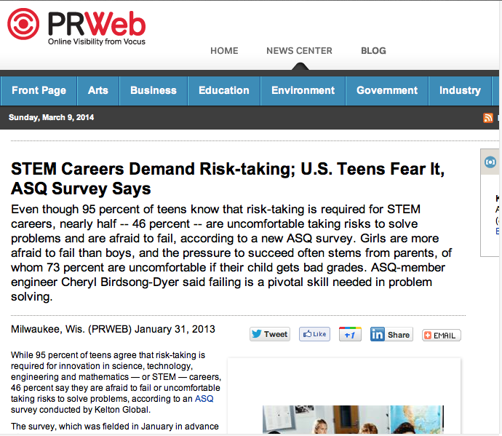
Trans-Atlantic Glider Challenge – May 24, 2006 –
UNESCO E.U./U.S. Baltic Sea Conference in Lithuania
Dr. Rick Spinrad
Assistant Administrator
NOAA
Office of Oceanic and Atmospheric Research
RU27: 7,400 km in 221 days
RU27: 7,400 km in 221 days
“I have something you need to do for the good of your country.”
“Take one of your gliders, modify it, and fly it across the Atlantic, inspiring students along the way.”
Positive risk-taking is required for innovation in STEM careers!

Slide 8
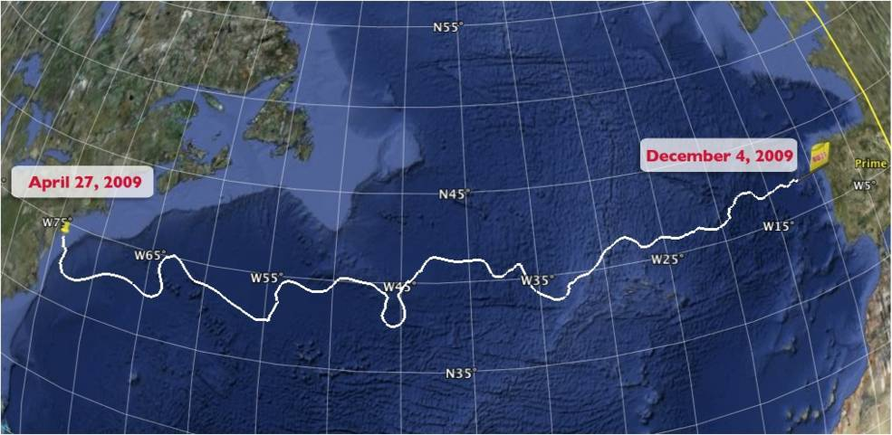
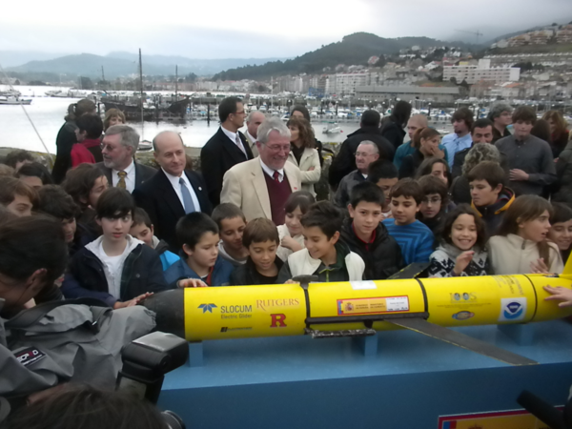
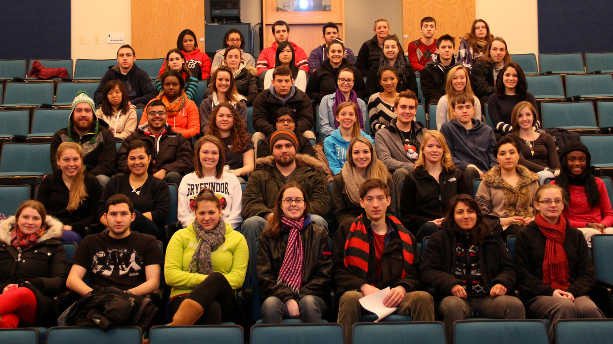
The Trans-Atlantic Glider Challenge
December 9, 2009 – Baiona, Spain
RU27: 7,400 km in 221 days
Trans-Atlantic Glider Challenge
Notes:
Letters from students to Spanish schools
Watch one, do one teach one. Borrowed best practices from COSEE, used data from ocean observatories. Increased students by over 400% with between 50 and 100 undergrads involved in the lab and research on a consistent basis. Reached carrying capacity.

Slide 9
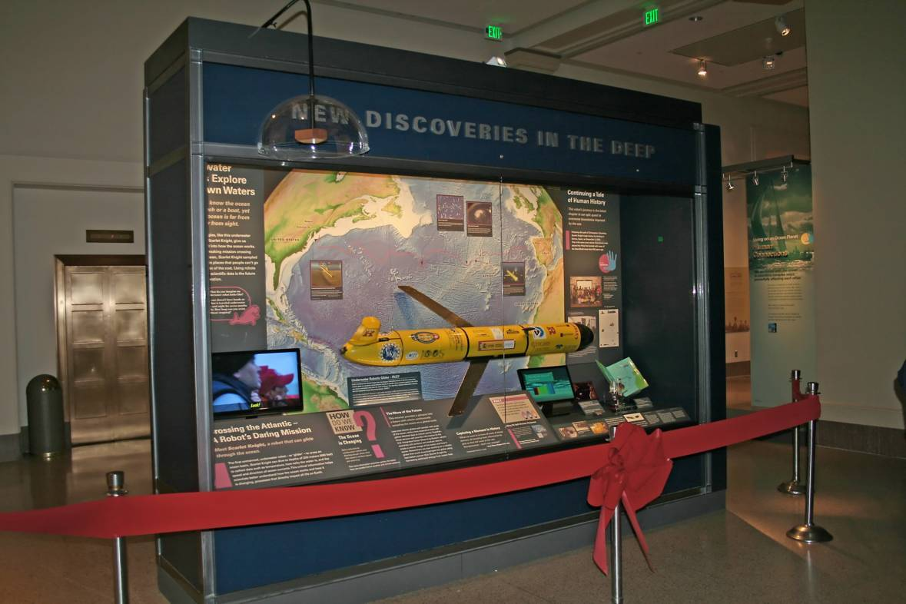
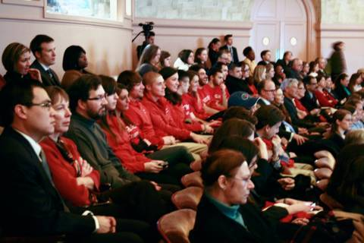
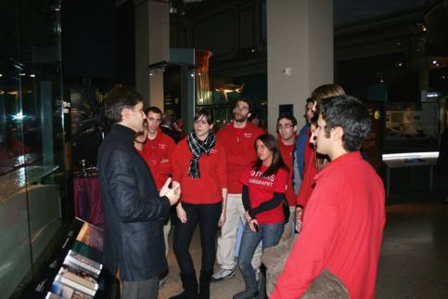
The Scarlet Knight’s Ribbon Cutting Ceremony
at the Smithsonian: Dec. 9th, 2010
Rutgers Students are welcomed by White House Science & Technology Advisor Shere Abbott
Rutgers Students share Ocean Exploration stories with Fabien Cousteau
The Scarlet Knight in her display case at the Smithsonian’s
National Museum of Natural History, Ocean Hall, Washington, DC

Slide 10
Public Experiment
Vicarious Adventure
Traditional
Research
Traditional Research
Number of Marine Science Majors at Rutgers
female
male
Year

Slide 11
Beyond the Increase in the Numbers, a Change in the Diversity
Trans-Atlantic
Flight
Percent non-Caucasian
Year

Slide 12
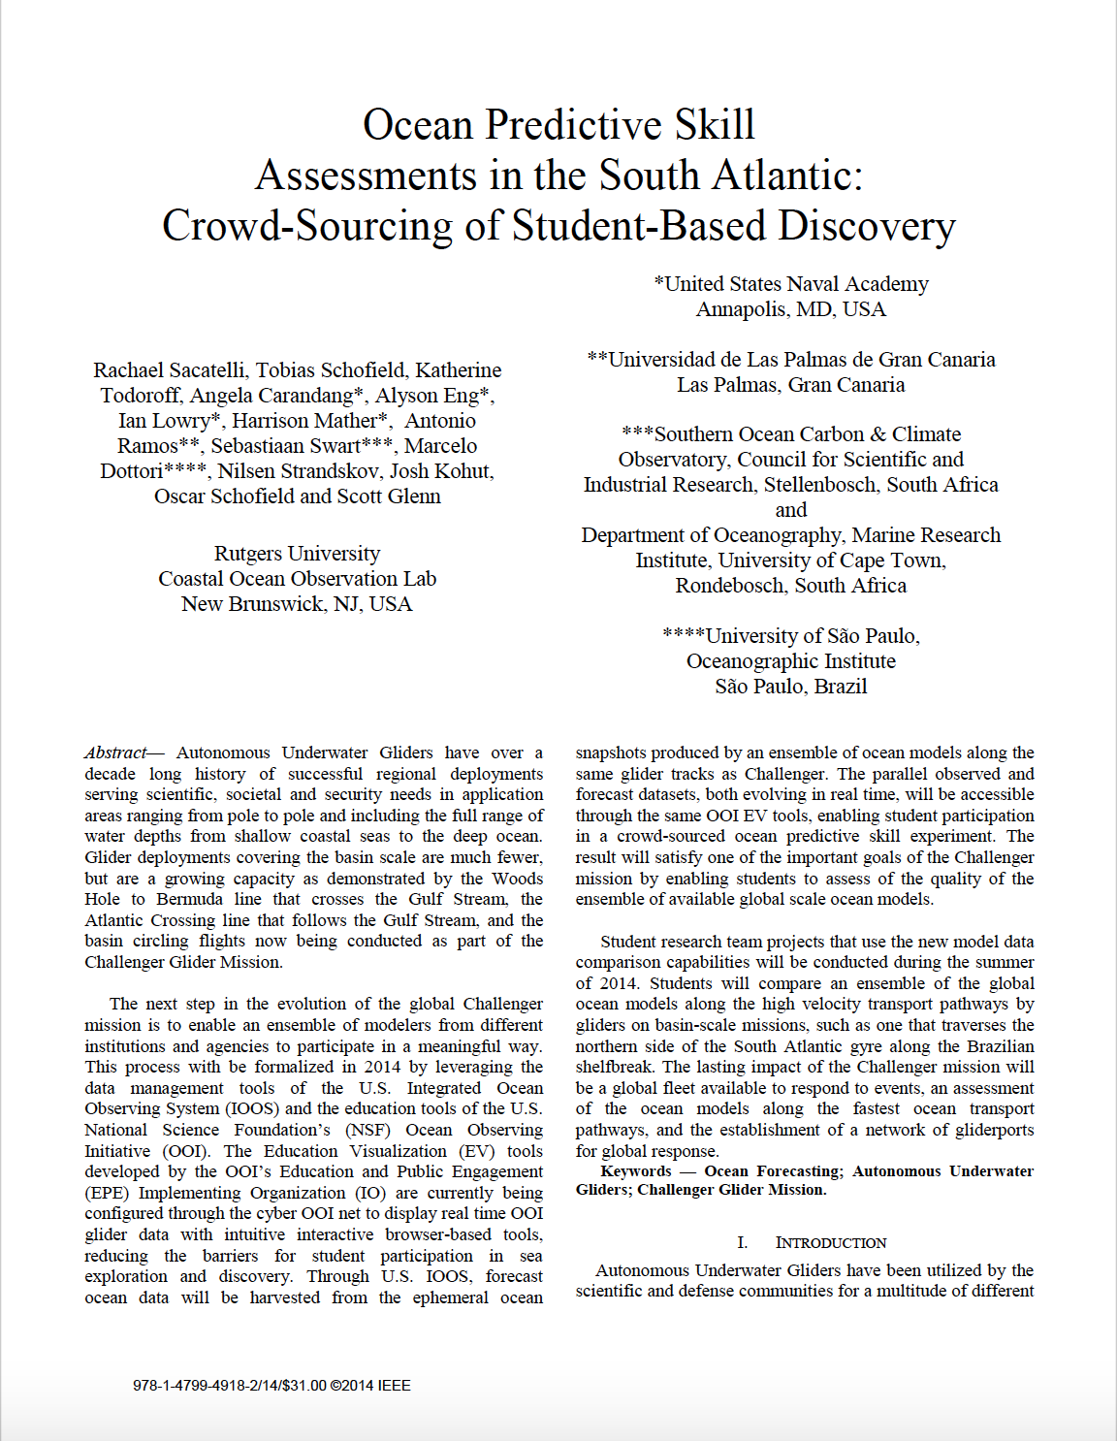
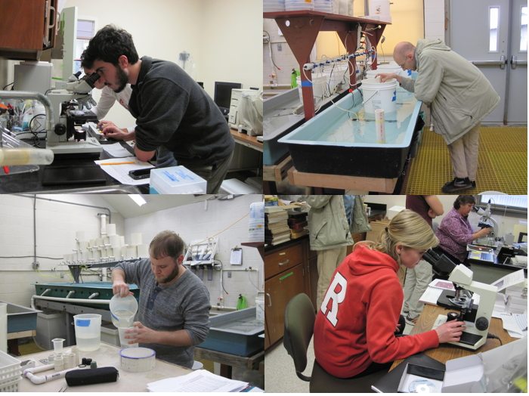
The Challenger Did Have a Lasting Impact For Those in the Major
(Improved Culture of Undergraduate Research, Many start in the Ocean Obs Class)
Works out to be
~1 student per
faculty per year
Undergraduate Independent Research
Problem Enrollment (Research Intensive)
Trans-Atlantic
Flight
Year

Slide 13
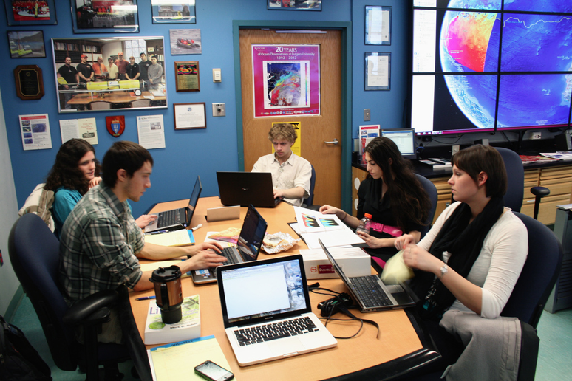
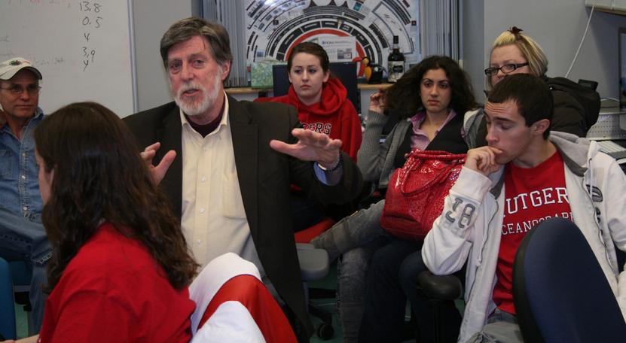
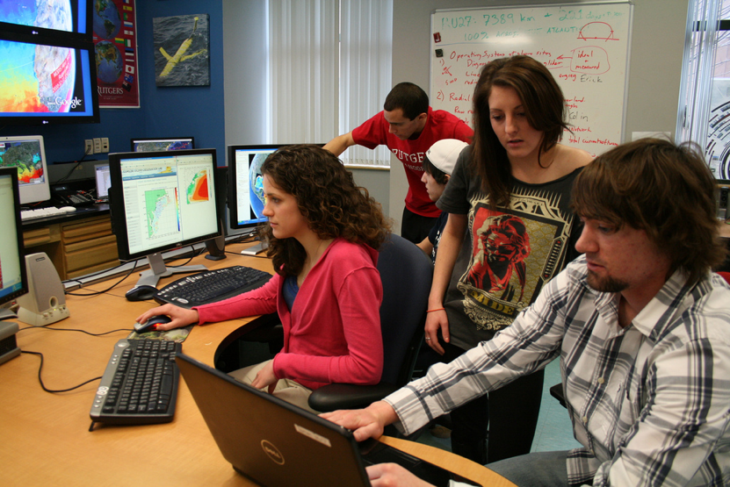
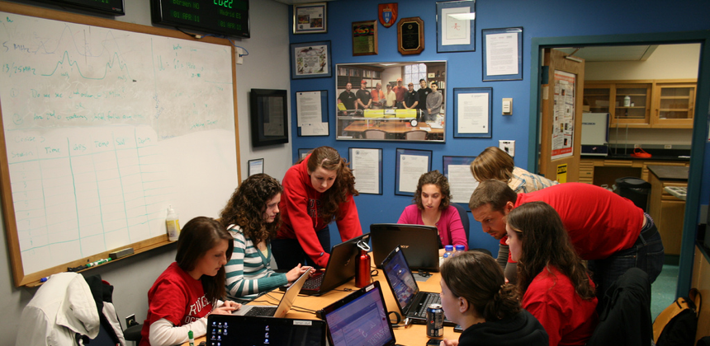
Team-Based Research Projects
Course Mechanics:
Marine Science Major requires 6 credits of Research.
Ocean Observatories course is 1.5 credits –one 80-minute class period per week.
Students can sign up multiple times.
What we (the teachers) do:
1) Mentorship Model – Cognitive Apprenticeship – Experiential
Watch One -> Do One -> Teach One
(Observer -> Worker -> Mentor)
2) Grand Challenges can only be achieved through sustained teamwork – research now bridges semesters and summers.
3) We do not fear failure – Undergraduate Education is a time for exploration and risk-taking.
What the students do:
Divide into research teams led by a mentor (teach one), and consisting of a few workers (do one) and a few observers (watch one).
Propose and conduct a team research project based on ocean observatory data.
Communicate results through blogs and presentations.

Slide 14
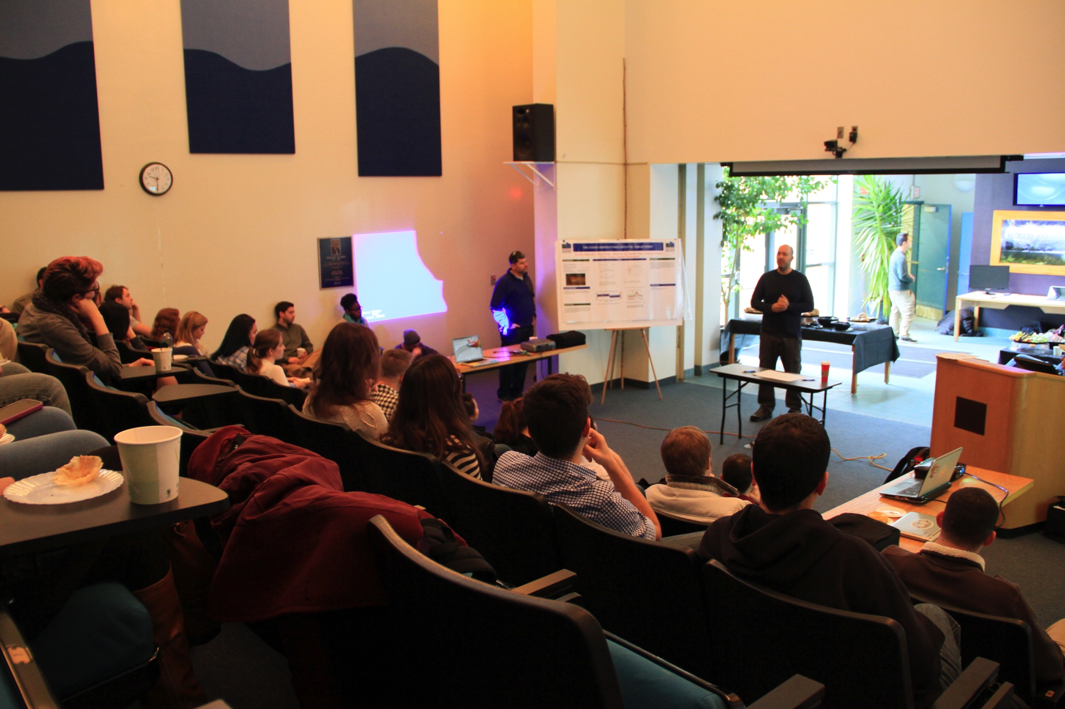
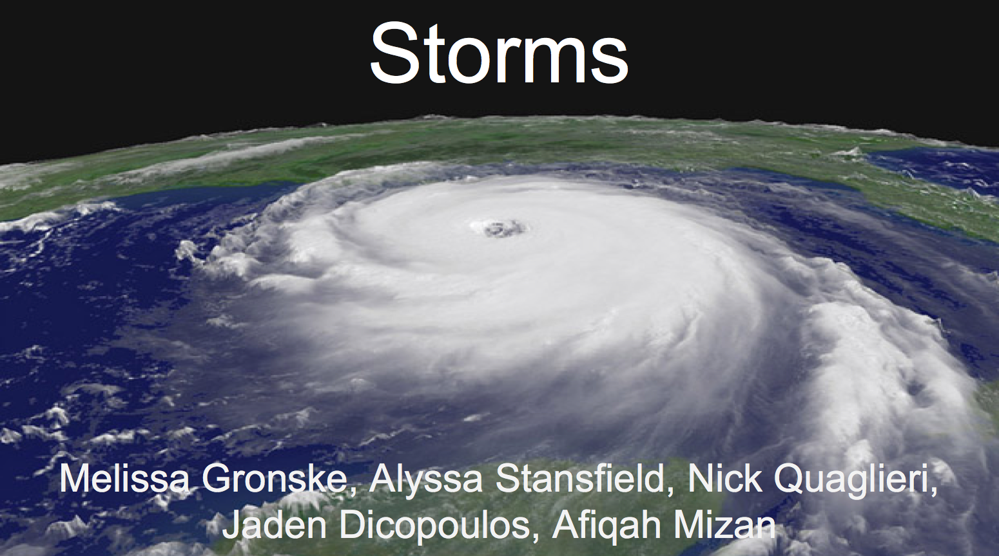
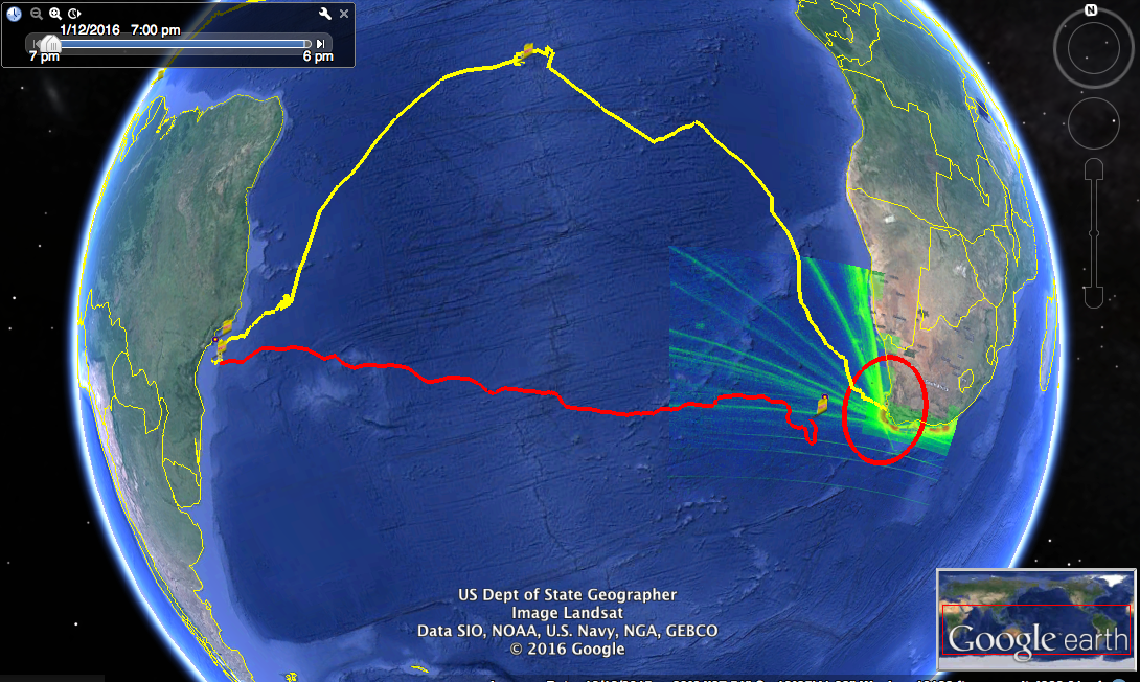
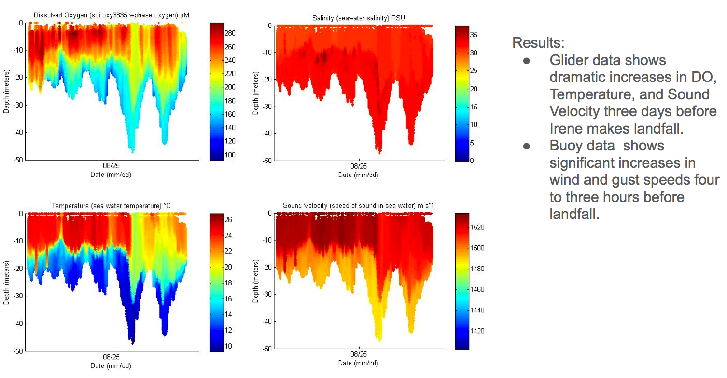
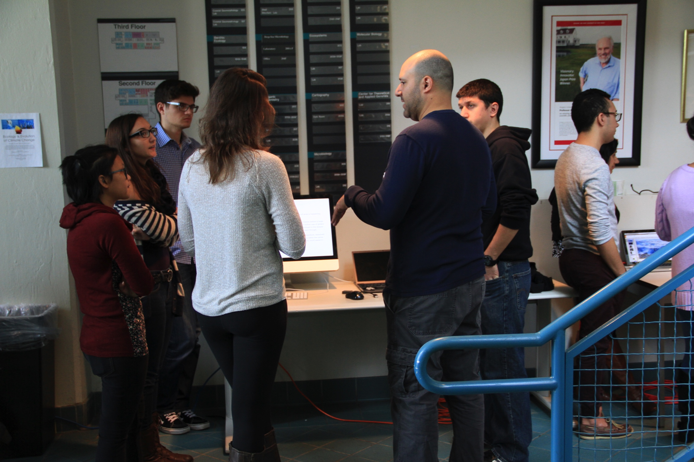
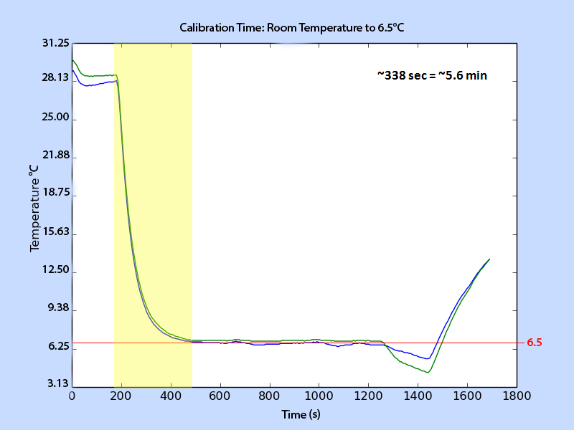
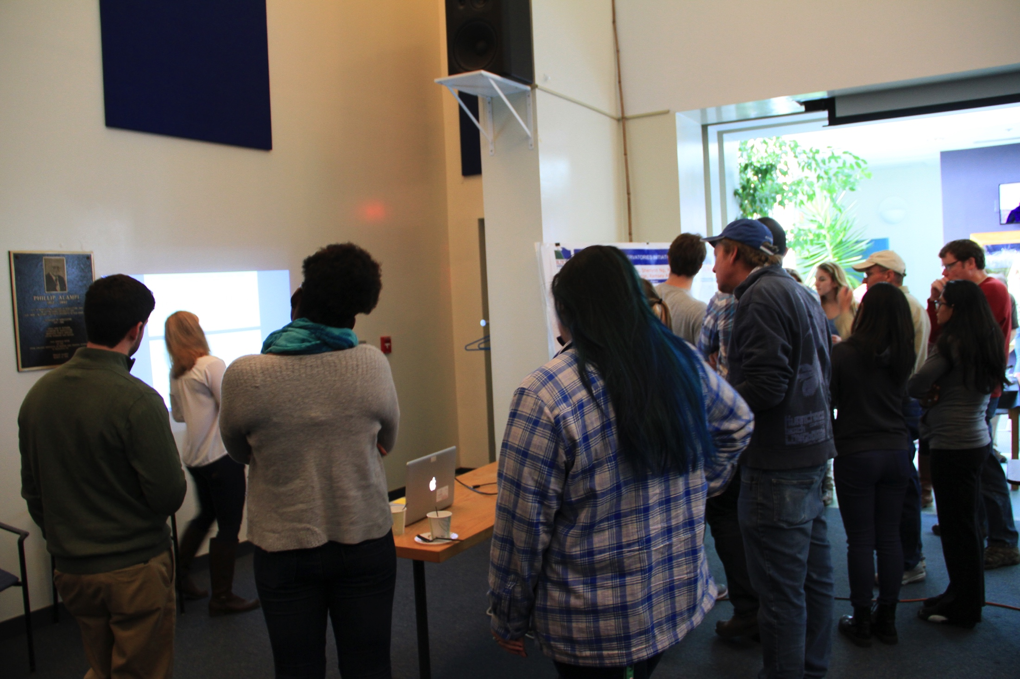
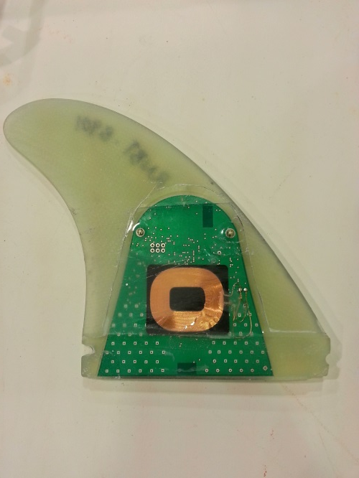
Student experience culminates in a range of projects presented in
a science symposium each semester
RENANLYSIS OF
OCEAN OBSERVATORY DATA
REAL-TIME GLIDER FLIGHT
PLANNING
HELPING COMPANIES OR LABS WITH NEW TECHNOLOGIES
Smartphin: Testing Responsiveness and Accuracy to Temperature Change
“Smart” surfboard fin created by Boardformula

Slide 15
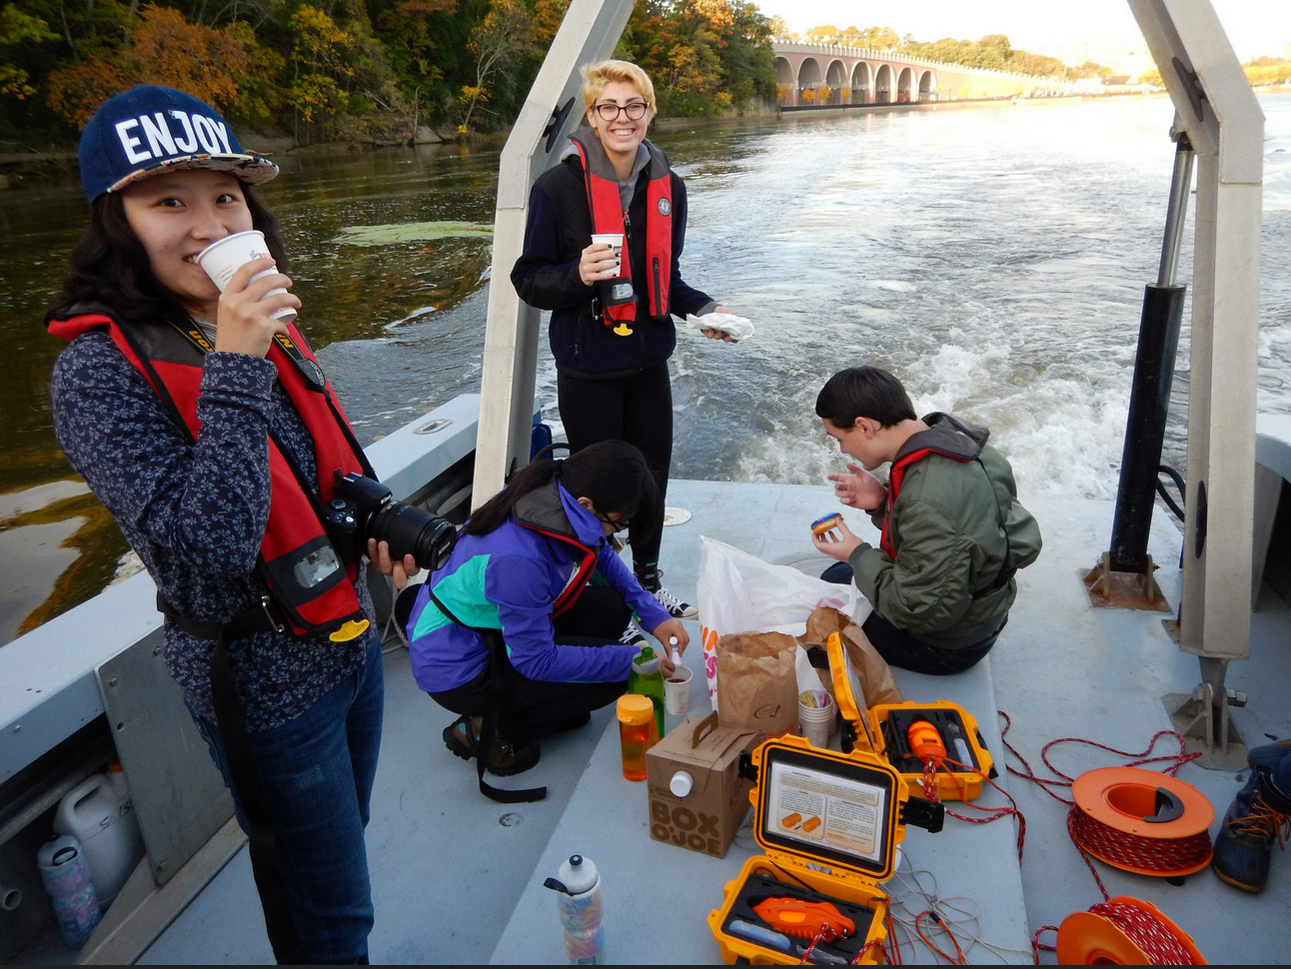
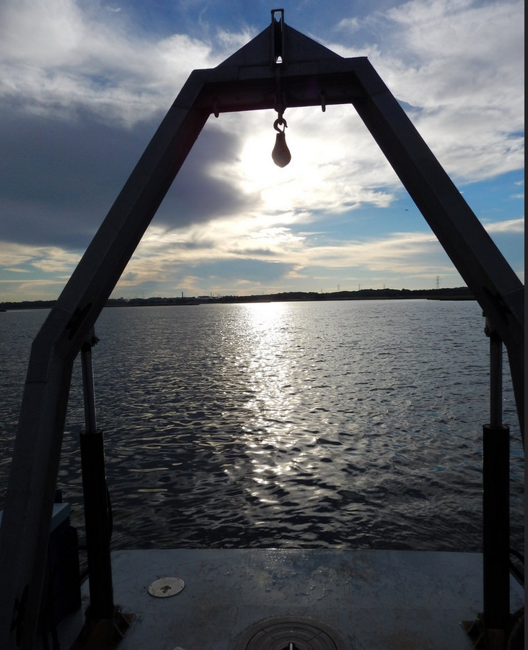
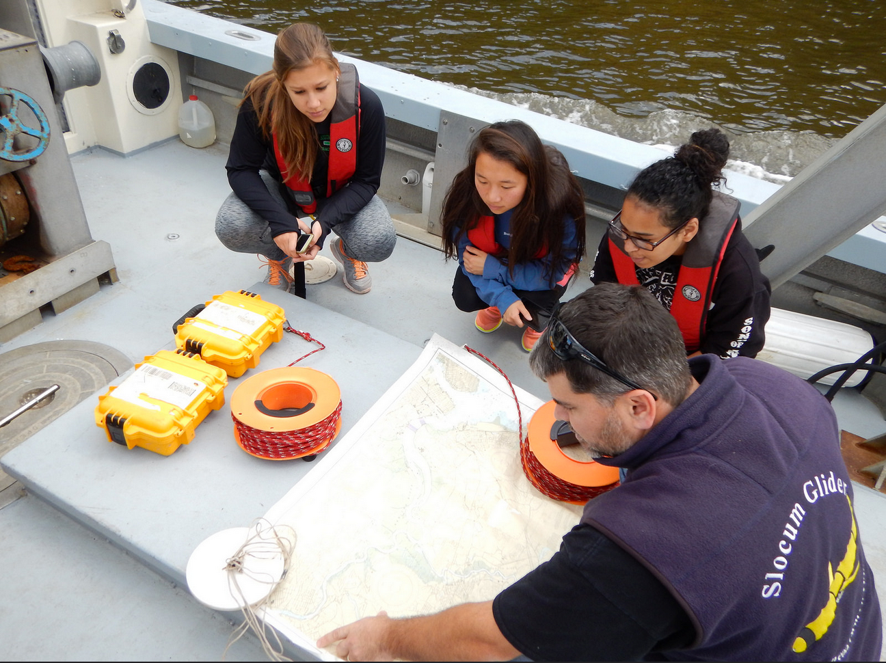
Entraining the students early
Oceanography House
(A first term freshmen learning community)
First quarter on campus, introduce them to opportunities at a research University, how to collect data, how look at data, 2nd term transition to the ocean observatory course

Slide 16
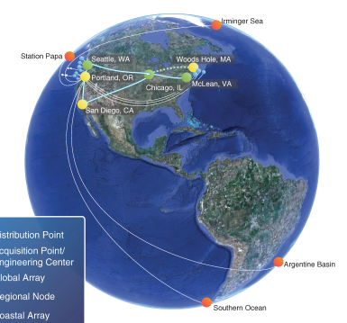
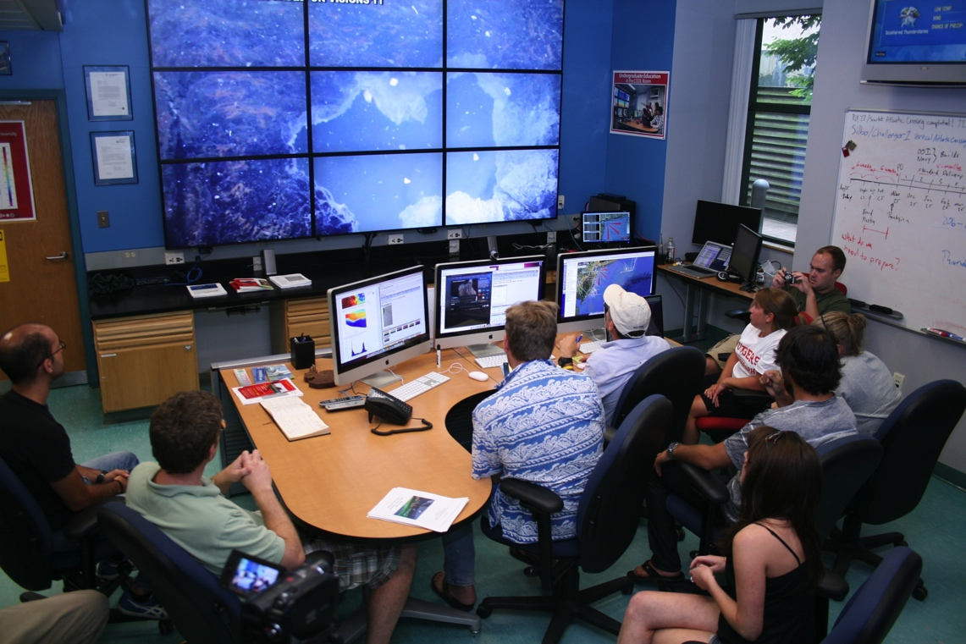
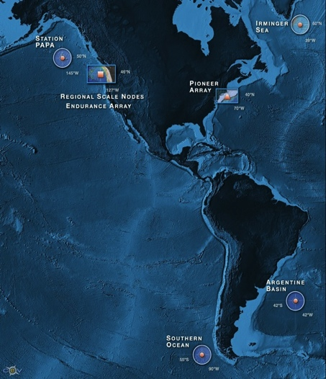


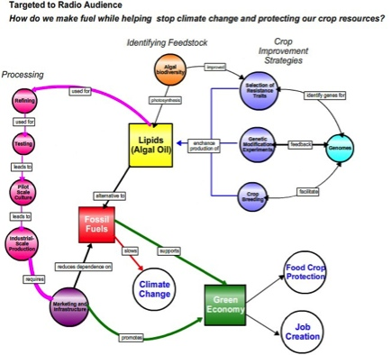
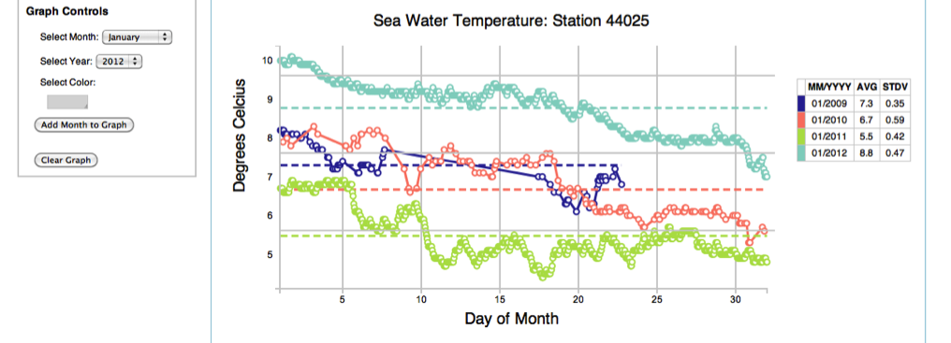

Hurdles to keeping it sustainable?
Tools to visualize data and lower hurdles to doing data discovery
OOI – Enabling the Undergraduate Classroom
Concept Maps
Data Visualization Tools
Investigaton Builder

Slide 17
Hurdles to keeping it sustainable?
Content to complement the data streams

Slide 18


Hurdles to keeping it sustainable?
3) Communication beyond subject matter experts
Unfortunately scientists are not always good communicators.

Slide 19



Entrain students from other Departments making them partners in capturing the story, let the Art, Music and English students help communicate the science

Slide 20

Lectures in Art, Music, and English Schools on Ocean sciences and then entrain the undergraduates to translate to be more compelling

Slide 21


Award winning documentaries, both with National Broadcasts.
Available on Netflix and Itunes.
The Ocean’s are polluted
and Josh Kohut is Angry!

Slide 22




Beyond feature length movies
(Professional student created short 1-4 min videos)
Ocean Innovators (Doug Webb History)
Why study at Rutgers?
Science of Glaciers
How do gliders work?

Slide 23



Going International with Challenger Glider Mission
Active Participants Today:
Challenger Society
POGO
U.S. IOOS
NOAA
ONR
NSF
Teledyne
Rutgers
Vetlesen
PLOCAN
ANFOG
KIOST
U. Las Palmas
U. Cape Town
U. Sao Paulo
USNA
CLS
Iridium

Slide 24


Linking Classes Across Countries
Shared Expeditions

Slide 25
Conclusions:
Observatories a new tool for education and engagement
Near-peer teams critical to the possible scale and sustainability of teaching
Opportunity to break barriers between academic departments is critical

