Slide 1
B-Cubed Kick Off Meeting
Science needs, hurdles, status
-case examples of science problems
Climate and weather examples
-community maturation
-blurring of the lines of education & research missions

Slide 2
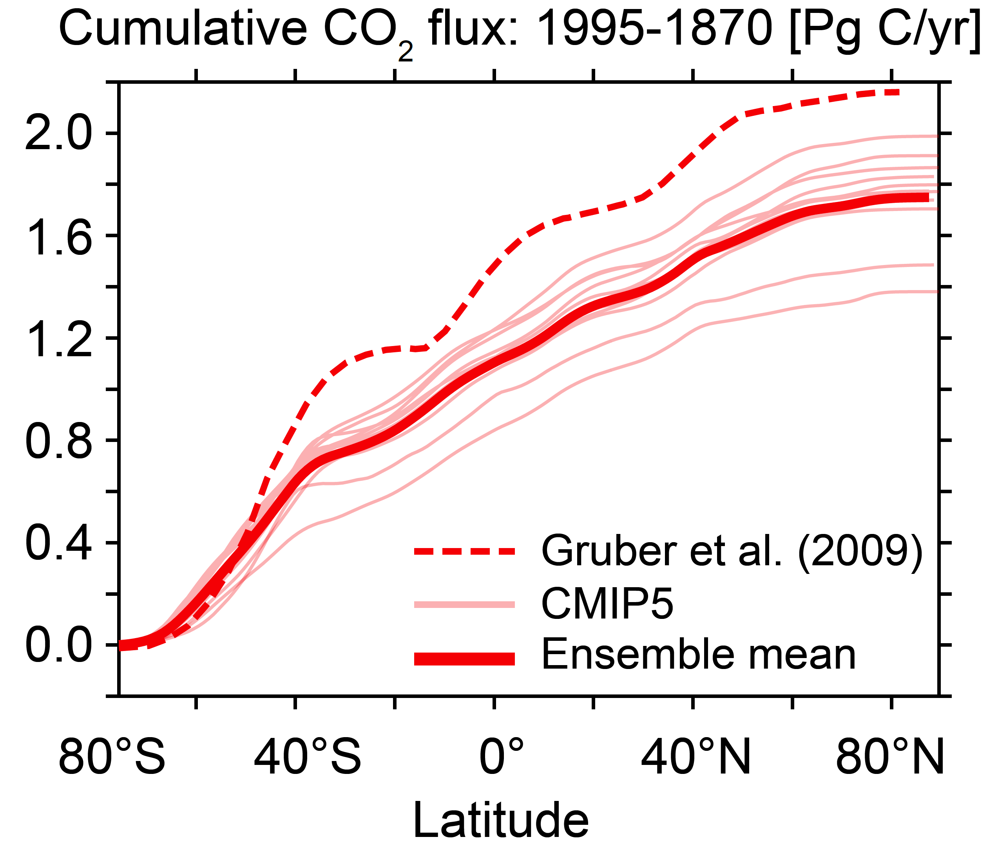
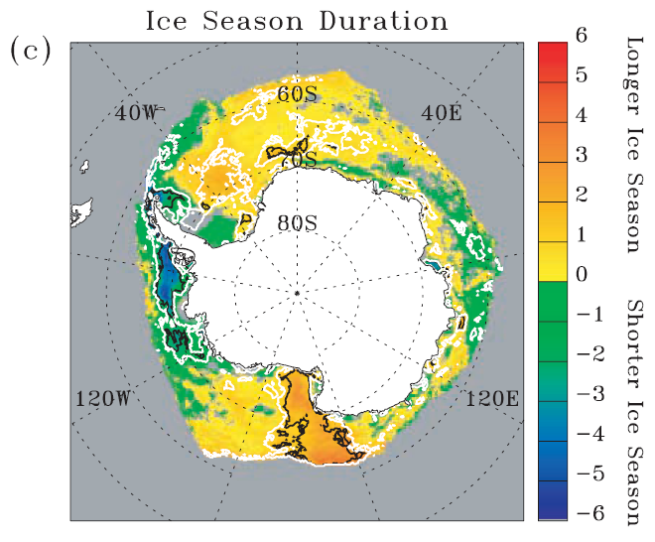
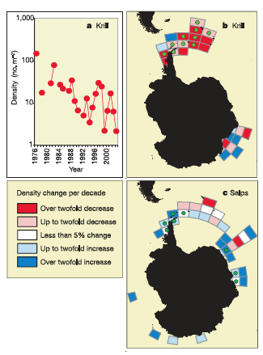
Science Requirements - status and issues, common practices, needs
Science need is great and there is urgency to make progress
The Southern Ocean takes up 51% of global anthropogenic carbon
Temperature is changing
Altering ice dynamics
Altering phytoplankton dynamics
Altering zooplankton dynamics
Altering high trophic
level dynamics

Slide 3
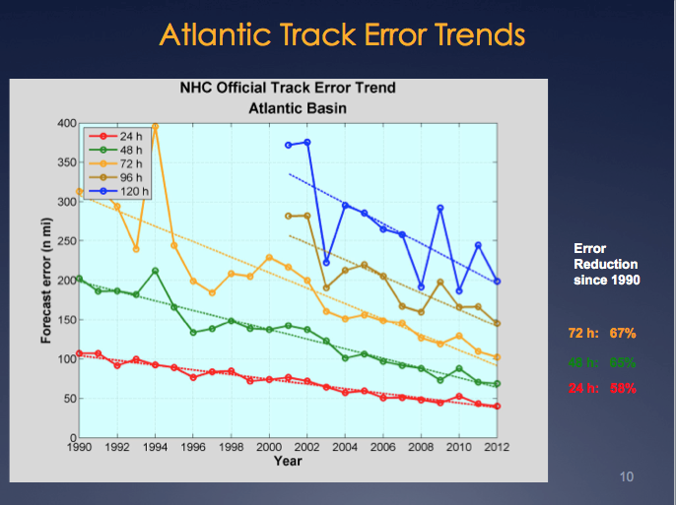
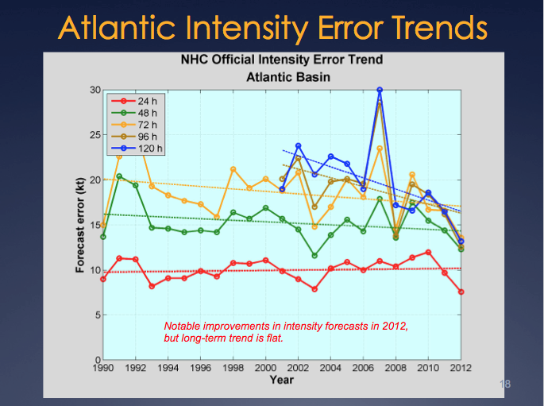

Science Requirements - status and issues, common practices, needs
Science need is great and there is urgency to make progress
Hurricane Irene
August 26, 2011
NOAA/NHC Damage:
#8 with >$15 Billion.
Track Accurate;
Intensity Over-predicted.

Slide 4

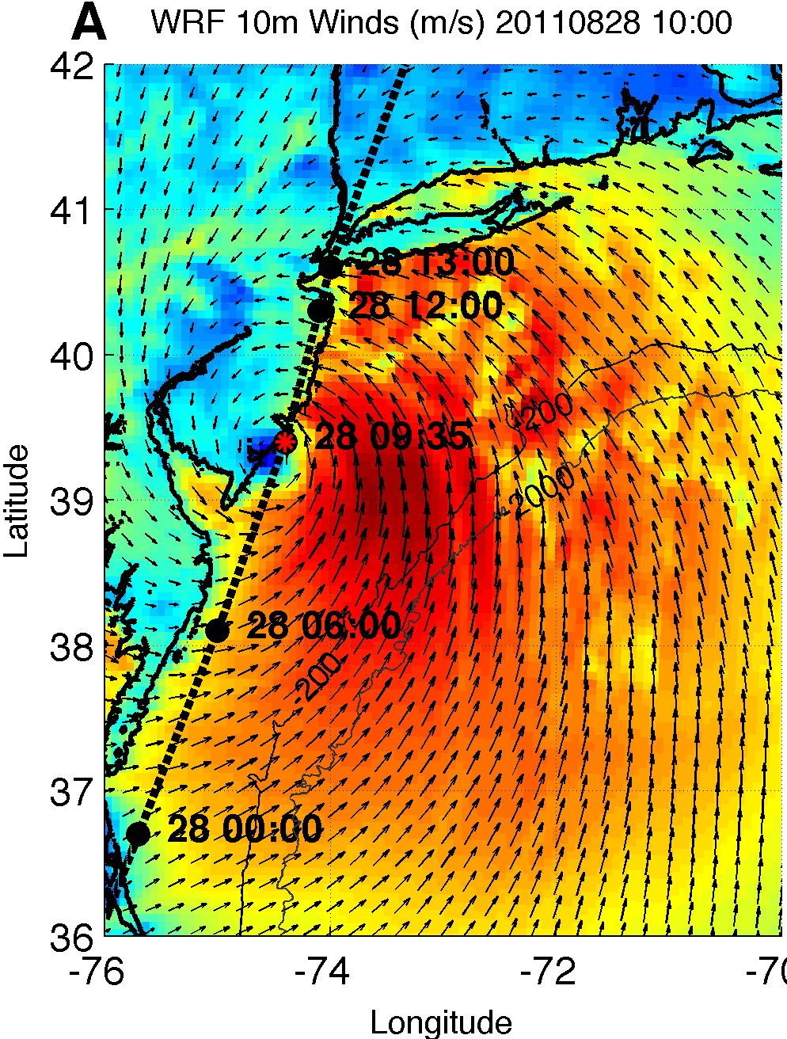
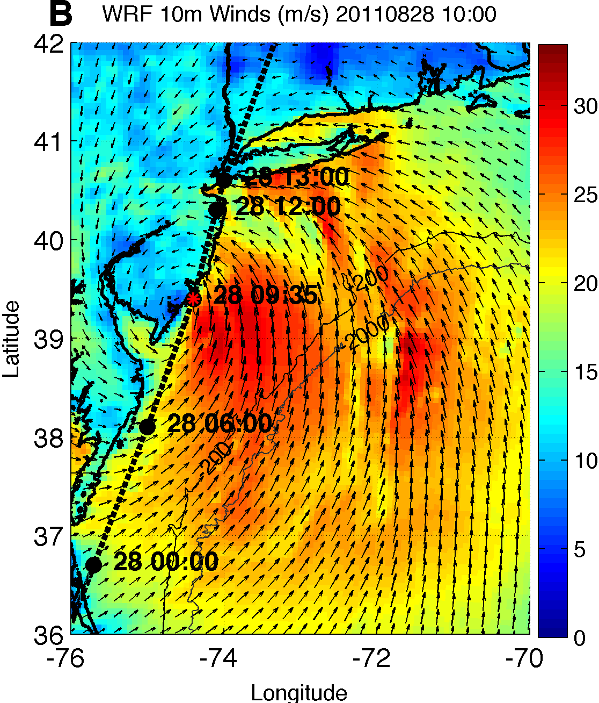
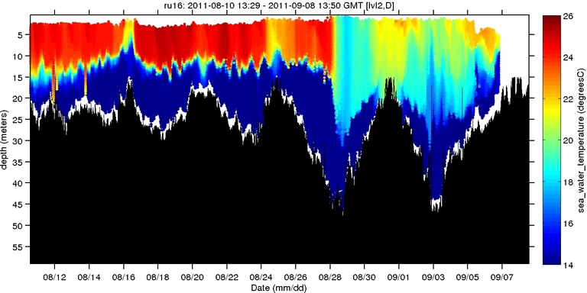
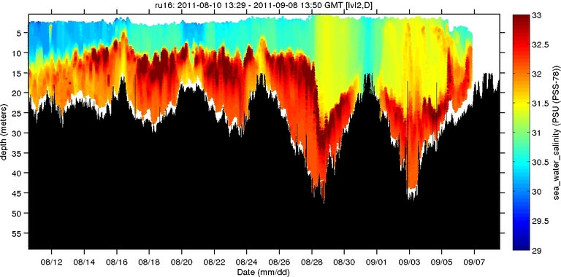
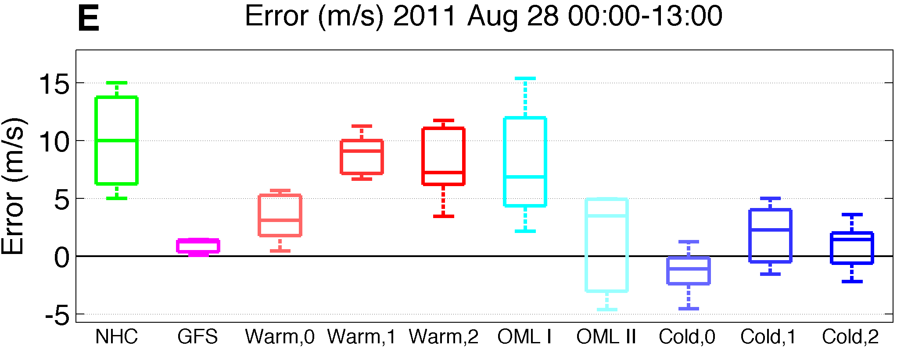
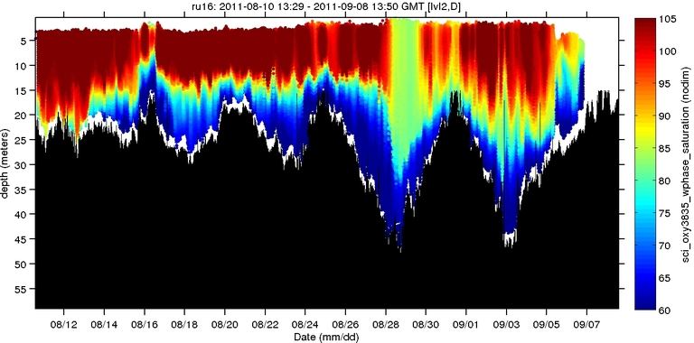
Science Requirements - status and issues, common practices, needs
Science need is great and there is urgency to make progress
Hurricane Irene
Warm SST
Cold SST
0
26
depth
Temperature
55
14
0
33
depth
Salinity
55
29
0
105
depth
% Saturation
(DO)
55
60
Aug 12
Sep 07

Slide 5
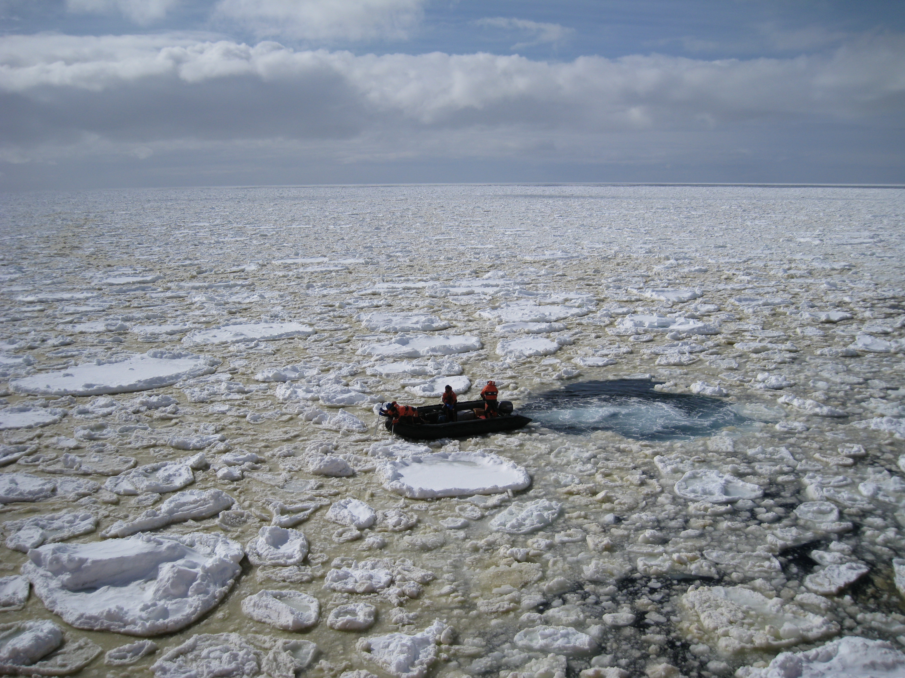
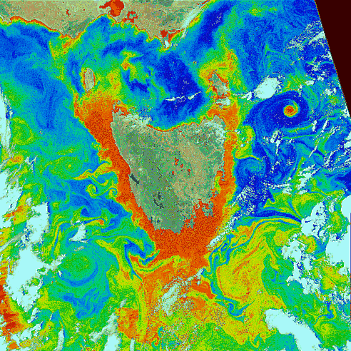
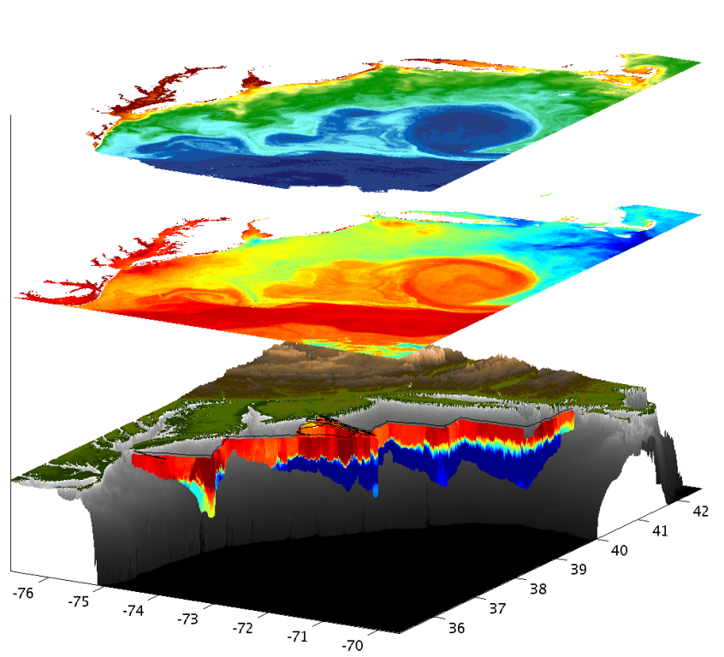
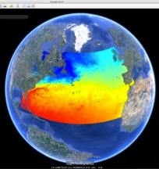
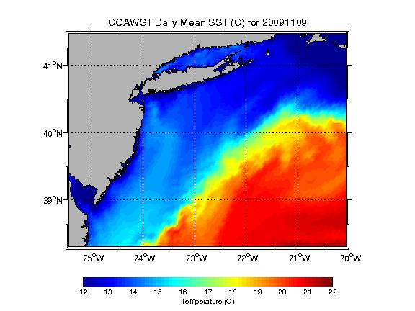
Science Requirements – community practices evolving and diverse
GSFC, NASA

Slide 6
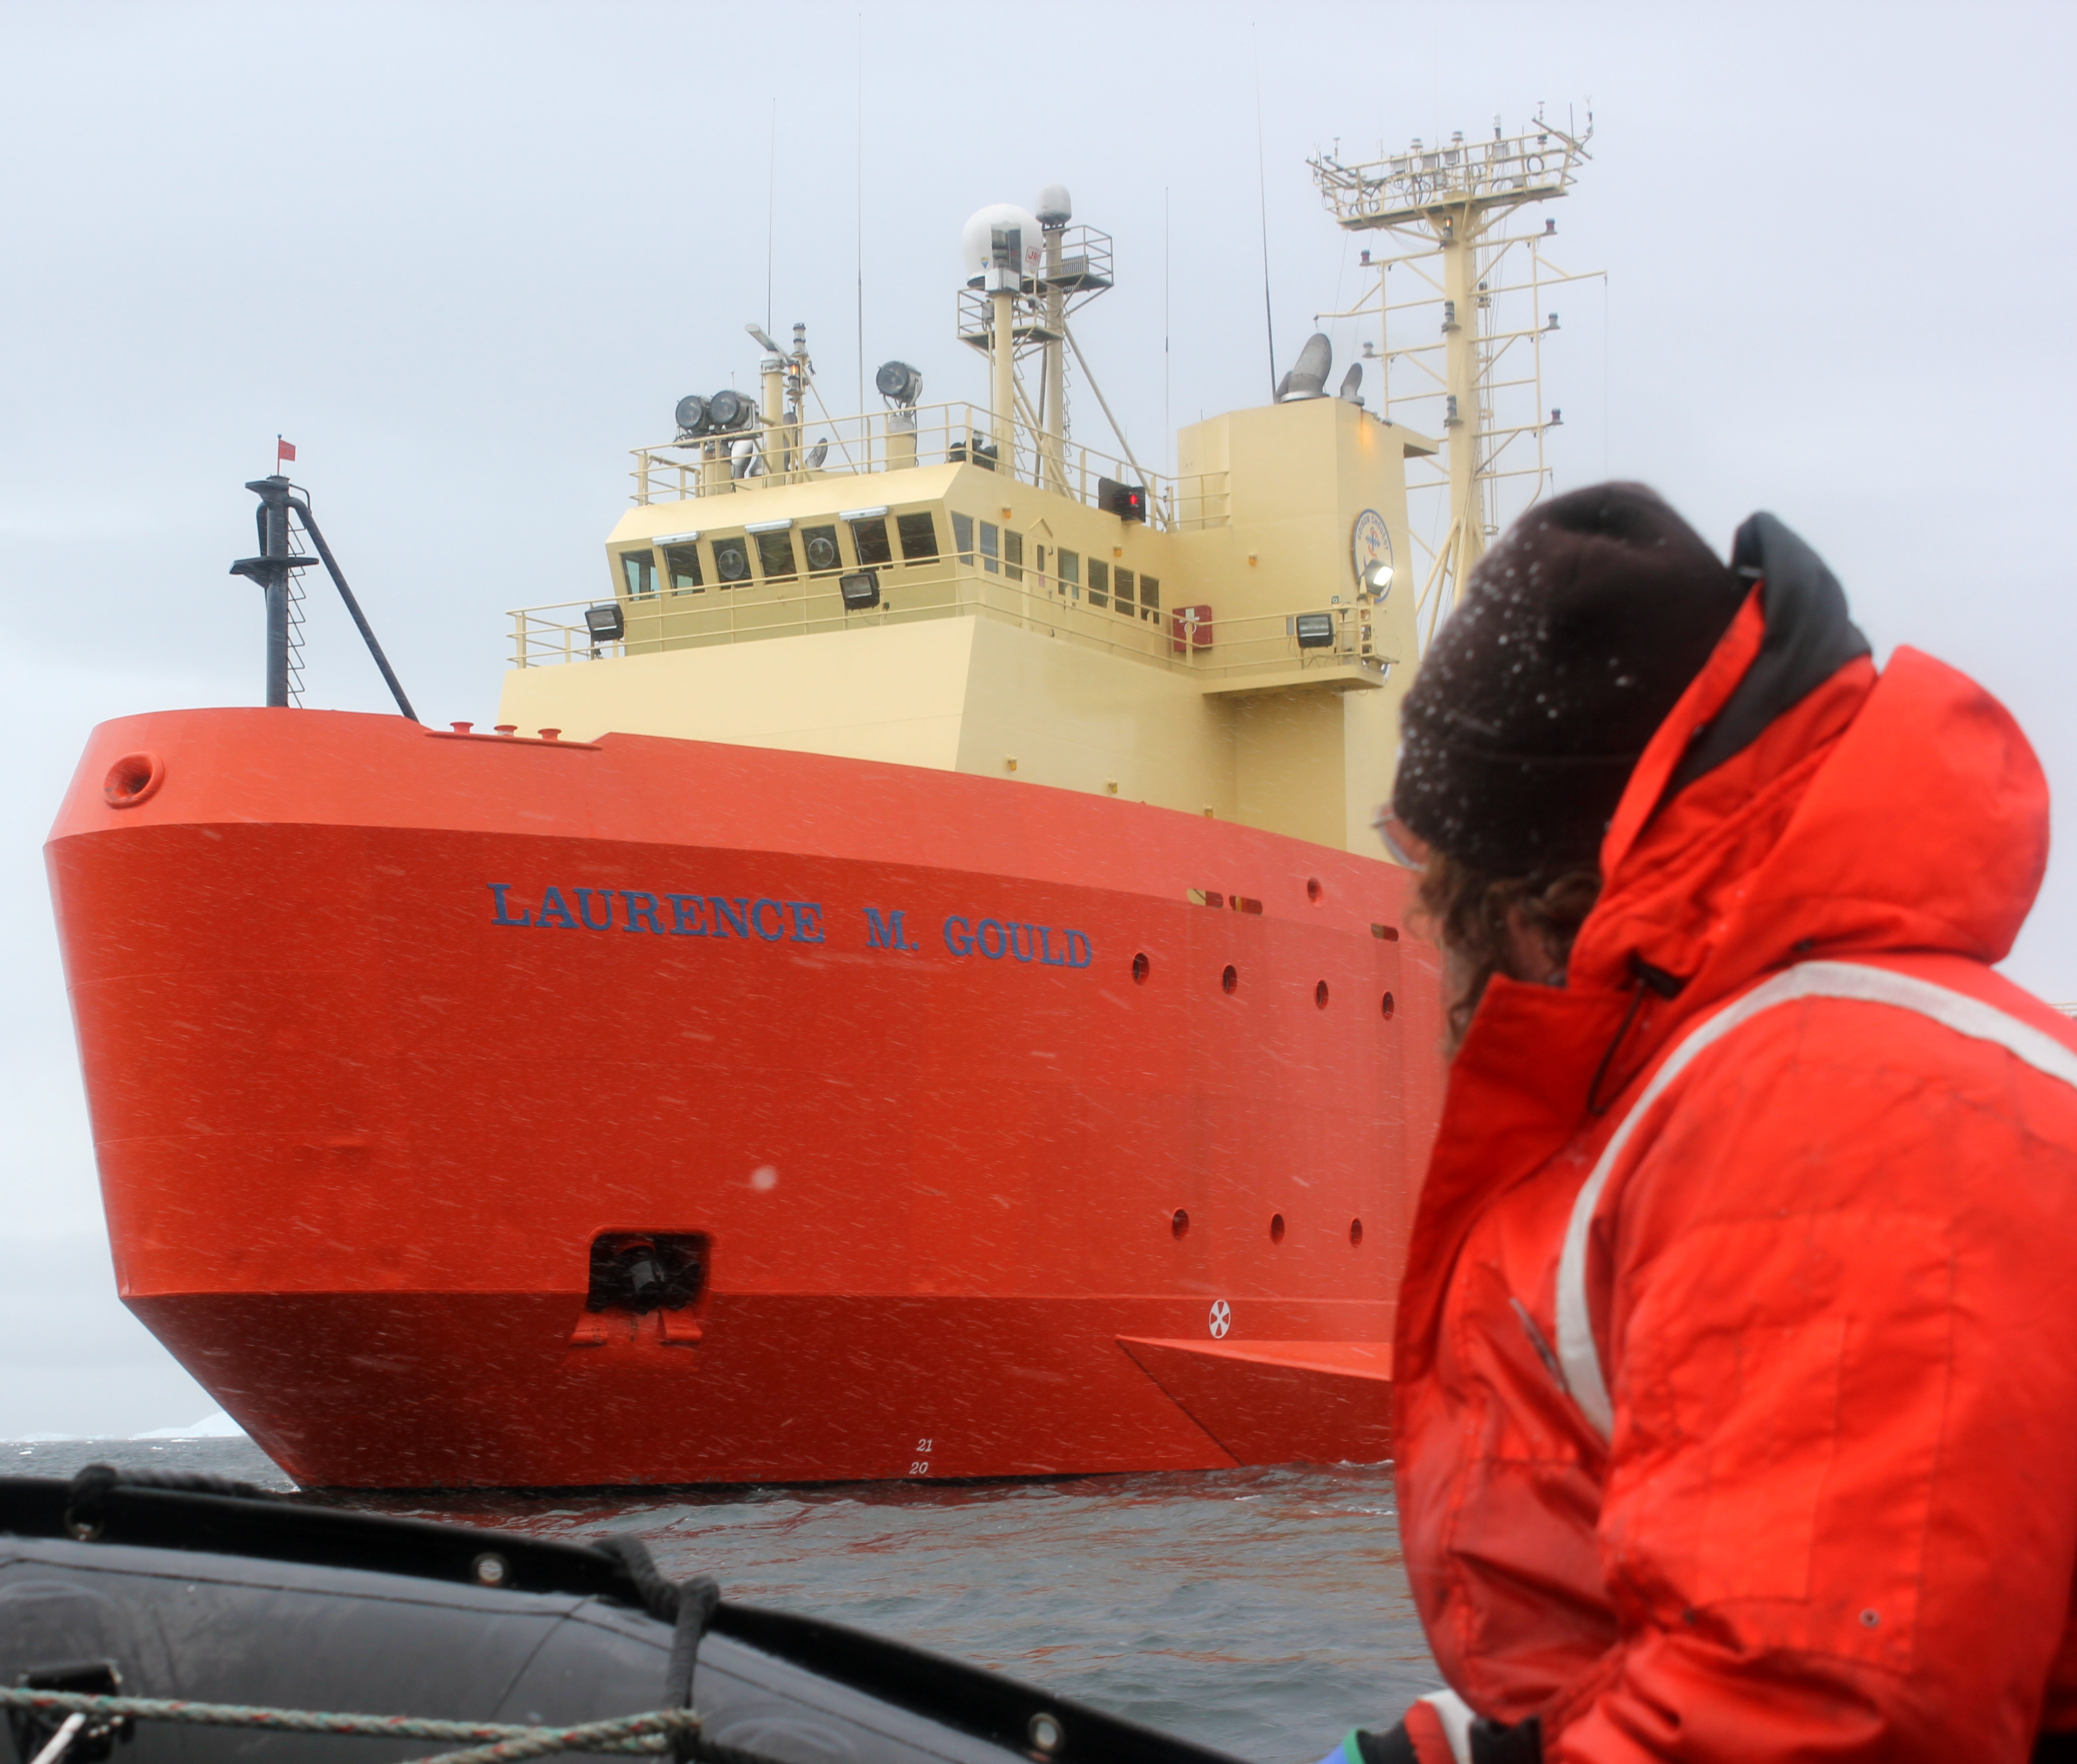
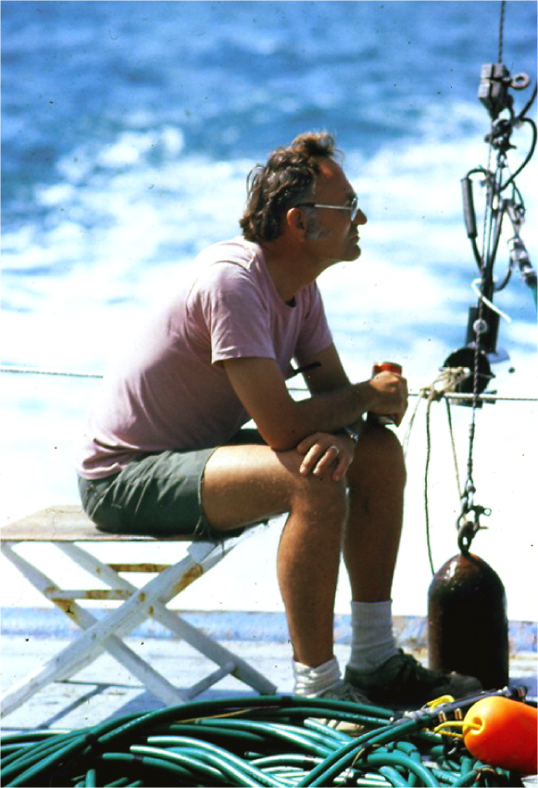
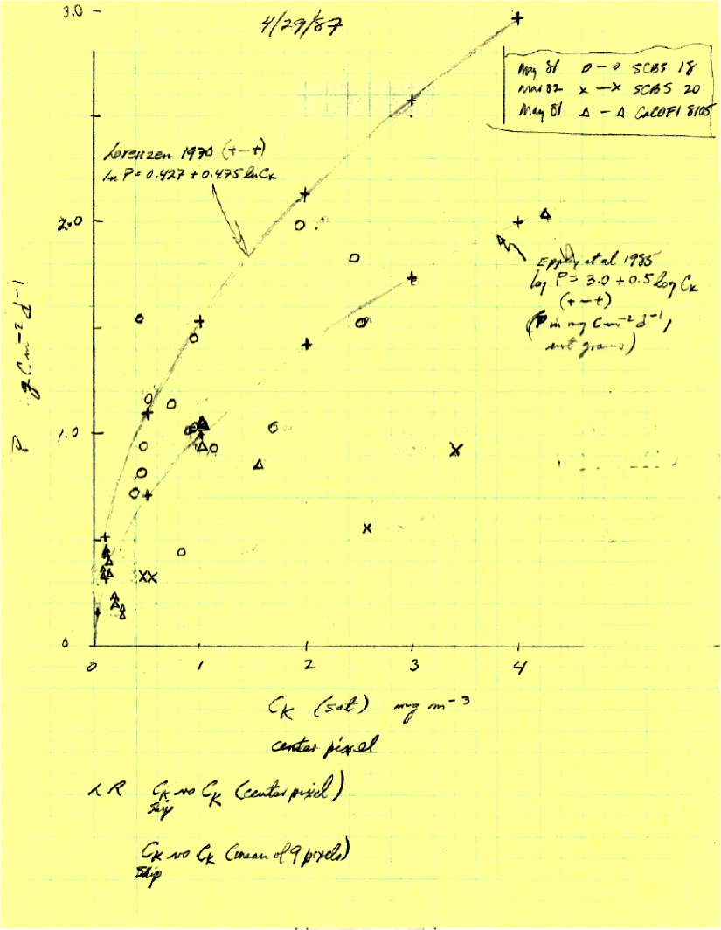
Science Requirements – issues and common practices
The classical ocean scientist: Looking Back (Lingering cultural hurdles)
Historically academic ocean science operated as single programs often defined by having dedicated access to ships for limited specified periods of time
  -Community still in transition, many specialized individualized data sets
  -Proprietary ownership, despite required the data sharing but never enforced and never funded
  -Data standards and QA/QC guarded by the individual scientists
  -Diverse communities of a wide range of skill capabilities
Eppley

Slide 7
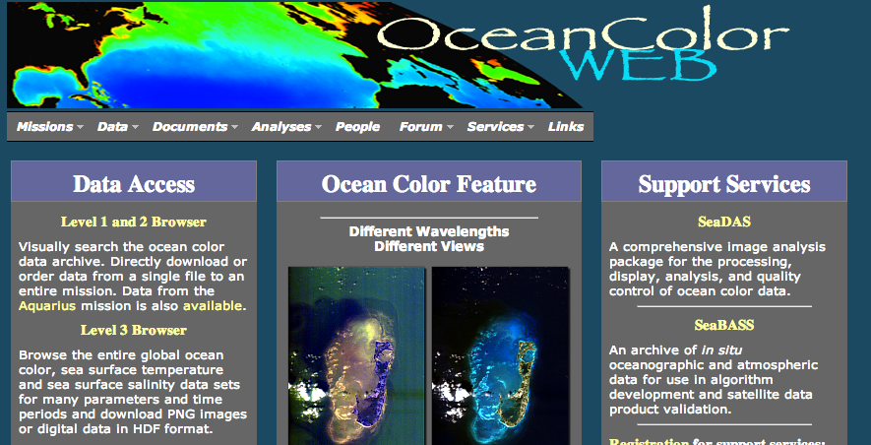
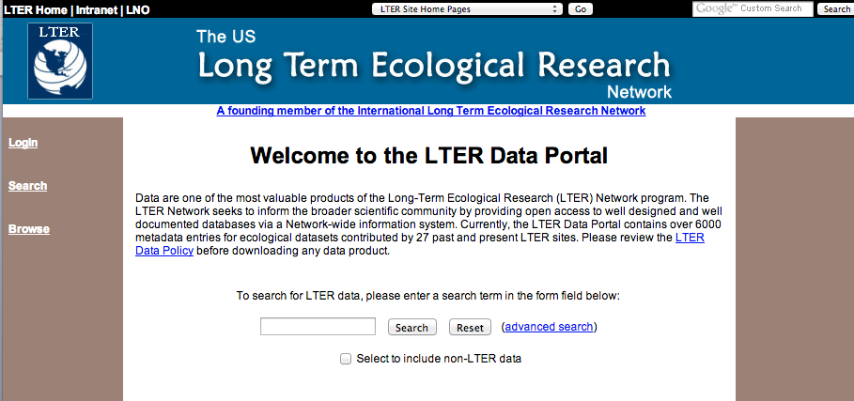
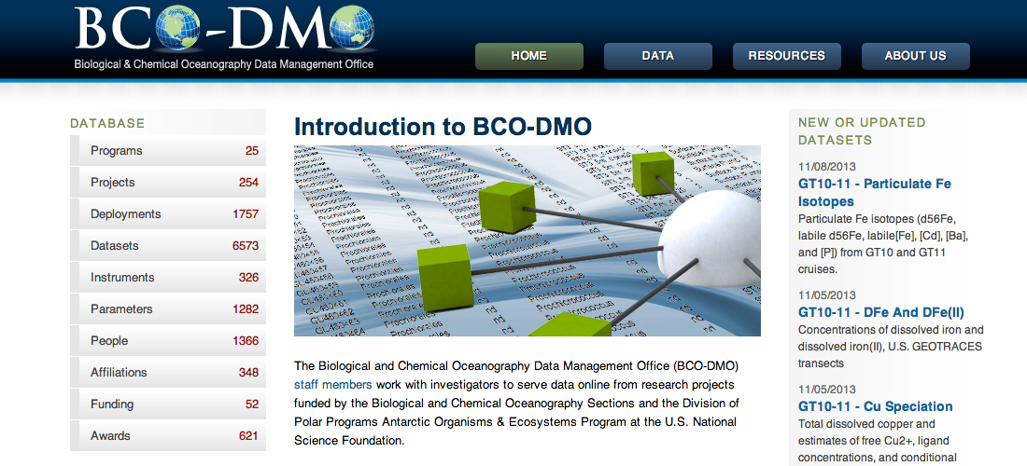
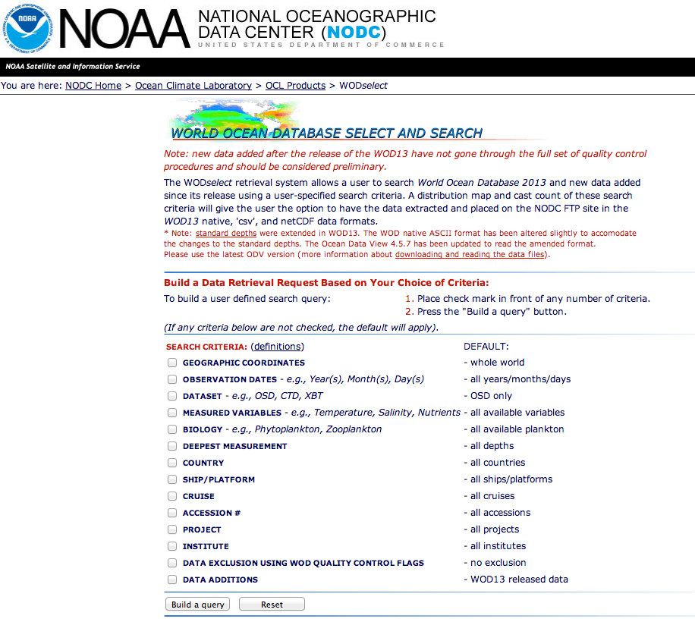
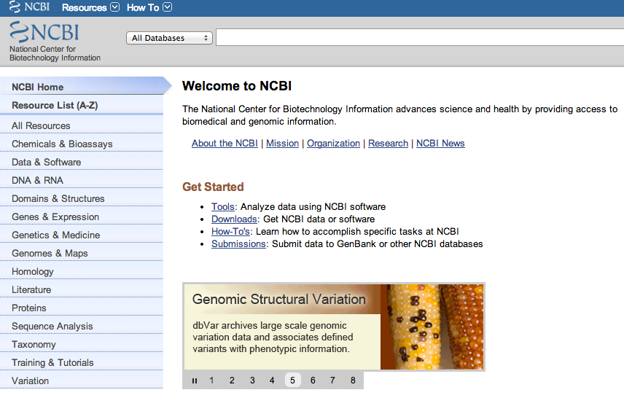
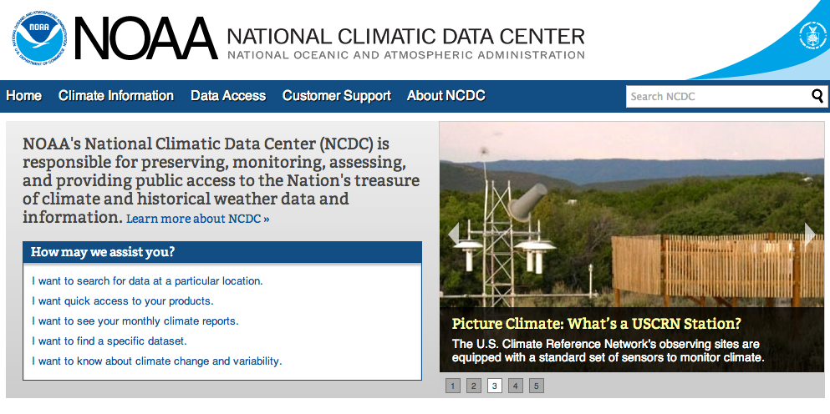
Distributed Databases
Stratified often by discipline
Too Many to keep up with

Slide 8
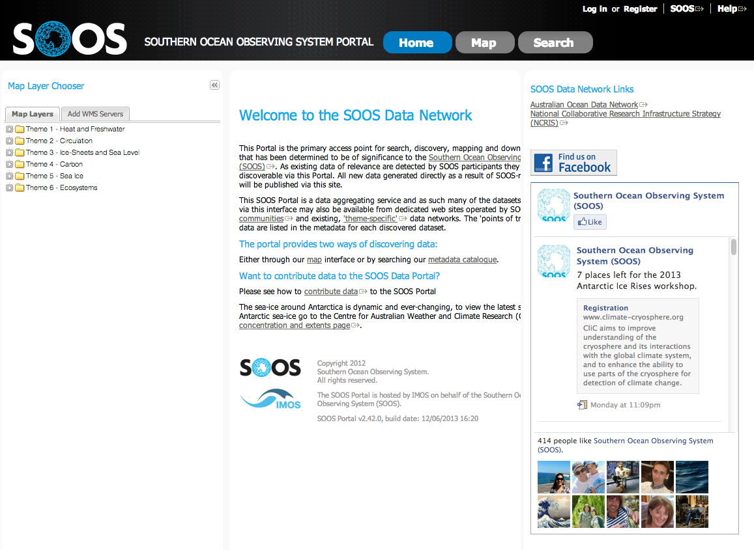
Data systems to tie international community often together based on geography

Slide 9
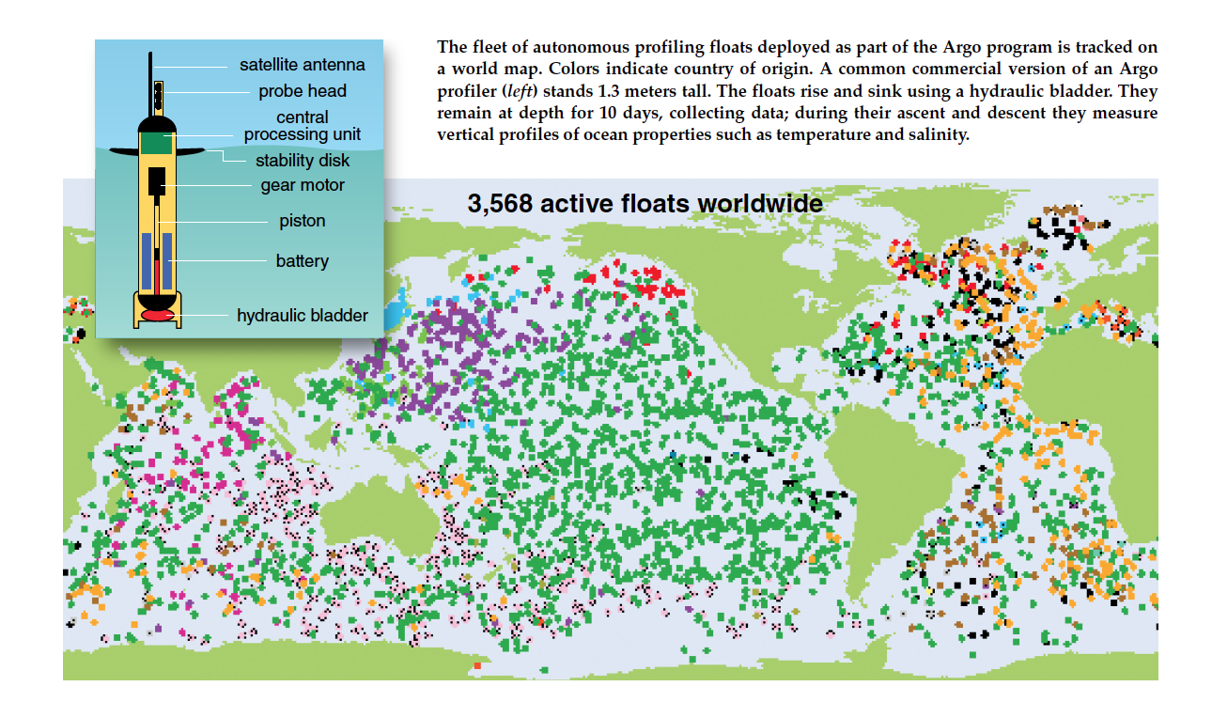
Maturation in community of practice, integrated research for a research theme
ARGO NETWORK: Maturations of data standards and community
-agreed upon infrastructure and data standards
-QA/QC
-international in scope

Slide 10
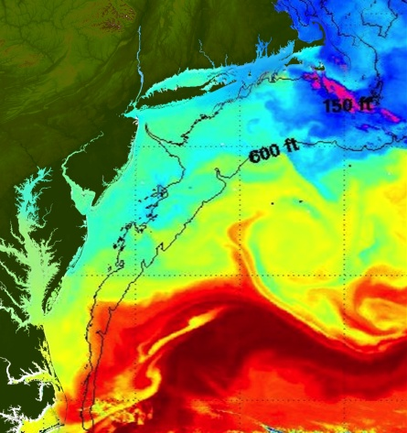
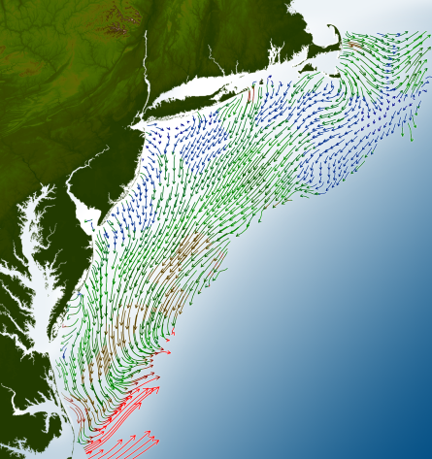
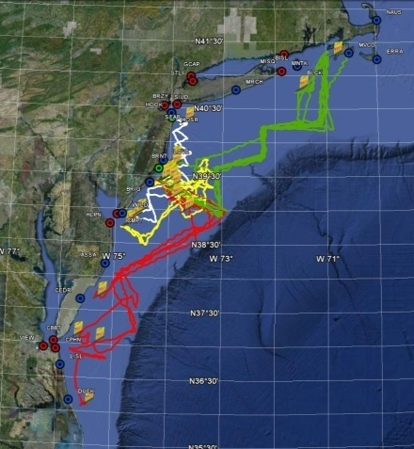
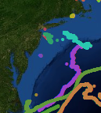
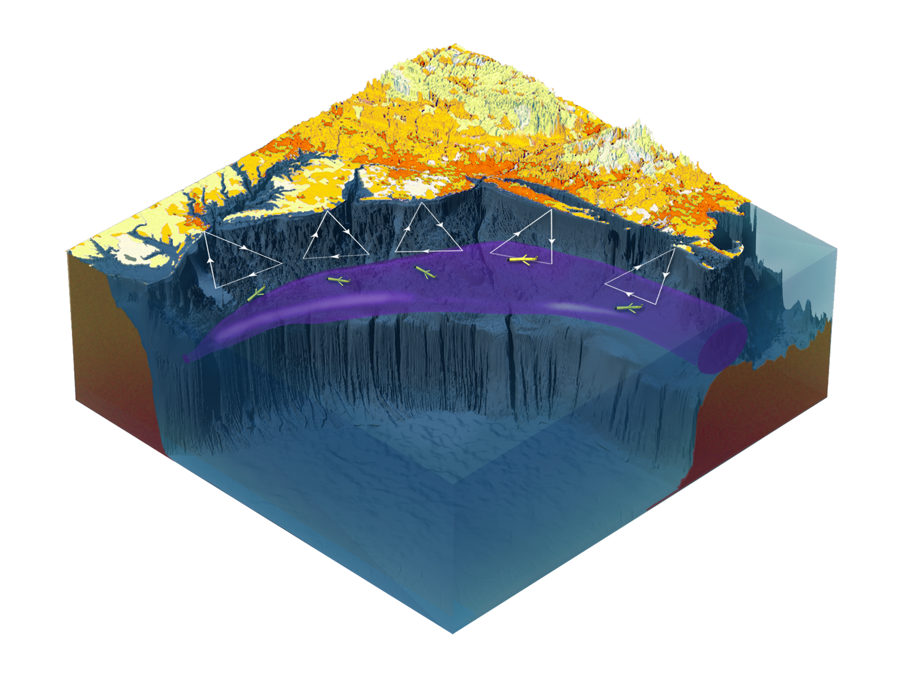

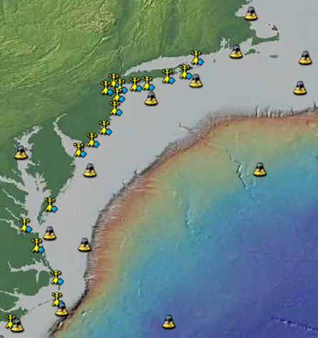
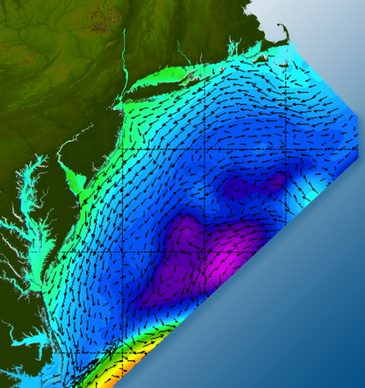

Science Requirements – issues and common practices
Maturation in community of practice, integrated research consortia
Satellites
HF-Radar
Gliders
Drifters
-integrated data collection,
-diverse data,
-distributed repositories,
-data available via automation (Thredds servers),
-visualization capabilities for exploration
-links into federal data management systems (GTS)
Population Density
To seek, discover & apply
new knowledge & understanding
of our coastal ocean
Weather Stations
Ocean Forecast Ensemble

Slide 11
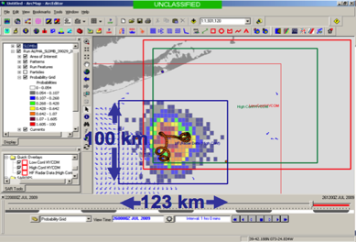
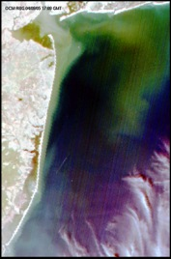
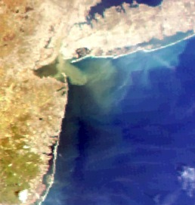
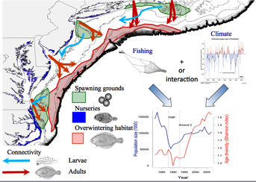
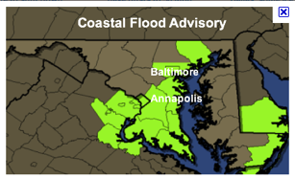
MARACOOS REGIONAL THEMES & SUCCESS STORIES
1) Maritime Operations – Safety at Sea
3) Water Quality – a) Floatables, b) Hypoxia, c) Nutrients
2) Ecosystem Decision Support - Fisheries
5) Energy – Offshore Wind
4) Coastal Inundation - Flooding

Slide 12
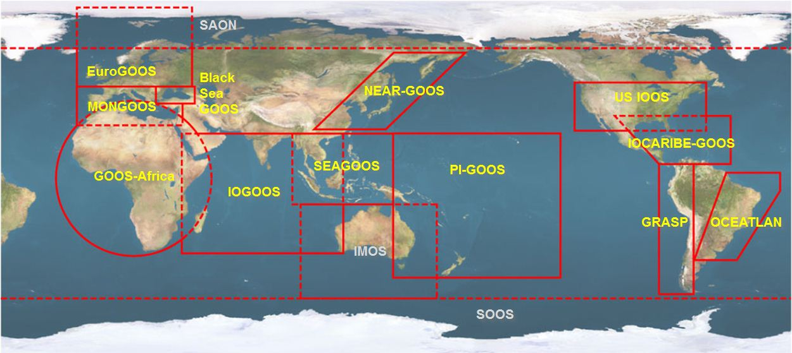





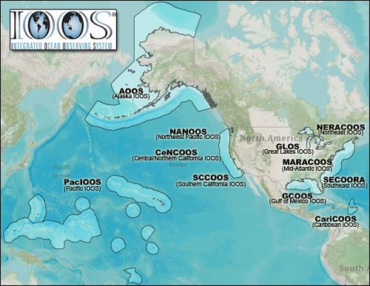













U.S. Integrated Ocean Observing System (IOOS)
Global Component
National Component
Regional Component
15 Regional Alliances in GOOS
Vessels -
Satellite
Satellite
CODAR
Ships/ Vessels
Glider
REMUS
Data Vis.
Modeling
Security
Leadership
Education
11 Regional Associations
17 U.S. Federal Agencies

Slide 13
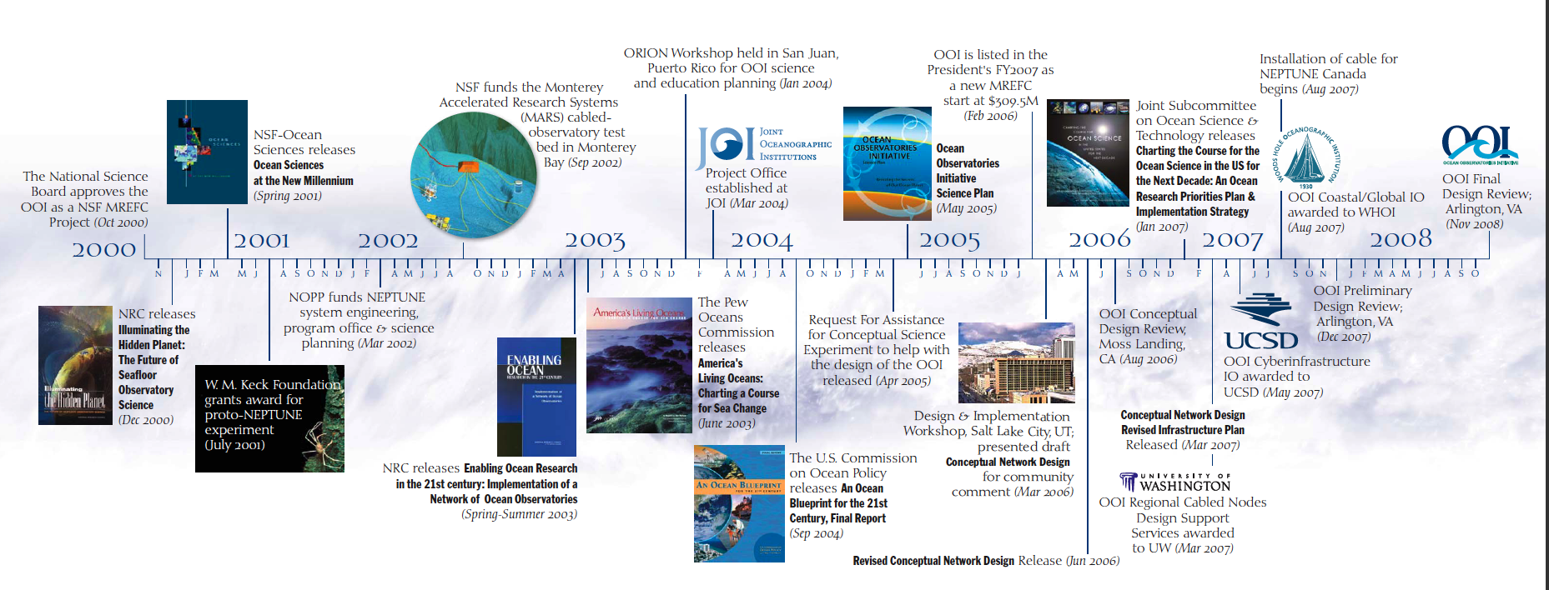
OOI Science Requirements Community Defined
Maturing community of practice
(National Science Foundation Ocean Observatory Initiative)
Overarching Science Themes
Forcing and exchanges at the boundaries
    Ocean-atmosphere exchange
    Fluid-rock interactions
Dynamics of the boundary regimes
    Coastal ocean dynamics and ecosystems
    The subseafloor biosphere
    Plate-scale, ocean geodynamics
Dynamics and variability of the ocean volume
    Climate variability
    Ocean circulation
    Turbulent mixing and biophysical interactions
    Ecosystems
Across the boundaries and in the interior
    Carbon cycling, ocean acidification, ecosystem health

Slide 14
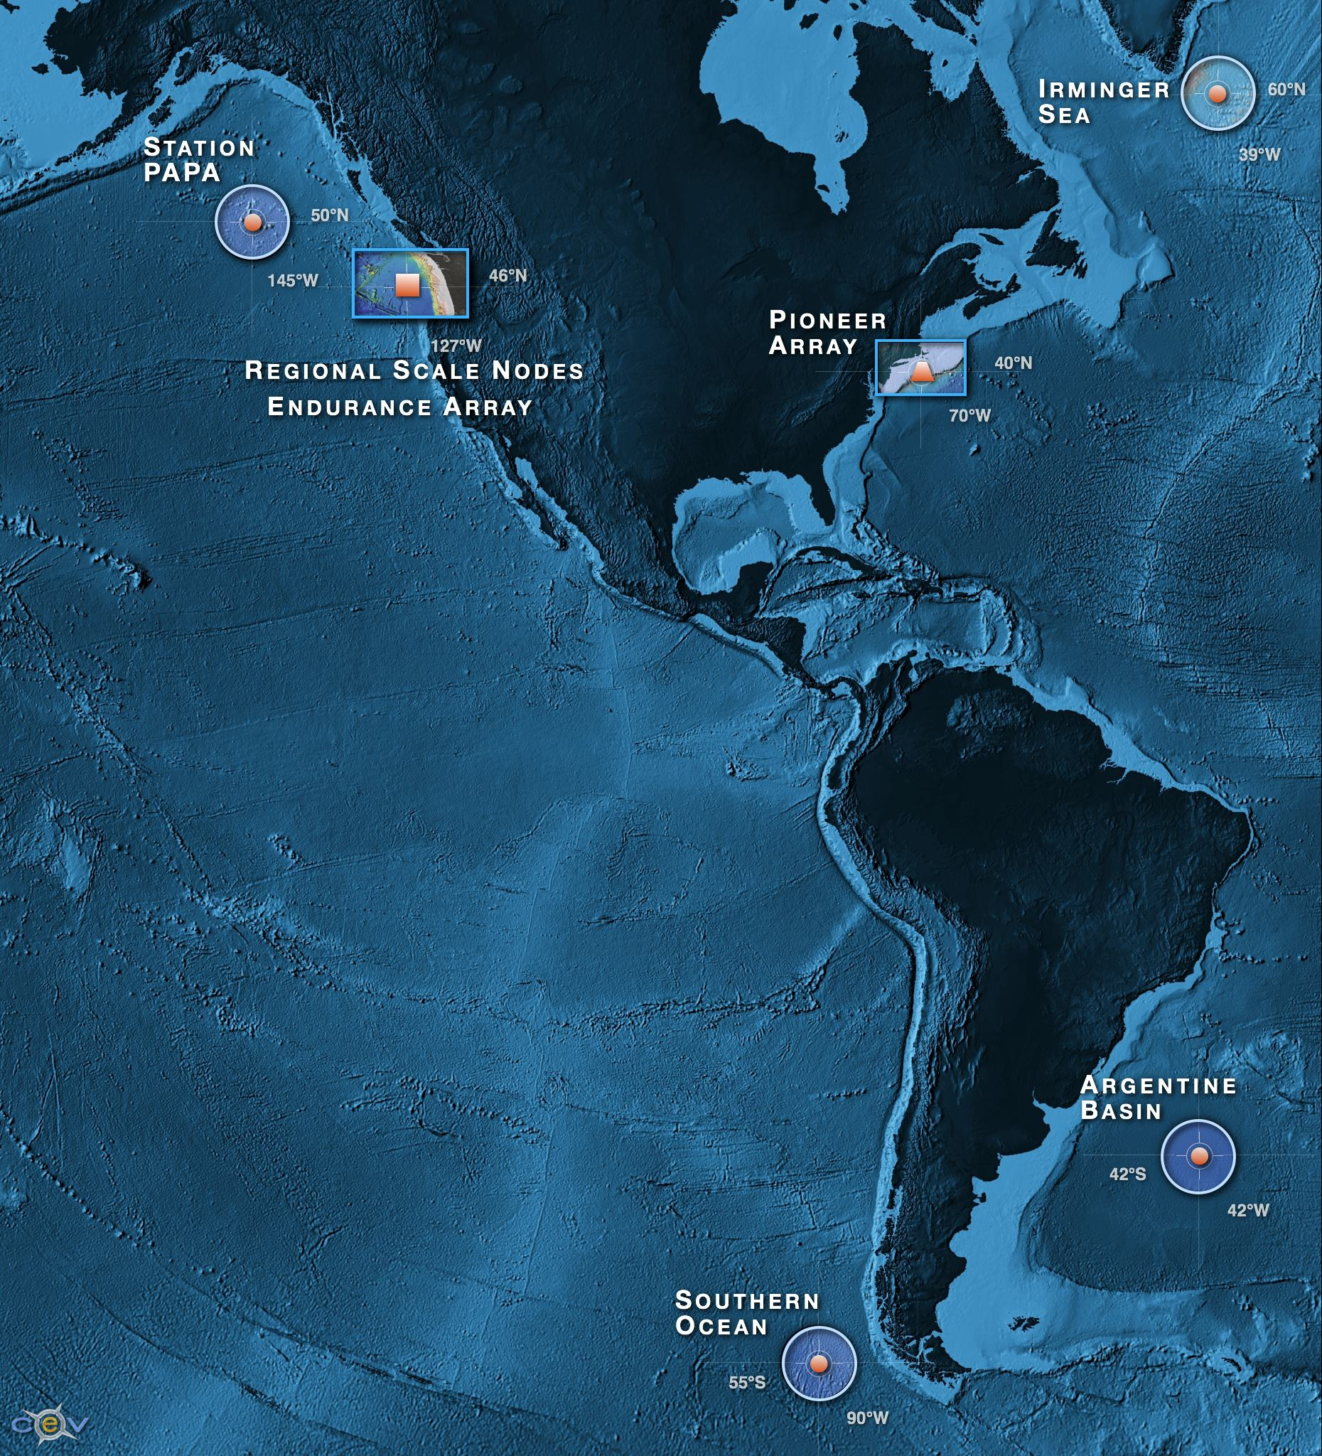
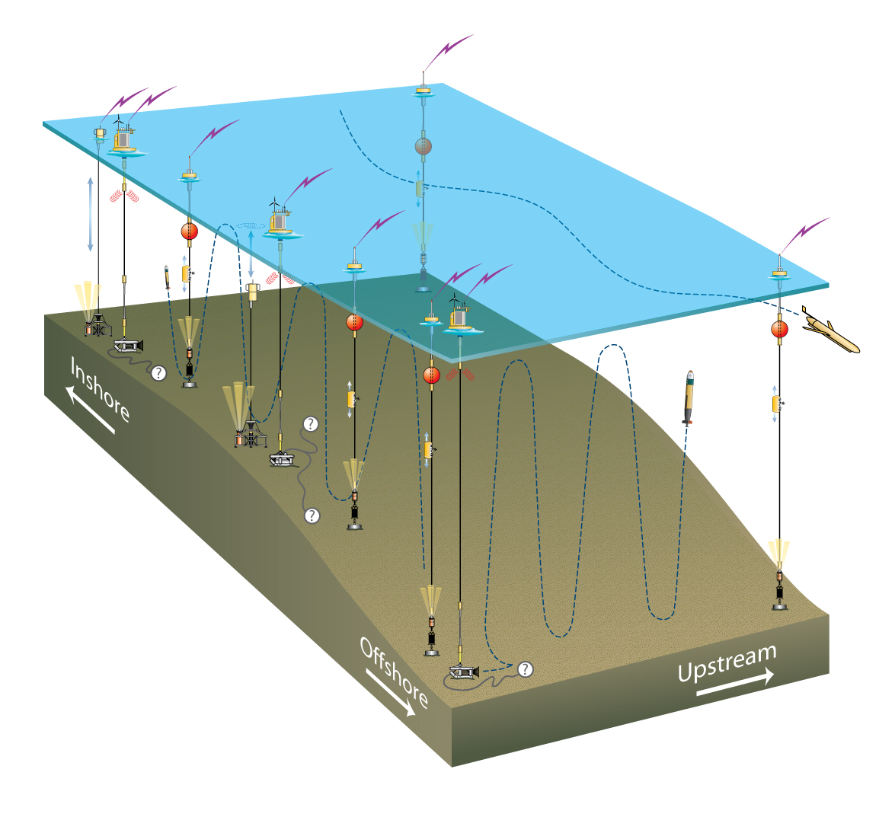
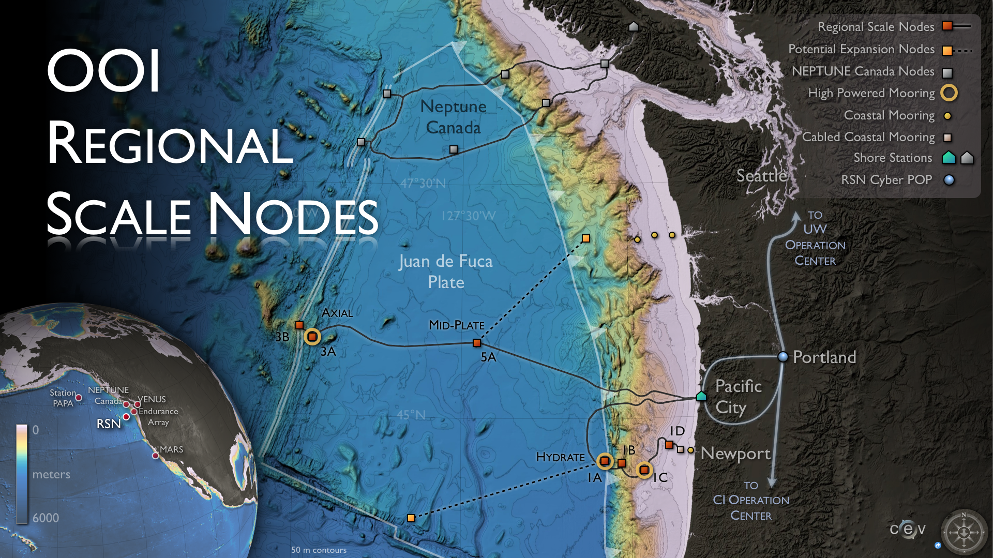
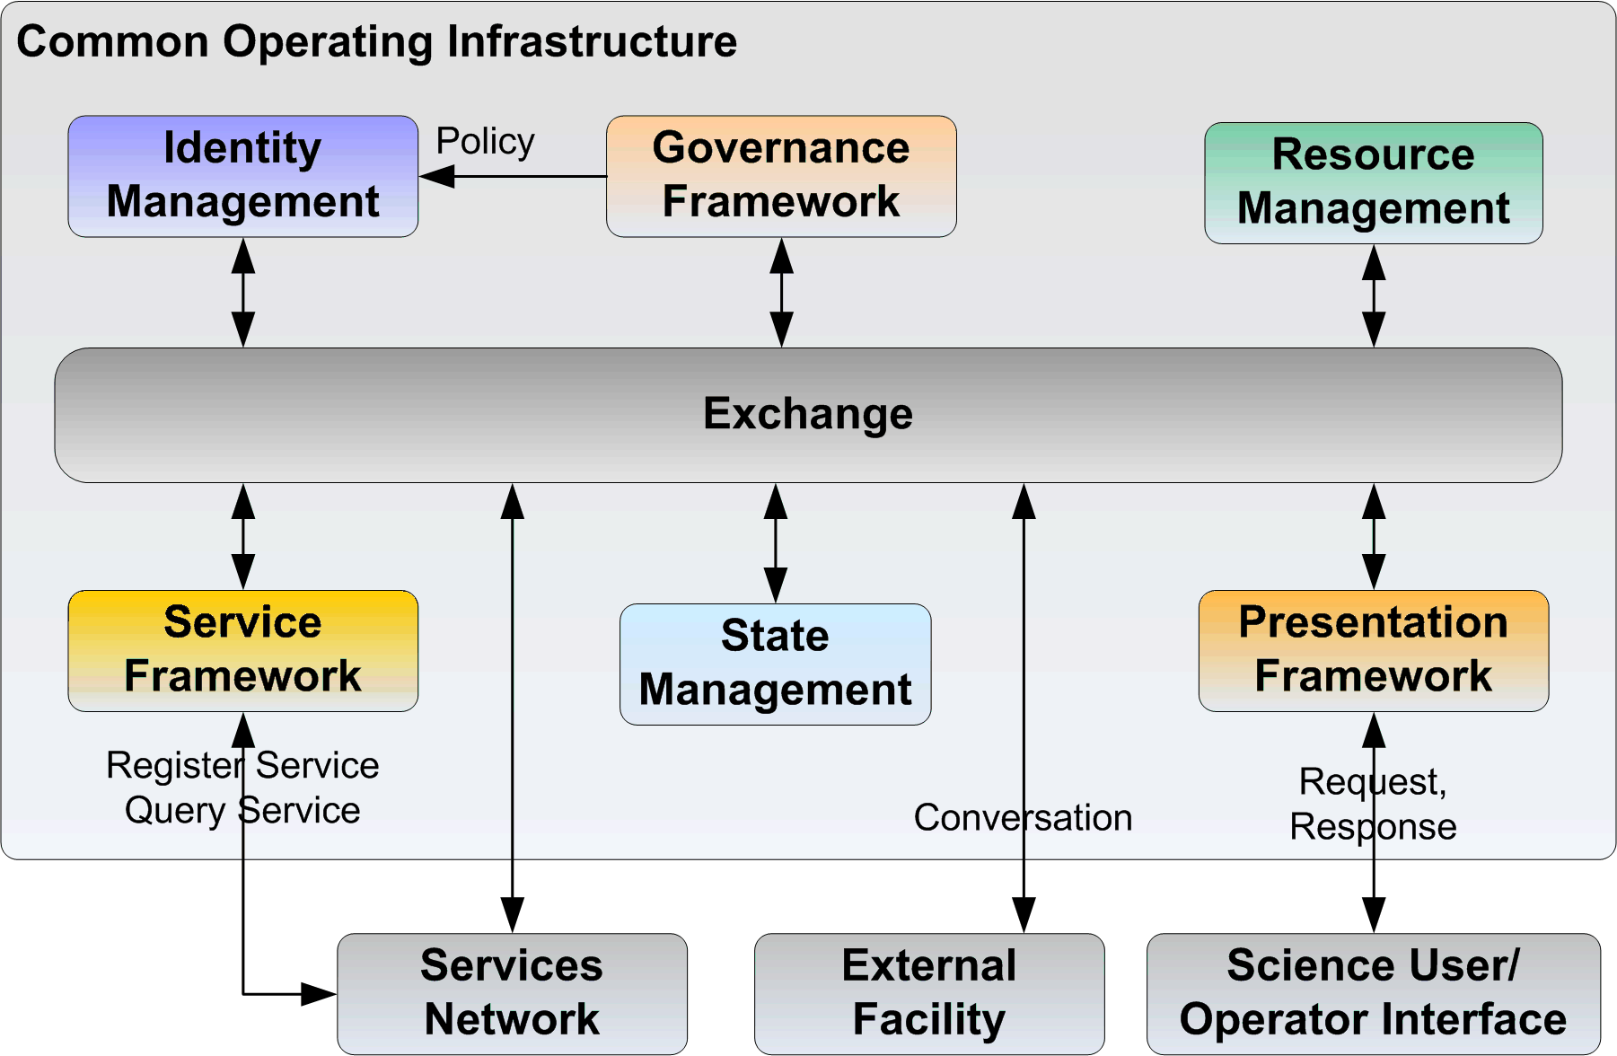
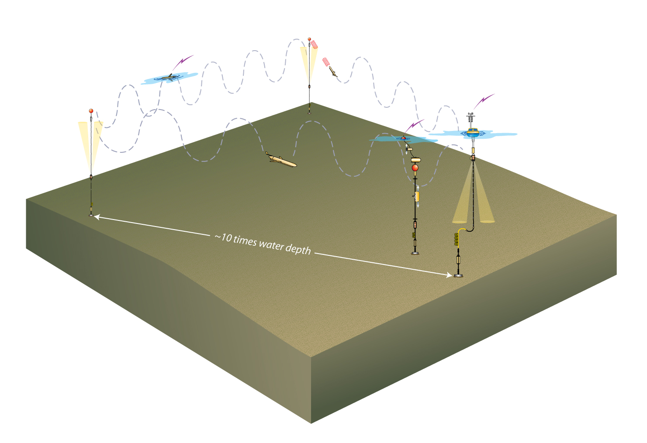
Maturing community of practice
(National Science Foundation Ocean Observatory Initiative)
-distributed fixed and mobile platforms carrying high diverse sensor arrays
-for some of the assets streaming data
-to be delivered through a cyberinfrastructure capability providing:

Slide 15
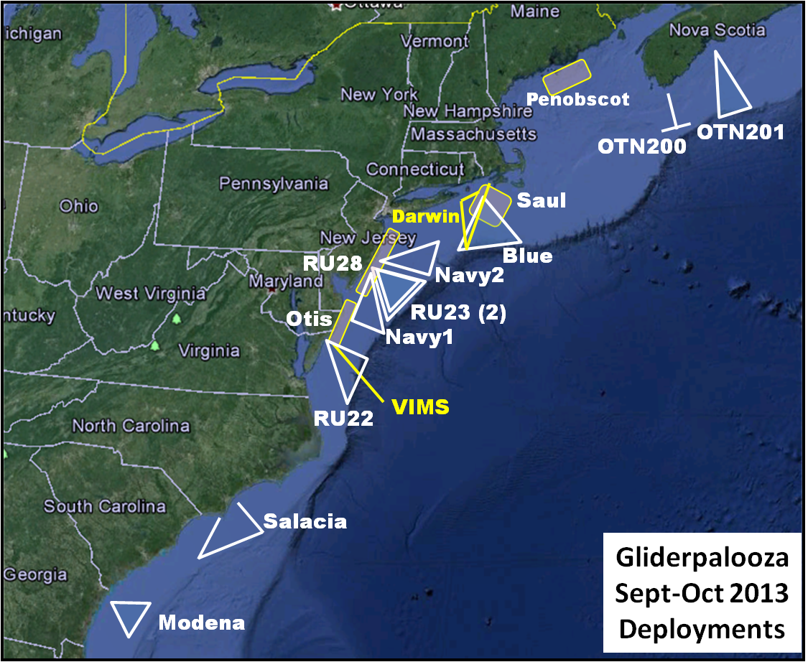
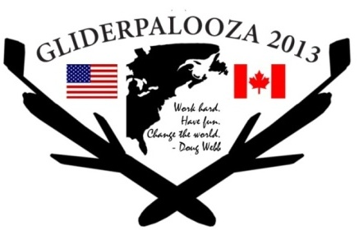
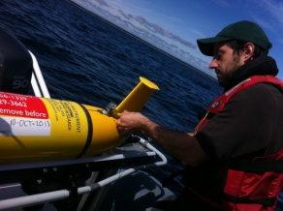





Gliderpalooza 2013
 | Group | Glider | Deploy | Funding
1 | Dalhousie | OTN200 (2) | 10-Sep | OTN
2 |  | OTN201 | 16-Sep | OTN
3 | UMaine | Penobscot (2) | 10-Sep | Maine
4 | WHOI | Saul | 10-Sep | ONR
5 | UMass | Blue | 6-Sep | MARACOOS/IOOS
6 | Rutgers | RU28 | 12-Sep | NJDEP
7 | UMaryland | RU22 | 22-Sep | MARACOOS/IOOS
8 | Rutgers | RU23 (2) | 10-Sep | MARACOOS/IOOS
9 | UDelaware | Otis | 12-Sep | Private
10 | VIMS | Stewart | 10-Oct | VIMS
11 | NC State | Salacia | 17-Sep | NASA
12 | Skidaway | Modena | 10-Sep | Skidaway/SECOORA/IOOS
13 | T. Webb | Darwin | 11-Sep | Self
14 | Navy | Navy1 | 10-Oct | Navy
Oscar Schofield
Professor Bio-Optical Oceanography
Rutgers University

Slide 16


Slide 17


Integrated data networks offering potential crowd sourcing and innovation for workforce development
Increase in Number & Scope of Research Internships
Locations: Australia, Antarctica, Svalbard, Spain, Canaries, Azores, California, Florida, New Jersey
Sponsors: NSF, DHS, Alumni
Trans-Atlantic Glider Challenge
Spring 2012 Course: >70 Students
Number of Marine Science Majors

Slide 18





Undergraduates can do real research, with right tools
RTOFS and MERCATOR
Temperature and Current Maps at 200 m
IEEE, MTS Oceans ‘13
(San Diego, USA)
RTOFS 200m temperature and currents on April 18th, 2013. The glider position is marked by the red dot.
MyOcean 200m temperature and currents on April 18th, 2013. The Gliders position is marked by a red dot.

Slide 19






Expanding the model
Developing tools to increase the crowd sourcing & educational opportunities with OOI Education and Public Engagement team (EPE)
Concept Maps
Data Visualization Tools
Lab Lesson Builder

Slide 20
HURDLES
Lone wolf
The majority probably start with google search
Mine the portals they know, many are not linked
Married to their analysis tools (excel, R, Matlab)
Consortia
Linking distributed data bases
Incorporating new data and data portals
Linking to research that flows from the data
Advanced networks
Incoporating increasingly diverse sensors
Search across theme and discipline

