Slide 1
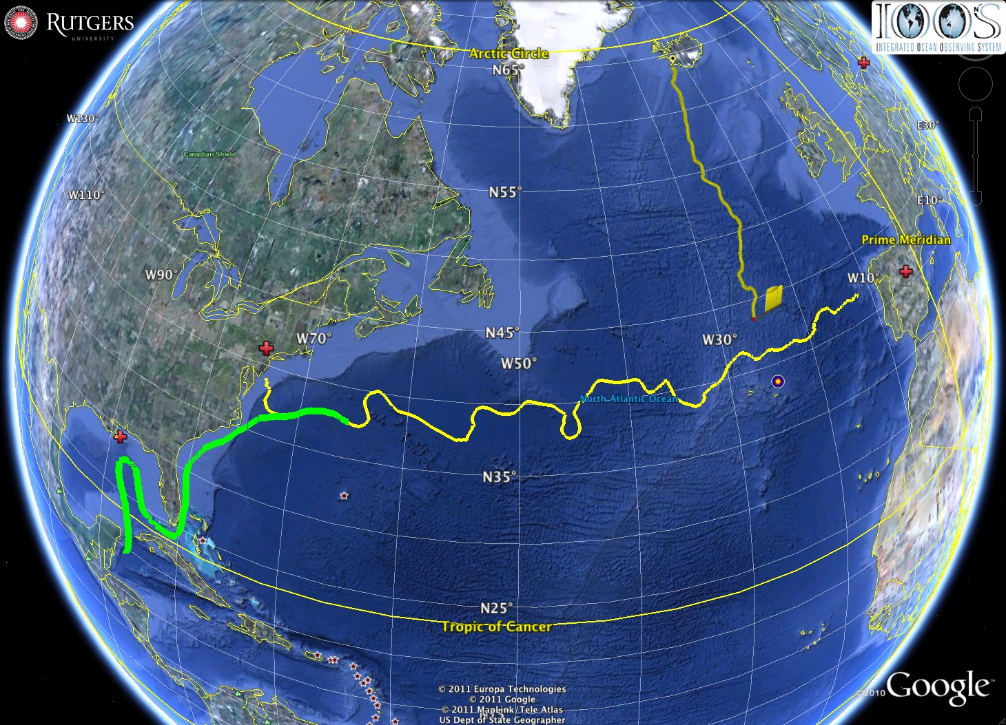



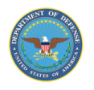


U.S. IOOS Response to the Gulf of Mexico Oil Spill:
The Critical Role of Modern Ocean Observing Networks
Madrid
Silbo
Rutgers
RU27
Deepwater
Horizon
Scott Glenn,
Representing
Many IOOS &
DHS Partners
Loop Current -----> Gulf Stream
National Center for
Secure and Resilient
Maritime Commerce
Many
Sponsors,
Including

Slide 2
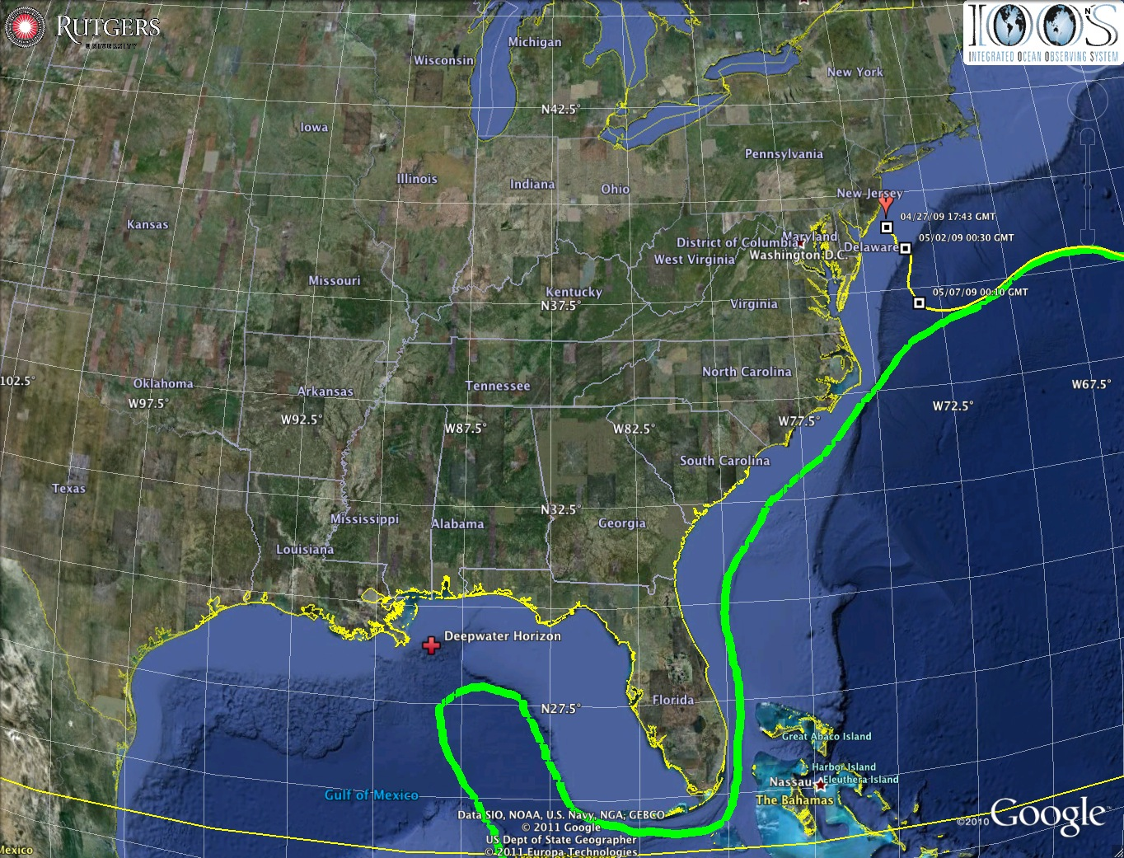
Oil Transport Questions: Will the oil….
Come ashore in Louisiana?
Spread east to Texas or west to Mississippi, Alabama and Florida pan handle in the wind-driven coastal currents?
Enter the Loop Current and be transported downstream?
Hit the Florida Shelf and be driven shoreward by winds?
Ride the Loop Current south and hit the Florida Keys?
Be transported out of the Gulf of Mexico by the Gulf Stream and impact the East Coast?
Is there oil below the surface? Where? How much?
Gulf of Mexico

Slide 3
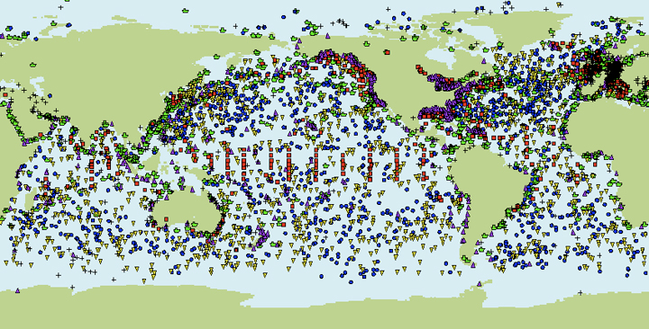

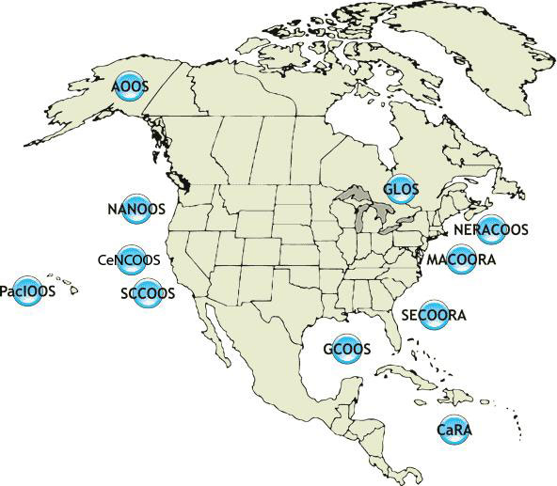
U.S. Integrated Ocean Observing System
IOOS Relationships
Global Component
National Component
Regional Component
Global Ocean Observing System
Vessels -
Satellite
Satellite
CODAR
Ships/ Vessels
Glider
REMUS
Data Vis.
Modeling
Security
Leadership
Education
11 Regional Associations
17 U.S. Federal Agencies

Slide 4









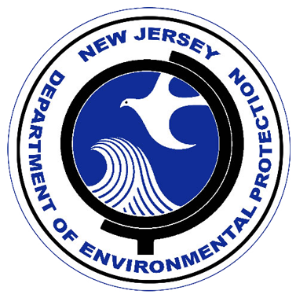




U.S. IOOS Mid Atlantic Regional Association Coastal Ocean Observing System
NSF Ocean Observing Initiative Education and Public Engagement Implementing Organization
DHS National Center for Secure and Resilient Maritime Commerce
ONR Slocum Glider Technology Center

Slide 5
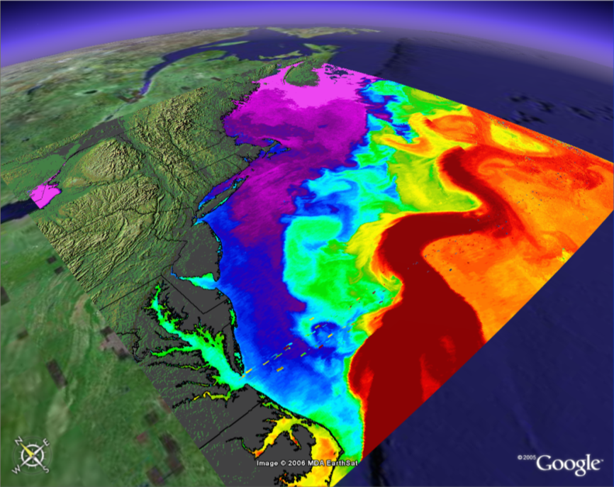
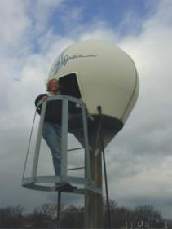
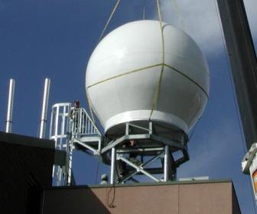
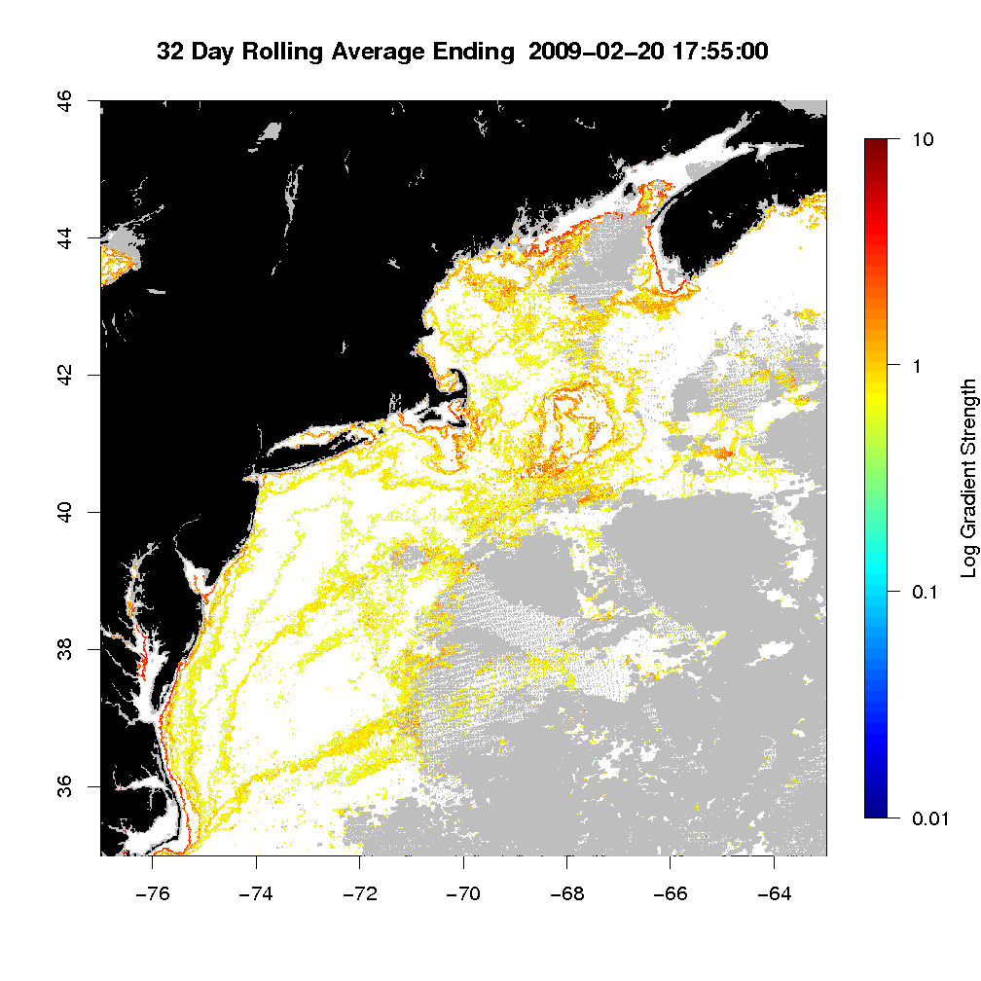
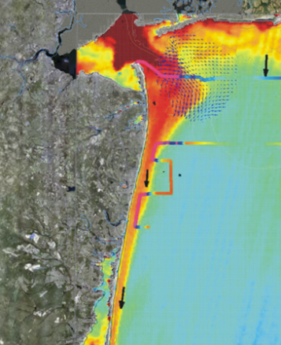
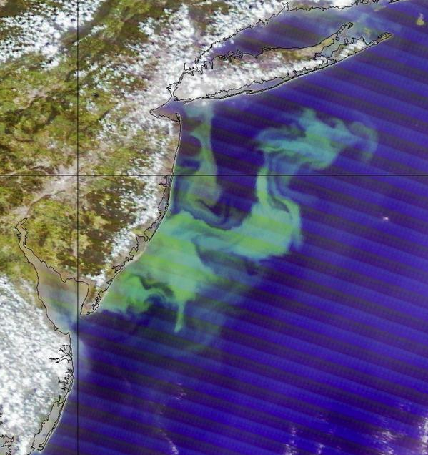
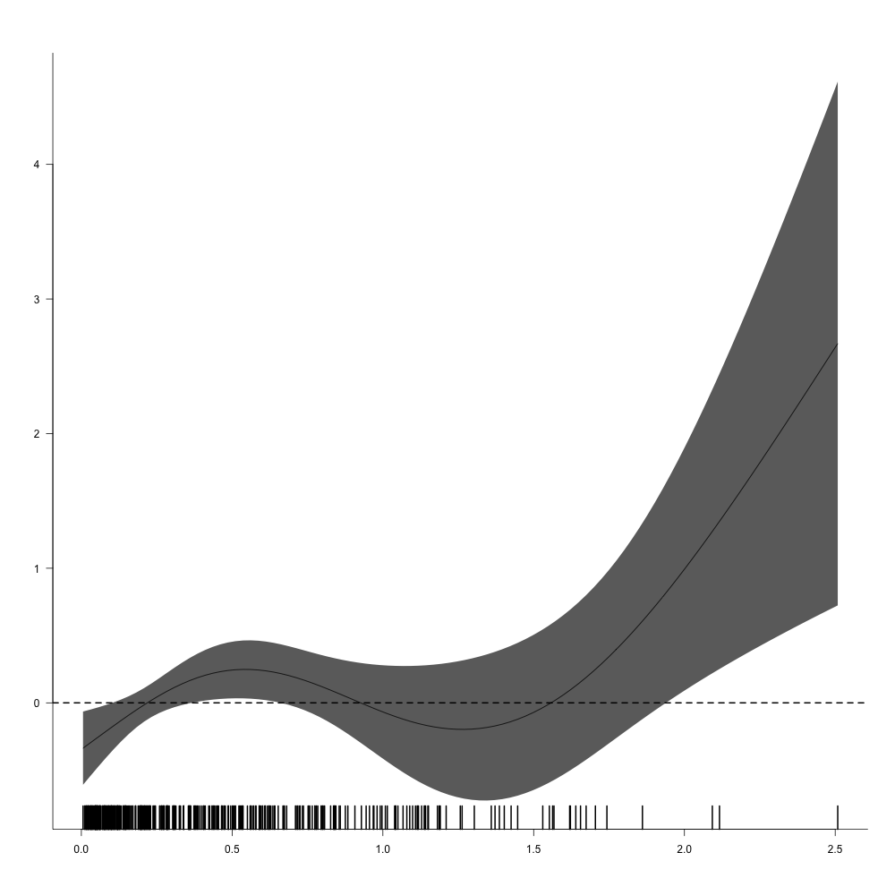
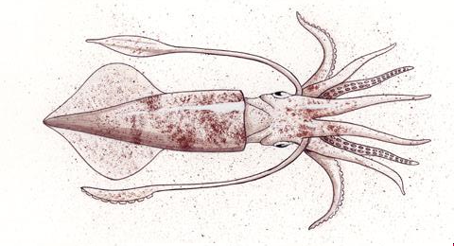
MARACOOS - International Constellation of Satellites – Since 1992
Sea Surface Temperature - SST
L-Band
(installed 1992)
X-Band
(installed 2003)
Corporate Partner: SeaSpace
Ocean Color
<River Plumes
Ocean Blooms>
Combined SST & Color
Water Mass Boundaries
Notes:
5

Slide 6
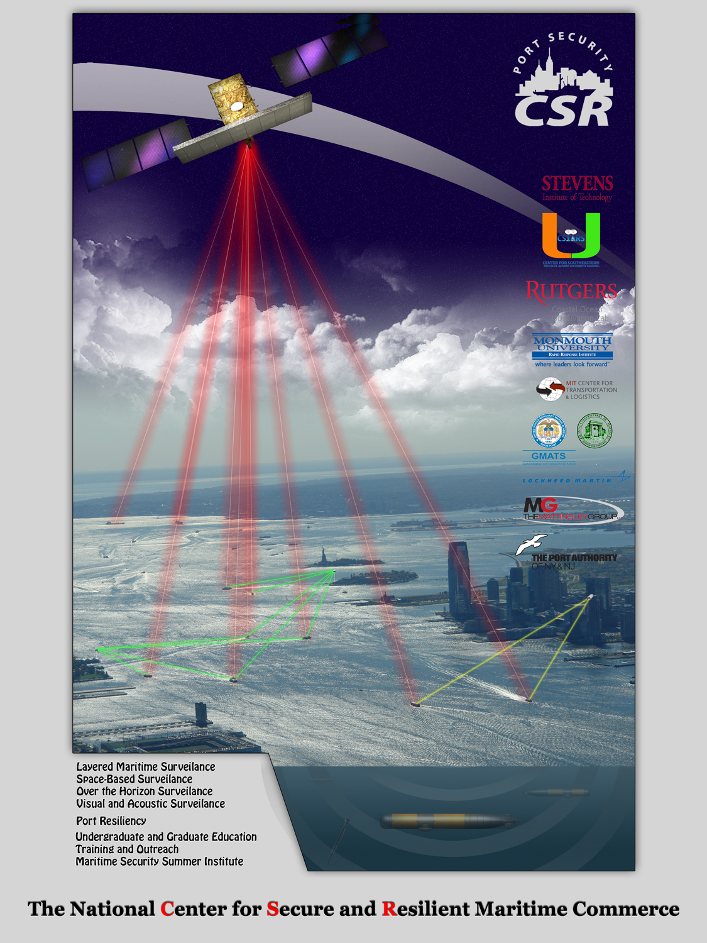
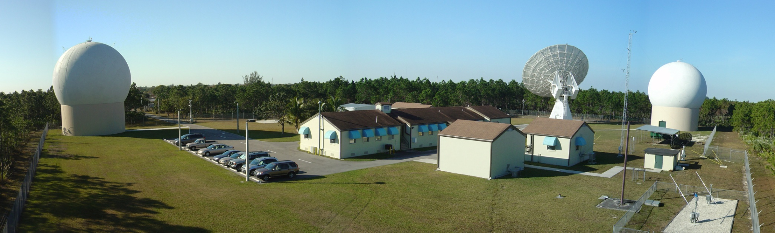

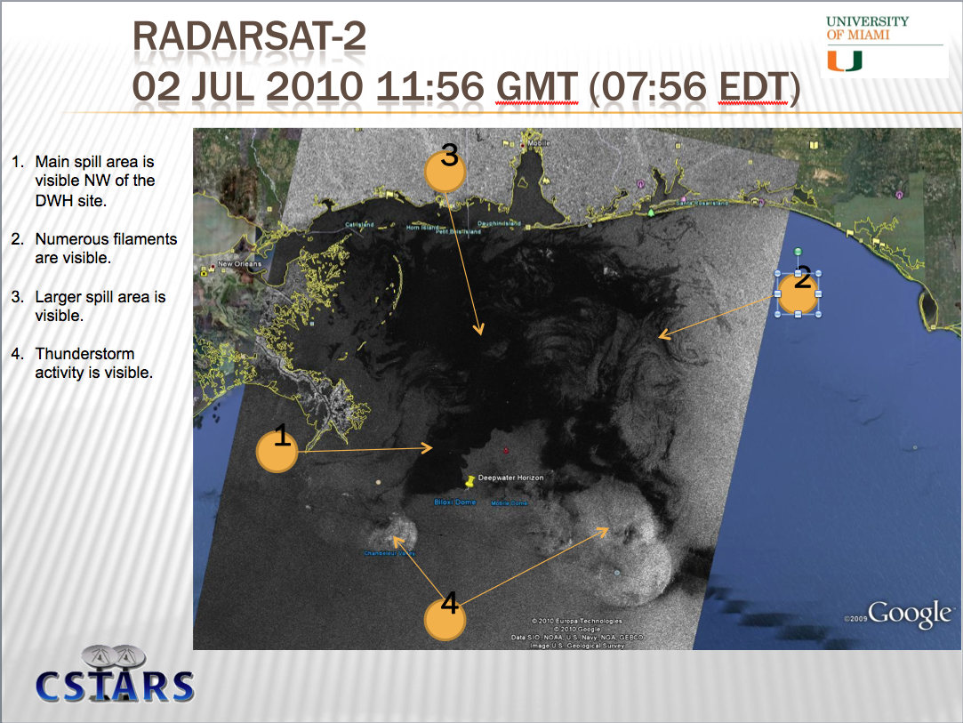

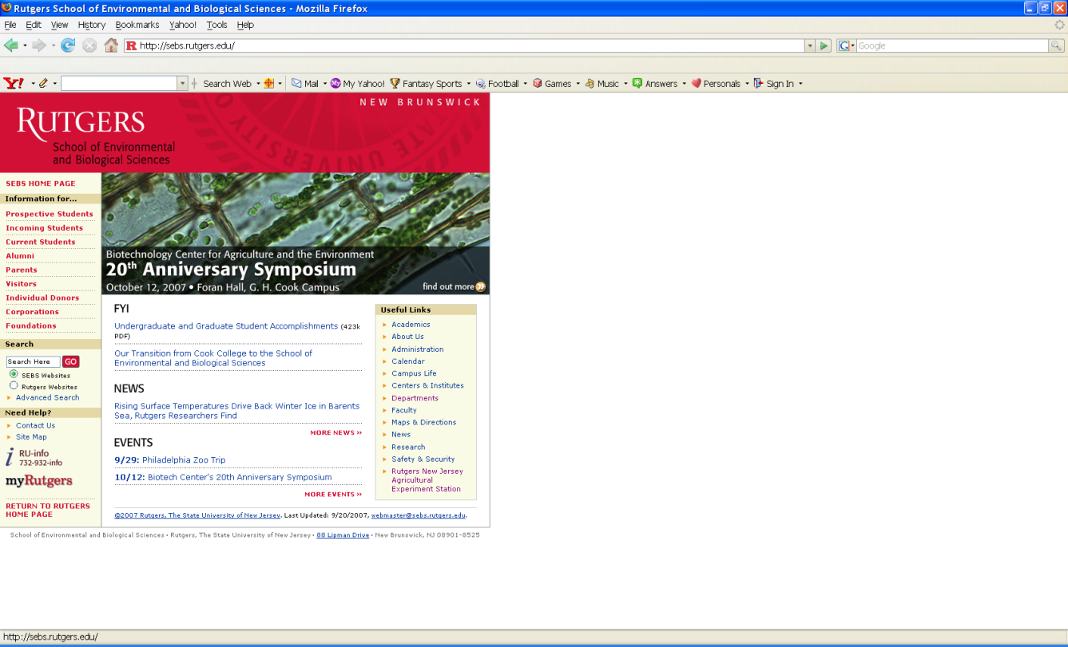


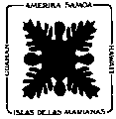





National Center for Secure and Resilient Maritime Commerce
A U.S. Department of Homeland Security Center of Excellence

Slide 7
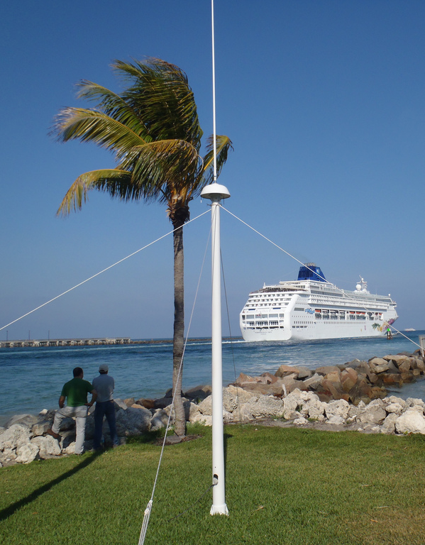
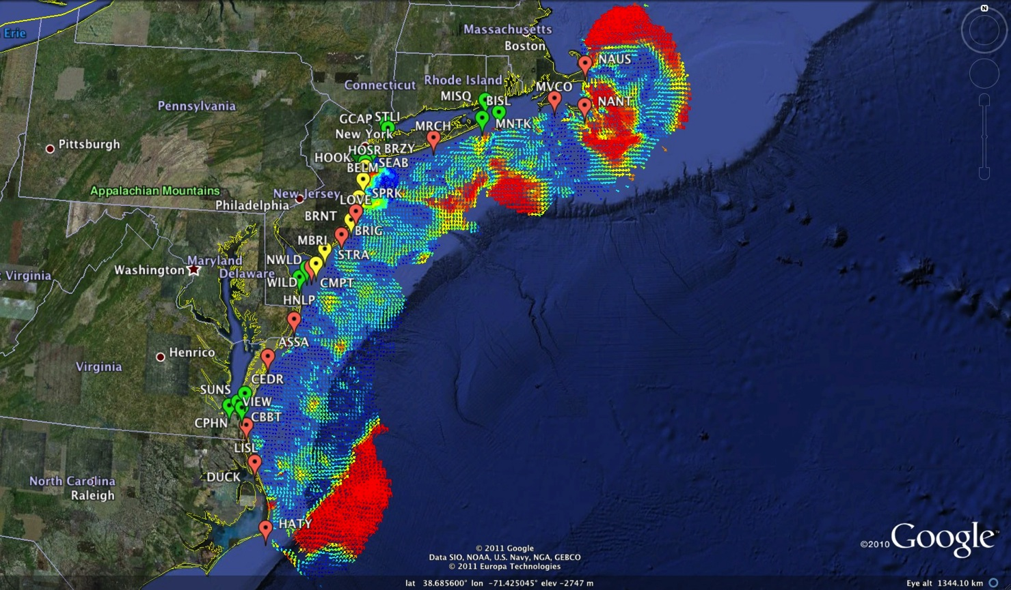
Mid-Atlantic Bight HF Radar Network – Since 1997
1000 km Alongshore Length Scale
Corporate Partner:
CODAR Ocean Sensors
Mid-Atlantic HF Radar Network
14 Long-Range CODARs
7 Medium-Range CODARs
15 Short-Range CODARs
36 Total
Triple Nested & Multistatic

Slide 8
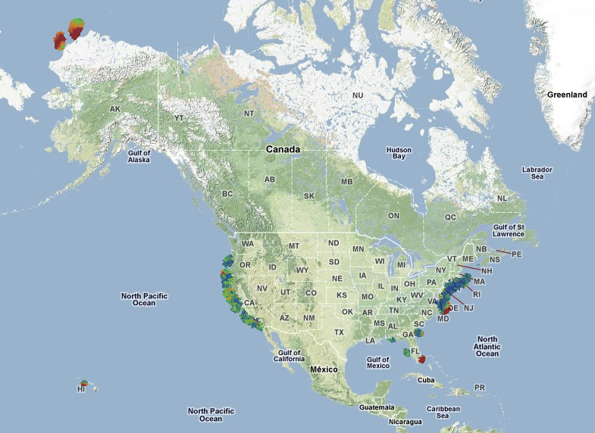
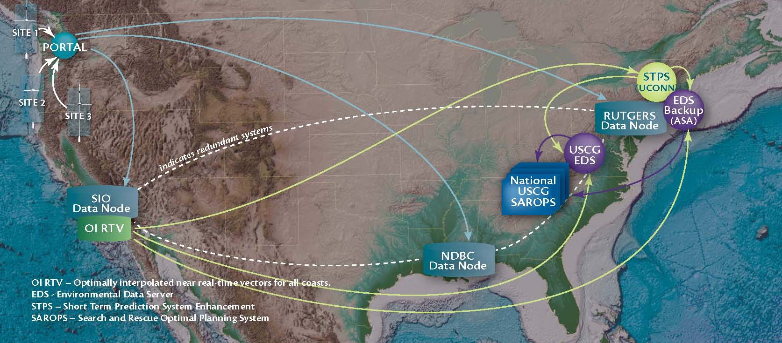
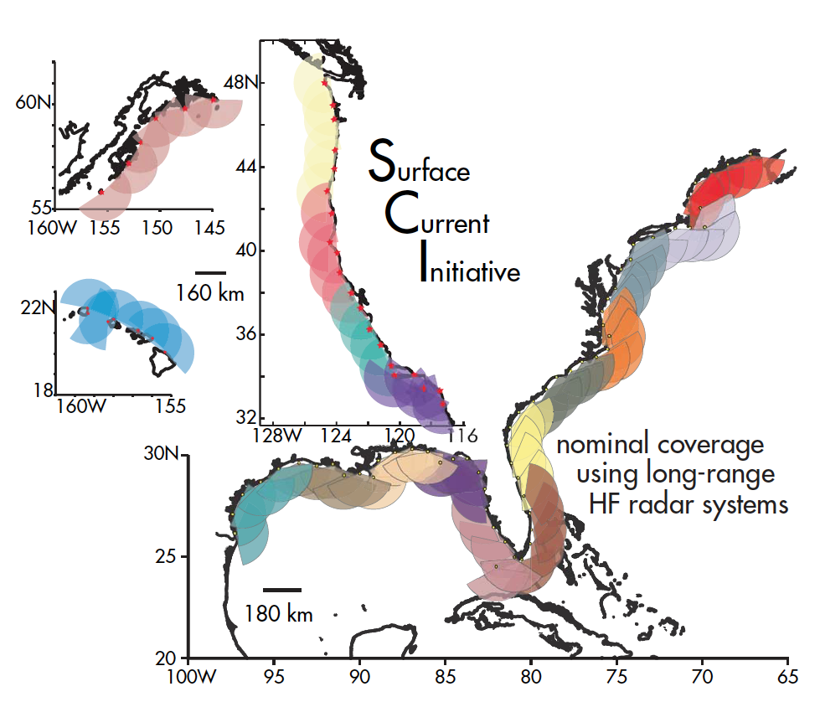
U.S. National HF Radar Network
Data Flow Since 2007
2004 Plan
Today’s Coverage
131 Radars

Slide 9
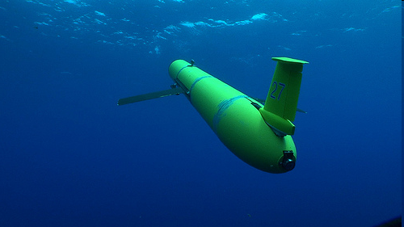
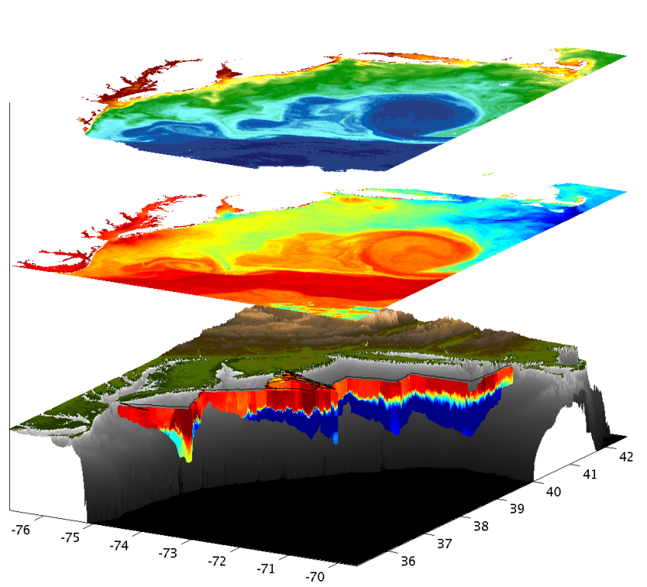
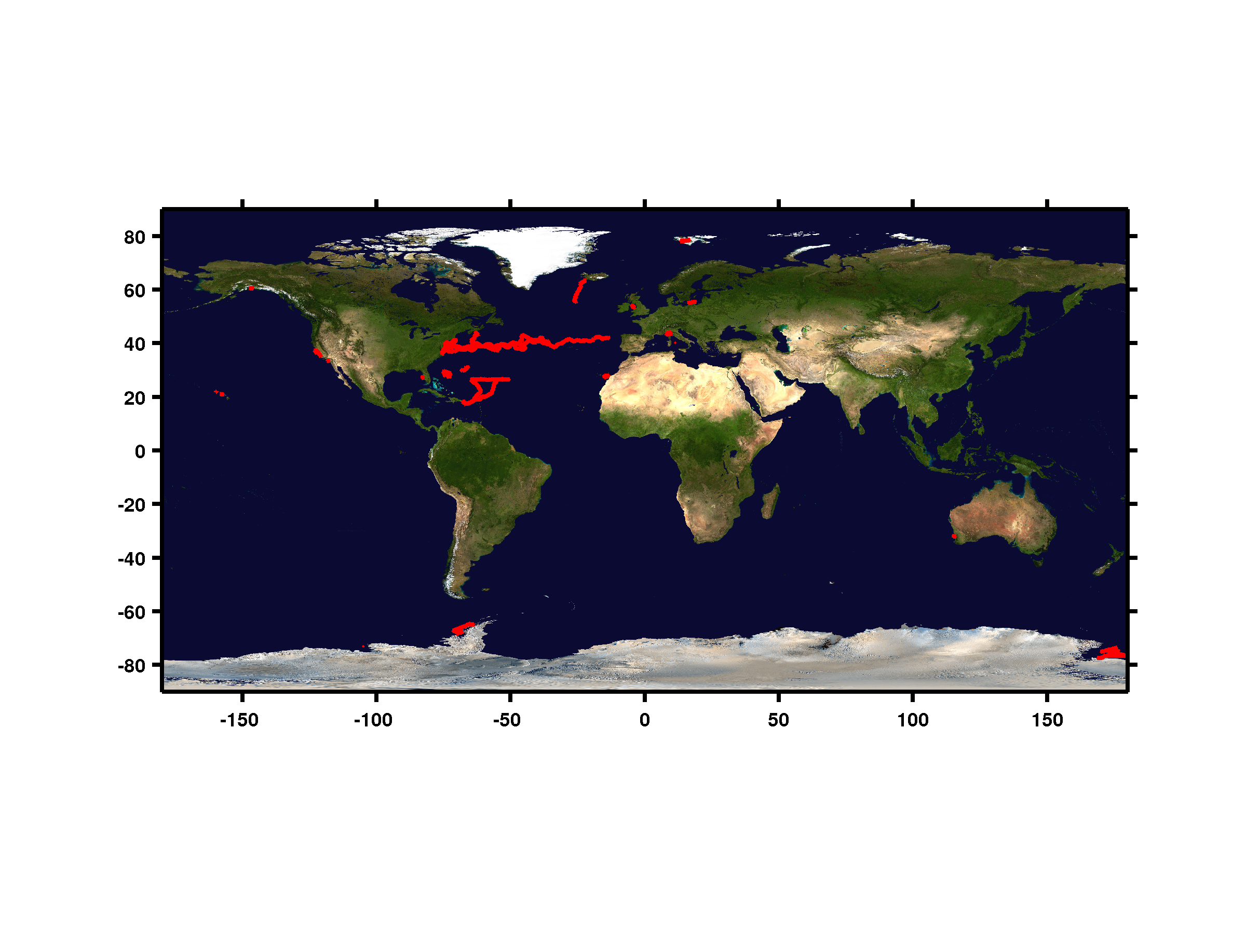
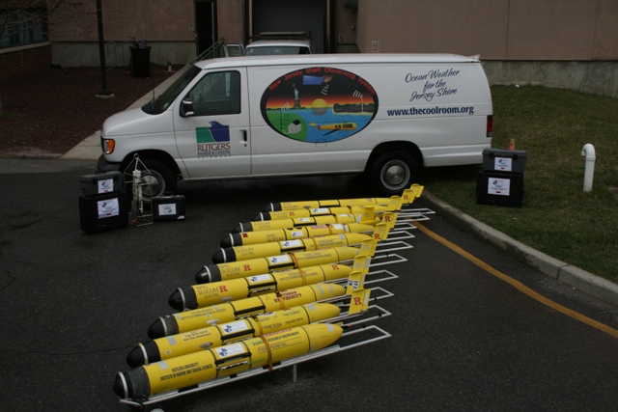
MARACOOS - Autonomous Underwater Gliders – Since 1998
Satellite Ocean Color
Satellite SST
Subsurface
Glider
Data
Corporate Partner: Teledyne Webb Research
< Glider Fleet
With Global Reach >

Slide 10
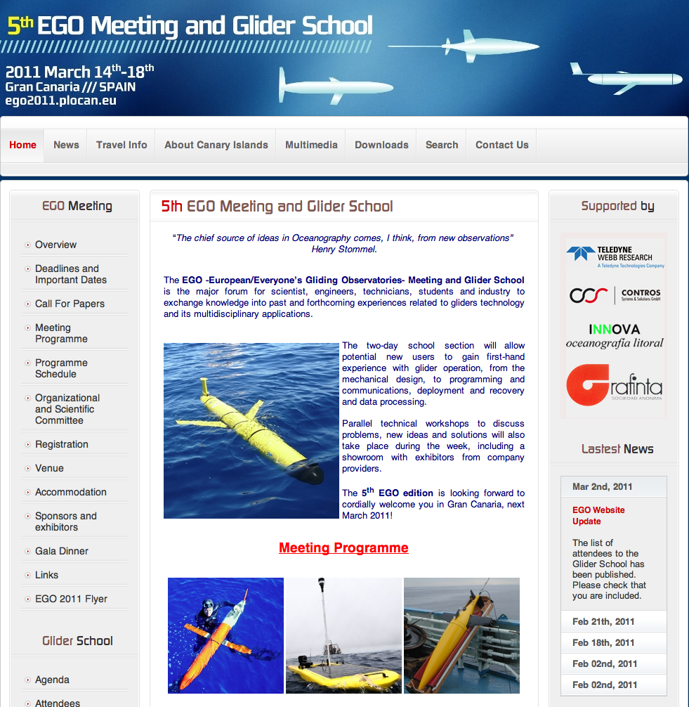
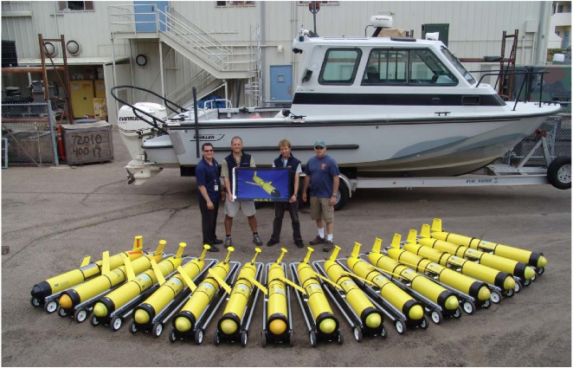
U.S. National Glider Network Components (2010)
Everyone’s
^
European Gliding Observatories
ONR Glider Technology Centers
Slocum Gliders – Rutgers
Seagliders – U. Washington
Spray Gliders – Scripps I.O.
U.S. Navy
Littoral Battlespace Sensing - Gliders

Slide 11
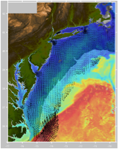
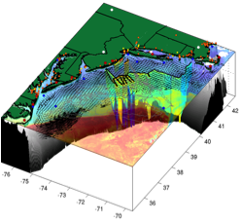
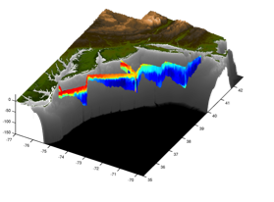
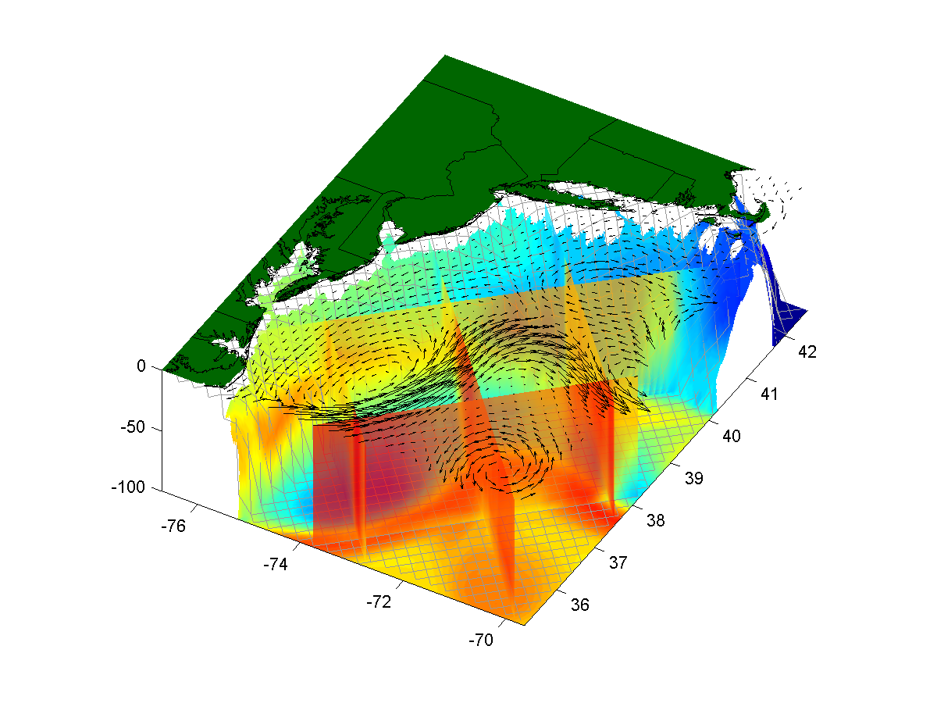
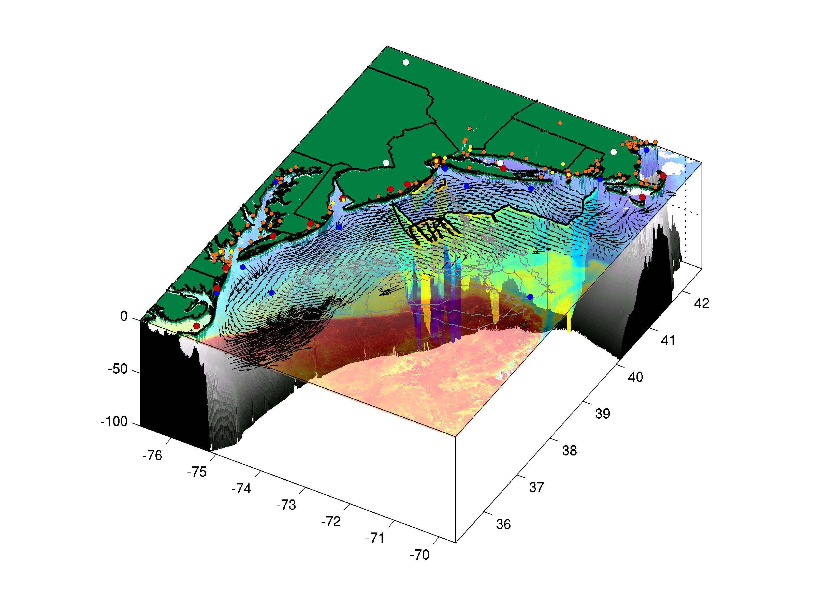
MARACOOS - Composite Data & Forecast Products
+
=
Remote Sensing
Gliders
3-D Nowcasts
+
=
3-D Nowcasts
Nested Models
4-D Forecast Ensembles

Slide 12

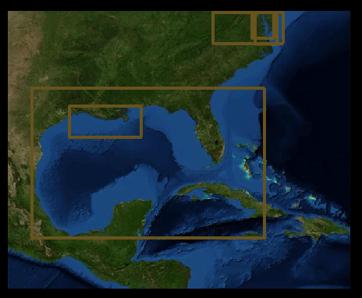
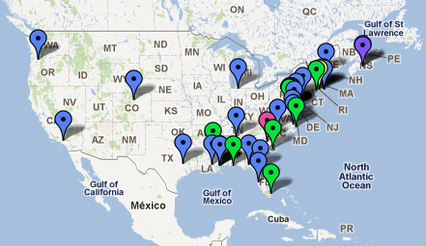
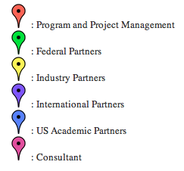
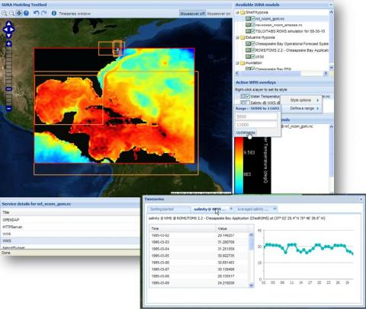



>80 Investigators
>40 Institutions
Cyberinfrastructure Dashboard

Slide 13
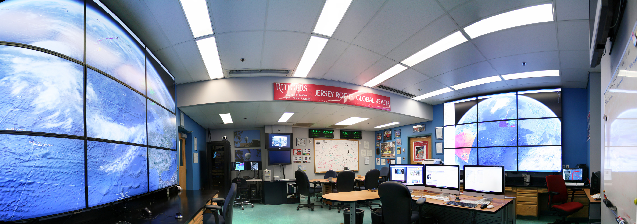
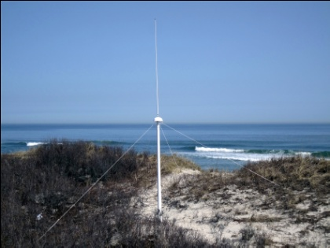
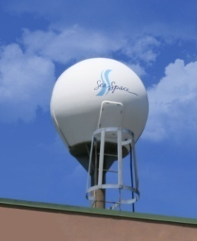
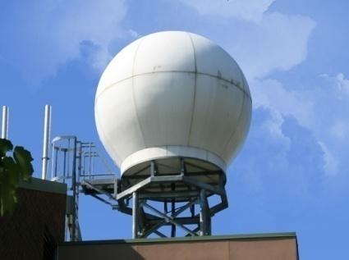
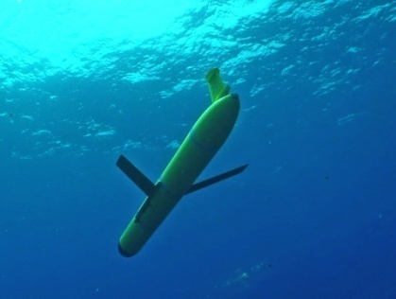
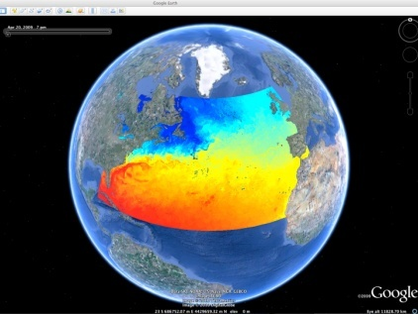
Rutgers University - Coastal Ocean Observation Lab
MARACOOS Operations Center
Vessels -
Satellite
Satellite
CODAR
Ships/ Vessels
Glider
REMUS
Data Vis.
Modeling
Security
Leadership
Education
CODAR Network
L-Band & X-Band Satellite Receivers
Glider Fleet
3-D Nowcasts
& Forecasts

Slide 14
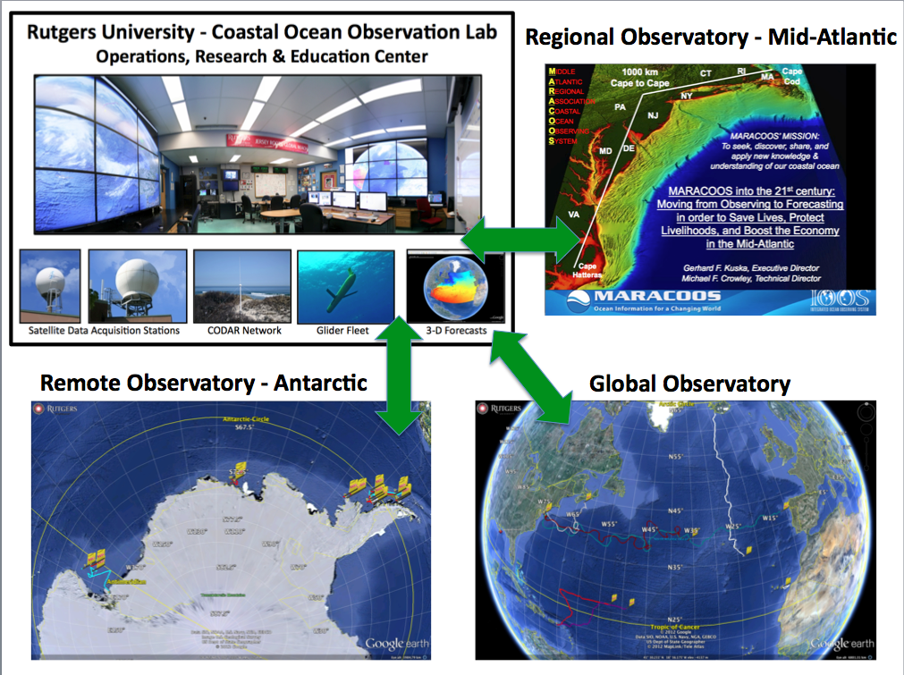

Slide 15
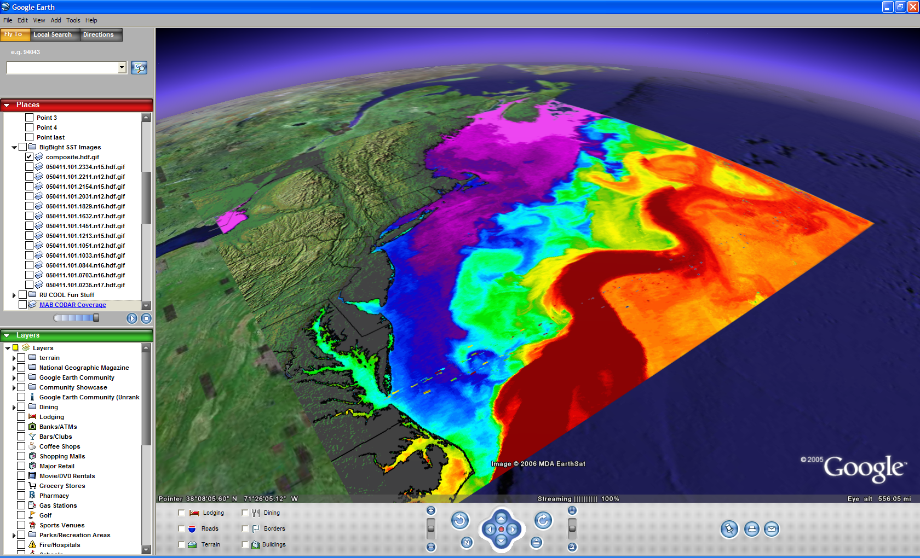

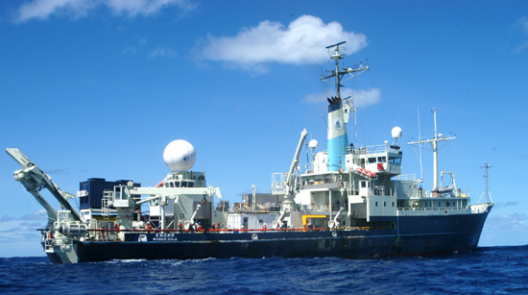
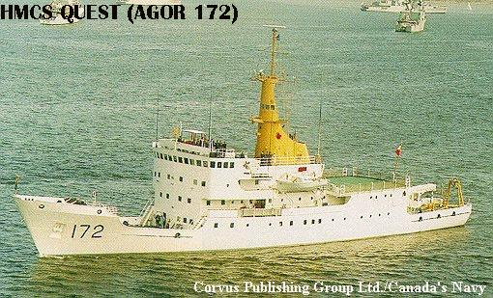
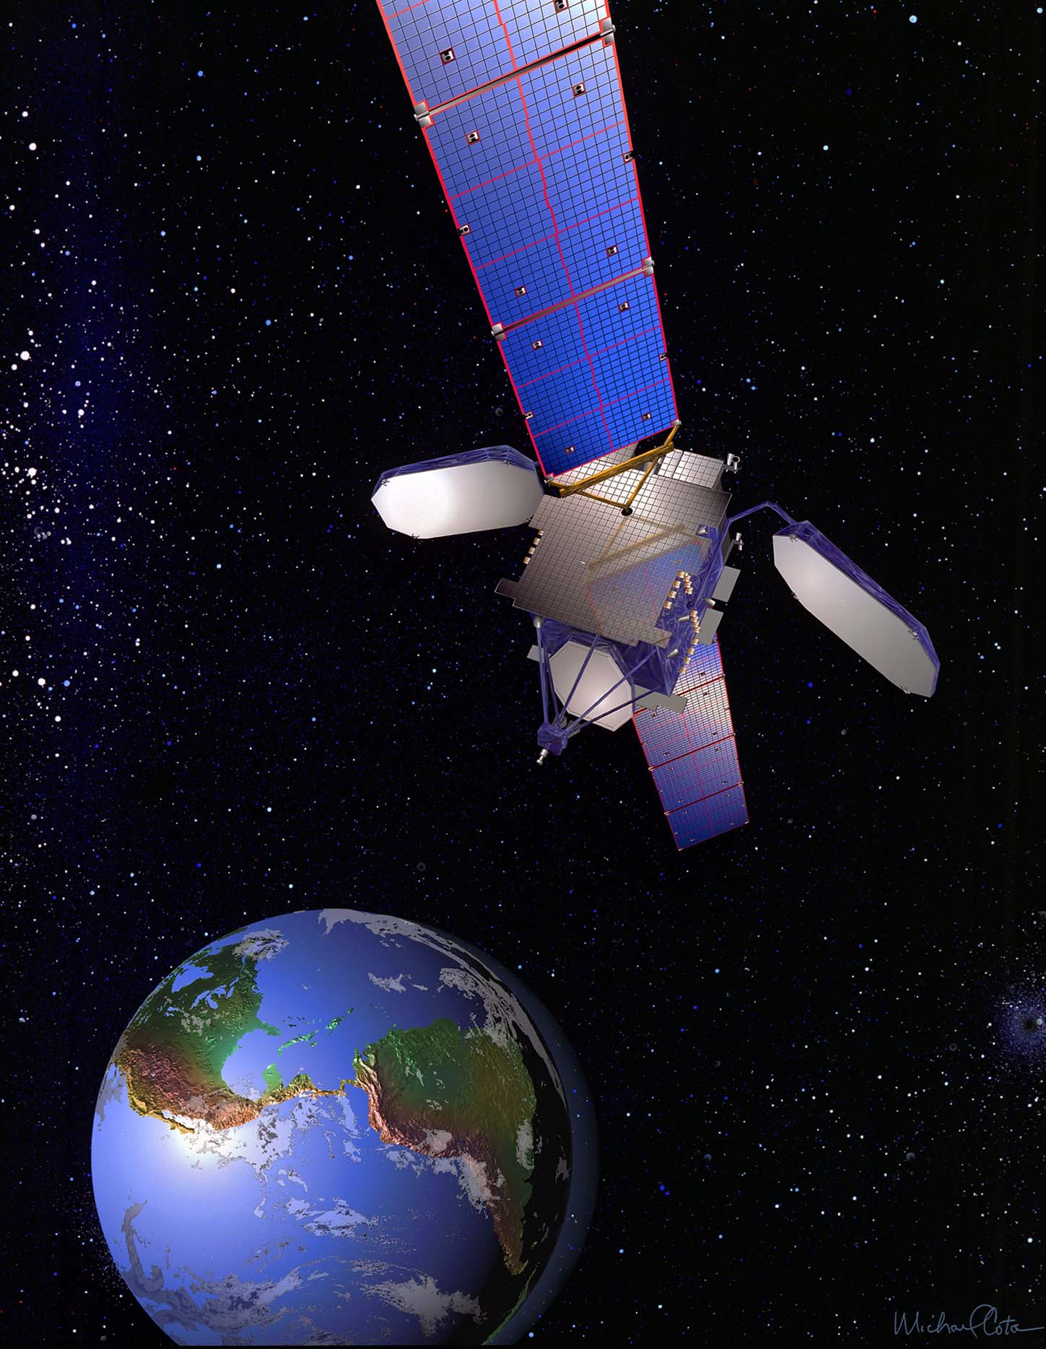







ONR Shallow Water 2006 Joint Experiment
HiSeasNet
>12 Satellites
48 Senior
PI’s & PM’s
Communication
7 Ships
3 Ground- stations
10 Gliders
1 Aircraft
62 Moorings

Slide 16

ONR Shallow Water 2006 Joint Experiment
HiSeasNet
>12 Satellites
48 Senior
PI’s & PM’s
Communication
7 Ships
3 Ground- stations
10 Gliders
1 Aircraft
62 Moorings

Slide 17




Trans-Atlantic Glider Challenge – May 24, 2006 –
UNESCO E.U./U.S. Baltic Sea Conference in Lithuania
Dr. Rick Spinrad
Assistant Administrator
NOAA
Office of Oceanic and Atmospheric Research
“I have something you need to do for the good of your country.”
“Take one of your gliders, modify it, and fly it across the Atlantic, inspiring students along the way.”
East-West
Distance Across:
5,500 km
Longest Mission
in 2006: 500 km
Increase Duration
Ruggedize for Storms
Corrosion & Biofouling
Global Roadmap

Slide 18




Trans-Atlantic Education: Glider RU27
Social networking tools developed to enable collaboration between scientists and students in the U.S., Canada, Portugal and Spain
PLOCAN
Universidad de Las Palmas de Gran Canaria
Google Earth
Interactive Interface
Web Portal
Briefing Blog

Slide 19



Deepwater Horizon Information Flow
Tools developed for education during the trans-Atlantic mission of RU27 adapted to coordinate response to the oil spill:
Collaborative web portal established as an aggregation center for information
Google Earth data/model interactive interface used for environmental analysis & glider path planning
Blog established to share analyses and provide comments – 127 briefs posted
Google Earth
Interactive Interface
Web Portal
Briefing Blog

Slide 20



Deepwater Horizon Oil Spill: Coordinated Rapid Response
Contributed Assets:
HF Radar Networks
USF, USM
Gliders
iRobot, Mote, Rutgers,
SIO, UDel, USF, Navy
Drifters & Profilers
Horizon Marine, Navy
Satellite Imagery
CSTARS, UDel, Rutgers
Ocean Forecasts
Navy, NCSU
Data/Web Services
ASA, Rutgers, SIO
Tropical Storm Bonnie crosses the Gulf of Mexico
USM HFR
TS Bonnie
USF HFR
USM HFR validation of SABGOM Forecast
in region with satellite detected oil slicks
HFR used for Oil Slick Forecasts by NOAA/NOS/OR&R

Slide 21

Deepwater Horizon Glider Data Flow
Individual glider operators provided, at minimum, Time, Lat & Lng time series.
Available CTD data forwarded to NOAA National Data Buoy Center.
Transmitted over the Global Telecommunication System for assimilation by models.
Glider | Owner | Deployed | Tot Days | Tot Dist (km)
RU21 | Rutgers | 1 | 35 | 607
RU23 | Rutgers | 5 | 87 | 1582
UD 134 | U of Delaware | 3 | 51 | 1111.5
Bass | U of South Florida | 3 | 31 | 552
Waldo | Mote Marine Lab | 4 | 74 | 1476
Sam | U of South Florida | 2 | 39 | 677
SG135 | NAVOCEANO | 1 | 86 | 1353
SG137 | NAVOCEANO | 1 | 86 | 970
SG515 | iRobot/U of Washington | 1 | 69 | 1500
Spray0040 | SIO | 1 | 106 | 3000
TOTALS: |  | 18 | 317 | 6005.5
Rutgers aggregation center
NOAA distribution center

Slide 22




Near Field Environmental Analyses: June 6 – Satellites, HFR, SABGOM & HyCOM
Satellite
+ HFR
Oil Forecast
+ HFR
HyCOM +
SABGOM
+ HFR
SABGOM
+ HFR

Slide 23



Near Field Environmental Analyses: Wind Shift – Strong Winds & Waves from SE
July 3
June 29
July 4
July 7

Slide 24




Far Field Environmental Analyses: June 6 Asset Maps, Satellite & HyCOM
June 6
June 6
June 6
June 6

Slide 25




Approach to West Florida Shelf: Asset Maps, HFR, Gliders, HyCOM
June 3
June 4

Slide 26





July, 2009
Extreme Far Field:
East Coast Risk Assessments:
HFR Fields from 2009
July 6
August, 2009
September, 2009
June 25

Slide 27

18 July 2010 Blog Entry - 2010-2020: The Ocean Forecasting Decade

Slide 28

18 July 2010 Blog Entry - 2010-2020: The Ocean Forecasting Decade

Slide 29

18 July 2010 Blog Entry - 2010-2020: The Ocean Forecasting Decade

Slide 30

18 July 2010 Blog Entry - 2010-2020: The Ocean Forecasting Decade

Slide 31

18 July 2010 Blog Entry - 2010-2020: The Ocean Forecasting Decade

Slide 32

18 July 2010 Blog Entry - 2010-2020: The Ocean Forecasting Decade

Slide 33

18 July 2010 Blog Entry - 2010-2020: The Ocean Forecasting Decade

Slide 34

18 July 2010 Blog Entry - 2010-2020: The Ocean Forecasting Decade

Slide 35

Feedback from the Deepwater Horizon
Incident Command Center
Composite of Satellite Observed Oil Spill Locations
“All - Greetings from Unified Area Command in New Orleans. I couldn't agree more - the IOOS community has acquitted itself very well during this entire incident. Not only has everyone provided valuable information - you have done it without getting in the way of the ongoing operations. It's been a pleasure to represent IOOS here and see all the great contributions from the larger IOOS community. “
- Sam Walker (IOOS representative to Deepwater Horizon Unified Command Center), June 18, 2010
“… AWESOME JOB - that call that we had last week was a very good thing. You are taking a huge burden off of the team here who is trying to simply capture the deluge of assets now being deployed. “
- Sam Walker (IOOS representative to Deepwater Horizon Unified Command Center), July 2, 2010
“…Thanks to everyone for all of your efforts to support the Response and the very professional and competent manner in which you have executed your efforts. IOOS has played a huge role in informing the modeling teams and the Unified Command through your extraordinary service. “
- Sam Walker (IOOS representative to Deepwater Horizon Unified Command Center), August 6, 2010

Slide 36
Feedback from the Deepwater Horizon
Incident Command Center
Composite of Satellite Observed Oil Spill Locations
“All - Greetings from Unified Area Command in New Orleans. I couldn't agree more - the IOOS community has acquitted itself very well during this entire incident. Not only has everyone provided valuable information - you have done it without getting in the way of the ongoing operations. It's been a pleasure to represent IOOS here and see all the great contributions from the larger IOOS community. “
- Sam Walker (IOOS representative to Deepwater Horizon Unified Command Center), June 18, 2010
We did not get in the way
“… AWESOME JOB - that call that we had last week was a very good thing. You are taking a huge burden off of the team here who is trying to simply capture the deluge of assets now being deployed. “
- Sam Walker (IOOS representative to Deepwater Horizon Unified Command Center), July 2, 2010
We reduced the burden
“…Thanks to everyone for all of your efforts to support the Response and the very professional and competent manner in which you have executed your efforts. IOOS has played a huge role in informing the modeling teams and the Unified Command through your extraordinary service. “
- Sam Walker (IOOS representative to Deepwater Horizon Unified Command Center), August 6, 2010
We informed modeling teams & leadership

Slide 37

From Page 10:
Also in support of oil spill response, NOAA requests a $5.0 million increase to implement the U.S. Integrated Ocean Observing System (IOOS®) Surface Current Mapping Plan using high frequency (HF) radar surface current measurements. HF radar provides information vital to oil spill response, national defense, homeland security, search and rescue operations, safe marine transportation, water quality and pollutant tracking, and harmful algal bloom forecasting.
www.legislative.noaa.gov/Testimony/Lubchenco033111.pdf

Slide 38
Transformations:
National HF Radar Network in US Budget Global HF Radar Network Initiated
U.S. Gliding Observatories Initiated EGO + USGO + Others = GGO
3) Competitive Science to Collaborative Societal Impact
4) Education to Applications

Slide 39





What’s missing?
Rapid Response HF Radar
Global Glider and HF Radar Cyber-Interface
Globally Distributed
Coastal Forecasting Testbeds
Workforce Training for Today & Tomorrow

Slide 40

Trans-Atlantic Glider Challenge – May 24, 2006 –
UNESCO E.U./U.S. Baltic Sea Conference in Lithuania
Trans-Atlantic Glider Challenge
Dr. Rick Spinrad
Assistant Administrator
NOAA
Office of Oceanic and Atmospheric Research
Spring 2012 Course: >70 Students
“I have something you need to do for the good of your country.”
“Take one of your gliders, modify it, and fly it across the Atlantic, inspiring students along the way.”

Slide 41




Companion Course at
Plataforma Oceanica de Canarias
Shared Glider Missions – Iceland to Azores; Azores to Canaries; Canaries to ????
Skype Sessions between classes
Two-way International Exchange programs
Students Learn Science from their teachers
Students Learn Culture from their peers

Slide 42





A Global Challenge – The Challenger Glider Mission
December 9, 2009 – Baiona, Spain
Ralph Rayner & Rick Spinrad’s Global Challenge:
Build a Global Glider Fleet
and Coordinate the First
Robotic Circumnavigation.
Revisit the Historic Track of the
HMS Challenger –
And inspire a global network
of students along the way.
HMS Challenger Voyage
First Scientific
Circumnavigation
1872-1876
128,000 km =
= 16 gliders
x 8,000 km/glider

