Slide 1
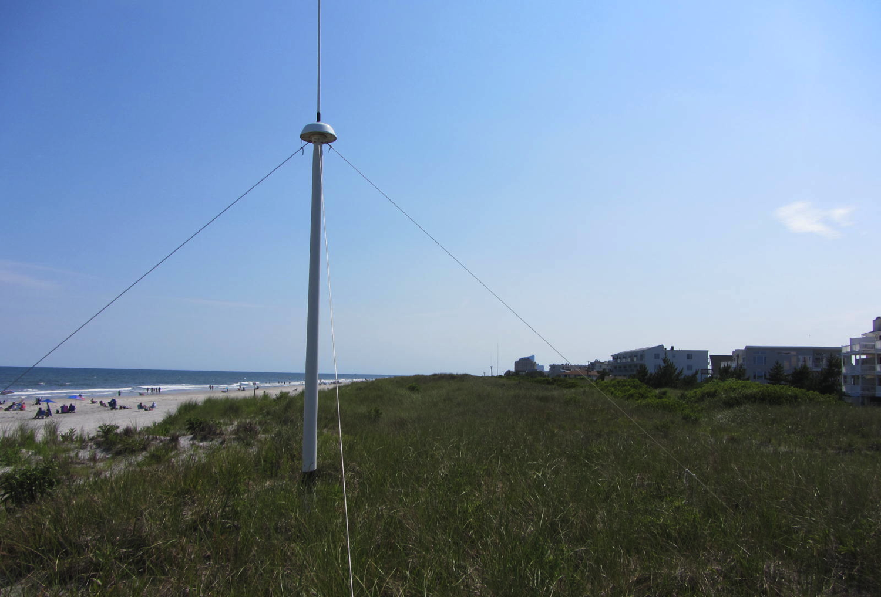
Automated Quality Control of High Frequency Radar Data
Hugh Roarty, Michael Smith, John Kerfoot, Josh Kohut and Scott Glenn

Slide 2
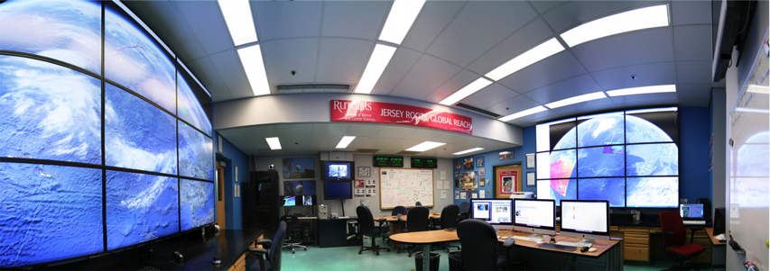

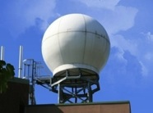
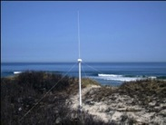
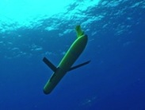
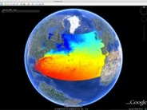
Rutgers University - Coastal Ocean Observation Lab
Operations, Research & Education Center
Vessels -
Satellite
Satellite
CODAR
Ships/ Vessels
Glider
REMUS
Data Vis.
Modeling
Security
Leadership
Education
Satellite Data Acquisition Stations
CODAR Network
Glider Fleet
3-D Forecasts

Slide 3
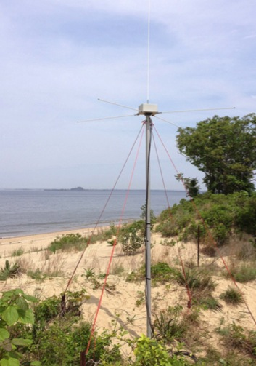
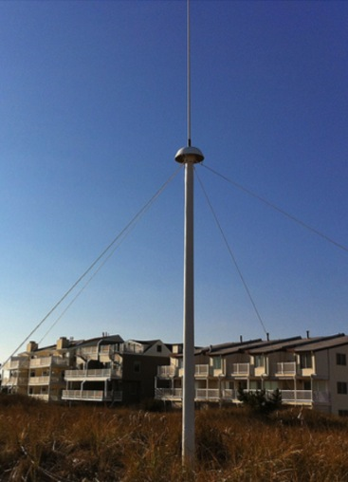
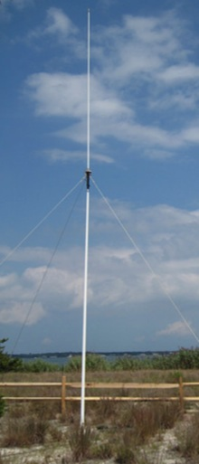
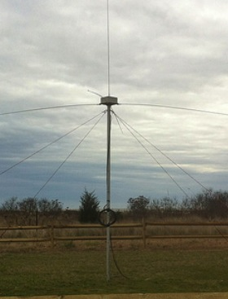
CODAR Compact HF Radar Antennas
25 MHz
13 MHz
5 MHz
Combined Transmitter & Receiver
Separate Transmitter & Receiver

Slide 4
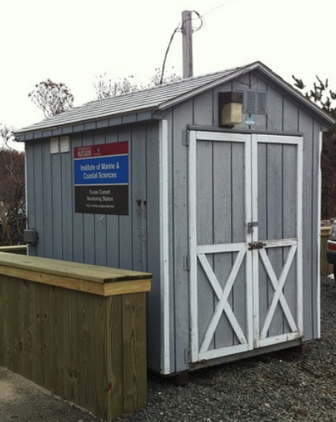
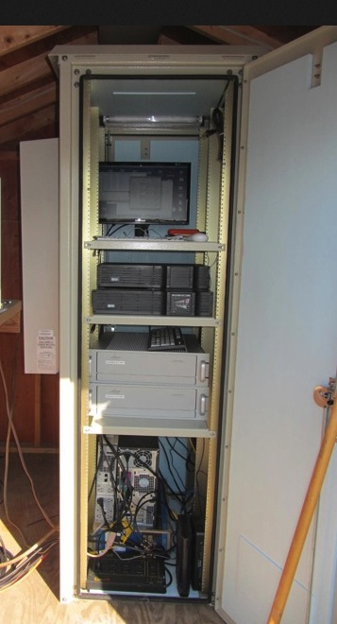
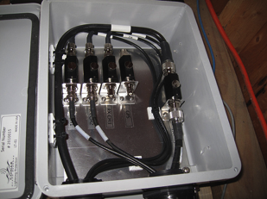
Shed and Enclosures
monitor
computer & external hard drive
A.C. unit
UPS system
transmitter
receiver
Two lines of Communication
Shed
Enclosure
Lightning Protection

Slide 5
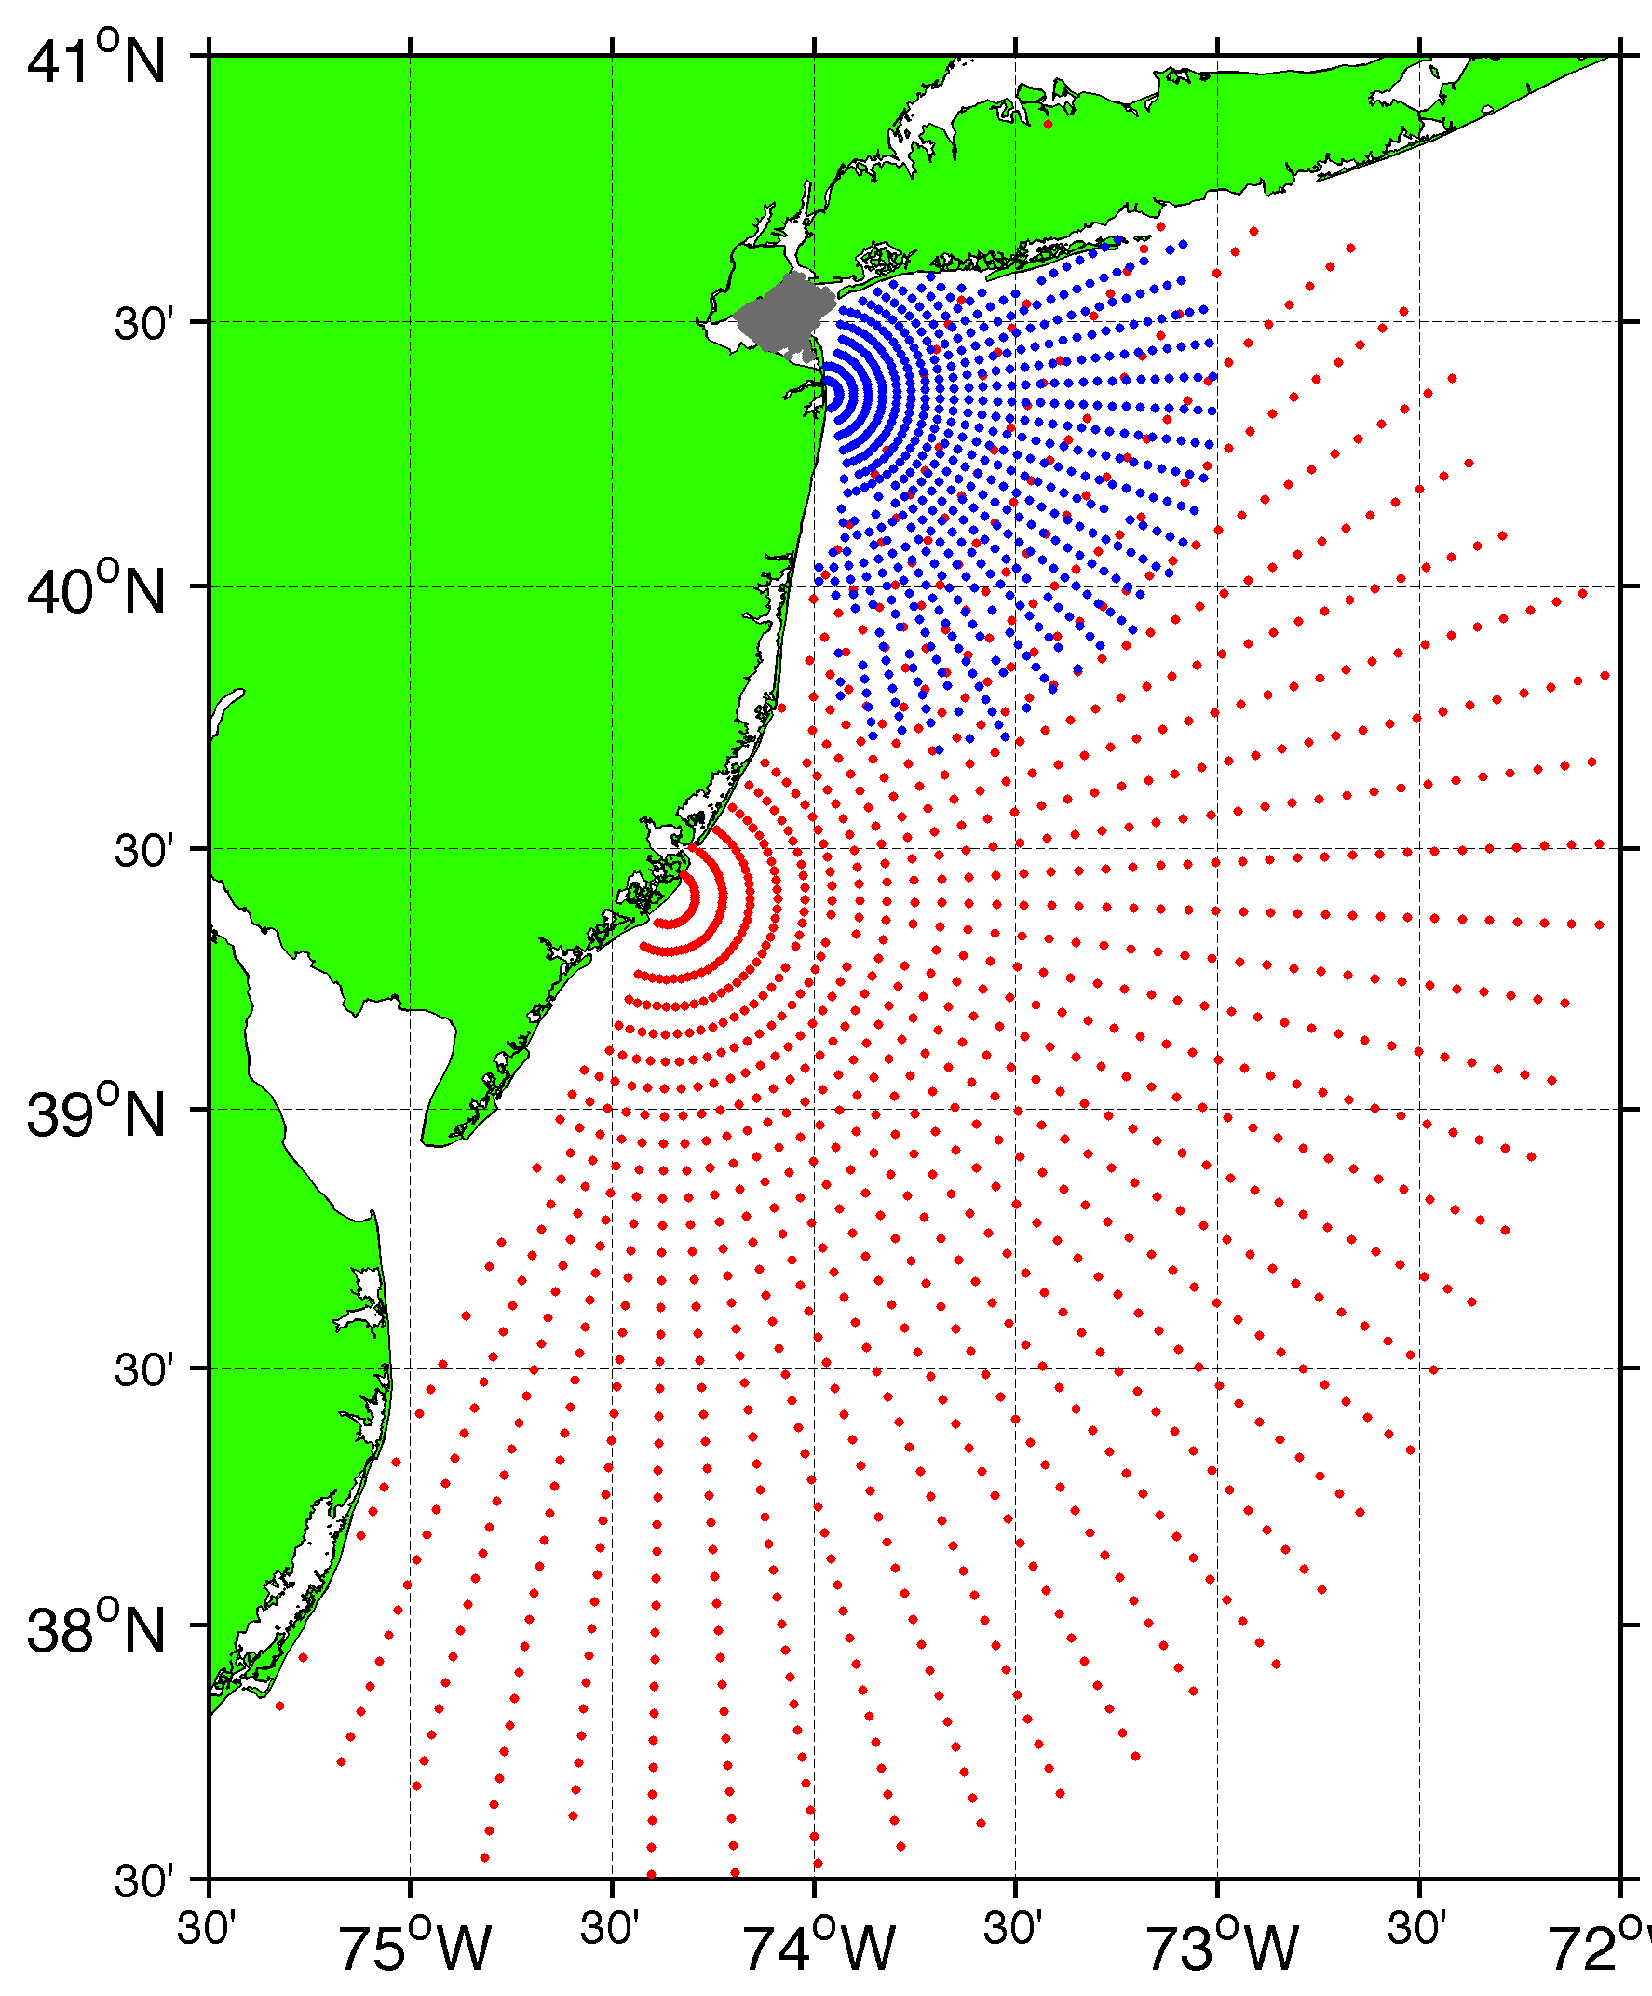
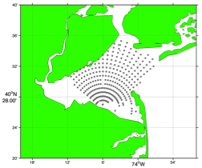
Surface Current Mapping Capability
25 MHz
Radar λ: 12 m Ocean λ: 6 m
Range: 30 km Resolution: 1 km
13 MHz
Radar λ: 23 m Ocean λ: 12 m
Range: 80 km Resolution: 3 km
05 MHz
Radar λ: 60m Ocean λ: 30 m
Range: 180 km Resolution: 6 km

Slide 6
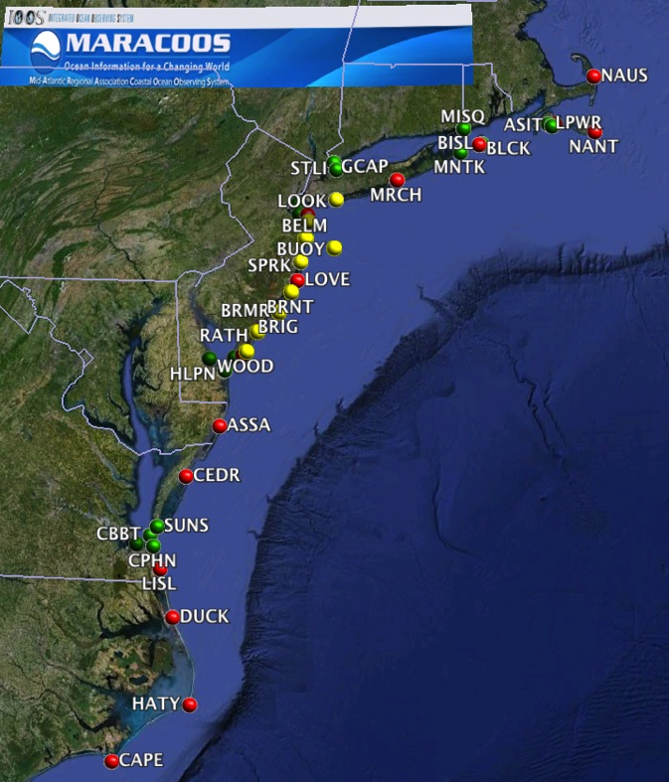
41 Sites in the Mid Atlantic
5 MHz
13 MHz
25 MHz

Slide 7
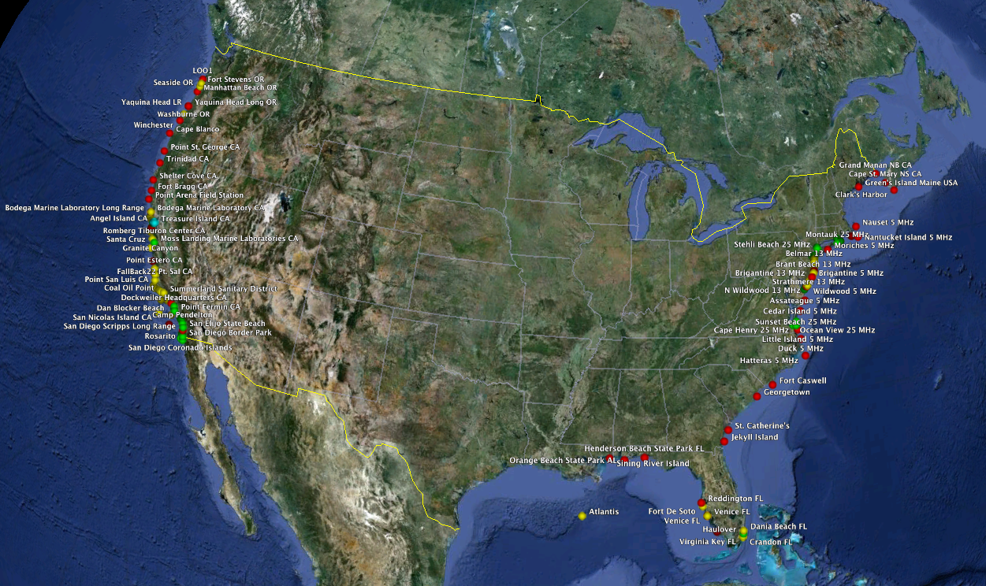
133 Sites in the USA

Slide 8
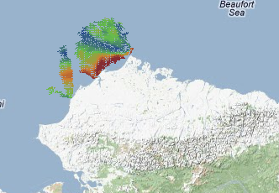
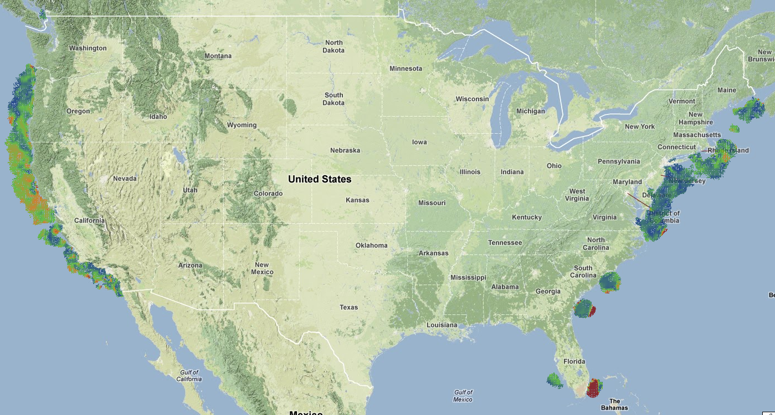
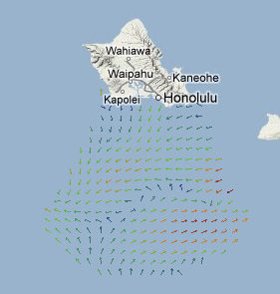
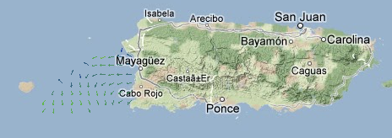
This Mornings Coverage

Slide 9
Current National Network Quality Control Checks
Is all required metadata present and variables are within limits (-90<lat<90)
Is the radial over water?
Are the radials below the threshold
  East and Gulf Coast 3 m/s
  West Coast 1 m/s

Slide 10
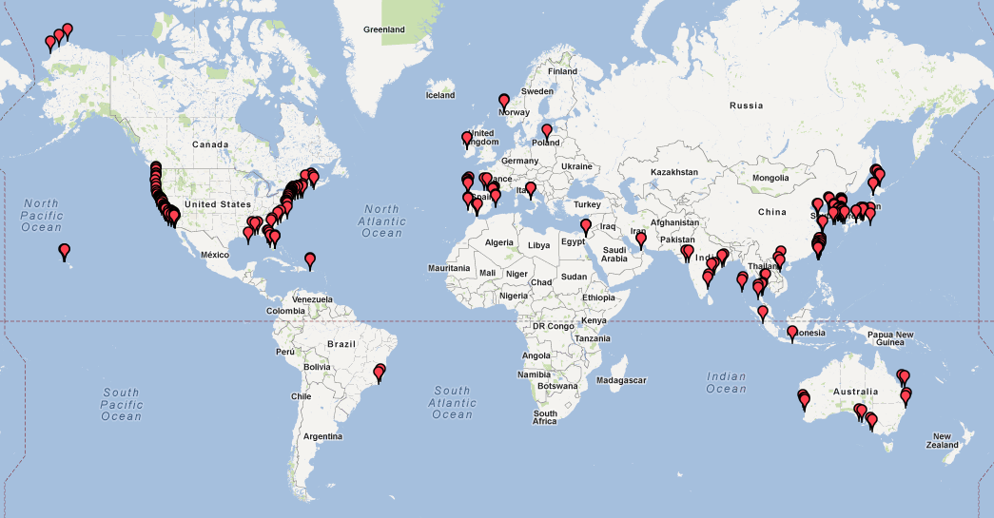
261 Stations Globally
261 Stations in 21 Countries

Slide 11
Radial Procedures

Slide 12
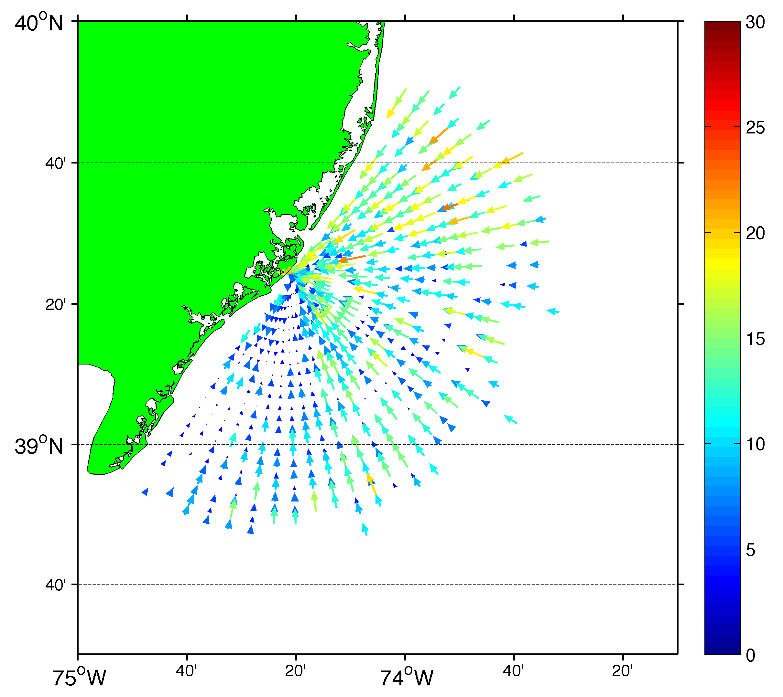
Radial Average Bearing
AND
Comparison Between Measured and Ideal Radials

Slide 13
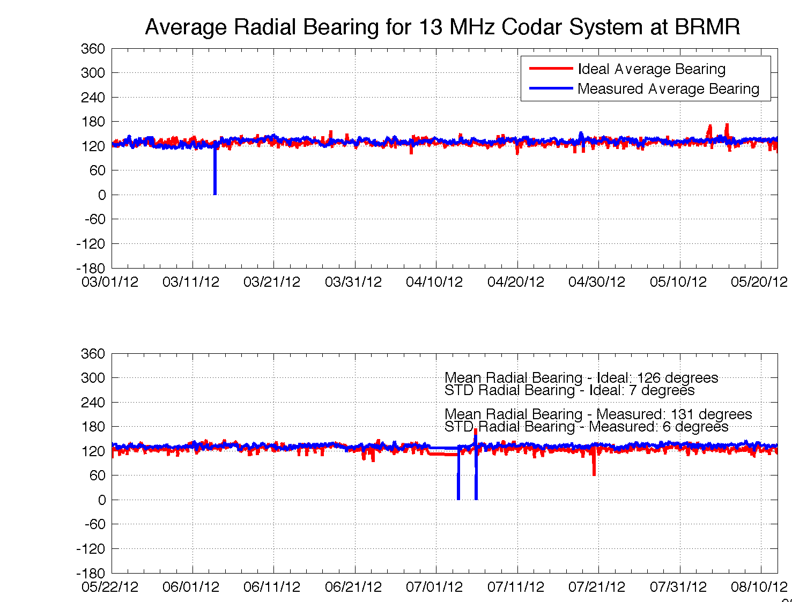
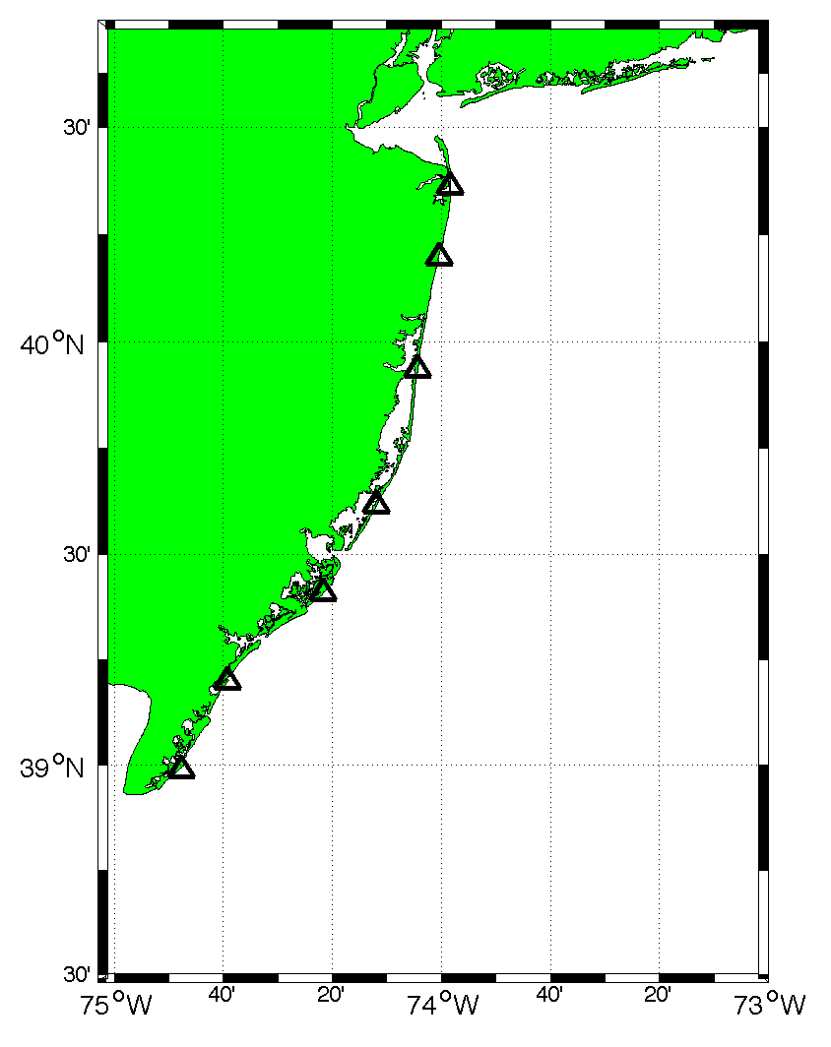
BRMR Site
40°
BRMR
130°
220°

Slide 14
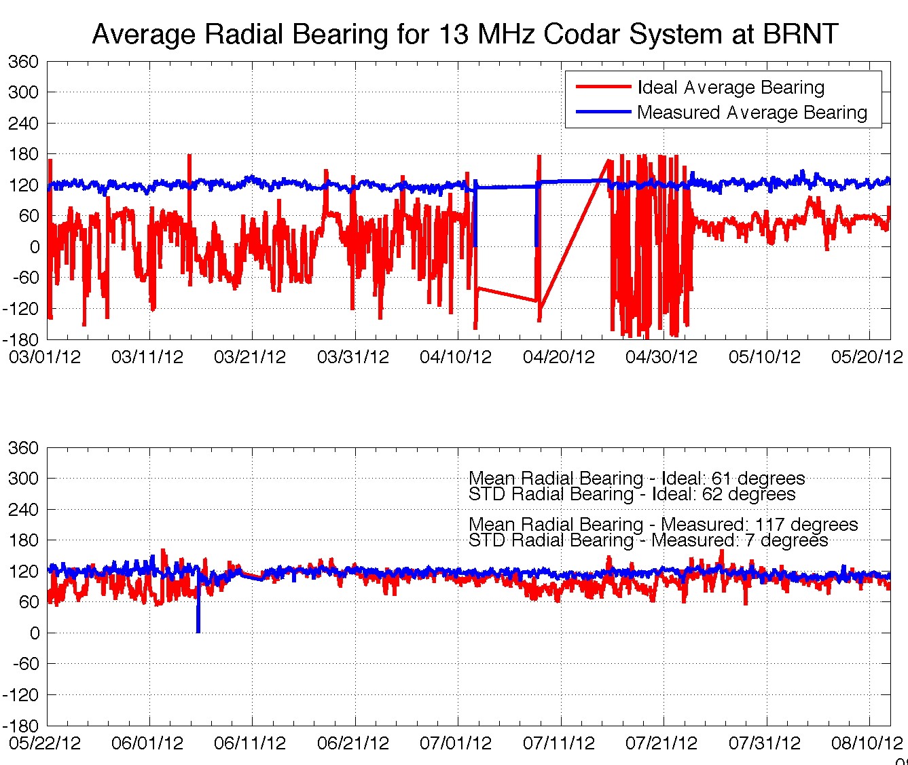
Antenna Problem at BRNT Site
30°
BRNT
120°
Replaced Antenna June 8
210°

Slide 15
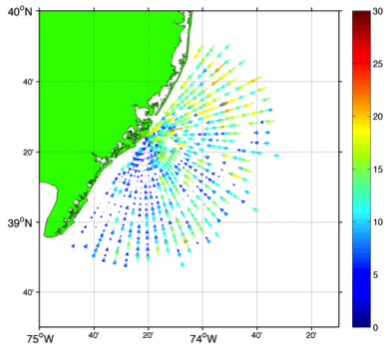
Average Radial Velocity
RDLi_BRMR_2012_08_1300
RDLi_BRMR_2012_08_1400
RDLi_BRMR_2012_08_1500
5 cm/s
7 cm/s
10 cm/s

Slide 16
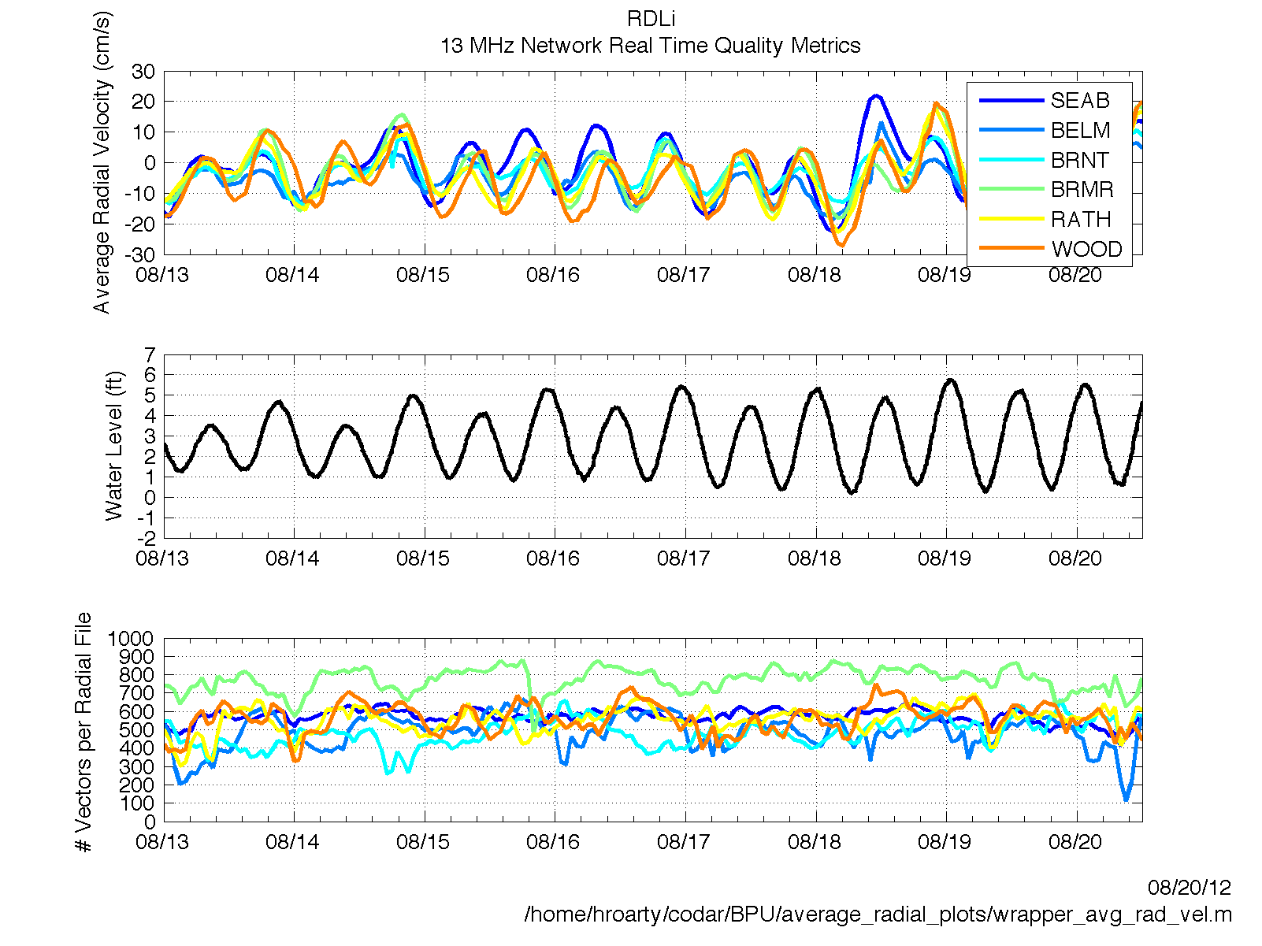

Slide 17
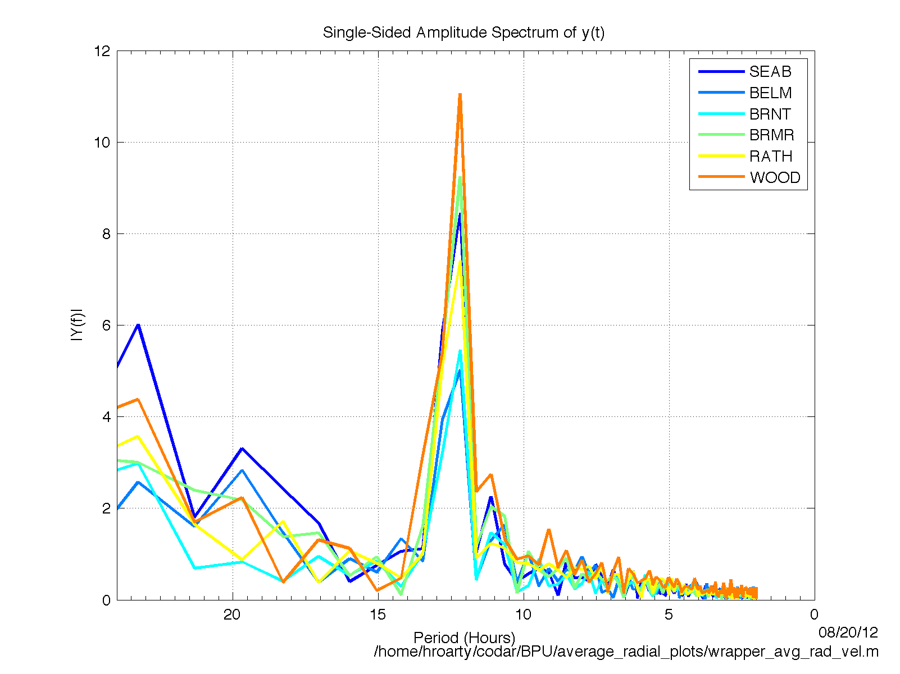
FFT of Average Radial Velocity Time Series

Slide 18
CENTRAL AGGREGATION

Slide 19
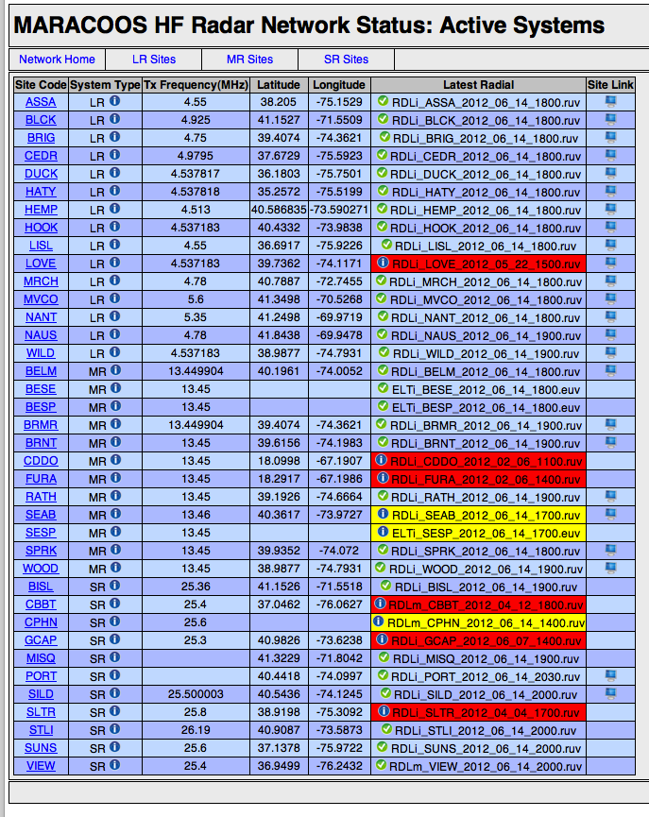
Radial Database
Central location to monitor region
Automatic reprocessing of totals with new radials

Slide 20
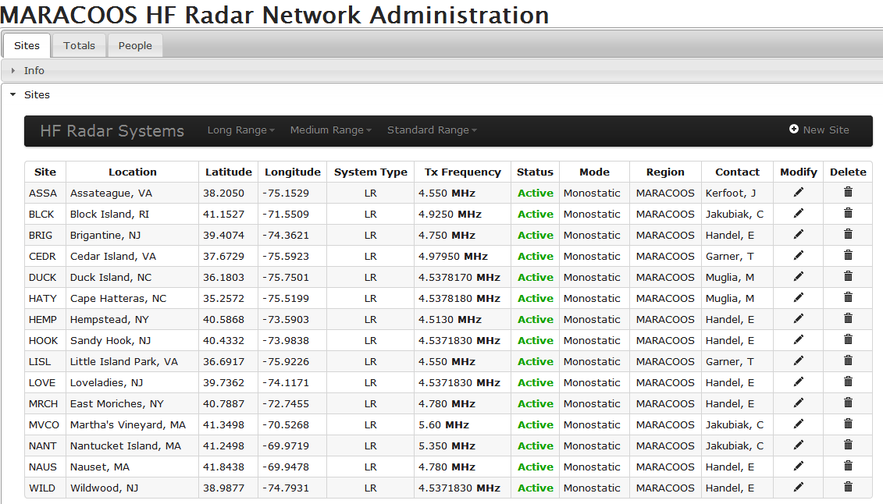
Administration of the Network by the Operators

Slide 21
Total metrics

Slide 22
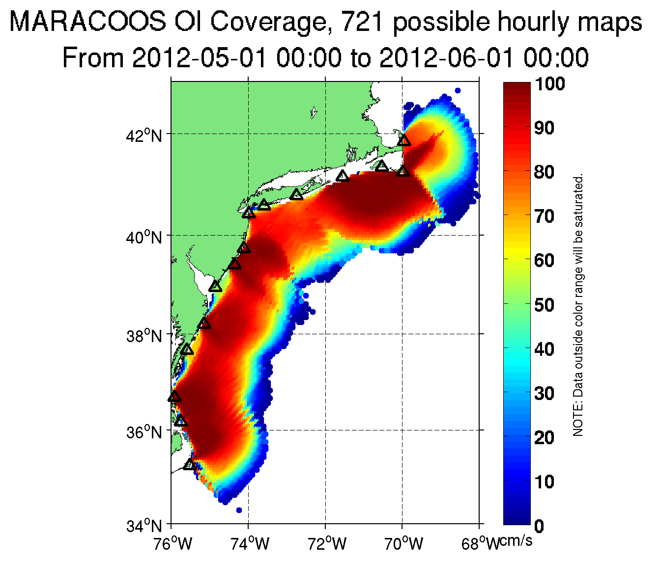

Slide 23
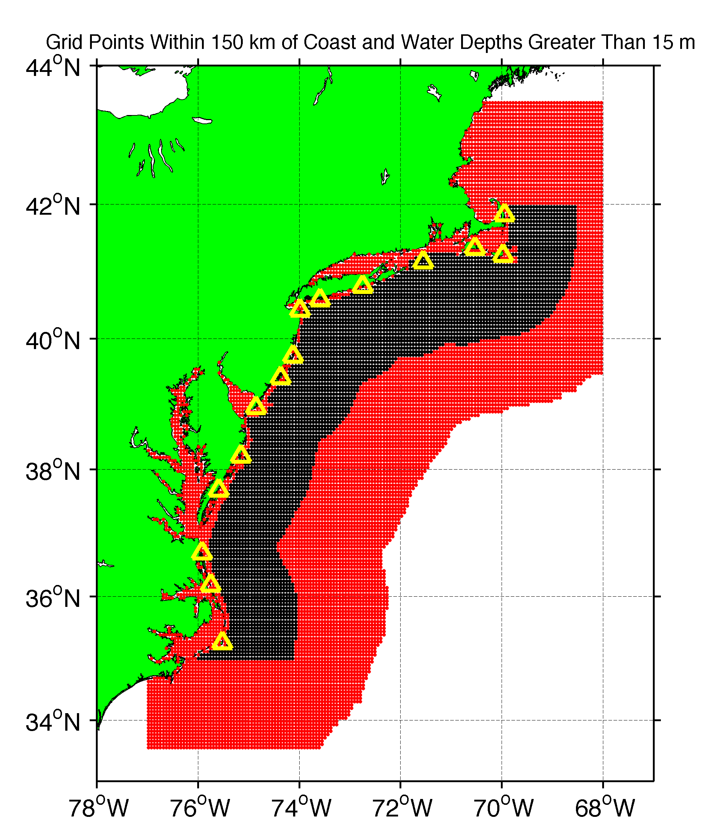
Red Points are the 6 km National Network grid
Black Points are:
Within 150 km of the coast
AND
Water depths greater than 15 m

Slide 25
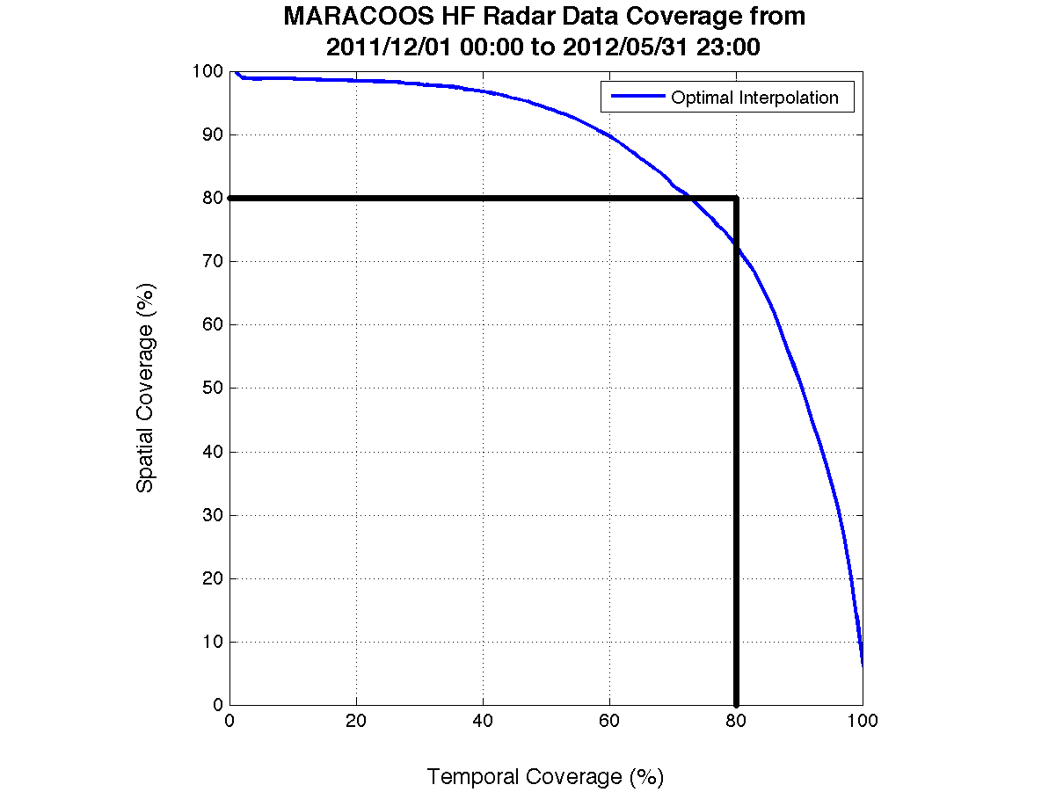
Most Recent Progress Period

