Slide 1
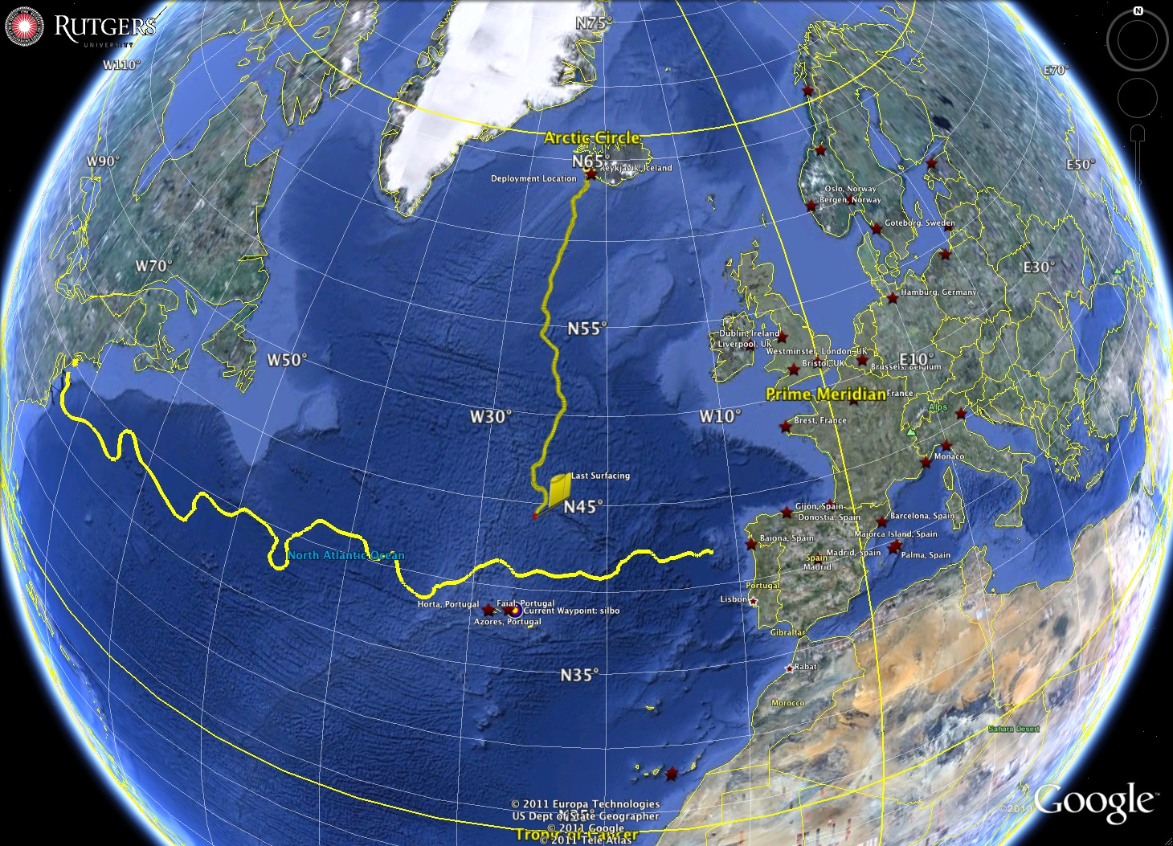
Development and Status
of the U.S. National
HF Radar Network
Gulf of Gdansk
Mid-Atlantic Bight
Scott Glenn, Josh Kohut & Hugh Roarty - Rutgers University
Jack Harlan - U.S. IOOS Program
Art Allen – U.S. Coast Guard, Office of Search and Rescue
Eric Terrill - Scripps Institution of Oceanography

Slide 2
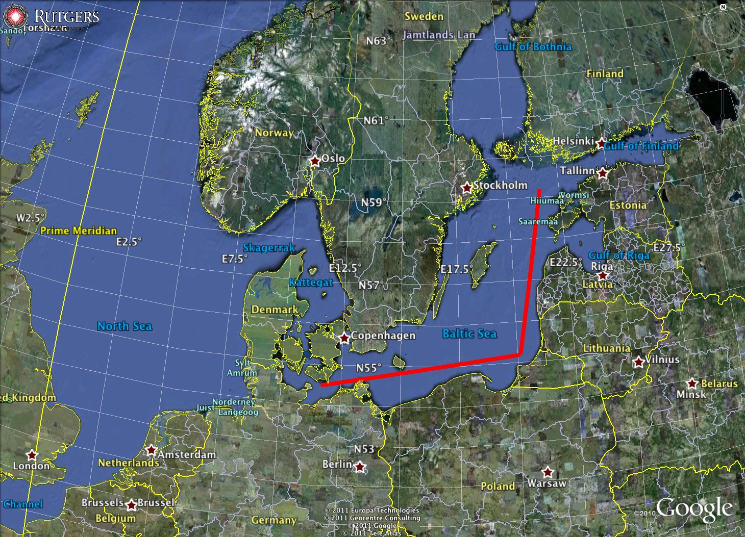
Baltic Sea is:
~1000 km in Length
Bordered by 9 Countries

Slide 3

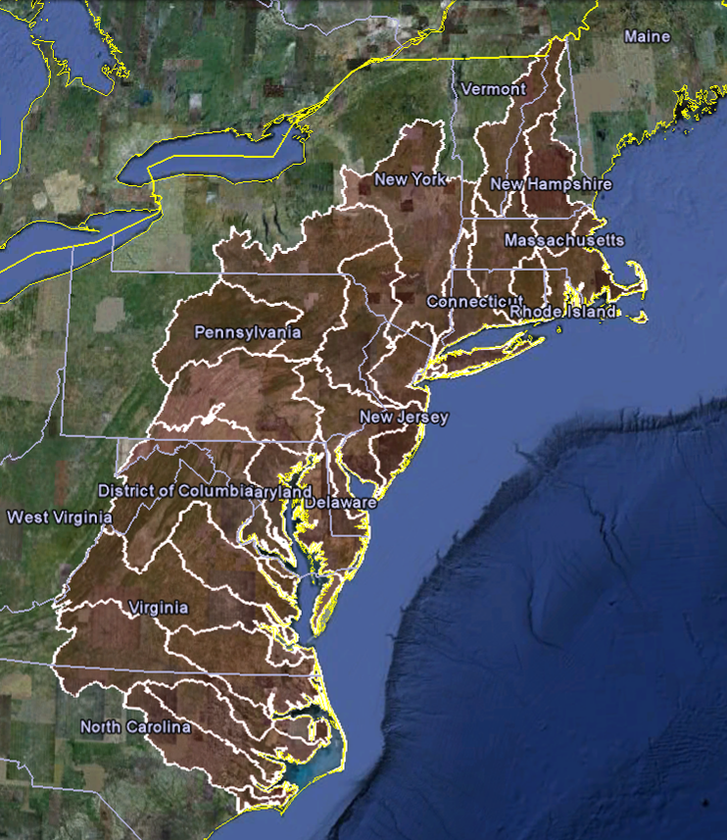

U..
Middle Atlantic
Regional Association
Coastal
Ocean Observing System
1000 km
Cape to Cape
CT
RI
Cape
Cod
MA
NY
10 States
PA
NJ
MD
DE
VA
Watersheds of the Middle Atlantic Bight
NC
Cape
Hatteras
To seek, discover and apply new knowledge & understanding of our coastal ocean
Notes:
3

Slide 4
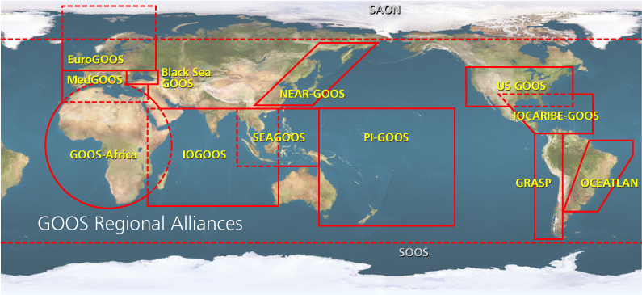

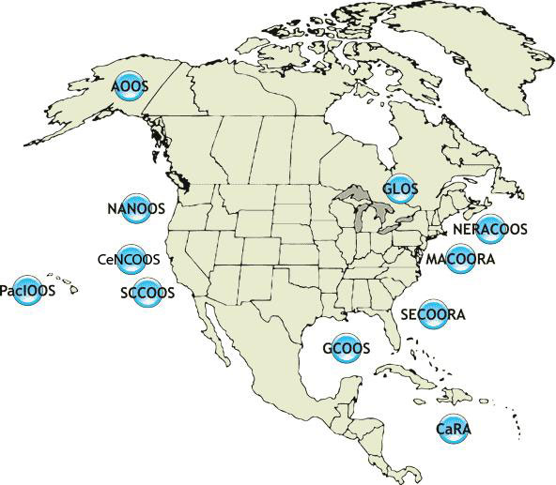
U.S. Integrated Ocean Observing System
IOOS Relationships
International Component
National Component
Regional Component
Global Ocean Observing System
Vessels -
Satellite
Satellite
CODAR
Ships/ Vessels
Glider
REMUS
Data Vis.
Modeling
Security
Leadership
Education
11 Regional Associations
18 U.S. Federal Agencies

Slide 5
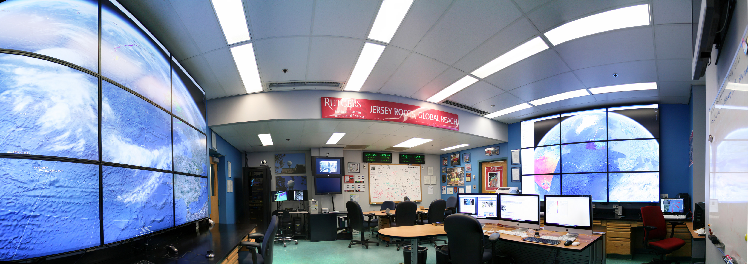
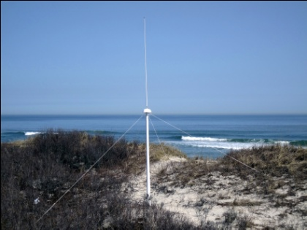
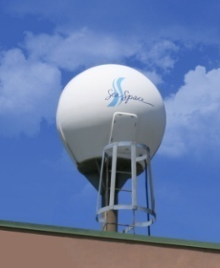
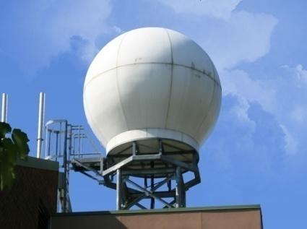
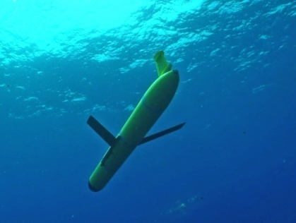
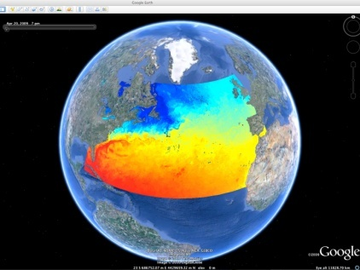
Rutgers University - Coastal Ocean Observation Lab
MARACOOS Operations Center
Vessels -
Satellite
Satellite
CODAR
Ships/ Vessels
Glider
REMUS
Data Vis.
Modeling
Security
Leadership
Education
CODAR Network
L-Band & X-Band Satellite Receivers
Glider Fleet
3-D Nowcasts
& Forecasts

Slide 6
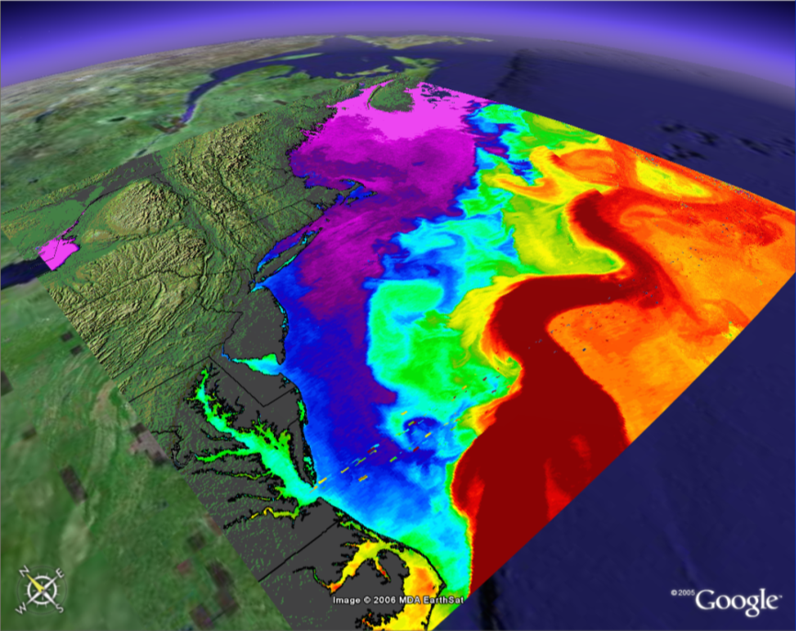
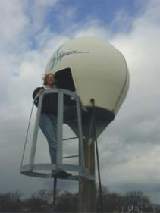
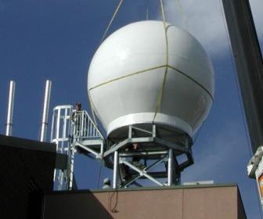
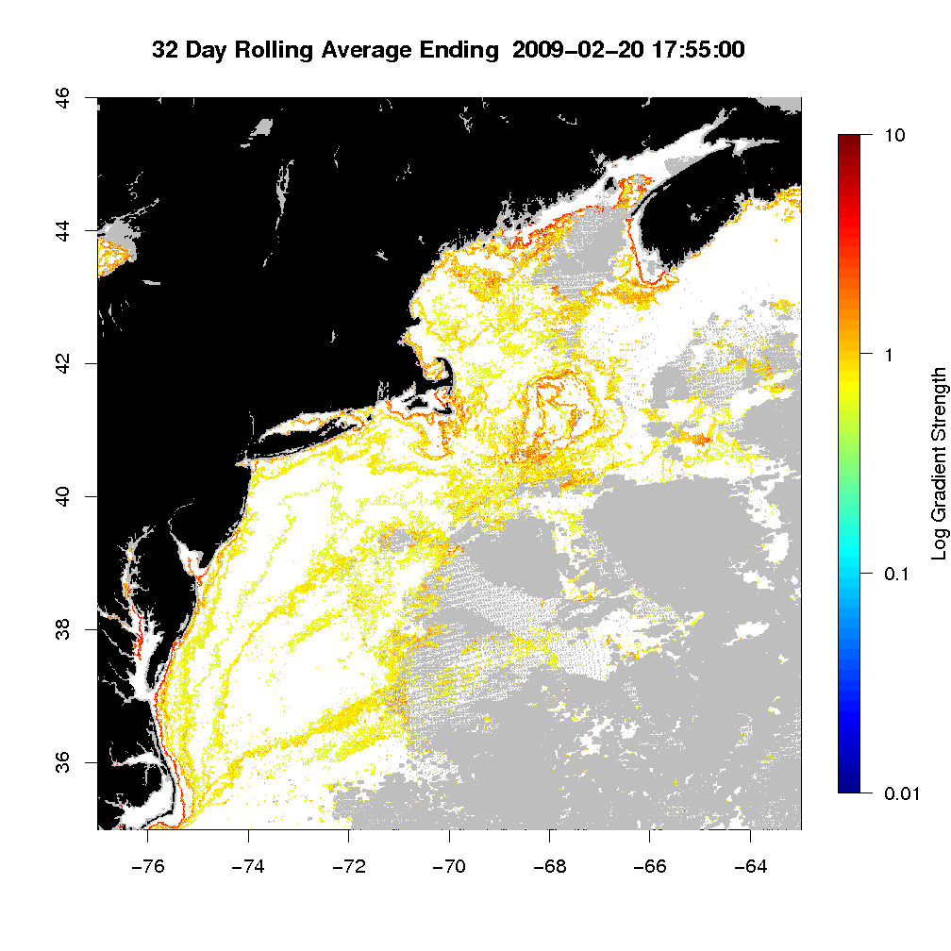
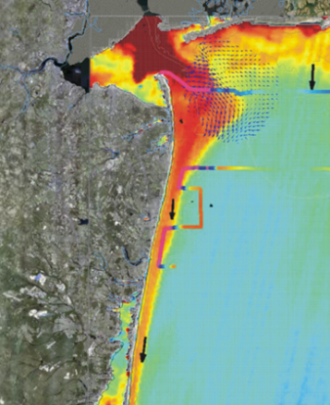
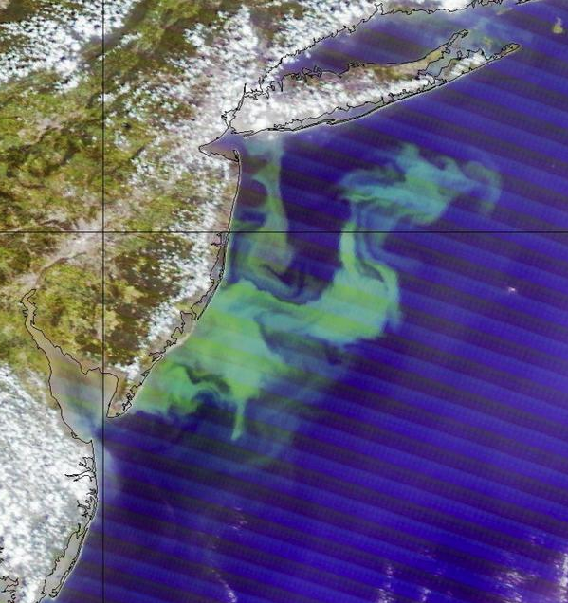
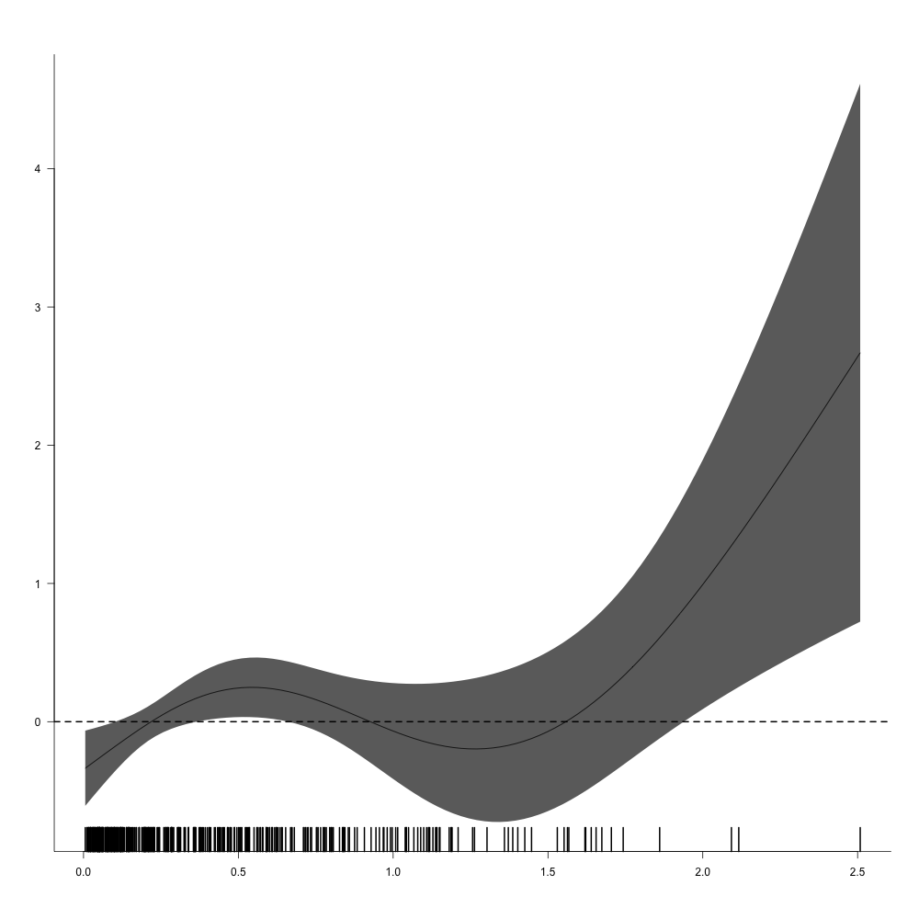
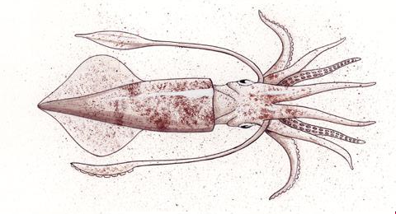
International Constellation of Satellites – Since 1992
Sea Surface Temperature - SST
L-Band
(installed 1992)
X-Band
(installed 2003)
Corporate Partner: SeaSpace
Ocean Color
<River Plumes
Ocean Blooms>
Combined SST & Color
Water Mass Boundaries
Notes:
6

Slide 7
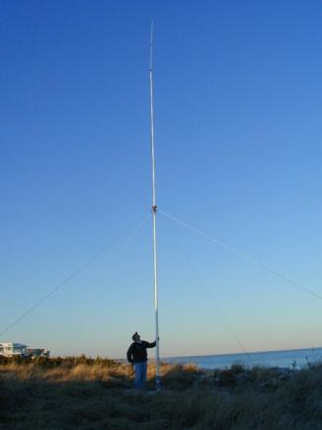
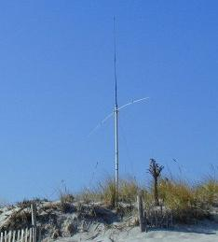
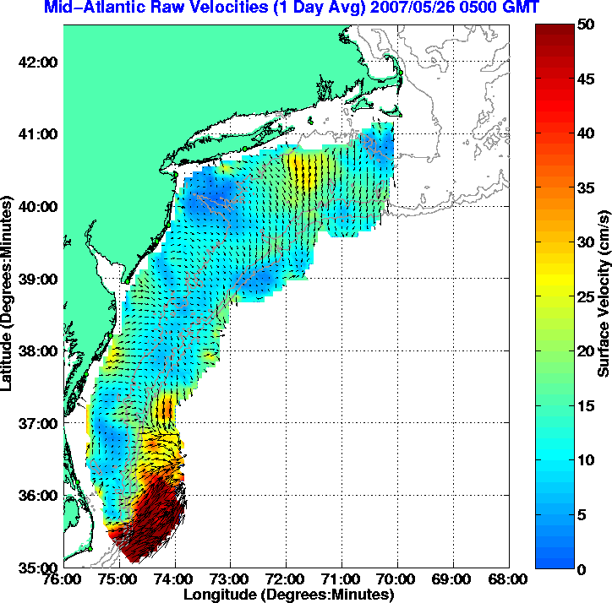
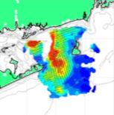
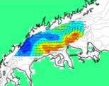
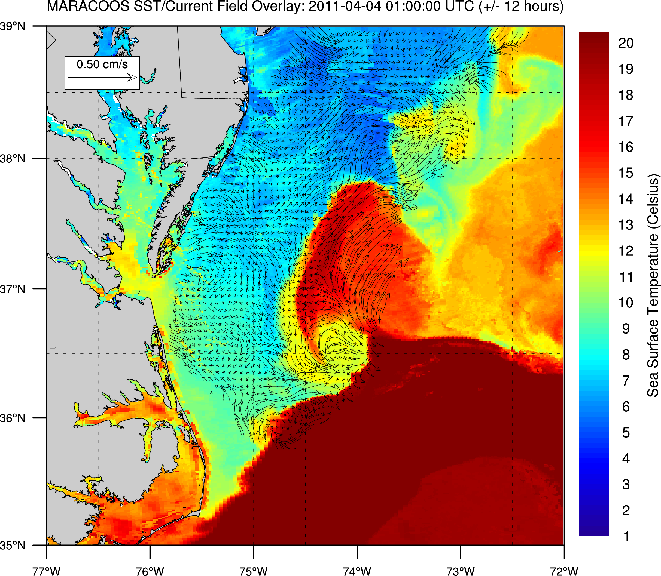
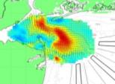
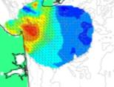
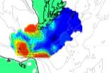
High Frequency Radar – Since 1996
Corporate Partner:
CODAR Ocean Sensors
Nested Grids of Hourly Surface Current Maps ^
Combined CODAR & Satellite Products >
Notes:
7

Slide 8
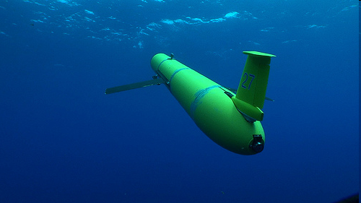
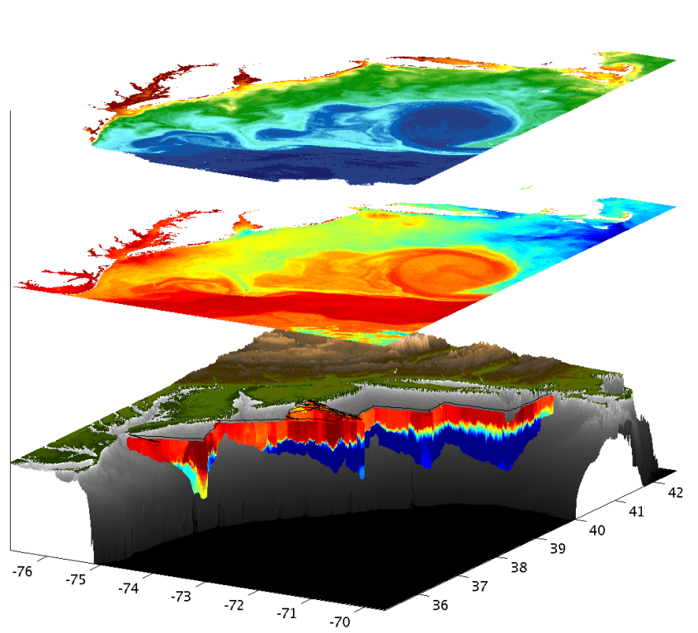
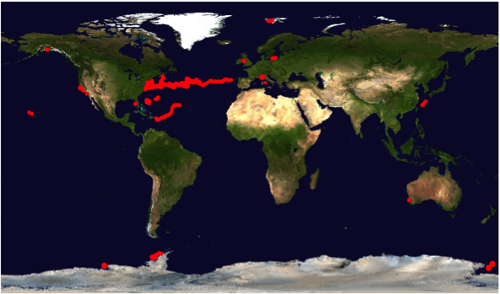
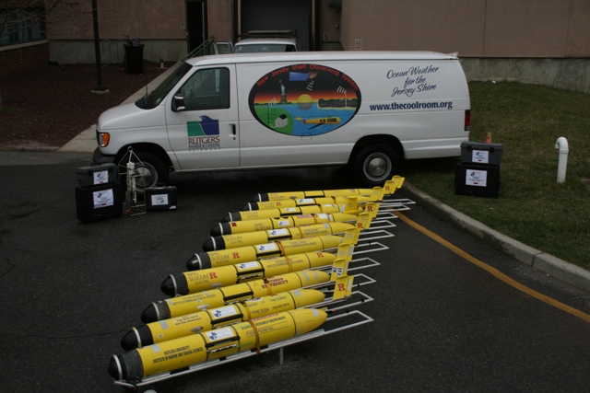
Autonomous Underwater Gliders – Since 1998
Satellite Ocean Color
Satellite SST
Subsurface
Glider
Data
Corporate Partner: Teledyne Webb Research
< Glider Fleet
With Global Reach >

Slide 9
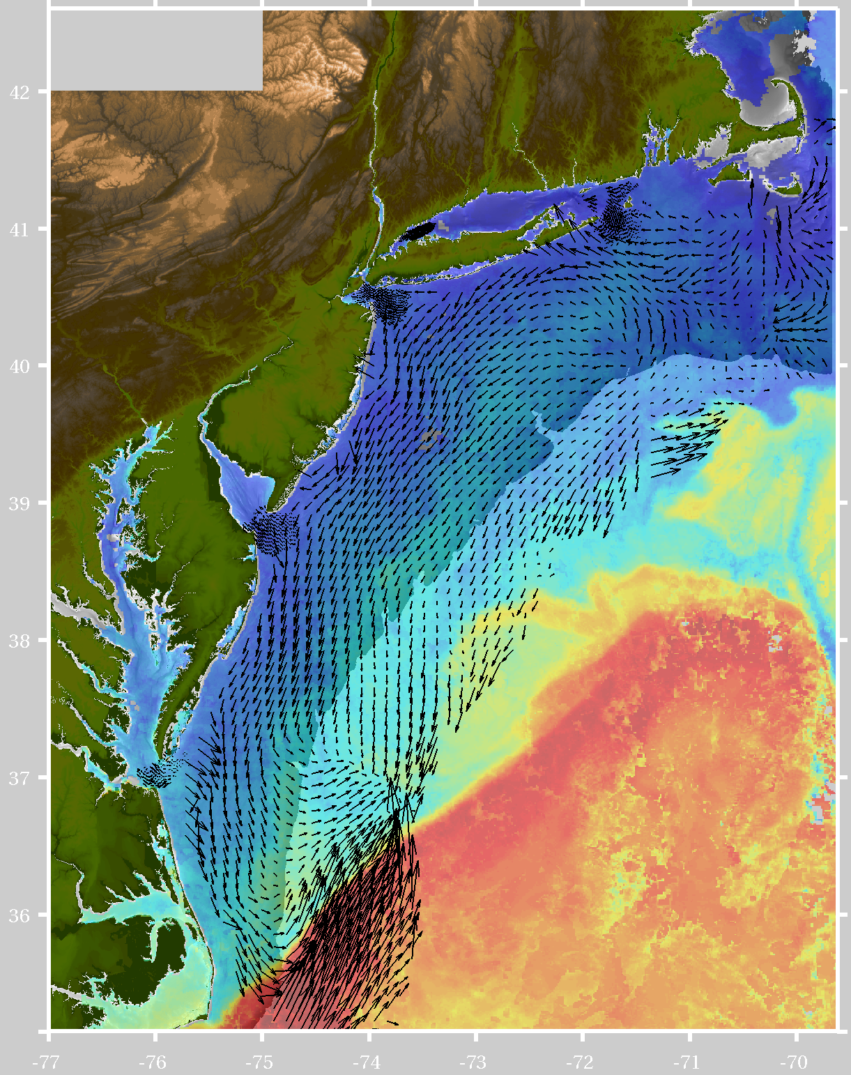
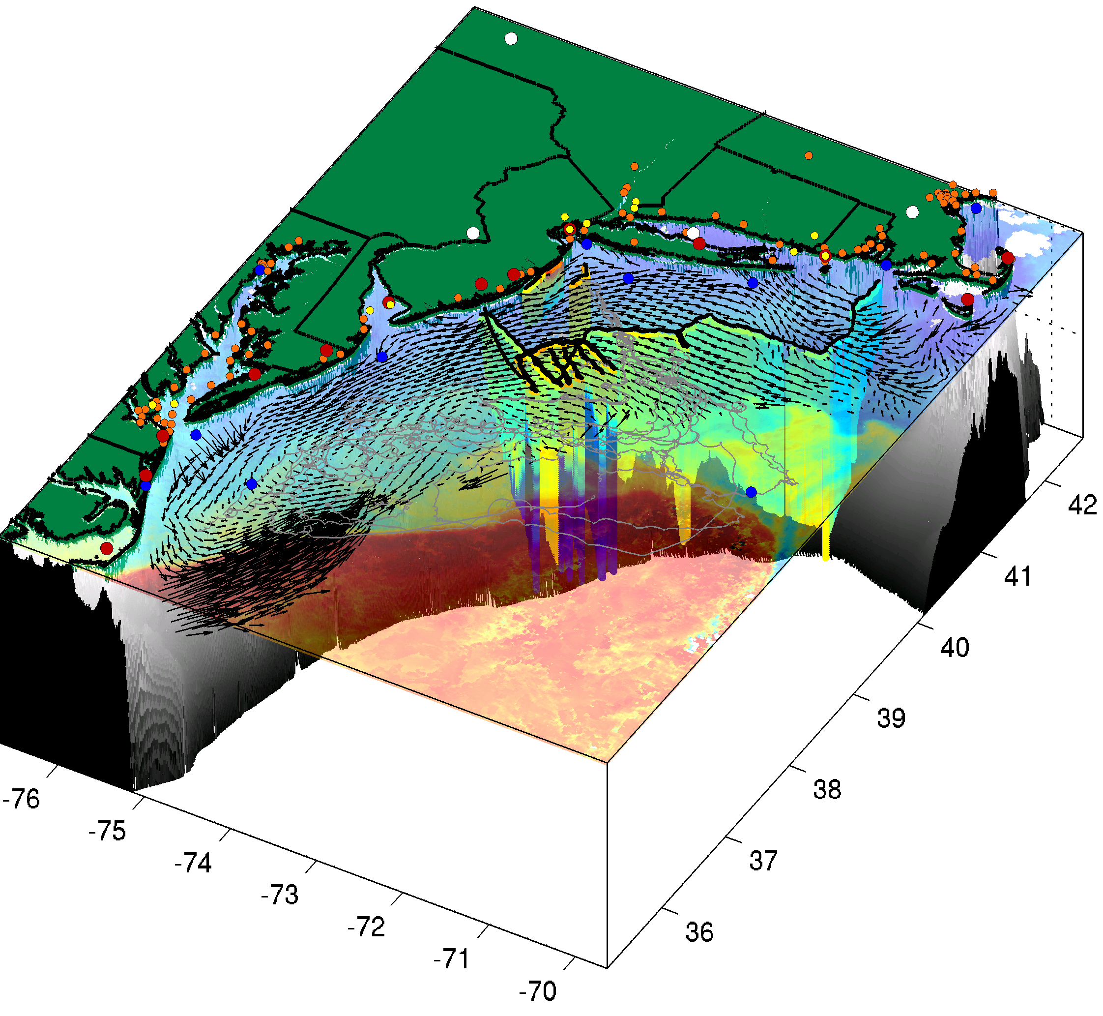
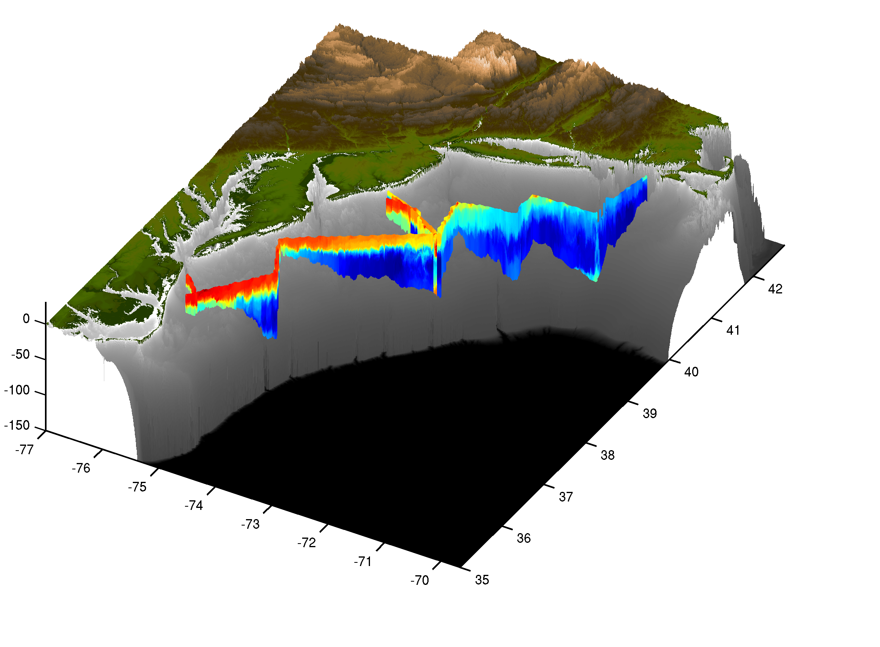
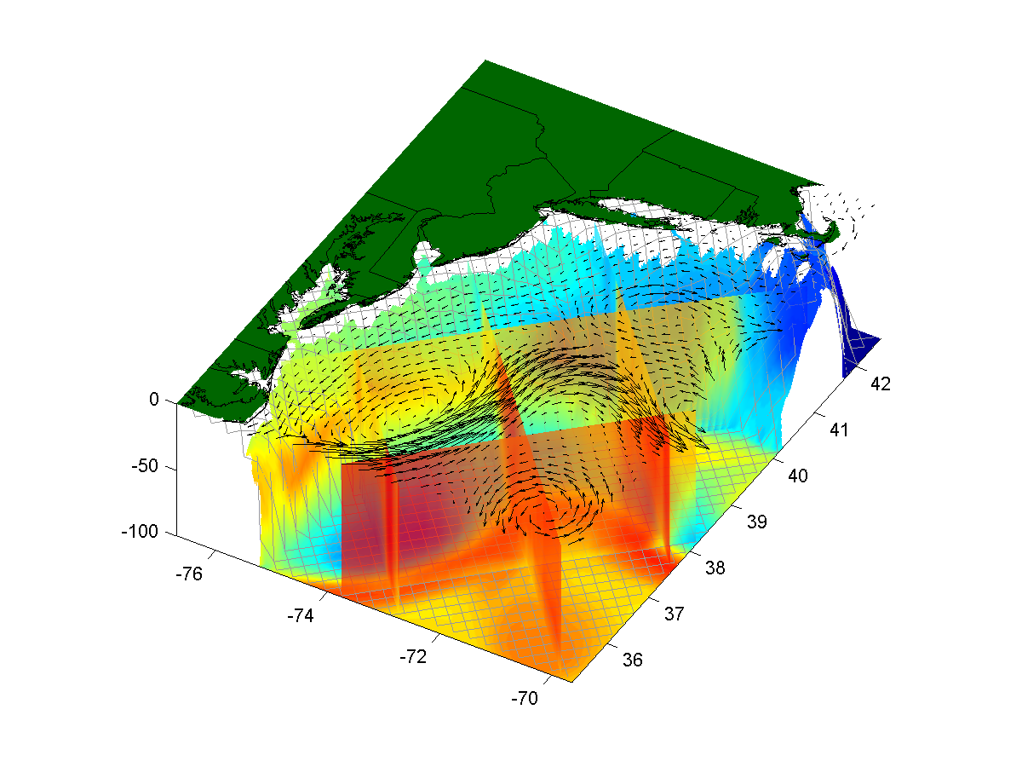
Composite Data & Forecast Products
+
=
Remote Sensing
Gliders
3-D Nowcasts
+
=
3-D Nowcasts
Nested Models
4-D Forecasts

Slide 10
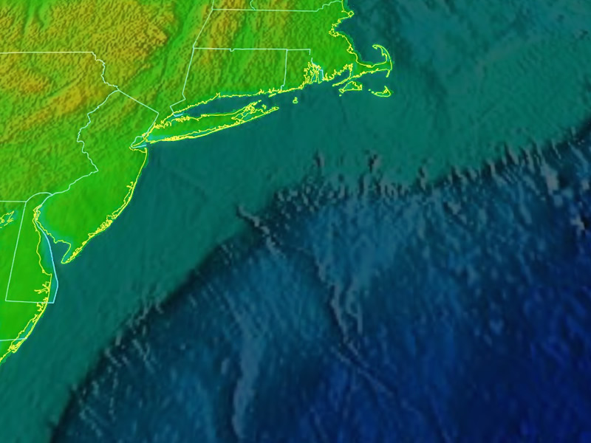
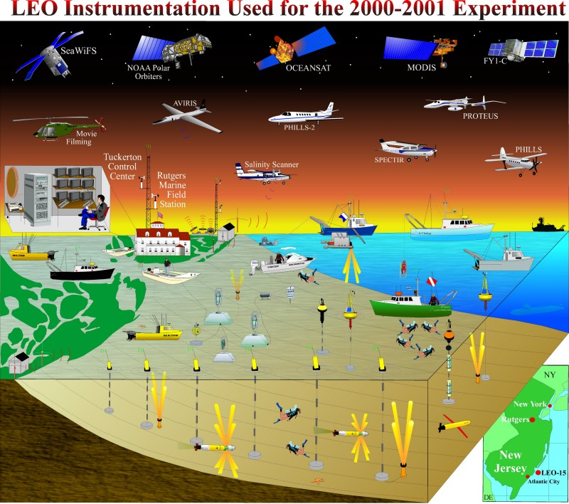
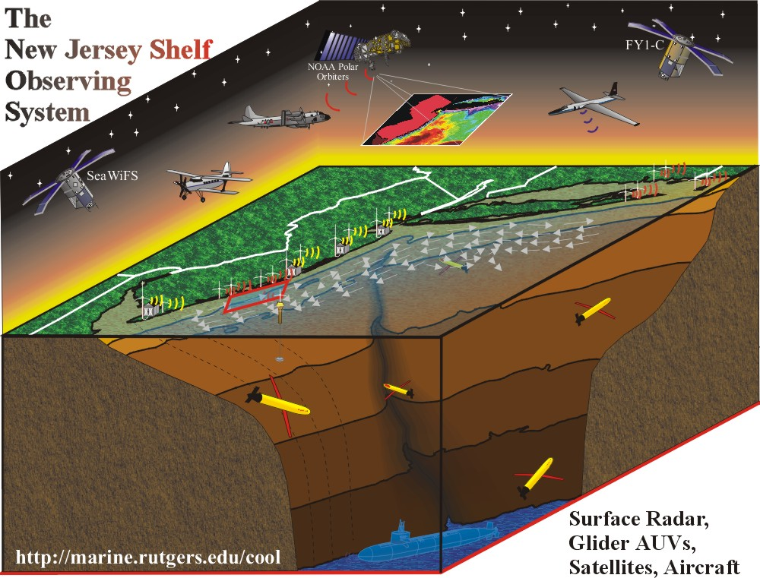
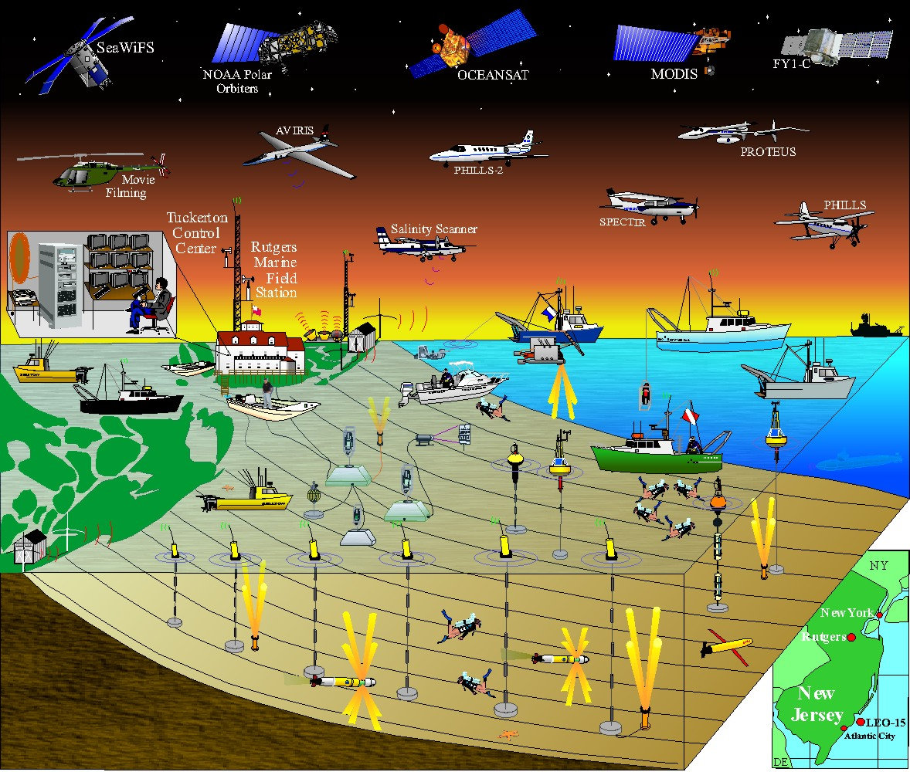
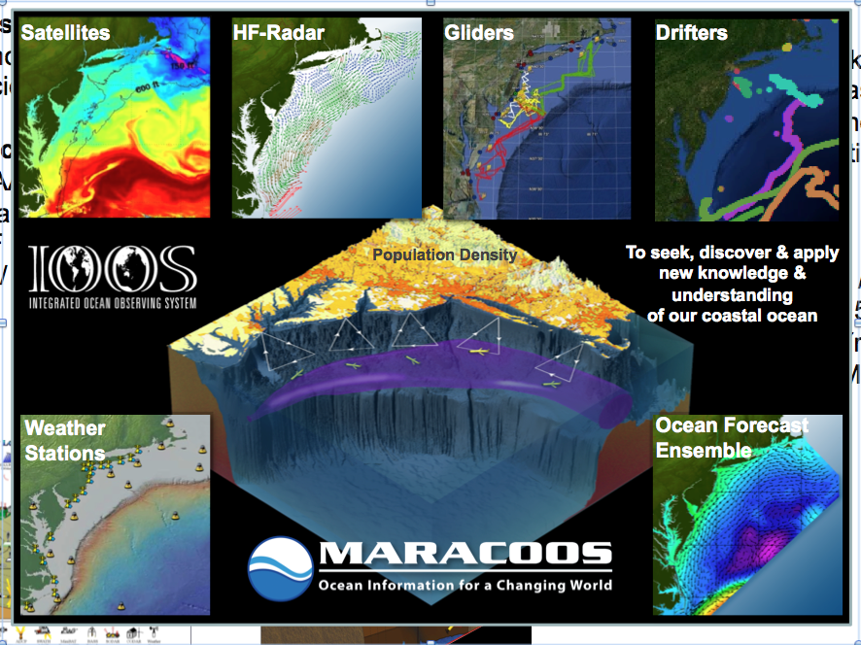
Observatory-Enabled
Collaborative Research
Campaigns
Since 1998
30 km x 30 km
ONR CBLAST
2005
NSF LaTTE 2004-2006
NSF MSF 2006-2007
LEO15
ONR SW06
2005-2006
New Jersey Shelf
Since 2001
300 km x 300 km
ONR CPSE
& HyCODE
1998-2001
NSF OOI CI IO
OSSE 2009
ONR MURI REA
2006-2010
Since 2004
1000 km x 300 km

Slide 11
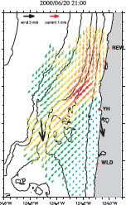
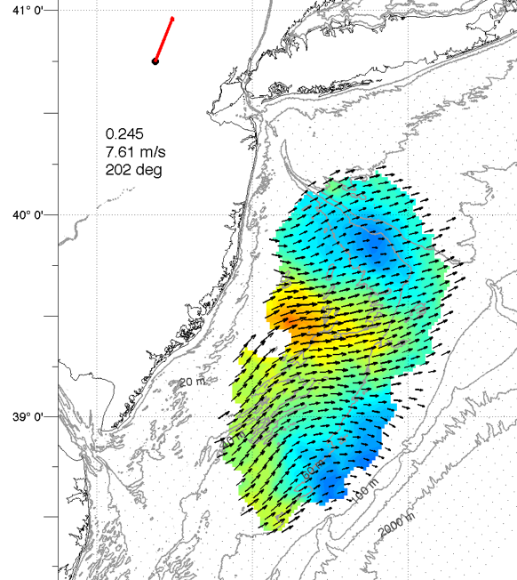
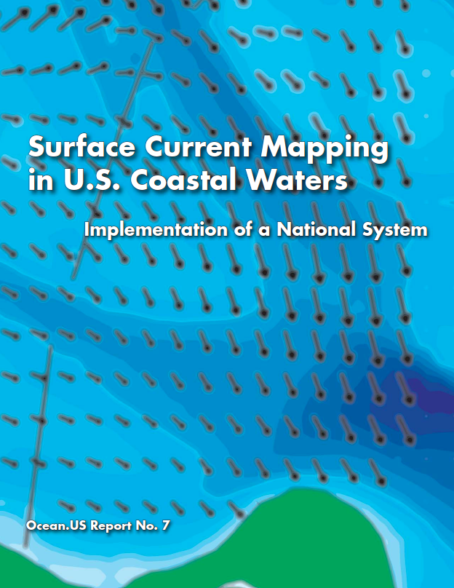
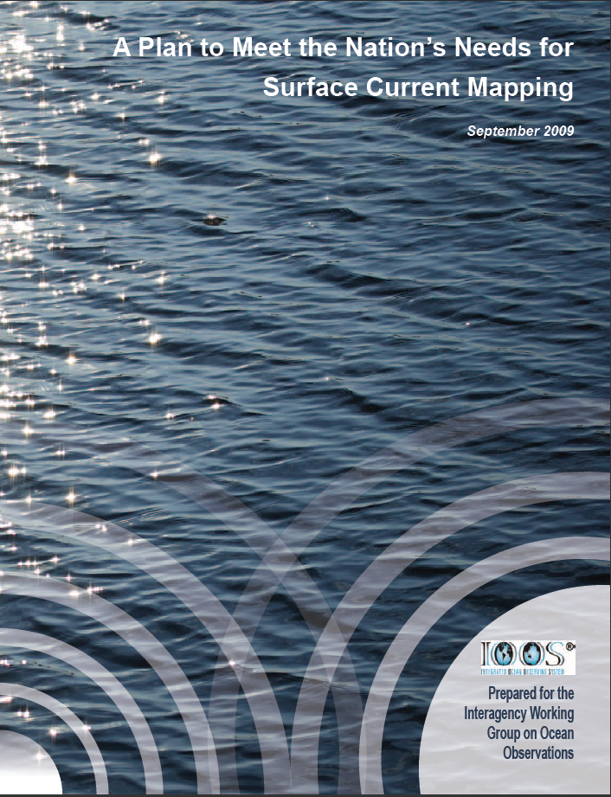
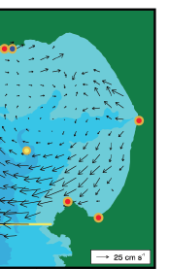
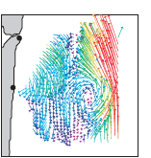

Development of a U.S. National HF Radar Network
1990’s Since 2000 Since 2004 Since 2007
Local Science Applications
International Coordination
Annual
Radiowave Oceanography
Workshop
(ROW)
HF Radar Developers
Ocean Scientists
Societal Products
Technical Expertise
National Coordination
Regional Implementation
Oregon New Jersey
California Florida
Coordination Meeting 1999

Slide 12
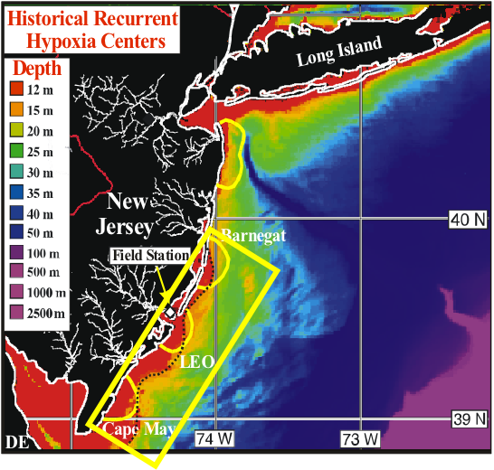
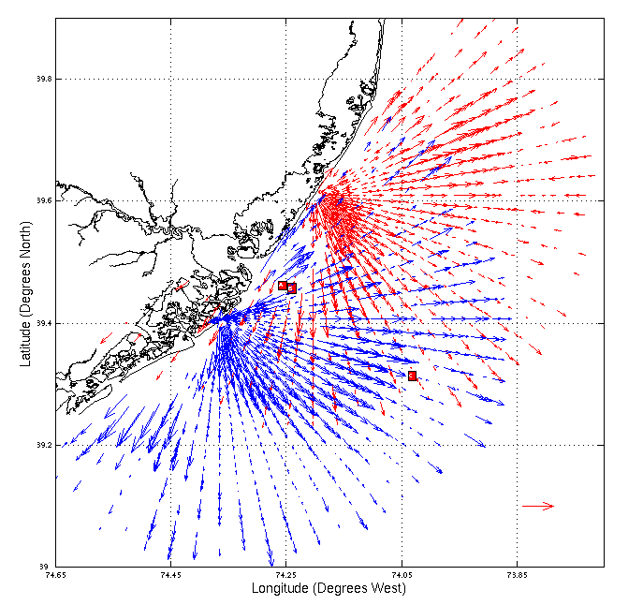
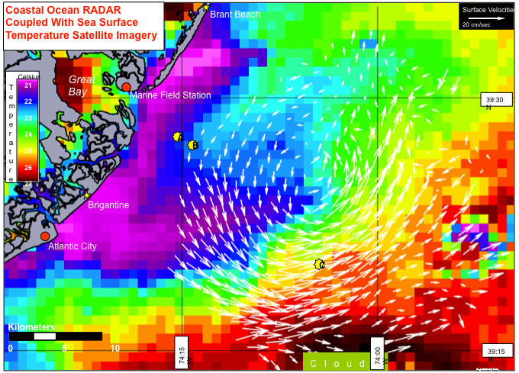
Science Driver - Coastal Upwelling (1998-2001)
Two 25 MHz
CODAR
HF Radars
Recurrent Hypoxia Centers ^
Collocated Topographically-Forced
Recurrent Upwelling Centers >
Notes:
Explain ekman, plume – stratification – death – decay - hypoxia

Slide 13



Application to Search and Rescue
United States Coast Guard
Office of Search and Rescue
Point measurement vs. Field of measurements:
Hurricane Floyd Simulation
O(4)
O(>10)
Search area reduced by factor of 4 (>10)
Courtesy Art Allen, USCG Office of SAR

Slide 14

Application to Search and Rescue
United States Coast Guard
Office of Search and Rescue
Plan for a National HF Radar Network
25 Centers around the Country
Each Operating 6 Long-Range Radars
O(4)
O(>10)

Slide 15


Science Driver – River Outflow (2004-2006)
Two 25 MHz
CODAR
HF Radars
Warsh – NOAA
1989
Recurrent Hypoxia Centers ^
Collocated Hydrodynamic-Forced
Recurrent River Plume Bulge >
Notes:
Explain ekman, plume – stratification – death – decay - hypoxia

Slide 16




Hourly Surface Current Maps every 30 Min of Hudson River Plume
Interaction of a River Plume + Tidal Cycle + Sea Breeze. (NOAA Ambrose Light Winds)

Slide 17


HF Radar derived Wave Evaluation
Long-term trends and focused process studies

Slide 18



Surf Zone Forecasts, NOAA National Weather Service
Marine/Aviation Desk
NWS Mount Holly uses CODAR wave data in a linear regression wave model. This model is part of a Surf Zone Forecast including rip current probability along the New Jersey and Delaware Coasts
County Warning Area

Slide 19


HF Radar Waves
Frequency Spectra

Slide 20


Science Driver – Cross-Shelf Exchange (2006-Pres)
New
Long-Range
5 MHz CODAR HF Radars
2000
Mean Along Shore Flow 5 cm/sec
Are there linkages between the high productivity zones at the coast and at the shelf break?
What is the role of the Hudson Shelf Valley & Canyon?
2001

Slide 21


Science Driver – Cross-Shelf Exchange (2006-Pres)
New
Long-Range
5 MHz CODAR HF Radars
Mean Along Shore Flow 5 cm/sec
6 Year Mean >
Variability >
Are there linkages between the high productivity zones at the coast and at the shelf break?
What is the role of the Hudson Shelf Valley & Canyon?

Slide 22





Science Driver – Cross-Shelf Exchange (2006-Pres)
Hudson River Plume – Fresh Water Advection Offshore Along the Hudson Shelf Valley
Coastal Phytoplankton Blooms – Advection Offshore by the Wind Driven Flow

Slide 23
Development of a U.S. National HF Radar Network
1990’s Since 2000 Since 2004 Since 2007
Local Science Applications
International Coordination
Annual
Radiowave Oceanography
Workshop
(ROW)
HF Radar Developers
Ocean Scientists
Societal Products
Technical Expertise
National Coordination
Regional Implementation
Oregon New Jersey
California Florida
Coordination Meeting 1999

Slide 24



U.S. National HF Radar Network
Data Flow Since 2007
2004 Plan
Today’s Coverage
131 Radars

Slide 25









MIDDLE ATLANTIC REGIONAL DRIVERS
Tropical Storms
Climate Change
Ocean Circulation
Critical Habitat
Northeasters
Population
Ports
Notes:
The MAB is a dynamic boundary between cooler arctic waters and warmer tropical waters, with complex seasonal physical dynamics.
Inundation driven by tropical storms and northeasters are year-round threats to the large populations that live on the broad coastal plain.
These dynamics structure shellfish and migratory fish habitats that support both commercial and recreational fisheries.
To further compound these challenges, climate warming is altering fish and shellfish habitats in the MAB, and new rainfall patterns with more frequent extremes are impacting homes, farms and reservoirs.
Developed watersheds and urban estuaries, impacted by a century of industrialization and growing coastal populations, degrade coastal water quality and diminish recreational economies.
This high population density often results in serious pressure and completing demands for marine and coastal resources. These nearshore waters contain tier-one ports, military bases, and important inshore shellfish and finfish grounds.
It is here that economically valuable uses such as recreation, tourism, and fisheries readily conflict with other valuable uses leading to a need for informed coastal and marine spatial planning.

Slide 26





MARACOOS REGIONAL THEMES & SUCCESS STORIES
1) Maritime Operations – Safety at Sea
3) Water Quality – a) Floatables, b) Hypoxia, c) Nutrients
2) Ecosystem Decision Support - Fisheries
5) Energy – Offshore Wind
4) Coastal Inundation - Flooding
Notes:
Scott

Slide 27



Long Range
HF Radar Expansion
(2001-2010)
Range ~ 180 km
Resolution 6 km
2003
2003
Transmit Antenna
2001
2010
2003
2000
2007
2001
2001
2006
MARACOOS
CODAR Sites
14 Long-Range
7 Medium-Range
14 Short-Range
35 Total CODARs
2006
Receive Antenna
2009
2003
2003

Slide 28




Long Range
HF Radar Workforce
Northern
Operator
Regional Coordinator
Hugh Roarty
Northern Operator
Chris Jakubiak
Central Operator
Ethan Handel
Southern Operator
Teresa Garner
Central
Operator
2 Operators
For 5 Sites
Southern
Operator
2 Operators
For 7 Sites

Slide 29





MARACOOS Annual Mean Surface Currents (2009)
Winter
Spring
Summer
Fall

Slide 30





U.S. Coast Guard: Search And Rescue Optimal Planning System SAROPS
Mid-Atlantic Operational Data Flow to SAROPS
SAROPS User Interface
SAROPS 96-Hour Search Area: HYCOM = 36,000 km²
SAROPS 96-Hour Search Area: HF Radar = 12,000 km²

Slide 31




U.S. Coast Guard: Search And Rescue Optimal Planning System SAROPS
1 Statistical & 3 Dynamical Data-Assimilative Forecast Models
1) STPS
U. Connecticut
2) NYHOPS
Stevens Institute of Technology
3) ROMS
Rutgers University
4) HOPS
U. Massachusetts, Dartmouth

Slide 32



Ecological Decision Support – Fisheries
+
Like Upwelling
Our Approach:
Develop statistical models using bottom trawl surveys and MARACOOS 3-D data to predict species distribution based on observed or forecasted MARACOOS 3-D fields.
Hate Downwelling
Downwelling Upwelling
Downwelling Upwelling

Slide 33





Water Quality – Nearshore Currents
Alongshore Current
Nearshore currents derived from single site radial currents track the movement of water quality constituents within 3 km of the beach.

Slide 34






Offshore Energy – High Resolution Atmospheric Forecast validated with HF radar
Spatial validation of Atmospheric Model with 13 MHz Multi-static
HF Radar Array
Additional Radar Sites
2-Site Mono-static Coverage
High Resolution Wind Resource
670 m horizontal resolution
Bistatic Geometries
2-Site Multi-static Coverage

Slide 35


Maritime Safety – Tracking Hurricane Irene
Hurricane Irene Approaches the
MARACOOS HF Radar Network

Slide 36


Maritime Safety – Tracking Hurricane Irene
39.5N 73W Surface Current Time Series >
Total Current Near-Inertial Current
Hurricane Irene Approaches the
MARACOOS HF Radar Network
Wave & Wind Direction Time Series >

Slide 37

Maritime Safety – Tracking Hurricane Irene
Hurricane Irene Approaches the
MARACOOS HF Radar Network

Slide 38



IOOS Coordinated Rapid Response: Deepwater Horizon Oil Spill
Contributed Assets:
HF Radar Networks
USF, USM
Gliders
iRobot, Mote, Rutgers,
SIO/WHOI, UDel, USF
Drifters & Profilers
Horizon Marine, Navy
Satellite Imagery
CSTARS, UDel
Ocean Forecasts
Navy, NCSU
Data/Web Services
ASA, Rutgers, SIO
Tropical Storm Bonnie crosses the Gulf of Mexico
USM HFR
TS Bonnie
USF HFR
USM HFR validation of SABGOM Forecast
in region with satellite detected oil slicks
HFR used for Oil Slick Forecasts by NOAA/NOS/OR&R

Slide 39

From Page 10:
Also in support of oil spill response, NOAA requests a $5.0 million increase to implement the U.S. Integrated Ocean Observing System (IOOS®) Surface Current Mapping Plan using high frequency (HF) radar surface current measurements. HF radar provides information vital to oil spill response, national defense, homeland security, search and rescue operations, safe marine transportation, water quality and pollutant tracking, and harmful algal bloom forecasting.
www.legislative.noaa.gov/Testimony/Lubchenco033111.pdf

Slide 40

National HF Radar Network
Already includes
131 Sites from
29 Organizations
First of 11 Regions is already
operational in Coast Guard
SAROPS
Several regional networks
came on line in 2010
A 5-Year Buildout Plan has
been developed.
While Search And Rescue
has been the driver, many
other applications benefit.
$5M USD request for FY12

Slide 41

Building the International
HF Radar Network
Past: Local science-driven networks have proven the value
Present: Several National Networks are now emerging
Future: Opportunity for synergistic partnerships

