Slide 1
Population ecology of Northwestern Atlantic grey seal (Halichoerus grypus)

Slide 2
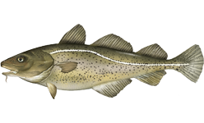
Grey seal (Halichoerus grypus)
Relatively large seal that experiences sexual dimorphism
Bulls reaching 2.5-3.3m in length and maximum weight of 400kg
Cows reaching 1.6-2m in length and maximum weight 250kg
Cape Cod breeding colony recovering in past 20 years
Pups rebounded from a handful in 1980 to more than 2,000 in 2008 (Thomspon, D. & Harkonen, T. ,2008)
Prey species
Sandlance = main staple, especially in winter.
Cod and silver hake when fish move into estuaries during late summer and fall.
Bowen W.D. & Harrison (1994)

Slide 3
Cape Cod
Climate largely influenced by Labrador current coming down from the North
Water temperature relatively cold, only rising above18˚C in summer months.
Islands
Martha’s Vineyard and Nantucket
Monomoy, Monomoscoy, Popponesset, Seconsett
Sandy shoals
Bay/estuaries
Buzzards Bay
Cape Cod Bay
Georges Bank supports lucrative fisheries of Atlantic cod and halibut

Slide 4
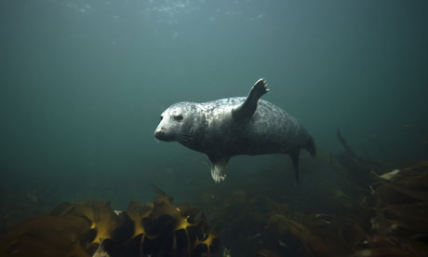
Hypotheses
Gray seal driven by need to breed, feed, and to engage in social interactions.
Preference for specific foraging locations dictated by temperature and bathymetry.
Data sources
Satellite SST temperature data from Rutgers Coastal Ocean Observation Lab
Seal GPS tags

Slide 5
Seasonal Variation of SST off of Cape Cod, MA

Slide 6
Overview of Seal Tracks
Cumulative tracks of grey seals 1-3 (Finner, Cunner, Quinn)
Cumulative tracks of grey seals 4-8 (Tuna, Andy, Sid, Sage, Gil)

Slide 7
Summary of Seal Data

Slide 8
Outliers
Many of the seals exhibited one or two abnormal trips
Quinn (Hg34-373-12) traveled almost 1000km from home down to Southern Virginia/North Carolina area. It is now recognized that this occurred after the seal was attacked by a shark.
Sage (Hg39-658-13) dove around 350m deep in November
Tuna’s (Hg39-646-13) GPS tag shows its has been hauled out since July. No diving or cruising. Made two far trips, 90km out southwest to Nomans Land Island and 50km south to Nantucket.
Sid (Hg39-654-13) seems to be the only seal to make a single trip to the middle of Cape Cod Bay.
Most outliers are likely due to equipment malfunction, however, a more in depth analysis may disprove this assumption.

Slide 9
Conclusions
Seals aggregate on the outer coast of Cape Cod, with two haul-out sites at Chatham and north Truro.
Assumed to forage on sandlance and other benthic/demersal prey in Pleasant Bay, sometimes taking trips out to Nantucket and Martha’s Vineyard.
Seals dive throughout the year, diving to an average depth between 20-30m.
No clear correlation between temperature and diving patterns
Seasonal variation: dives less frequently in the summer
Forage in cold water brought down by Labrador current.
Excursions to Nantucket may be motivated by the existance of the cold pool that lies east of the island all year.

Slide 10
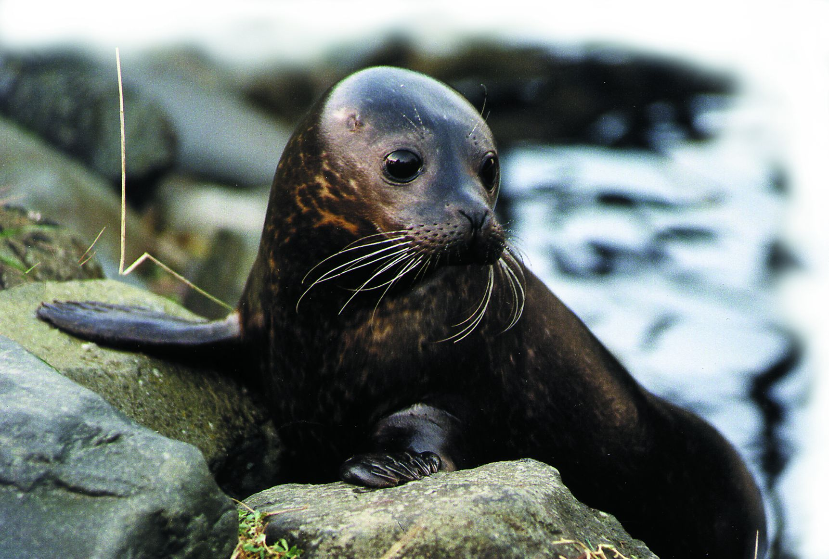
Difficulties Encountered
Specifics about each seal were not known (gender, age, etc)
Significant variance in behavior between seals, few generalizations were able to be made.
There was no glider deployed in the area, which may have provided additional insight.
Data is only from a relatively short period of time.
One seal, Quinn, was eaten in early August, truncating the available data for the time span of the experiment.

Slide 11
Future Research and Predictions
It could be interesting to look at grey seals in other locations and see how they behave.
If possible it would be interesting to track the fish the seals feed on and see how other living organisms affect the seals.
A glider mission collecting data from the Cape Cod area could help better analyze our data.
Recent debate over whether seal culls will benefit the recovery of the cod fishery. From this data we know the average depth traveled by seals. If we knew depth of the sea floor we could determine whether the seals are affecting cod or other prey species.

