Slide 2
RU-28
Espresso ROMS
Stevens NYHOPS
Surface
MARCOOS HOPS
15m
Predicting
High
25m
Predicting Low
On Target

Slide 3
First Look: Temperature
Models:
Espresso ROMS appears to predict on the low side of what the glider measured
MARCOOS HOPS appears to predict high at 15m but on target for measured at 25m
Stevens NYHOPS appears to be on target for satellite measured surface temperature
Initial Errors:
Preliminary use of web tools suffer poor resolution and flexibility
Probable initial analysis errors stemming from visual inspection
Immediate Goal:
Develop a more precise means of comparing model predictions to various data points

Slide 4
Maracoos water temperature
Stevens NYHOPS surface temperature

Slide 5
Maracoos bottom temperature 9/12/13 ESPRESSO water temperature 9/12/13

Slide 6
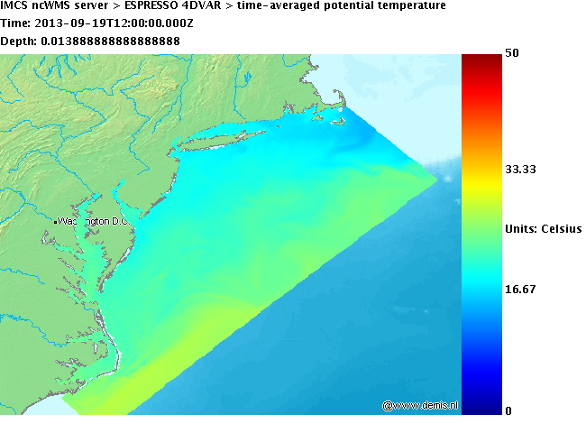
Maracoos bottom temperature 9/19/13
ESPRESSO water temperature 9/19/13

Slide 7
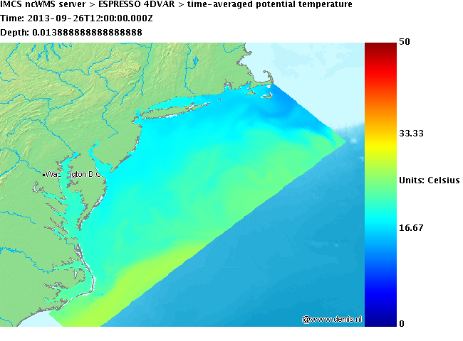
Maracoos bottom temperature 9/26/13
ESPRESSO 9/26/13

Slide 8
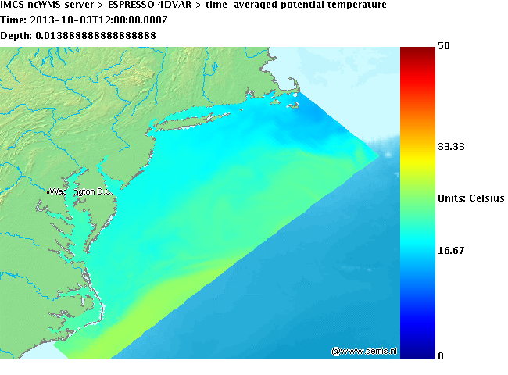
Maracoos bottom temperature 10/03/13
ESPRESSO 10/03/13

Slide 9
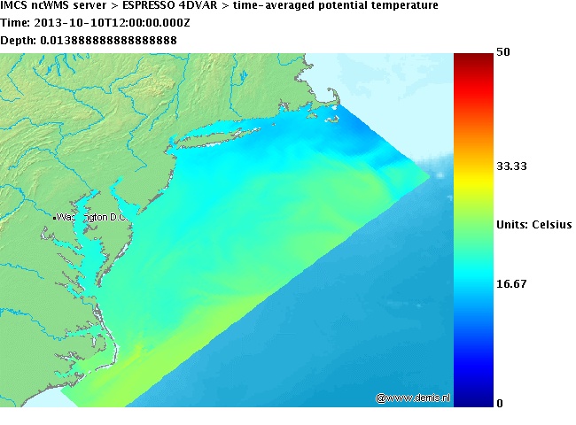
Maracoos bottom temperature 10/03/13
ESPRESSO 10/03/13

Slide 10
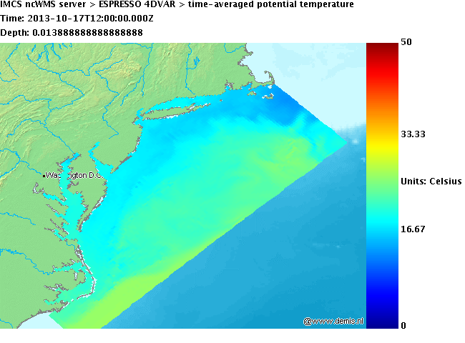
Maracoos bottom temperature 10/17/13
ESPRESSO 10/17/13

Slide 11
Maracoos bottom temperature 10/24/13
ESPRESSO 10/24/13

Slide 14
Temperature
Models:
Espresso ROMS appears to predict around what the glider measured but is often off several degrees in either direction
MARCOOS HOPS appears on target for measured at 25m but high at 50m and 75m
Errors:
Due to lack of Matlab knowledge our selection of tools remained limited
Animation paths are close but not exact
Verdict:
Despite the inprecision of our methods the MARCOOS HOPS model is clearly wrong at most depths
ROMS Espresso appears to stay within 3 degrees of the glider until near shore/ near estuary where it became inconsistant and usually on the high side

