Slide 1

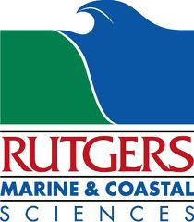
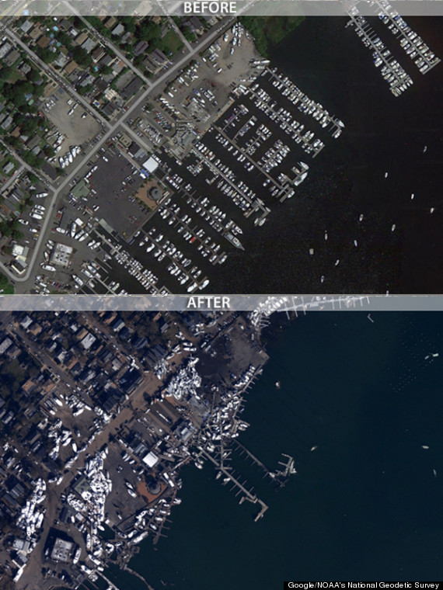
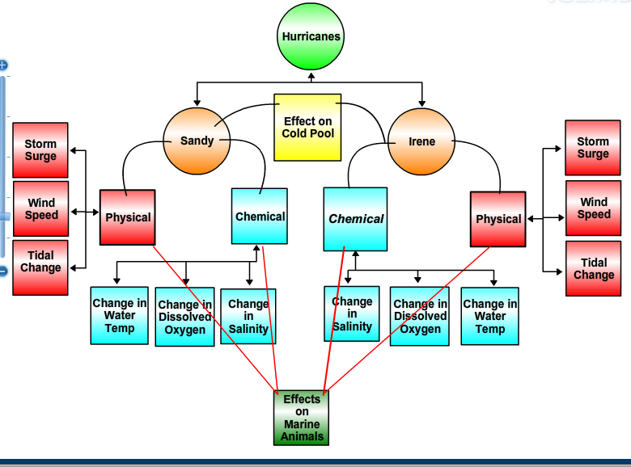
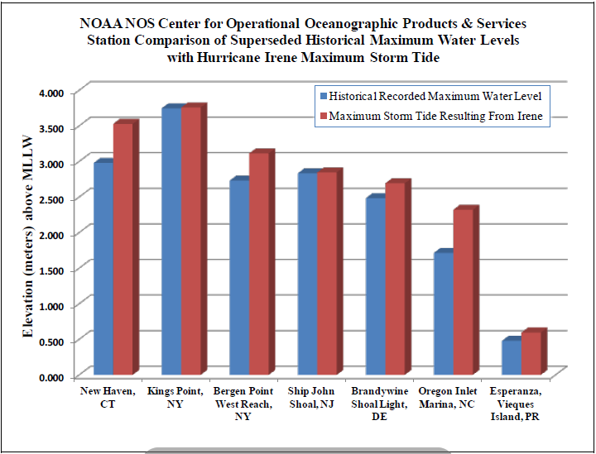
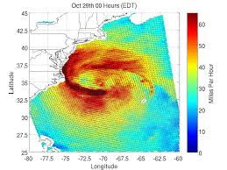
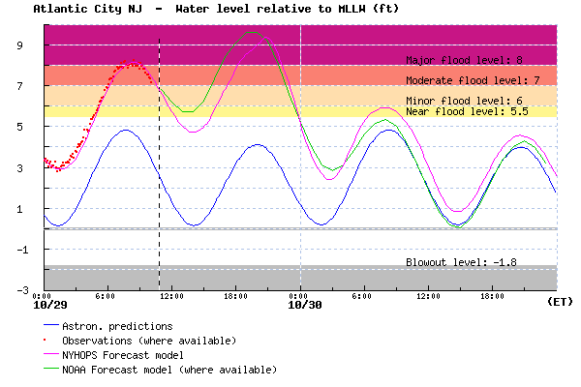
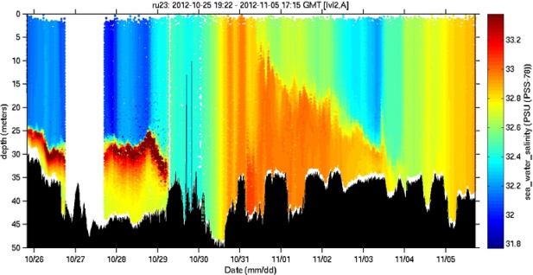
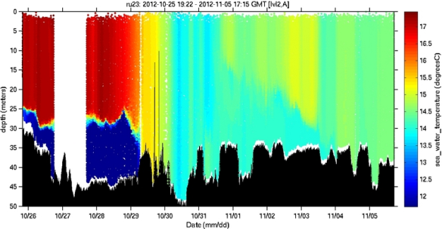
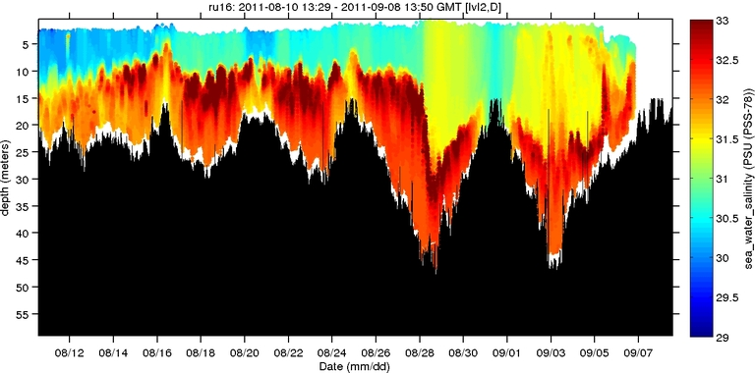
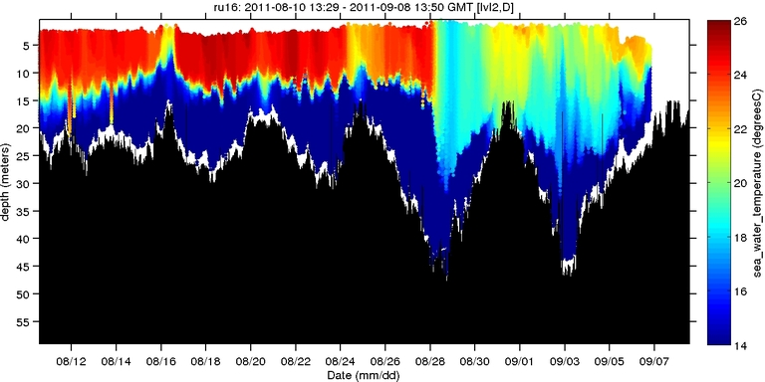
Chemical, Physical and Biological Effects of Hurricane Irene and Hurricane Sandy
Nelle D’Aversa, Kevin O’Rourke, Skyler Gray, Alison Belsky, Michael Glincman, Peter Habib, Tommy Raybould, Katie Saldutti
Scott Glenn, Oscar Schofield and Josh Kohut
Rutgers University
Hurricane Irene over the North East Coast (NOAA Water Level and Meteorological Data Report for
Hurricane Irene).
The effects of Hurricane Sandy’s storm surge in Staten Island, New York.
Wind speeds of Hurricane Sandy as the storm moves towards the East coast.
Graph of historical water levels and the maximum storm tide recorded during Hurricane Iren (NOAA Water Level and
Meteorological Data Report for Hurricane Irene).
Observed and predicted storm tides during Hurricane Sandy. Observed storm tides is was not available for entire course of Hurricane Sandy.
Tack of Hurricane Irene (NOAA Water Level and Meteorological Report for Hurricane Irene).
References
Fanelli, Colleen, and Paul Fanelli. "Hurricane Irene." NOAA Water Level and Meteorological Data Report. National Oceanic and Atmospheric Administration, 14 Oct. 2011. Web. 19 Nov. 2013. http://tidesandcurrents.noaa.gov/publications/Hurricane_Irene_Water_Level_and_Meteorological_Data_Report.pdf
"RU16 Deployment Dock." RU-COOL Slocum Glider Mission Control. RU Marine Sciences, n.d. Web. 03 Dec. 2013.
RU23 Deployment Dock." RU-COOL Slocum Glider Mission Control. N.p., n.d. Web. 03 Dec. 2013.
Changes in Salinity during Hurricane Sandy (10/26 – 11/05).
Changes in temperature during Hurricane Sandy (10/26 – 11/05).
Changes in salinity during Hurricane Irene recorded by RU16 (6/12 – 9/07)(RU16
Deployment Dock).
Changes in water temperature during Hurricane Irene (8/12 – 9/05) (RU16 Deployment Dock).

