Slide 1
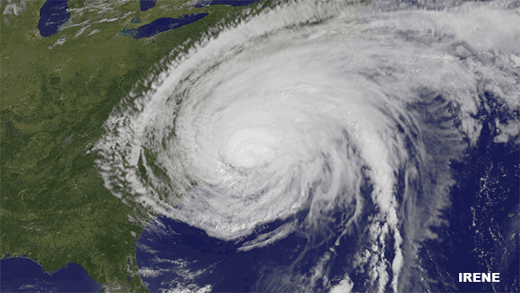
Hurricane Sandy vs. Hurricane Irene

Slide 2
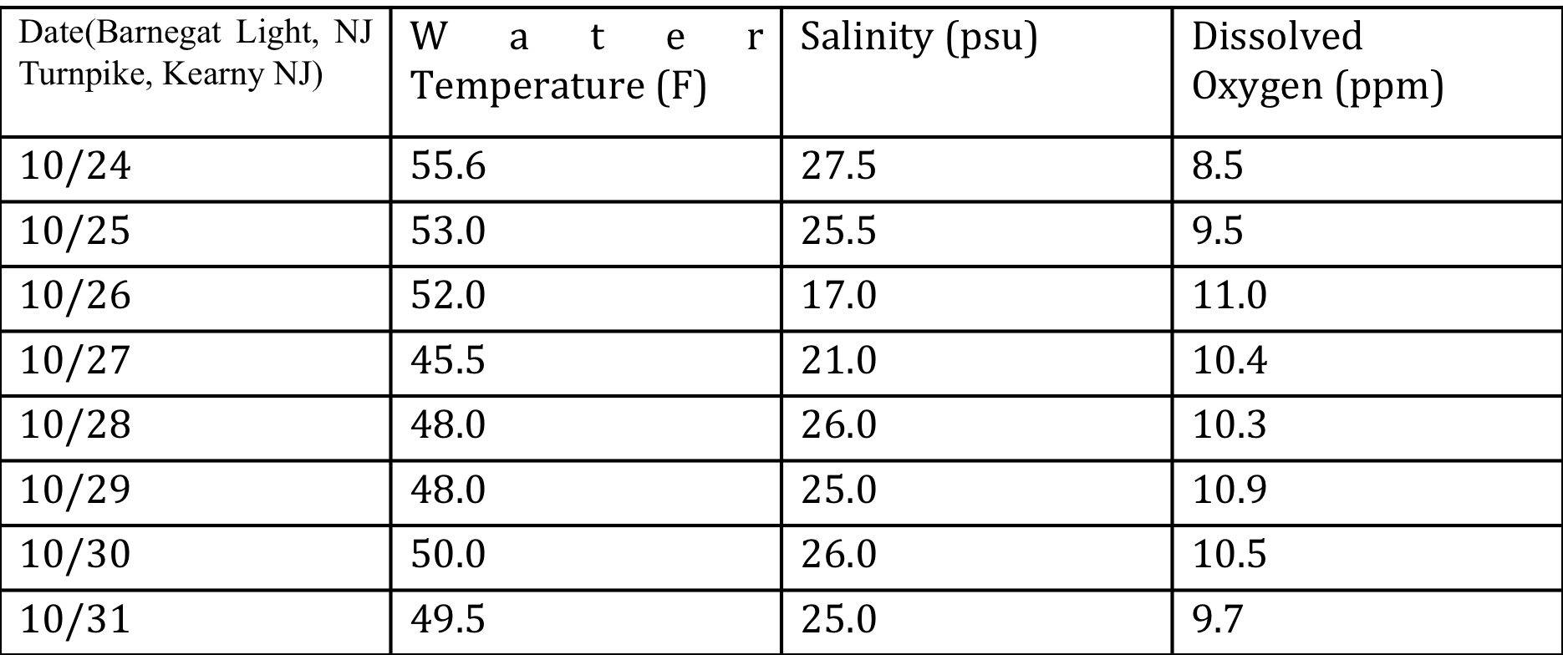
Hurricane Sandy Data Chemical Aspects
Date (Piermont Pier, NY) | Salinity (psu) | Water Temperature (F) | Dissolved Oxygen (ppm)
10/24 | 7.3 | 59.0 | 6.5
10/25 | 7.0 | 58.2 | 6.0
10/26 | 6.7 | 56.0 | 6.6
10/27 | 7.8 | 54.5 | 8.2
10/28 | 7.2 | 56.0 | 8.0
10/29 | 7.2 | 56.5 | 8.0
10/30 | 7.0 | 57.0 | 8.5
10/31 | 7.1 | 57.5 | 8.0

Slide 3
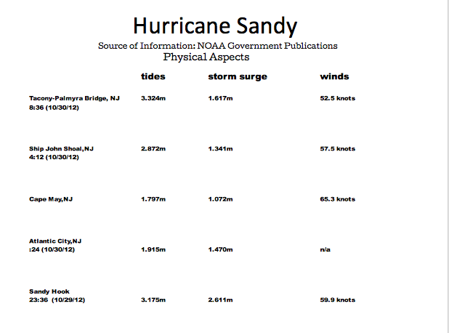

Slide 4
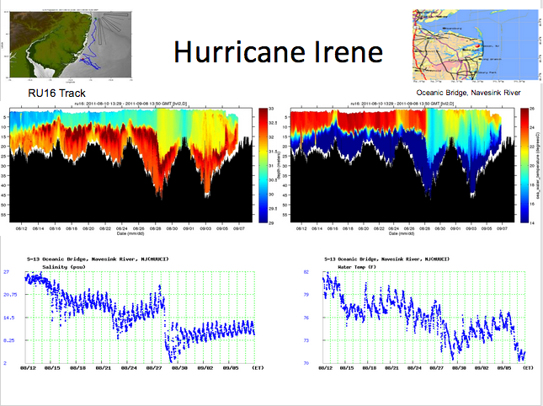

Slide 5
Time | Wind Speed | Wind Direction | Max Wind
00:42 | 30 | E | 48
01:42 | 23 | ESE | 37
02:42 | 27 | E | 45
03:42 | 29 | ESE | 56
04:42 | 26 | ESE | 64
05:42 Center made landfall | 25 | ESE | 39
06:42 | 31 | ESE | 35
07:42 | 24 | ESE | 39
08:42 | 28 | SW | 34
09:42 | 24 | WSW | 33
10:42 | 28 | W | 35
11:42 | 29 | W | 37
12:42 | 30 | W | 39
13:42 | 27 | WNW | 41
14:42 | 35 | W | 43
15:42 | 35 | W | 45
16:42 | 44 | W | 56
17:42 | 37 | W
18:42 | 40 | W | 53
19:42 | 33 | WNW | 44
20:42 | 30 | NW | 37
21:42 | 26 | WNW | 32
22:42 | 23 | WNW | 27
23:42 | 18 | WNW | 22
←Station placed at Sandy Hook NJ wind measurements were taken every hour. Shows wind direction and speed
↑Graph expressing wind speed throughout August 28, 2011
Station Name | Date & Time | Storm Surge ft | Storm Tide ft
Burlington, Delaware River, NJ | 08/28/2011 06:36 | 3.42 | n/a
Tacony-Palmyra Bridge, NJ | 08/28/2011 07:06 | 3.44 | n/a
Ship John Shoal, NJ | 08/28/2011 00:48 | 2.47 | n/a
Cape May, NJ | 08/28/2011 00:06 | 2.48 | 5.53
Atlantic City, NJ | 08/28/2011 00:00 | 2.15 | 4.34
Sandy Hook, NJ | 08/28/2011 12:36 | 4.63 | 6.93
←Stations in New Jersey measuring height of storm surge and storm tide during Hurricane Irene

Slide 6
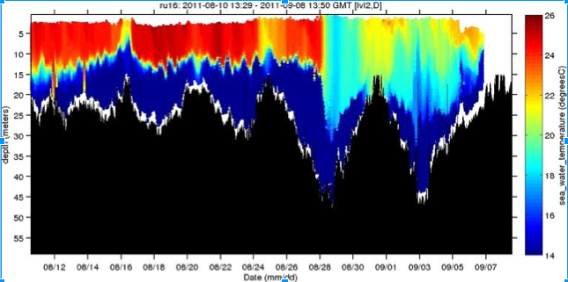
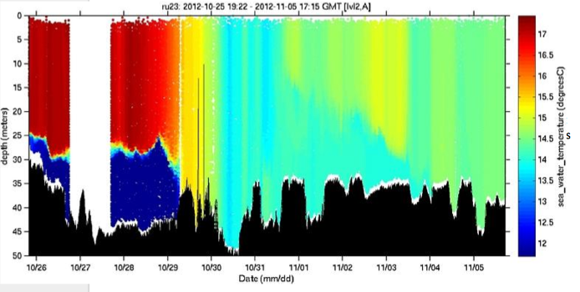
Effects of Hurricane Activity on the Cold Pool
The cold pool is an area of cold dense water located off the east coast that sits underneath the warm water due stratification of the water levels caused by this density differences.
During a storm event we see that the cold pool is very affected because of mixing and churning.
The water in the cold pool is mixed into the warmer waters above it, which causes a breaking down of the stratified layers of water.
In the Glider data below one can see once the storm (Irene) hits on about the 28th that we see a huge change in the position of the thermocline and mixed layer which extends into the cold pool.
The bigger the storm the deeper the mixing as one can see form the data below
IRENE
SANDY

Slide 7
8/18
8/26
8/12
9/7
9/4
9/28
SANDY
9/15
10/03
10/26
11/05

Slide 8
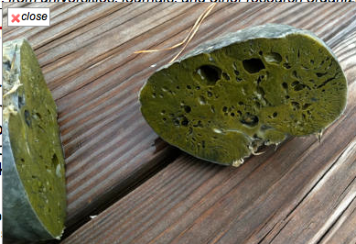
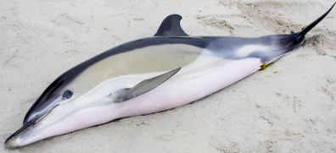
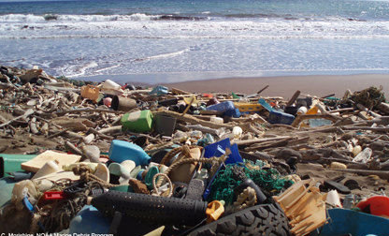
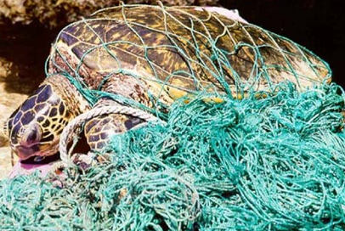
BIOLOGICAL IMPACTS
- Marine mammals blown to shore
- Pollutants/Debris kill marine animals
- Invertebrates (sponges) break off & die

Slide 9
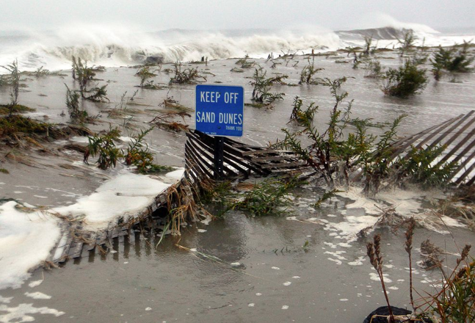
- Massive fish kills
- Sea turtle nests obliterated
& beach / dune erosion
- Foreign substances cause
imbalance in ecosystem
- Marine plants uprooted & killed

Slide 10
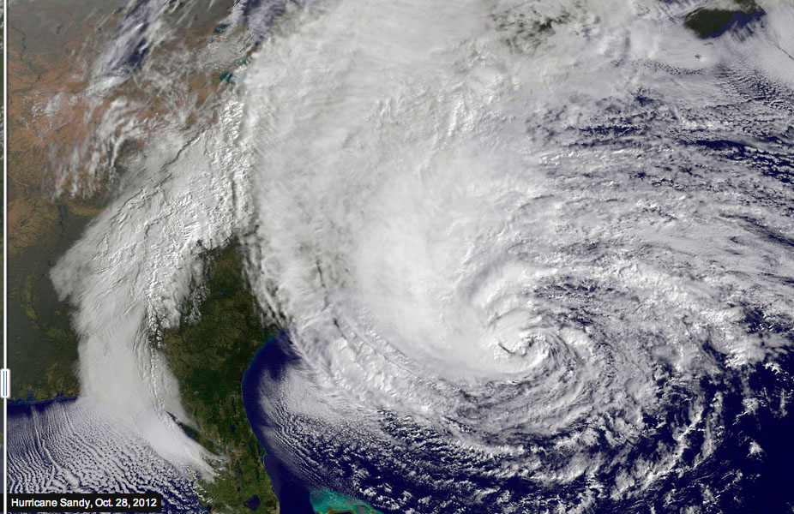
Hurricane Sandy

Slide 11
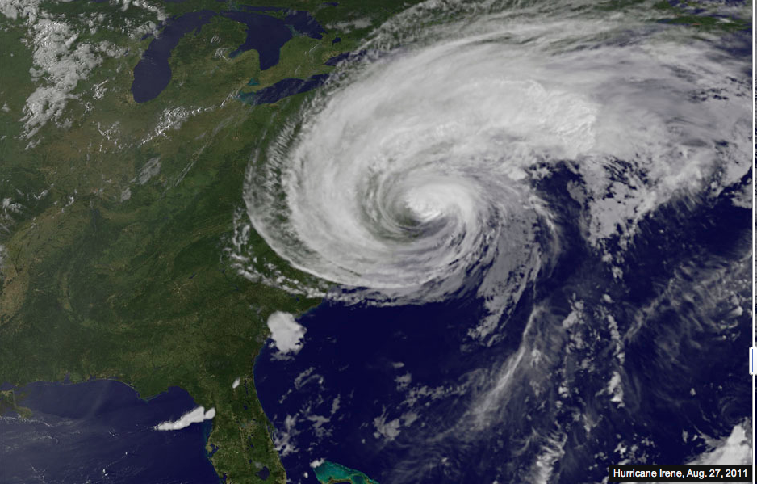
Hurricane Irene

Slide 12
Hurricane Statistics
Category 1 hurricanes average:
sustained winds from 74-95 mph
storm surge of 4-5 feet above normal
minimum central pressure of 980 mb (millibars)
Category 2 hurricanes average:
sustained winds from 96-110 mph
storm surge of 6-8 feet above normal
minimum central pressure of 80-965 mb (millibars)

