Slide 1
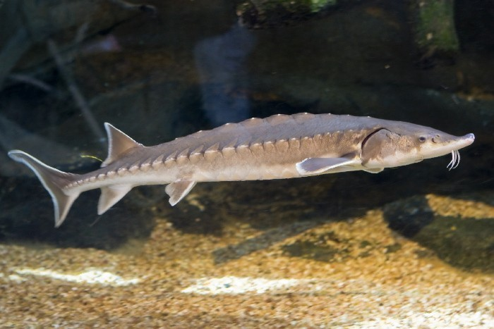
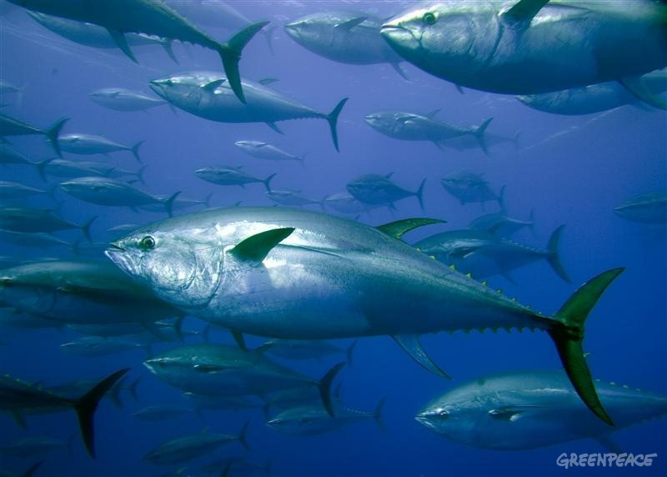
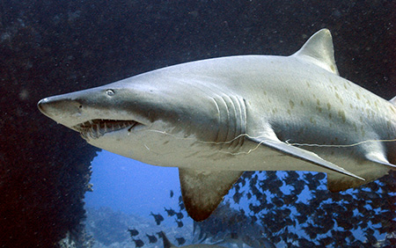
Migration Patterns of Fish in the Northeast
Kara Millaci, Kara Kowalczuk, Sam Ratcliff, Mendel Teitelbaum, Mike Mcardle, Kyle Hafstad

Slide 2
Atlantic Sturgeon

Slide 3
Regional Distribution
Notes:
http://www.nefsc.noaa.gov/press_release/2010/News/NR1025/

Slide 4
Spatial Distribution
Notes:
http://www.nefsc.noaa.gov/sos/spsyn/af/sturgeon/

Slide 5
Specific Water Body Masses
Notes:
salinity (b) water mass fronts (grey arrows show the mean surface current or the average movement of water during the fishes detection) (c) and the unique water mass in which the glider detected the Atlantic sturgeon (Nov. 2-15, 2011)
MARACOOS SEMI-ANNUAL REPORT: 12/1/2012 – 5/31/2013

Slide 6
Sand Tiger Shark
Also known as sand sharks, gray nurse sharks, or sand tigers.
Notes:
In 2012, hoping to find migratory patterns using gliders.

Slide 7
Fun Facts!
The only known shark that stores air in its stomach to maintain neutral buoyancy.
Docile animals, despite its fierce appearance.
Brown-gray, 6.5-10.5 feet long, 200-350 lbs, 15 yrs or more.
Feed on bony fishes, small sharks, rays, squids, crabs, and lobsters.
Low reproduction rate.

Slide 8
Migratory Patterns
Close to the shoreline
Found in all warm seas except the eastern Pacific.
Western Atlantic: Gulf of Maine to Argentina.
A migratory species in parts of its range:
Pole ward migration occurs in the summer and equatorial migration in autumn and winter.
"Sand Tiger Sharks, Carcharias taurus ~ MarineBio.org." MarineBio Conservation Society. Web. Monday, December 02, 2013. <http://marinebio.org/species.asp?id=92>. Last update: 1/14/2013 2:22:00 PM

Slide 9
Migration Patterns
Spring 2011-2012
Fall 2011-2012

Slide 10
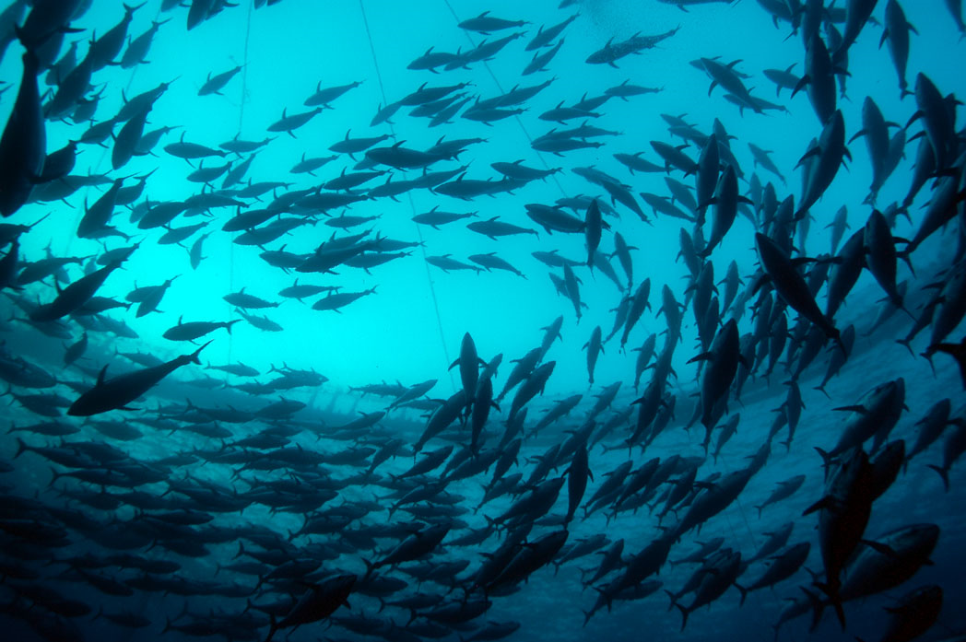
Migration Patterns of Bluefin Tuna
Very migratory species
Tuna has been spotted in most areas across the globe
Tagged fish have been spotted traveling from South Atlantic to North Atlantic
A large mass of Bluefin tuna are found in Northeast

Slide 11
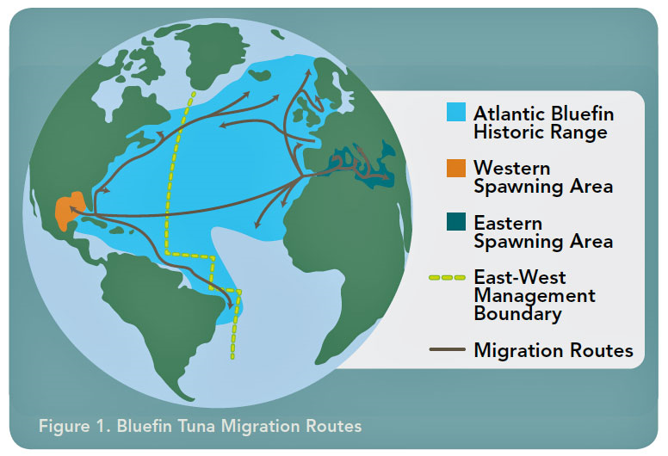
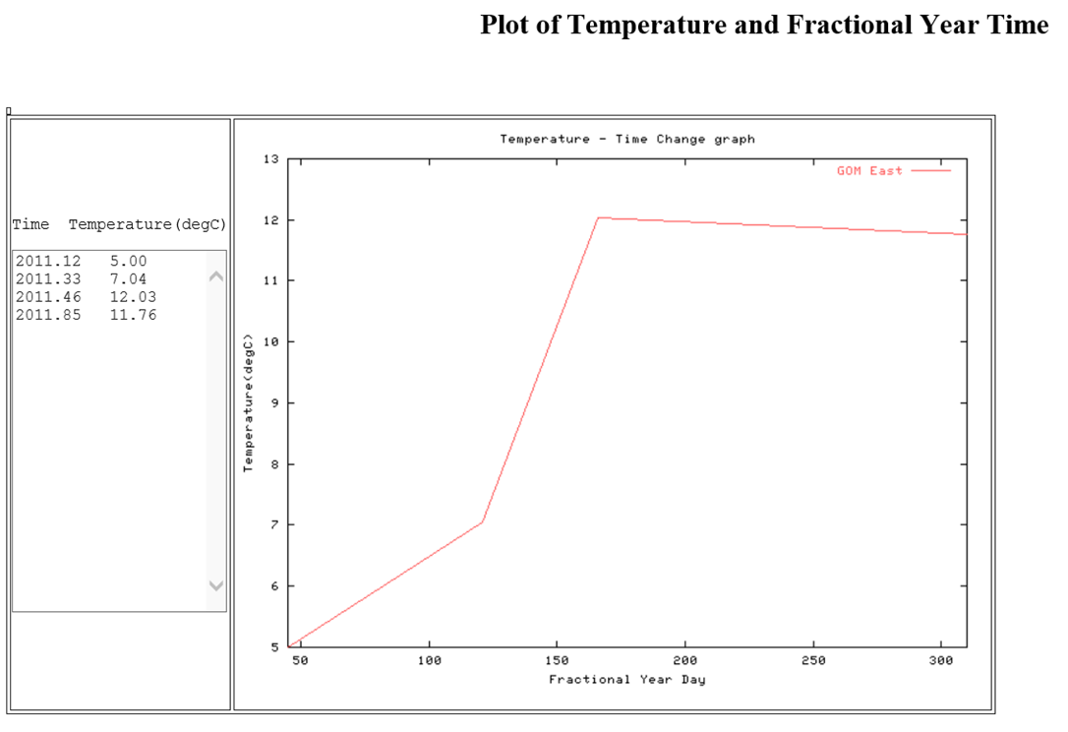
Reasons Why They Migrate
Temperature
Salinity
Food Abundance
Tuna fish are predators
They migrate where prey is available
Baitfish move towards the coastline when temperature increases
This provides a food source for tuna so they also migrate

Slide 12
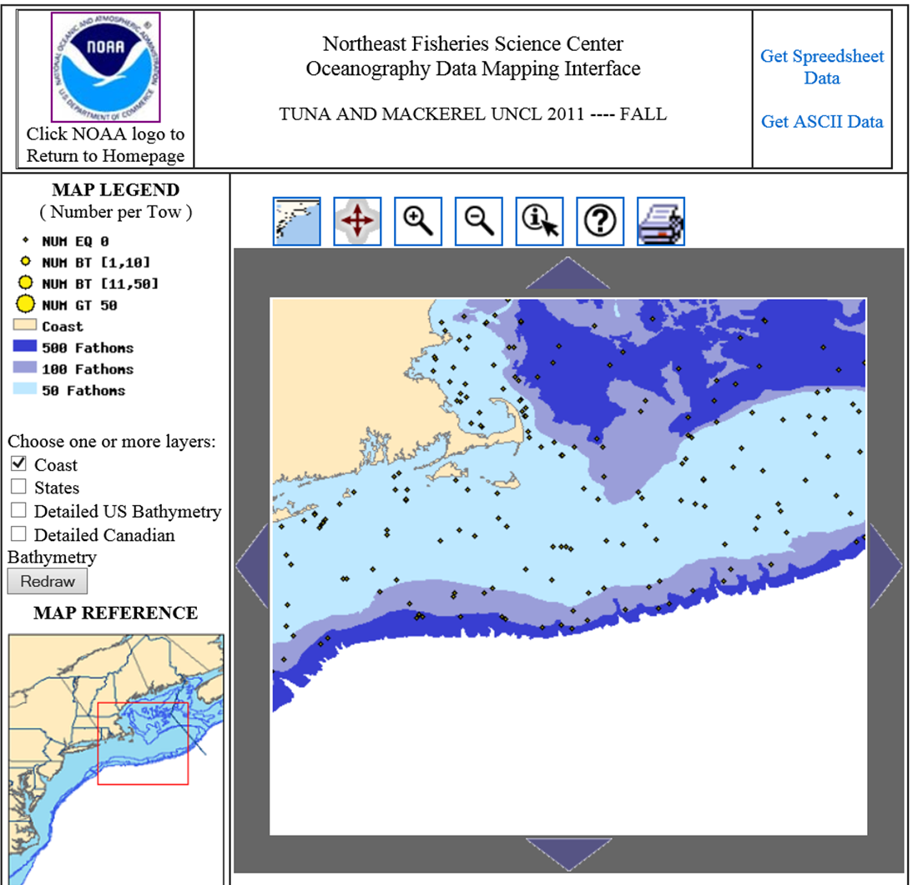
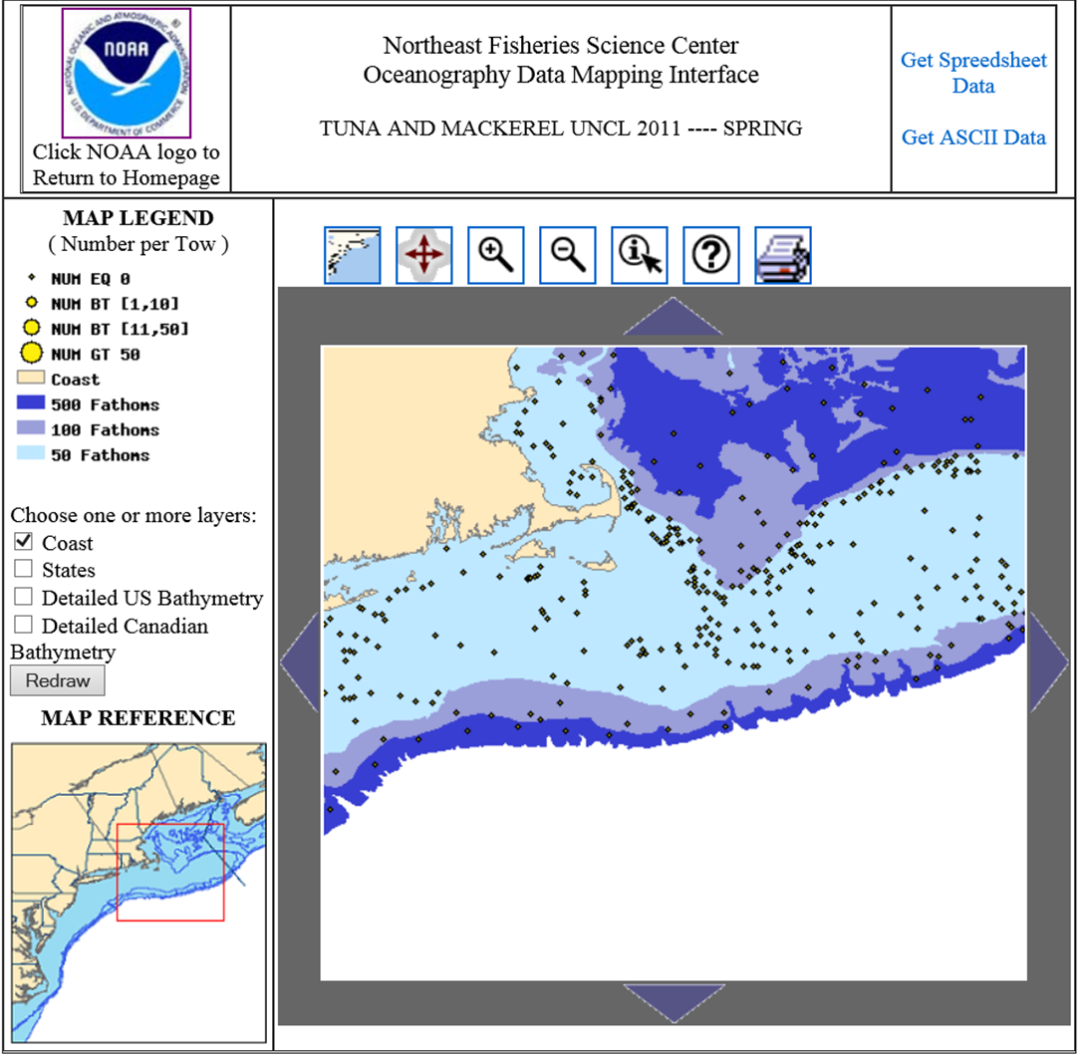
Comparisons of Data
Fall 2011
Spring 2011

Slide 13
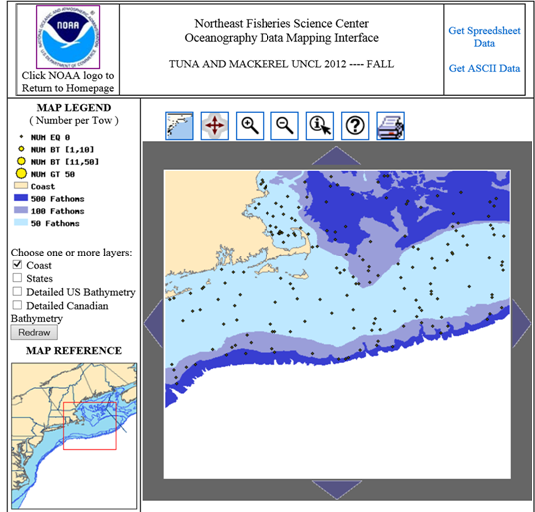
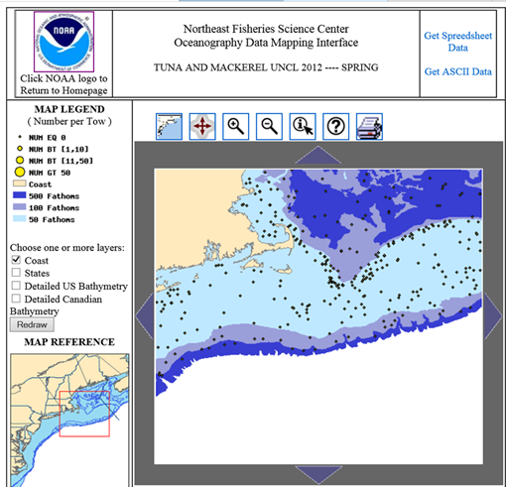
Comparisons of Data
Fall 2012
Spring 2012

