Slide 1
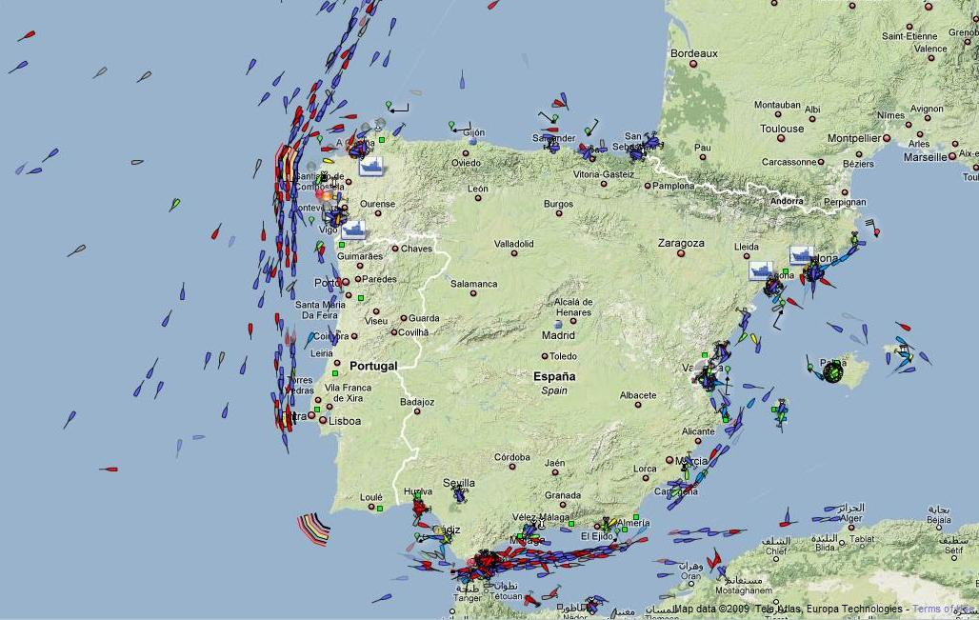
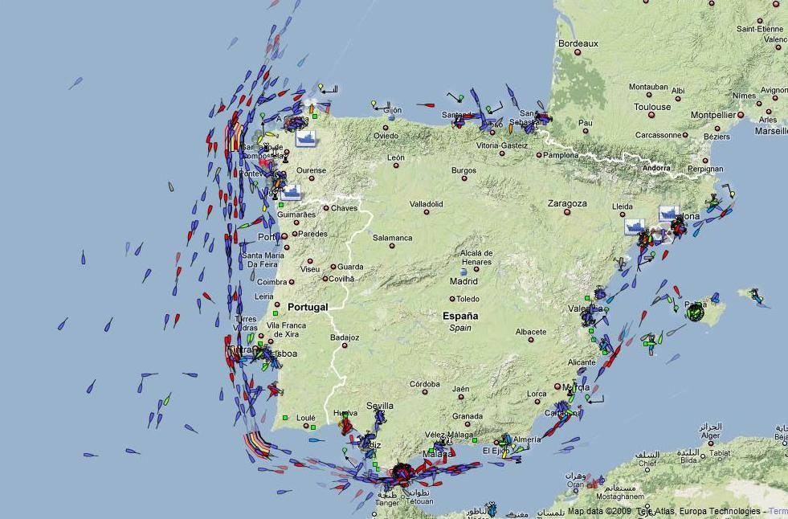
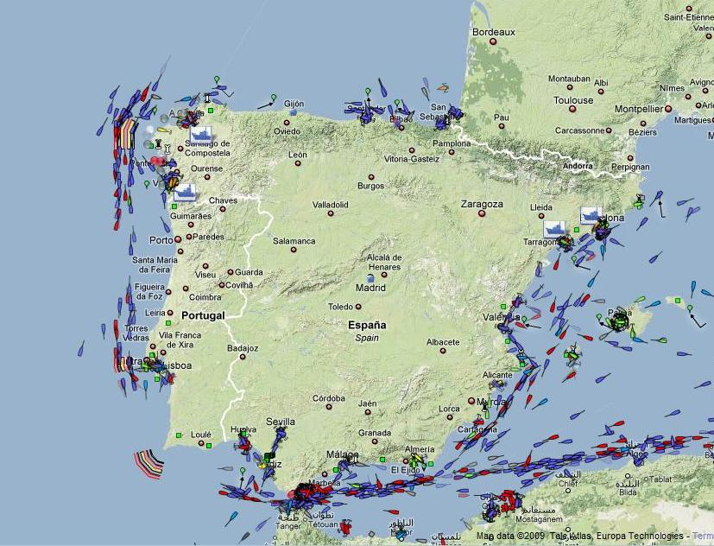
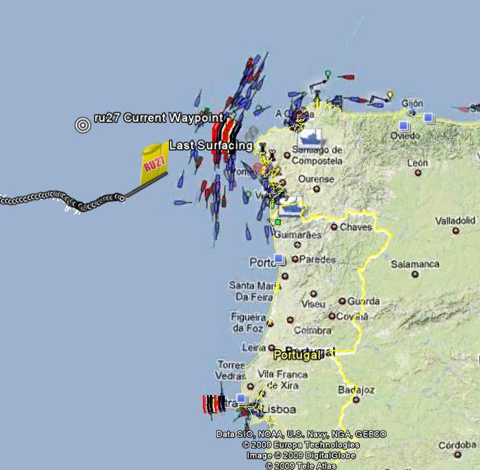
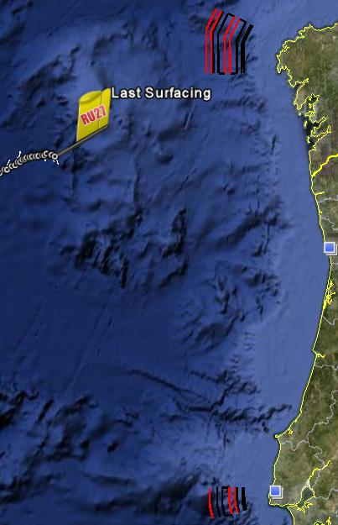
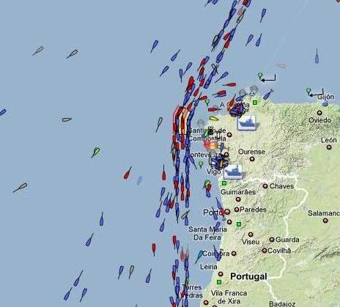
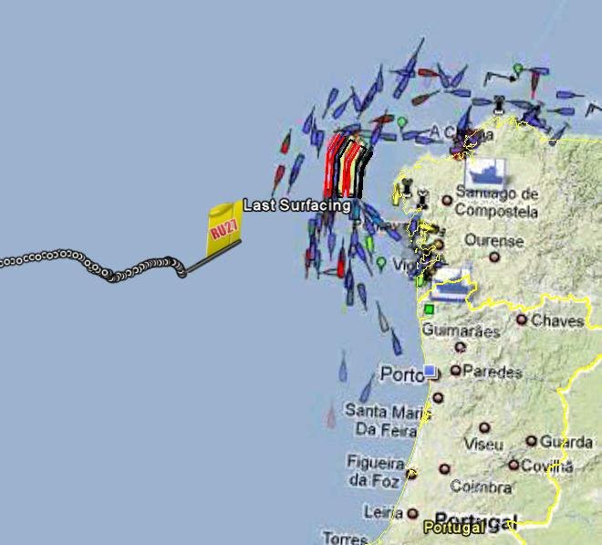
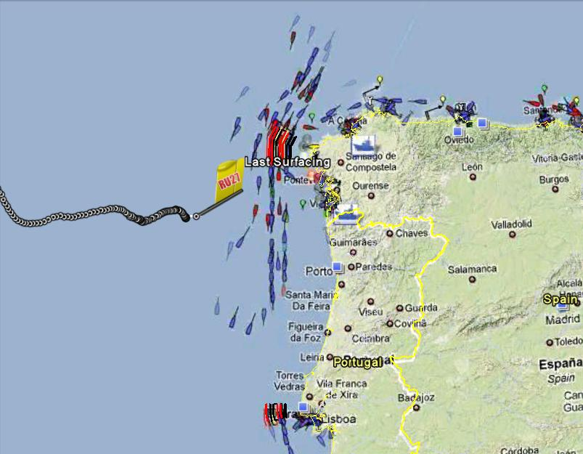
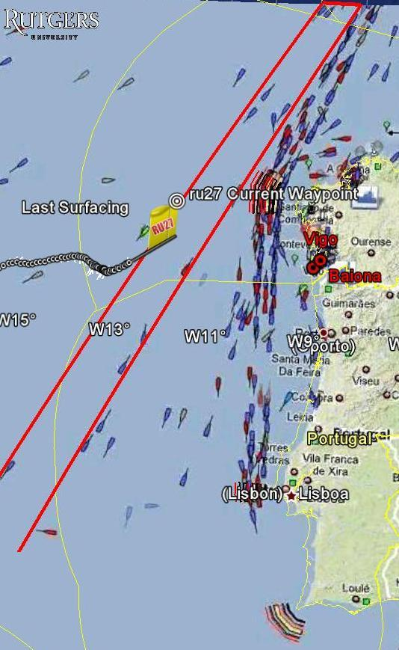
Vessel Tracking
Vessels in the shipping lanes off the coast of Spain and Portugal have been closely monitored since RU27’s approach to the coast in September. Vessels are a hazard to RU27 and if she was come into contact with one the results could be devastating.
Below is a screenshot of the shipping lanes. This image has the largest amount of vessels that we have seen off the coast since we started monitoring the shipping lanes in September. Many of the vessels are outside of the shipping lanes creating a potential danger for RU27 when she surfaces.
Shannon Harrison, Amelia Snow, Leo Rishty
Atlantic Crossing Class: Fall 2009
The purpose of vessel tracking during the trans-Atlantic mission was to ensure a safe recovery of RU27. Screenshots of vessel traffic off the coast of Spain and Portugal were taken regularly and overlaid into Google Earth. Screenshots of vessel traffic were also animated which enabled us to more easily see traffic patterns. Trends in the amount and location of vessels traveling along the coastline were analyzed and a safe location for recovery was determined.
To the left is a screenshot of a file in Google Earth that shows the shipping lanes off the coast of Spain and Portugal.
For most of RU27’s journey across the Atlantic she would come to the surface every 8 hours. During the day of recovery she will surfacing much more frequently. When RU27 is at the surface she is at greater risk of coming into contact with a vessel which could potentially end her mission. The vessels off the coast will be monitored closely until RU27 is safely onboard the recovery boat.
The screenshot shown above is an “average day” for the shipping lanes off the coast. Most of the vessels are in the shipping lanes.
The screenshot above is from December 1, 2009 at 3pm. The image shows that RU27 is over 100 kilometers away from the closest vessel so RU27 is not in any immediate danger.
This screenshot is an image of the vessels overlaid into Google earth. The image shows RU27’s location as of November 26, 2009. The red lines show the area that many boats travel through when they cross the Atlantic; this was an area of avoidance for RU27
Above is a screenshot from October 12, 2009. This image shows a large amount of vessels outside of the shipping lanes. Many of these vessels were in range of where RU27 is located now.
Above is an image showing RU27’s location and the vessels in the shipping lanes as of December 3, 2009.
The image above shows RU27’s last location before she was recovered. Also in this image is an overlay of the vessels at the time of the recovery.

