Slide 1
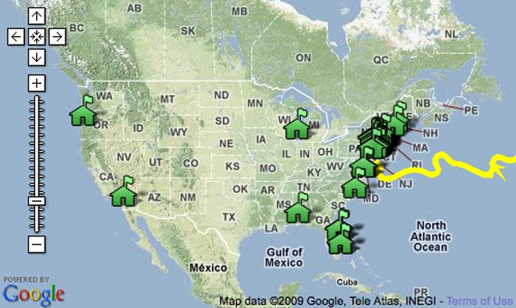
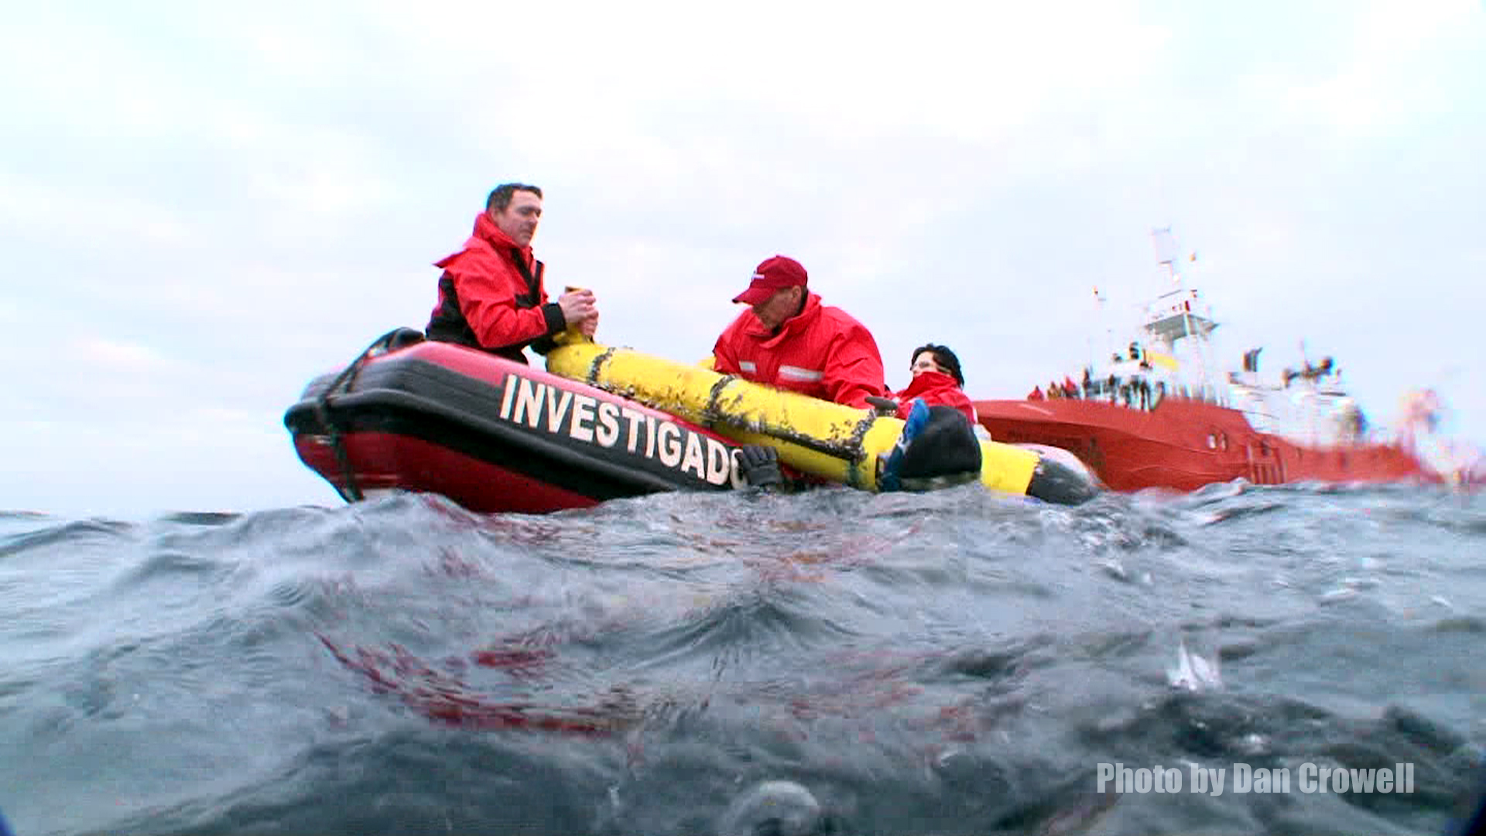
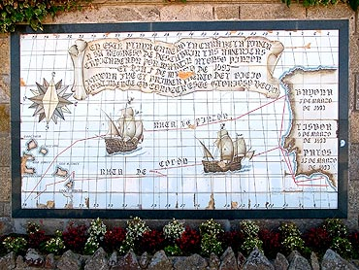
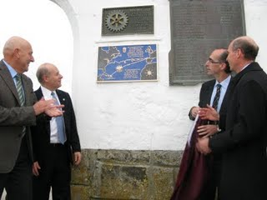
Student Logistics For Getting RU-27 To Spain
Dakota Goldinger & Nicolette Aquilino
History in the Making in Baiona, Spain
Student Outreach and Involvement
As part of the student outreach and education of the historic transatlantic mission of RU-27 elementary and middle school students were asked to write letters to RU-27 that would travel with the “Scarlet Knight” as she completed her mission across the Atlantic Ocean.
When RU-27 was recovered off the coast of Spain on December 4th, 2009 it was brought aboard the Investigator and then transferred to the Zodiac. With RU-27 safely aboard the Zodiac it headed back to the small ocean port town of Baiona, Spain. Baiona, Spain ,an ocean port fishing town with a population of roughly 11,337 people ,was the first town to hear about the successfully Trans-Atlantic Crossing of RU-27, but this would not be the first time that Baiona would be the first town to hear of a successful Trans-Atlantic Crossing. On March 1st, 1493 Columbus returned to Baiona, Spain with his ship the Pinta making the city the first to hear about the discovery of America after Columbus made his Trans-Atlantic Crossing.
Atlantic Crossing Students Fall 2009
One of the letters that was send to Glider Team and map of Participating Classrooms
Once RU-27 completed her mission the letters that traveled inside RU-27 on a flash drive were recovered and printed out in Spain. The Atlantic Crossing class of Fall 2009 wrote a letter from our students to their students informing the students that RU-27 completed her mission to Spain successfully on December 4th, 2009 after being at sea for 221 days. The letters were mailed back from Spain to the students along with the original letter that they sent RU-27.
Commemorative plaque and statue in Baiona in Honor of Columbus's successful Trans-Atlantic Crossing
Pulling RU-27 aboard the Investigator
Plaque commemorating the Trans-Atlantic Crossing of RU-277 near a plaque commemorating the voyage of Columbus's ship the Pinta
Students celebrating the success of RU-27

