Slide 1
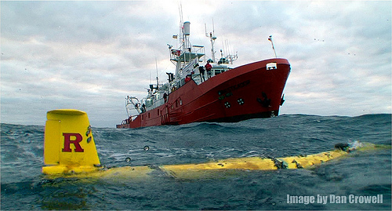
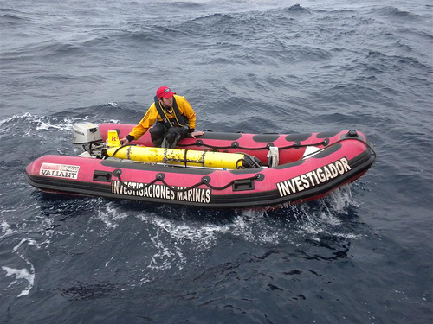
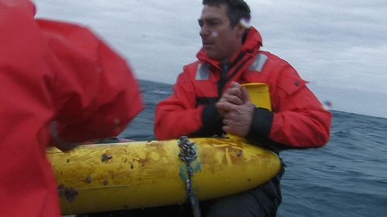
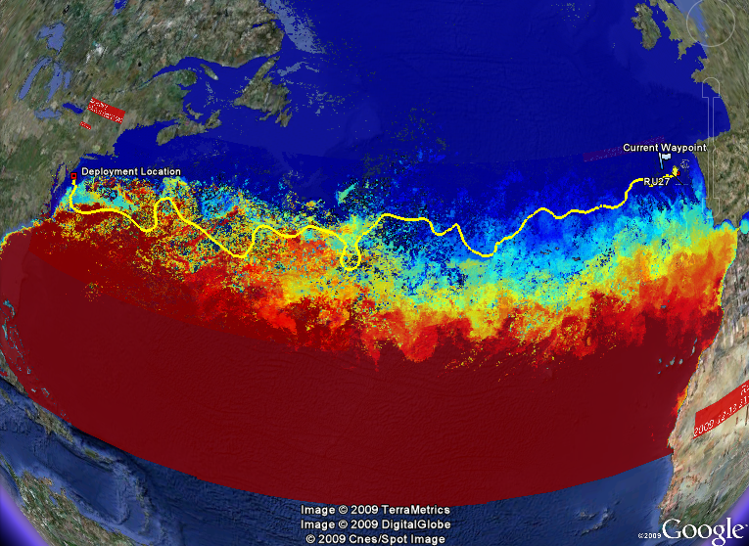
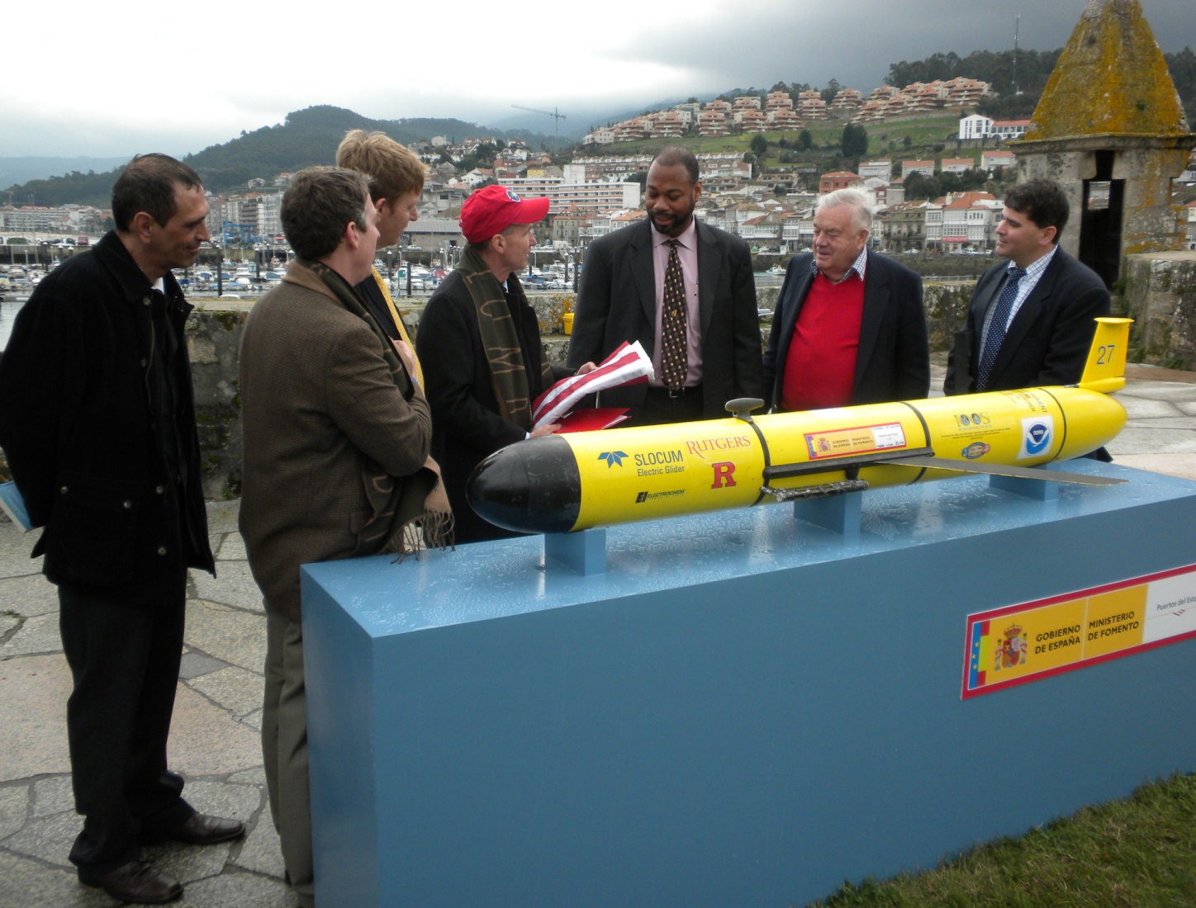
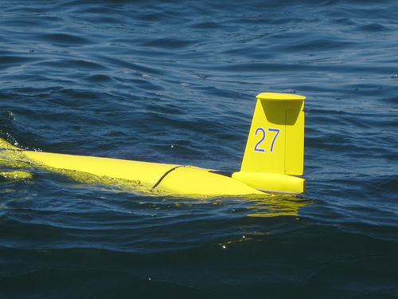
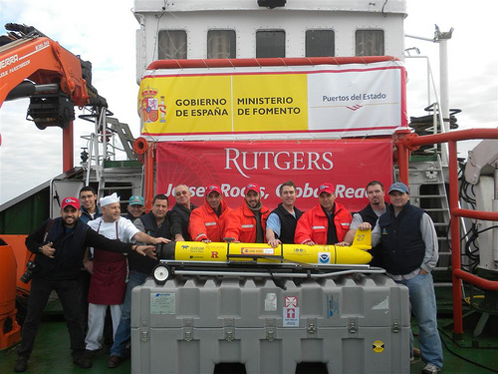
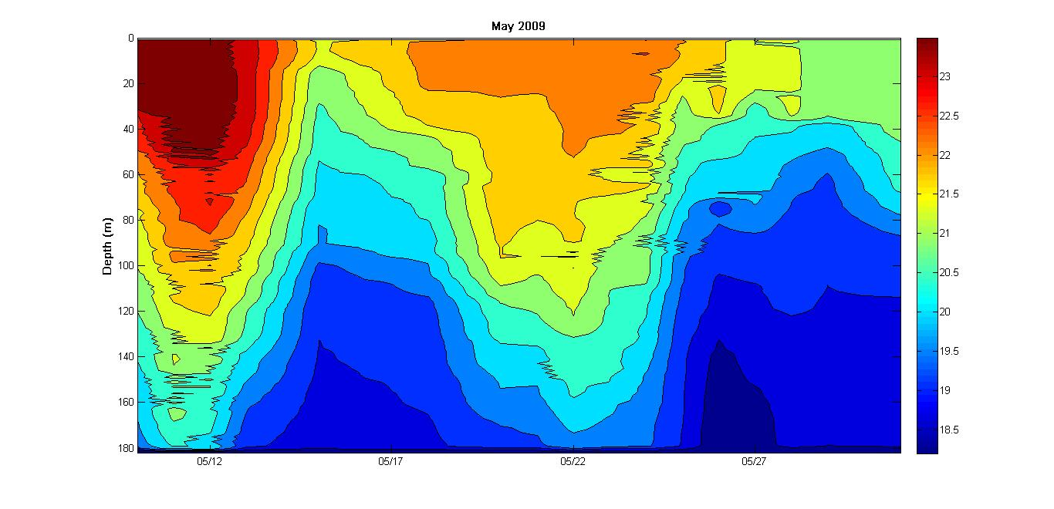
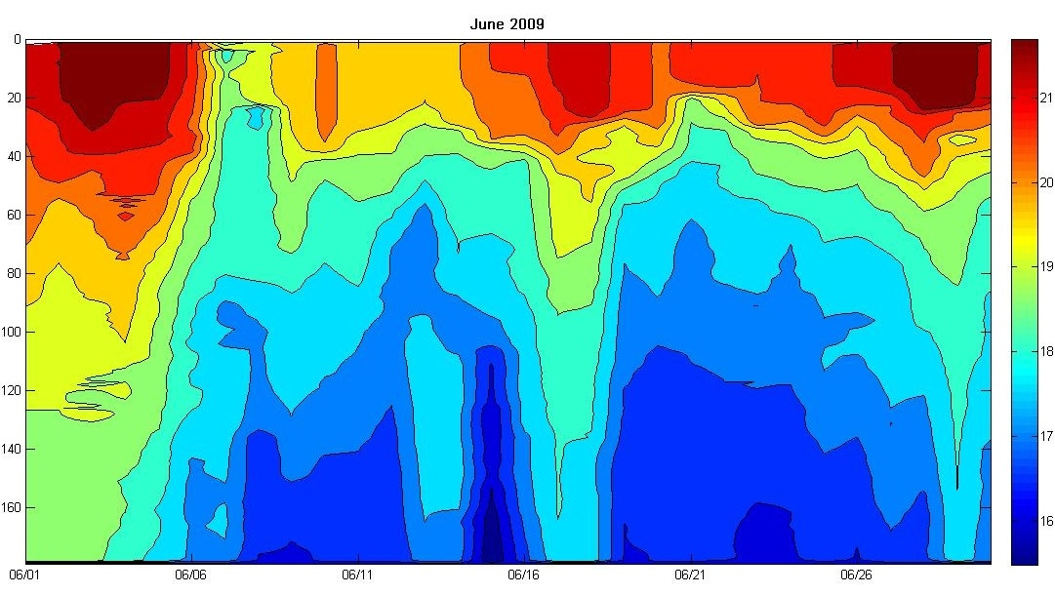
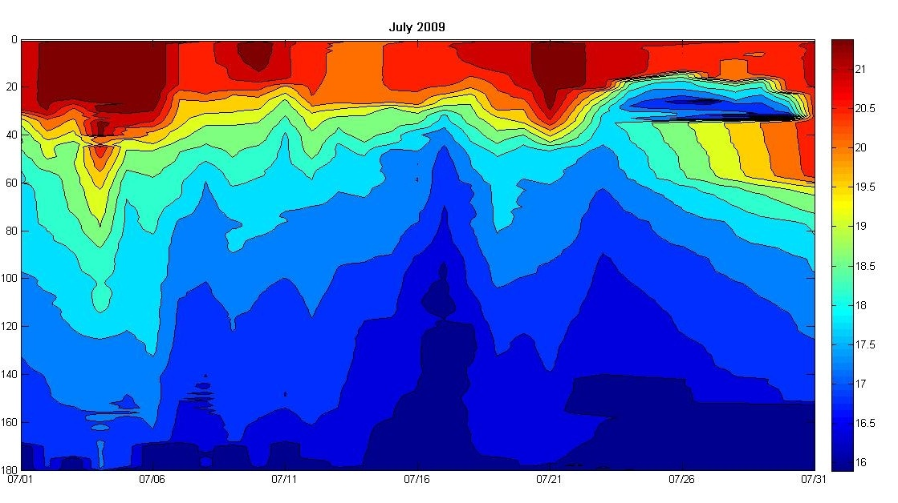
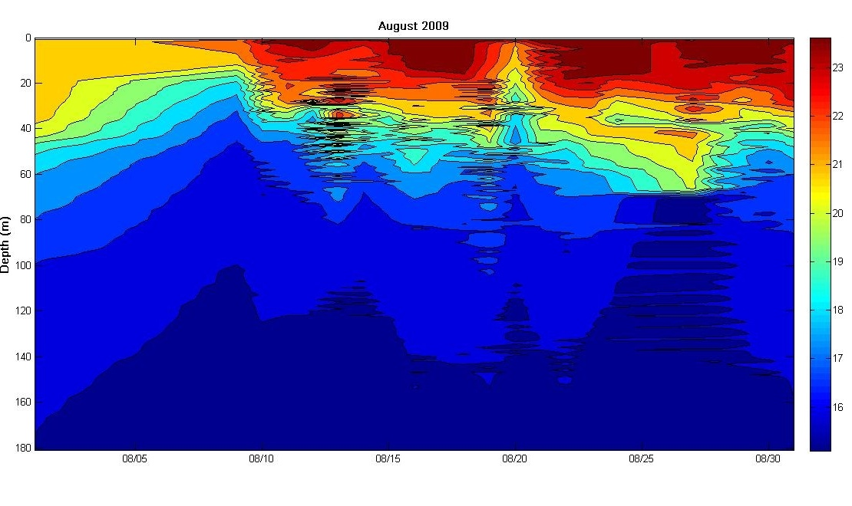
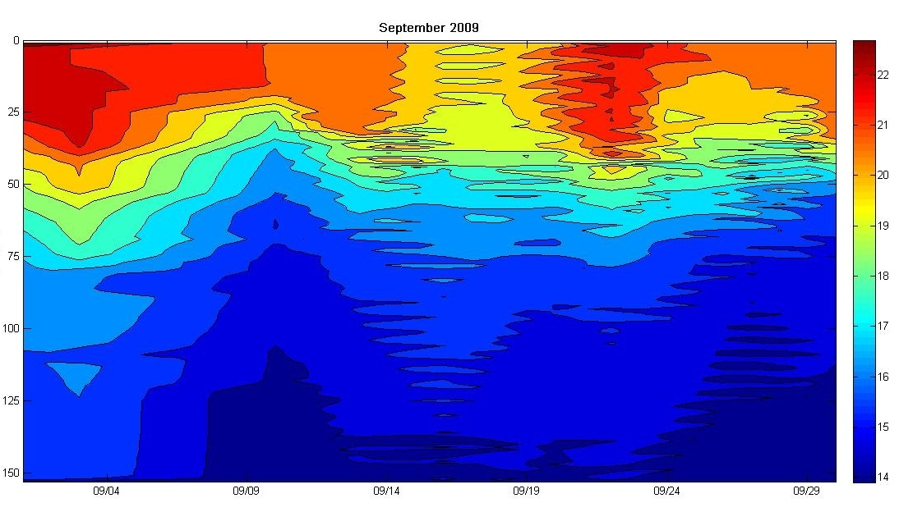
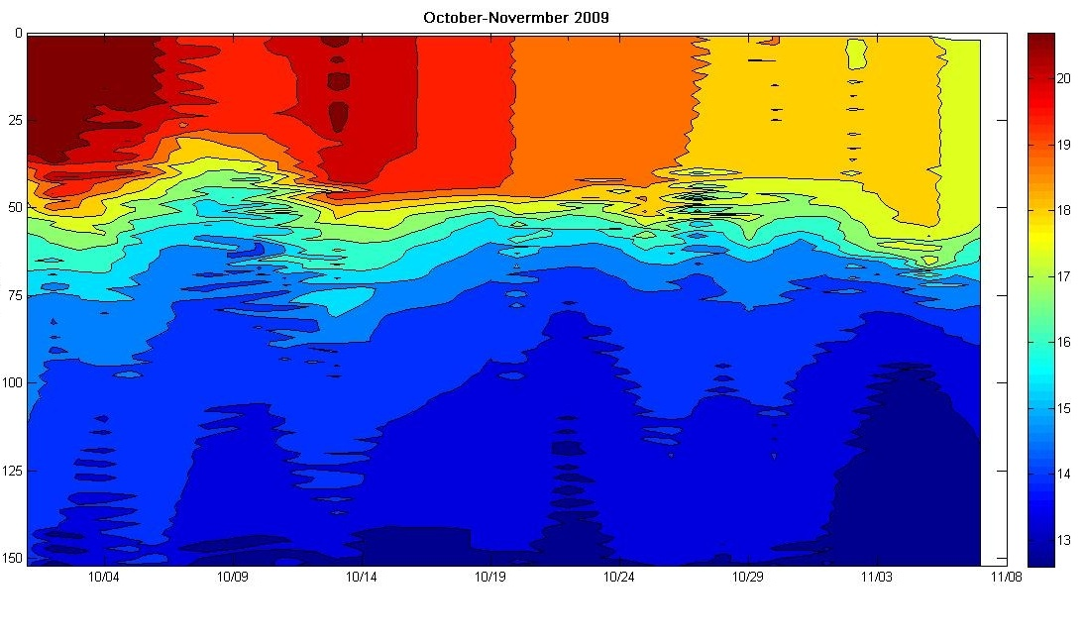
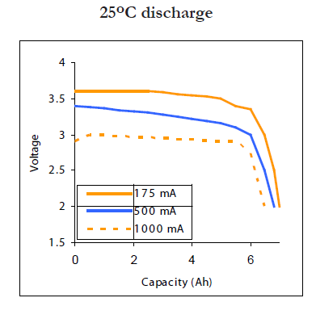
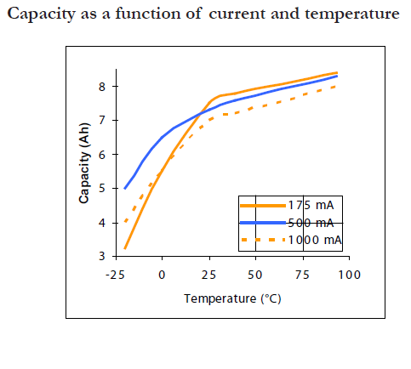
Atlantic Crossing Underwater Weather Colin Evans¹, Abe Gelb¹, Scott Glenn², Josh Kohut², Oscar Schofield², John Kerfoot²
Abstract
During the period of RU27’s travel, much data has been gathered through CTD casts. Scarlet has provided unique and unseen data involving temperature, salinity, and density throughout the entire Atlantic crossing mission. The most important data that needed to be examined towards the end of her journey was temperature measurements, as this posed somewhat of a threat to battery life and biology growth. Tracking the thermocline and temperature differences in the water column were extremely important in order to assist Scarlet in the completion of her long-term journey across the vast Atlantic Ocean.
Figure3. Scarlet spotted in Vigo, Spain.
Figure4. RU27 being transported safely back to the ship (Investagador).
Figure5. RU27 recovered in Vigo covered in barnacles.
Figure6. Scarlet posing for pictures with Rutgers and scientists from Spain, along with its creator, Doug Webb.
Figure1. Scarlet starting her mission heading towards Spain.
Figure2. RU27 resting in Vigo, Spain along with her companions from Rutgers and Spain.
Observations
Temperature throughout entire water column began to get cooler in late September (Figure7).
Bottom water temperatures reached nearly 12 degrees C.
Constant change in thermocline positioning and strength, which sometimes had an effect on Scarlet’s flight yo patterns.
Possible correlation with temperature and bio-fouling.
Figure7. Trans-Atlantic temperature profile showing thermocline changes, SST changes, and bottom water temperature changes.
Conclusions
Cold temperatures did not have much of an impact on battery efficiency. (Figure7,8).
- Important to vary inflection depths throughout mission due to wide temperature ranges and thermocline changes.
- Tracking thermocline important for limiting bio-fouling (Figure5,7).
Materials and Methods
Plots generated through the use of the MATLAB program, Google Earth, and RU27’s CTD casting. Other information attained from Puertos del Estado website, Electrochem website, and our companions in Spain.
Figure8. Scarlet’s lithium battery efficiencies in relation to water temperature (Electrochem).

