Slide 1
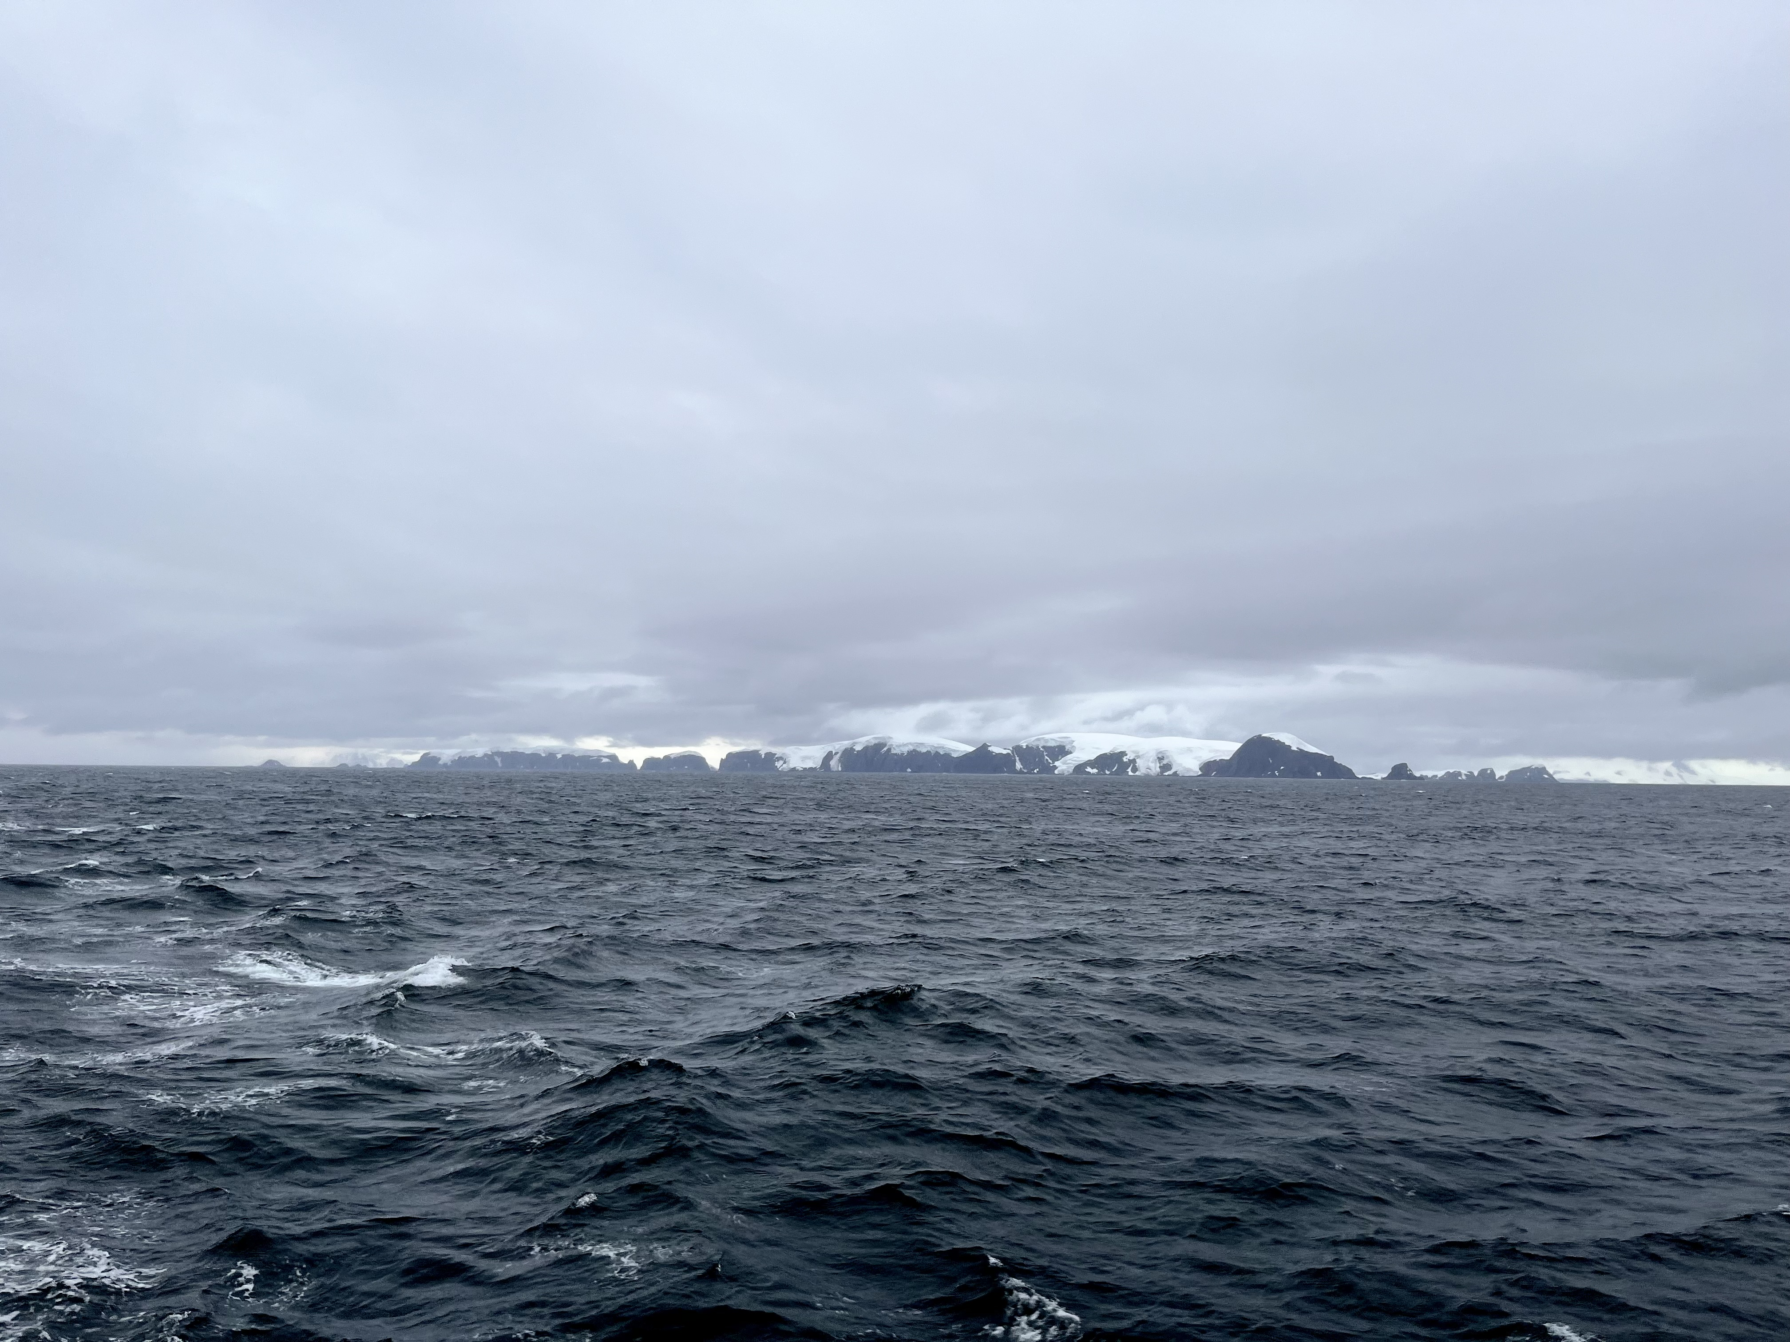
Seasonality of the Eddy Subduction Pump in the Southern Ocean:
Observations From BGC-Argo Floats
Michael Chen¹, Oscar Schofield¹
¹Rutgers University, USA
Ocean Sciences Meeting
Feb 23, 2024
mlc383@marine.rutgers.edu

Slide 2
The Southern Ocean plays an outsized role in global carbon cycling
Potentially up to 50% of ocean’s annual uptake of anthropogenic CO_{2 (Gruber et al, 2009)}

Slide 3
Carbon Export: the movement of carbon from ocean’s surface to the interior

Slide 4
Carbon Export: the movement of carbon from ocean’s surface to the interior
Eddy Subduction Pump (ESP):
Physical carbon export driven by submesoscale vertical velocities

Slide 5
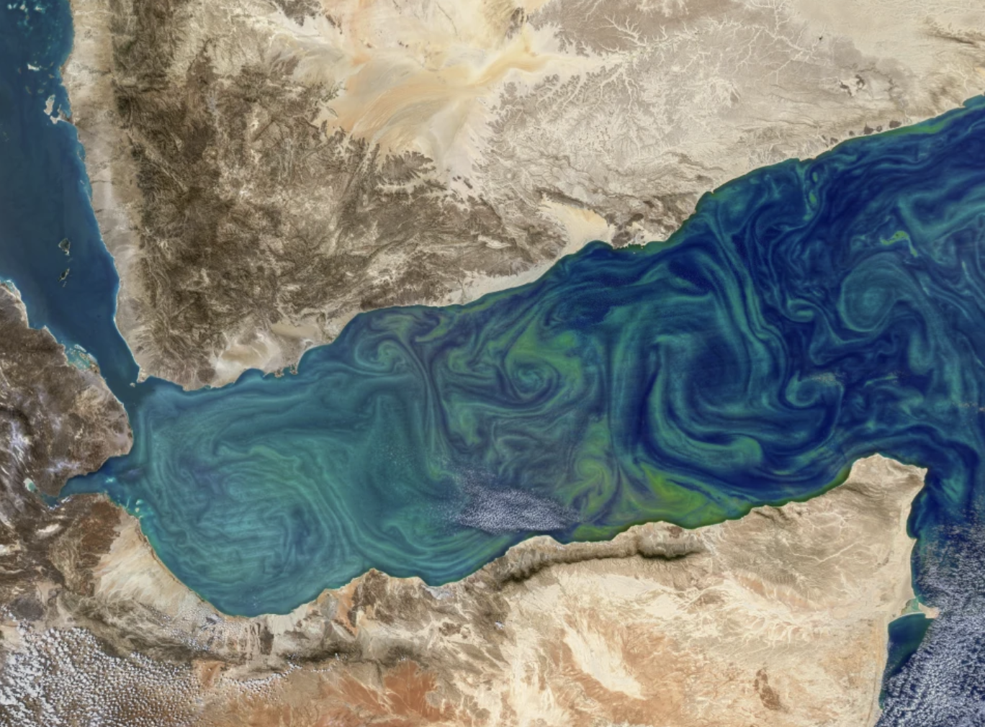
The ocean has a dynamic submesoscale eddy field
Image from Lévy et al (2018). MODIS, NASA Earth Observatory, Gulf of Aden

Slide 6
The ocean has a dynamic submesoscale eddy field
Image from Lévy et al (2018). MODIS, NASA Earth Observatory, Gulf of Aden

Slide 7
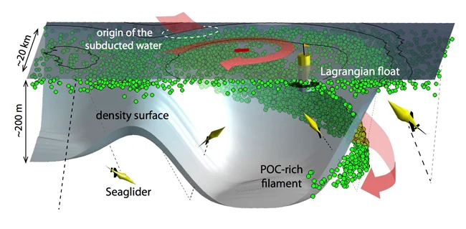
Eddies in 3 dimensions

Slide 8
Eddies in 3 dimensions
Schematic by Melissa Omand

Slide 9
Eddies in 3 dimensions
Schematic by Melissa Omand
At eddy boundaries, vertical velocities can inject surface water along tilted isopycnals, carrying surface carbon to depth

Slide 10
Eddies in 3 dimensions
Schematic by Melissa Omand
Spatiotemporal scale: O(1) day , O(10) km

Slide 11
Motivation: Eddy subduction’s seasonality remains unconstrained in carbon export models

Slide 12
Motivation: Eddy subduction’s seasonality remains unconstrained in carbon export models Challenge: Observing these episodic events is difficult

Slide 13
Float profiles can observe parcels of subducted water if they pass through them
Schematic by Melissa Omand

Slide 14
Subducted water carries fingerprints of its surface origins
🤚
Schematic by Melissa Omand

Slide 15
These fingerprints create subsurface anomalies in:
🤚
Schematic by Melissa Omand

Slide 16
These fingerprints create subsurface anomalies in:
Spice
(density-compensating variations in temperature + salinity)
🤚
Schematic by Melissa Omand

Slide 17
These fingerprints create subsurface anomalies in:
Spice
(density-compensating variations in temperature + salinity)
🤚
Apparent Oxygen Utilization (AOU)
Schematic by Melissa Omand

Slide 18
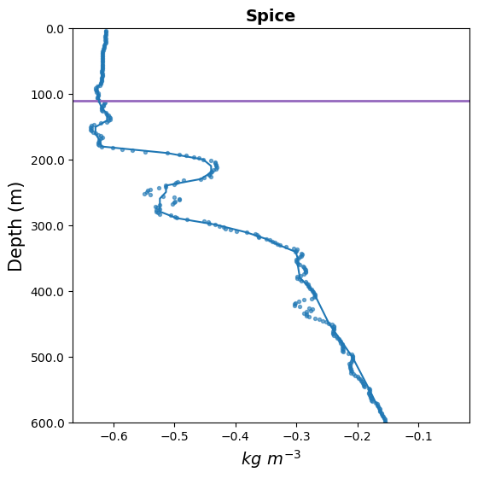
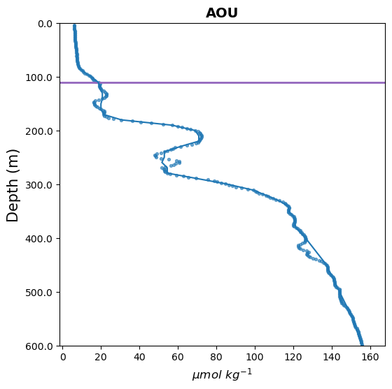
Methods: detecting eddy subduction as subsurface anomalies (“fingerprints”)
Spice
AOU
MLD
Methods based on Chen et al (2021) and Llort et al (2018)

Slide 19
Methods: detecting eddy subduction as subsurface anomalies (“fingerprints”)
Spice
AOU
Surface values are lower than at depth
MLD
Methods based on Chen et al (2021) and Llort et al (2018)

Slide 20
Methods: detecting eddy subduction as subsurface anomalies (“fingerprints”)
Spice
AOU
MLD
Identify surface intrusions as relative minima in the mesopelagic
Methods based on Chen et al (2021) and Llort et al (2018)

Slide 21
Methods: detecting eddy subduction as subsurface anomalies (“fingerprints”)
Spice
AOU
MLD
Methods based on Chen et al (2021) and Llort et al (2018)
Estimate a “reference” profile (without subduction)

Slide 22
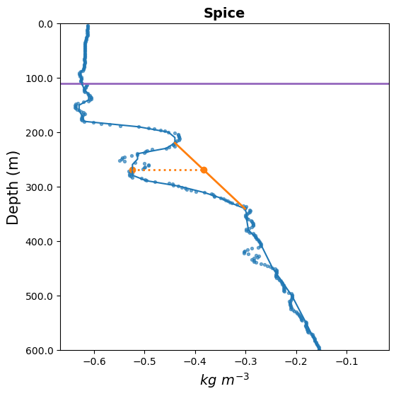
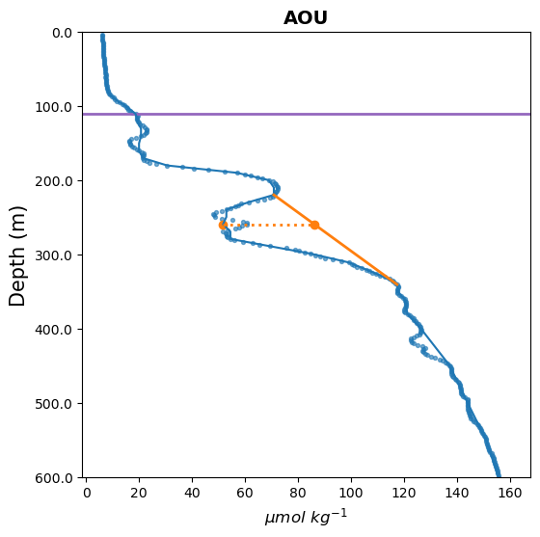
Methods: detecting eddy subduction as subsurface anomalies (“fingerprints”)
Spice
AOU
MLD
Methods based on Chen et al (2021) and Llort et al (2018)
Estimate a “reference” profile (without subduction)

Slide 23
Methods: detecting eddy subduction as subsurface anomalies (“fingerprints”)
Spice
AOU
MLD
Calculate the magnitude of the anomaly
Methods based on Chen et al (2021) and Llort et al (2018)

Slide 24
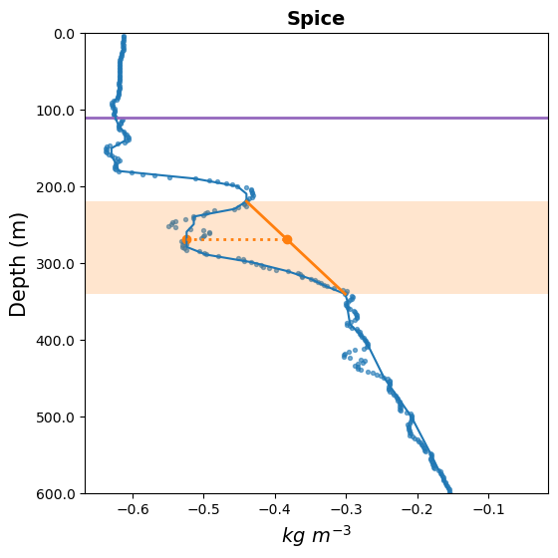
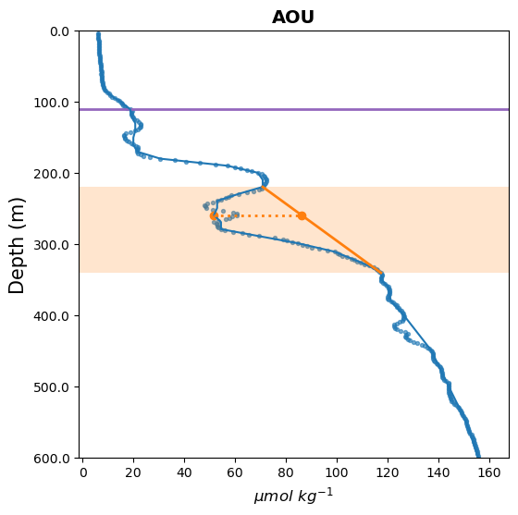
Methods: detecting eddy subduction as subsurface anomalies (“fingerprints”)
Spice
AOU
MLD
Eddy subduction event
Methods based on Chen et al (2021) and Llort et al (2018)

Slide 25
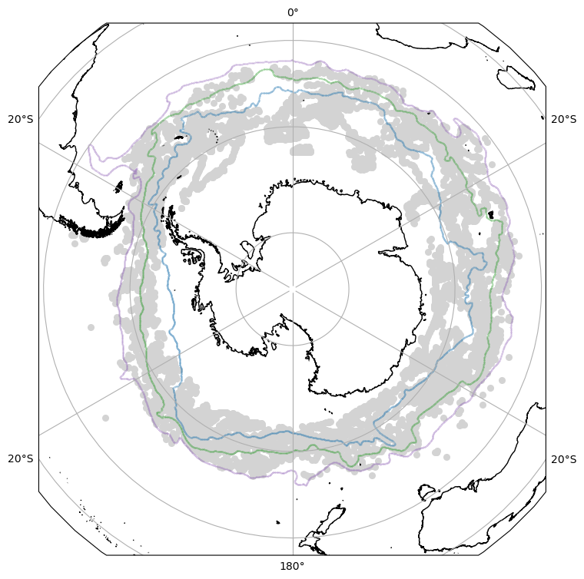
Apply this detection to BGC-Argo profiles across the Southern Ocean
9000+ profiles
2008 - 2023

Slide 26
Apply this detection to BGC-Argo profiles across the Southern Ocean
9000+ profiles
2008 - 2023

Slide 27
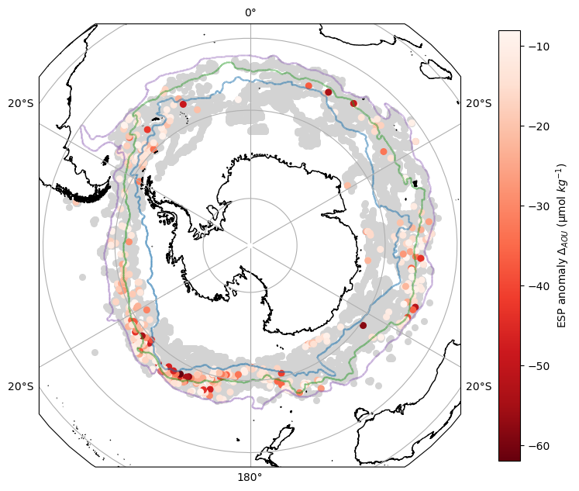
Eddy subduction in about 4% of profiles, concentrated in areas with strong, topographically-influenced eddy kinetic energy

Slide 28
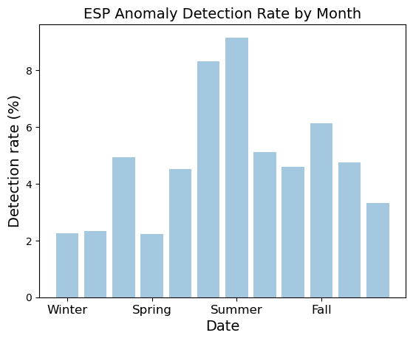
Most eddy subduction detected during the summer

Slide 29
Most eddy subduction detected during the summer
Time of detection
=/=
Time of subduction

Slide 30
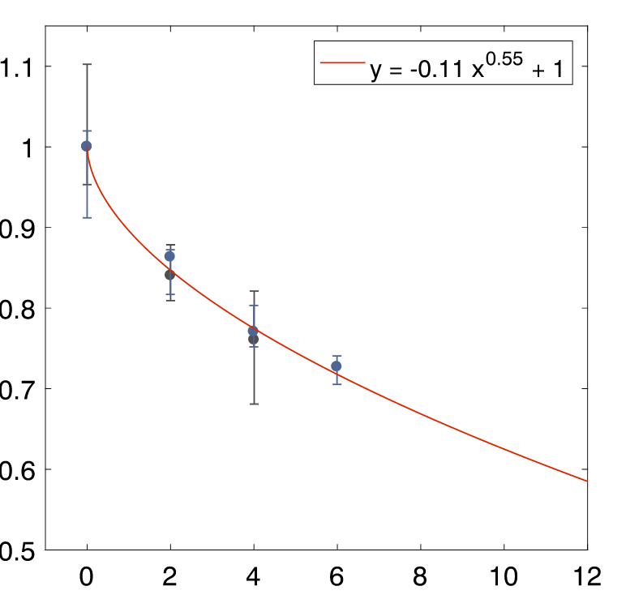
Forensics: ”Dating” subducted material using Chl/bbp ratios
Chl/bbp ratio decays after organic material leaves the mixed layer
Proxy for freshness of exported material
Chl/bbp
Days since leaving mixed layer
Figure from Lacour et al 2019

Slide 31
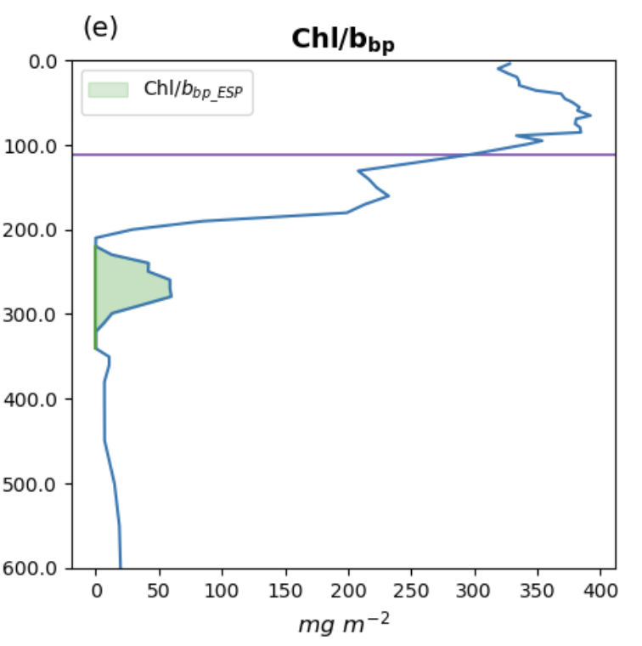
Calculate the chl/bbp ratios within subduction events

Slide 32
Calculate the chl/bbp ratios within subduction events

Slide 33
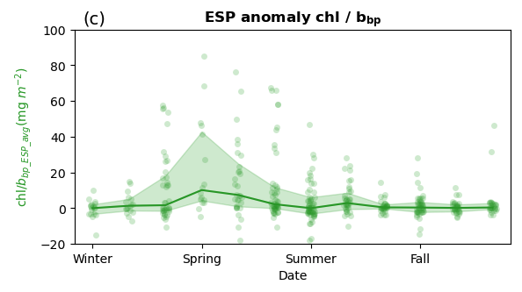
Freshest subduction occurs during the spring
Chl/bbp ratio
(mg m⁻²)

Slide 34
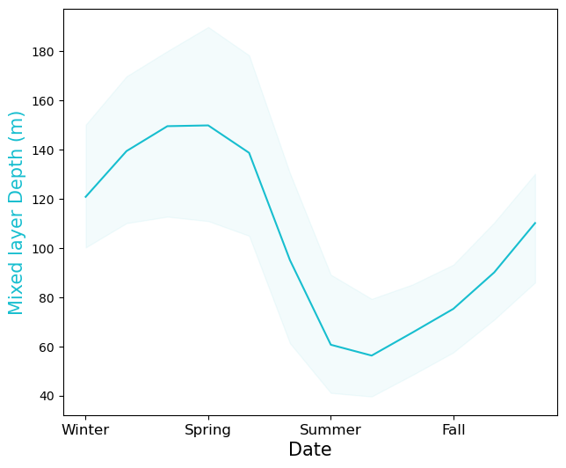
Springtime conditions across the SO
Mixed layers are deep
Large amounts of potential energy to energize submesoscale motions

Slide 35
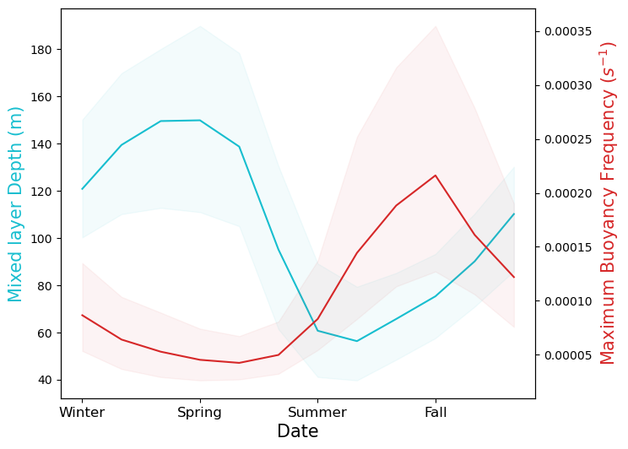
Springtime conditions across the SO
Mixed layers are deep
Stratification is weak
Vertical motions can penetrate to depth

Slide 36
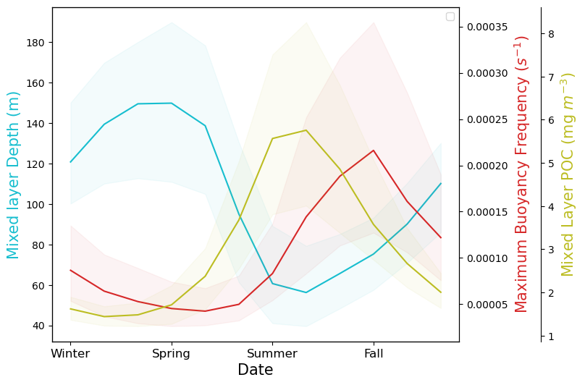
Springtime conditions across the SO
Mixed layers are deep
Stratification is weak
Surface POC is increasing
Carbon is available to be exported

Slide 37
Spring is an overlap window between physical and biological conditions for export
Mixed layers are deep
Stratification is weak
Surface POC is increasing

Slide 38
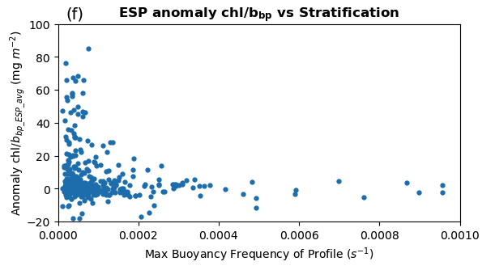
Freshly subducted material is associated with weak stratification
Freshness
Stratification strength

Slide 39
The Eddy Subduction Pump is likely most active in the spring across the Southern Ocean
This fills an important gap in our understanding of global carbon export

Slide 40
Acknowledgements
Data were collected and made freely available by the Southern Ocean Carbon and Climate Observations and Modeling (SOCCOM) Project funded by the National Science Foundation, Division of Polar Programs (NSF PLR -1425989 and OPP-1936222), supplemented by NASA, and by the International Argo Program and the NOAA programs that contribute to it. The Argo Program is part of the Global Ocean Observing System.
FINESST Grant
#80NSSC22K1451
Notes:
Mostly gonna focus on fixation

Slide 41
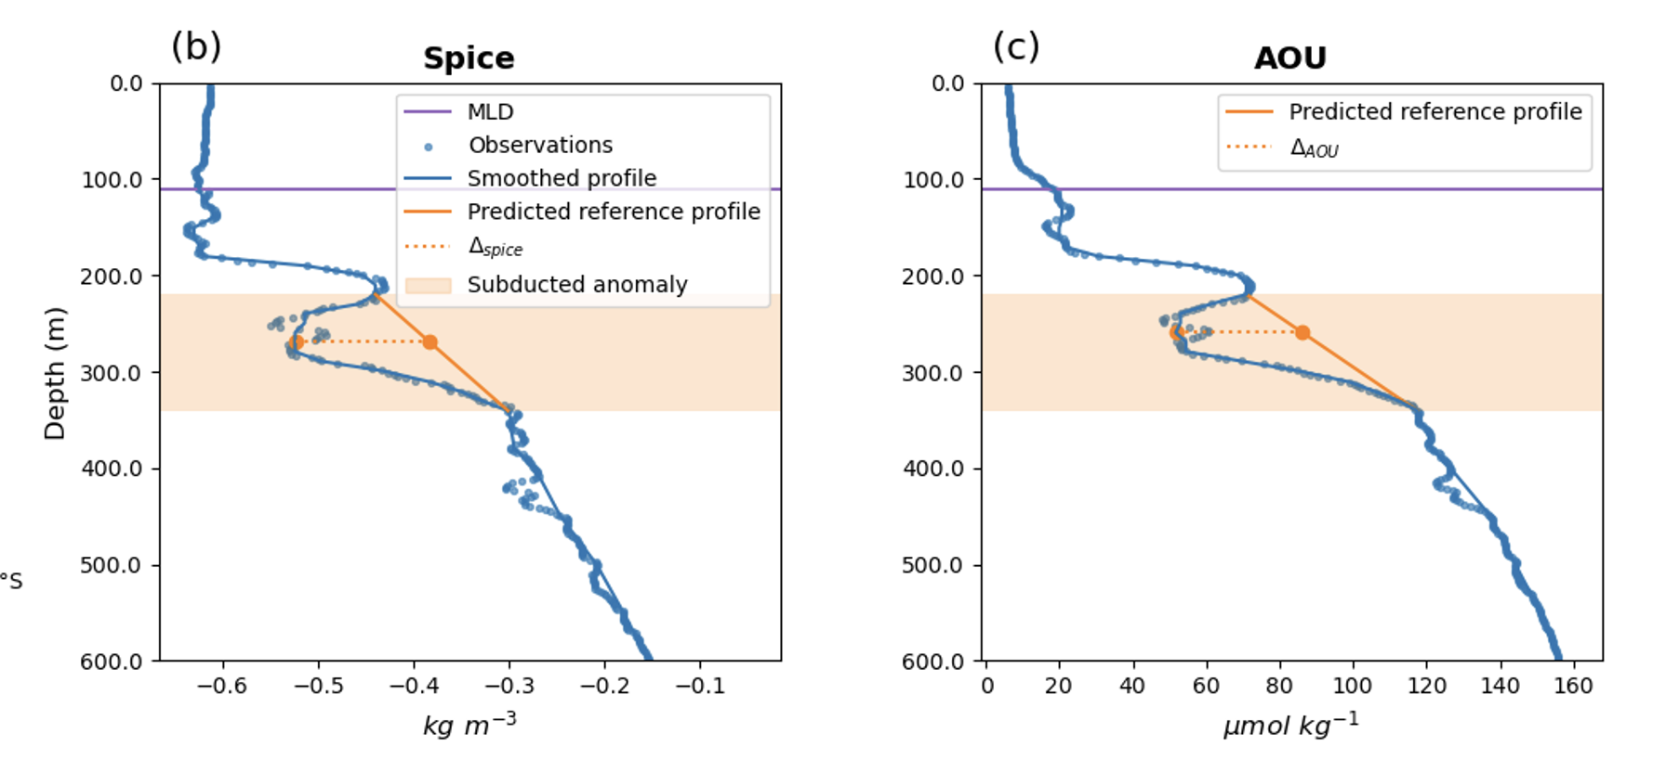
Questions?
mlc383@marine.rutgers.edu
Notes:
Mostly gonna focus on fixation

Slide 42
Calculate the subduction-driven Chl/bbp ratio

Slide 43
Calculate the subduction-driven Chl/bbp ratio
- Integrate through anomaly

Slide 44
Calculate the subduction-driven Chl/bbp ratio
- Integrate through anomaly
- Subtract background quantity (other processes such as sinking material)

Slide 45
Calculate the subduction-driven Chl/bbp ratio

Slide 46
POC within anomalies is highest in the summer

Slide 47
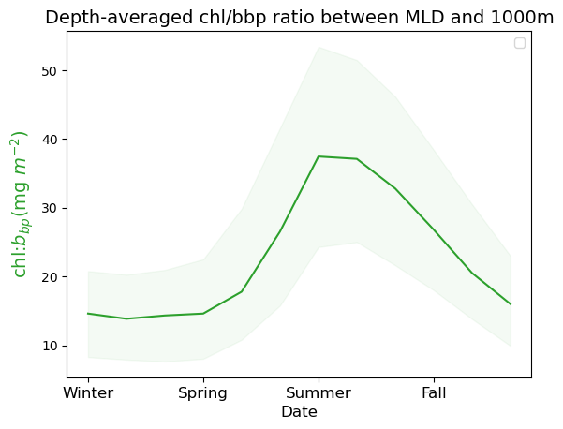
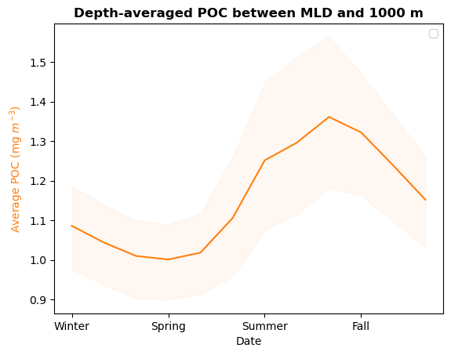
Mesopelagic Chl/bbp and POC increase in the summer
All profiles (not just ones with anomalies)

Slide 48
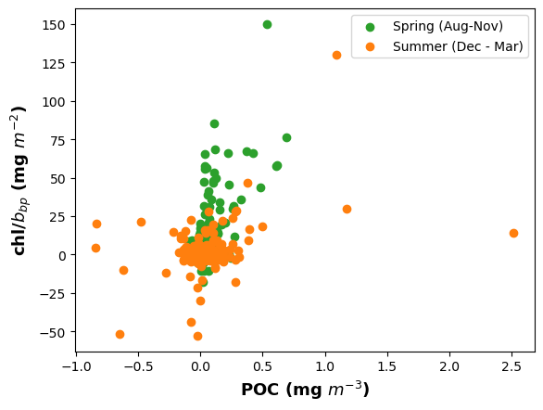
High POC summer events still have lower chl/bbp ratios than spring ones

Slide 49
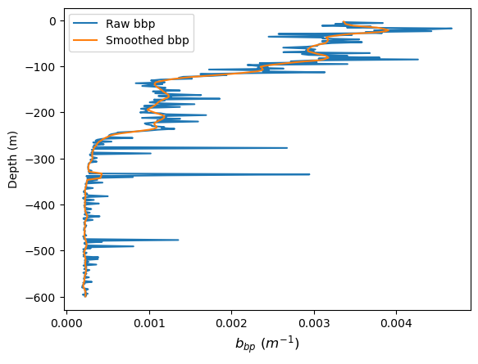
Sinking particles: Spike analysis for high-resolution (2m) Navis floats
Smoothed profiles with a 5-point running median, followed by a 7-point running mean

Slide 50
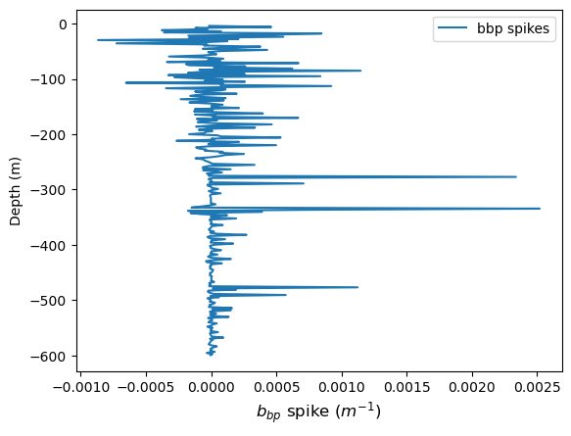
Spike analysis
Subtracted the smoothed from the raw to get the spike profile

Slide 51
Quantify the number of spikes per profile
Only between the MLD and 600m
Bbp spike thresholds (following Rembeauville et al 2017):
0.001 m⁻¹ < spike < 0.004 m⁻¹
Larger spikes indicate large, motile organisms

Slide 52
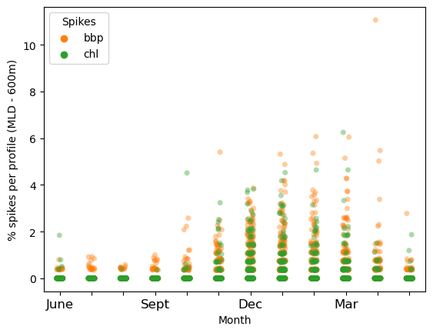
Sinking of large particles is highest in the summer
Spike analysis detects large sinking particles

