Slide 1
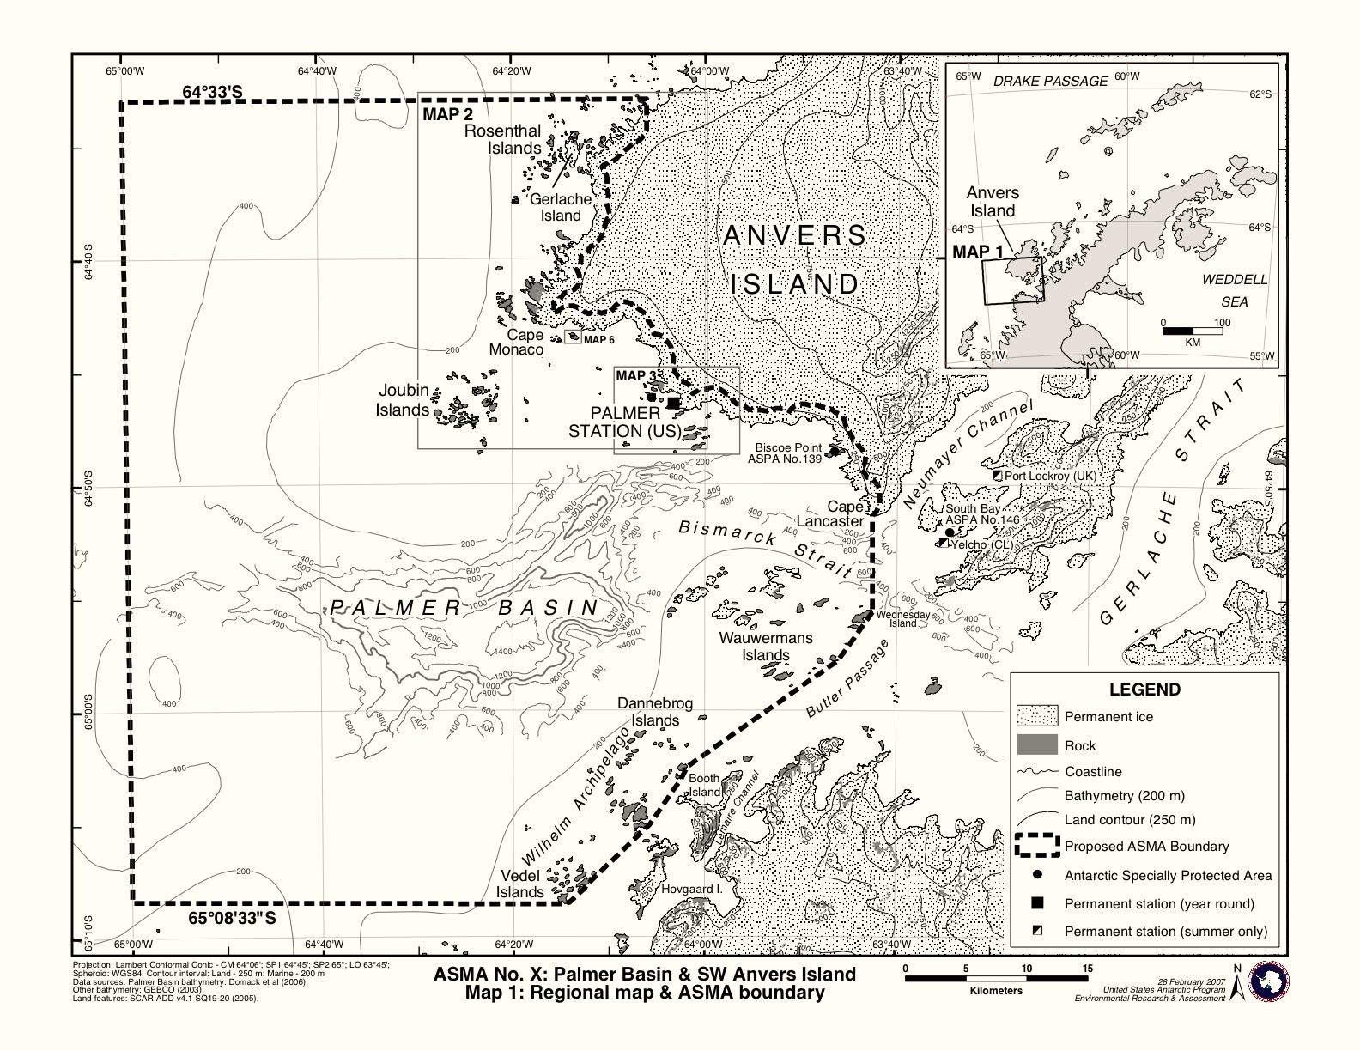
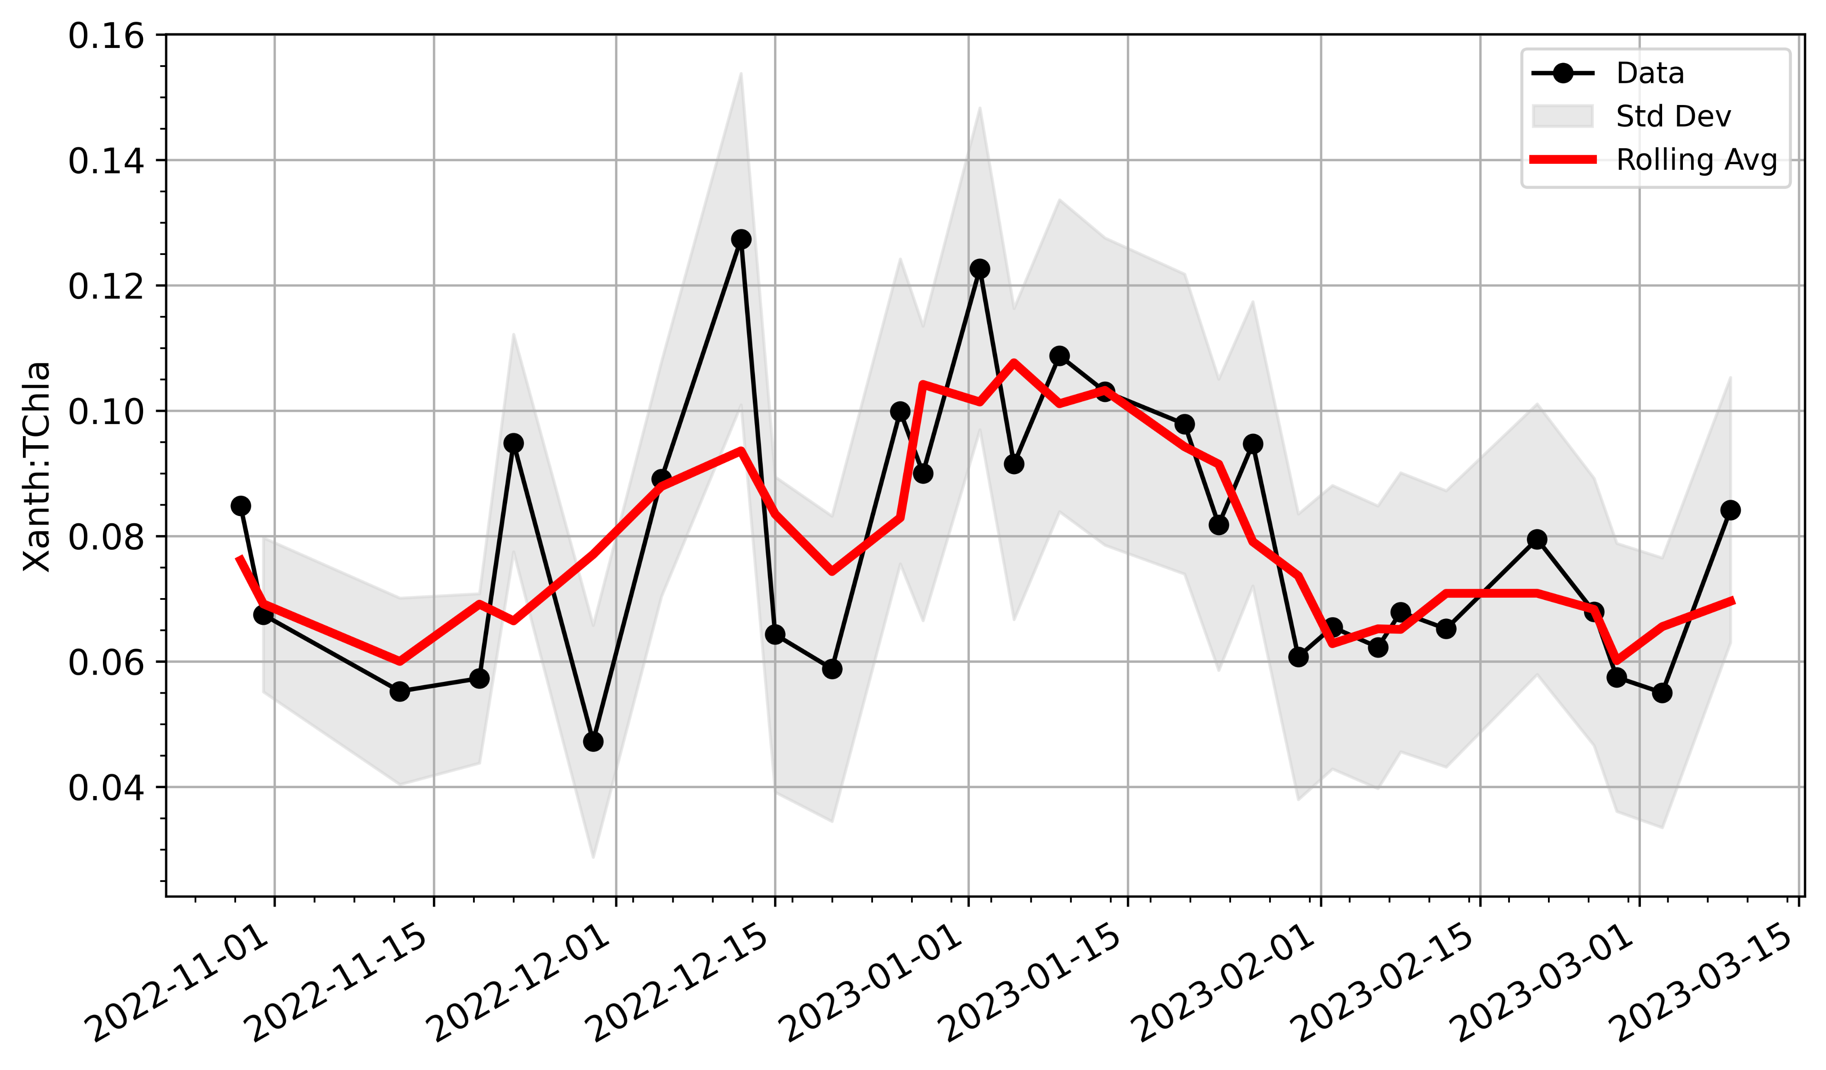
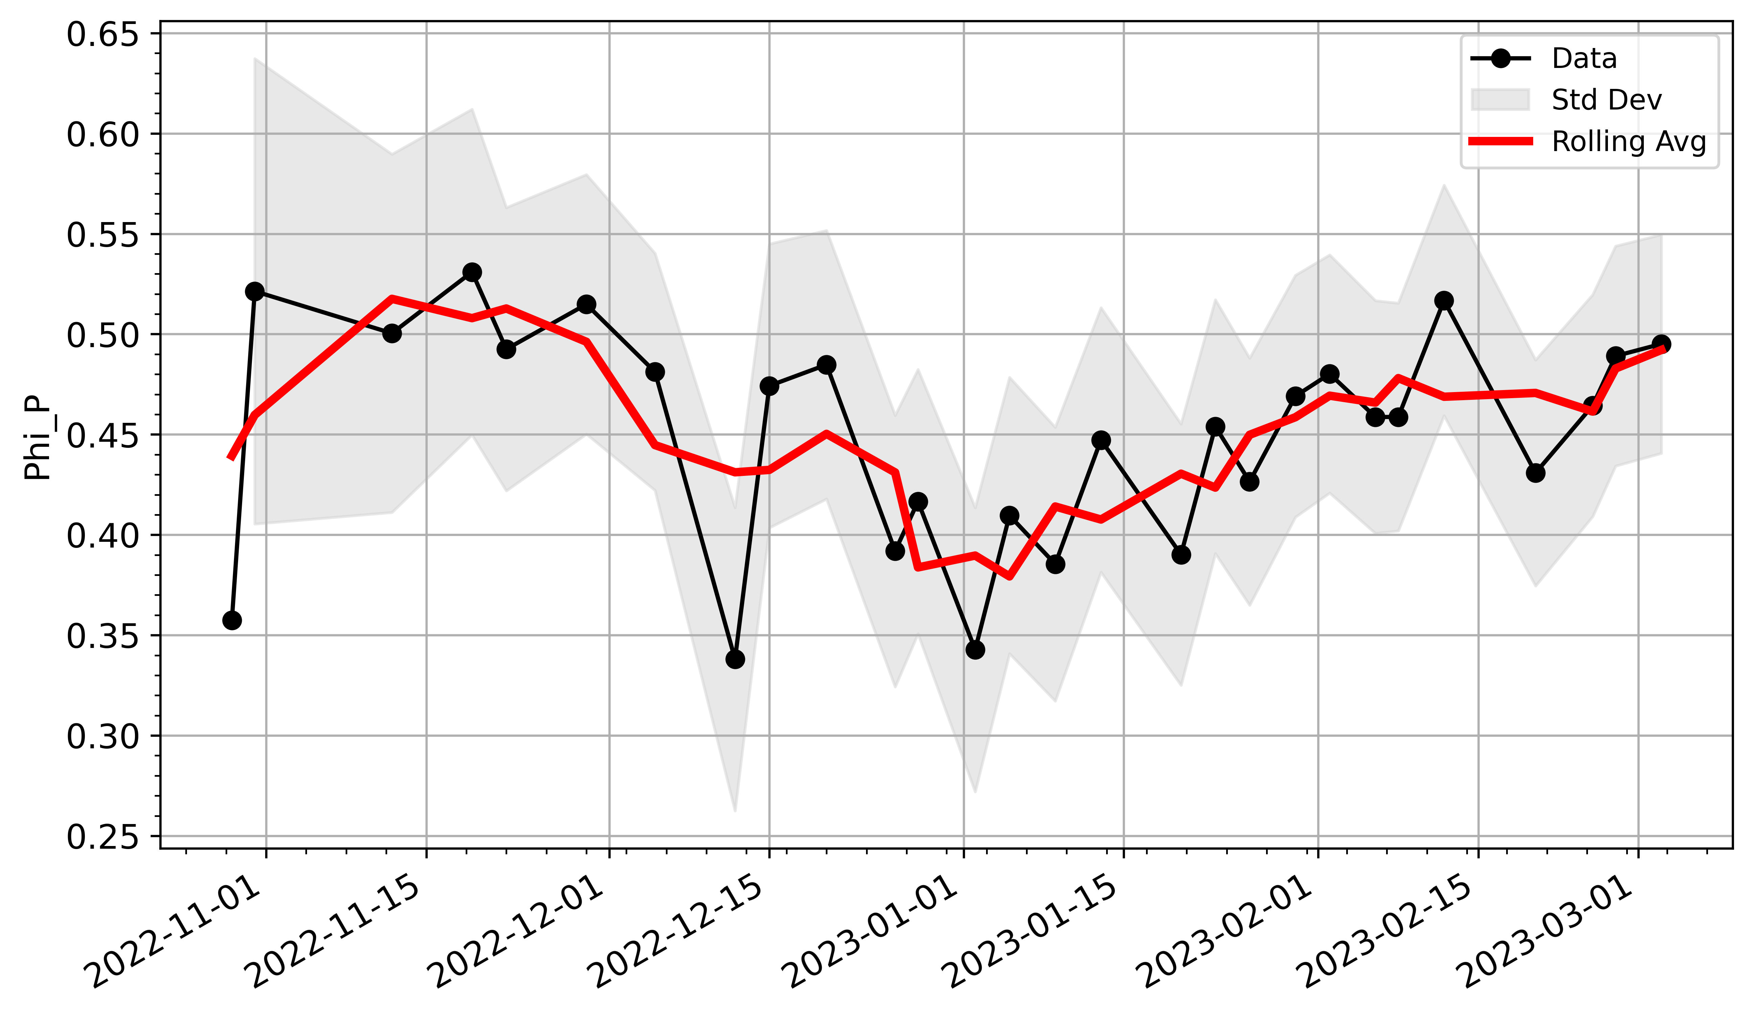
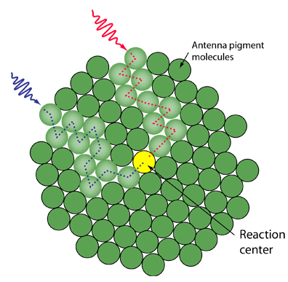
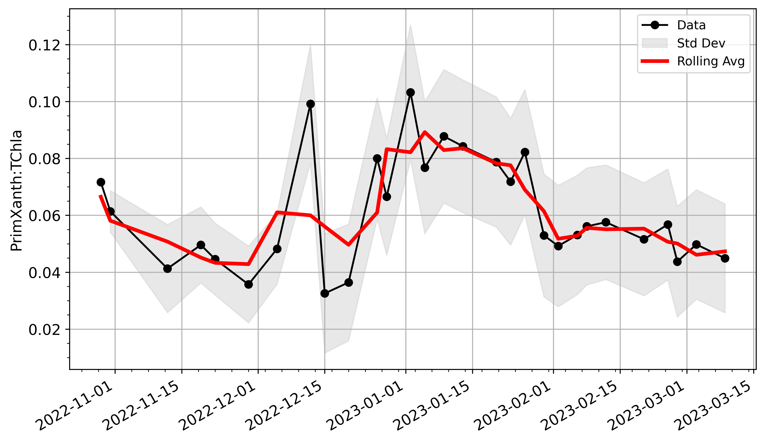
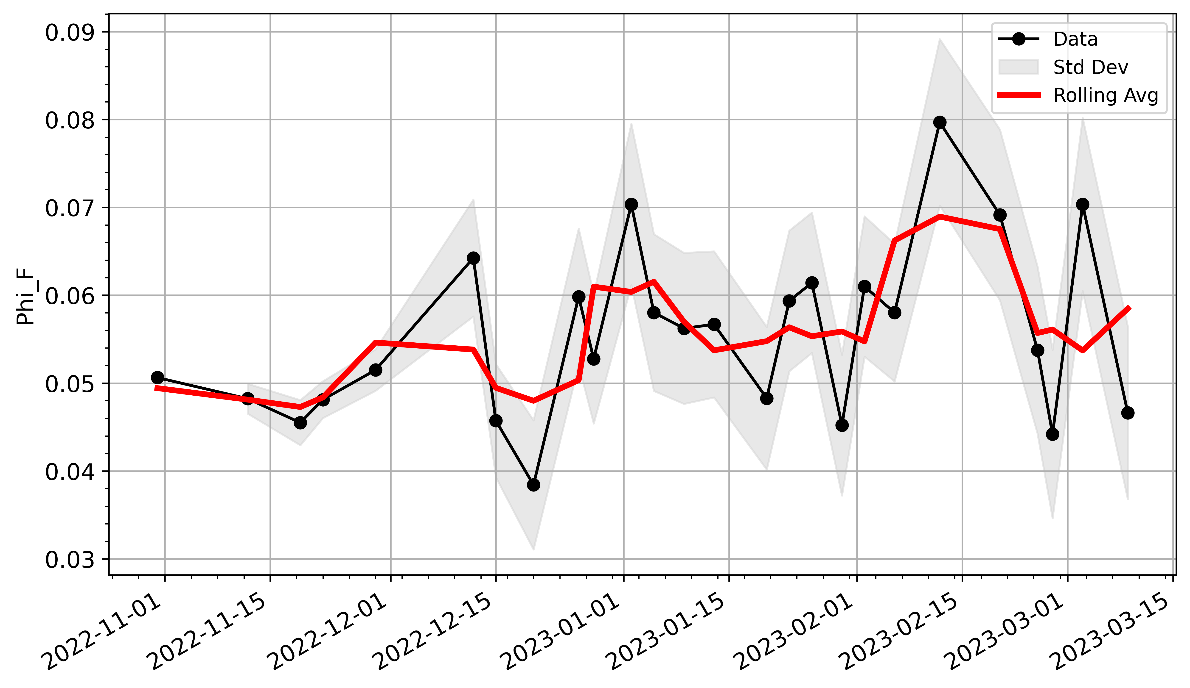
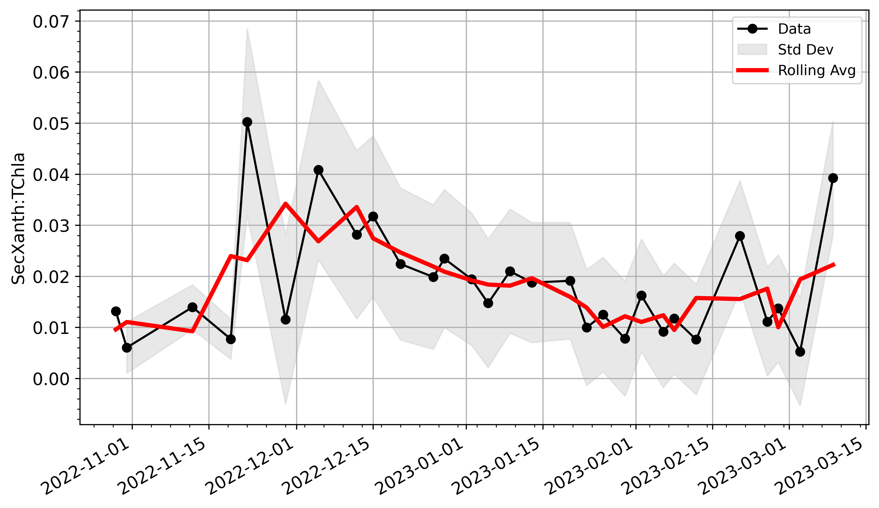
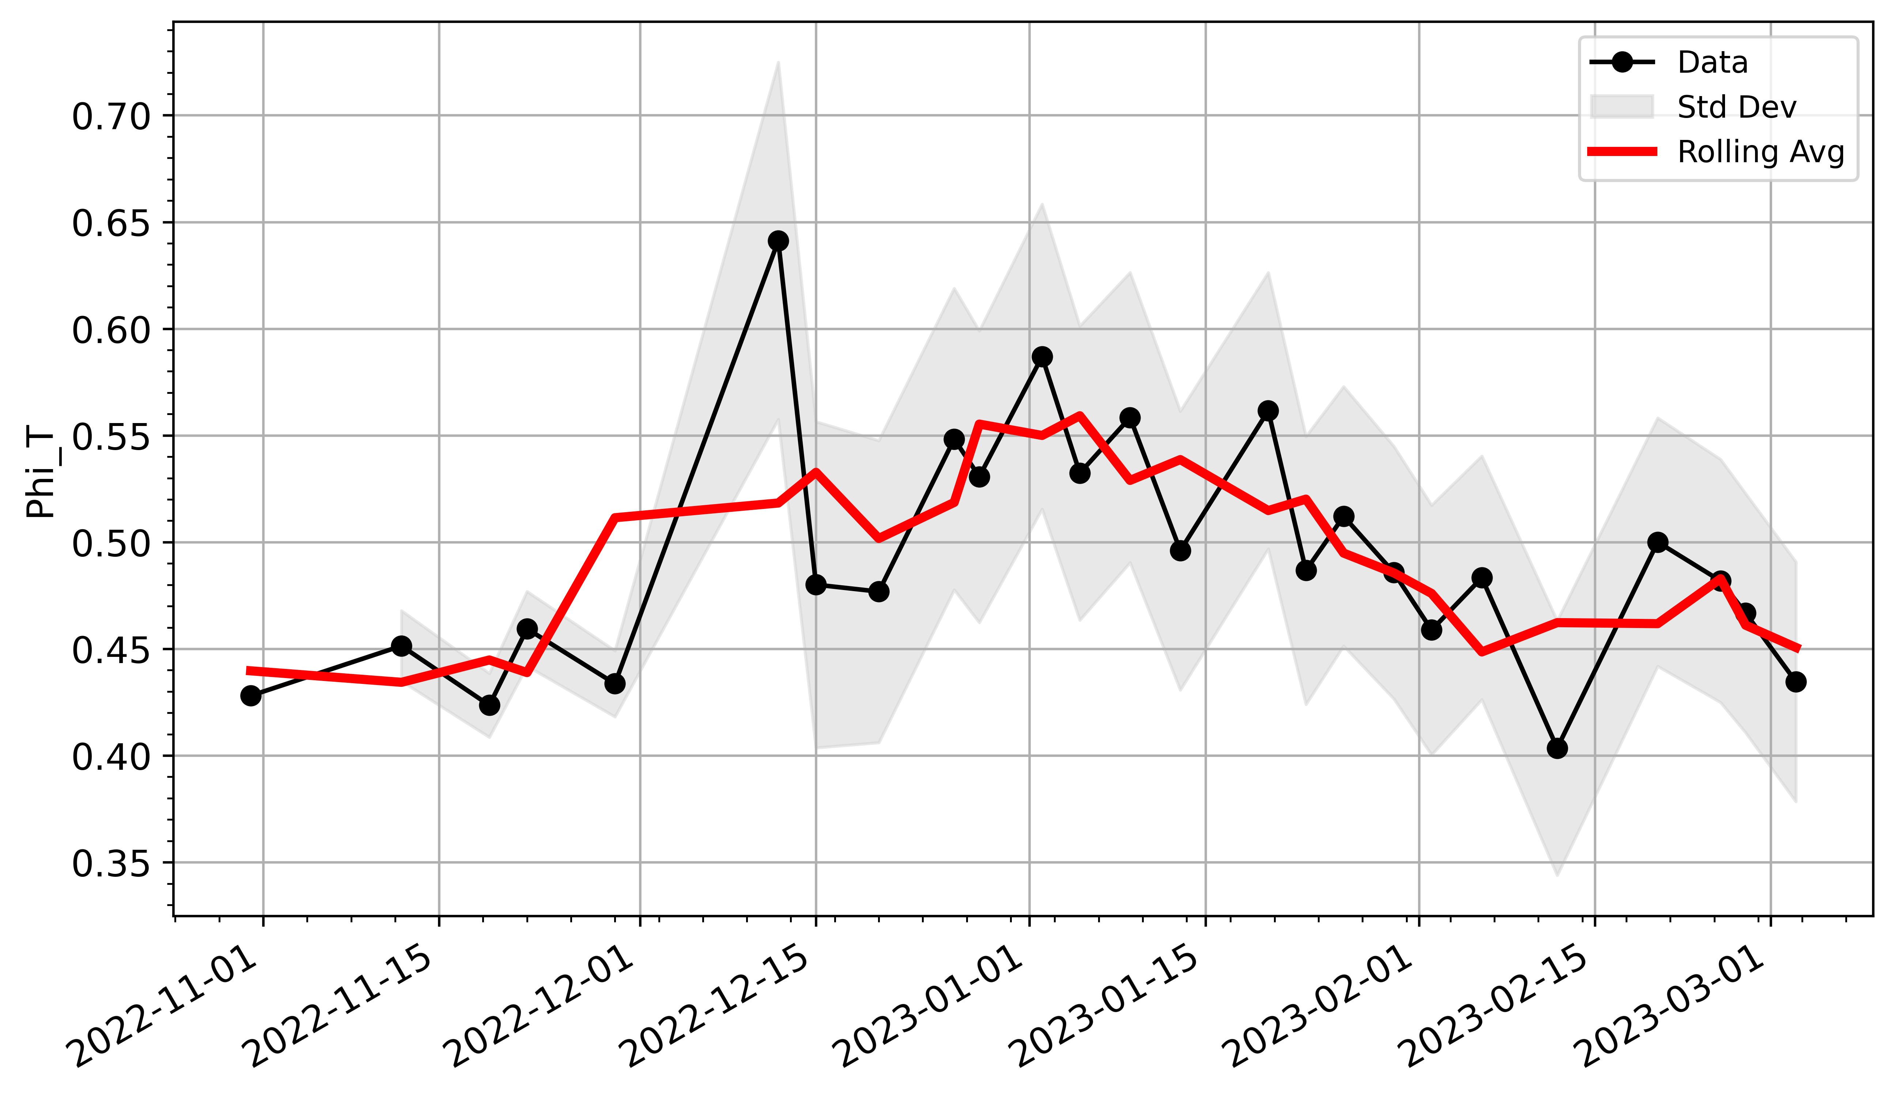
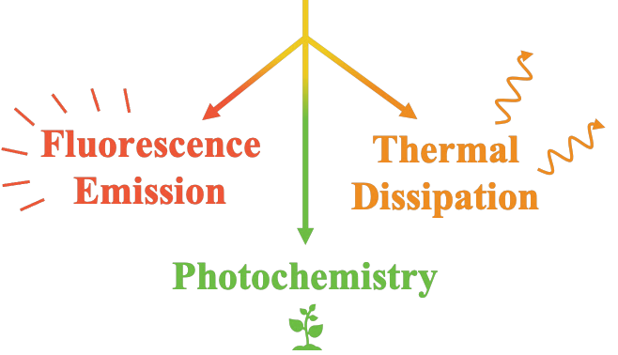
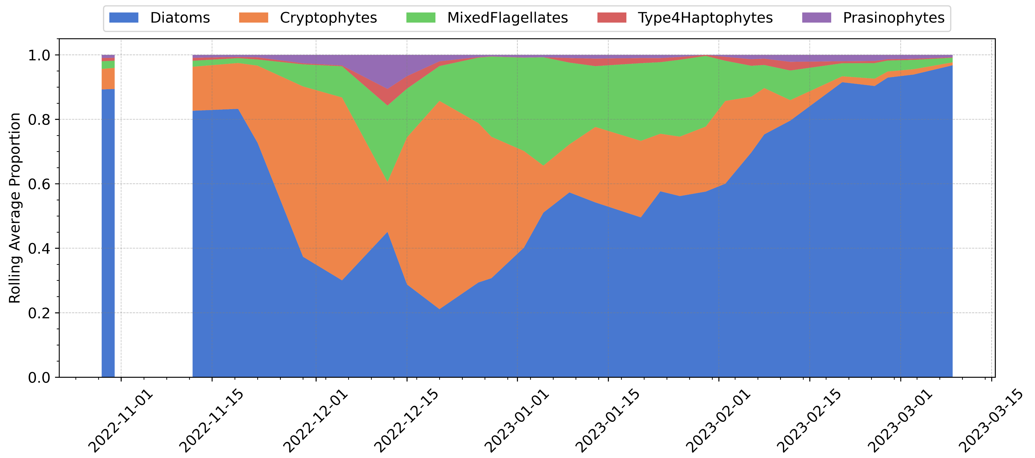
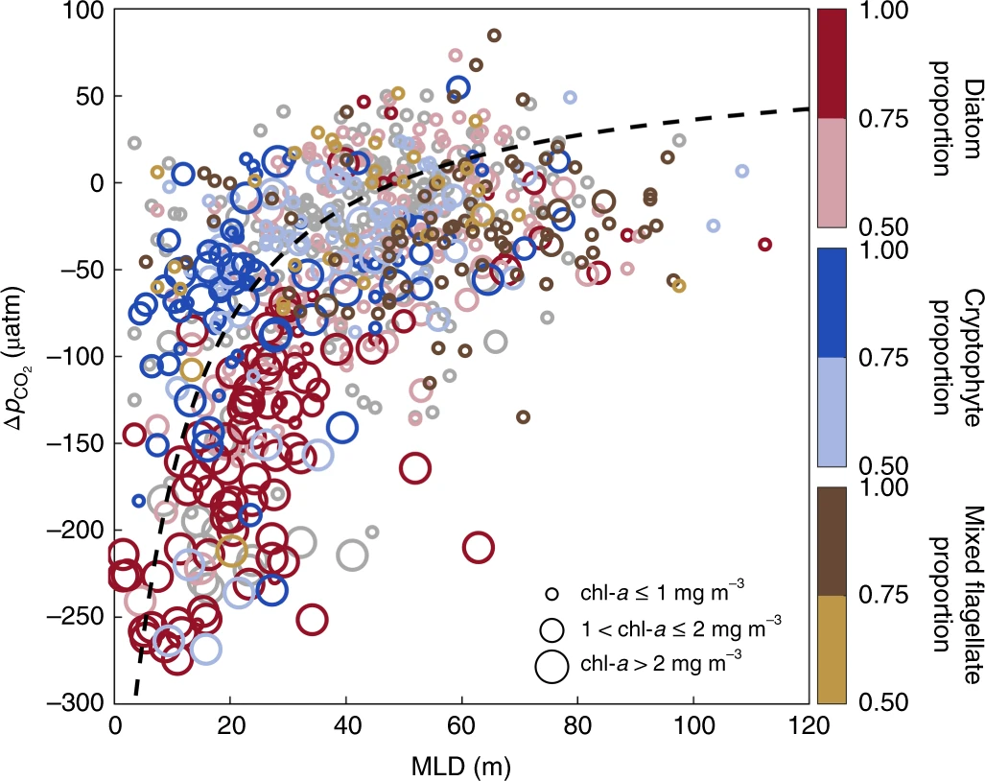
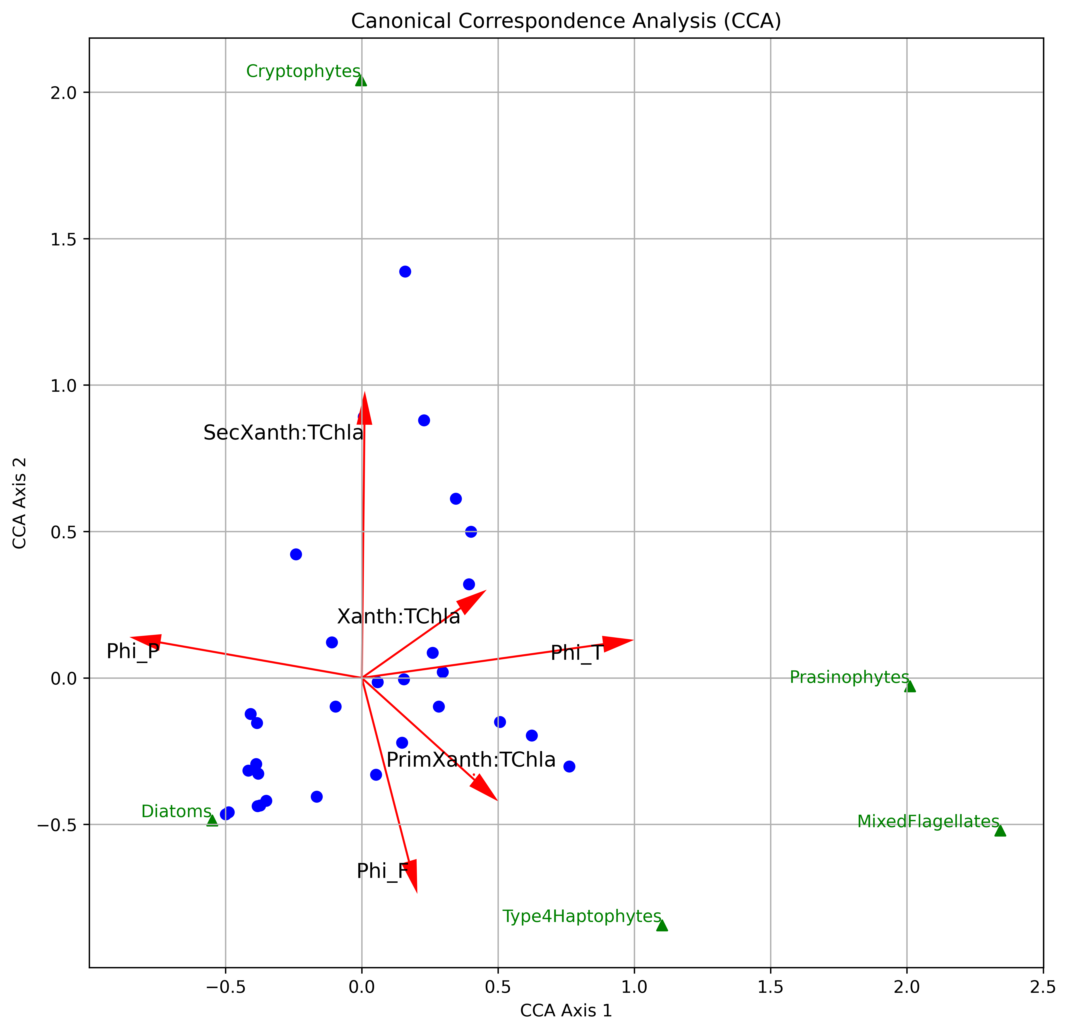
PI44A-1729: Seasonal Variability of Fluorescence-Based Phytoplankton Photophysiology in the Rapidly Warming West Antarctic Peninsula
Quintin Diou-Cass¹, Nicole Waite¹, Oscar Schofield¹
¹Department of Marine and Coastal Sciences, Rutgers University, Piscataway, New Jersey 08854
Abstract
Methods & Metrics
Results II
In the West Antarctic Peninsula (WAP), rapid warming, intensified wind forcing, widespread glacial melt, and declining sea ice have produced strong uncertainties in future ecosystem states, particularly in terms of phytoplankton ecology. Within the WAP, many studies have suggested that phytoplankton are heavily regulated by light. Observations have tied their dynamics to key climate-driven properties like seasonal sea ice extents and prevailing wind patterns that control surface mixing and light availability. Due to their light-limited nature, the photophysiological capabilities of the algae are believed to be a critical factor defining community response to climate perturbations, playing a key role in properties like productivity and community composition. However, the number of studies collecting detailed measurements of photophysiology across community responses to change (both natural and abnormal) is limited, especially across extended time periods. To that end, we compiled a suite of physiological, hydrographic, and community composition data across a seasonal cycle to gain insight into the photophysiology signals underlying seasonal successions in major taxonomic groups. Between Oct-2022 and Mar-2023, biweekly measurements were taken across the water column near Palmer Deep Canyon as part of the Palmer Antarctic Long Term Ecological Research (LTER) project. Across this seasonal timespan, we observed a distinct succession in the relative dominance of major taxonomic groups that aligned with shifts in both the state and function of algal photophysiology. A canonical correspondence analysis of taxonomic groups in the context of these photophysiological metrics highlighted three distinct photophysiological clusters, divided along axes of excitation energy dissipation and photoprotective pigment cycling. We believe these results highlight the differing photophysiological strategies of the major phytoplankton groups, which indeed appear to contribute to their distinct succession across shifting physical settings during the growing seasons in the coastal Antarctic.
SAMPLING: Biweekly CTD-rosette casts were conducted at Station E on the edge of Palmer Deep Canyon (location shown right) between October 29th (2022) and March 9th (2023). Biomass samples were collected at discrete depths quantified for pigments via HPLC, which were used to document community composition (via CHEMTAX) and photophysiology (via light-dependent pigment ratios). Fluorescence-based estimates of photophysiology (energy dissipation) were measured at discrete sampling depths on MiniFIRe and Picosecond Lifetime (PicoLiF) fluorometers. Data used in this analysis represents the average within the upper 10m of the water column
WAP
Seasonal fluctuations in photophysiological state (stressed vs not-stressed) occur in tandem with compositional shifts
Palmer Station
E
Palmer Deep Canyon
Xanth:TChla
$$Φ_{P}$$
In Spring > Summer:
Cells are happy; photoprotection is low, and diatoms dominate the community
In Peak Summer:
Cells are the most stressed; photoprotection is high, and cryptophytes/mixed flagellates push out diatoms for dominance
In Summer > Fall:
Cells become less stressed; photoprotection relaxes, and the community transitions back to diatoms
Light Energy
How Do We Measure Algal Photophysiology?
PrimXanth:TChla
$$Φ_{F}$$
USING PIGMENTS
Types of pigments (photoprotective vs photosynthetic) relative to chlorophyll-a tell us about photophysiological state
Light
Harvesting
Antenna
Complex
Algae invest in photoprotective or photosynthetic pigments depending on their light environment
SecXanth:TChla
$$Φ_{T}$$
Introduction
USING FLUOROMETRY
The proportional fate of absorbed light energy (either use in photosynthesis or dissipation) tells us about relative photophysiological function
$$Φ_{F}$$
$$Φ_{T}$$
Mixed Flagellates
The bridge between photophysiology and community composition is critical to ecology, yet understudied
$$Φ_{P}$$
The more “stressed” a cell is, the more light energy is diverted away from photosynthesis
In algal communities of the WAP, taxonomically-linked differences in productivity⁽²⁾, CO₂ drawdown⁽³⁾, and trophic transfer⁽⁴⁾ have been observed (example: the figure to the right), providing strong evidence that phytoplankton composition is a key factor shaping community function
Cryptophytes
Results I
Major taxonomic groups of the WAP form three distinct photophysiological clusters: Diatoms, Cryptophytes, and Group 3 (mostly Mixed Flagellates)
Diatoms
At the same time, observational correlations and experimental evidence within the coastal regions have shown that phytoplankton dynamics are light-limited along the WAP⁽¹⁾, meaning that photophysiological capabilities are likely critical in regulating ecological dynamics (including composition)
Brown et al. (2019)
Diatoms routinely associate with the healthiest photophysiology (low photoprotection, low stress)
Cryptophytes and Group 3 associate with photoprotective mechanisms, where Cryptophytes are associated with more active photoprotection (SecXanth:TChla) than Group 3
Group 3 is negatively associated with high photochemistry
Conclusions & Implications
Group 2
Photoprotective cycling appears to be a key component dividing major taxonomic groups, and varies seasonally
Pathways of energy dissipation vary seasonally, but do not appear to be tightly correlated with taxonomic groups
Photophysiology is critical to quantify in order to properly decipher algal response across biophysical interactions
Symbol size indicates chl-a via HPLC. Symbol color indicates diatom, cryptophyte, or mixed flagellate proportion (grey indicates that no group dominated, that is represented ≥50% of total chl-a). The black dashed line indicates Δ�CO2 modelled as a function of MLD with a constant rate of biological production. n = 702 [from Brown et al. 2019]
What are the photophysiological signatures underlying seasonal dynamics in major Antarctic phytoplankton groups?
The suggested significance of photophysiology to ecological dynamics, combined with the rising importance of community composition, leads us to ask:
$$Φ_{P}$$
Group 3
Figure Left: a Canonical Correspondence Analysis (CCA) plot of community composition relative to photophysiological parameters. Red vectors show physiological variables, where length and position of the vector indicates the direction and strength of the correlation between the associated metric and the major taxonomic groups (green triangles). Blue dots represent individual samples used in the analysis
Over a seasonal cycle, differences in photophysiological capabilities (strategies) between major taxonomic groups appear to play a substantial role in the successional patterns observed across the growing season
$$Φ_{T}$$
To answer this question, the seasonal successions in phytoplankton taxa observed around Palmer Deep Canyon (a nutrient-replete, light-limited, ecological hotspot) make for a perfect setting to address this topic…
As surface mixing dynamics shift with changing climates, photophysiological capabilities may play a key role in defining the dominant community structure in ecological hotspots
Group 1
$$Φ_{F}$$
Questions? Comments?
Looking for a Post-Doc??
Contact me at: qpd1@marine.rutgers.edu
dioucass@gmail.com
Citations & Acknowledgments:
Henley, S. F., et al. (2019). Variability and change in the west Antarctic Peninsula marine system: research priorities and opportunities. Progress in Oceanography, 173, 208-237.Lin
Brown, M. S., et al. (2019). Enhanced oceanic CO2 uptake along the rapidly changing West Antarctic Peninsula. Nature Climate Change, 9(9), 678-683.
Saba, G. K., Fraser, W. R., Saba, V. S., Iannuzzi, R. A., Coleman, K. E., Doney, S. C., ... & Schofield, O. M. (2014). Winter and spring controls on the summer food web of the coastal West Antarctic Peninsula. Nature communications, 5(1), 4318.
* * * *
This analysis was funded through the NSF as part of the Palmer Long-Term Ecological Research (LTER) project and was completed as part of a doctoral dissertation at Rutgers University. Acknowledgments should be given to Oscar Schofield for his intellectual contributions and support of the project, and to Nicole Waite for assistance with LTER data aggregation and processing.
Notes:
Beginning: Light availability is believed to play an important role in phytoplankton ecology in the coastal WAP; being shown to impact overall productivity and possibly play an important role in taxonomic composition (across both seasonal and interannual timescales). However, the role of light availability in structuring seasonal successions is understudied. To that end, we used a combined method of pigment-based and fluorometry-based metrics for photophysiology over a seasonal cycle to explore the correlations between major taxonomic groups and the photophysiological status of the phytoplankton community.
Middle:
End:

