Slide 1
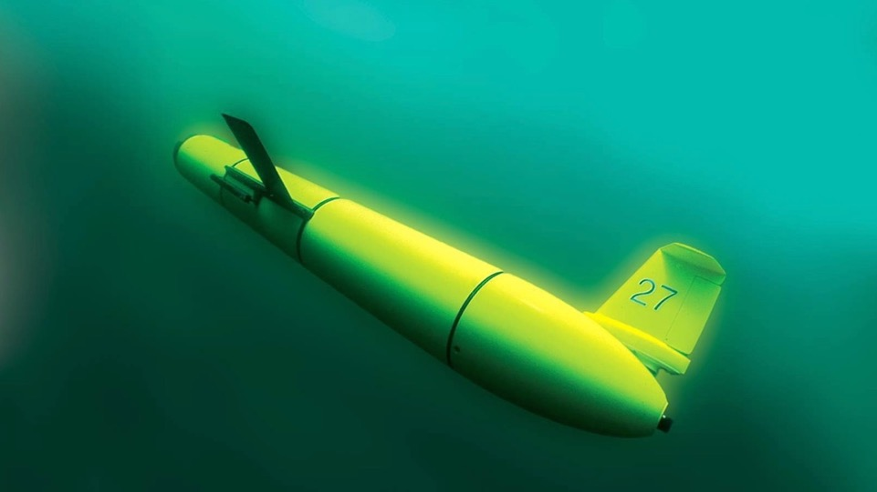
Perspectives on Offshore Wind and the Environment from a Local
Oceanographer and Meteorologist
Dr. Josh Kohut & Dr. Joe Brodie
Center for Ocean Observing Leadership
Department of Marine and Coastal Sciences
School of Environmental and Biological Sciences

Slide 2


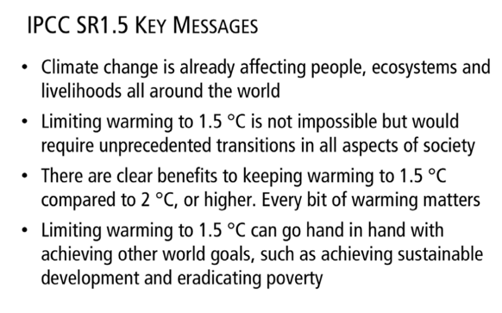
October 2018

Slide 3
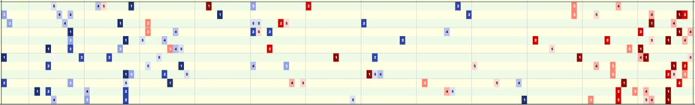

New Jersey’s Extreme Temperature Months
Jan
Apr
Jul
Oct
Dec
1895 1930 1960 1990 2020
Courtesy of the Office of the New Jersey State Climatologist, Dr. David Robinson

Slide 4
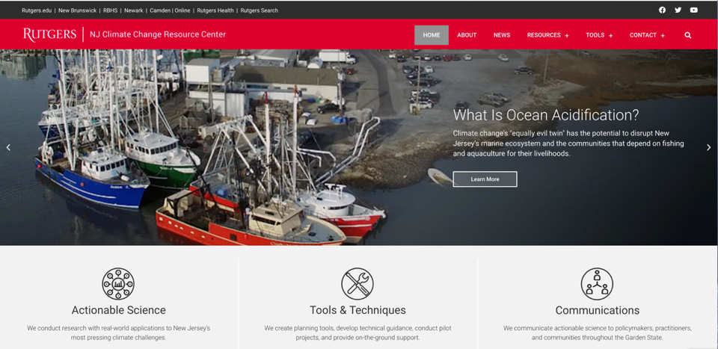
https://njclimateresourcecenter.rutgers.edu/

Slide 5
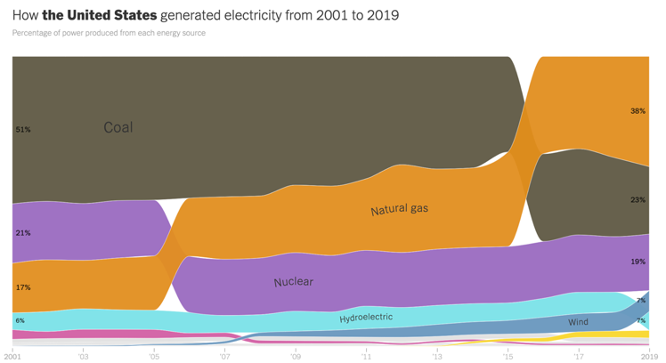
How Do We Get Our Electricity?
https://www.nytimes.com/interactive/2020/10/28/climate/how-electricity-generation-changed-in-your-state-election.html
Notes:
Yellow - solar
Gray – Geothermal/biomass
Pink - oil
Wind is actually the fastest growing sector, with more new wind capacity built each year than any other power source (past 2 years)

Slide 6
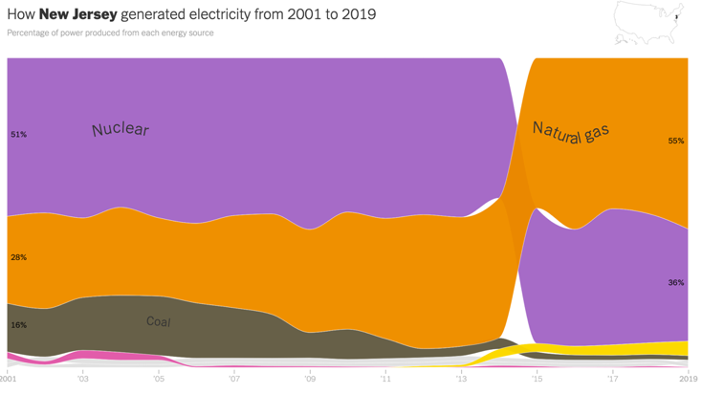
What About New Jersey?
https://www.nytimes.com/interactive/2020/10/28/climate/how-electricity-generation-changed-in-your-state-election.html
Notes:
Yellow - solar
Gray – Geothermal
Pink – oil
Does not include out of state imports

Slide 7
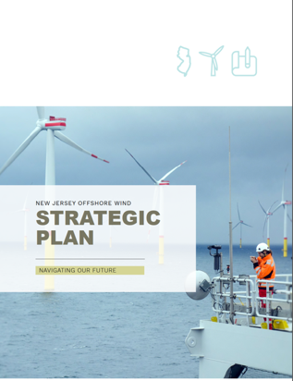

What About New Jersey?
7.5 GW of
Offshore wind
2035
September 2020
Notes:
Yellow - solar
Gray – Geothermal
Pink – oil
Does not include out of state imports

Slide 8
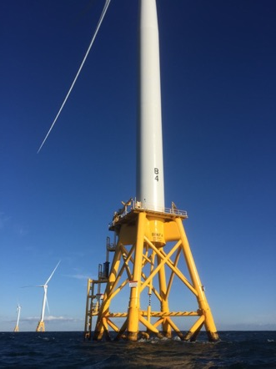
What is Offshore Wind?
Wind turbines constructed in the ocean:
  Do not occupy land resources
  Can be built considerably larger than on land
Only two small operating offshore wind farms in the US
  Block Island, RI (5 turbines, 30 MW)
  Coastal Virginia (2 turbines, 12 MW)
Offshore development faces many challenges beyond land-based wind
  Physical and biological ocean characteristics and concerns
  Multiple ocean uses

Slide 9
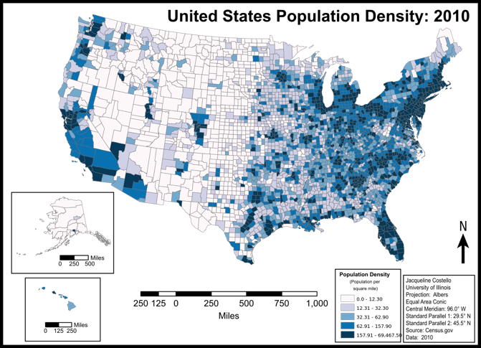
High Population Density

Slide 10
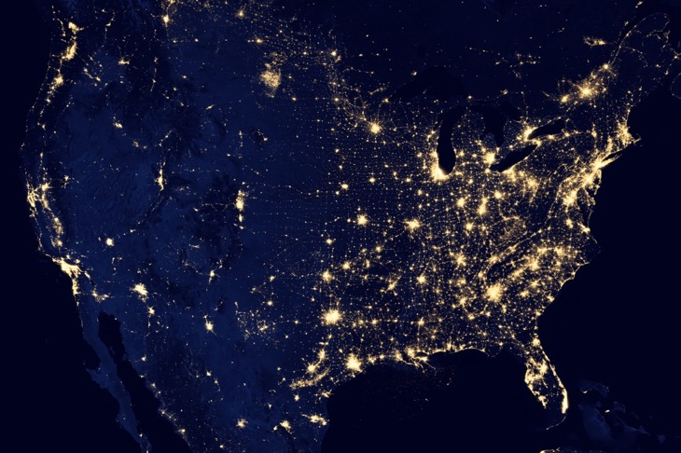
High Population Density
Intense Power Demand
NASA

Slide 11
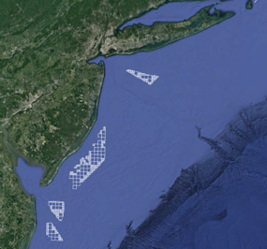
High Population Density
Intense Power Demand
Strong Wind Resource

Slide 12
State Commitments to Offshore Wind
State | OSW Goal (MW) | Target Date
Massachusetts | 5,600 | 2035
Rhode Island | 430 | 2025
Connecticut | 2,000 | 2030
New York | 9,000 | 2035
New Jersey | 7,500 | 2035
Maryland | 1,568 | 2030
Virginia | 5,200 | 2034
North Carolina | 8,000 | 2040
Total | 39,298
Federal Goal: 30 GW (30,000 MW) by 2030
Sources: DOE 2021 Offshore Wind Market Report and NCSL
As of August 2021
Notes:
For comparison, Oyster Creek was 636 MW
NJ commitment is about 50% of NJ total electricity use
Maine coming soon

Slide 13
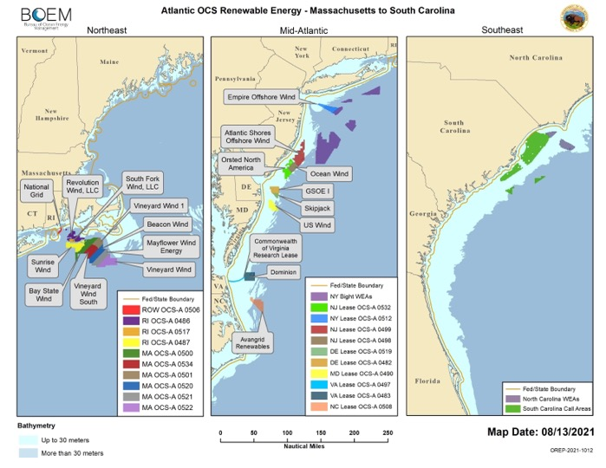

Slide 15
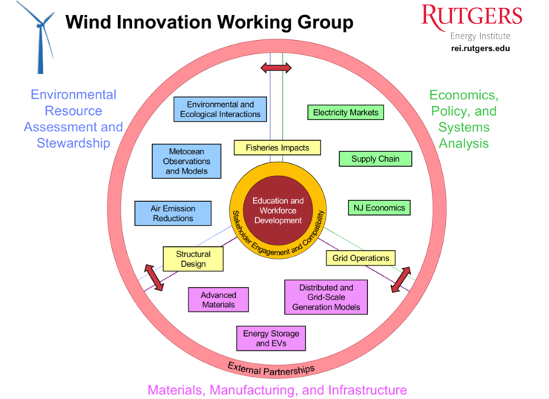

Slide 16
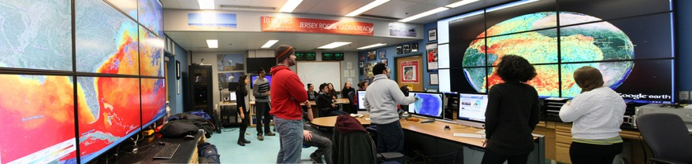
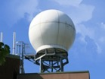
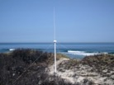
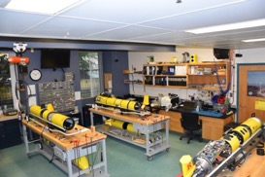



Rutgers University - Center for Ocean Observing Leadership
MARACOOS – A forum to bring forward the best science & technology
46 Site CODAR Network
Satellite Receivers
>500 Glider
Deployments
Glider Lab
Ocean
Modeling
Notes:
16
All of this gets combined into our overall operations, research, and educational initiatives in the “COOL Room,” shown here (with a class in the background)
Thanks to many partners

Slide 17
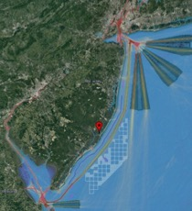
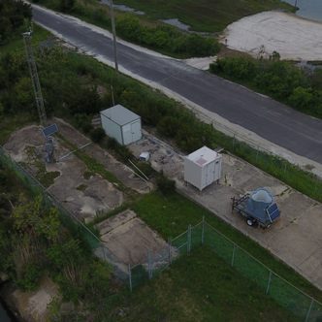
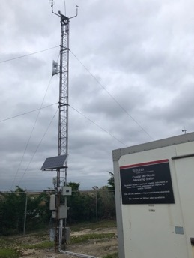
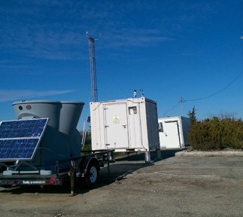
Rutgers Coastal Met-Ocean Monitoring Site

Slide 18
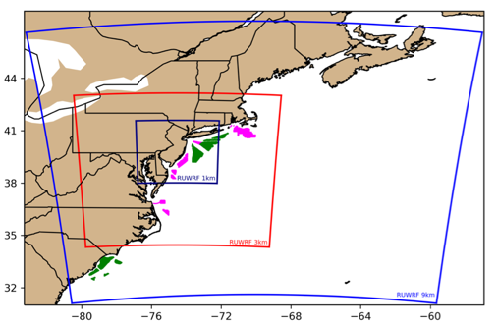

Modeling NJ’s Wind Resource: RU-WRF
Continuously run daily since 2011 through present day
Includes modeling done at 9 km, 3km, and 1 km resolution
Hourly data, to allow for various types of analysis
Utilizes RUCOOL ocean data to capture coastal upwelling, a large driver of coastal wind features like sea breezes

Slide 19
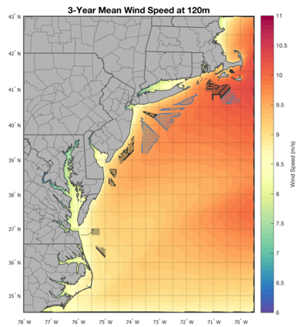
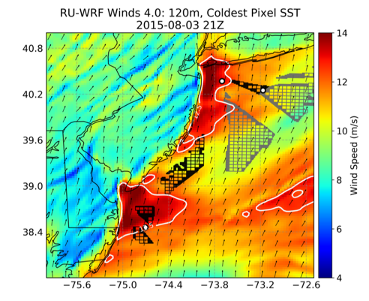

Real-Time Weather Modeling RU-WRF
Notes:
Not coupled to ocean (yet), but includes SST data using our unique coldest pixel algorithm that removes clouds, yet retains cold upwelling
We currently only run the 0Z run, but with new compute resources, might be adding cycles
Composite of NASA-SPoRT and AVHRR SST data
Made publicly available on our website
Several groups using RU-WRF data to run ocean models

Slide 20
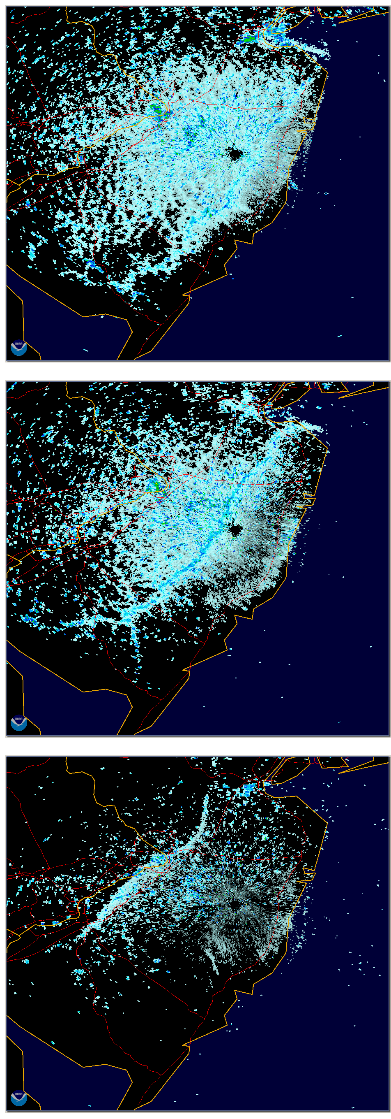
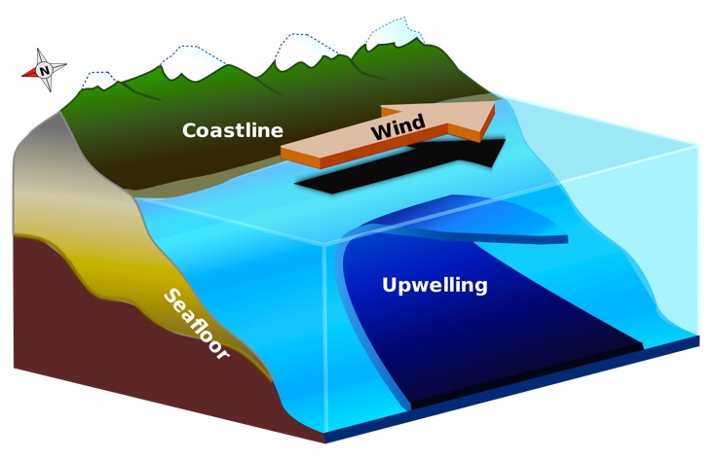
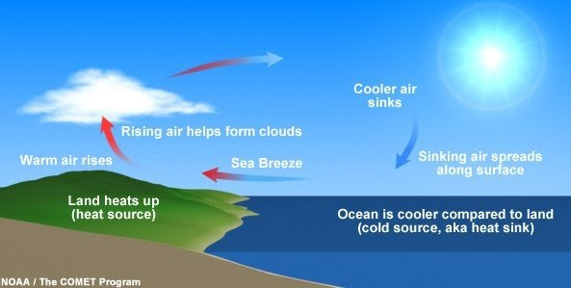
Sea breezes are common;
Driven by land-sea temperature difference
Depending on height and strength of the return flow, and the location of the subsidence zone, turbines could experience different winds throughout the rotor layer
Upwelling
NWS Mt Holly radar
20 Jun 2000

Slide 21
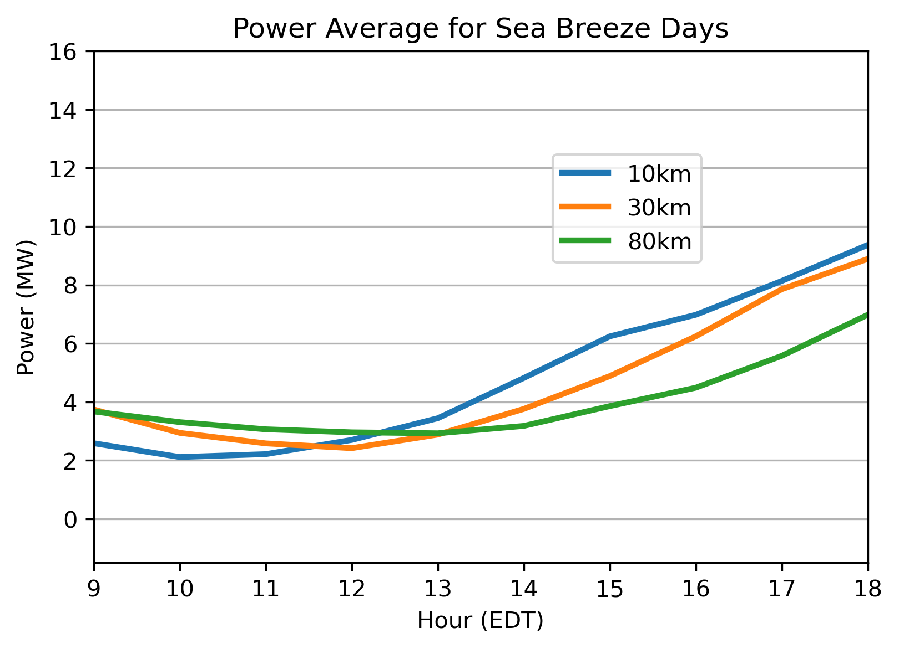
Sea breezes can drive offshore wind
on otherwise less windy days

Slide 22

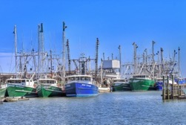
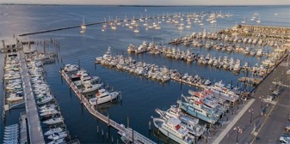
Fishing Industry Concerns and Research Priorities
Access: Before, during, and after construction
  Placement and spacing of turbines and cables
  During fishing activities and while transiting
  Cumulative impacts
Ecosystem Impacts: Influences on physical and biological processes
  Ocean-atmosphere interactions, currents, cold pool dynamics
  Distribution, behavior, reproduction, and survival of marine fishery resources
Navigation and Safety: During fishing activities and while transiting
  Varying weather conditions, different user groups, radar impacts

Slide 24

Influence on continental shelf oceanography and associated ecological processes
Research Needs
How much overlap is there between offshore energy areas that are targeted for development and the cold pool?
What is the threshold of stratification that will be impacted by offshore wind turbines?
How does this relate to the seasonal evolution of the cold pool off our coast?

Slide 25

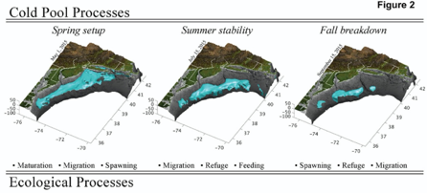
Influence on continental shelf oceanography and associated ecological processes

Slide 26
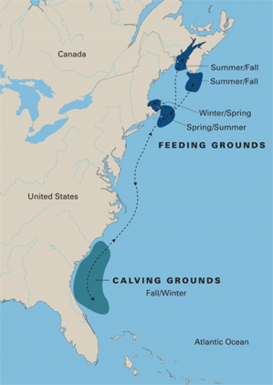
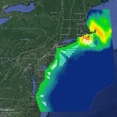
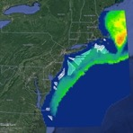
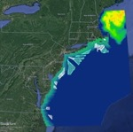
Marine Mammals
Right Whale Migration
APR
JUN
DEC
Data: Duke University Marine Geospatial Ecology Lab
Photo: NOAA

Slide 27
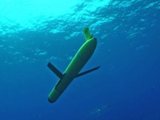
Offshore Construction Challenges
Offshore construction must cease when right whales in the area
Currently determined using trained spotters with binoculars on boats
Acoustic detecting equipment on autonomous marine platforms (buoys, gliders) can detect vocalizing whales
More efficient at less cost?
Mark Baumgartner, Robots4Whales (WHOI)

Slide 28
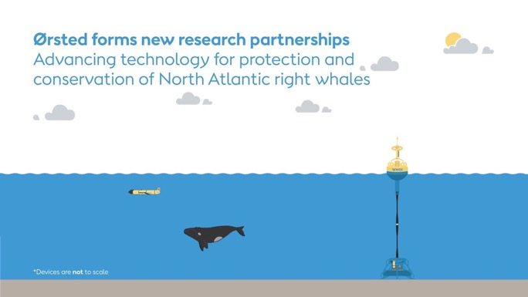


Academic and Industry Collaboration: ECO-PAM
https://go.rutgers.edu/ECO-PAM

Slide 29

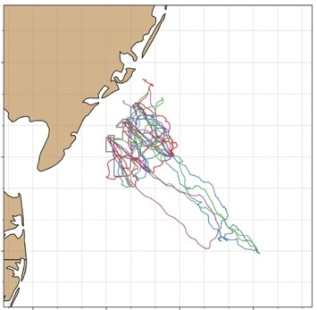
High Resolution Mapping focused on the Ocean Wind Site
4 Deployments Completed
1 Currently Underway
3 Additional NJ Deployments funded

Slide 30
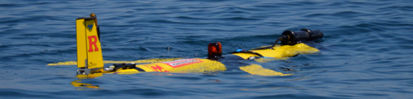
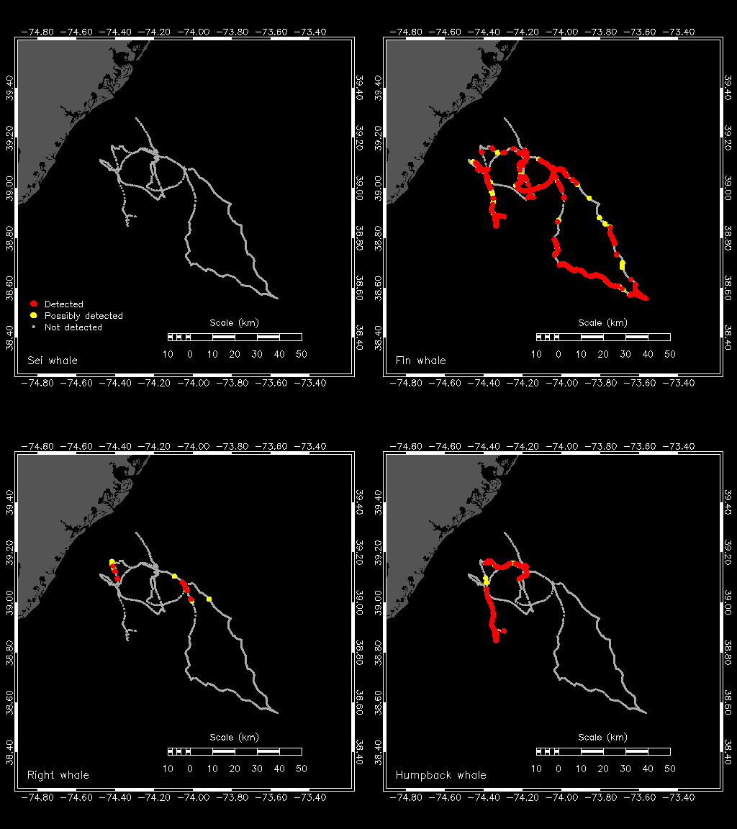
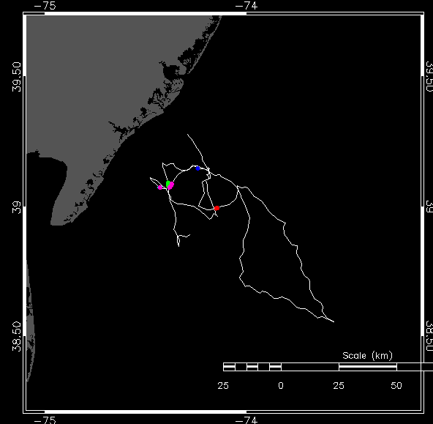
High Resolution Mapping focused on the Ocean Wind Site:
Marine Mammals
January 13, 2022 - Yesterday
Right
Whale
Fin
Whale
Fish

Slide 31
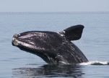
High Resolution Mapping focused on the Ocean Wind Site:
Marine Mammals

Slide 32

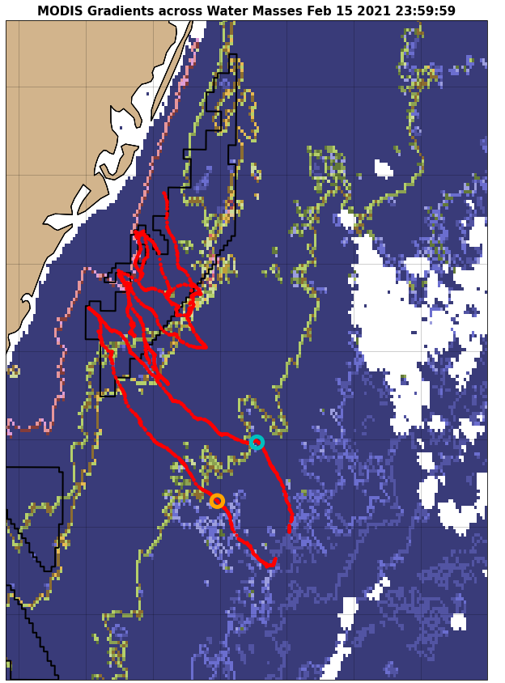
High Resolution Mapping focused on the Ocean Wind Site:
Marine Mammals
Center for Ocean Observing Leadership

Slide 33
High Resolution Mapping focused on the Ocean Wind Site:
Marine Mammals

Slide 34
In Summary
Offshore wind is coming to the US, and to NJ
The ocean is a complex place, and all stakeholders can contribute their expertise to the responsible deployment of offshore wind.
Researchers at Rutgers as a whole are helping to better inform this process, making sure the best science is used to make the best decisions

Slide 35
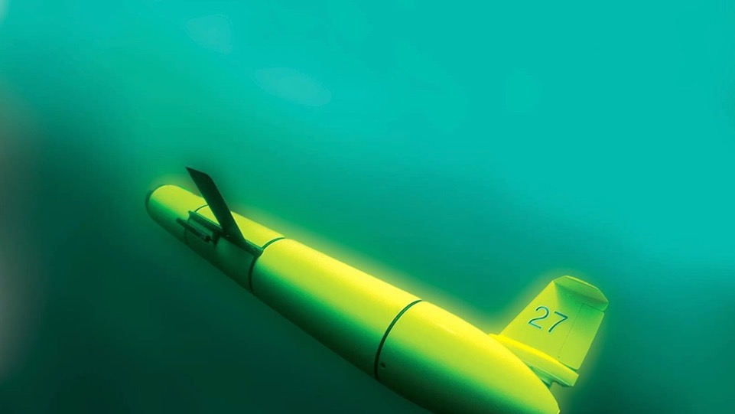
Thank you!
For more information:
Josh Kohut
kohut@marine.rutgers.edu
Joe Brodie
jbrodie@marine.rutgers.edu
https://go.rutgers.edu/RUCOOL-OSW

