Slide 1
Technology for Understanding Offshore Wind and the Environment
Joseph Brodie (he/him/his)
Time for Turbines
27 January 2021

Slide 2

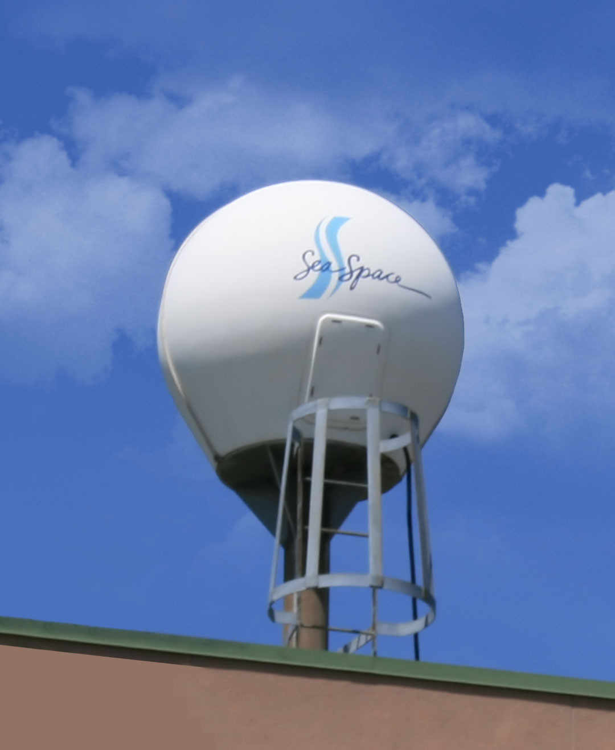
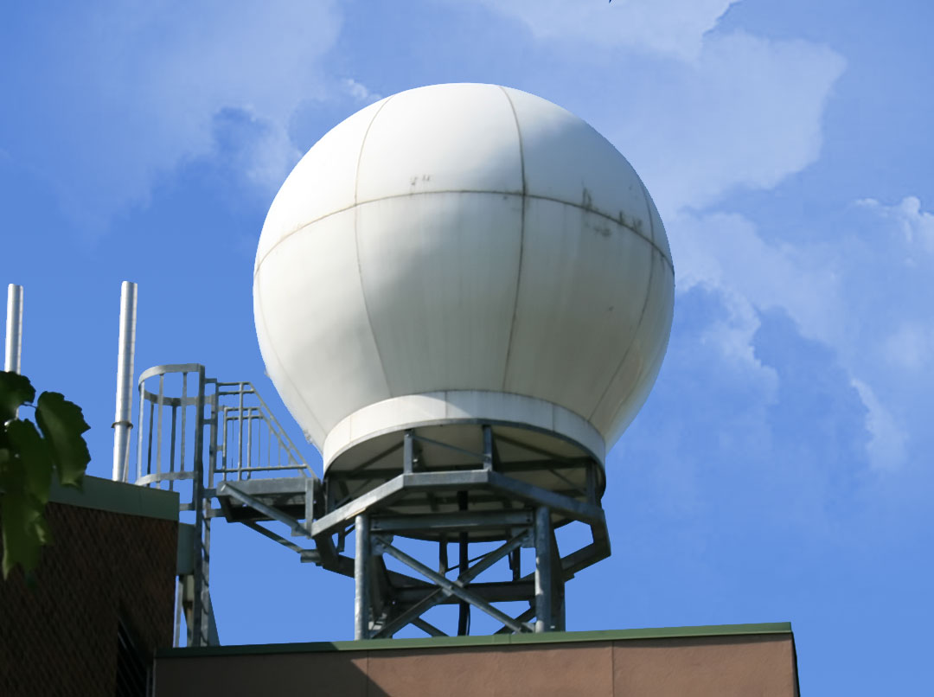
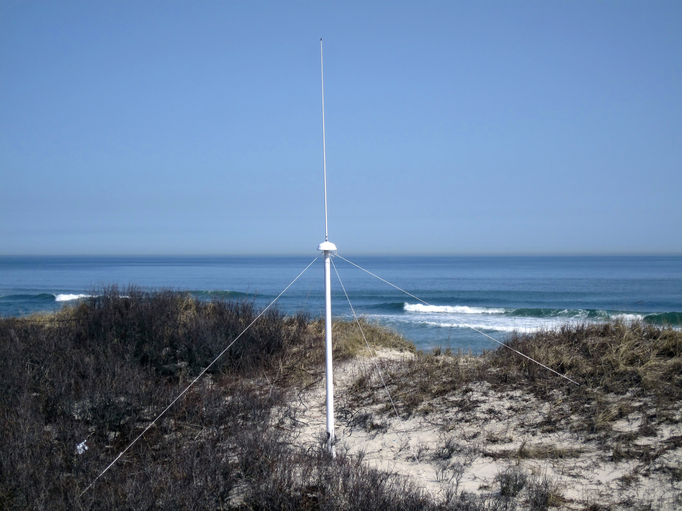
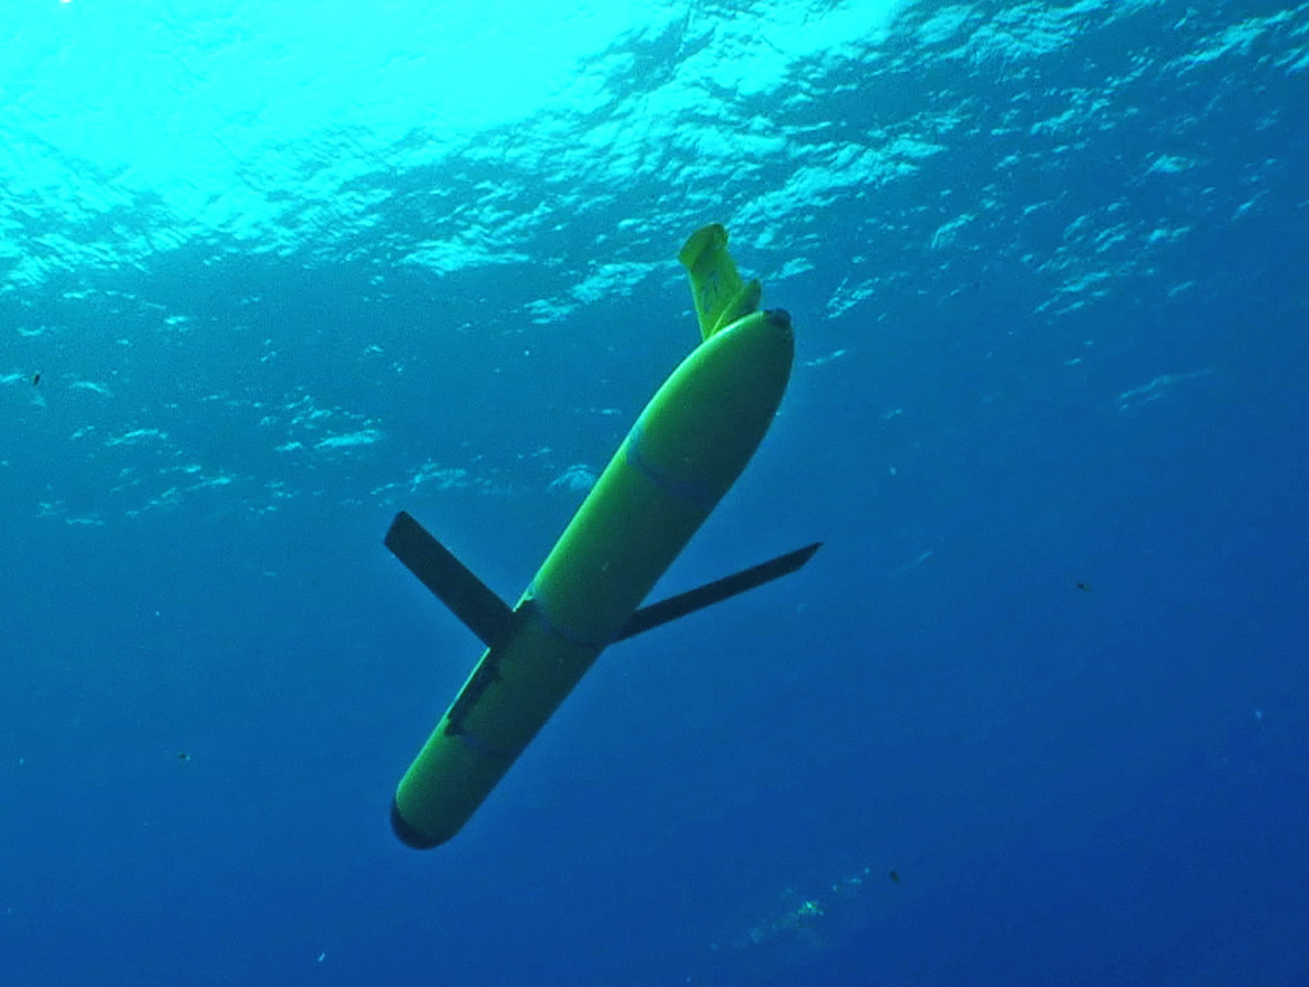
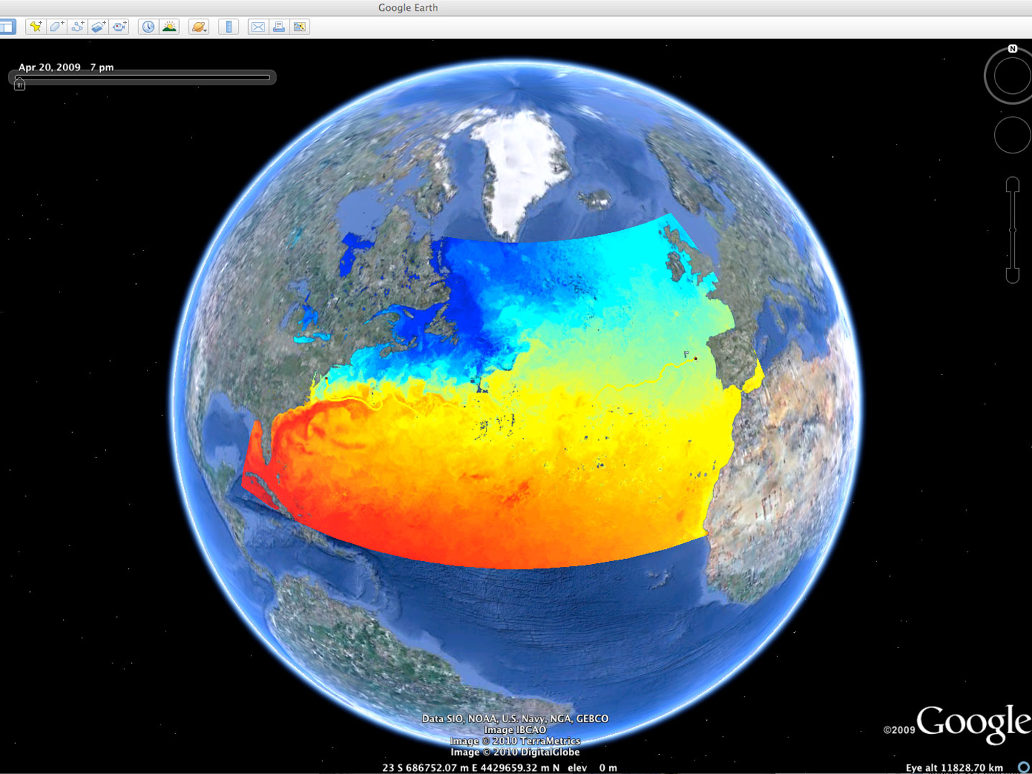
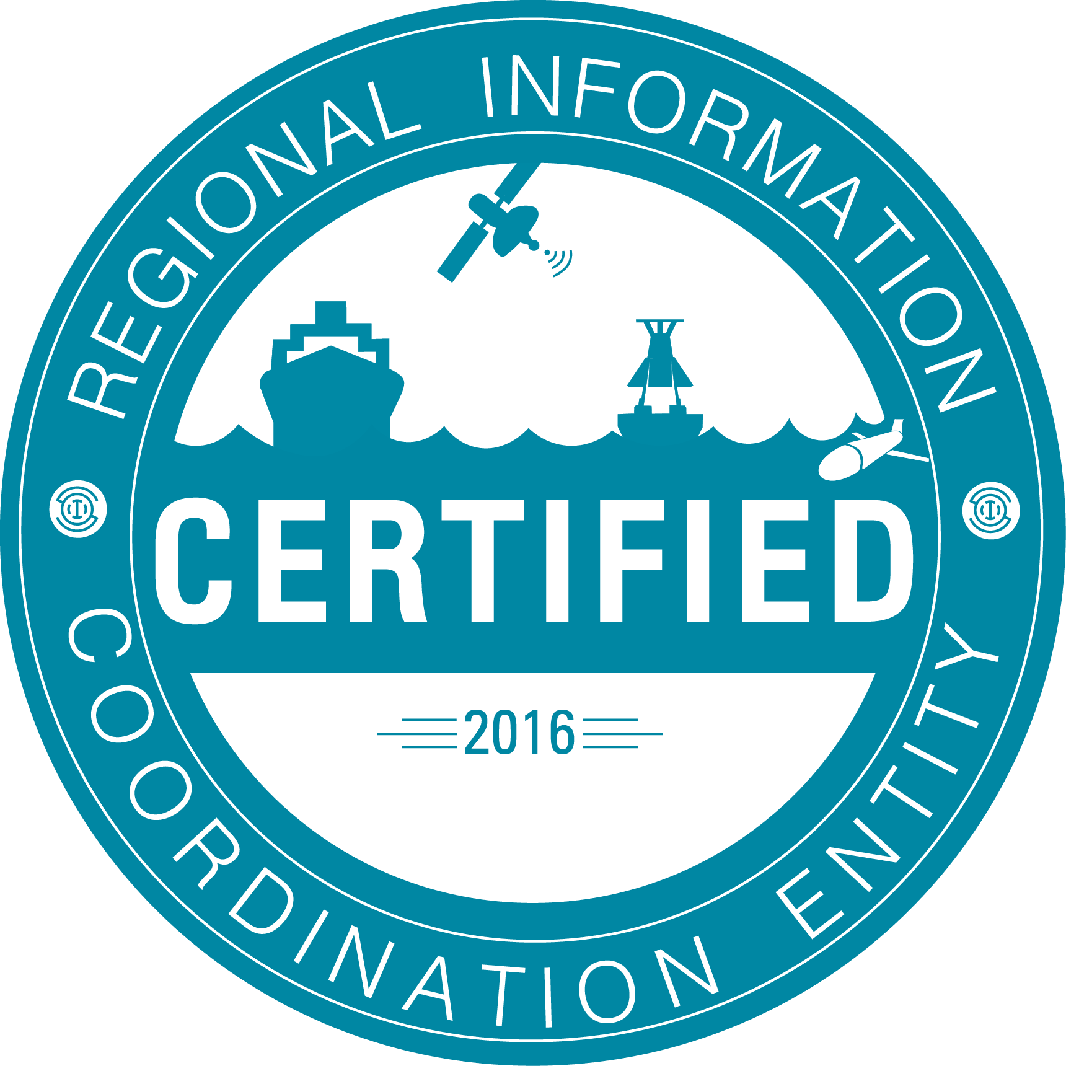




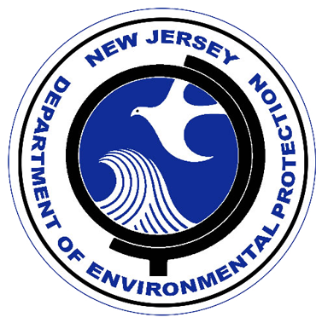
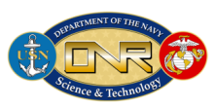







Rutgers University - Center for Ocean Observing Leadership
MARACOOS – A forum to bring forward the best science & technology
L-Band & X-Band Satellite Receivers
46 Site CODAR Network
~ 500 Glider Deployments
3-D Nowcasts
& Forecasts
+ Many More!
Notes:
2
Companies – TWR, Seaspace, CODAR, Aquawind, Weatherflow, Sequoia Scientific, Seabird Electronics, Wetlabs, Satlantic, Nortek

Slide 3
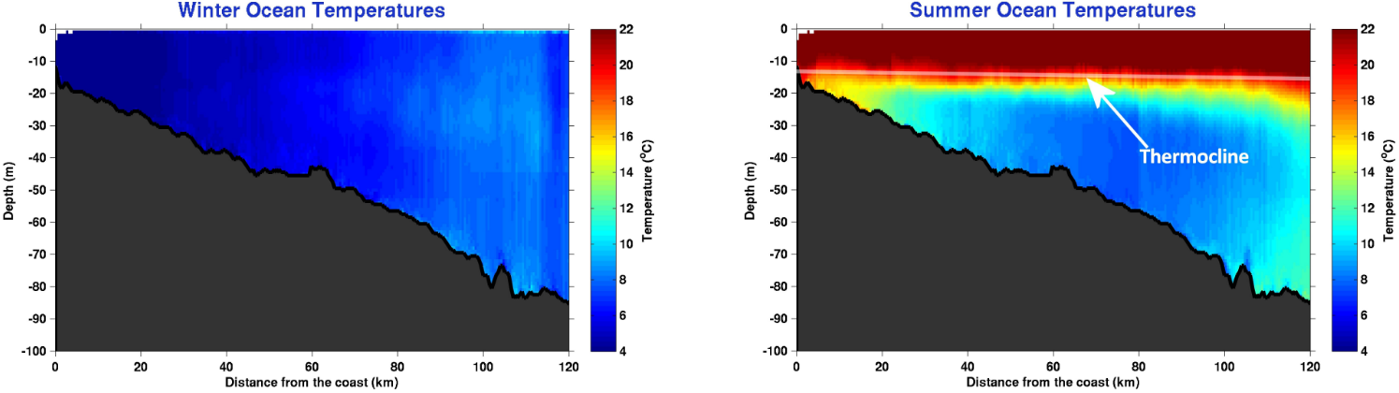
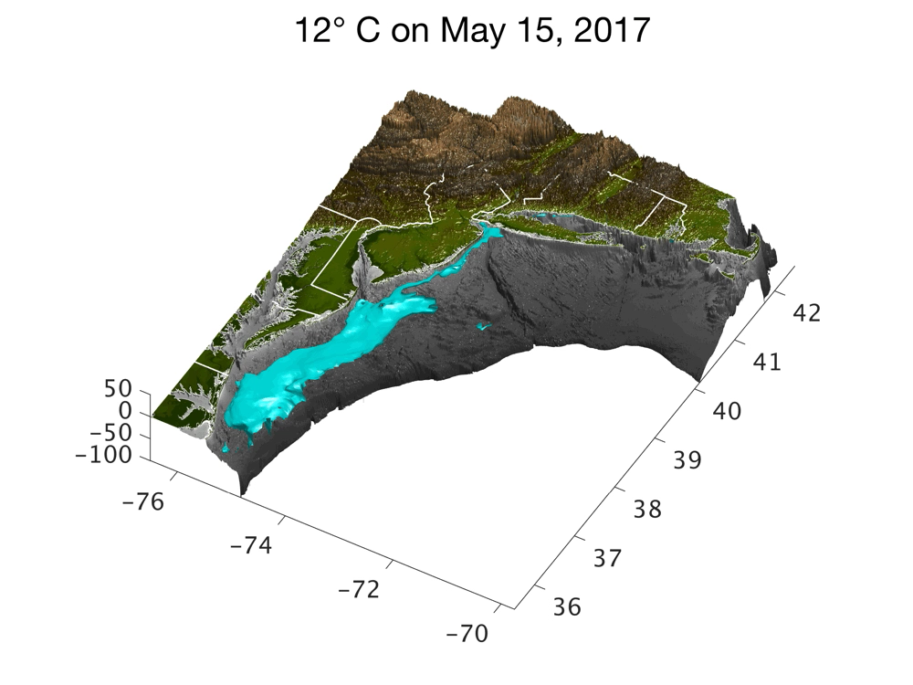
Essential Ocean Feature: Mid-Atlantic Cold Pool
Winter Temperature
Summer Temperature

Slide 4
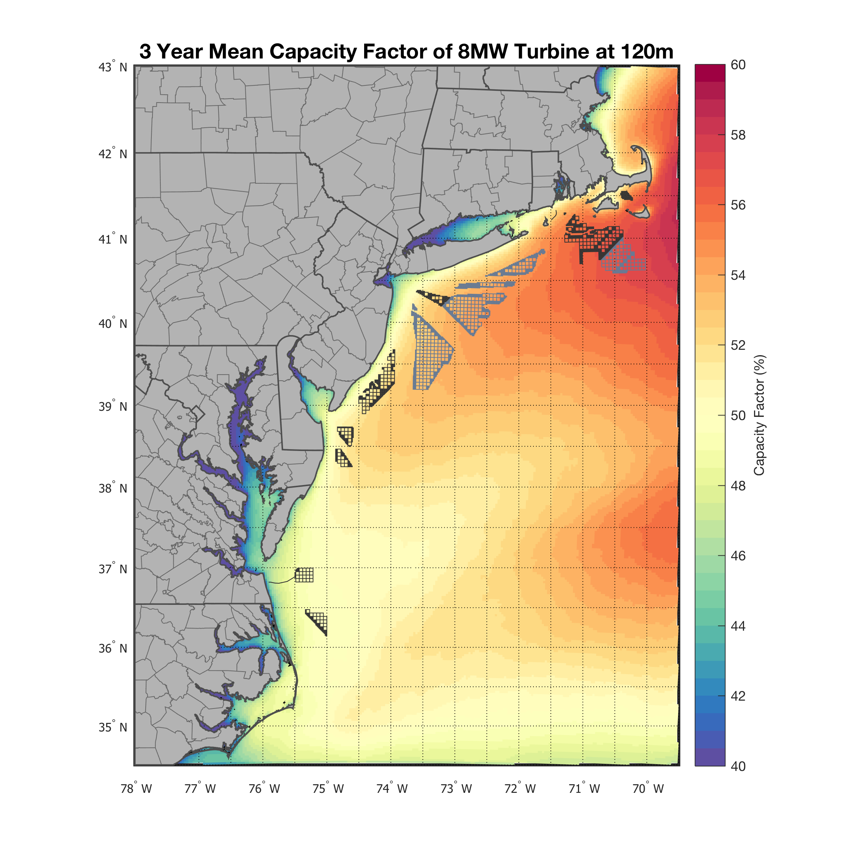
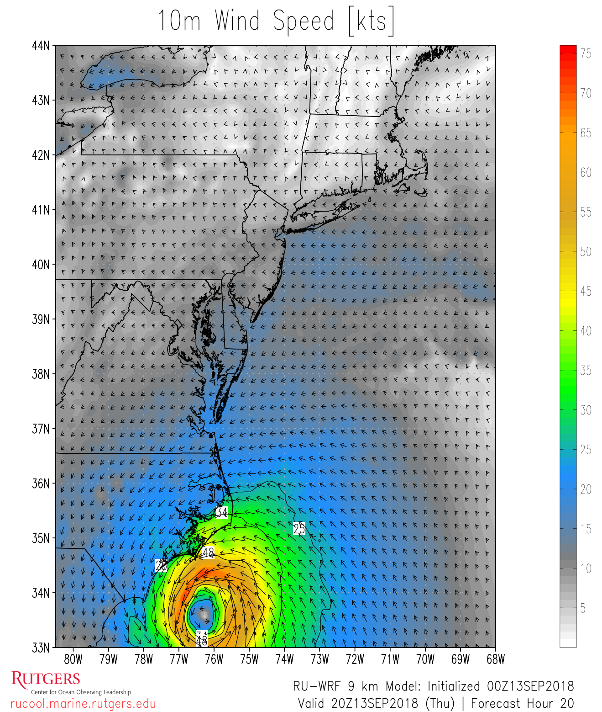
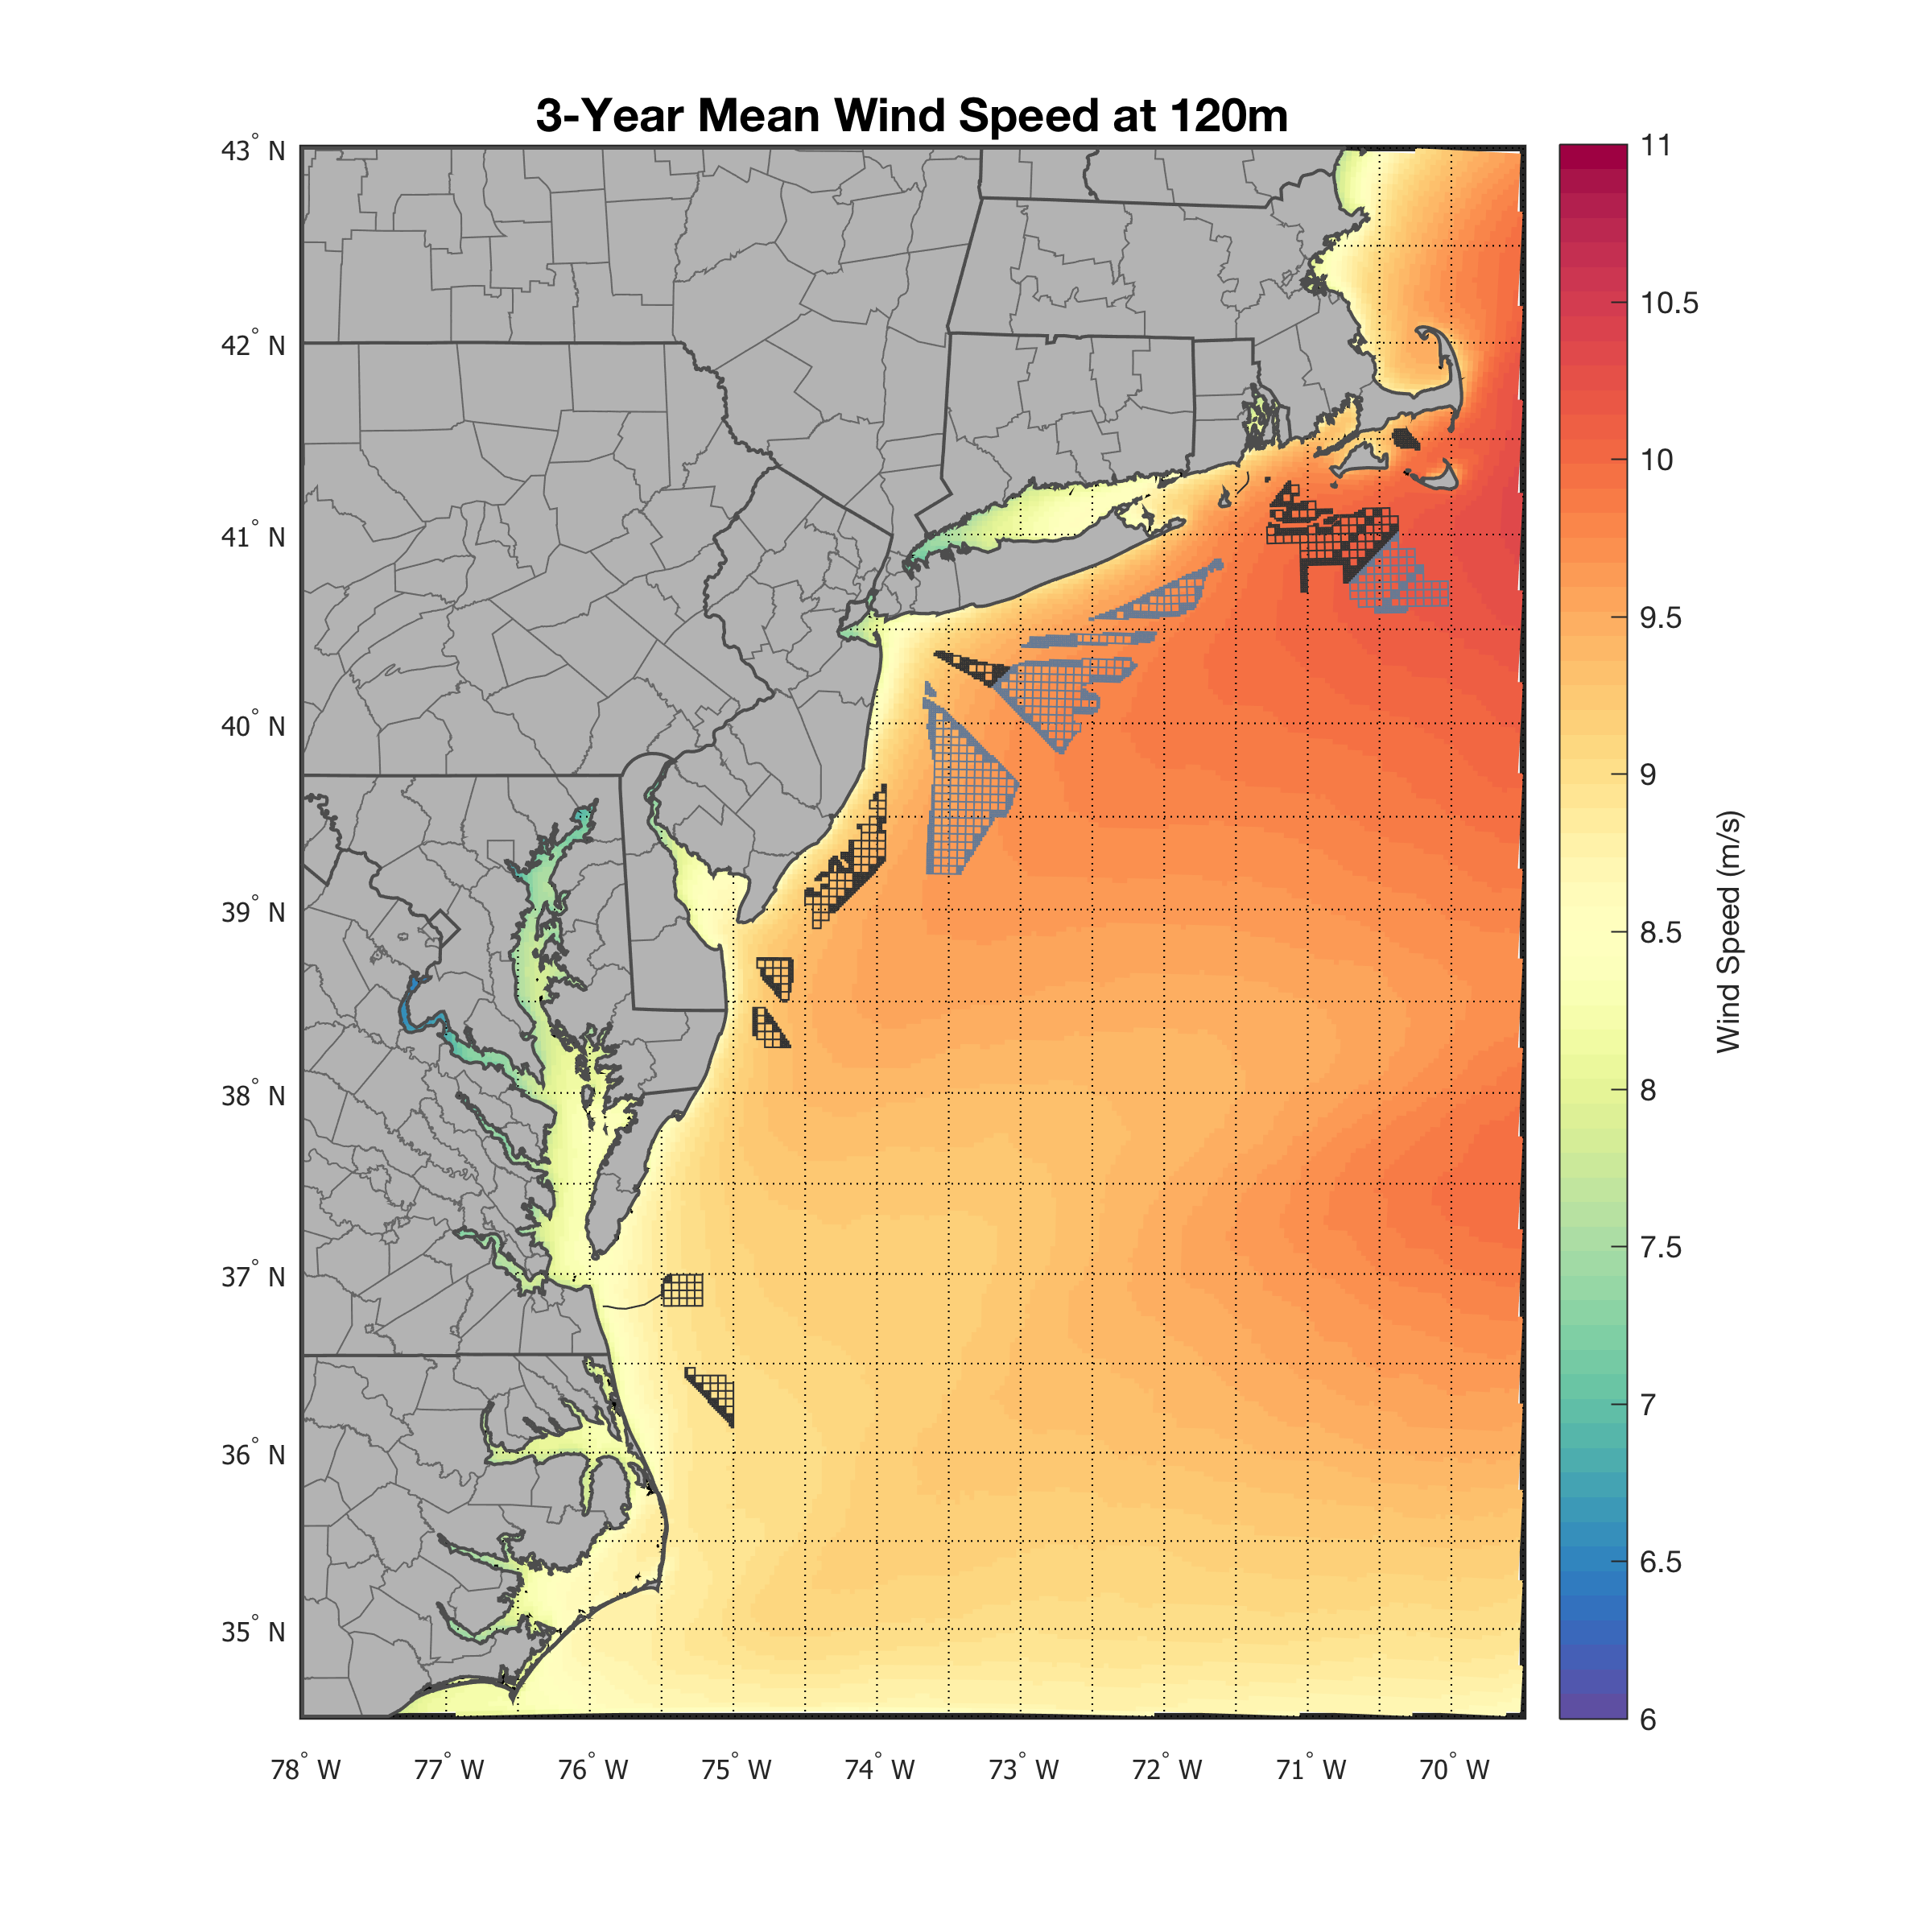
Atmospheric Modeling with RU-WRF
Daily weather model run since 2011, generates hourly output
Includes key ocean temperature data
Used for research on hurricanes and sea breezes
Assessment of NJ’s offshore wind resource
Hurricane Florence
Wind Resource:
3 Year Mean
8.5 to 10 m/s
48% to 55%
Notes:
See the speed gradient a bit more clearly

Slide 5
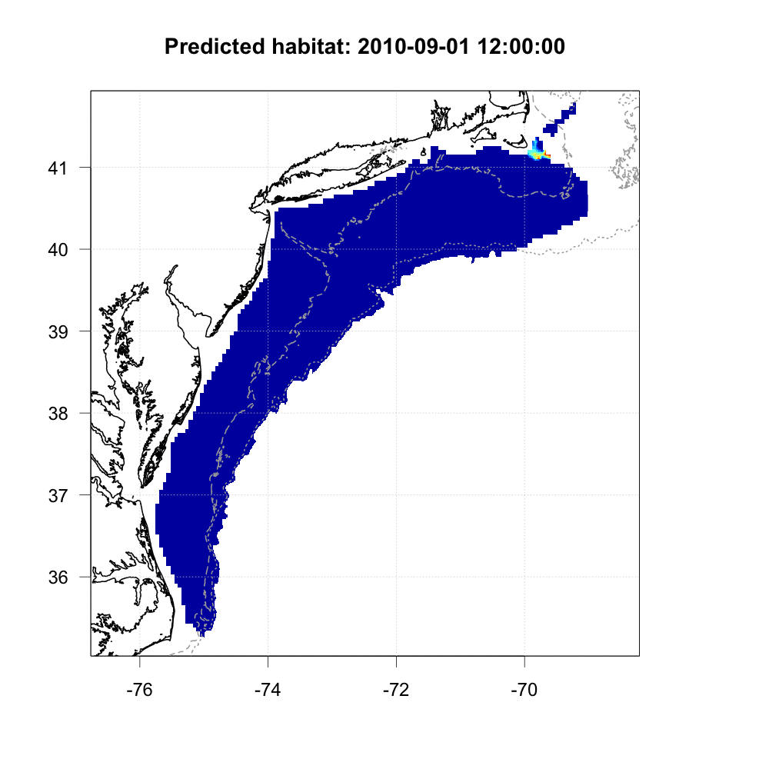
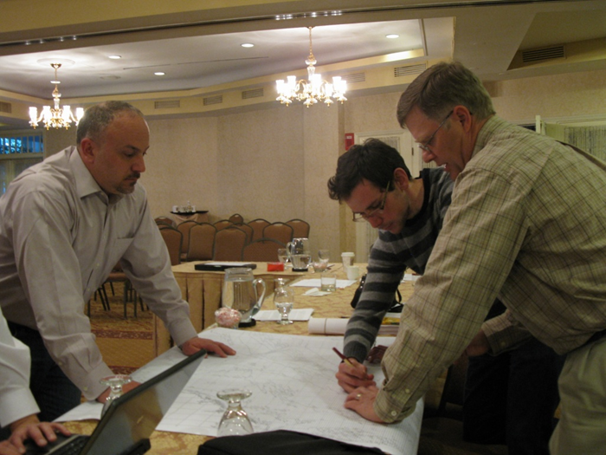
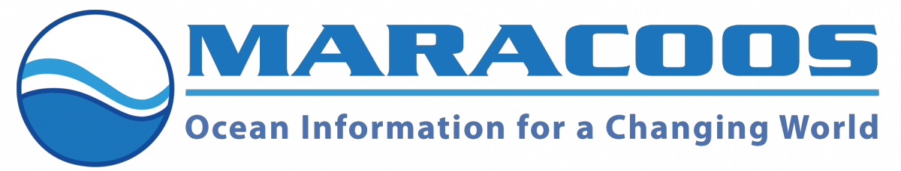
Supporting Fisheries in the Mid-Atlantic Bight:
It takes a Community
PI: Dr. Josh Kohut, RUCOOL
OpenOcean Partnership
Fishing Industry
Fishery Scientists/Ecologists
Physical and Biological Oceanographers
Fisheries Management
Human Dimensions
Notes:
Habitat Suitability Index, 0 to 1 (red is 1, zero is blue), unitless
John Manderson’s model

Slide 6
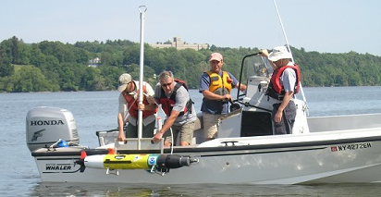
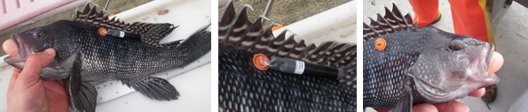
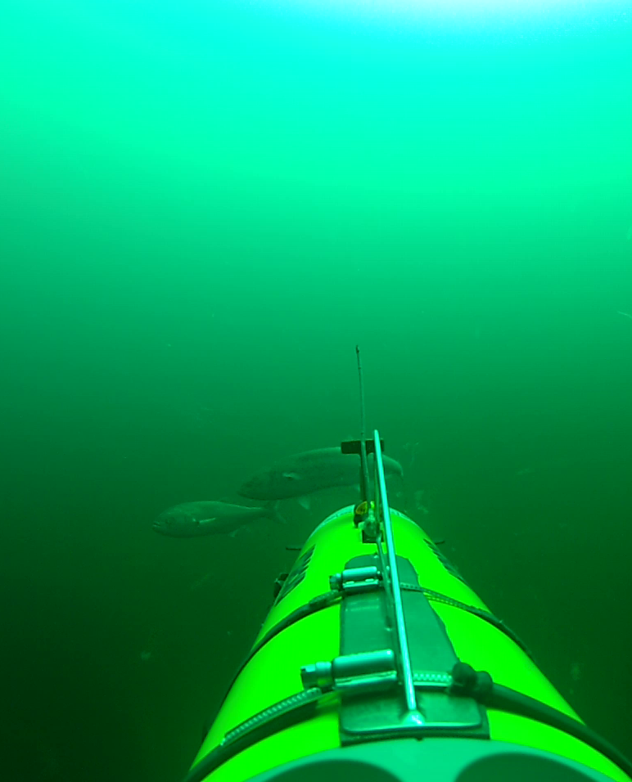
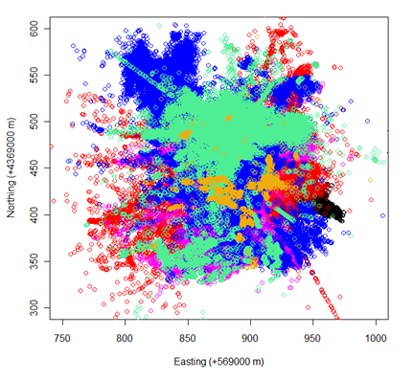
Using REMUS to Monitor Fish
PI: Dr. Thomas Grothues, RUMFS
Black Sea Bass Space Use
2 months, 5 tagged specimen
Notes:
Space used by 5 telemetered black sea bass over a 2 month period in a reef area, able to look at response to habitat change and bottom fish distribution
“baited camera trap” to attract predators that are already in the region to appear in front of the camera
Combine acoustic technology with camera technology, search out and pinpoint the position of tagged fish over a wide area, for tracking fish that do not stay in the reef area

Slide 7
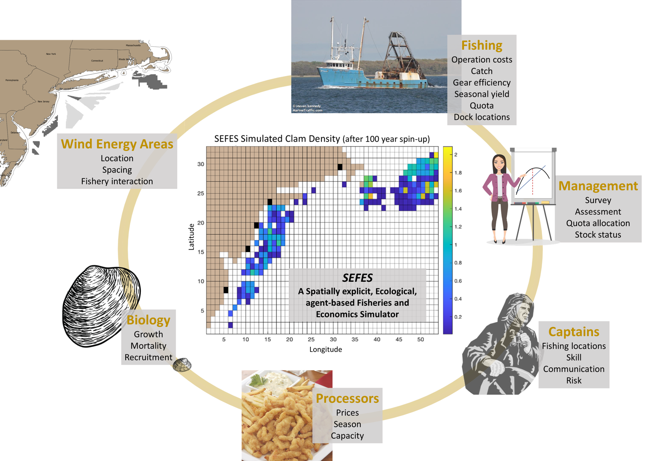
PI: Dr. Daphne Munroe, RU Haskin
SEFES:
A Spatially explicit, Ecological,
agent-based Fisheries and Economic Simulator

Slide 8
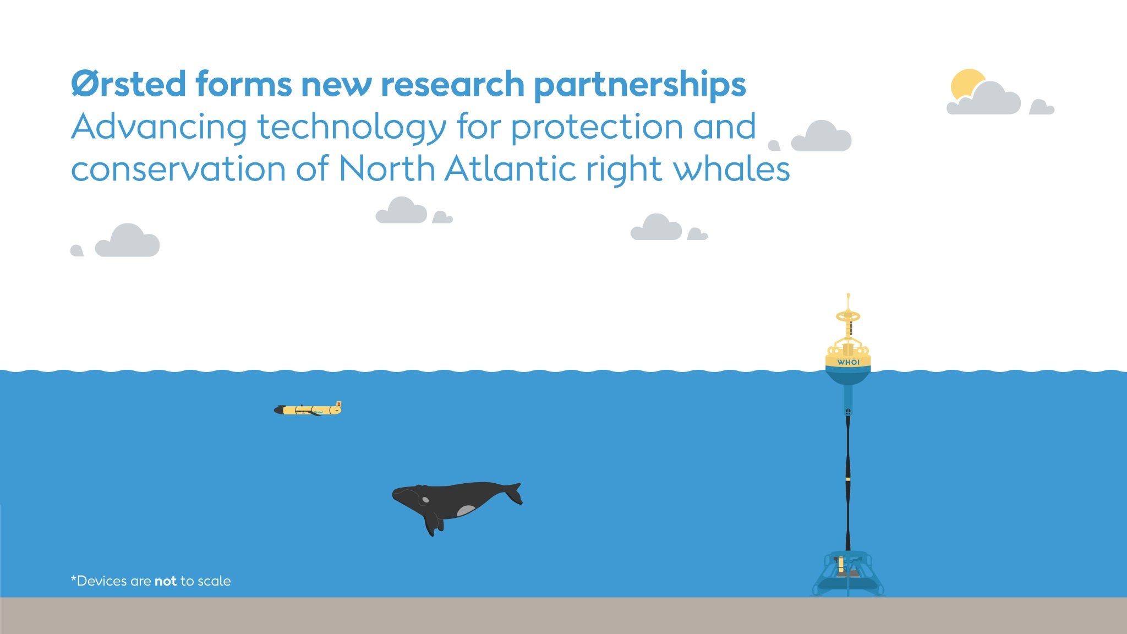
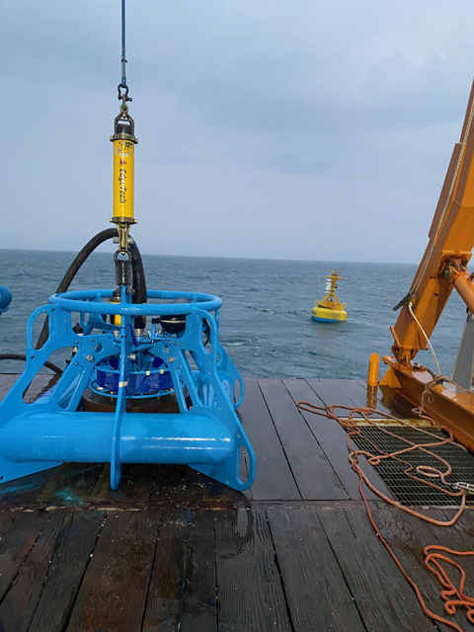
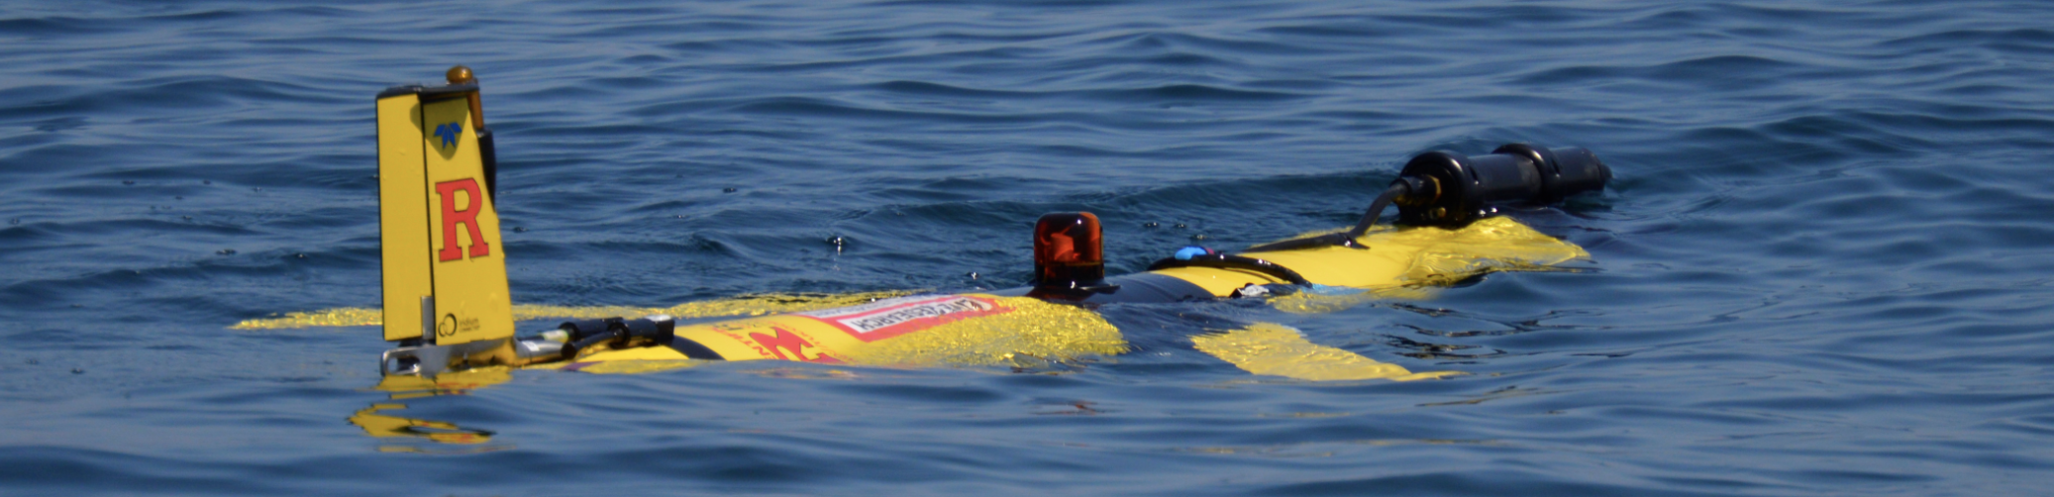


ECO-PAM: Technology to Protect the Right Whale
https://go.rutgers.edu/ECO-PAM

Slide 9
Tracking Weather and Climate
While Listening for Whales
Right Whale Detections
Nov-Dec 2020
Coastal Upwelling During the Summer
Satellite Sea Sfc Temp, 11 August 2020
https://go.rutgers.edu/ECO-PAM

Slide 10
Notes:
Just a snapshot. Lots of other technology in use or under development.
Lidars for tracking birds and bats.

