Slide 1







West Antarctic Peninsula and Scotia Arc RWG
Co-chairs – Kate Hendry and Oscar Schofield
(Kate soon rotating off and Juan rotating on)
2016 - 2020

Slide 2
WAPSA Achievements (2016 – 2020)
Products
Author | Title | Year | DOI | Type | Citations/ Views/ Downloads | H-Index
K. Hendry et al. | WAPSA 2020 Online Workshop Report | 2020 | 10.5281/zenodo.4018199 | Workshop Report/ Report Series | 40 views/ 21 downloads
S. Henley et al. | Variability and change in the west Antarctic Peninsula marine system: Research priorities and opportunities | 2019 | 10.1016/j.pocean.2019.03.003 | Journal Publication | 17 citations | 1
K. Hendry, M. Meredith, H. Ducklow (eds) | West Antarctic Peninsula: Theme issue | 2018 |  | Special Issue (14 articles) | 159 citations | 9
K. Hendry, S. Henley, O. Schofield | Understanding a changing West Antarctic Peninsula | 2017 | 10.1029/2017EO084155 | Journal Publication
K. Hendry, S. Henley, O. Schofield | Developing the West Antarctic Peninsula International Network within SOOS Workshop Report | 2017 | 10.5281/zenodo.3941413 | Workshop Report/ Report Series | 83 views/ 43 downloads
Events
Name | Year | Location | Funders | Type | Attendees | Nations | Institutions | Workshop Outputs
West Antarctic Peninsula and Scotia Arc Working Group Meeting | 2020 | Online | N/A | Virtual workshop | 80 | 11 | 50 | Workshop Report, online resources
WAPSA Meeting at POLAR18 | 2018 | Davos
Developing the West Antarctic Peninsula International Network within SOOS | 2017 | BAS, UK | BAS, SOOS, SCAR, SCOR, NERC-ORCHESTRA | In-person workshop | 87 | 11 | 34 | Workshop Report, Journal Publication, Special Issue
Royal Society of the United Kingdom Science Meeting | 2017 | UK | Royal Society

Slide 3
WAPSA Achievements (2016 – 2020)
Programs
Name | Year | Countries | SOOS Endorsed
Research Center: Dynamics of High Latitude Marine Ecosystems – IDEAL | 2016-2020 | Chile | Yes
Resolving CO₂ system seasonality in the WAP with year-round autonomous observations | 2016-2019 | United States | Yes
Nutrient dynamics and deep water behaviour in the WAP sea ice zone | 2014-2018 | United Kingdom | Yes
DynOPO (Dynamics of the Orkney Passage Outflow) | 2013-2016 | United Kingdom | Yes
ChinStrAP (Changes in Stratification at the Antarctic Peninsula) | 2014-2015 | South Africa, United States, United Kingdom | Yes
Palmer LTER (Palmer Long Term Ecological Research) | Long term | United States | Yes
RaTS (Rothera Time Series) | Long term | United Kingdom

Slide 4
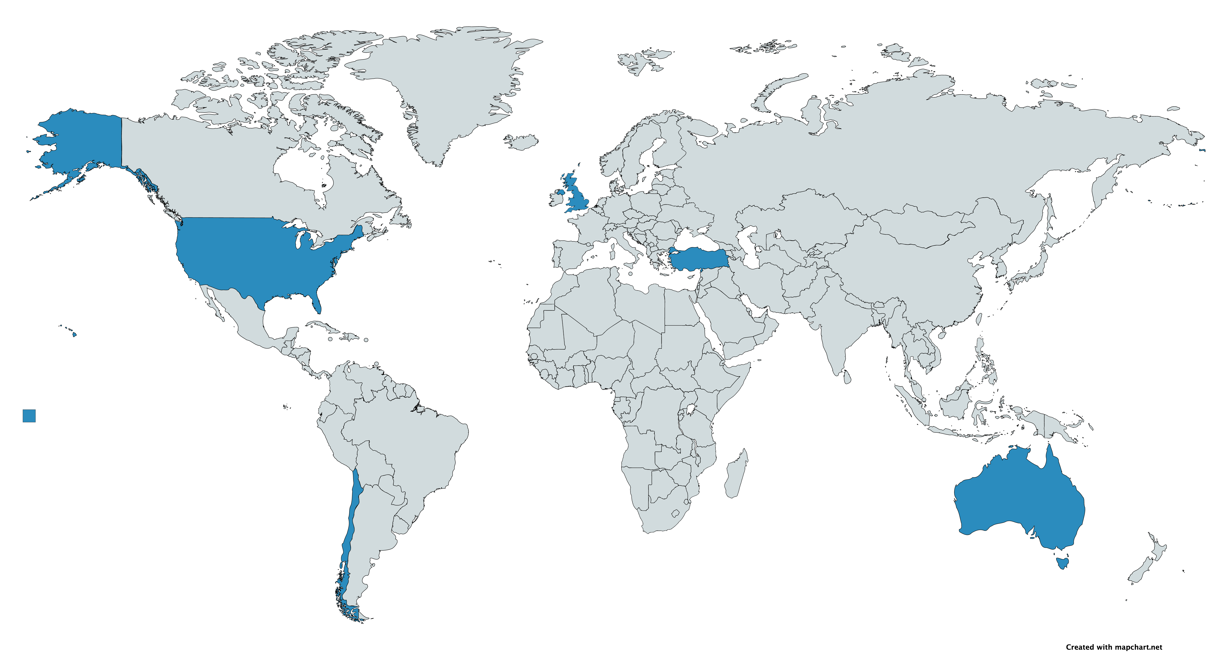
Data Efforts
Engagement with DMSC to include key WAPSA datasets in SOOSmap and cruises into DueSouth (ongoing)
Co-development of student projects with DMSC to improve discoverability, accessibility and usability of Southern Ocean datasets
  L. Roberts (MSci project) on Southern Ocean Argo data, supervised by K. Hendry (Uni. Bristol) & M. Donnelly (BODC)
DueSouth Expedition Entries
SOOSmap Data Entries
18
18
59
34

Slide 5
Leadership
Name | Role | Country | Expertise | Year Started
Kate Hendry | Co-chair | United Kingdom | Biogeochemistry | 2016* (rotating off late 2020)
Oscar Schofield | Co-chair | United States | Biogeochemistry | 2016*
Juan Höfer | Co-chair/ APECS Rep. | Chile | Biology | 2018 (transitioning from APECS Rep. to Co-chair late 2020)*
Sian Henley |  | United Kingdom | Biogeochemistry | 2017
Irene Schloss |  | Argentina | Biology | 2017
Philip Trathan |  | United Kingdom | Biology and Policy | 2018
Andrew Meijers |  | United Kingdom/ Australia | Physical Oceanography | 2018
Doris Abele |  | Germany | Biology | 2017
In-Young Ahn |  | South Korea | Biology | 2017
Javier Arata |  | Canada | Biology | 2017
Burcu Ozsoy |  | Turkey | Physical Oceanography | 2018
Mauricio Mata |  | Brazil | Physical Oceanography | 2017
New (nominations due 30th Sept.) |  |  |  | 2020
New APECS Rep. (nominations due Dec..) |  |  |  | 2021
*Co-chair term of 3-years with a possible 2nd term.

Slide 6
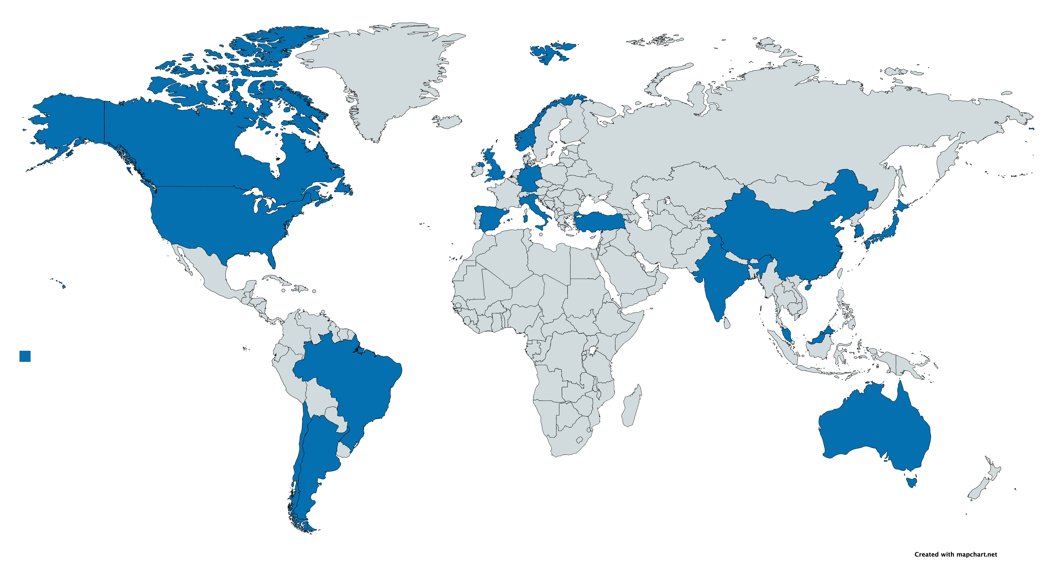
Coordination/Network Actions
Engagement with the Scotia Arc scientific community to raise the profile of the RWG and encourage involvement of new and diverse members to the RWG (ongoing)
Increase member and community engagement through Mailchimp newsletters and Airtable working group views (ongoing)
Preliminary discussions with Phil Trathan (BAS) to create stronger links with CCAMLR (ongoing)
Membership/Mailing List
26
24
16
Total = 66
16 countries, 48 institutions

Slide 7
WAPSA Future Plans (2021 onwards)
Action plan to develop sub-regions based on adaptation of CCAMLR regions (keeping in mind SOOS RWG definitions) (https://www.ccamlr.org/en/system/files/CCAMLR-Convention-Area-Map.pdf)
Ensure all the community EOVs are fully adopted by the WAP and Scotia Arc communities
  Updating and distributing the existing EOV lists to the WAPSA science communities
Develop/leverage existing websites
  Develop a list-serve for the WAPSA community to facilitate cross-talk (underway using Airtable and Mailchimp)
  Contribute to a SOOS-wide community website linking the EOV core measurements to recommended methods to guide the community to standardized measurements
  Ensure the full data range of sustained datasets collected by the WAPSA community is fully update in the SOOS data portals
Develop a short-term federal strategy for developing joint projects
Develop community-wide data expertise and science data efforts to provide an international baseline for the WAP and Scotia Arc
  Identify “sentinel” states of community interest (discuss and identify candidate sites over the next 2 years)
  Coordinate a series of inter-laboratory efforts to ensure data quality/assurance measures for the distributed WAP and Scotia Arc science communities (identify variable and laboratory lists over the next 2 years)
  Develop a list of opportunistic sampling variables, where water could be sent to a lab for analysis
Long term goal (5 years) to identify the need for deployment of technologies that provide sustained regional measurements in space and time (i.e. weather stations, shallow and deep glider network)
Engage meaningfully with the UN Decade of Ocean Science for Sustainable Development and to seek benefits from involved for the working group objectives

