Slide 1
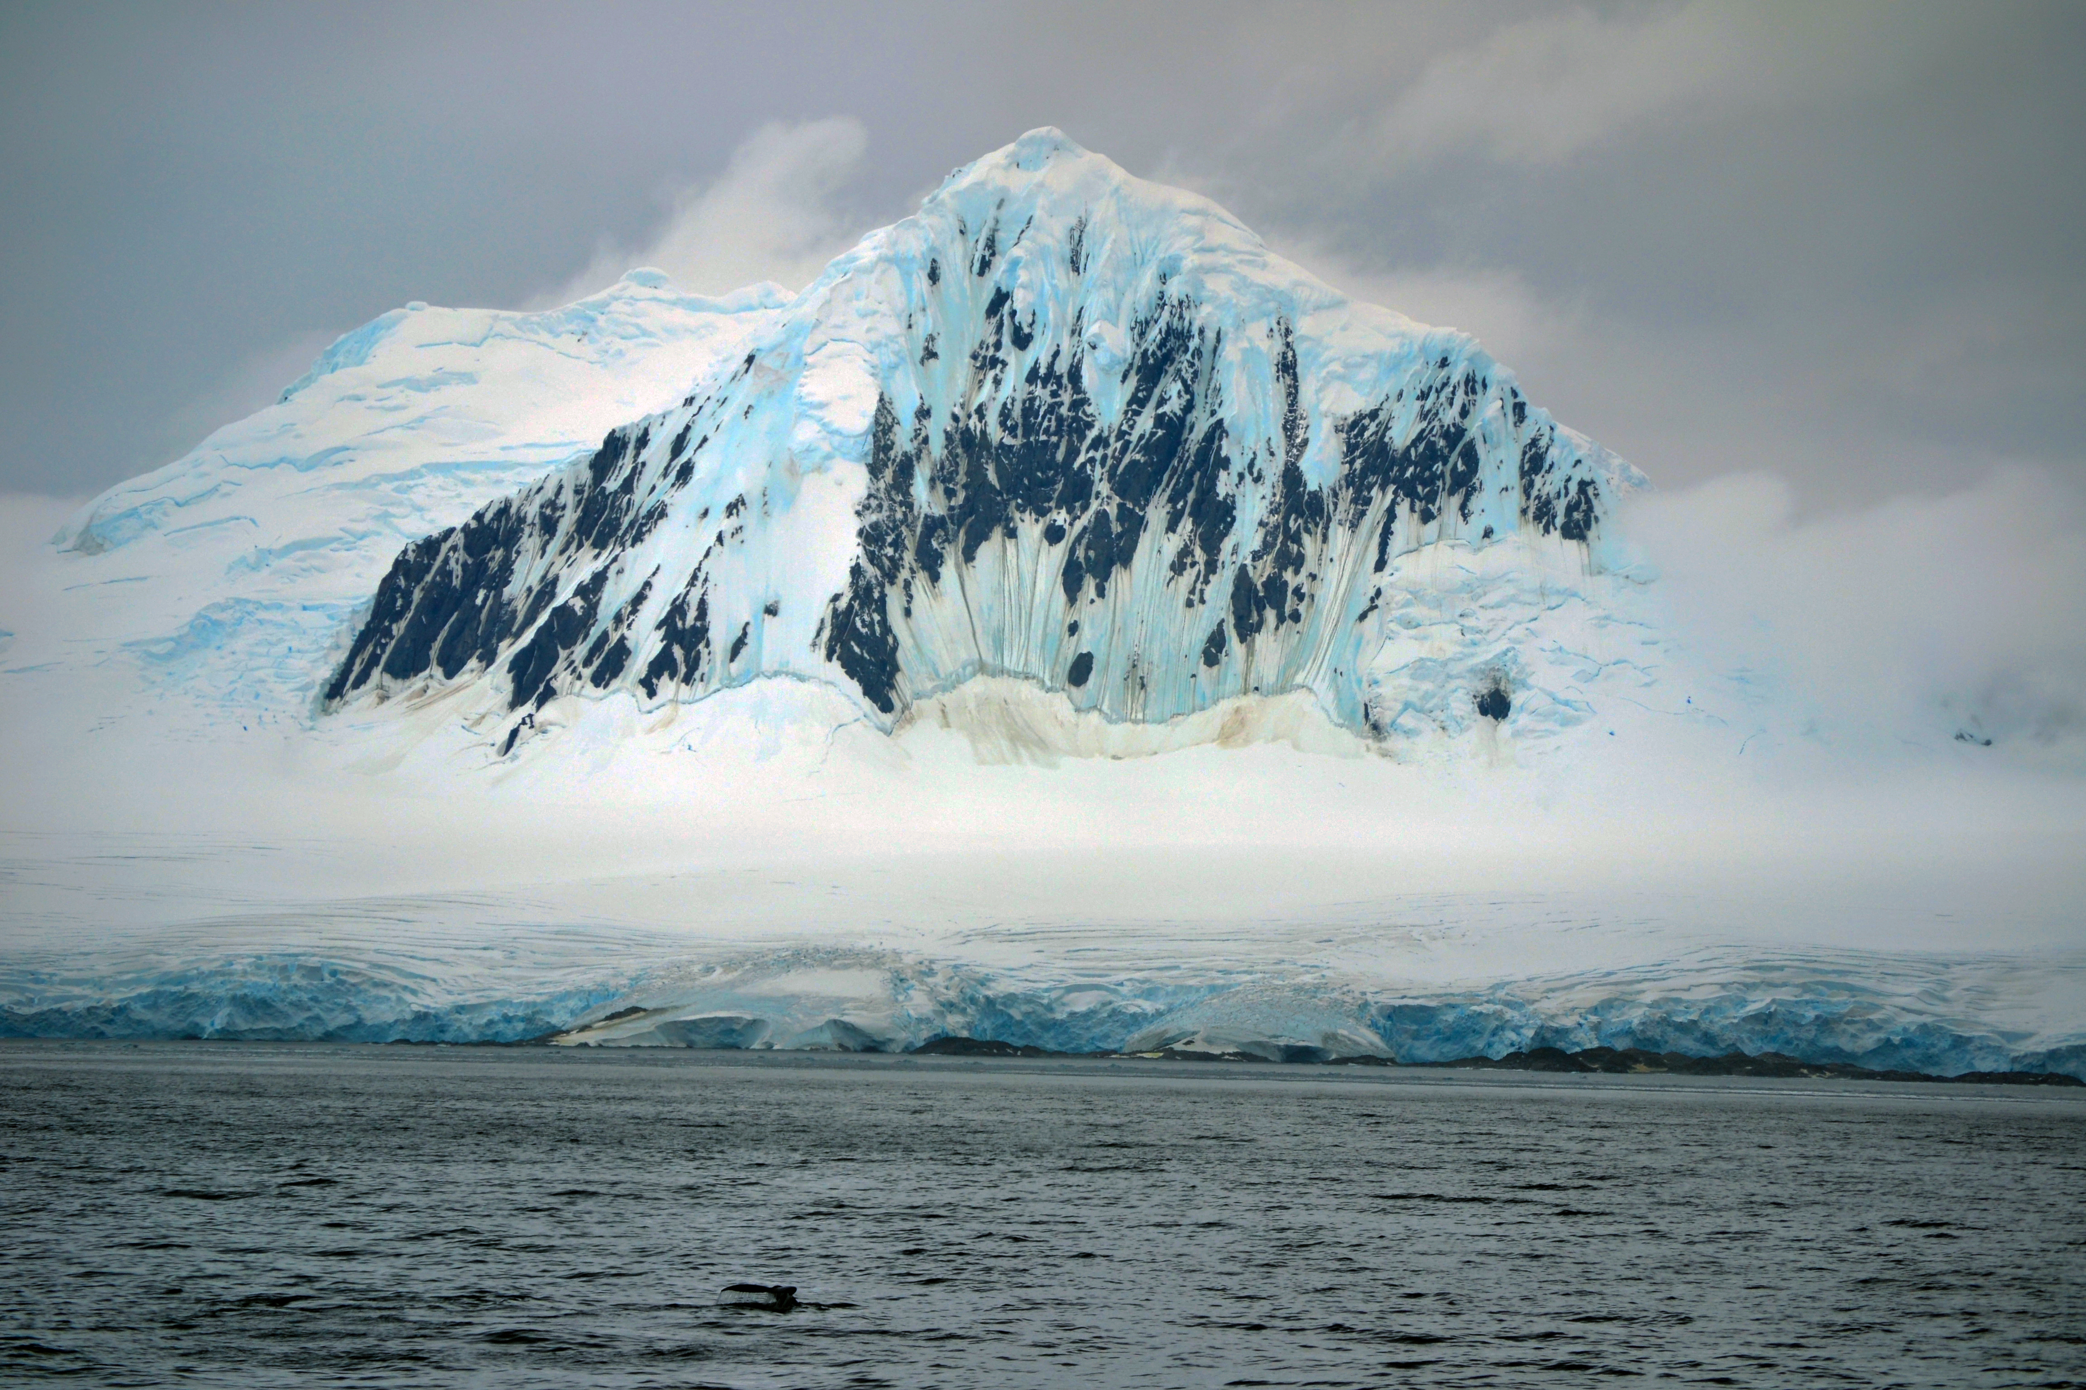
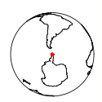
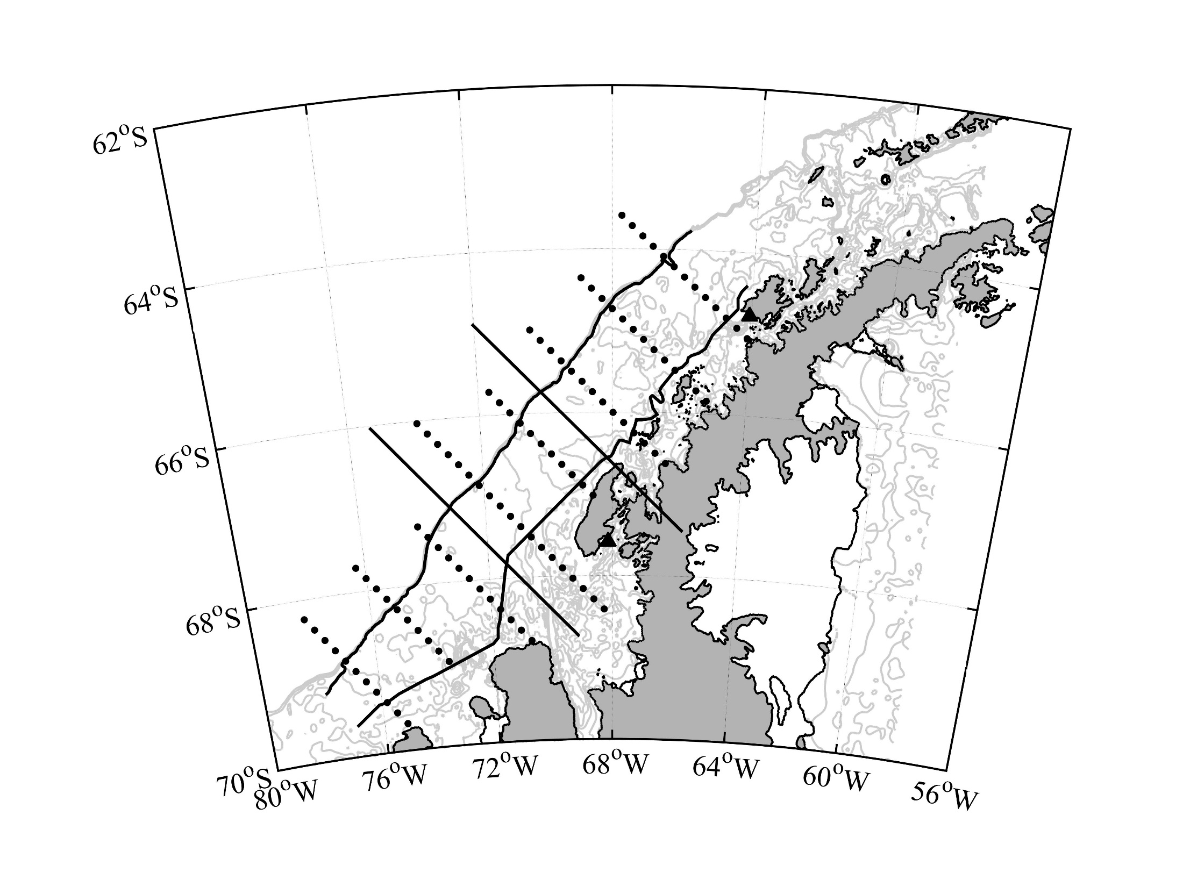
Polar food web resilience in the face of a shifting climate
Palmer LTER
Oscar Schofield on behalf of many
LTER Renewal submitted
in Spring 2020
Welcome to new team members
Carlos Moffat (U. Delaware)
Megan Cimino (UC Santa Cruz)
Ben Van Mooy (WHOI)

Slide 2
Our Conceptual Model

Slide 3
Local scale
Climate Press
Annual standardized
anomalies
Smoothed multi-year
standardized anomalies
Long term trends
Anomalies

Slide 4
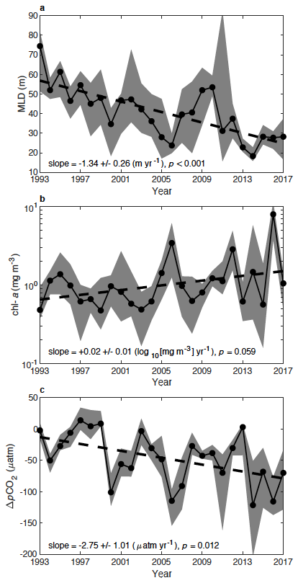
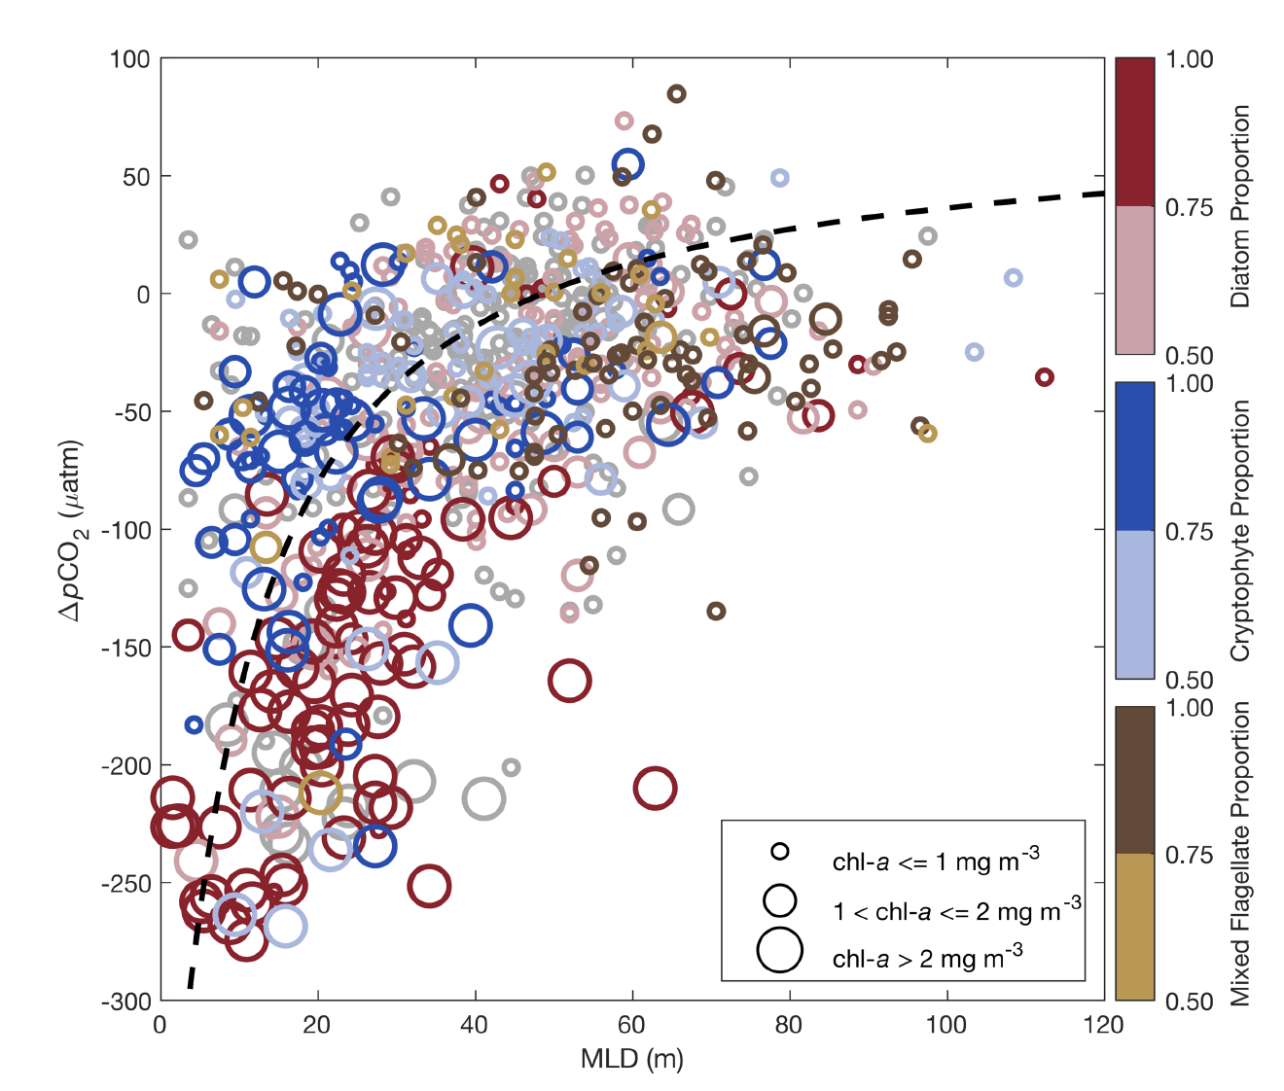
Regional scale Climate Press
Ice change opening
the ocean to sun and atmosphere
Efficiency of the system is a function of the diversity and biomass
Upper ocean mixed layer
Chlorophyll a
ΔCO2
Brown et al. 2019. Nature Climate Change
DOI: 10.1038/s41558-019-0552-3

Slide 5
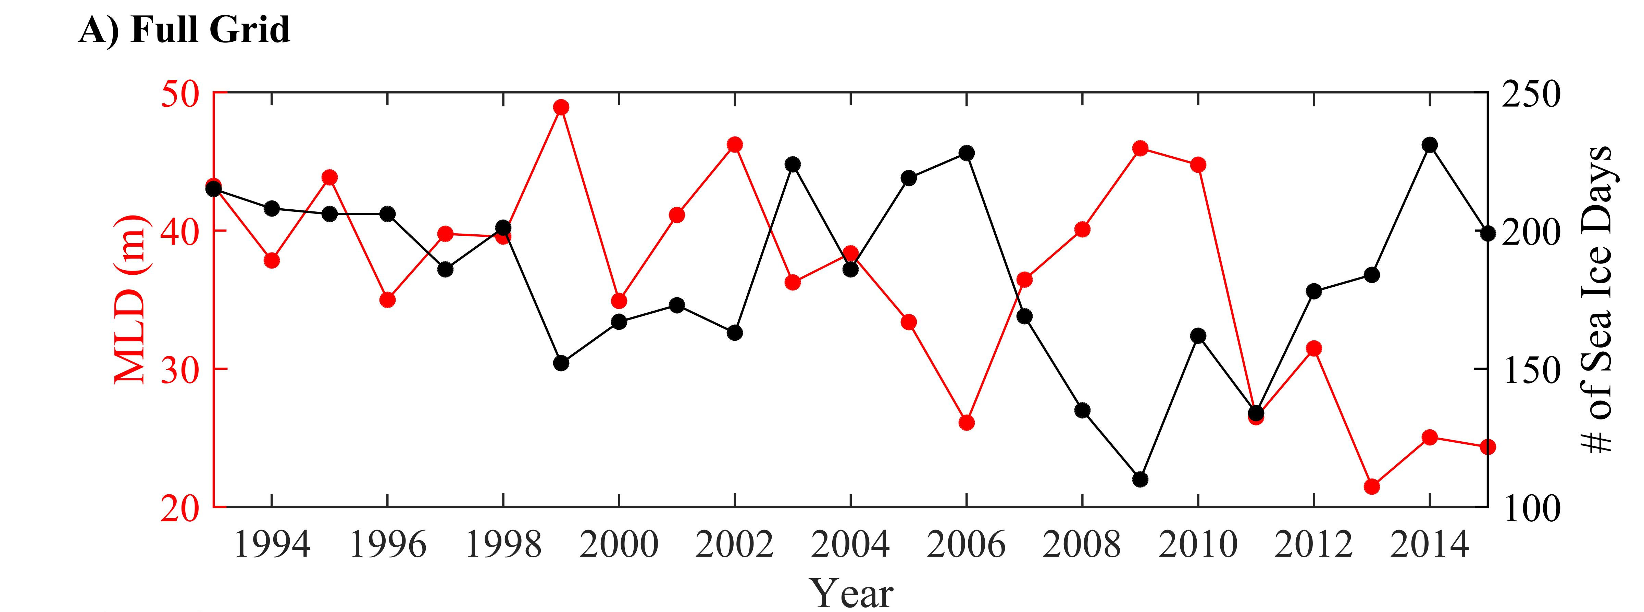
Decadal Press-Pulse: Regional Sea Ice
Schofield et al. 2018. Phil Trans Royal Soc
DOI: 10.1098/rsta.2017.0173

Slide 6
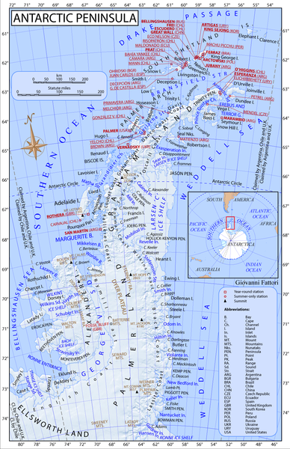
Decadal Press-Pulse
Time Series from Land Stations across the Peninsula
(daily measurements across the Peninsula)
Kim et al. 2018
Comparison of decadal times series of chlorophyll a across the
Argentinean Base
Both north stations show increased chlorophyll since ice recovery, not in south.
US Base
UK Base
Kim et al. 2018. Phil Trans Roy Soc

Slide 7
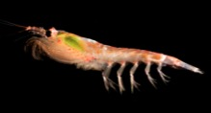
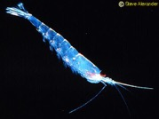
Decadal Press-Pulse
E. superba
E. Crystallorophias
(ice-obligate)
p < 0.001
r² = 0.45
Steinberg et al. (2015)
updated

Slide 8
Synoptic Pulses

Slide 9
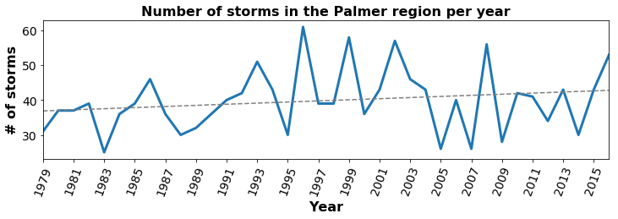
Synoptic Pulses
R² = 0.2

