Slide 1
Glider-based observations reveal seasonal carbonate chemistry variability in U.S. Mid-Atlantic shellfishery management zones
Liza Wright-Fairbanks¹, Grace Saba¹, Baoshan Chen², Wei-Jun Cai², and Travis Miles¹
Rutgers University Dept. of Marine and Coastal Sciences
University of Delaware School of Marine Science and Policy

Slide 2
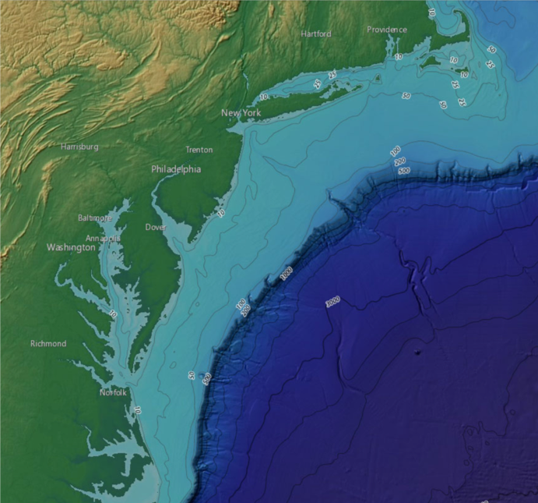
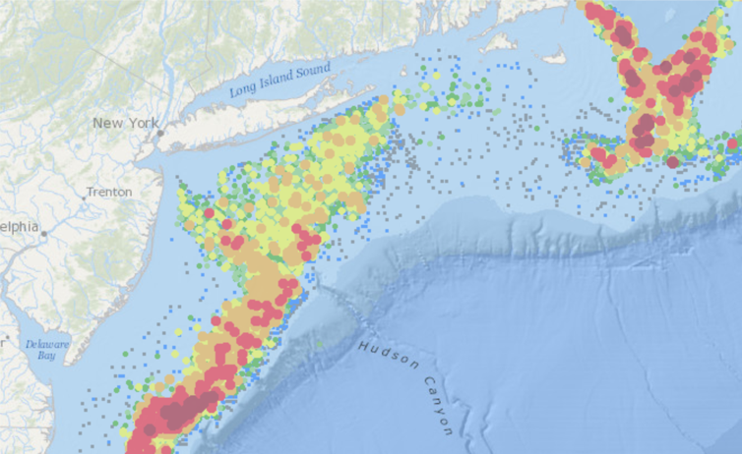
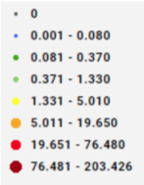
The Mid-Atlantic Bight (MAB)
Housed within the U.S. Northeast Shelf
Important human-coastal interactions
Home to economically important fin and shellfisheries
NOAA
NOAA NCEI
Scallop catch biomass by meat weight in kg
Notes:
Bounded by Cape Hatteras in the South, George’s Bank in the North
Major estuaries/bays: Chesapeake, Delaware, Raritan Bay, Long Island Sound

Slide 3
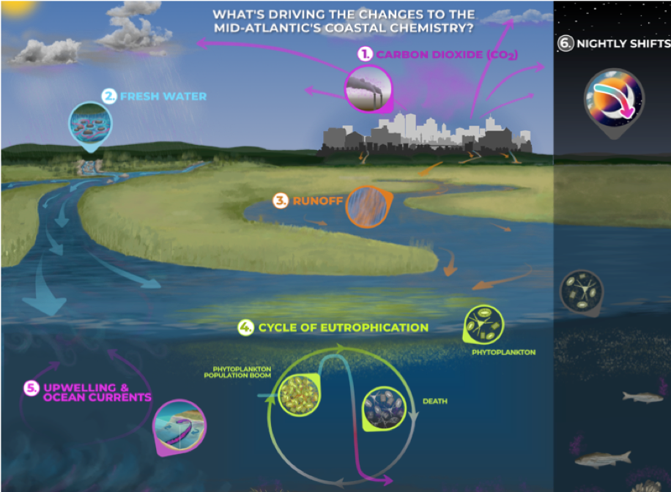
Drivers of MAB Acidification
Atmospheric CO₂
Freshwater Input
Nutrient Loading
Upwelling
Seasonal Stratification
Water Mass Influence
NOAA Sea Grant

Slide 4
Drivers of MAB Acidification
Atmospheric CO₂
Freshwater Input
Nutrient Loading
Upwelling
Seasonal Stratification
Water Mass Influence
NOAA Sea Grant

Slide 5
Drivers of MAB Acidification
Atmospheric CO₂
Freshwater Input
Nutrient Loading
Upwelling
Seasonal Stratification
Water Mass Influence
NOAA Sea Grant

Slide 6
Drivers of MAB Acidification
Atmospheric CO₂
Freshwater Input
Nutrient Loading
Upwelling
Seasonal Stratification
Water Mass Influence
NOAA Sea Grant

Slide 7
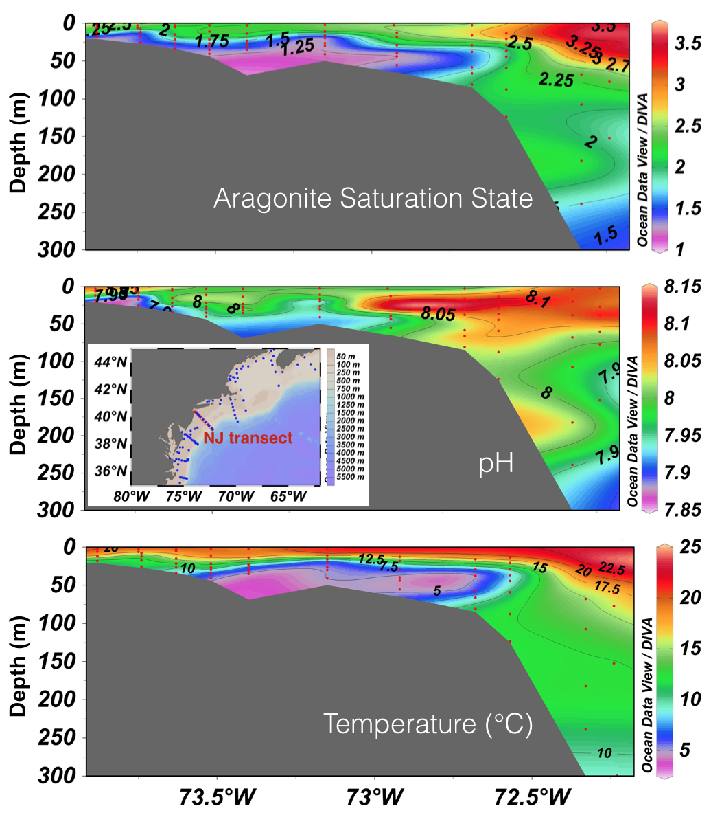
Drivers of MAB Acidification
Atmospheric CO₂
Freshwater Input
Nutrient Loading
Upwelling
Seasonal Stratification
Water Mass Influence
Wanninkhof et al. 2015

Slide 8
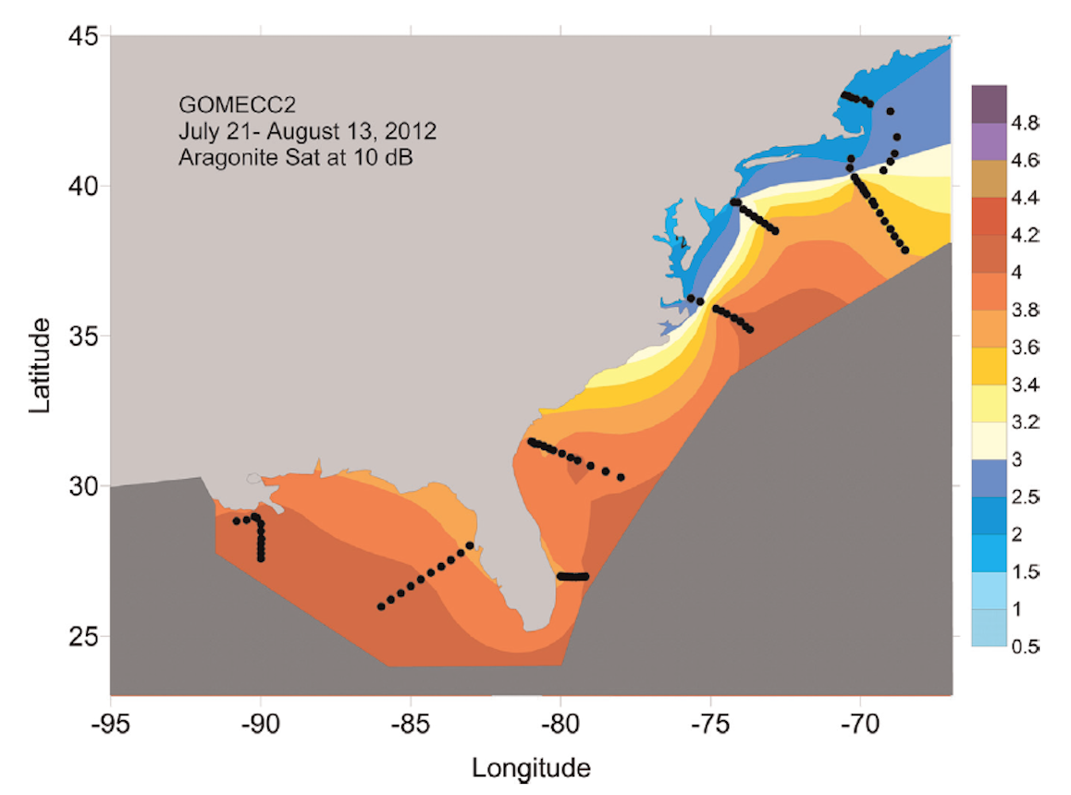
Drivers of MAB Acidification
Atmospheric CO₂
Freshwater Input
Nutrient Loading
Upwelling
Seasonal Stratification
Water Mass Influence
Wanninkhof et al. 2015
Notes:
Cold water coming down from gulf of maine/labrador sea
Warm water coming up from gulf stream, deflecting off north Carolina, but still has influence over shelf break waters
Dominant front at shelf break where warm and cold meet

Slide 9
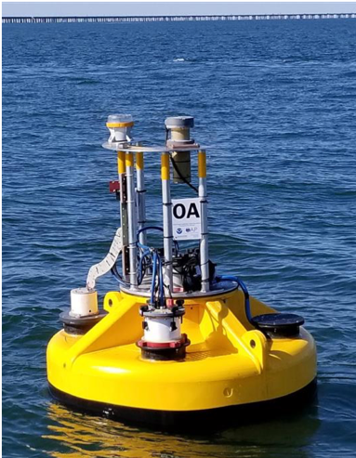
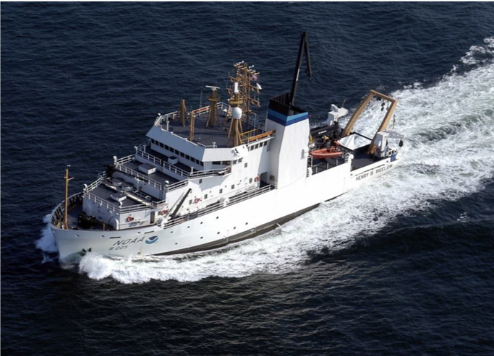
Acidification Monitoring Gaps
Low spatial resolution
Low temporal resolution, costly
Notes:
Low spatial resolution horizontally and vertically in the water column

Slide 10
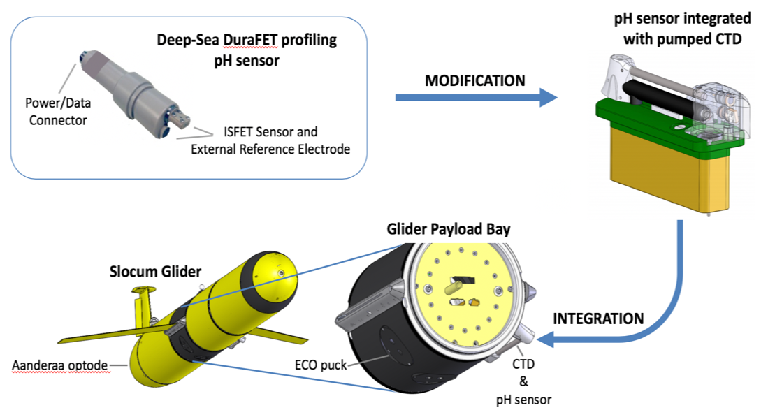
pH Glider Development
Dr. Grace Saba’s presentation:
Thursday 8:45 am
Saba, Wright-Fairbanks, et al., 2019: Frontiers in Marine Science

Slide 11
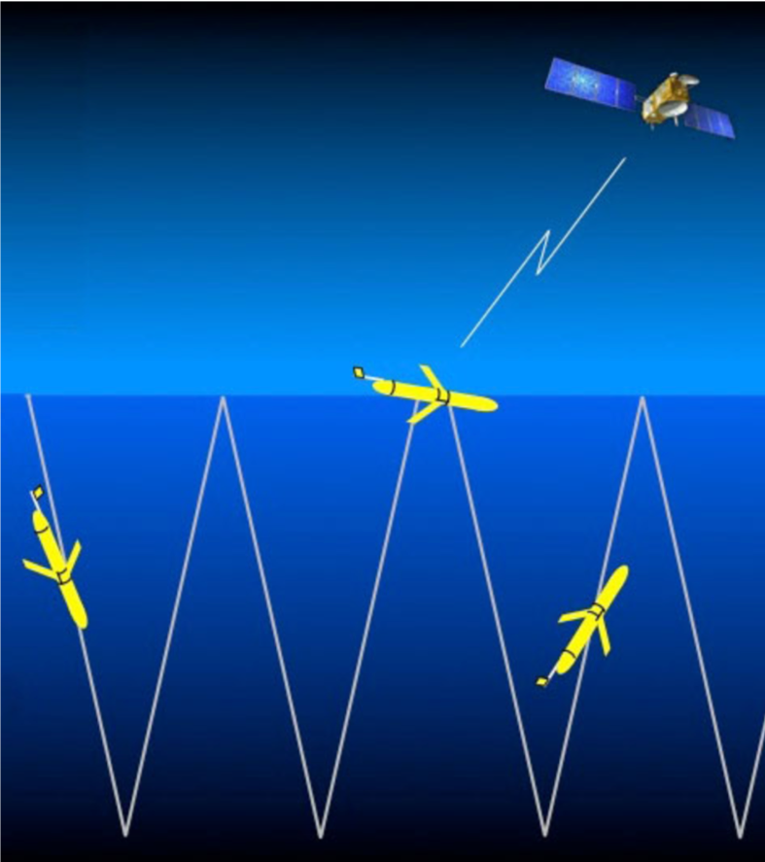
Slocum Glider Operations
30-60 day deployments
Horizontal speed: 20 km/day
Vertical profiling: 10-15 cm/s
Sampling frequency: 0.5 Hz
Measurements every 20-30 cm vertically
pH, conductivity, temperature, depth, chlorophyll, oxygen
WHOI

Slide 12
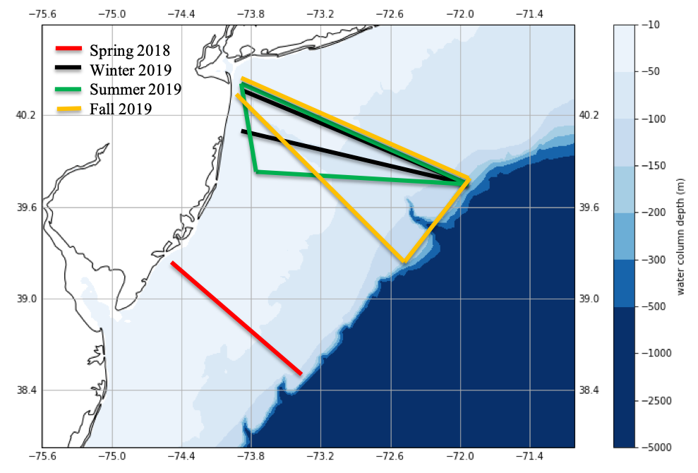
Seasonal pH Glider Deployments

Slide 13
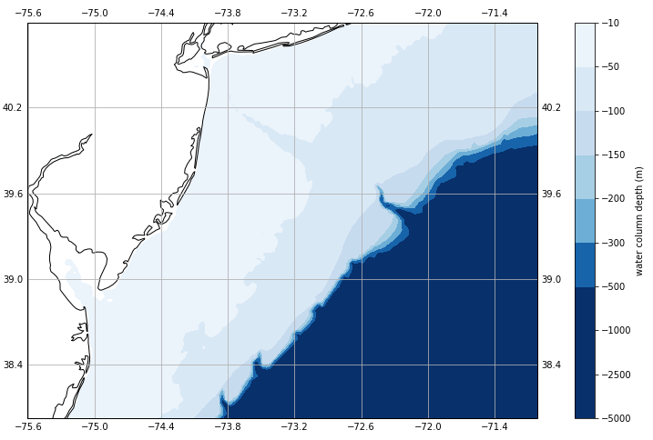
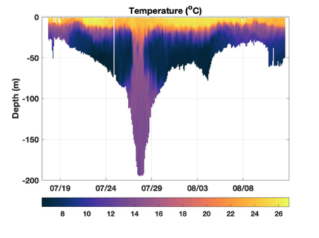
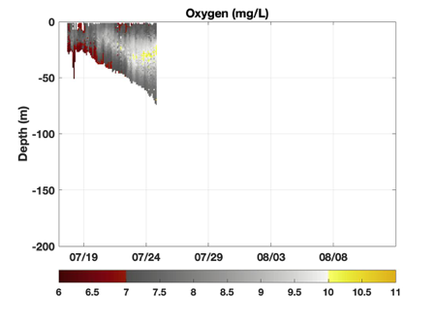
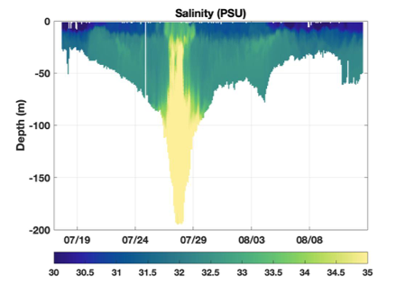
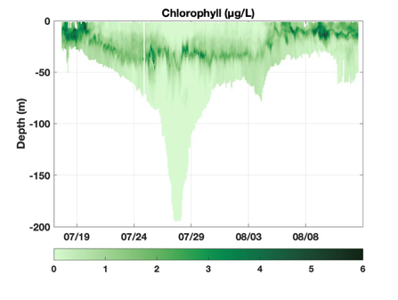
Example Data: Summer 2019

Slide 14
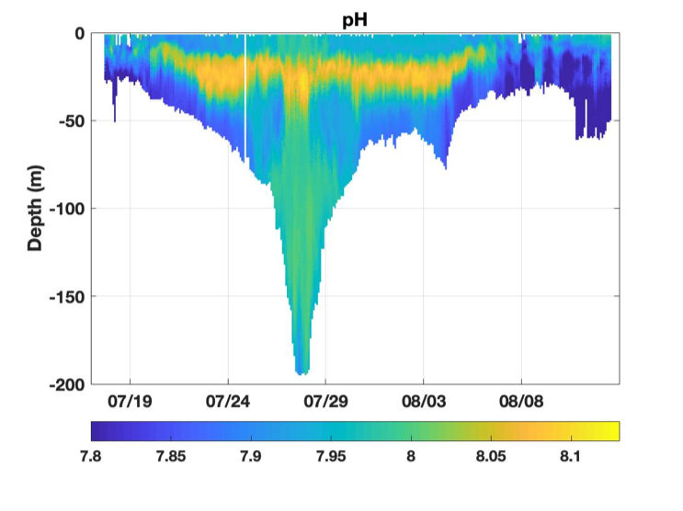
Example Data: Summer 2019

Slide 15
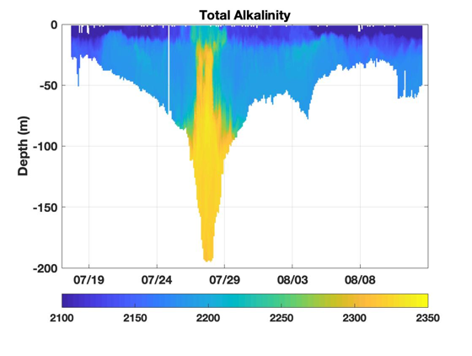
Example Data: Summer 2019

Slide 16
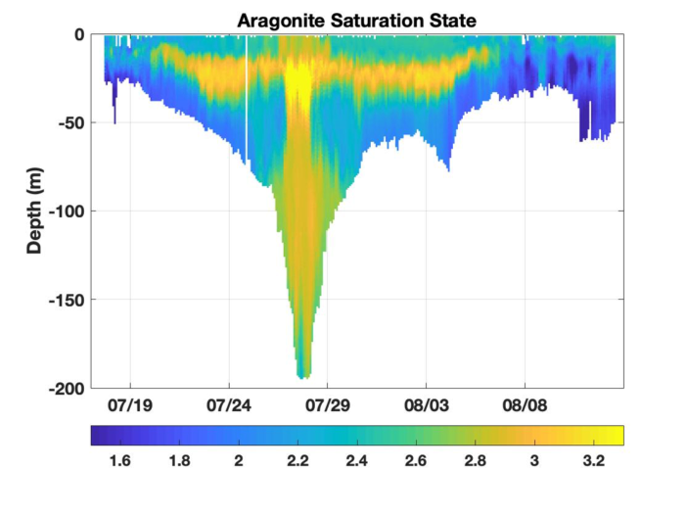
Example Data: Summer 2019

Slide 17
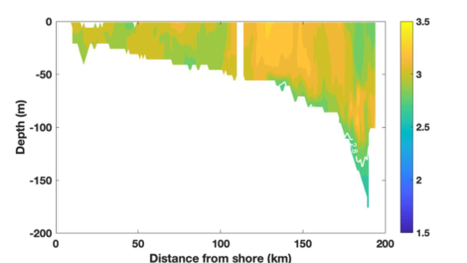
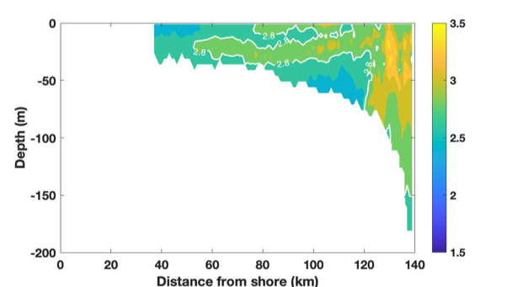
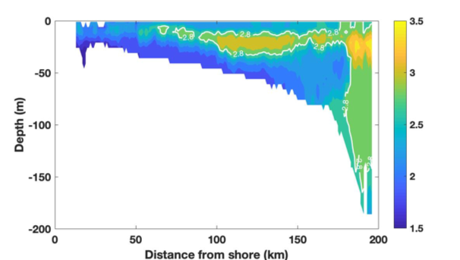
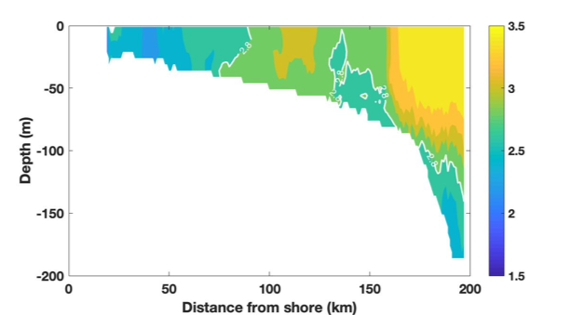
Seasonal $Ω$_{arag}
Winter
Spring
Summer
Fall
Notes:
Bins: 1 m distance, 5 m depth

Slide 18
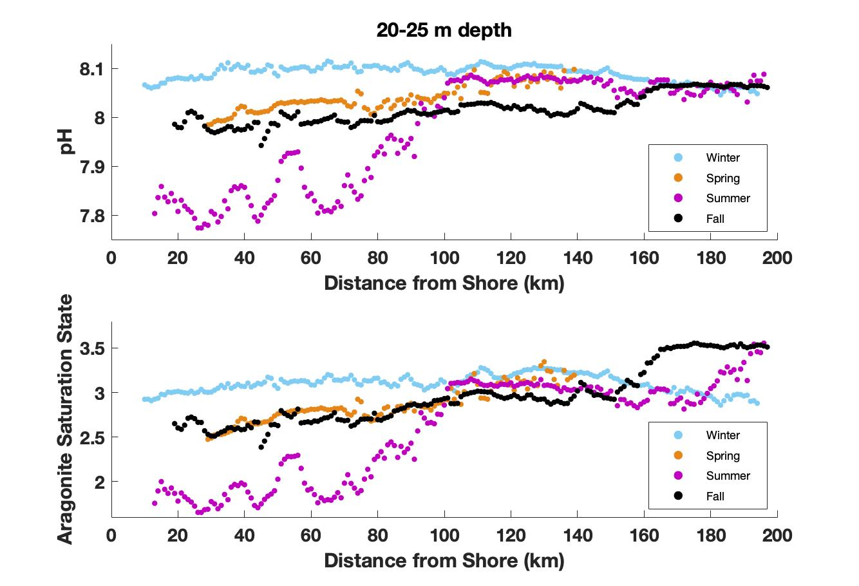
Seasonal Changes in the MAB

Slide 19
Scallop Spawning Season Conditions
Average pH: 8.014
Average $Ω$_{arag}: 2.73
Average pH: 7.906
Average $Ω$_{arag}: 2.17
Spring $Ω$_{arag}
NOAA Fisheries
$486 million!
Summer/Early Fall $Ω$_{arag}

Slide 20
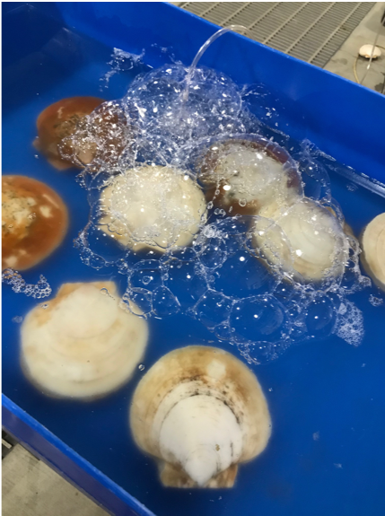
Future Work
Larval scallop experiments
pCO₂ (410 ppm, 600 ppm, 1200 ppm)
Food concentration (aquaculture standard,
¼ standard)
Mortality rate, growth rate, lipid accumulation
Modeling work
Larval dispersal in MAB
Notes:
Remove modeling work??

Slide 21
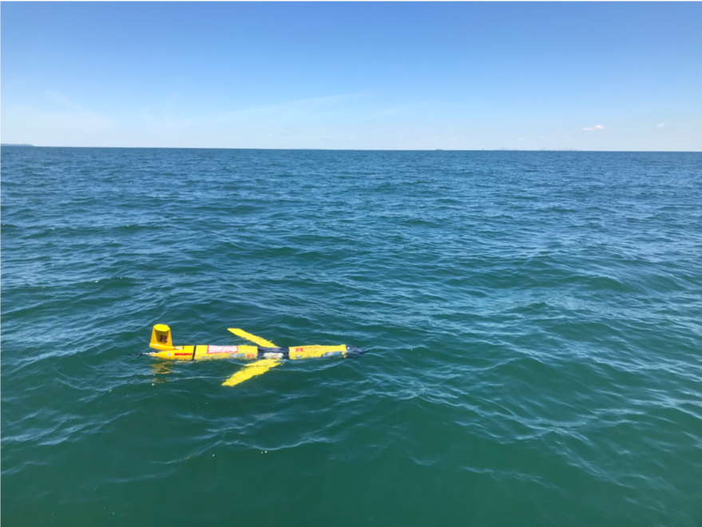
Acknowledgements
Saba Lab Group: Grace Saba, Emily Slesinger, Lori Garzio, Brandon Grosso, Laura Wiltsee, Kasey Walsh
Rutgers COOL group
Glider Technicians: Dave Aragon, Chip Haldeman, Nicole Waite
ekw31@marine.rutgers.edu
@ScienceLiza
Collaborators: Sea-Bird Scientific/WET Labs (Andrew Barnard, Charlie Branham), Teledyne Webb Research (Clayton Jones), Atlantic Capes Fisheries (Peter Hughes), NJ Aquaculture Innovation Center (Sean Towers)
Funding: NSF OTIC Program (OCE #1634520), NOAA OAP/NJSCG (#NA18OAR4170087)

