Slide 1
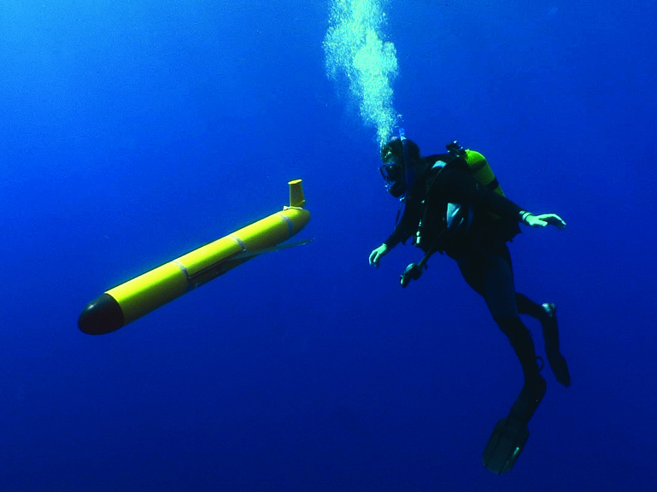
Goal: Improving our Understanding & Forecasting of Essential Ocean Features & Essential Ocean Processes responsible for Rapid Co-evolution
Mid Atlantic Bight: Summary of 2019 Glider Operations
Contributing Scientists:
Travis Miles, Scott Glenn,
Maria Aristizabal, Wendell Brown, Donglai Gong, Matt Oliver, Gerhard Kuska

Slide 2
Regionally-specific Essential Ocean Features impacting
Atlantic Hurricane Intensity
In biology, co-evolution occurs when two or more species reciprocally affect each other’s evolution…
- WIKIPEDIA
Rapid Co-evolution of the Ocean & Atmosphere in Hurricanes and Tropical Cyclones
Seasonal Stratification, Cold Pool
Gulf Stream,
Shelf
Loop Current,
Eddies,
Fresh Water
Warm Pool,
Upper Ocean Heat Content,
Fresh Water Barrier Layers
Heat & Fresh Water
Inflow

Slide 3
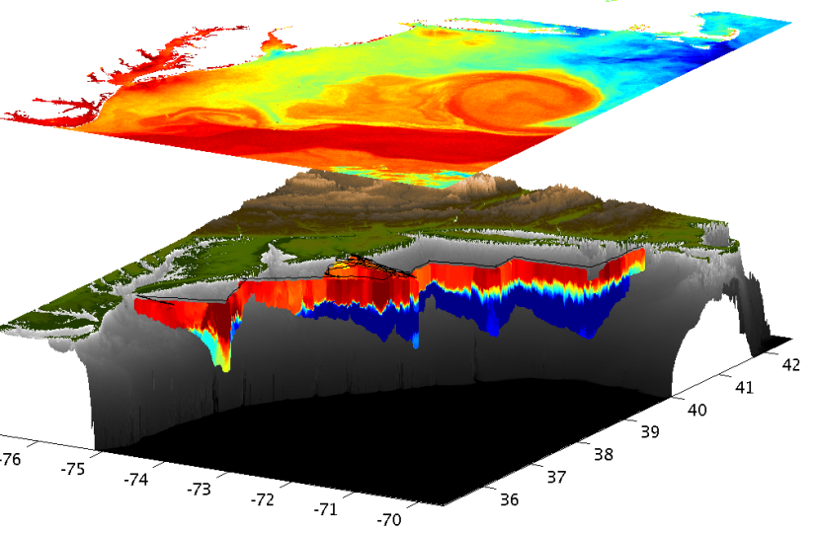
Essential Ocean Feature - Mid-Atlantic’s Cold Pool
An unseen from space, cold bottom layer beneath a warm seasonal surface layer
Mid Atlantic
Winter (1-layer)
Mid Atlantic
Summer (2-layers)
Cold Pool
Satellite SST
Glider Zig-Zags
or Triangles

Slide 4
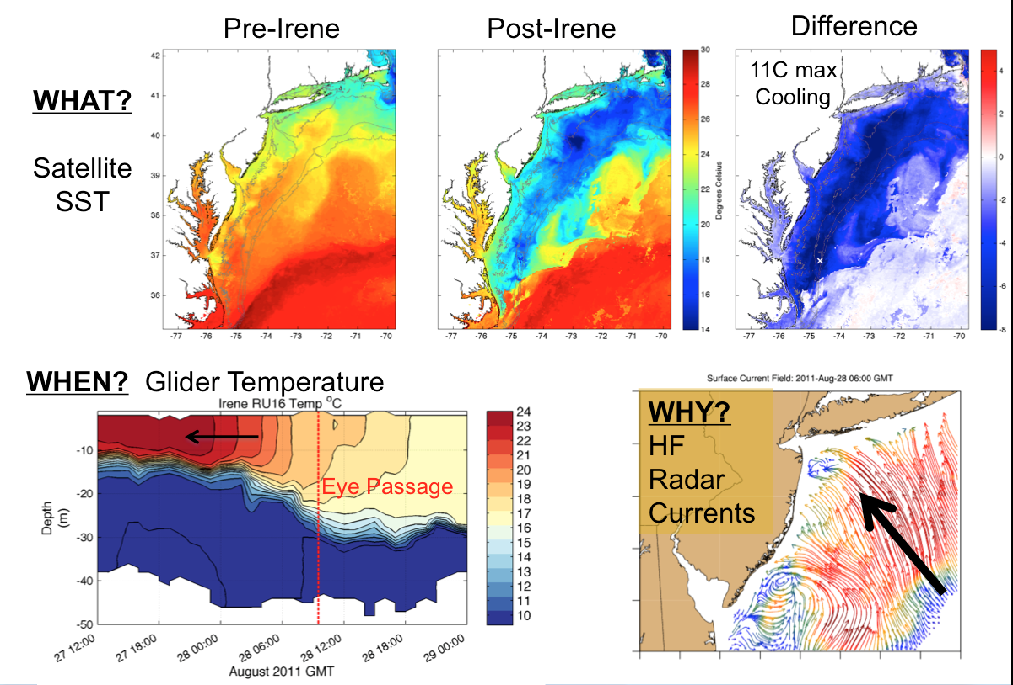
Essential Ocean Process and Impacts
Glenn et al., 2016 Nature Communications

Slide 5
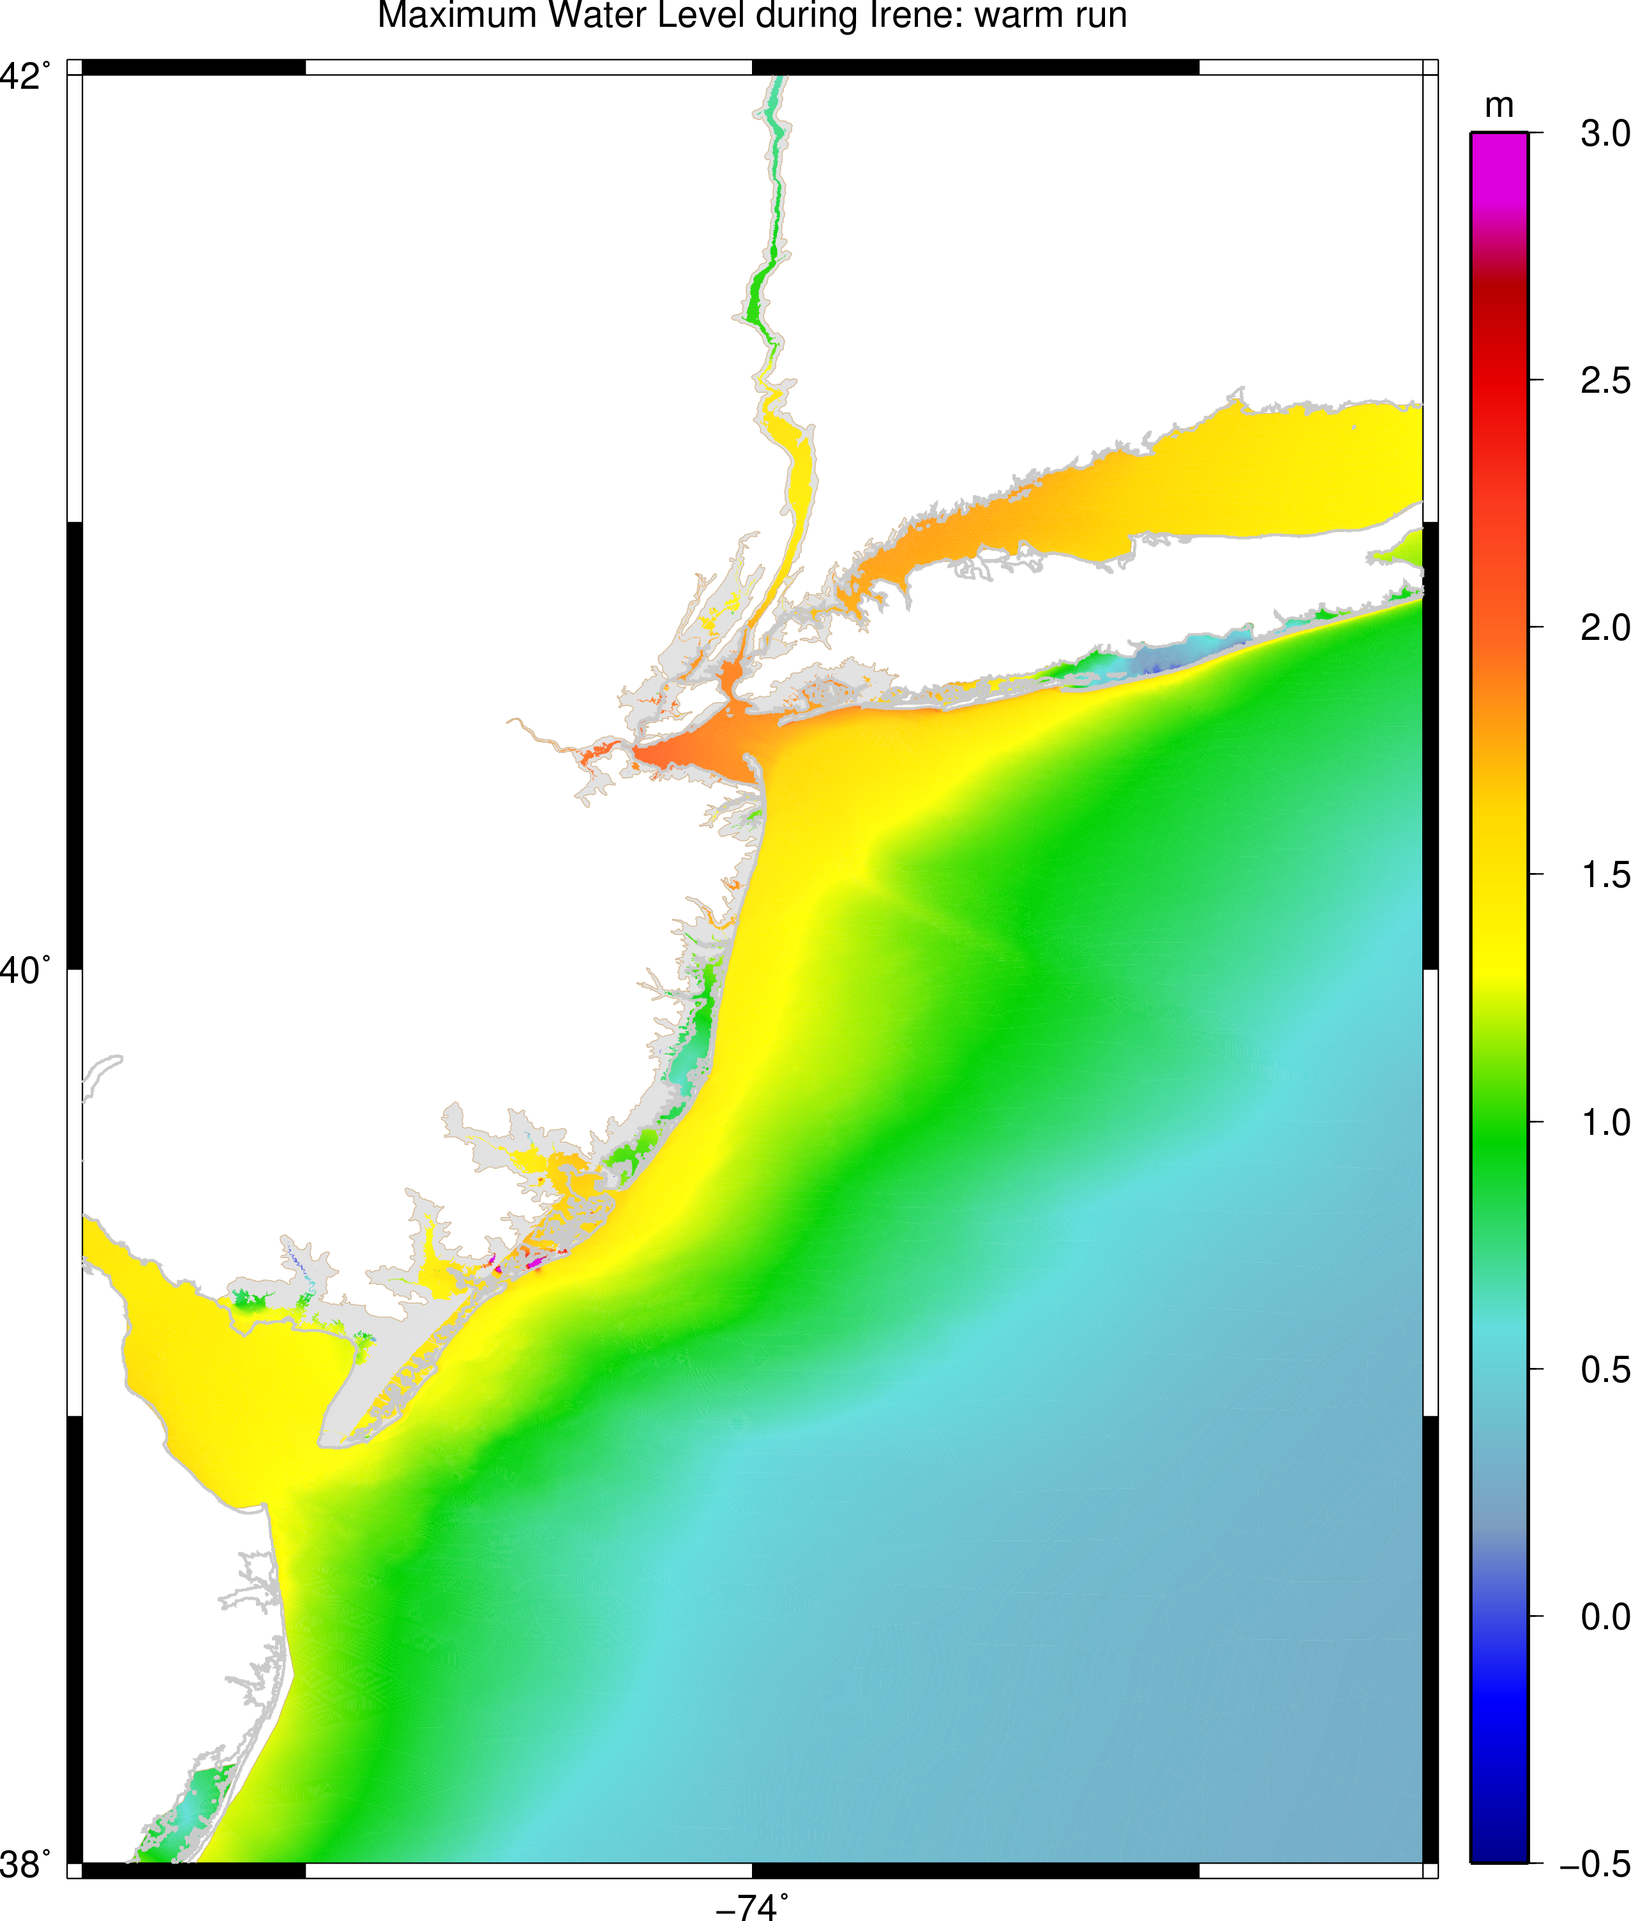
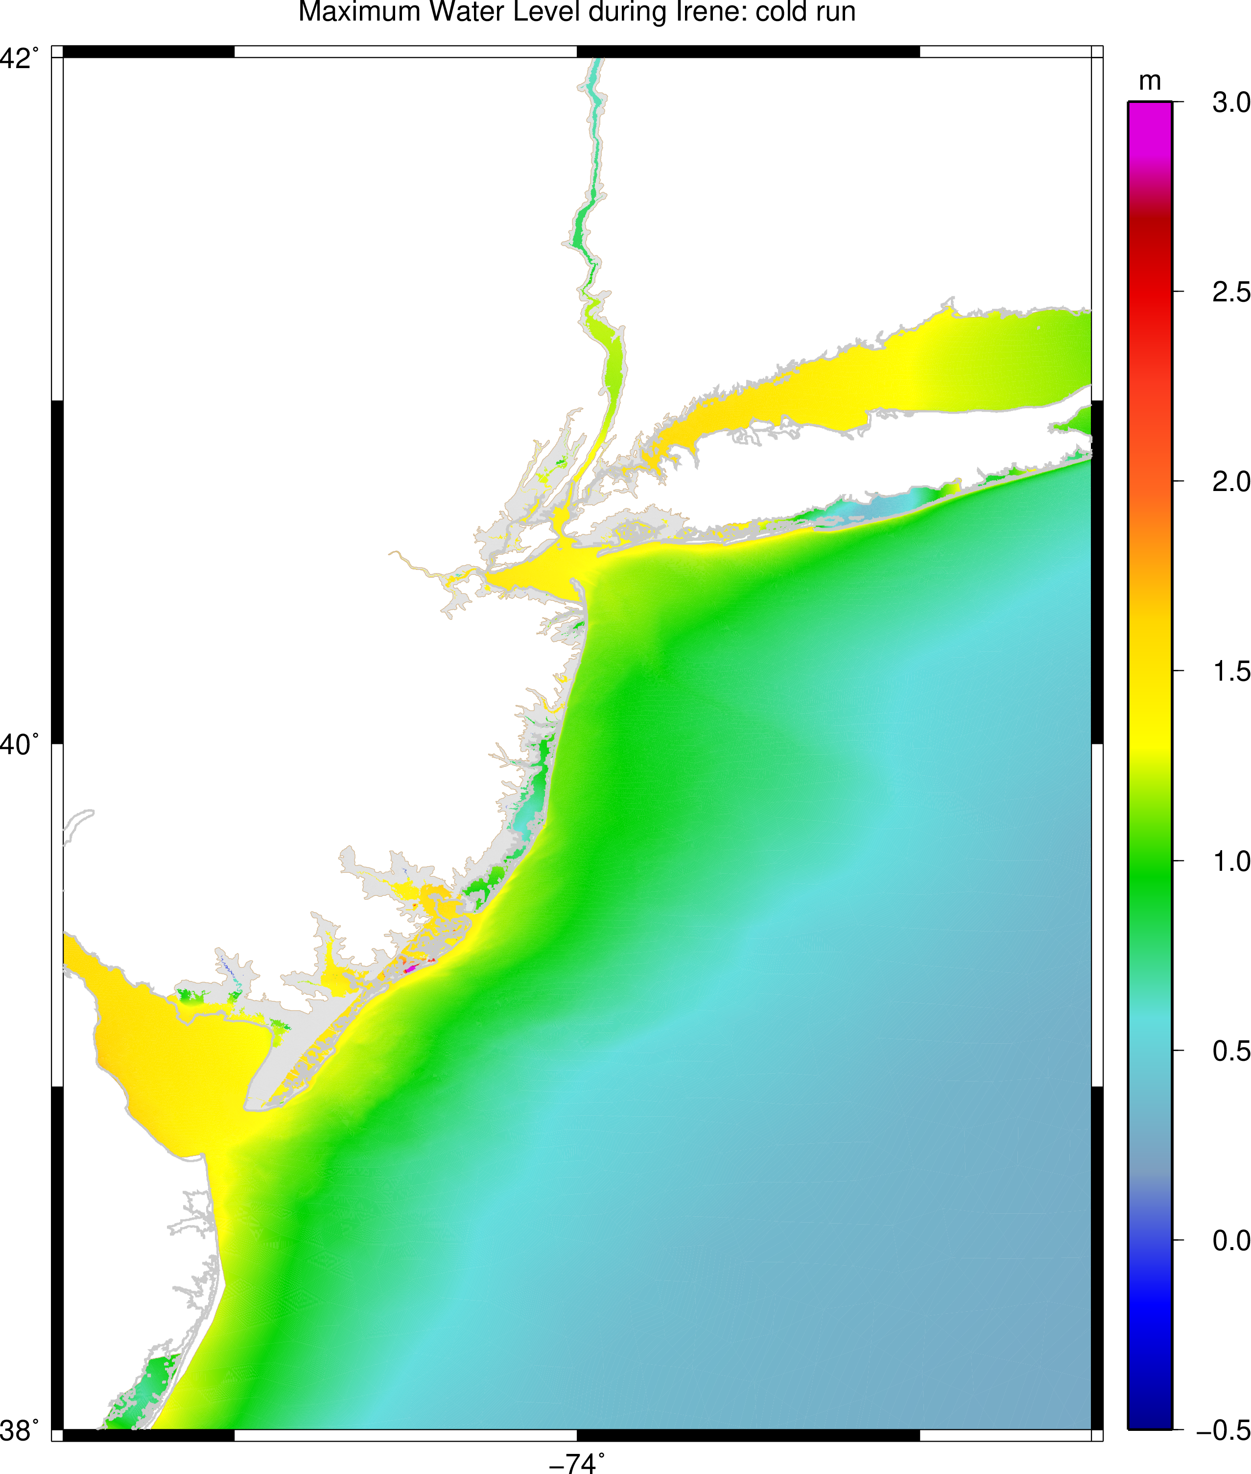
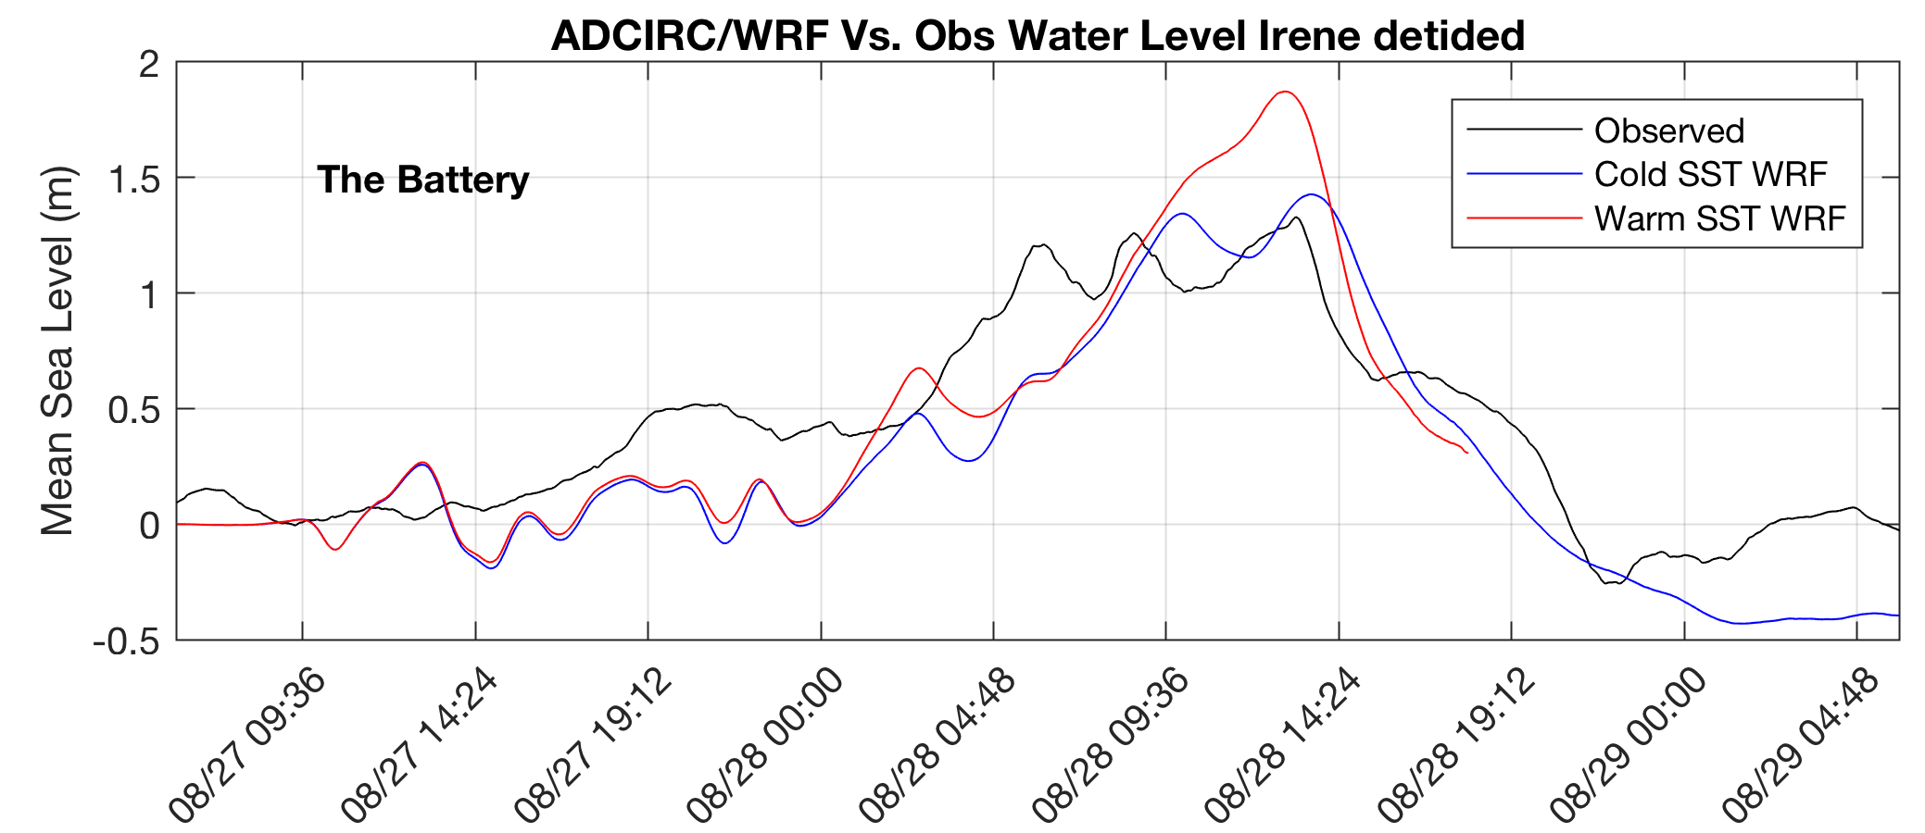
Essential Ocean Process and Impacts
Maximum water level:
Warm Run
Maximum water level:
Cold Run
Glenn et al., 2016 Nature Communications
Miles et al., in prep

Slide 6
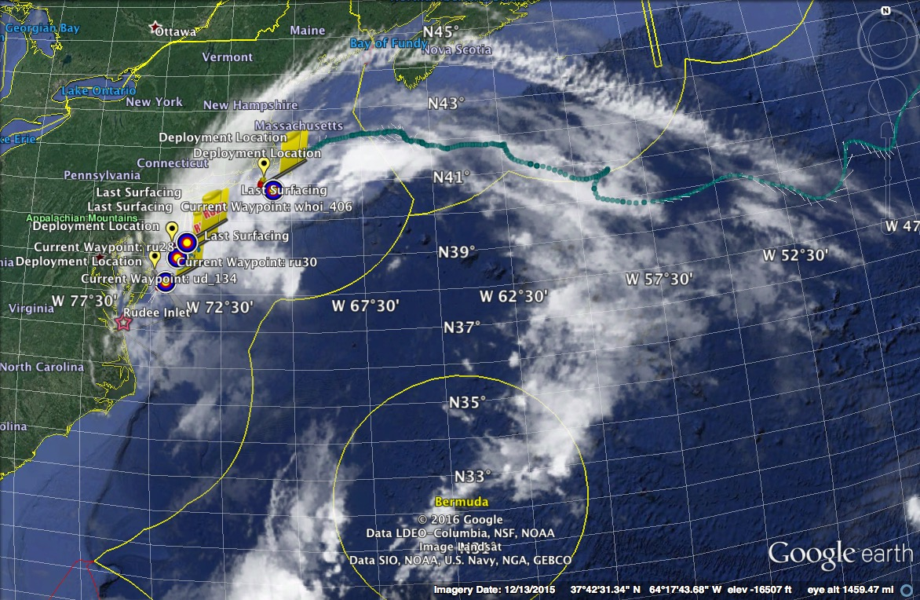
Hurricane Hermine Response: NOAA OAR CINAR Tempests Fleet Launched, 9/2016
Glider
GOFS 3.0 (HYCOM)
RTOFS
Forecast Models Lack an Essential Ocean Feature - Cold Pool
Glider data rejected for assimilation – too far from the model “truth”

Slide 7
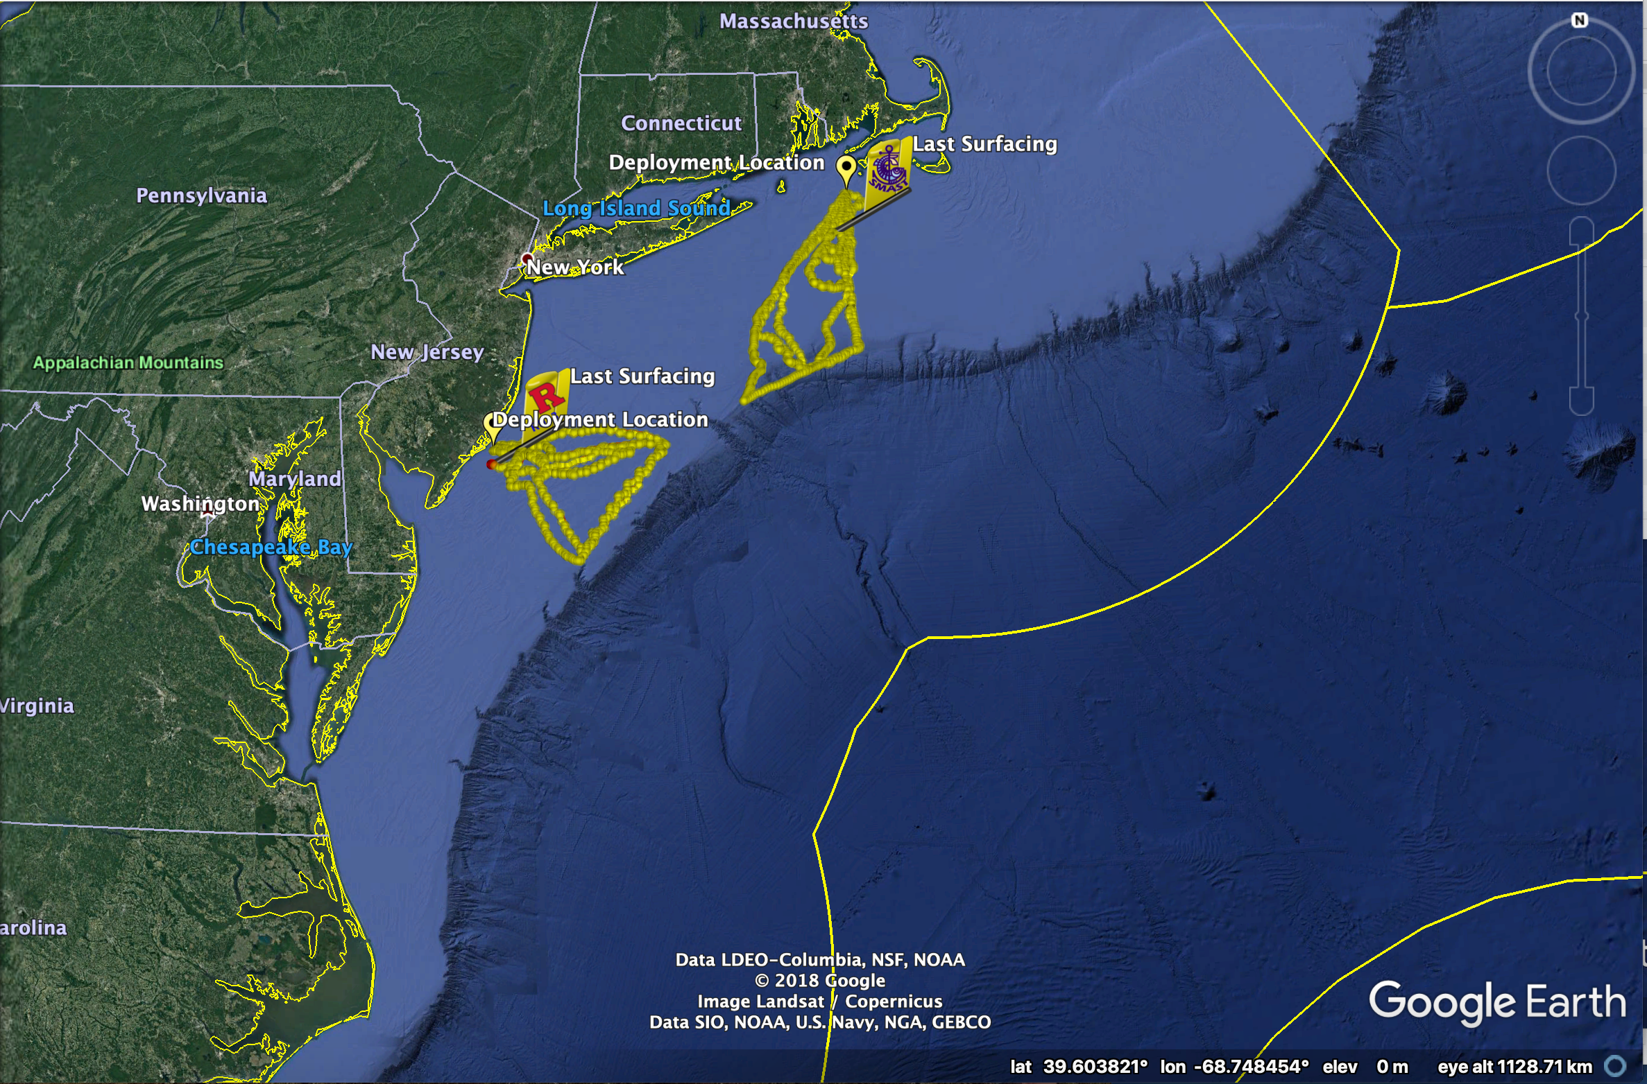
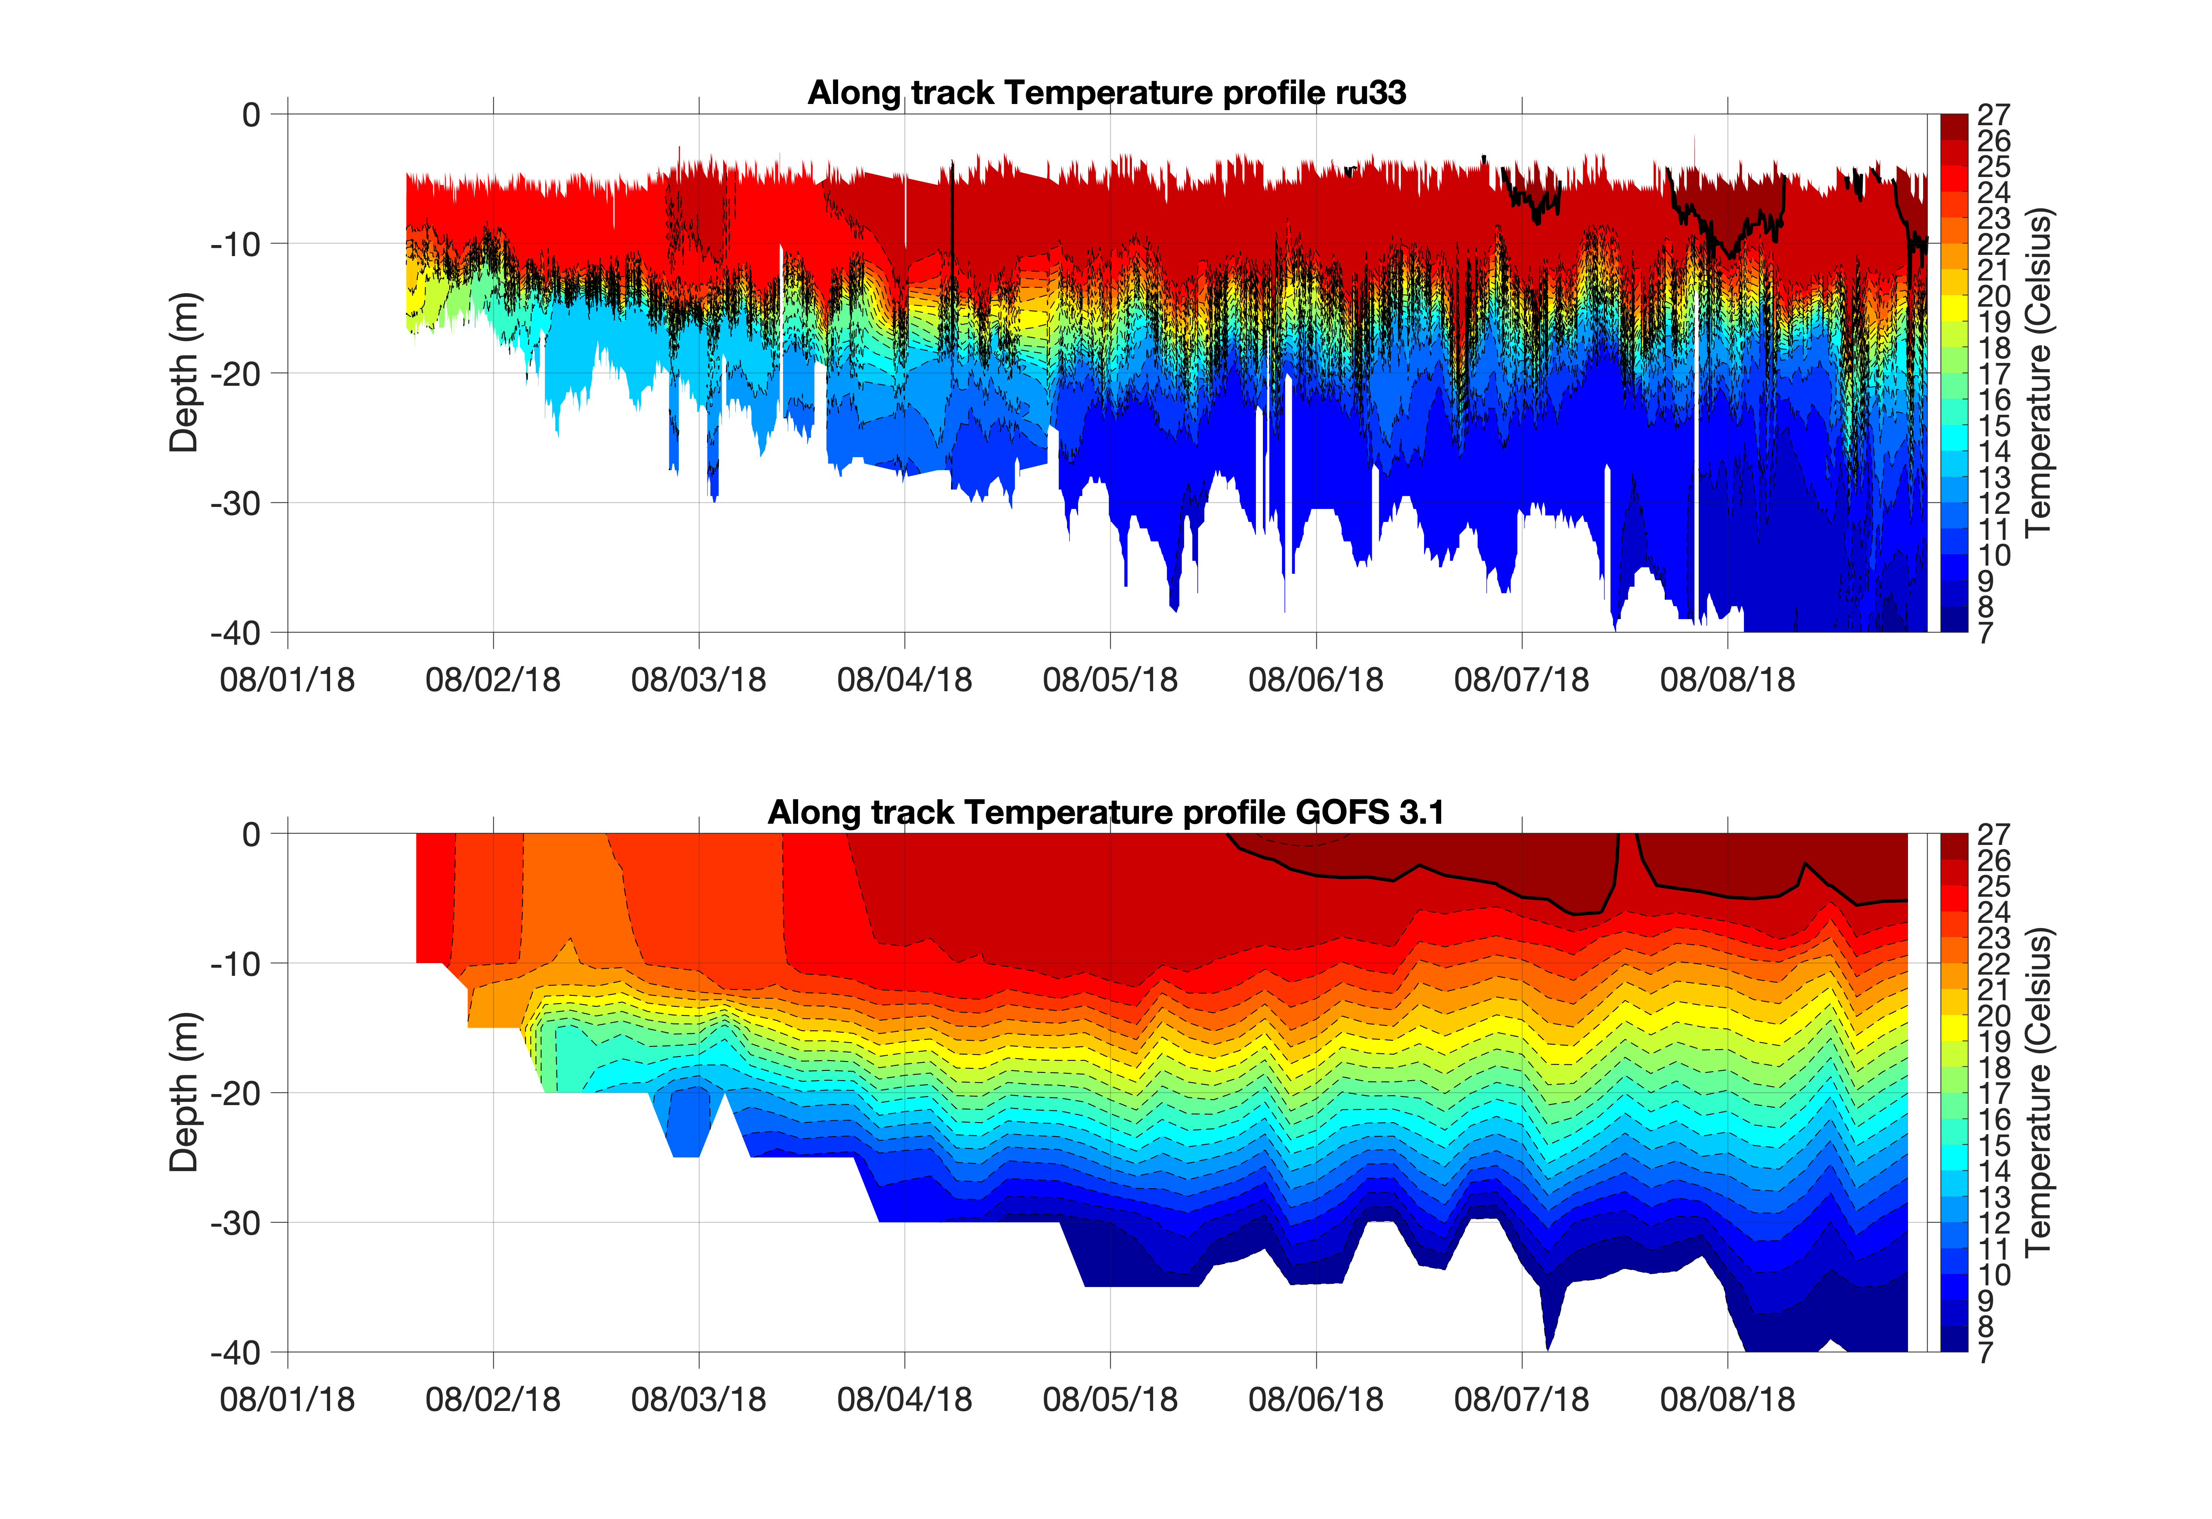
2018 Mid Atlantic Glider Repeat Triangle Surveys
Glider Blue
Aug 8-Nov 8, 2018
Glider RU33
Aug 1-Oct 9, 2018
Glider RU33
Navy Model
GOFS 3.1
Notes:
At the time only able to do comparisons with Navy GOFS 3.1
Over the last year Maria has started harvesting realtime RTOFS (publicly available)
And additional POM, RTOFS, HYCOM etc. models

Slide 8
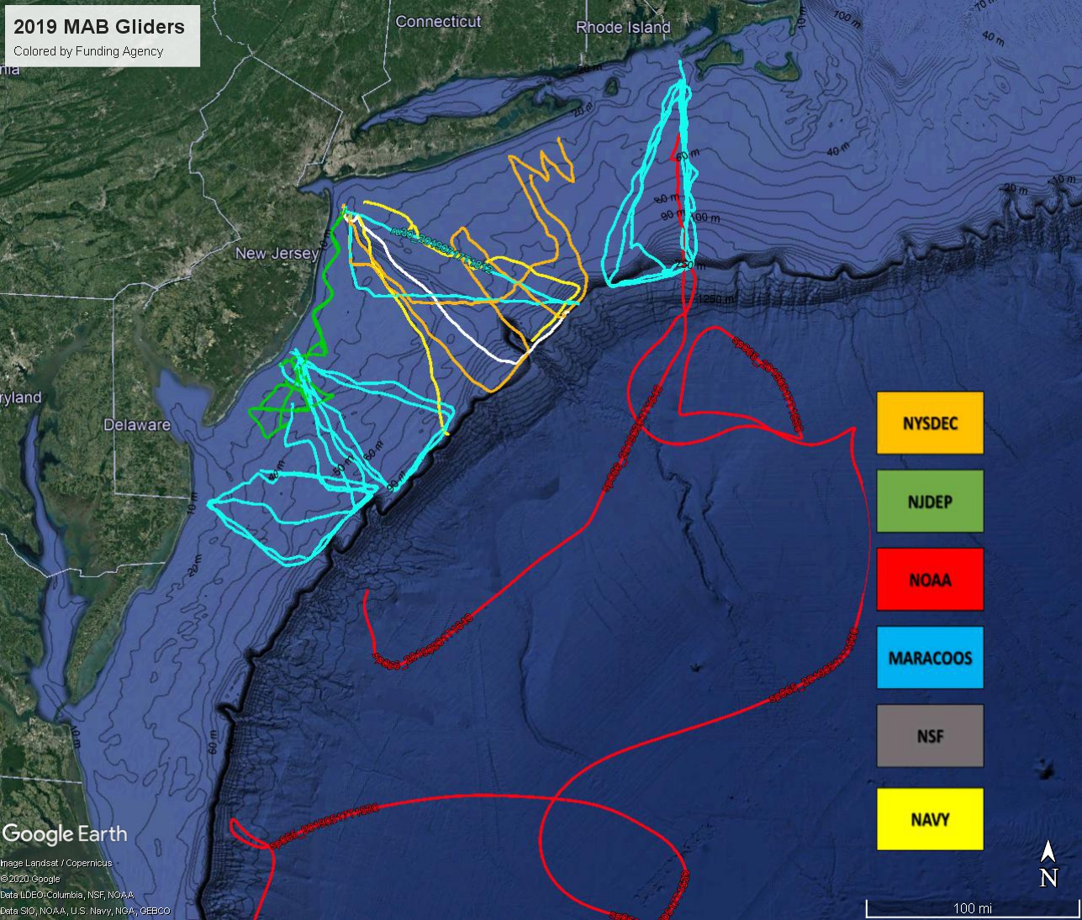
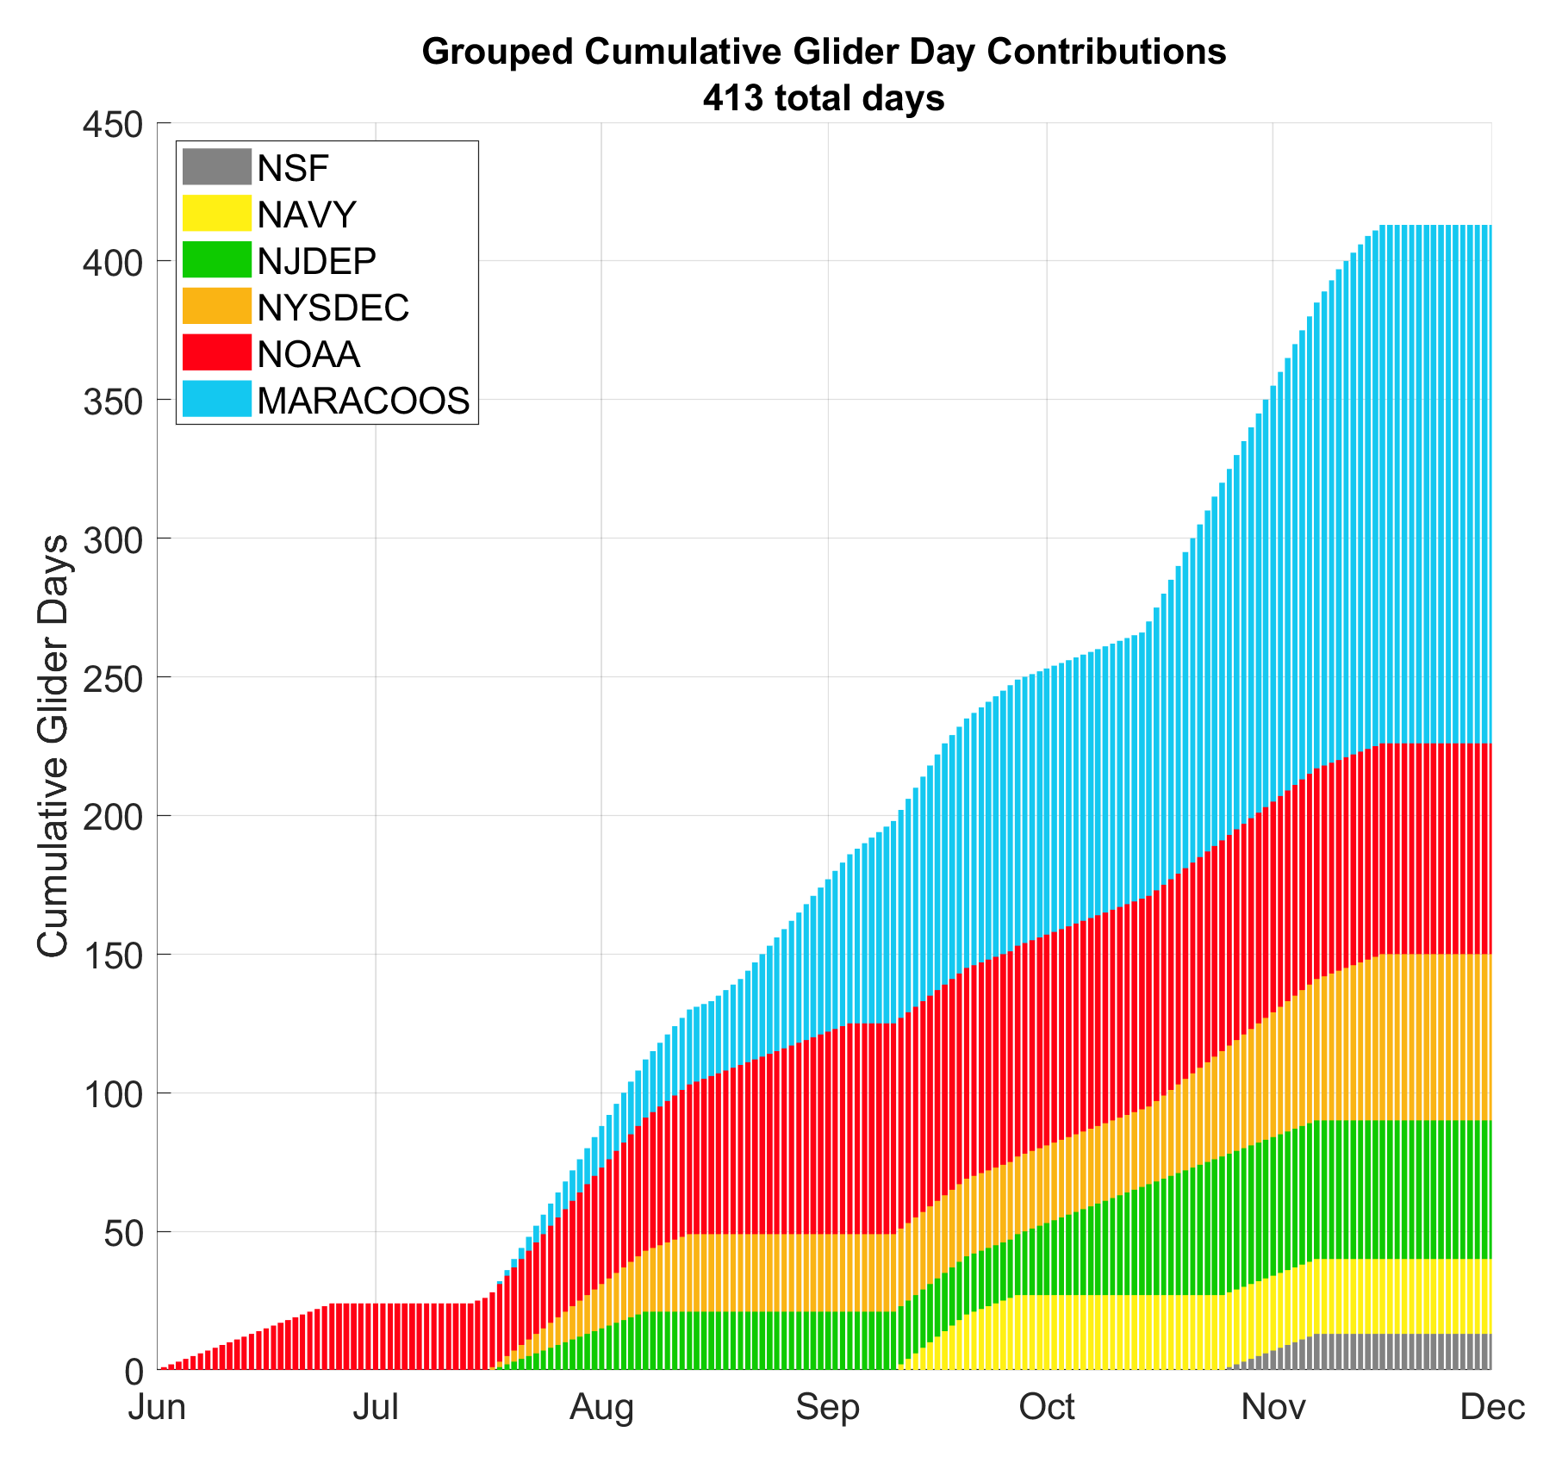
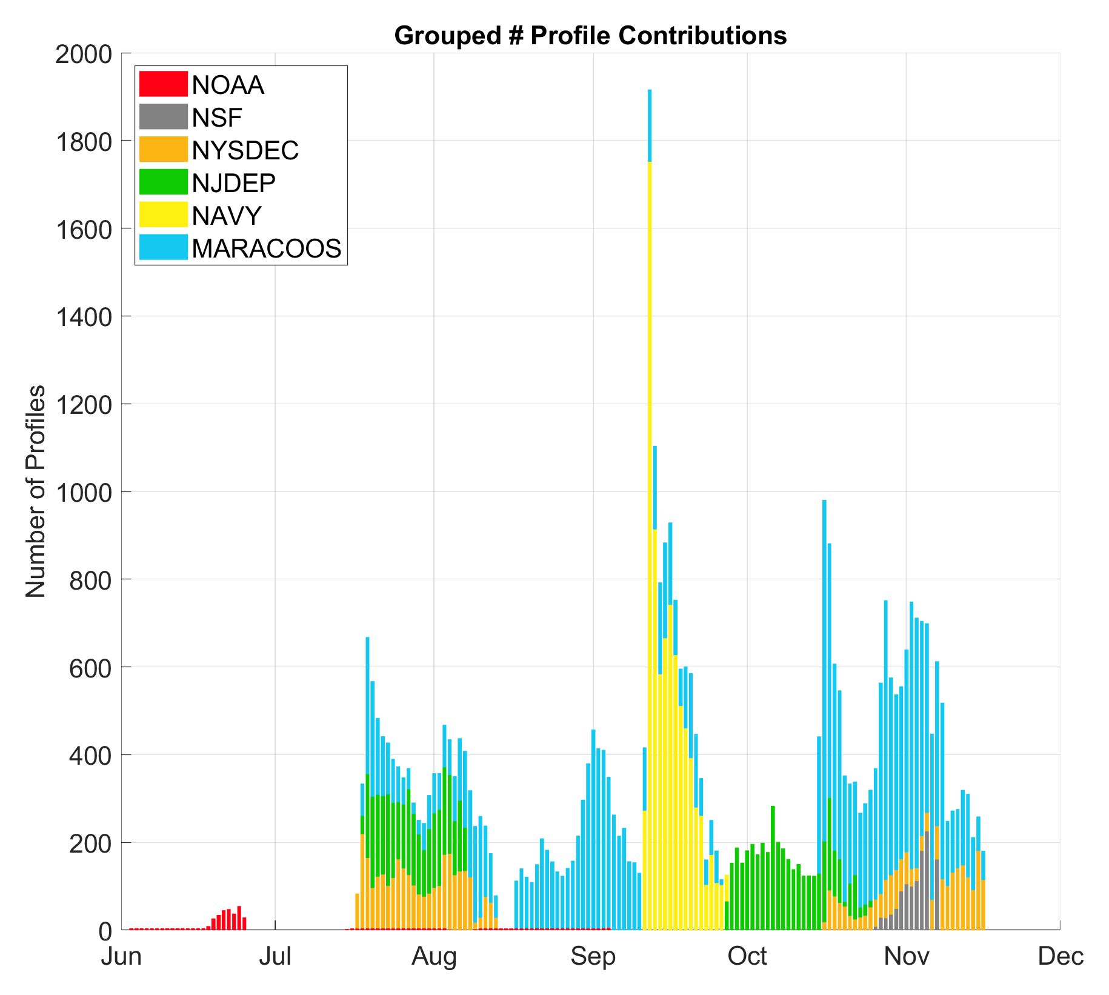
Total: 413 Days
Total: 44,504
Notes:
IFAA Hurricane Supplemental (Different color than MARACOOS)
MARACOOS Core
NOAA OAR (check DAC)
Navy color adjustments (Yellow)
NJDEP (light green maybe)

Slide 9
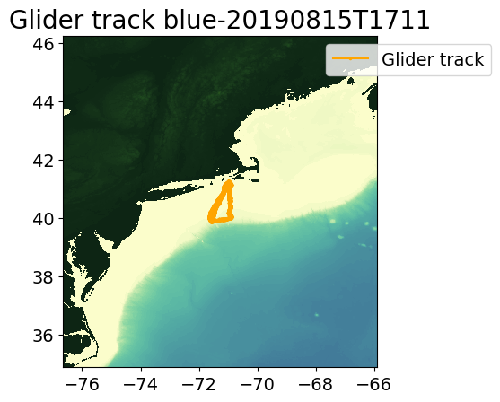
Blue August - September

Slide 10
Blue August - September
Average temperature above the pycnocline
Depth integrated Heat from 26ºC isotherm to surface
Energy required to fully mix the water column

Slide 11
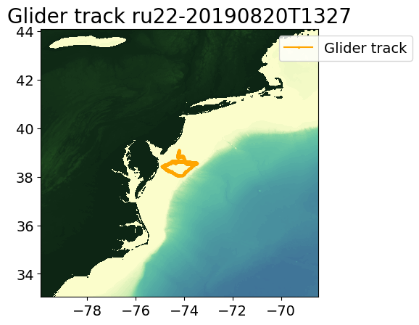
RU22 August - September

Slide 12
RU22 August - September
Average temperature above the pycnocline
Depth integrated Heat from 26ºC isotherm to surface
Energy required to fully mix the water column

Slide 13
2019 Summary
Autonomous vehicles have been contributing sustained observations toward hurricane intensification studies in the Mid Atlantic for 6 consecutive years. (CINAR Tempests, MARACOOS, Navy, and IFAA Hurricane Supplemental).
Observations have continued to improve the representation of the essential ocean feature (MAB Cold Pool) in the full suite of models.
Research efforts are continuing to evaluate and improve the essential ocean processes. 3D coastal ocean circulation, submesoscale vertical mixing, and air-sea coupling.
Future OSSE’s and OSE’s are needed to further asses impacts of ocean data in this, and other regions.

