Slide 1





78 Million People (1/4 of U.S.)
1000 km Cape to Cape
U..
Middle Atlantic
Regional Association
Coastal
Ocean Observing System
Cape
Cod
Stratified
Coastal Ocean Interactions with
Tropical Cyclones
Sandy
Irene
Barry
Scott Glenn, Travis Miles,
Greg Seroka, Robert Forney,
Hugh Roarty, Oscar Schofield,
Josh Kohut (Rutgers),
Yi Xu (China) & Fei Yu (China)
Nature Communications (2016)
Arthur
Cape
Hatteras
Notes:
1

Slide 2
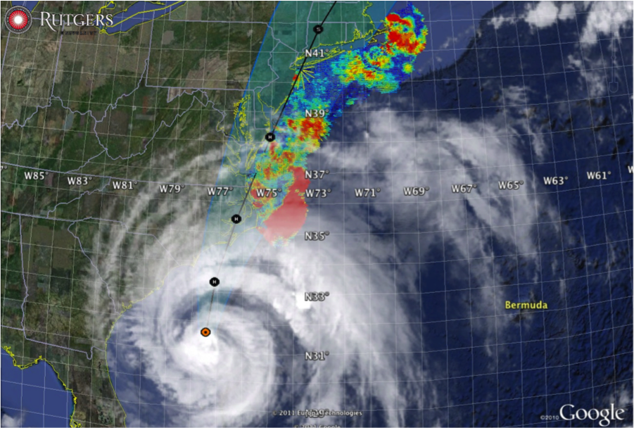

Hurricane Irene
August 28, 2011
NOAA/NHC Damage:
#7 with >$16 Billion.
Track Accurate;
Intensity Over-predicted.
Hurricane Sandy
October 29, 2012
NOAA/NHC Damage:
#2 with >$68 Billion.
Track Accurate;
Surge Under-predicted.
Georgas et al., 2014,
J. of Extr. Even.
Colle et al., 2015,
J. Mar. Sci. & Engr.

Slide 3
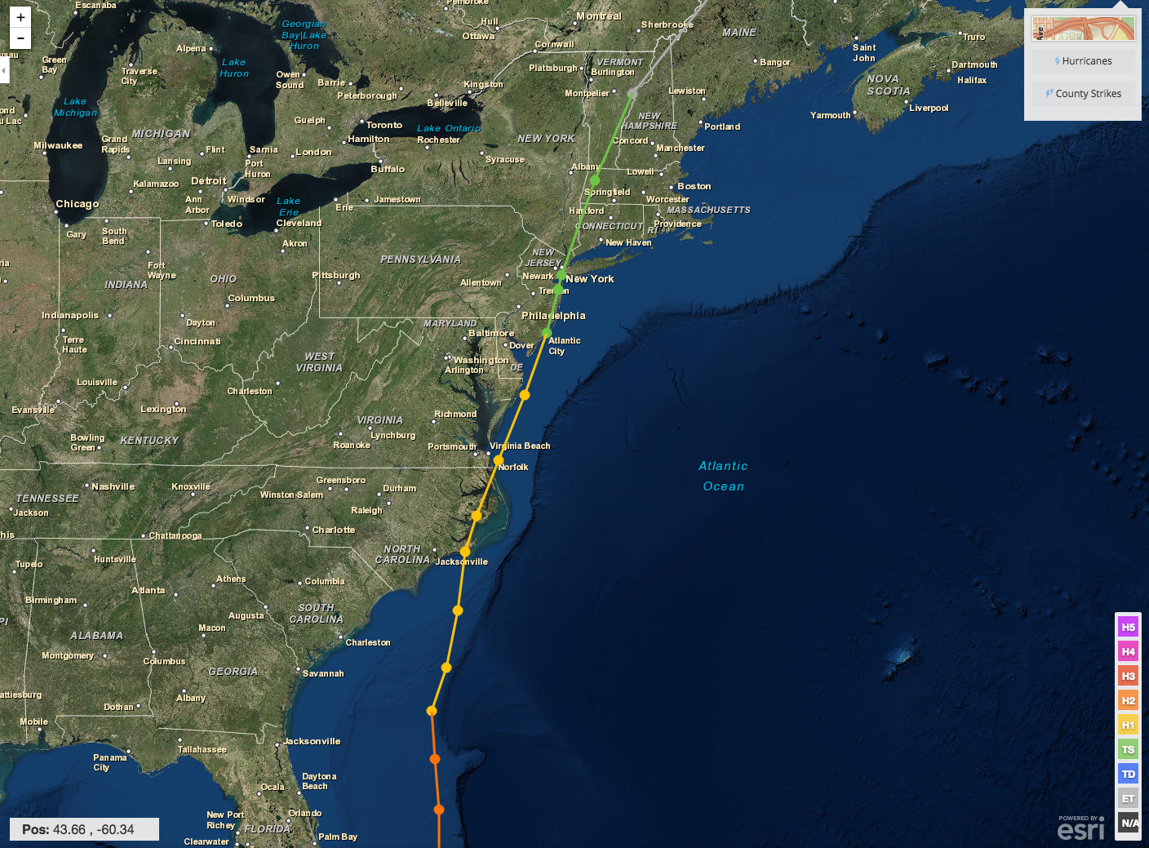
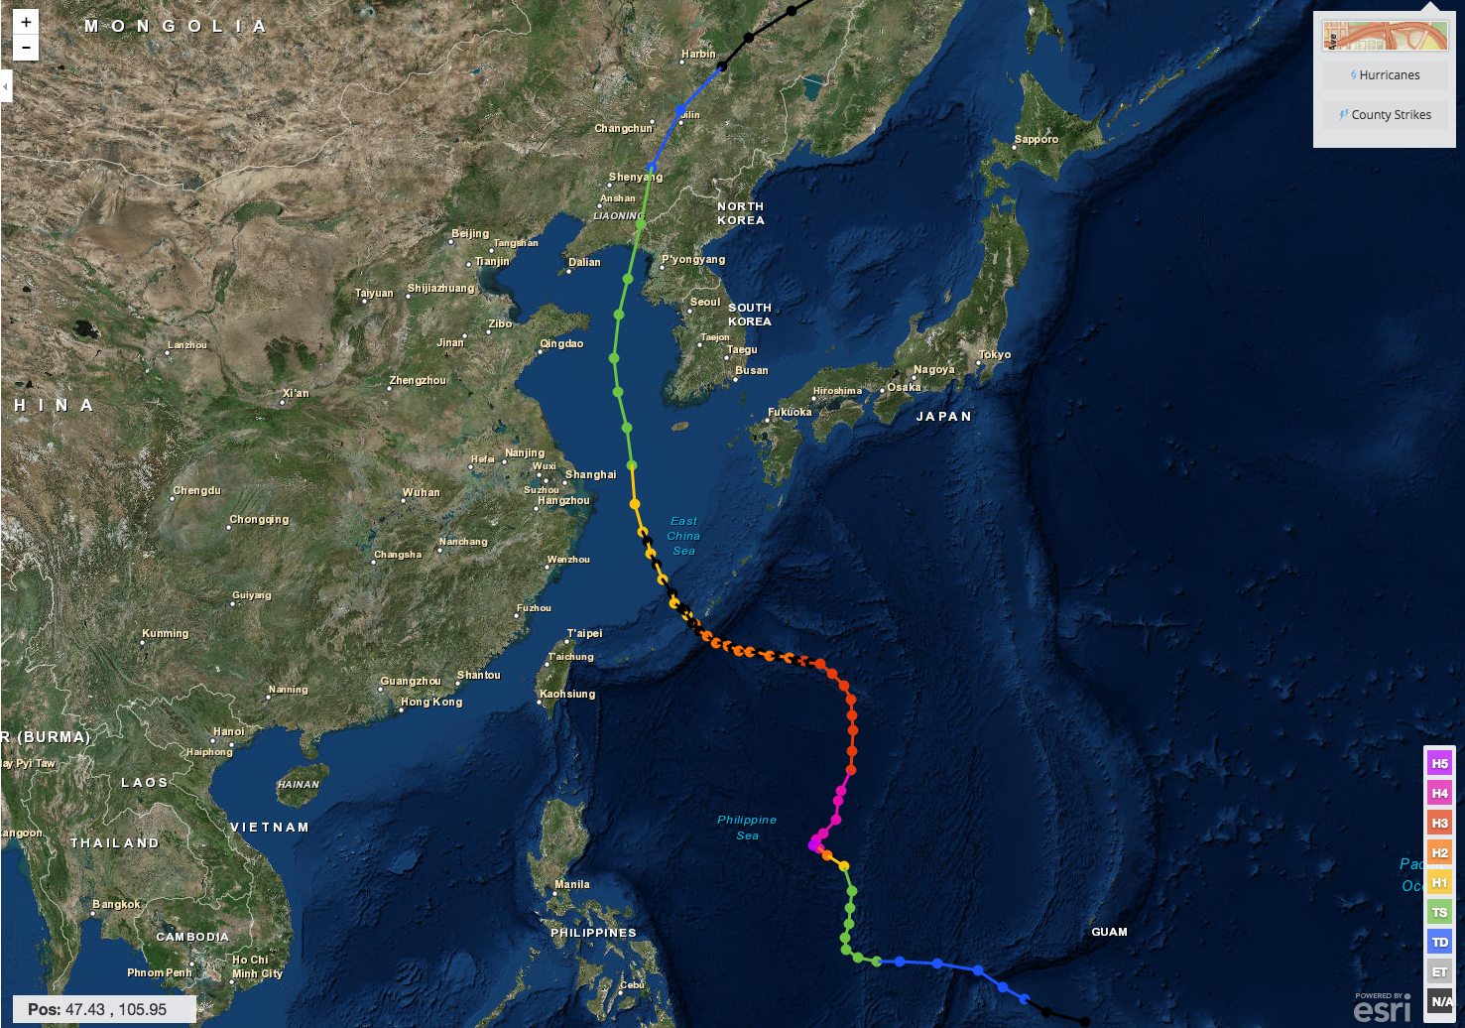
Hurricane Irene & Super-Typhoon Muifa:
What do these summer of 2011 storms have in common?
Hurricane Irene
26-29 August 2011
Super-Typhoon Muifa
26 July - 9 August 2011

Slide 4

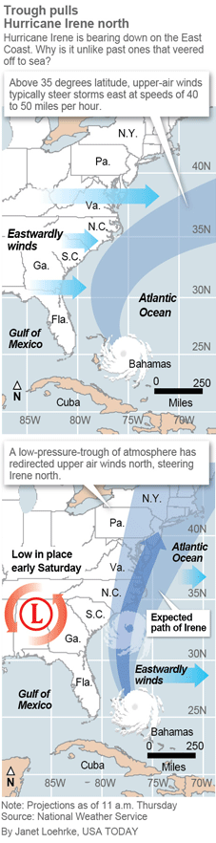
Pre-Irene Storm Warnings
Over 2 million people ordered to “flee the storm’s path”.
President Obama: Shaping up to be a “historic hurricane” and urged residents to “be prepared for the worst”. “Don’t wait. Don’t delay.”
New Jersey Governor Christie: Ordered evacuation of 1 million people - “This is going to be an enormous storm, and for New Jersey, something we haven’t seen in over 60 years”. “Get the hell off the beach”.
New York Mayor Bloomberg: “Staying behind is dangerous, staying behind is foolish, and its against the law”. “The time to leave is right now”. The bridges, streets and subways were nearly empty ahead of a nearly unprecedented mass transit shutdown.

Slide 5
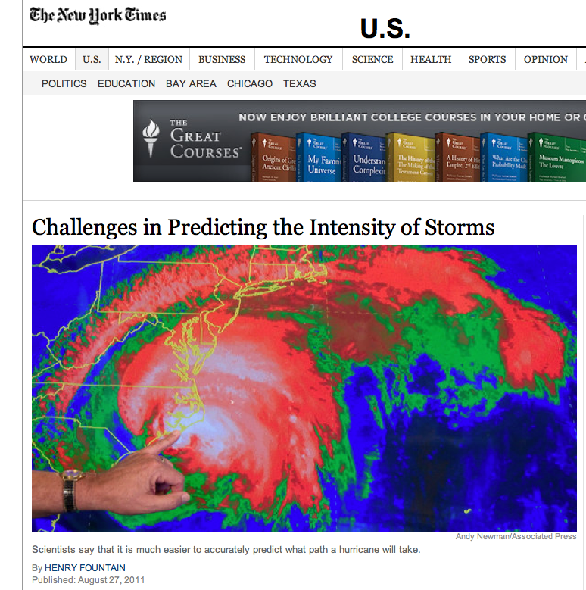
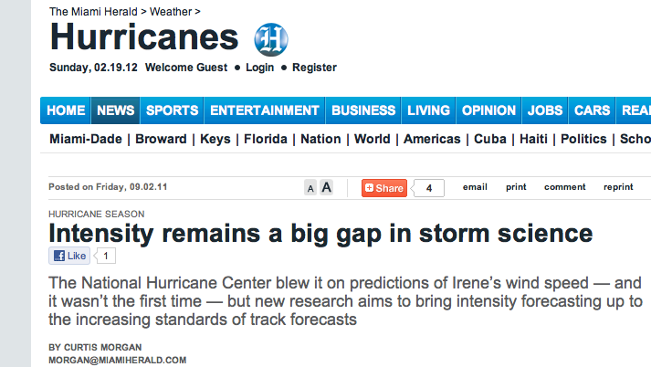
Post-Irene News Reports:
Track accurately forecast
days in advance.
Intensity (wind speed), and the resulting impacts, were over-predicted.
Close the Intensity Science Gap!

Slide 6
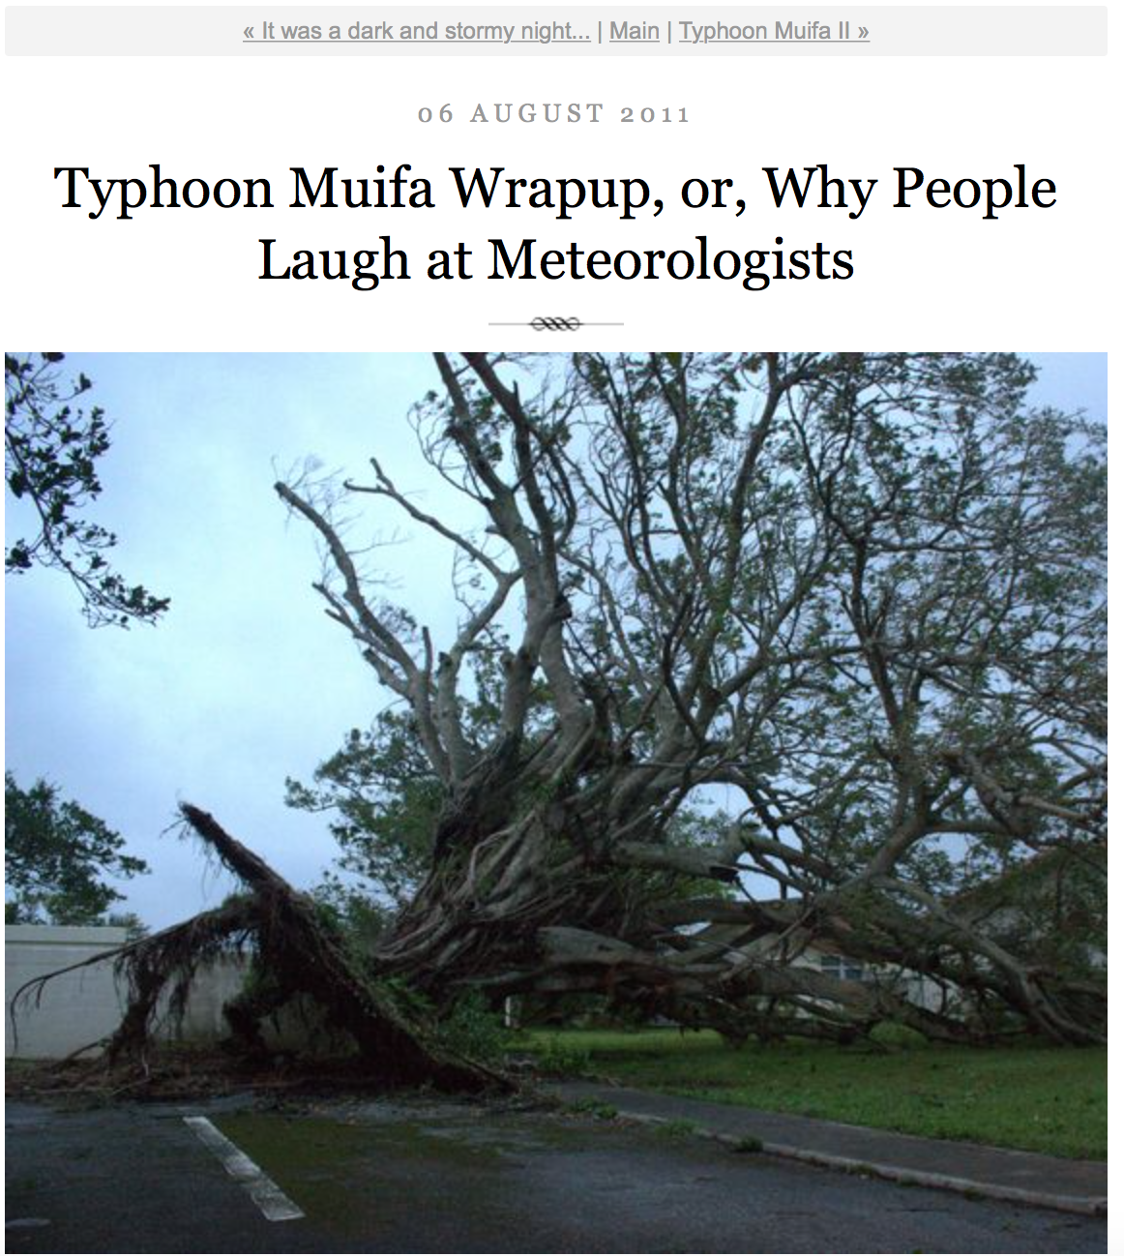
Pre-Muifa preparation:
SHANGHAI Aug 6 (Reuters) - Chinese authorities evacuated more than 200,000 residents from eastern Zhejiang province and cancelled more than 200 flights, as the region braced itself for a typhoon that could be the worst in the area in years.
Post-Muifa Blog entry:
As Muifa moved toward us over the week, at first it looked like we were literally going to take a direct hit from a category 4 typhoon … gradually was downgraded to a 2, it started to seem like no big deal … Basically we started out worried and got less and less so as it moved toward us and were mostly grateful for the 4-day weekend…

Slide 7
Hurricane Irene
August 26, 2011
Summer stratification
Coastal response
Mixing cooled surface
Limited intensity
Conclusion
(Up Front)
Hurricane Sandy
October 29, 2012
After Fall transition
Single layer ocean
No mixing/cooling
No intensity reduction

Slide 8
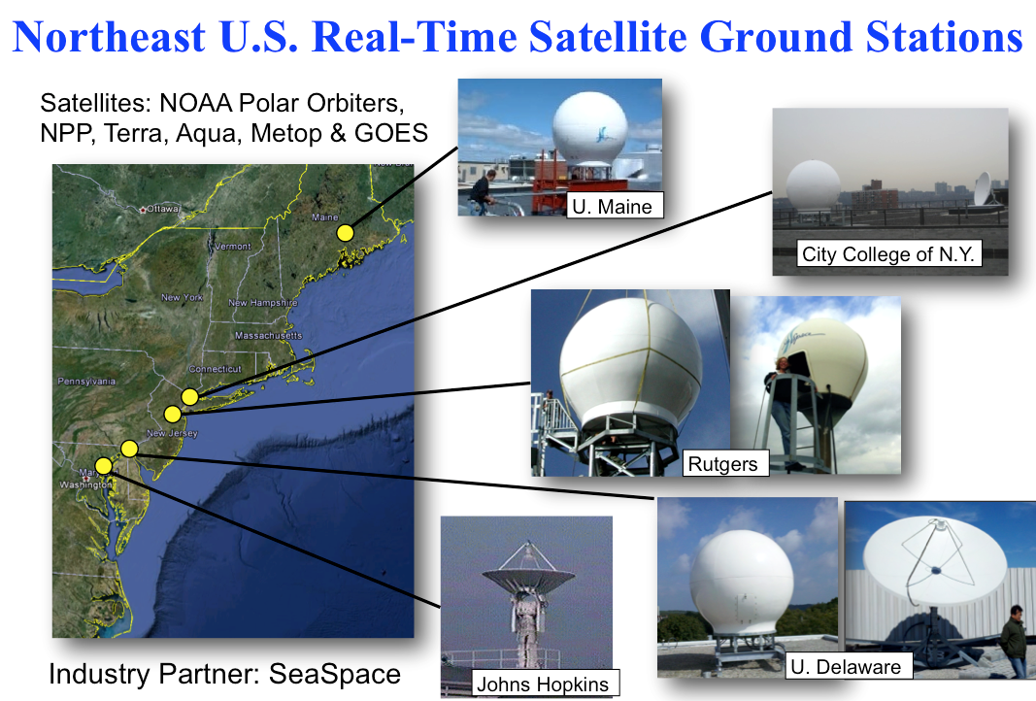
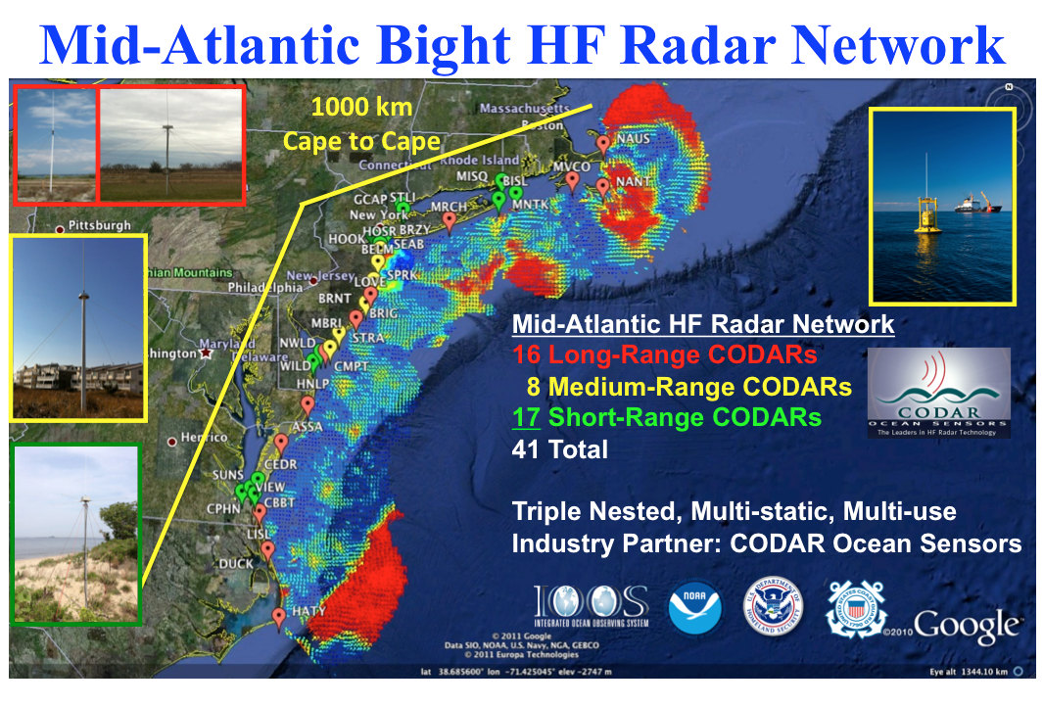

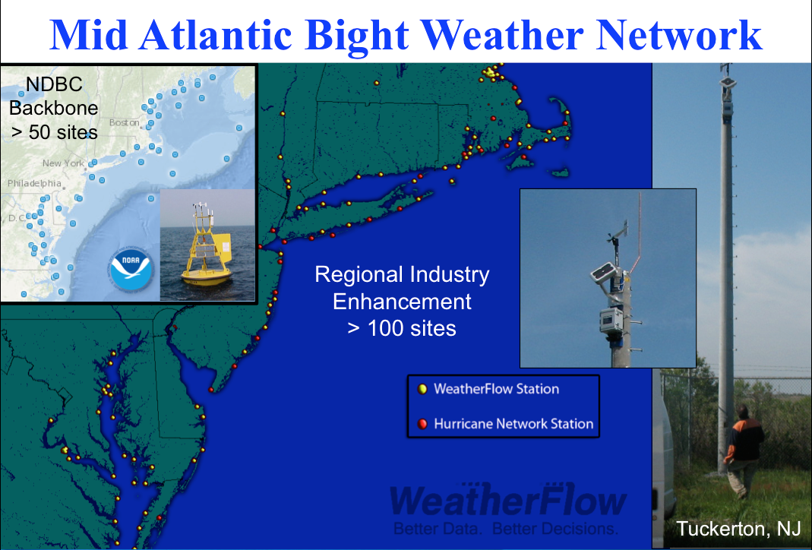
Mid-Atlantic Regional-Scale Observation Network

Slide 9
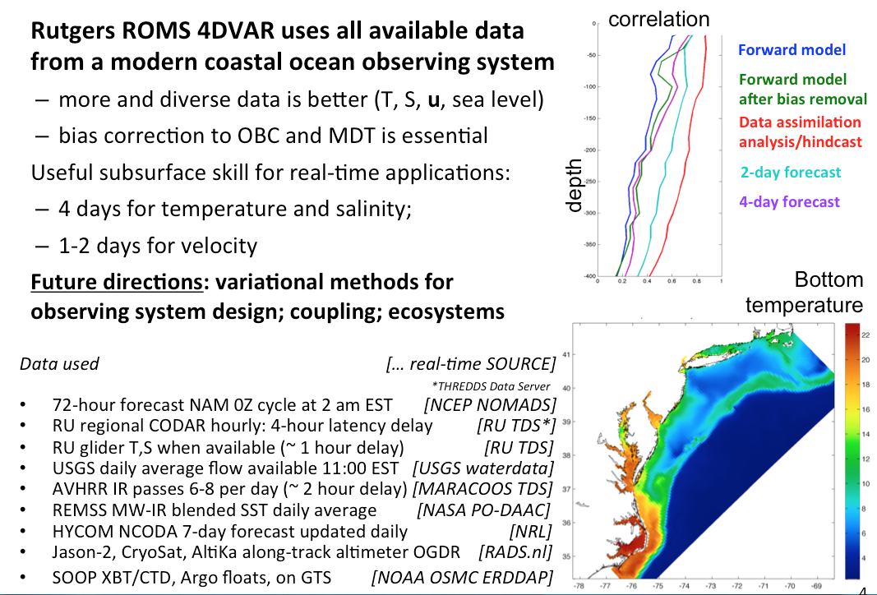
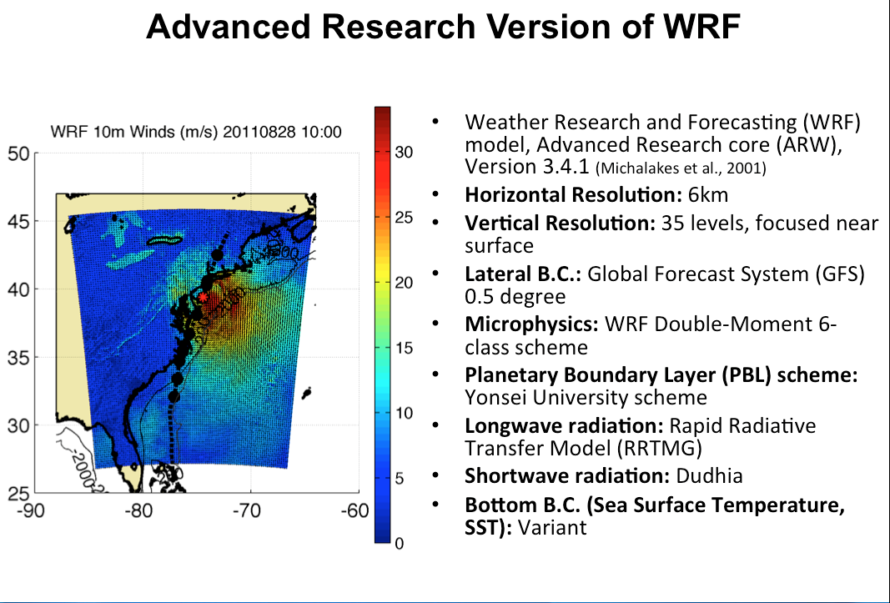

Mid-Atlantic Ensemble of Forecast Models Include:
Mid-Atlantic Operations Center @

Slide 10


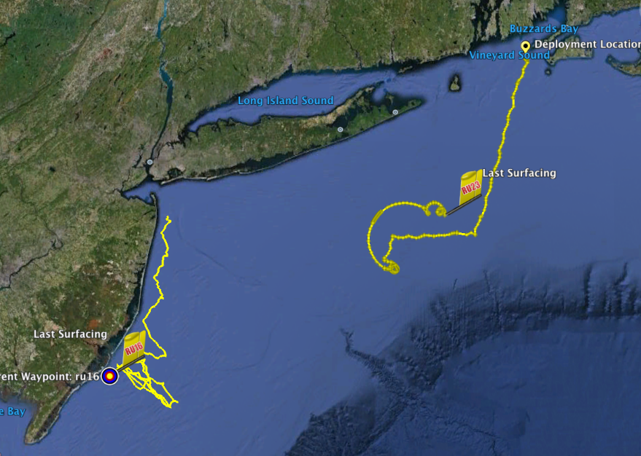
Hurricane Irene Track August 26-29 2011
Two Gliders Deployed

Slide 11
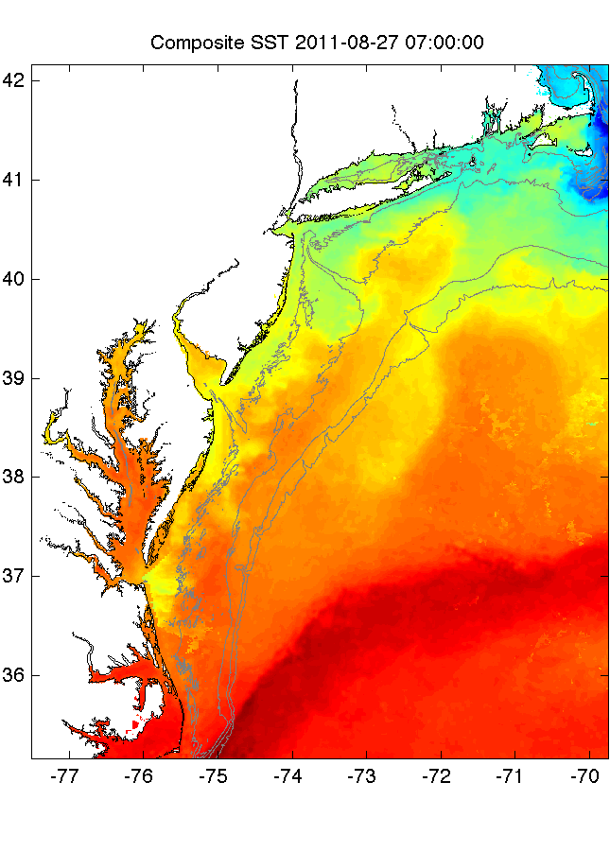
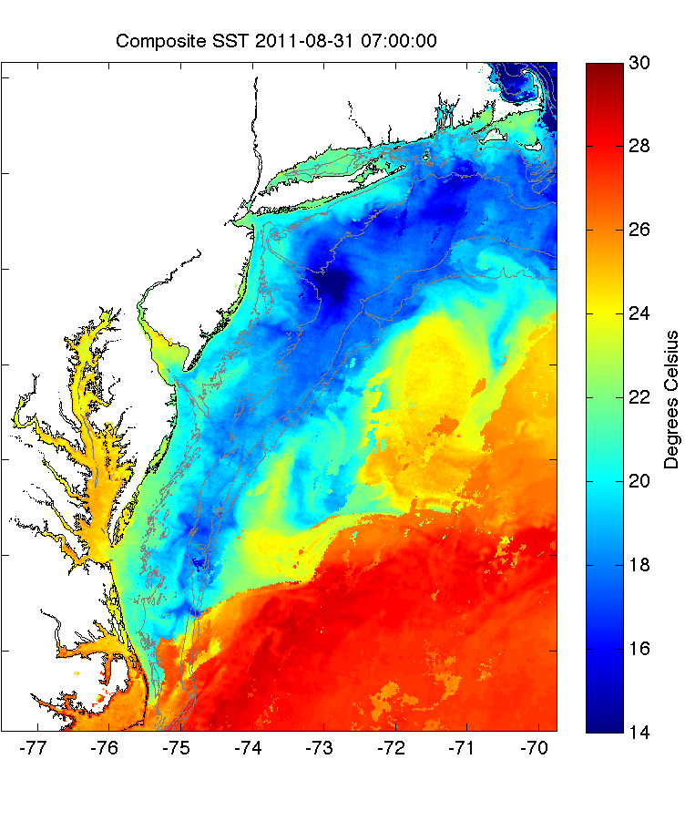
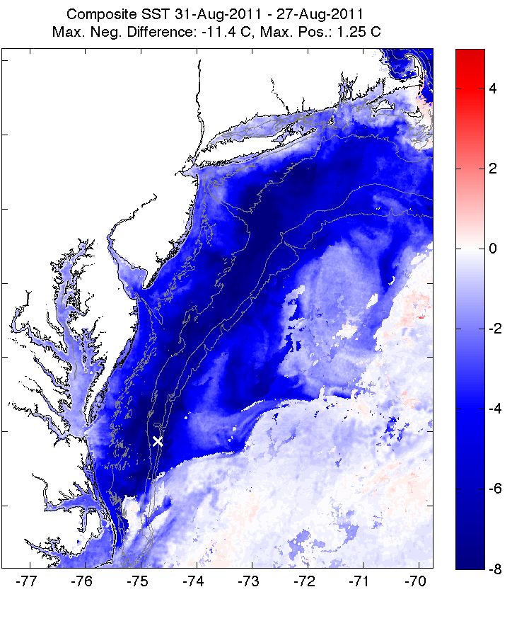
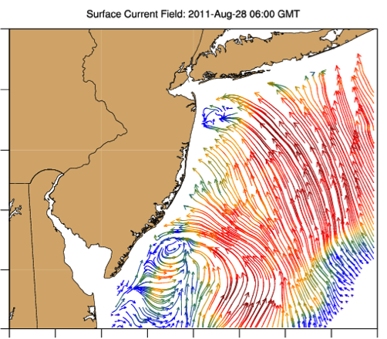
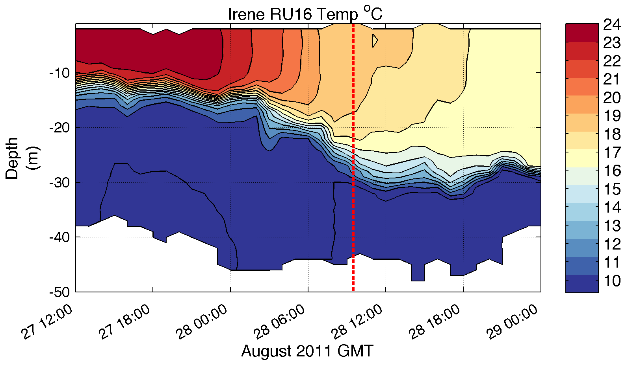
Pre-Irene
Post-Irene
Difference
11C max Cooling
WHAT?
Satellite
SST
WHEN? Glider Temperature
WHY?
HF Radar
Currents
Eye Passage

Slide 12
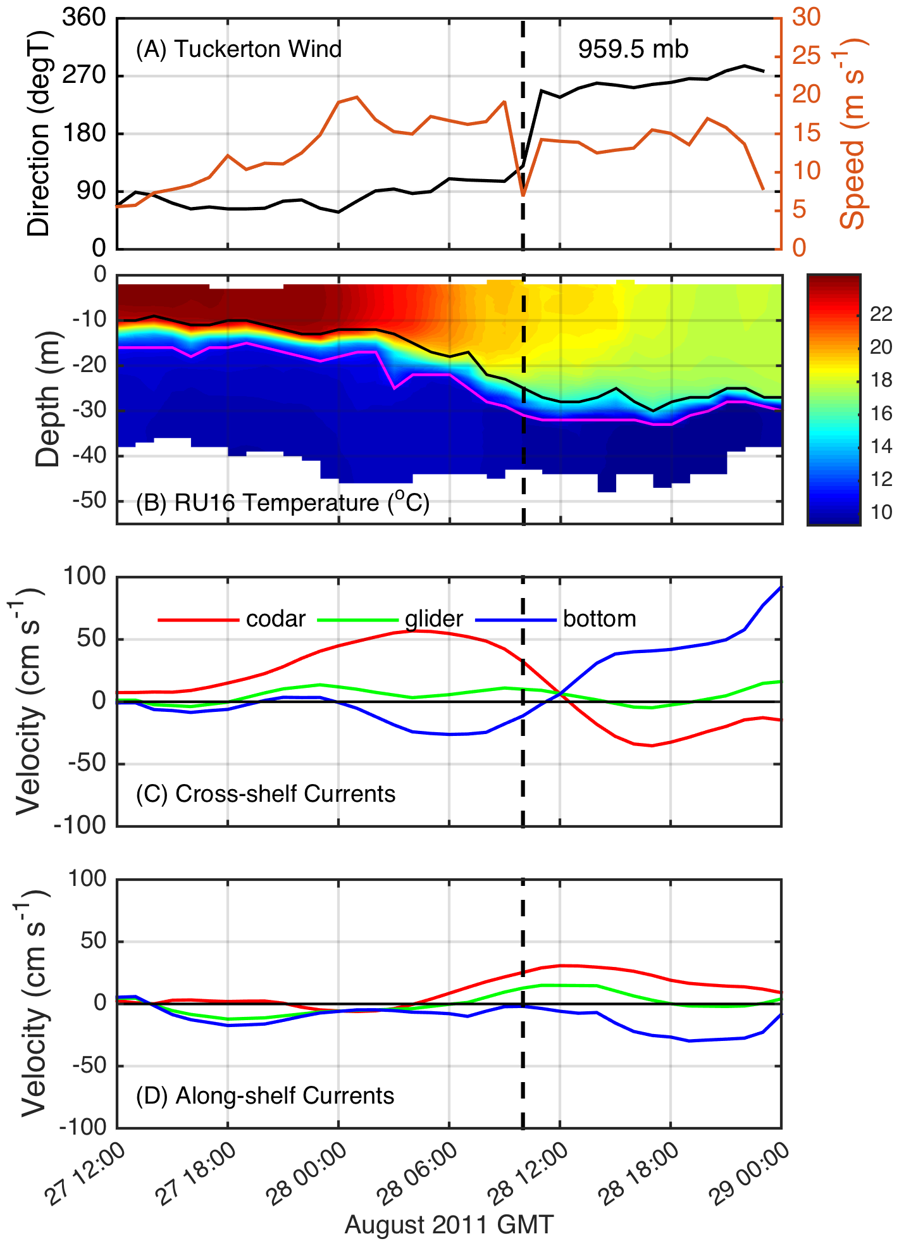
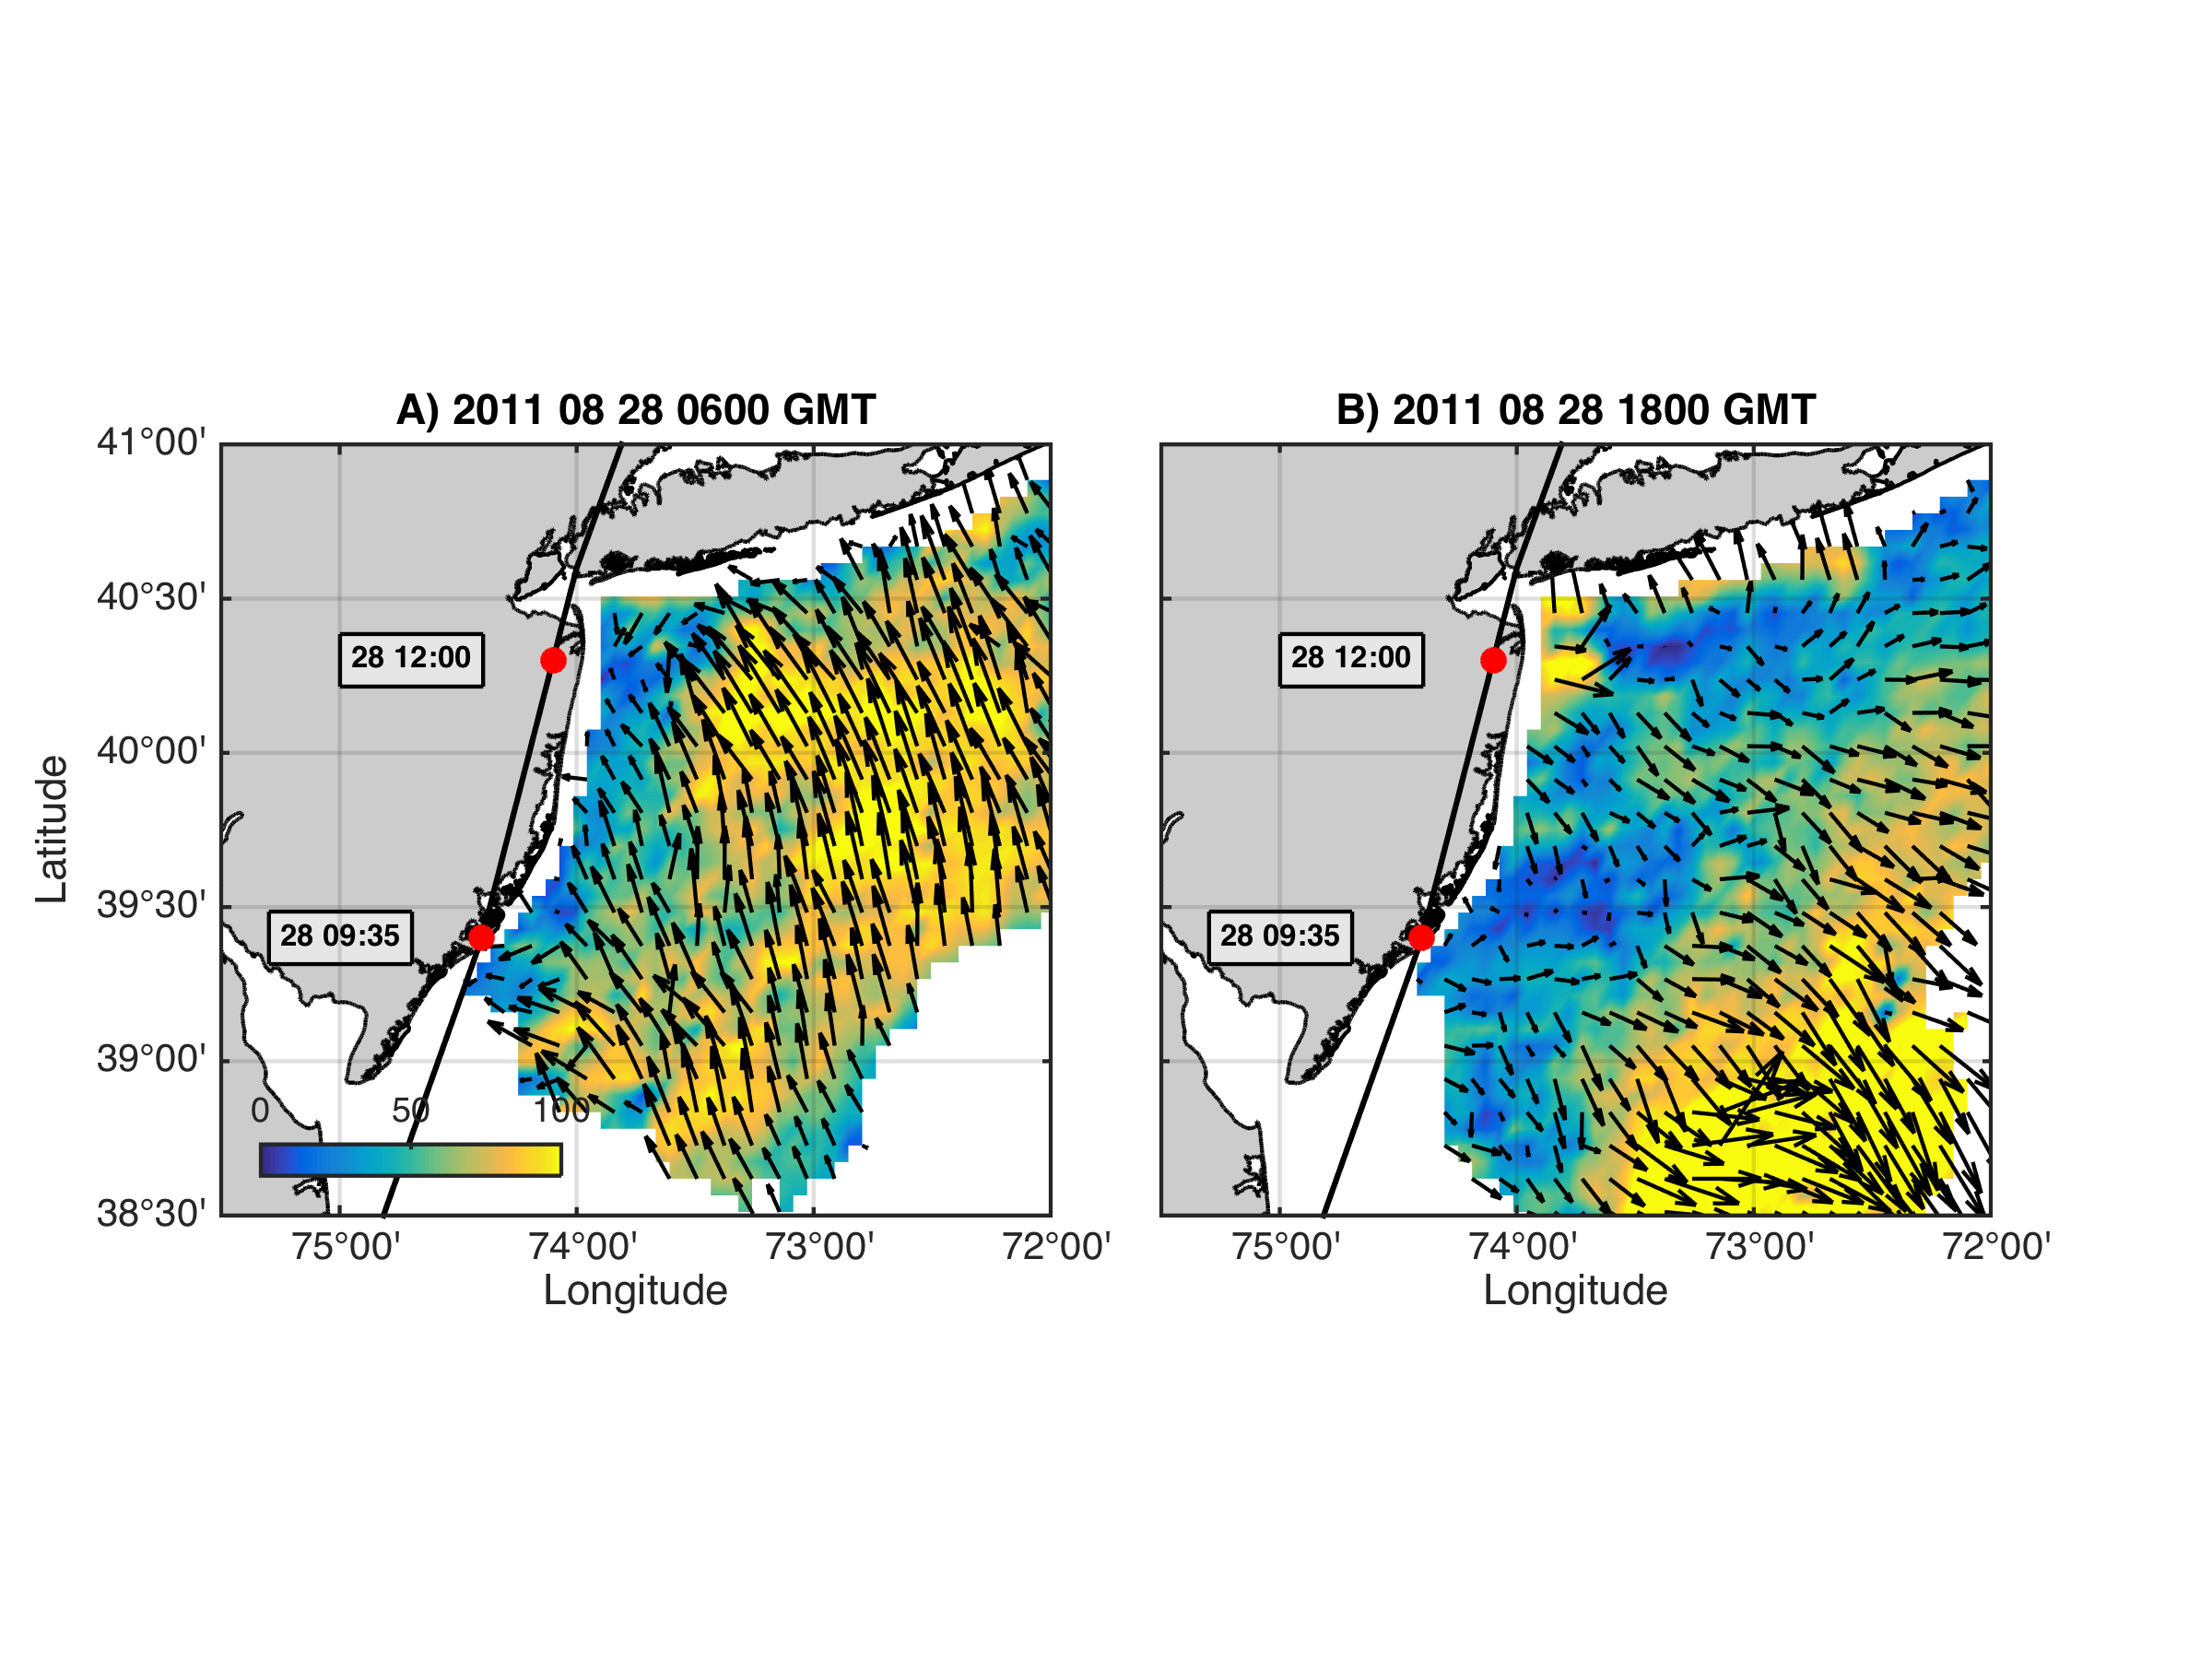
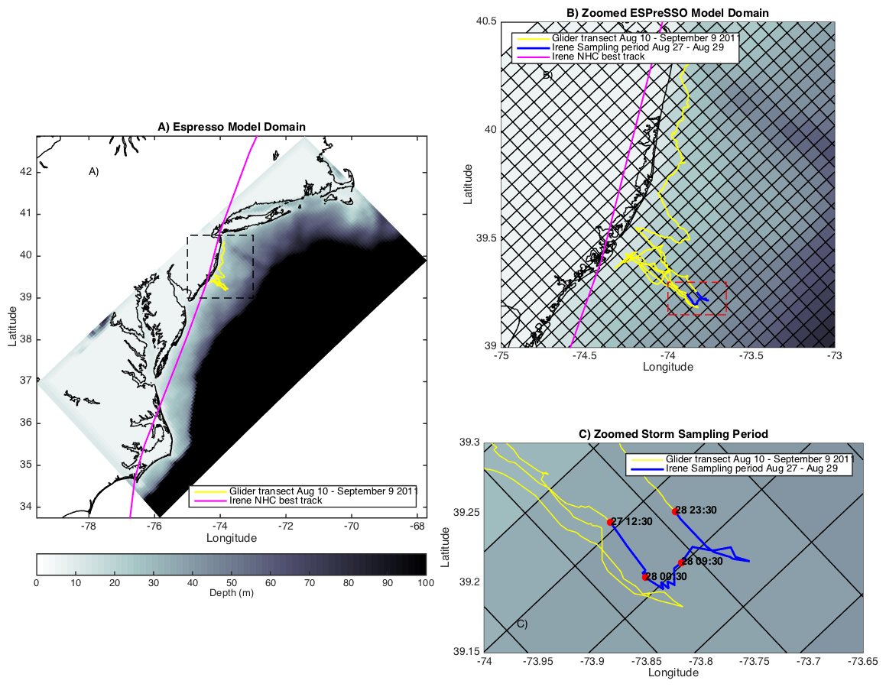
Coastal Baroclinic Circulation
Before Eye
After Eye
Before Eye After Eye
Glider Track, Model Grid
& Bathymetry
Storm Period in Blue

Slide 13
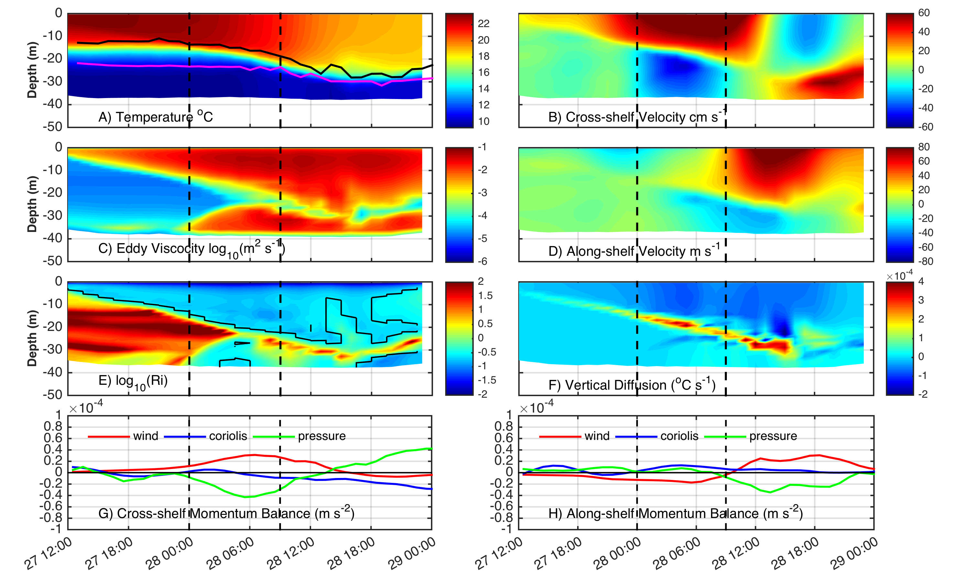
ROMS Model Results at Glider Location
Coastal Baroclinic Circulation Enhances Mixing & Cooling

Slide 14
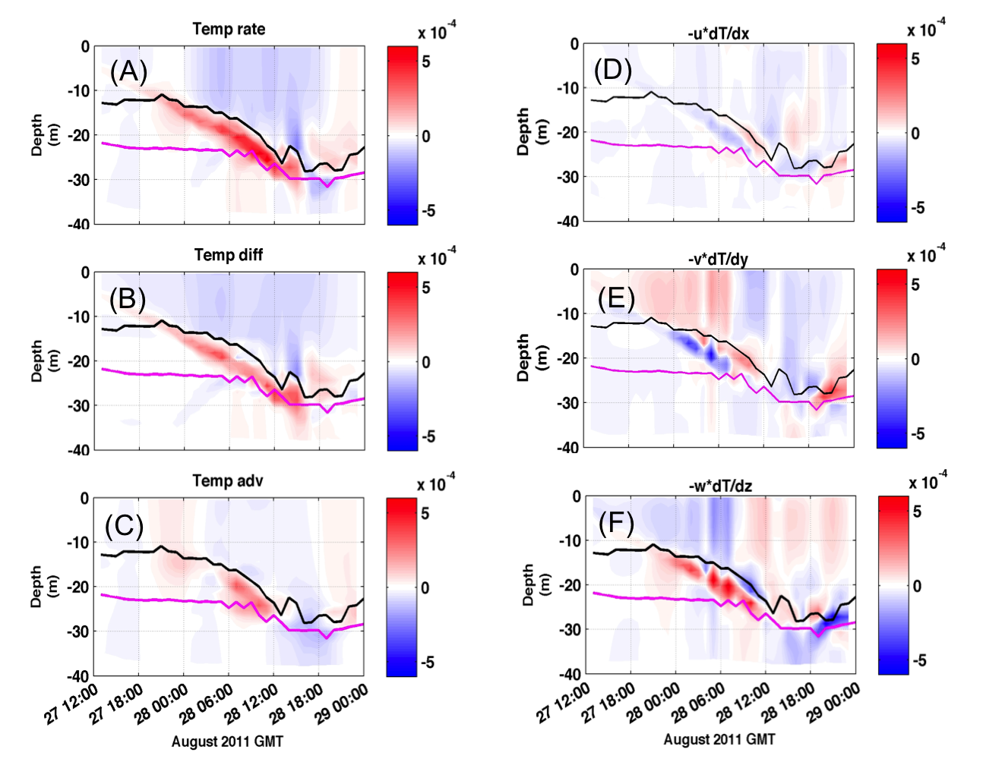
ROMS Model Results at Glider Location
Temperature Diagnostic Equations – Mixing Dominates Advection

Slide 15
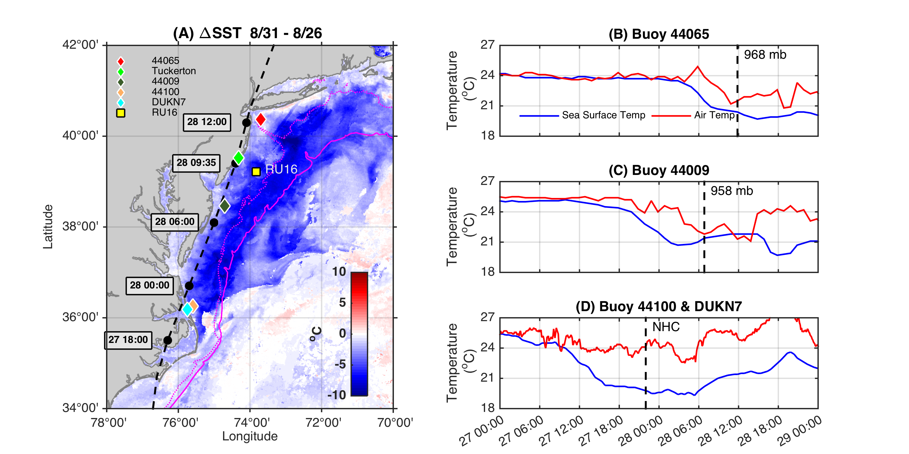
Ahead-of-Eye-Center Cooling in Irene:
Nearshore Buoy Observations
After - Before
85%
80%
94%

Slide 16
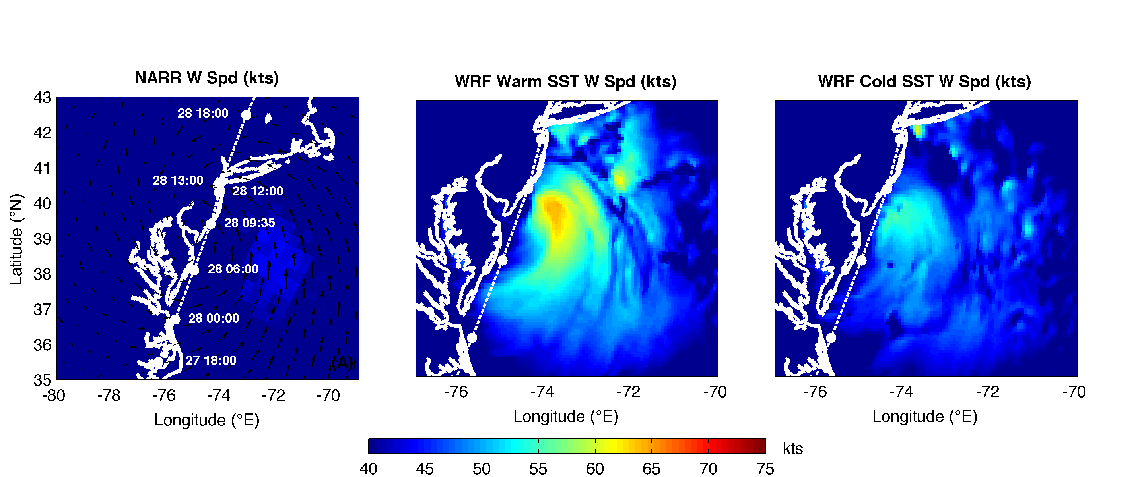
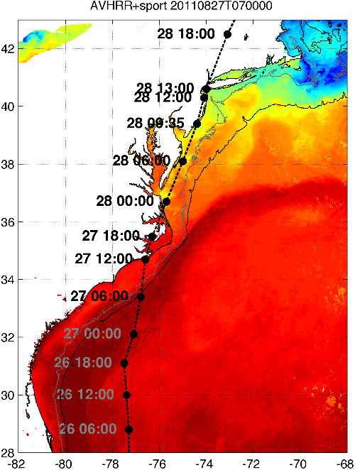
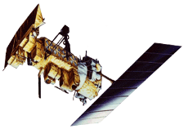

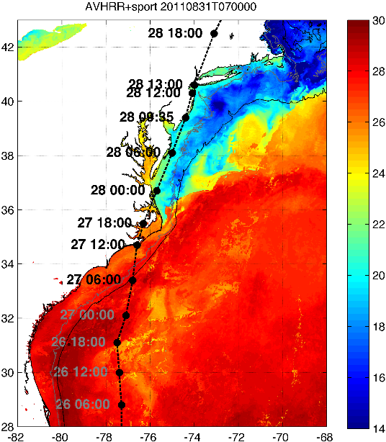

Rutgers Atmospheric Forecast Sensitivity Study
Warm Ocean
Boundary Condition
Cat 1 Hurricane
Tropical Storm
Cold Ocean
Boundary Condition
IMPACT?
>10 knots reduction in peak wind speed
Notes:
76-94% cooling ahead-of-eye
Average = 84% cooling ahead-of-eye

Slide 17
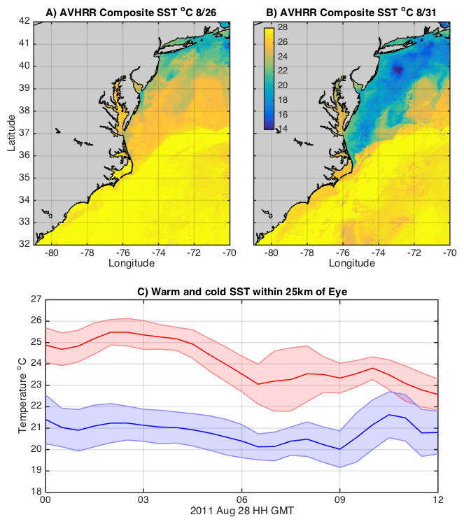
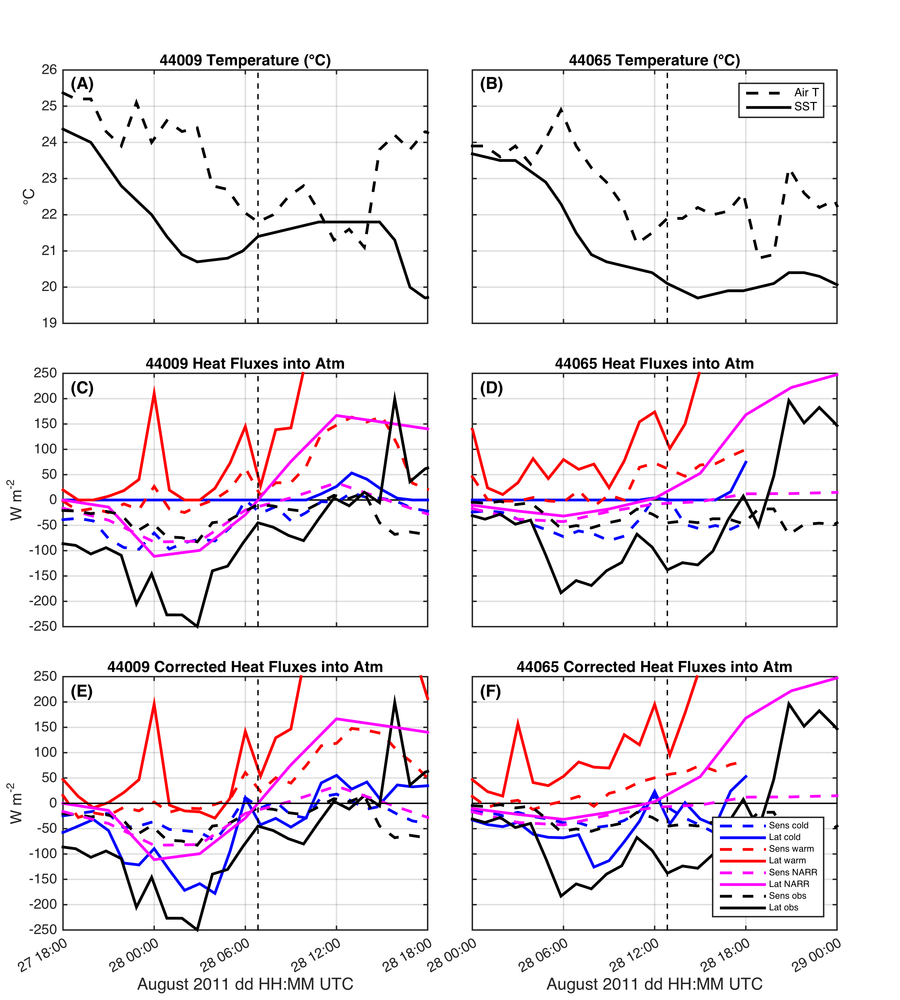
SST within 25 km of eye & impact on air-sea heat flux
Warm
Cold
Northern Buoy
26C
Central Buoy

Slide 18
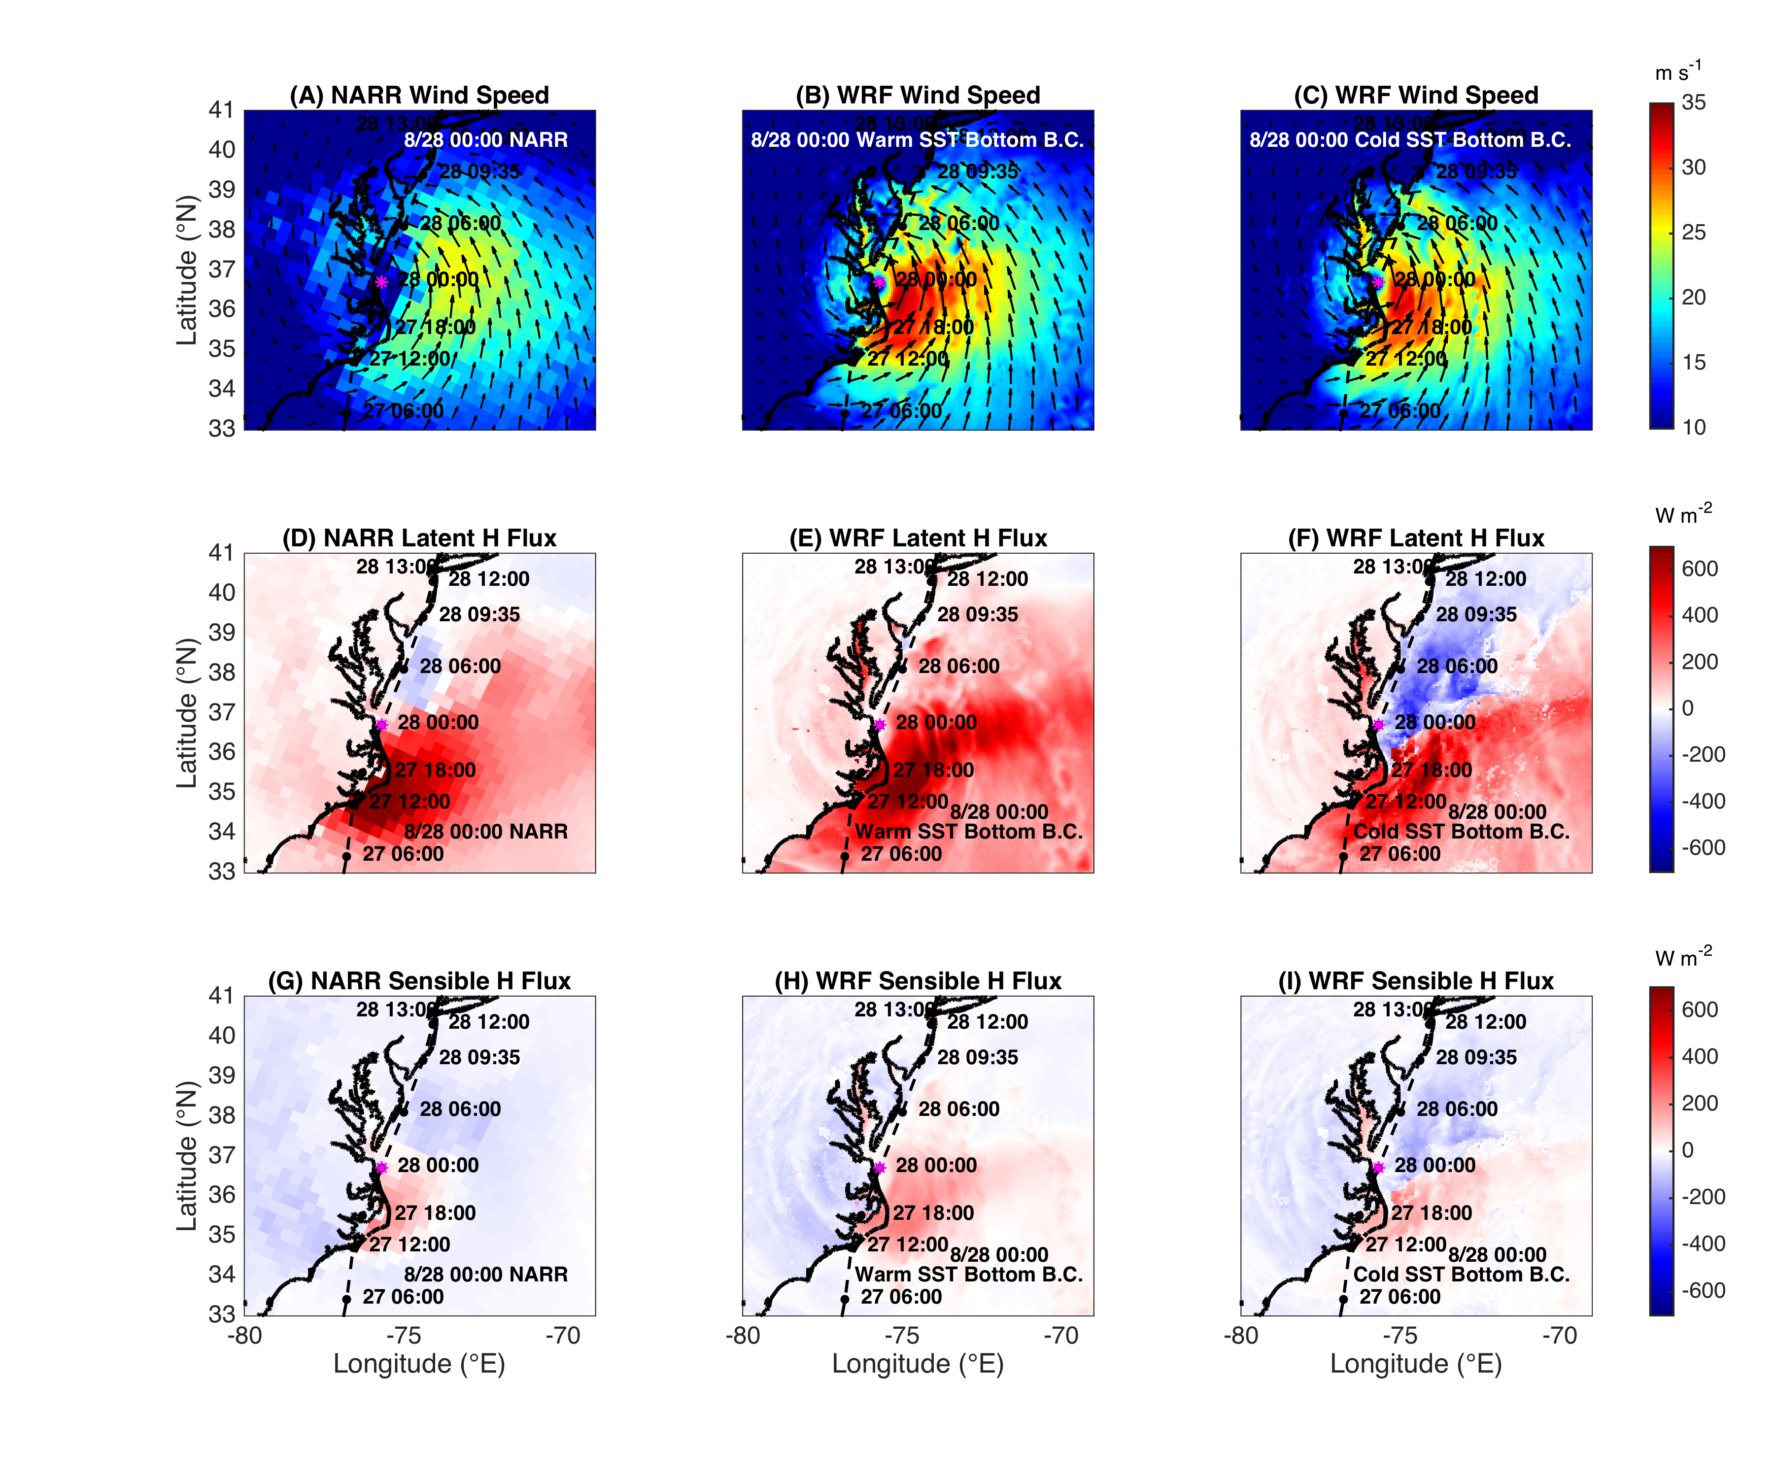
WRF Heat Flux Comparison to
North American
Regional
Reanalysis
NARR
WARM SST
COLD SST
Wind
Latent heat flux
Sensible heat flux

Slide 19
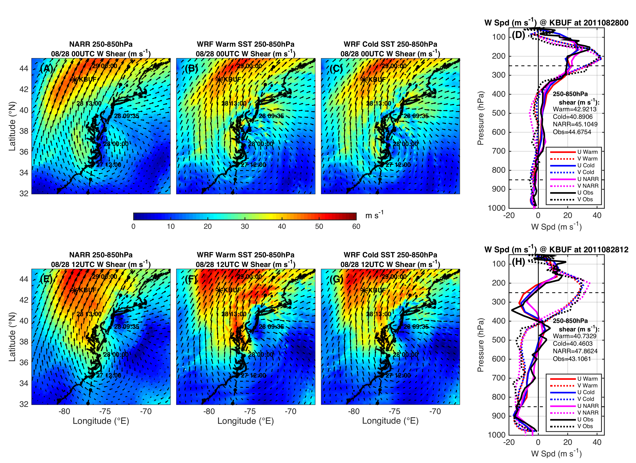
Wind Shear
WRF 250-850 hPa Wind Shear
KBUF RADIOSONDE
NARR
WARM SST
COLD SST
August 28
00:00 Z
August 28
12:00 Z

Slide 20
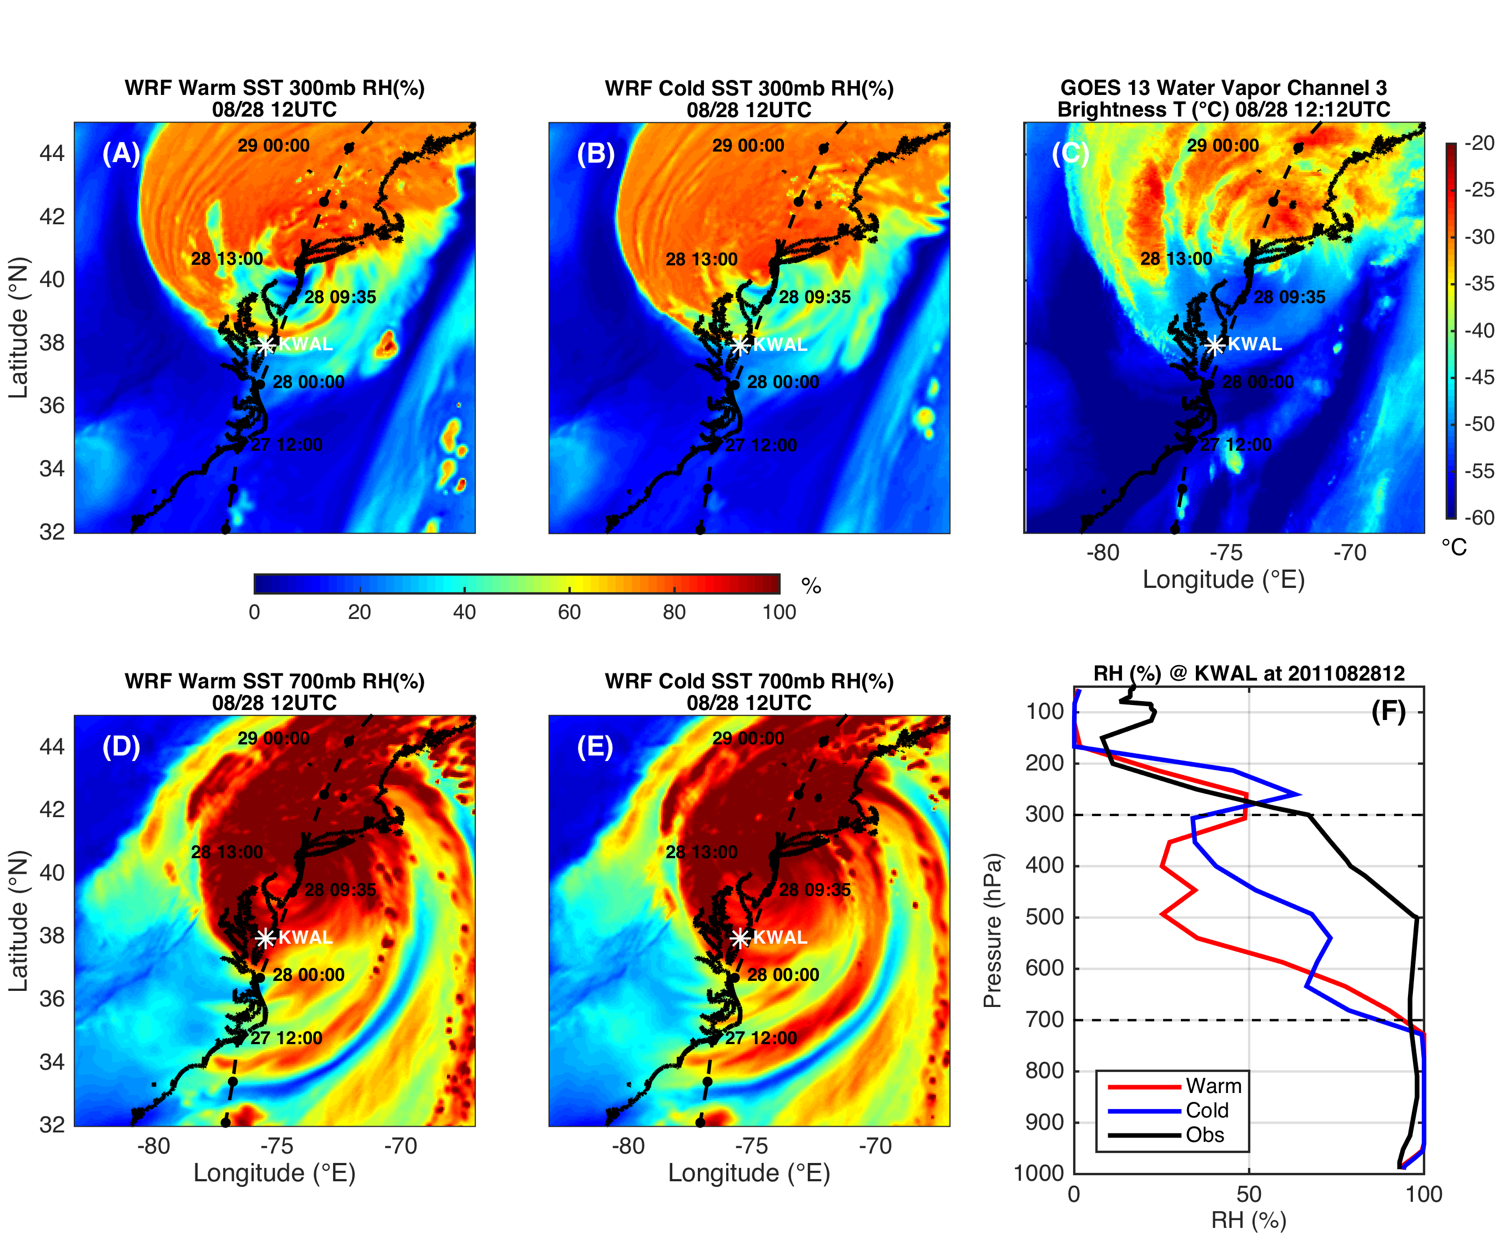
WRF Dry air intrusion (700 and 300 mb RH)
Moisture
WARM SST
COLD SST
OBSERVED
300mb
→Wind shear, dry air intrusion resolved by WRF
700 mb
Notes:
SST sensitivity is not affecting or not being affected by humidity

Slide 21
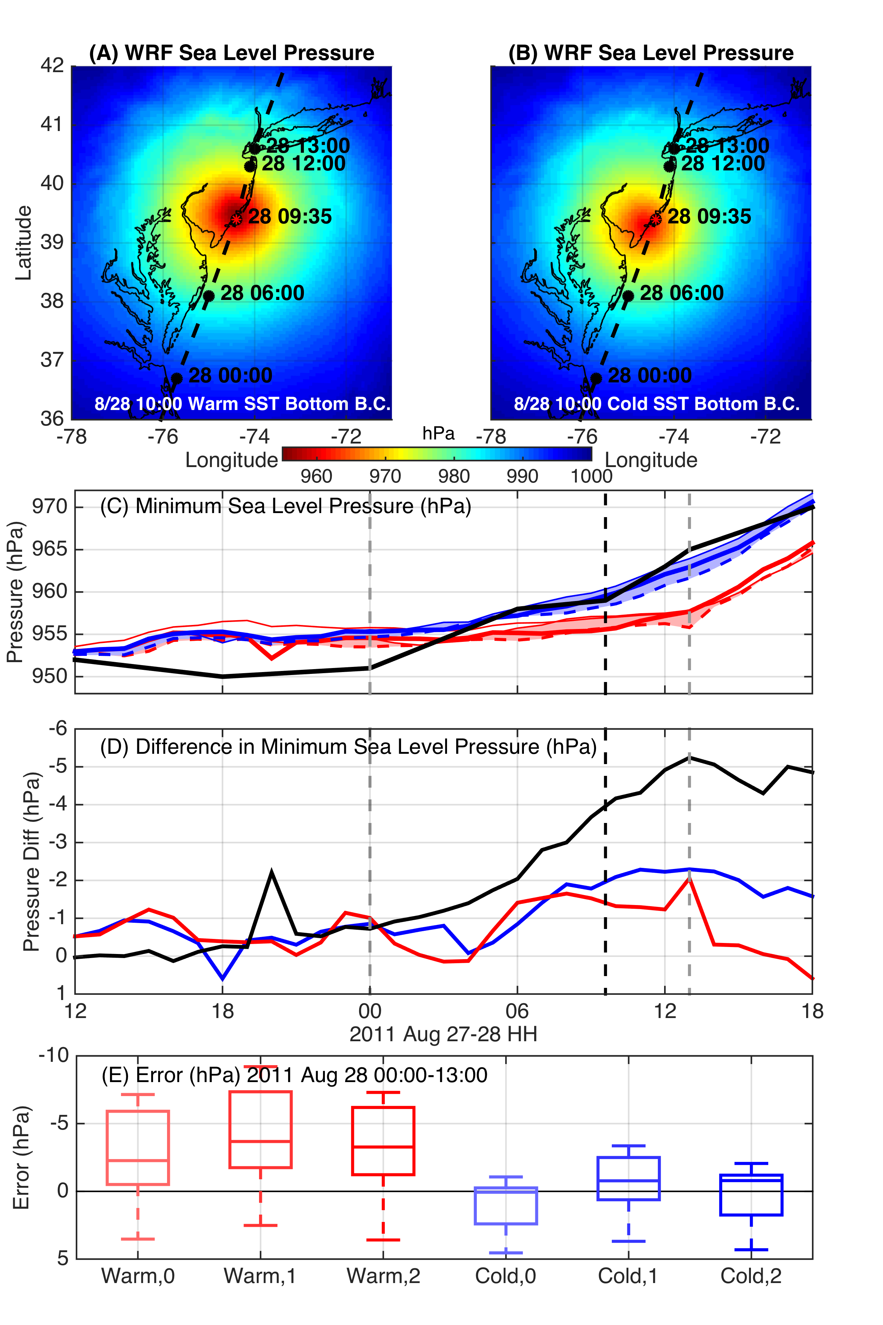
WRF Model Sensitivity Study
Over 140 model runs
Paired to compare sensitivities
Central pressure & max wind
Sensitivity to SST greatest
Seroka, Miles, Xu, Kohut, Schofield & Glenn,
Hurricane Irene Sensitivity to Stratified Coastal Ocean Cooling, In Review, Monthly Weather Review

Slide 22
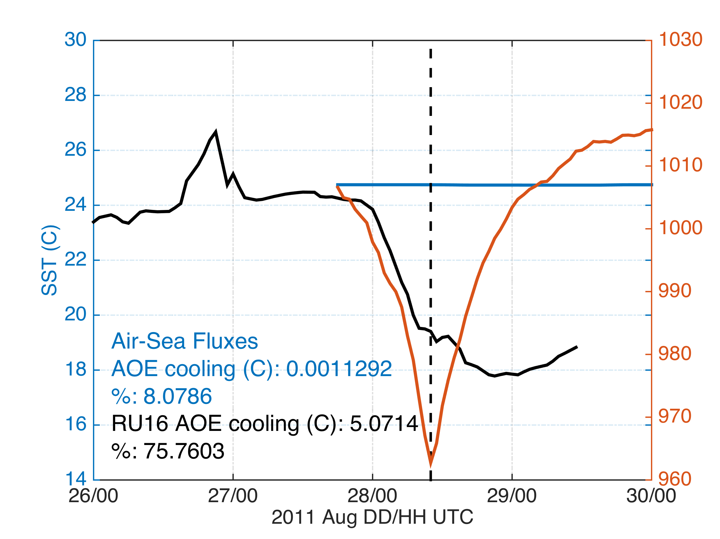
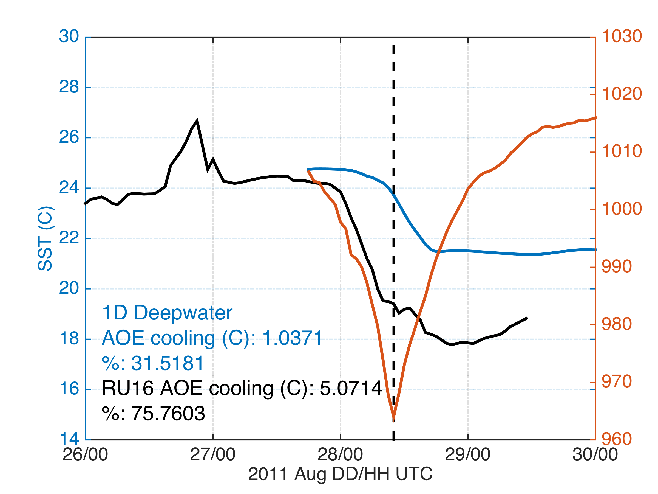
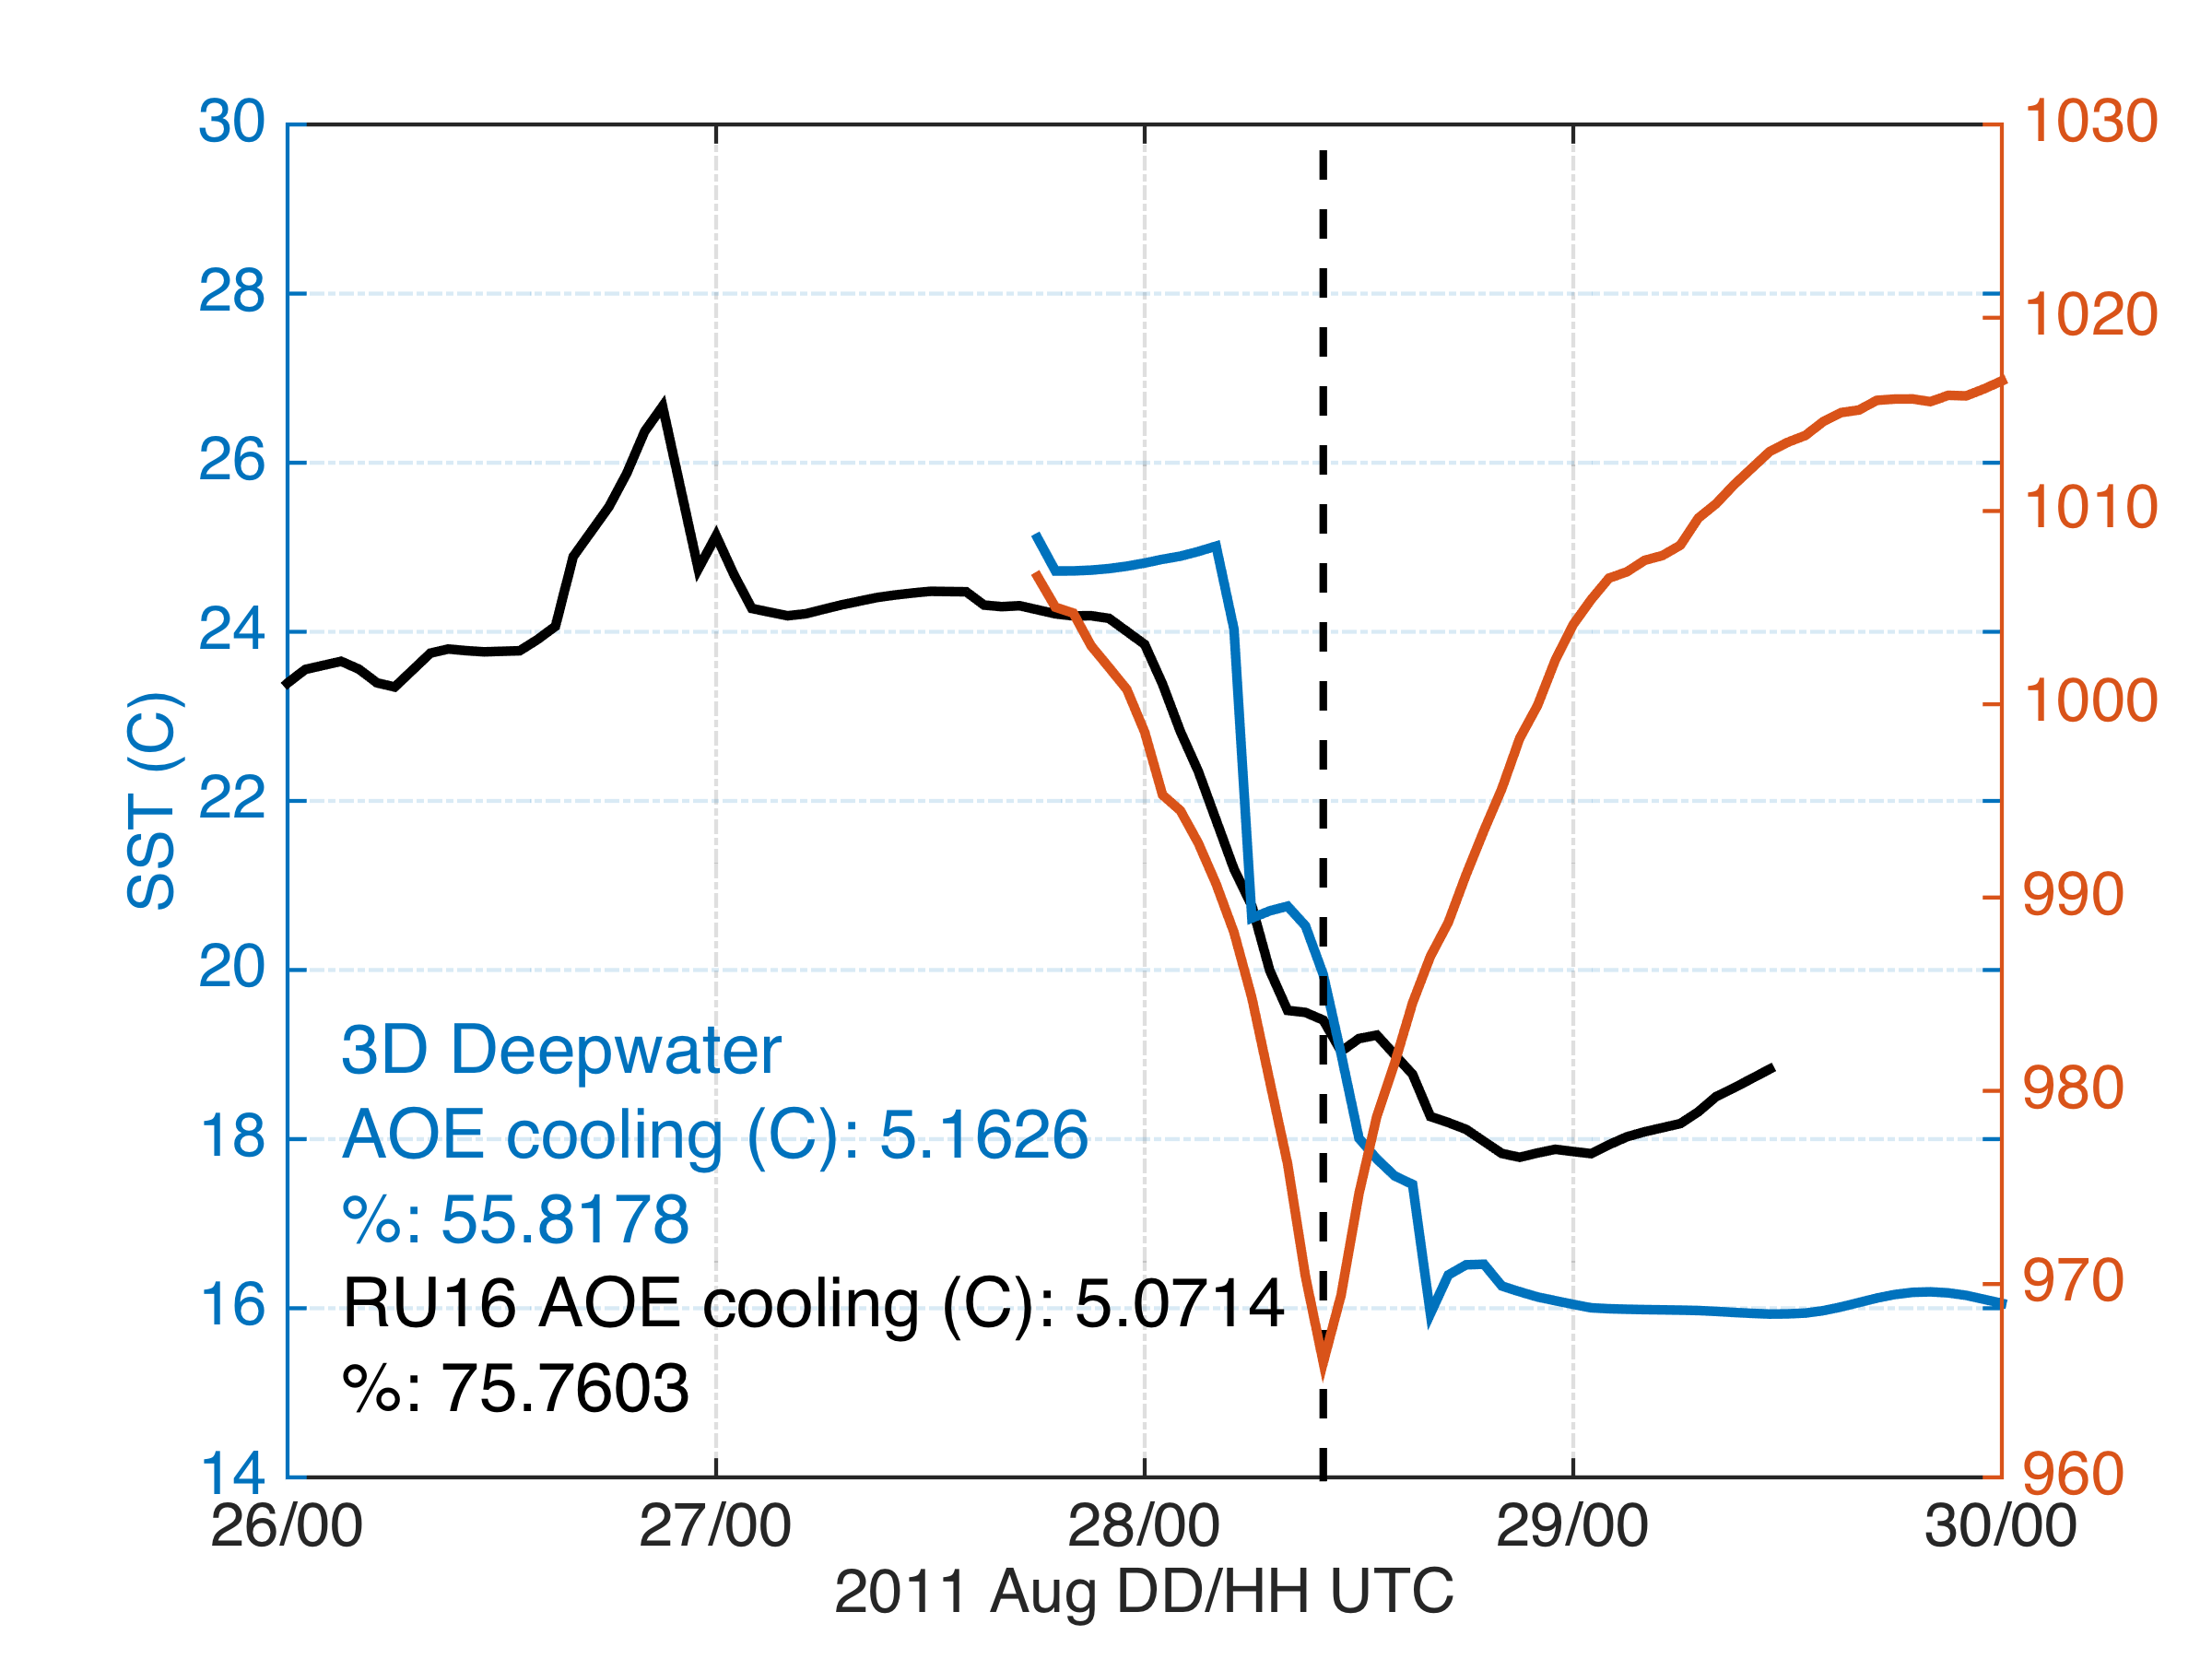
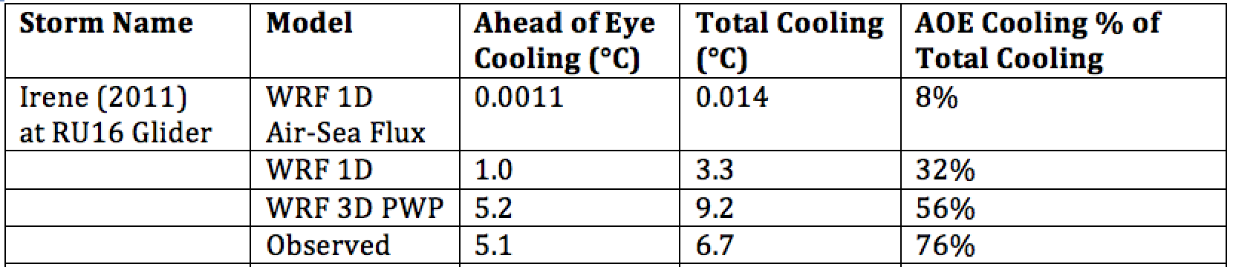
Modeled Deepwater Cooling Processes in Hurricane Irene
Air-Sea Fluxes Only
1-D Mixing
3-D PWP (Upwelling)
Storm-induced cooling in deep water is often equally distributed between the front and back half of the storm (Price et al., 1981)

Slide 23
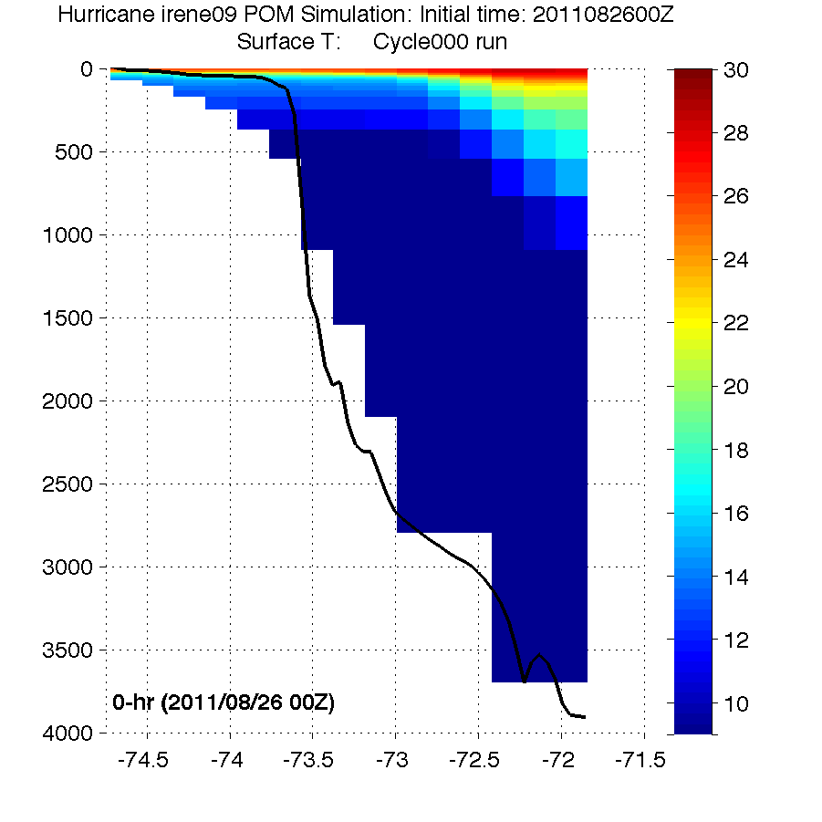
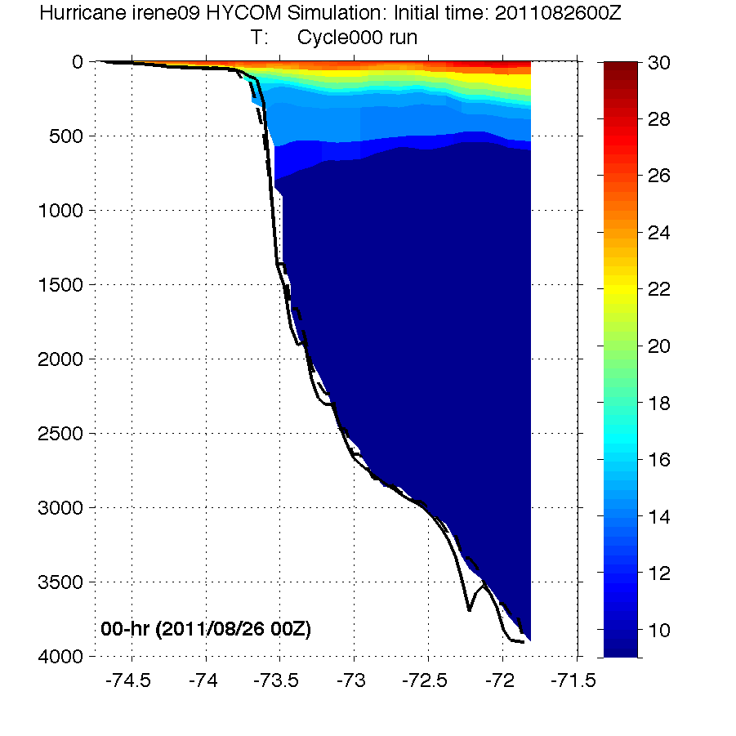
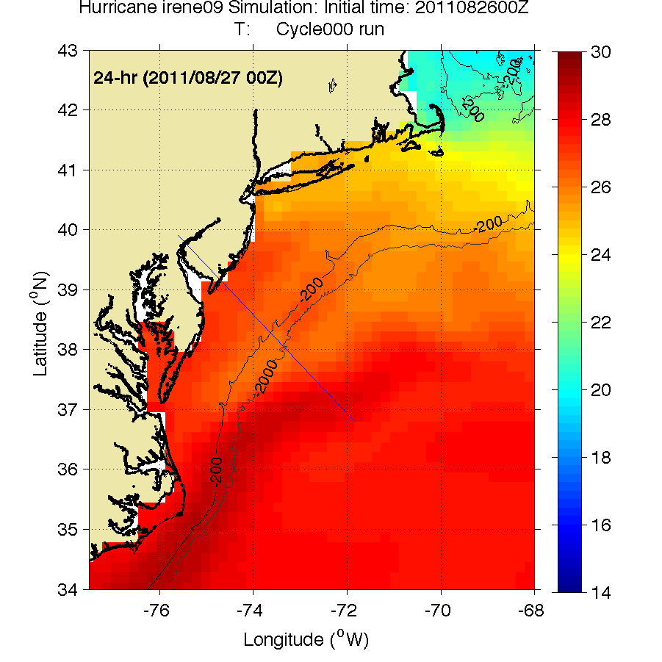
HWRF Cross-shelf Transects
HWRF-POM
Before
HWRF-HYCOM
Before
Thank you to Hyun-Sook Kim and Zhan Zhang for providing HWRF data
Observed bathymetry from NOAA National Geophysical Data Center, U.S. Coastal Relief Model, Retrieved date goes here, http://www.ngdc.noaa.gov/mgg/coastal/crm.html

Slide 24
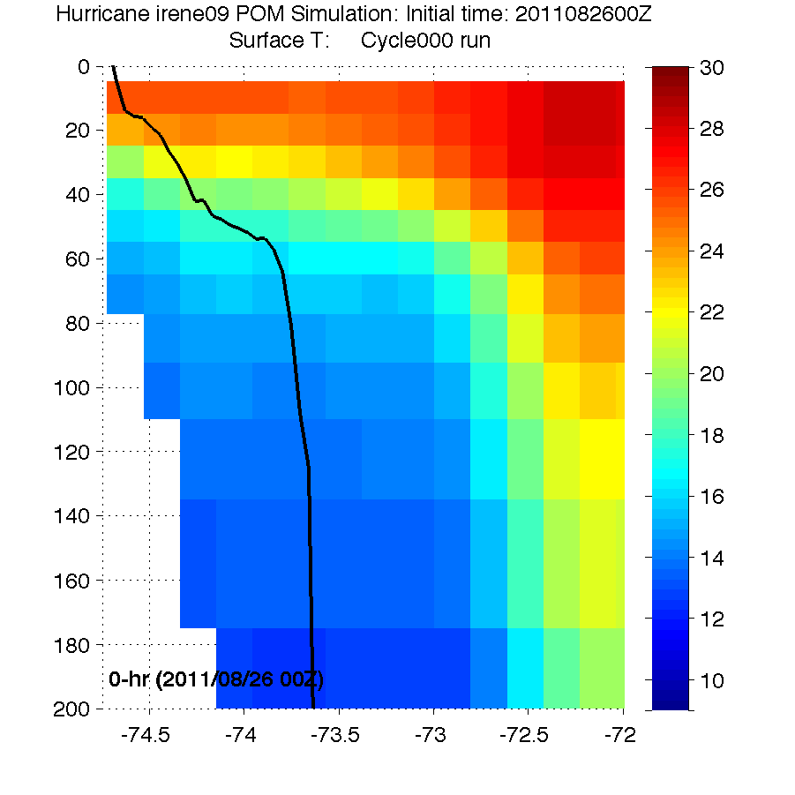
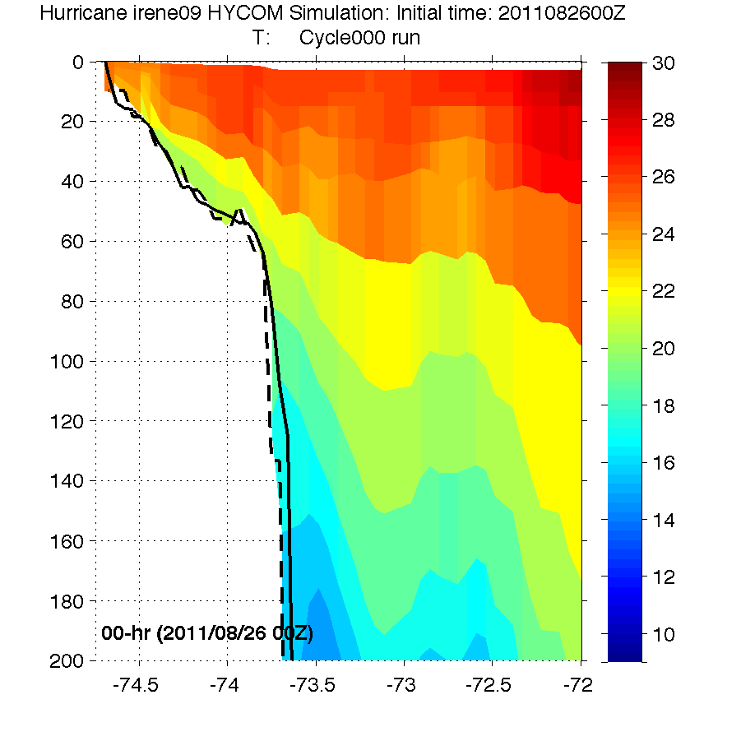
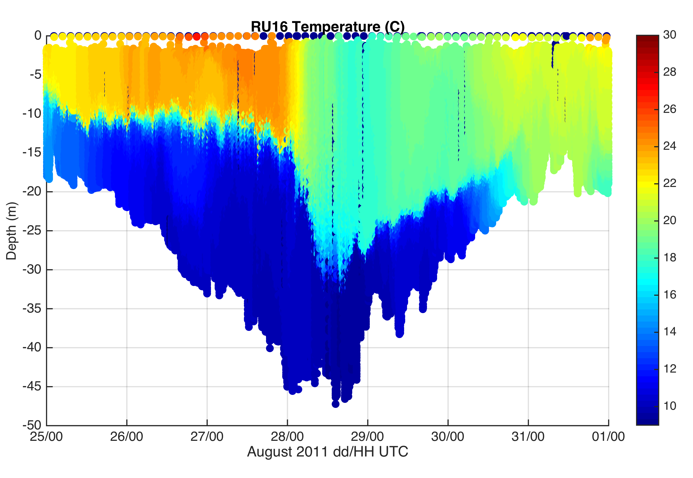
HWRF Cross-shelf Transects
HWRF-POM
Before
HWRF-HYCOM
Before
Before
RU16 Glider
RU16 Glider
Thank you to Hyun-Sook Kim and Zhan Zhang for providing HWRF data
Observed bathymetry from NOAA National Geophysical Data Center, U.S. Coastal Relief Model, Retrieved date goes here, http://www.ngdc.noaa.gov/mgg/coastal/crm.html

Slide 25
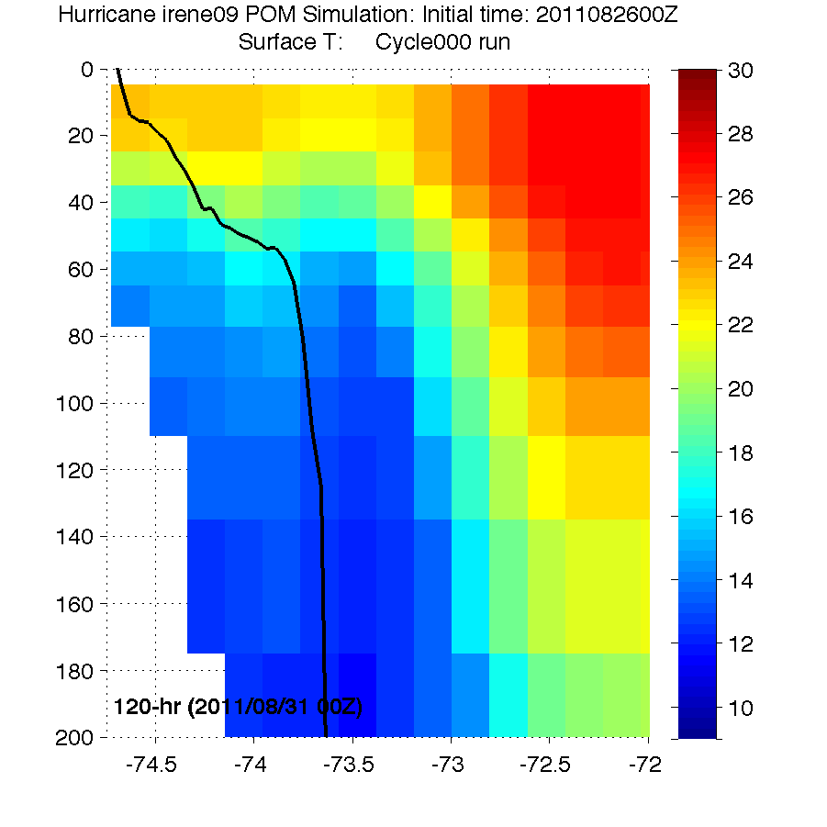
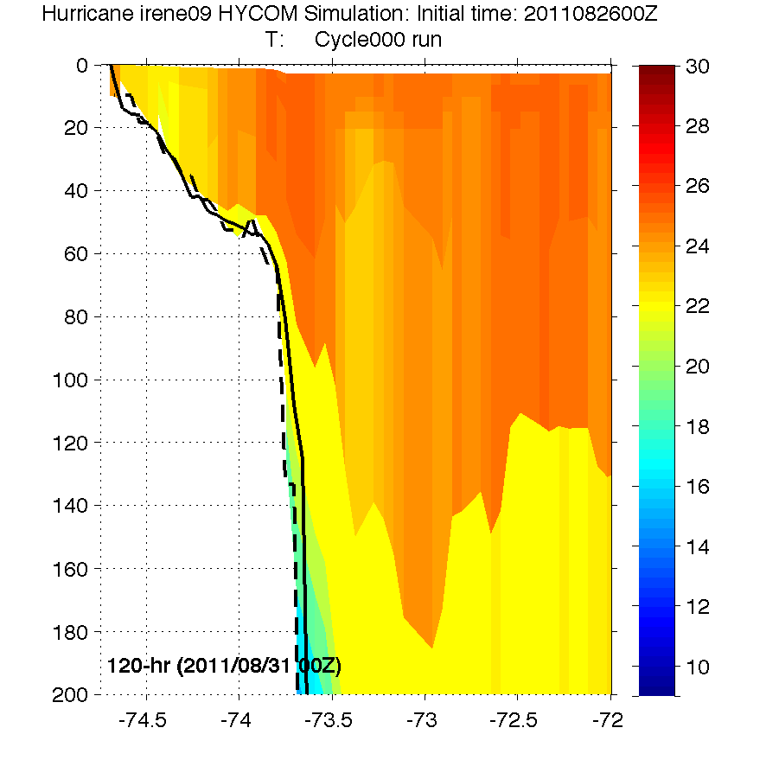
HWRF Cross-shelf Transects
HWRF-POM
Before
HWRF-HYCOM
Before
Before
After
HWRF-POM
After
HWRF-HYCOM
After
RU16 Glider
Thank you to Hyun-Sook Kim and Zhan Zhang for providing HWRF data
Observed bathymetry from NOAA National Geophysical Data Center, U.S. Coastal Relief Model, Retrieved date goes here, http://www.ngdc.noaa.gov/mgg/coastal/crm.html

Slide 26
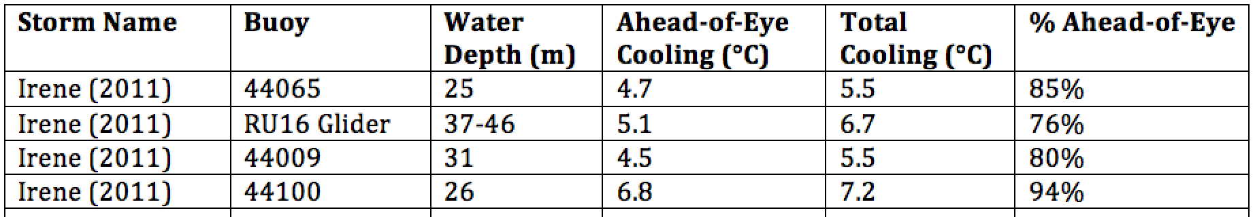
Hurricane Irene
August 26, 2011
Summer Storm
Strong Stratification
Coastal Response
Mixing Cooled Surface
Limited Intensity

Slide 27
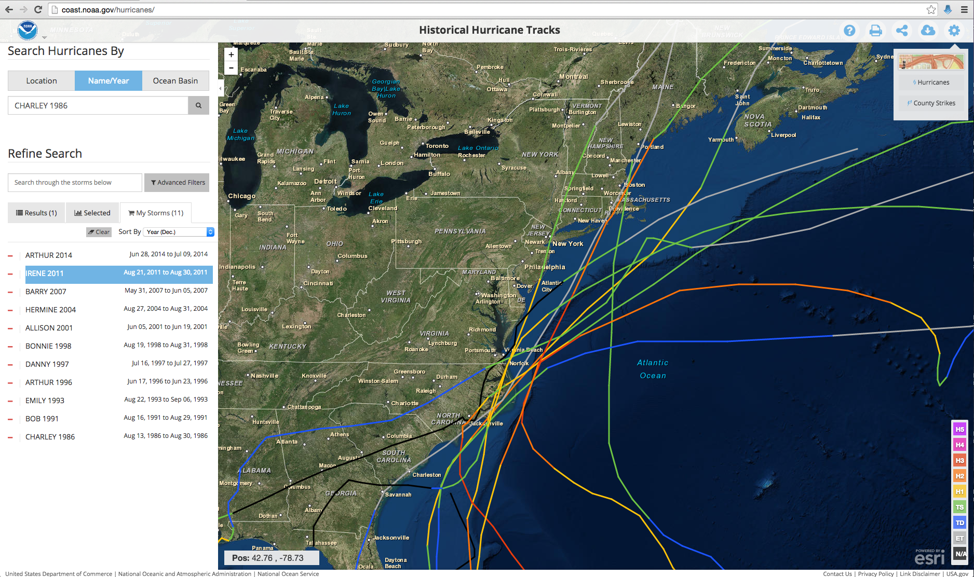
Historical Hurricanes Crossing the
Middle Atlantic Bight Continental Shelf in Stratified Season

Slide 28
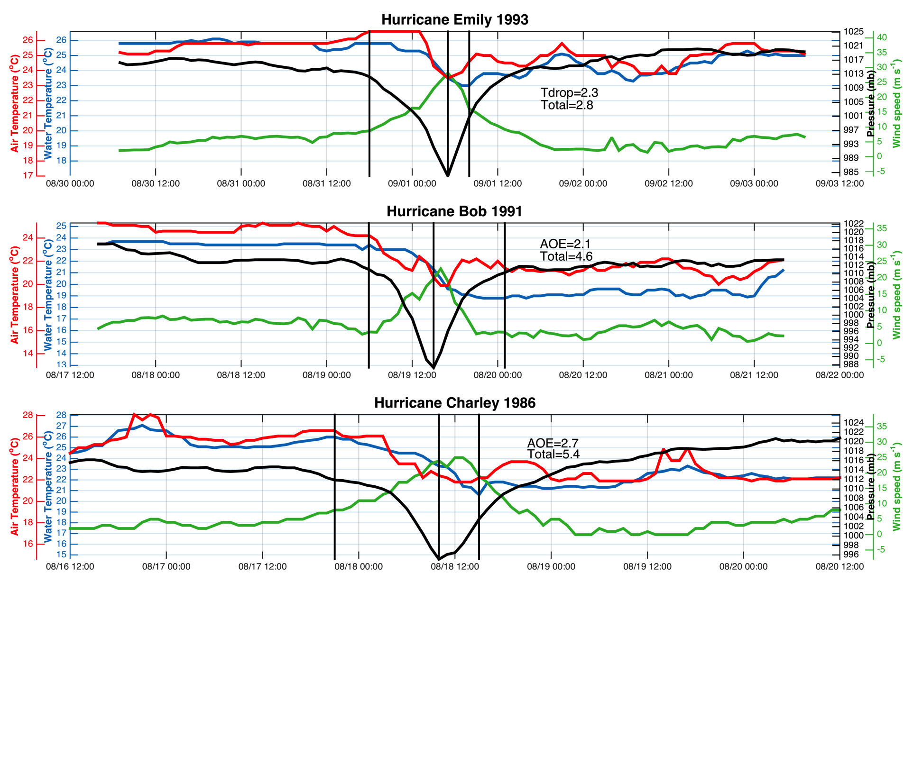
Ahead-of-Eye-
Center Cooling:
Water Temp
Air Temp
Air Press
Wind Speed
First
Three
Hurricanes
Objective criteria:
Hurricane eye over MAB continental shelf in stratified summer season (June-August)
Buoy must have air pressure, wind speed, water temperature (air temperature bonus)
First vertical line is warmest water temperature when wind speed exceeds 5 m/s
Center line is coolest temperature before pressure minimum
Last line is coolest temperature after pressure minimum & wind speed below 5 m/s

Slide 29
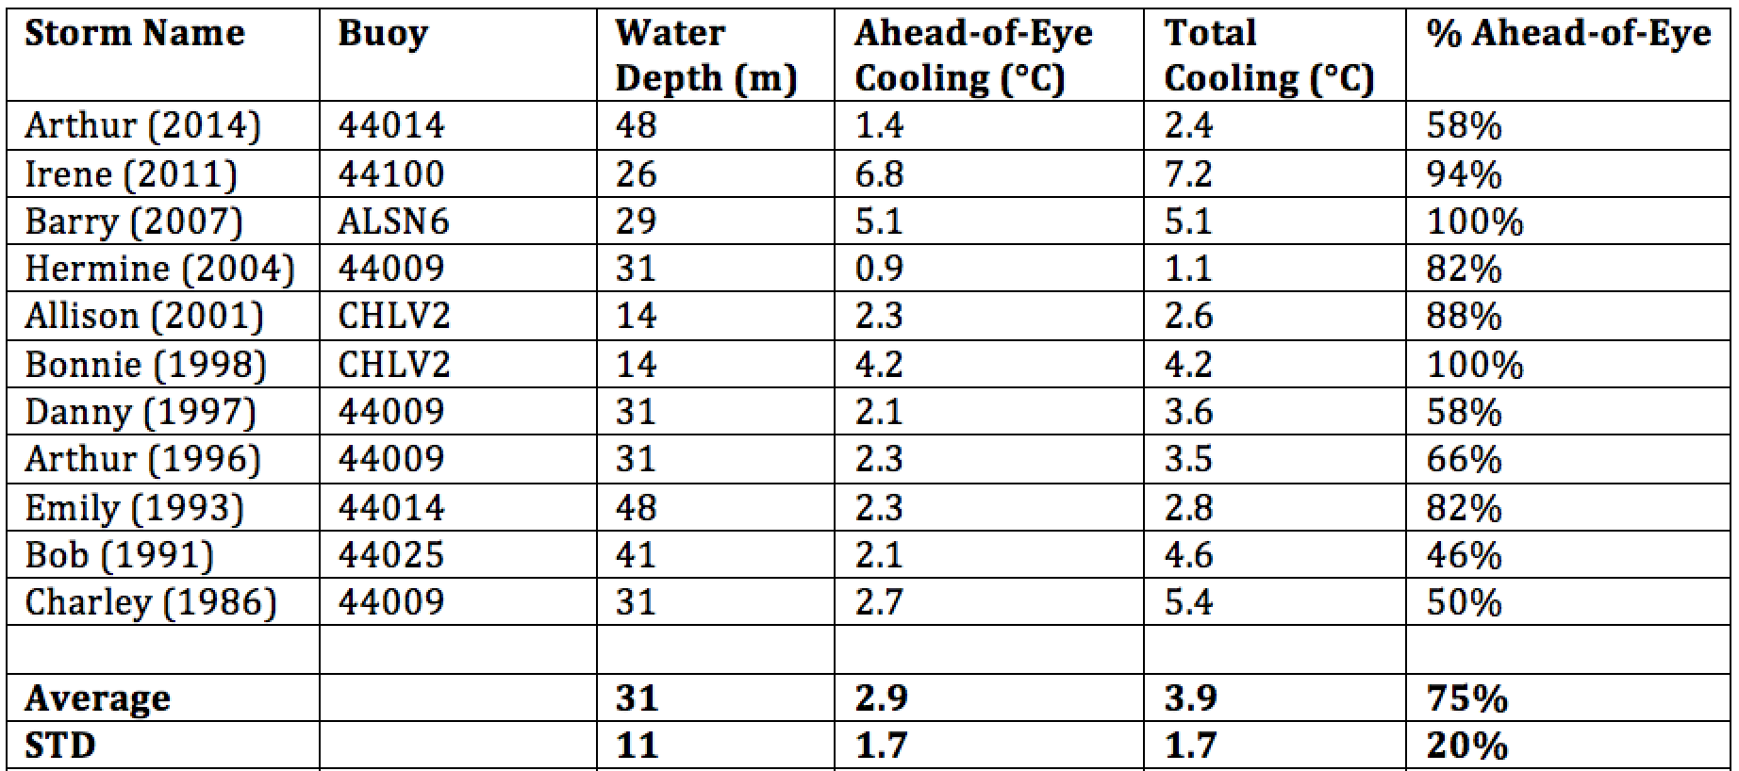
Historical Hurricanes Crossing the MAB in Stratified Season
Observed Ahead-of-Eye-Center Cooling
Storm-induced cooling in deep water is often equally distributed between the front and back half of the storm (Price et al., 1981)

Slide 30

Hurricane Sandy
October 29, 2012
See Miles et al (2015):

Slide 31



Superstorm Sandy: 2 Days Before Landfall

Slide 32

Superstorm Sandy: 1 Day Before Landfall

Slide 33

Superstorm Sandy: Morning Before Landfall

Slide 34

Superstorm Sandy: Landfall (20:00 Local)
Notes:
Insert Comment on recent rebuild/hurricane hardened HF Radar stations?

Slide 35



Current Response:
Two-layer flow weak onshore near the surface, offshore at the bottom during stratified conditions. Weak onshore flow after stratification erodes.
Initially weak Along-shore flow during stratified conditions, increased to strong south-westward flow over 1 m s^{-1.}
Suggests offshore advection of cold pool water near the bottom.

Slide 36
Hurricane Irene
August 26, 2011
Summer Storm
Strong Stratification
Coastal Response
Mixing Cooled Surface
Limited Intensity
Hurricane Sandy
October 29, 2012
Fall transition
Single layer ocean
Limited mixing/cooling
No intensity reduction

Slide 37
78 Million People (1/4 of U.S.)
1000 km Cape to Cape
Cape
Cod
Sandy
Irene
Barry
Arthur
Cape
Hatteras

Slide 38




Historical Typhoons Crossing the Yellow Sea in the Stratified Season
Summer/Winter SST Difference
Ramya Ramadurai, 2009
Bottom Temp
26 Typhoons
tracked across northern East China Sea & Yellow Sea since 1985
Chen et al., CSR, 1992

Slide 39



Typhoon Muifa - Total Cooling Observed by Satellite
SST
Before
Muifa
Track
SST
After
SST
Difference
Up to 7C
From: Sun, Duan, Zhu, Wu, Zhang & Huang, Acta Oceanol. Sin., 2014

Slide 40


Typhoon Muifa:
Ahead-of-Eye-Center Cooling
observed by Coastal Buoy
Muifa
Track
From: Fei Yu, Institute of Oceanology, Chinese Academy of Sciences
Yi Xu, State Key Laboratory of Estuarine & Coastal Research, East China Normal University

Slide 41



UMaine
GMRI
Storm Glider (v1)
CTD, ECOpuck
Optode, Aquadopp
Accelerometer,
Power Bay
WHOI
Rutgers
UMaryland
3 Layers of Rapid-Response Observations:
Rapid-profiling ALAMO floats – Deep ocean density structure
Storm Gliders (4) – Shelf density structure
Near-shore buoys (8) – Nearshore surge
3 Layers of Nested Models:
Basin-scale ROMS – Unbiased initial condition
Regional ROMS – Forecast of SST evolution
Local FVCOM – 3-D storm surge forecast

Slide 42

Received on shore at Rutgers
Received at NCEP for Assimilation
In Operational Models

Slide 43


Hurricane Arthur Forecast Track on morning of July 2, 2014
First warnings: late June 30
Go decision: July 2
Event over: July 5
Hurricane Arthur: July 3, 2014

Slide 44

Acknowledgements
NOAA NOS - U.S. IOOS - MARACOOS
NOAA OAR – CINAR (Disaster Recovery Act)
NOAA NCEP – OPC/EMC
EPA/NJ DEP
NJ BPU
Teledyne Webb Research
Questions?

Slide 45
Hurricane Arthur: July 3, 2014

Slide 46



Hurricane Arthur
ASCAT Winds, WRF Winds, CODAR Currents
July 4, 2014

Slide 47



Hurricane Arthur
CODAR Current Fields
Late July 4, 2014
(Before Eye)
Early July 5, 2014
(After Eye)
Late July 5, 2014
(After Eye)

Slide 48



Before Eye After Eye
Hurricane Arthur
Storm Glider Deployments
July 3-6, 2014

Slide 49

SST: 3-Day Coldest Dark-Pixel Composite
Preserves the coldest ocean features from Irene
Required 3 days (August 29-31) to fill in.

Slide 50



SST Response during Irene’s Inertial Tail
Significant SST cooling not observed.
In many locations SST warming observed.
August 29
SST
August 31
SST

Slide 51

Observed Cooling in Hurricane Irene
Ahead-of-Eye-
Center Cooling:
Water Temp
Air Temp
Air Press
Wind Speed

Slide 52

Ahead-of-Eye-
Center Cooling:
Water Temp
Air Temp
Air Press
Wind Speed
Middle
Four
Hurricanes

Slide 53

Ahead-of-Eye-
Center Cooling:
Water Temp
Air Temp
Air Press
Wind Speed
Final
Four
Hurricanes

