Slide 1
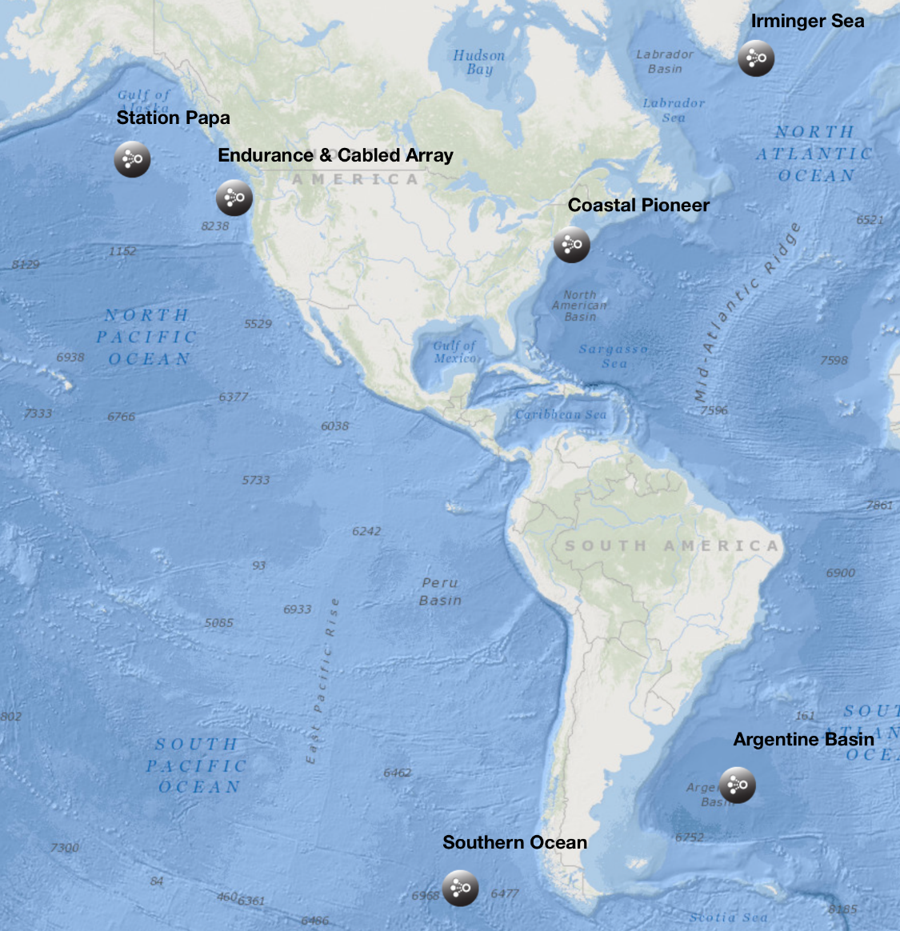
OOI Data Management and QA/QC: Lessons Learned and the Path Ahead
Michael F Vardaro, M. Crowley, L. Belabbassi, M. Smith, L. Garzio, F. Knuth, J. Kerfoot, S. Glenn, O. Schofield, S. Lichtenwalner
Rutgers University, Dept. of Marine & Coastal Sciences, New Brunswick, NJ

Slide 2
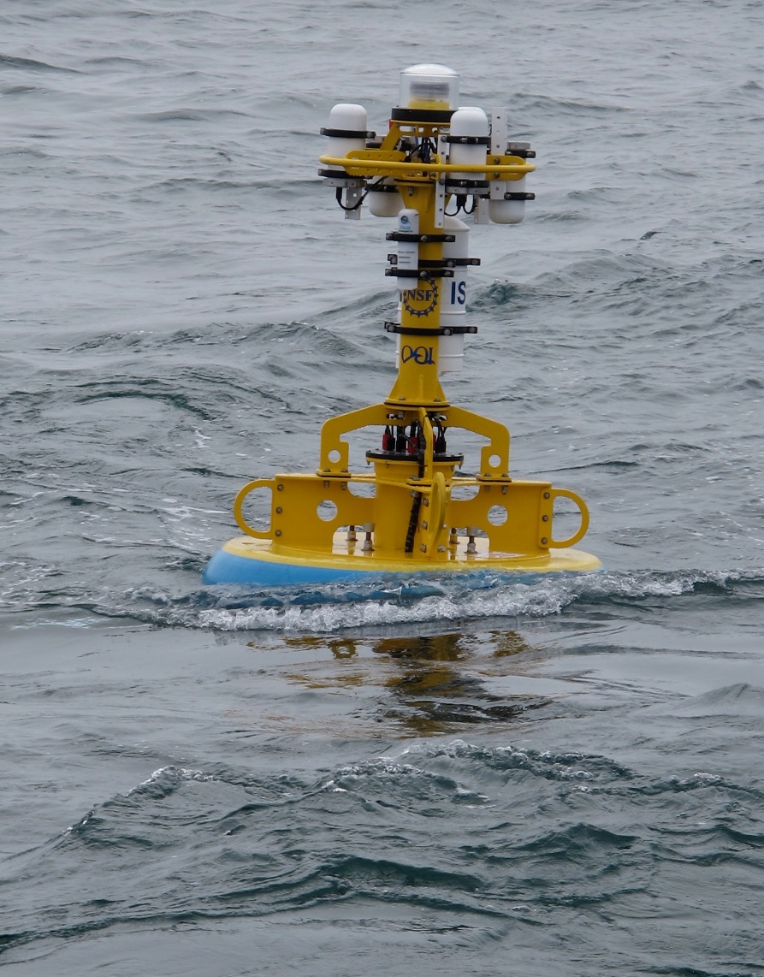
Table of Contents:
OOI Data Evaluation Team
OOI Data Flow
OOI Data Evaluation Procedures
Lessons Learned
Metadata
Communications
QA vs. QC
Future Plans

Slide 3
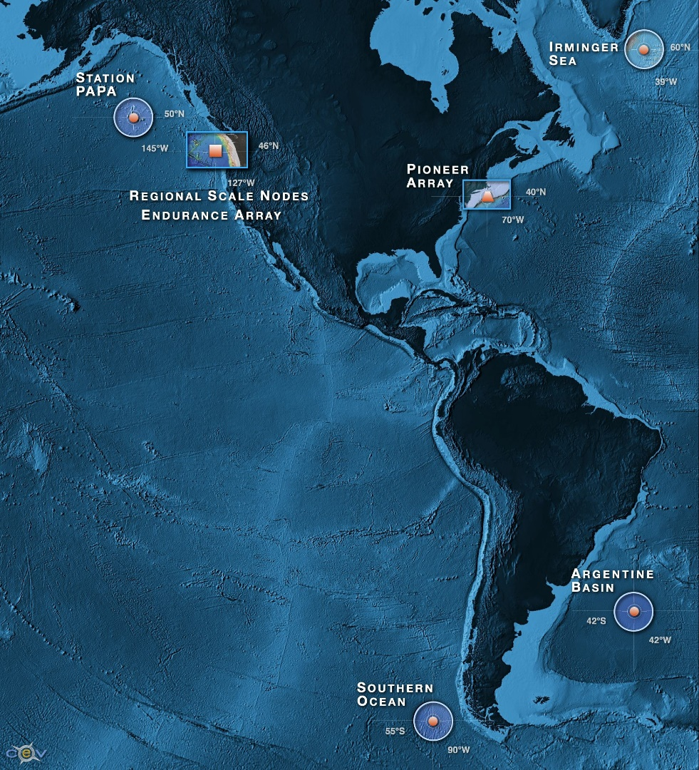
OOI By the Numbers
7
50
33
>850
>2500
>100K
Arrays
Stable Platforms
Moorings, Profilers, Nodes
Mobile Assets
Gliders, AUVs
Instruments
Science Data Products
Science/Engineering Data Products

Slide 4
Data Team
Leadership
&
Oversight
CI PI
Manish Parashar
Science/User PI
Scott Glenn
Science/User PI
Oscar Schofield
Program Management
System Engineering PM
RU – Ivan Rodero
Project Coordinator
Caroline McHugh
Science PM
RU – Mike Crowley
RDI2
COOL
Software Team
System Team
User Services Team
Data Team
Software Team Manager
Bill Kish
IT Manager
Juan José Villalobos
Data Manager
Mike Vardaro
Technical Help Desk & Education-Outreach
Sage Lichtenwalner
Software Test Eng.
Matthew Danku
Network Engineer
Jim Housell
Asst. Data Manager Leila Belabbassi
Data Evaluator
Friedrich Knuth
Software Configuration & Maintenance
Janeen Pisciotta
System Administrator
Aamir Jadoon
Data Evaluator
Lori Garzio
Data Evaluator
Mike Smith
Rutgers Support
OOI Management: Steady State: 1 FTE
OOI Operations:
12 FTEs

Slide 5
Data Flow

Slide 6
OOI Data Product Levels
Raw data: The datasets as they are received from the instrument
May contain multiple L0, L1, or L2 parameters, data for multiple sensors, and be in native sensor units
Always persisted and archived by the OOI
Example: format 0 binary file from an SBE-37IM on a Global Flanking Mooring.
Level 0 (L0): Unprocessed, parsed data parameter that is in instrument/sensor units and resolution
Sensor by sensor (unpacked and/or de-interleaved) and available in OOI supported formats (e.g., NetCDF)
Always persisted and archived by the OOI
Example: SBE-37IM Temperature portion of the hex string
Level 1 (L1): Data parameter that has been calibrated and is in scientific units
QC may be applied at this level, utilizing simple automated techniques or human inspection
Actions to transform Level 0 to Level 1 data are captured and presented in the metadata of the Level 1 data
Example: SBE-37IM Temperature converted from hex to binary and scaled to produce degrees C
Level 2 (L2): Derived data parameter created via an algorithm that draws on multiple L1 data products
Products may come from the same or from separate instruments
Example: SBE-37IM Density and Salinity

Slide 7
Data Flow Example: Pioneer Profiler
CTDPF
DOFST
FLORT
PARAD
VEL3D
Profiler Controller
Inductive Modem
Ocean
WHOI
Instrument
Platform Controller
Telemetry
Iridium
OMC Platform Shore Server
rsync
OMC Data Server
MOPAK RTE
Inductive Modem
ADCPS/T
Rutgers
Data Files from CGSN
User
RU Acquisition Point Server
Dataset Agent
Driver
uFrame Database
Data Product Algorithm
GUI

Slide 8
Data Processing Flow
Cabled Ingest Config
(MIOs/SD)
Preload
Database
(All)
QC Parameters
(RU)
A/A
Parameters
(MIOs)
Data from RSN
Recorded
Streaming
User
Acquisition Point Server
(RU)
Dataset Agent
Driver
(Omaha)
uFrame Database
(Omaha)
Data Product Algorithms, QC, A/A
(Omaha)
GUI
(ASA-RPS)
Data files
from CGSN (Telemetered and Recovered)
Ingestion Sheet (.csv)
(MIOs/RU)
Cal Sheets
(MIOs)
Algorithms
(OSU)

Slide 9
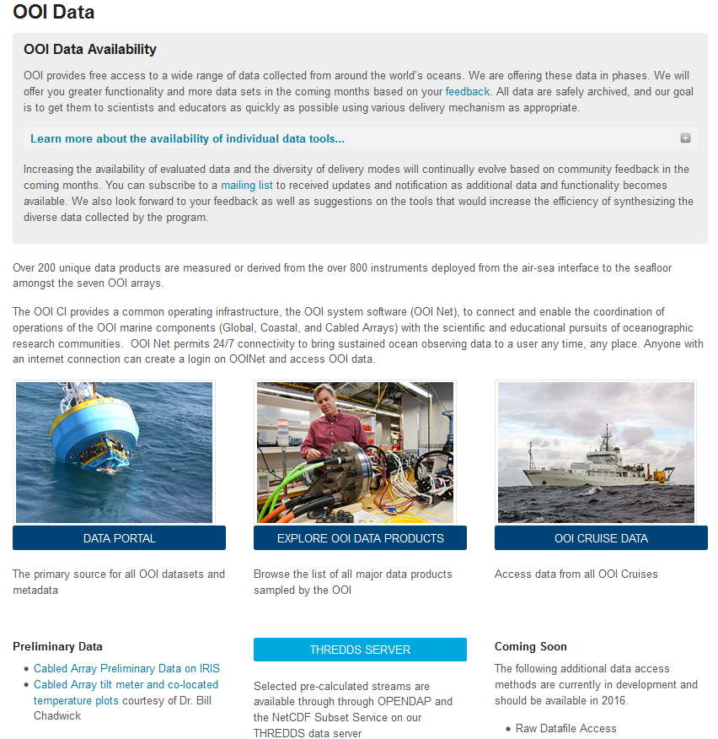
Data Access Points
Data Portal (GUI)
THREDDS Server
Aggregated data products in NetCDF and CSV
ERDDAP (Spring-Summer 2016)
Raw data files (Spring 2016)
Shipboard Data
Large Format Data
Still Camera & HD Video
Seismic Sensors
Hydrophones
Bioacoustic Sonar
Direct Pass to community organizations (e.g. seismic to IRIS)

Slide 10
OOI Essential Ocean Variables (EOVs)
All Arrays, all platforms:
CTD data products (Temperature, Conductivity, Pressure, Density, Salinity)
Dissolved Oxygen
ADCP (all series)
Bulk Meteorology (all products)
Surface Wave Spectra – significant wave height
Fluorometric Products (CDOM/Chlorophyll/Backscatter)
Nitrate
Seawater pH
In-Water and Air/Sea pCO₂
Cabled Array EOVs (these instruments are only on the Cabled Array):
HD Camera Products
Bottom Pressure/Tilt Products
Seafloor Pressure
Low-Frequency Hydrophone Products
Vent Fluid and Particulate DNA Sampler – D1000 Temperature Products

Slide 11
QC Procedures and Tools

Slide 12
Data Evaluation Team QA/QC Testing

Slide 13
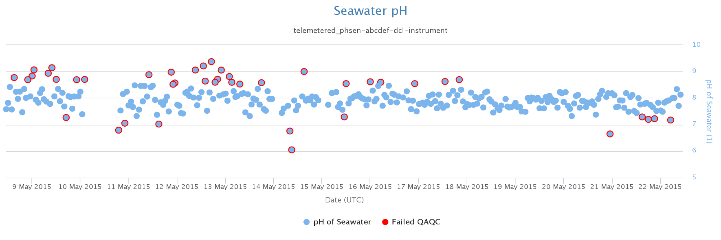
OOI Automated QC Procedures
7 automated QC algorithms can produce 8 flags (including logical “or” which combines flags) which are plottable and are included in downloaded files
Coded based on specifications written by OOI Project Scientists, derived from QARTOD manuals and other observatory experiences
Algorithms refer to “lookup tables” assembled by OOI Project Scientists with input from subject matter experts: https://github.com/ooi-integration/qc-lookup
Global Range Test
Local Range Test
Spike Test
Stuck Value Test
Trend Test
Temporal Gradient Test
Spatial Gradient Test (Profile)

Slide 14
QC Challenges
Local range values will require ongoing gathering of environmental data for each platform
Spike test is currently very simple, and needs tweaking to avoid false positives/negatives (especially in biological data) and to work with certain data types
Trend test may not work as designed, because it requires the system to compare data prior to the user request date
Gradient test is complicated to apply, requires 2D dataset
Not all QC algorithms apply to all data products – ongoing review with Project Scientists
The QC algorithms do NOT trigger alerts in the system
Alerts/alarms only trigger when new data is telemetered/streamed
Can set alerts on L1/L2 data streams based on Global/Local range values

Slide 15
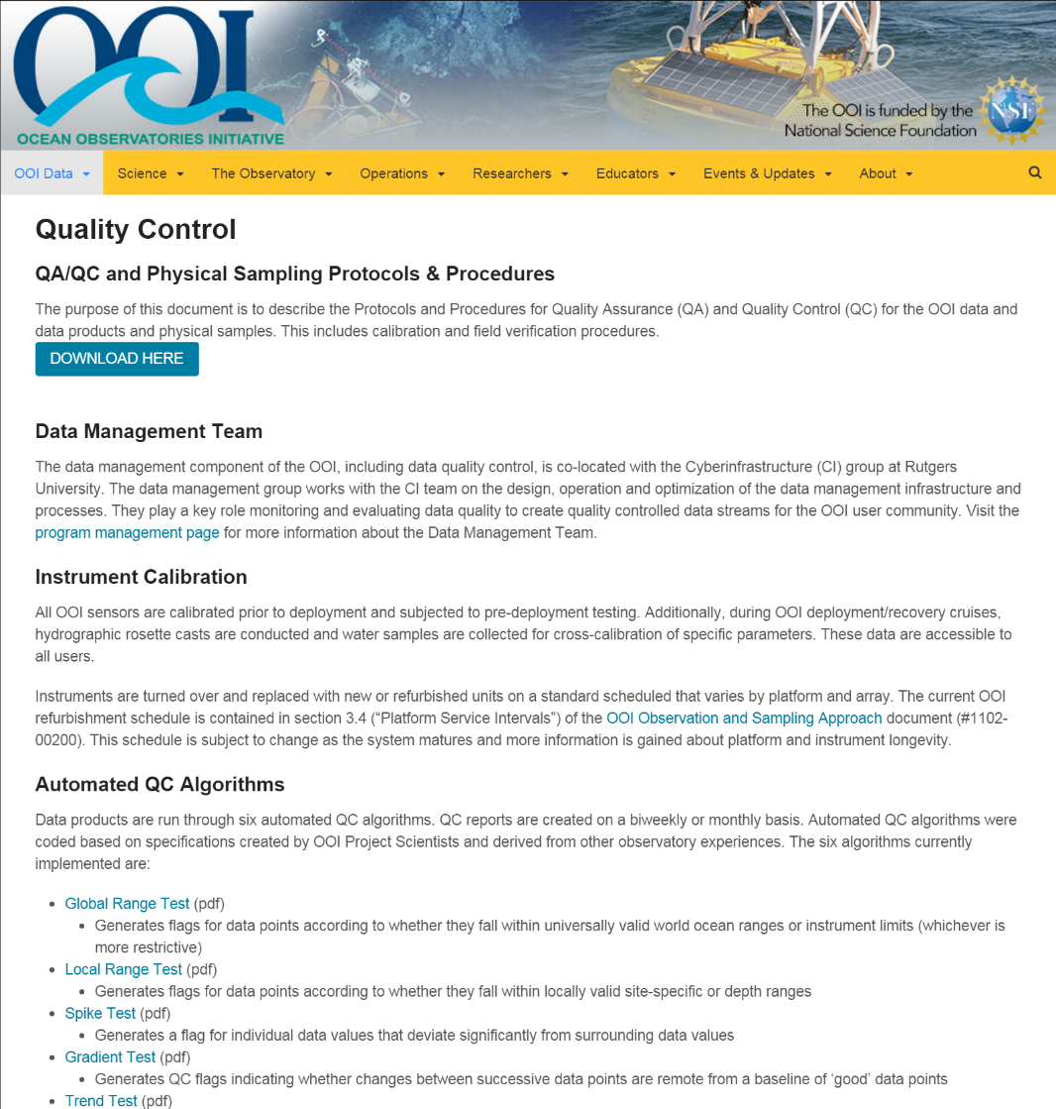
Data Evaluation Procedures & Tools
Data Management Plan (Spring 2016):
1102-00000_Data_Management_Plan_OOI
Data QA/QC and Sampling Plan:
1102-00300_QAQC_Cal_Physical_Samples_OOI
Sampling Strategy Document:
1102-00200_Observation_and_Sampling_Approach_OOI
Data Product Specifications:
1341-000xx (DPS) and 1342-000xx (Data Flow)
Data Product and QC Algorithms:
github.com/ooici/ion-functions/tree/master/ion_functions/data
github.com/ooici/ion-functions/tree/master/ion_functions/qc
Quality Control Lookup tables:
github.com/ooi-integration/qc-lookup
Data Team download and plotting tools:
github.com/najascutellatus/plot-nc-ooi

Slide 16
Lessons Learned

Slide 17
Metadata standards
Process of defining, collecting, and determining presentation of metadata has been ongoing for longer than anticipated
Software developers interpreted metadata standards differently than intended by the science requirements
Climate and Forecast (CF-1.6) standards adopted
Presentation in NetCDF header is incomplete but being improved
Provenance contained within file, which is not standard
Encoded in JSON format, requires extraction
Contains error notifications and information on how product was created
More formatting work needs to be done

Slide 18
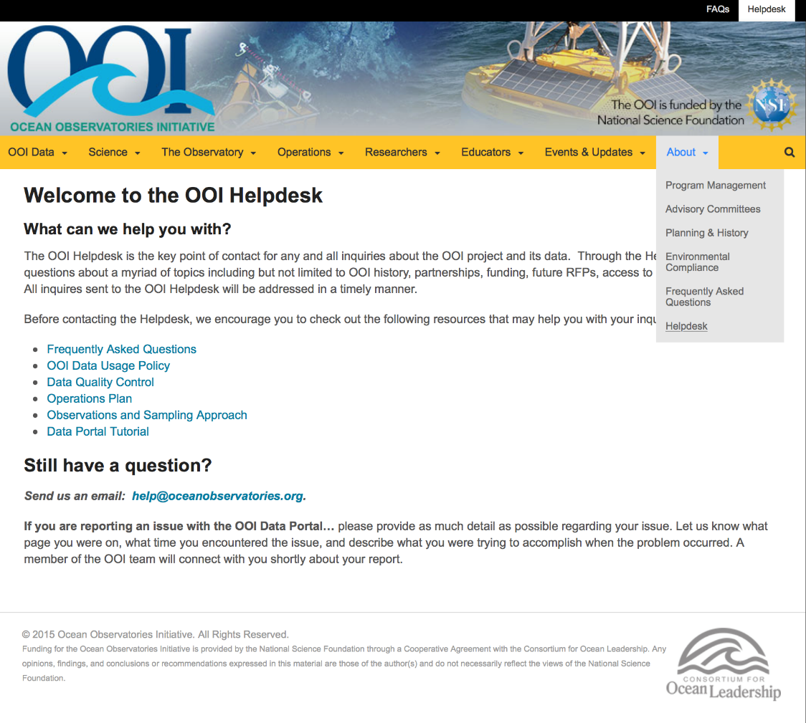
Communication
The main method of communication from the data team to users is via annotation (requires enhancement)
Main method of communication from users to data team is through help desk requests (via website)
Also needed to standardize and improve communication between data team and Marine Implementing Organization personnel

Slide 19
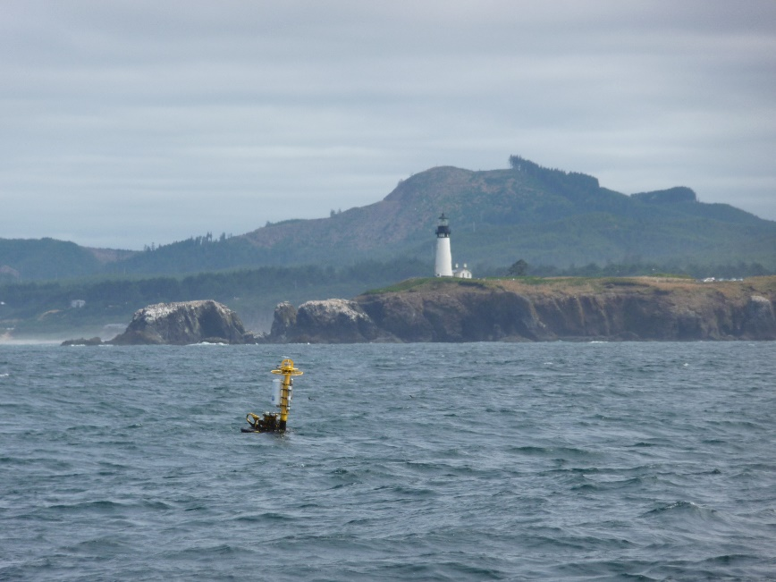
QA vs. QC
Quality Control is a product check to identify flaws or defects
Quality Assurance is a defined process used to diagnose why a product is flawed or being produced incorrectly
The data team has had to become increasingly familiar with the end-to-end production of data products
Wider teamwork required to track (sometimes mysterious) issues back to a specific cause
Software error or missing data vs…
Instrument miscalibration by vendor vs…
Instrument settings changed during deployment vs…
Mooring run over by ship

Slide 20
Future Plans

Slide 21
Near-Term Priorities
Deliver high quality data to the community, enabled and accelerated via feedback and community “eyes” on the products
Requires transparency in software releases, QC procedures, and documentation
Hybrid data delivery approaches to augment asynchronous data delivery via GUI, using THREDDS, ERDDAP, etc.
Organize a cross-project team to define and develop a method for post-recovery secondary calibration. This group will rely on external community input.
Several high value and high interest OOI datasets (e.g. bioacoustics, covariance flux measurements, vent fluid chemistry) will require entraining the external community in data quality and delivery discussions
Addition of a data forum and additional communications to external scientists
OOI is more then a collection of sensors: an ongoing distributed community discussion

Slide 22
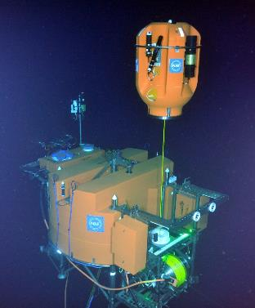
OOI at Oceans 2016
TOWN HALL TOMORROW AT 12:30pm - Rooms 220-221
Consortium for Ocean Leadership & OOI Booth 611 in Exhibitor Hall
Posters Today at 4pm
OD14A-2394 - OOI Data Access and Visualization via the Graphical User Interface - Lori Garzio
OD14A-2397 - The Ocean Observatories Initiative: Unprecedented access to real-time data streaming from the Cabled Array through OOI Cyberinfrastructure - Friedrich Knuth
OD14A-2396 - OOI Data Acquisition Functions and Automated Python Modules - Mike Smith
OD14A-2399 – OOI Data Pre-Processing: Diagnostic Tools to Prepare Data for QA/QC Processing - Leila Belabbassi
Poster Thursday 4pm
ED44B-1728: The OOI Ocean Education Portal: Enabling the Development of Online Data Investigations - Sage Lichtenwalner

Slide 23
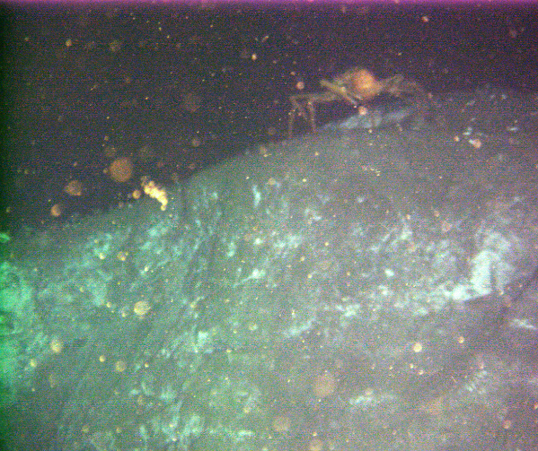
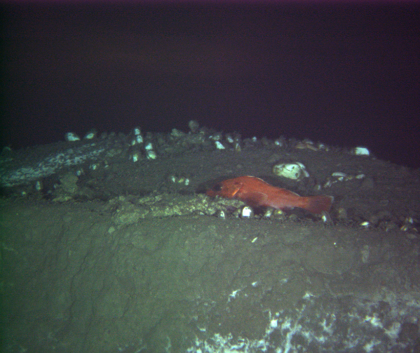
Questions?
OOI Main Web site: http://oceanobservatories.org
Data Portal: http://ooinet.oceanobservatories.org
Mike Vardaro, Data Manager, OOI CI Data Team
vardaro@marine.rutgers.edu
Acknowledgements: NSF, COL, Rutgers University, University of Washington, WHOI, Oregon State University, RPS-ASA, Raytheon, UCSD/SIO

