Slide 1
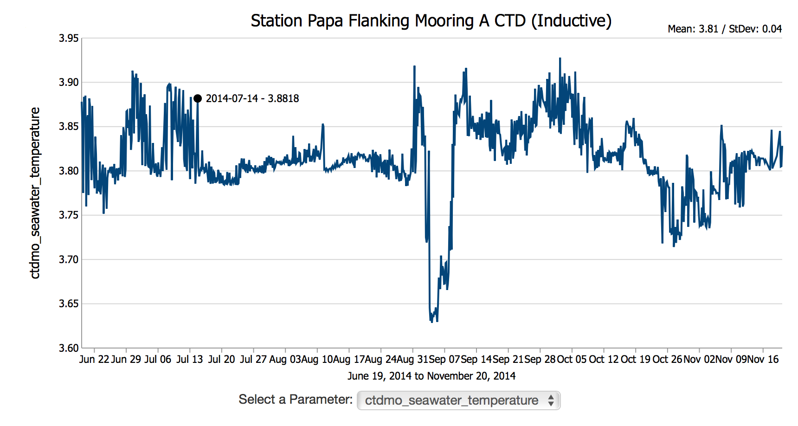
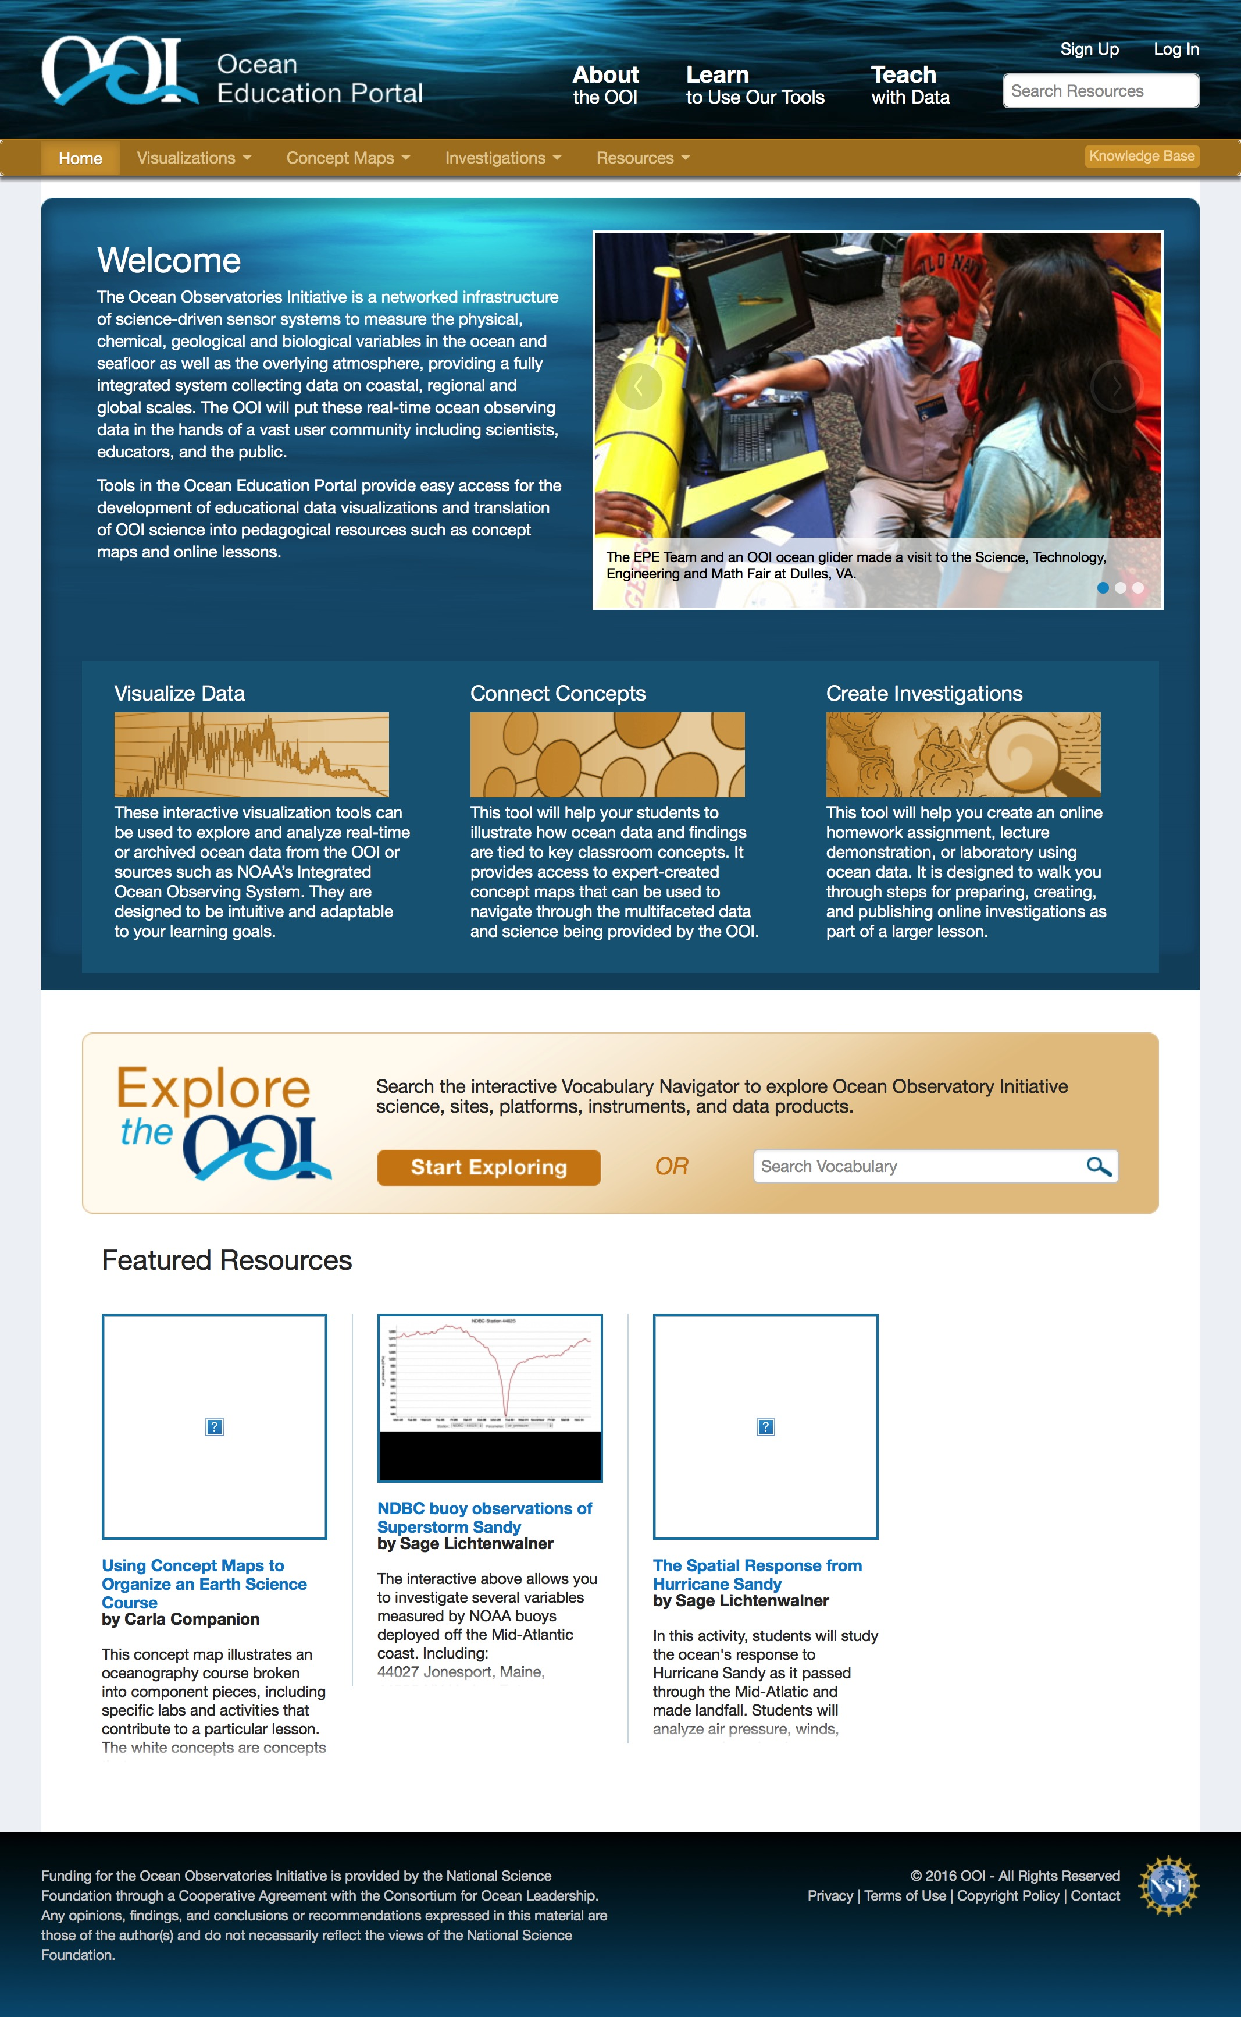
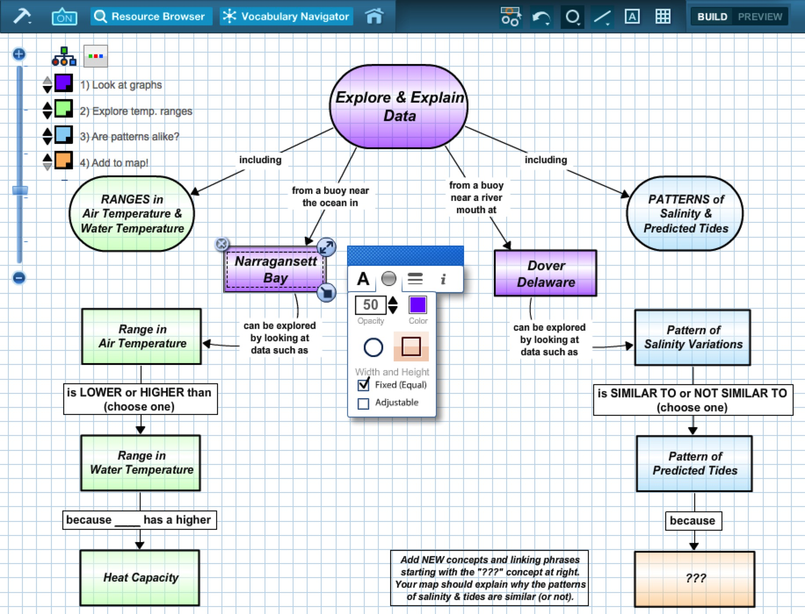
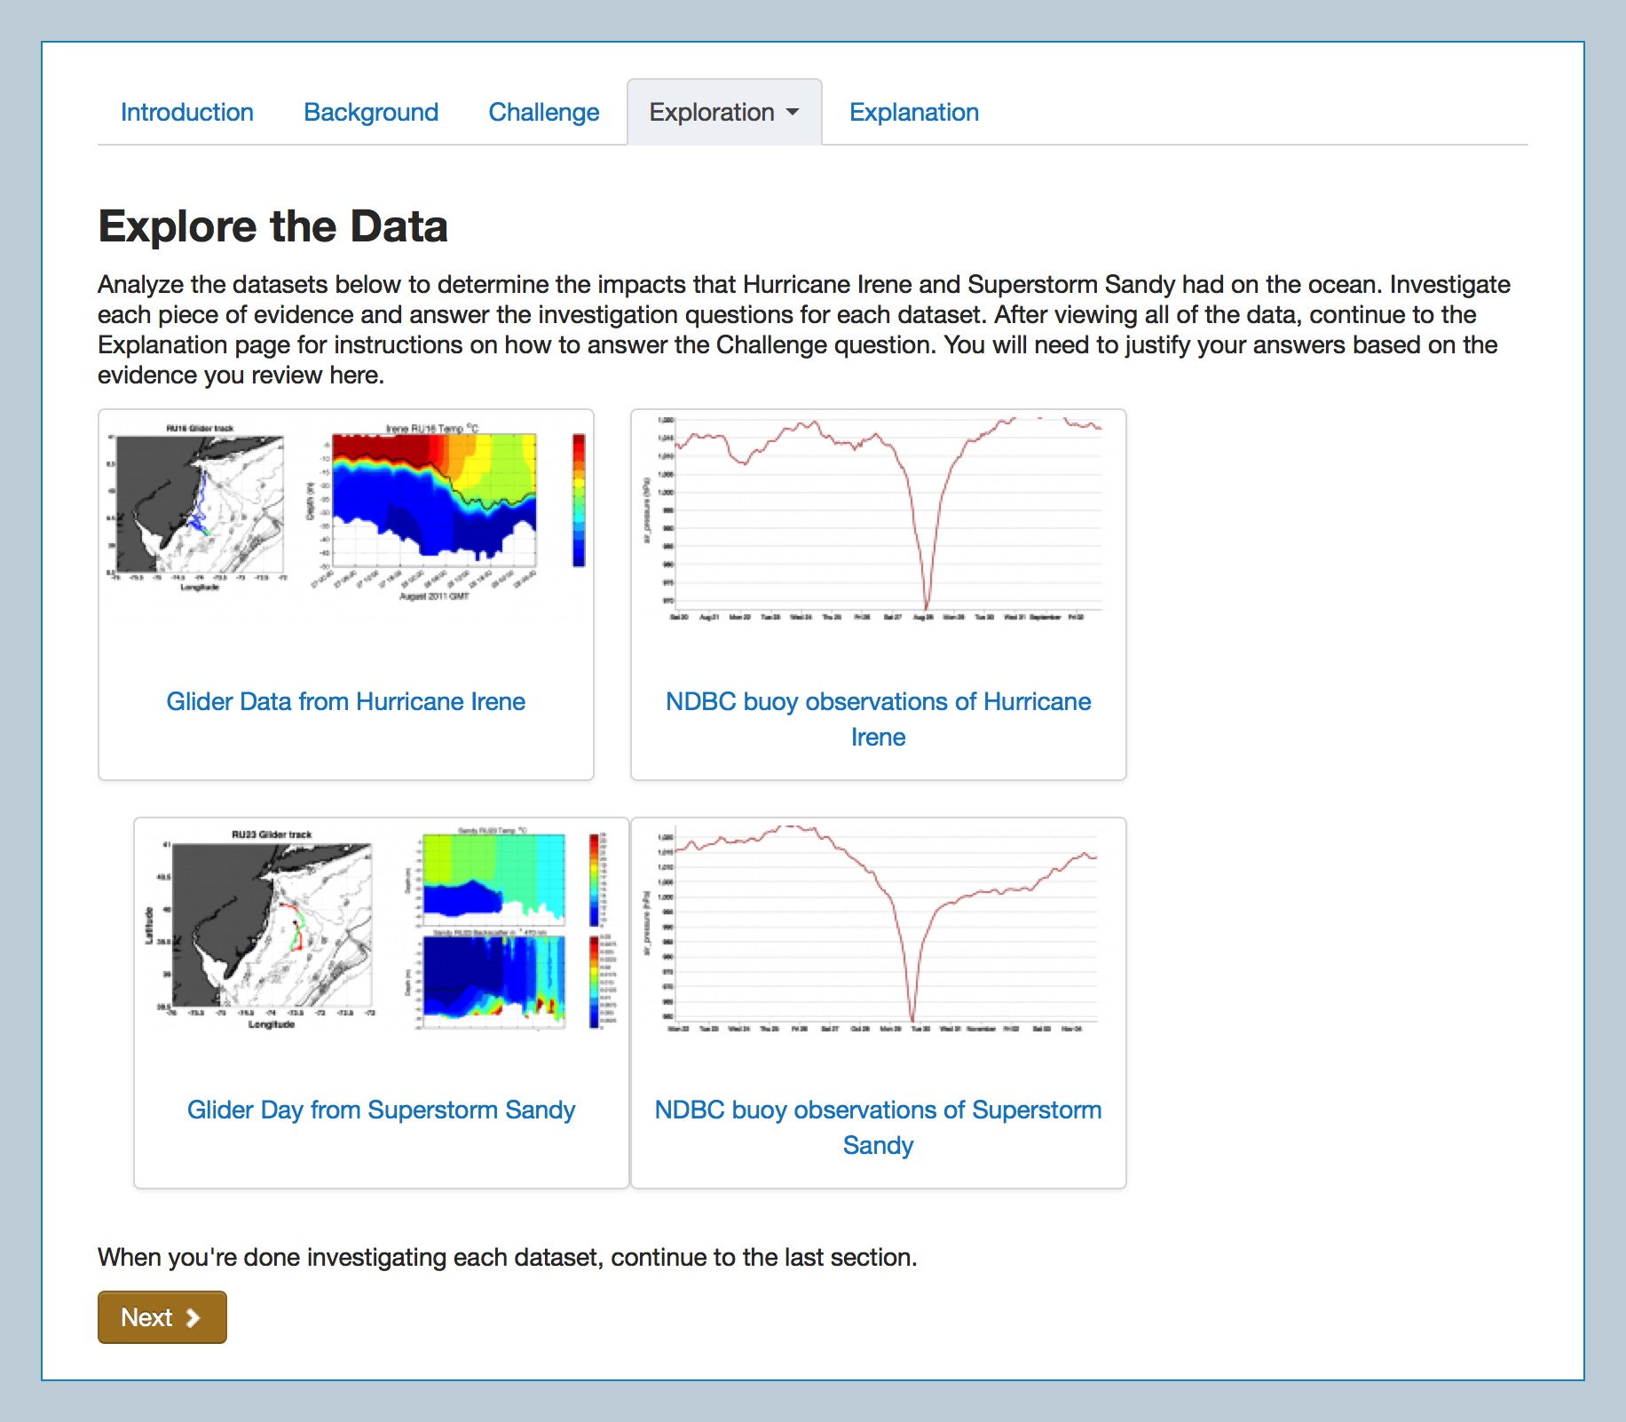
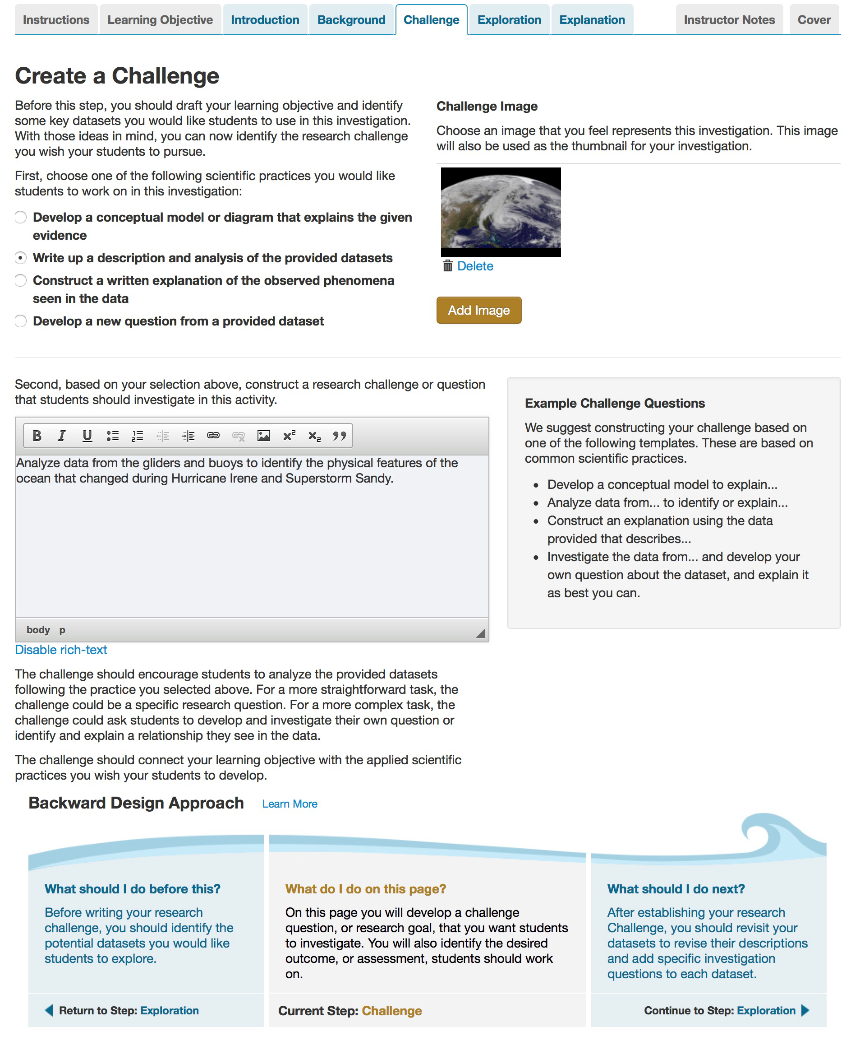
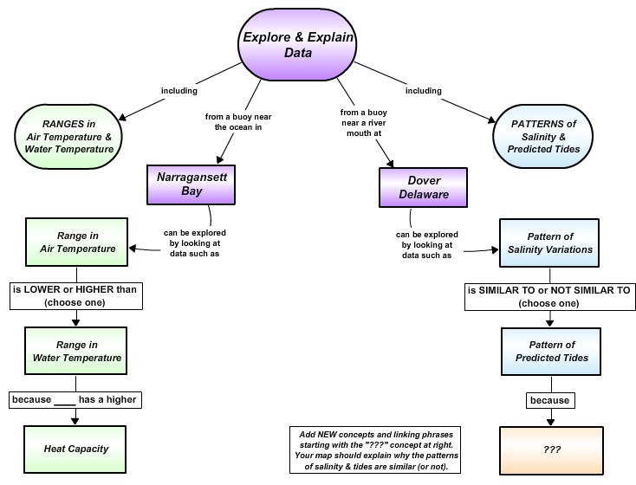
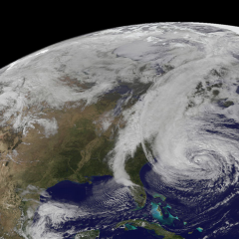
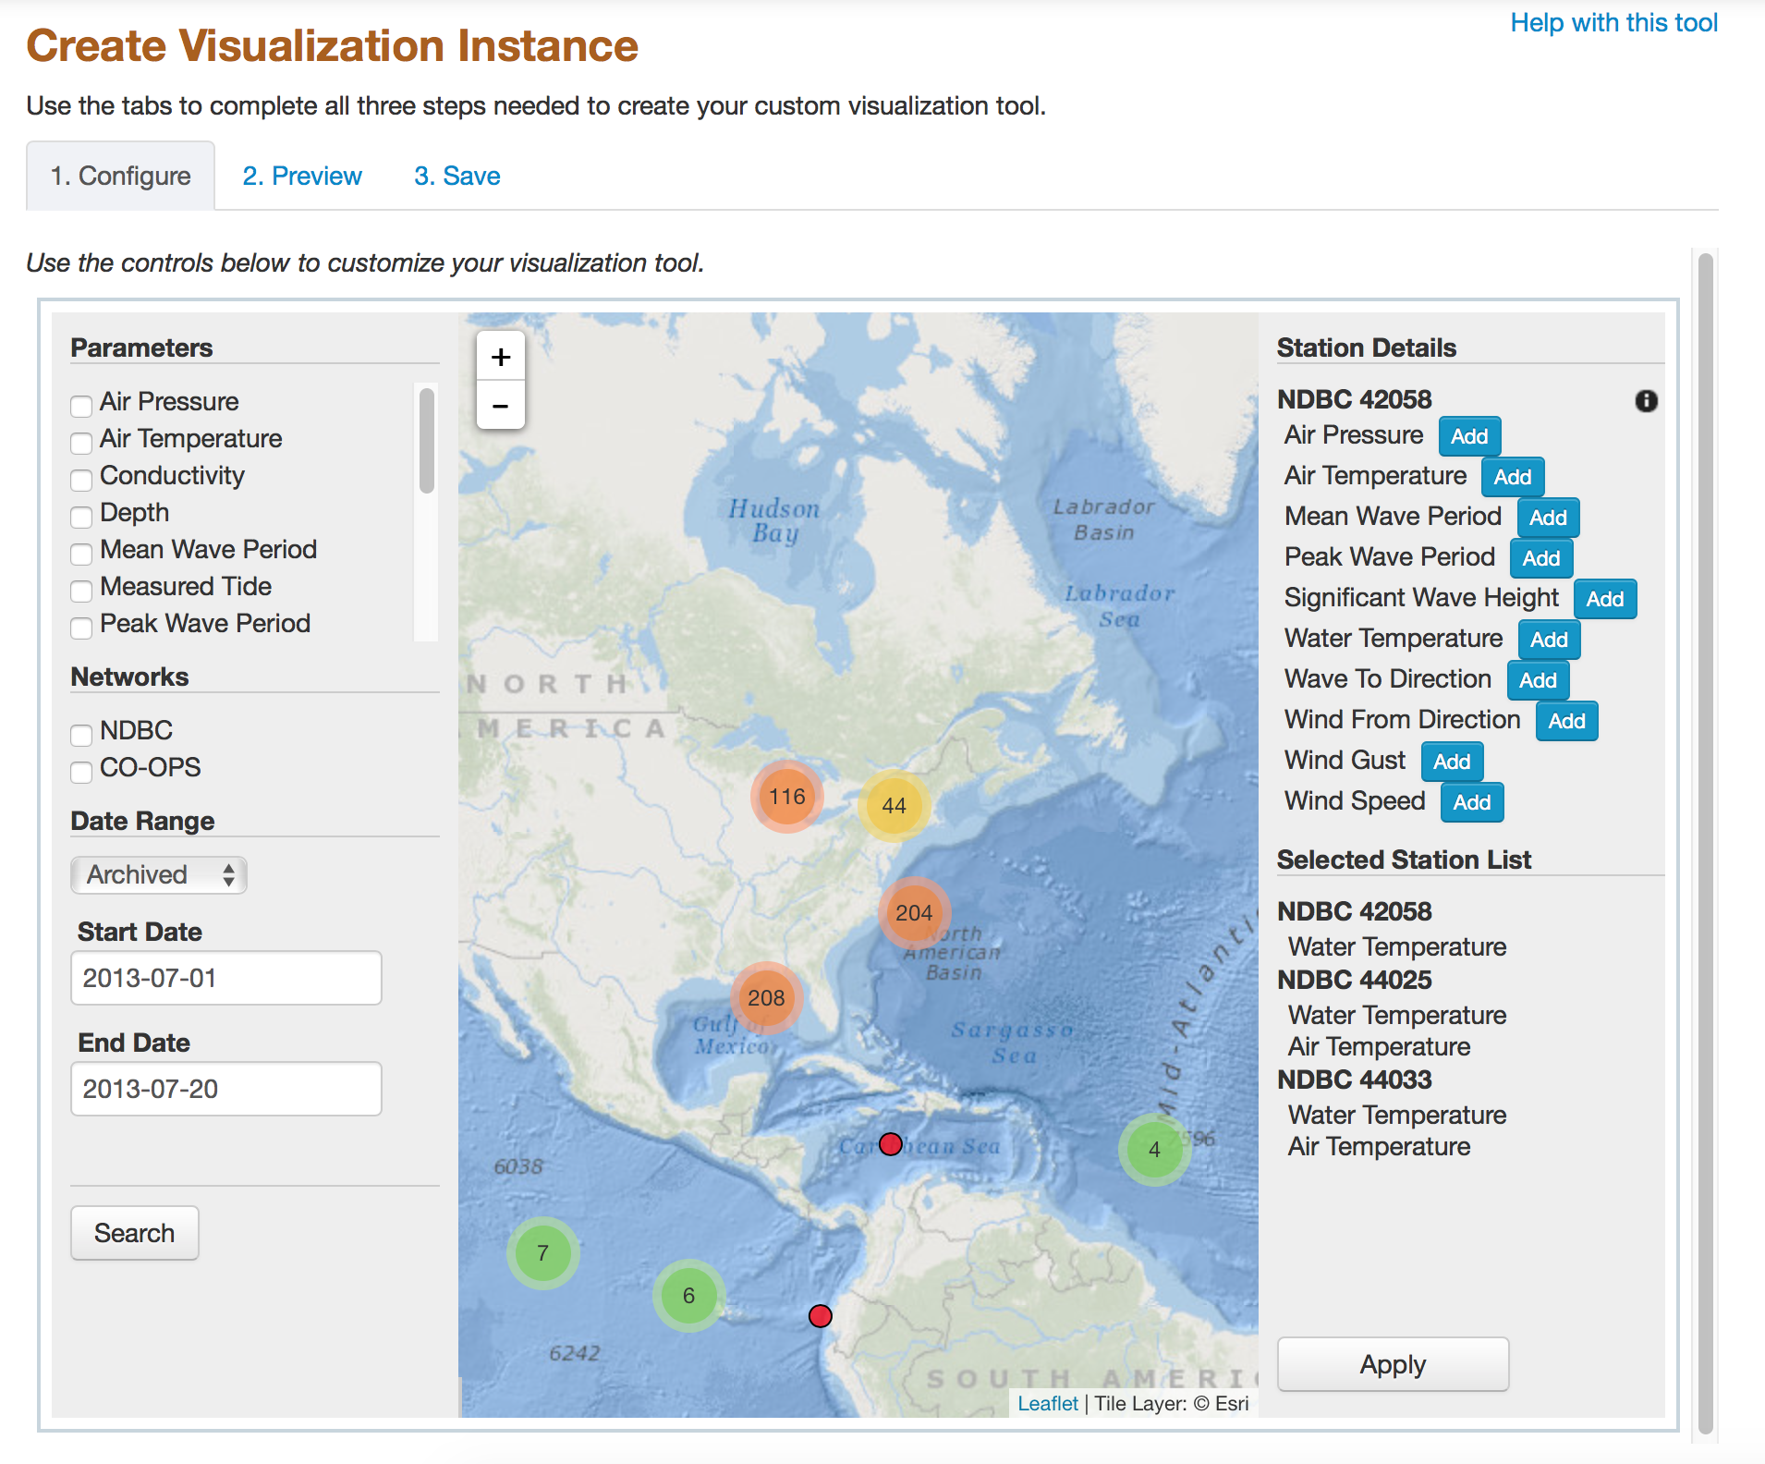
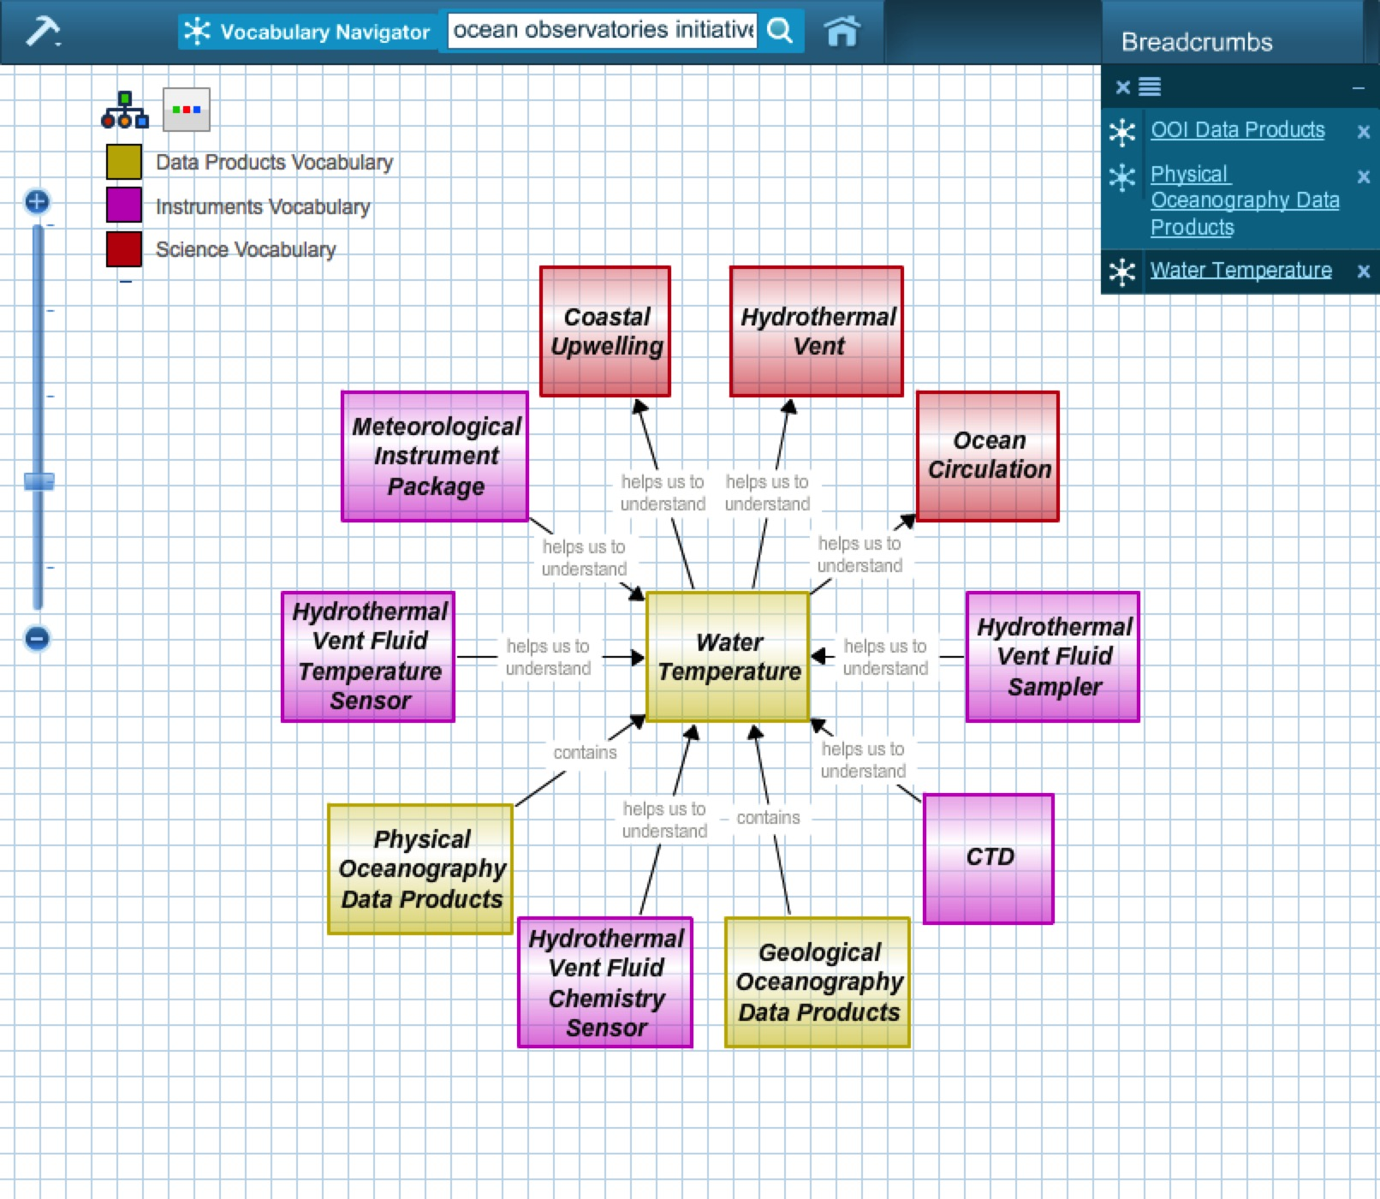
The OOI Ocean Education Portal: Enabling the Development of Online Data Investigations
Poster ED44B-1728
C. Sage Lichtenwalner¹, J. McDonnell¹, M. Crowley¹, A. deCharon², C. Companion², S. Glenn¹
¹ Rutgers University, ² University of Maine
Introduction
The Ocean Observatories Initiative (OOI) was designed to transform ocean science, by establishing a long-term, multi-instrument, multi-platform research infrastructure at 7 arrays around the word. This unprecedented investment in ocean observation, funded by the National Science Foundation, provides a rich opportunity to reshape ocean science education as well.
As part of the initial construction effort, an online Ocean Education Portal was developed to support the creation and sharing of educational resources by undergraduate faculty at universities and community colleges. The portal includes a suite of tools that enable the development of online activities for use as group or individual projects, which can be used during lectures or as homework assignments.
The site includes:
A suite of interactive educational data visualization tools that provide simple and targeted interfaces to interact with OOI datasets;
A concept map builder that can be used by both educators and students to build networked diagrams of their knowledge; and
A “data investigation” builder that allows faculty to assemble resources into coherent learning modules.
The site also includes a “vocabulary navigator” that provides a visual way to discover and learn about the OOI’s infrastructure and scientific design. The site allows users to browse an ever-growing database of resources created by the community, and likewise, users can share resources they create with others.
As the OOI begins its 25-year operational phase, it is our hope that faculty will be able to use the tools and investigations on the Ocean Education Portal to bring real ocean science research to their undergraduate students.
1) Educational Visualization Tools
The site provides an extensible framework for delivering flexible and customizable visualization tools for use by educators and students.
Capabilities
A collection of interactive visualization tools that allow you to explore and analyze OOI datasets
An online interface to customize visualization tools to meet specific educational goals
The ability to embed custom instances on third-party web pages
A searchable library of visualizations created by others
Visualization Tool Design Philosophy
Simple – Intuitive & easy to use
Interactive – To support deeper understanding
Customizable – Adaptable to fit your learning goals
Embeddable – Place them in context within your lessons
Focused – Learning outcome driven, not data driven – these are not your typical comprehensive complex data exploration tools
Educational – Primary goal is to aid students’ analysis and understanding of scientific processes, not dealing with data formats and graphing
2) Concept Map Builder
A Concept Map is a conceptual diagram used to graphically visualize the relationships between individual concepts. The OOI Concept Map Builder allows you to create your own concept maps to share.
Capabilities
Add detailed descriptions to each concept and linking phrases between them
Attach relevant images, videos, data visualizations, and other concept maps to each concept to add depth
Categorize concepts using colors and then toggle concept groups on/off while presenting to build a map in stages to tell a story
Import concepts from the OOI Vocabulary Navigator to seed a new concept map with relevant concepts
Share concept maps with other users who can copy your map to create their own version
How can I use concept maps in my teaching?
Create maps to visualize your lecture content or course curriculum
Have students create their own maps to demonstrate how they have synthesized learned information
Have students create maps before and after learning a topic to help them understanding how their knowledge has changed
Have students use maps to plan and present group projects
OOI Vocabulary Navigator
The interactive Vocabulary Navigator allows you to explore OOI science, sites, platforms, instruments, and data products. These maps can then be imported into other maps you create.
3) Data Investigation Builder
The Ocean Education Portal provides a platform for educational users, including students and teachers, to create online investigations to explore oceanographic datasets from the OOI and other observatories. The investigations help put oceanographic datasets and science into appropriate educational contexts.
Capabilities
The builder provides a wizard to assist in the creation of online educational units using an Engage, Explore, Explain approach
Customized visualization tools, concept maps, images, and movies can all be embedded within an online investigation
Units can be shared with students directly, to peer faculty, or to the community at large through the searchable library
Units can be copied and customized to meet specific learning goals
An example “front-end” of a Single Time Series OOI tool. This visualization tool has been customized to only show data form a specific instrument for a specific time period, though students can still change the displayed parameter.
An example “student view” from an investigation showing several pieces of evidence that must be explored as part of an overall challenge question. Each piece of evidence can also include additional questions and background information to direct student thinking towards a larger goal or question.
An example concept map being created in the OOI Concept Map Builder.
An example “back-end” interface for the Simple Time Series with Map tool. This interface allows you to customize the visualization tool by choosing the specific NDBC and CO-OPS stations and parameters you want to make available, along with the specific date range students should see.
An example of the “wizard” interface that assists users in creating online investigations. Note how the blue tabs follow the same order as the student view while additional guidance on instructional pedagogy is provided at the bottom.
How can you contribute?
Use the provided visualization tools to create custom visualization instances that highlight notable events and phenomena in the data that you would like students to explore.
Do you know JavaScript? You can work with the OOI Education team to create a new visualization tool that others can use to interact with OOI or any other dataset available via web services.
Get Started Today!
The OOI Education Portal is now live. We invite you log onto the site, play with the tools, create your own resources, and let us know what you think.
http://education.oceanobservatories.org
For more information, please contact sage@marine.rutgers.edu
An example view from the Vocabulary Navigator showing the relationships between the “Water Temperature” concept, which is part of the “Data Product” vocabulary, and other concepts. Users can explore the vocabulary further by clicking on individual concepts, or they can view descriptions and related media.
Acknowledgments: The OOI is funded by the National Science foundation and managed by the Consortium for Ocean Leadership. We would like to thank NSF for its years of dedication and support to the COSEE program as well as the OOI project which have made this work possible.

