Slide 1
Win-Win Partnerships: Broader Impacts that Make a Difference
February 25, 2016

Slide 2
Visit us at polar-ice.org
Notes:
A program designed to connect scientists, educators, and students using data and research from the Arctic and Antarctica regions.

Slide 3
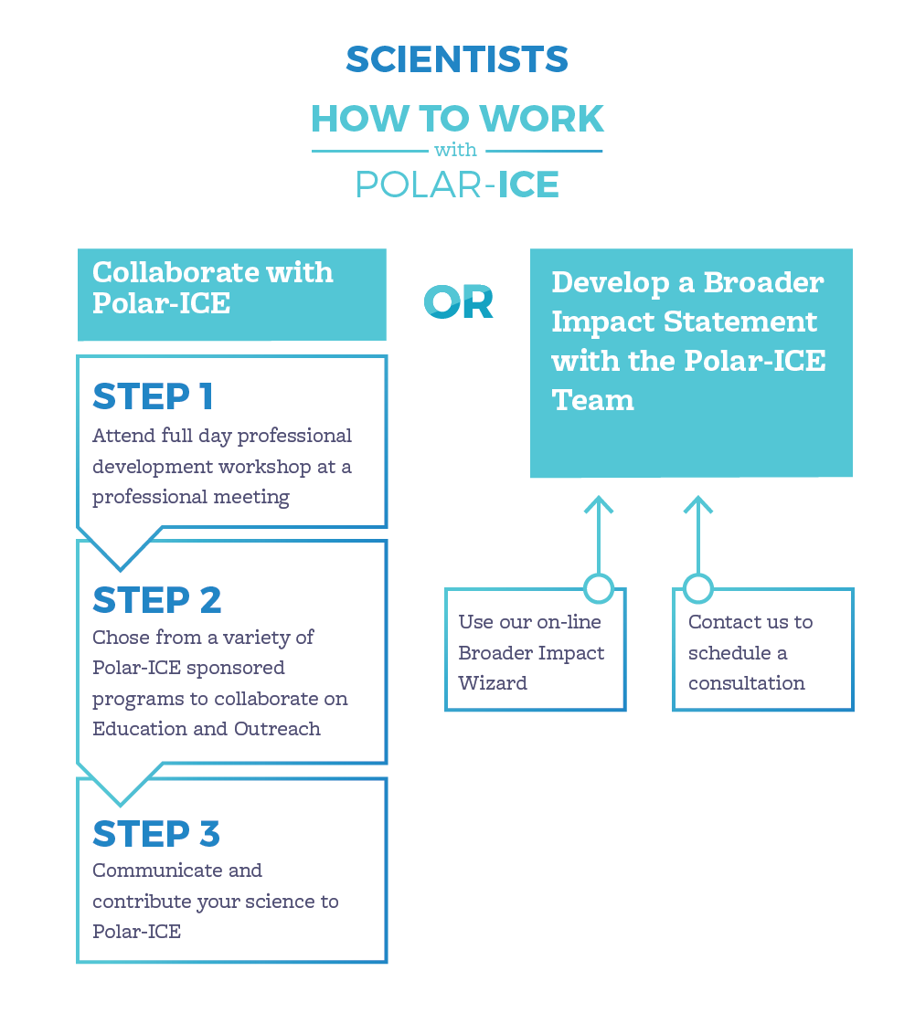

Slide 4
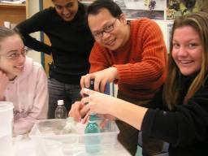
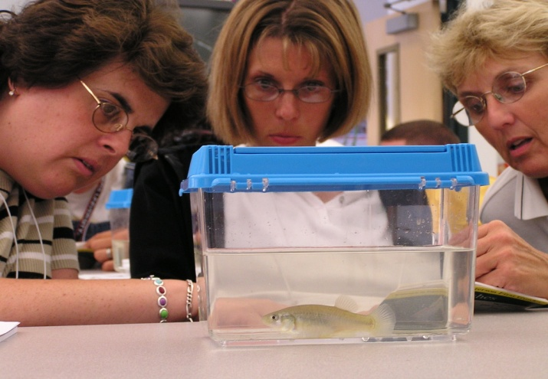
Outline of Today’s Presentation
Overview: What do we mean by broader impacts and why is it important?
Explore: Broader Impacts Wizard
Reflection: Feedback, Comments, and Questions

Slide 5
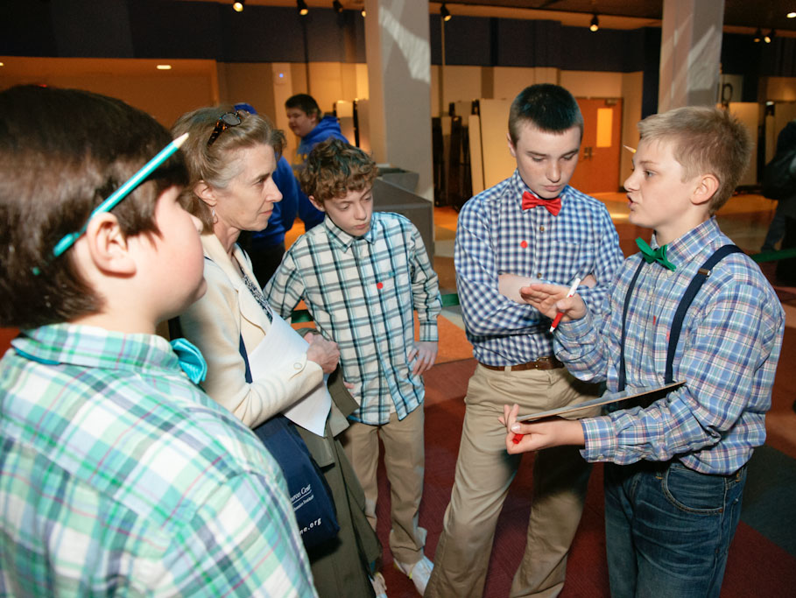
What is a Broader Impact Activity?
…a planned experience, engagement, action, function, etc. that is conducted over a finite period of time for a specific purpose and with a target audience.
Notes:
If the target audience is undergraduate or graduate students, the activities should be in addition to traditional undergraduate coursework- go beyond normal faculty responsibilities.

Slide 6
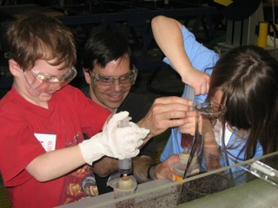
Engagement..
The PI and/or project team mutually and actively involves target audience participants in the proposed BI activity(ies).

Slide 7
Turn and Talk
Why are Broader Impacts of scientific research important to you? What interests you about BIs?

Slide 8
NSF’s Merit Review Criteria in GPG
Following BI goals might be considered:
Full participation of women, persons with disabilities, and underrepresented minorities in STEM
Improved STEM education and educator development at any level
Increased public scientific literacy and public engagement in STEM
Development of a diverse, globally competitive STEM workforce
Increased partnership between academia, industry
Enhanced infrastructure for research and education
Notes:
How well does the activity advance discovery and understanding while promoting teaching, training and learning?
• How well does the proposed activity broaden the participation of underrepresented groups (e.g., gender, ethnicity, disability, geographic, etc.)?
• To what extent will it enhance the infrastructure for research and education, such as facilities, instrumentation, networks and partnerships?
• Will the results be disseminated broadly to enhance scientific and technological understanding?
• What may be the benefits of the proposed activity to society? National security?

Slide 9
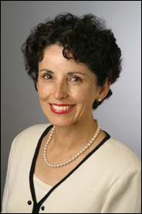
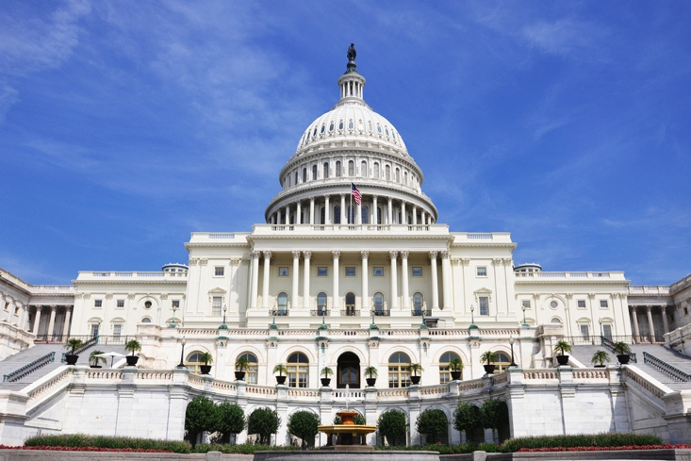
“As a federal agency, we need to stay relevant with those who entrust us with taxpayer funds. We need to reach out to Congress and other stakeholders and be proactive in explaining…why we are vital to our nation’s future.”
--France Córdova, Director
National Science Foundation
“Each grant application [must be] relevant to the national interest.”

Slide 10
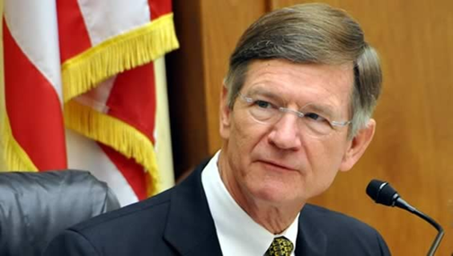
House Committee on Science, Space & Technology
--Lamar Smith, Chairman
Notes:
The senator's report cited this half-million-dollar research grant. But that money actually went to a lot of different research that he and his colleagues did on this economically important seafood species and the treadmills were just a small part of it, a way to measure how shrimp respond to changes in water quality.
The Republican aides were looking for anything that Representative Lamar Smith (R–TX), their boss as chair of the House Committee on Science, Space, and Technology, could use to support his ongoing campaign to demonstrate how the $7 billion research agency is “wasting” taxpayer dollars on frivolous or low-priority projects, particularly in the social sciences.

Slide 11
All in all… Broader Impacts are important!
Criterion II is required
Some evidence that an outstanding BI will give you an “edge” and improve funding potential
Relevant to national interests

Slide 12
National Alliance for Broader Impacts

Slide 13
Broader Impact Project Discussion
Stephanie Schroeder

Slide 14
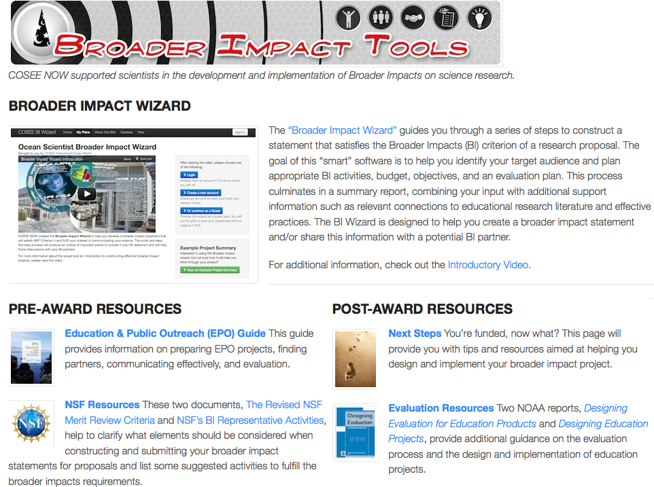
http://coseenow.net

Slide 15
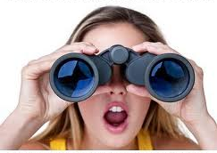
Let’s explore this tool…

Slide 16
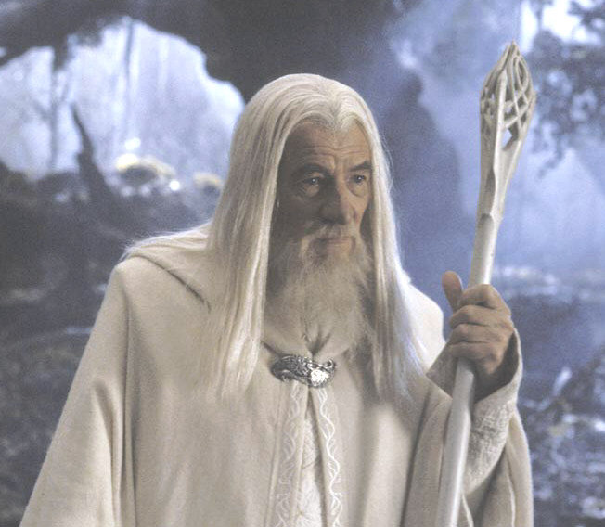
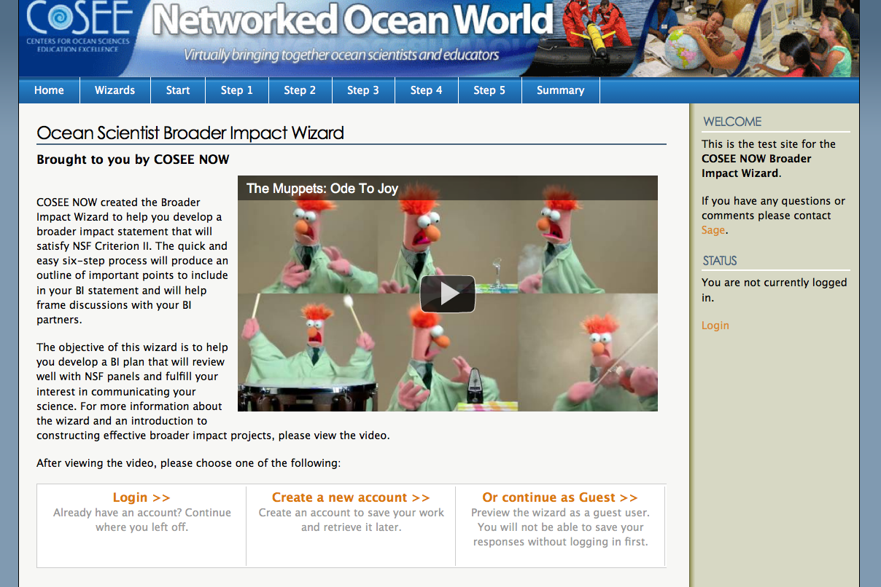
Broader Impact Wizard
Notes:
Today, I will be focusing on a new application that we are adding to this suite of online tools. The Broader Impact Wizard… is smart software which support users in the construction and implementation of successful broader impact statements.

Slide 17
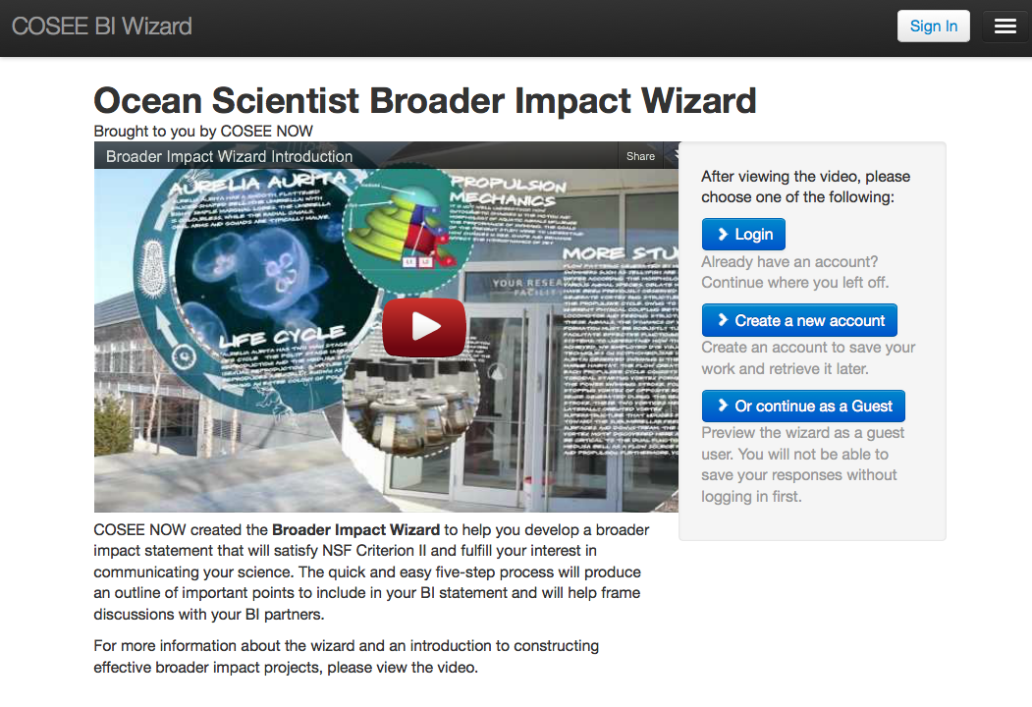
Notes:
Mention this was prototyped for ocean scientists – can/should be expanded to other disciplines.

Slide 18
http://coseenow.net/wizard
Notes:
Mention log in and videos

Slide 19
Notes:
Mention log in and videos

Slide 20
Notes:
Mention log in and videos

Slide 21
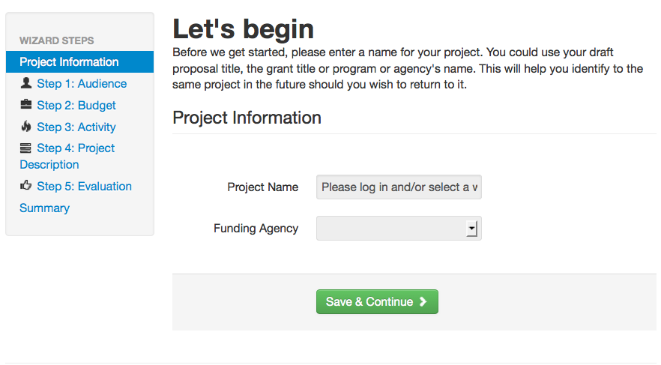
Notes:
Mention log in and videos

Slide 22
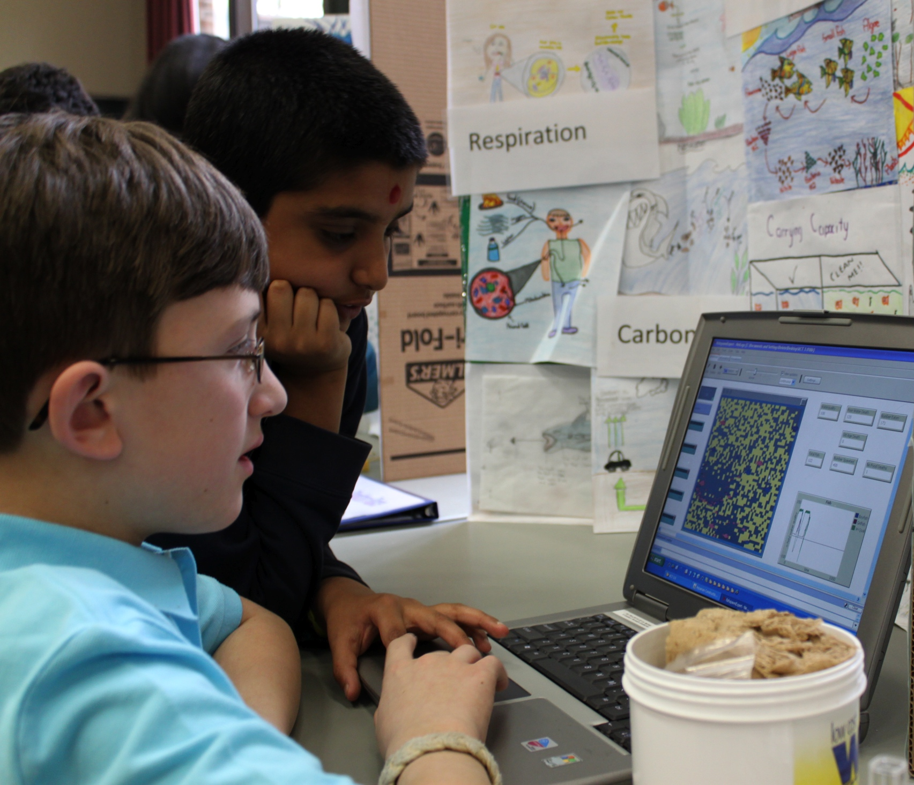
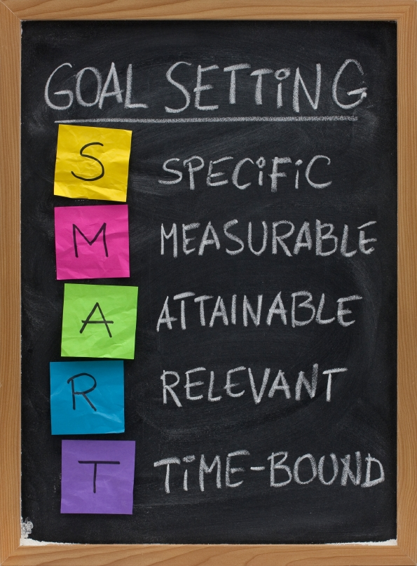
Steps to Broader Impact Success
1: Audience
2: Budget
Audience
3: Activity
5: Evaluation
4: BI Project Description
Notes:
The BI Wizard walks the user through five steps (list them) and from the information inputed intp by the user forthese steps, provides them with a summary report to help plan and draft their proposed broader impact project and/or share this information with a potential partner

Slide 23
Audience
Audience
Budget
Activity
Bi Project Description
Evaluation
Size of Audience
Depth of Engagement
Reviewer Question: What is the potential for the proposed activity to benefit society and contribute to achievement of specific desired societal outcomes?

Slide 24
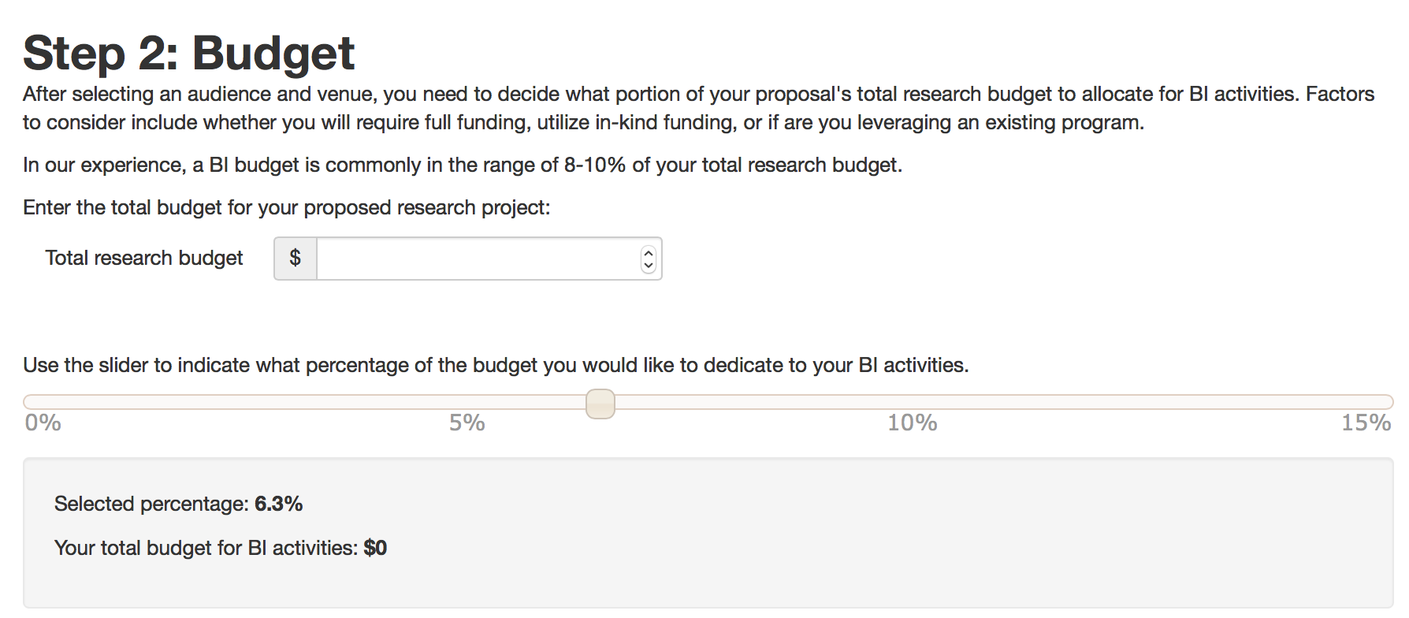
Budget
Audience
Budget
Activity
Bi Project Description
Evaluation
Institutional Infrastructure
At least 10% of total budget
Reviewer Question: Are there adequate resources available to the PI (either at the home institution or through collaborations) to carry out the proposed activities? Is the budget allocated for BI activities sufficient to successfully implement them?
Notes:
After selecting an audience and venue, we ask the scientist to think about how much money they will be dedicating to their BI efforts. As most of you probably know, a successful BI project will have an realistic budget. Therefore, the budget will be a major factor in determining what activities they can do with their audience. Users can enter their total research budget and then use the slider to determine what percentage of this total budget that they would like to dedicate to their BI activities.
As a reference point, we have also included a note explaining that based upon our experience, we have found that a typical BI budget is about 10% of the total research budget.

Slide 25
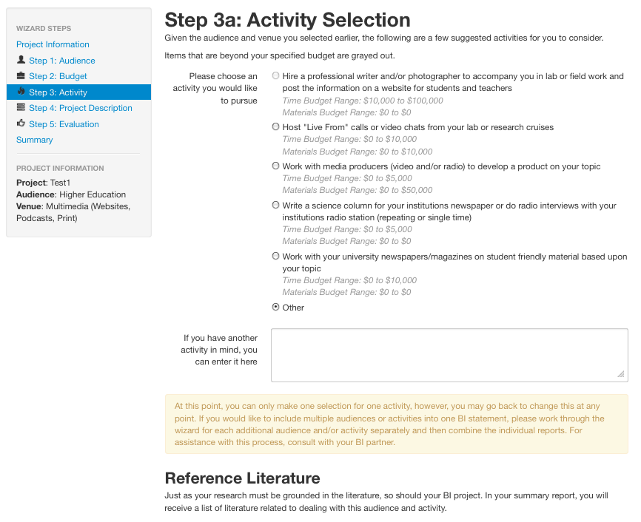
Activity Selection
Audience
Budget
Activity
Bi Project Description
Evaluation
Effective practices
Citing educational literature to situate your project in what has already been done
Correlated to your budget
Reviewer Question: Is the plan for carrying out the proposed activity well-reasoned, well organized, and based on a sound rationale?
Notes:
Based upon the audience and budget that the user selected in the previous steps, the wizard then outputs suggested BI activities for them to consider when working with this audience. Included with the information for each activity are rough estimates of the costs Both time and material) that are associated with each activity. Options that are beyond the specified budget from the previous are grayed out and cannot be selected by the user. This helps to ensure that the user has allotted an appropriate budget for their desired activity. If the user would like to select one of the grayed out activities, they must go back and adjust their budget accordingly. Of course, values listed are typical costs and depending on the specifics of the activity, these values may vary. Which leads me to another important function on this page, the partner section.

Slide 26
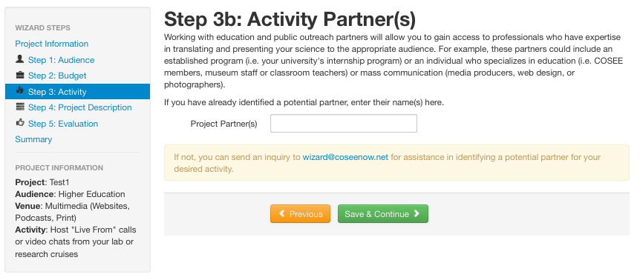
Partners
Audience
Budget
Activity
Bi Project Description
Evaluation
Comprehensive team to successfully execute the proposed BI plan
Reviewer Question: How well qualified is the individual, team, or Institution to conduct the proposed activities?
Notes:
Based upon the audience and budget that the user selected in the previous steps, the wizard then outputs suggested BI activities for them to consider when working with this audience. Included with the information for each activity are rough estimates of the costs Both time and material) that are associated with each activity. Options that are beyond the specified budget from the previous are grayed out and cannot be selected by the user. This helps to ensure that the user has allotted an appropriate budget for their desired activity. If the user would like to select one of the grayed out activities, they must go back and adjust their budget accordingly. Of course, values listed are typical costs and depending on the specifics of the activity, these values may vary. Which leads me to another important function on this page, the partner section.
To get a true sense of what the activity is, including how much it will cost, we highly recommend to the user that they find an education and outreach partner. In the wizard, we explain that not only can their E&O partner help find the best way to translate and present the science, but they can also help with the implementation of the project. As you can see, currently, we have an e-mail account set up such that those without partners can e-mail us for help finding one, but eventually we would like to have a list of potential partners included within the software. If you are interested in this, please contact me or anyone from COSEE NOW. For those of you who have done BI I projects, did you partner with someone to do these activities (raise your hand)? What were the benefits and challenges to those partnerships? Do you feel that the BI activities were improved by these partnerships? Will anyone share how? Has anyone had any negative experiences working in a partnership?

Slide 27
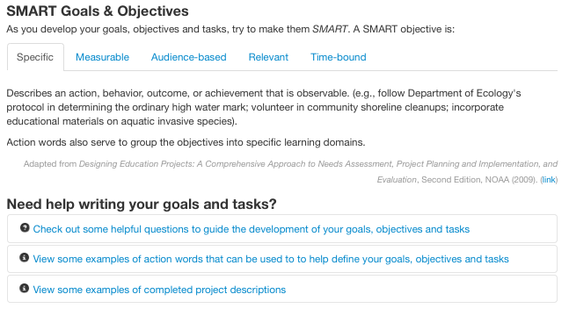
Broader Impact Project Description
Audience
Budget
Activity
Bi Project Description
Evaluation
SMART objectives
Reviewer Question: To what extent do the proposed activities suggest and explore creative, original, or potentially transformative concepts?

Slide 28
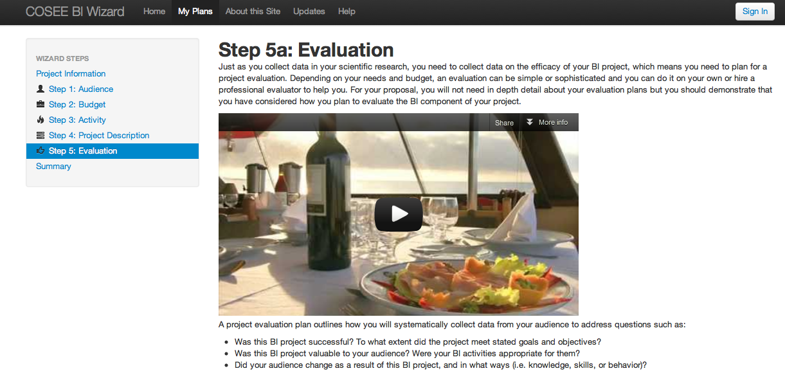
Evaluation
Audience
Budget
Activity
Bi Project Description
Evaluation
Measurable outcomes
Methods for assessing impact are articulated
Reviewer Question: Does the plan incorporate a mechanism to access success?
Notes:
The last step in the process is the evaluation step. Explain evaluation. For this step, we provide a video and text describing the basics of evaluation and the types of evaluation that may be involved in their project. As with the partner page, we also encourage them to consult an expert evaluator to guide them through the process. In this step, we also ask them to consider which forms of evaluation that they might need and to check these off for inclusion into the summary report at the end.

Slide 29
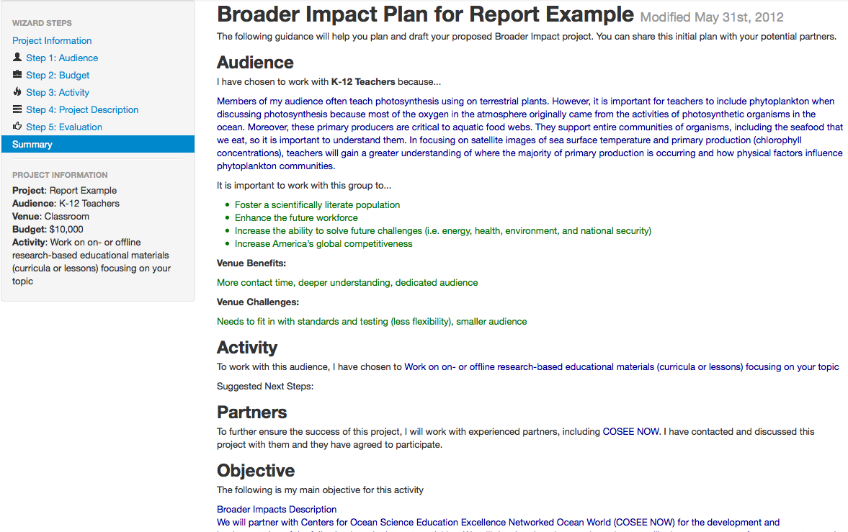
Scientists input/data
Helpful info
on audience
Activity notes
Objectives
Drafted in Wizard
Notes:
As I mentioned previously, after they go through the steps, the user is provided with a summary report. This report is intended to help the user plan and draft their proposed broader impact project can also be shared with a potential partner to help with planning. Due to the size, I had put it on two slides. Here is the first part. All of the information that the user entered is included in this report along with some additional information that they may find helpful, including an annotated bibliography with references dealing with their specific audience and venue.

Slide 30
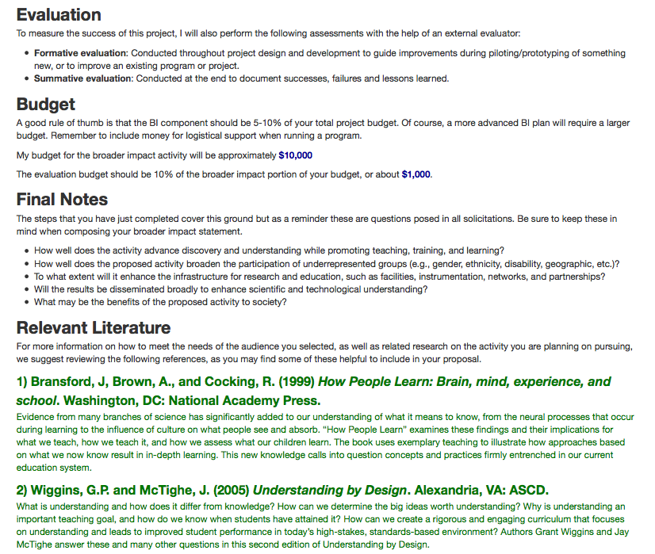
Evaluation
Plan
Reminder about NSF criterion II
Literature
review
Notes:
And this is the second section. Note that along with the information that they entered, we have also reminded them of the 5 questions included in all NSF solicitations regarding broader impacts.

Slide 31
Pre-Award Materials
EPO Guide
NSF’s Representative Activities
References
Evaluation Manuals
Additional Guidance on Partnerships
Post Award Materials
Case studies
Next Steps
Additional funding for E&O activities
Journals to publish the results of your work
Stronger connection to learning sciences and effective practices

