Slide 1

78 Million People (1/4 of U.S.)
1000 km Cape to Cape
U..
Middle Atlantic
Regional Association
Coastal
Ocean Observing System
Cape
Cod
Stratified
Coastal Ocean Interactions with
Tropical Cyclones
Sandy
Irene
Arthur
Scott Glenn, Travis Miles,
Greg Seroka, Robert Forney,
Hugh Roarty, Oscar Schofield, Josh Kohut (Rutgers),
Yi Xu (China) & Fei Yu (China)
Nature Communications (2016)
Cape
Hatteras
Notes:
1

Slide 2
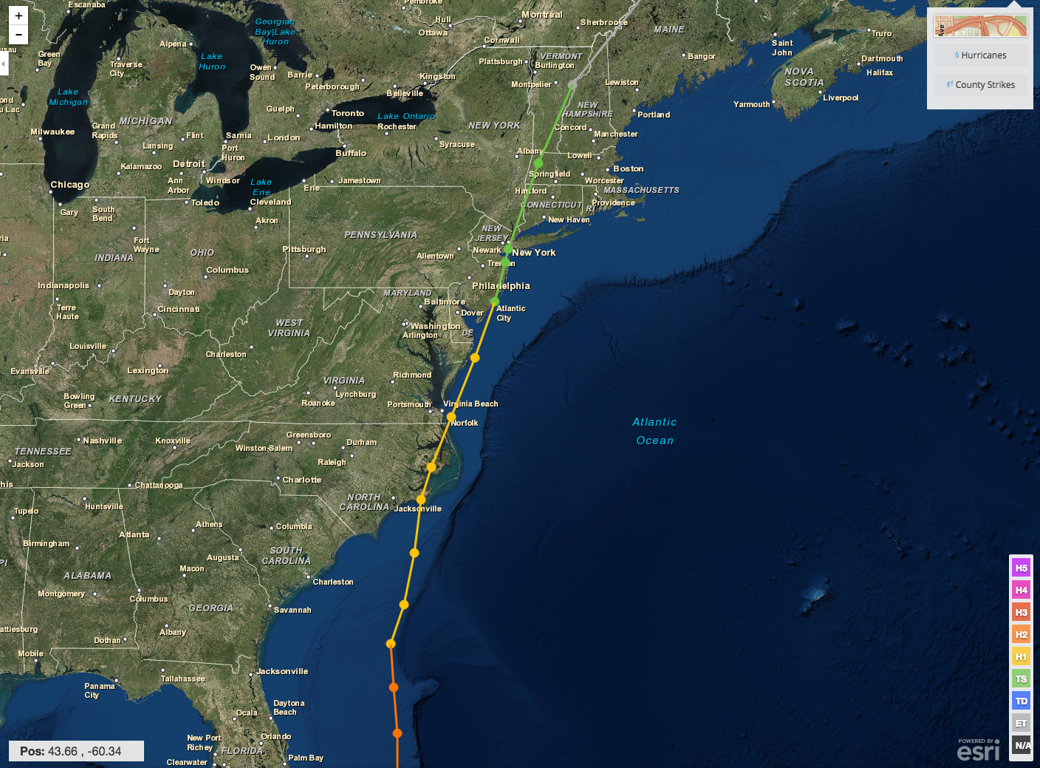
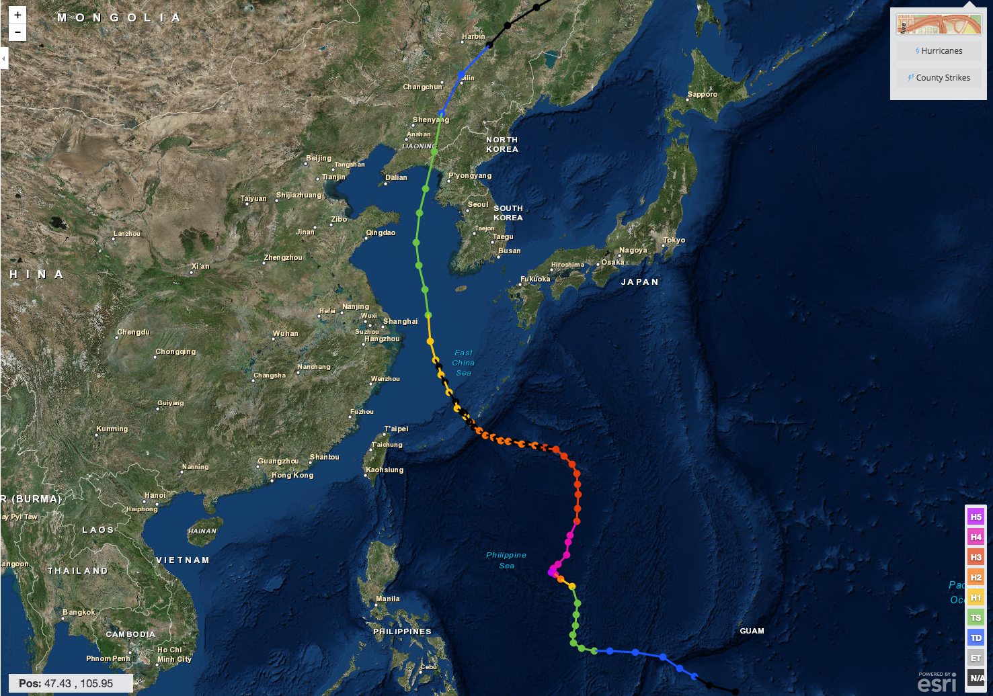
Hurricane Irene & Super-Typhoon Muifa:
What do these summer of 2011 storms have in common?
Hurricane Irene
26-29 August 2011
Super-Typhoon Muifa
26 July - 9 August 2011

Slide 3

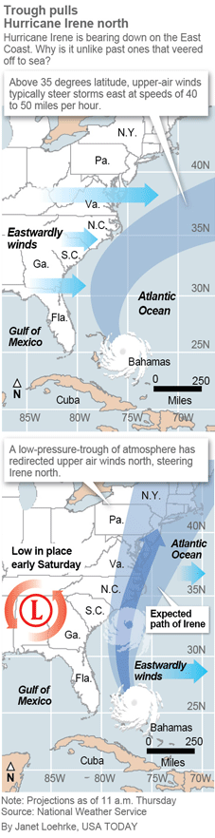
Pre-Irene Storm Warnings
Over 2 million people ordered to “flee the storm’s path”.
President Obama: Shaping up to be a “historic hurricane” and urged residents to “be prepared for the worst”. “Don’t wait. Don’t delay.”
New Jersey Governor Christie: Ordered evacuation of 1 million people - “Get the hell off the beach”. “Do not waste any more time working on your tan”.
New York Mayor Blumberg: “Staying behind is dangerous, staying behind is foolish, and its against the law”. “The time to leave is right now”. The bridges, streets and subways were nearly empty ahead of a nearly unprecedented mass transit shutdown.

Slide 4
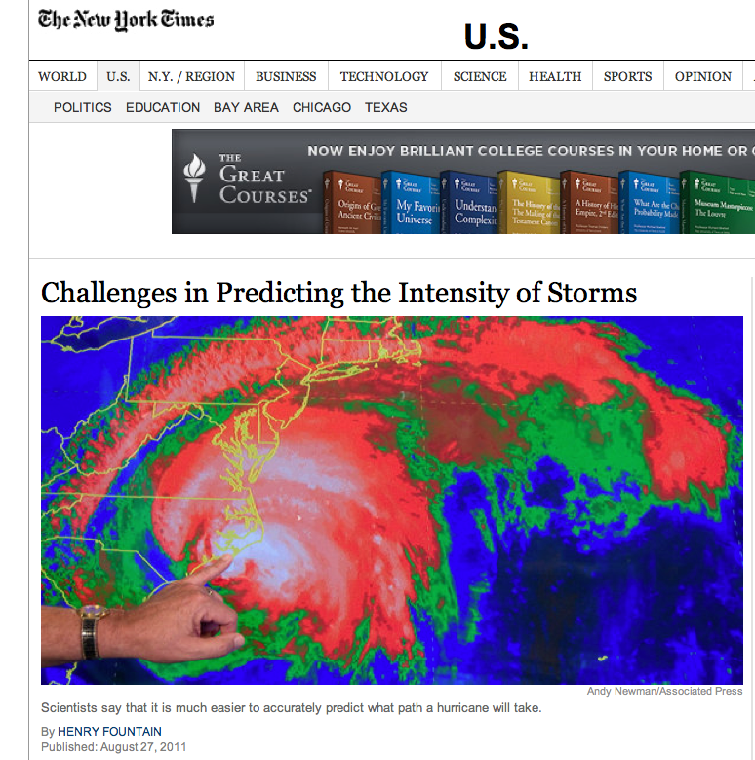
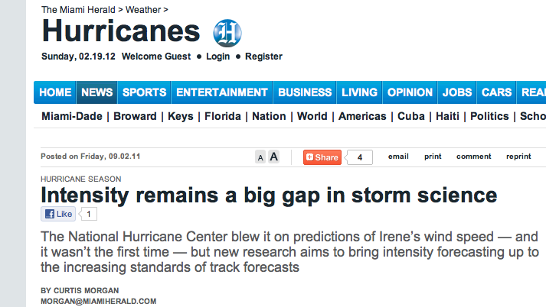
Post-Irene Analysis:
Track accurately forecast
days in advance.
Intensity (wind speed), and the resulting impacts, were over-predicted.
Close the Intensity Science Gap!

Slide 5
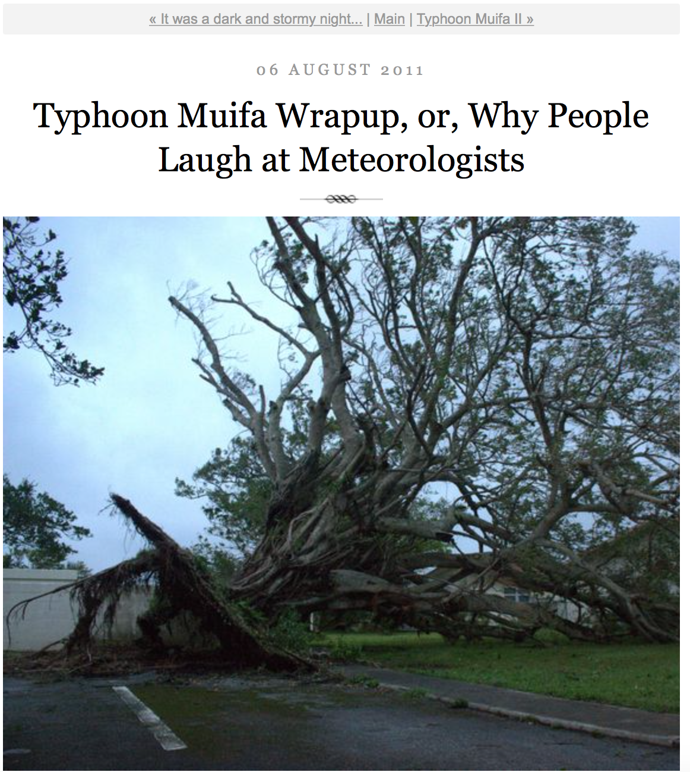
Pre-Muifa preparation:
SHANGHAI Aug 6 (Reuters) - Chinese authorities evacuated more than 200,000 residents from eastern Zhejiang province and cancelled more than 200 flights, as the region braced itself for a typhoon that could be the worst in the area in years.
Post-Muifa Blog entry:
As Muifa moved toward us over the week, at first it looked like we were literally going to take a direct hit from a category 4 typhoon … gradually was downgraded to a 2, it started to seem like no big deal … Basically we started out worried and got less and less so as it moved toward us and were mostly grateful for the 4-day weekend…

Slide 6
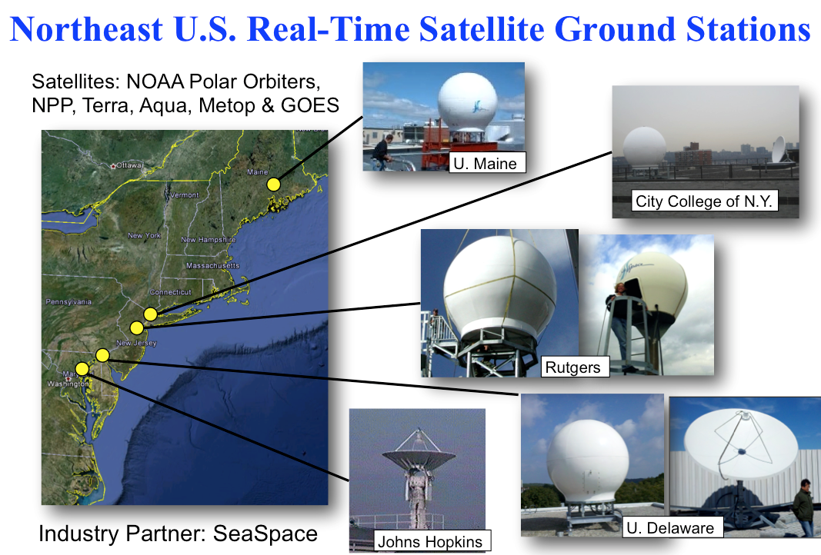
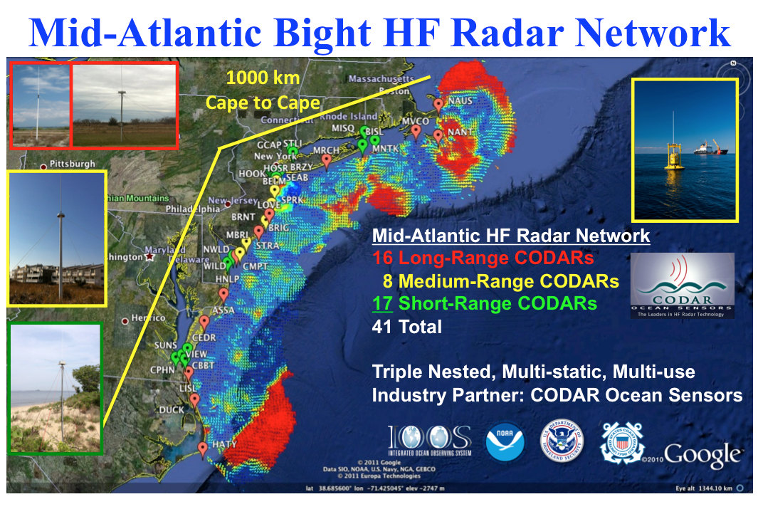
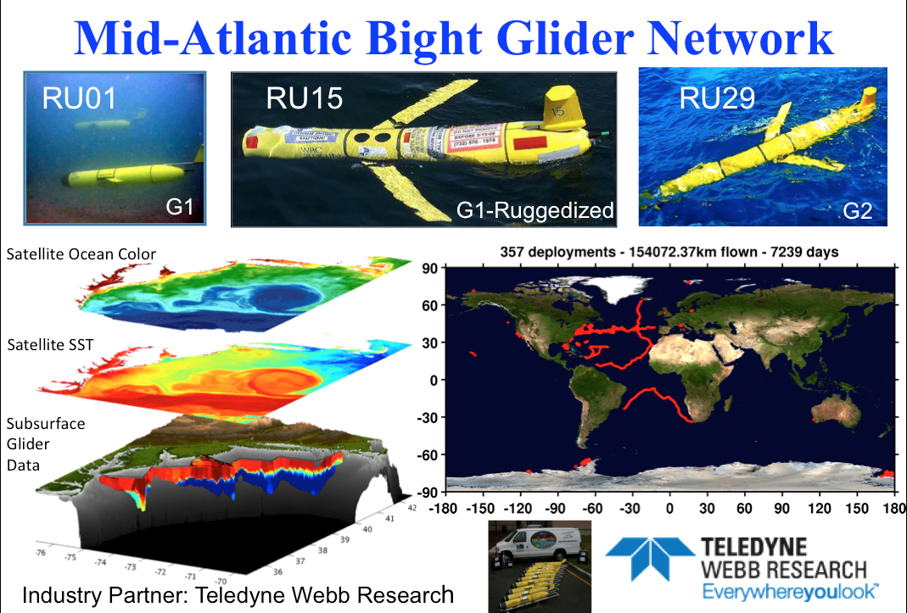
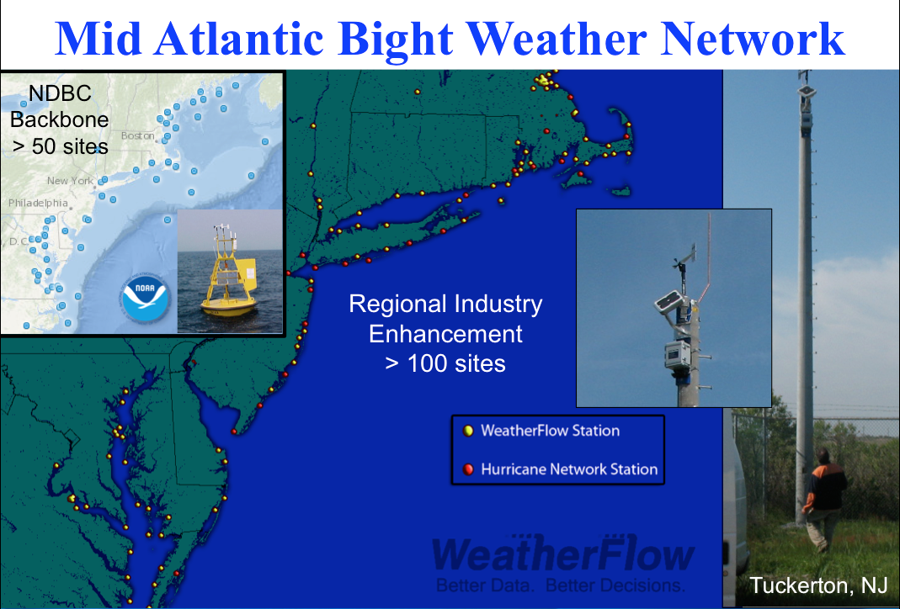
Mid-Atlantic Regional-Scale Observation Network

Slide 7
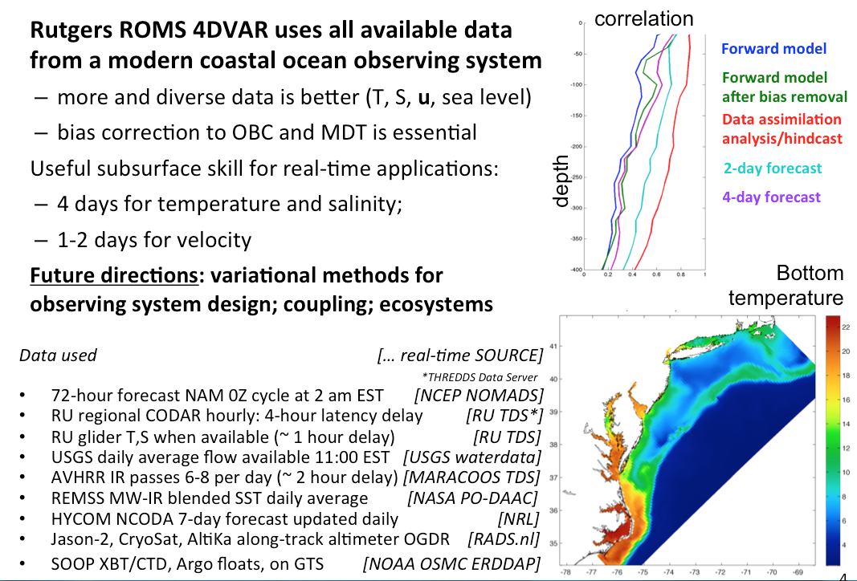
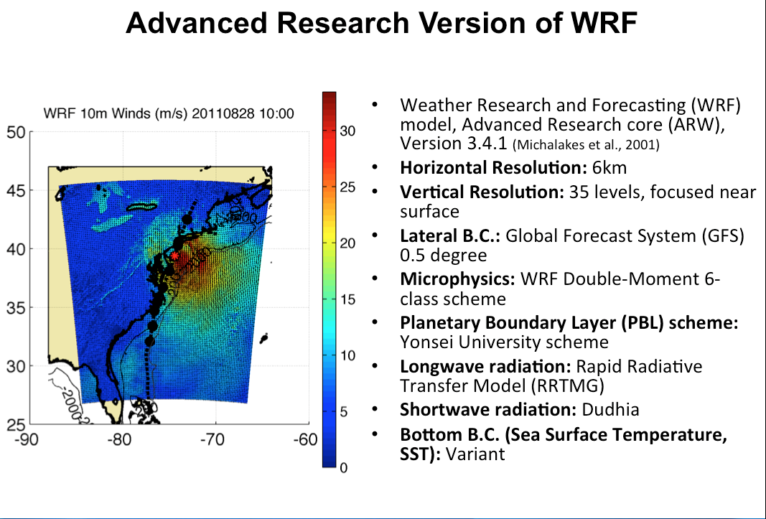

Mid-Atlantic Ensemble of Forecast Models Include:
Mid-Atlantic Operations Center @

Slide 8
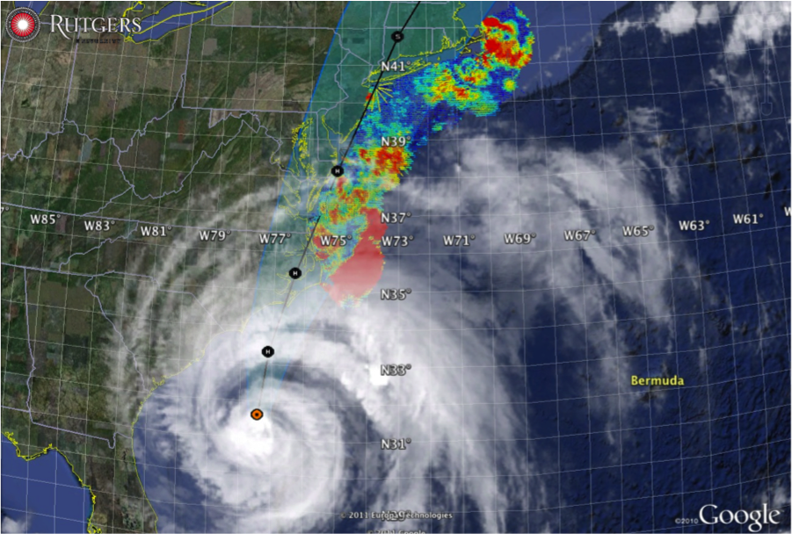

Hurricane Irene
August 28, 2011
NOAA/NHC Damage:
#7 with >$16 Billion.
Track Accurate;
Intensity Over-predicted.
Hurricane Sandy
October 29, 2012
NOAA/NHC Damage:
#2 with >$68 Billion.
Track Accurate;
Impact Under-predicted.

Slide 9
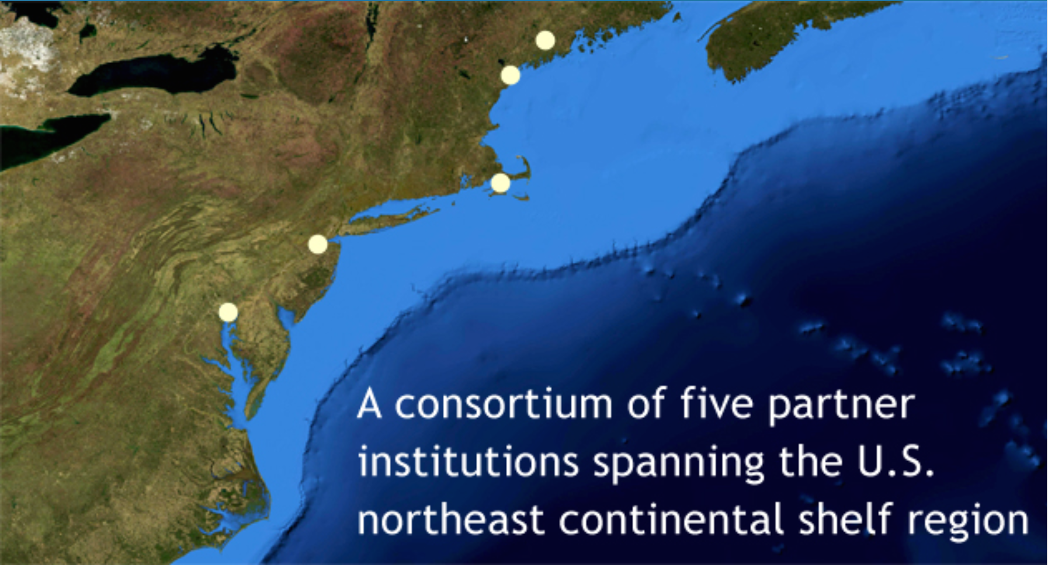



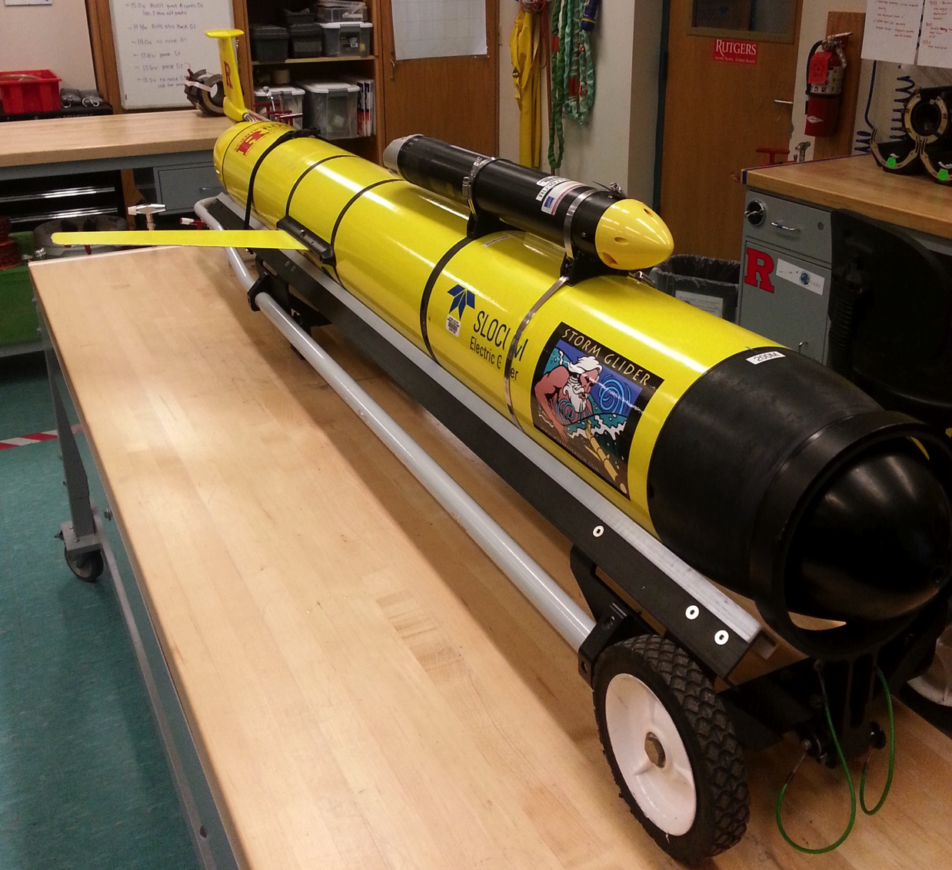
UMaine
GMRI
Storm Glider (v1)
CTD, ECOpuck
Optode, Aquadopp
Accelerometer,
Power Bay
WHOI
Rutgers
UMaryland
3 Layers of Rapid-Response Observations:
Rapid-profiling ALAMO floats – Deep ocean density structure
Storm Gliders (4) – Shelf density structure
Near-shore buoys (8) – Nearshore surge
3 Layers of Nested Models:
Basin-scale ROMS – Unbiased initial condition
Regional ROMS – Forecast of SST evolution
Local FVCOM – 3-D storm surge forecast

Slide 10
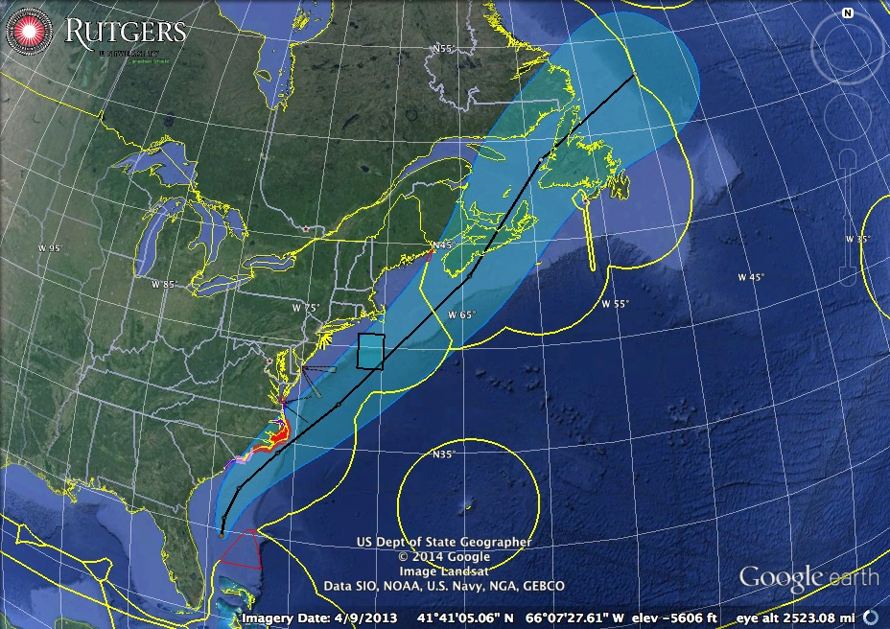
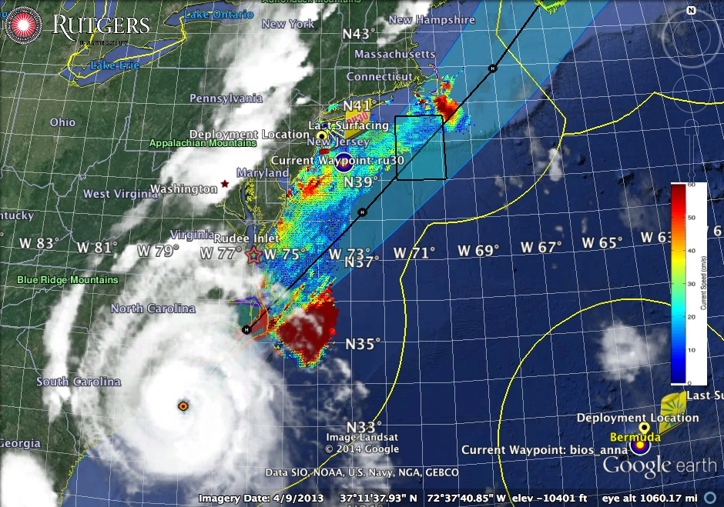
Hurricane Arthur Forecast Track on morning of July 2, 2014
First warnings: late June 30
Go decision: July 2
Event over: July 5
Hurricane Arthur: July 3, 2014

Slide 11

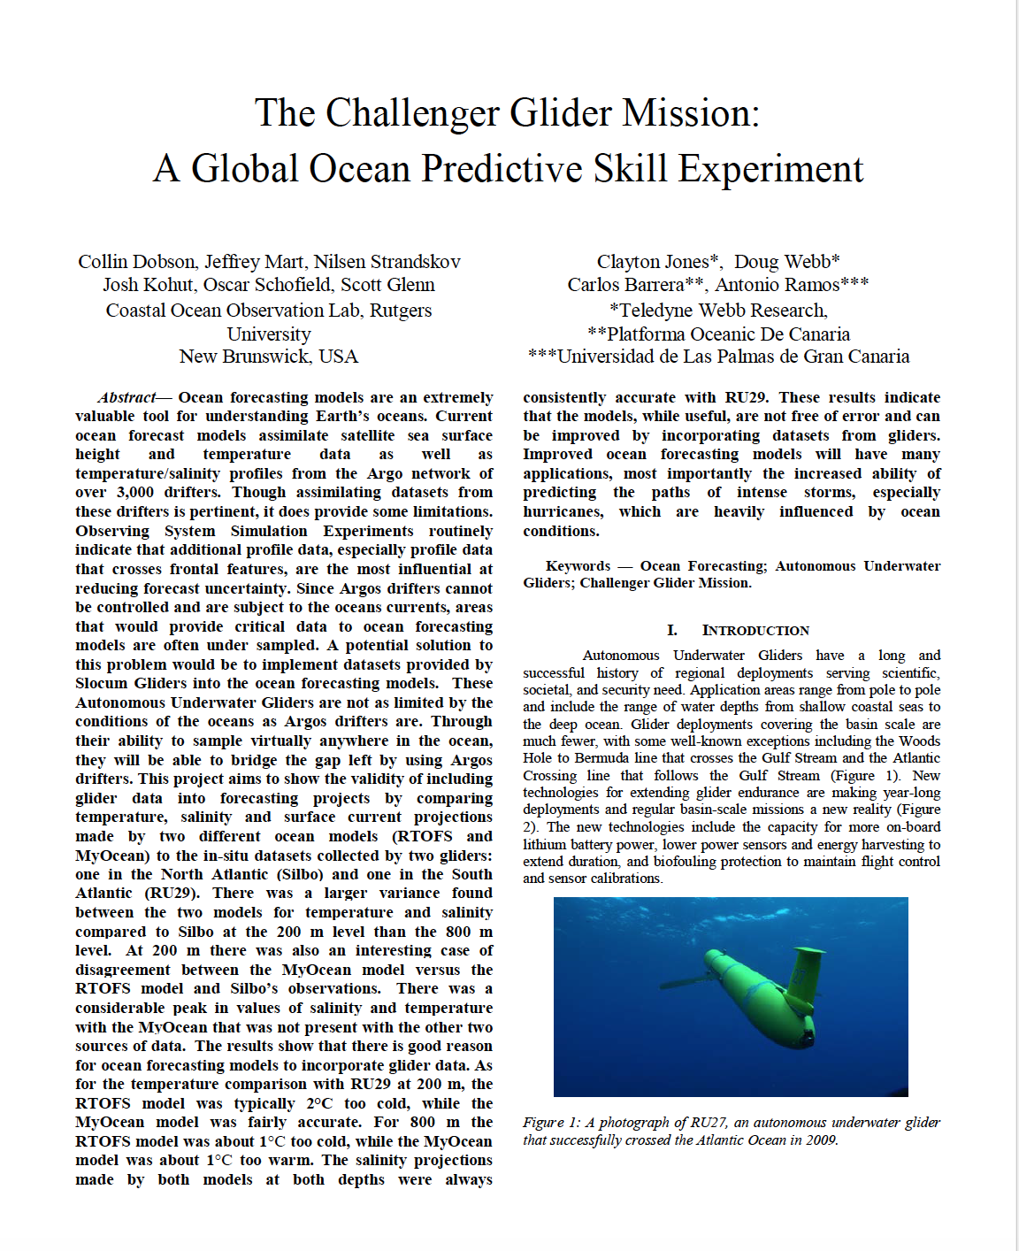

Dr. Louis Uccellini, Director, National Weather Service
Speaks to Students at Rutgers
“Explore our global models”
“Embed your students”
Greg
Seroka

Slide 12
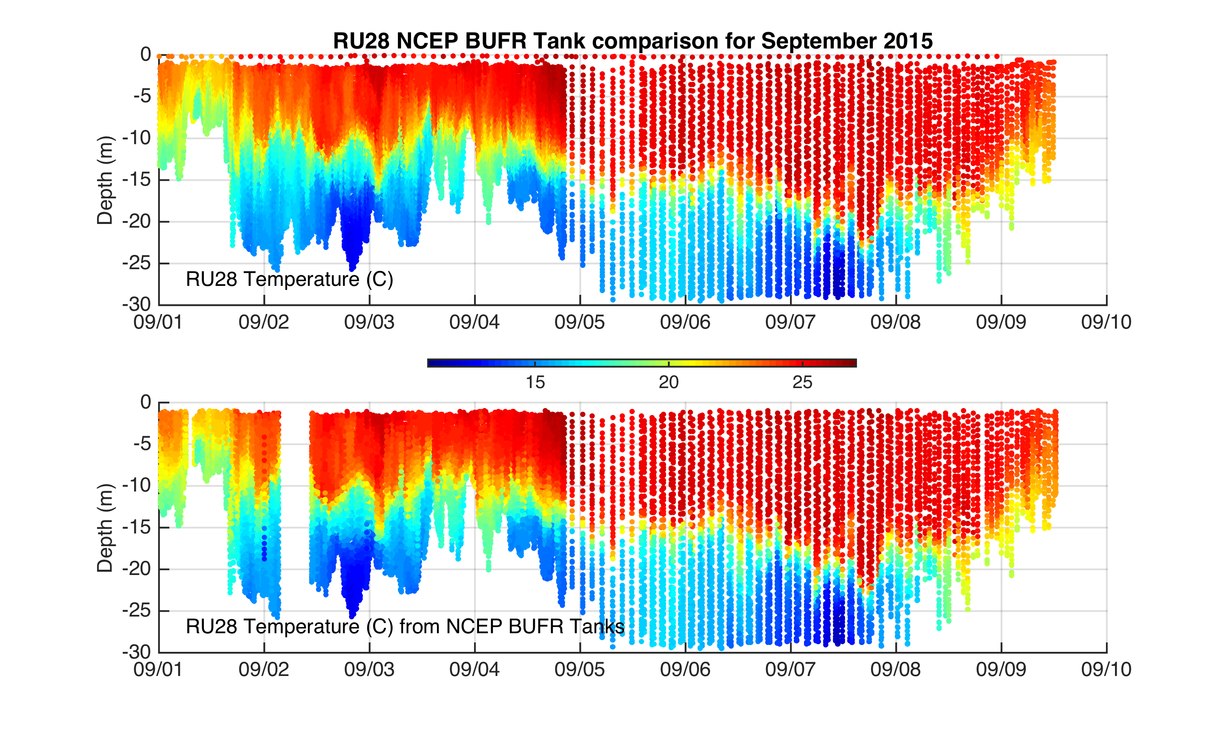
Dr. Louis Uccellini, Director, National Weather Service
“And send us your glider data over GTS”
Received on shore at Rutgers
Received at NCEP for Assimilation
In Operational Models

Slide 13
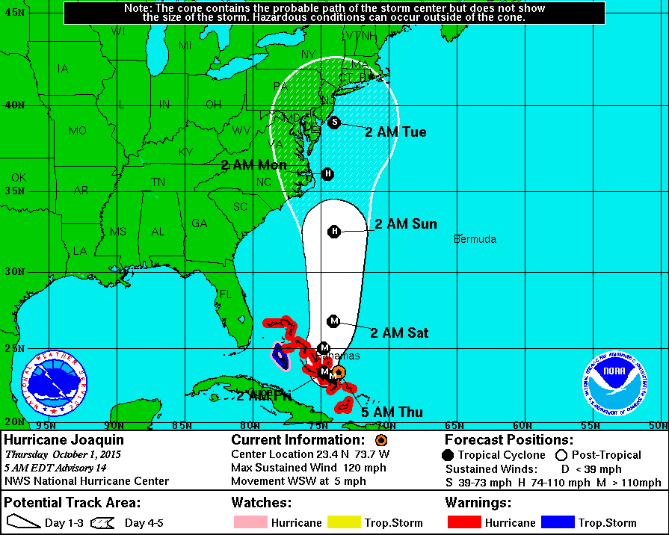
Dr. Louis Uccellini, Director, National Weather Service
“And send us your glider data over GTS”
Hurricane Joaquin forecast on Oct 1, 2015

Slide 14


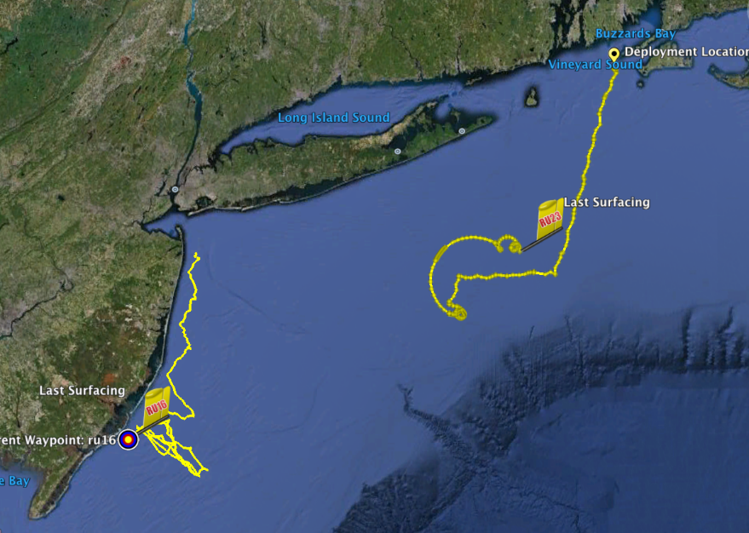
Hurricane Irene Track August 26-29 2011
Two Gliders Deployed

Slide 15
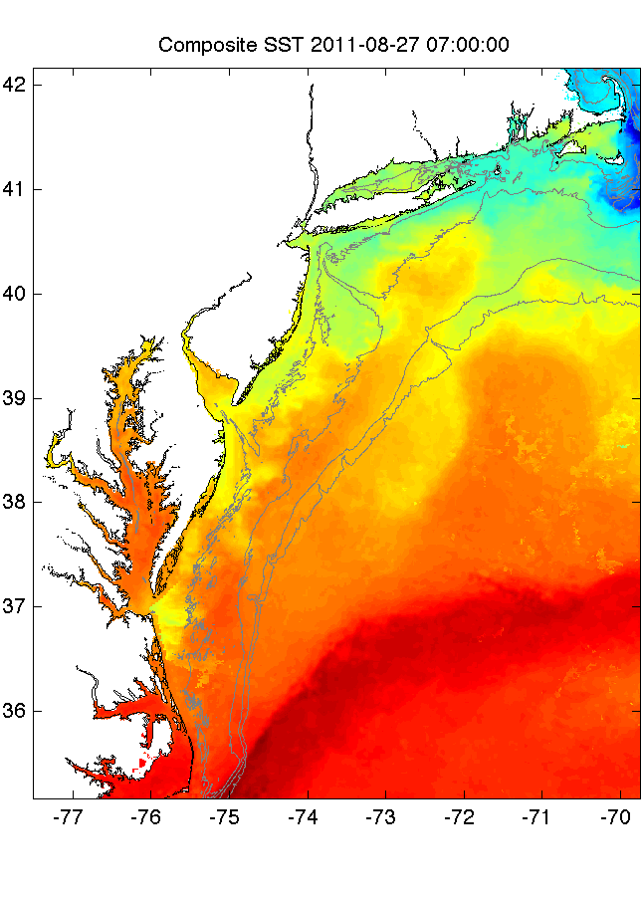
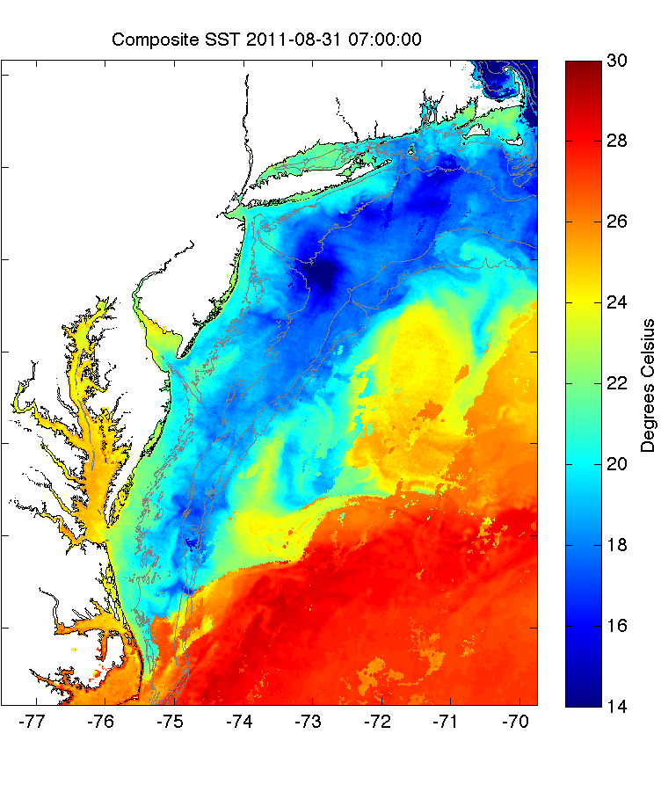
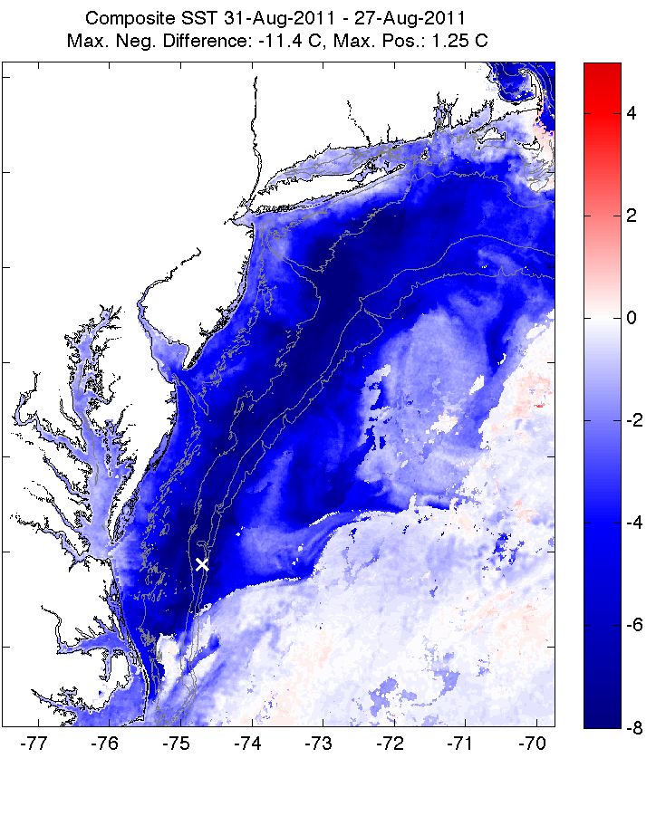
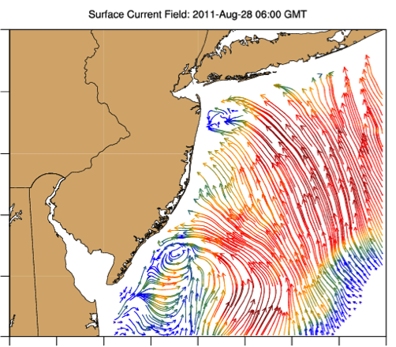
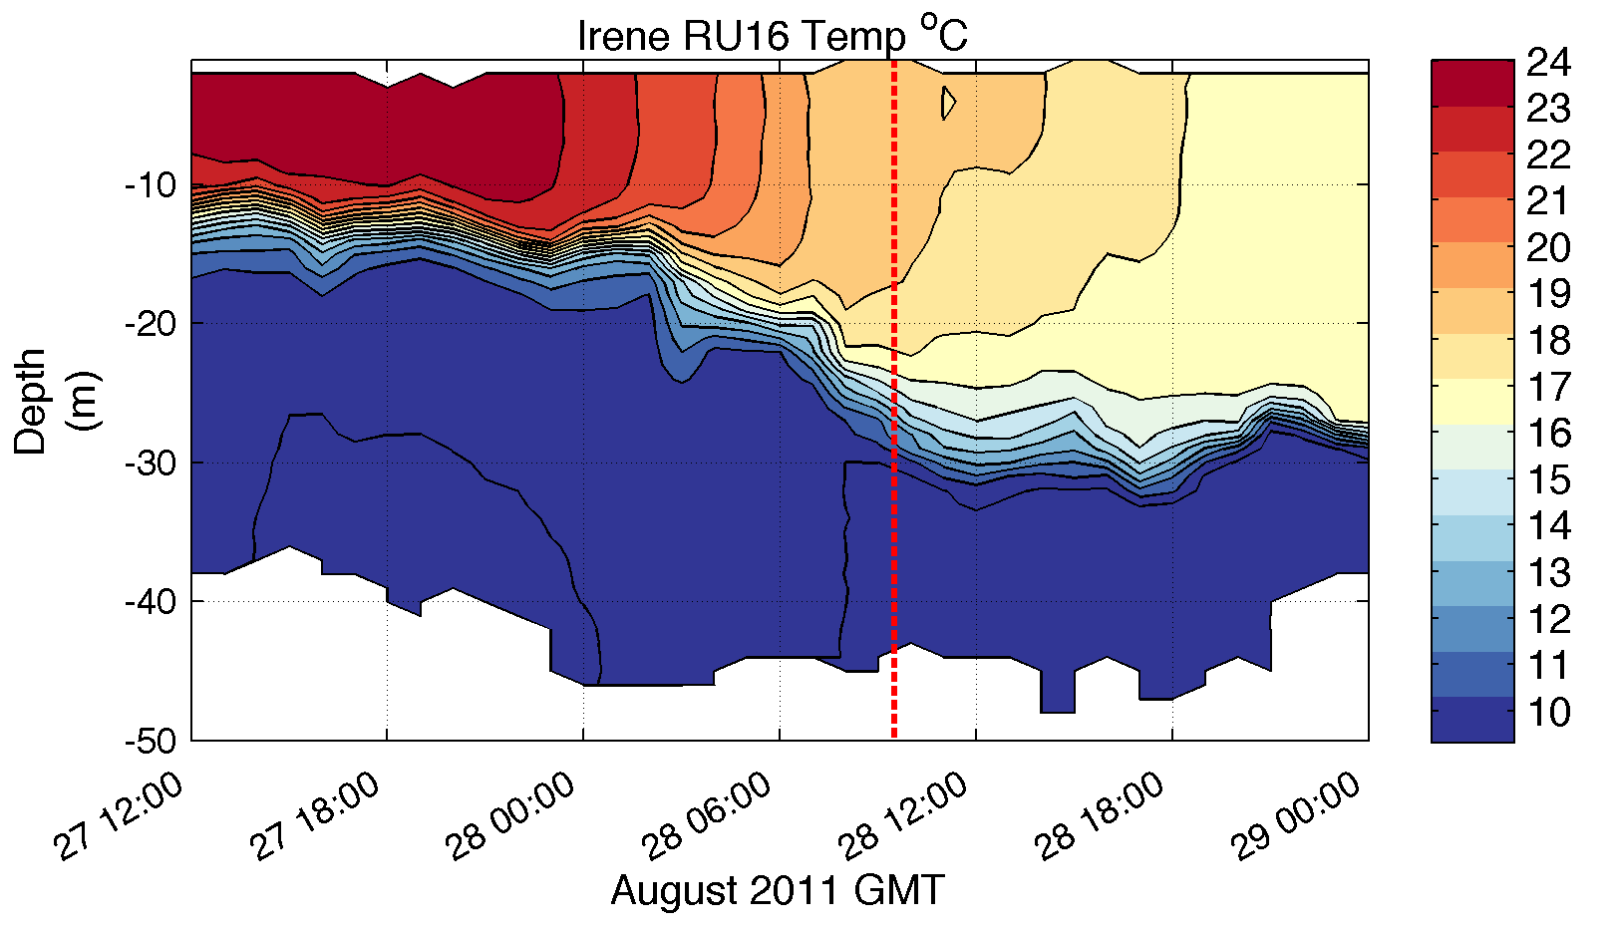
Pre-Irene
Post-Irene
Difference
11C max Cooling
WHAT?
Satellite
SST
WHEN? Glider Temperature
WHY?
HF Radar
Currents
Eye Passage

Slide 16
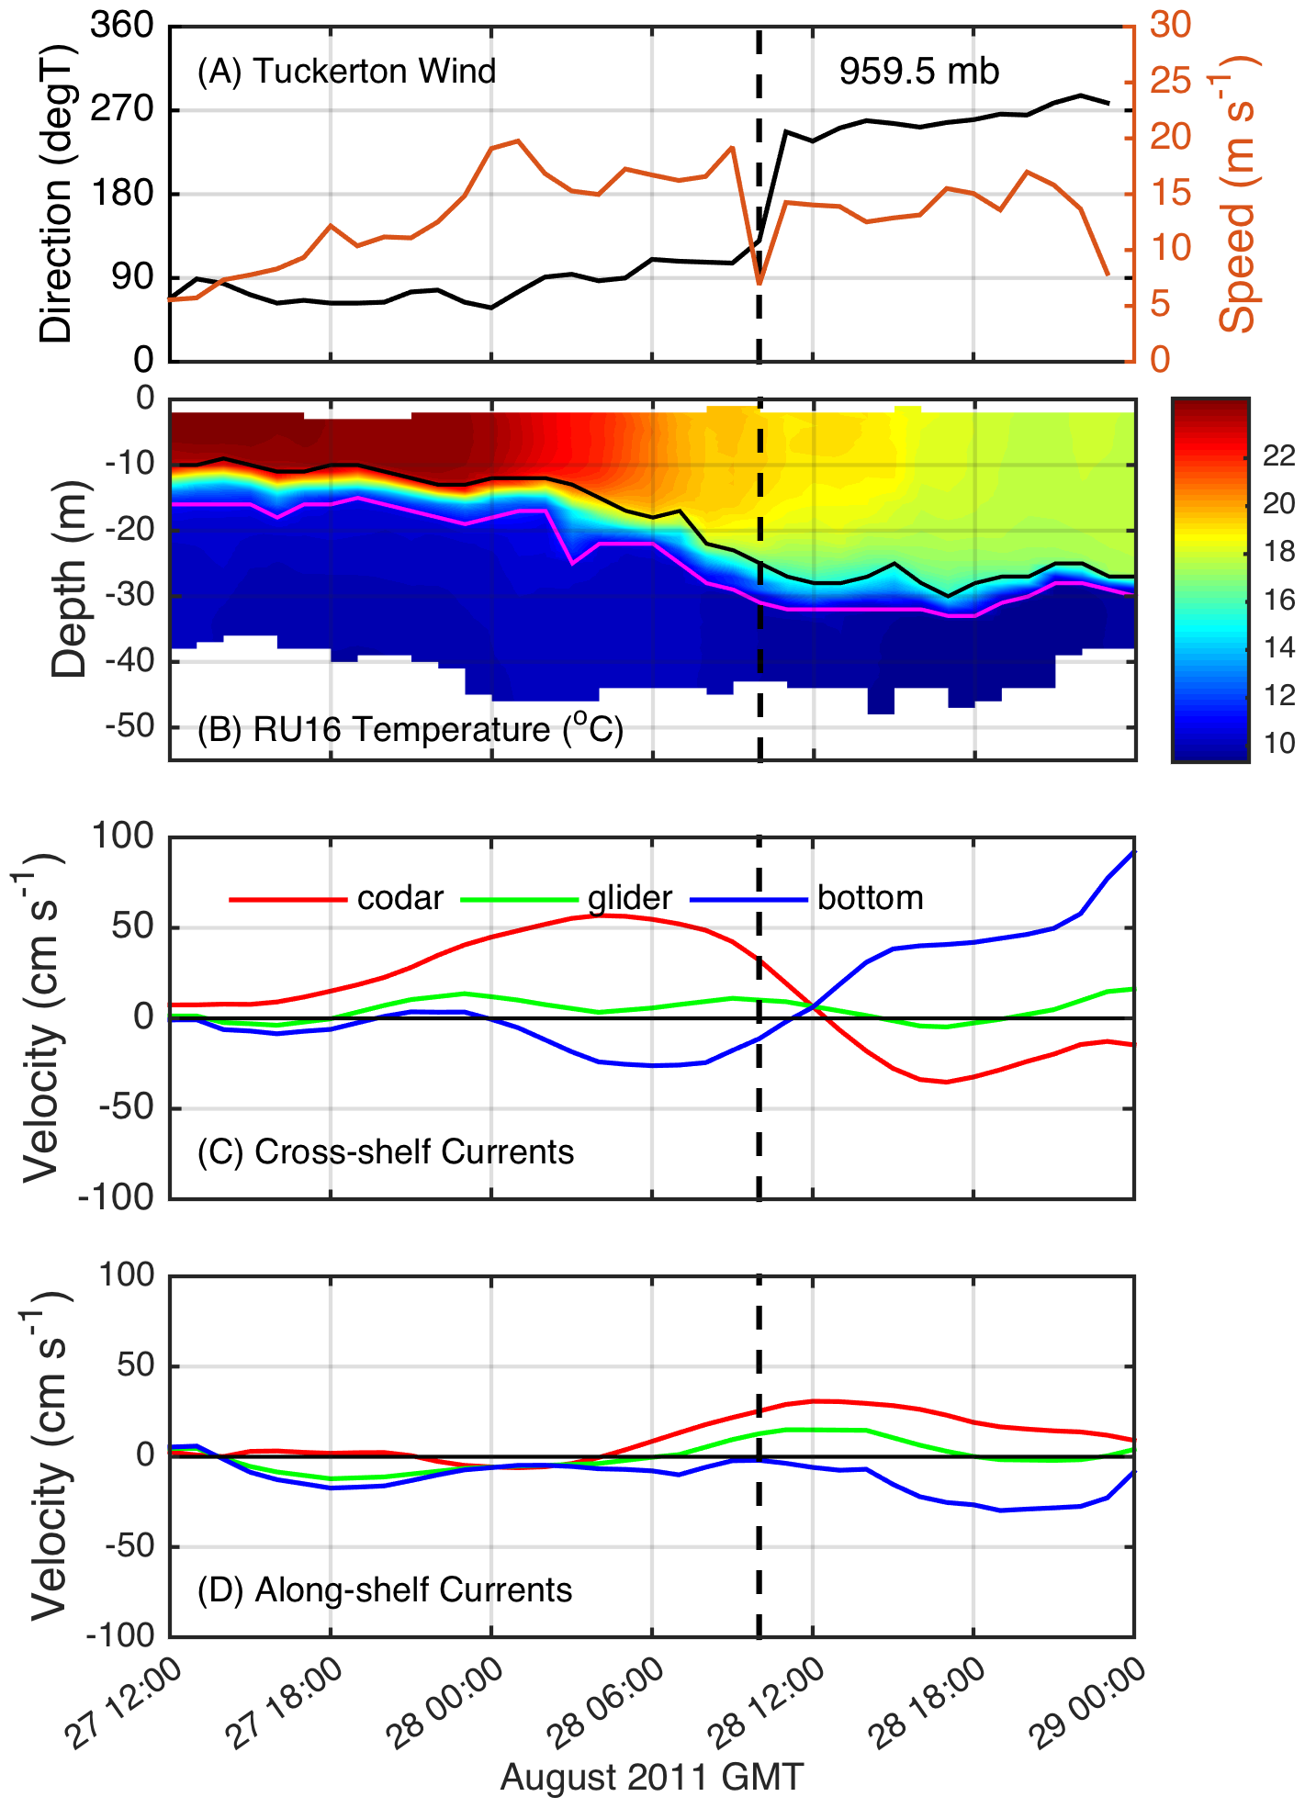
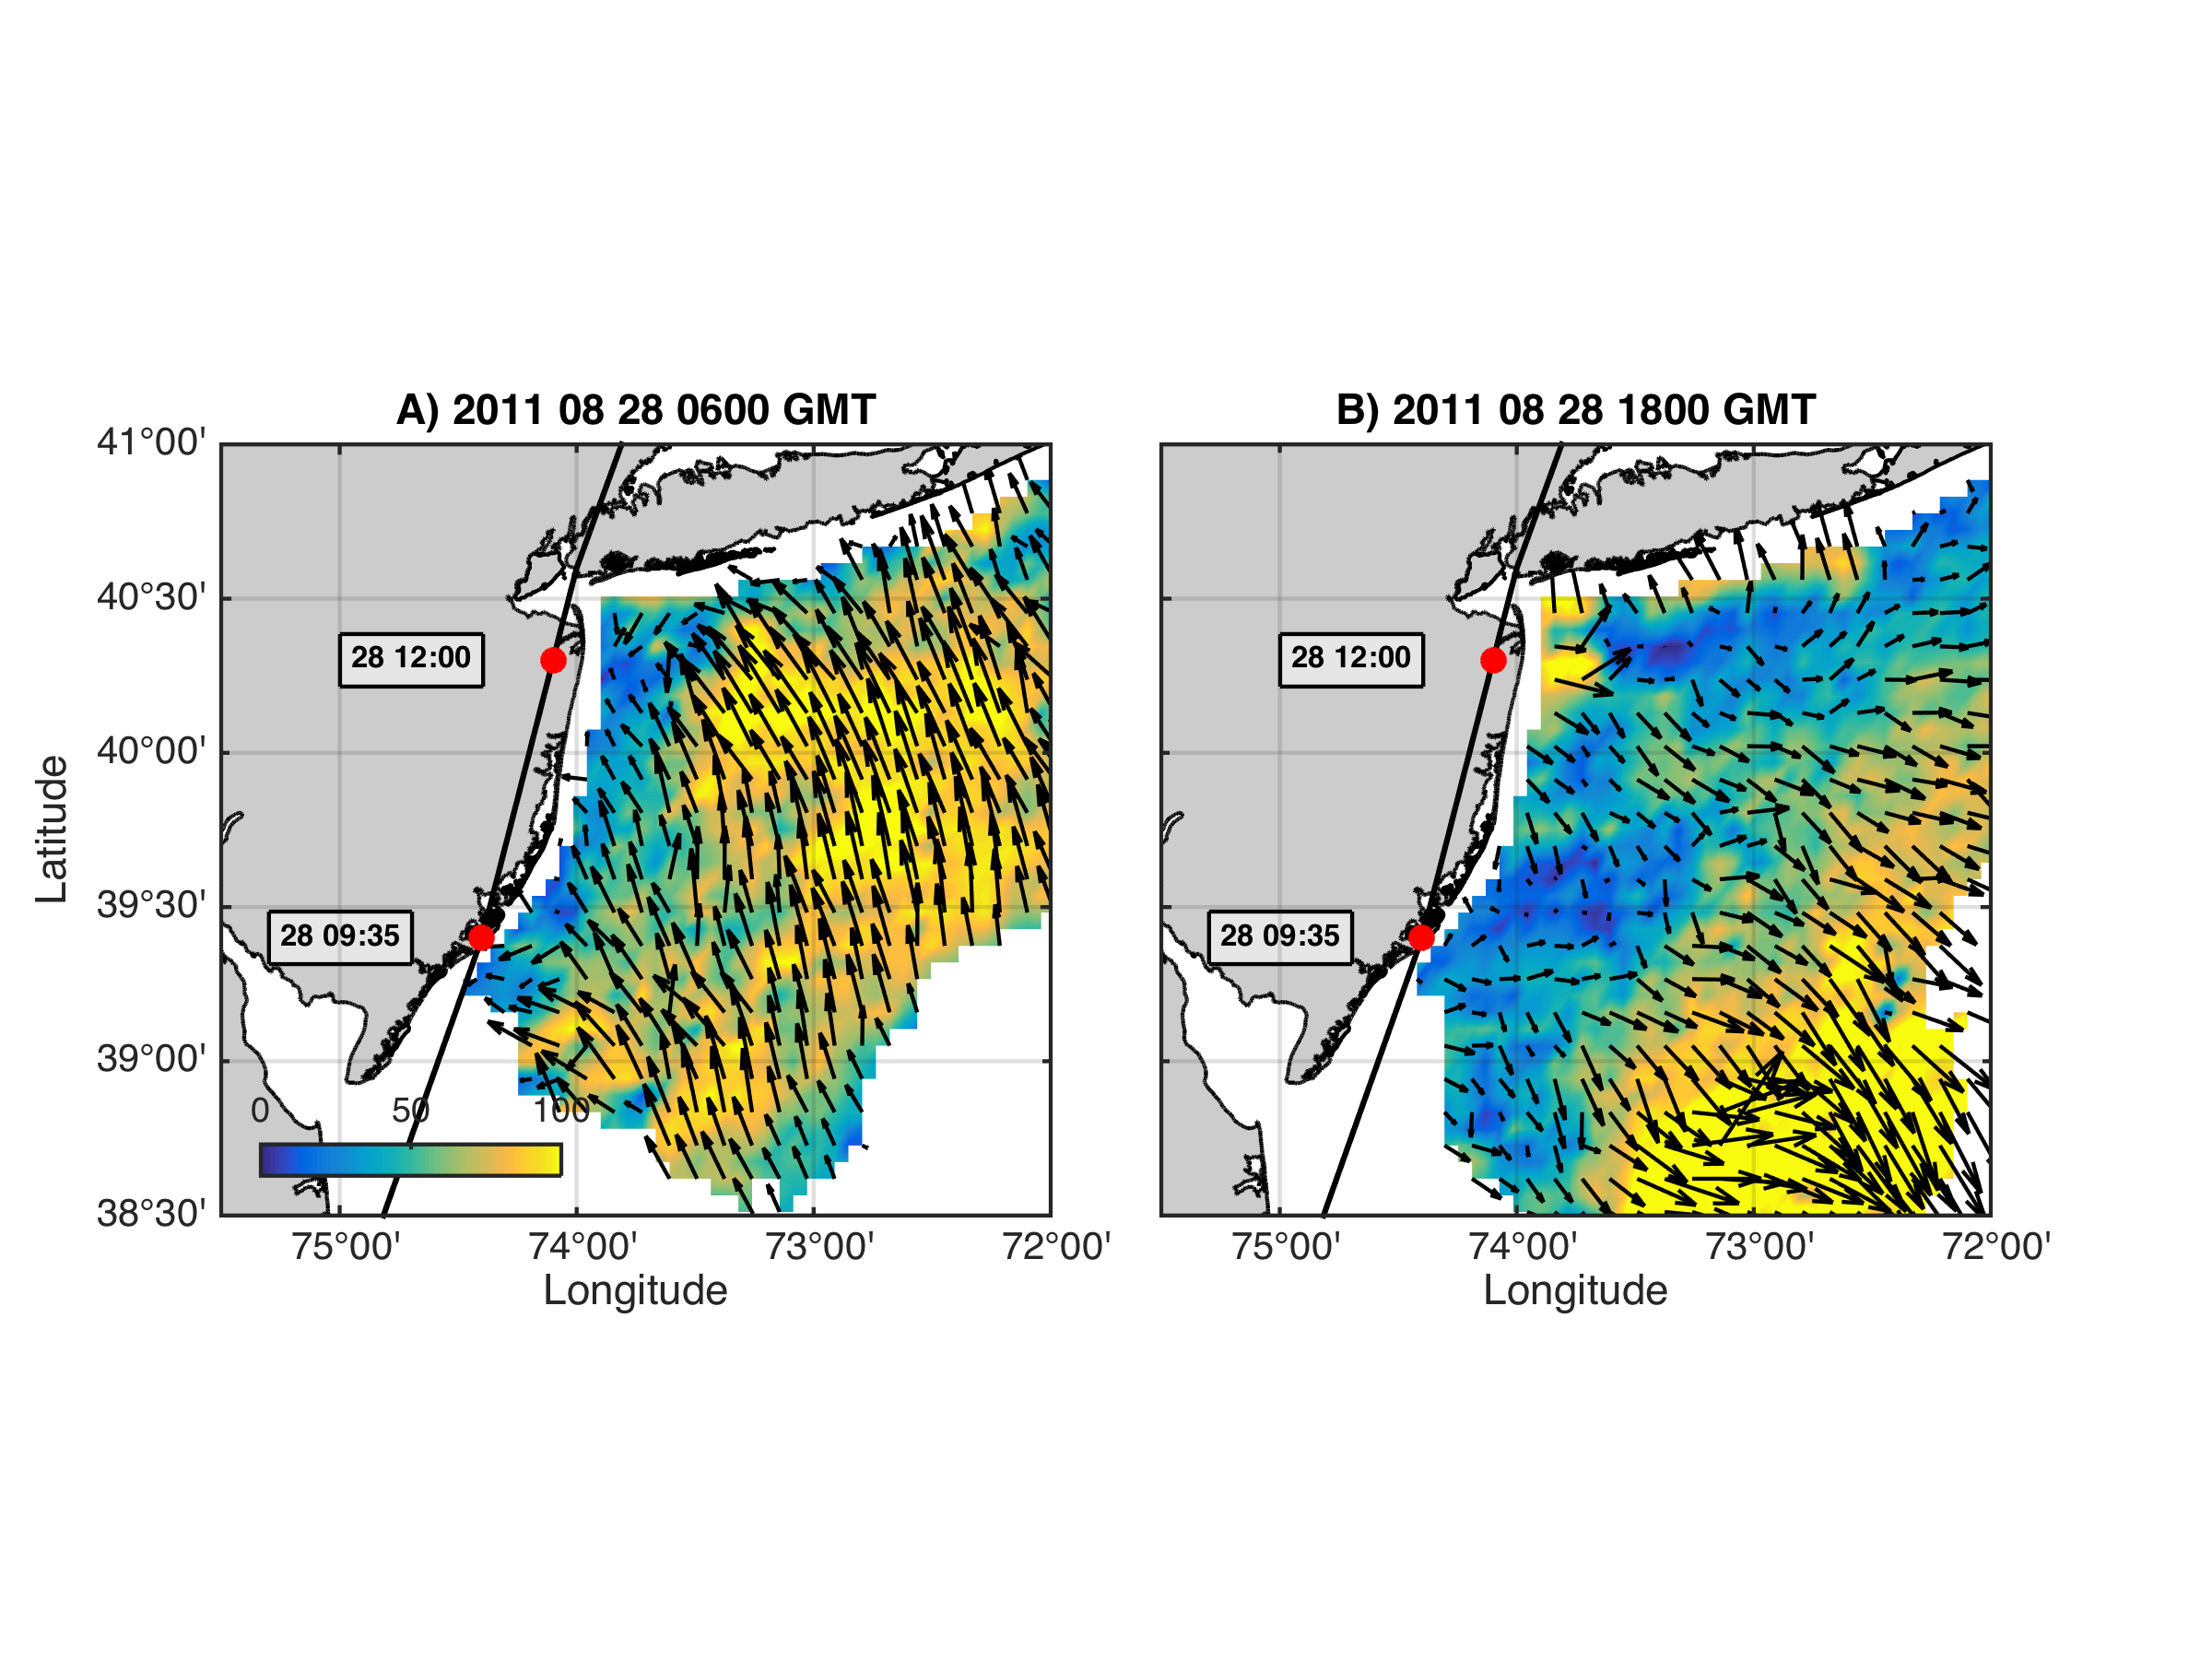
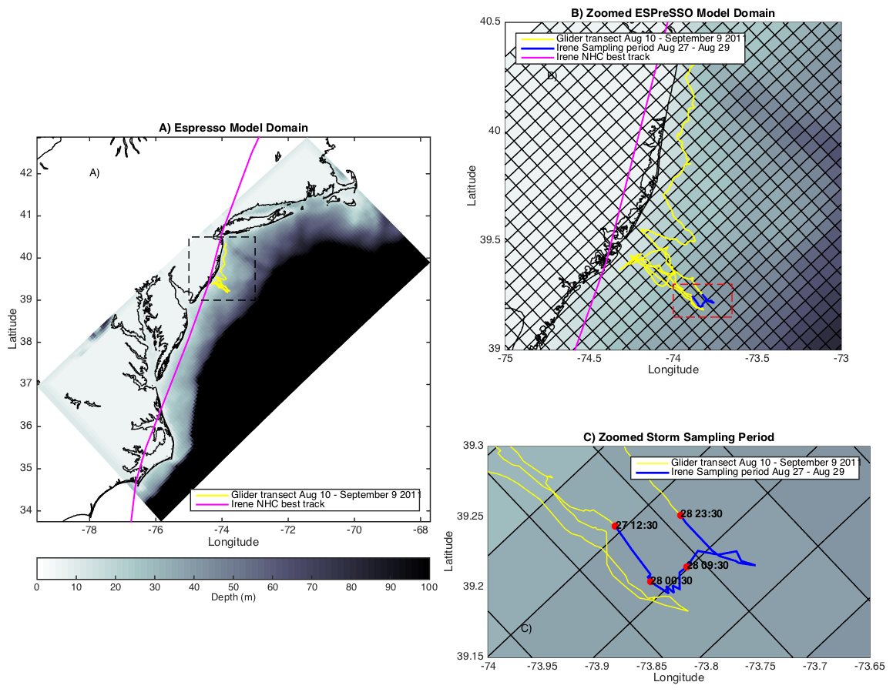
Coastal Baroclinic Circulation
Before Eye
After Eye
Before Eye After Eye
Glider Track, Model Grid
& Bathymetry
Storm Period in Blue

Slide 17
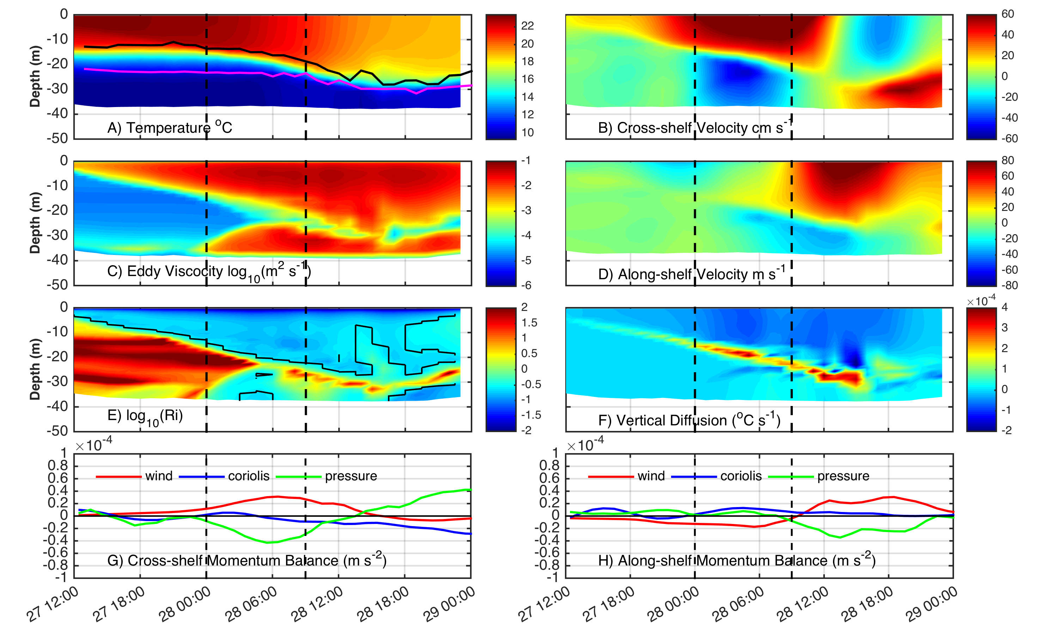
ROMS Model Results at Glider Location
Coastal Baroclinic Circulation Enhances Mixing & Cooling

Slide 18
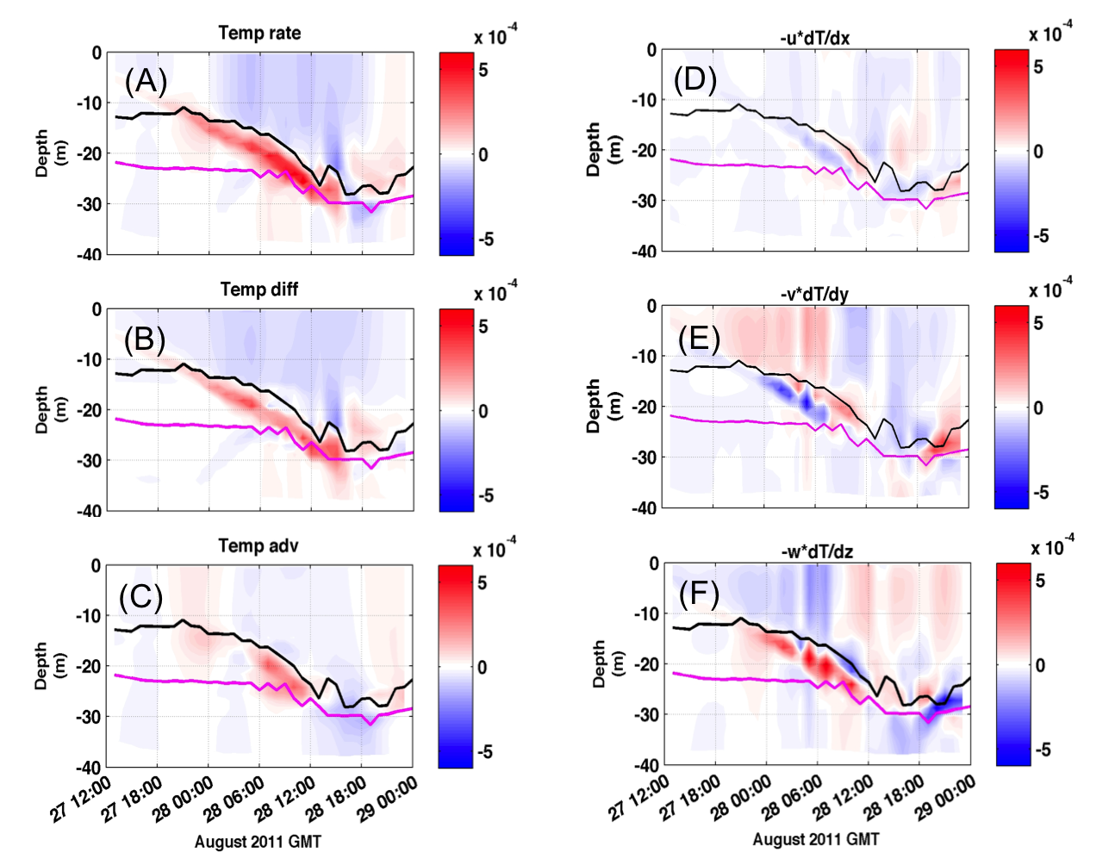
ROMS Model Results at Glider Location
Temperature Diagnostic Equations – Mixing Dominates Advection

Slide 19
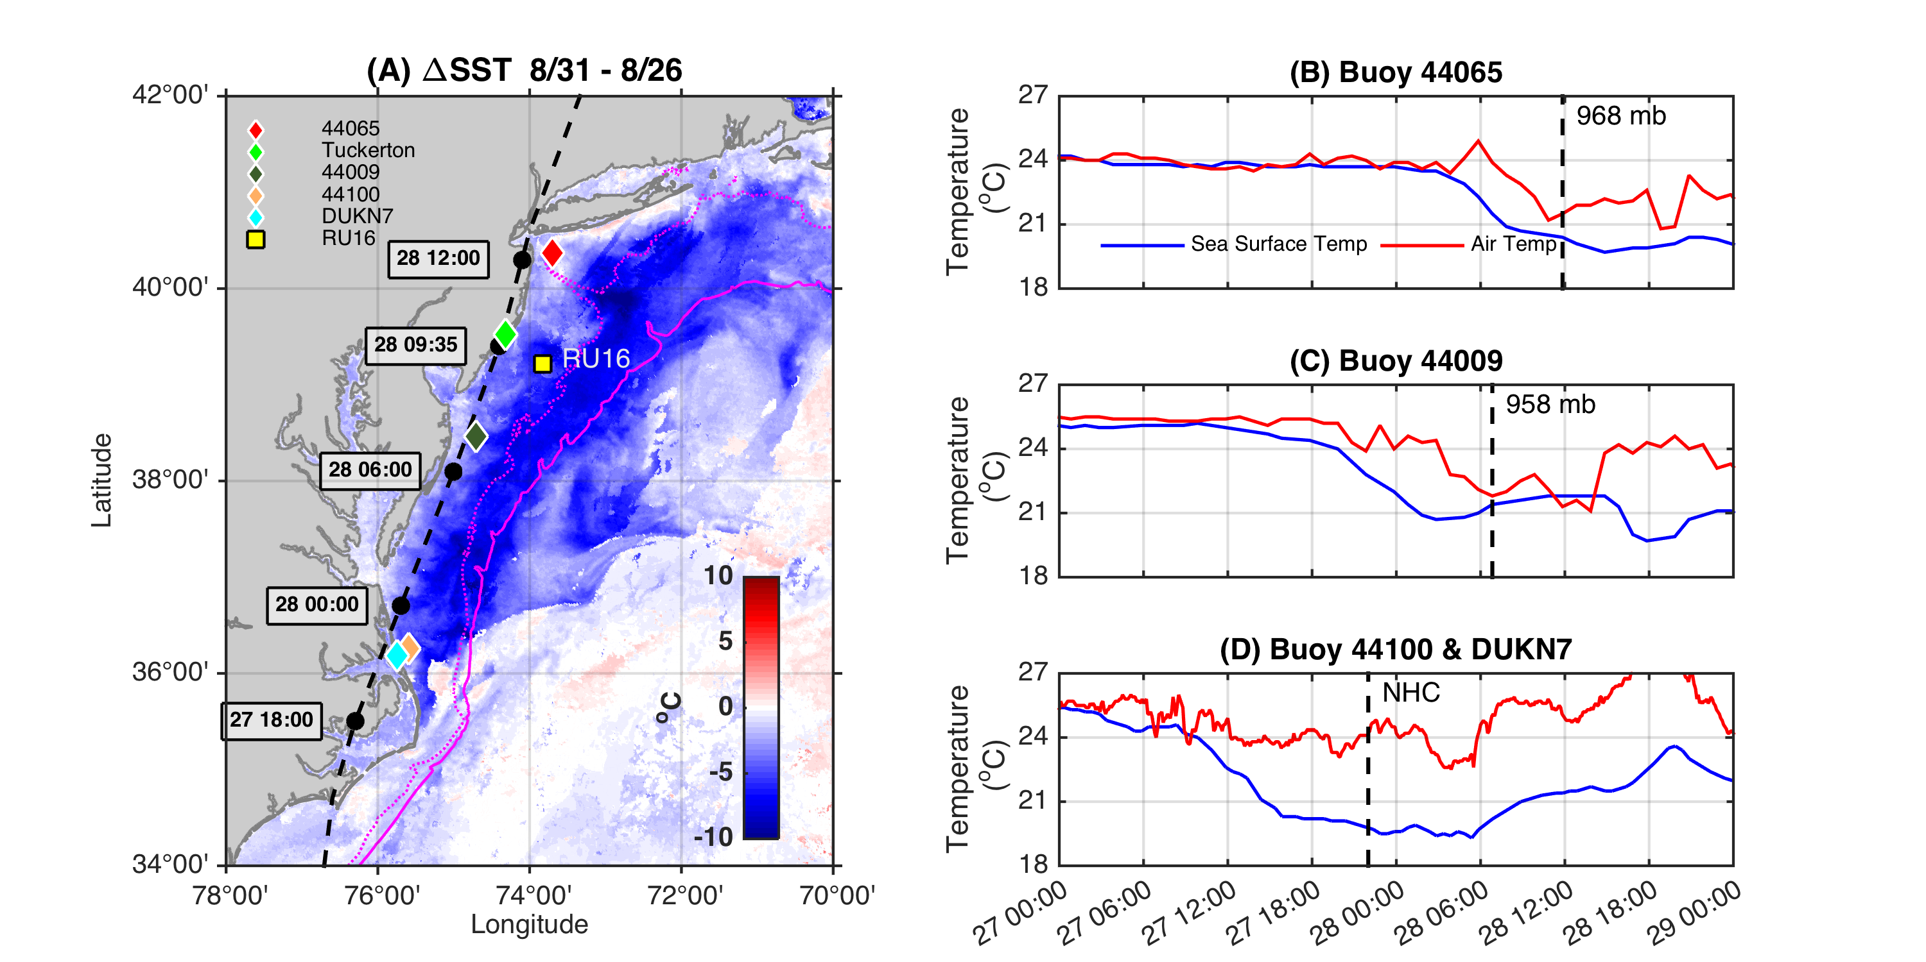
Ahead-of-Eye-Center Cooling in Irene:
Nearshore Buoy Observations

Slide 20
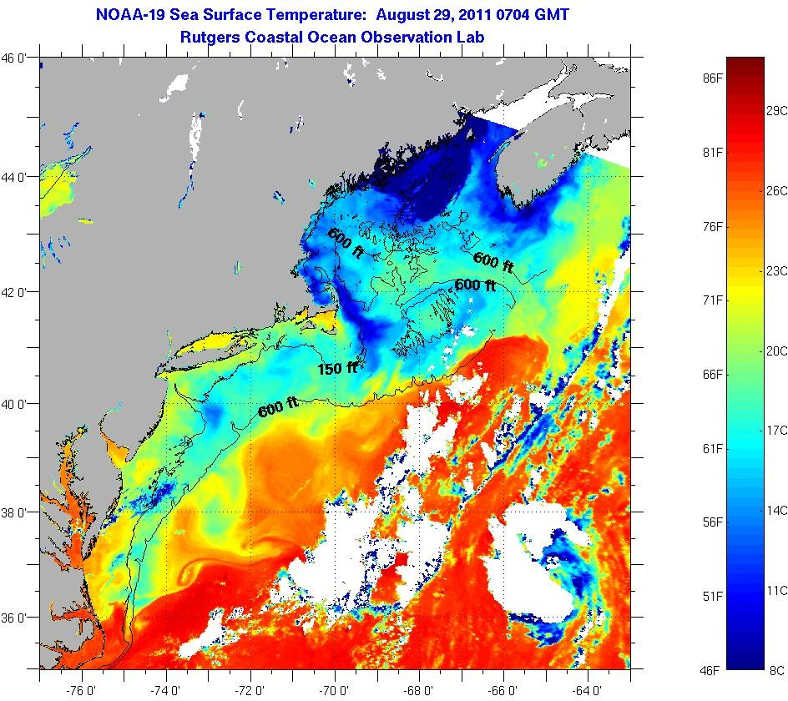
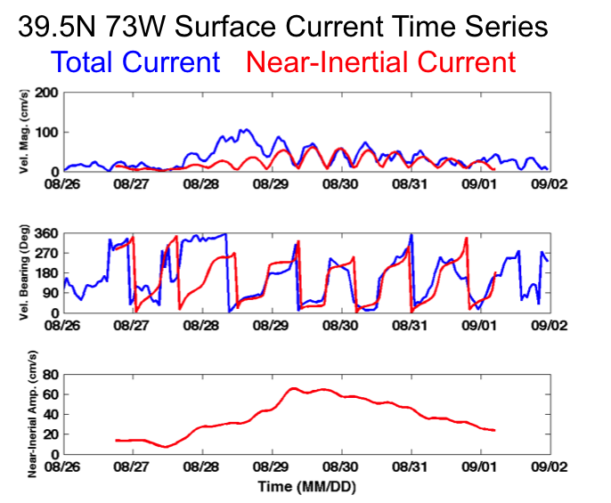
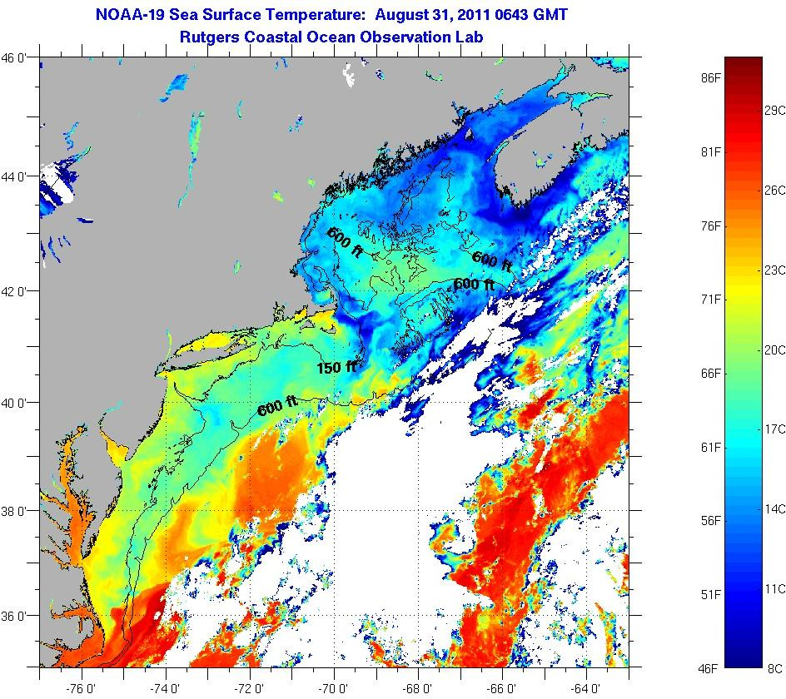
SST Response during Irene’s Inertial Tail
Significant SST cooling not observed.
In many locations SST warming observed.
August 29
SST
August 31
SST

Slide 21
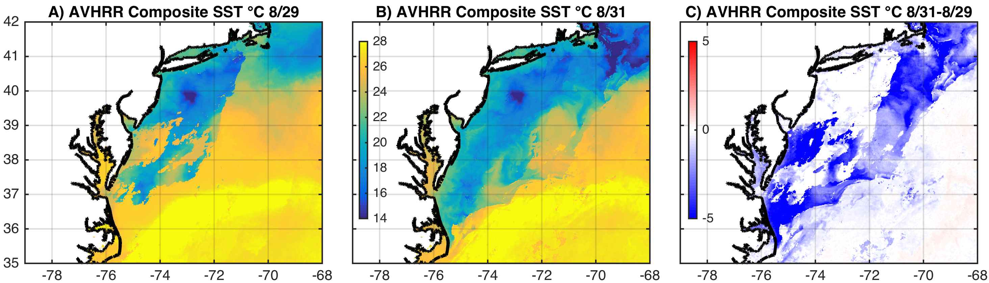
SST: 3-Day Coldest Dark-Pixel Composite
Preserves the coldest ocean features from Irene
Required 3 days (August 29-31) to fill in.

Slide 22
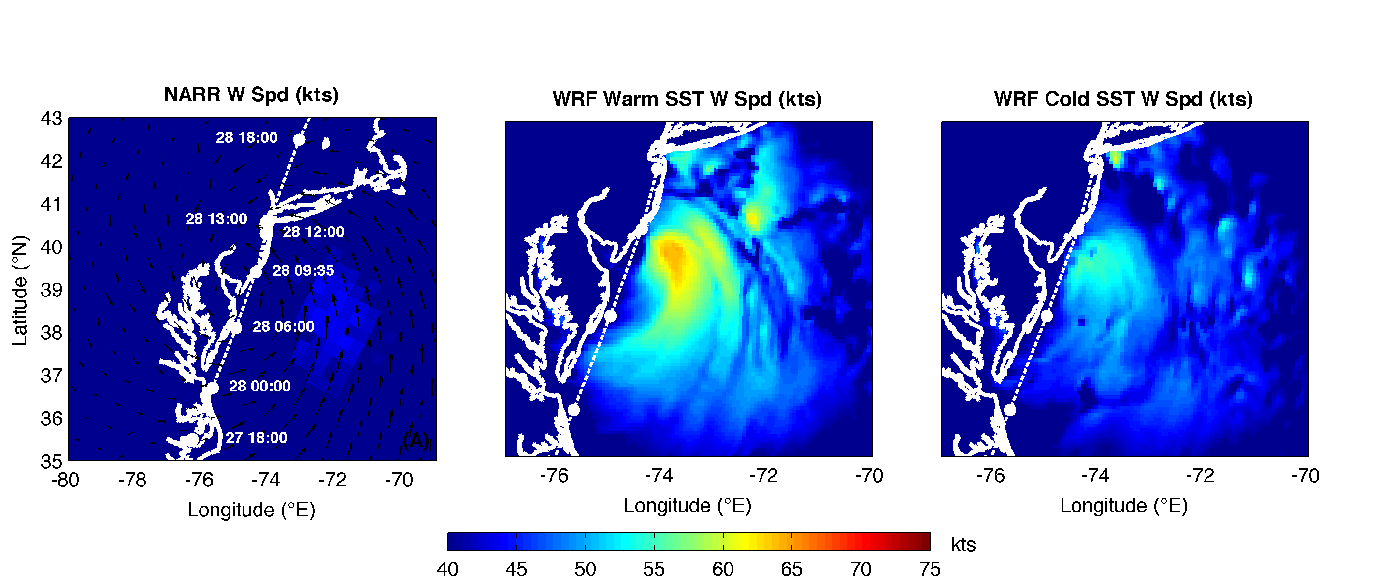
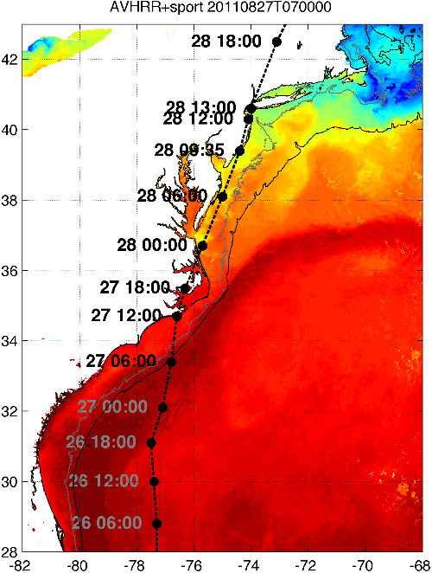
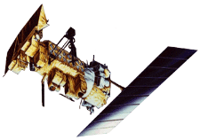

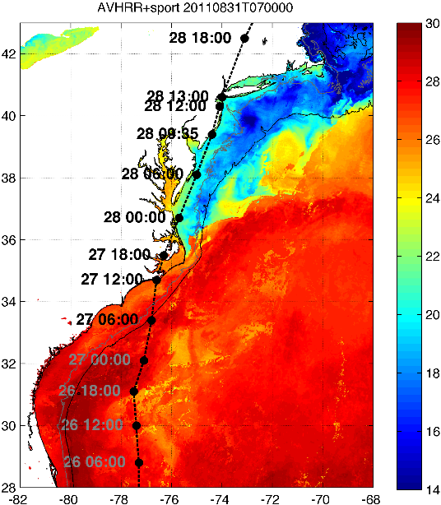

Rutgers Atmospheric Forecast Sensitivity Study
Warm Ocean
Boundary Condition
Cat 1 Hurricane
Tropical Storm
Cold Ocean
Boundary Condition
IMPACT?
>10 knots reduction in peak wind speed

Slide 23
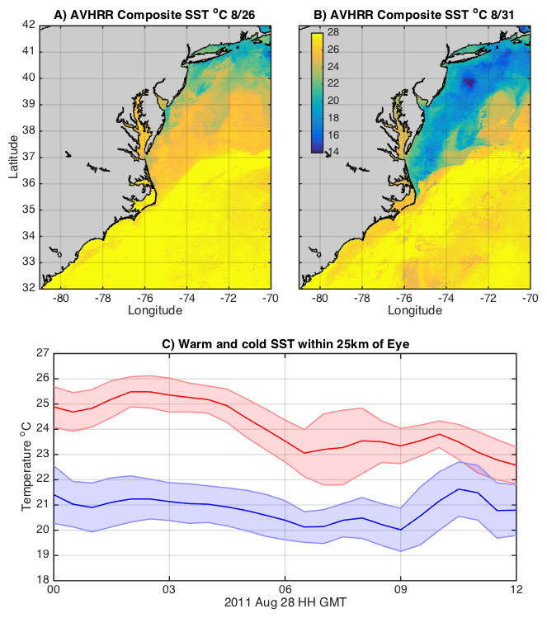
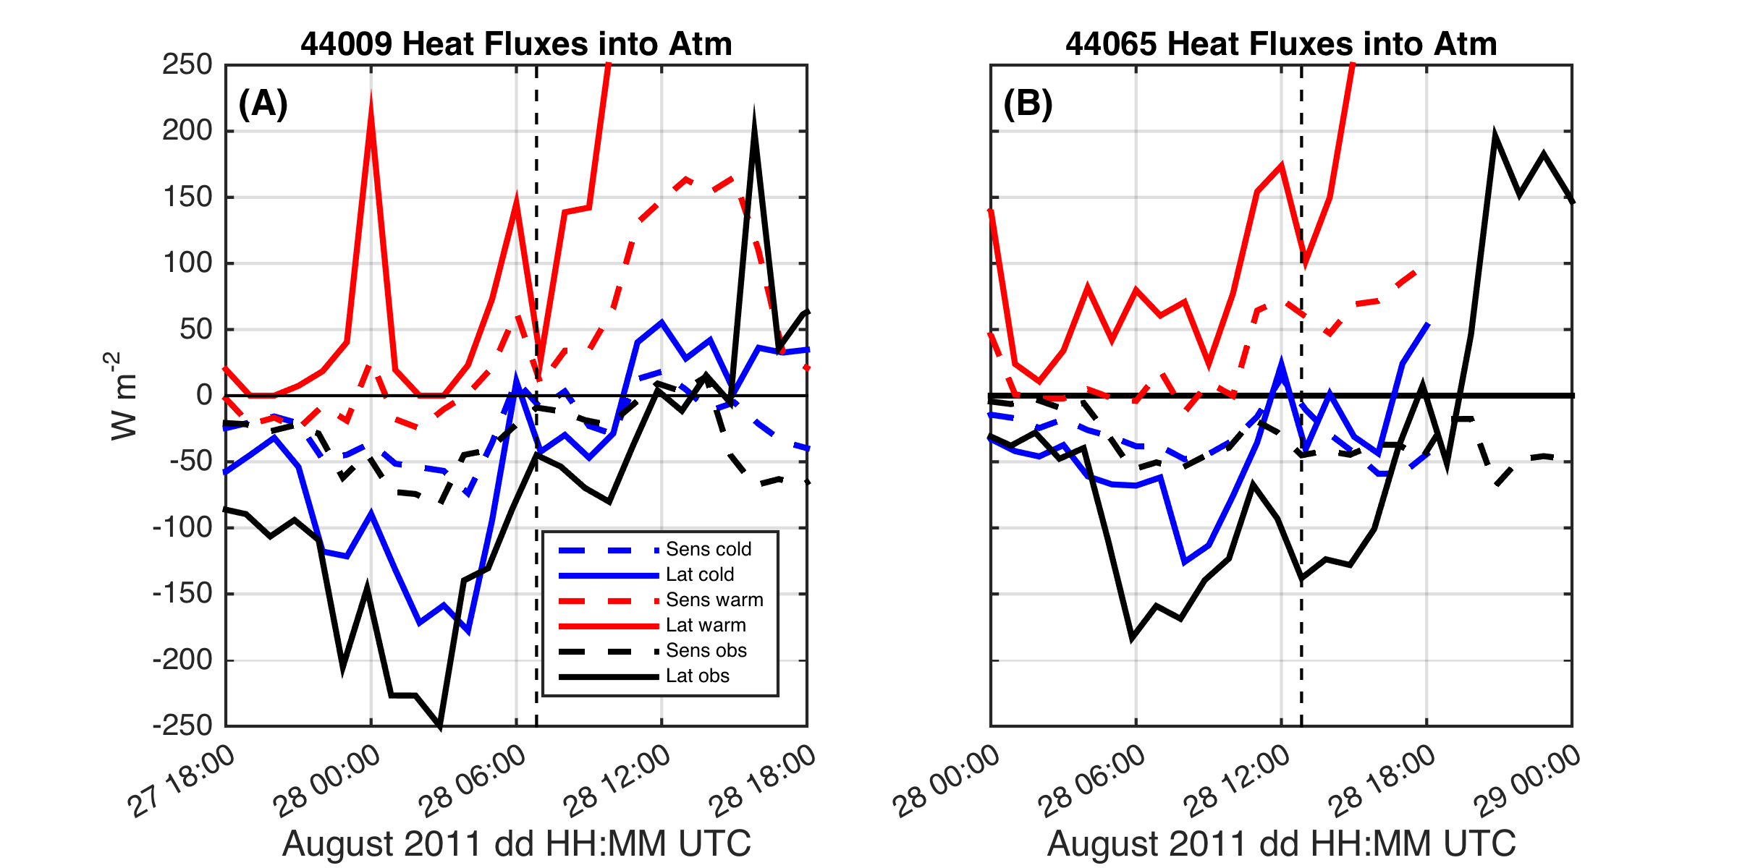
SST within 25 km of eye & impact on air-sea heat flux
Warm
Cold
Northern Buoy
26C
Central Buoy

Slide 24
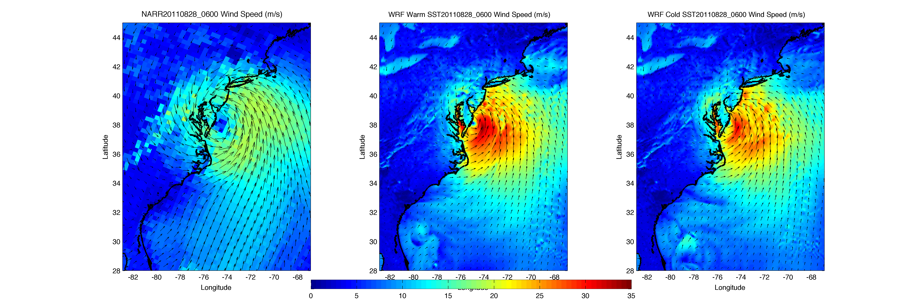
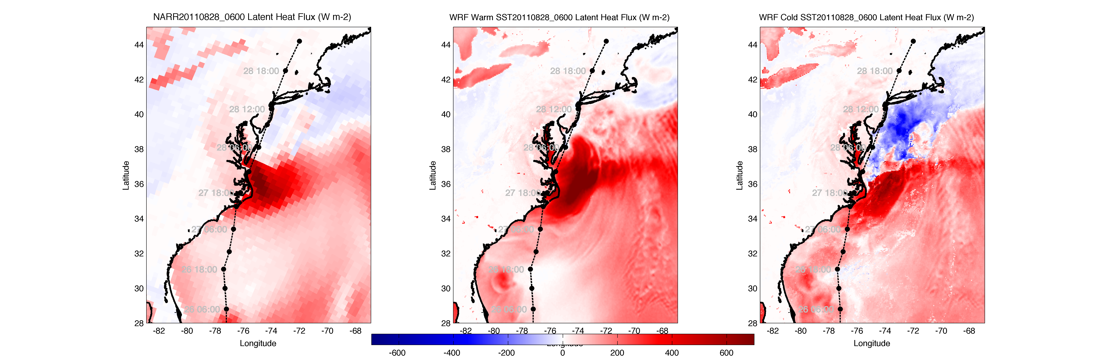
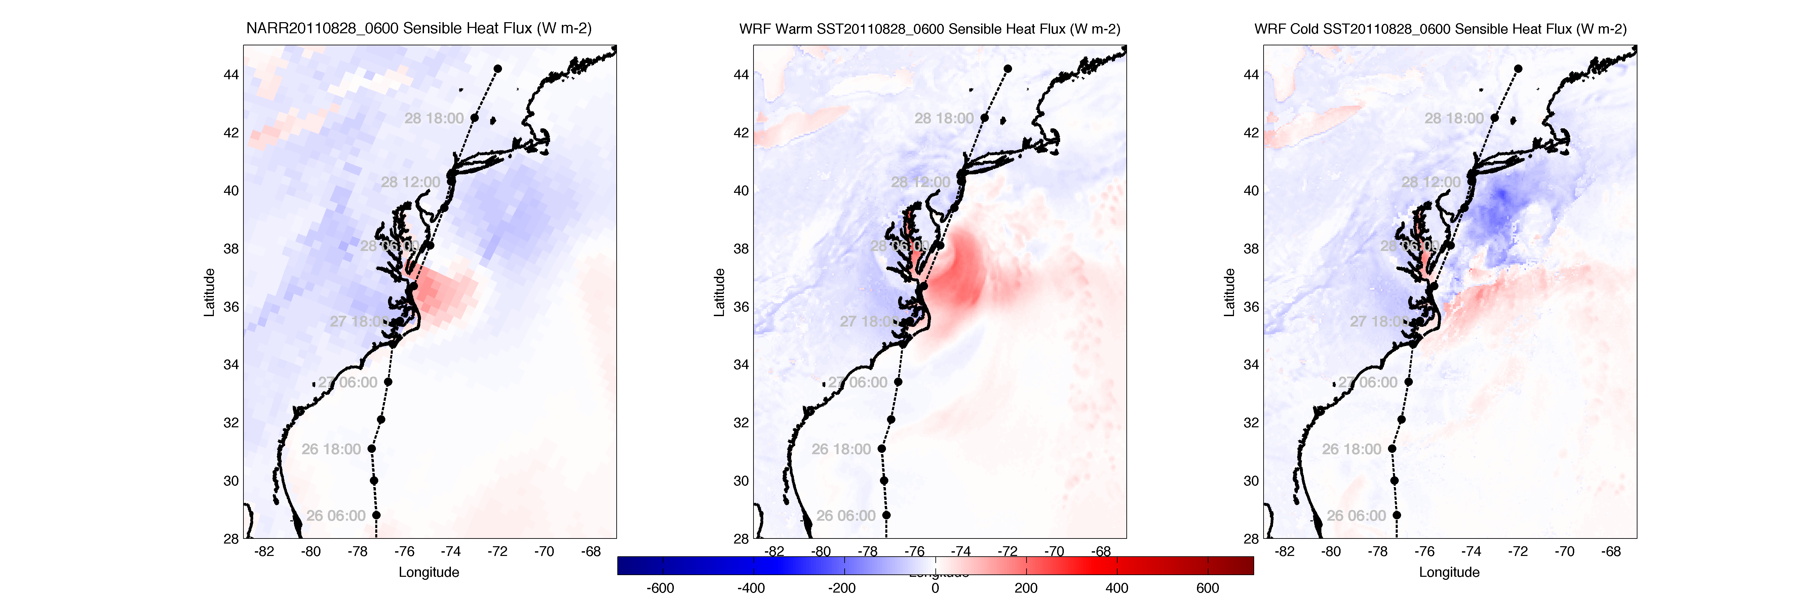
NARR
WARM SST
COLD SST
WRF Heat Flux Comparison to
North American Regional Reanalysis
Wind
Latent heat flux
Sensible heat flux

Slide 25
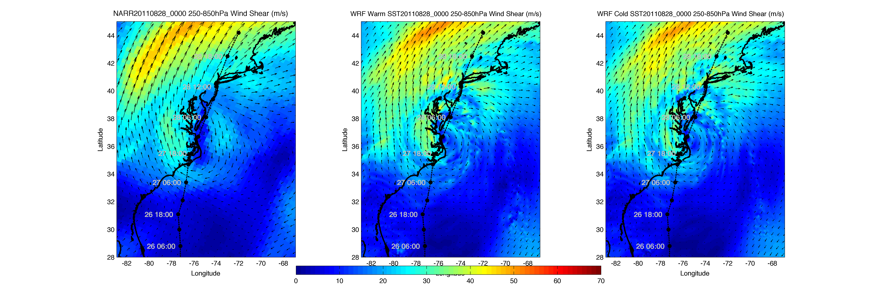
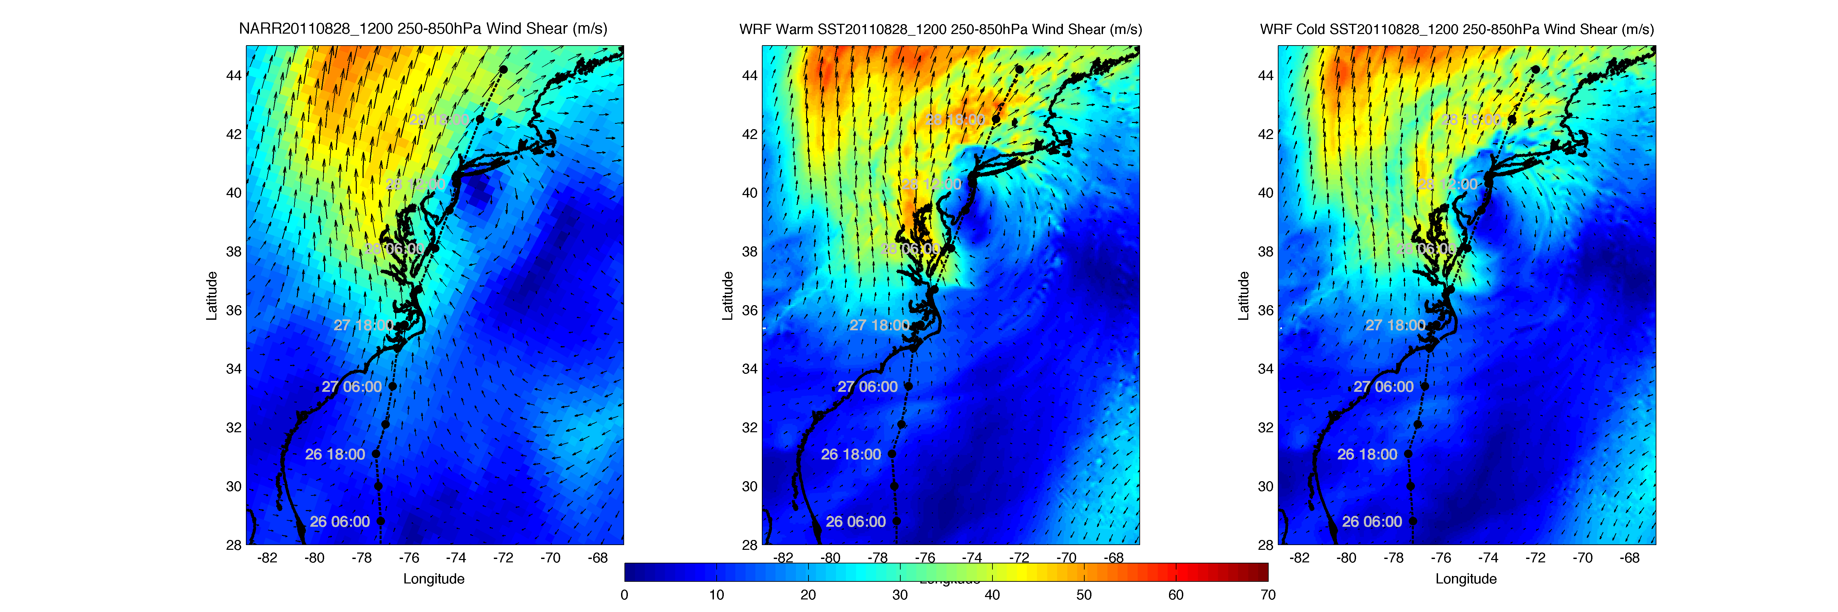
WRF 250-850 hPa Wind Shear
NARR
WARM SST
COLD SST
August 28
00:00 Z
August 28
12:00 Z

Slide 26
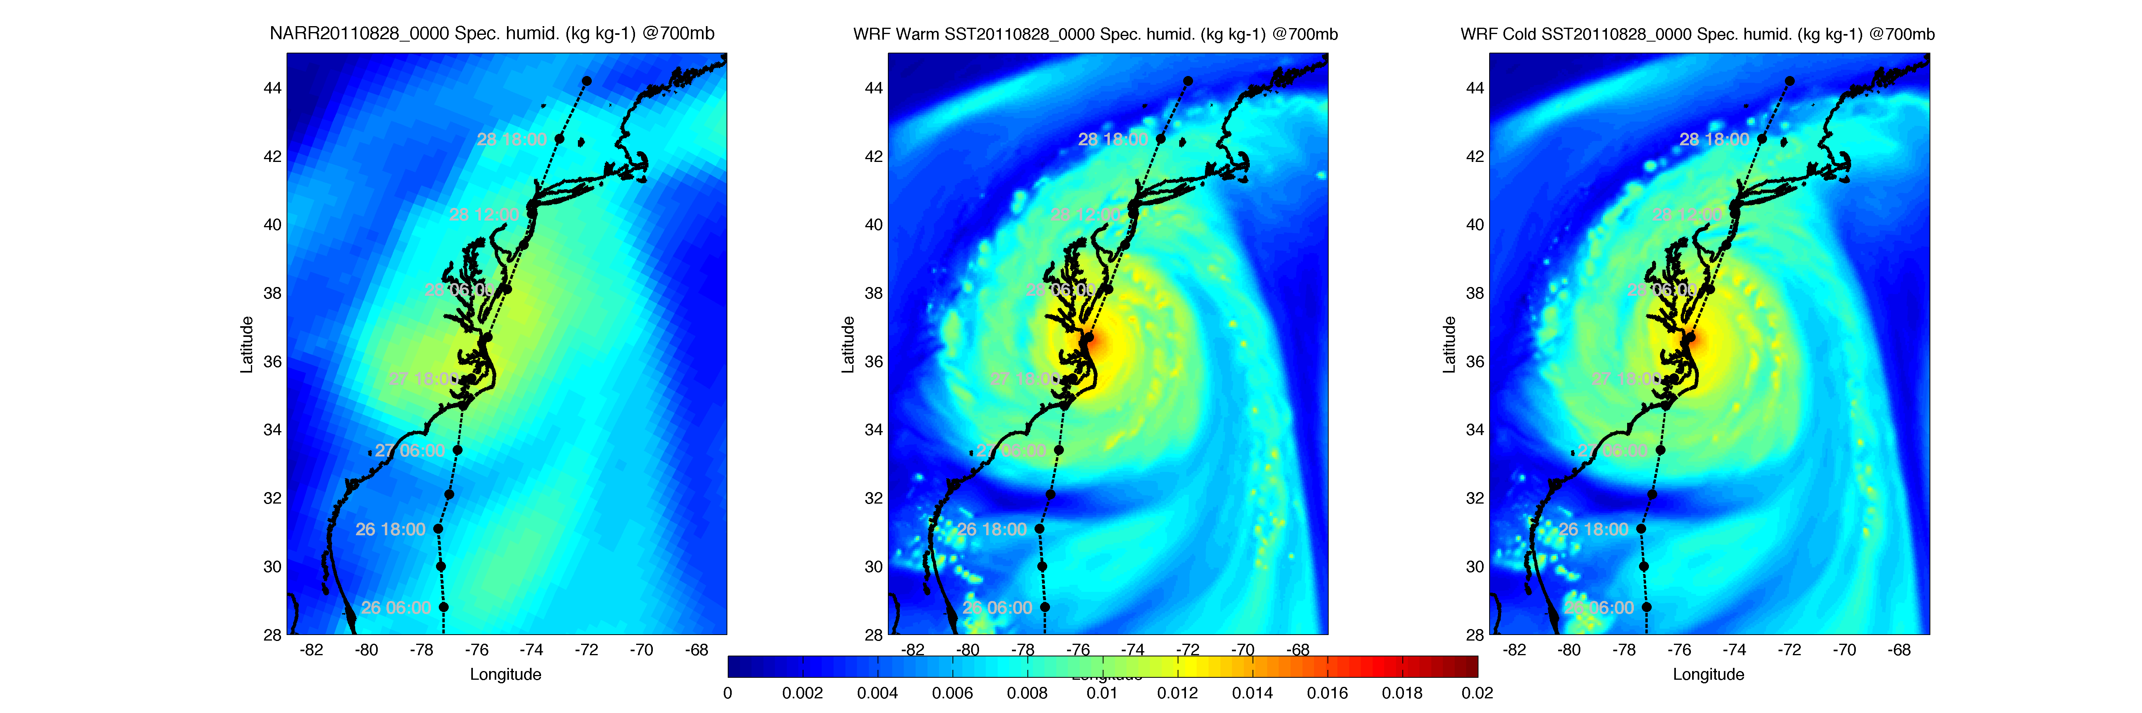
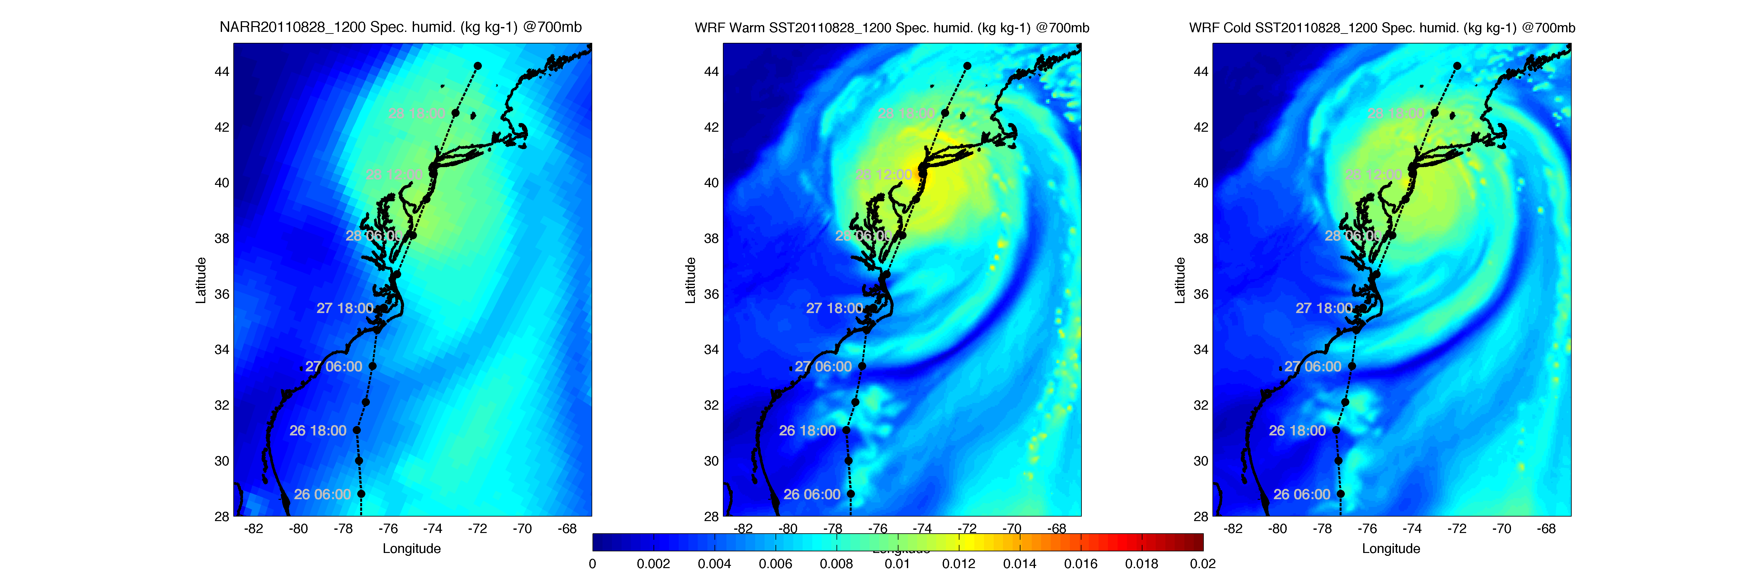
WRF Dry air intrusion (700 mb specific humidity)
NARR
WARM SST
COLD SST
August 28
00:00 Z
August 28
12:00 Z
Notes:
SST sensitivity is not affecting or not being affected by humidity

Slide 27
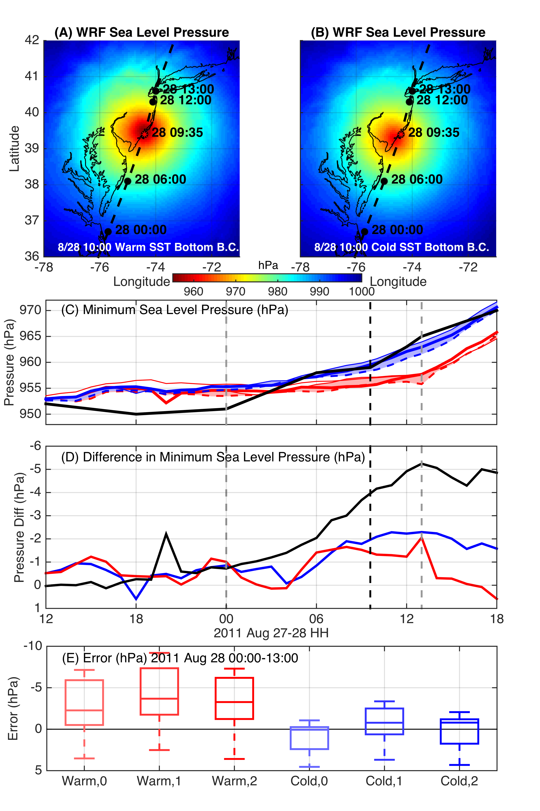
WRF Model Sensitivity Study
Over 130 model runs
Paired to compare sensitivities
Central pressure & max wind
Sensitivity to SST greatest
Seroka, Miles, Xu, Kohut, Schofield & Glenn,
Hurricane Irene Sensitivity to Stratified Coastal Ocean Cooling, Submitted to Monthly Weather Review

Slide 28




Modeled Deepwater Cooling Processes in Hurricane Irene
Air-Sea Only
1-D Mixing
3-D PWP (Upwelling)

Slide 29


Observed Cooling in Hurricane Irene
Ahead-of-Eye-
Center Cooling:
Water Temp
Air Temp
Air Press
Wind Speed

Slide 30

Historical Hurricanes Crossing the
Middle Atlantic Bight Continental Shelf in Stratified Season

Slide 31

Ahead-of-Eye-
Center Cooling:
Water Temp
Air Temp
Air Press
Wind Speed
First
Three
Hurricanes
Objective criteria:
Hurricane eye over MAB continental shelf in stratified summer season (June-August)
Buoy must have air pressure, wind speed, water temperature (air temperature bonus)
First vertical line is warmest temperature when wind speed exceeds 5 m/s
Center line is coolest temperature before pressure minimum
Last line is coolest temperature after pressure minimum & wind speed below 5 m/s

Slide 32

Ahead-of-Eye-
Center Cooling:
Water Temp
Air Temp
Air Press
Wind Speed
Middle
Four
Hurricanes

Slide 33

Ahead-of-Eye-
Center Cooling:
Water Temp
Air Temp
Air Press
Wind Speed
Final
Four
Hurricanes

Slide 34

Historical Hurricanes Crossing the MAB in Stratified Season
Observed Ahead-of-Eye-Center Cooling

Slide 35
Hurricane Arthur: July 3, 2014

Slide 36



Hurricane Arthur
ASCAT Winds, WRF Winds, CODAR Currents
July 4, 2014

Slide 37



Hurricane Arthur
CODAR Current Fields
Late July 4, 2014
(Before Eye)
Early July 5, 2014
(After Eye)
Late July 5, 2014
(After Eye)

Slide 38



Before Eye After Eye
Hurricane Arthur
Storm Glider Deployments
July 3-6, 2014

Slide 39




Historical Typhoons Crossing the Yellow Sea in the Stratified Season
Summer/Winter SST Difference
Ramya Ramadurai, 2009
Bottom Temp
26 Typhoons
tracked across northern East China Sea & Yellow Sea since 1985
Chen et al., CSR, 1992

Slide 40



Typhoon Muifa - Total Cooling Observed by Satellite
SST
Before
Muifa
Track
SST
After
SST
Difference
Up to 7C
From: Sun, Duan, Zhu, Wu, Zhang & Huang, Acta Oceanol. Sin., 2014

Slide 41


Typhoon Muifa:
Ahead-of-Eye-Center Cooling
observed by Coastal Buoy
Muifa
Track
From: Fei Yu, Institute of Oceanology, Chinese Academy of Sciences
Yi Xu, State Key Laboratory of Estuarine & Coastal Research, East China Normal University

Slide 42

Hurricane Irene
August 26, 2011
Summer Storm
Strong Stratification
Coastal Response
Mixing Cooled Surface
Limited Intensity
Hurricane Sandy
October 29, 2012
See Miles et al (2015):

Slide 43



Mobile Subsurface Sampling Capabilities
Drifters
Gliders
Ships
Increasing Control, Capacity & Cost
Decreasing Endurance & Risk Tolerance

Slide 44


UNESCO Intergovernmental Oceanographic Commission
Ocean Science Day: 17 June 2015, Paris
Glider Challenge:
High Resolution for
4D Oceanic Measurements
UNESCO IOC Science Day, 17 June 2015
Glider Challenge: High resolution for 4D oceanic measurements
Human Challenge: Typhoon & Hurricane Readiness
On a Changing Planet

