Slide 1

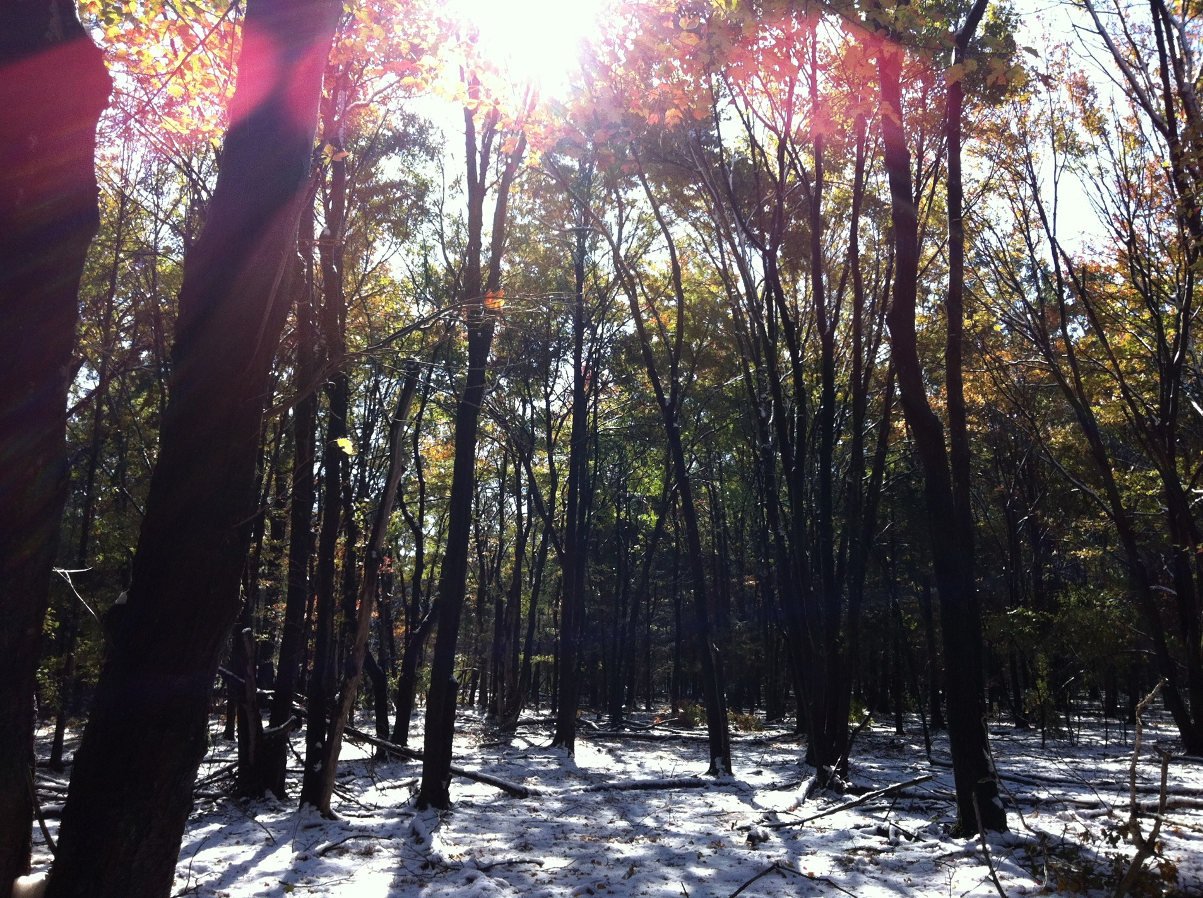
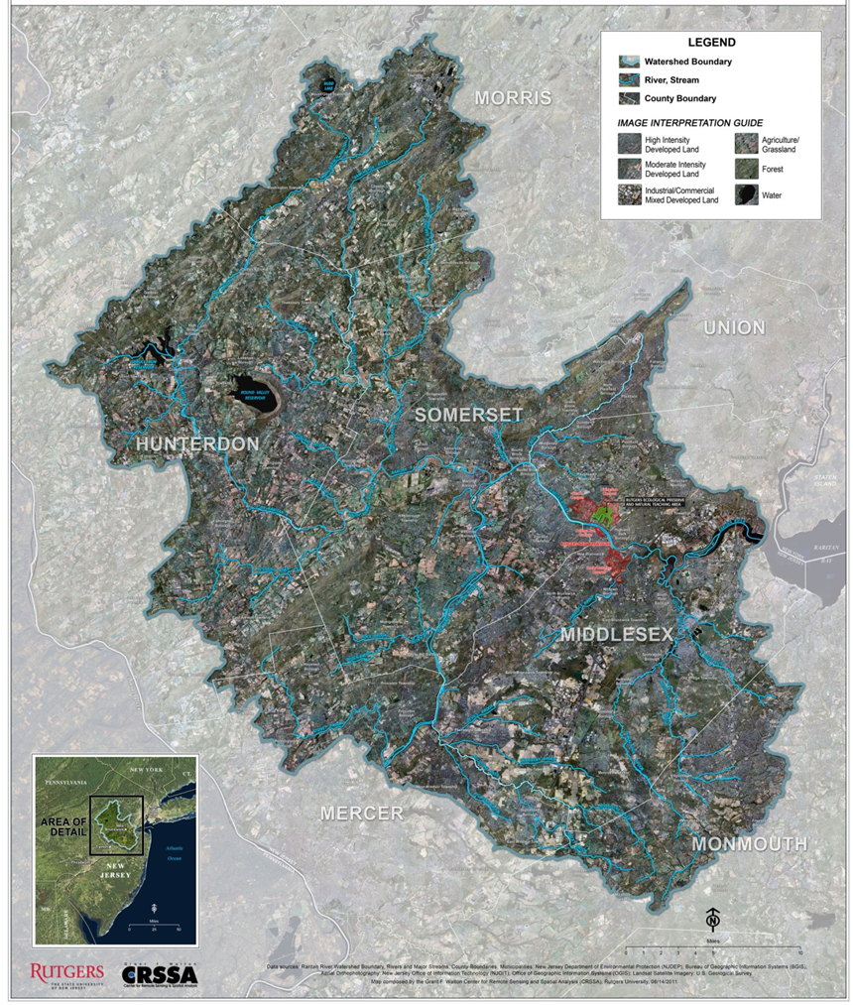
Rutgers’s future is the Raritan River
8th Annual Sustainable Raritan River Conference
June 10, 2016
Oscar Schofield
Marine and Coastal Sciences
Center of Ocean Observing Leadership

Slide 2
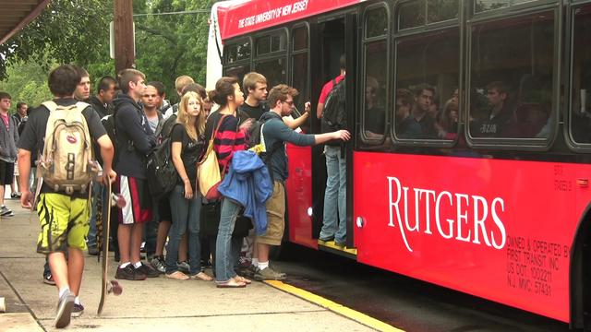

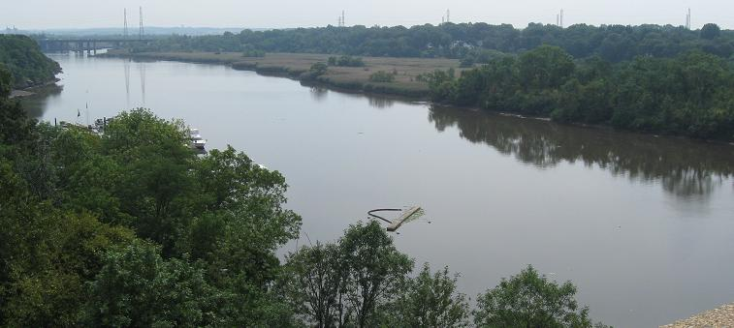
Right now, most Rutgers Students perceive the river as a barrier that makes it hard to get between campuses
Student’s current view of the river

Slide 3

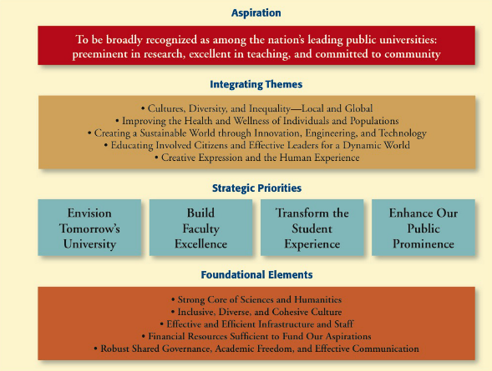
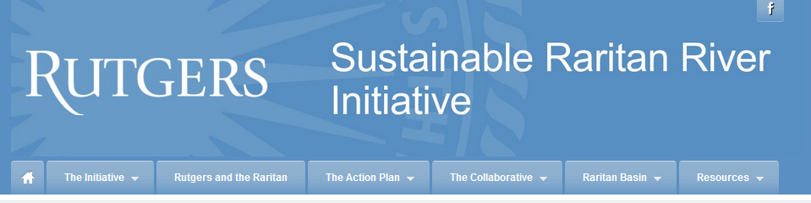
Rutgers self study suggests paths to improve and we believe that
the Raritan will be an important part of the solution
The strategic priorities for the University will all
be met in some form by transforming the Raritan to focal point for the University

Slide 4
Building Faculty Excellence
The Raritan is a unique laboratory available to Rutgers
Raritan represents a unique watershed with almost a century of urbanization
(Richard J. Walsh, Save the Raritan, Queen of Rivers, 1928)
Images courtesy of Dr. John Reinfelder

Slide 5
Building Faculty Excellence
The Raritan is a unique laboratory available to Rutgers
It represents a unique integrator of environmental forcing between terrestrial, aquatic (fresh and marine), and human influences. This provides a unique environment for many interdisciplinary problems, How has is the river changed? Have conditions improved? How will it change in the future? How can we use the river to spawn many interdisciplinary projects?
Dissolved oxygen in the Raritan River estuary June 1949
(x 1.36 = mg/L)
(Ketchum et al., 1952)
O₂ (mg/L)
(Chant, pers. comm.)
Images courtesy of Dr. John Reinfelder

Slide 6
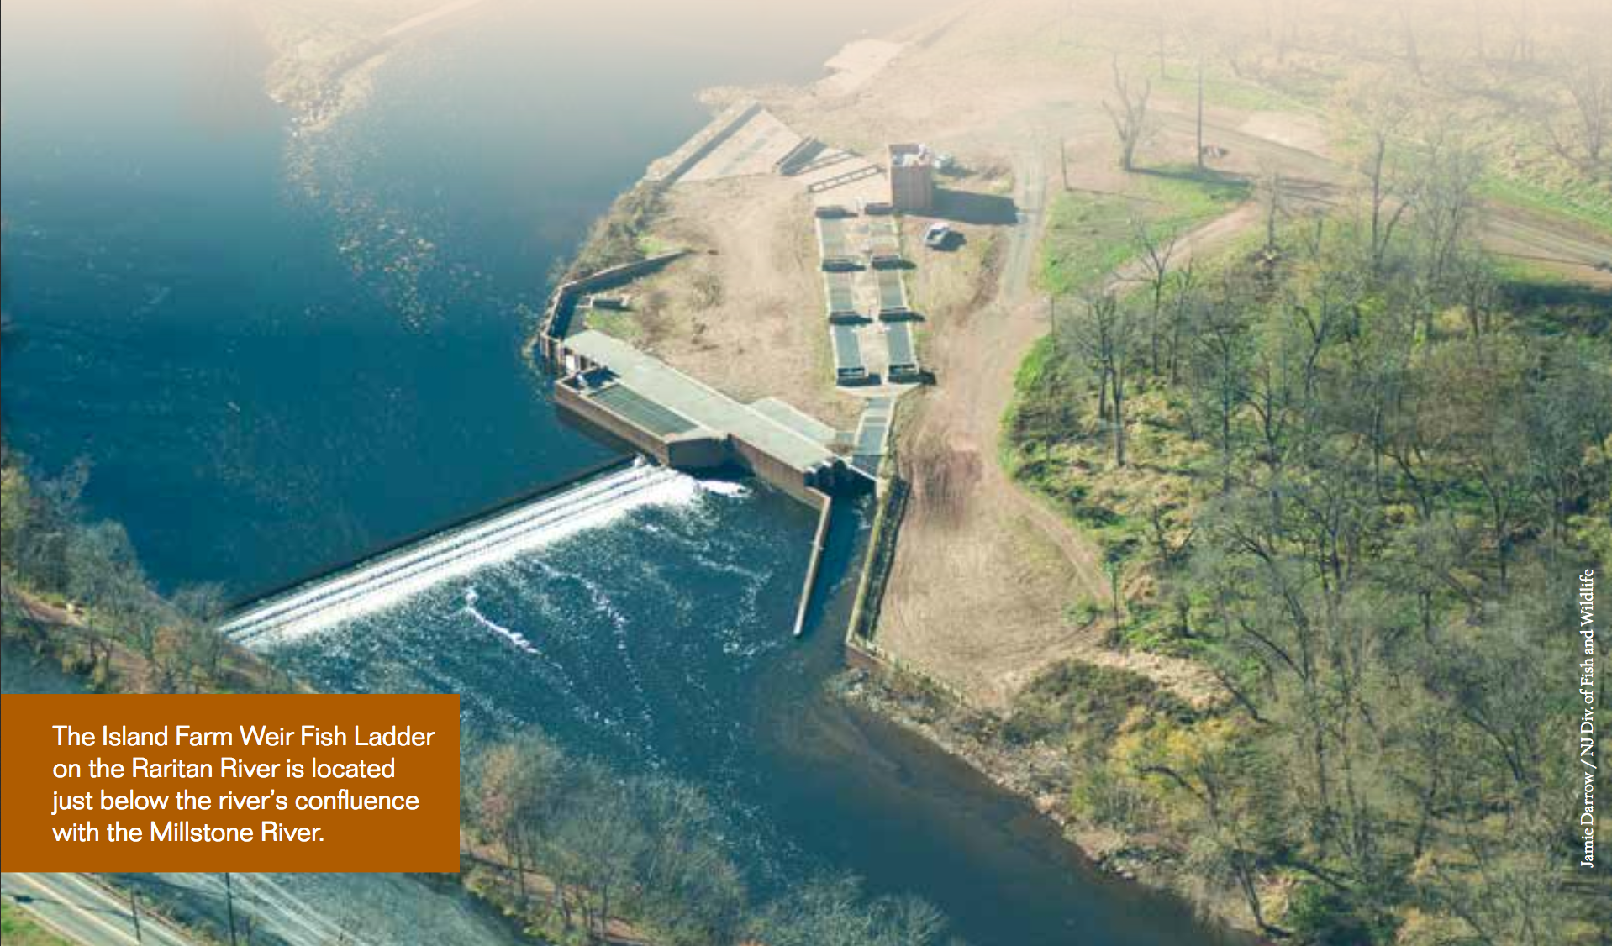
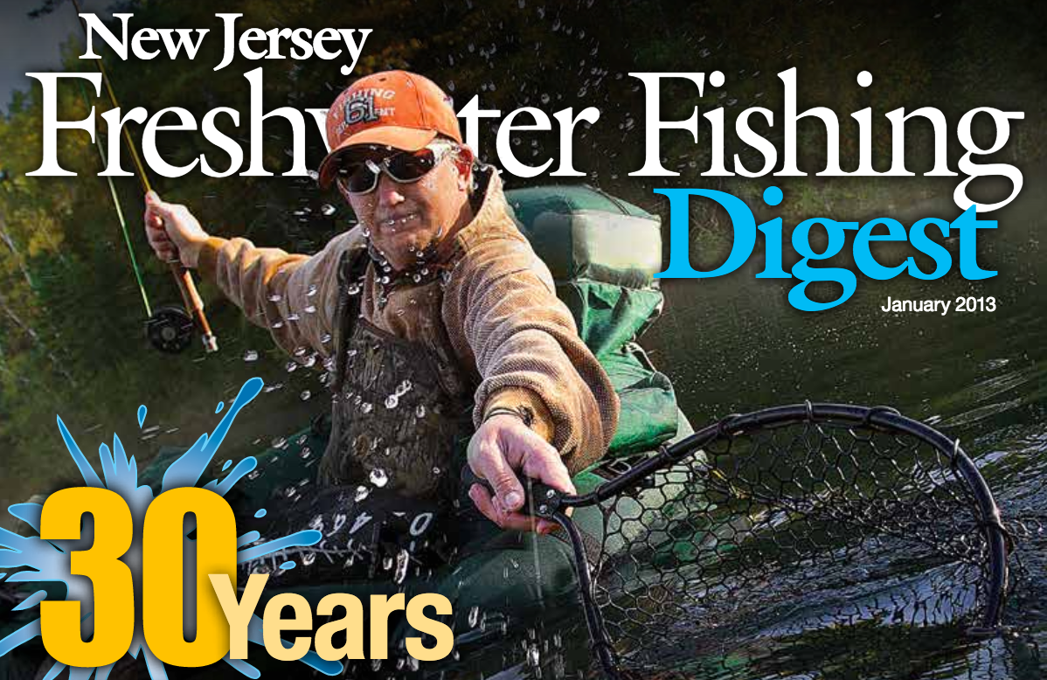
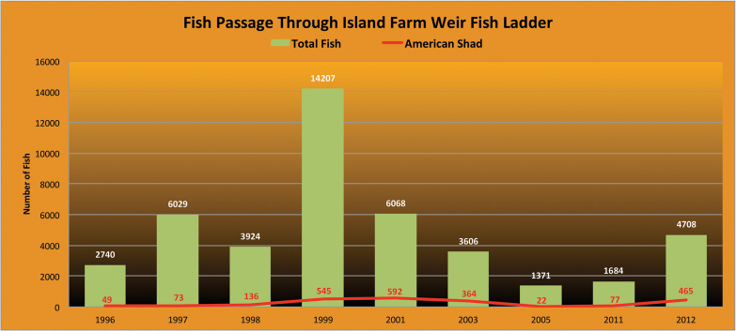
Building Faculty Excellence
The Raritan is a unique laboratory available to Rutgers
How are current policy and regulations impacting the the watershed and river? Can we provide quantitative metrics and models that will enable development of assessment and management efficacy tools? How will the river to spawn many interdisciplinary projects?

Slide 7
Transforming the Student Experience
The Raritan is a unique under-utilized teaching lab that might provide hands-on, exciting and unique educational experiences
A limited survey faculty who use the river in undergraduate courses ( feedback from 17 Professors)
15 / 17 have used the Raritan River in their teaching in the past few years
- 14 / 15 bring their students to the Raritan
5 mentioned using the Raritan for internship work
7 taught a specialty course and used the Raritan
6 mentioned that they used the Raritan in a Byrne seminar
6 specifically mentioned that they would benefit from access to a boat
Hurdles: Lack of access, no shared community experiences, no leveraging between classes, limited integrated data on the watershed and much less for data in the river itself

Slide 8
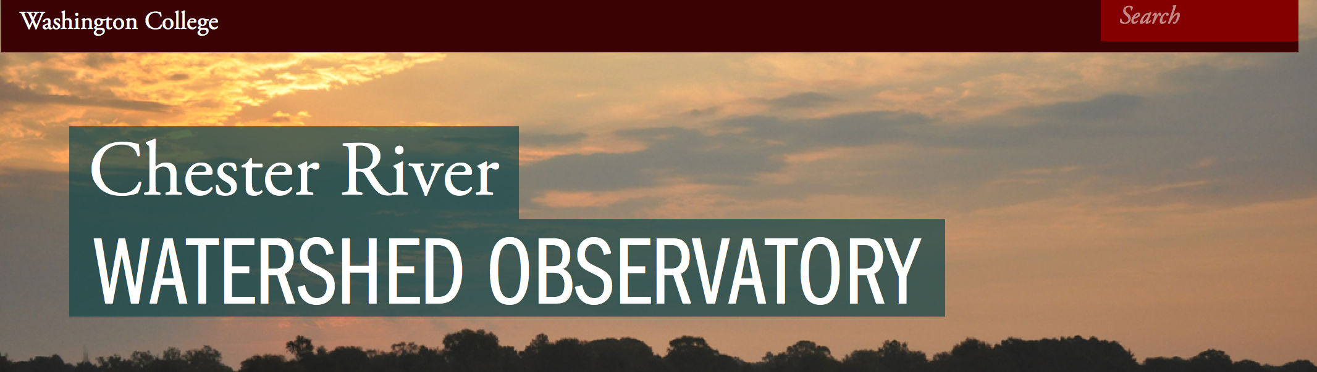
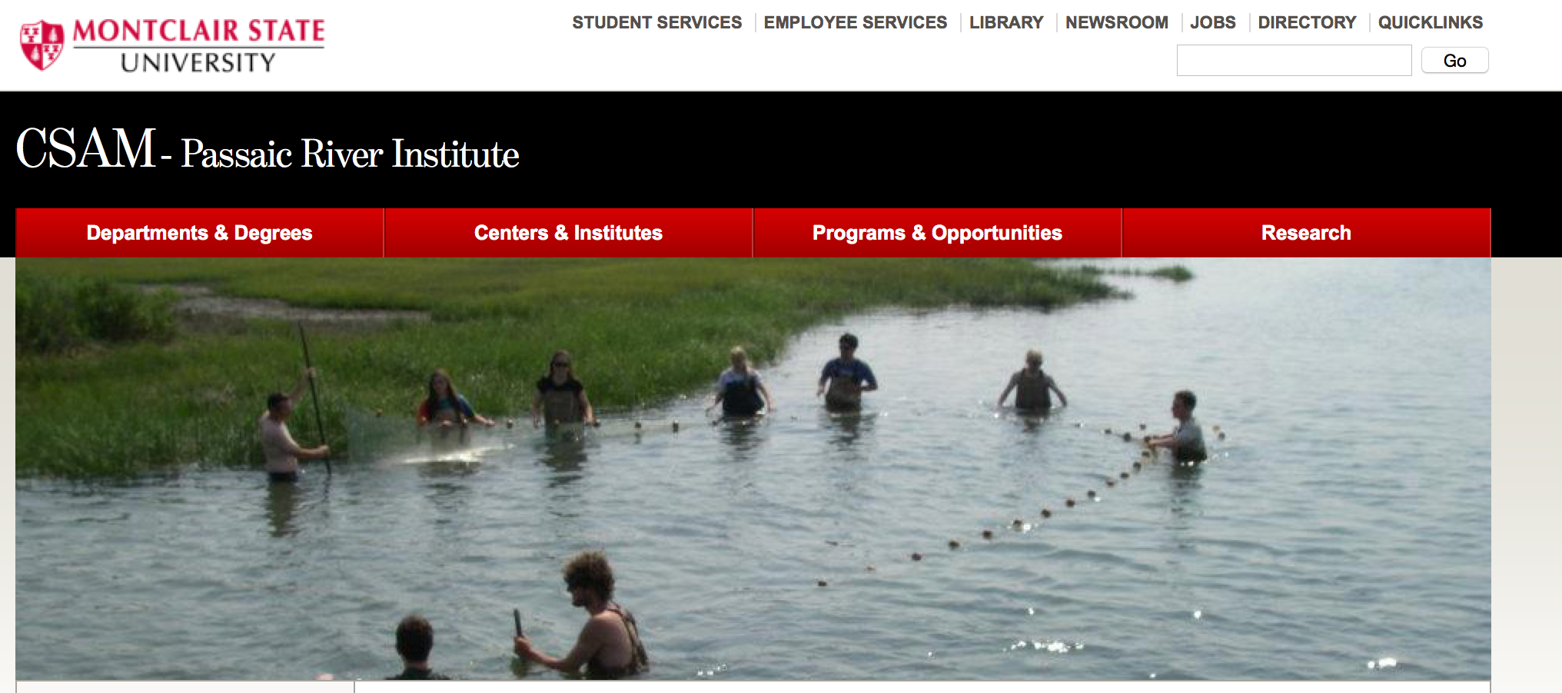
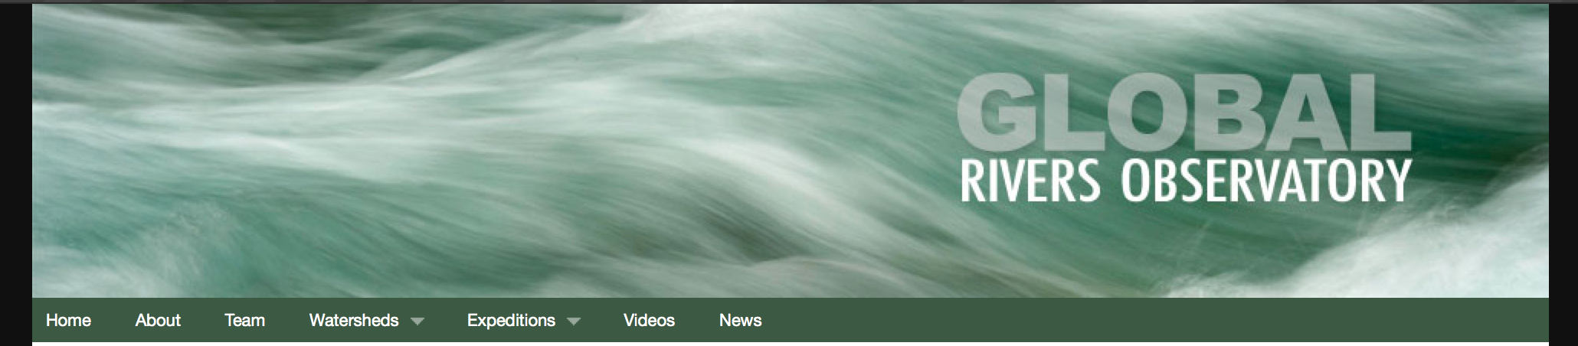
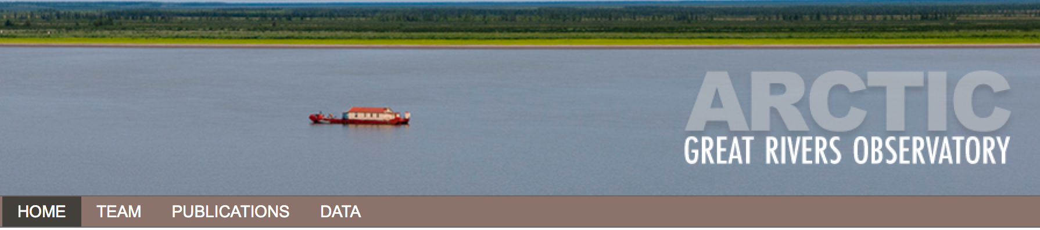
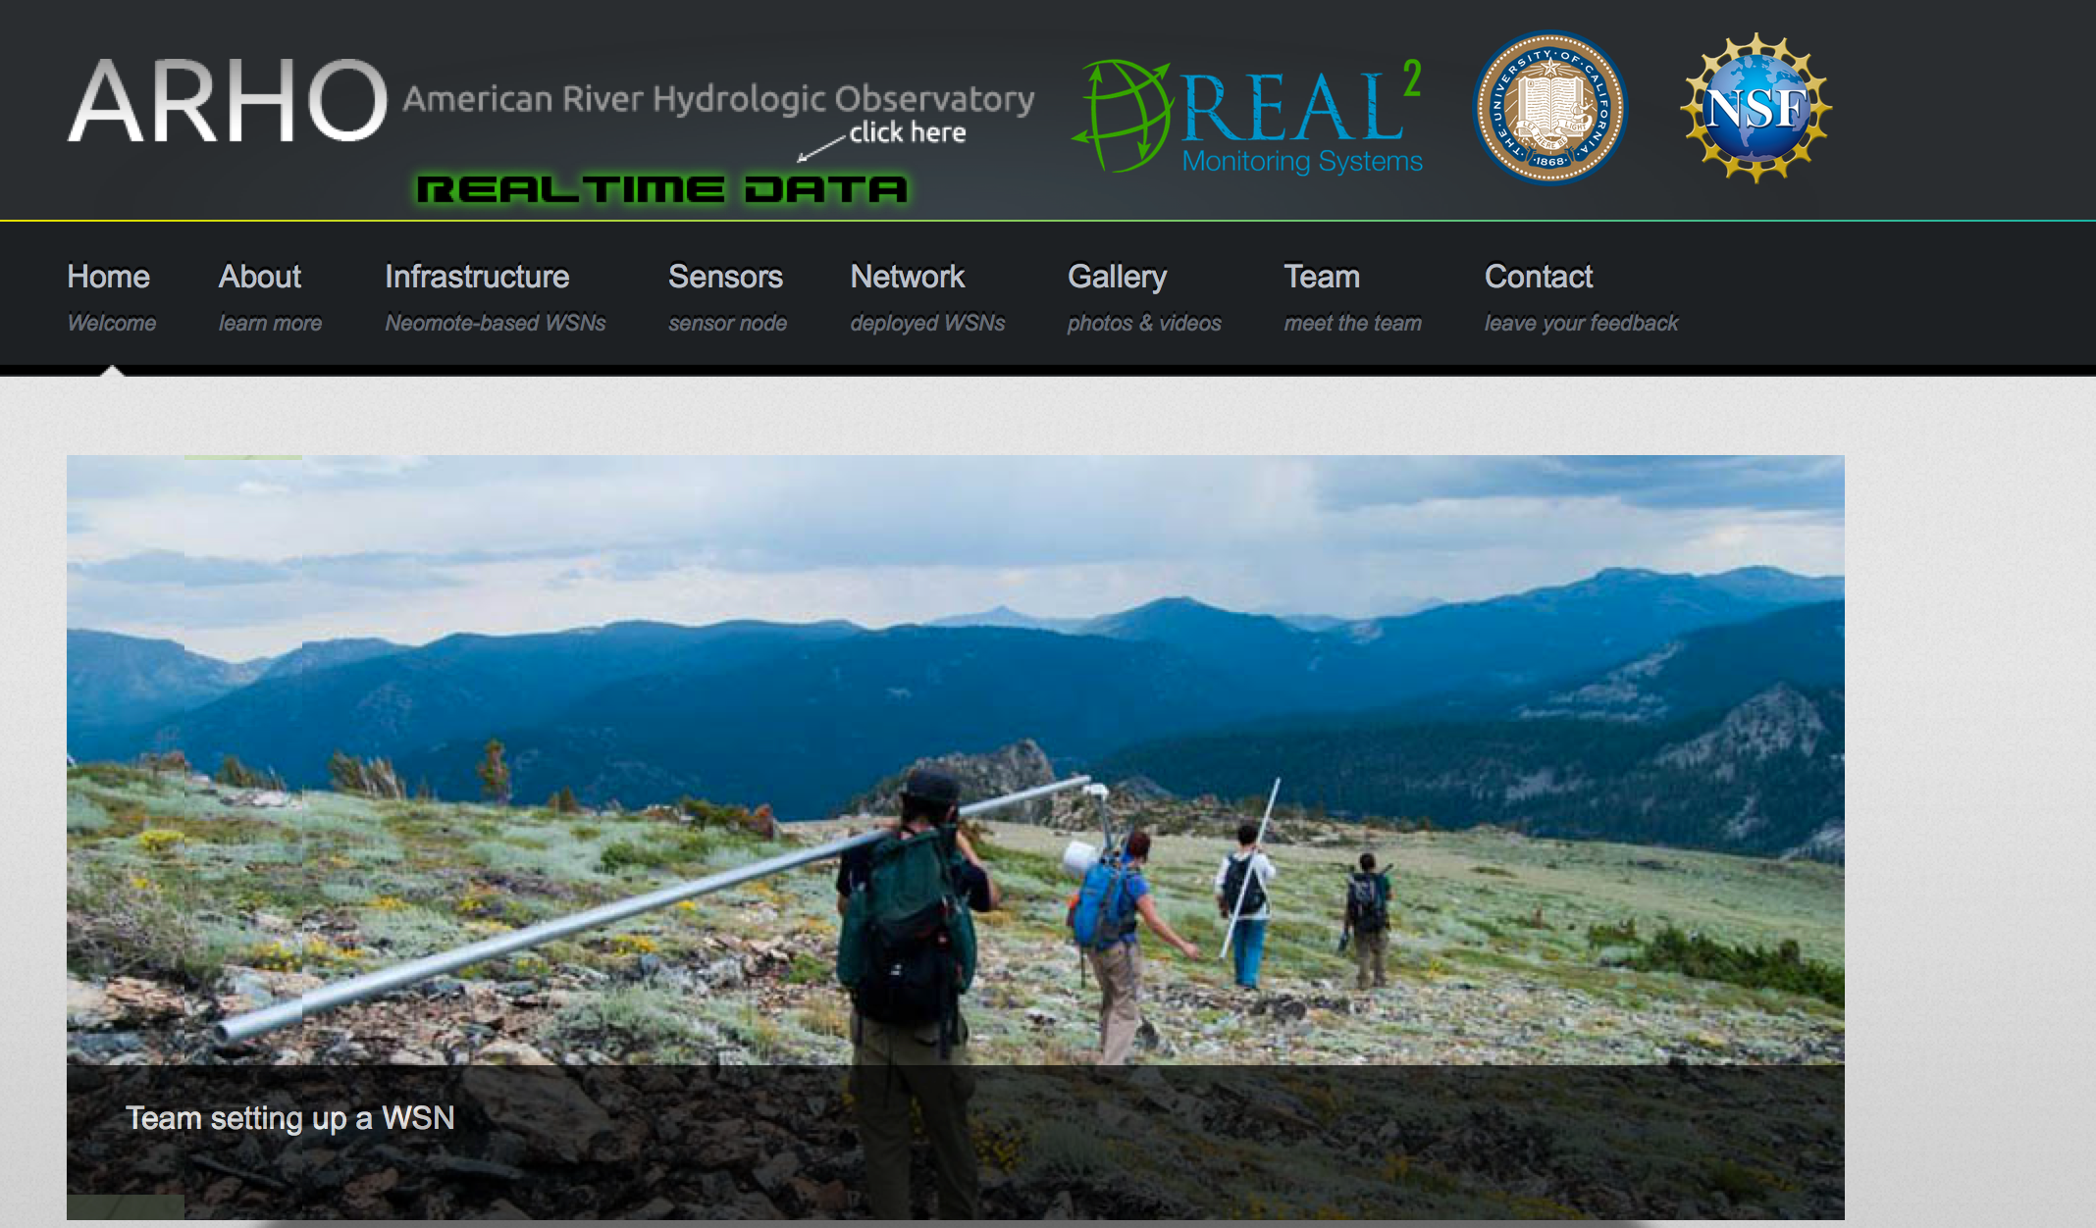
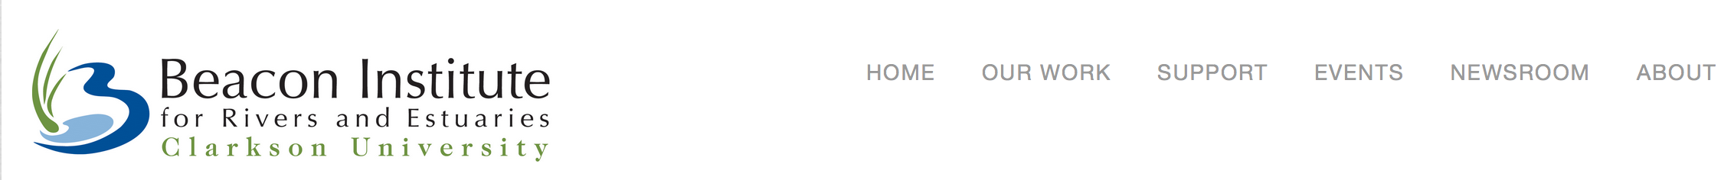
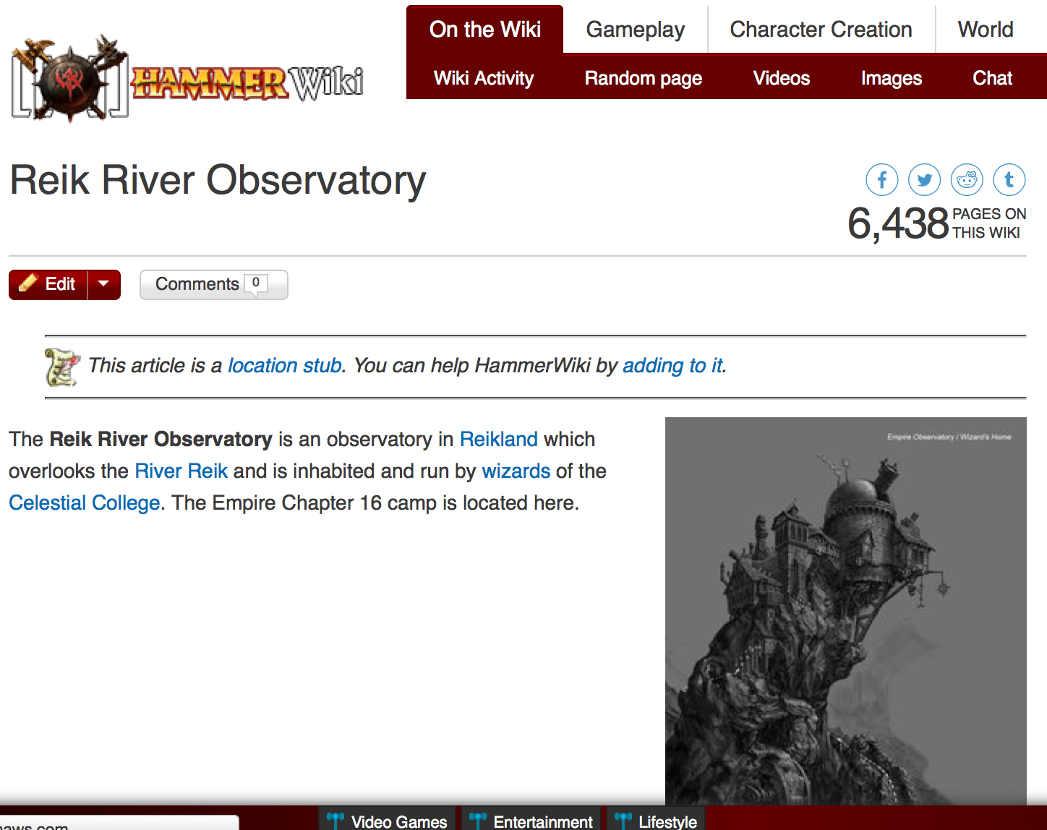
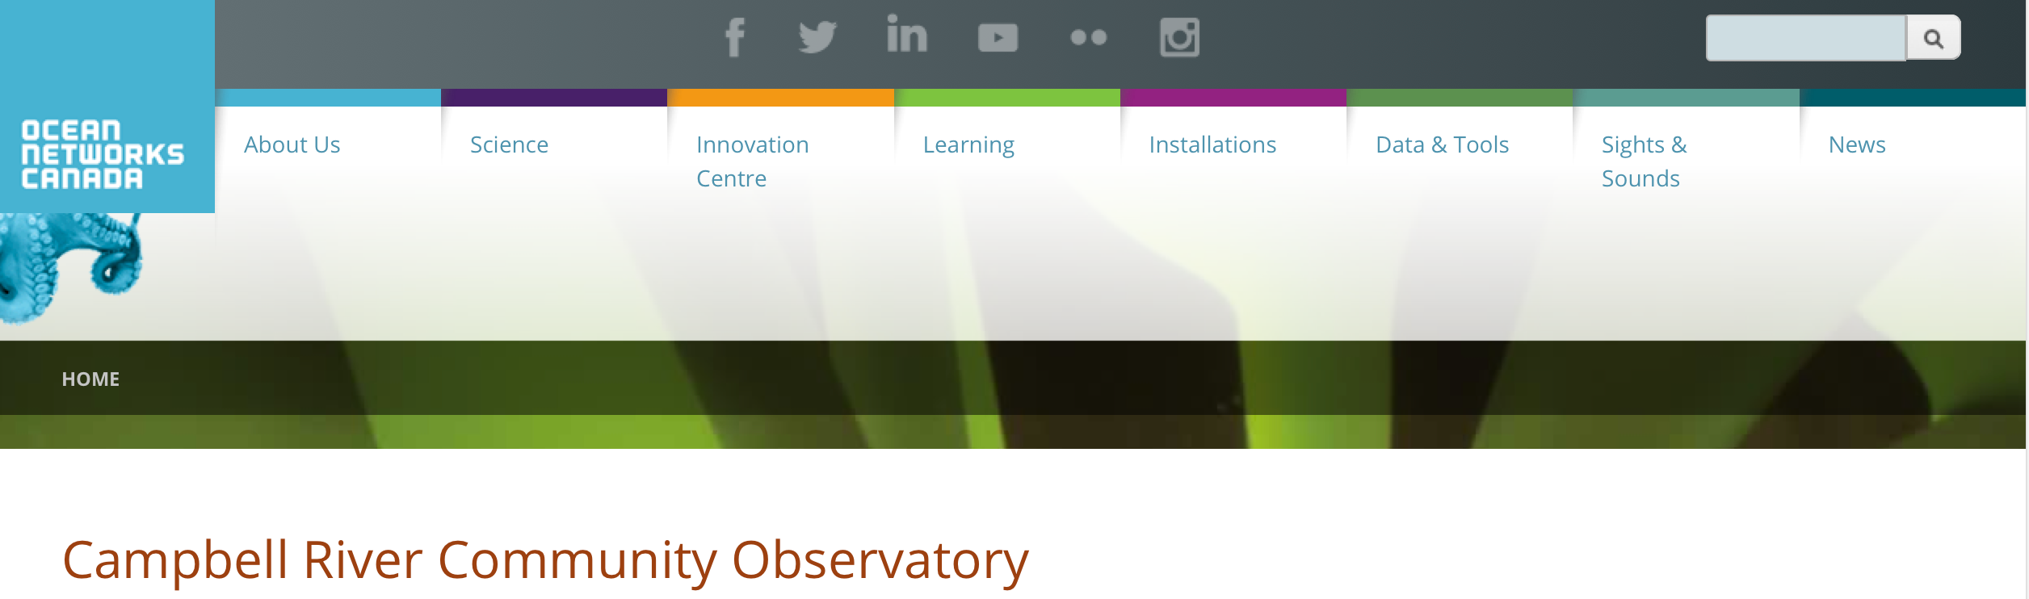
Enhance our public prominence
Lack of integrated efforts from presence in the river to development of data tools is leaving an niche for other schools
The Reik River Observatory
is an observatory which overlooks the River Reik and is inhabited by wizards of the Celestial College

Slide 9


Enhance our public prominence
A night not much different then tonight, when those crazy kids dared the Raritan beast….
-Alternative
Funding Mechanisms
-National public exposure

Slide 10
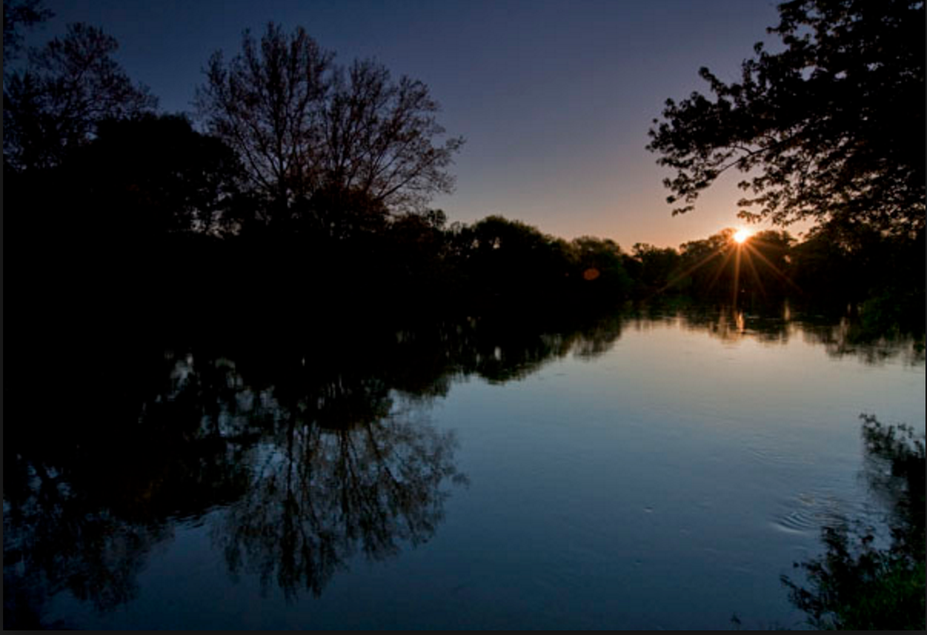
Looking Forward, Dawn on New Day of Rutgers and the Raritan

Slide 11
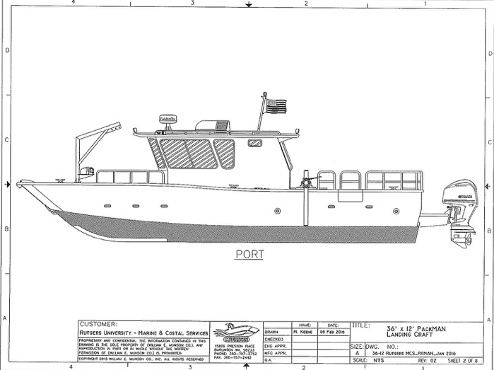
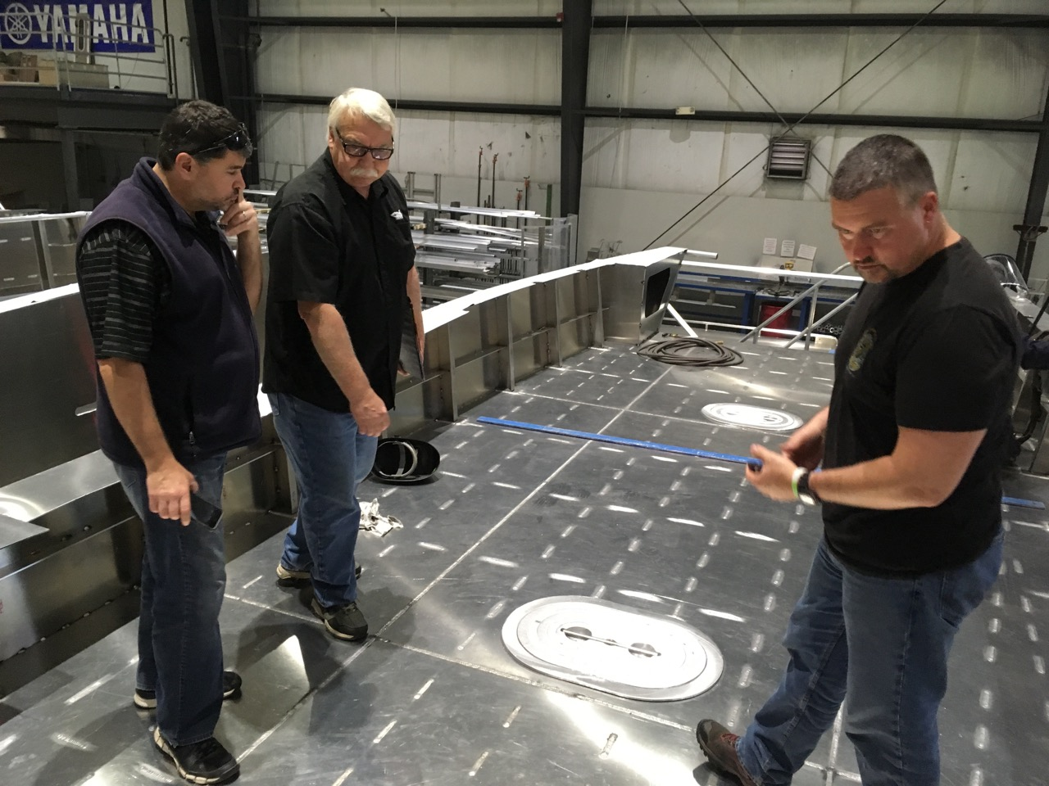
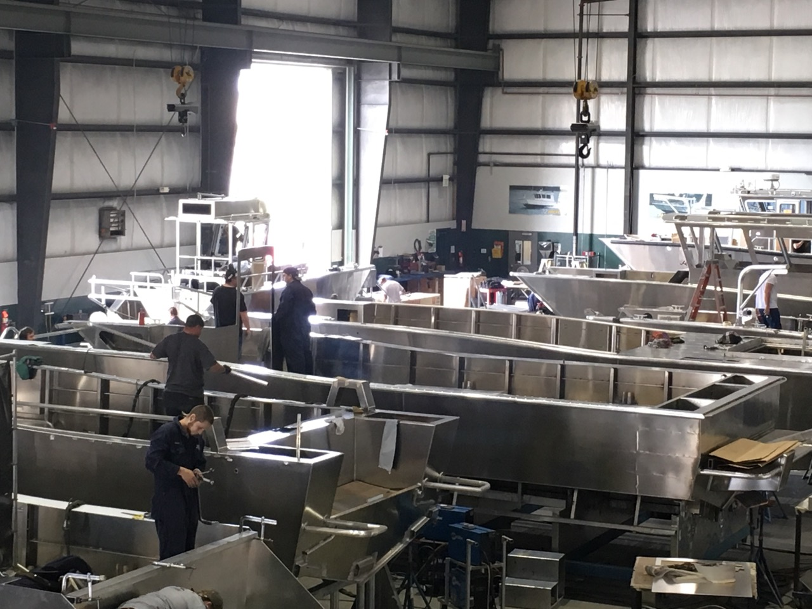
Building Faculty Excellence & Transforming Student Experience
With support from RU, a new river boat instrumented with scientific sensors and computers is being built and slated for delivery in August 2016. The goal is to provide access to the river for research and class
Visit to ship yard last week

Slide 12
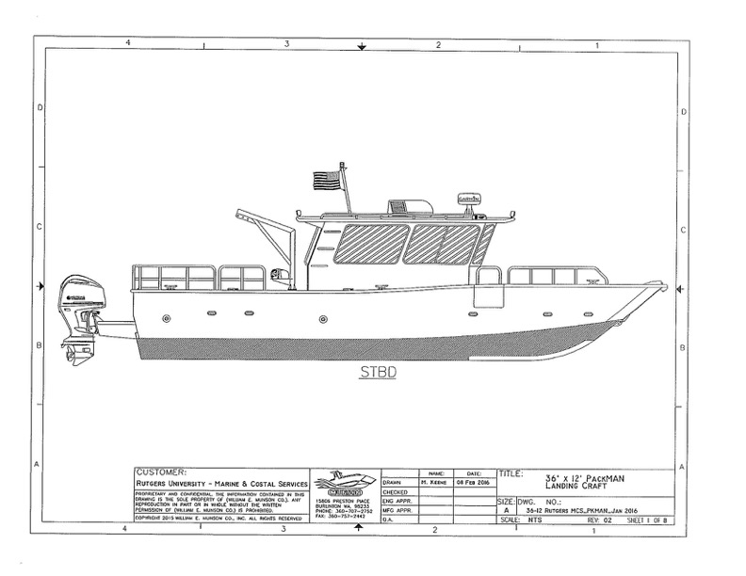
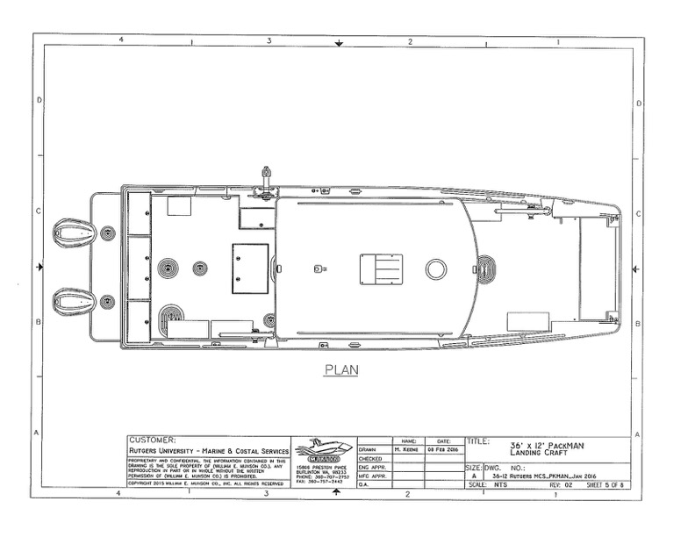
Looking Forward: Building Faculty Excellence & Transforming Student Experience
-Boat Coast Guard rated for over 20 students
(4 classes/day ~1hr lecture section, could 80 students/day, shooting for 50-70 ship days over next few years, 4000-5600/year)
-Basic set of instrumentation following recommendations by NJ DEP
-Protocols will meet the NJ DEP needs so student data from Raritan can be included in state databases
-Data to flow into a accessible database
-Web-site w/ policies for reserving space to be opened this summer
-sufficient speed to allow researchers get to and from New York Harbor and local regions
-Open to those in and outside Rutgers

Slide 13
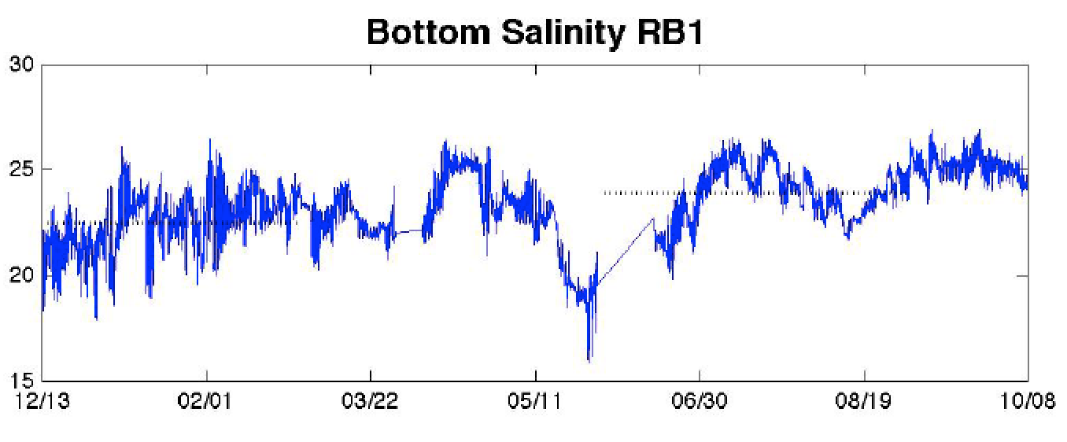
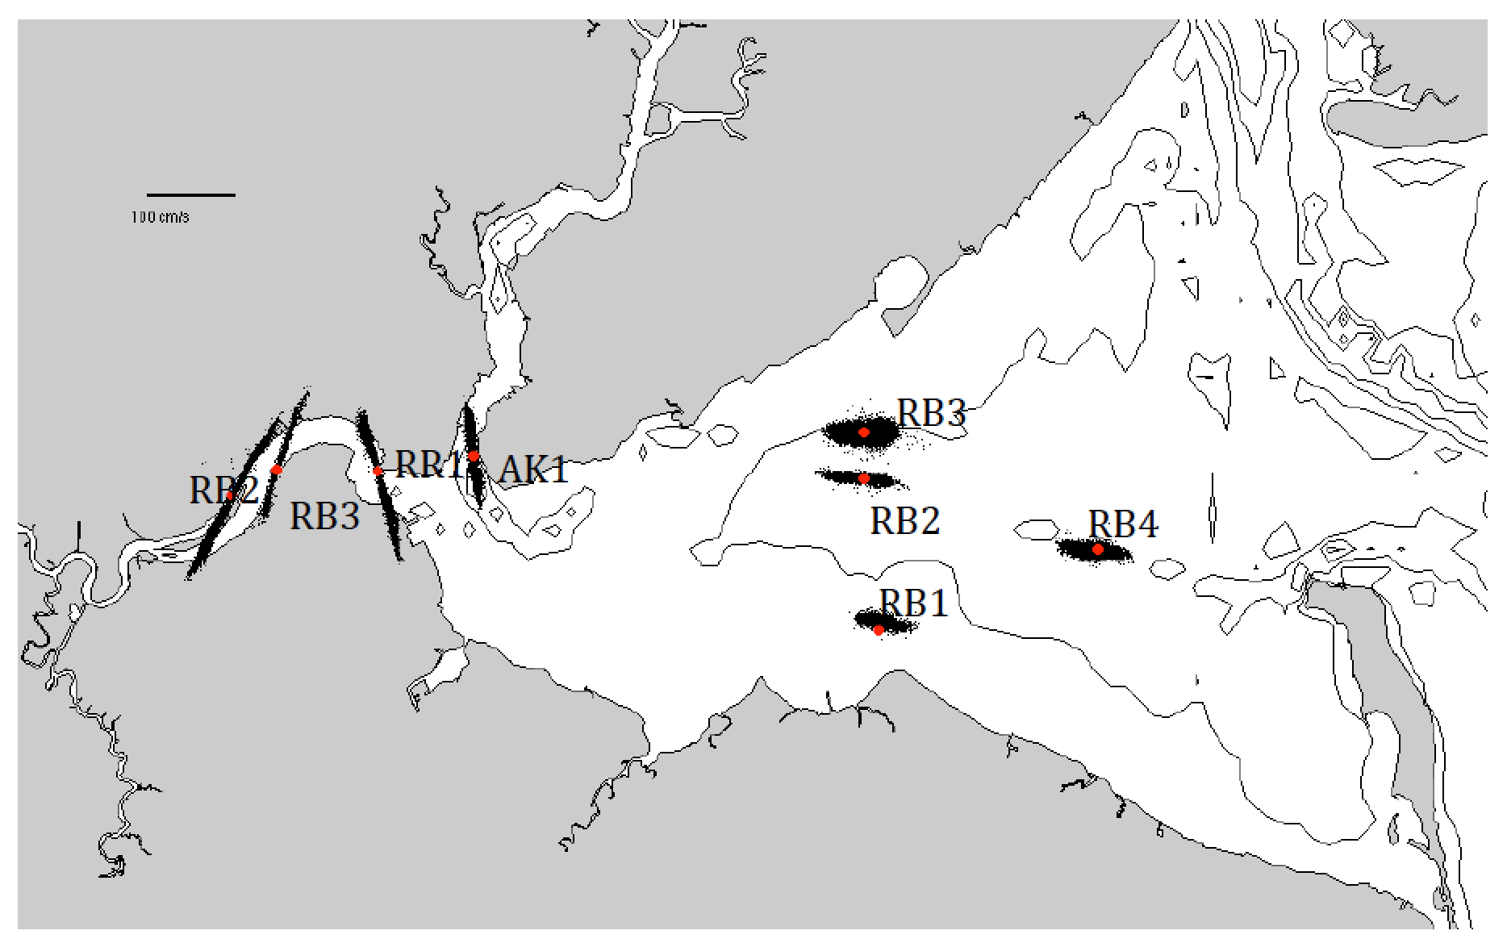
To complement the ship spatial efforts, to set up the permanent instrumented nodes throughout the River
Looking Forward: Building Faculty Excellence & Transforming Student Experience
Creation of river network
Installing sensors
Long term monitoring in the River
Chant and Kohut 2012

Slide 14
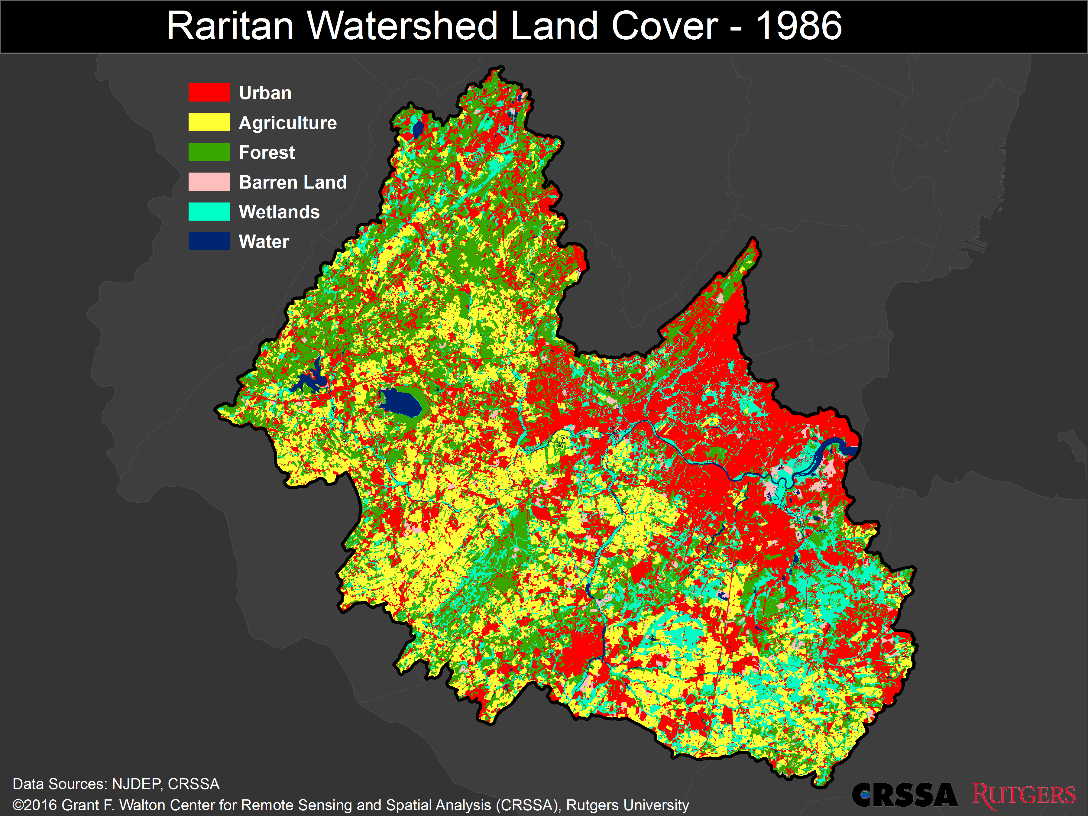
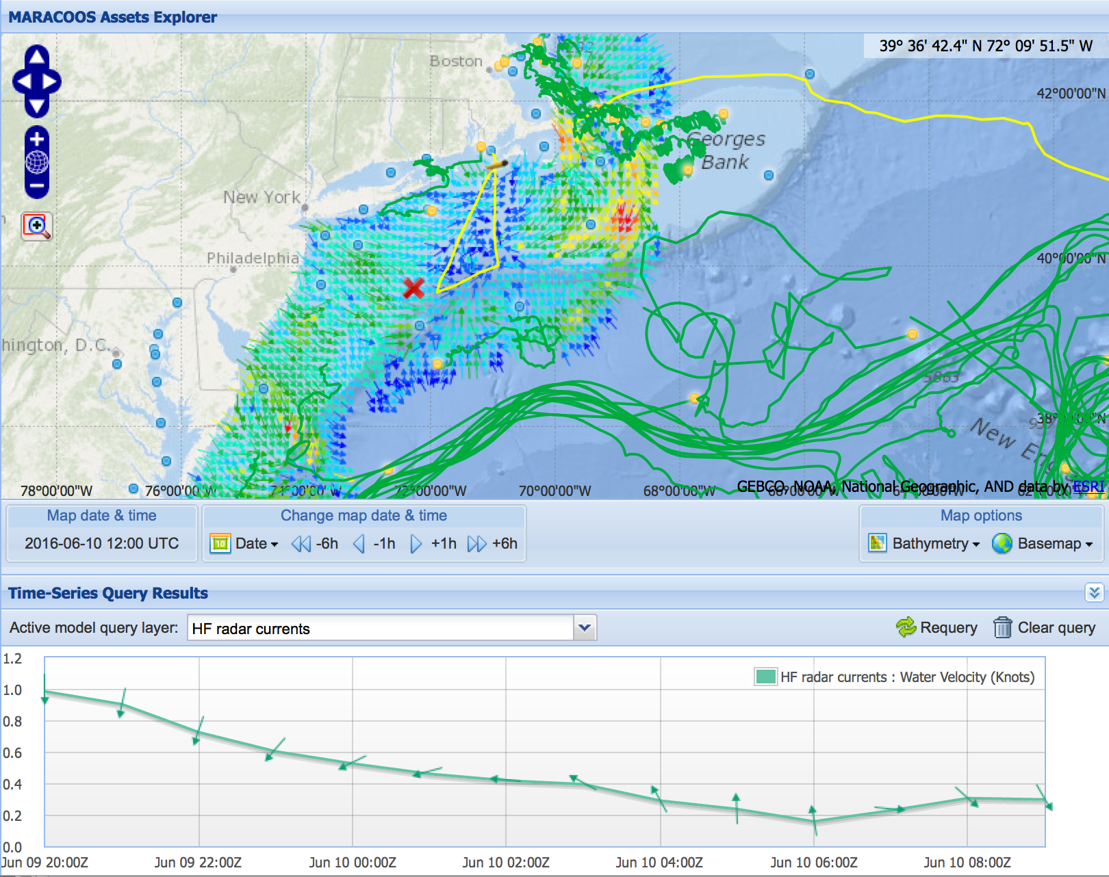
Looking Forward: Building Faculty Excellence & Transforming Student Experience
Newly developed River network embedded with great assets Rutgers leads
Enable holistic research & classes looking at the integrated system we live
WATERSHED
MARINE SYSTEM
Watershed data-systems (CRSSA)
New Jersey Ocean (RU COOL)

Slide 15
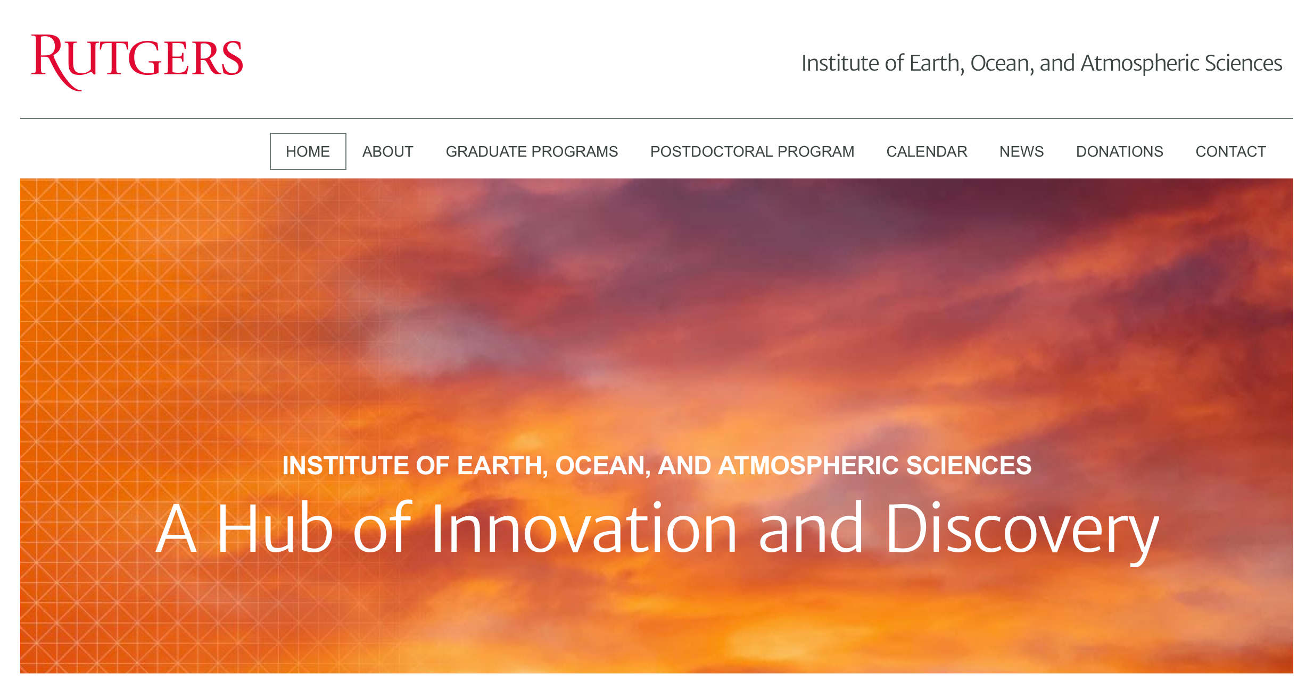
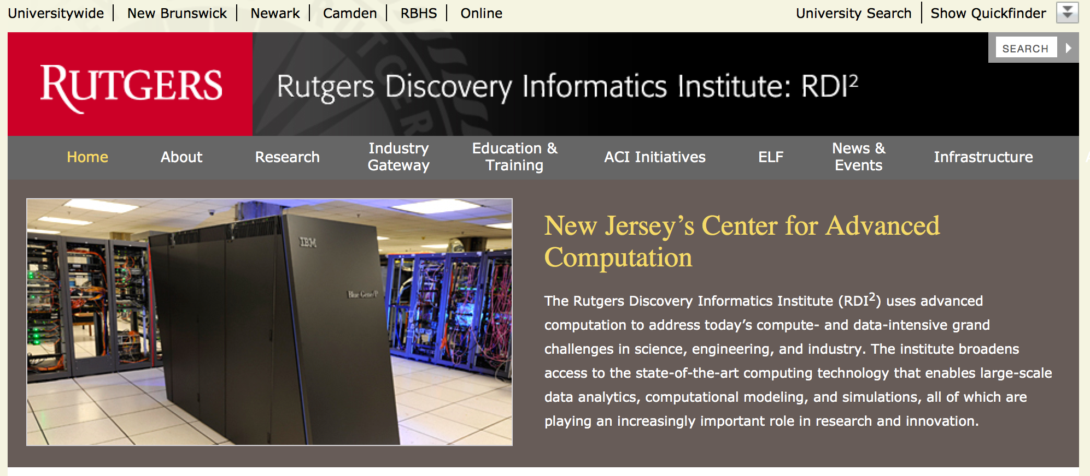
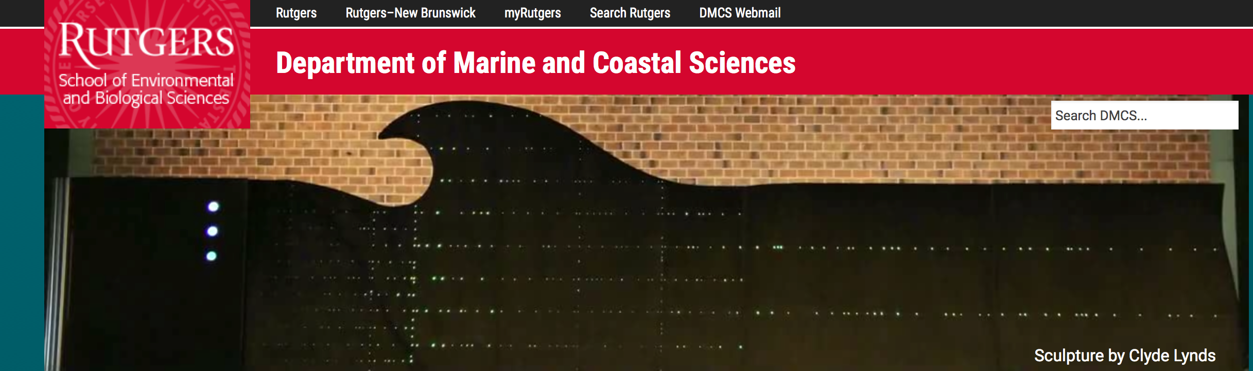
Looking Forward: Building Faculty Excellence & Transforming Student Experience
Planning underway for a symposium for Spring 2017 focused on cyber-environmental tools.
-Taking advantage Rutgers owns some of the largest environmental databases in the world.
-Developing modes that enable Computer Science faculty and students to develop tools/algorithms that might enable synthesis and extract knowledge
-Environmental/Computer Sciences for competitive hackathons for directed user needss

Slide 16
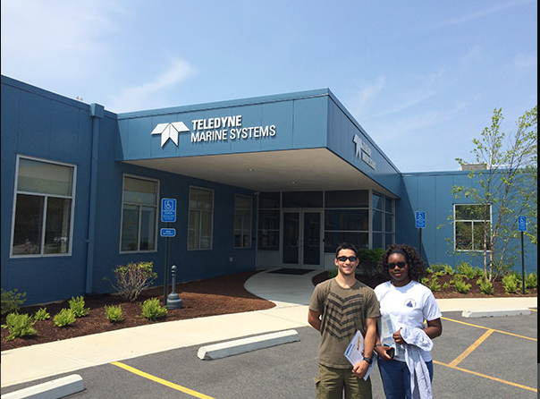
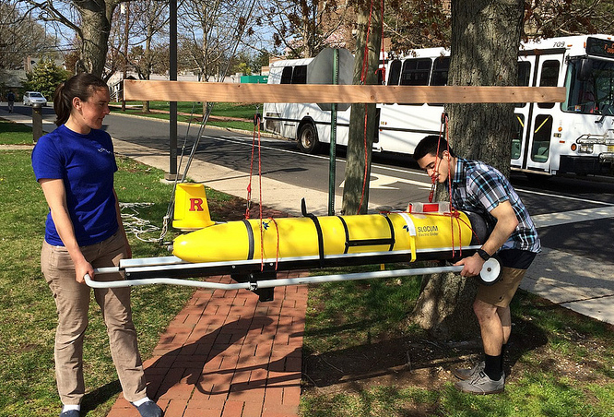
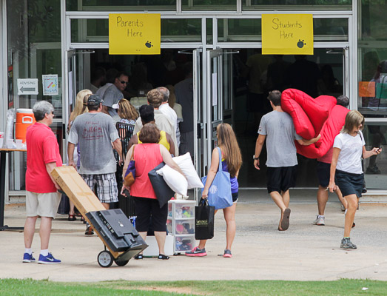
Looking Forward: Building Faculty Excellence & Transforming Student Experience
Grad School
(MS or PhD)
Seniors (trying to graduate, completion)
Research in Lab
Earth Systems, PO, CO, BO ….
Advanced courses
Typical
Faculty
2-3 students/academic year
Marine Dynamics,
Core Courses (Theory)
Choose a major
English, Inorganic Chem, Calculus, Intro Oceanography ….
Intro Courses, Required Course Loads
Freshmen (maybe focused)

Slide 17
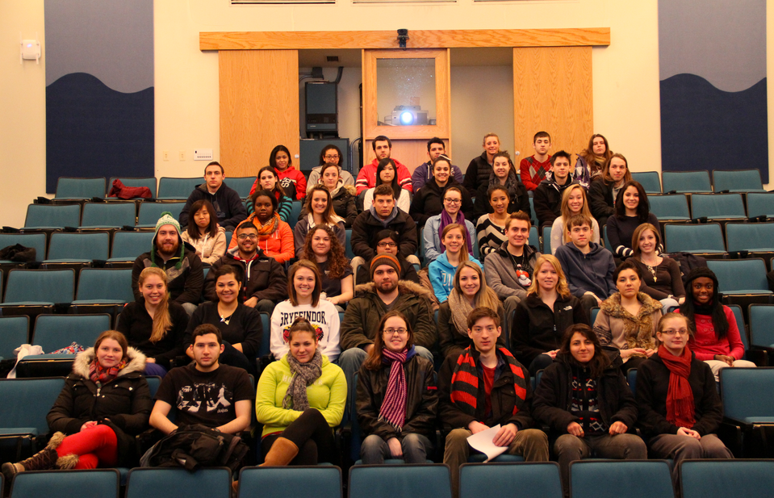
Looking Forward: Building Faculty Excellence & Transforming Student Experience
Grad School
(MS or PhD)
Seniors (trying to graduate, completion)
Research in Lab
Advanced courses
Typical
Faculty
2-3 students/academic year
Core Courses (Theory)
Choose a major
Intro Courses, Required Course Loads
Freshmen (maybe focused)
(hundreds of new students in the field)

Slide 18
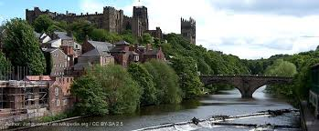
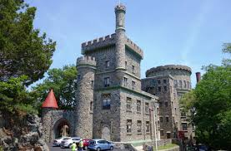
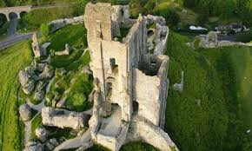
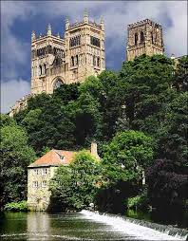
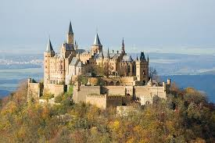
Looking Forward: Building Faculty Excellence & Transforming Student Experience
Our Universities still largely remain full of ivory tower fiefdoms with limited integration across majors, getting better but still long way to go
Physics (we have lots of potential energy)
Engineering (we solve problems)
History (we have the long view)
Art
(we have soul)
Marine Science (we’re deep)

Slide 19
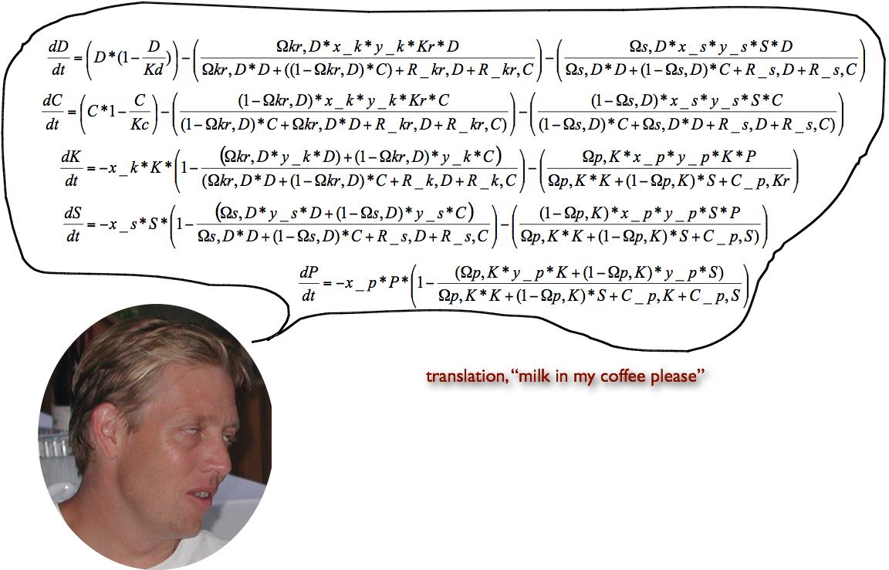
Looking Forward: Building Faculty Excellence & Transforming Student Experience
How can be better communicators?
VERY IMPORTANT GIVEN USUAL MODE BY WHICH SCIENTISTS COMMUNICATE

Slide 20
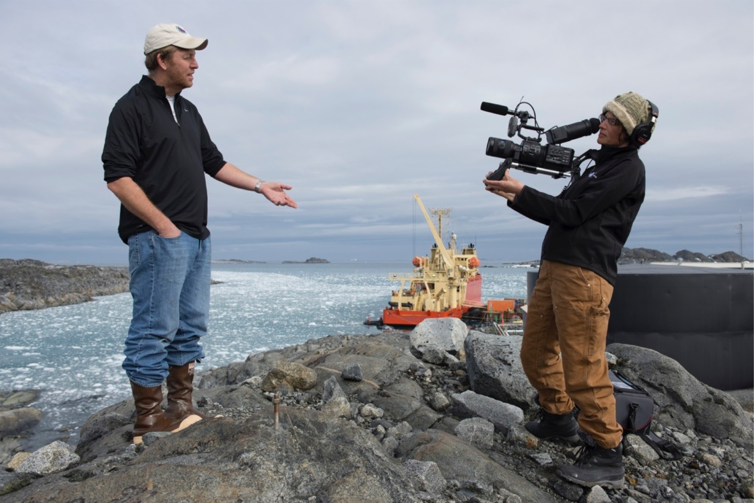
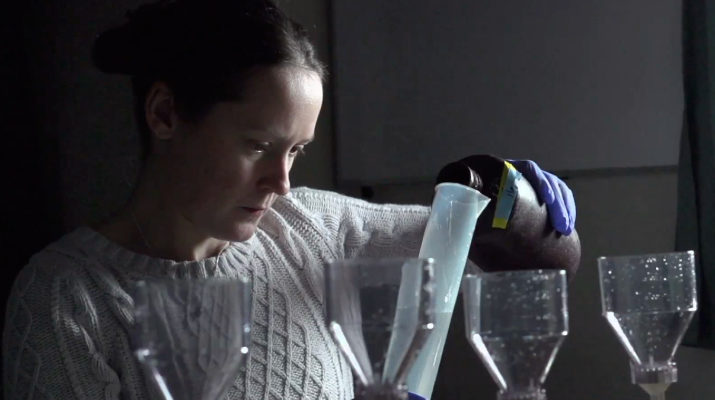
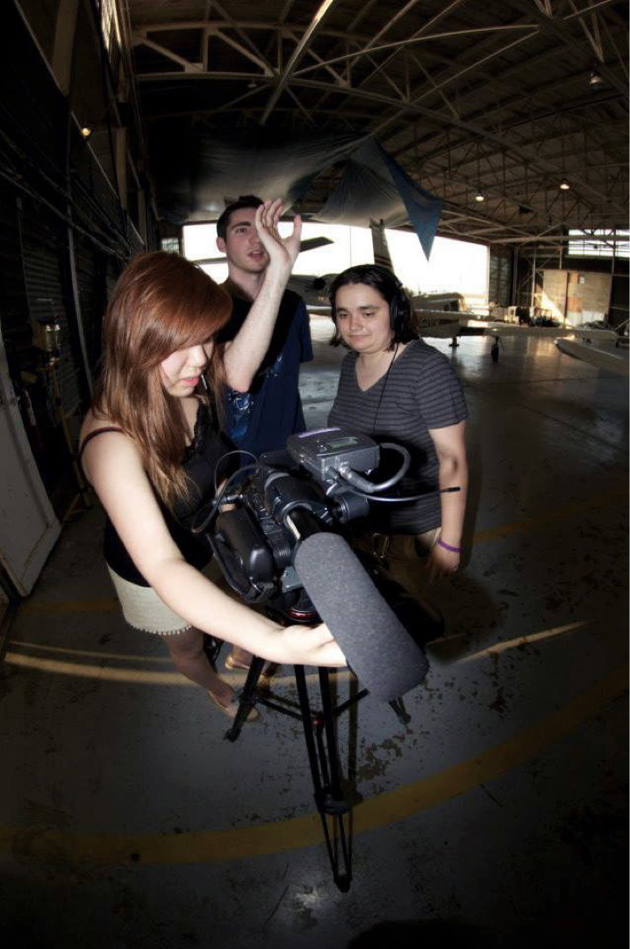
Looking Forward: Building Faculty Excellence & Transforming Student Experience
Breaking down the barriers between sciences and humanities for capturing stories, images, inspiration
-Mason Gross Digital Film-making
-Human Ecology Science Communication

Slide 21
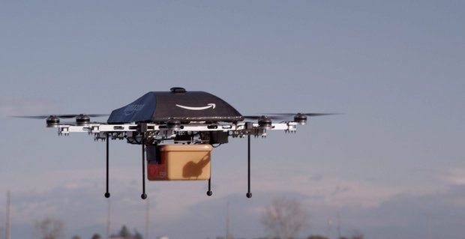
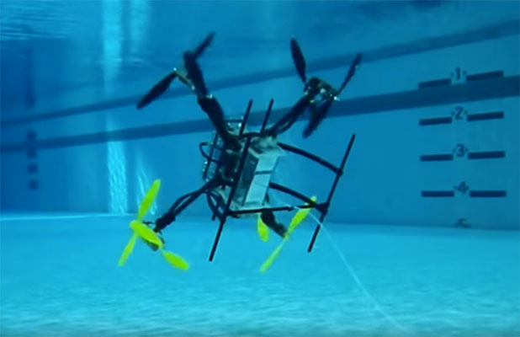
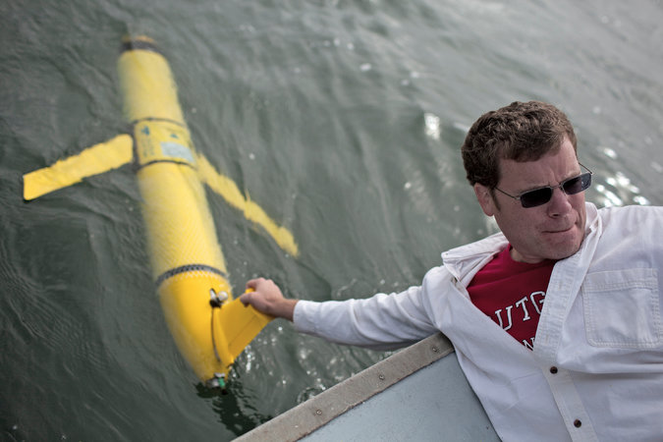
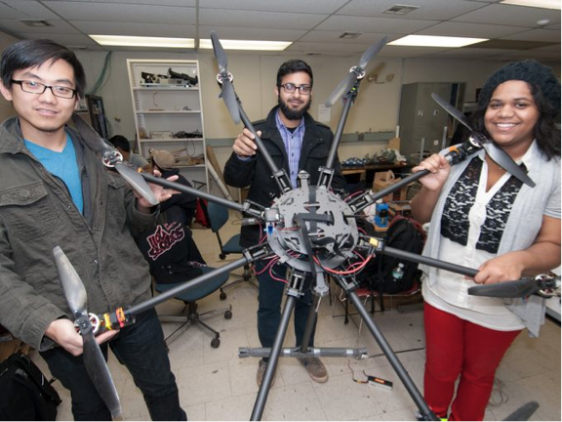
Looking Forward: Building Faculty Excellence & Transforming Student Experience
Developing new approaches to study the Raritan Watershed: Tapping into the unique Rutgers strengths in robotics and autonomous sampling

Slide 22
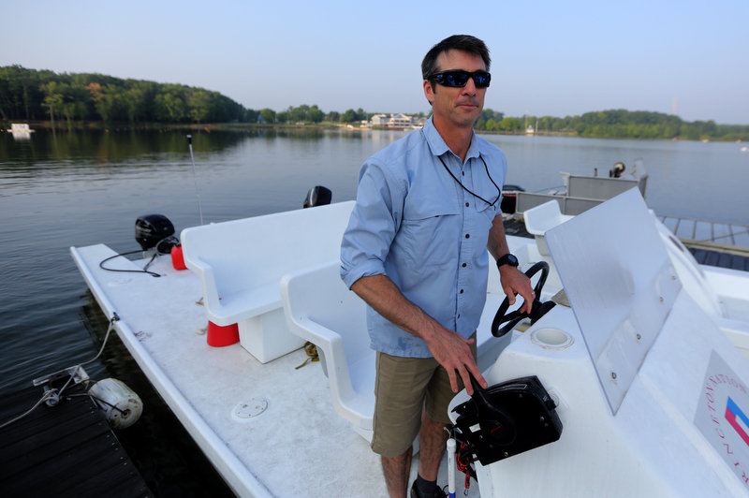
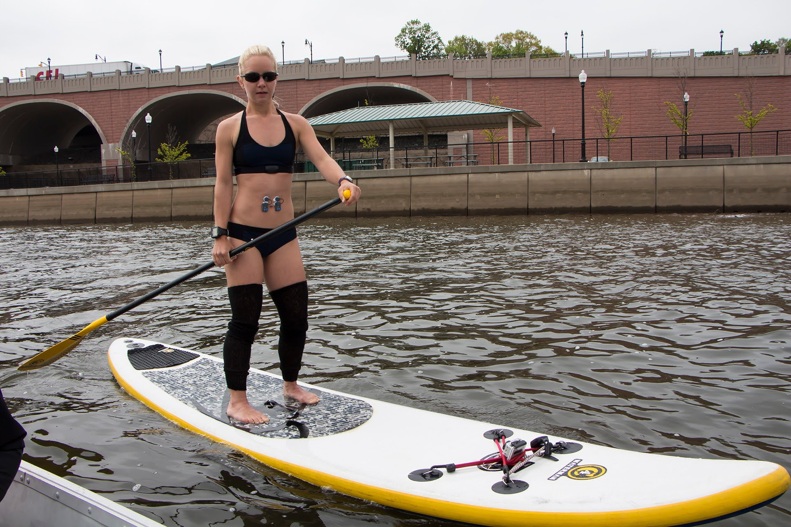
Looking Forward: Building Faculty Excellence & Transforming Student Experience
New courses cutting across the University to provide students unique skill sets.
Developing partnerships between RU athletics and Schools of Environmental and Biological Sciences, Engineering, Bloustein and Arts & Sciences
-Developing professional certificates environmental sampling
-Outfitting recreational activities kayaks with small sensors that make every trip to collect valuable data
-Make student activities collect research and environmental stewardship by all vessels, platforms and environmental stewardship
-Make humans data-points to better understand how humans interact with the environment

Slide 23
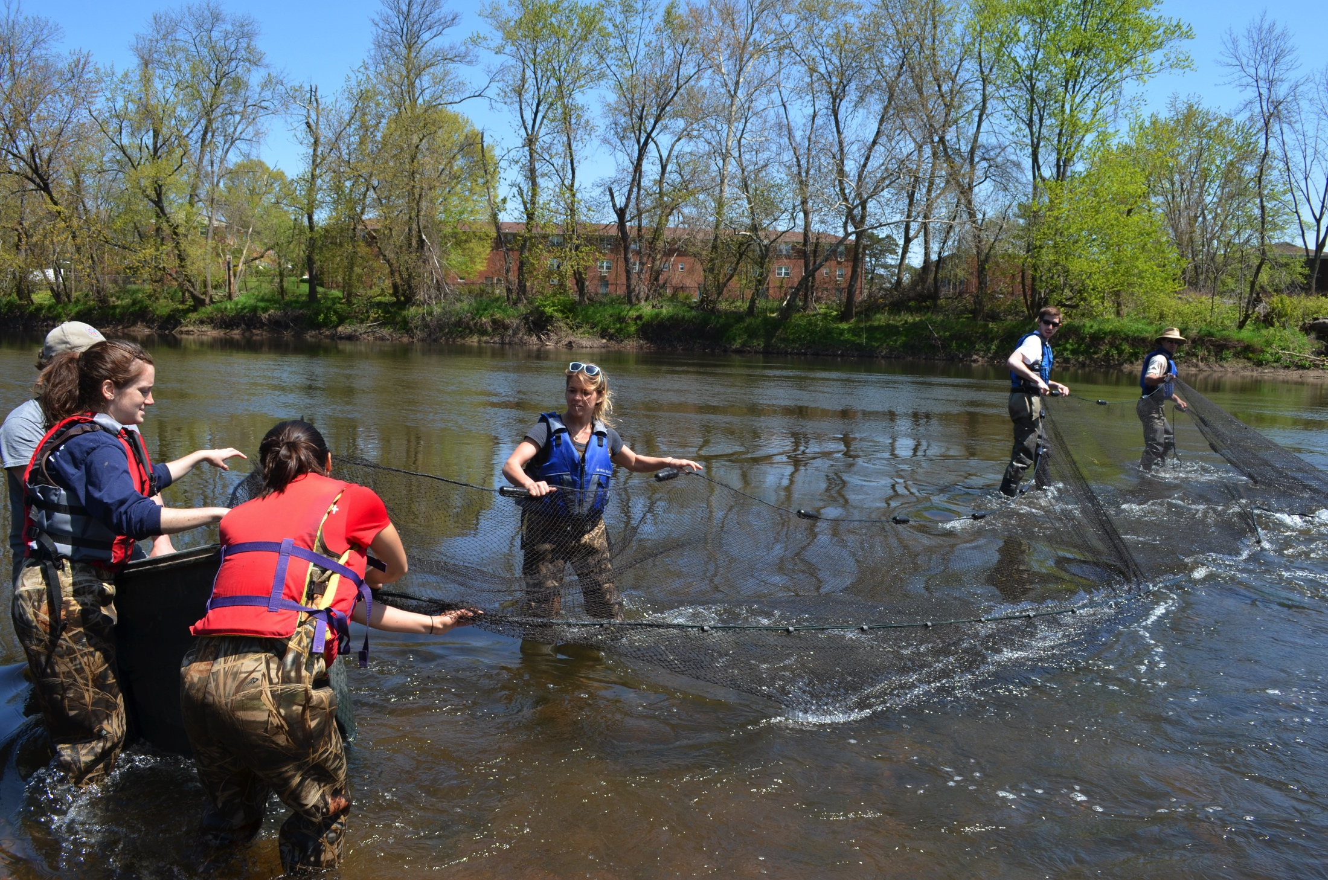

Looking Forward: Building Faculty Excellence & Transforming Student Experience
Entraining students to work with community groups, providing a firm message of service and learning through giving, activity for the good of society and the university
Volunteer with Prof. Olaf Jenson’s Shad and River Herring Tagging Project
Collect Samples and Investigate Water Quality with the Raritan Headwater’s Association Stream Monitoring Program

Slide 24


Looking Forward: Building Faculty Excellence & Transforming Student Experience
Conclusions:
-The Raritan will be a central tool for Rutgers research/engineering excellence
-Rutgers student will learn and work in the Raritan
-Raritan which was a barrier will become a magnet linking the Rutgers community across schools

