Slide 1
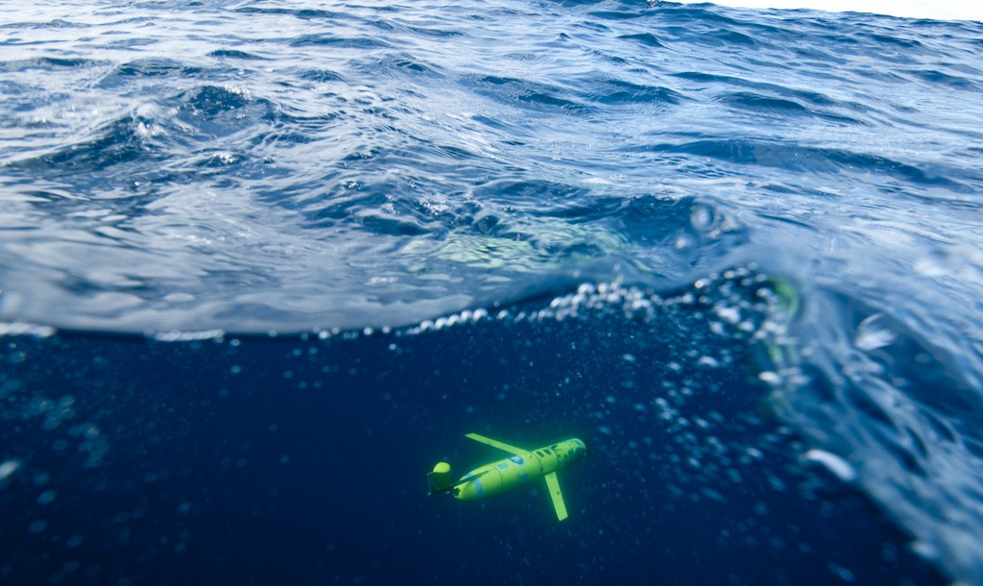
Globalizing Frontier Technologies
RUCOOL GLIDER
APPLICATIONS
Conclusions:
1) Gliders are mature
2) They allow small groups to have a global presence
3) Applications are diverse
Scott Glenn, Oscar Schofield, Josh Kohut, Clayton Jones, Doug Webb, on behalf of many!

Slide 2

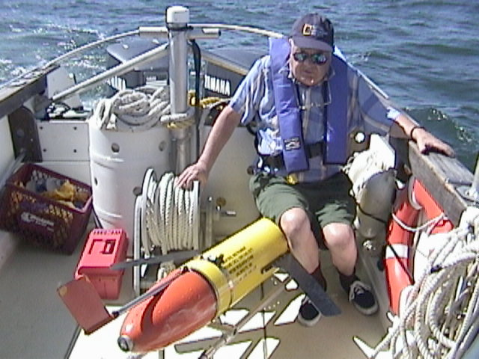
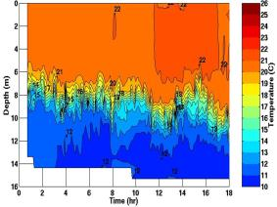
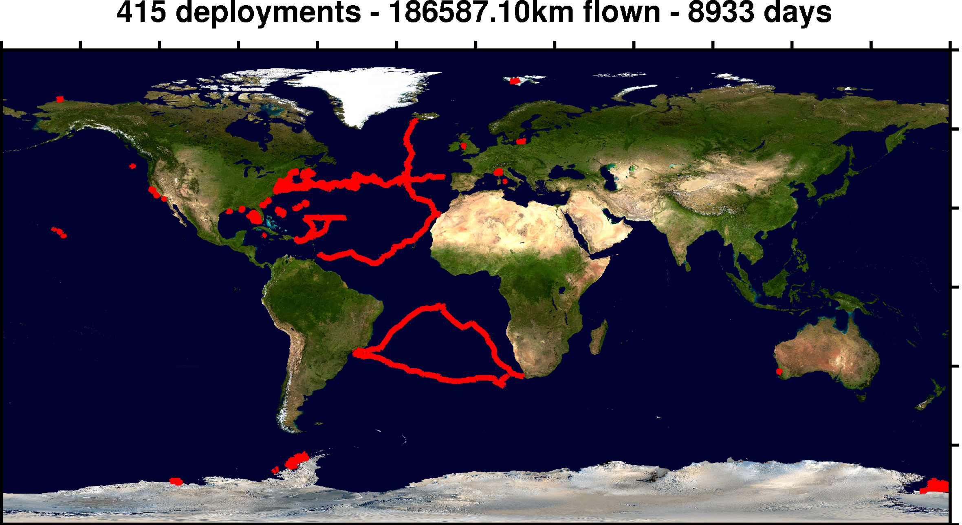
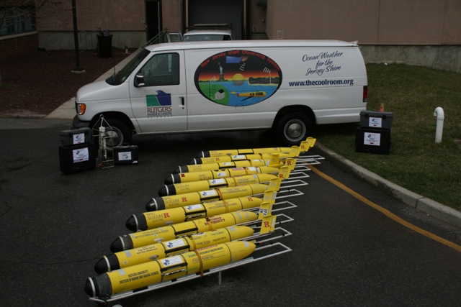
Doug with first at sea test
Glider history
1989 (Stommel’s
Sloccum Mission)
1999 (Test Flight)
2003 (First cross
shelf mission)
Time
2006 (First
Antarctic mission)
2009 (First
Basin Crossing)
2011-2012
(Hurricane missions)
2013-2016 (South
Atlantic gyre w/
Challenger)

Slide 3
















RI
U..
Middle Atlantic
Regional Association
Coastal
Ocean Observing System
10 States - 76 Million People
1000 km Cape to Cape
CT
Cape
Cod
MA
NY
PA
NJ
DE
>40 PIs
>20 Institutions
>50 Members
>2000 Contacts
MD
Our Test Bed for hardening the technology
VA
NC
Cape
Hatteras

Slide 4

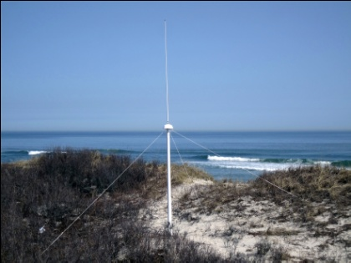
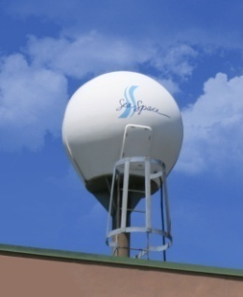
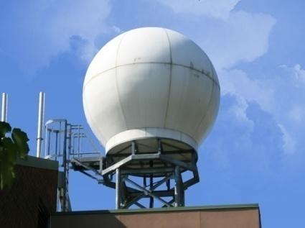
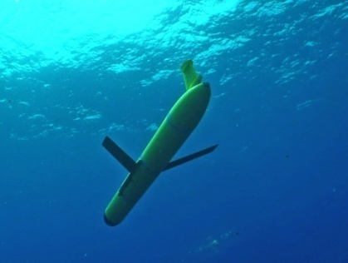
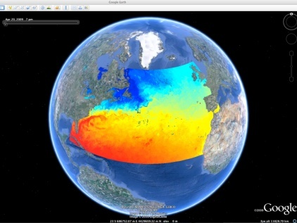
RUTGERS UNIVERSITY
Center for Ocean Observing Leadership
Vessels -
Satellite
Satellite
CODAR
Ships/ Vessels
Glider
REMUS
Data Vis.
Modeling
Security
Leadership
Education
CODAR Network
L-Band & X-Band Satellite Receivers
Glider Fleet
3-D Nowcasts
& Forecasts

Slide 5
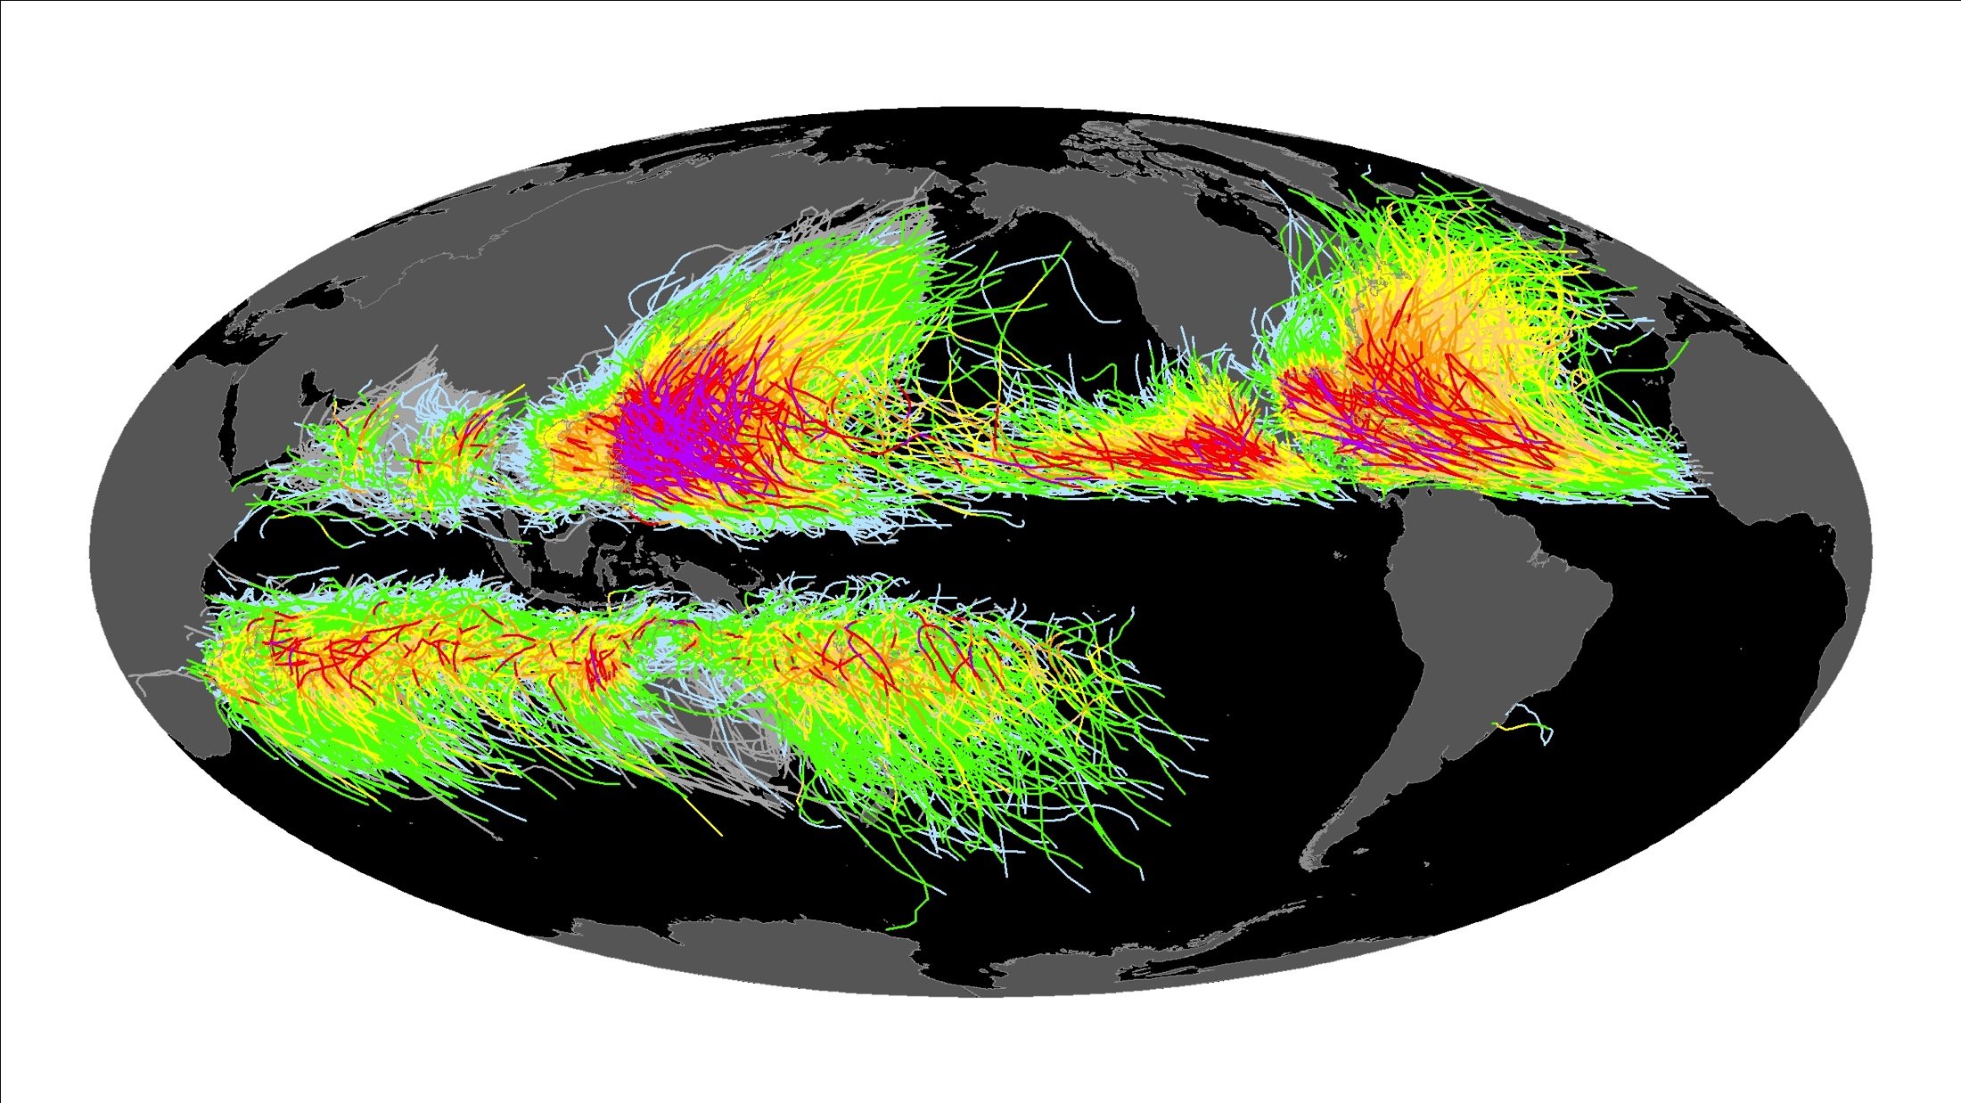
Forecasting of hurricane/typhoon track has improved over the last 20 years
Forecasting of hurricane/typhoon track has NOT improved over the last 20 years

Slide 6


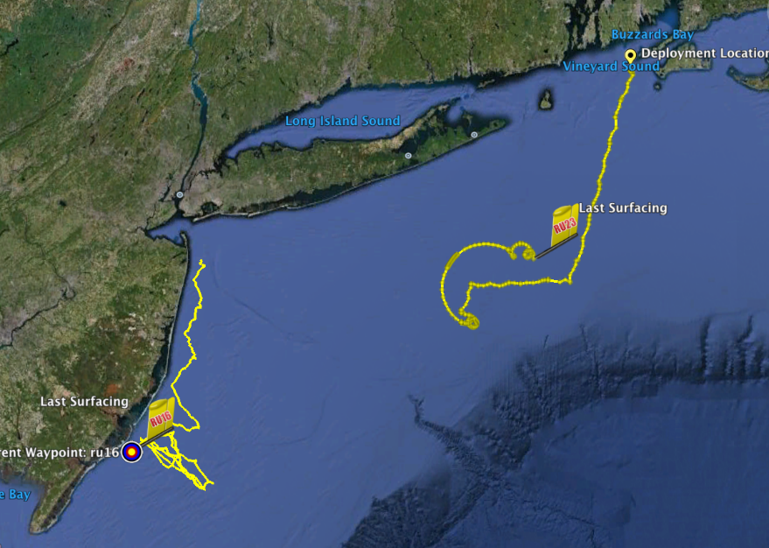
Hurricane Irene
August 27-28, 2011
Irene approaches the Mid Atlantic Bight
Coastal Observatory
Two Gliders Deployed

Slide 7
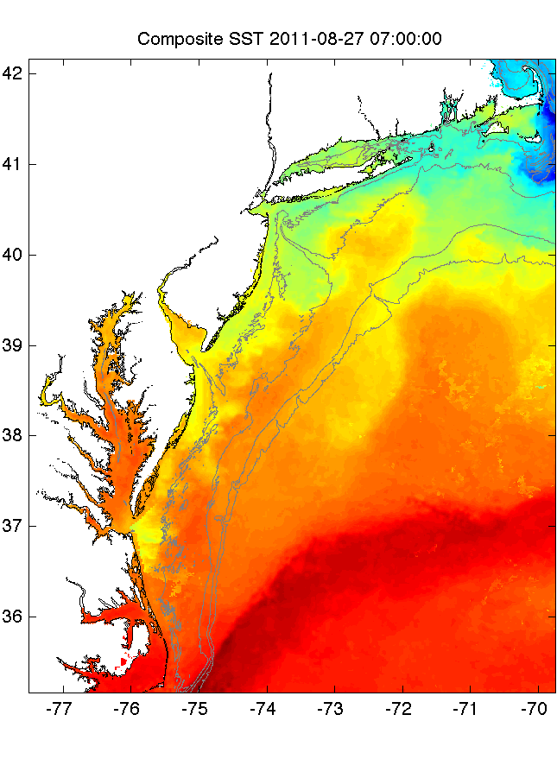
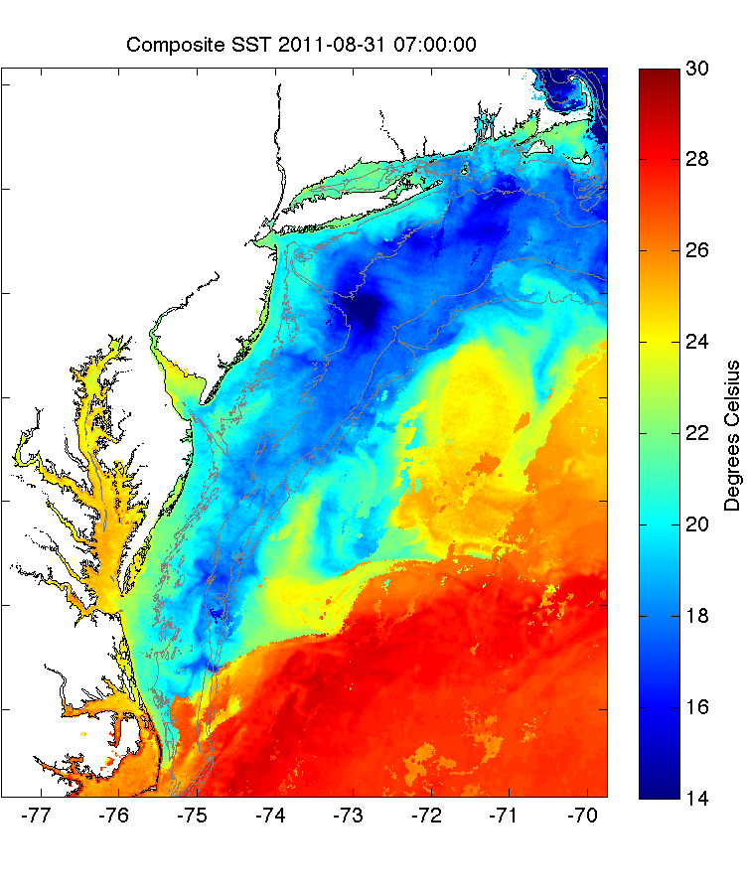
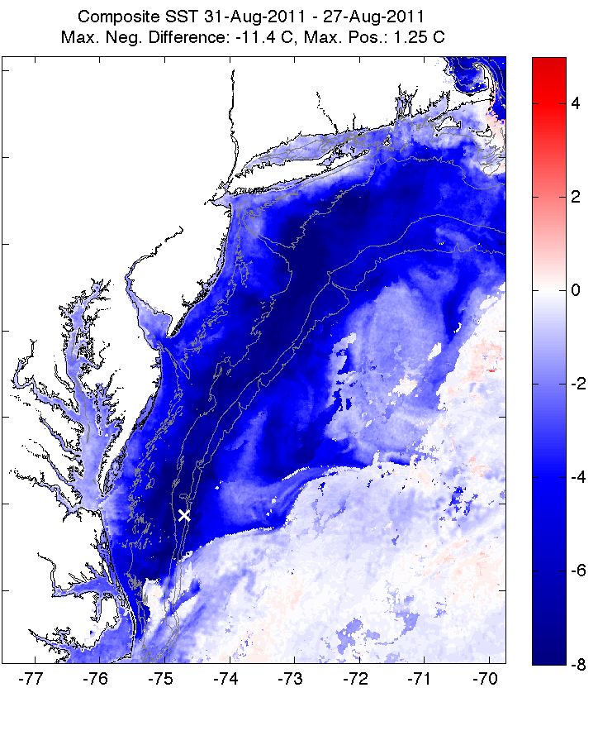
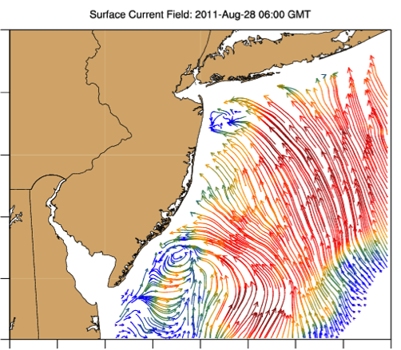
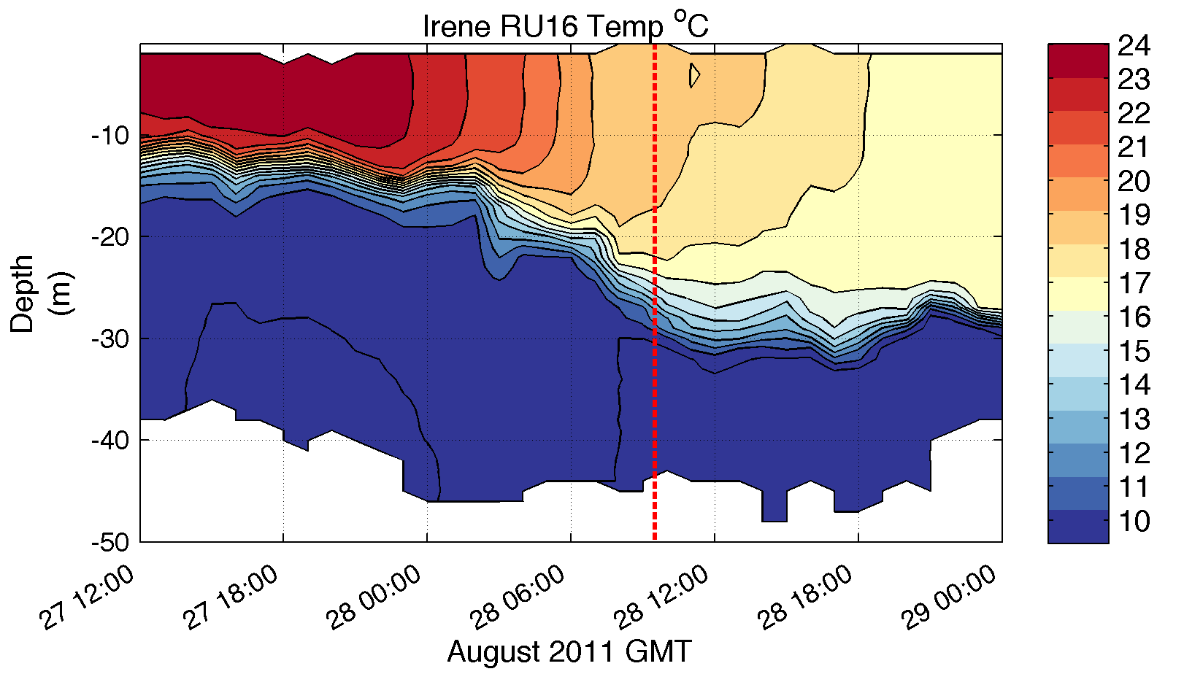
Pre-Irene
Post-Irene
Difference
11C max Cooling
WHAT?
Satellite
SST
WHEN? Glider Temperature
WHY?
HF Radar
Currents
Eye Passage
?

Slide 8
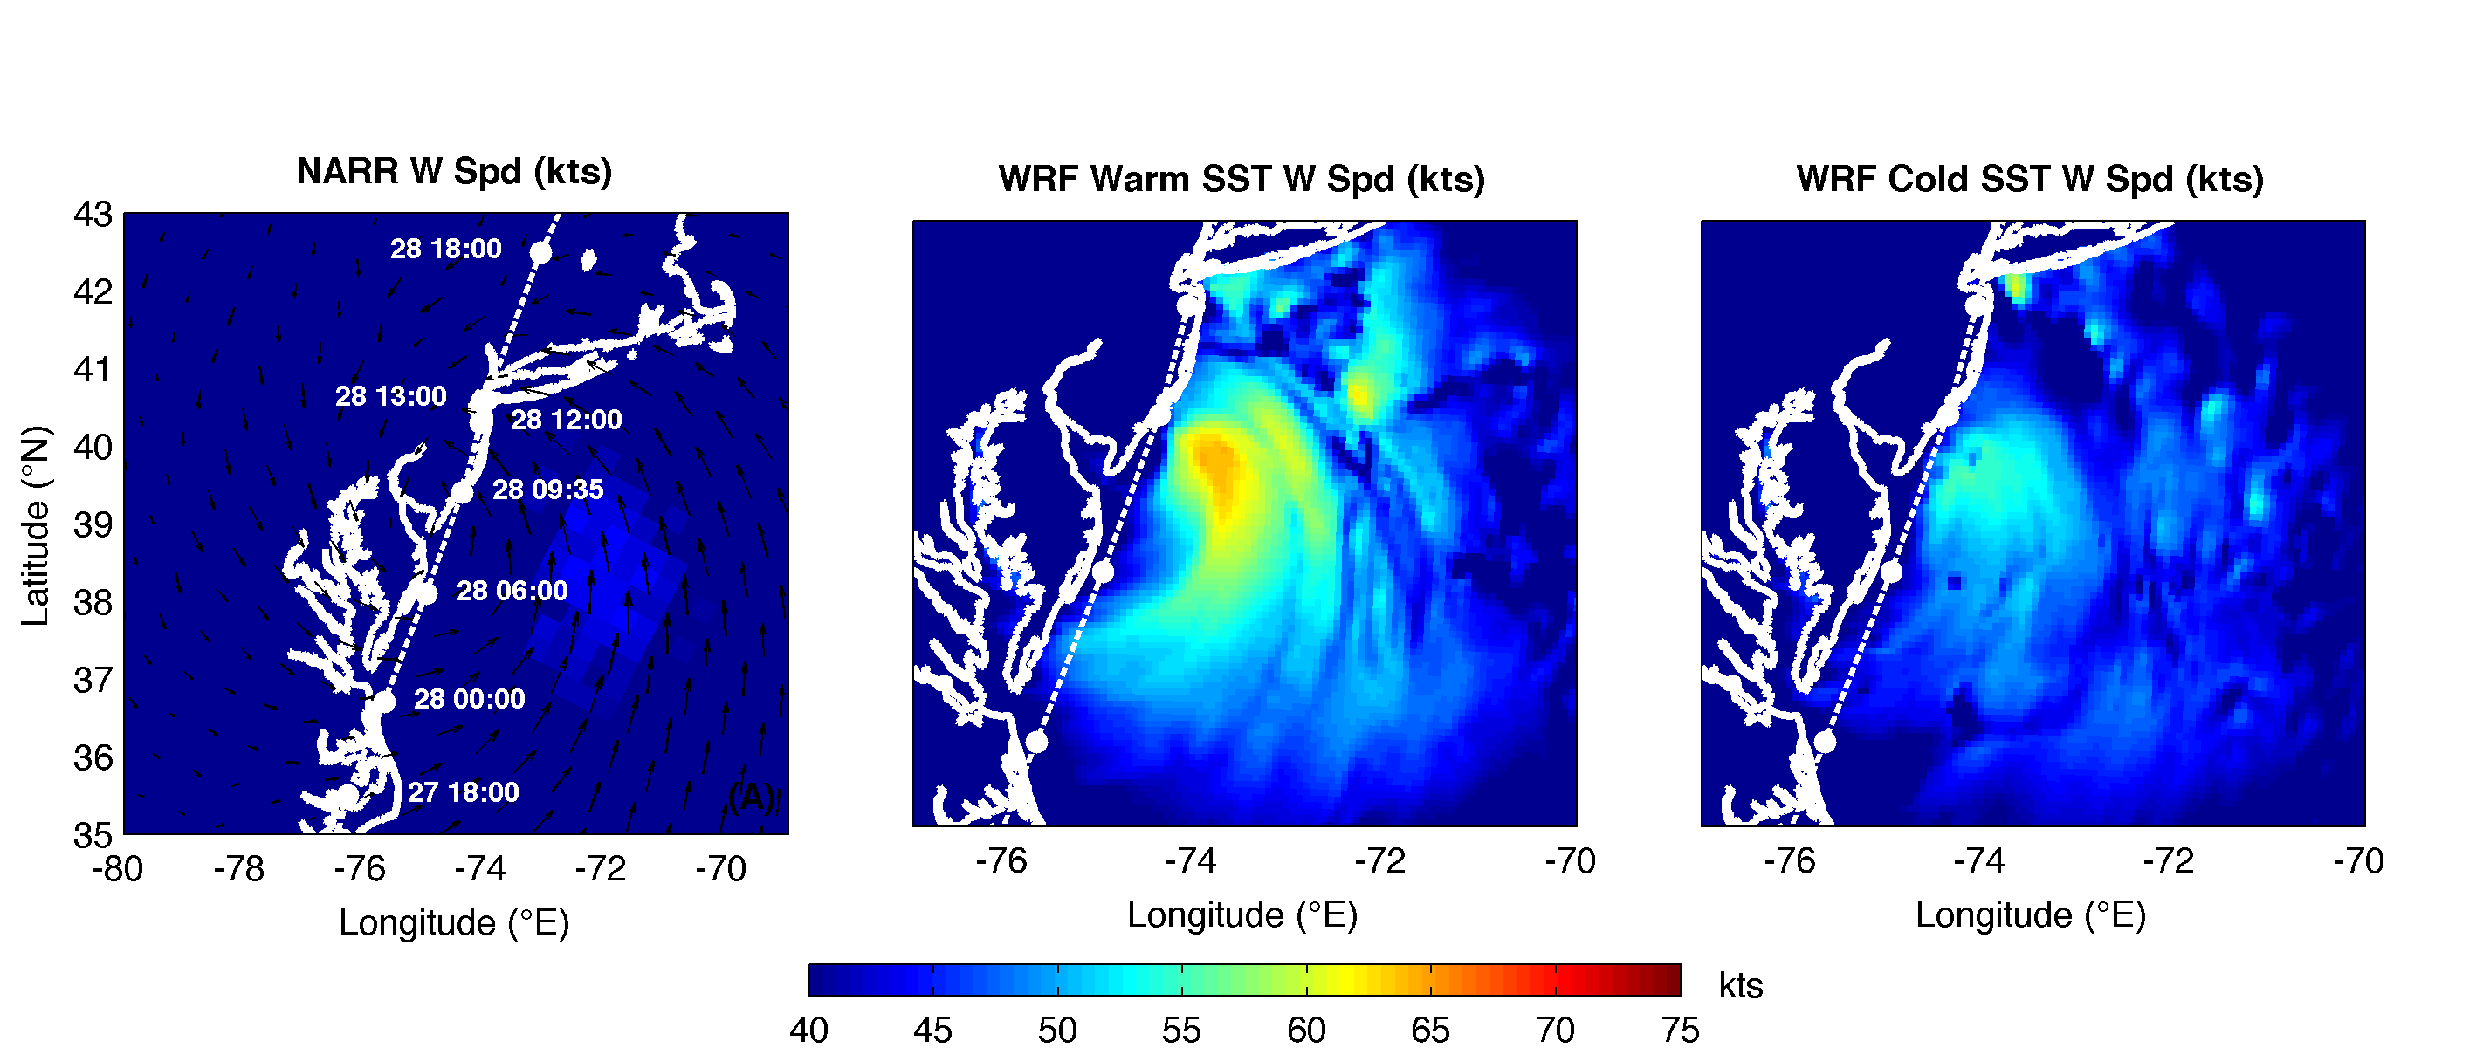
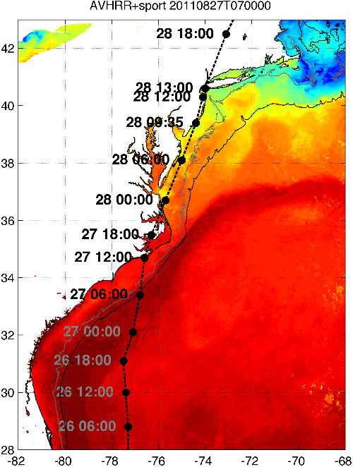
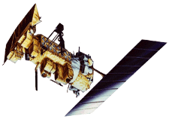

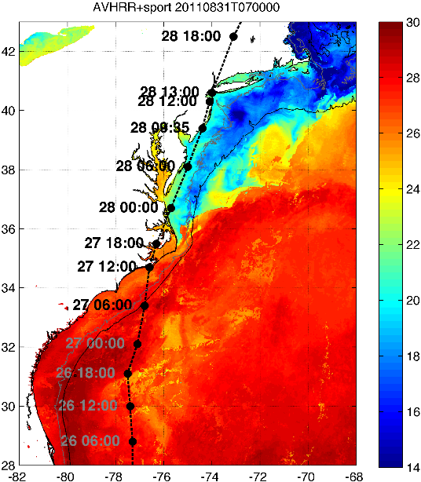

Rutgers Atmospheric Forecast Sensitivity Study
Warm Ocean
Boundary Condition
Cat 1 Hurricane
Tropical Storm
Cold Ocean
Boundary Condition
IMPACT?
>10 knots reduction in peak wind speed

Slide 9


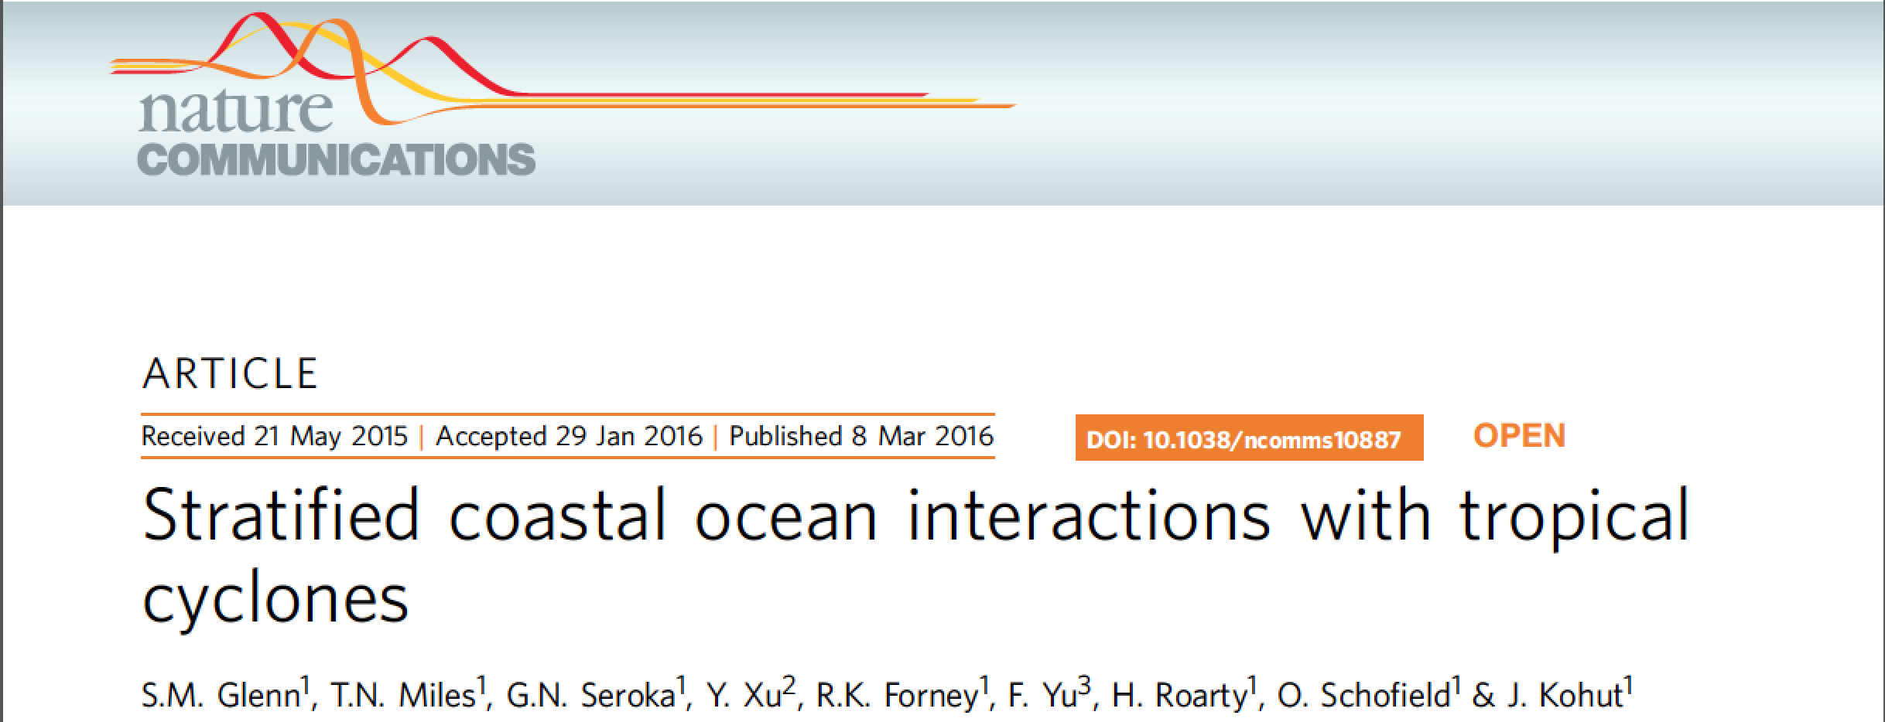
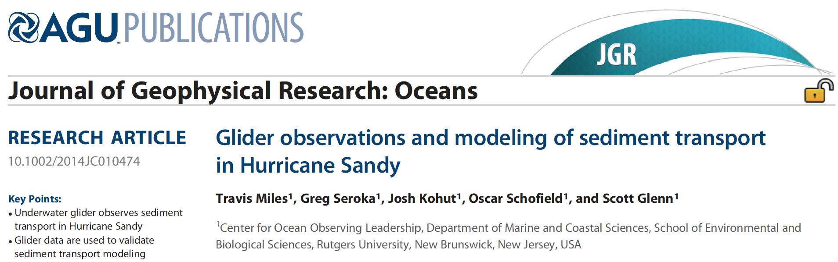
Summer Storm
Strong Stratification
Coastal Response
Mixing Cooled Surface
Limited Intensity

Slide 10
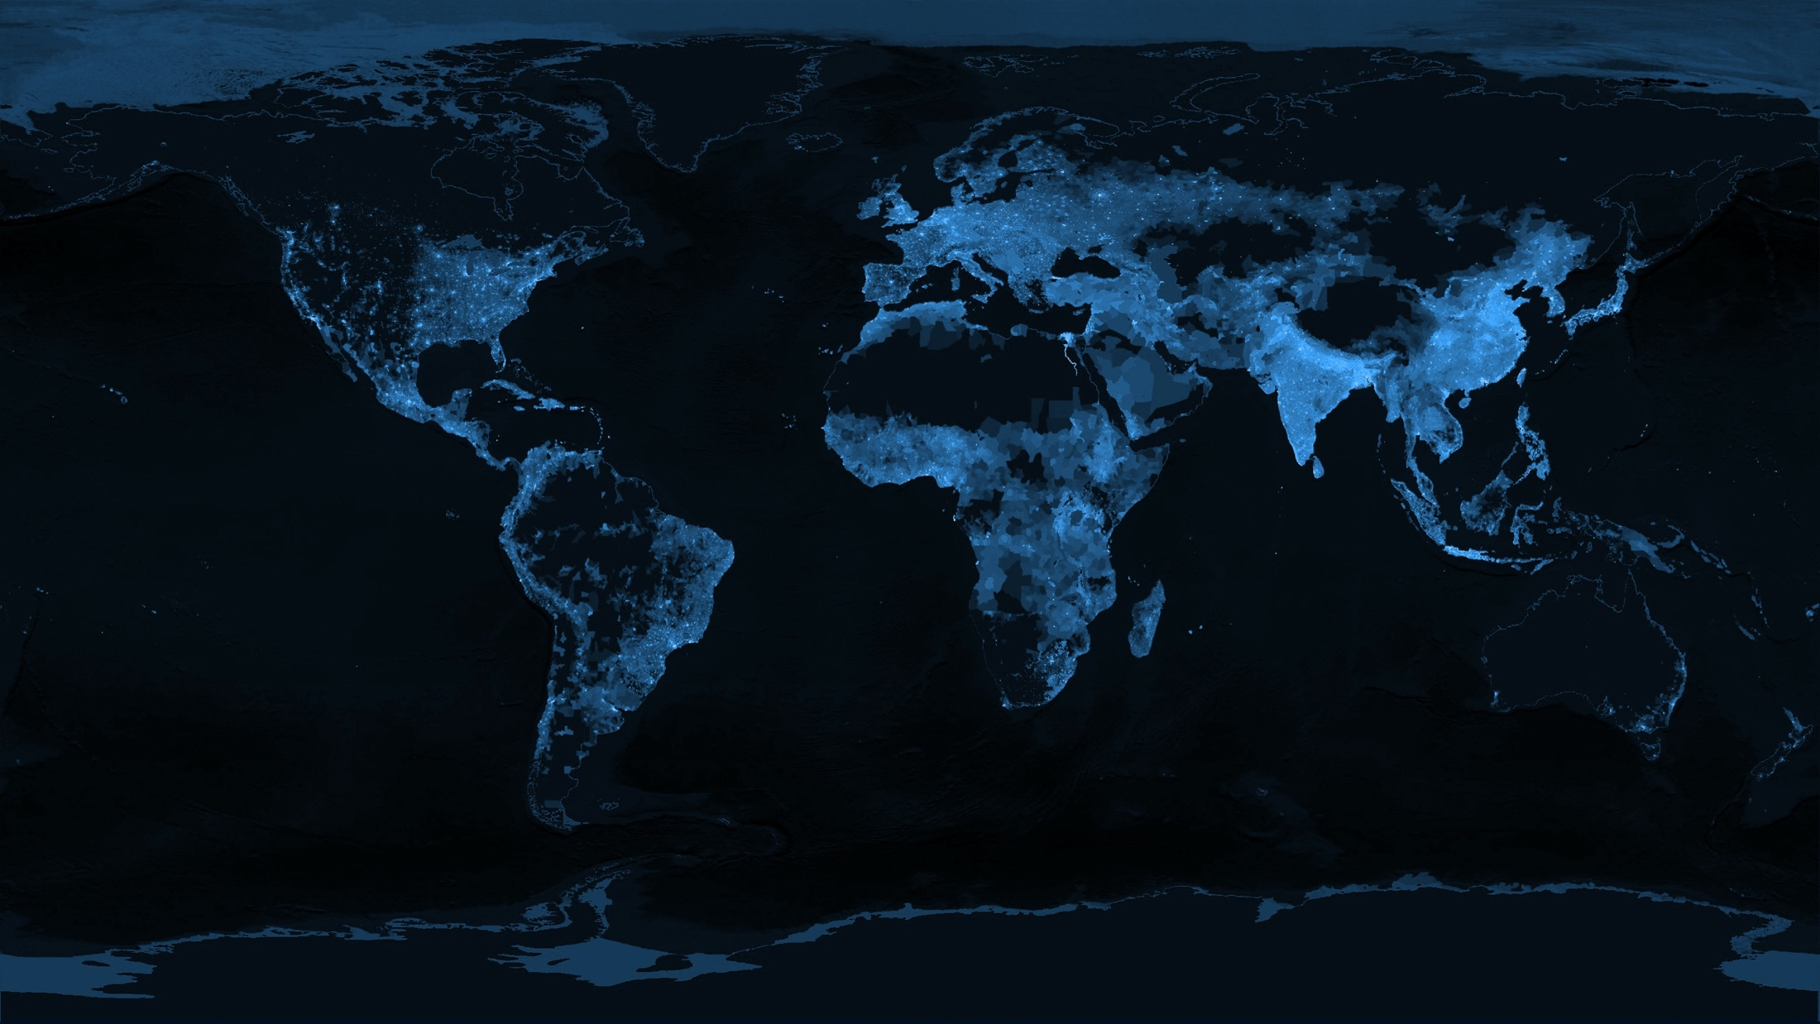
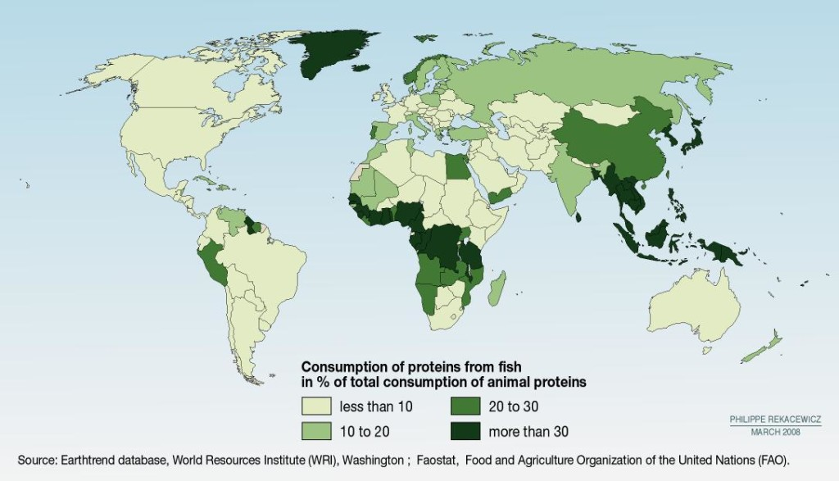
Humanity and sustainability/management of coastal systems
Human populations growing and increasingly migrating to the coastlines with currently 13 of 20 global megacities on the coast. This is exerting significant stress on coastal systems.
Humanity, especially in the developing world increasingly rely heavily on oceans for their food. Increased need for new ways to ensure sustainable fishing and aquaculture

Slide 11
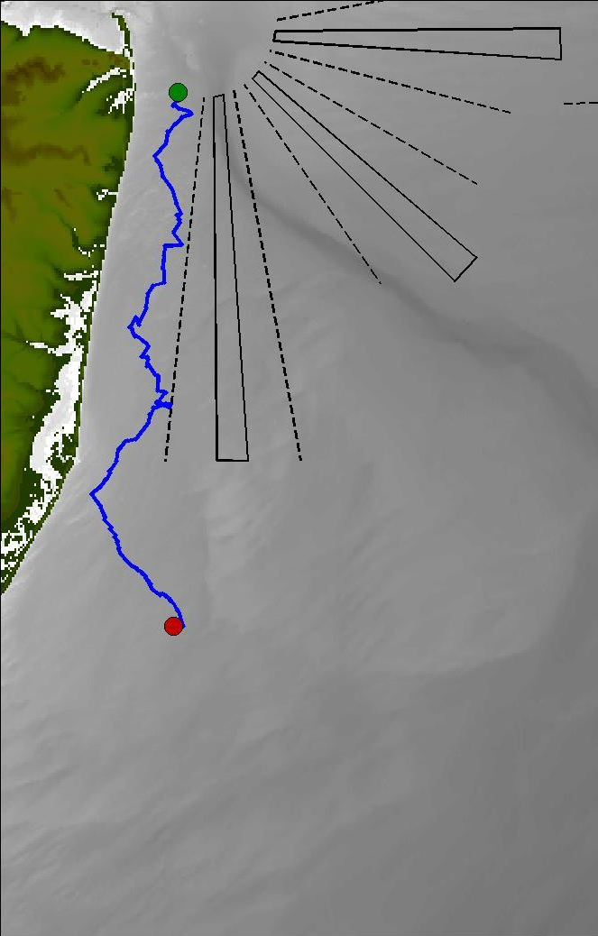


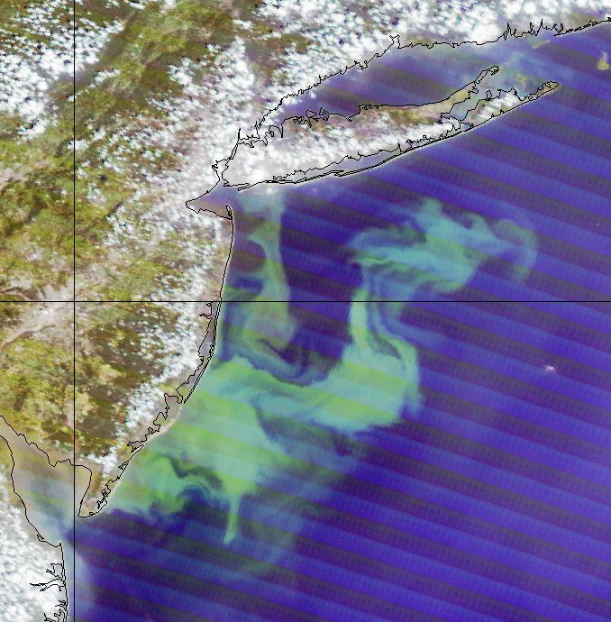
State of New Jersey is now using gliders to map summer water quality. Is low bottom water oxygen due to outflows from the New York city or is a naturally driven by natural dynamics.
State sponsored state wide surveys providing 3-4 missions each summer, and provides close to 10,000 profiles/summer as opposed to ~150 profiles/summer by ship/
New York
city outflow
Upwelling driven
phytoplankton bloom

Slide 12
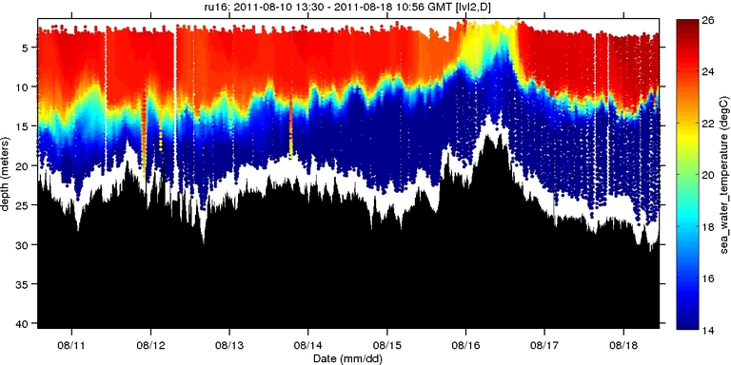
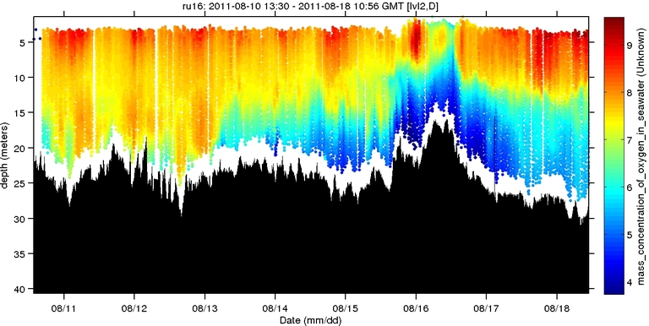
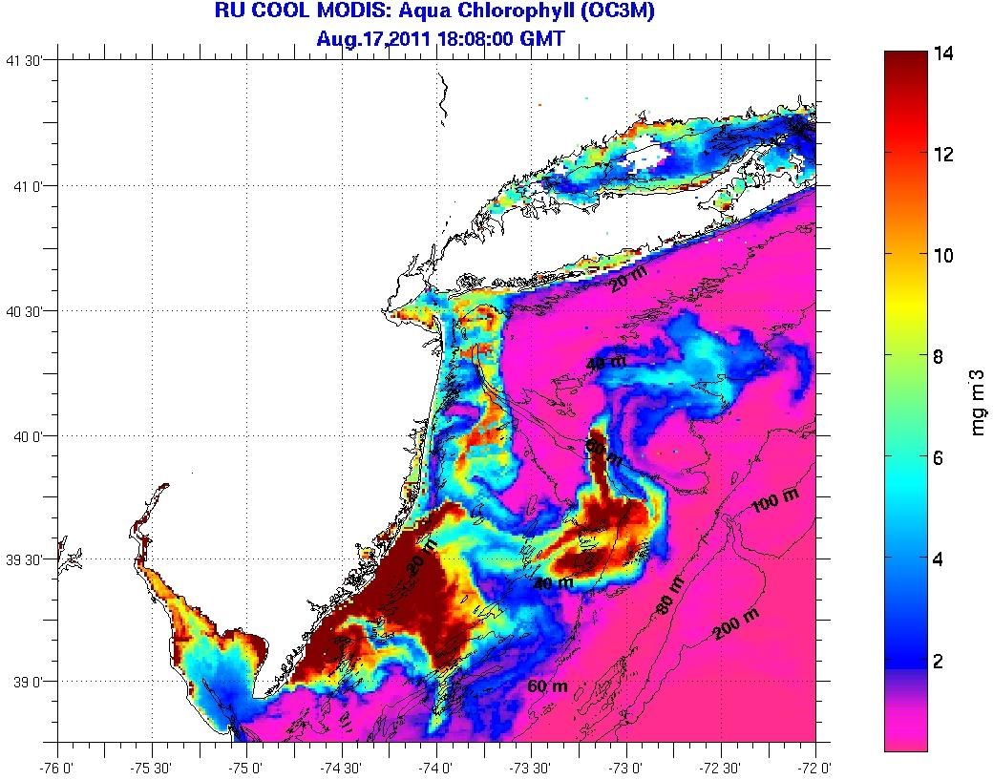
Autonomous Platforms:
Dissolved Oxygen
2011-2012
Temperature (°C)
Dissolved Oxygen (mg/L)

Slide 13
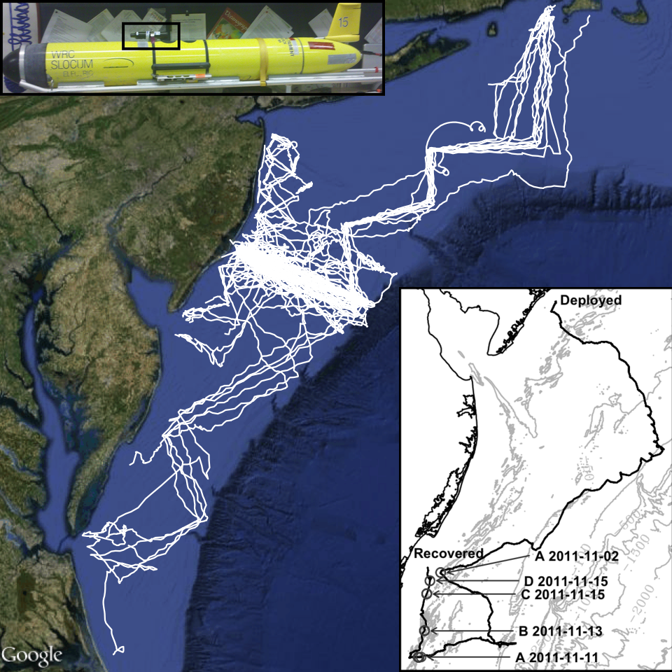
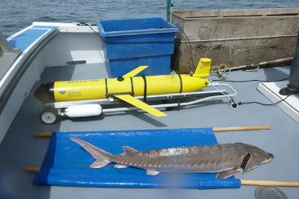

Receiver Integrated Glider
Mobile tracking of offshore environments
Reach currently unmonitored areas
Natural addition to ongoing research
Increase understanding of fisheries interactions
New templates for future fishery management based on dynamic fish populations living in a dynamic ocean.

Slide 14
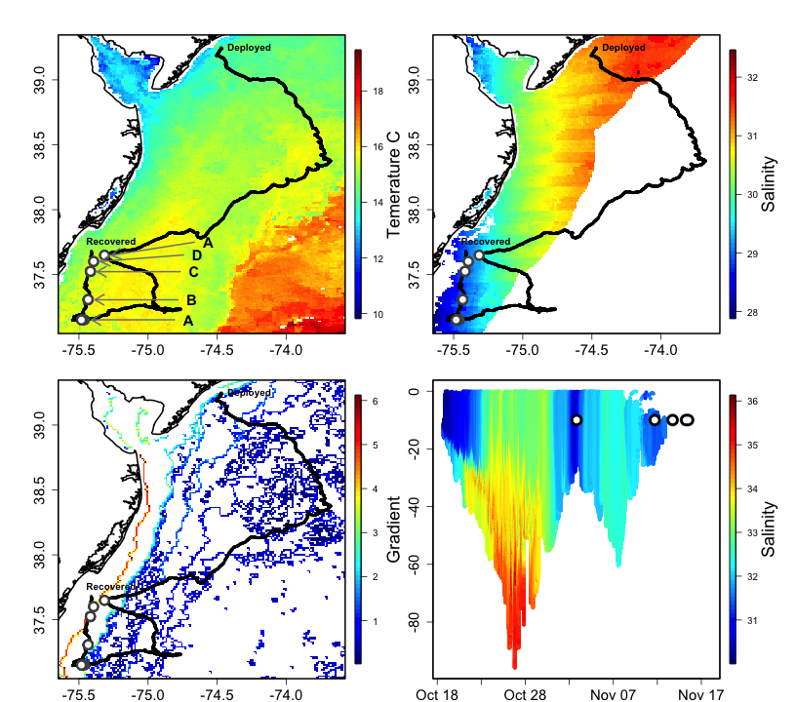
Receiver Integrated Glider
Enables coupling of data sets
  Telemetry data
  Temperature
  Salinity
  Productivity
Moves us beyond fixed arrays

Slide 15
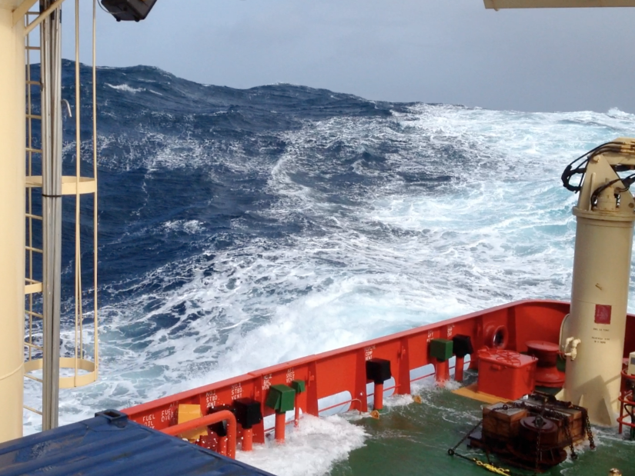
Rignot et al., 2008
Polar systems showing significant change in both the Arctic and Antarctic. Sampling heavily constrained by rough seas and ice.

Slide 16
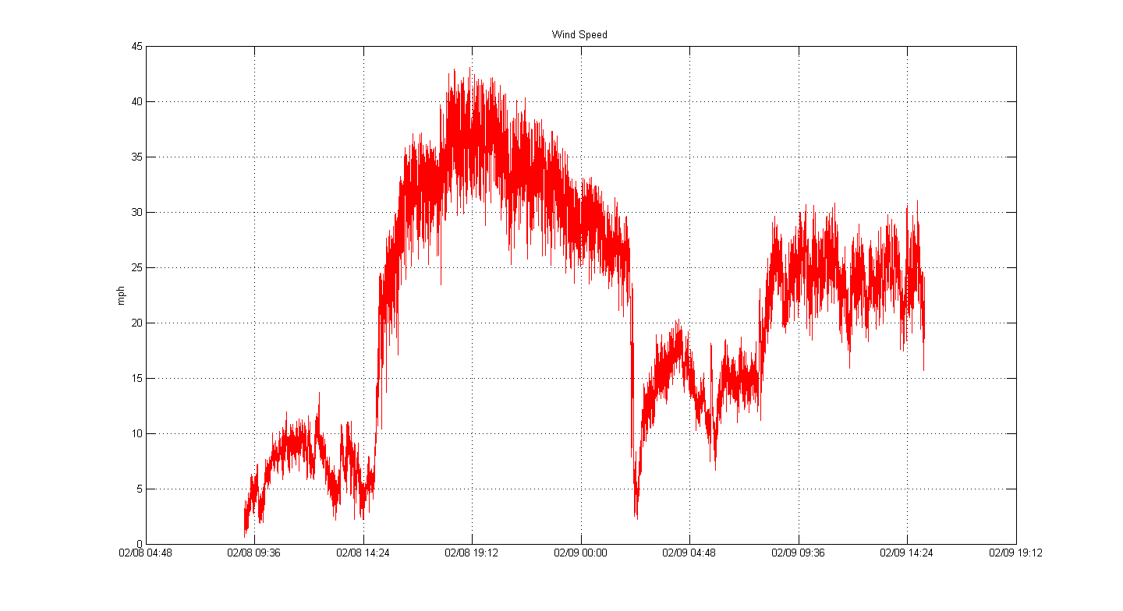
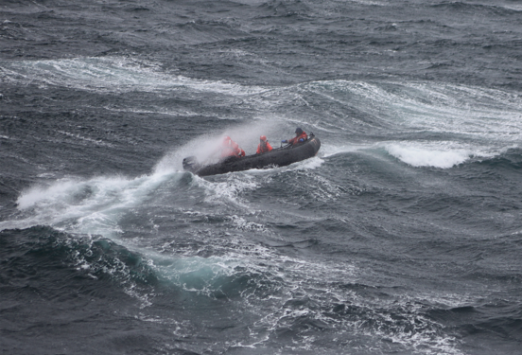
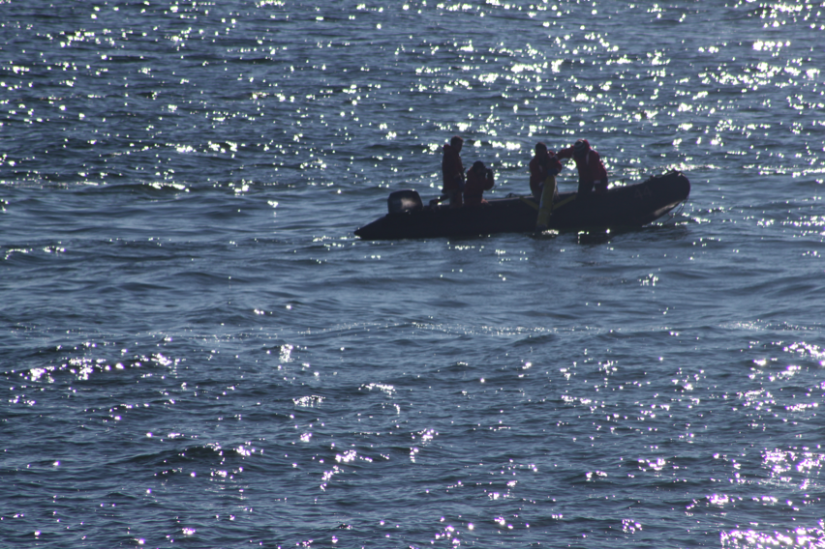
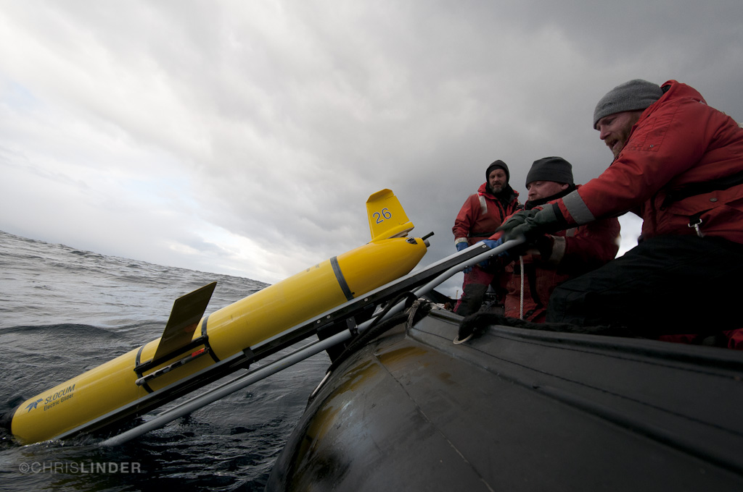
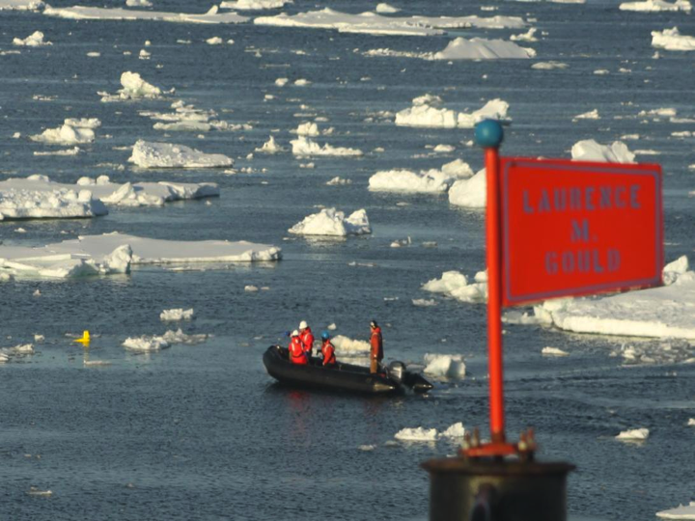
24 Hour Winds (knots)
40
31
22
13
4

Slide 17
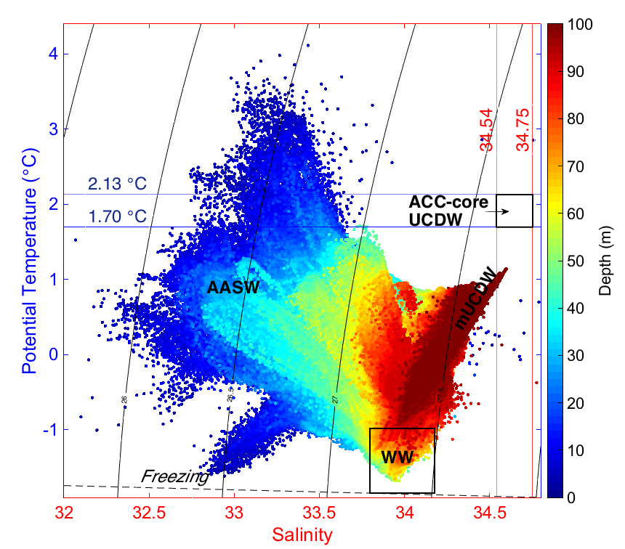
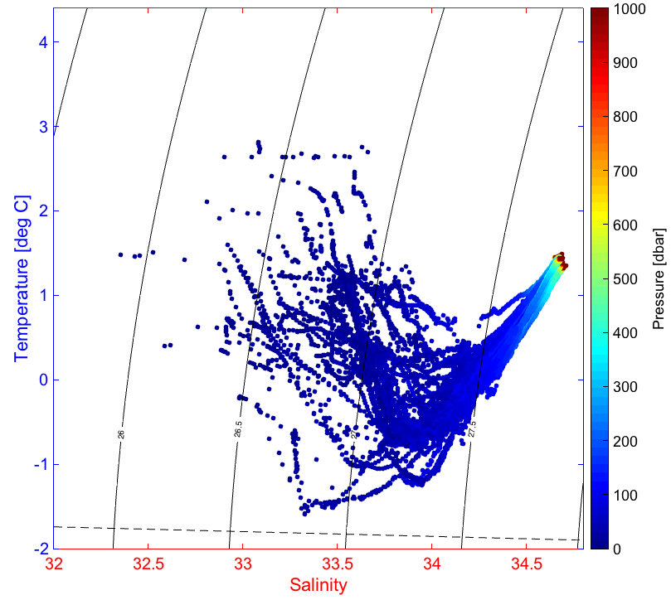
The power of using gliders to sample an extreme environment
Higher temporal coverage
Higher spatial coverage
~200 water column profiles (in 23+ years)
25,000+ water column profiles (in 6 years)

Slide 18
Gliders define where the flux of heat from the deep sea is transported across the continental shelf at depth. Gliders being used to define the dissipation of heat during the cross shelf transport of the warm water of the modified circumpolar water.

Slide 19
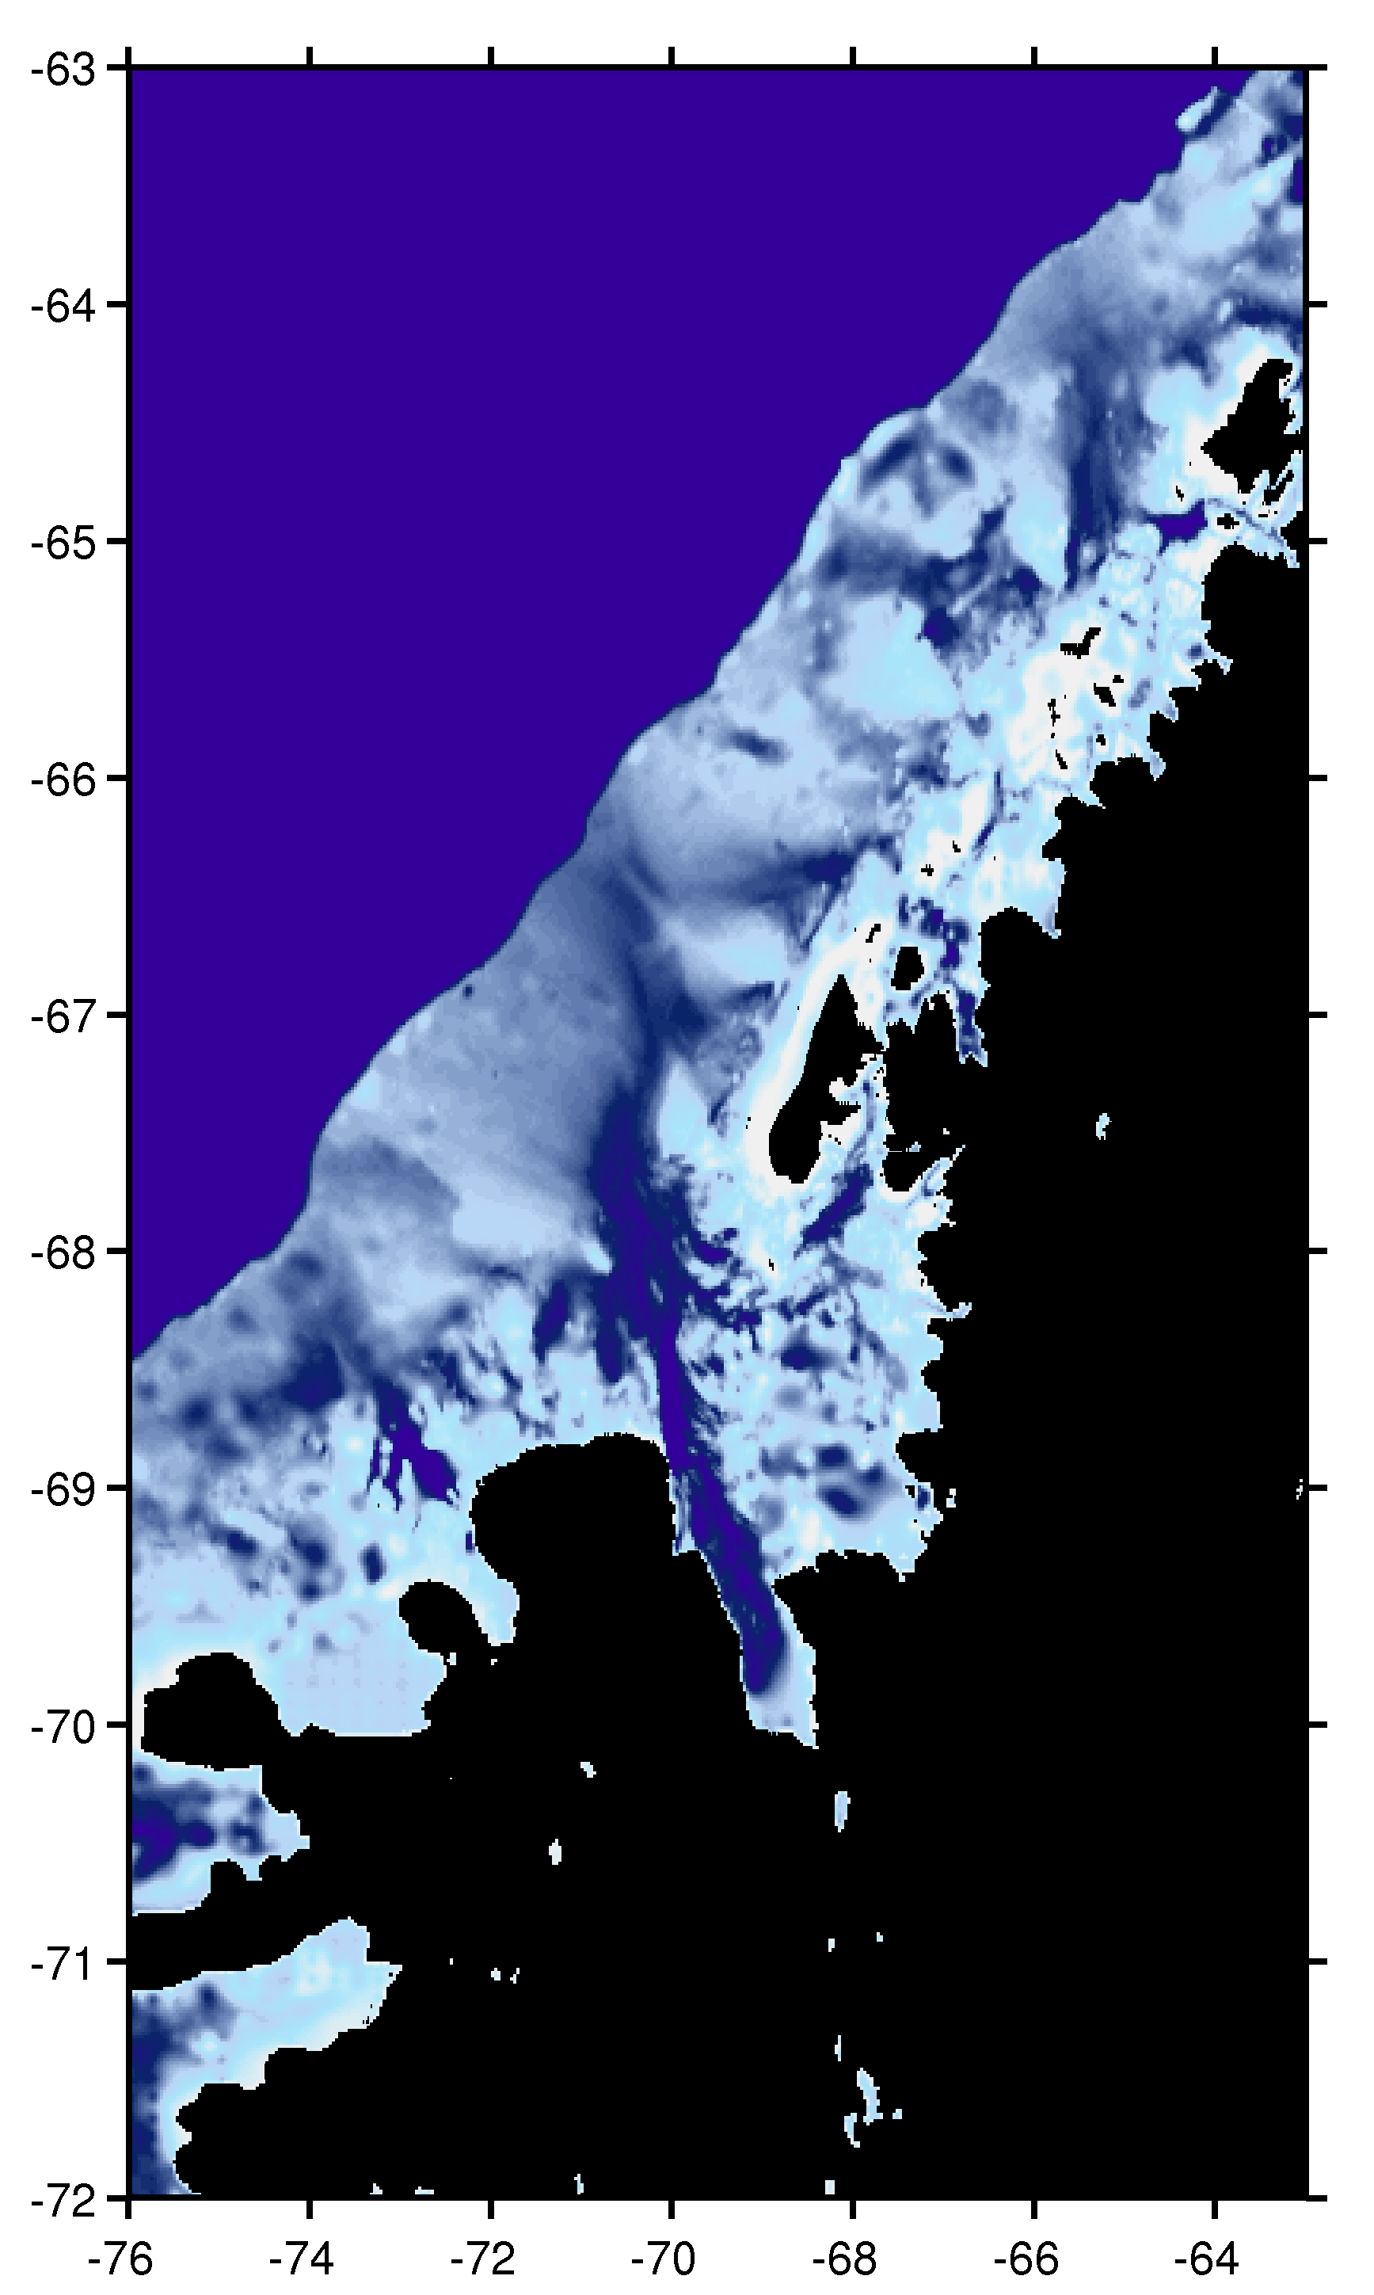
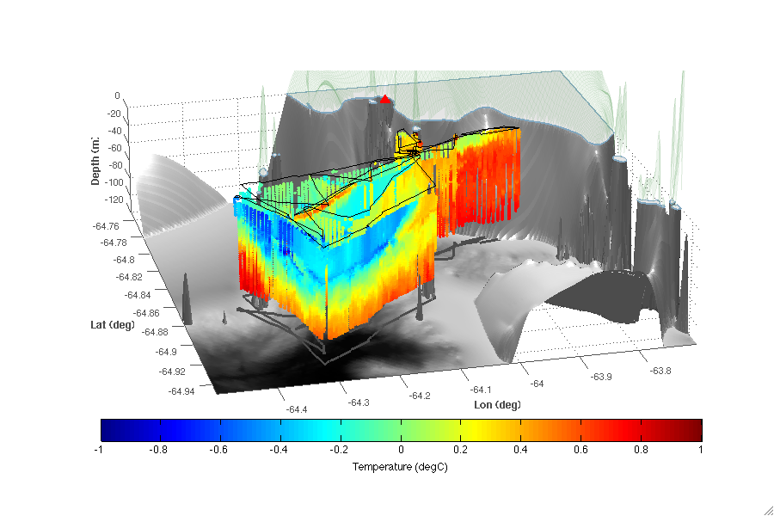
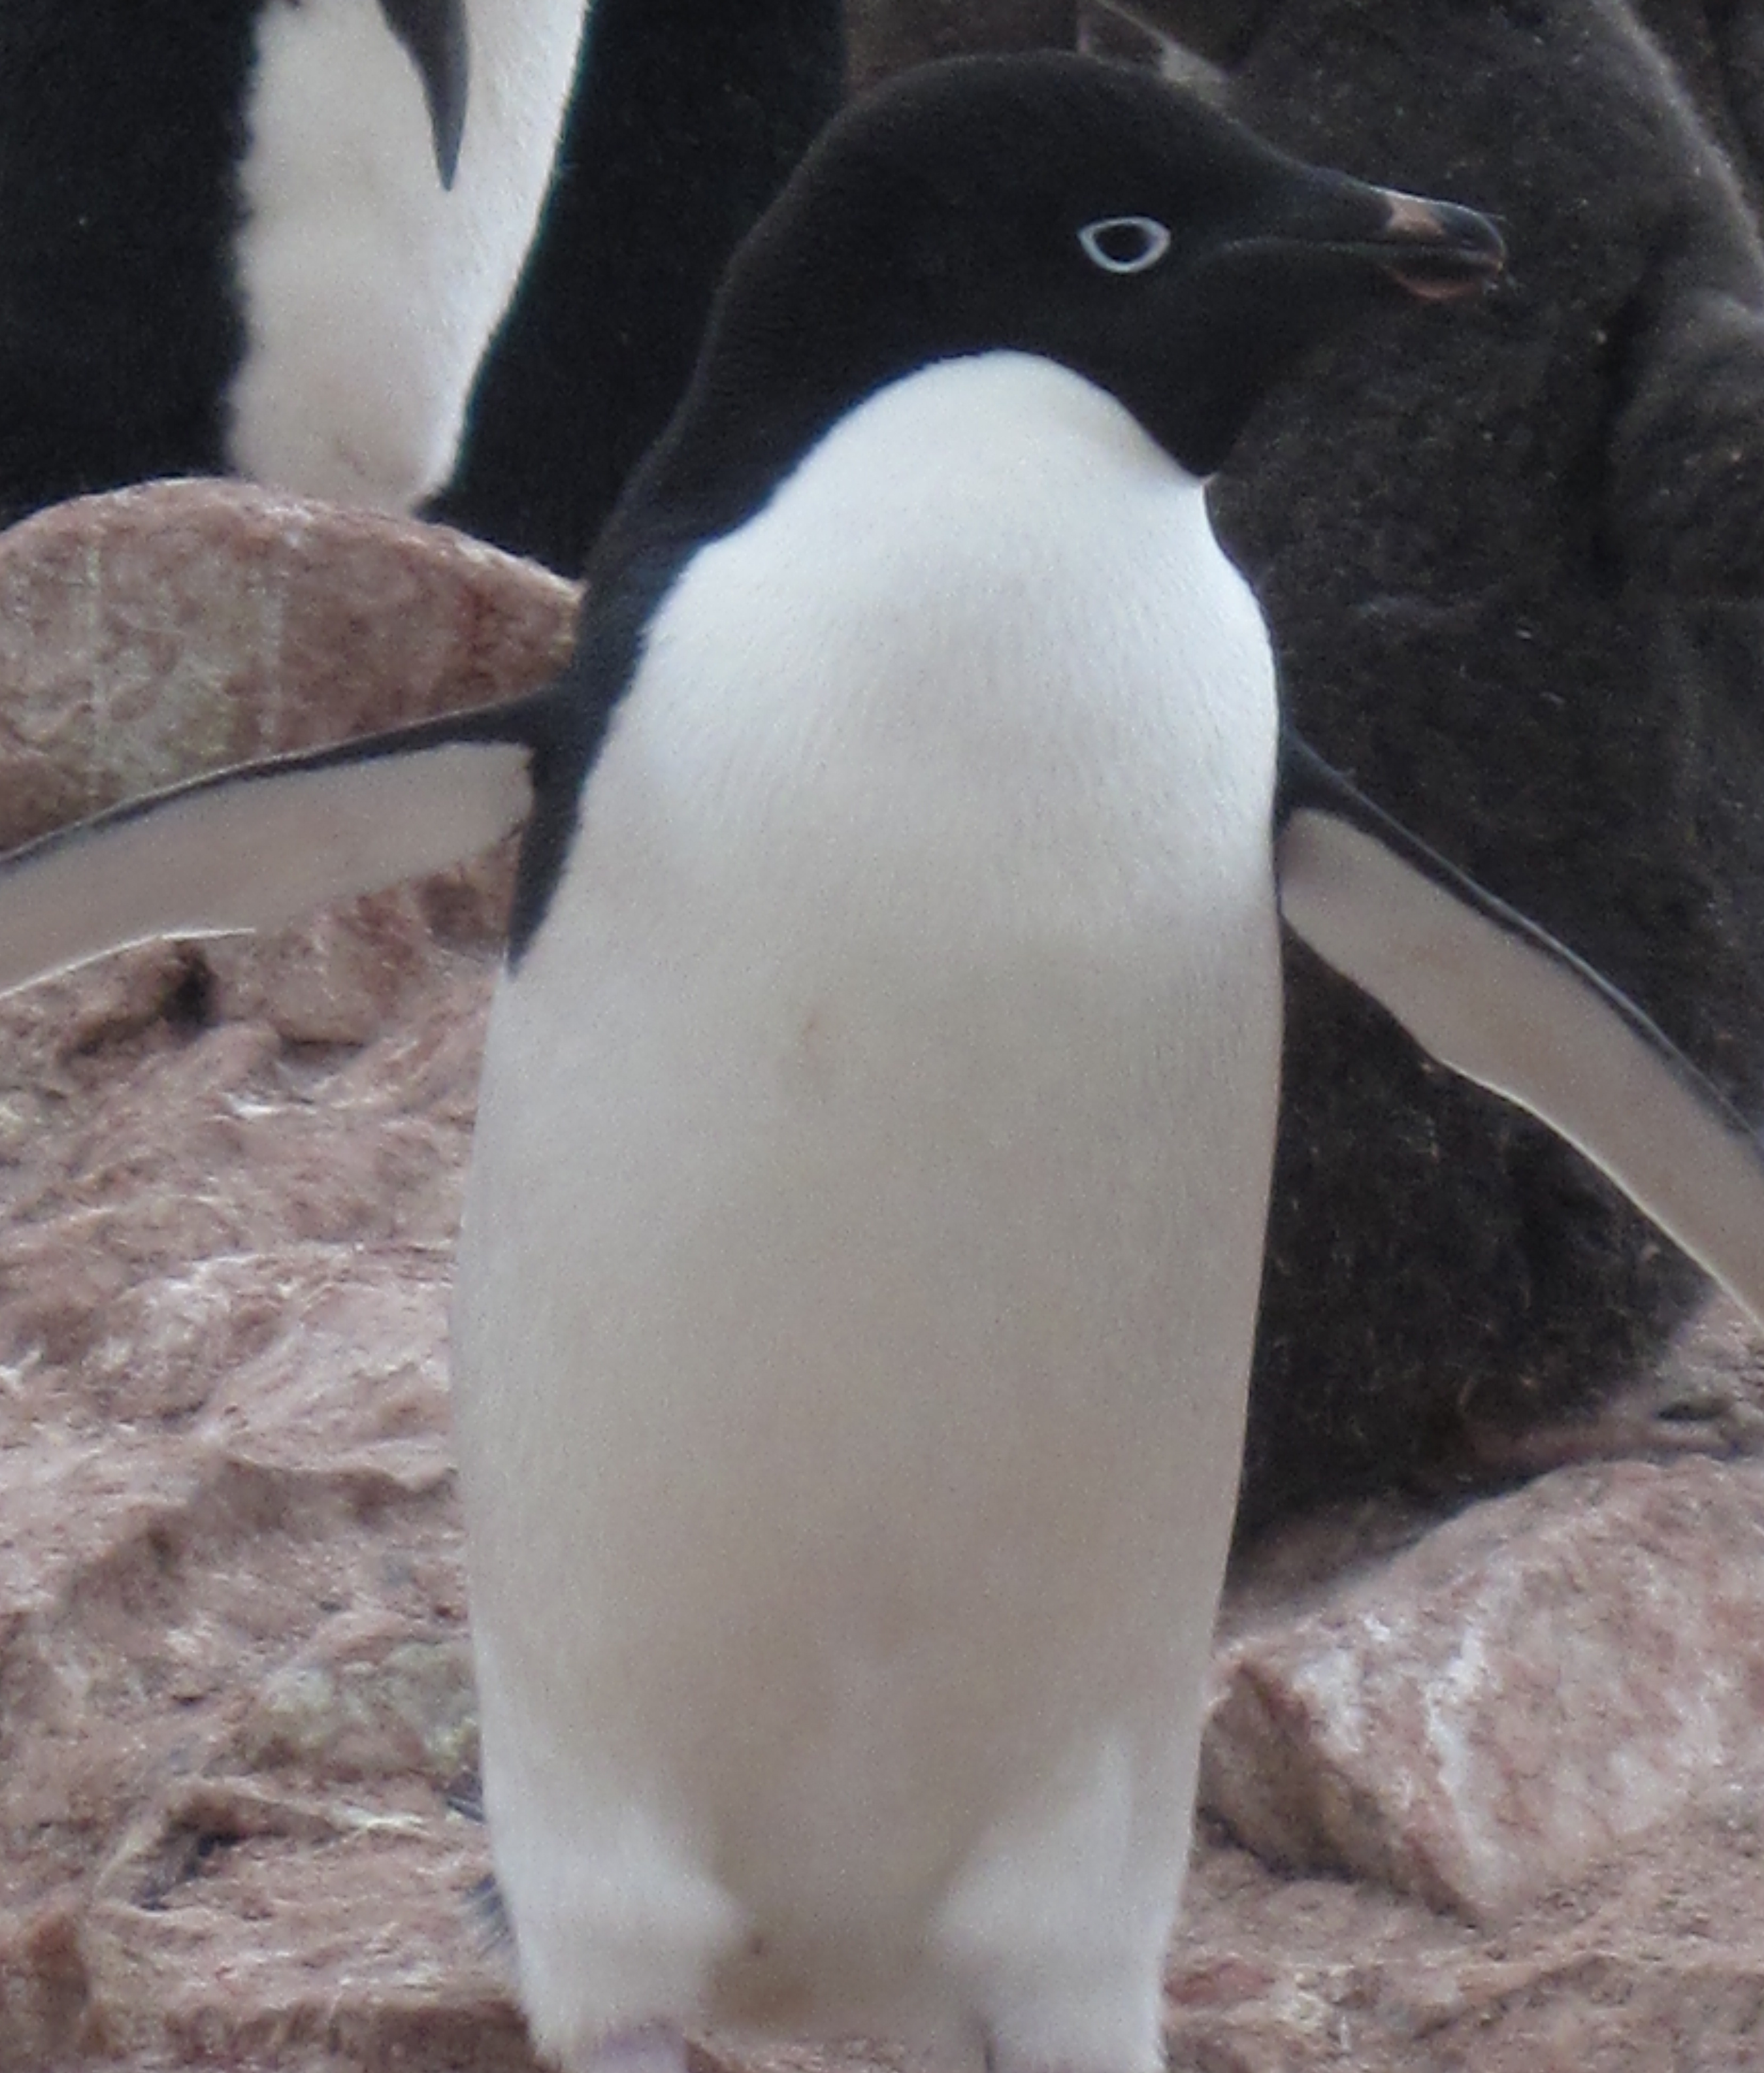

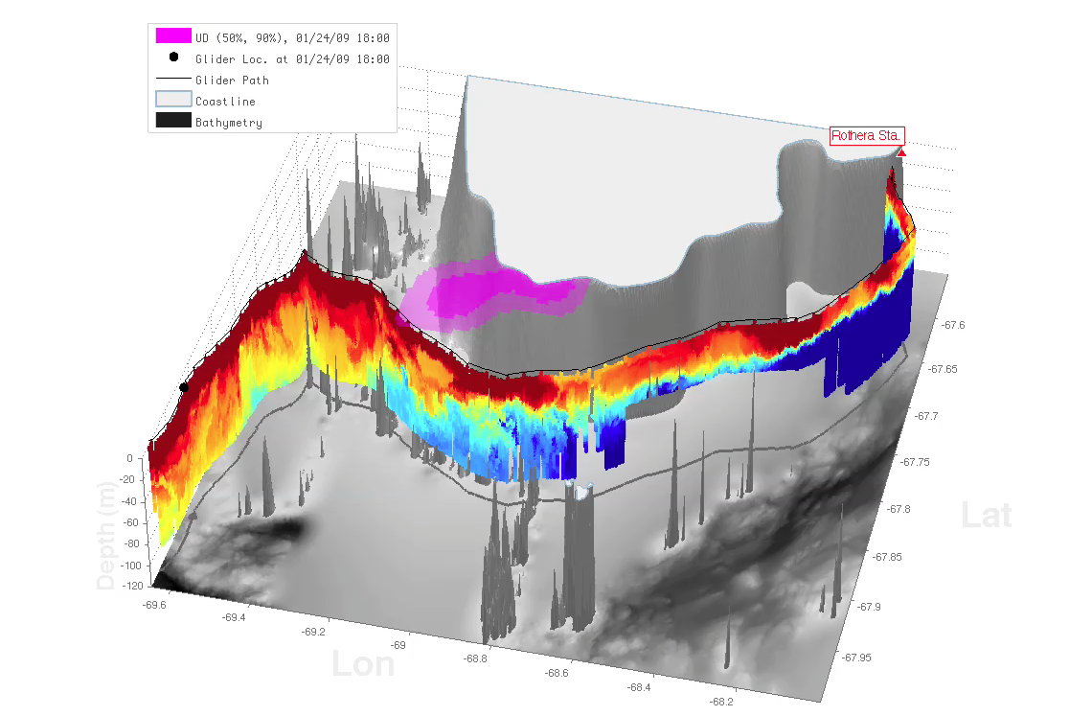
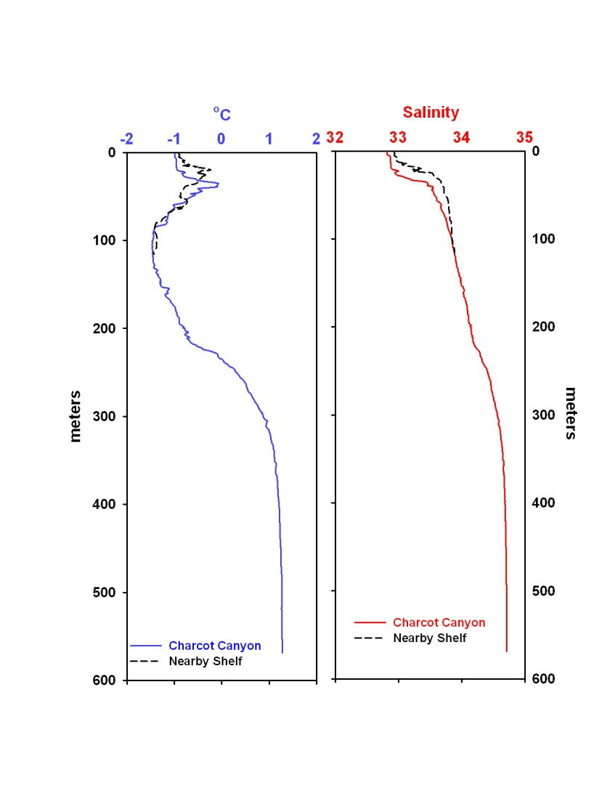
A)
0
Depth (m)
120
-64.8
Latitude
Antarctic Circumpolar Current
-64.9
-64.3
Longitude
-63.9
<-1
0
>1
Temperature (C)
Rothera
-2
°C
2
0
0
-67.7
Depth (m)
Latitude
120
Depth (m)
-69.4
-67.9
Longitude
-68.4
<-1
0
>1
Temperature (C)
600

Slide 20

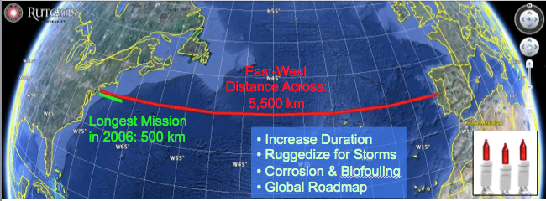
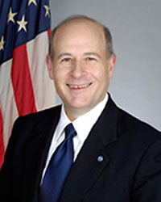

Trans-Atlantic Glider Challenge – May 24, 2006 –
UNESCO E.U./U.S. Baltic Sea Conference in Lithuania
Dr. Rick Spinrad
Assistant Administrator
NOAA
Office of Oceanic and Atmospheric Research
RU27: 7,400 km in 221 days
“I have something you need to do for the good of your country.”
“Take one of your gliders, modify it, and fly it across the Atlantic, inspiring students along the way.”

Slide 21
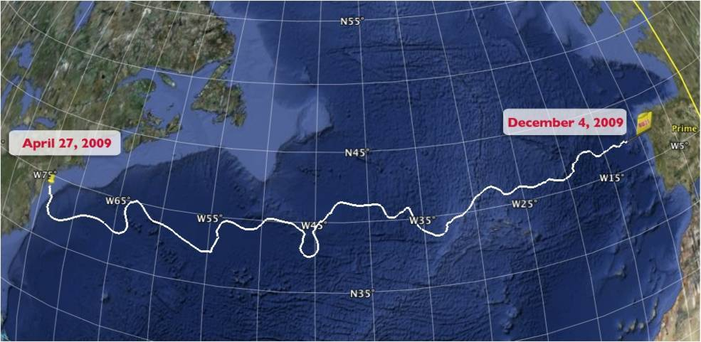
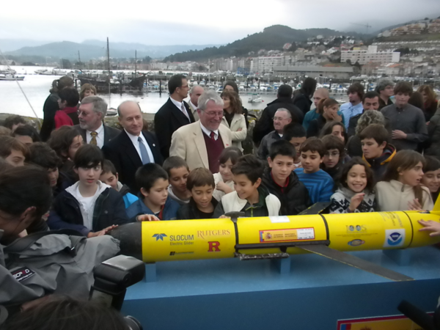

The Trans-Atlantic Glider Challenge
December 9, 2009 – Baiona, Spain
RU27: 7,400 km in 221 days
Trans-Atlantic Glider Challenge
Notes:
Letters from students to Spanish schools
Watch one, do one teach one. Borrowed best practices from COSEE, used data from ocean observatories. Increased students by over 400% with between 50 and 100 undergrads involved in the lab and research on a consistent basis. Reached carrying capacity.

Slide 22






Global Challenger Glider Mission
Creating the Next Generation of Ocean Explorers
Glider Silbo >10,000 km flown

Slide 23

Glider RU29: Launched at Cape Town 11 Jan 2013, flown >13,000 km
Glider Days Km
SILBO LEG1 164 3941
SILBO LEG2 76 1706
SILBO LEG3 303 4390
RU 29 LEG1 289 5667
RU 29 LEG2 189 4720
RU 29 LEG3 268 6506
TOTAL TODAY 1289 26930

Slide 24

RTOFS and MERCATOR Comparison to RU29
Ascension Island to Ubatuba, Brazil
Turtle Tracks
Deep Eddy
Cabo Frio Eddy
Full Track Temp Difference
Argo Validation
Cabo Frio Coastal Eddy
Deep Ocean Eddy
Mid-Gyre “Turtle Tracks”
Undergraduate
involvement
Notes:
MTS articles with tudents as first authors – comparing gliders to models and argo floats

Slide 25

Thank You!
http://rucool.marine.rutgers.edu

