Slide 1
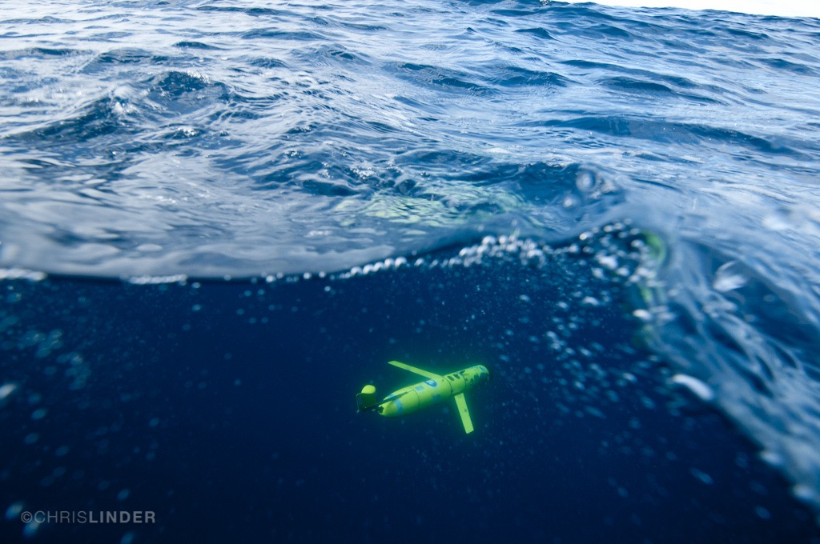

Gliders: a maturing technology To Study
Ecosystem Dynamics in the Ocean
Rutgers Center of Ocean Observing Leadership:
Oscar Schofield, Josh Kohut, Travis Miles, Grace Saba
Teledyne Webb: Clayton Jones, Doug Webb

Slide 2
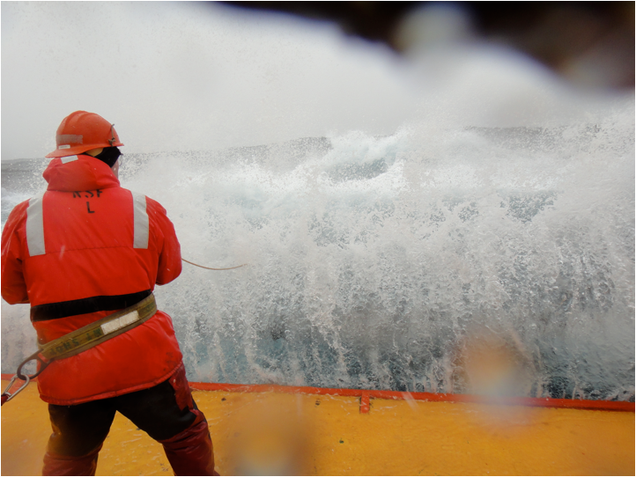
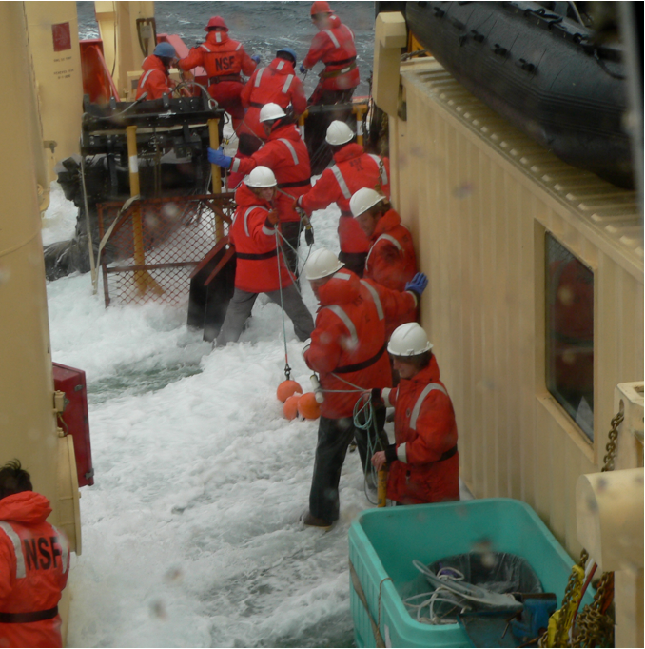
Fundamental challenge for understanding marine ecosystems is to collect sustained spatial relevant physical, chemical, and biological data to increase fundamental knowledge

Slide 3
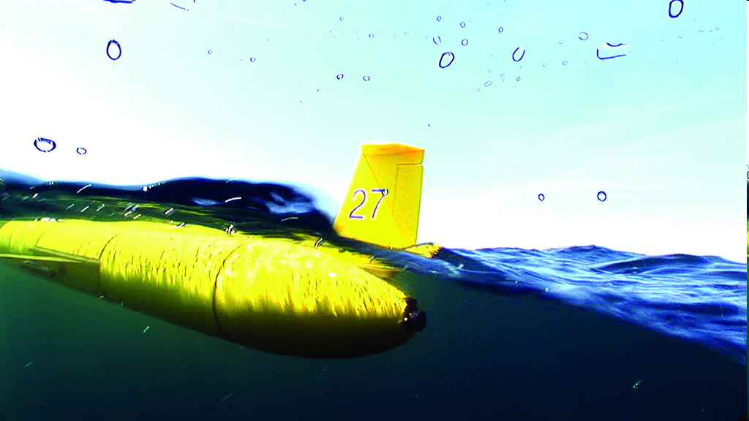

Glider’s are buoyancy driven “steerable” underwater vehicles with real-time communications, developed by multiple groups funded by ONR
Buoyancy pump in ← the glider pulls in 0.5 L of water
When surfacing to connect glider inflates air bladder
ARGOS and
FreeWave Antennas
Iridium Antenna
Glider begins to dive downward
Push pump out → glider inflects and begins to climb to the surface
At programmed
intervals
one dive and one climb is called a ‘yo’

Slide 4
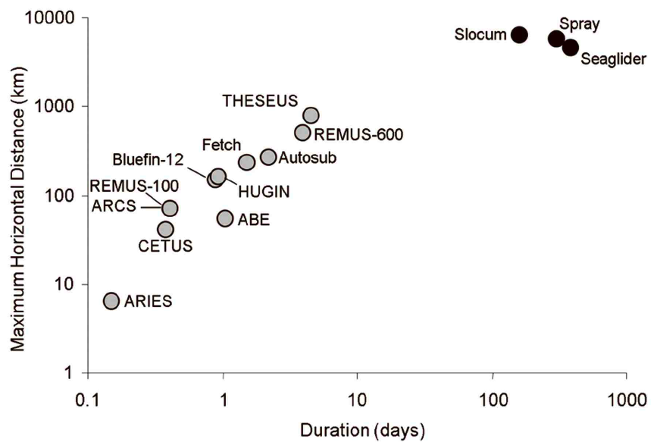
Glider’s are “steerable” underwater vehicle with real-time communications that can cover great distances over long periods
-Long duration
-Grand space scales
Moline et al. 2009

Slide 5
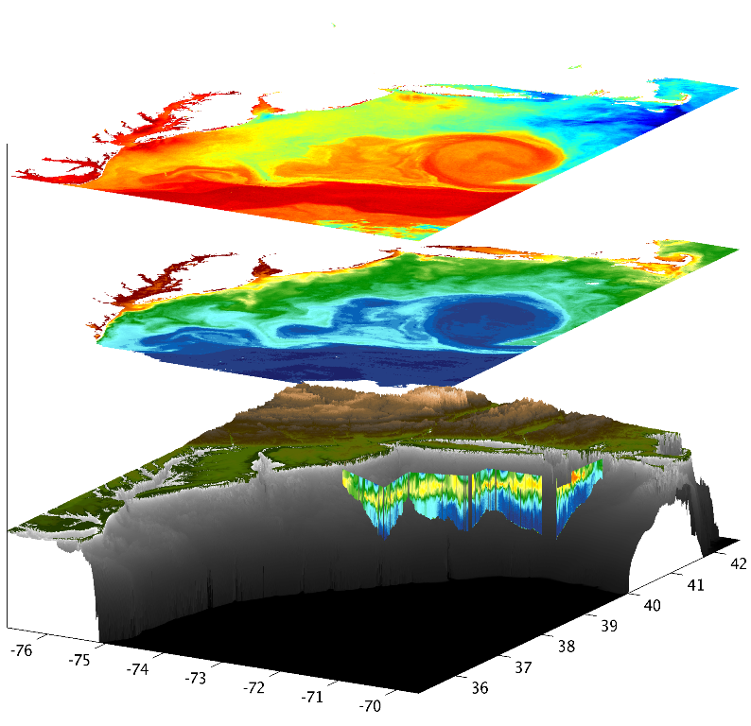
These systems can now collect data over scales similar to remote sensing technologies
SST
Chl
Chl

Slide 6

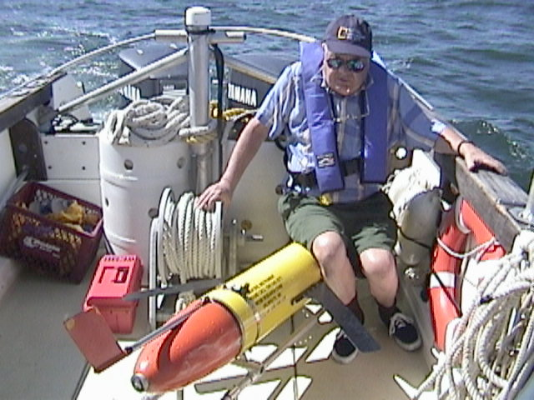
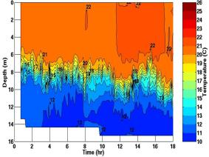
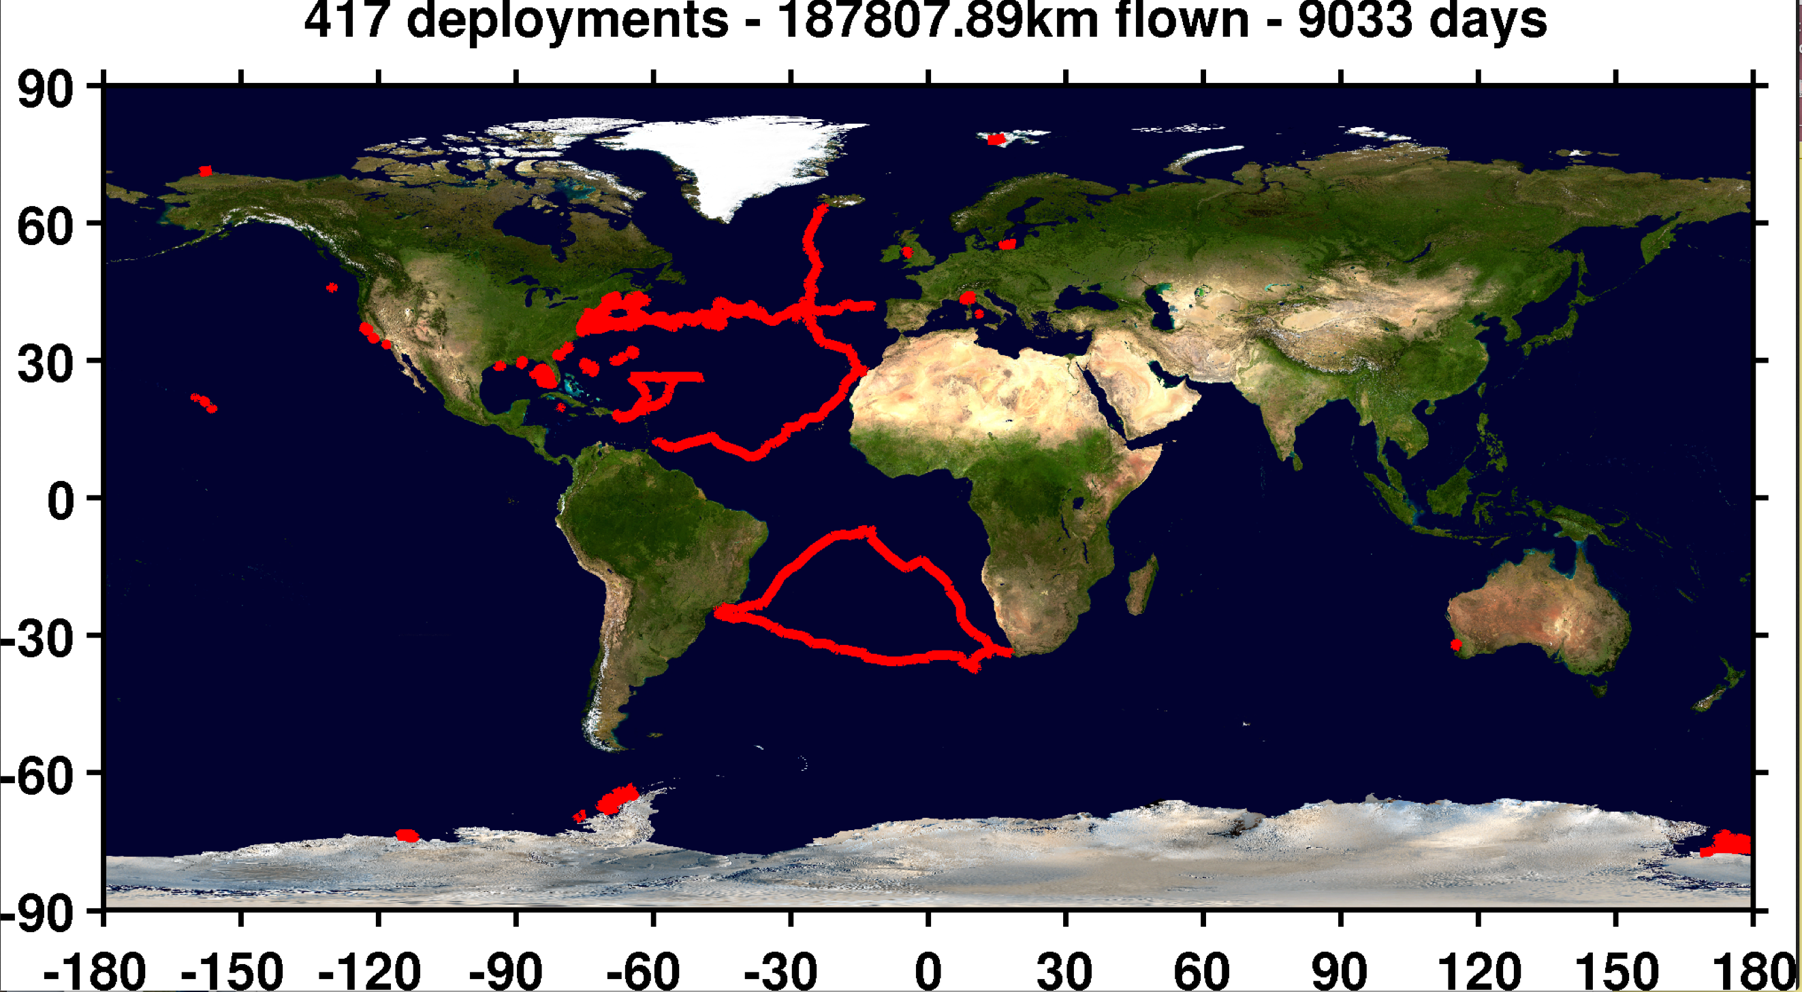
Glider history and our timeline of their evolution
Doug with first at sea test
Glider history
1989 (Stommel’s
Sloccum Mission)
1999 (Test Flight)
2003 (First cross
shelf mission)
Time
2006 (First
Antarctic mission)
2009 (First
Basin Crossing)
2011-2012
(Hurricane missions)
2013-2014 (South
Atlantic gyre w/
Challenger)

Slide 7
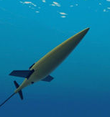
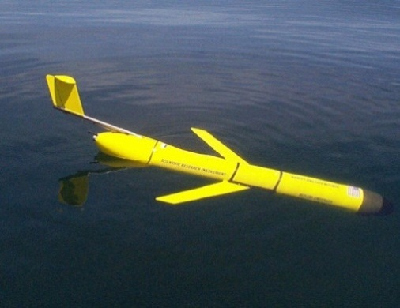
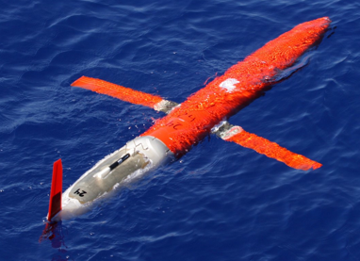
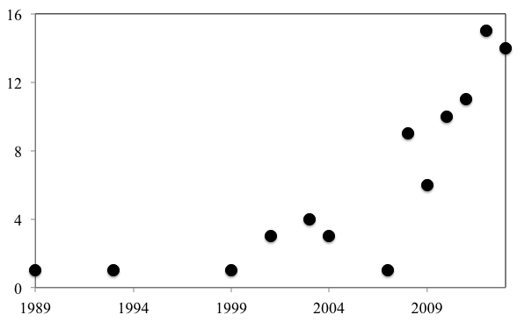
Gliders are being accepted by the community and
are having science impact
Climate
Education
Fish
& Birds
Glider Design
& Description
Engineering & Planning (28%)
Biology and Chemical Oceanography (32%)
Biogeochemistry
Publications that used glider data
Glider Networks
& Observatories
Plankton
Ecology
Water Column
Physics
Ocean
Circulation
Year
Physical Oceanography (35%)
Schofield et al. MTS 2015

Slide 8

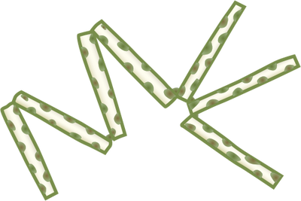
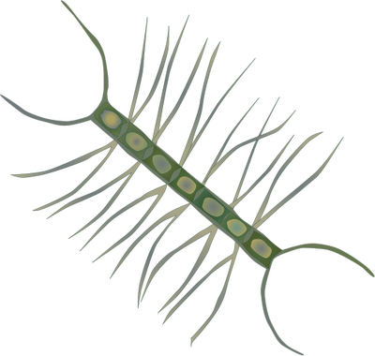
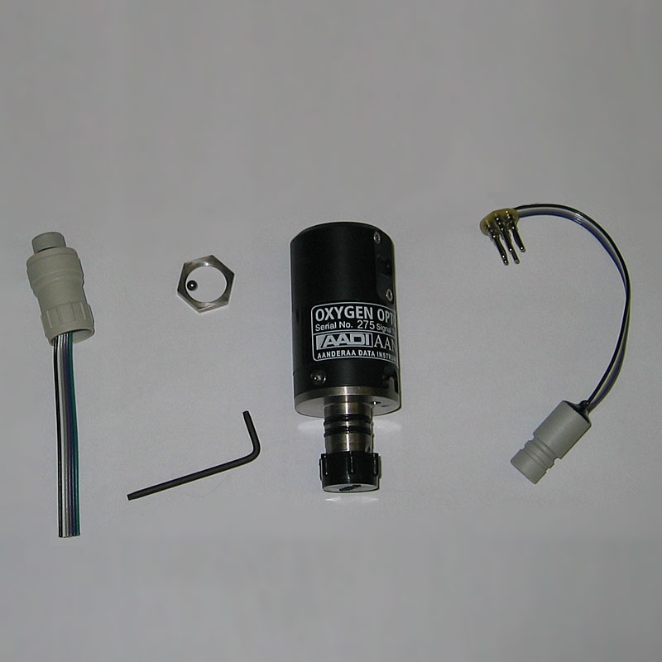
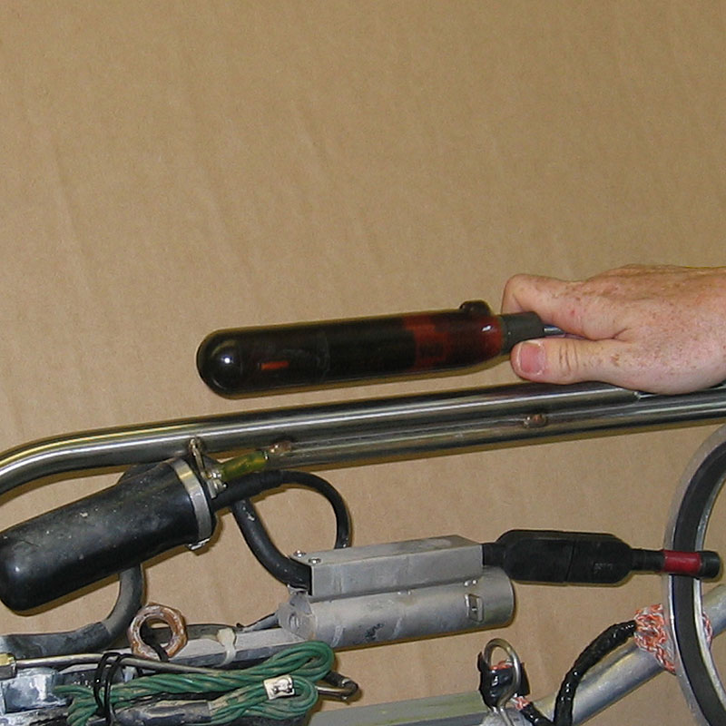
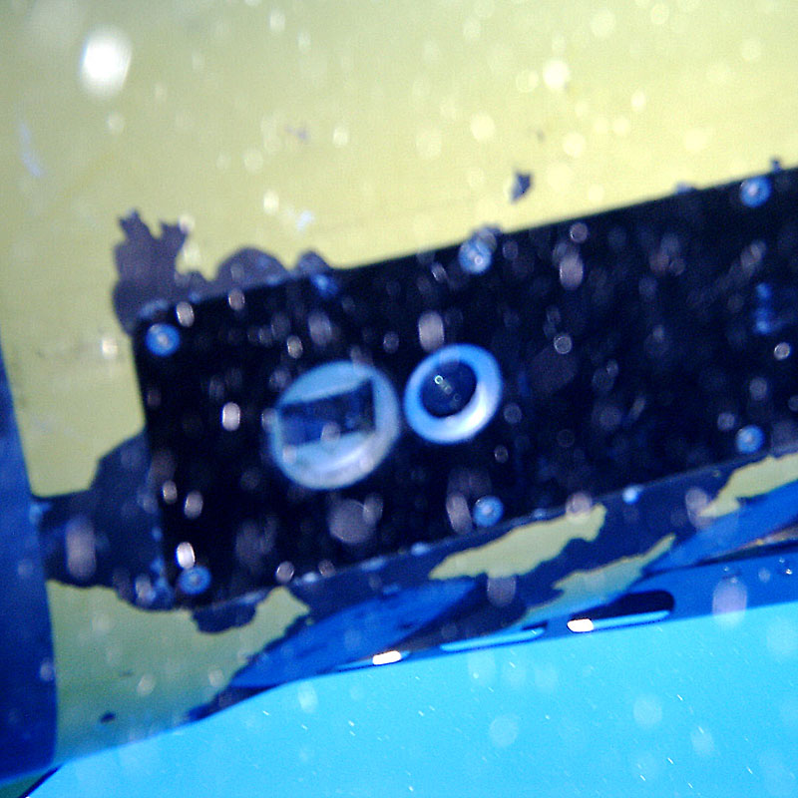
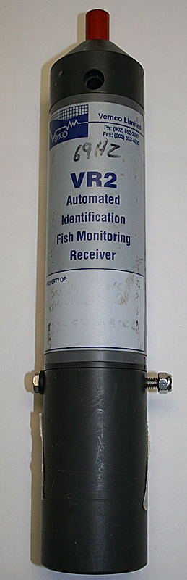
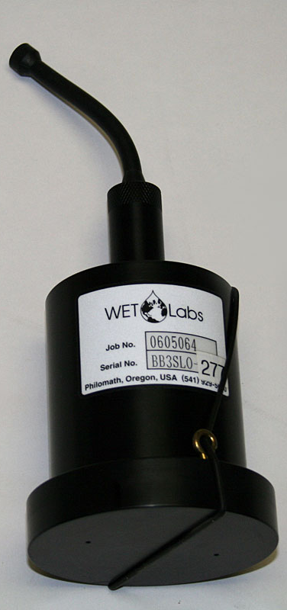
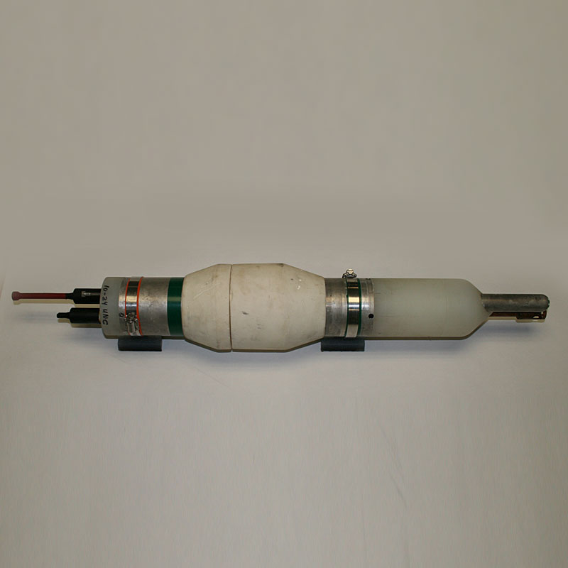
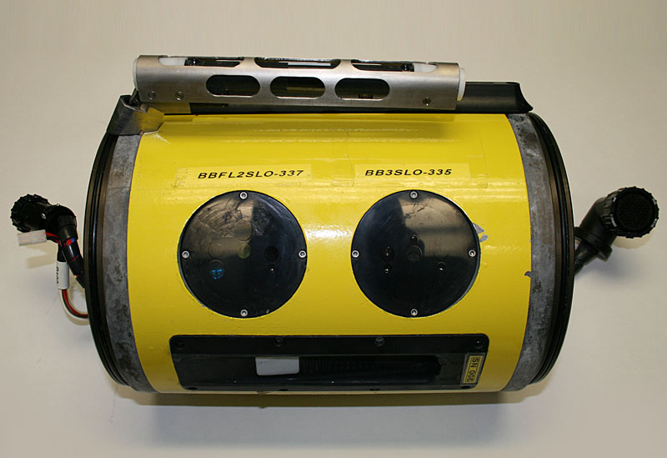
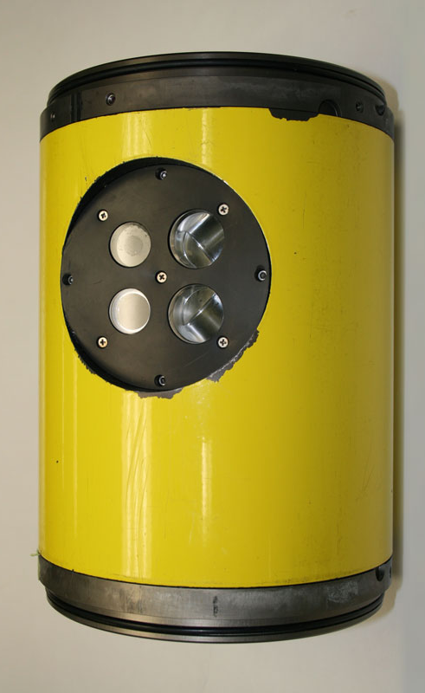
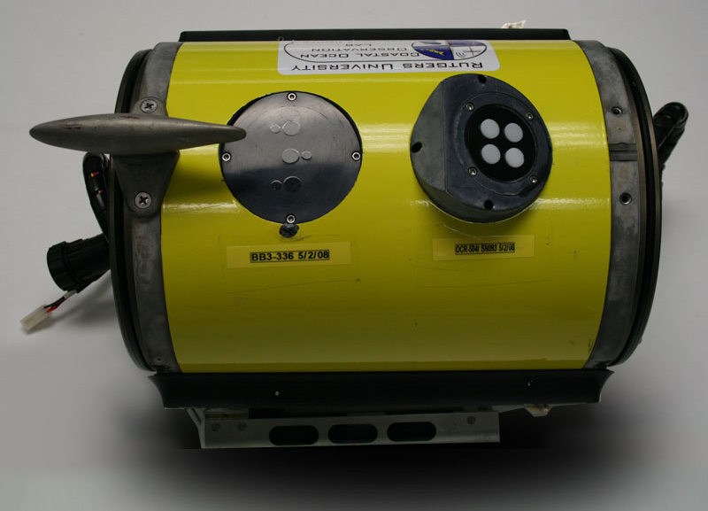
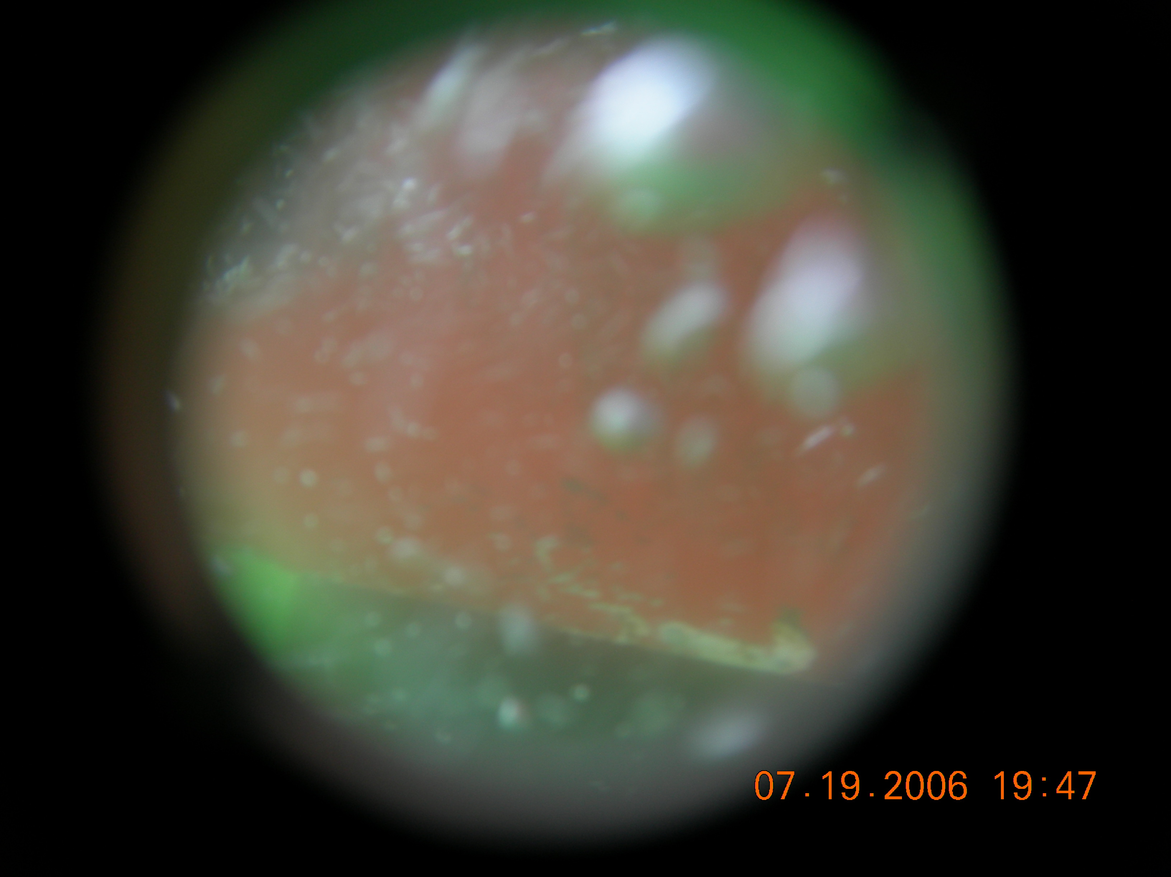
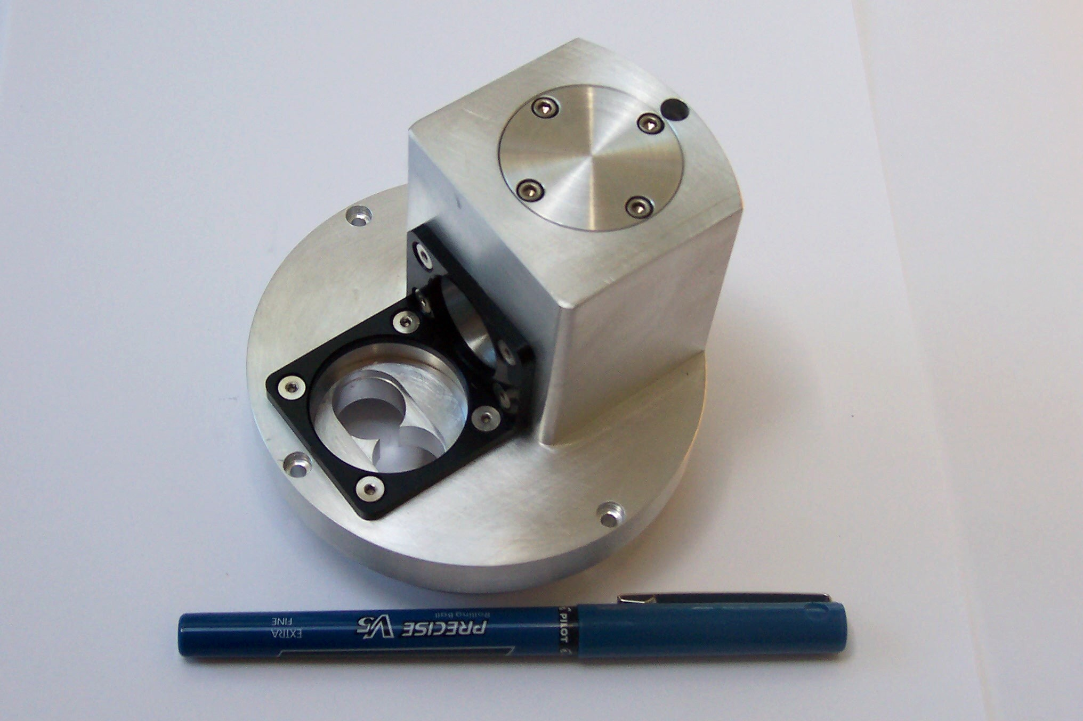
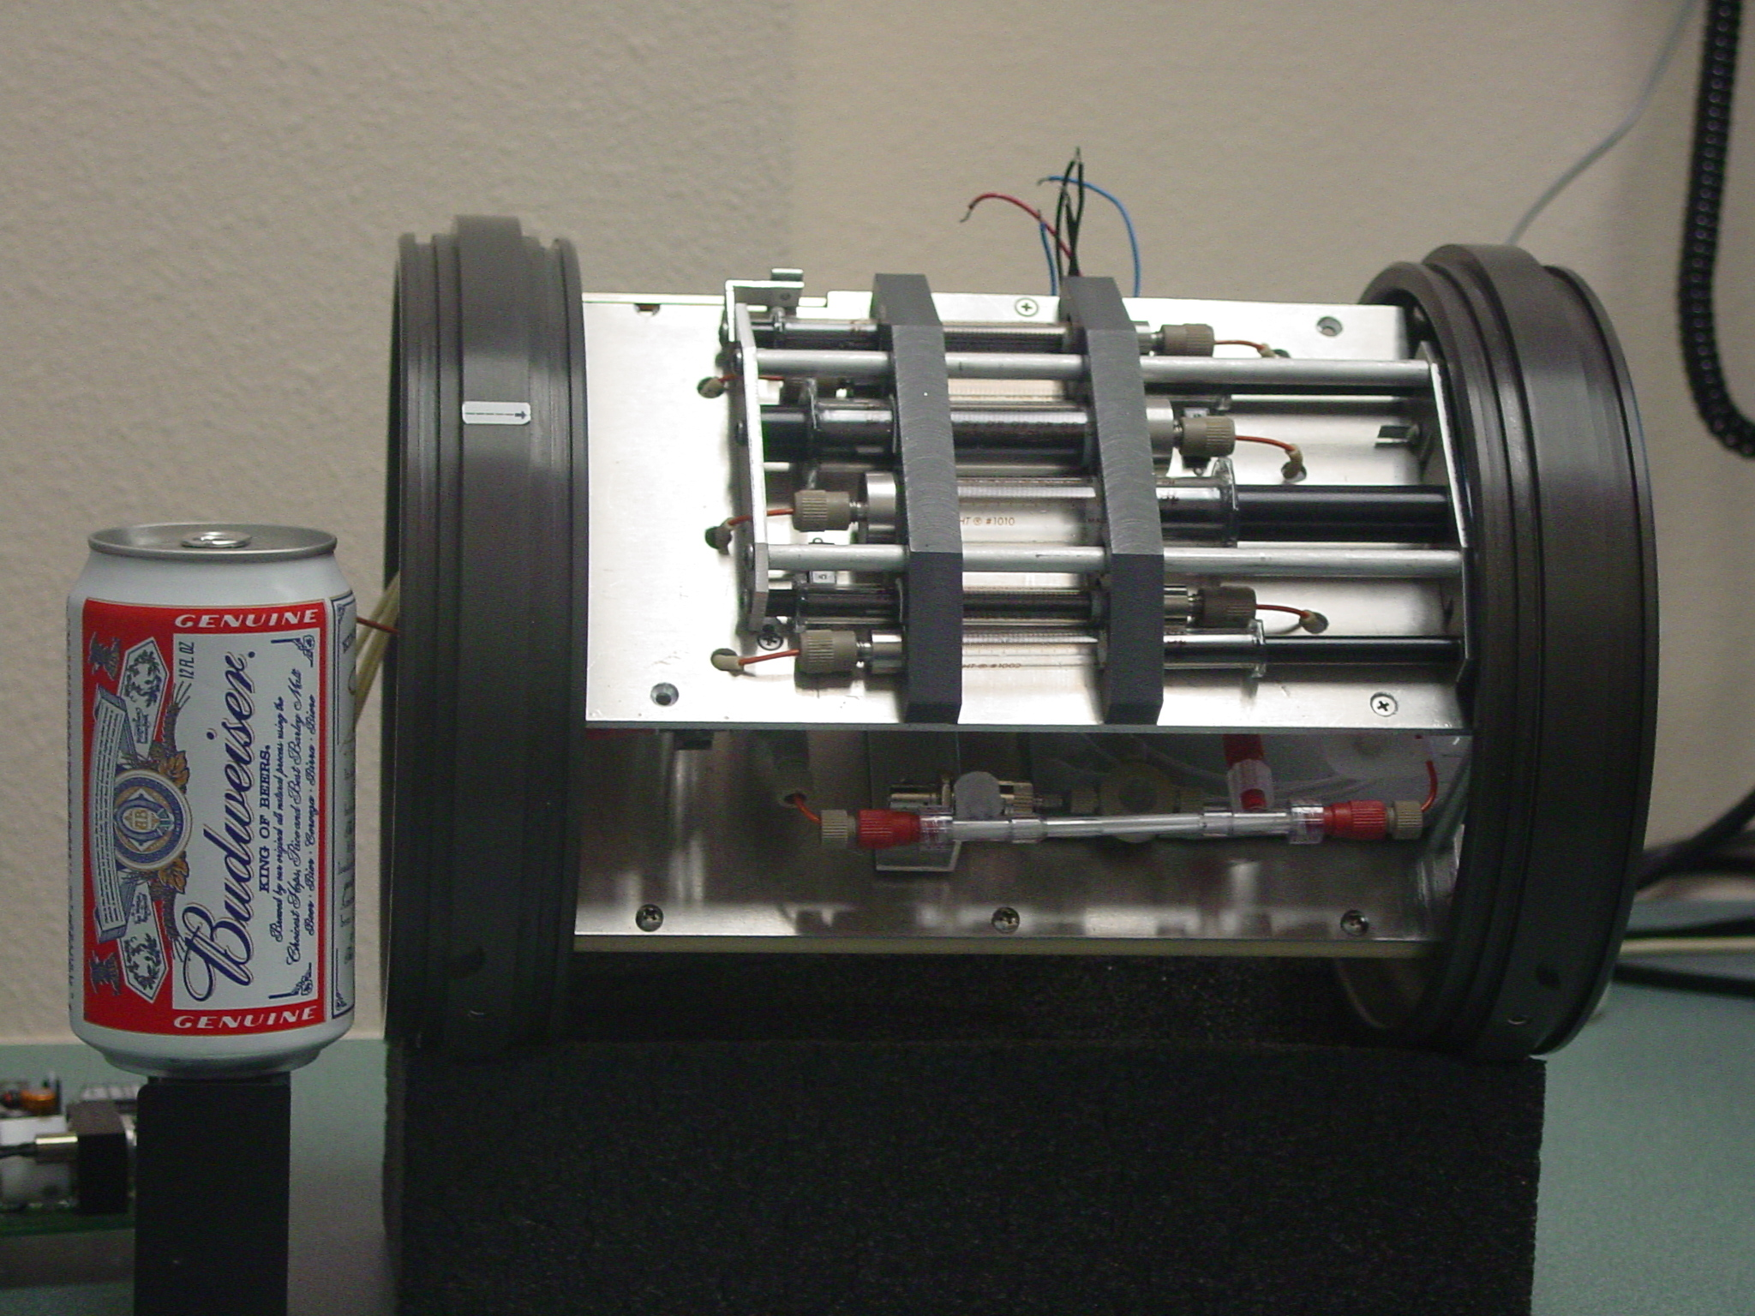
What can science data can be collected by gliders?
IN SITU
OPTICS
TRANSPORT
TRACE GASES
Inherent optics
Absorption (λ)
Scattering (λ)
Volume scattering
Attenuation (λ)
Refractive Index
Apparent Optics
(λ) Light intensity
up & down
ADCP
Estimated geostrophic
currents
Optical Oxygen
Optical CO2
Mass Spectrometers
Phytoplankton
WATER
COLUMN
PHYSICS
Concentration
Spectral Backscatter
Hyperspectral Absorption
Chlorophyll fluorescence
Imagery (visual, holography)
Diversity
Spectral Backscatter (proxy for composition/size)
Imagery (visual, holography)
“Omics”
Rates
Kinetic fluorescence
Photoacoustics
Stimulated oxygen kinetics
Macro/ Micro
nutrients & chem
Temperature
Salinity
Turbulence
CHEMISTRY
Optical nutrients
Optical CO2
Optical pH
Mass Spectrometers
e⁻
Proteins
Lipids
Carbos
Chl a
Zooplankton
TEP, DOM
Concentration
Acoustic backscatter
Imagery (visual, holography)
Diversity
Multi frequency Acoustics Imagery (visual, holography)
“Omics”
Organic Matter Flux
Concentration
Spectral Backscatter spikes
Particle settling rate
Imagery (visual, holography)
Diversity
Imagery (visual, holography)
“Omics”
Mass Spectrometers
Rates
Spatial calibrated fall rates
via imagery
Higher Trophic Levels
Concentration
Acoustic backscatter
Imagery (visual, holography)
Passive acoustics
Acoustic tags + Receiver
Diversity
Multi frequency Acoustics Imagery (visual, holography)
“Omics”
Passive acoustics
Acoustic tags + Receiver
Marine snow & Export Flux
Schofield et al. MTS 2015

Slide 9
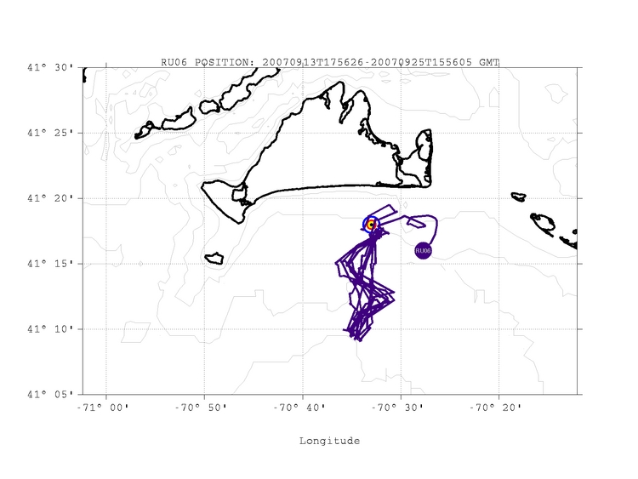
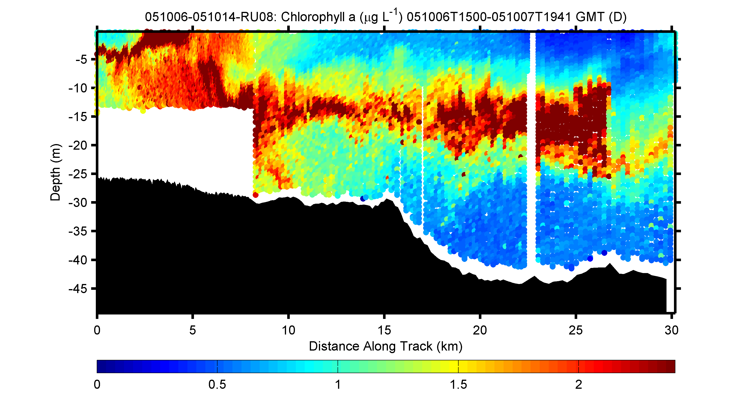
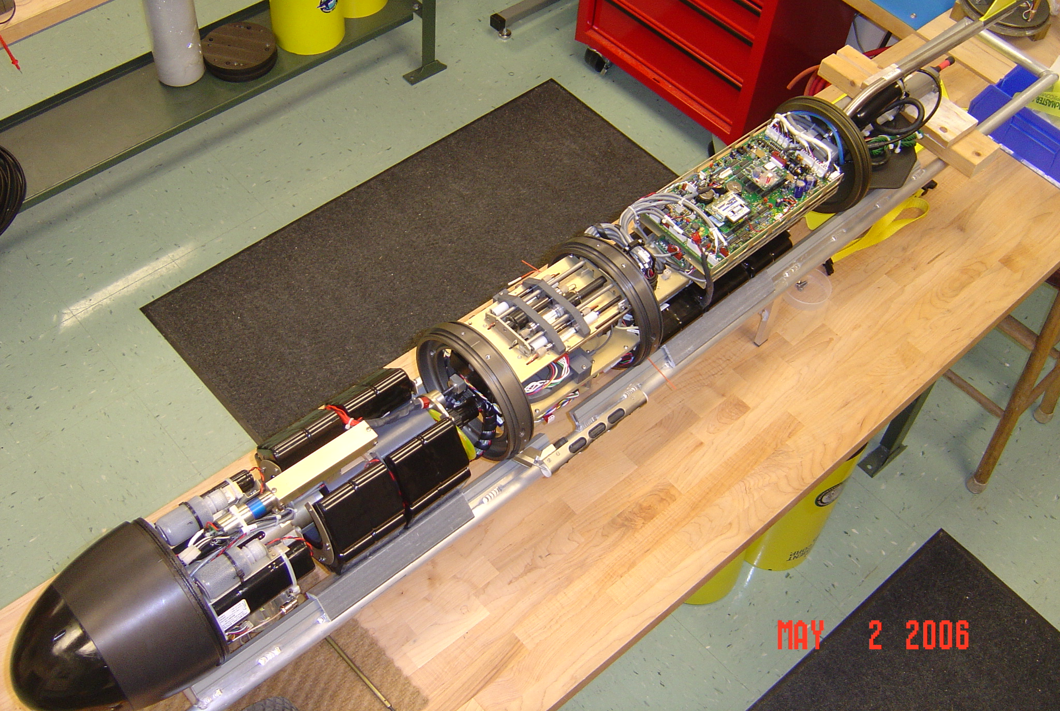
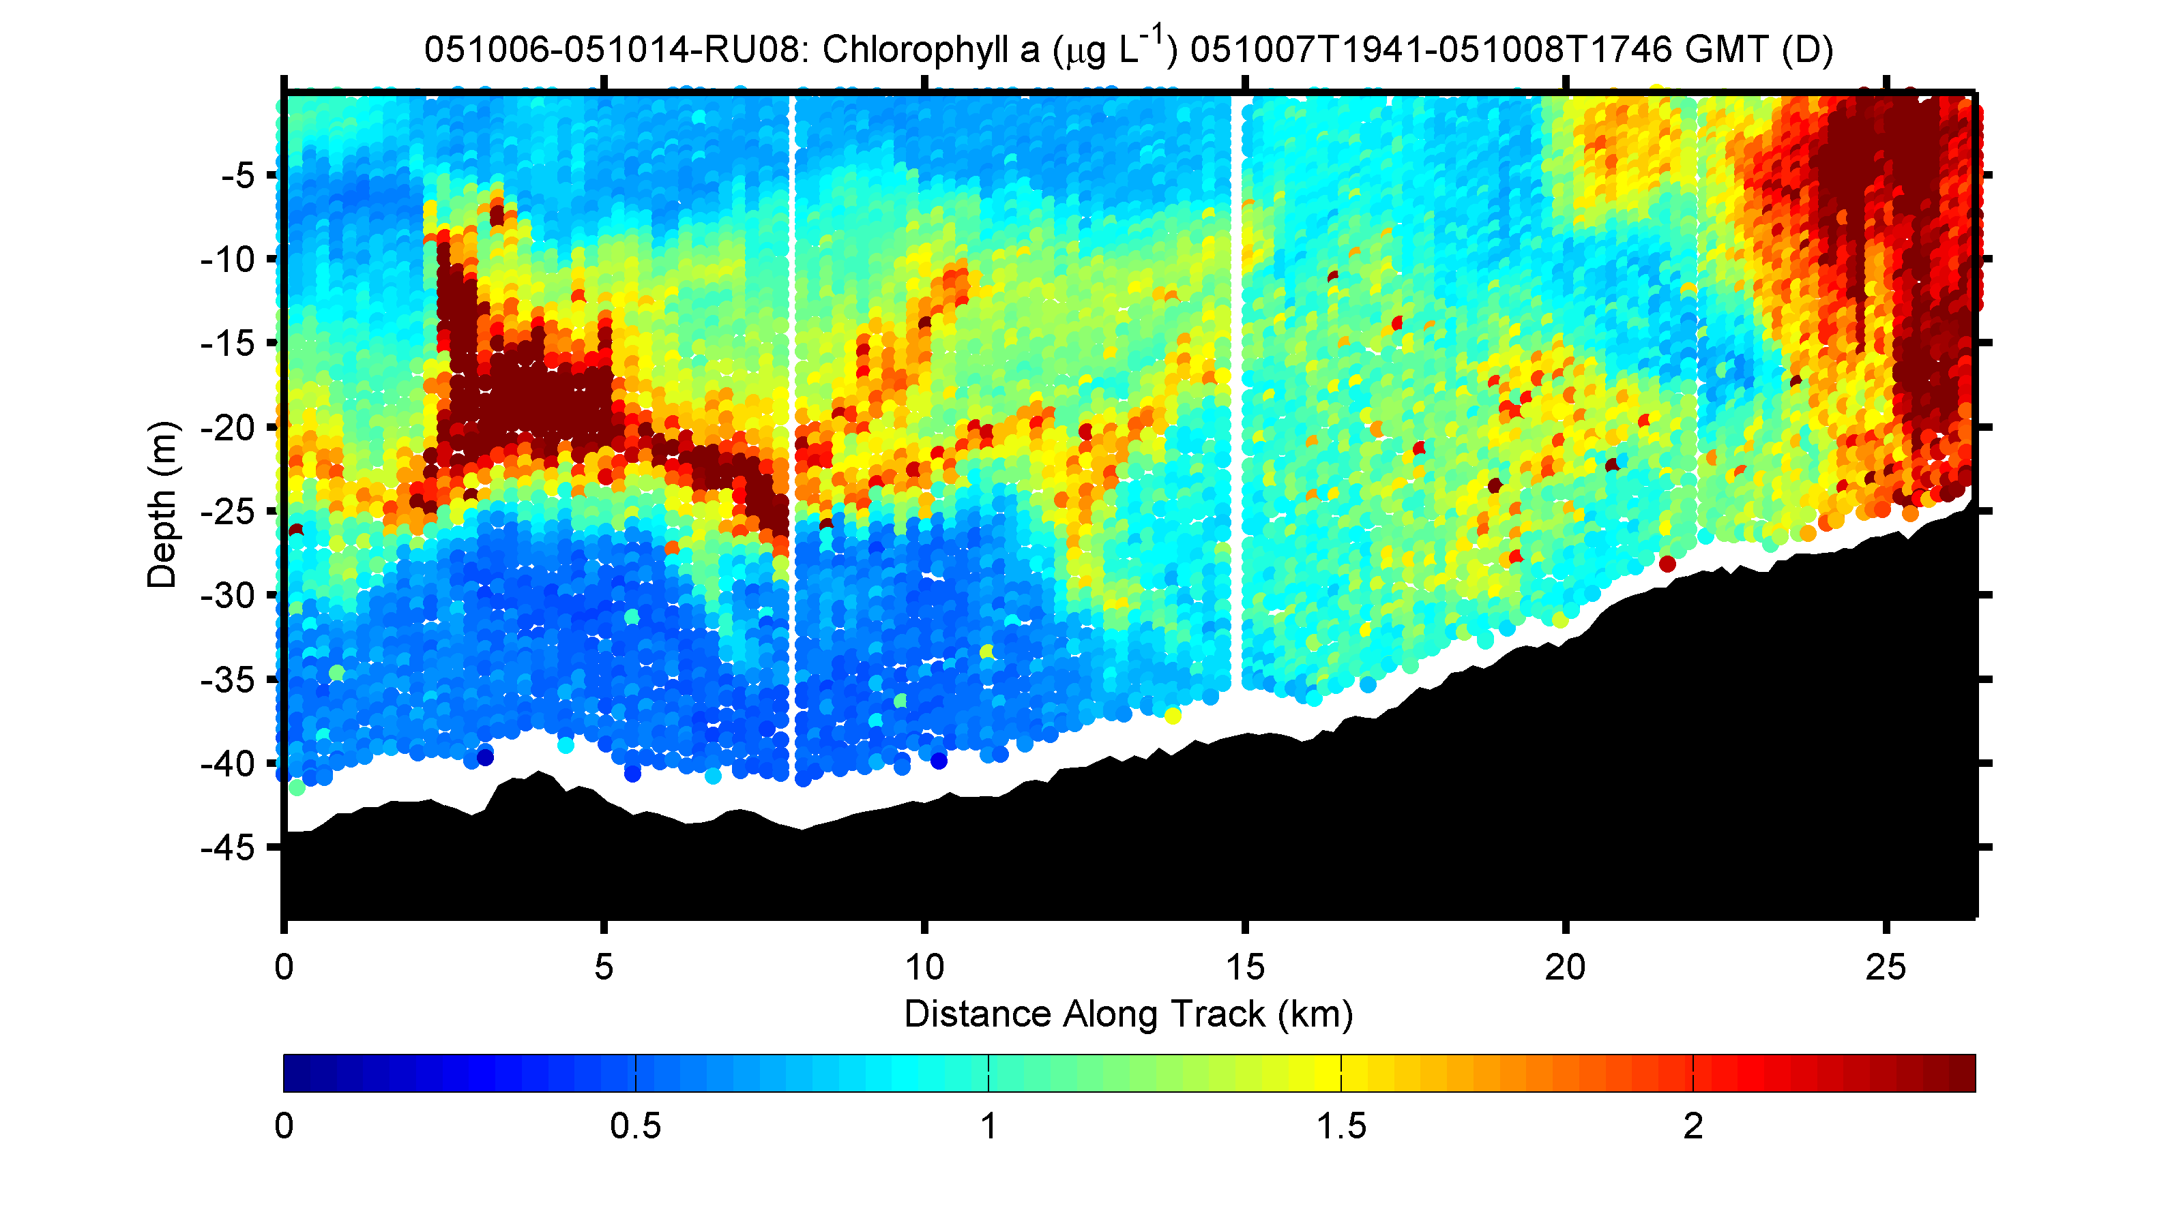
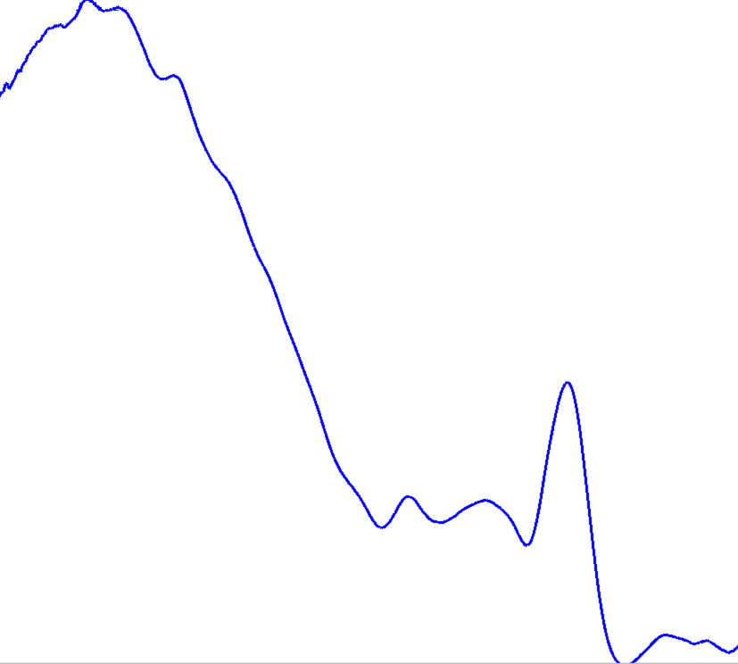
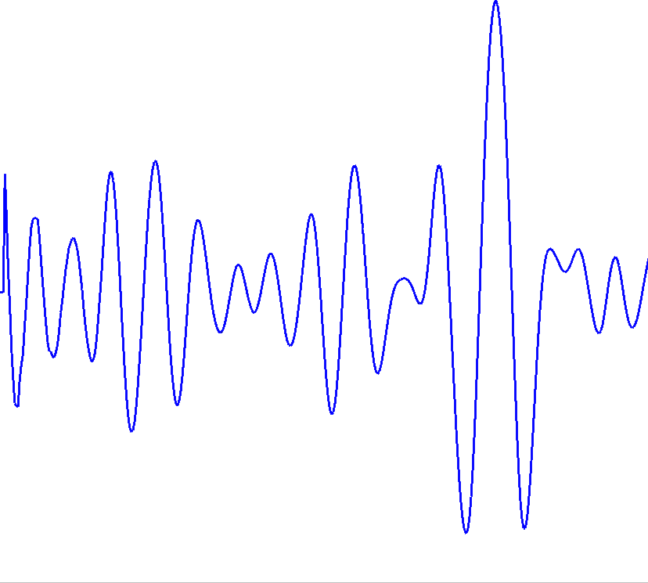
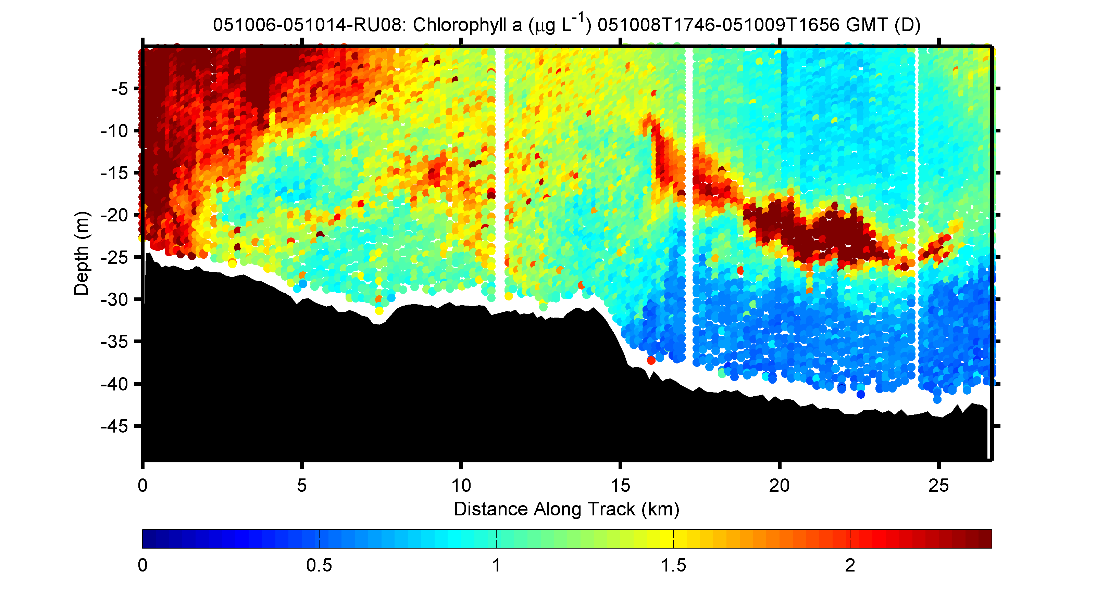
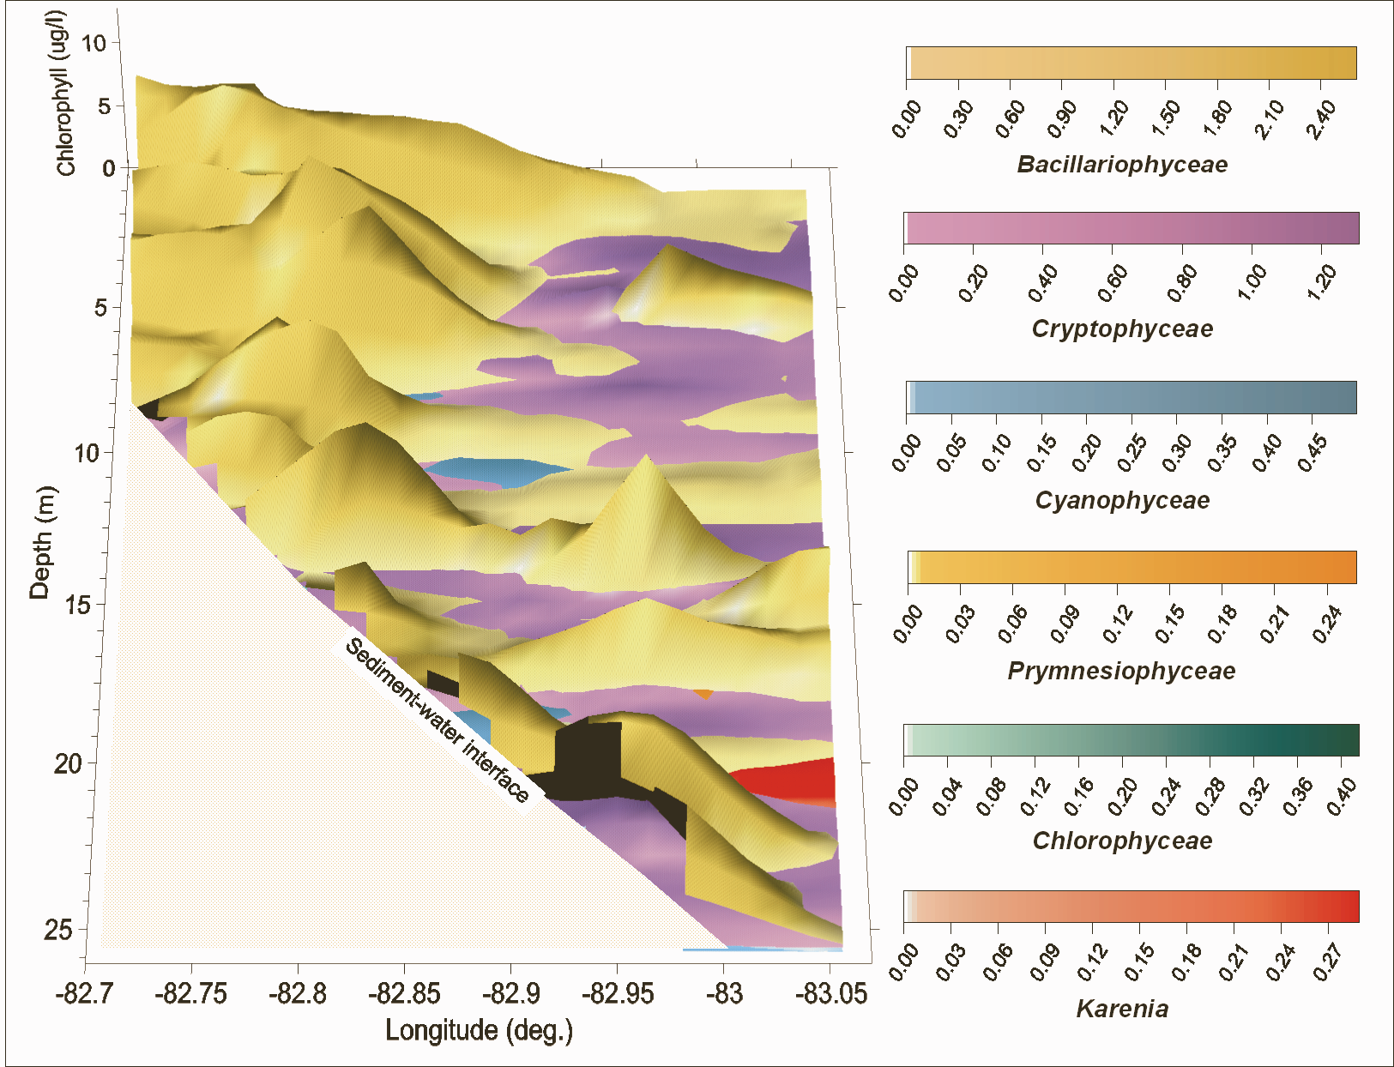
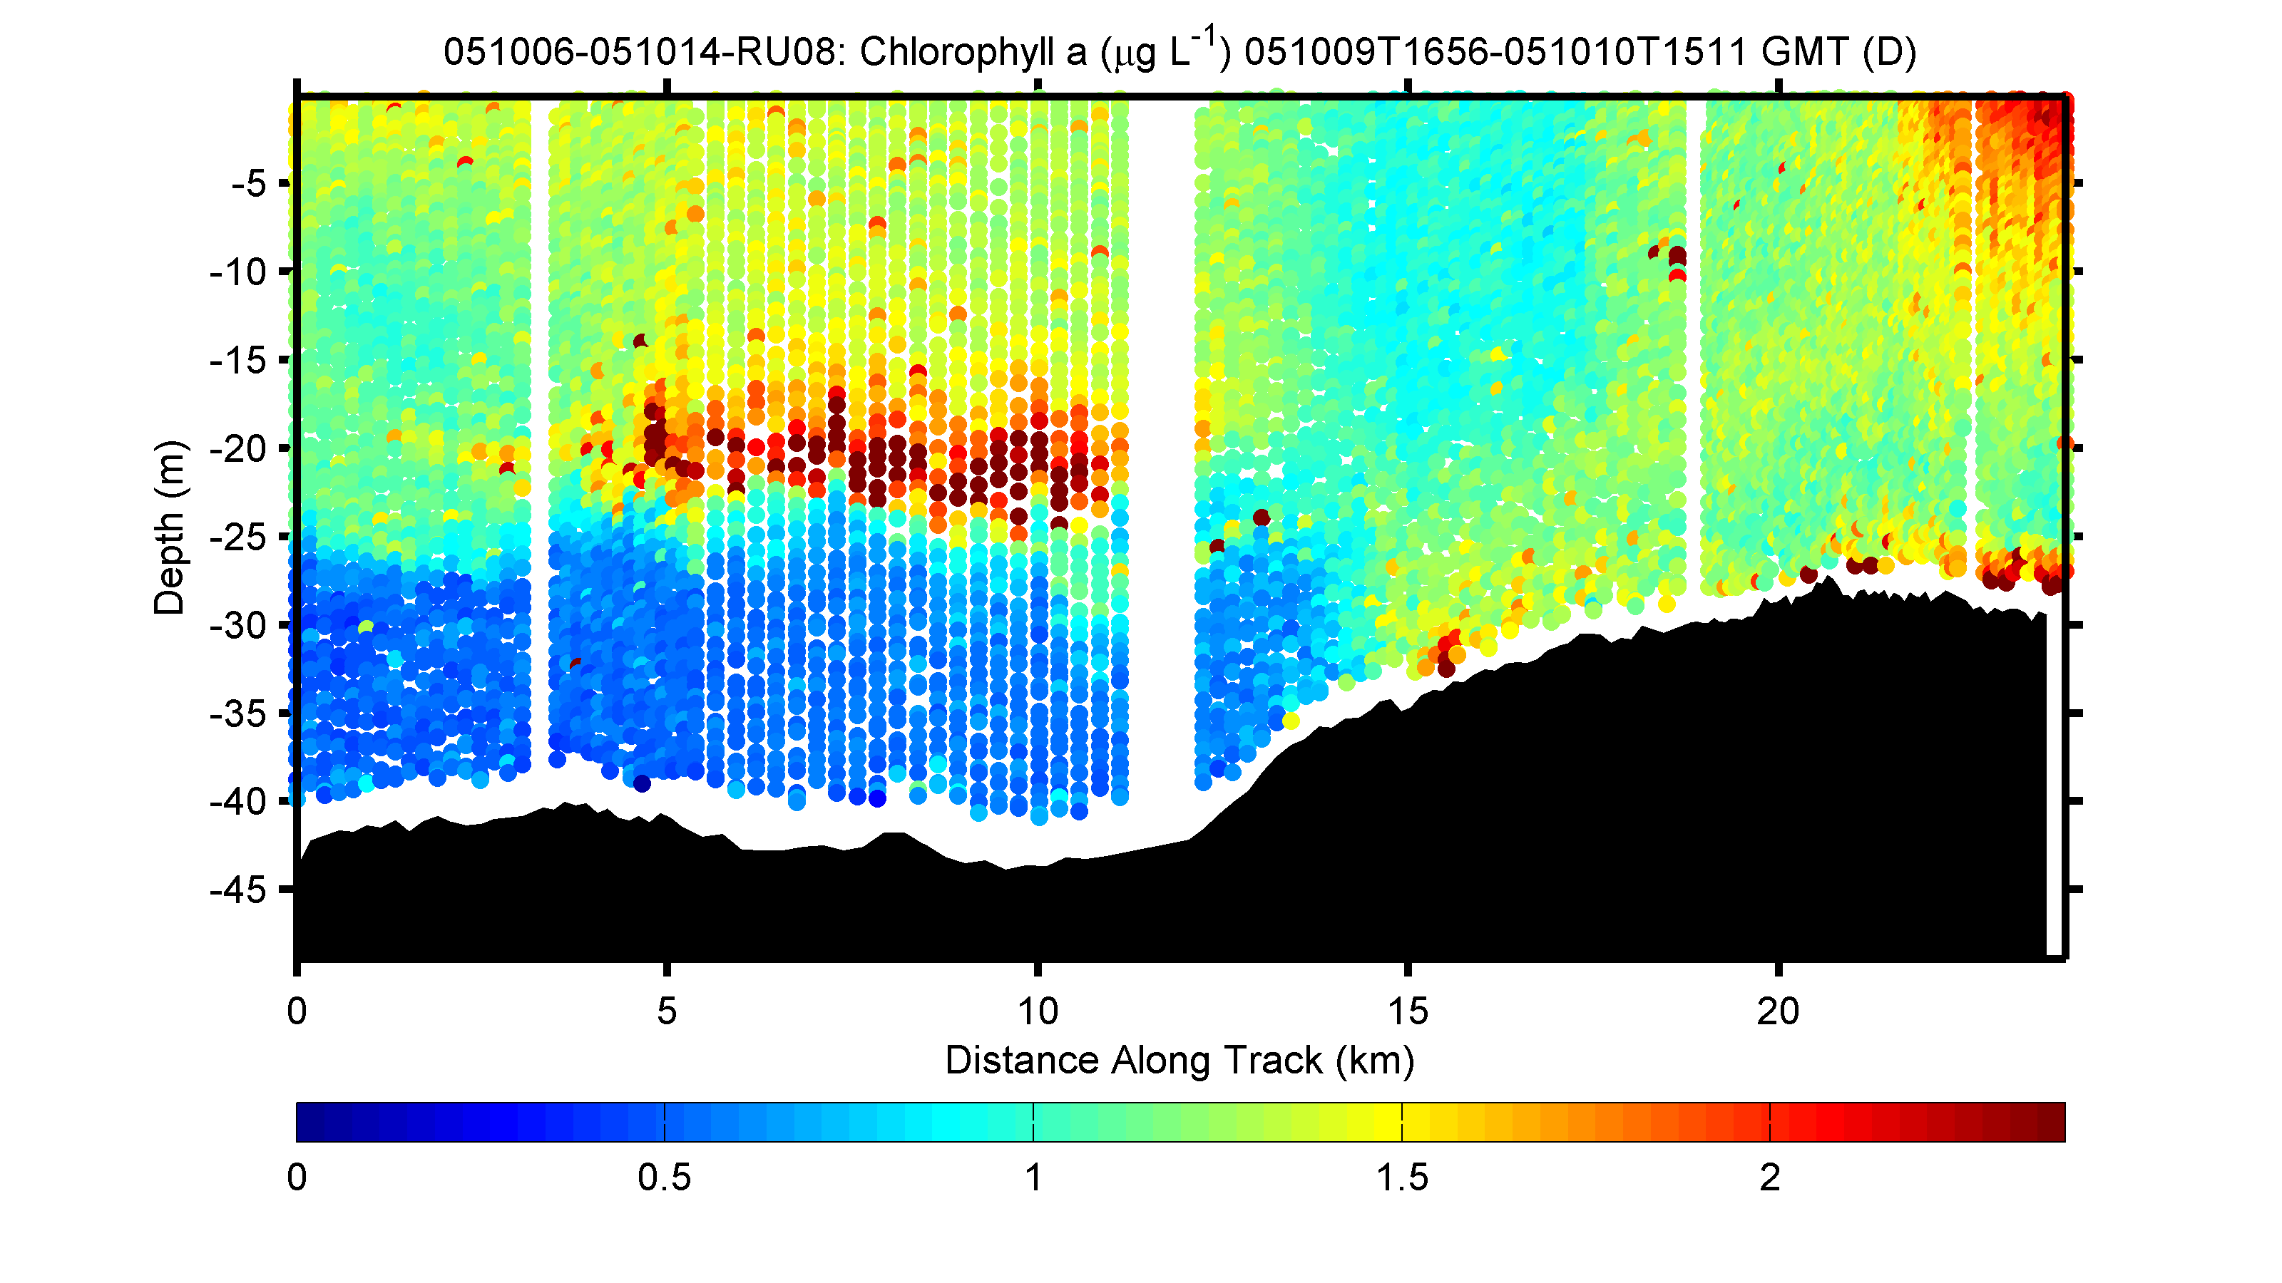
Gliders can provide high resolution biomass and taxa estimates
Phytoplankton biomass
Phytoplankton communities
Phytoplankton response
To passage of Nor’Easter
storm

Slide 10
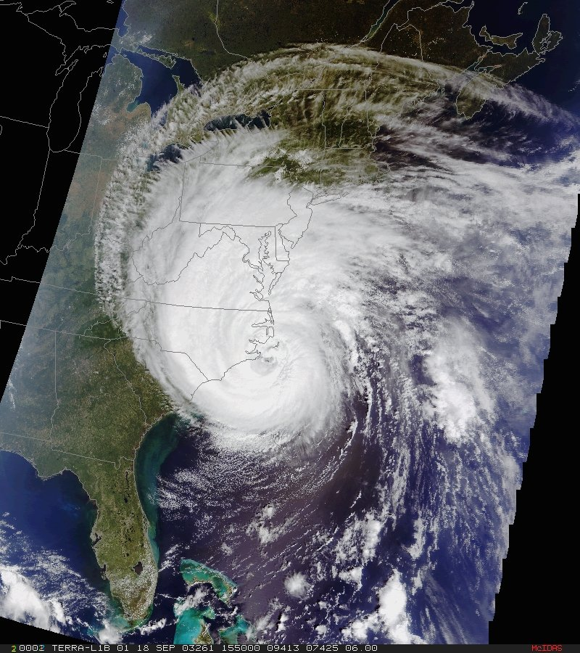
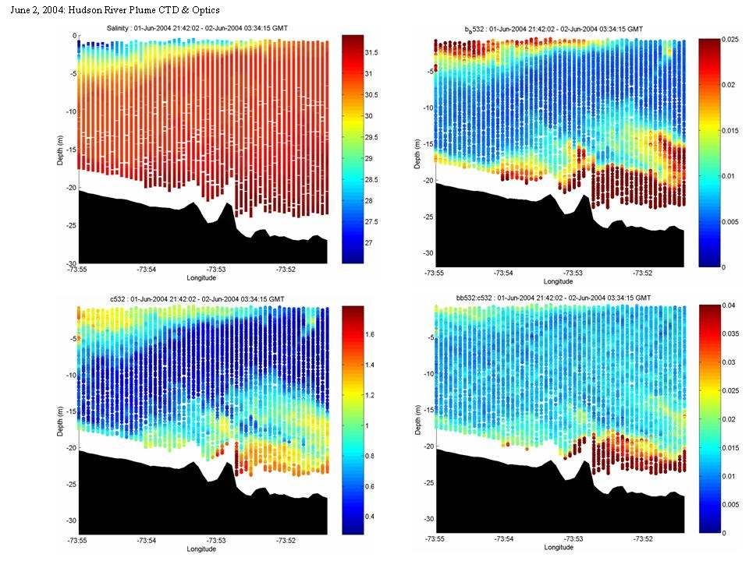
Glider’s provide insight into the nature of phytoplankton composition
c_{b650}
C_{b650}/b_{b650}
Empirical algorithms
%Mineral (in situ)
salinity
b_{b650}

Slide 11
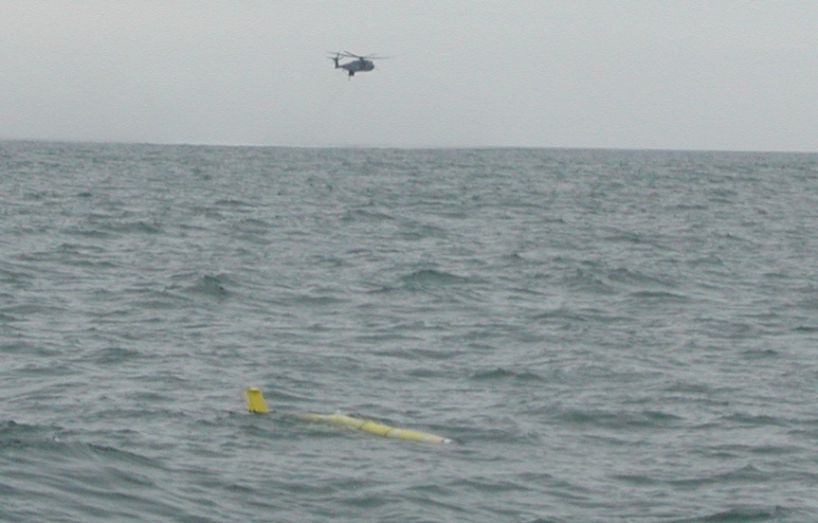
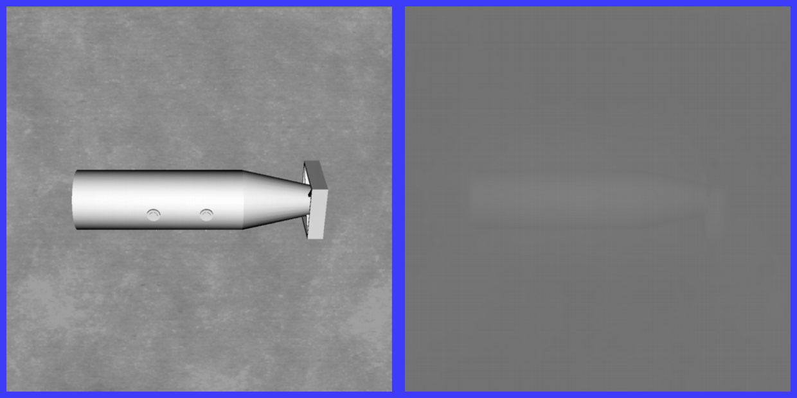
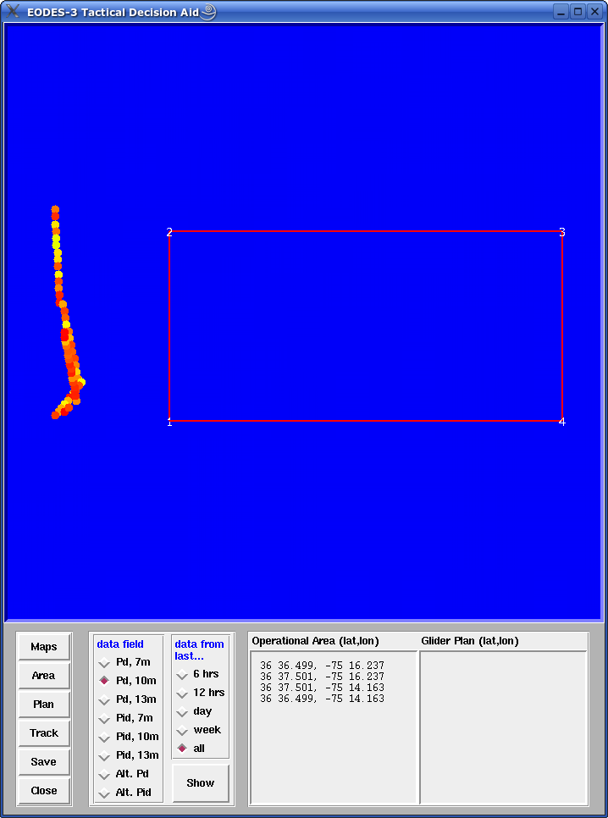
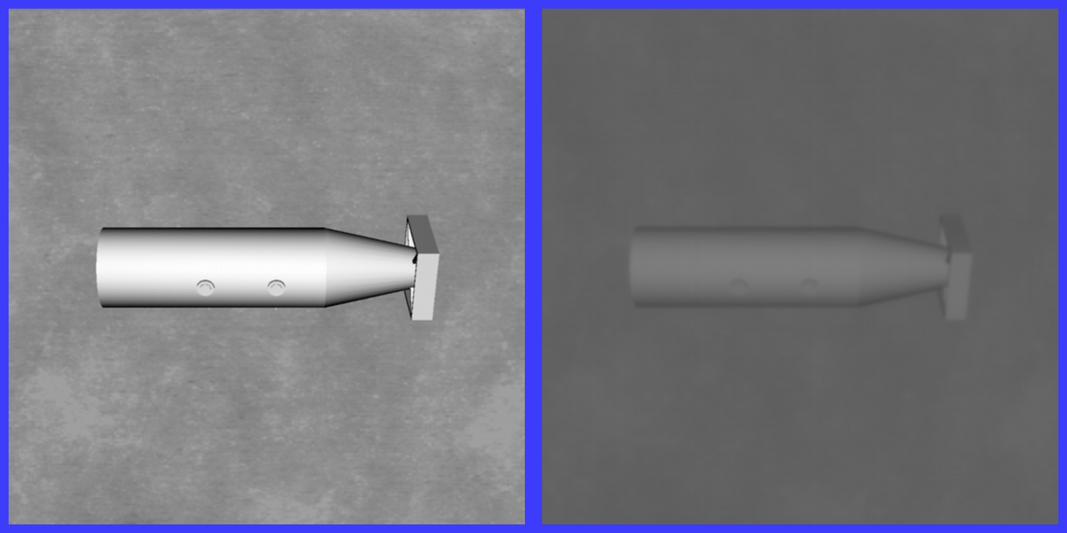
From the optics, one can calculate water column turbidity. What is the depth of the euphotic zone?
An example for a very applied problem: What can you see?
Helicopter or diver….
Towed MCM detection system
April 24, 2005
Clear water
Real water
MIREM April 2005
probability of detection
at an altitude of 10m
off bottom
April 26, 2005
Clear water
Real water
Red = poor detection

Slide 12
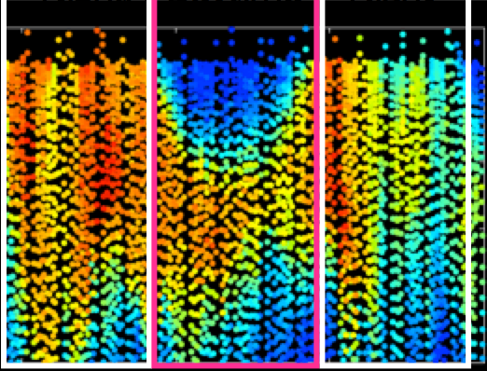
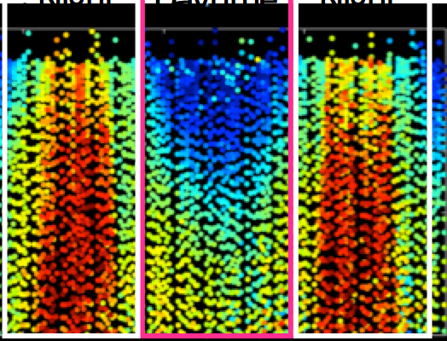
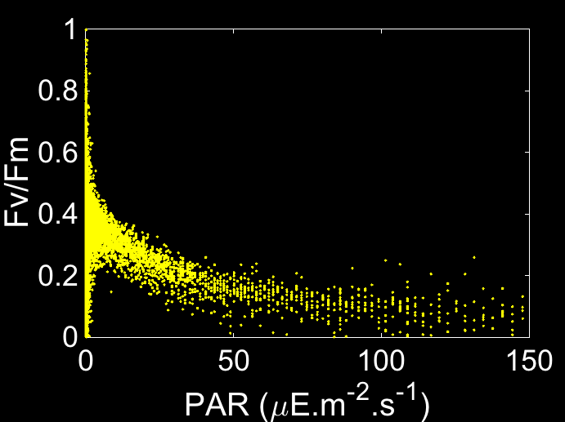
The ability to look at phytoplankton physiology and rate processes
PROXY FOR BIOMASS
HEALTH
Night
Daytime
Night
Night
Daytime
Night
0
0
25
25
50
50
02/20
02/21
02/20
02/21
Time (month/day)
Time (month/day)
0
4000
8000
0
0.3
0.6
Biomass Proxy (Fm)
Quantum Yield of Photosynthesis (Fv/Fm)

Slide 13
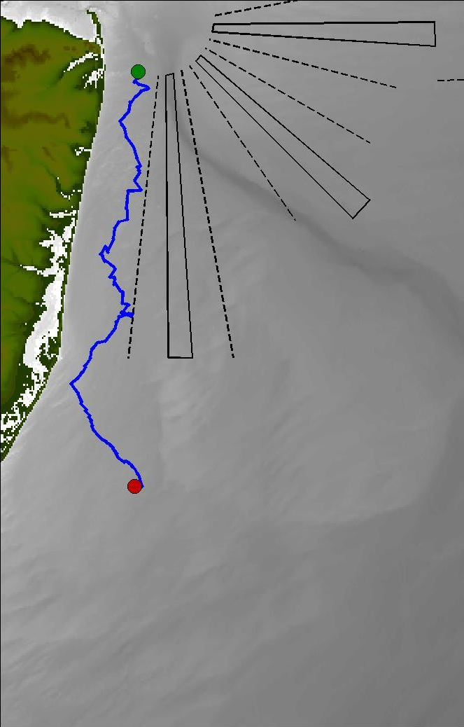


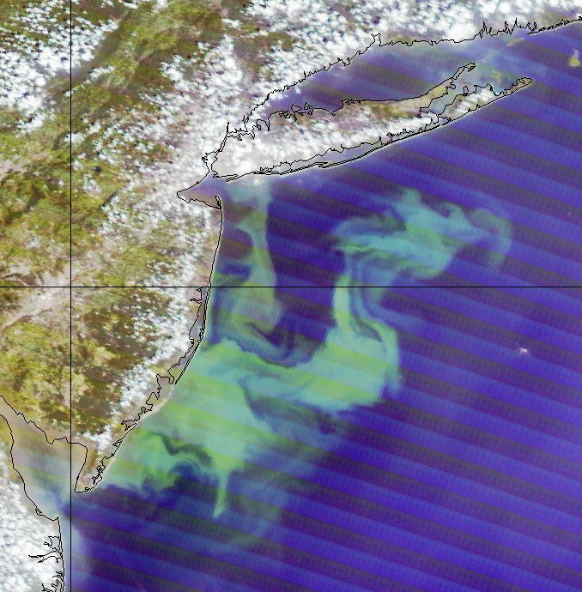

Ability to link phytoplankton to watercolumn biogeochemistry
State of New Jersey is now using gliders to map summer water quality. Is low bottom water oxygen due to outflows from the New York city or is a naturally driven by natural dynamics.
State sponsored state wide surveys providing 3-4 missions each summer, and provides close to 10,000 profiles/summer as opposed to ~150 profiles/summer by ship/
New York
city outflow
Upwelling driven
phytoplankton bloom

Slide 14
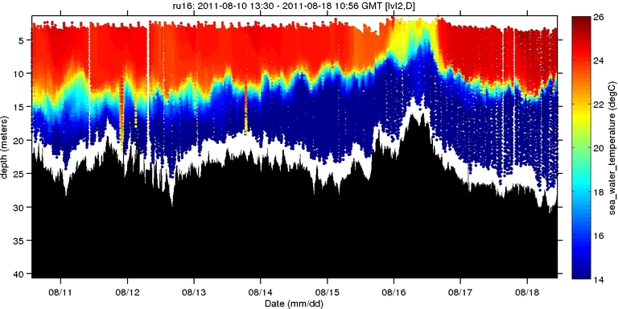
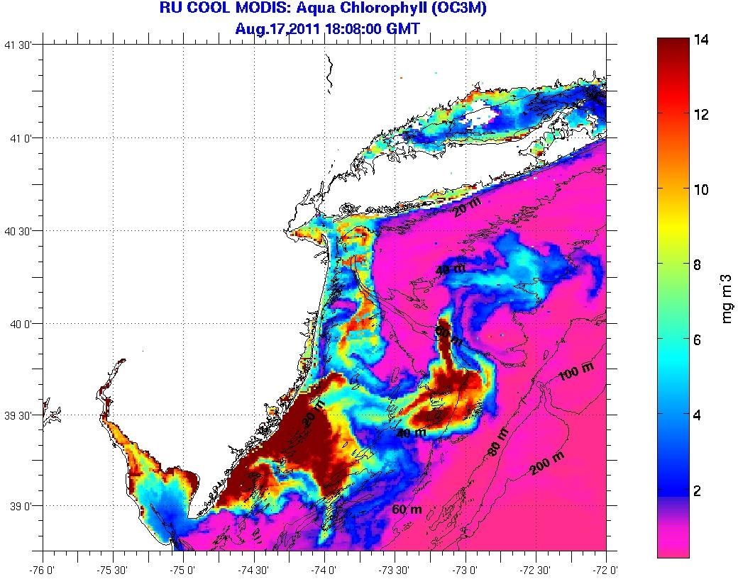
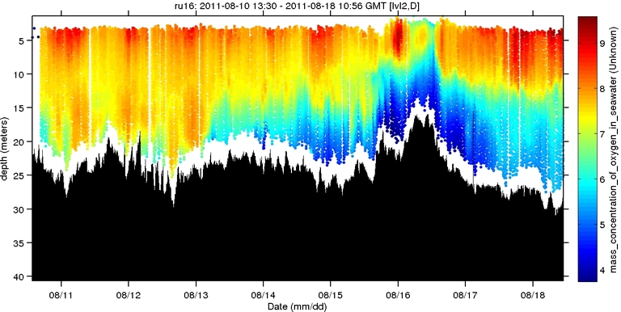
Ability to link phytoplankton to watercolumn biogeochemistry
Autonomous Platforms:
Dissolved Oxygen
2011-2012
Temperature (°C)
Dissolved Oxygen (mg/L)

Slide 15





Glider’s provide high resolution maps to link to physical drivers
Mixed layer dynamics determine the presence or absence of phytoplankton blooms

Slide 16


Active acoustics to map zooplankton community and concentration
Careful calibration of zooplankton with glider-class ADCP.
Powell & Ohman. 2012
Glider resolved to the vertical migration at frontal regions along California.
Powell & Ohman 2015

Slide 17




Active acoustics to map macro-zooplankton community and concentration
Guihen et al. 2014

Slide 18

Animal dynamics via active optics
wind speed (m s⁻¹)
Ophelia
Sensor damage?
Saturation?

Slide 19

Gliders being able to track animals based on passive acoustics
Receiver Integrated Glider
Enables coupling of data sets
  Telemetry data
  Temperature
  Salinity
  Productivity
Moves us beyond fixed arrays

Slide 20


Building distributed glider communities through Gliderpalooza
IOOS (<10% gliders), NASA, Navy, NERC, OOI, EPA, SECOORA, Teledyne, ONR, VIMS, GLERL, CONCORDE
2013
2014

Slide 21



Gliders being able to track animals based on passive acoustics
Drs. Baumgartner (WHOI) and Fratantoni (SeaTrec) from to develop autonomous gliders, equipped with a reliable acoustic detection algorithm to allow near real time detection of North Atlantic right, fin, sei and humpback whales.
Dr. Baumgartner
Dr. Fratantoni

Slide 22



Coming soon (2-4 years) micro- and small zooplankton imaging
Holographic images from Monterey
by an AUV
Design strategies are underway
Thanks to James Bellingham (WHOI)

Slide 23






Gliders assessing biological hotspots
A)
0
Depth (m)
120
-64.8
Latitude
Antarctic Circumpolar Current
-64.9
-64.3
Longitude
-63.9
<-1
0
>1
Temperature (C)
Rothera
-2
°C
2
0
0
-67.7
Depth (m)
Latitude
120
Depth (m)
-69.4
-67.9
Longitude
-68.4
<-1
0
>1
Temperature (C)
600

Slide 24




Dynamic analysis of penguin foraging in the vertical
Penguin
Foraging
locations
Kahl et al., 2010

Slide 25

Dynamic analysis of penguin foraging in space

Slide 26



Glider data improving model simulations opening the door to ecosystem trajectories
Glider
temperature
ROMs
temperature
Glider
salinity
ROMs
salinity
Use thermal niche model + temperature hindcasts ~ estimate habitat distribution in NW Atlantic
=

Slide 27

Glider data provides direct data into undergraduate class to improve STEM education

Slide 28


NOAA glider tools provides direct data into undergraduate class to improve STEM education

Slide 29


Observed Model vs Glider Differences
(Results from undergrad summer research)
New tools open data analysis across demographic, opportunities for unique crowd sourcing opportunities
Most variation between the two models and RU29 exist within the first 300 meters of the water column
MyOcean model has a fairly consistent 1˚C to 2˚C difference in temperature from RU29
RTOFS model was fairly consistent with the RU29 data at lower depths but had very large discrepancies in magnitude at certain locations.

Slide 30


Hurdles: Substrates for formation of artificial reefs
Hurdles: Biofouling (see below), pace of sensor integration, slow but accelerating rate of standardization (Calibration, Qa/Qc, etc)
NSF OOI Glider Argentinean Basin

Slide 31






Thank You!
40
31
22
13
4
http://rucool.marine.rutgers.edu

