Slide 1
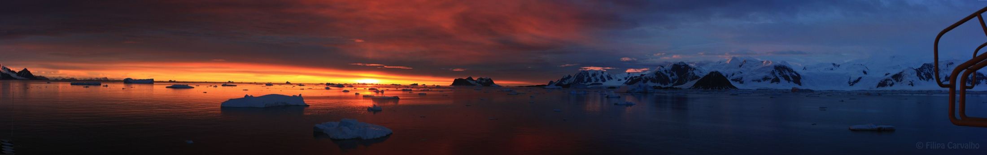




Phytoplankton Dynamics in the LTER
Rutgers: Oscar Schofield, Michael Brown, Filipa Carvahlo, Nicole Couto, Alex Kahl, Josh Kohut, Martin Montes-Hugo, Nicole Waite, Schuyler Nardelli, Paul Falkowski, Jonathan Sherman, Grace Saba
Collaboraters: UNC (Adrian Marchetti, Carly Moreno), UConn
(Heidi Dierssen), OSU (Bethan Jones), U Del. (Matt Oliver, Mark Moline)

Slide 2
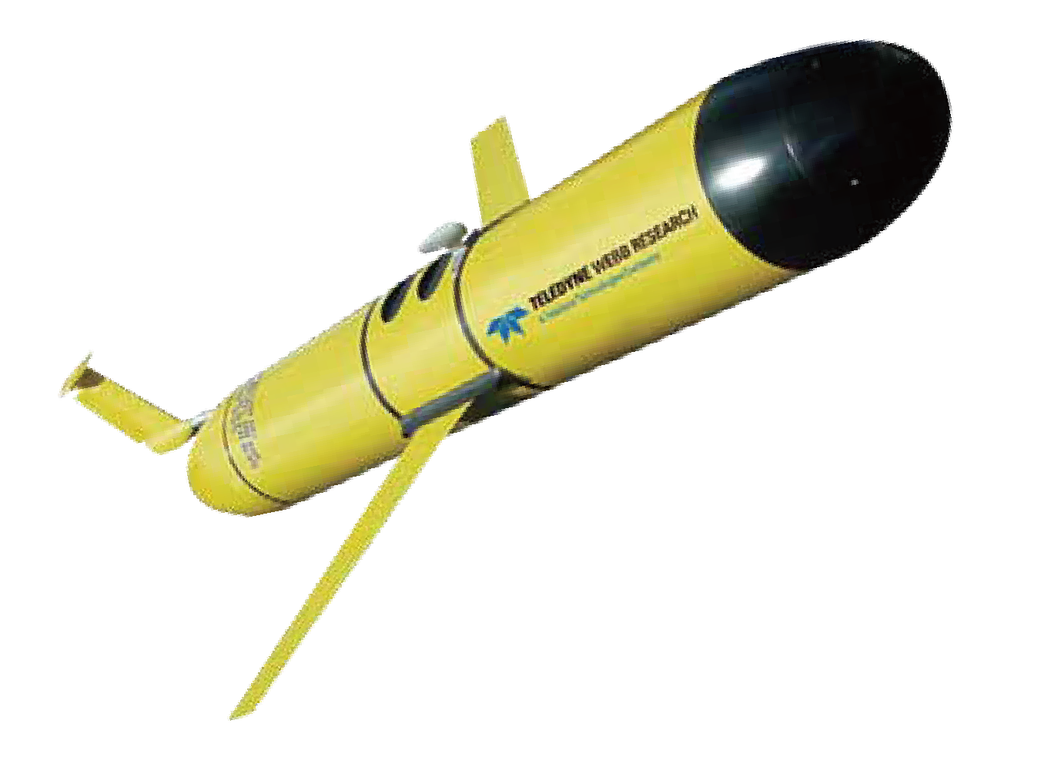
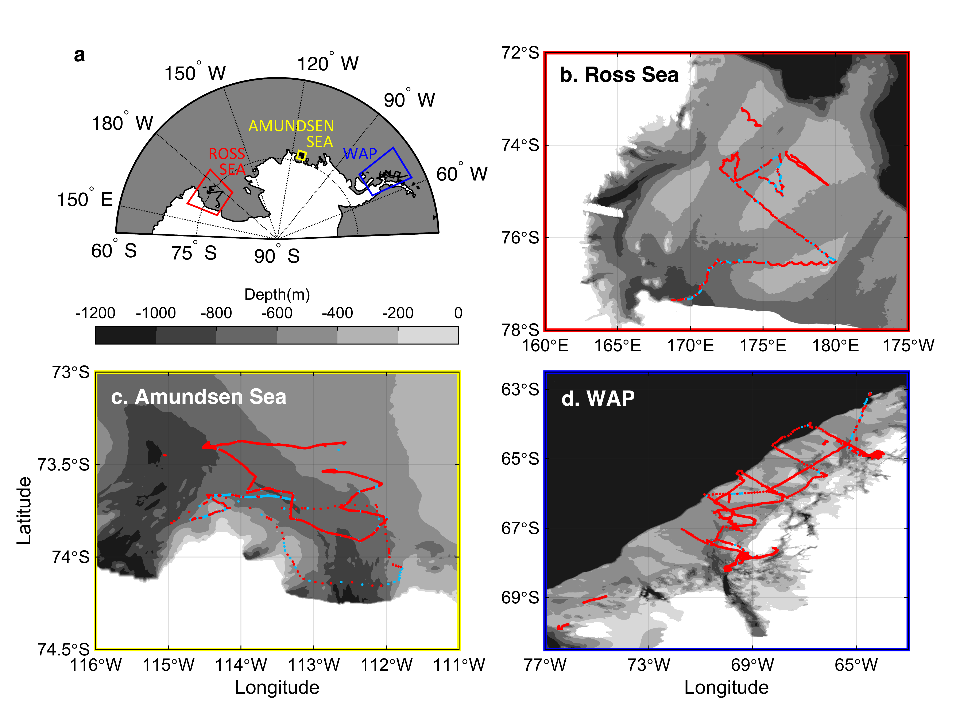
RU Antarctic Glider Deployments
Are there commonalities across coastal Antarctica?
 | # deployments | # Profiles | # Days
WAP | 26 | 16 673 | 407
Ross Sea | 3 | 2 212 | 67
Amundsen Sea | 3 | 2 247 | 26

Slide 3
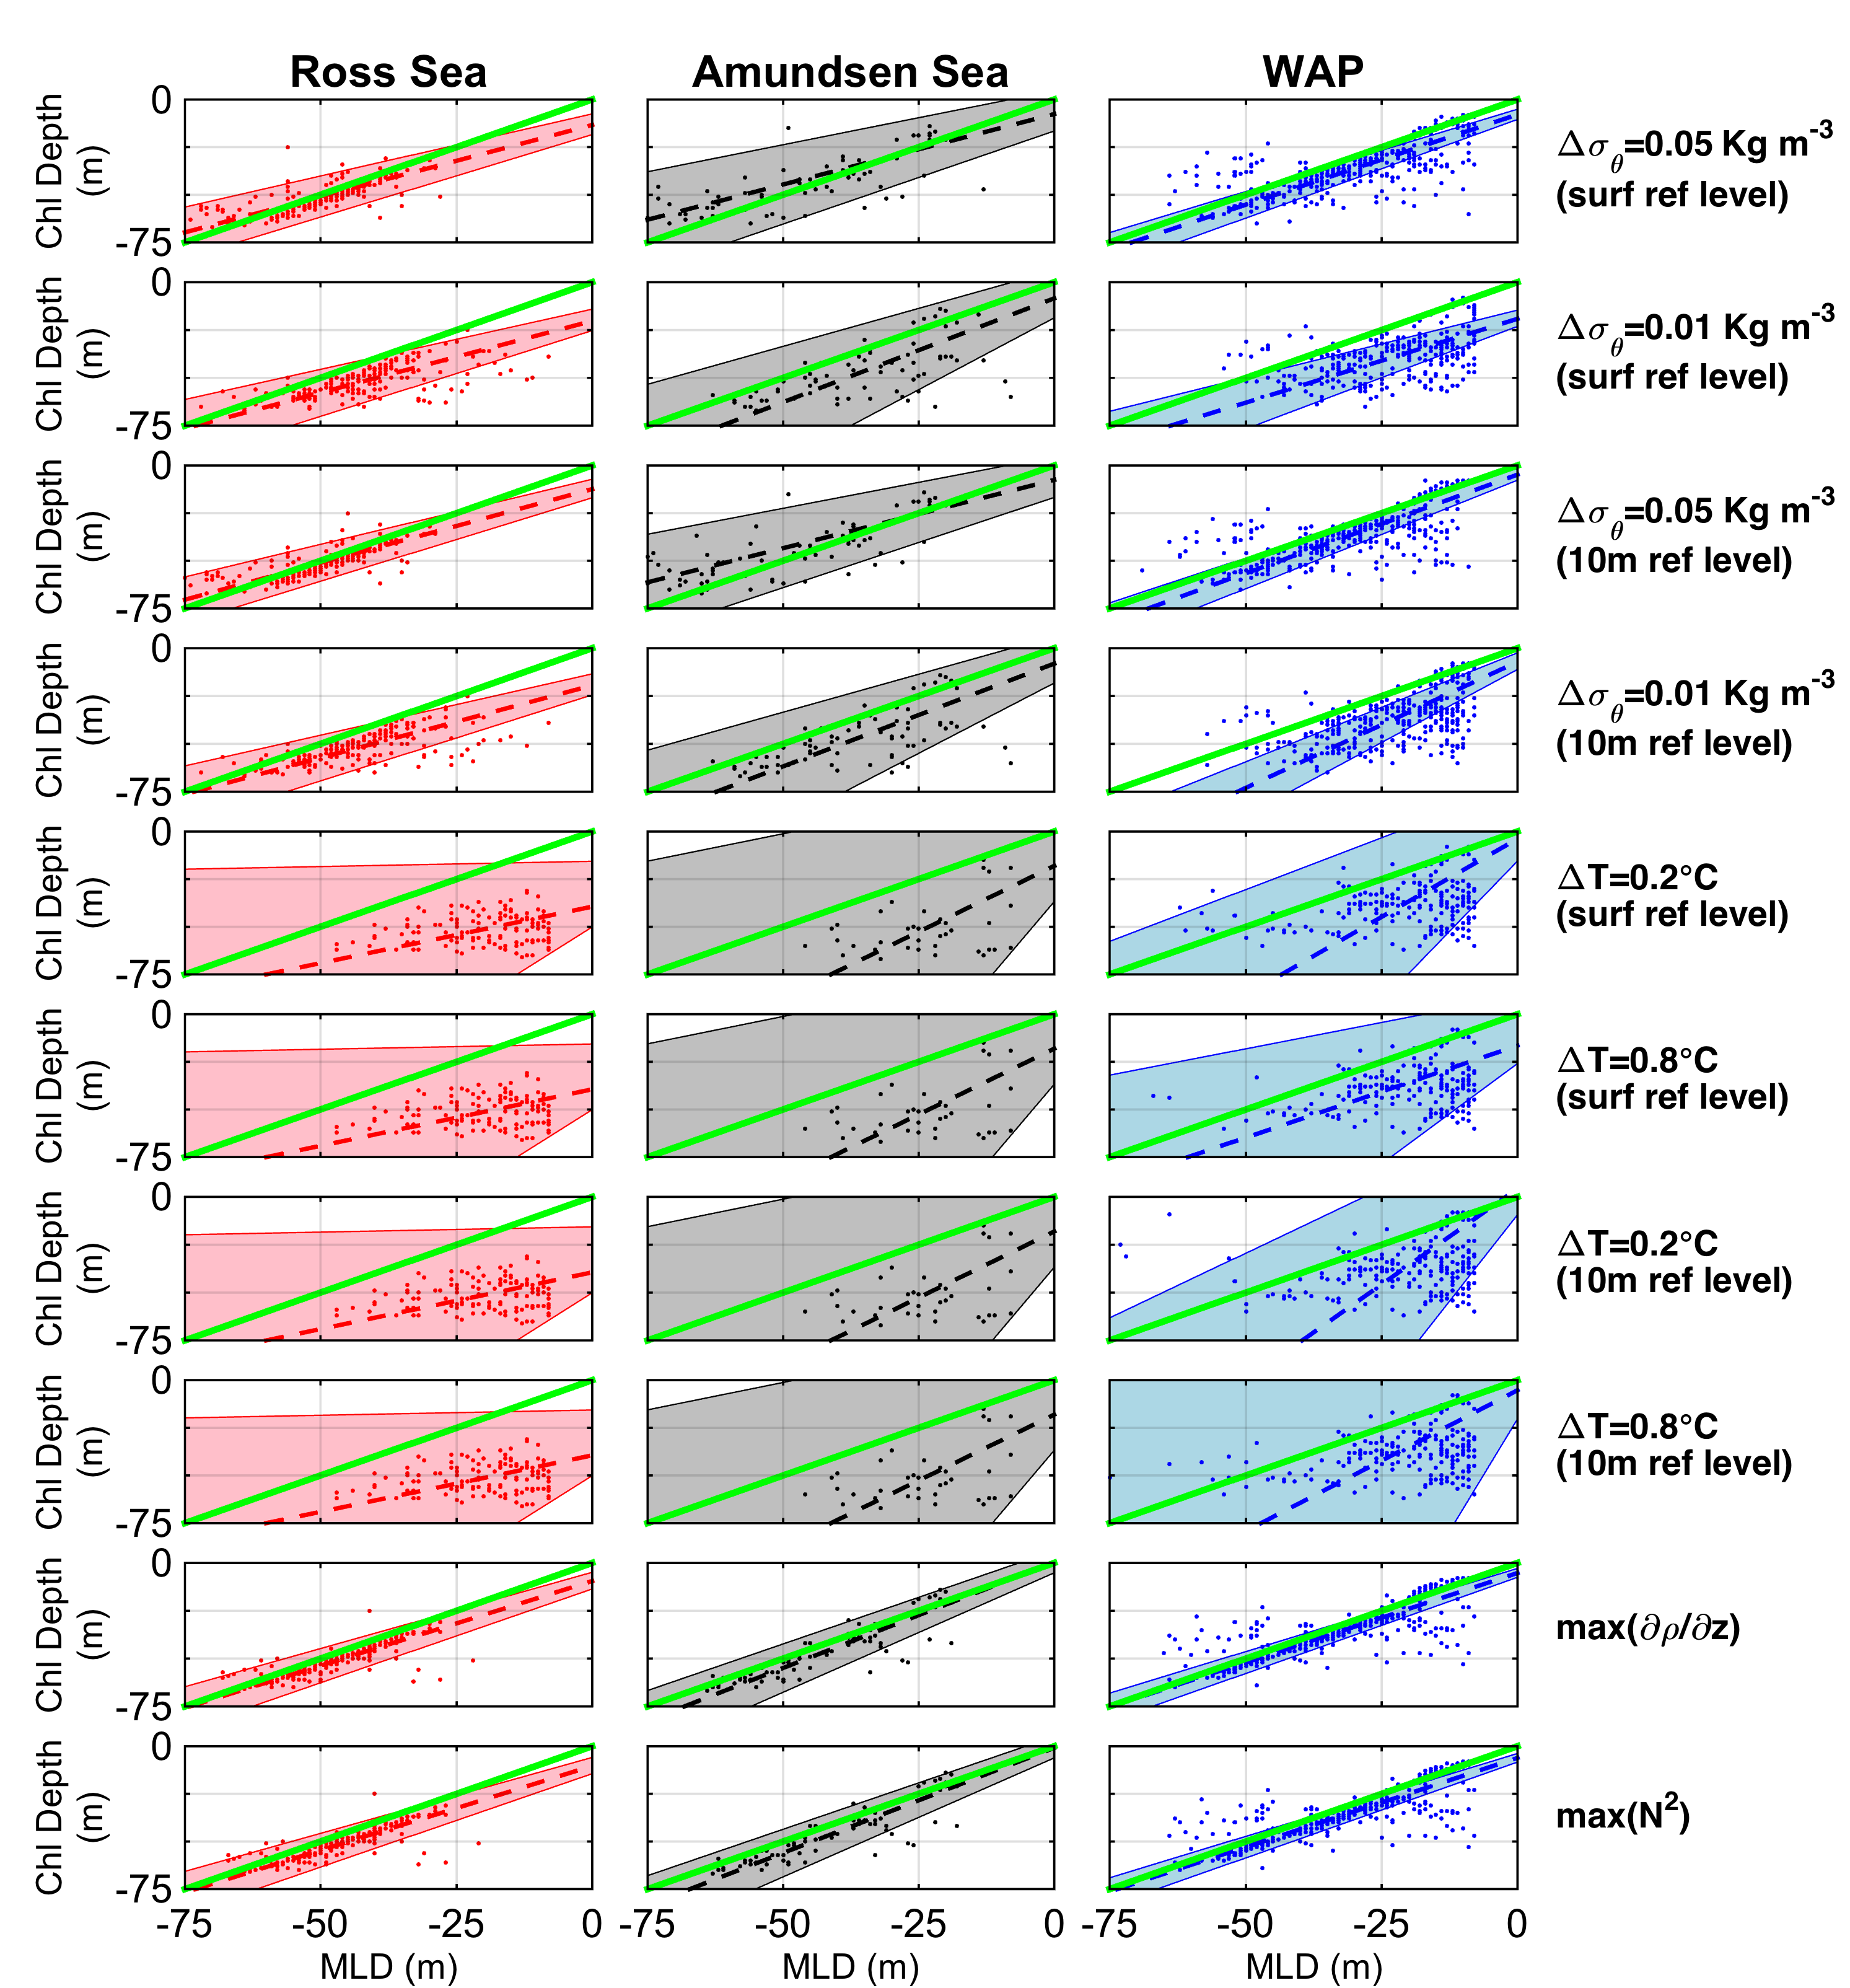
MLD Definition Matters
Carvalho et al. Revision submitted

Slide 4
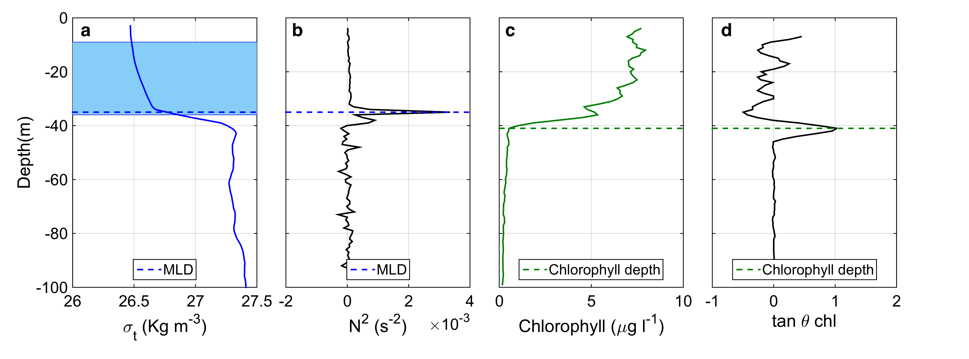
MLD vs Chlorophyll depth
Density profile example
Chlorophyll profile example

Slide 5
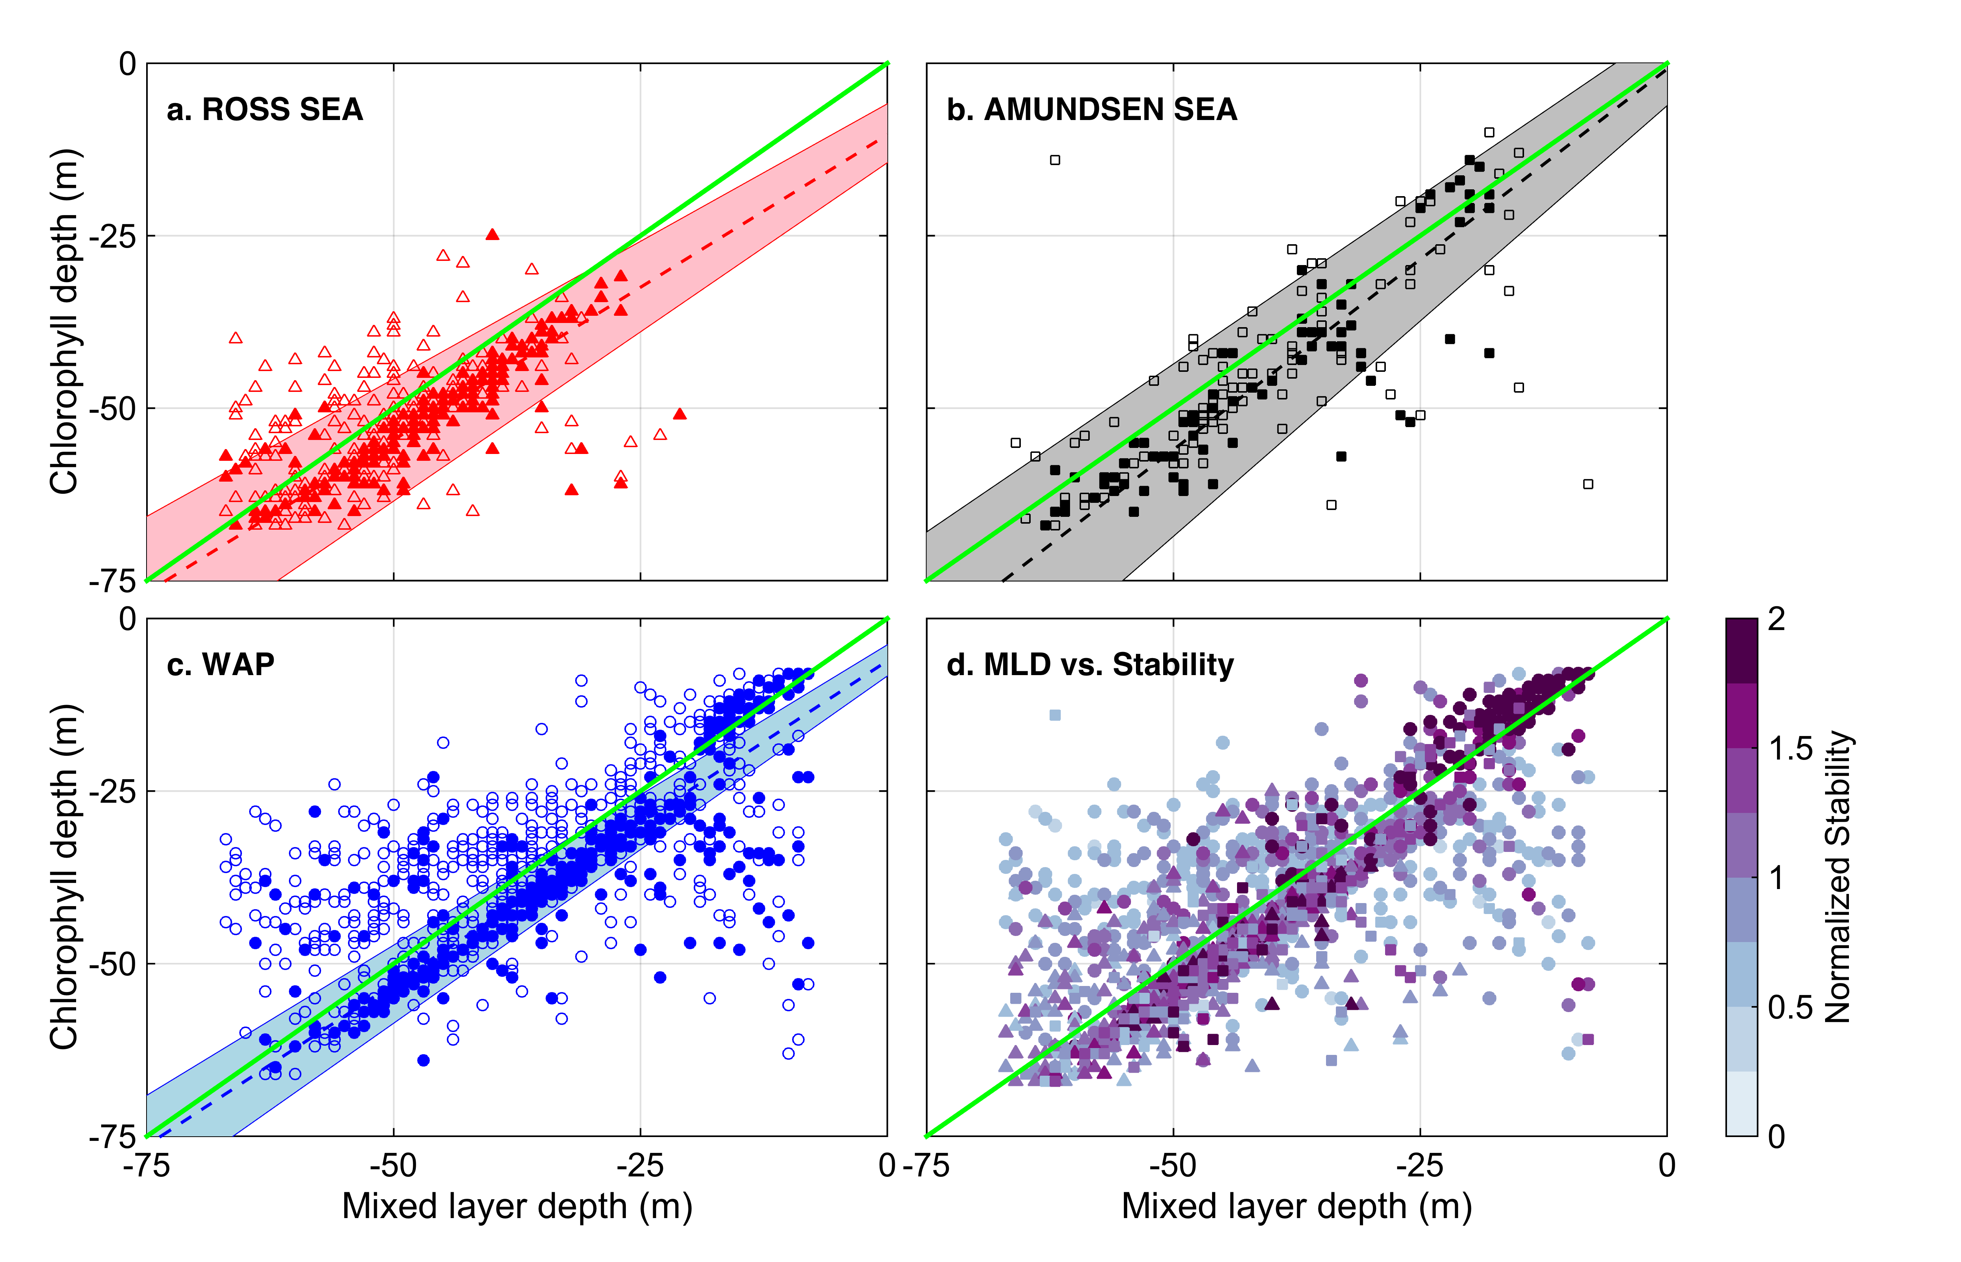
Ecological relevant mixed layer depth (MLD)
Buoyancy frequency is good proxy for MDL in phytoplankton studies
Carvalho et al, 2016 (GRL, in review)

Slide 6
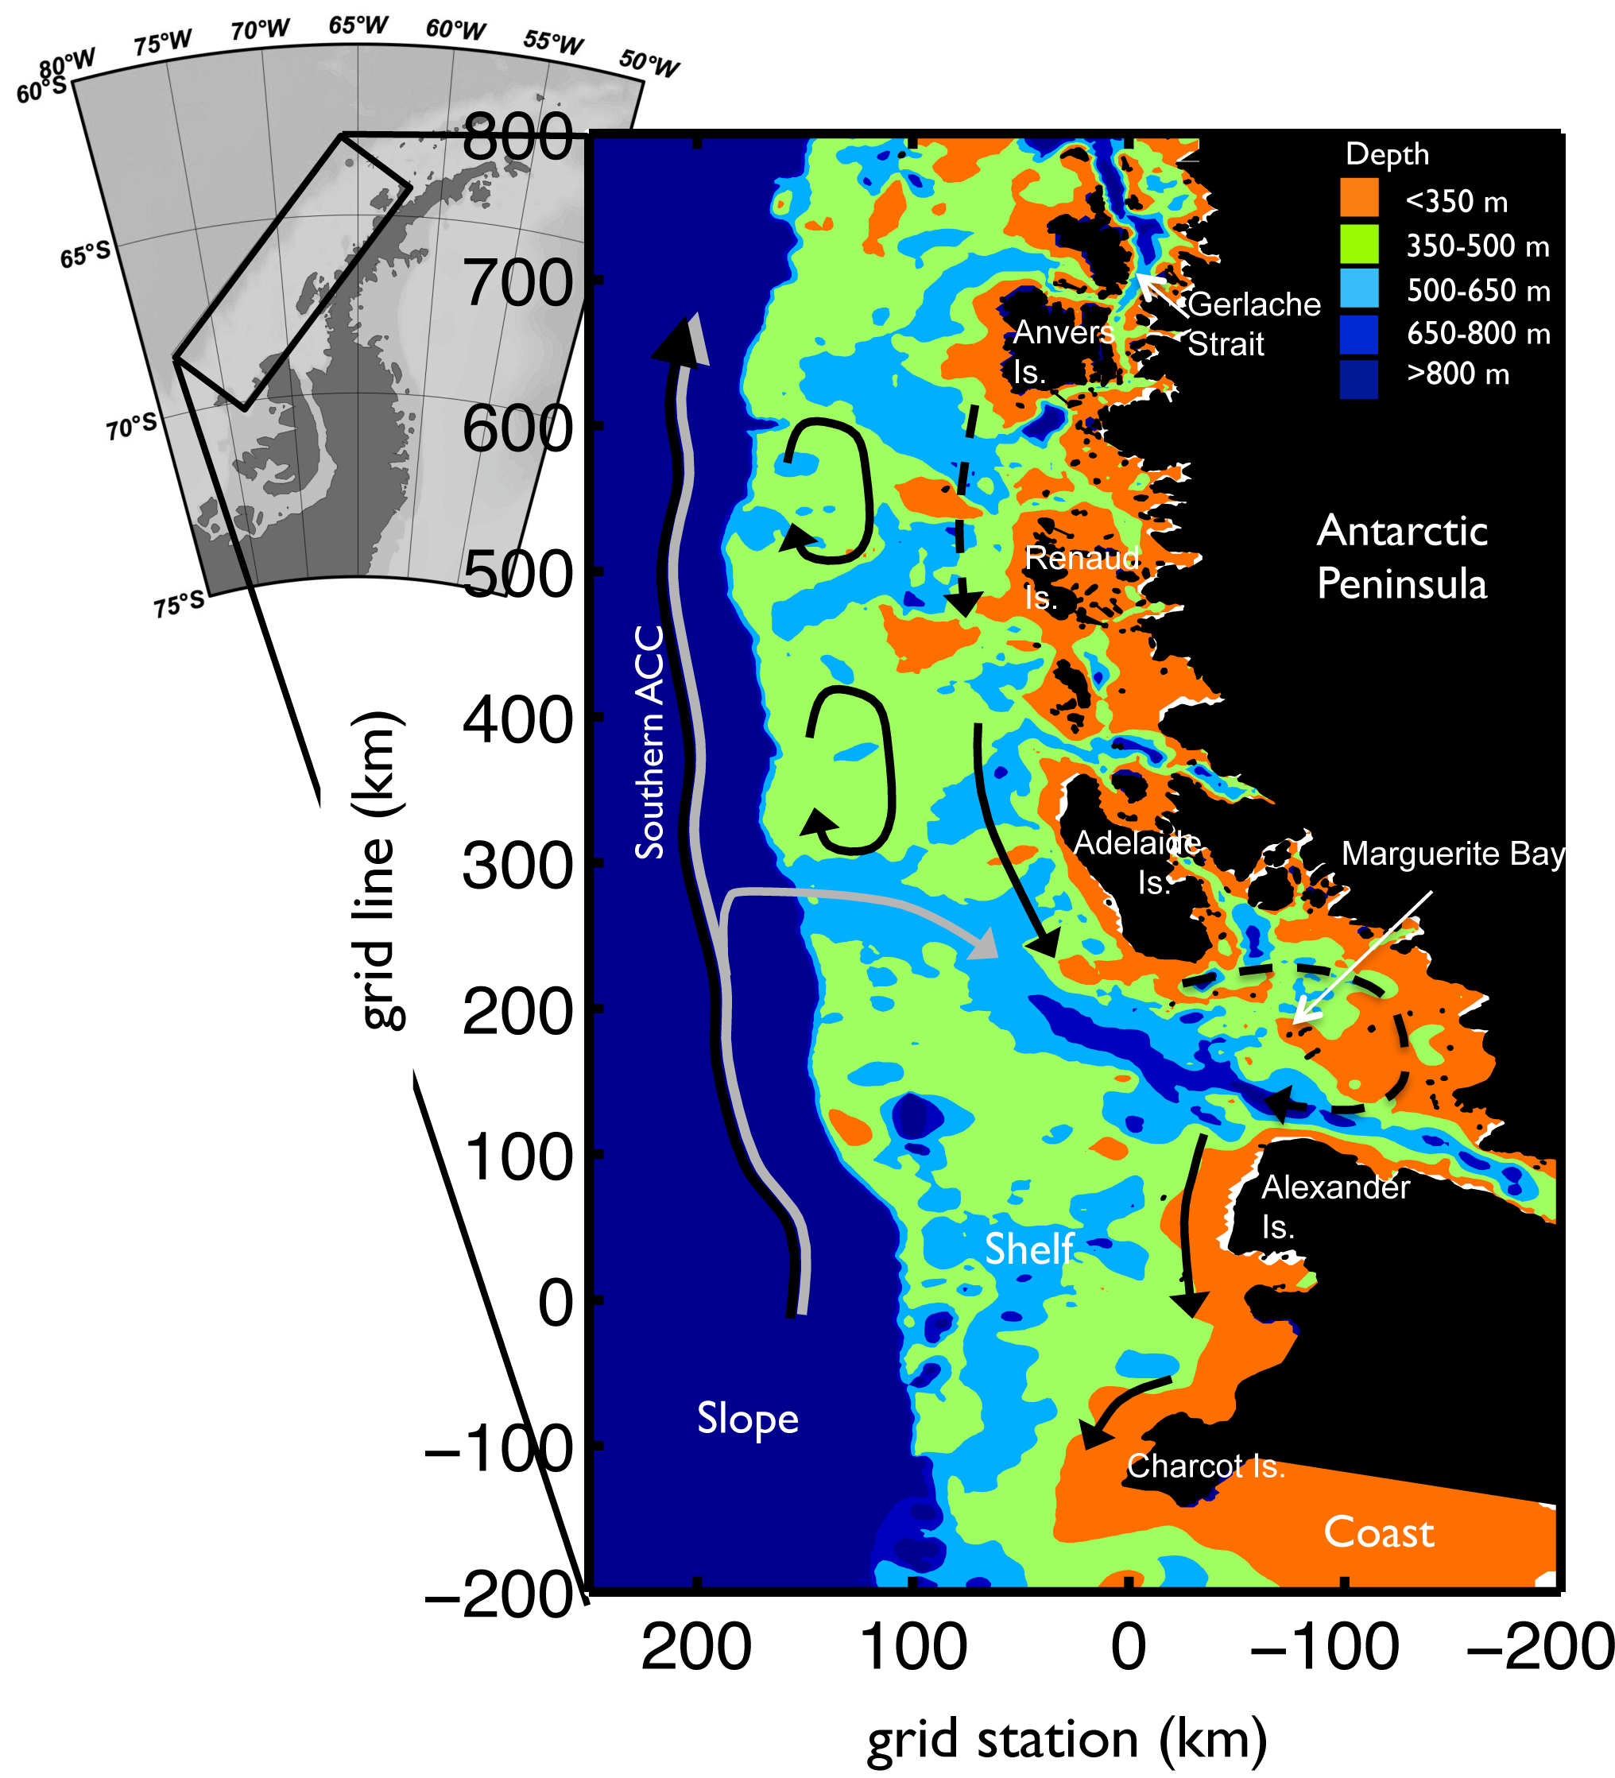
WAP Canyons are “Biological Hotspots”
Palmer Deep Canyon
“Biological Hotspots” along the Peninsula associated with deep undersea canyons.
Penguin Colonies at costal termini of cross-shelf canyons/troughs
Predictable /elevated food availability;
Phytoplankton growth in canyon heads;
Blooms variable in space and space
Eveleth et al., 2016
Notes:
Moving on to the next slide we have a coastline of the WAP, where we see Anvers Is, where Palmer Station is, Adeleide Is where Rothera (the UK station) is. Highlighted are 3 canyon systems which are known biological hotspots in the WAP, Palmer Deep, Margarite Trough and Canyon near Charcot Is.

Slide 7
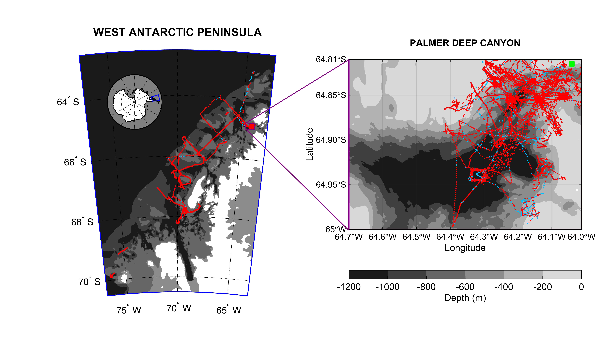
West Antarctic Peninsula Glider Deployments
Over 30,000 individual glider profiles in the canyon alone

Slide 8
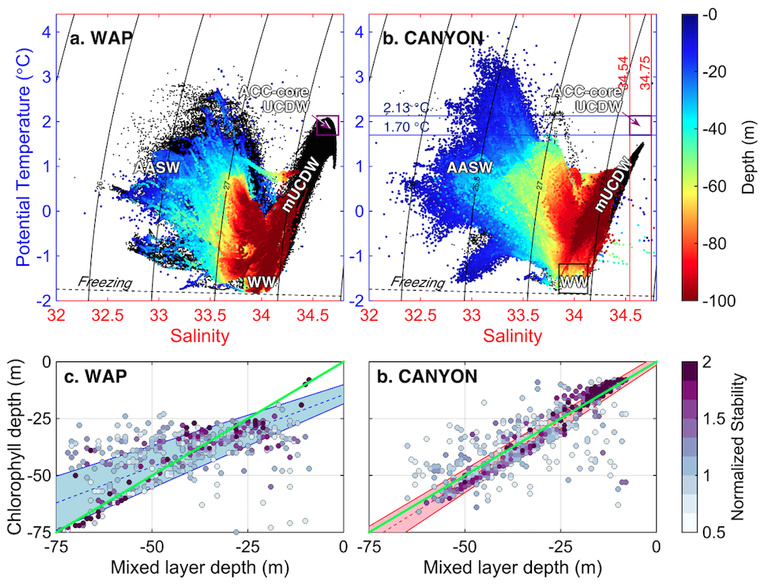
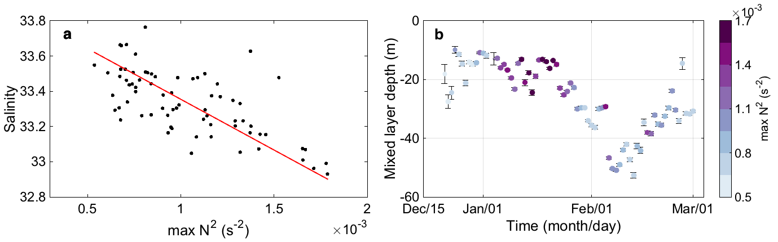

Slide 9
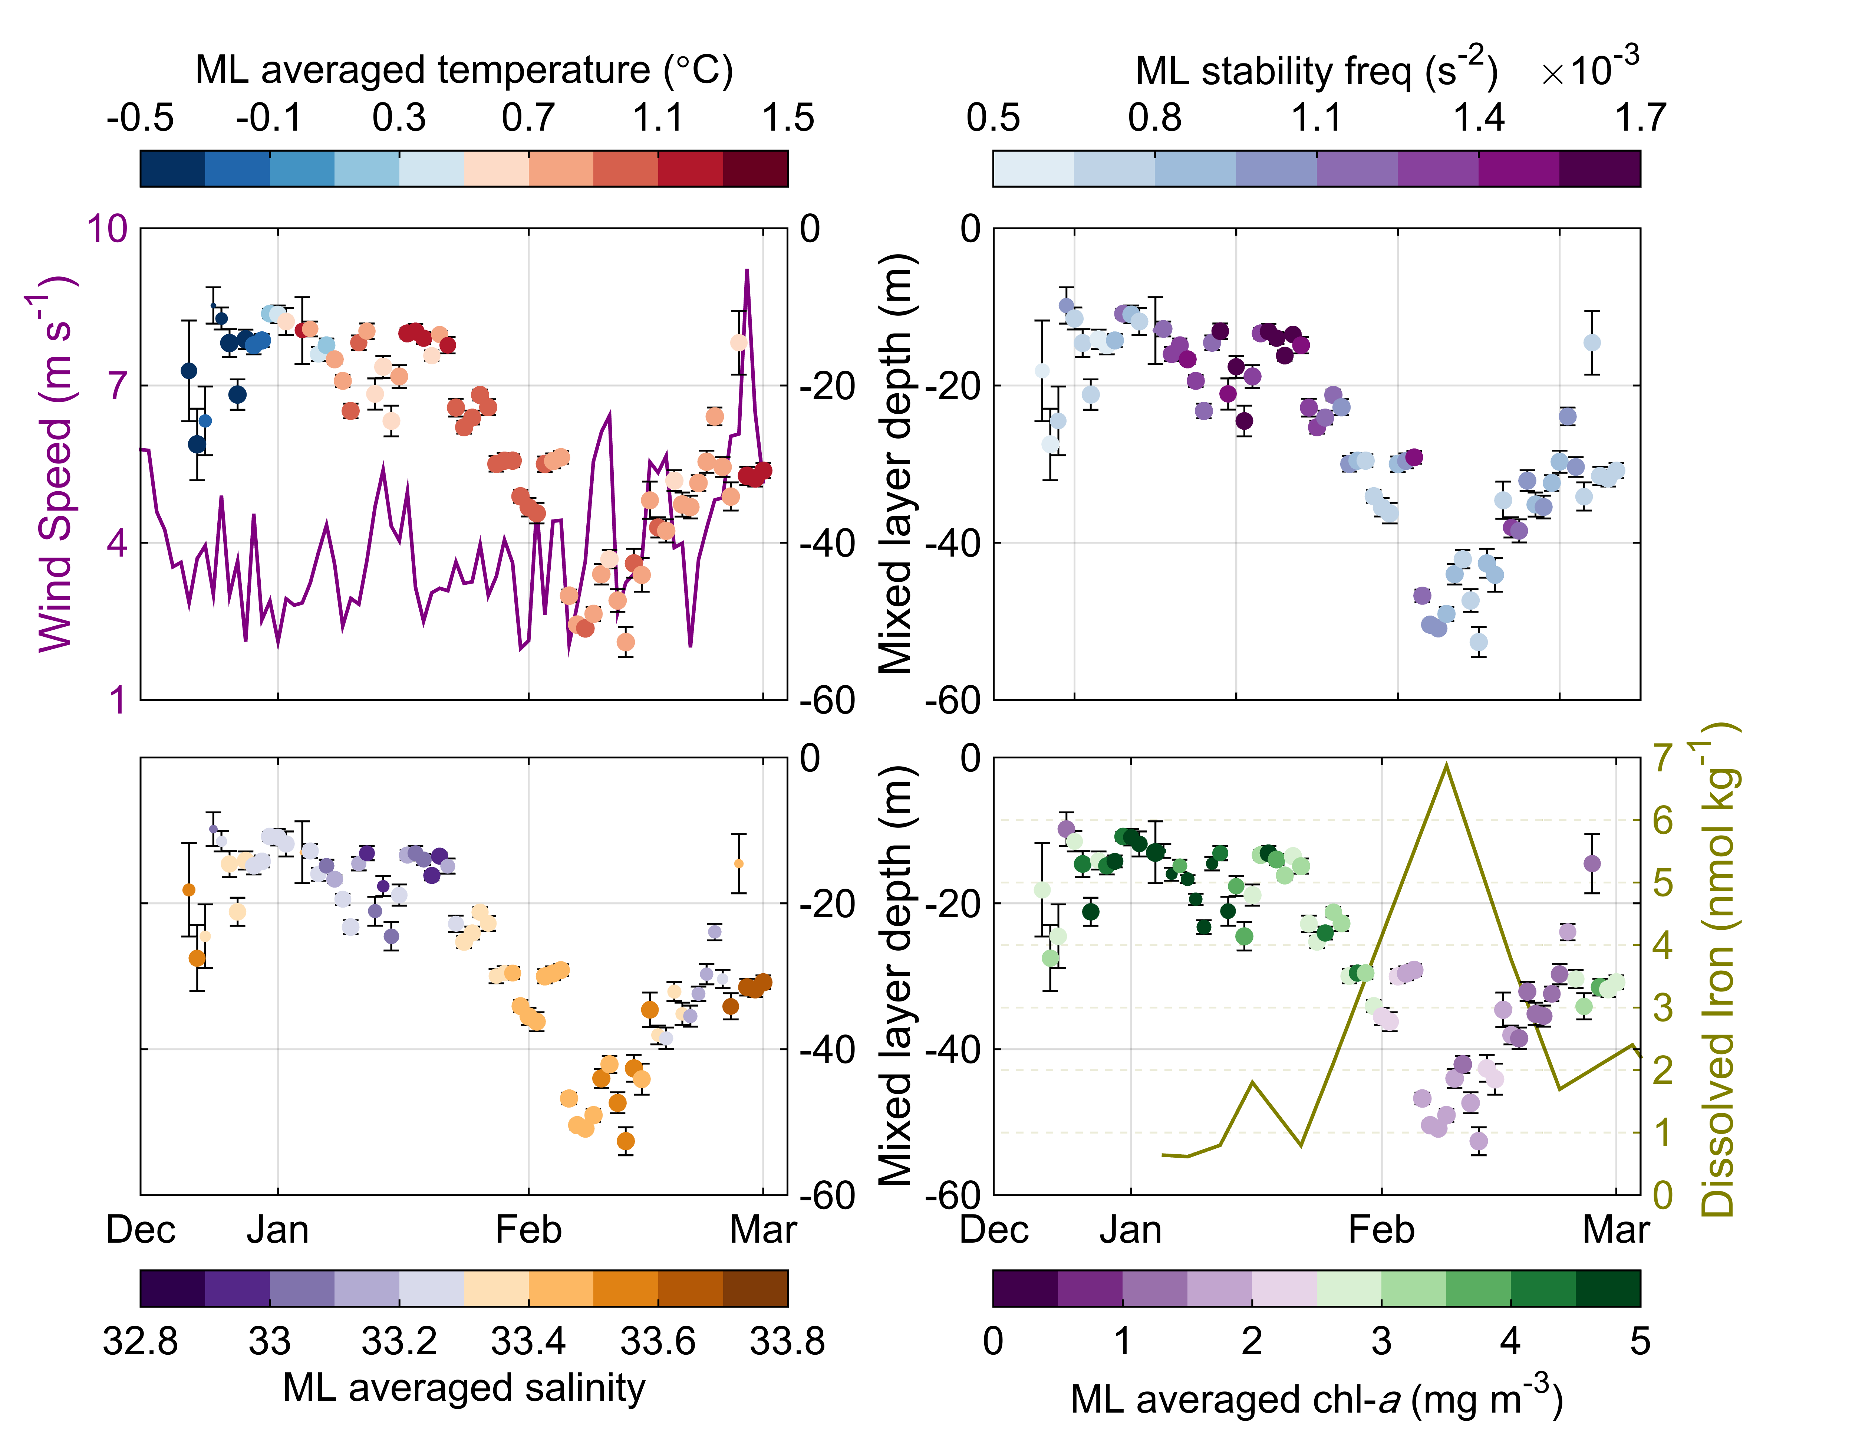
Seasonal cycle at Palmer Deep Canyon (WAP)
Shallow MLD + increased stratification = increased chlorophyll
Carvalho et al, 2016 (JGR)

Slide 10
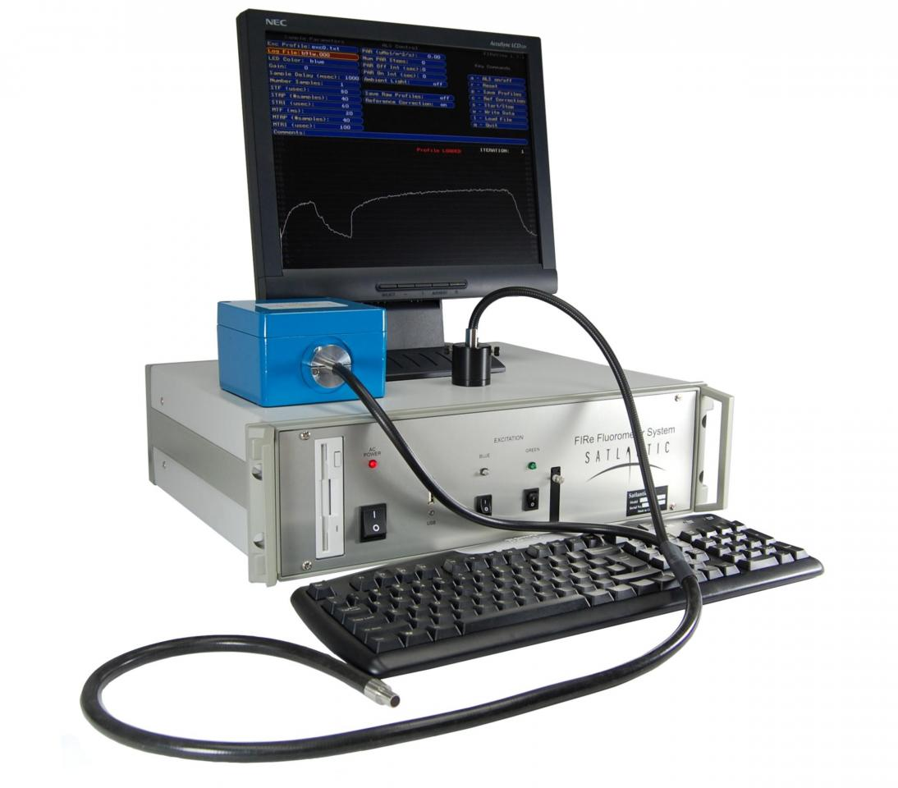
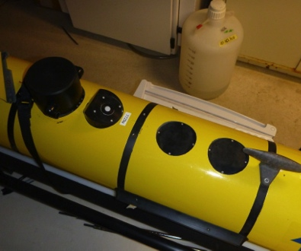
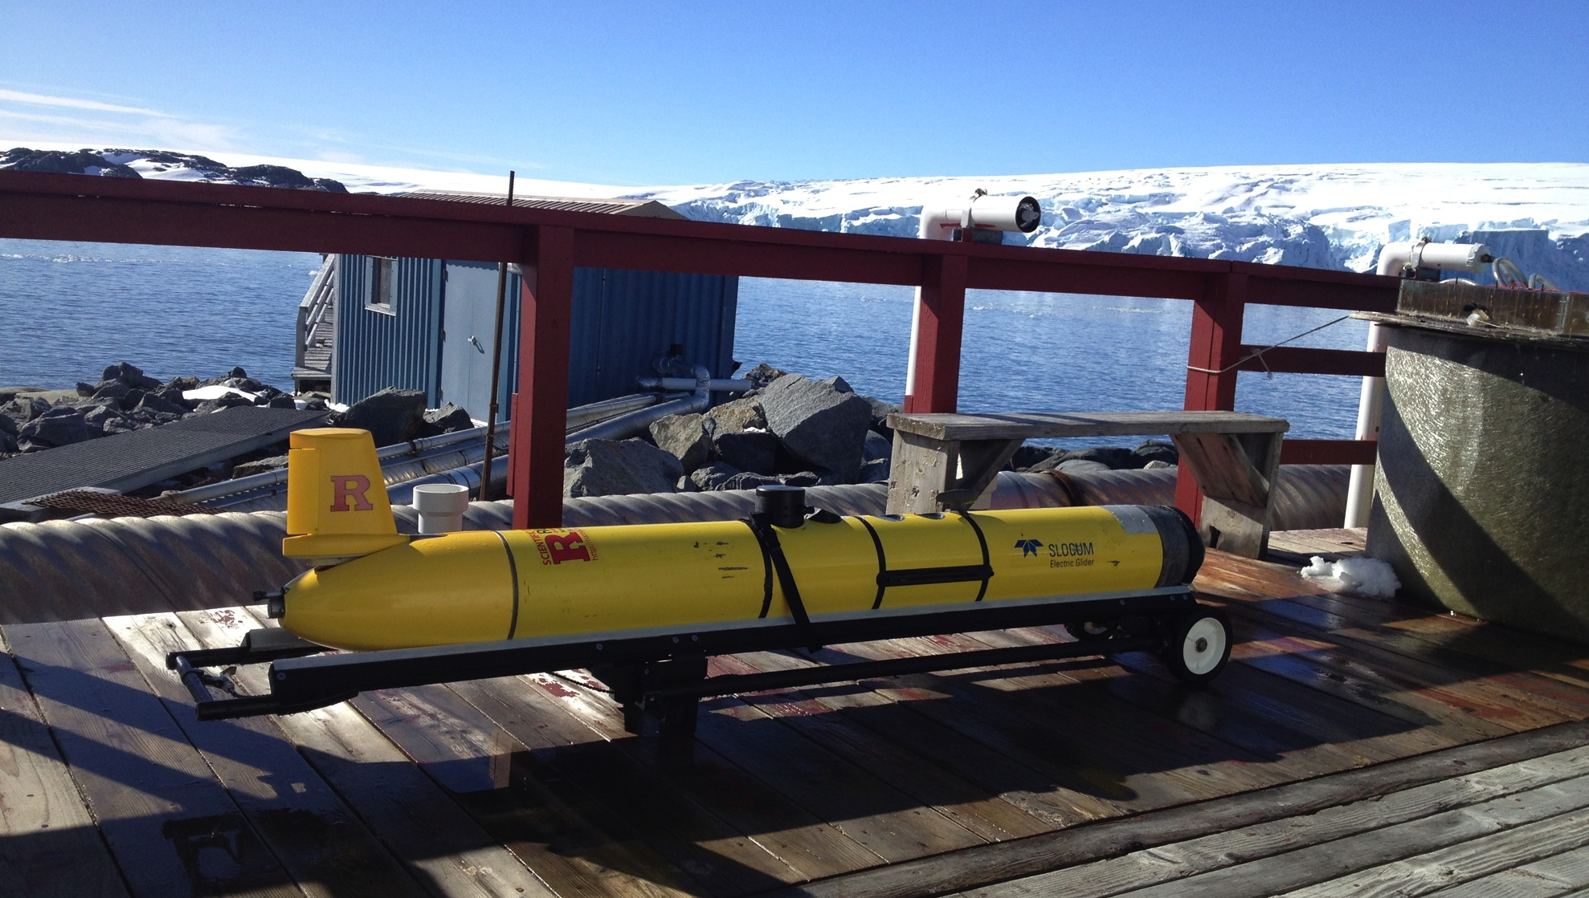
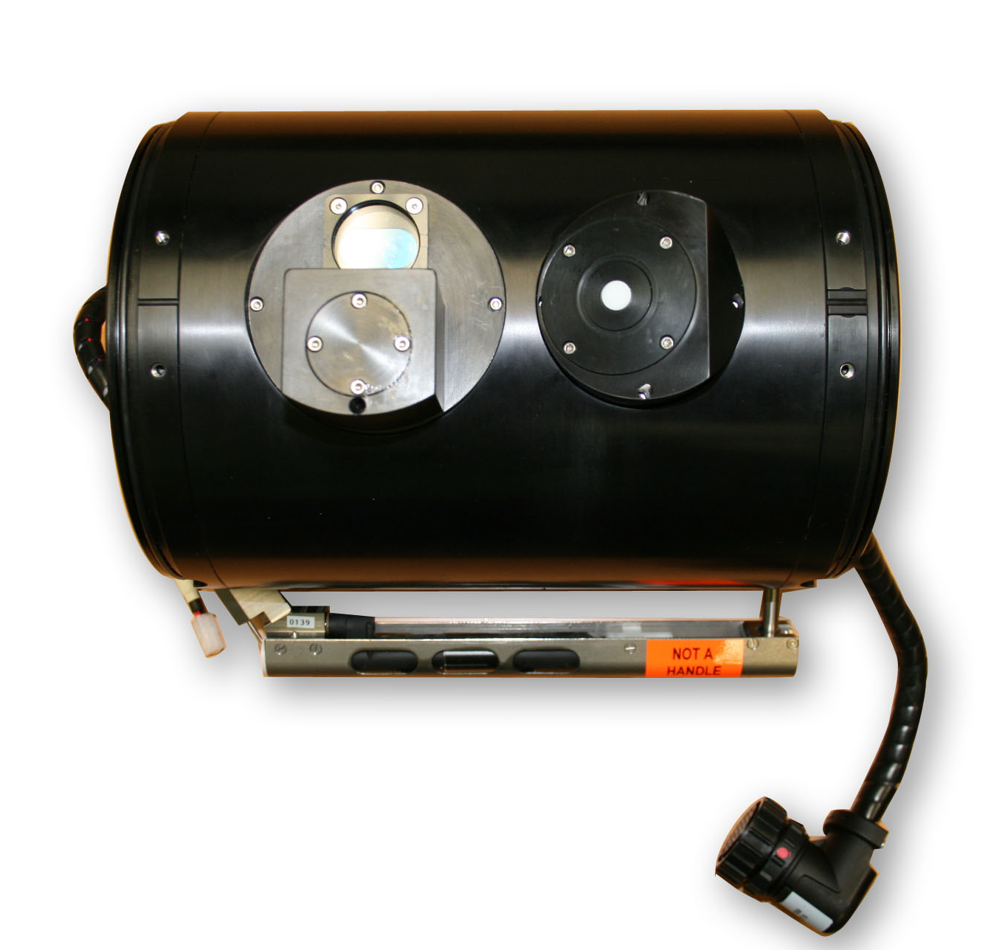
Fluorescence Induction and Relaxation Sensor
Using gliders to map phytoplankton physiology
FIRe glider

Slide 11
“Healthy” Phytoplankton have higher F_{v}/F_{m}
Increasing F_{v}/F_{m}

Slide 12
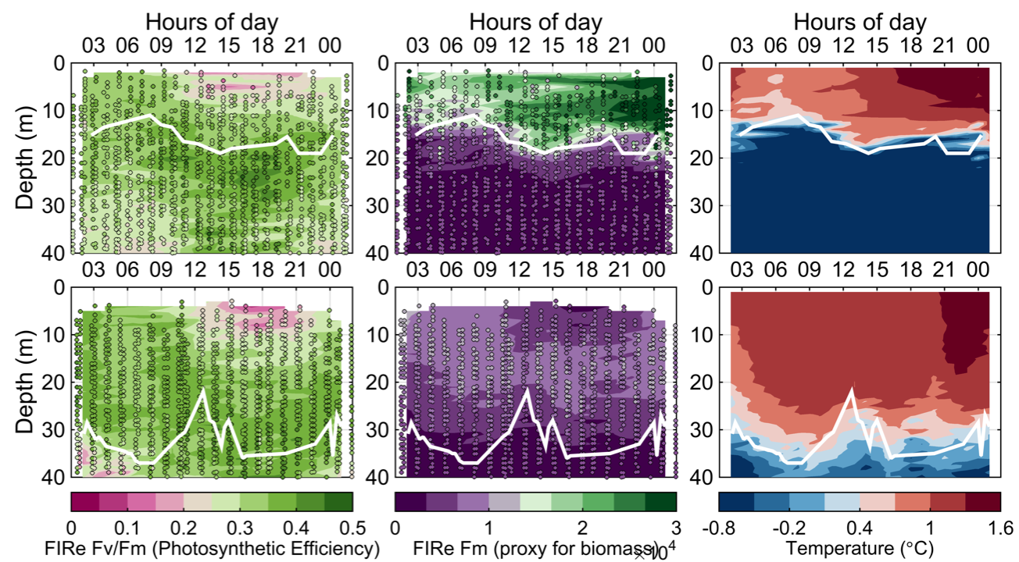
Diel cycles show evidence of
Non-Photochemical Quenching (NPQ)
Comparison between different MLD – evaluation of photoacclimation regimes

Slide 13
Using the Fire to provide proxy for photosynthetic rates
and photoacclimation signatures

Slide 14
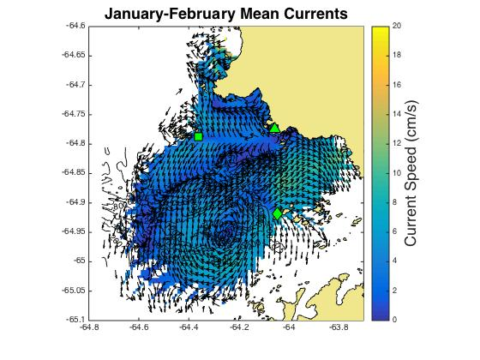
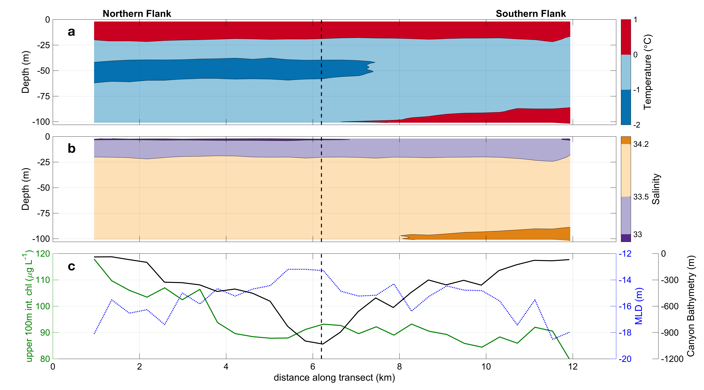
Sorting variability within the shelf

Slide 15
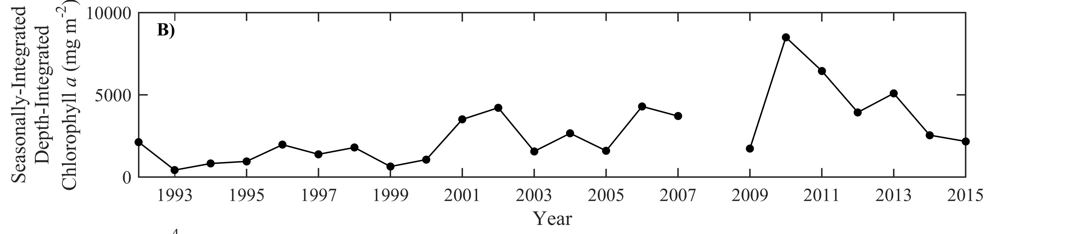
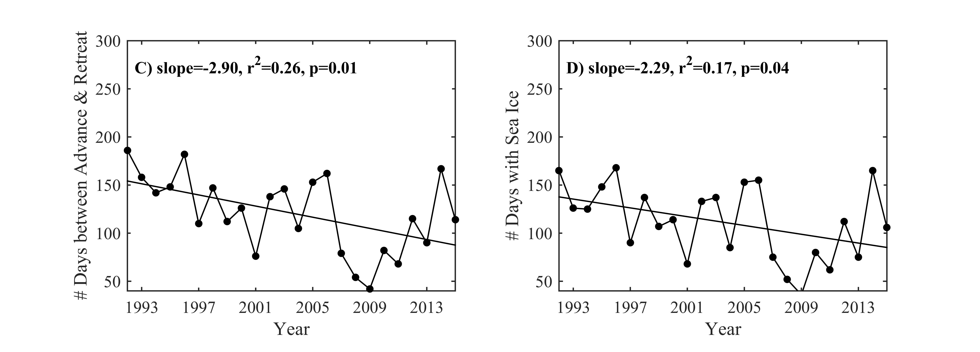
Recent Changes at Palmer
Schofield et al. Revision submitted

Slide 16
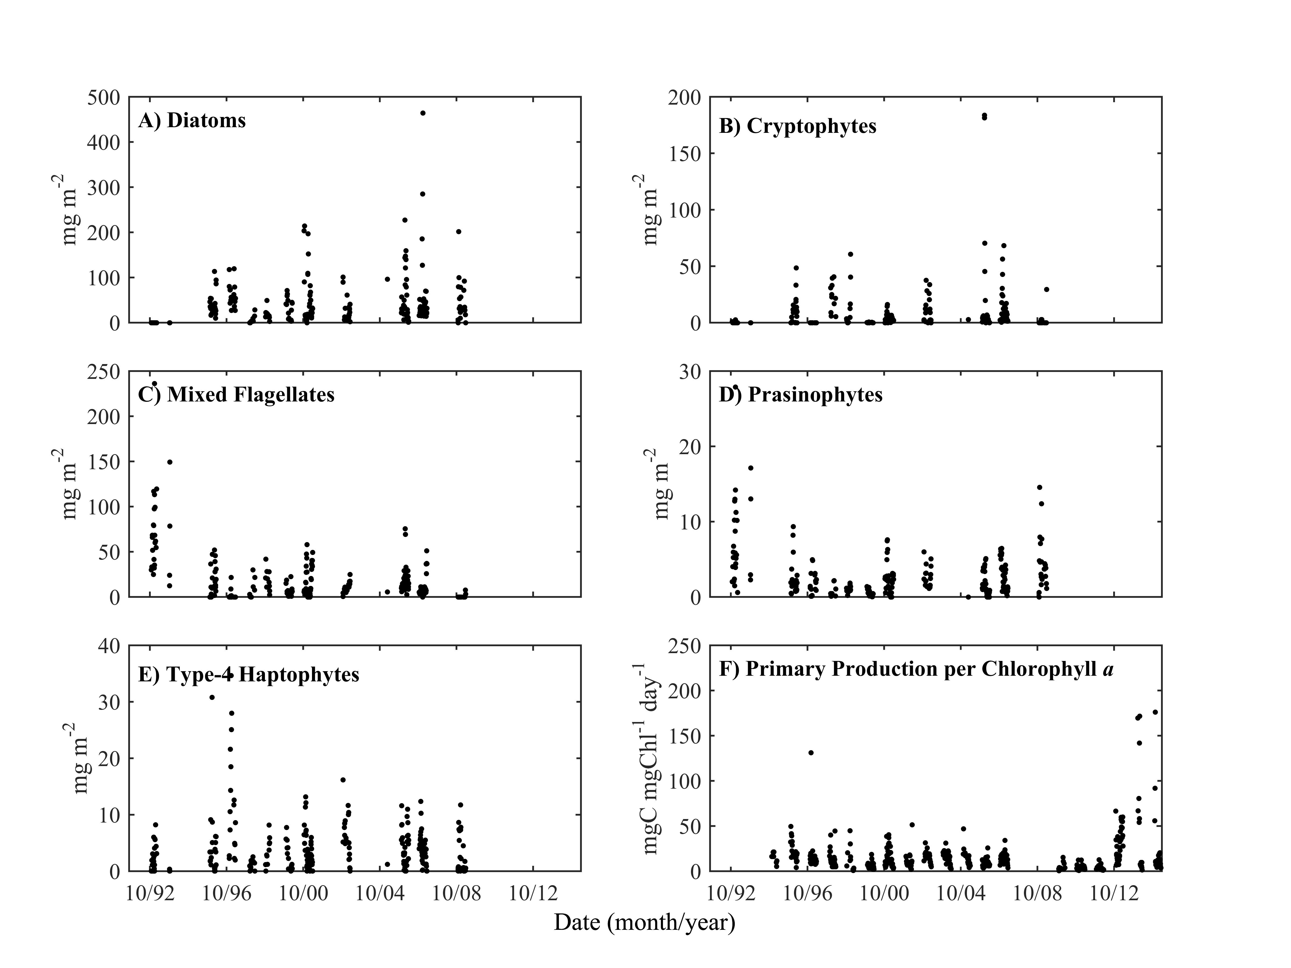
Who dominates the phytoplankton?

Slide 17
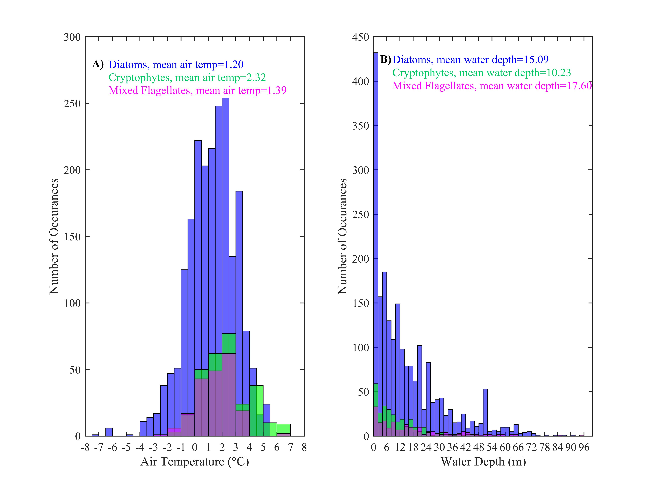

Slide 18
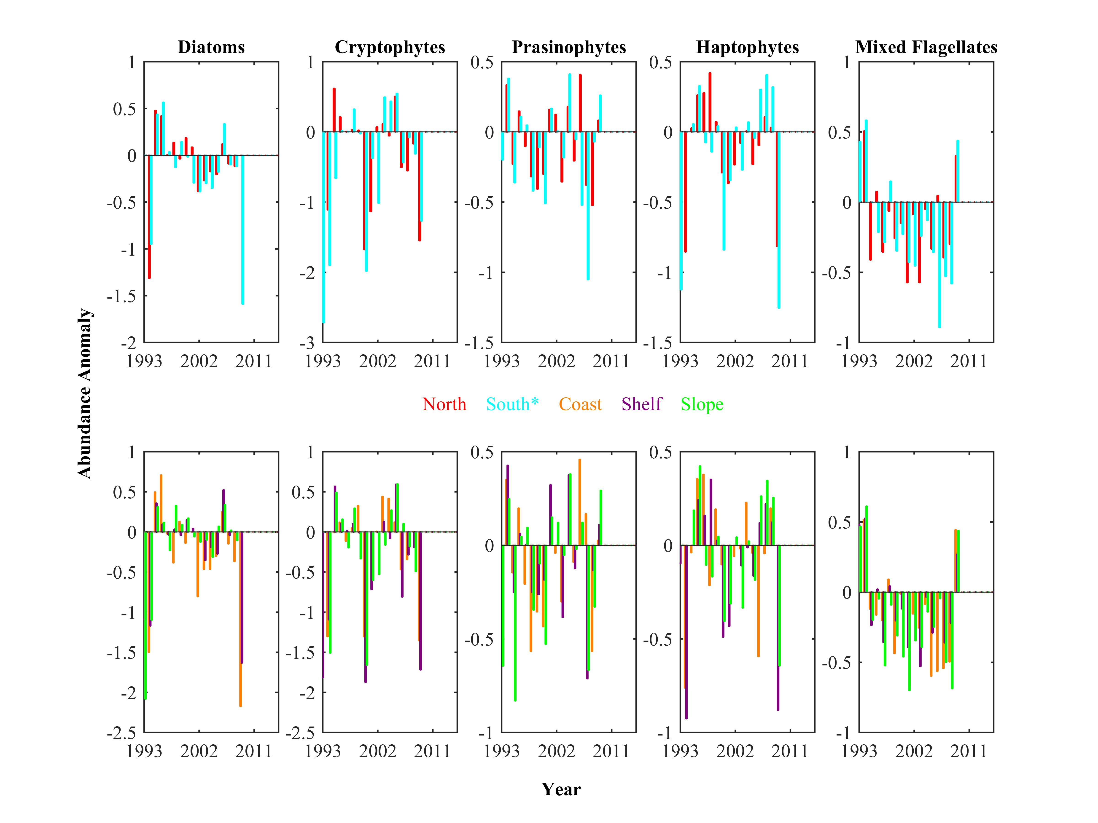
Phytoplankton variability across the WAP as a whole
Waite et al. In prep

Slide 19
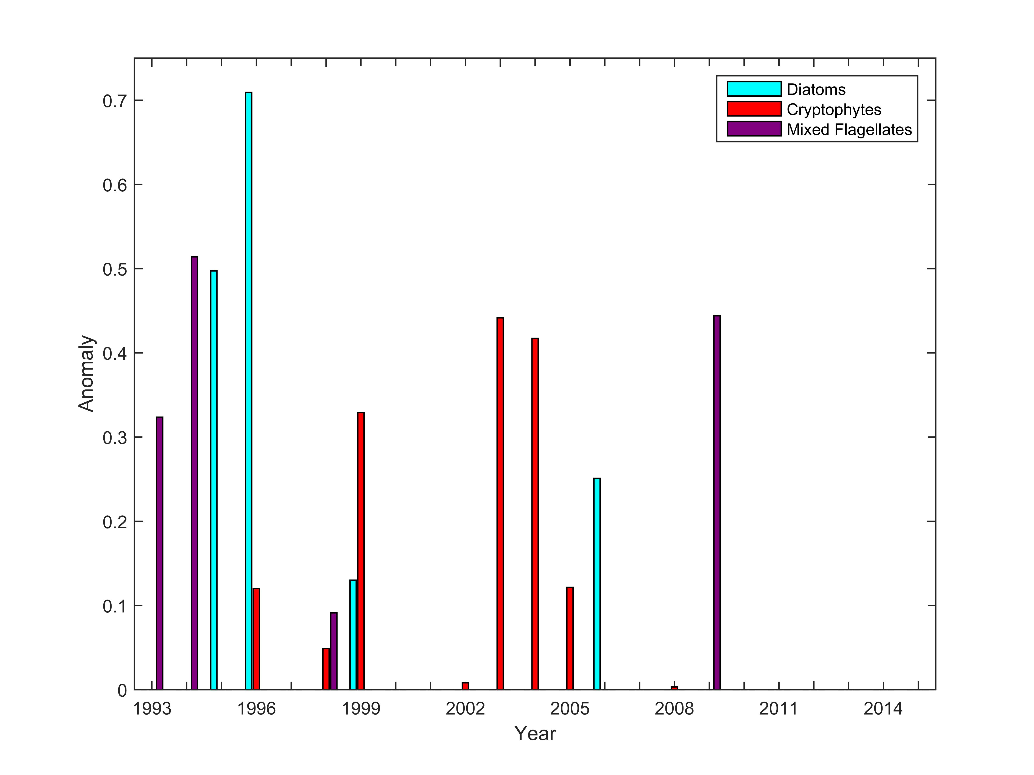
There is little overlap between positive Diatoms, Cryptophytes, and Mixed Flagellate years. (Coast)

Slide 20
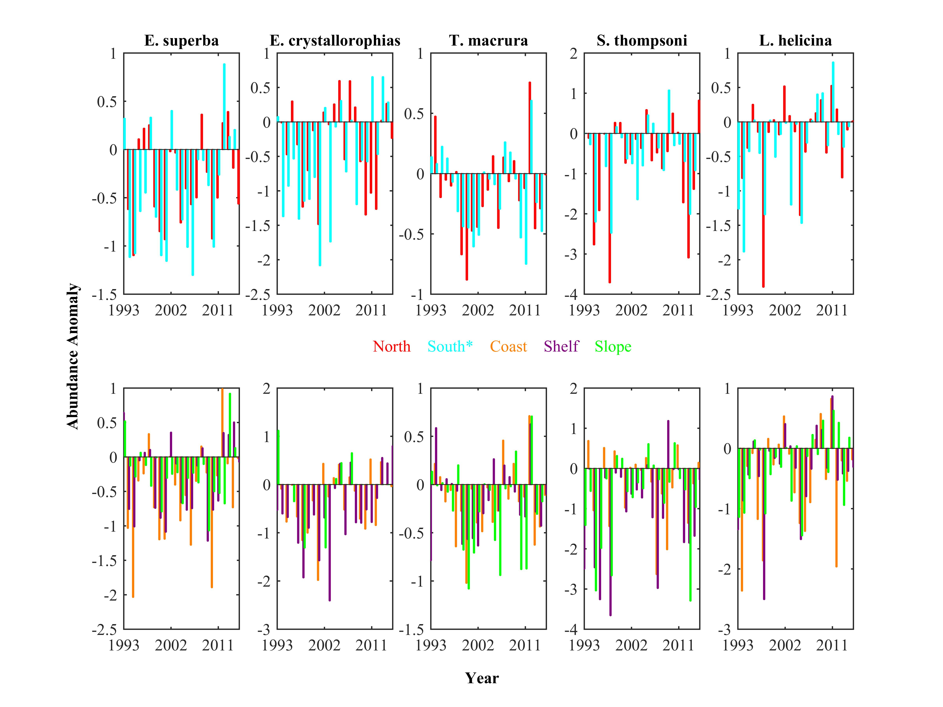
There are distinct positive and negative years for each zooplankton and phytoplankton taxa with little overlap in positive years between taxa.

Slide 21
North – South Gradient
Notes:
North-South gradient results
-Line color = positive (green) or negative (red) correlation
-Line style = lag phase (solid = 0yr; dashed =1yr; dotted =2yr)

Slide 22
Inshore – Offshore Gradient
Notes:
Inshore-Offshore gradient results
-Line color = positive (green) or negative (red) correlation
-Line style = lag phase (solid = 0yr; dashed =1yr; dotted =2yr)

Slide 23
All cryptophytes are not the same
Thanks to
Andrew Irwin

Slide 24
Path Forward (Species Identifications)
Rob Olson and Heidi Sosik (Inventors)
Lisa Campbell (Uber user)

Slide 25
Path Forward (Glider Operations)
Formalize Station to Station glider transects to fill in space over time (tenative: 2016/17 glider from Palmer to Rothera, 2017/18 Gliders from Palmer to King George and to Rothera)
New sensors: With Doug, deployed passive acoustic sensors on all the Palmer deep and WAP deployments
Integrate in ADCP gliders as standard deployments
New sensor suites, example the OPD & LISST HOLO

