Slide 1
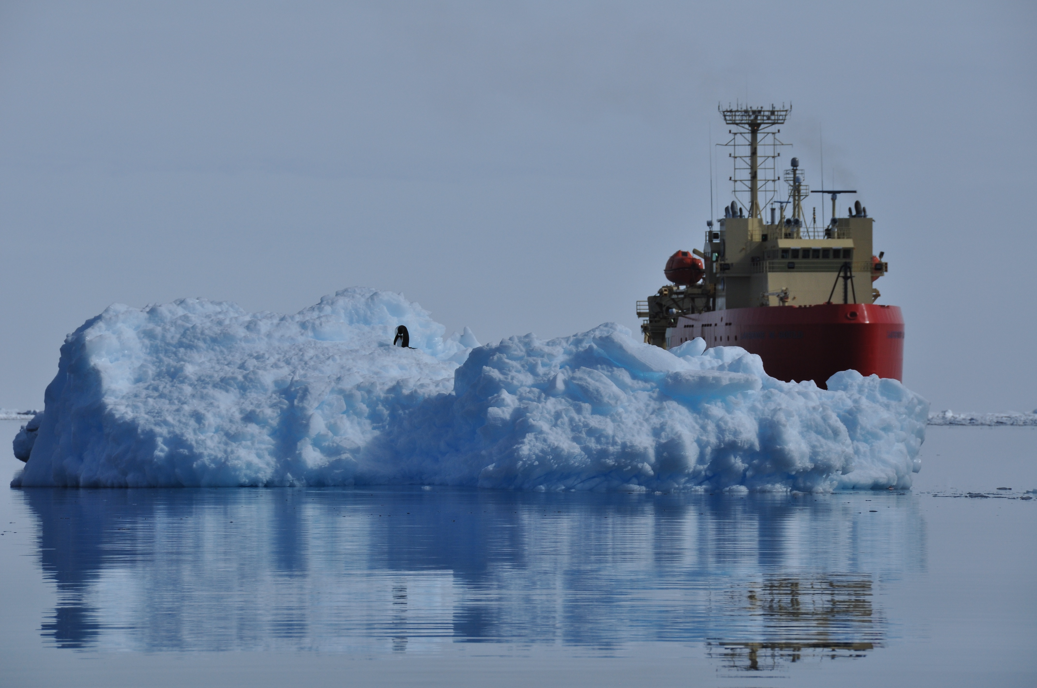

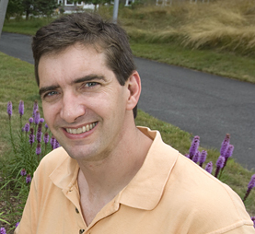
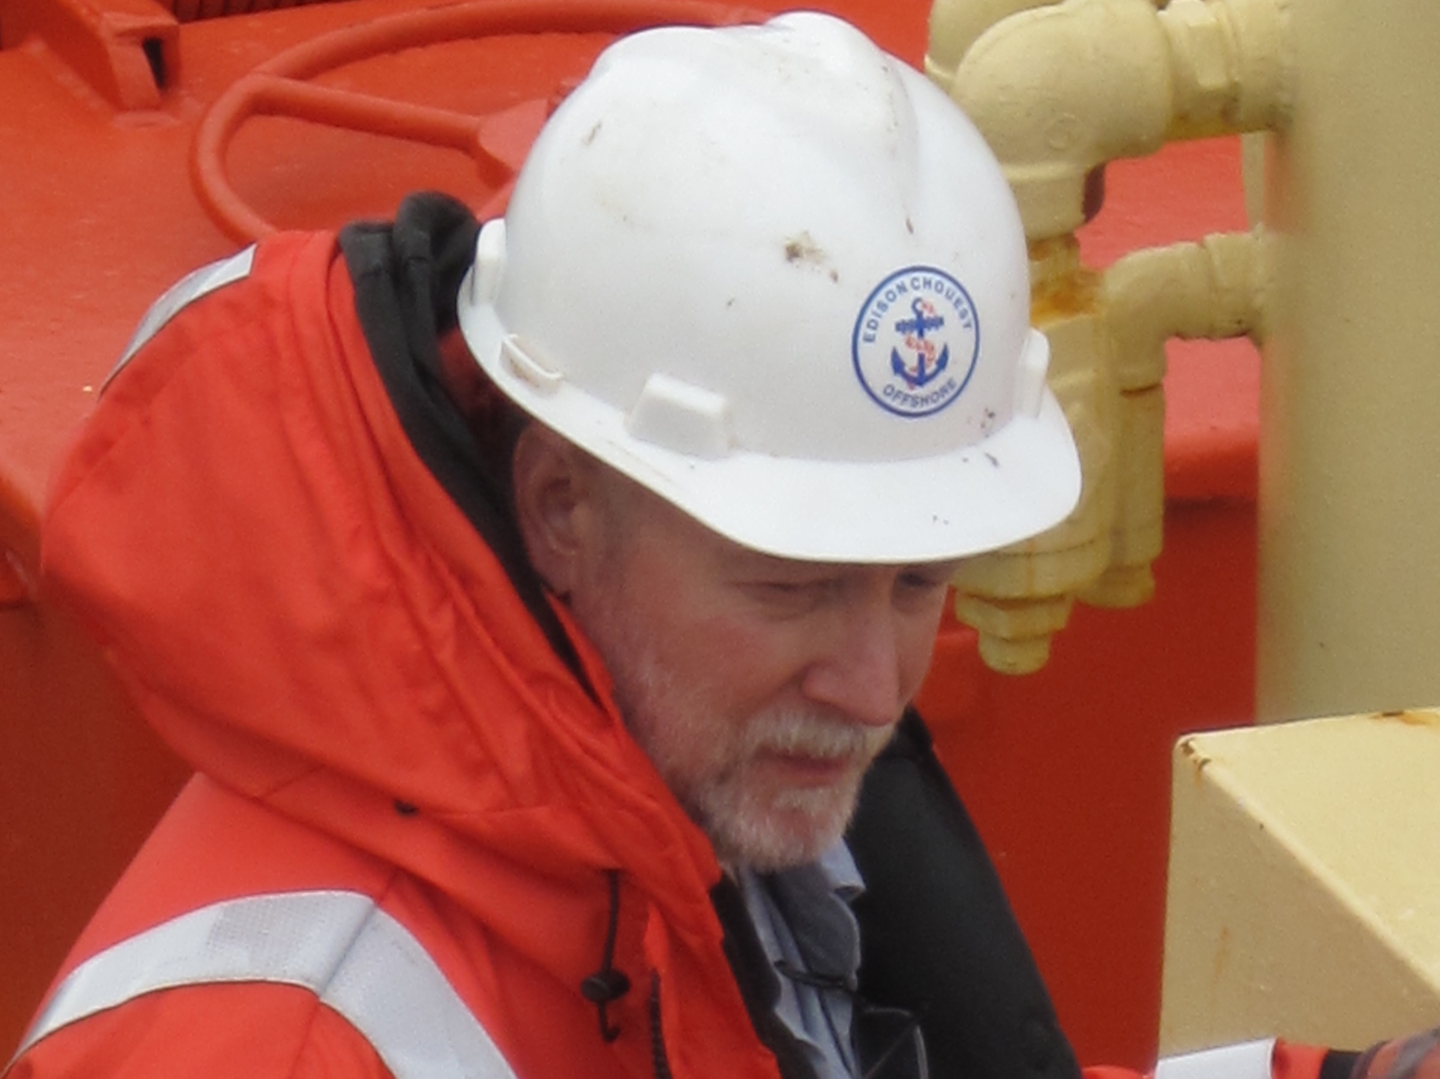
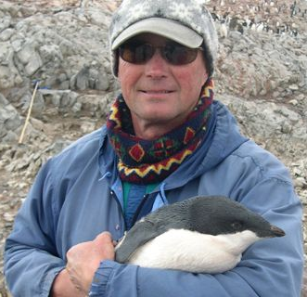
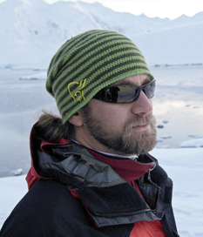
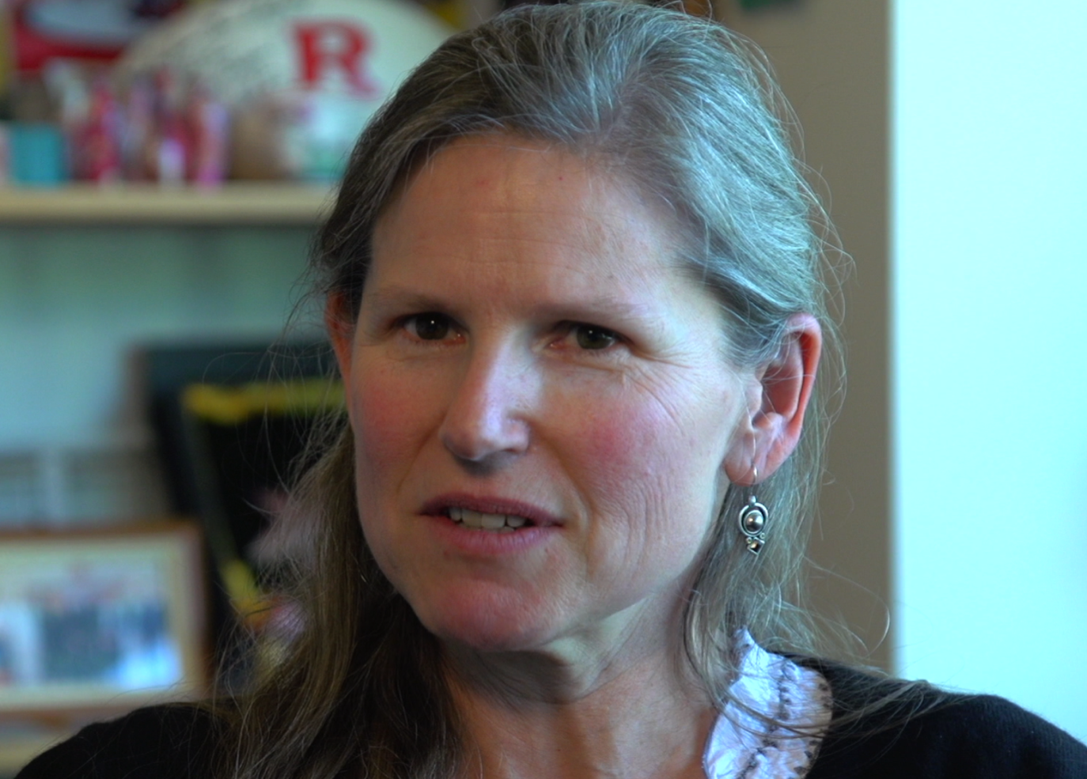
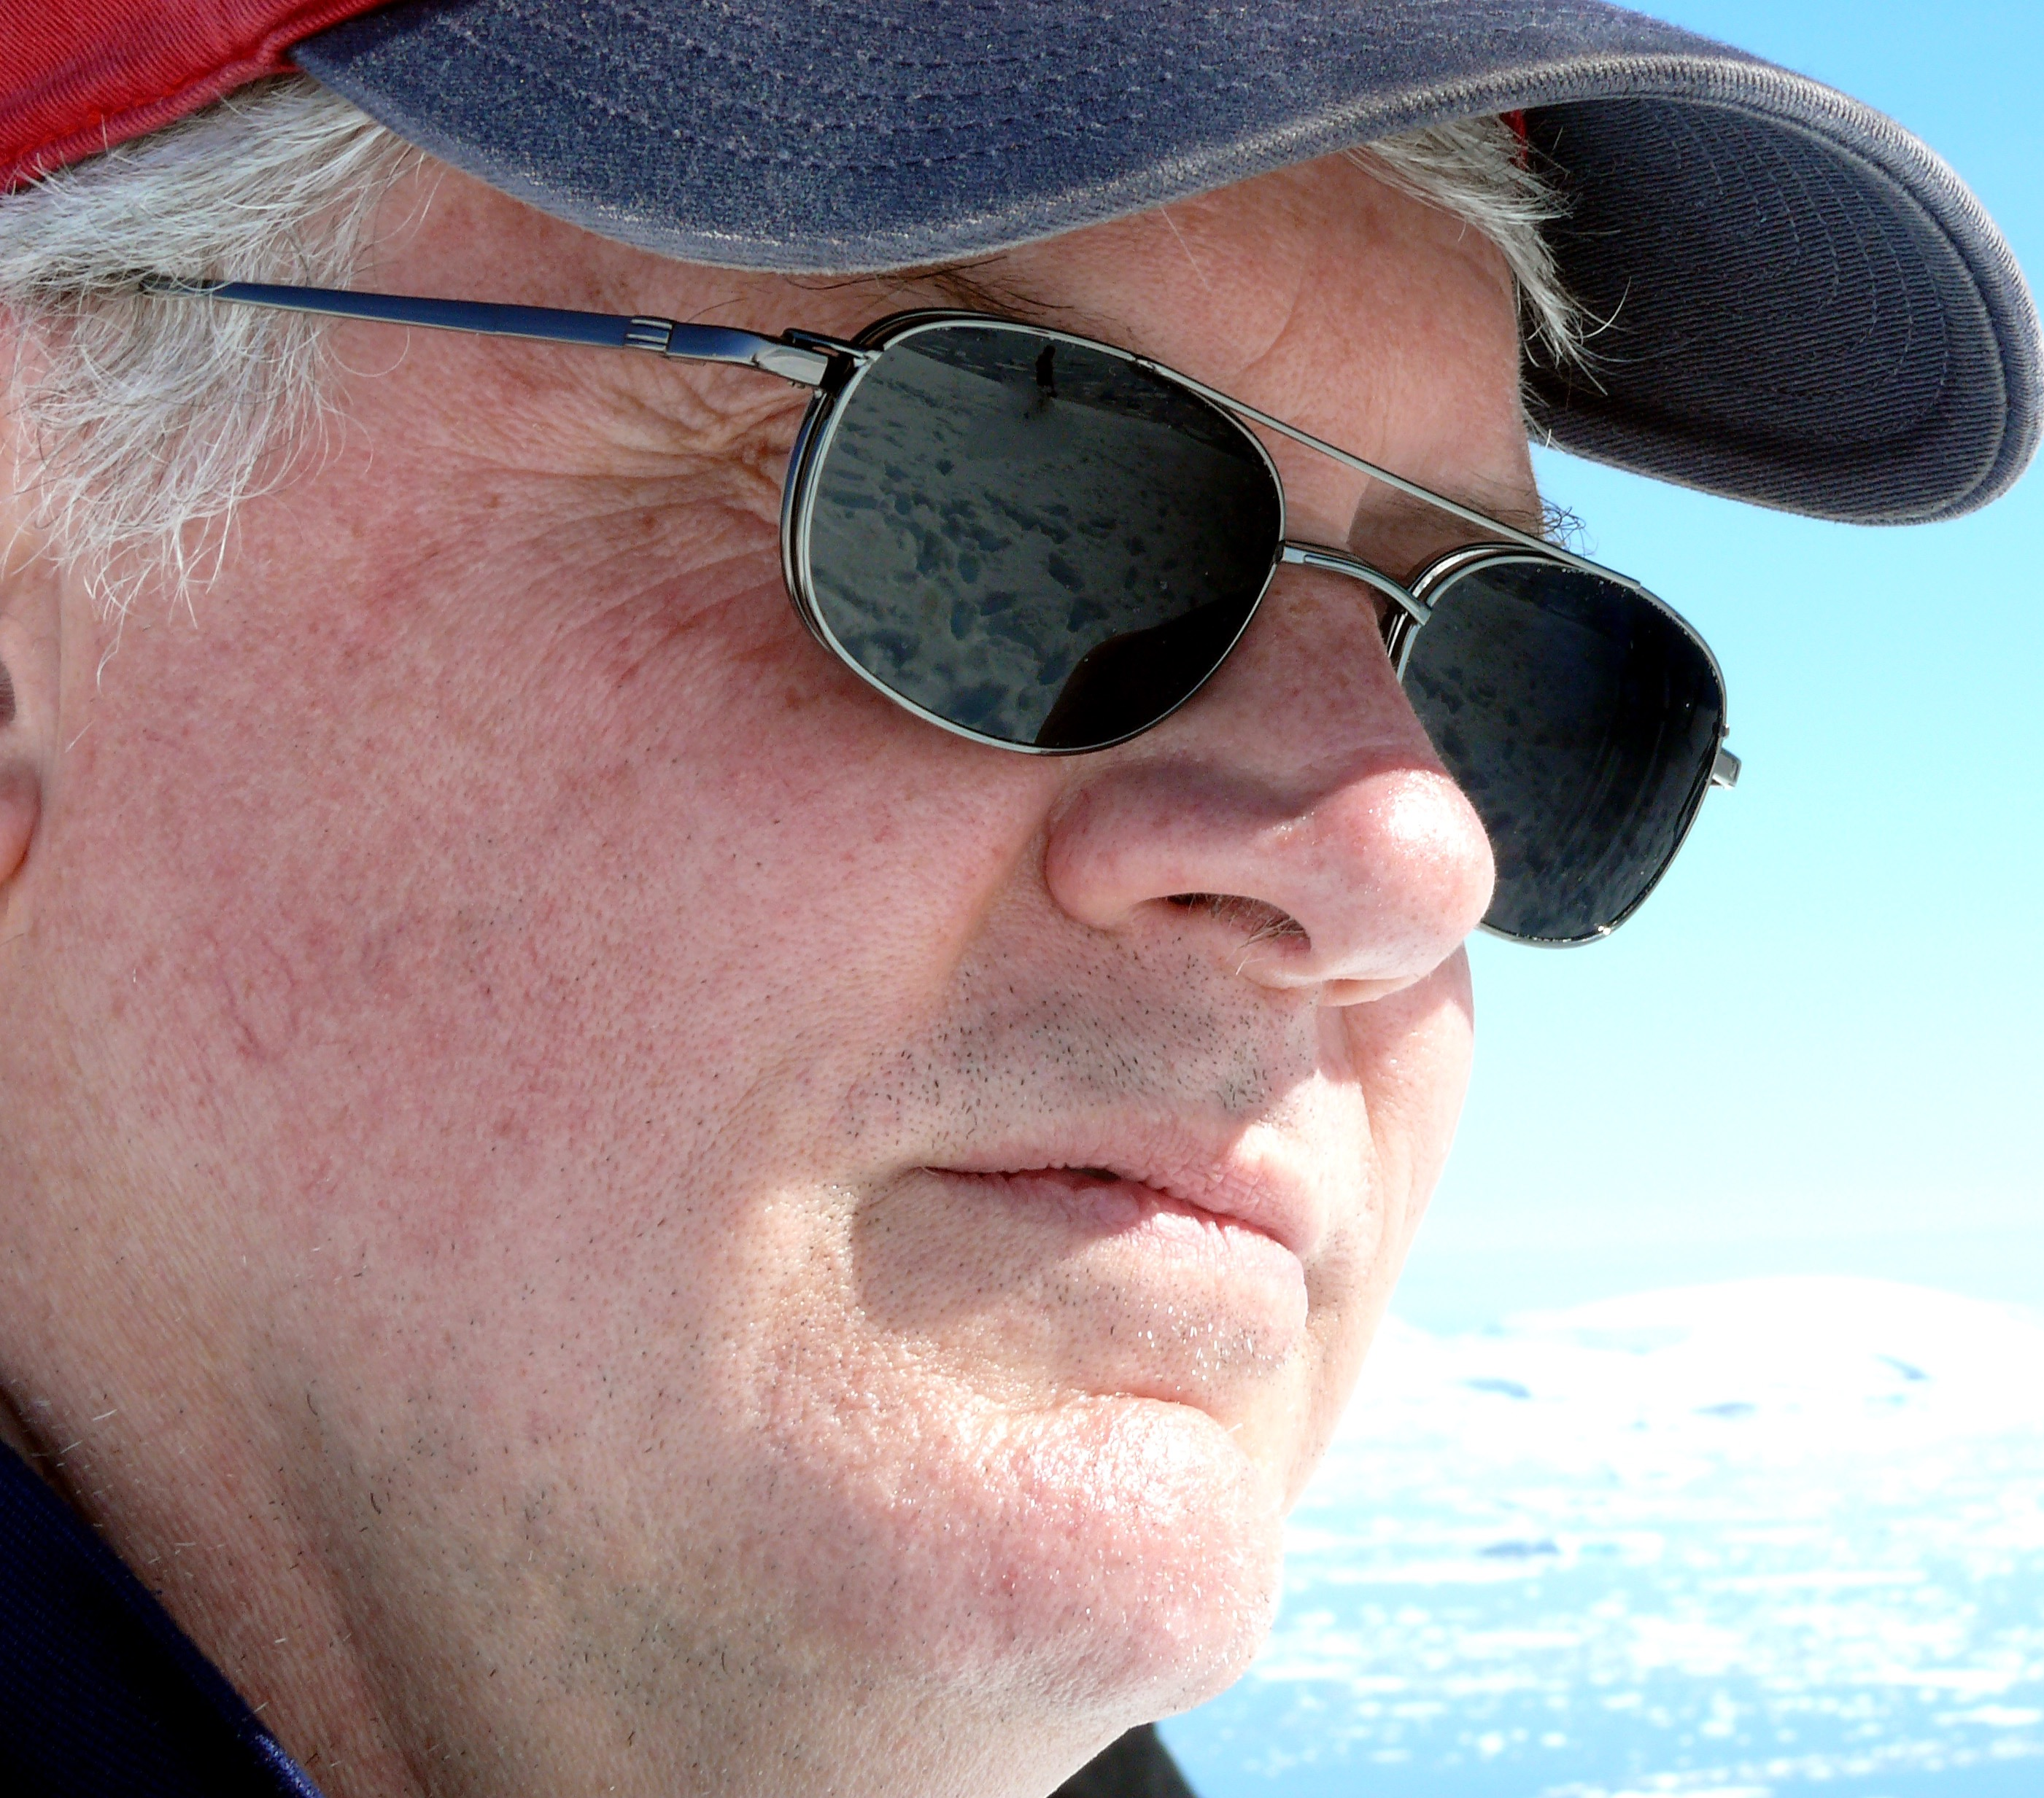
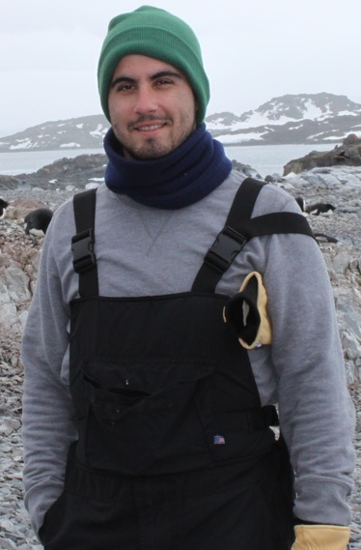
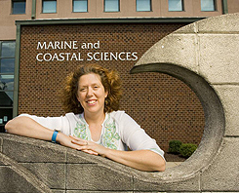
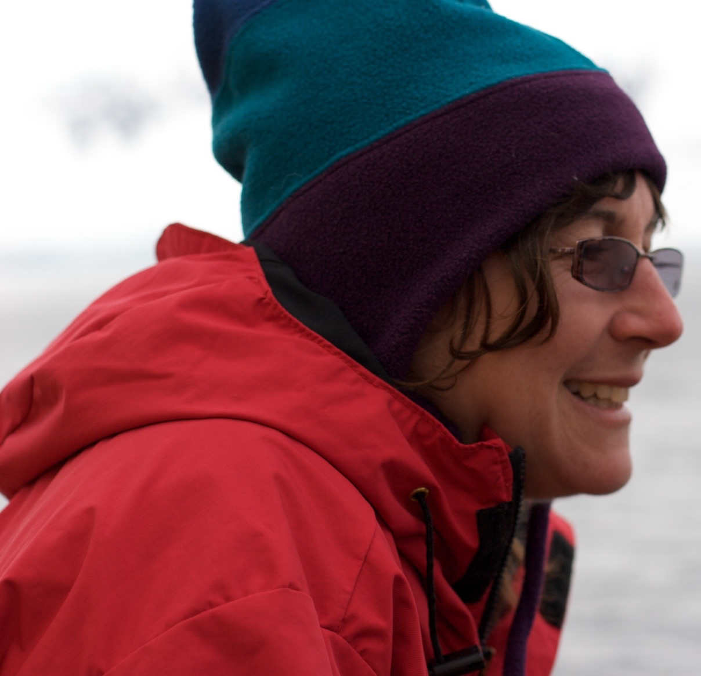
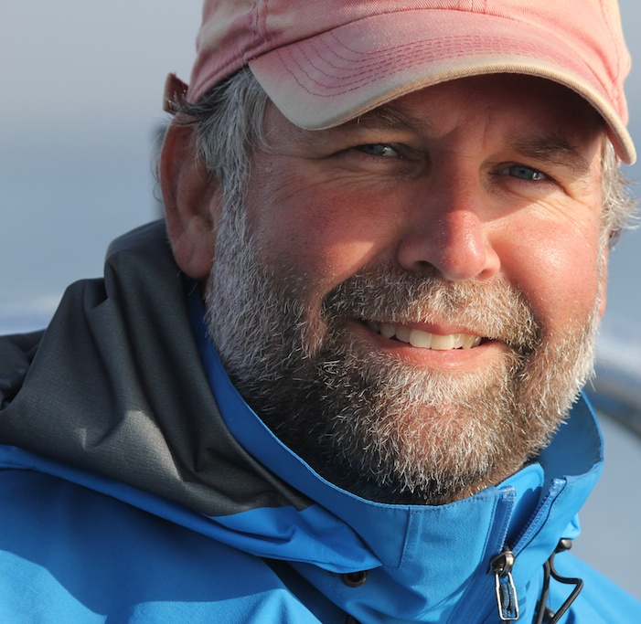
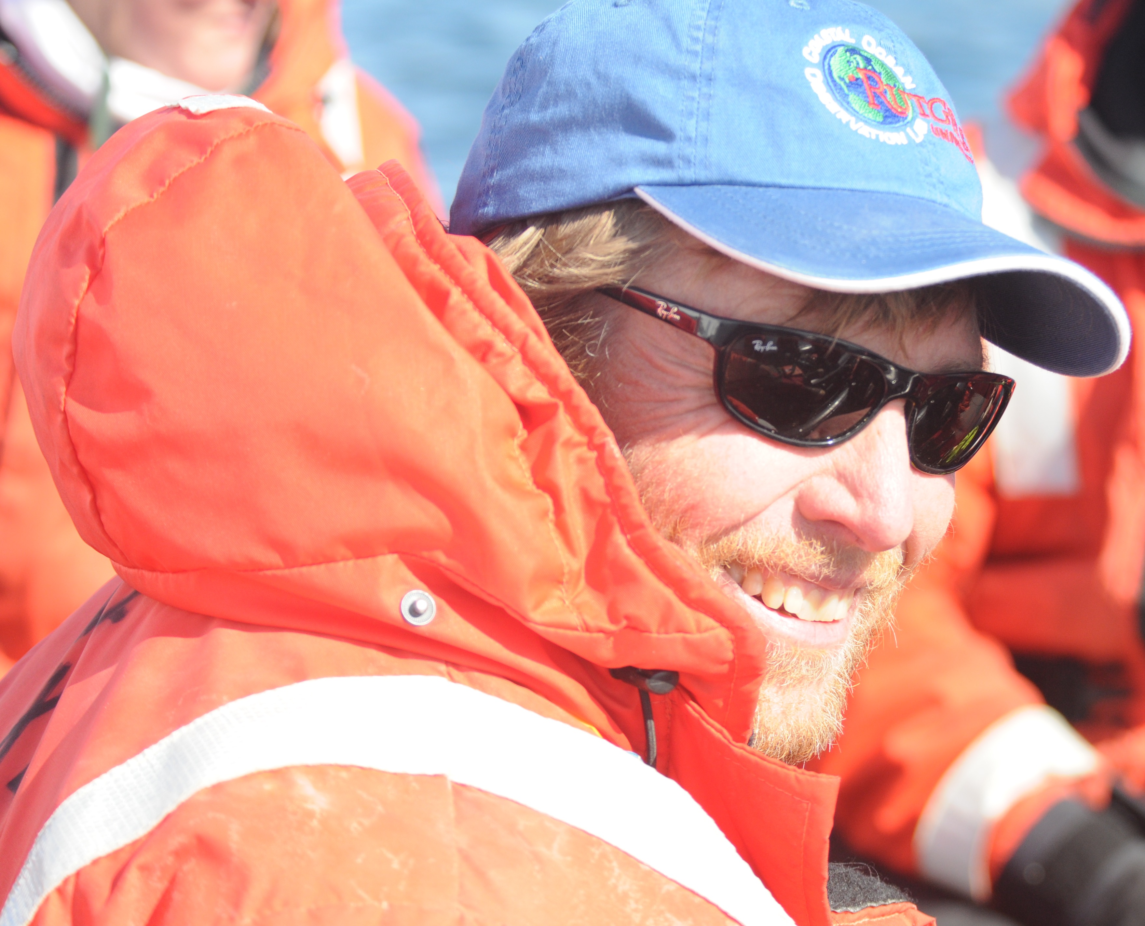
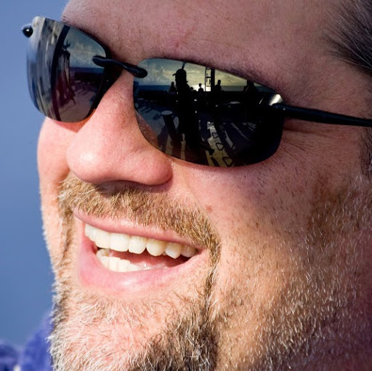
Oscar Schofield, Hugh Ducklow, Debbie Steinberg, Grace Saba, Travis Miles, Ana Filipa Carvalho, Nicole Couto, Nicole Waite, Alex Kahl, Zoe Finkel, Andrew Irwin, Vincent Saba
The
Team
Scott Doney
(Models, Biogeochem)
Doug Martinson
(Physical Ocean, Ice)
Sharon Stammerjohn
(Climate, Ice)
Bill Fraser
(Birds)
Ari Friedlaender
(Whales, Seals)
James Connors
(Data)
Dave Johnston
(Whales, Seals)
Oscar Schofield
(Phytoplankton)
Doug Nowacek
(Whales, Seals)
Hugh Ducklow PI
(Bacteria, Biogeochem)
Janice McDonnell
(Outreach)
Debbie Steinberg
(Zooplankton)

Slide 2

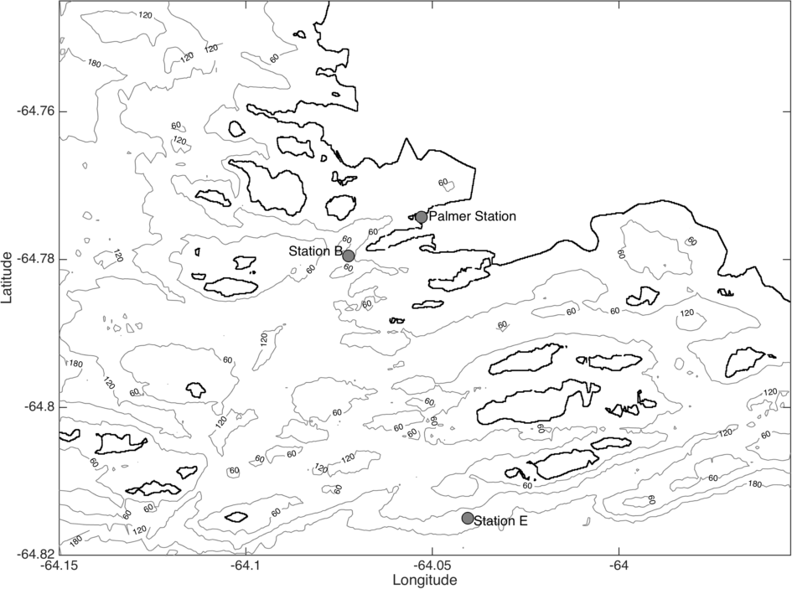
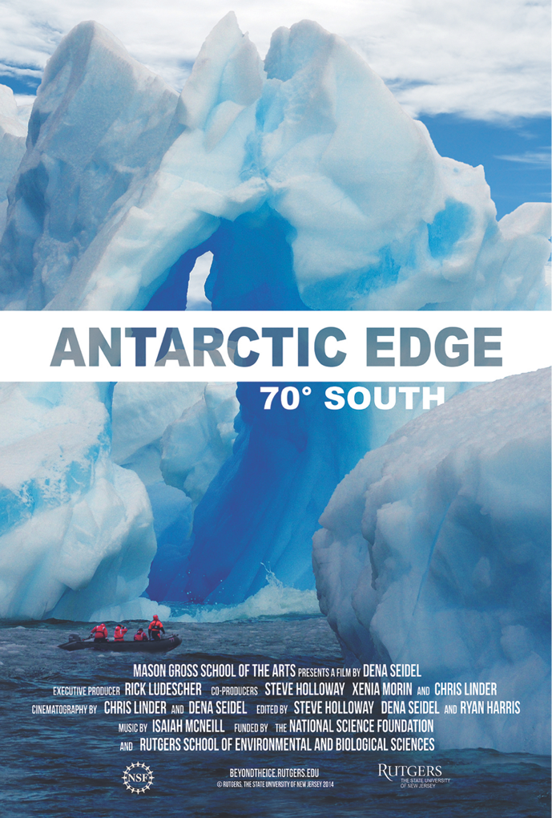
Sponsored by NSF, LTER is focused on understanding long term changes in the ecology and biogeochemistry of the marine system of the rapidly changing West Antarctic Peninsula. Currently conducting its 24 field season
Approach:
Palmer
Annual time series measurements at Palmer Station, nominally October through March
Annual cruise spanning the Peninsula during month of January
Station and cruise is augmented with Slocum glider deployments
Active satellite and modeling program
Linked to education and outreach programs
For more Info:
Program website: http://pal.lternet.edu/
or
Program documentary available at Netflix or ITunes

Slide 3
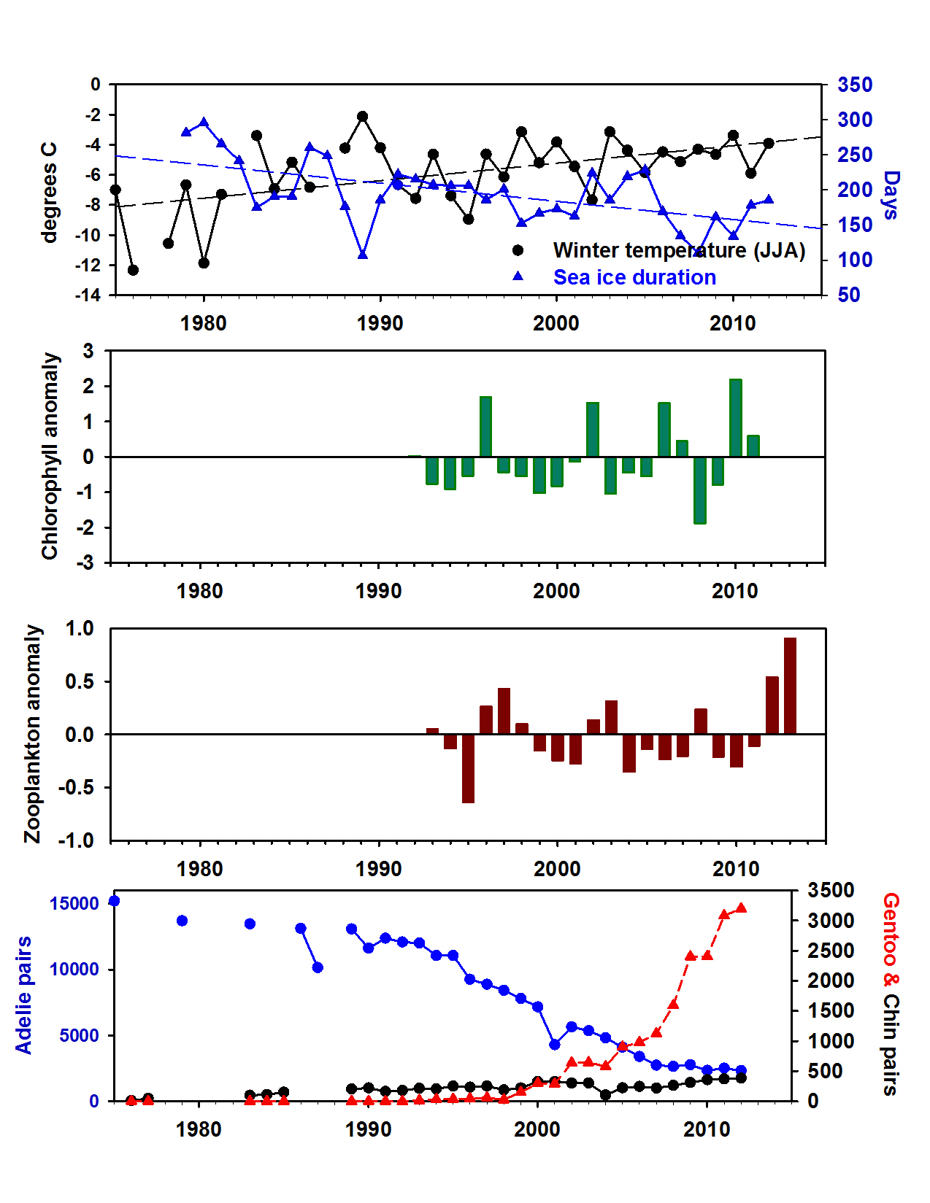
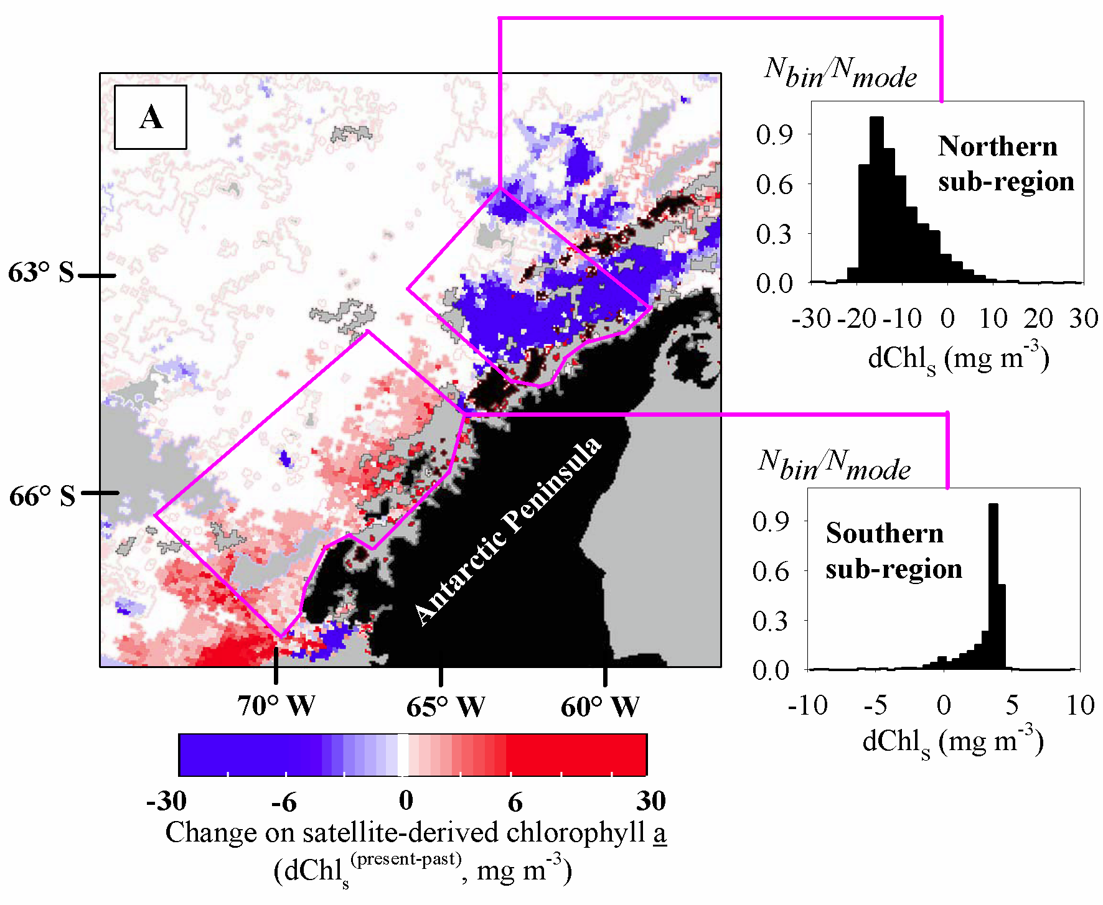
PAL signature long-term datasets
Phytoplankton
-90%
+67%
Montes Hugo et al. 2014
Science

Slide 4
Additions to traditional measurements for biology
New Additions (Species Identifications)
Rob Olson and Heidi Sosik (Inventors)
Lisa Campbell (Uber user)

Slide 5
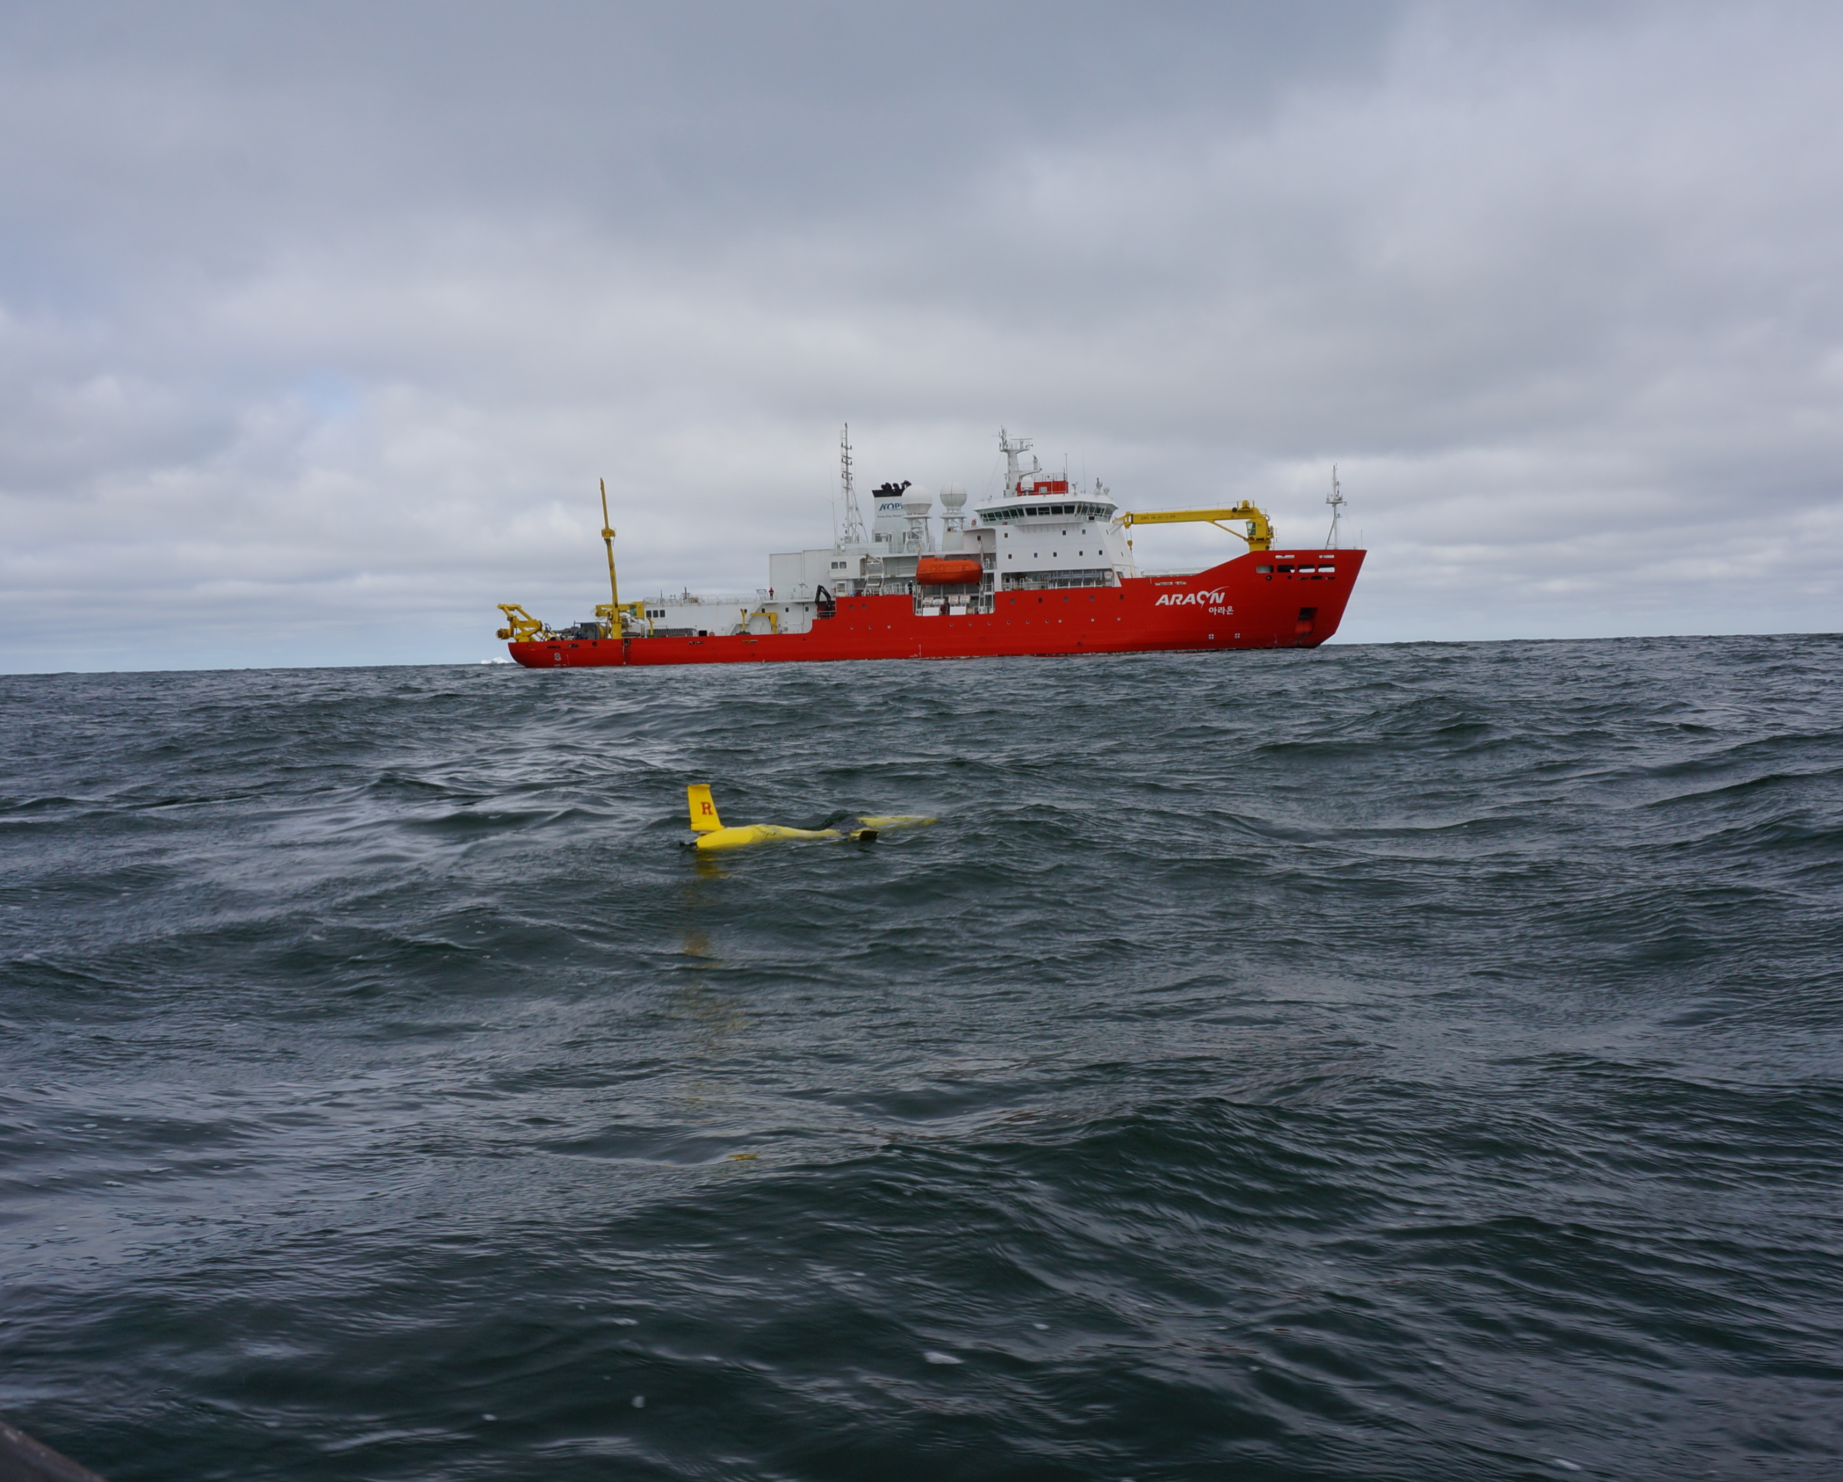

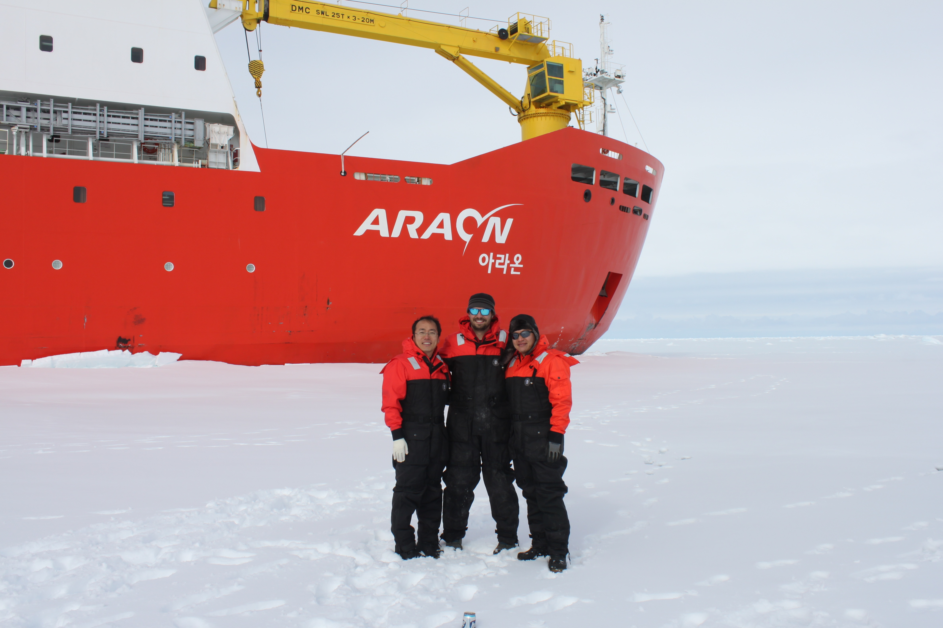
Korean KOPRI and Rutgers Collaborations
Glider Deployments

Slide 6
Glider missions in Amundsen
2010/2011 Amundsen Sea Polynya International Research Expedition
2013/2014 Korea Polar Research Institute Araon Cruise
2015/2016 Korea Polar Research Institute Araon Cruise

Slide 7
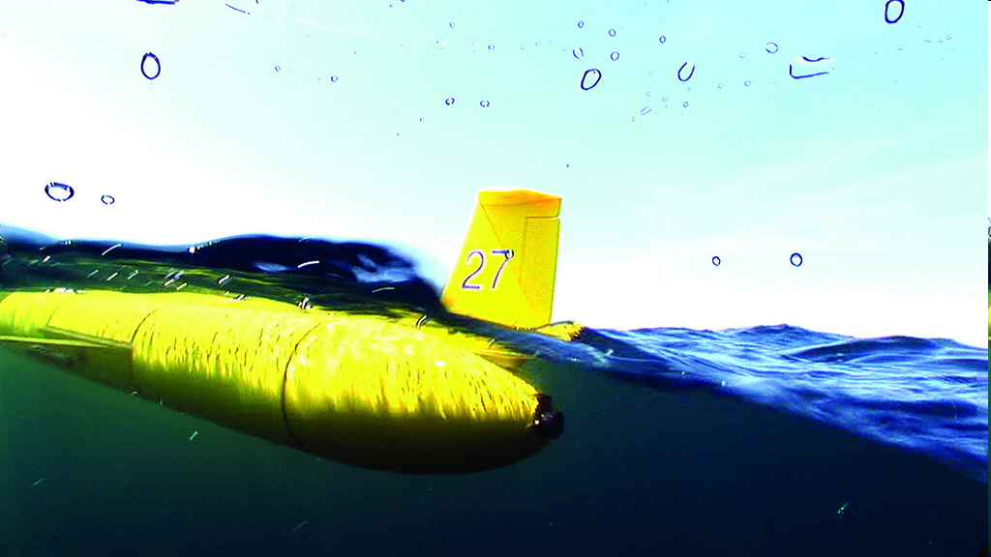

Glider’s are buoyancy driven “steerable” underwater vehicles with real-time communications, developed by multiple groups funded by ONR
Buoyancy pump in ← the glider pulls in 0.5 L of water
When surfacing to connect glider inflates air bladder
ARGOS and
FreeWave Antennas
Iridium Antenna
Glider begins to dive downward
Push pump out → glider inflects and begins to climb to the surface
At programmed
intervals
one dive and one climb is called a ‘yo’

Slide 8

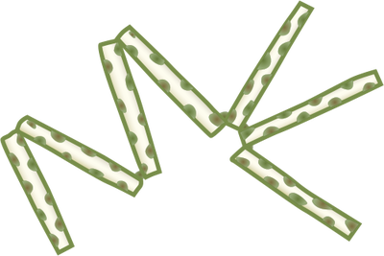
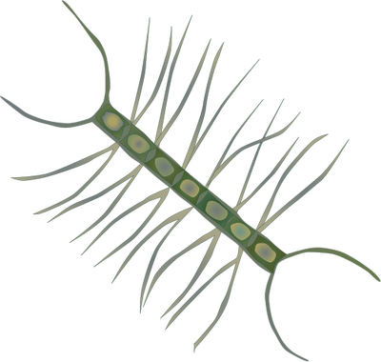
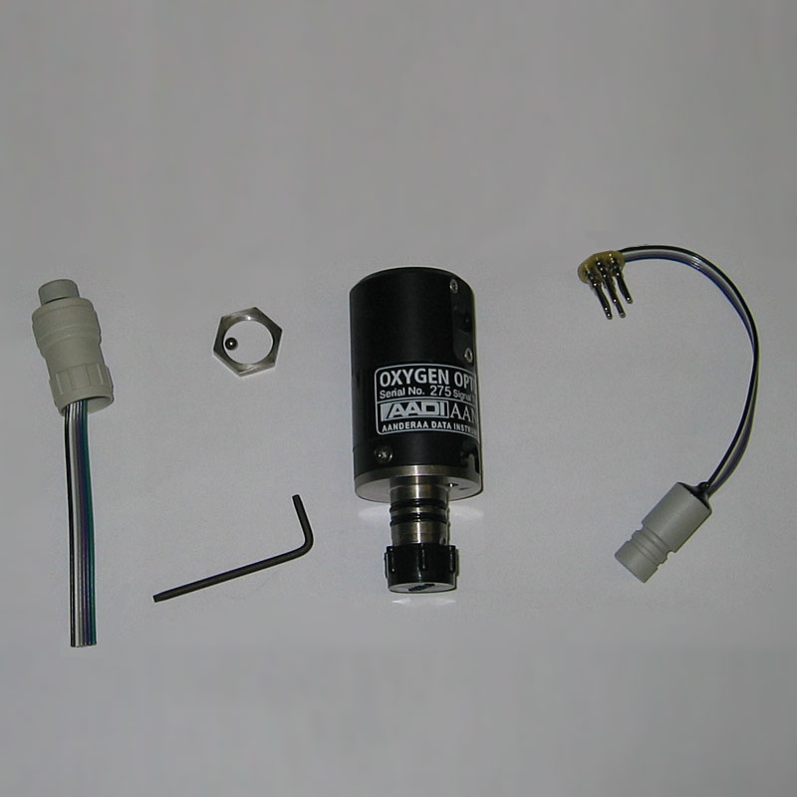
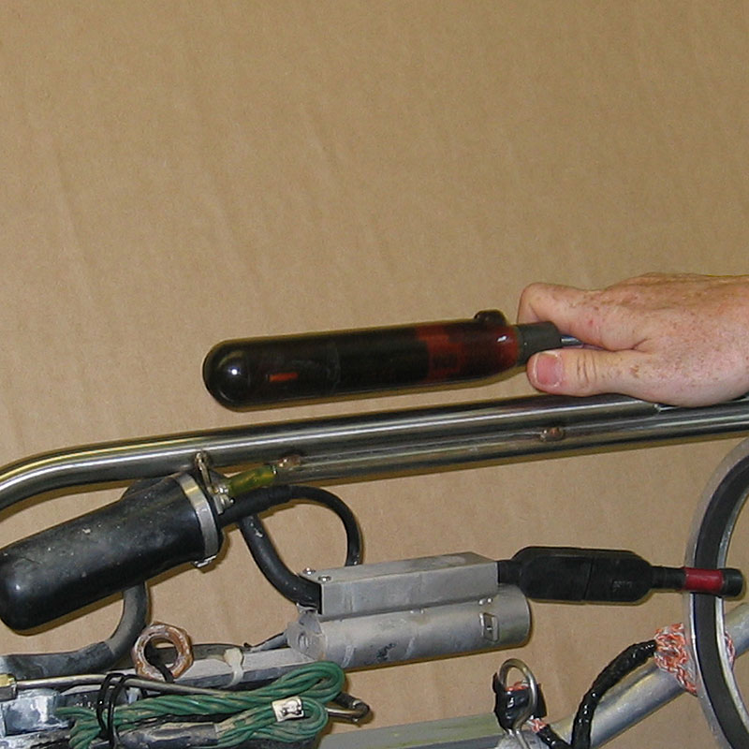
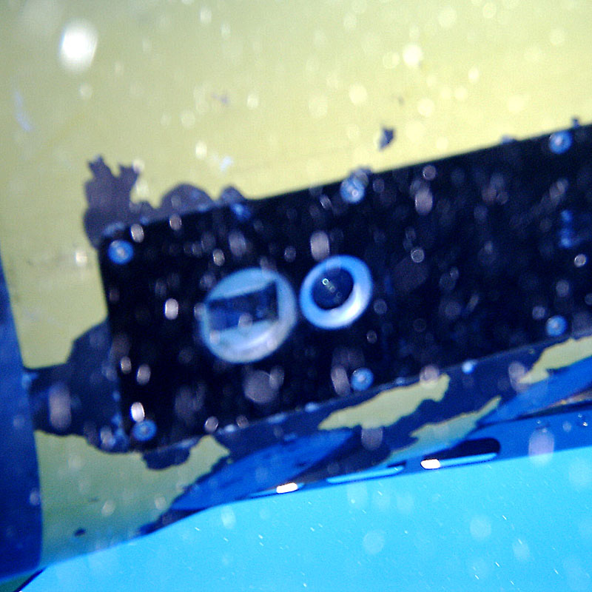
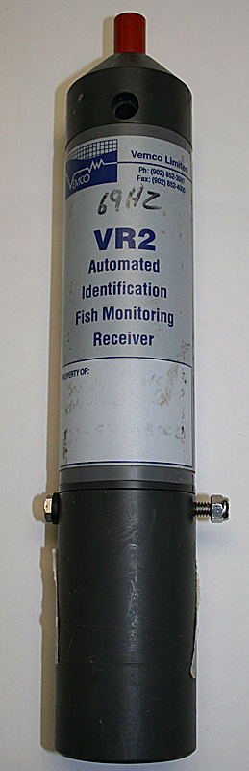
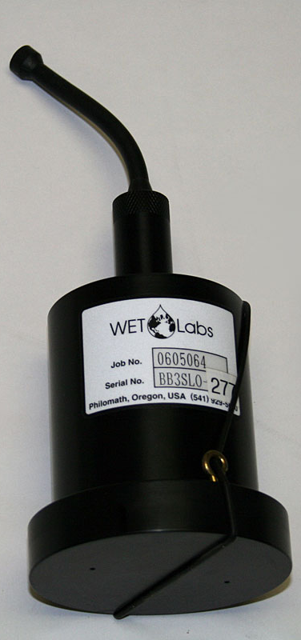
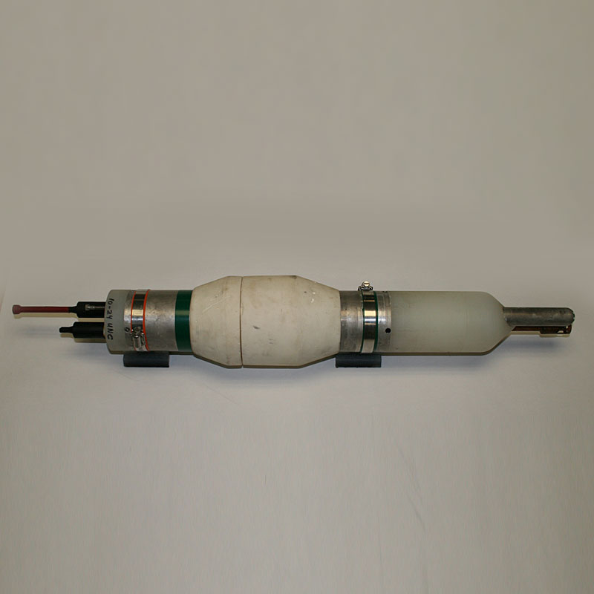
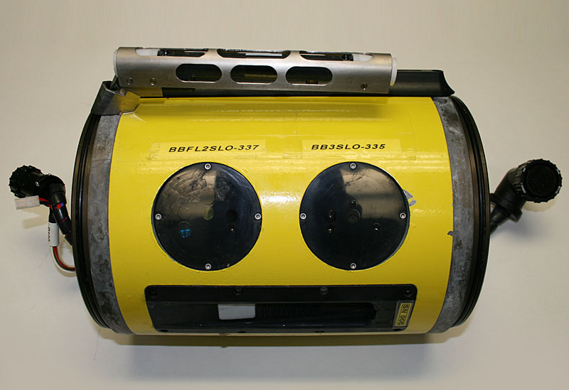
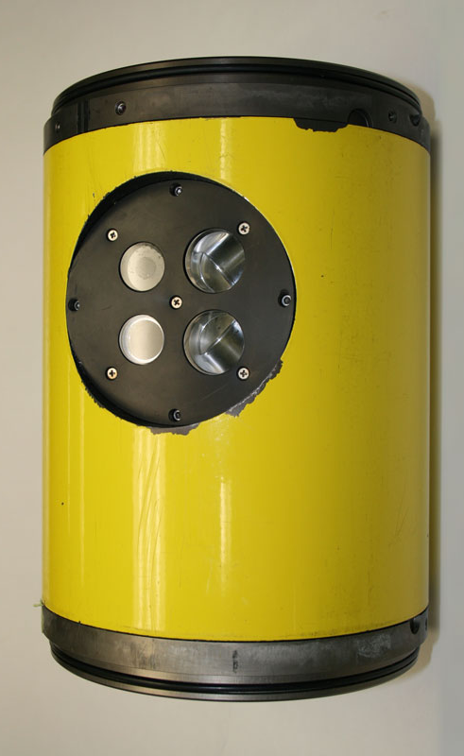
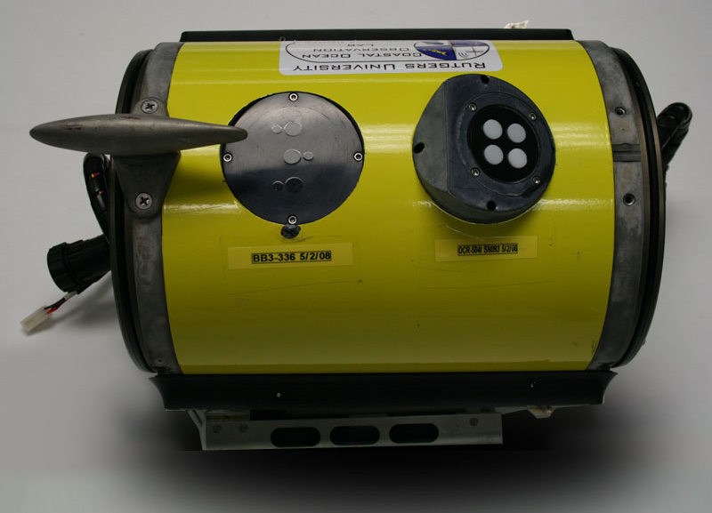
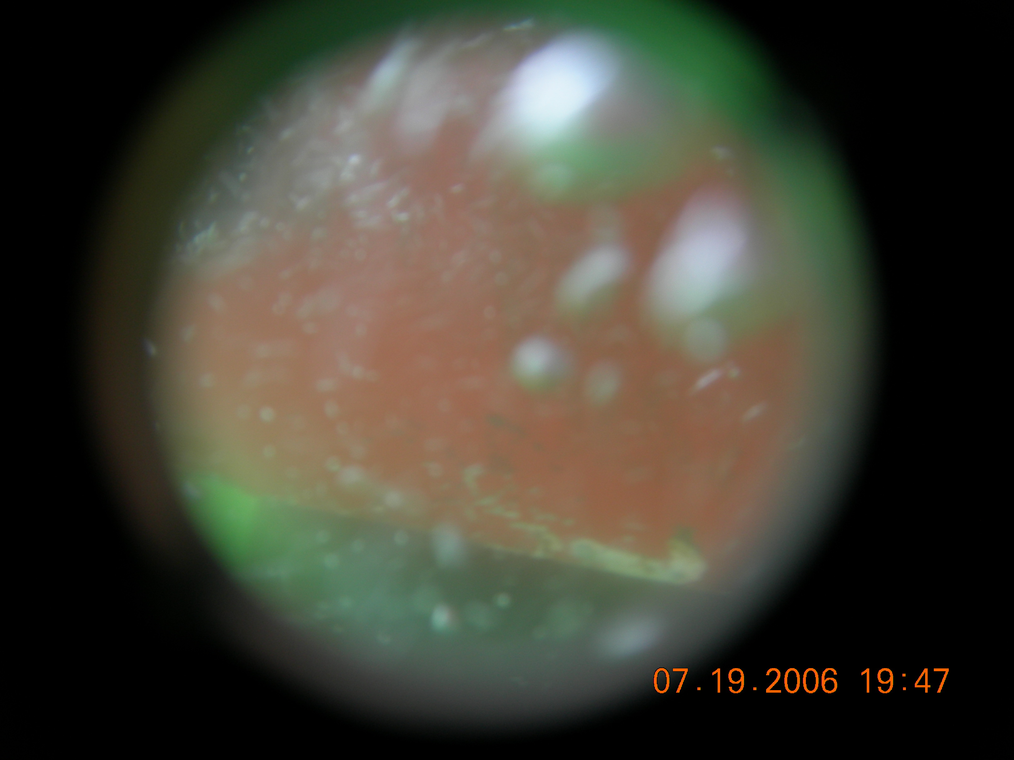
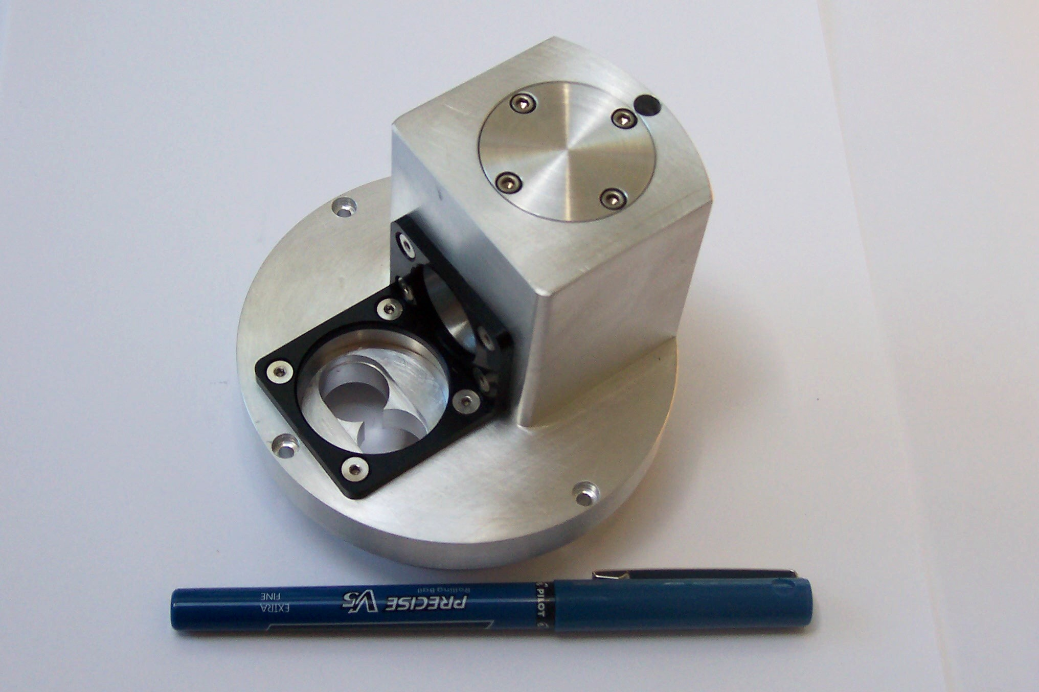
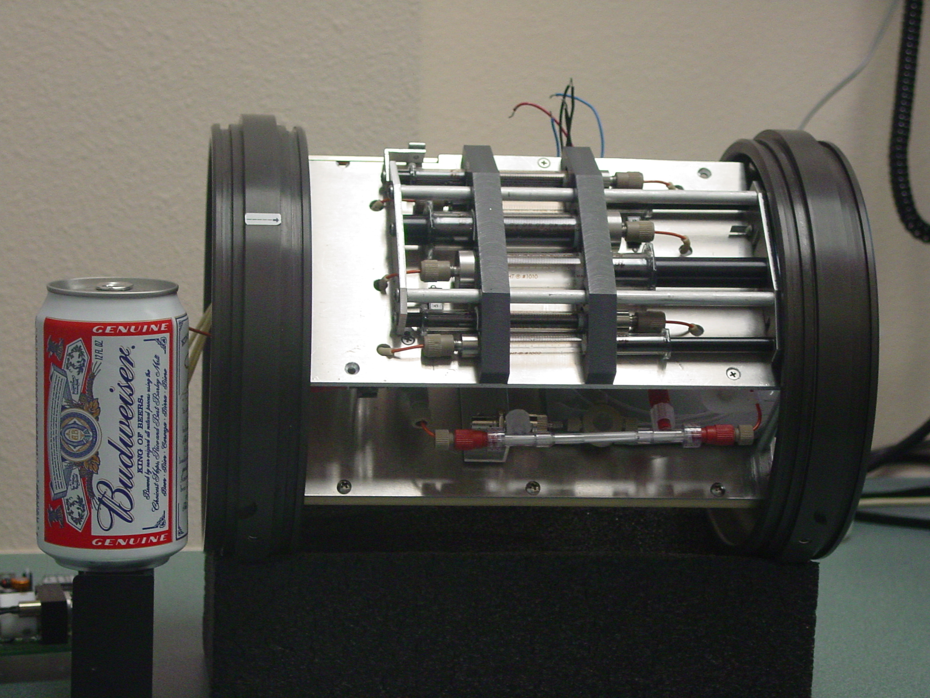

What can science data can be collected by gliders?
IN SITU
OPTICS
TRANSPORT
TRACE GASES
Inherent optics
Absorption (λ)
Scattering (λ)
Volume scattering
Attenuation (λ)
Refractive Index
Apparent Optics
(λ) Light intensity
up & down
ADCP
Estimated geostrophic
currents
Optical Oxygen
Optical CO2
Mass Spectrometers
Phytoplankton
WATER
COLUMN
PHYSICS
Concentration
Spectral Backscatter
Hyperspectral Absorption
Chlorophyll fluorescence
Imagery (visual, holography)
Diversity
Spectral Backscatter (proxy for composition/size)
Imagery (visual, holography)
“Omics”
Rates
Kinetic fluorescence
Photoacoustics
Stimulated oxygen kinetics
Macro/ Micro
nutrients & chem
Temperature
Salinity
Turbulence
CHEMISTRY
Optical nutrients
Optical CO2
Optical pH
Mass Spectrometers
e⁻
Proteins
Lipids
Carbos
Chl a
Zooplankton
TEP, DOM
Concentration
Acoustic backscatter
Imagery (visual, holography)
Diversity
Multi frequency Acoustics Imagery (visual, holography)
“Omics”
Organic Matter Flux
Concentration
Spectral Backscatter spikes
Particle settling rate
Imagery (visual, holography)
Diversity
Imagery (visual, holography)
“Omics”
Mass Spectrometers
Rates
Spatial calibrated fall rates
via imagery
Higher Trophic Levels
Concentration
Acoustic backscatter
Imagery (visual, holography)
Passive acoustics
Acoustic tags + Receiver
Diversity
Multi frequency Acoustics Imagery (visual, holography)
“Omics”
Passive acoustics
Acoustic tags + Receiver
Marine snow & Export Flux
Schofield et al. MTS 2015

Slide 9
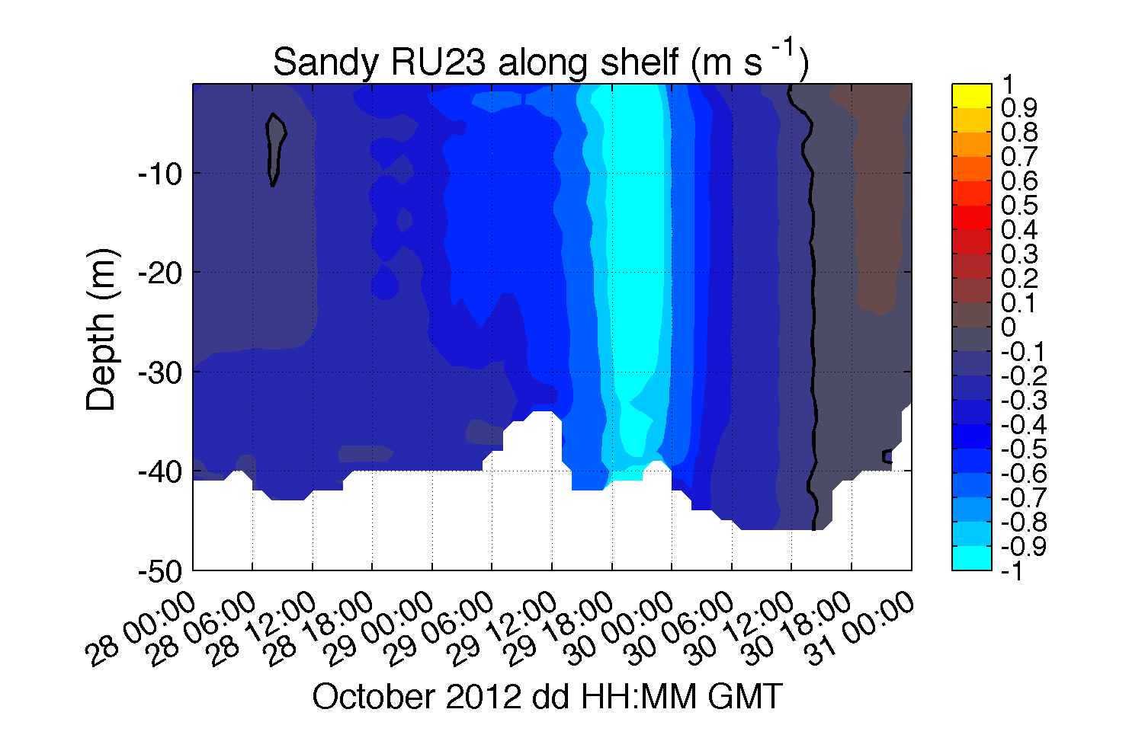
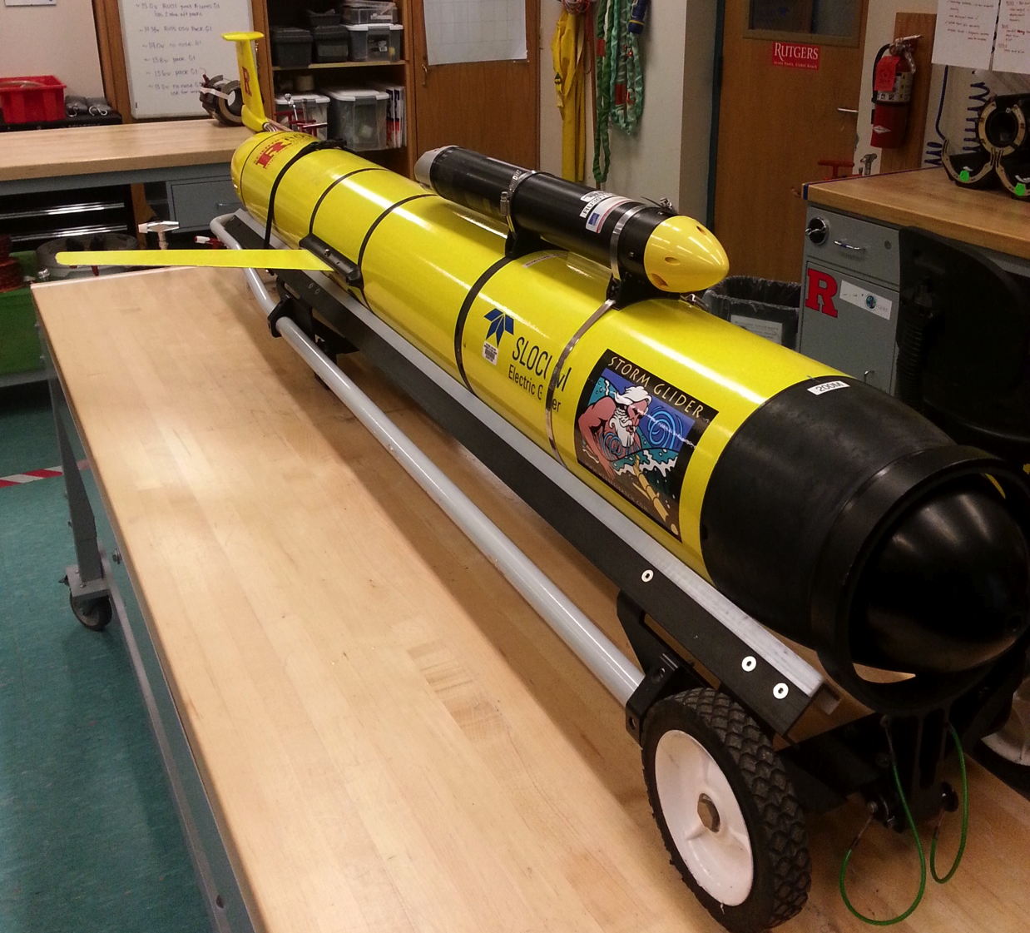

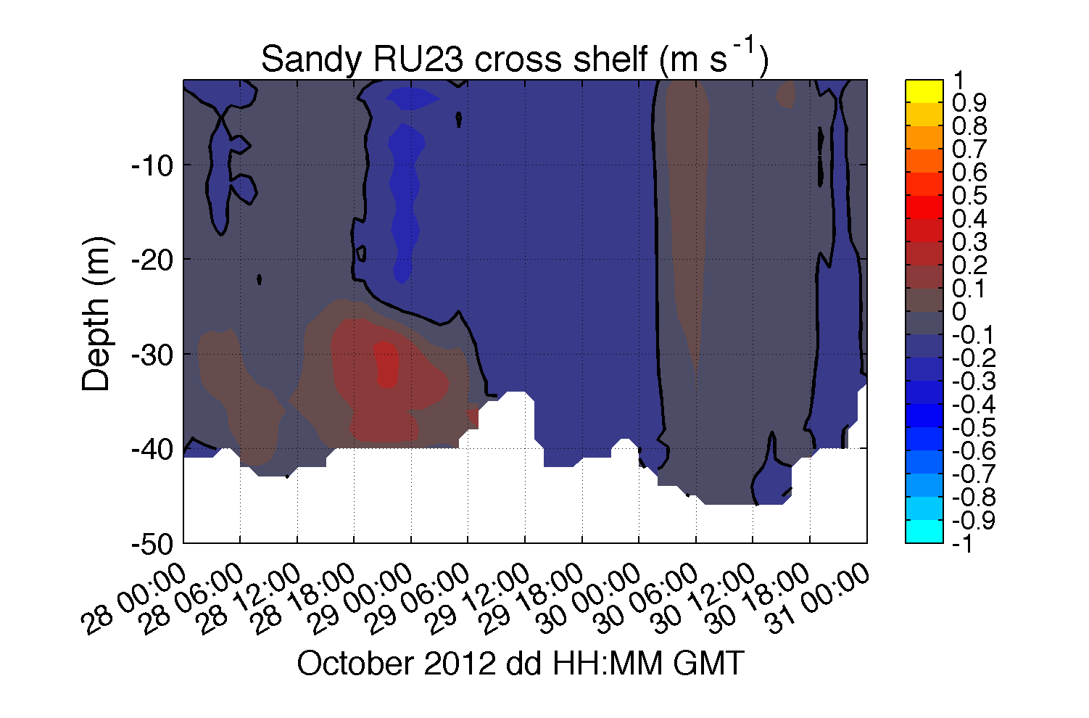
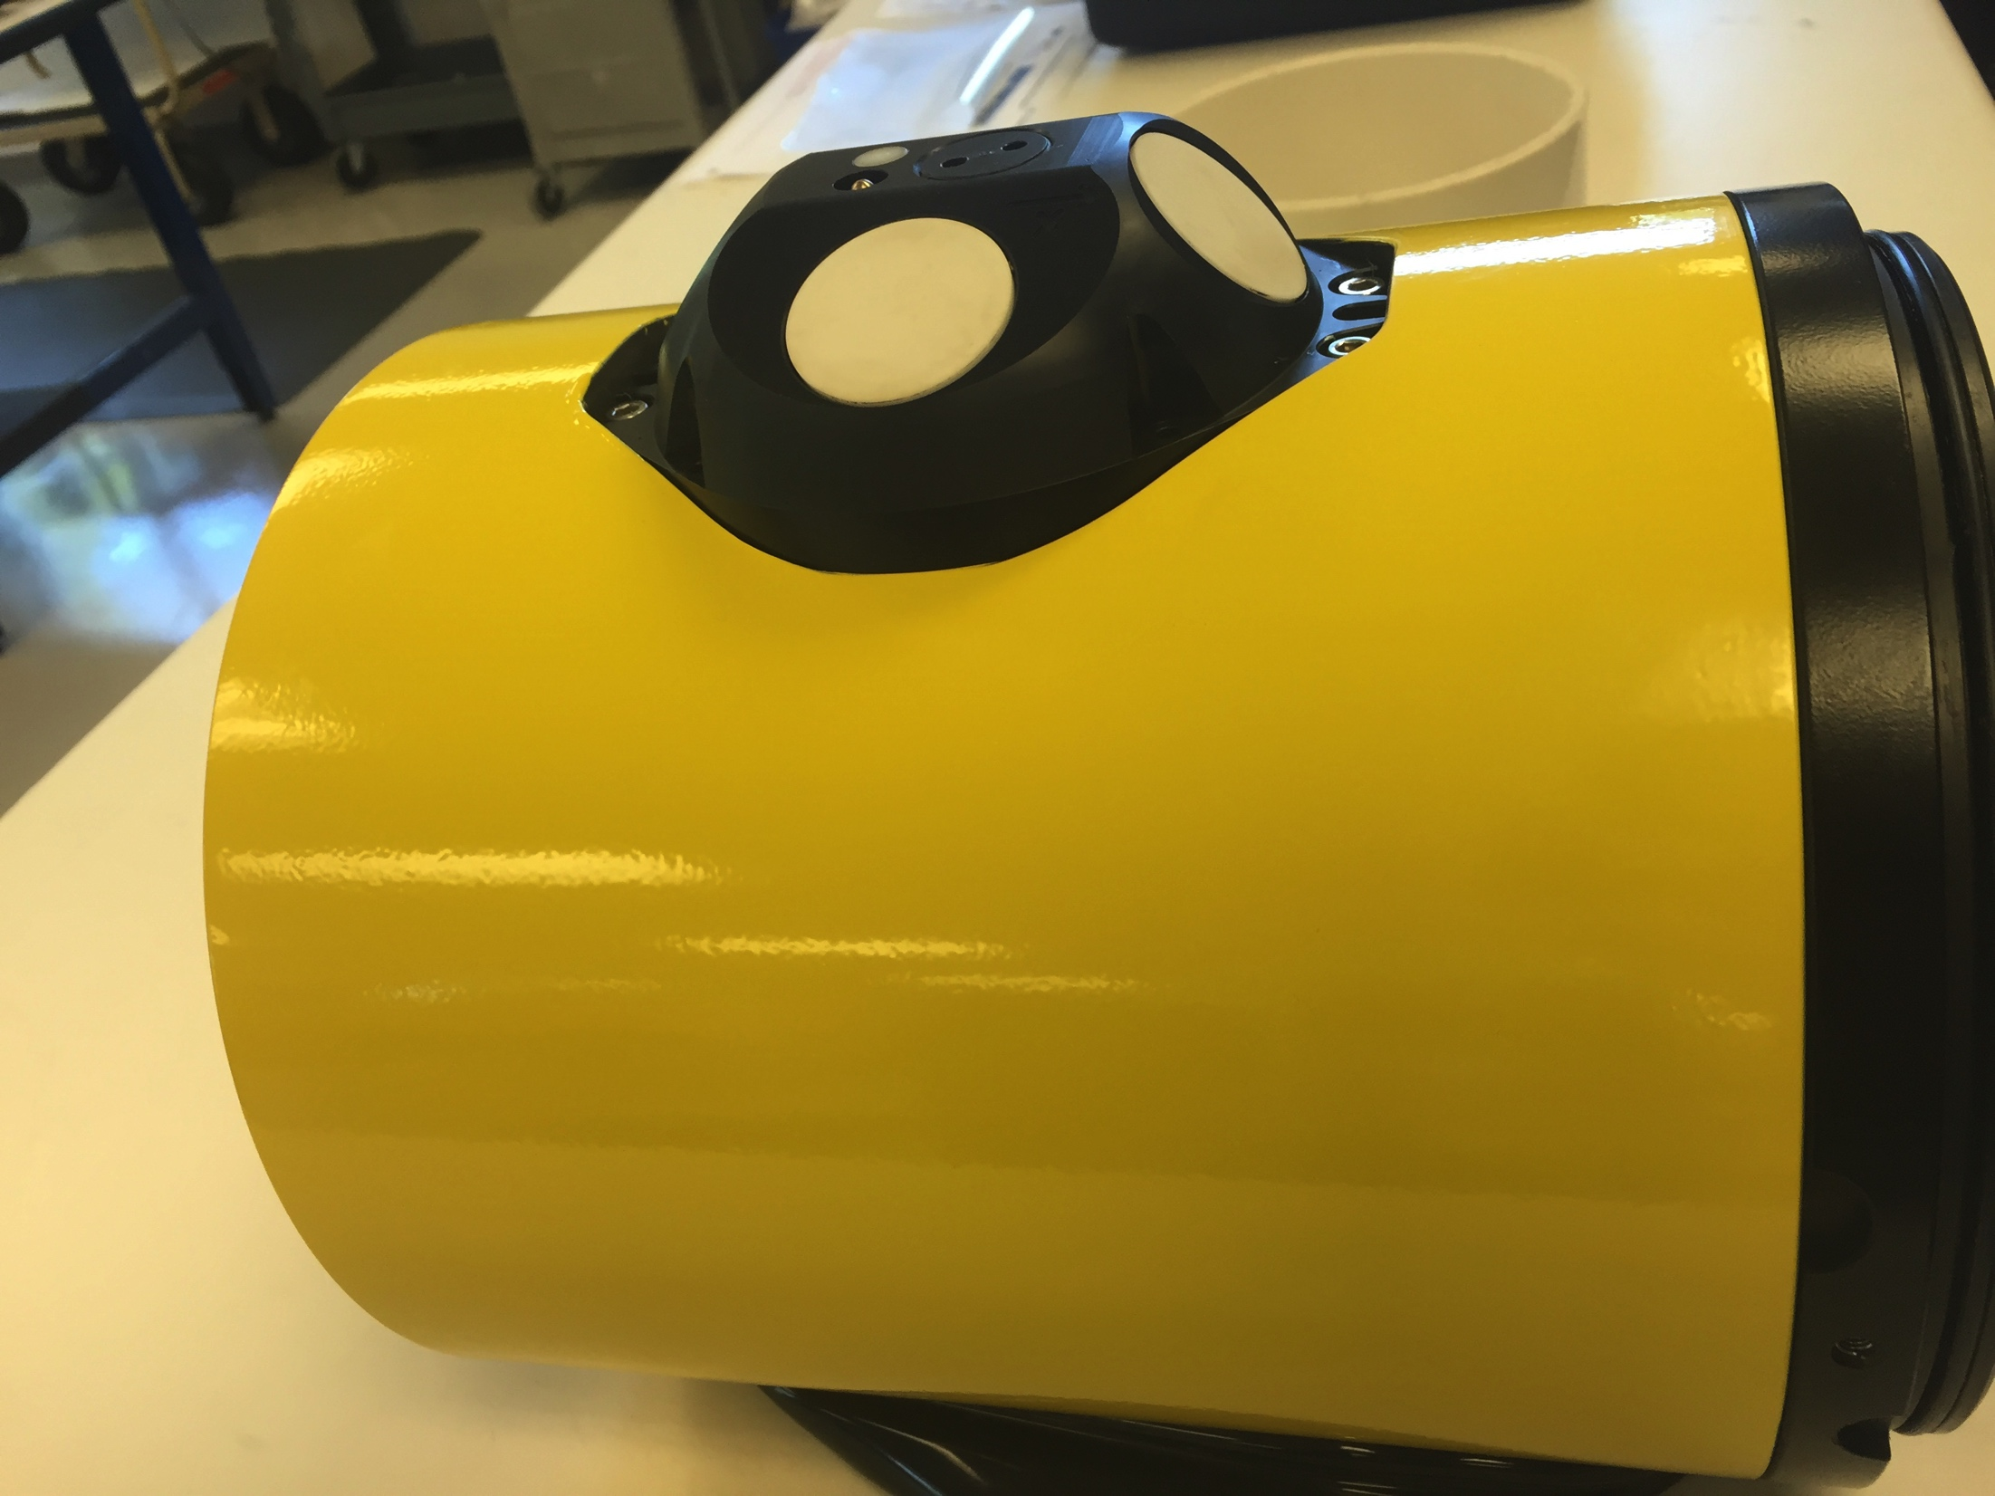
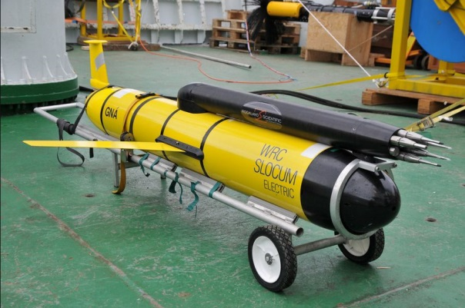
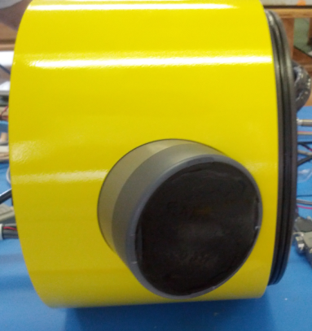
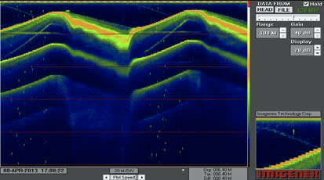
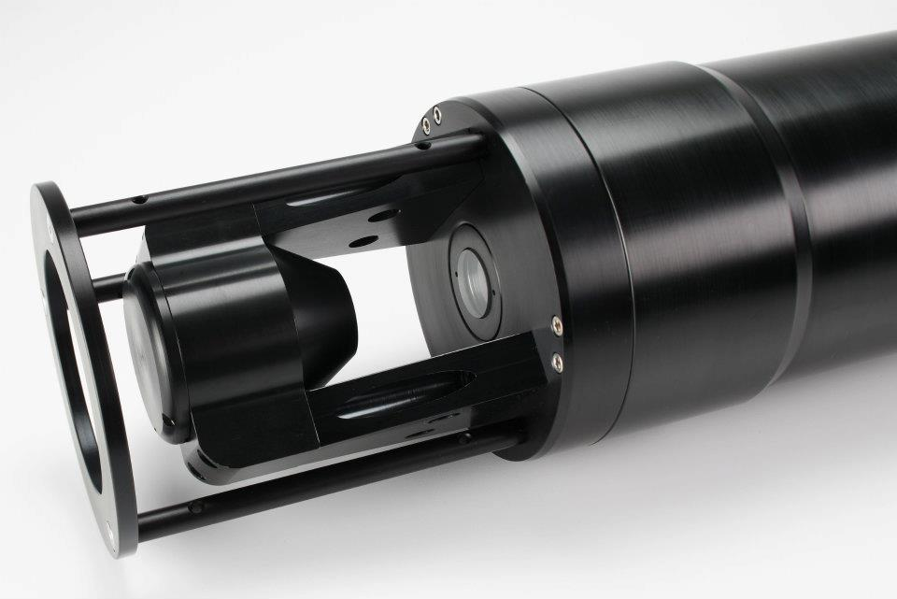
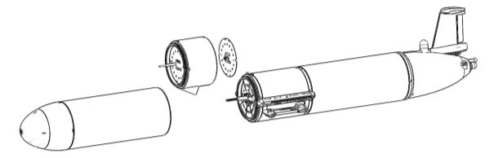
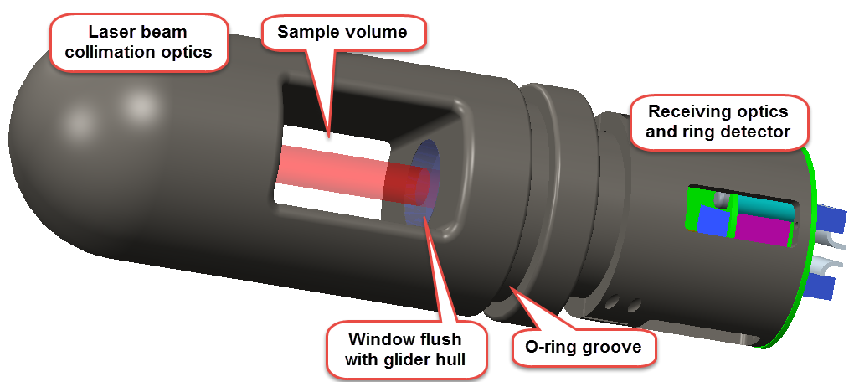
New in situ measurements from gliders
Nortek Aquadopp (shallow max. 200 meters) deployed in Hurricane Sandy
Rockland Scientific Turbulence Microrider
Imagenex Echosounder
Nortek Integrated 1 MHz AD2CP (Deep maximum 1000 meters) – LADCP Processing in development.

Slide 10
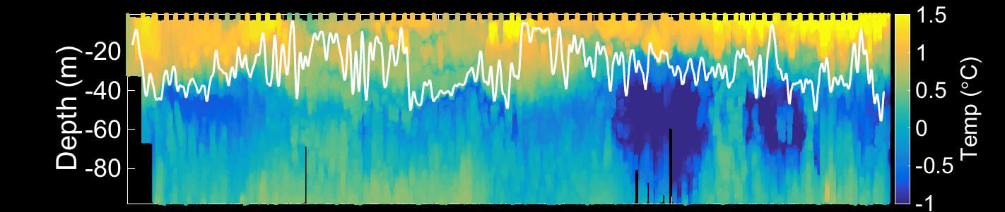
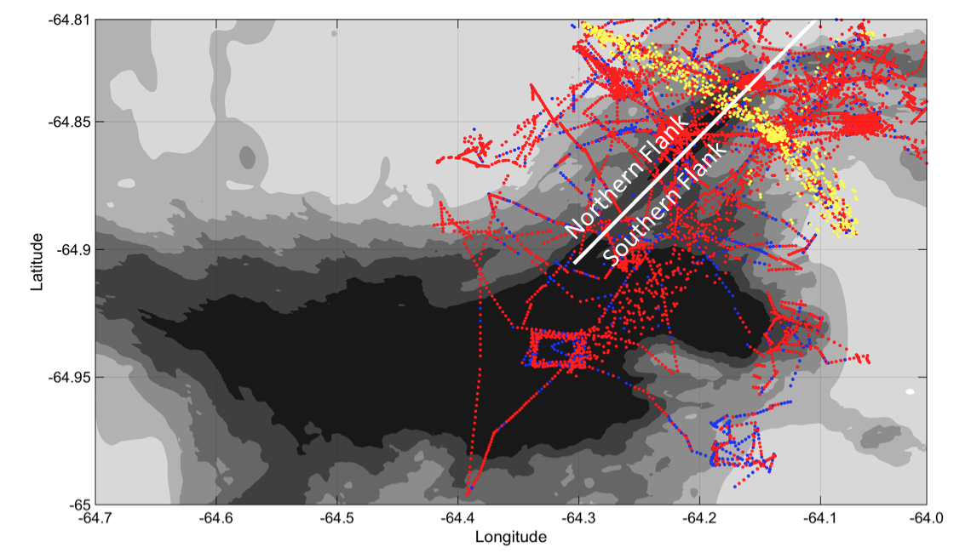
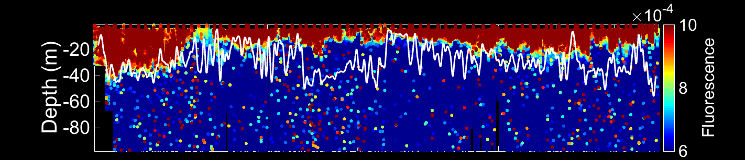
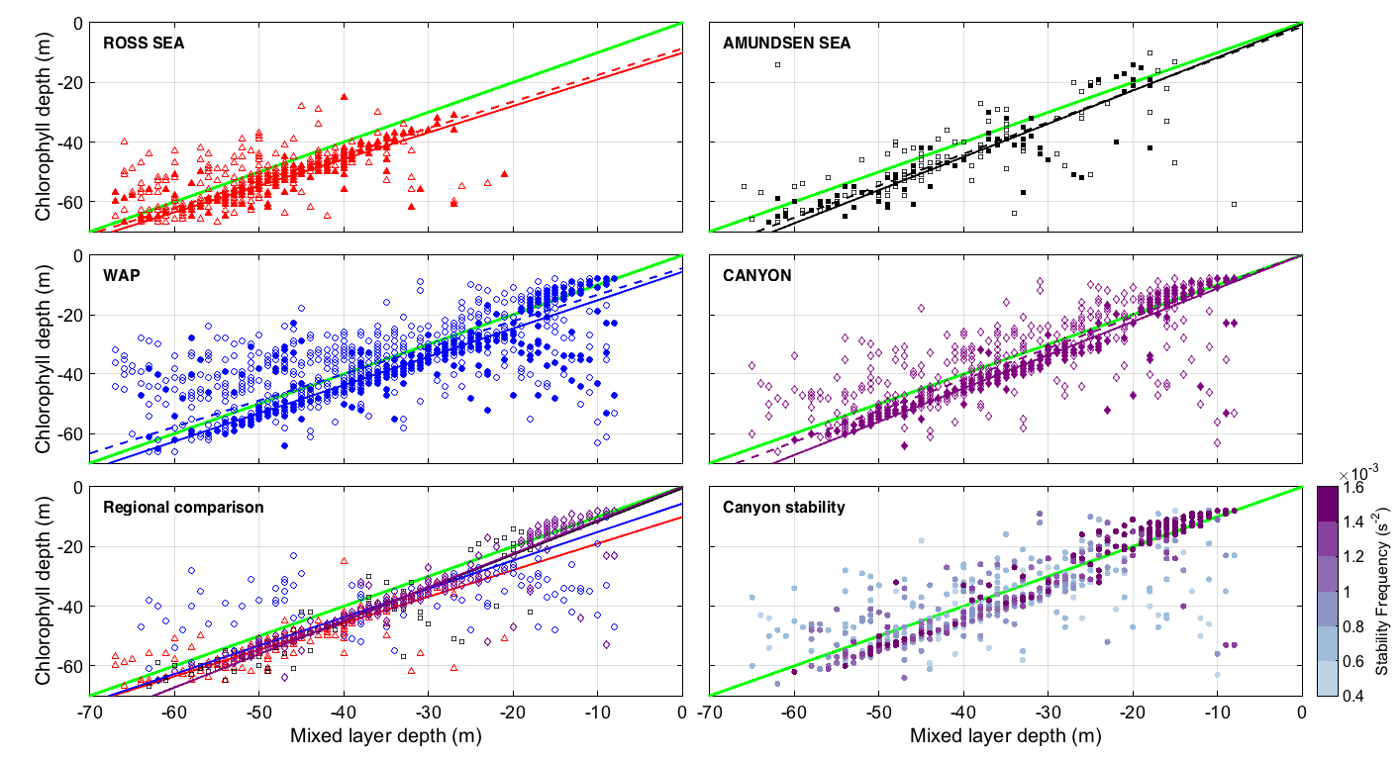
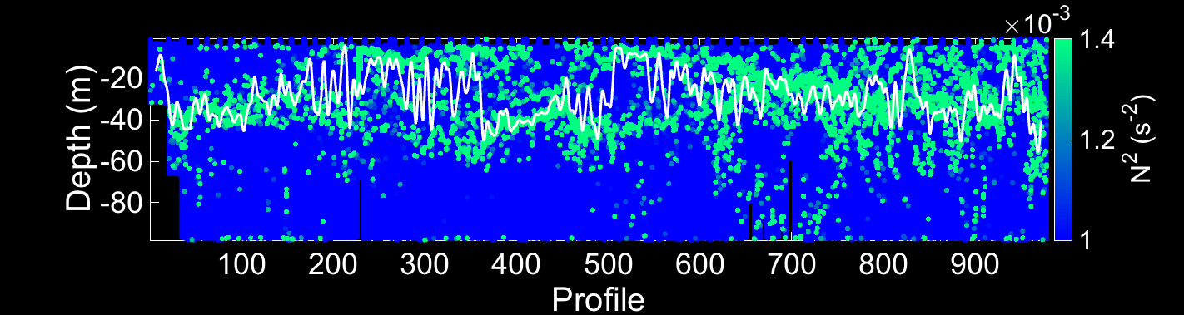
Glider’s provide high resolution maps to link to physical drivers
Mixed layer dynamics determine the presence or absence of phytoplankton blooms

Slide 11
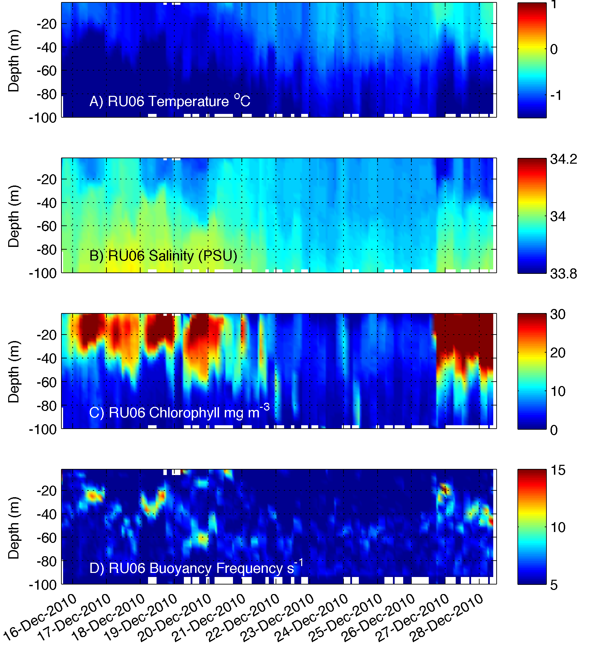




Gliders provide high resolution biomass and taxa estimates
Phytoplankton biomass
Phytoplankton communities

Slide 12


Glider’s provide insight into the nature of phytoplankton composition
c_{b650}
C_{b650}/b_{b650}
Empirical algorithms
%Mineral (in situ)
salinity
b_{b650}

Slide 13




From the optics, one can calculate water column turbidity. What is the depth of the euphotic zone?
An example for a very applied problem: What can you see?
Helicopter or diver….
Towed MCM detection system
April 24, 2005
Clear water
Real water
MIREM April 2005
probability of detection
at an altitude of 10m
off bottom
April 26, 2005
Clear water
Real water
Red = poor detection

Slide 14



The ability to look at phytoplankton physiology and rate processes
PROXY FOR BIOMASS
HEALTH
Night
Daytime
Night
Night
Daytime
Night
0
0
25
25
50
50
02/20
02/21
02/20
02/21
Time (month/day)
Time (month/day)
0
4000
8000
0
0.3
0.6
Biomass Proxy (Fm)
Quantum Yield of Photosynthesis (Fv/Fm)

Slide 15




Active acoustics to map macro-zooplankton community and concentration
Guihen et al. 2014

Slide 16

Animal dynamics via active optics
wind speed (m s⁻¹)
Ophelia
Sensor damage?
Saturation?

Slide 17






Peninsula hotspots
A)
0
Depth (m)
120
-64.8
Latitude
Antarctic Circumpolar Current
-64.9
-64.3
Longitude
-63.9
<-1
0
>1
Temperature (C)
Rothera
-2
°C
2
0
0
-67.7
Depth (m)
Latitude
120
Depth (m)
-69.4
-67.9
Longitude
-68.4
<-1
0
>1
Temperature (C)
600

Slide 18

Gliders being able to track animals based on passive acoustics
Receiver Integrated Glider
Enables coupling of data sets
  Telemetry data
  Temperature
  Salinity
  Productivity
Moves us beyond fixed arrays

Slide 19



Gliders being able to track animals based on passive acoustics
Drs. Baumgartner (WHOI) and Fratantoni (SeaTrec) from to develop autonomous gliders, equipped with a reliable acoustic detection algorithm to allow near real time detection of North Atlantic right, fin, sei and humpback whales.
Dr. Baumgartner
Dr. Fratantoni

Slide 20



Coming soon (2-4 years) micro- and small zooplankton imaging
Holographic images from Monterey
by an AUV
Design strategies are underway
Thanks to James Bellingham (WHOI)

Slide 21


Observed Model vs Glider Differences
(Results from undergrad summer research)
New tools open data analysis across demographic, opportunities for unique crowd sourcing opportunities
Most variation between the two models and RU29 exist within the first 300 meters of the water column
MyOcean model has a fairly consistent 1˚C to 2˚C difference in temperature from RU29
RTOFS model was fairly consistent with the RU29 data at lower depths but had very large discrepancies in magnitude at certain locations.

Slide 22






Thank You!
40
31
22
13
4
http://rucool.marine.rutgers.edu

Slide 23
Food web is tightly coupled. High chlorophyll anomaly years result in high krill recruitment and immediately affect krill diet
Saba et al. 2014 Nature Communications

