Slide 1

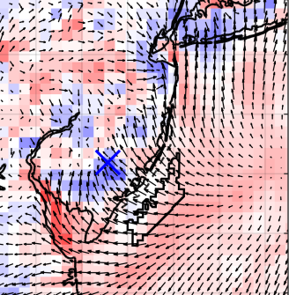
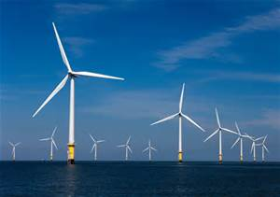

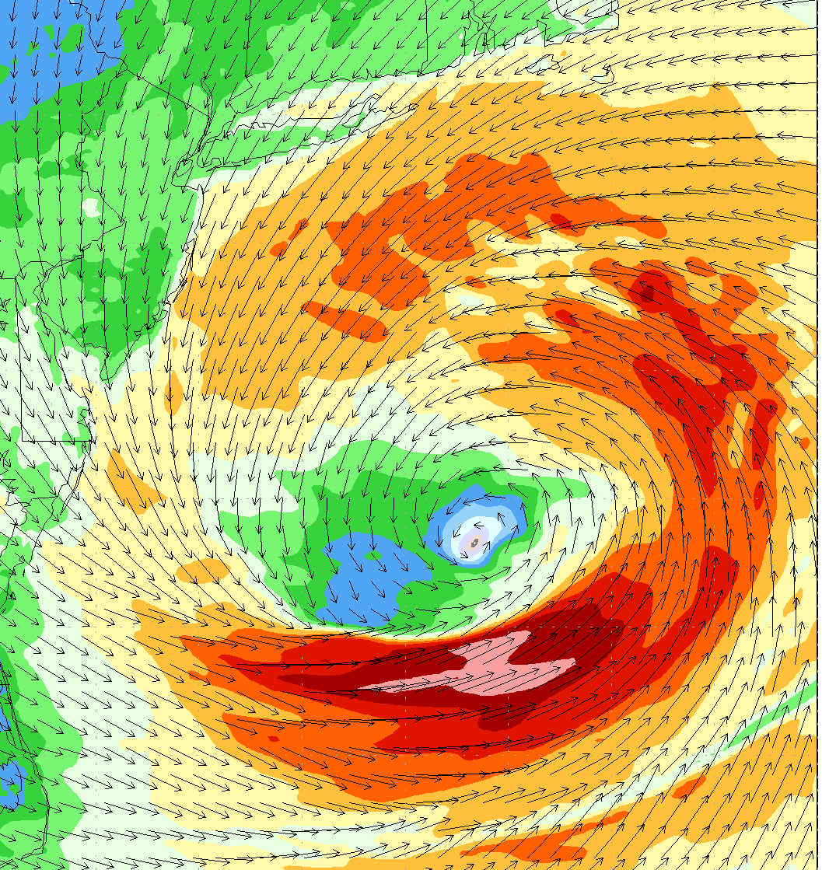
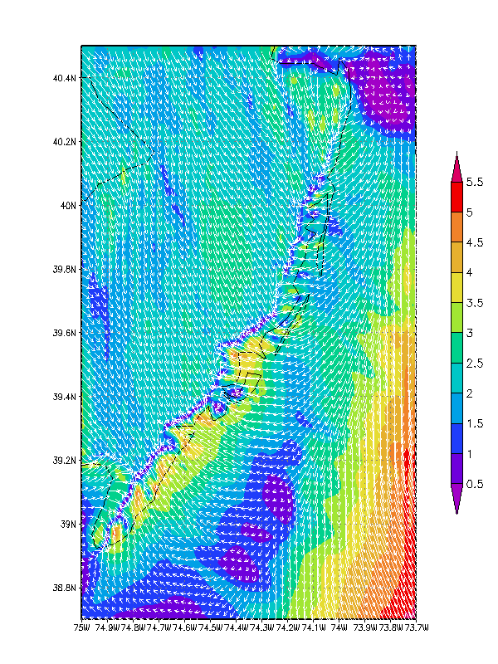
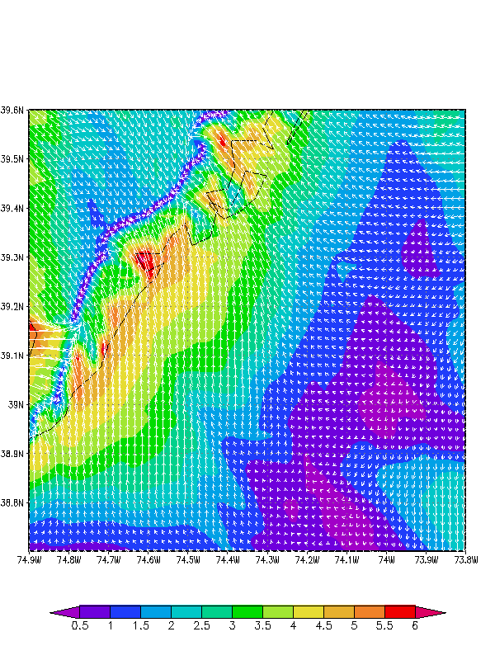
NEW JERSEY’S OFFSHORE WIND RESOURCE
Innovative Sea Breeze Analyses
New Jersey Board of Public Utilities (NJBPU)
Tropical Cyclone Modeling
Rutgers Center for Ocean Observation Leadership (RU-COOL)
Rutgers Dept. of Marine and Coastal Sciences (DMCS)
New Ocean Data
Hi-Res Weather Model
Spatial Validation Data
Wind Power Statistics

Slide 2
NJ Board of Public Utilities Wind Energy Modeling Reports
Key Findings:
A high resolution wind model has been developed and validated for the NJ WEA.
The wind resource off of New Jersey is very conducive to energy development.
Wind is highly variable in space and time due to year round coastal storms and seabreeze’s during peak energy demand.
Notes:
Box around each

Slide 3



Rutgers University Weather Research & Forecasting
(RU-WRF) Model
What is the Weather Research Forecast (WRF) system: A numerical weather prediction (NWP) modeling framework based on full atmospheric physics and parametrizations used for both research and operational forecasts.
Community Supported Model
Many others Agencies and University Partners

Slide 4
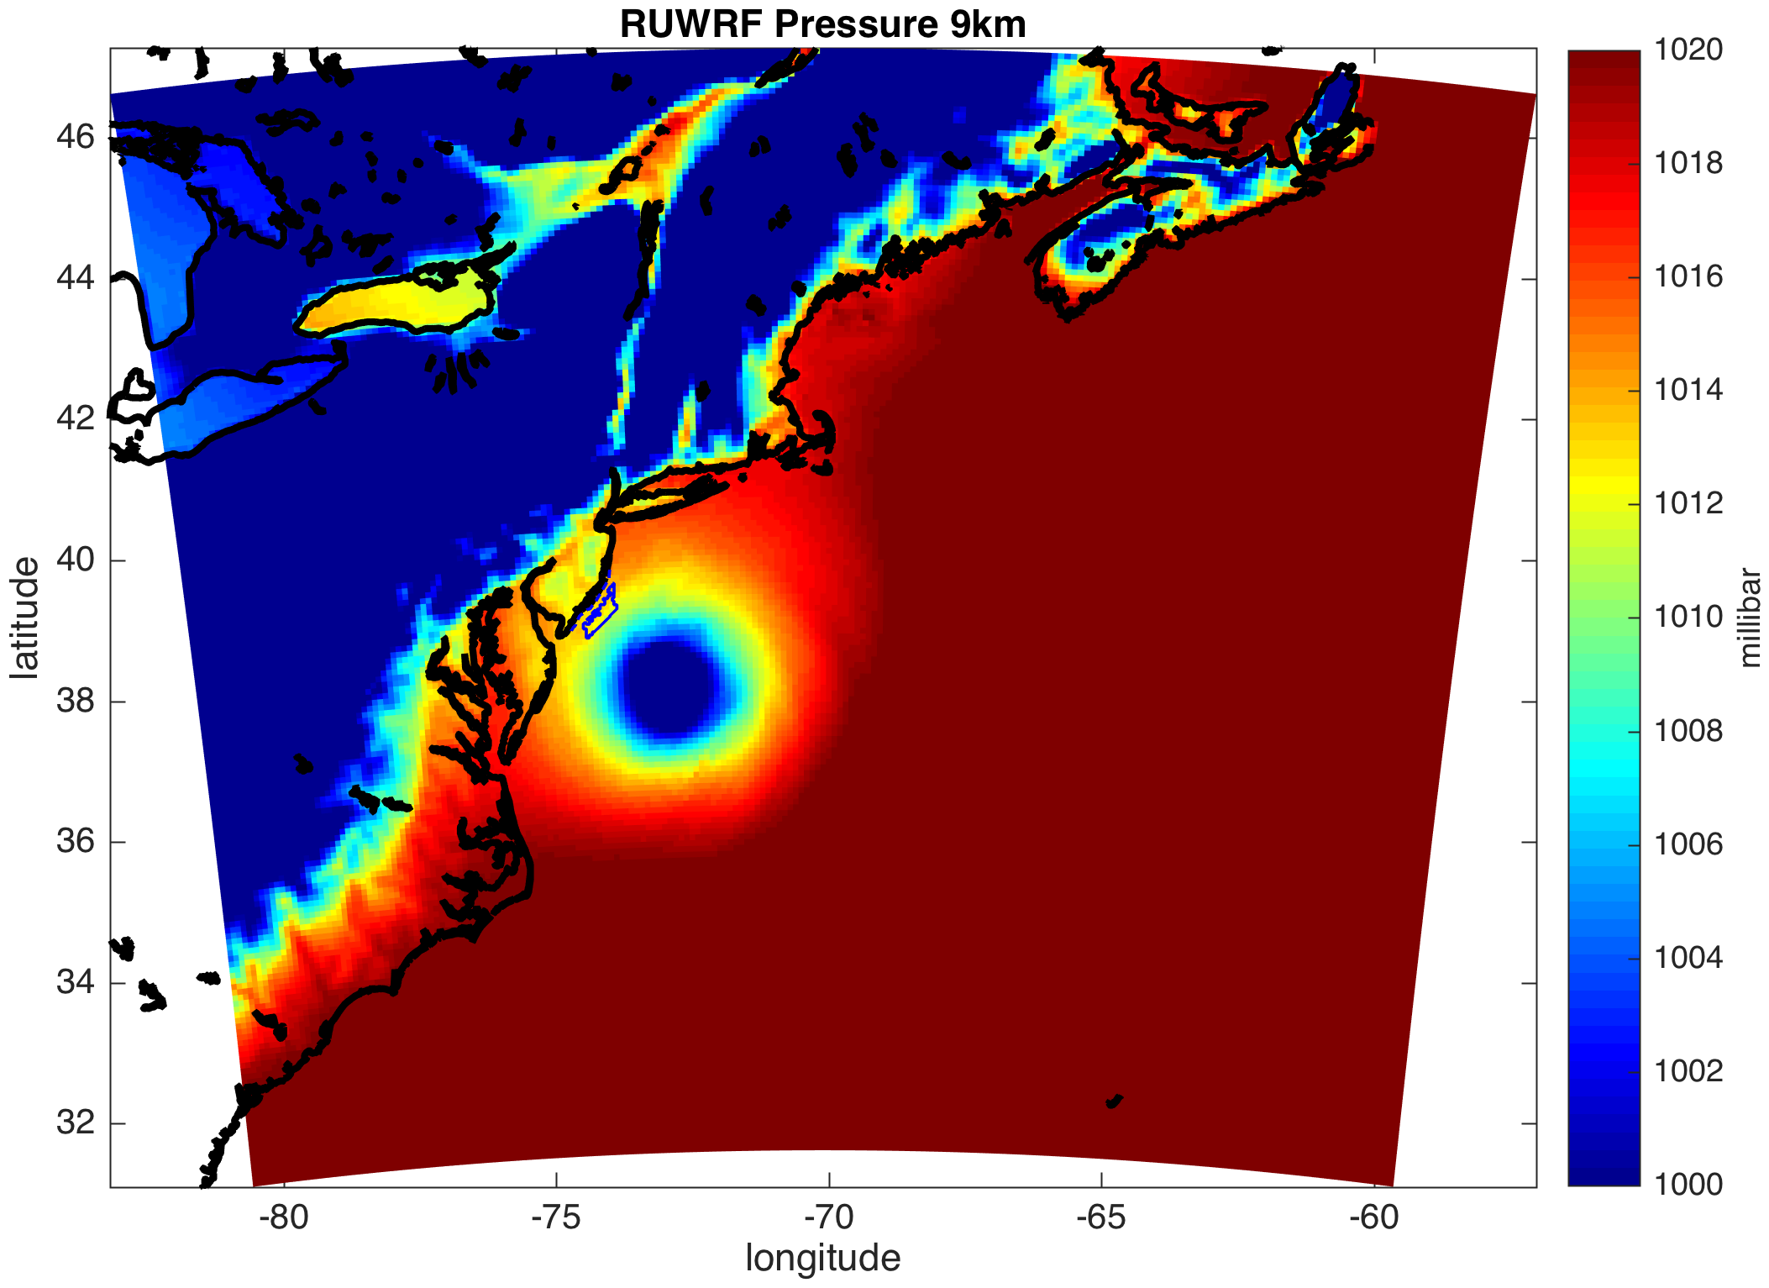
Rutgers University Weather Research & Forecasting
(RU-WRF) Model
Triple nested: 9km-3km-1km
  9km: 0, 6, 12, 18Z cycles
  3km: 0, 12Z cycles
  1km: 12Z cycle (Research Mode)
Hourly forecast:
  9km: out 5 days
  3km: out 2 days
  1km: out 1 days (Research Mode)
Boundary Conditions:
  9km: 0.25 degree Global Forecast System
  3km: RU-WRF 9km
  1km: RU-WRF 3km (Research Mode)
Vertical Levels:
40 levels more tightly packed near the surface.
July 4th 2014 – Hurricane Arthur passage
Notes:
High Resolution
Long-time period (5 years)
Sea

Slide 5
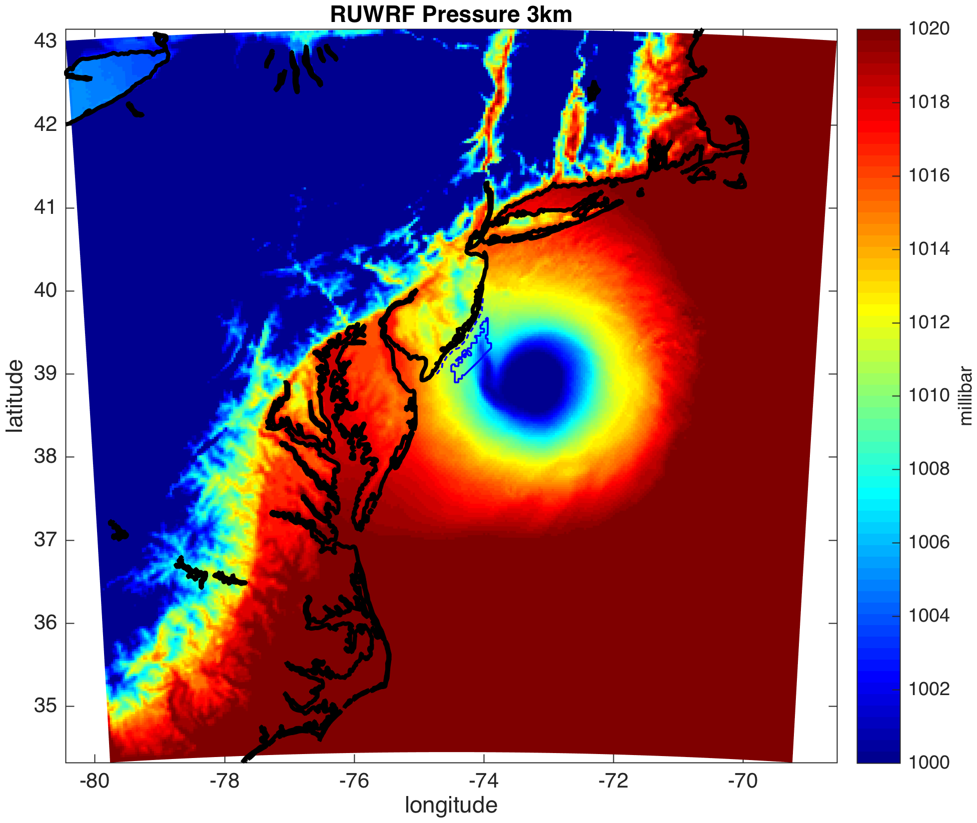
Rutgers University Weather Research & Forecasting
(RU-WRF) Model
Triple nested: 9km-3km-1km
  9km: 0, 6, 12, 18Z cycles
  3km: 0, 12Z cycles
  1km: 12Z cycle (Research Mode)
Hourly forecast:
  9km: out 5 days
  3km: out 2 days
  1km: out 1 days (Research Mode)
Boundary Conditions:
  9km: 0.25 degree Global Forecast System
  3km: RU-WRF 9km
  1km: RU-WRF 3km (Research Mode)
Vertical Levels:
40 levels more tightly packed near the surface.
July 4th 2014 – Hurricane Arthur passage
Notes:
High Resolution
Long-time period (5 years)
Sea

Slide 6
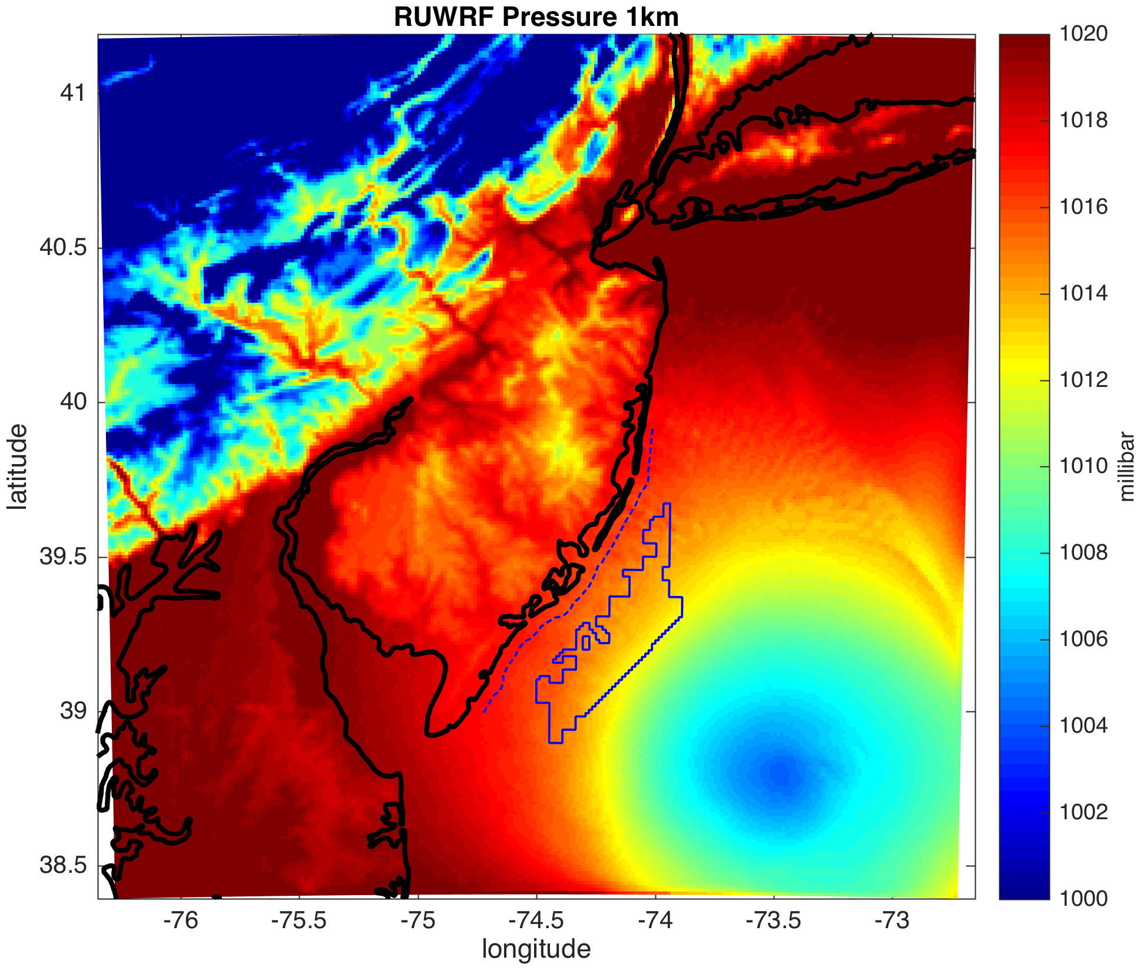
Rutgers University Weather Research & Forecasting
(RU-WRF) Model
Triple nested: 9km-3km-1km
  9km: 0, 6, 12, 18Z cycles
  3km: 0, 12Z cycles
  1km: 12Z cycle (Research Mode)
Hourly forecast:
  9km: out 5 days
  3km: out 2 days
  1km: out 1 days (Research Mode)
Boundary Conditions:
  9km: 0.25 degree Global Forecast System
  3km: RU-WRF 9km
  1km: RU-WRF 3km (Research Mode)
Vertical Levels:
40 levels more tightly packed near the surface.
July 4th 2014 – Hurricane Arthur passage
Notes:
High Resolution
Long-time period (5 years)
Sea

Slide 7
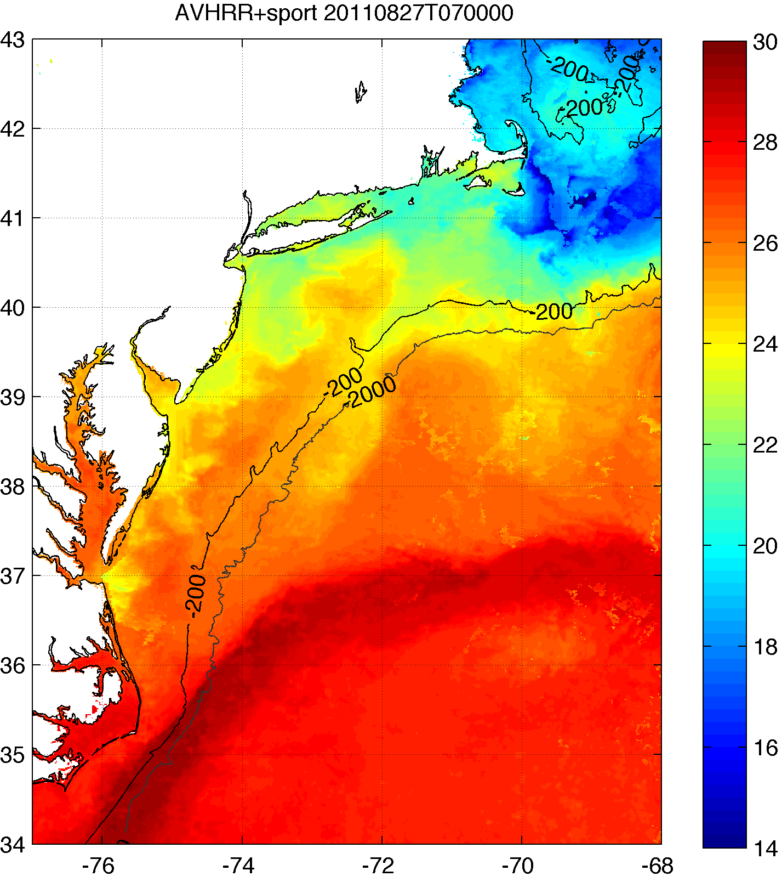
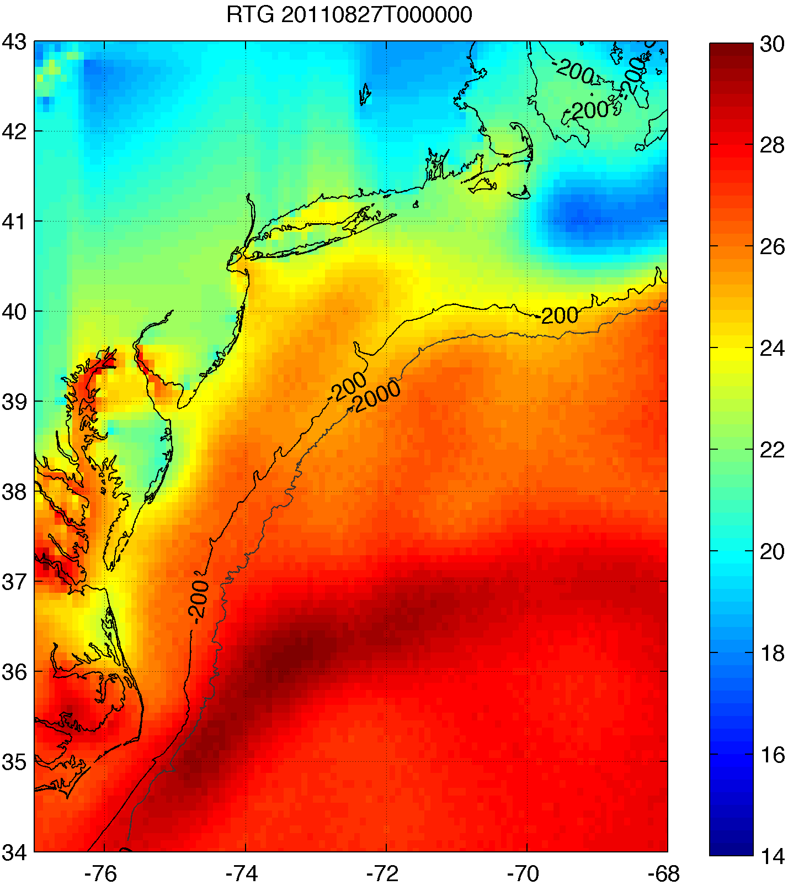
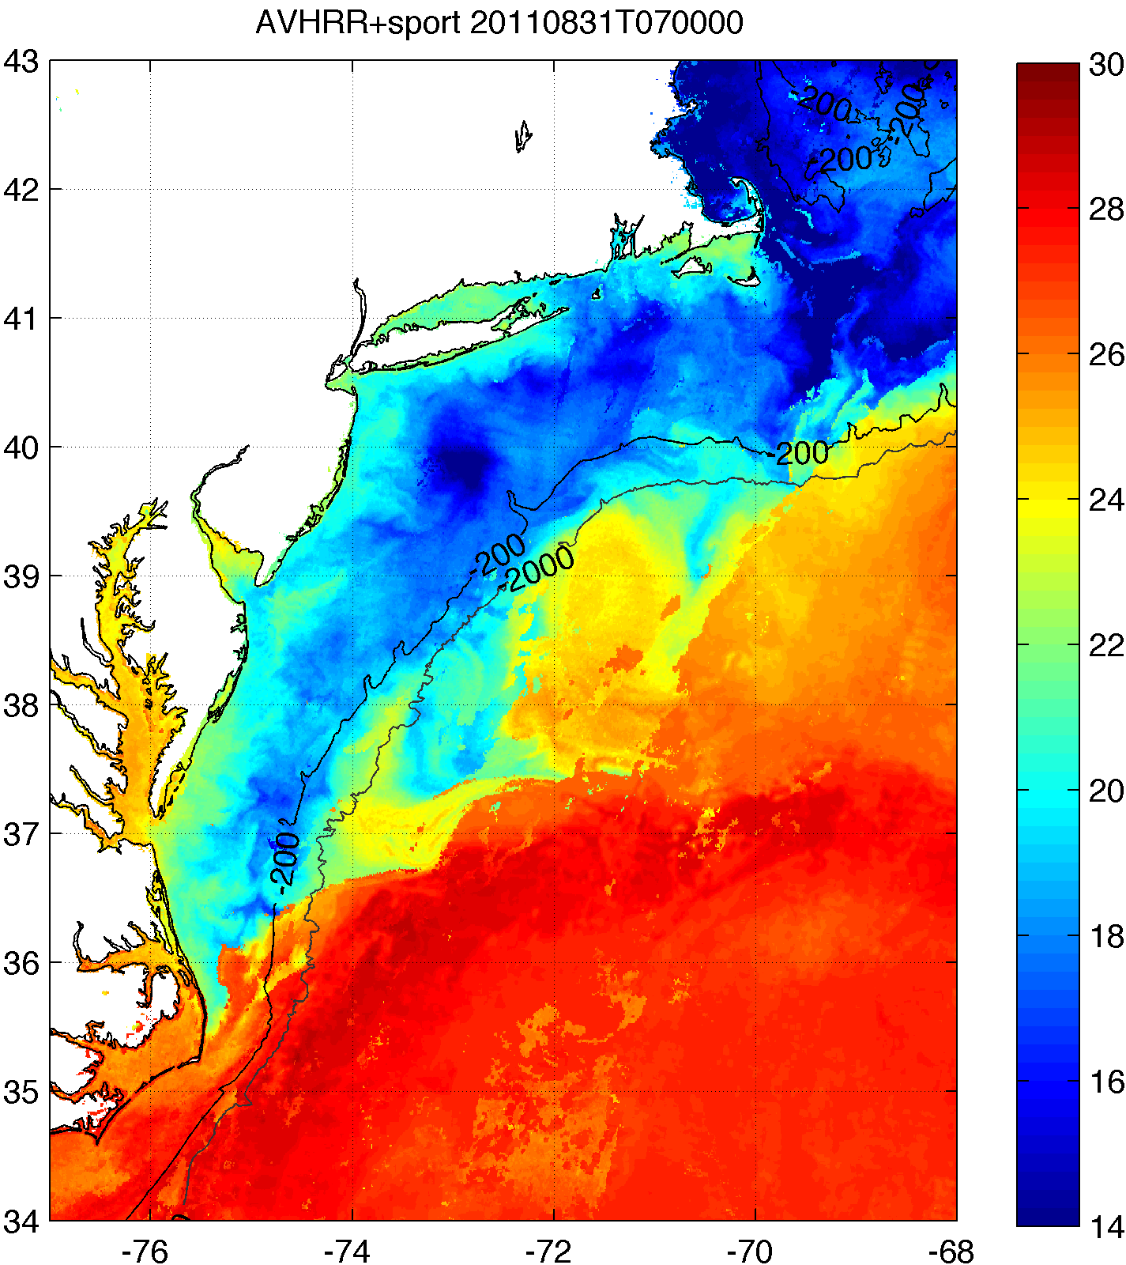
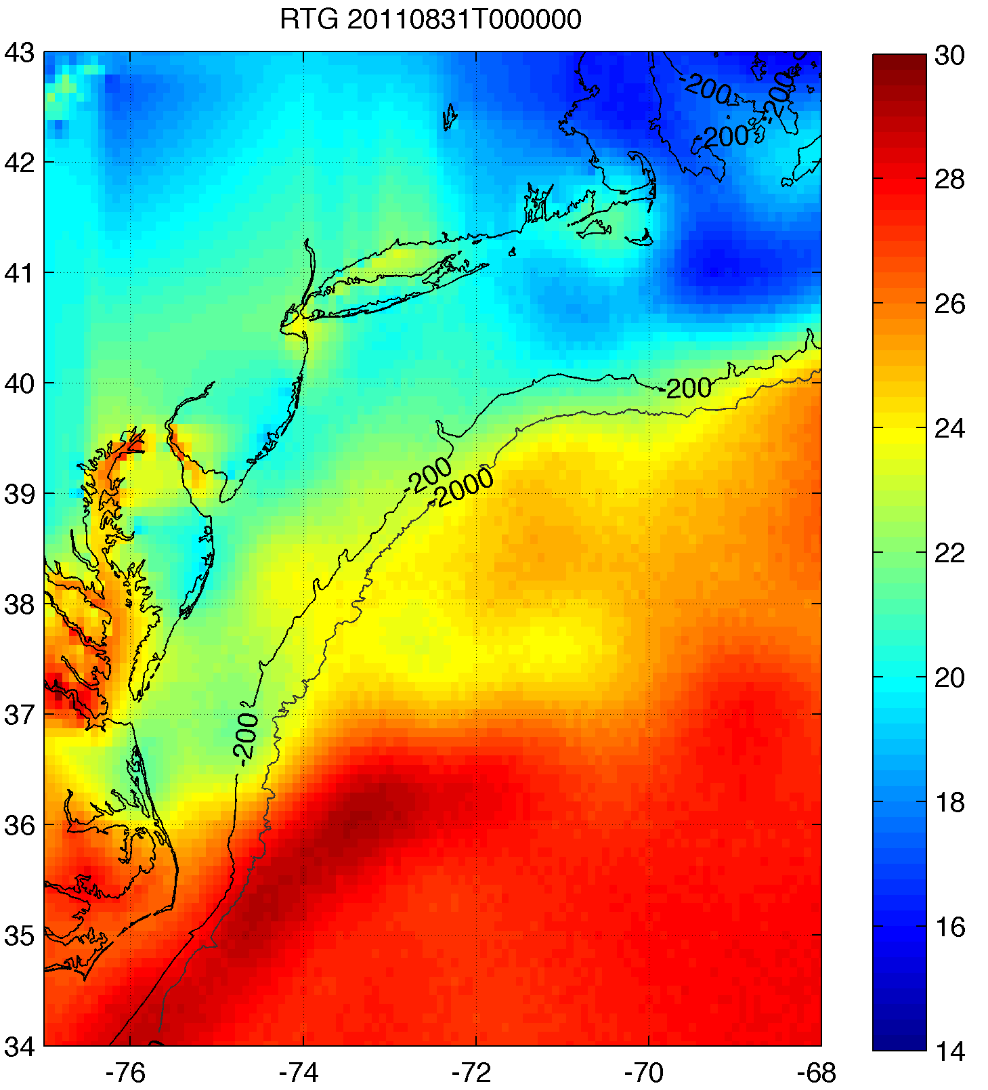
RU-WRF uses coldest pixel SST composite
for bottom boundary conditions
  Web: http://rucool.marine.rutgers.edu/ruwrf-mesoscale-meteorological-model-forecast
Rutgers SST
NOAA RTG HR SST
NAM model
BEFORE IRENE
Example:
Hurricane Irene
August 2011
AFTER IRENE

Slide 8
RU-WRF 3km Validation Results
Period of Validation: May 2012-May 2013 (including Hurricane Sandy)
*Based on standard validation criteria for mesoscale atmospheric models (Pielke, 1984; Dvorak et al., 2012)

Slide 9
Annual Mean Wind Speed (m/s)
Annual Mean Wind Power Density (W m⁻²)

Slide 10
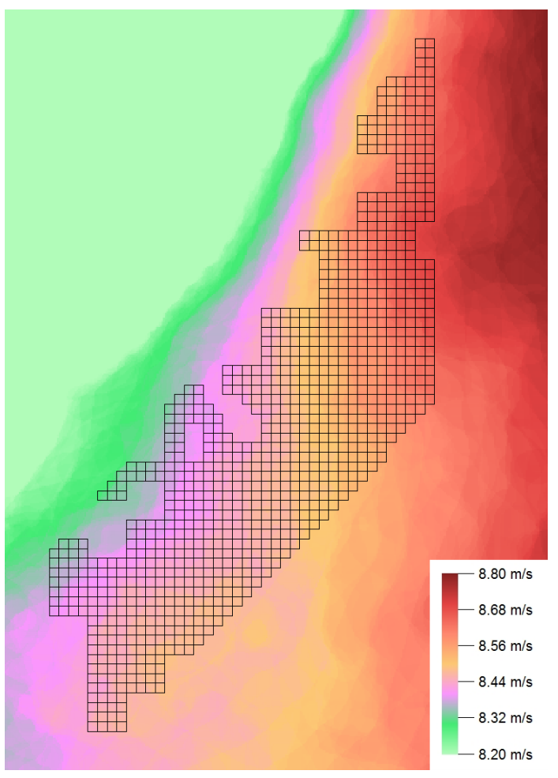
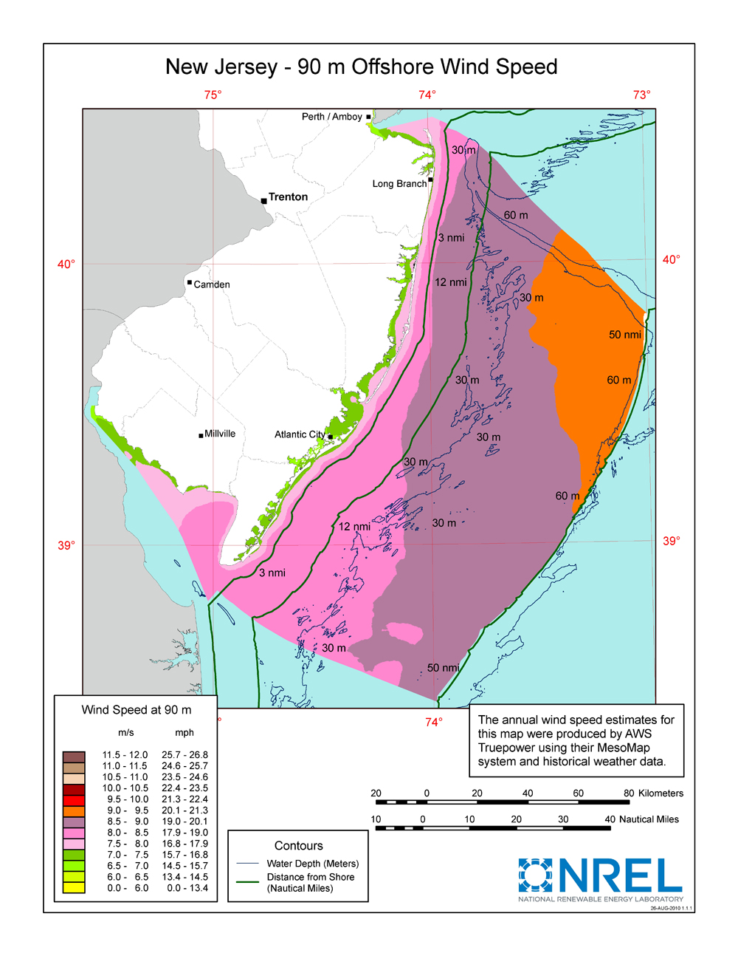


Motivation for OSW Program
Offshore wind (OSW) developers typically use annual average
wind distribution + wind rose for “site suitability” and project planning
Modeling at >=20km grid spacing
Annual Average
NJ WEA Potential Capacity >=3,000 MW

Slide 11
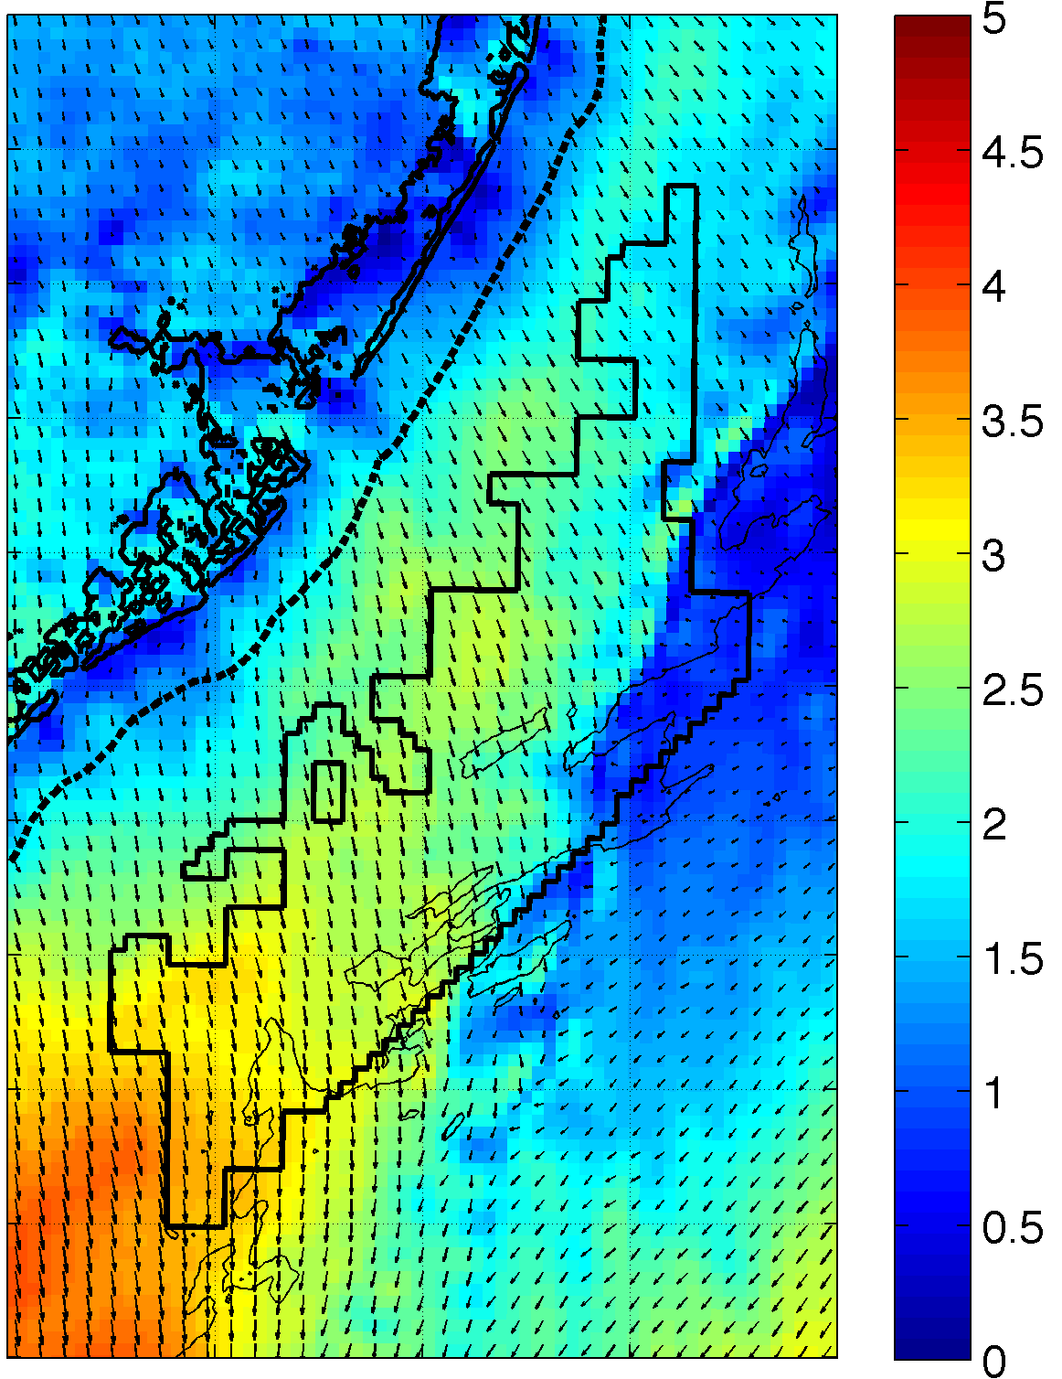
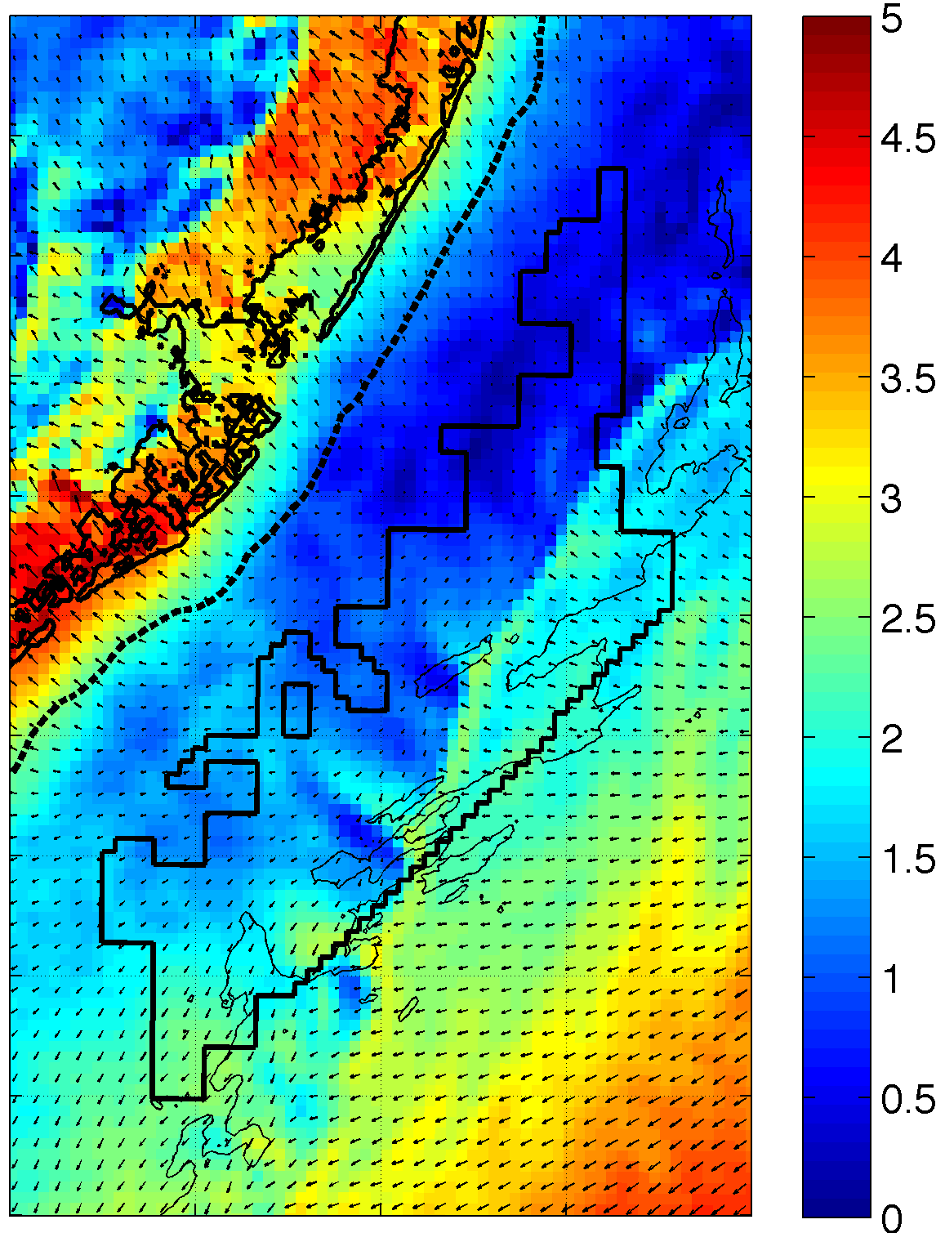
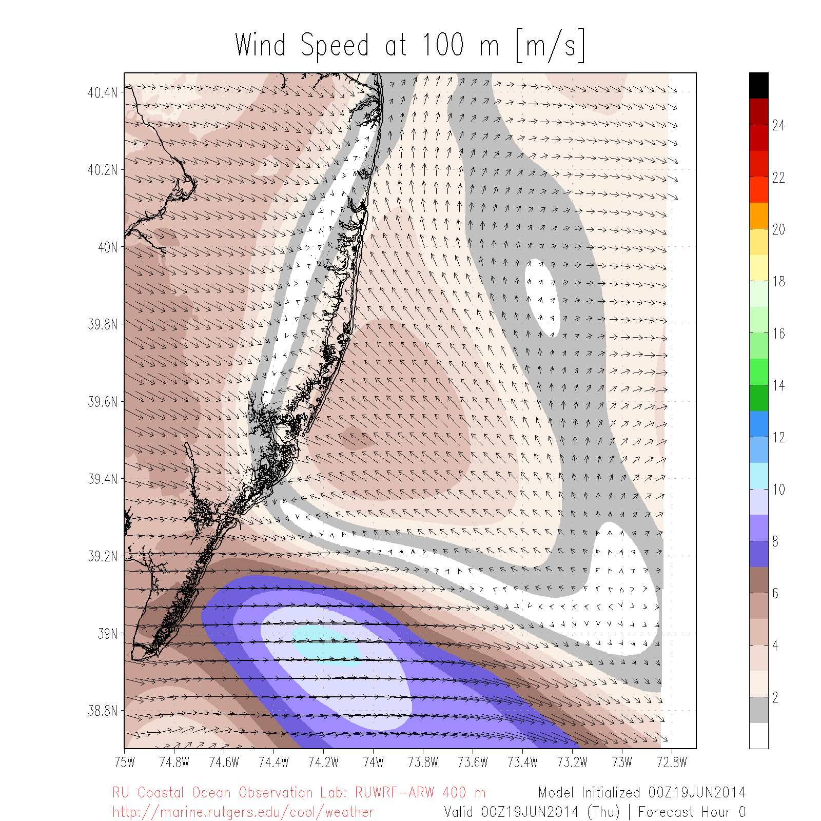
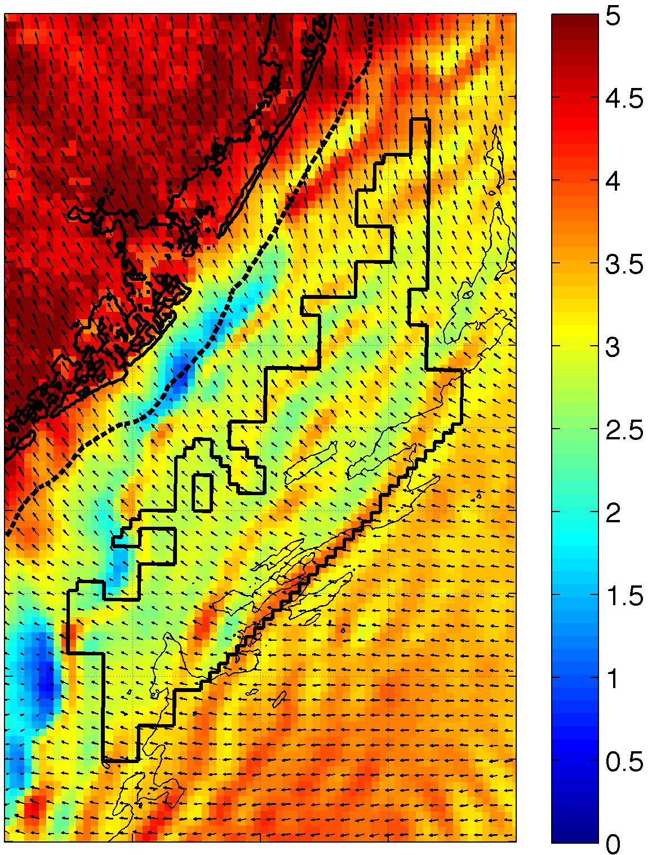
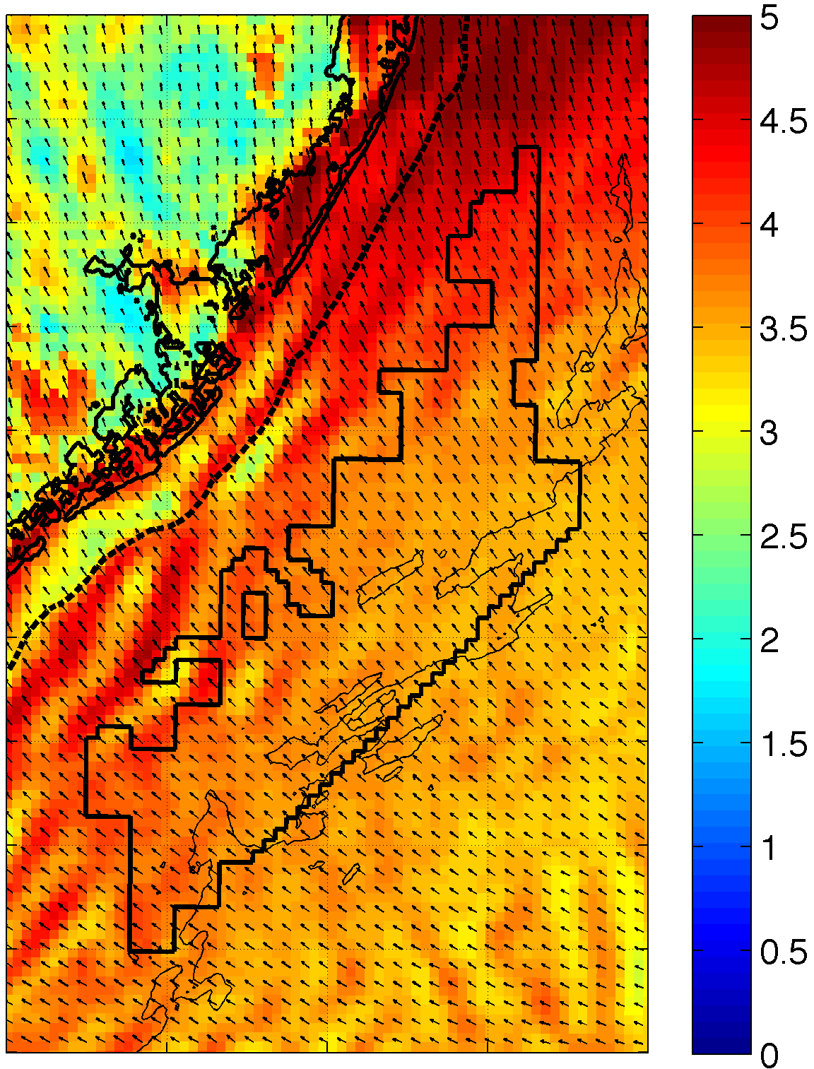
Wind Variability: Sea Breeze
September 12, 2012 10m Winds
June 19, 2014 100m Winds
14:00
17:00
20:00
23:00
Notes:
Largest sources of variability during peak energy demand period during summer
Resolution of model is capable of resolving these processes – captures seabreeze, changes through time, not static
Two different cases
Shows that there can be a north-south variability in seabreeze

Slide 12
Wind Variability: Sea Breeze
Onshore 100m max blue convergence aligned with inland weather radar sea breeze front
Max red divergence propagates offshore
Seroka et al. in prep.
Notes:
-Blue X for southern cross section, MD cross section?
Answer to vertical velocity:
Only using relative numbers of RD for paper (offshore extent (max); upwelling-non-upwelling)
WRF is consistent with continuity
2D LCS is not- assuming no vertical velocity, which is a valid assumption to make because vertical velocities are very small (100X smaller than horizontal velocities)

Slide 13
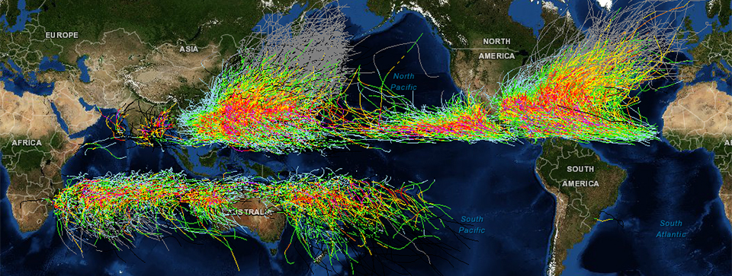
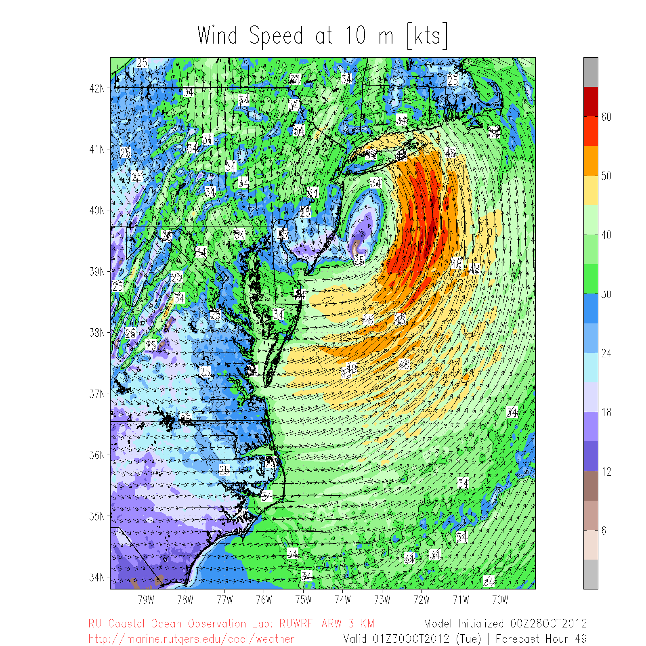
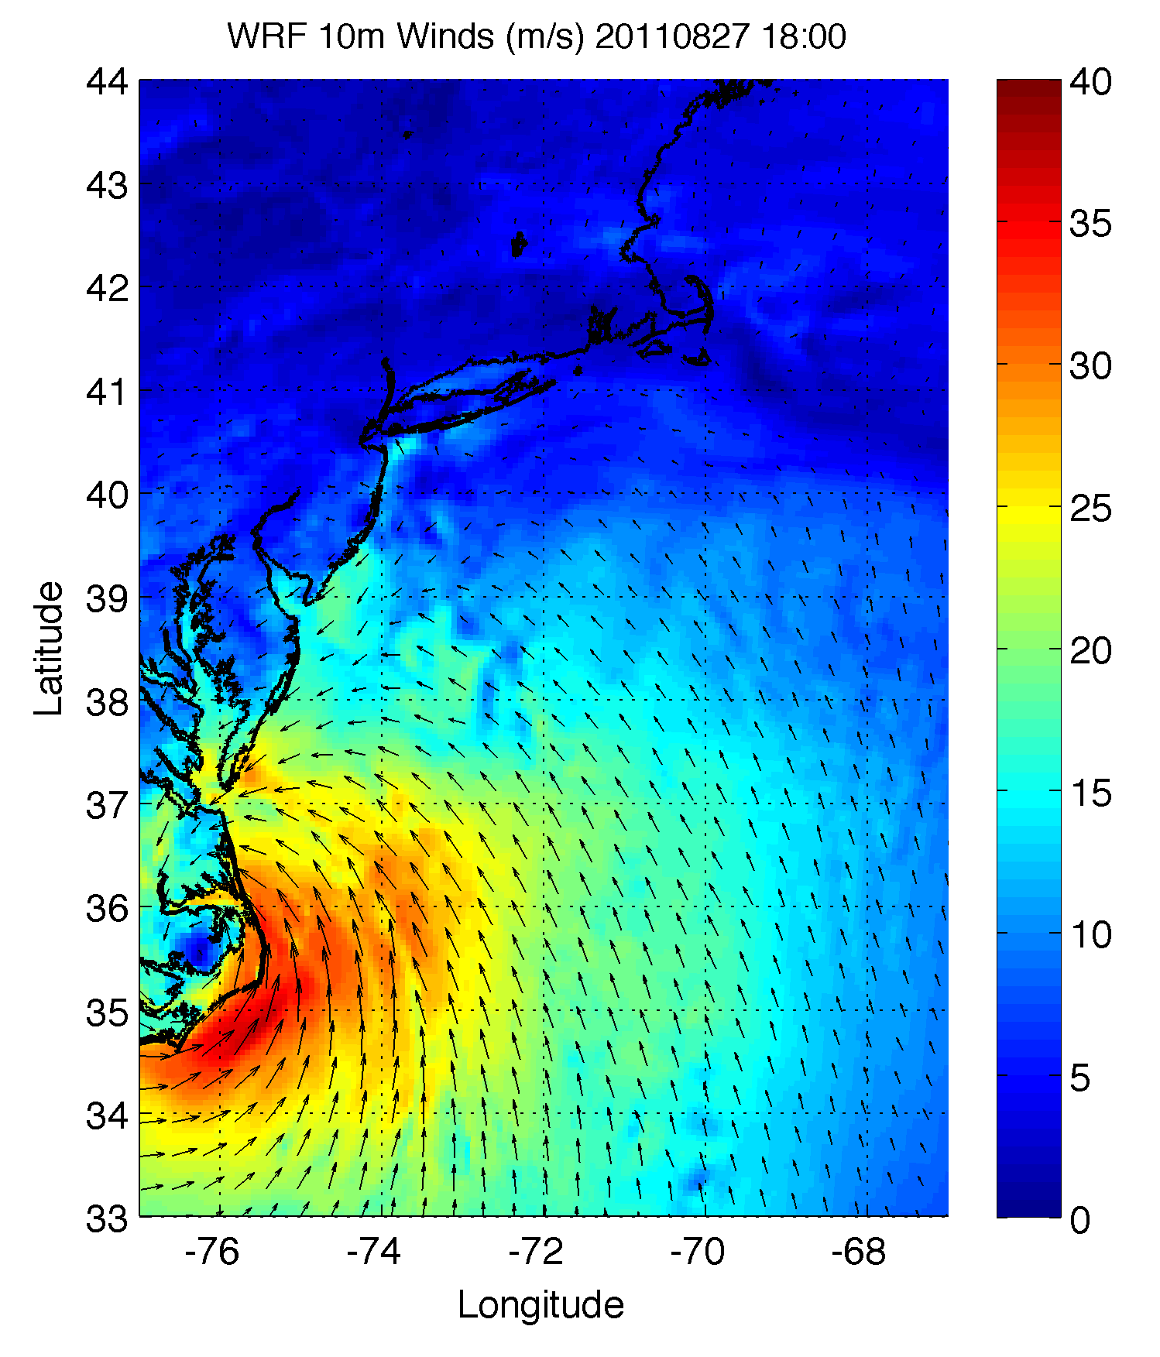
Wind Variability: Tropical Cyclones
Irene 2011
Arthur 2014
Sandy 2012
Notes:
Figure showing frequent storm tracks

Slide 14
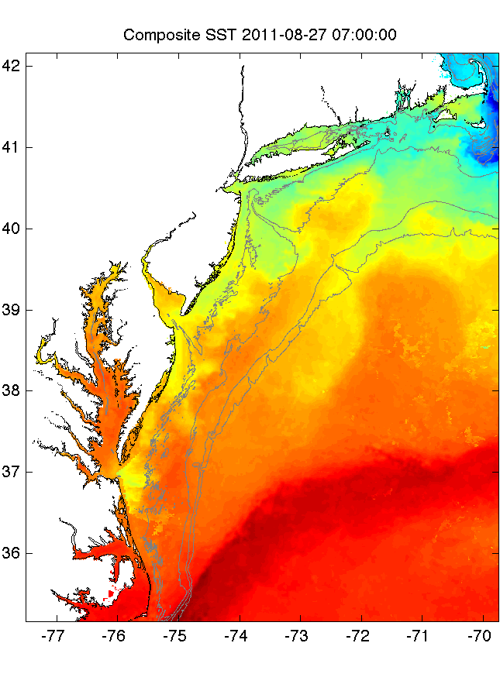
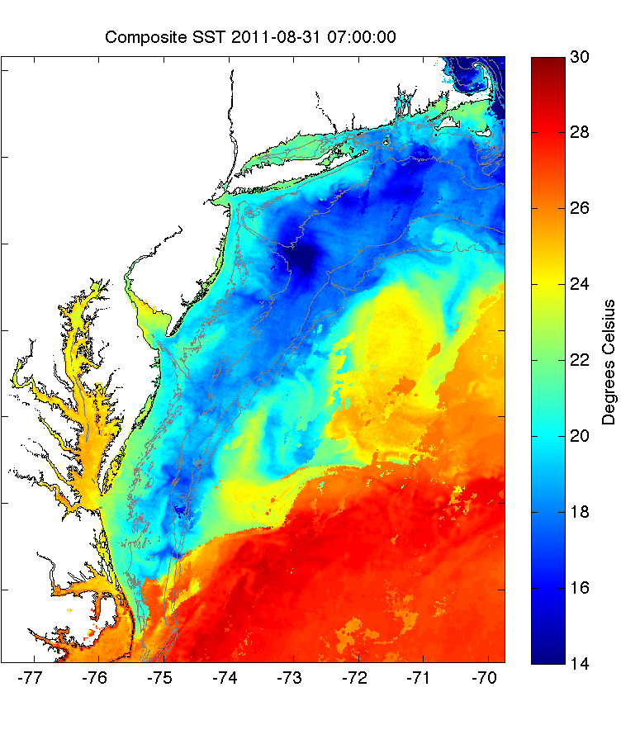
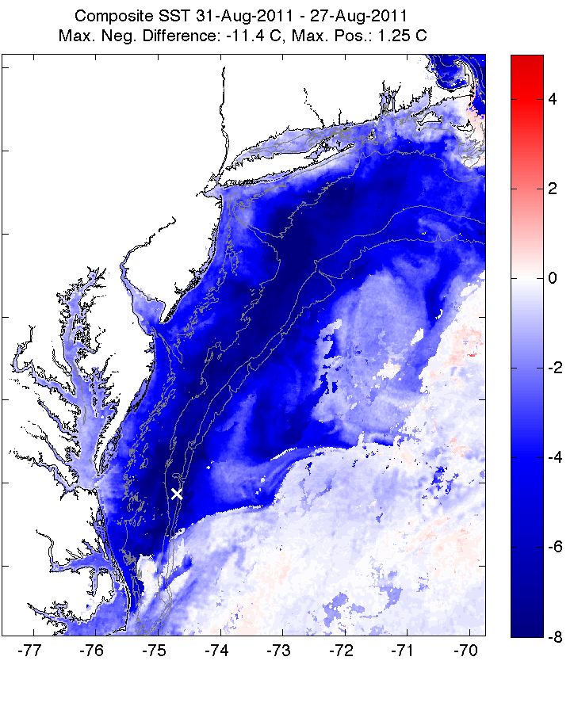
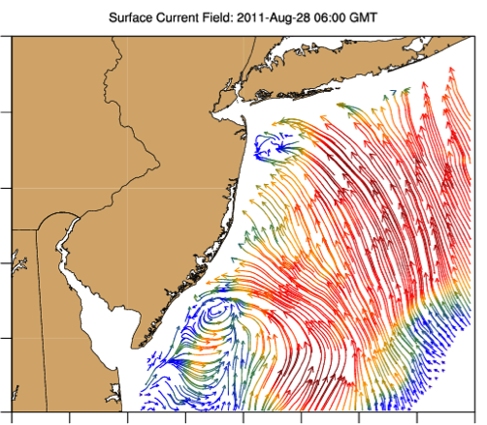
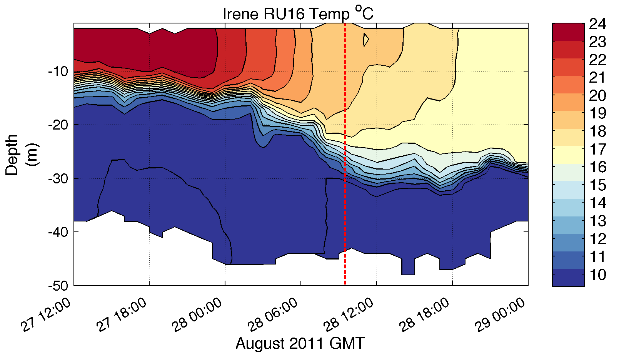
Pre-Irene
Post-Irene
Difference
11C max Cooling
WHAT?
Satellite
SST
WHEN? Glider Temperature
WHY?
HF Radar
Currents
Eye Passage

Slide 15
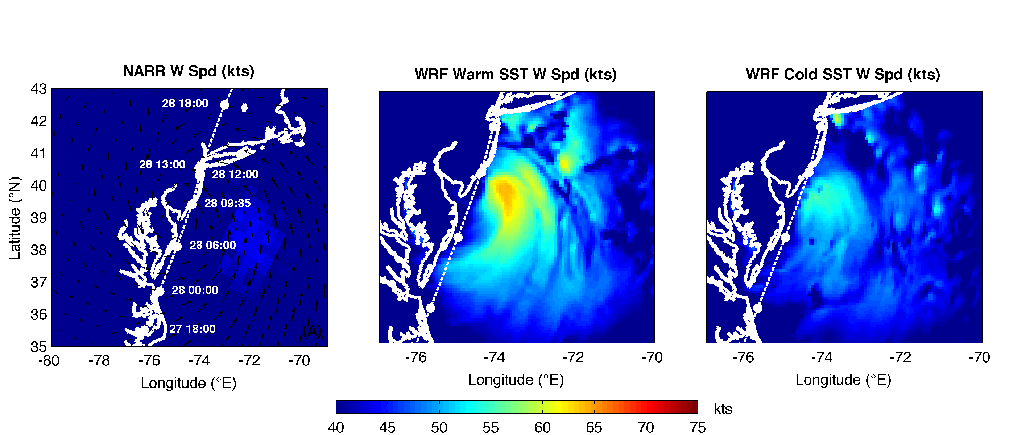
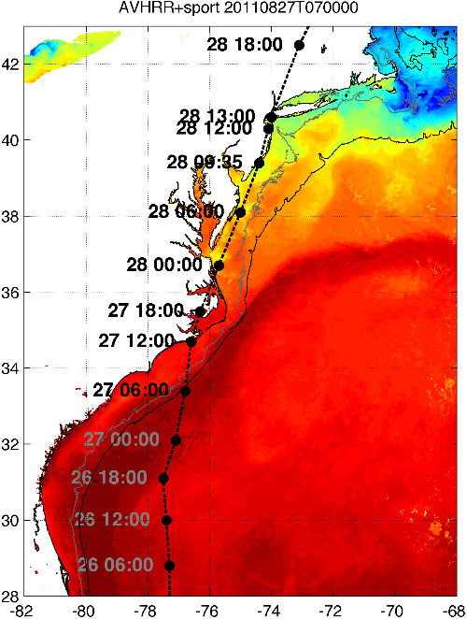
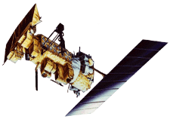

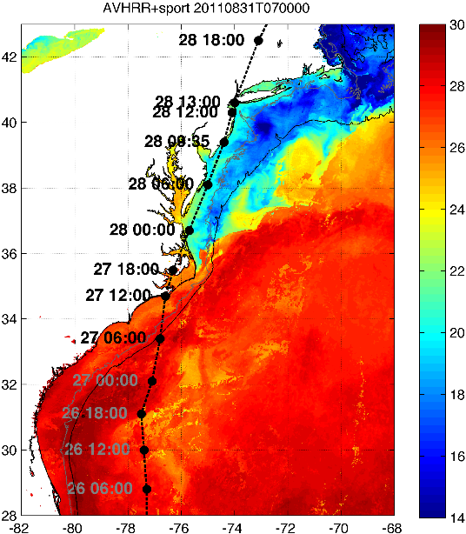

Rutgers Atmospheric Forecast Sensitivity Study
Warm Ocean
Boundary Condition
Cat 1 Hurricane
Tropical Storm
Cold Ocean
Boundary Condition
IMPACT?
>10 knots reduction in peak wind speed
Notes:
76-94% cooling ahead-of-eye
Average = 84% cooling ahead-of-eye

Slide 16
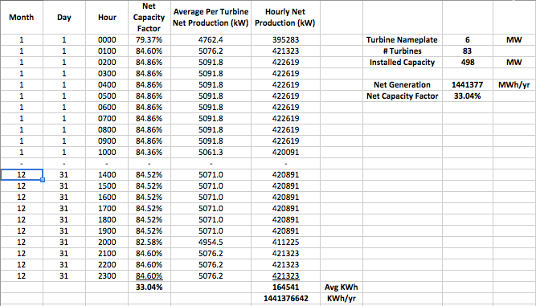
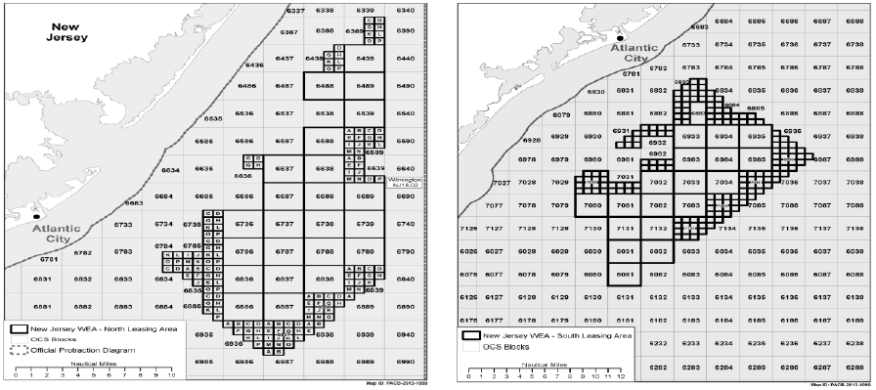
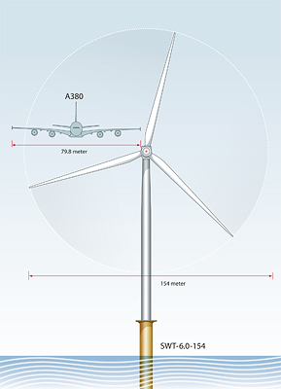
“Hypothetical” Wind Farm Production Data
Scenarios: 1100, 2000, 3000 MW; 8X10, 10X12, 10X15
Data: Hourly Net Capacity Factors, Hourly Power Production(KW), Total Annual Energy Produced (MWh) aggregated over the entire WTG array.
North Zone
6 MW WTG
South Zone

Slide 17
Rutgers Offshore Wind integrated modeling platform
Atmospheric Models
Economic Models
Environmental Models
Electricity Market Model
NJ Macroeconomic Model
2. Hourly
Wind
Turbine
Energy
Production
(MWh)
DMCS
3. PJM
Energy UC &
Dispatch
(Dayzer)
CEEEP
9. Reduced
Air Emissions including CO₂ & GHGs - and related
Health Impacts
SEBS
5. Wholesale
OSW
Electricity
Revenue
($/MWh)
CEEEP
Specific OSW application
4. PJM
Capacity
Model
($/MW-day)
CEEEP
7. OREC ∆
Cost
($/MWh)
CEEEP
-
11. Market
Impacts
RECON
6. Wholesale
OSW
Electricity
Cost
($/MWh)
CEEEP
+
10. Air Pollutants
Non-
Market
Impacts
SEBS
1. Hourly
Wind
Speeds
DMCS
=
8. NJ State
Economic
Impact
RECON
12. Net
Impacts
RECON & CEEEP

Slide 18
Future Opportunities
Validation of the full 5+ year time-series by an independent entity.
Characterize interannual and event-scale variability in the WEA.
Quantify the impact of the above variability on economic and environmental models.

Slide 20
NEW JERSEY’S OFFSHORE WIND RESOURCE
Innovative Sea Breeze Analyses
New Jersey Board of Public Utilities (NJBPU)
Tropical Cyclone Modeling
Rutgers Center for Ocean Observation Leadership (RU-COOL)
Rutgers Dept. of Marine and Coastal Sciences (DMCS)
New Ocean Data
Hi-Res Weather Model
Spatial Validation Data
Wind Power Statistics

Slide 21
NJ Board of Public Utilities Wind Energy Modeling Reports
Key Findings:
A high resolution wind model has been developed and validated for the NJ WEA.
The wind resource off of New Jersey is very conducive to energy development.
Wind is highly variable in space and time due to year round coastal storms and seabreeze’s during peak energy demand.
Notes:
Box around each

Slide 22
Future Opportunities
Validation of the full 5+ year time-series by an independent entity.
Characterize interannual and event-scale variability in the WEA.
Quantify the impact of the above variability on economic and environmental models

