Slide 1




2nd Workshop on Coastal Ocean Radar Network (CORNet)
Wuhan, China
17-18 April 2016
HF Radar Applications in the Coastal Ocean
Scott Glenn & Hugh Roarty
Rutgers University
Academic – Industry Partnership Since 1998

Slide 2
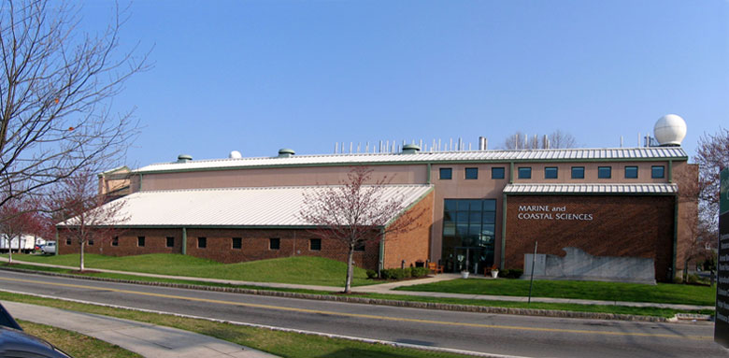
25 Years of Ocean Observing at:
Rutgers University (RU)
Center for Ocean Observation Leadership (COOL)
Department of Marine and Coastal Sciences (IMCS)
New Brunswick, New Jersey, USA
http://rucool.marine.rutgers.edu
Dr. Scott Glenn
Distinguished Professor
MARACOOS Principal Investigator
National HF Radar Steering Committee
glenn@marine.rutgers.edu
Dr. Hugh Roarty
Operations Center Director
MARACOOS HFR Coordinator
Global HF Radar Network Chair
hroarty@marine.rutgers.edu

Slide 3
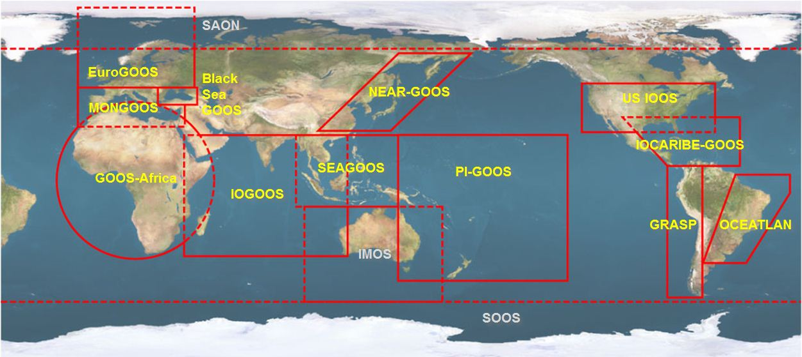





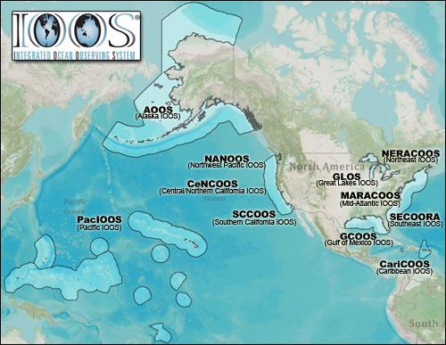













U.S. Integrated Ocean Observing System (IOOS)
Global Component
National Component
Regional Component
15 Regional Alliances in GOOS
Vessels -
Satellite
Satellite
CODAR
Ships/ Vessels
Glider
REMUS
Data Vis.
Modeling
Security
Leadership
Education
11 Regional Associations
17 U.S. Federal Agencies
Serving Society & Science
http://ioos.gov

Slide 4
















RI
U..
Middle Atlantic
Regional Association
Coastal
Ocean Observing System
78 Million People (1/4 of U.S.)
1000 km Cape to Cape
CT
Cape
Cod
MA
NY
PA
NJ
MARACOOS:
A Sustained Real-time Observation & Forecast System
DE
MD
>40 PIs
>20 Institutions
>50 Members
>2000 Contacts
Scott Glenn + Many
VA
NC
Cape
Hatteras
Notes:
4

Slide 5
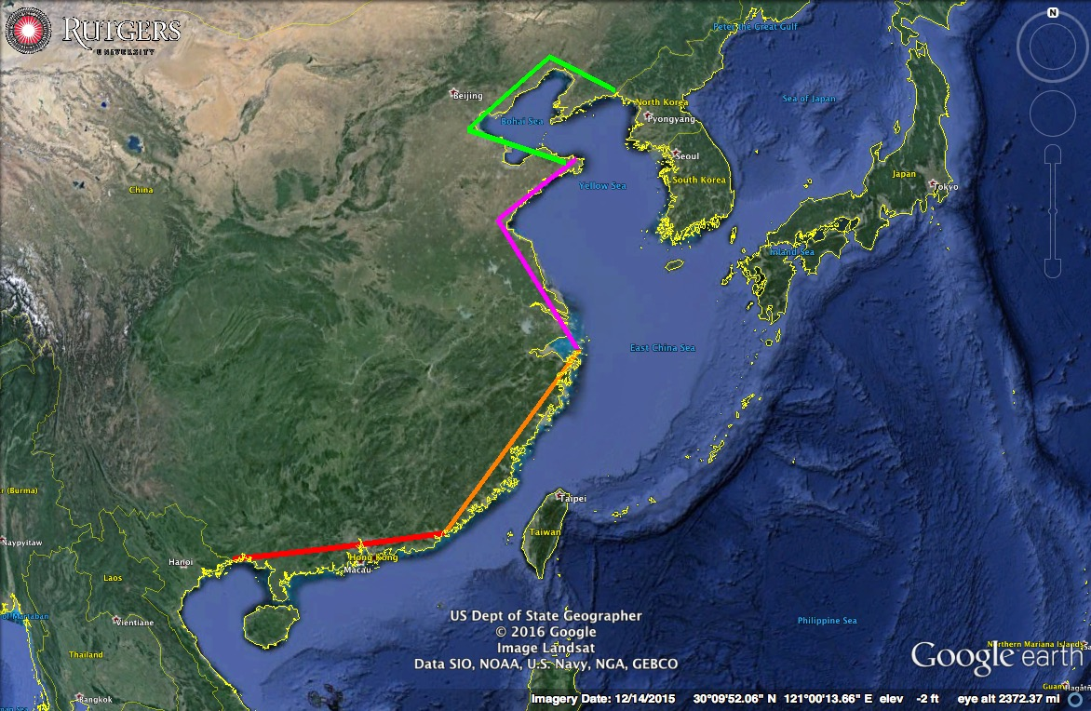
Coastal China:
Four ~1000 km
Regional Segments

Slide 6
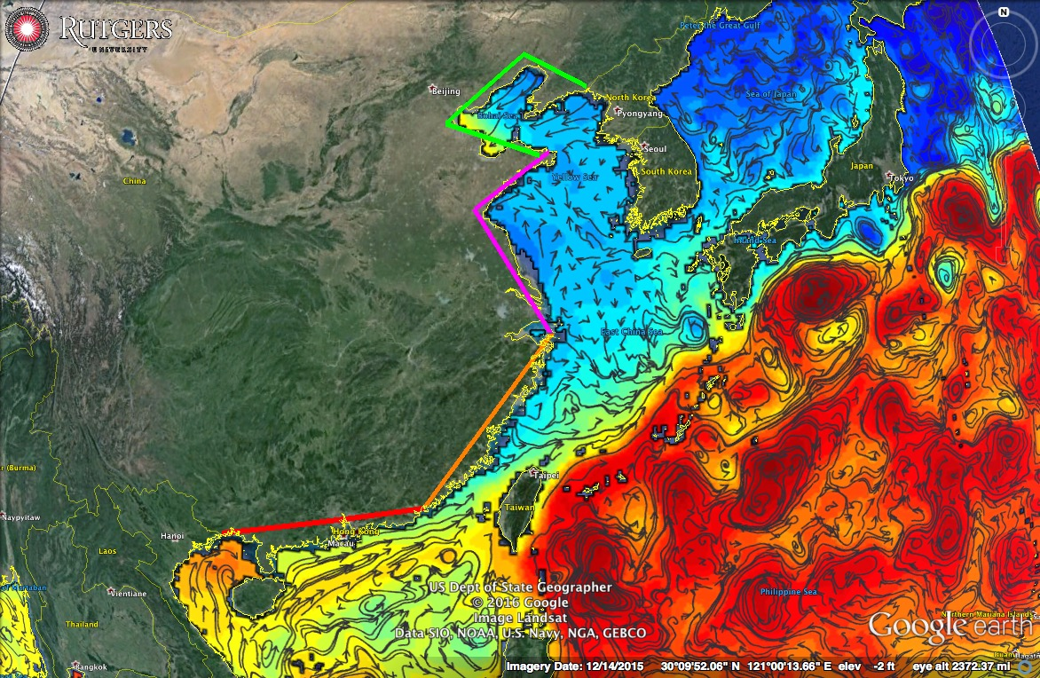
Coastal China:
Four ~1000 km
Regional Segments

Slide 7
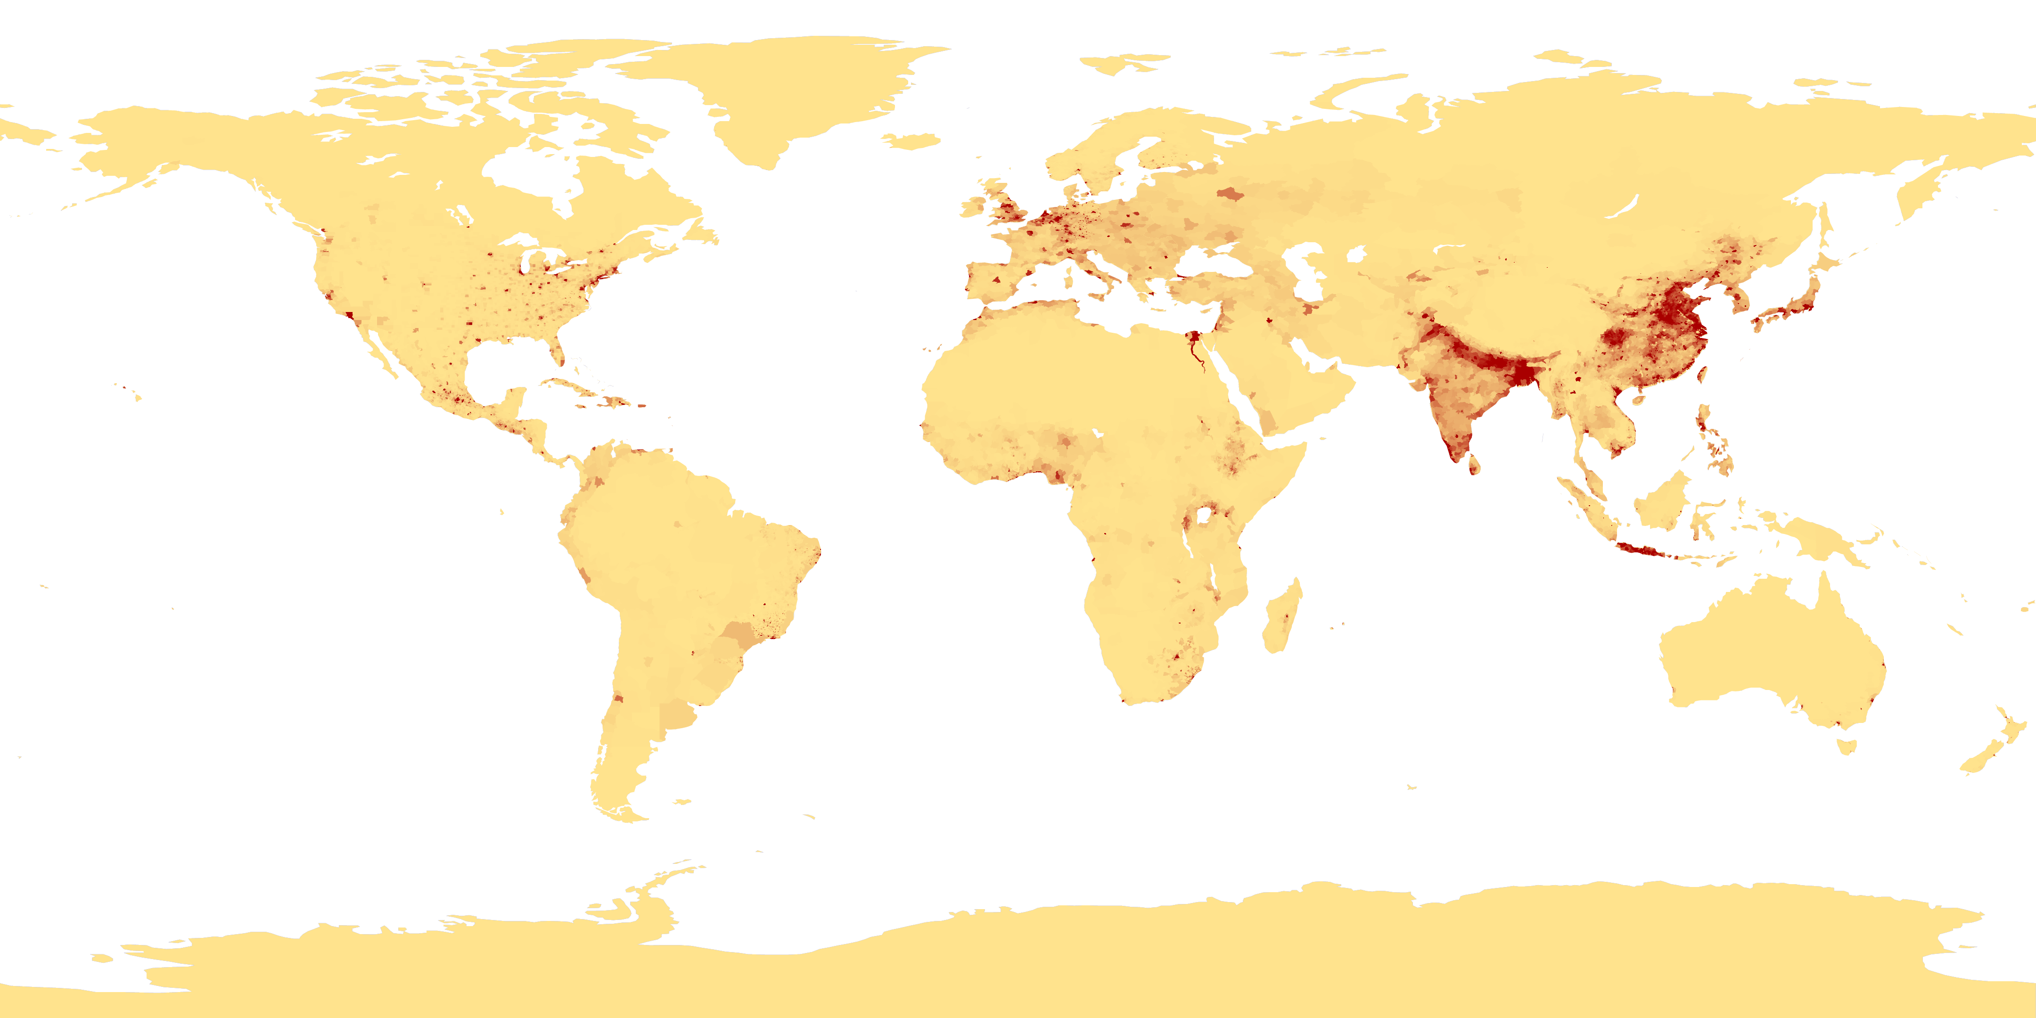
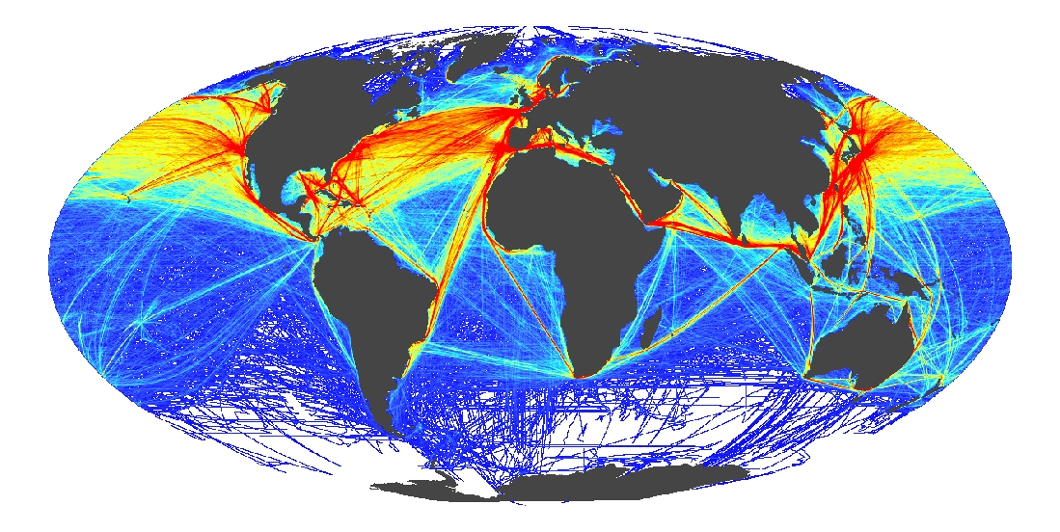
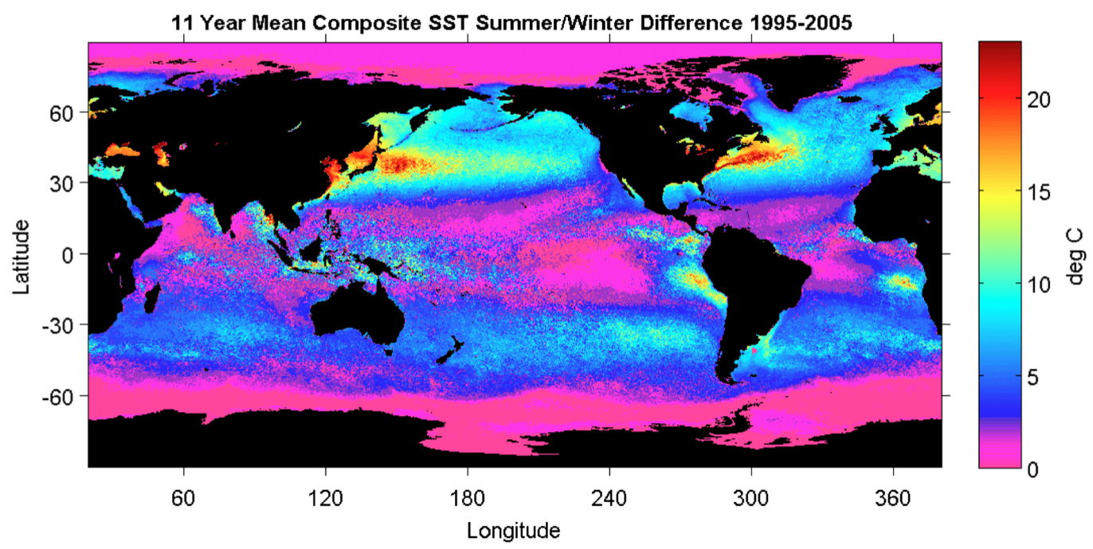
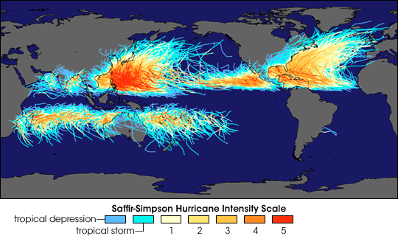
Global Drivers
Coastal Population Centers
International Commerce
Ocean Seasonality
Tropical Cyclones

Slide 8
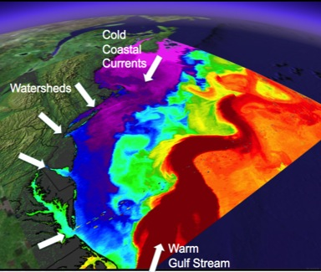
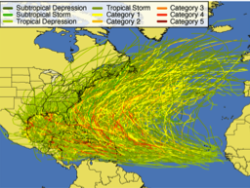
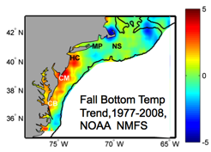
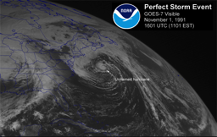
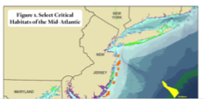
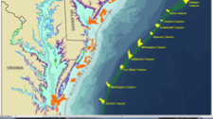
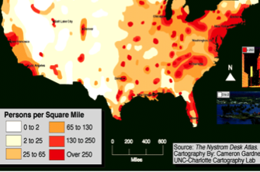
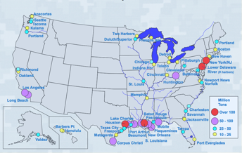
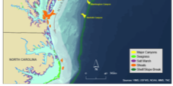
MID-ATLANTIC REGIONAL DRIVERS
Tropical Storms
Climate Change
Ocean Circulation
Critical Habitat
Northeasters
Population
Ports

Slide 9
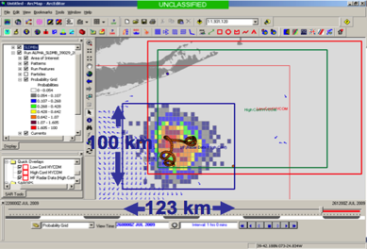
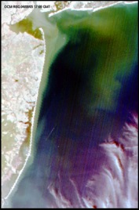
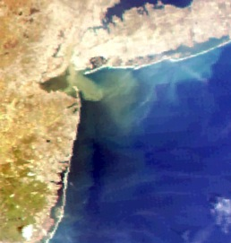
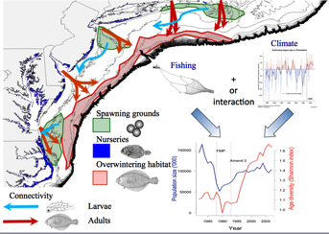
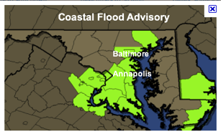
MARACOOS REGIONAL RESPONSE THEMES
1) Maritime Operations – Safety at Sea
3) Water Quality – a) Floatables, b) Hypoxia, c) Nutrients
2) Ecosystem Decision Support - Fisheries
5) Energy – Offshore Wind
4) Coastal Inundation - Flooding

Slide 10
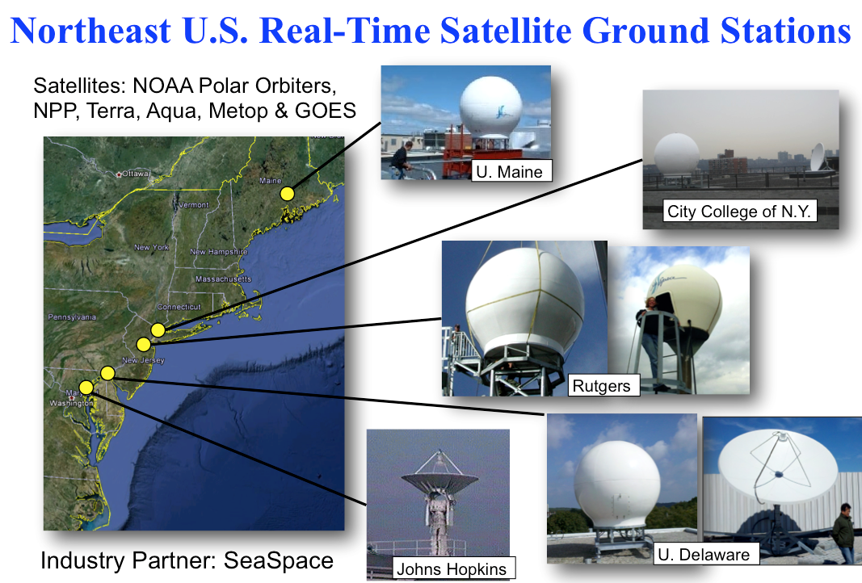
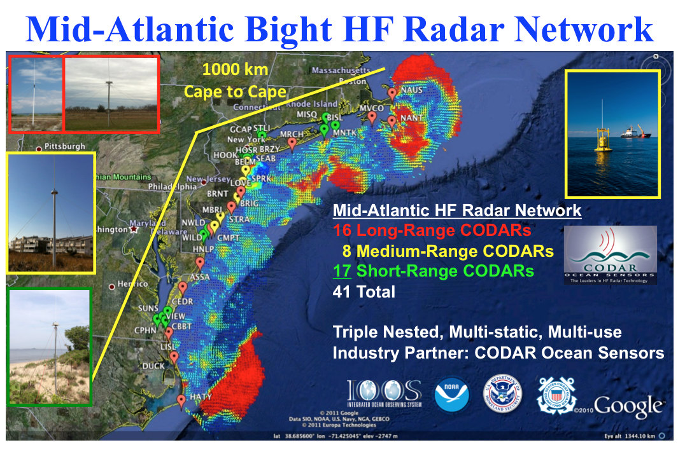
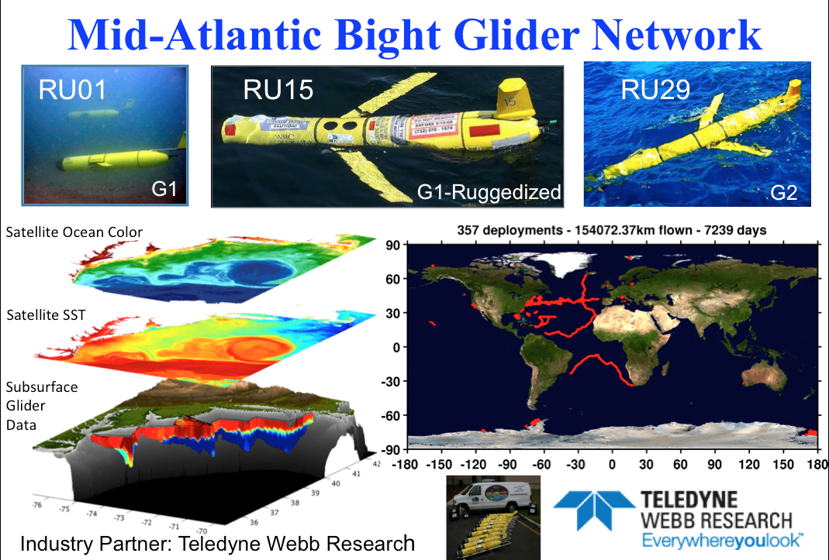
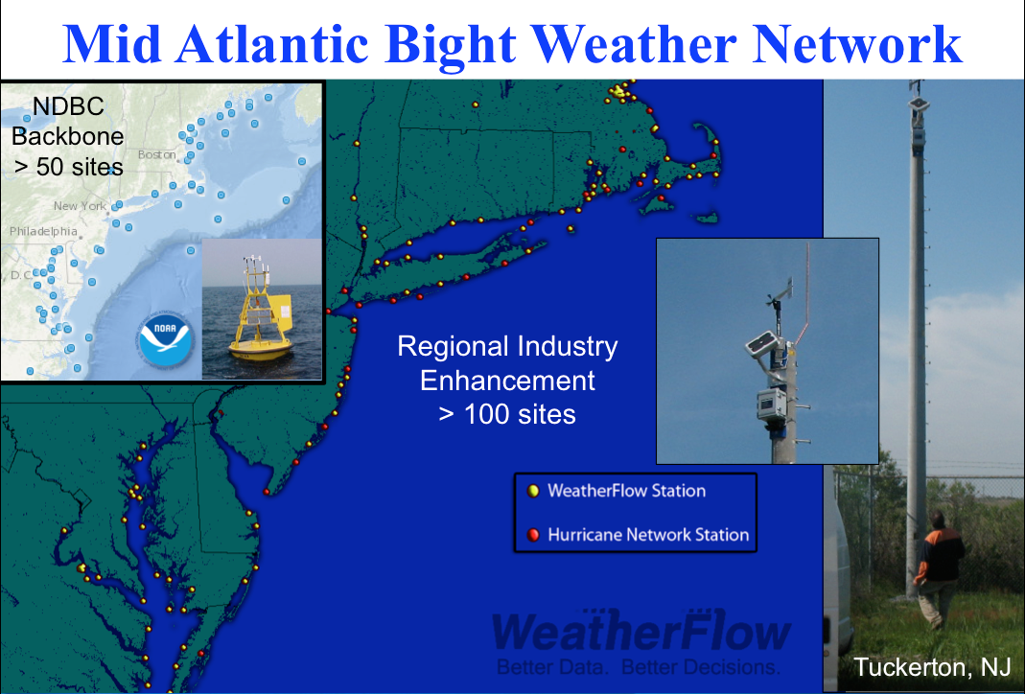
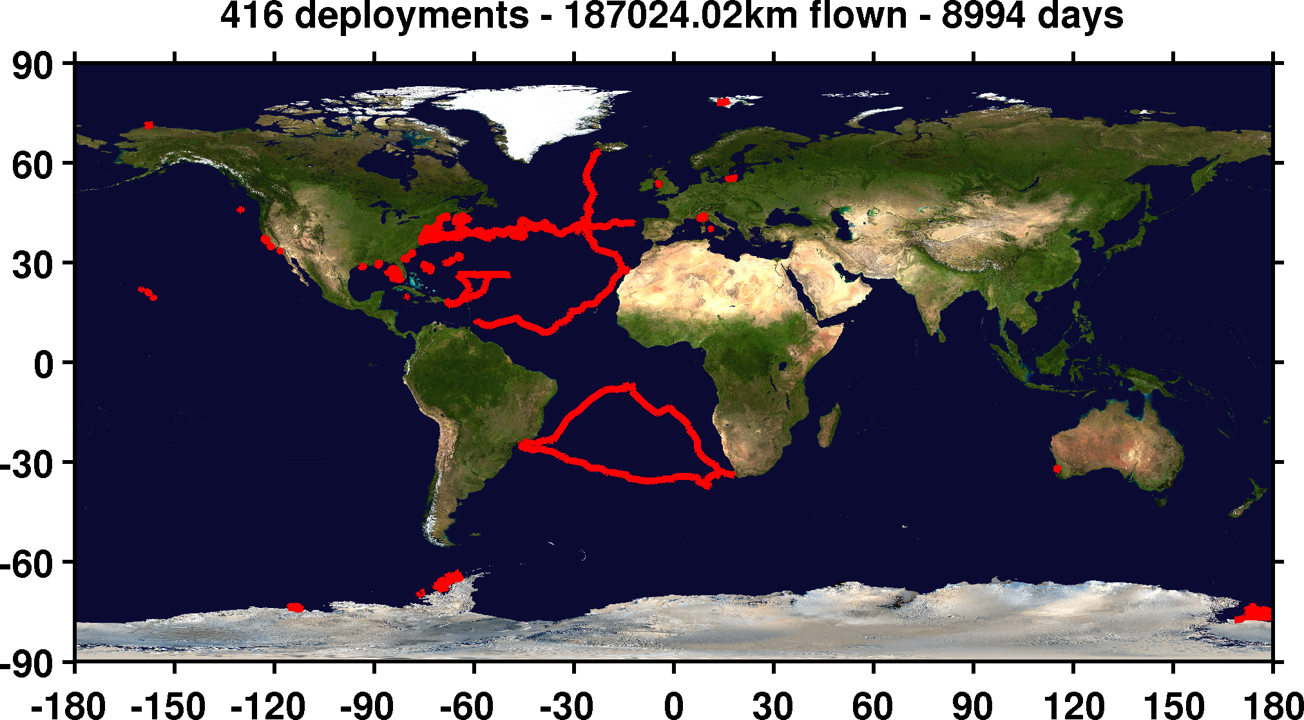

Mid-Atlantic Regional-Scale Observation Network

Slide 11
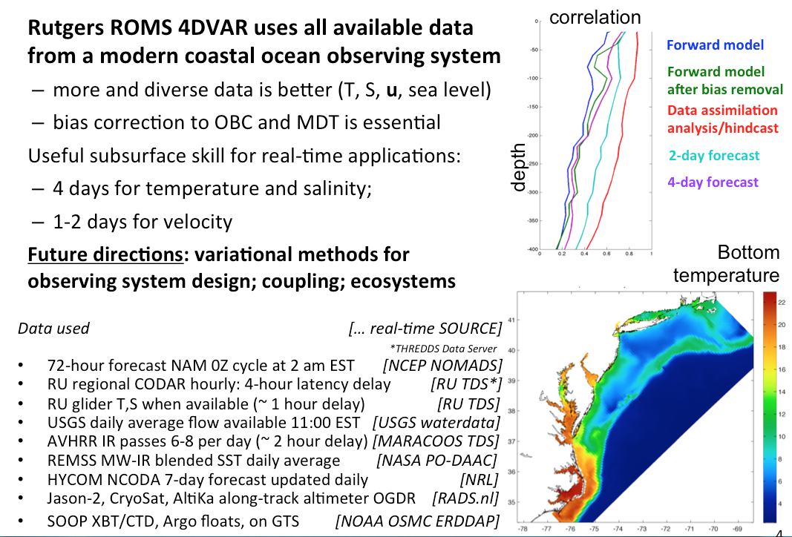
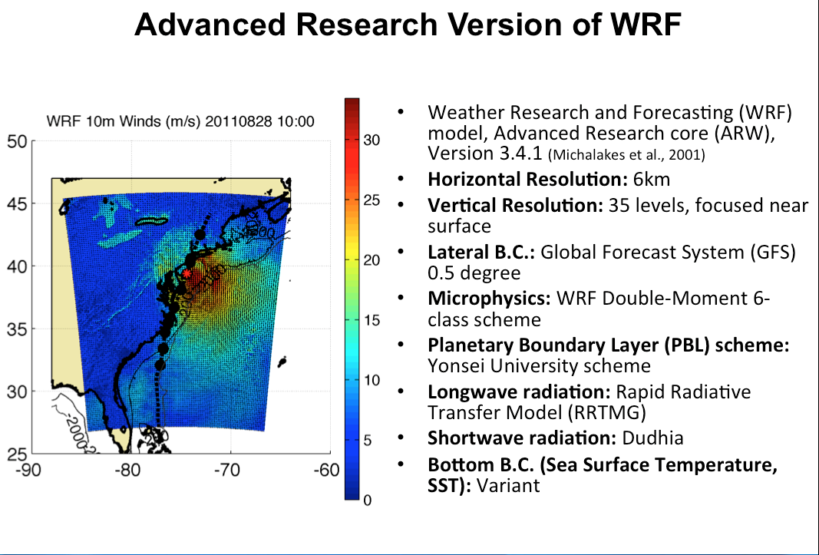

Mid-Atlantic Ensemble of Forecast Models Include:
Mid-Atlantic Operations Center @

Slide 12






Integration Matrix: Capabilities Support Multiple Themes
Regional Priority Themes | Regional Observation & Modeling Capabilities
 | Weather Mesonet | HF Radar Network | Statistical STPS | Satellite Imagery | Glider Surveys | Dynamical Ocean Forecasts
Theme 1. Maritime Safety | Operational Input to USCG SAROPS | Operational input to USCG SAROPS | Operational input to USCG SAROPS | SST for survivability planning | Assimilation dataset for forecast models | Surface currents for SAROPS
Theme 2. Ecological Decision Support | Weather forecast ensemble validation | Circulation and divergence maps for habitat |  | SST & Color for habitat | Subsurface T & S for habitat | 3-D fields of T, S, circulation for habitat
Theme 3. Water Quality | Winds for transport, river plumes, & upwelling | Surface currents for floatables, bacteria, spill response | Surface currents for floatables, bacteria, spill response | Ocean color for river plumes | Nearshore dissolved oxygen surveys | Surface currents for floatables, bacteria, spill response
Theme 4. Coastal Inundation | Weather forecast ensemble validation | Current forecast model validation |  | SSTs assimilation into forecast models | Assimilation dataset for forecast models | Nested forecast ensembles
Theme 5. Offshore Energy | Historical analysis & wind model validation | Historical current analysis & wind model validation |  | Historical analysis surface fronts & plumes for siting | Historical analysis of subsurface fronts & plumes | Coupled ocean-atmosphere models for resource estimates

Slide 13
Integration Matrix: Capabilities Support Multiple Themes
Regional Priority Themes | Regional Observation & Modeling Capabilities
 | Weather Mesonet | HF Radar Network | Statistical STPS | Satellite Imagery | Glider Surveys | Dynamical Ocean Forecasts
Theme 1. Maritime Safety | Operational Input to USCG SAROPS | Operational input to USCG SAROPS | Operational input to USCG SAROPS | SST for survivability planning | Assimilation dataset for forecast models | Surface currents for SAROPS
Theme 2. Ecological Decision Support | Weather forecast ensemble validation | Circulation and divergence maps for habitat |  | SST & Color for habitat | Subsurface T & S for habitat | 3-D fields of T, S, circulation for habitat
Theme 3. Water Quality | Winds for transport, river plumes, & upwelling | Surface currents for floatables, bacteria, spill response | Surface currents for floatables, bacteria, spill response | Ocean color for river plumes | Nearshore dissolved oxygen surveys | Surface currents for floatables, bacteria, spill response
Theme 4. Coastal Inundation | Weather forecast ensemble validation | Current forecast model validation |  | SSTs assimilation into forecast models | Assimilation dataset for forecast models | Nested forecast ensembles
Theme 5. Offshore Energy | Historical analysis & wind model validation | Historical current analysis & wind model validation |  | Historical analysis surface fronts & plumes for siting | Historical analysis of subsurface fronts & plumes | Coupled ocean-atmosphere models for resource estimates

Slide 14
Integration Matrix: Capabilities Support Multiple Themes
Regional Priority Themes | Regional Observation & Modeling Capabilities
 | Weather Mesonet | HF Radar Network | Statistical STPS | Satellite Imagery | Glider Surveys | Dynamical Ocean Forecasts
Theme 1. Maritime Safety | Operational Input to USCG SAROPS | Operational input to USCG SAROPS | Operational input to USCG SAROPS | SST for survivability planning | Assimilation dataset for forecast models | Surface currents for SAROPS
Theme 2. Ecological Decision Support | Weather forecast ensemble validation | Circulation and divergence maps for habitat |  | SST & Color for habitat | Subsurface T & S for habitat | 3-D fields of T, S, circulation for habitat
Theme 3. Water Quality | Winds for transport, river plumes, & upwelling | Surface currents for floatables, bacteria, spill response | Surface currents for floatables, bacteria, spill response | Ocean color for river plumes | Nearshore dissolved oxygen surveys | Surface currents for floatables, bacteria, spill response
Theme 4. Coastal Inundation | Weather forecast ensemble validation | Current forecast model validation |  | SSTs assimilation into forecast models | Assimilation dataset for forecast models | Nested forecast ensembles
Theme 5. Offshore Energy | Historical analysis & wind model validation | Historical current analysis & wind model validation |  | Historical analysis surface fronts & plumes for siting | Historical analysis of subsurface fronts & plumes | Coupled ocean-atmosphere models for resource estimates

Slide 15
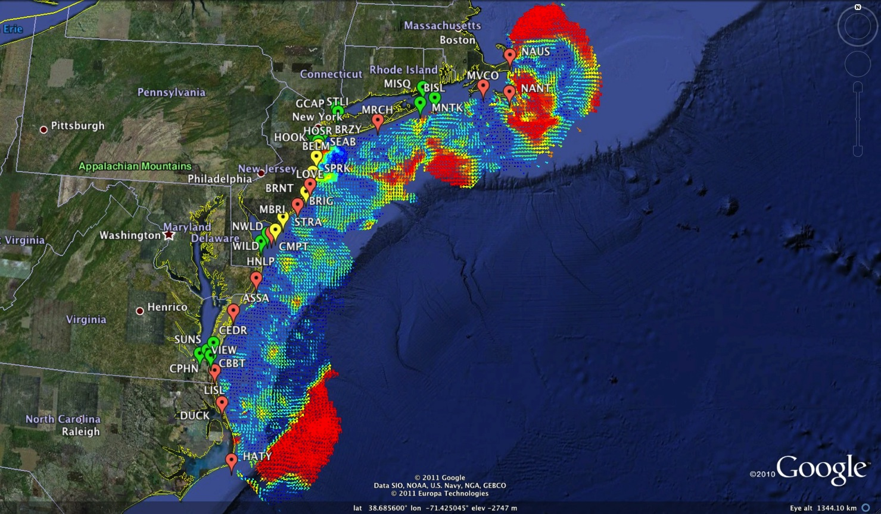
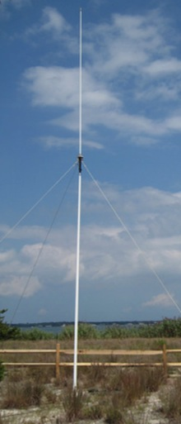
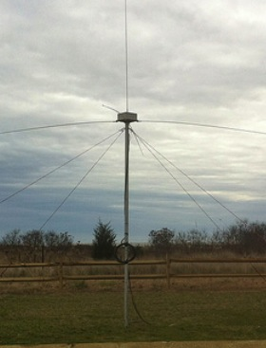
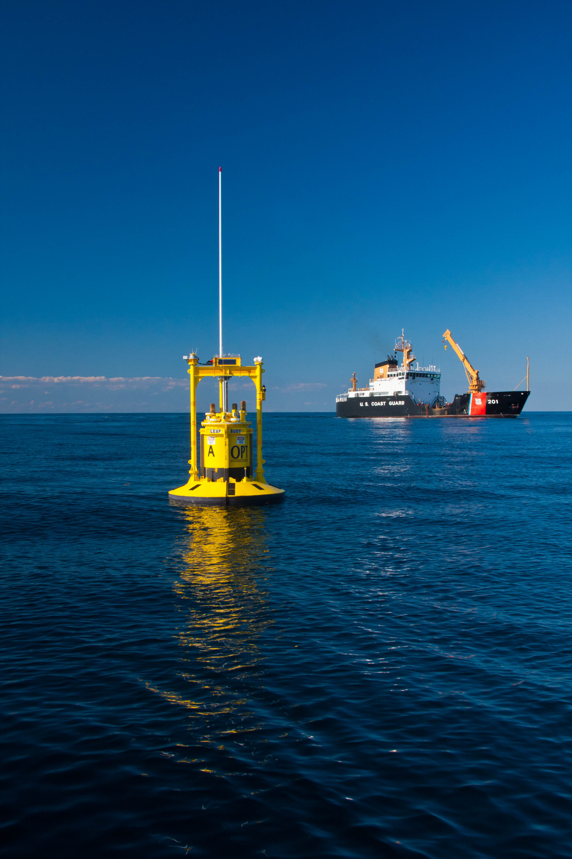
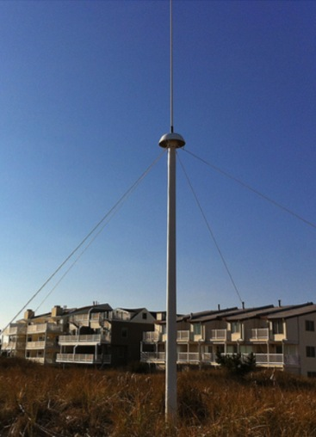
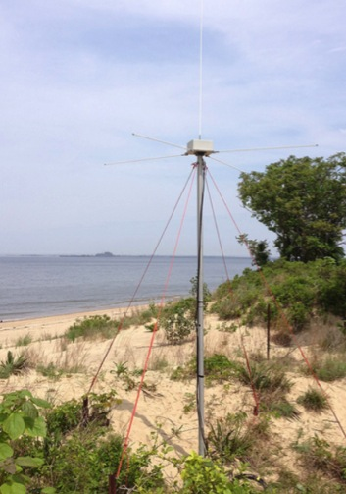
Mid-Atlantic Bight HF Radar Network
1000 km
Cape to Cape
Mid-Atlantic HF Radar Network
17 Long-Range CODARs
7 Medium-Range CODARs
17 Short-Range CODARs
41 Total CODARs in Region
+5 CODARs outside Region
46 Total CODARs
Triple Nested, Multi-static, Multi-use
Industry Partner: CODAR Ocean Sensors

Slide 16
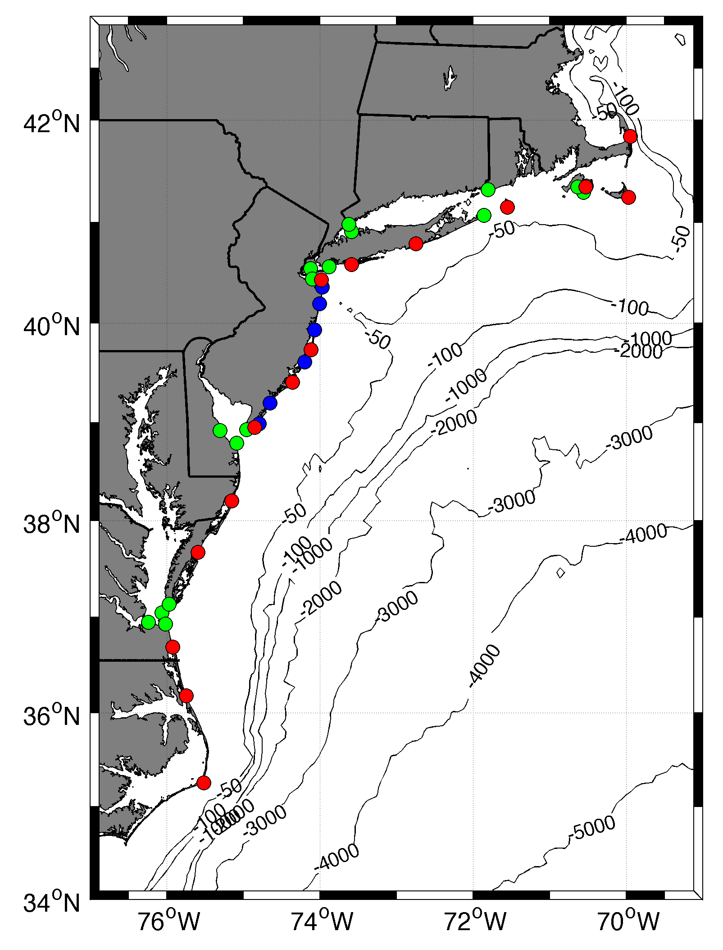










MARACOOS
HF Radar Network:
Distributed Site Ownership
 | 5 MHz | 13 MHz | 25 MHz
U Mass
WHOI
U Conn
URI
Stevens
Rutgers
Delaware
ODU/CIT
UNC
10 | 17 | 7 | 17
10 Organizations
41 Stations Total in Region

Slide 17
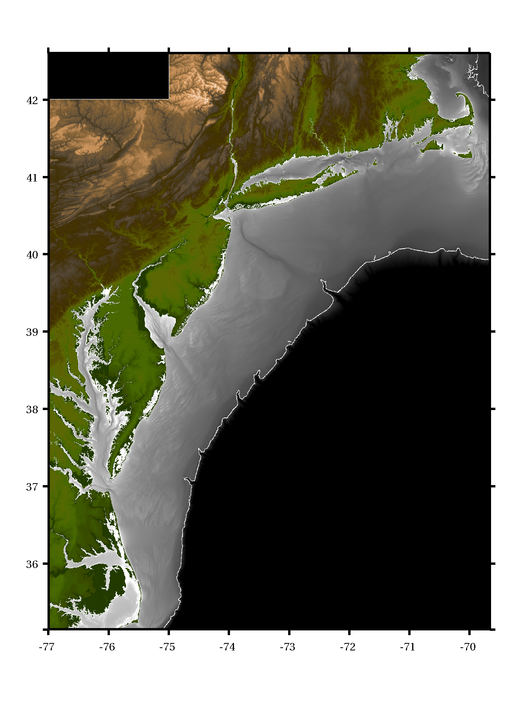





MARACOOS
HF Radar Network:
Distributed Site Support
Northern
Operator
Regional Coordinator
Dr. Hugh Roarty
Distributed Technicians
Matt Grossi
Todd Fake
Ethan Handel
Teresa Updyke
Central
Operator
Southern
Operator

Slide 18
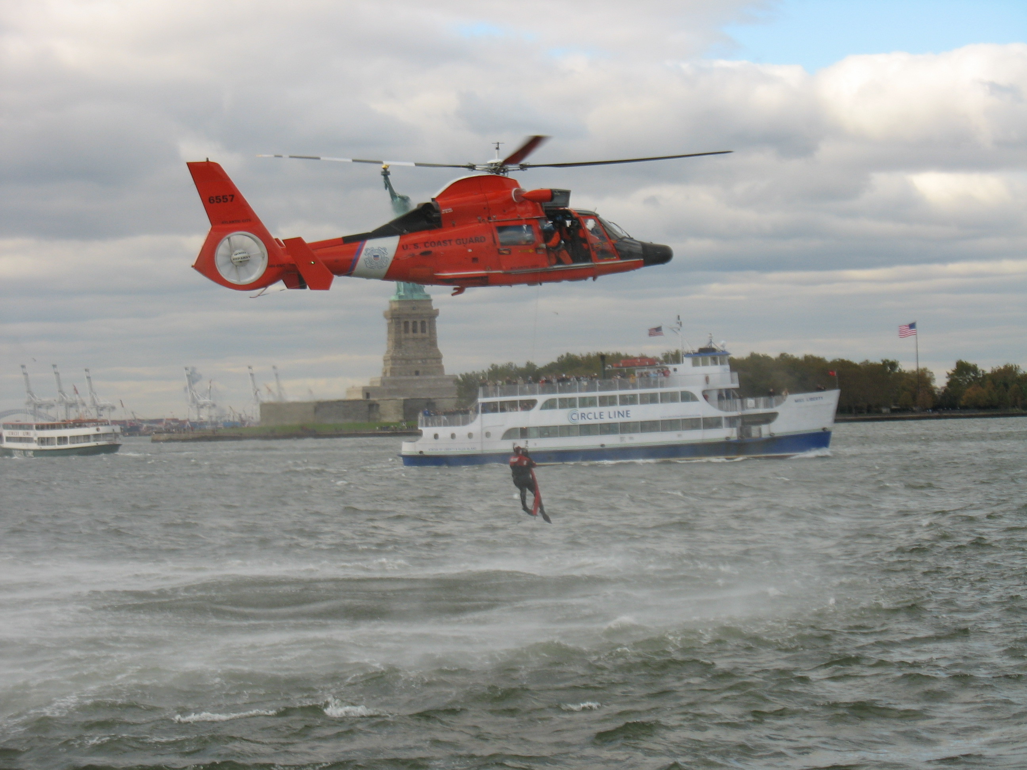
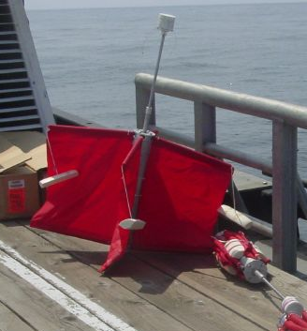
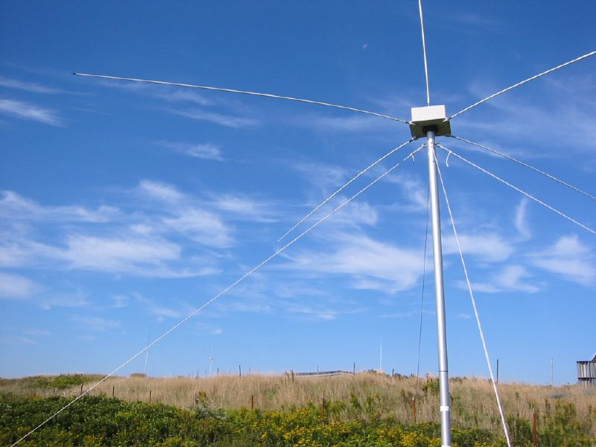
Success Stories – Making a Difference
Optimizing HF Radar for SAR using USCG Surface Drifters
Art Allen
U.S. Coast Guard
Scott Glenn
Rutgers University
Mid-Atlantic Regional Association
Coastal Ocean Observing System

Slide 19

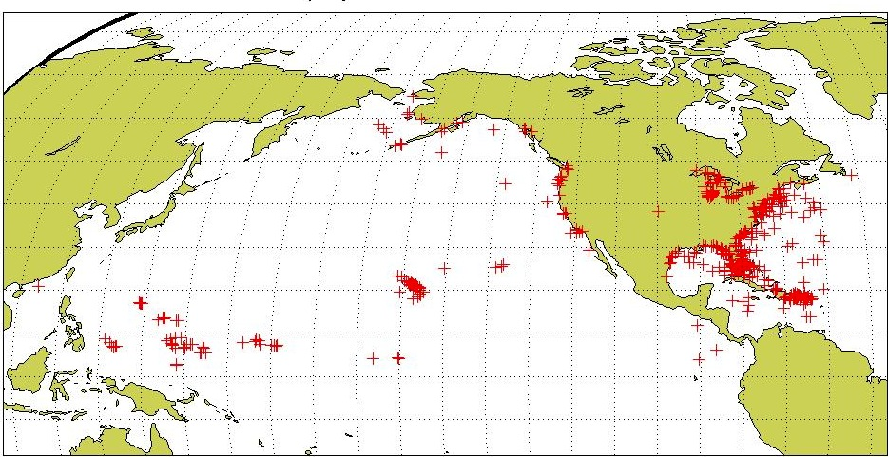
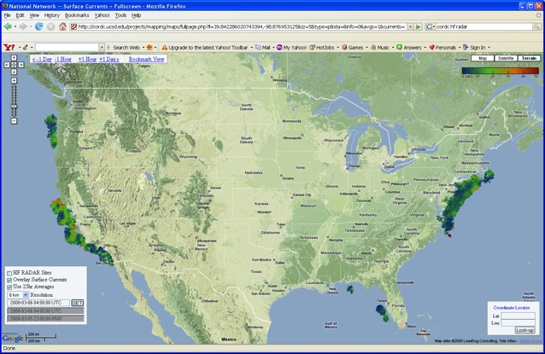
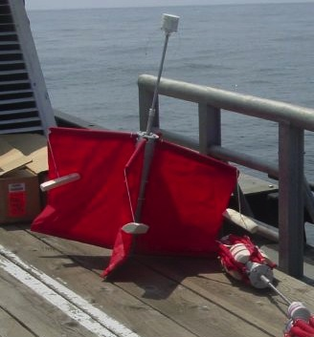
Self-Locating Data Marker Buoy
(SLDMB) Deployments
1 Jan 2006 – 31 Dec 2007
Notes:
Here are the initial deployment positions for our SLDMBs. From these records we selected only those that exceeded 4 days in length

Slide 20
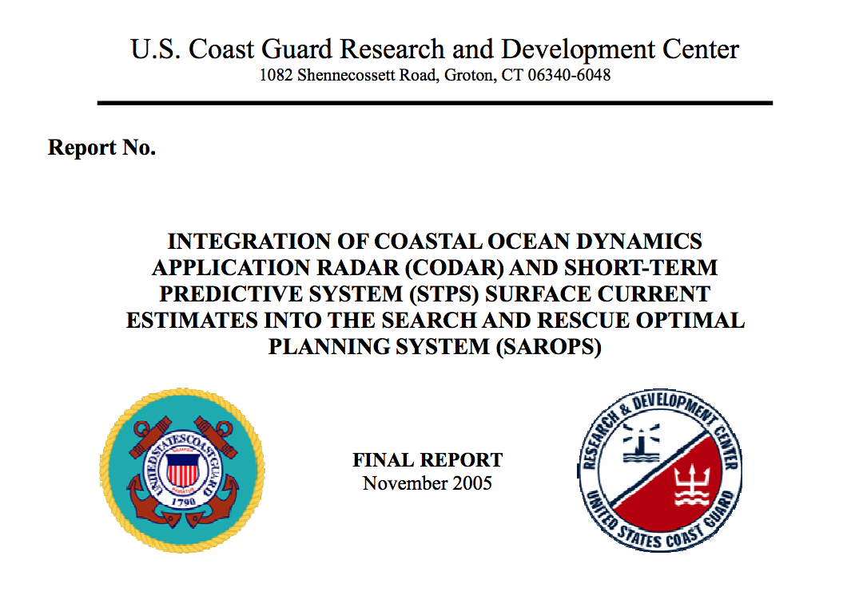

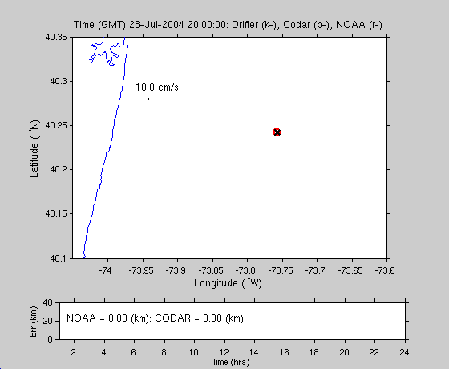
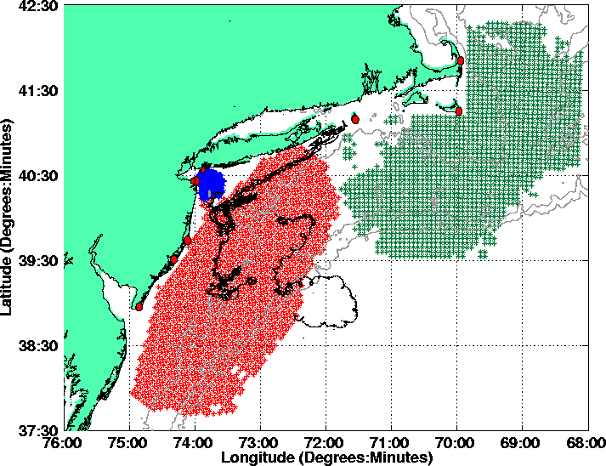
USCG Search And Rescue
Status 2004
Can HF Radar provide improved estimates of the location of SLDMB?

Slide 21
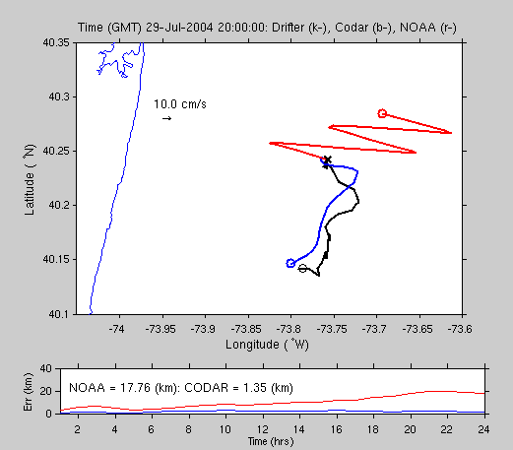
USCG Search And Rescue
Status 2004
Can HF Radar provide improved estimates of the location of SLDMB?

Slide 22
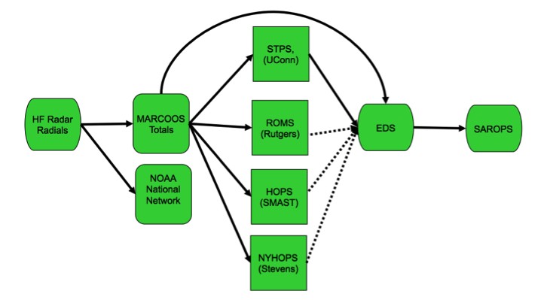
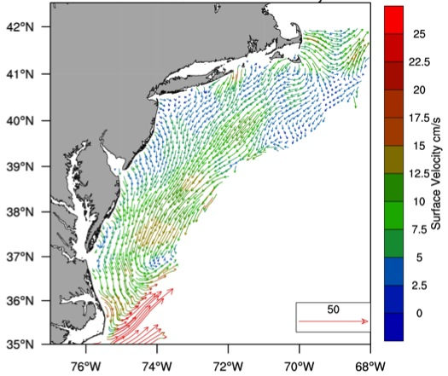



Transition Objective –
Operational Use of HF Radar Surface Currents for Search And Rescue
Surface Currents
Data Acquisition
Data Product Generation & Management
Search And Rescue Optimal Planning System (SAROPS)

Slide 23


5000 Virtual Drifters –
Search Area After 96 Hours
154 km
100 km
232 km
123 km
HYCOM
36,000 km²
CODAR
12,000 km²
Notes:
HYCOM (Low Conf) 48 hours

Slide 24

May 4, 2009: After a year of testing, NOAA Announces on
U.S. Department of Commerce Website that
MARACOOS CODAR is Operational in SAROPS
2009-2010 Activity:
Bring all
sustained regional-scale HFR networks up to operational status in USCG SAROPS
3 West Coast Regions for
California & Oregon are ready.

Slide 25


2010 Deepwater Horizon Oil Spill
Oil Transport Questions: Will the oil….
Come ashore in Louisiana?
Spread east to Texas or west to Mississippi, Alabama and Florida pan handle in the wind-driven coastal currents?
Enter the Loop Current and be transported downstream?
Hit the Florida Shelf and be driven shoreward by winds?
Ride the Loop Current south and hit the Florida Keys?
Be transported out of the Gulf of Mexico by the Gulf Stream and impact the East Coast?
Gulf of Mexico

Slide 26





Responding to Crisis: Deepwater Horizon
U.S. IOOS partnership demonstrated ability to:
Quickly deploy technologies: Gliders and HF radar, saving resources/improving safety
Models/Imagery ingested into NOAA/Navy models
Data assimilation improved spill response decision-making and public understanding
USM HFR
USF HFR
June 2
HFR validation of SABGOM Forecast combined with satellite detected oil slicks
Briefing Blog
127 Briefs
Web Portal
HFR data informed NOAA
trajectory forecasts

Slide 27
Feedback from the Deepwater Horizon
Incident Command Center
Composite of Satellite Observed Oil Spill Locations
“All - Greetings from Unified Area Command in New Orleans. I couldn't agree more - the IOOS community has acquitted itself very well during this entire incident. Not only has everyone provided valuable information - you have done it without getting in the way of the ongoing operations. It's been a pleasure to represent IOOS here and see all the great contributions from the larger IOOS community. “
- Sam Walker (IOOS representative to Deepwater Horizon Unified Command Center), June 18, 2010
“… AWESOME JOB - that call that we had last week was a very good thing. You are taking a huge burden off of the team here who is trying to simply capture the deluge of assets now being deployed. “
- Sam Walker (IOOS representative to Deepwater Horizon Unified Command Center), July 2, 2010
“…Thanks to everyone for all of your efforts to support the Response and the very professional and competent manner in which you have executed your efforts. IOOS has played a huge role in informing the modeling teams and the Unified Command through your extraordinary service. “
- Sam Walker (IOOS representative to Deepwater Horizon Unified Command Center), August 6, 2010

Slide 28

Feedback from the Deepwater Horizon
Incident Command Center
DHS S&T Impact Award
Composite of Satellite Observed Oil Spill Locations
“All - Greetings from Unified Area Command in New Orleans. I couldn't agree more - the IOOS community has acquitted itself very well during this entire incident. Not only has everyone provided valuable information - you have done it without getting in the way of the ongoing operations. It's been a pleasure to represent IOOS here and see all the great contributions from the larger IOOS community. “
- Sam Walker (IOOS representative to Deepwater Horizon Unified Command Center), June 18, 2010
We did not get in the way
“… AWESOME JOB - that call that we had last week was a very good thing. You are taking a huge burden off of the team here who is trying to simply capture the deluge of assets now being deployed. “
- Sam Walker (IOOS representative to Deepwater Horizon Unified Command Center), July 2, 2010
We reduced the burden
“…Thanks to everyone for all of your efforts to support the Response and the very professional and competent manner in which you have executed your efforts. IOOS has played a huge role in informing the modeling teams and the Unified Command through your extraordinary service. “
- Sam Walker (IOOS representative to Deepwater Horizon Unified Command Center), August 6, 2010
We informed modeling teams & leadership

Slide 29

From Page 10:
Also in support of oil spill response, NOAA requests a $5.0 million increase to implement the U.S. Integrated Ocean Observing System (IOOS®) Surface Current Mapping Plan using high frequency (HF) radar surface current measurements. HF radar provides information vital to oil spill response, national defense, homeland security, search and rescue operations, safe marine transportation, water quality and pollutant tracking, and harmful algal bloom forecasting.
www.legislative.noaa.gov/Testimony/Lubchenco033111.pdf

Slide 30


Hurricane Irene
August 28, 2011
NOAA/NHC Damage:
#7 with >$16 Billion.
Track Accurate;
Intensity Over-predicted.
Avila & Cangialosi, 2012, Tropical Cyclone Report
Hurricane Sandy
October 29, 2012
NOAA/NHC Damage:
#2 with >$68 Billion.
Track Accurate;
Surge Under-predicted.
Georgas et al., 2014, J. of Extr. Even.
Colle et al., 2015, J. Mar. Sci. & Engr.

Slide 31


Hurricane Irene & Super-Typhoon Muifa:
What do these summer of 2011 storms have in common?
Hurricane Irene
26-29 August 2011
Super-Typhoon Muifa
26 July - 9 August 2011

Slide 32



Hurricane Irene Track August 26-29 2011
Two Gliders Deployed

Slide 33





Pre-Irene
Post-Irene
Difference
11C max Cooling
WHAT?
Satellite
SST
WHEN? Glider Temperature
WHY?
HF Radar
Currents
Eye Passage

Slide 34

Ahead-of-Eye-Center Cooling in Irene:
Nearshore Buoy Observations
After - Before
85%
80%
94%

Slide 35






Rutgers Atmospheric Forecast Sensitivity Study
Warm Ocean
Boundary Condition
Cat 1 Hurricane
Tropical Storm
Cold Ocean
Boundary Condition
IMPACT?
>10 knots reduction in peak wind speed
Notes:
76-94% cooling ahead-of-eye
Average = 84% cooling ahead-of-eye

Slide 36


Historical Hurricanes Crossing the
Middle Atlantic Bight Continental Shelf in Stratified Season

Slide 37

Historical Hurricanes Crossing the MAB in Stratified Season
Observed Ahead-of-Eye-Center Cooling
Storm-induced cooling in deep water is often equally distributed between the front and back half of the storm (Price et al., 1981)

Slide 38


Typhoon Muifa:
Ahead-of-Eye-Center Cooling
observed by Coastal Buoy
Muifa
Track
From: Fei Yu, Institute of Oceanology, Chinese Academy of Sciences
Yi Xu, State Key Laboratory of Estuarine & Coastal Research, East China Normal University

Slide 39
Hurricane Irene
August 26, 2011
Summer stratification
Coastal response
Mixing cooled surface
Limited intensity
Conclusion
Hurricane Sandy
October 29, 2012
After Fall transition
Single layer ocean
No mixing/cooling
No intensity reduction

Slide 40


Hurricane Irene
August 26, 2011
Glenn et al., Nat. Com., 2016
Hurricane Sandy
October 29, 2012
Miles et al., JGR, 2015

Slide 41





U.S. National HF Radar Network
June 2004
U.S. IOOS
HF Radar Data Flow
For US Coast Guard
Search And Rescue
Since 2007

Slide 42



Established the Radiowave Operators Working Group (ROWG)
At the 2004 Radiowave Oceanography Workshop (ROW)
in Townsville, Australia

Slide 43

Established the Radiowave Operators Working Group (ROWG)

Slide 44


Sustained HFR Network Operations
Annual Coverage and Mean: 2006 to 2012

Slide 45

Grid Points for USCG 80-80 Metric
U.S. Coast Guard
HF Radar Metric
Total Current Vectors:
80% Spatial Coverage
80% of the Time
USCG SAR Grid
National HFR Grid

Slide 46

2009
2010
2008

Slide 47


U.S. National HF Radar Network
Table 4: Full 5-Year Buildout. Estimated acquisition & maintenance costs.
Technician fully encumbered salary is
estimated at $130,000;
Purchase and deployment for DF HFRs,
LPA HFRs are $160,000 and $300,000,
respectively.
Two technicians for each 7 DF HFRs,
4 LPA HFRs, respectively.
September 2009
http://www.ioos.gov/hfradar/

Slide 48



Resilient CODAR Shore Site:
Shed, Enclosure, Tx/Rx, Comms, Power, GPS, AIS
monitor
computer & external hard drive
A.C. unit
UPS system
transmitter
receiver
Two lines of Communication
Shed
Enclosure
Lightning Protection

Slide 49

Acquisition & Installation and
Annual Technician Support cost
estimates based on the U.S.
National HF Radar Network
design parameters.
Active Spares Approach
Spares used to fill the largest gaps.
Improve data quality when all are running.
Improve network resiliency when one site goes down.
HFR Network Design Example:
1000 km / ( 75 km/segment )
= 13 Segments of Coast
Segment Color Key
Red > 90 km
90 km > Orange > 70 km
70 km > Green

Slide 50

Active Spares Approach
Spares used to fill the largest gaps.
Improve data quality when all are running.
Improve network resiliency when one site goes down.
AMAG
Segment Color Key
Red > 90 km
90 km > Orange > 70 km
70 km > Green
CORE

Slide 51

MARACOOS
Consistently Exceeds USCG 80-80 Metric
Through Improved Site Resiliency & Active Spares.
Accomplished with 1/2 of the U.S. IOOS (2009) Recommended Technician Support

Slide 52

U.S. National HF Radar Network Snapshot: April 11, 2016

Slide 53



Rutgers Operations Center is also a Training Center
Students navigate an underwater glider across the South Atlantic
Skype with a classroom in Spain
Viewing Live Video from the Ocean Floor

Slide 54





2013 High Frequency Radar Class @
University of Puerto Rico Mayaguez

Slide 55




National HF Radar Network in South Africa
National Planning Workshop 2014
HF Radar Course at University Cape Town 2015
Intensive Classroom & Field Program followed by Skype Sessions
HF Radar Deployment with SA Navy

Slide 56


HF Radar Network Lessons Learned:
Essential Collaboration began in 2003
Established ROWG to foster Technical Collaboration
Network Still Growing within an Integrated System
Free, Open & Sustained Access to Quality Data
Products Serve Multiple Societal & Science Needs
Operational Costs exceed Procurement Costs
Operational Cost Savings achieved by:
  National Data Server
  Regional Field Technology Centers
  Resilient & Active Spare Radar Sites
Workforce Training is Essential
Establish Noble Goals

