Slide 1
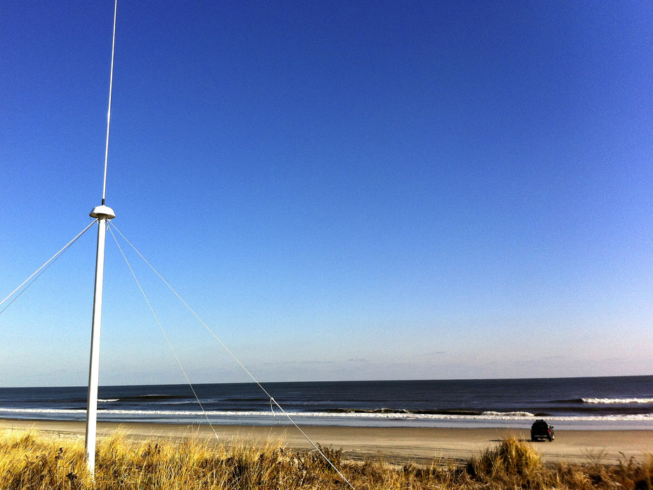
The Global High Frequency Radar Network
Dr. Hugh Roarty
Dr. Scott Glenn
Dr. Josh Kohut
Mr. Michael Smith
Mr. Ethan Handel
Mr. Colin Evans
Wuhan University
Radar & Signal Processing Lab
16 April 2016

Slide 2
High Frequency Radar
What Does It Measure
Where Is It Applied
What Are The Applications

Slide 3
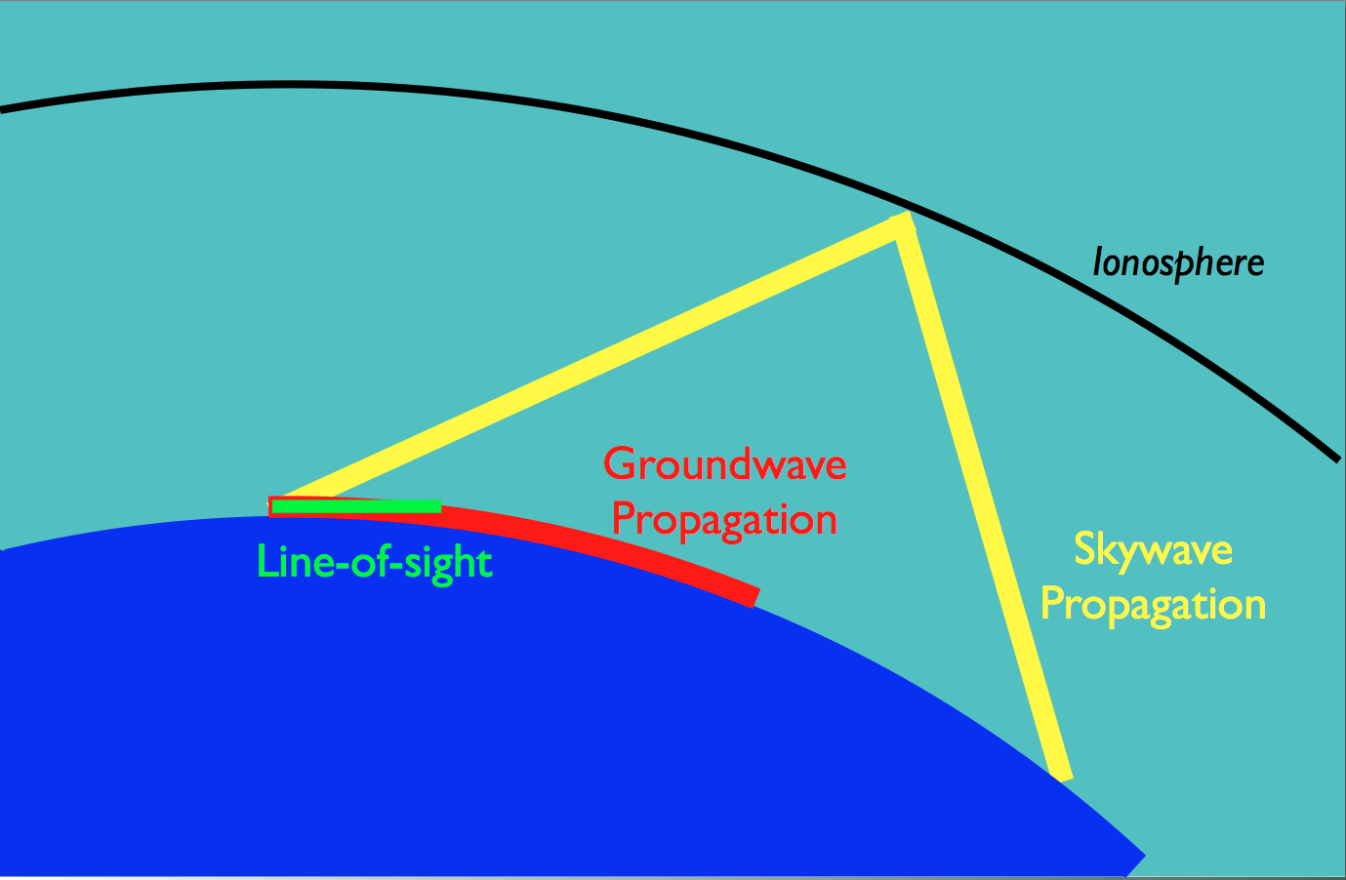
“The benefits of
HF radar are over the horizon measurements and
persistent surveillance”
Radar measures roughness and motion

Slide 4
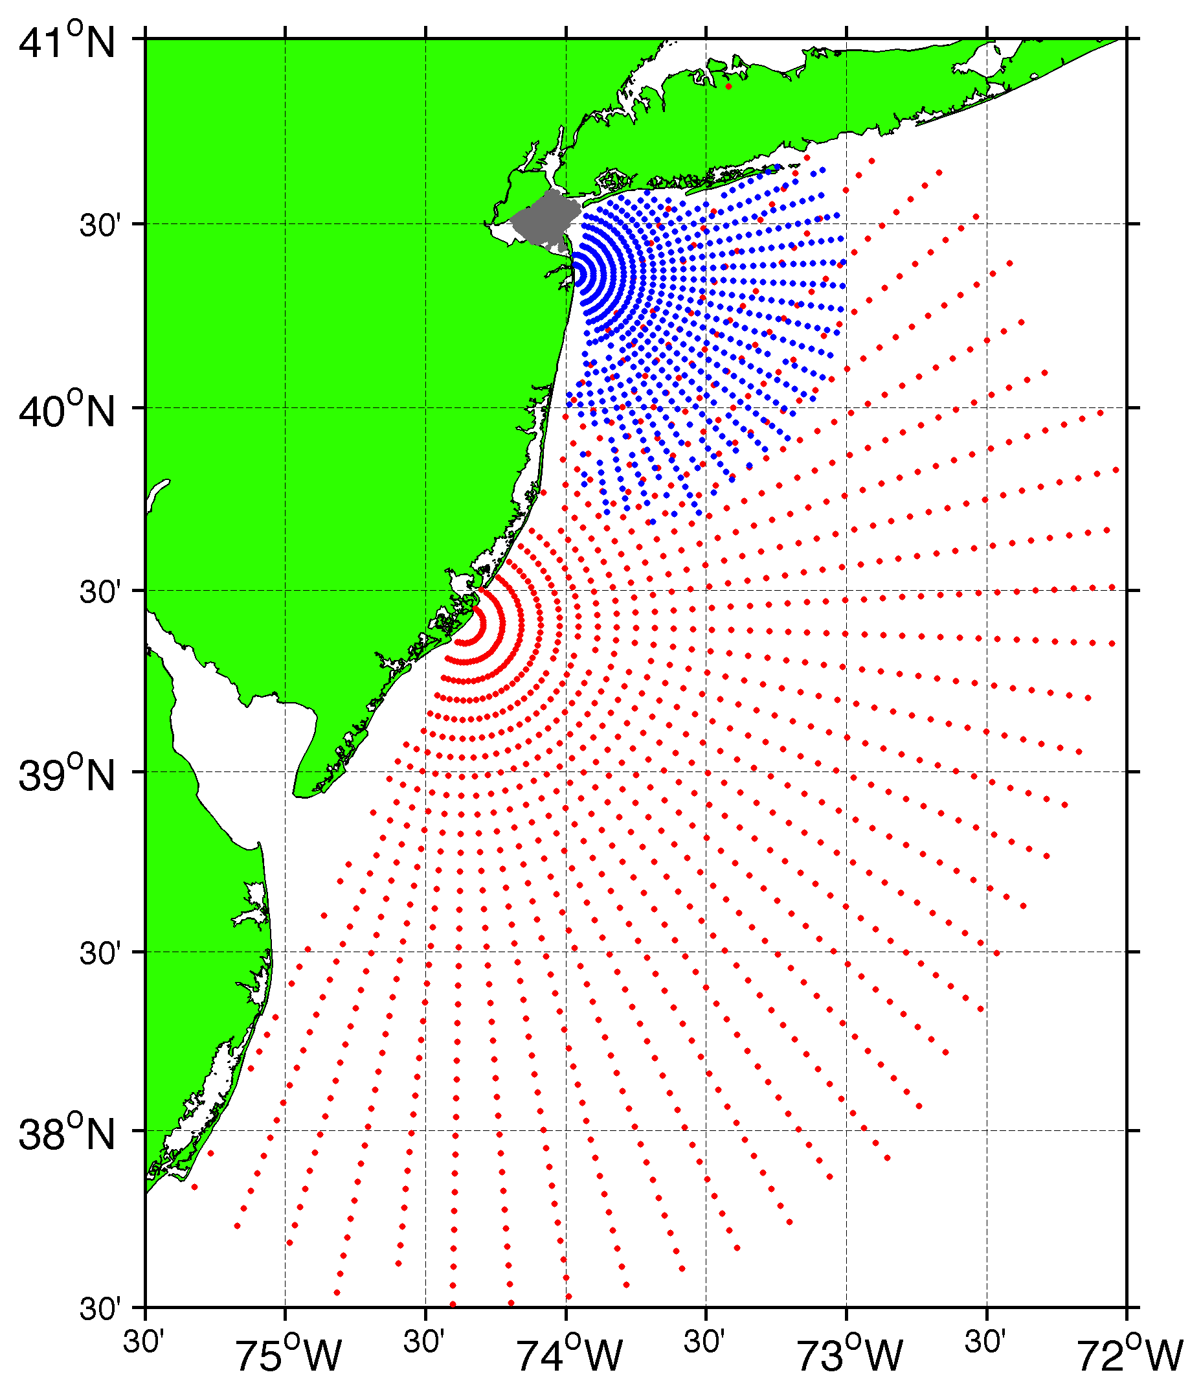
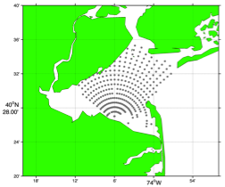
Surface Current Mapping Capability
25 MHz
Radar λ: 12 m Ocean λ: 6 m
Range: 30 km Resolution: 1 km
13 MHz
Radar λ: 23 m Ocean λ: 12 m
Range: 80 km Resolution: 3 km
05 MHz
Radar λ: 60m Ocean λ: 30 m
Range: 180 km Resolution: 6 km

Slide 5
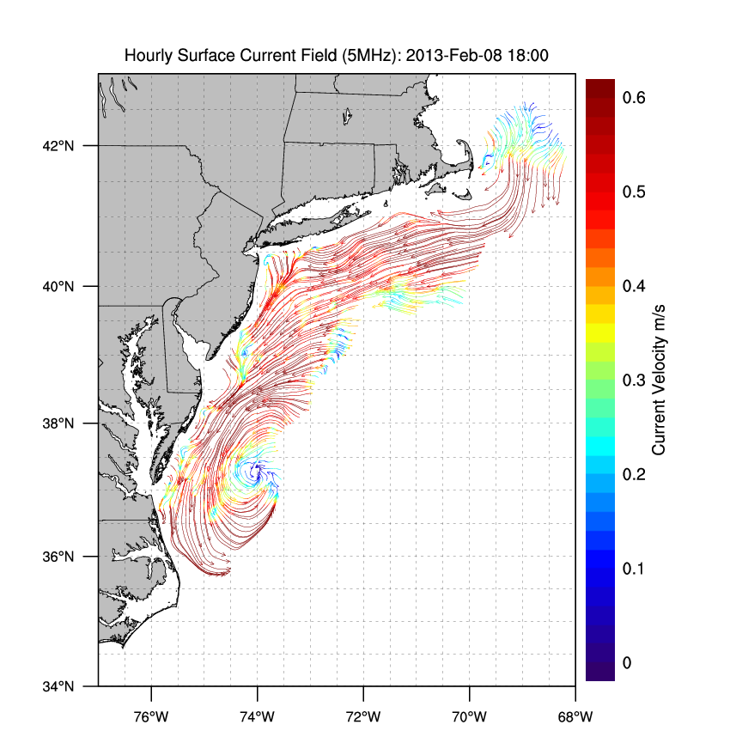
Winter Storm Nemo
February 9, 2013

Slide 6
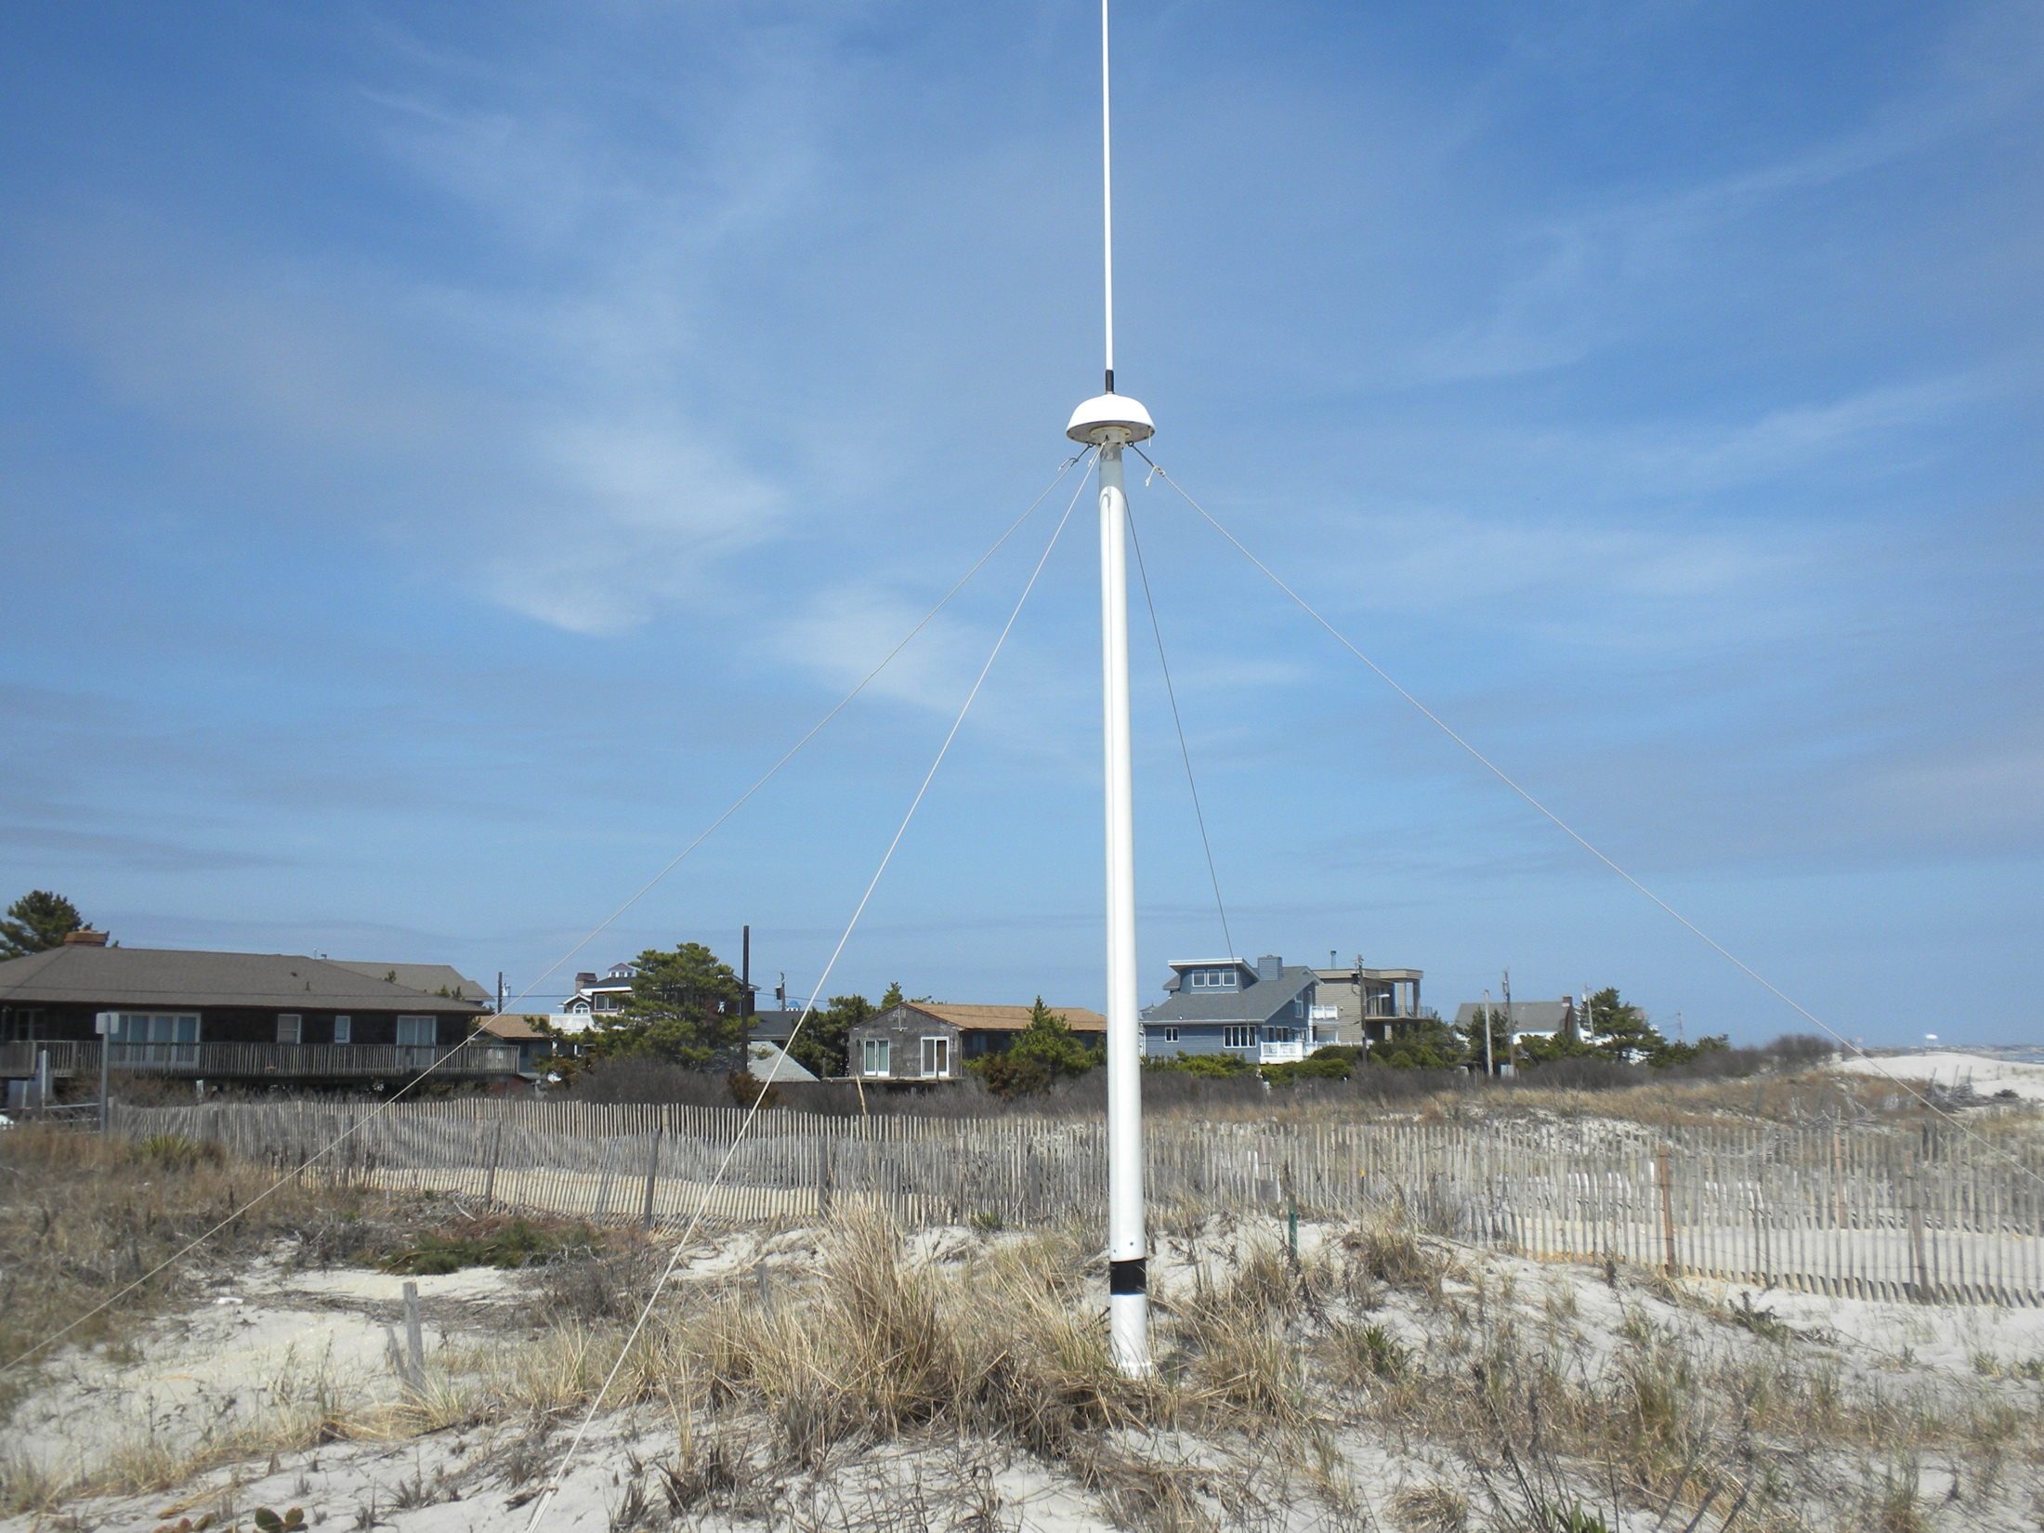
13 MHz Transmit and Receive Antenna
4 meters

Slide 7
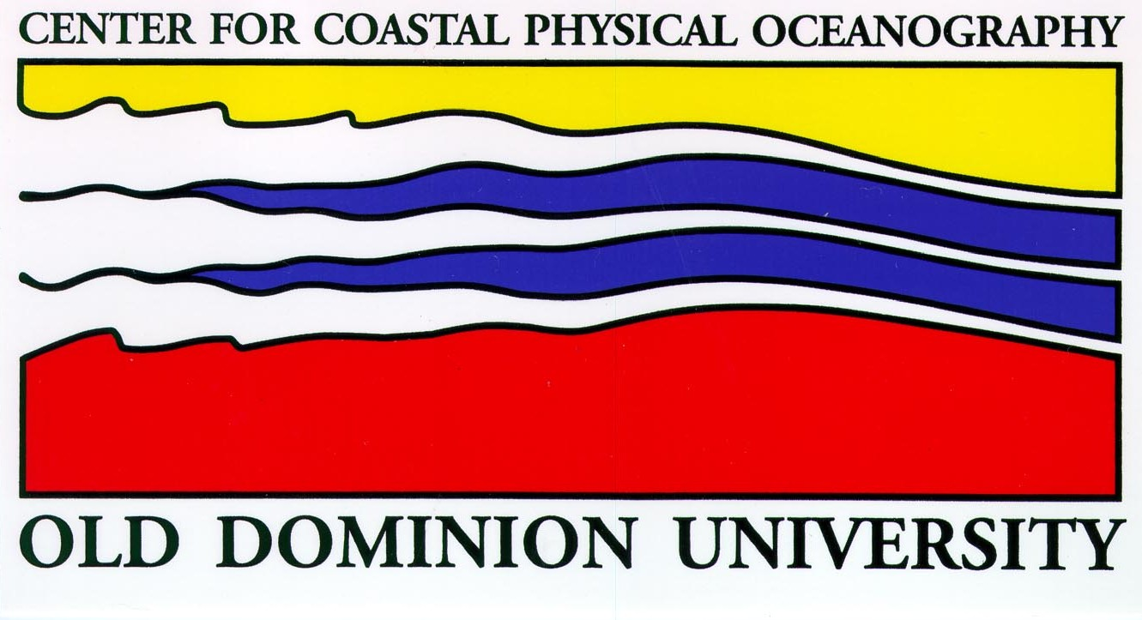
MIDATLANTIC HF RADAR NETWORK
 | 5 MHz | 13 MHz | 25 MHz
U Mass
WHOI
U Conn
URI
Stevens
Rutgers
Delaware
ODU/CIT
UNC
9 | 17 | 8 | 17
41 Stations in Total

Slide 8
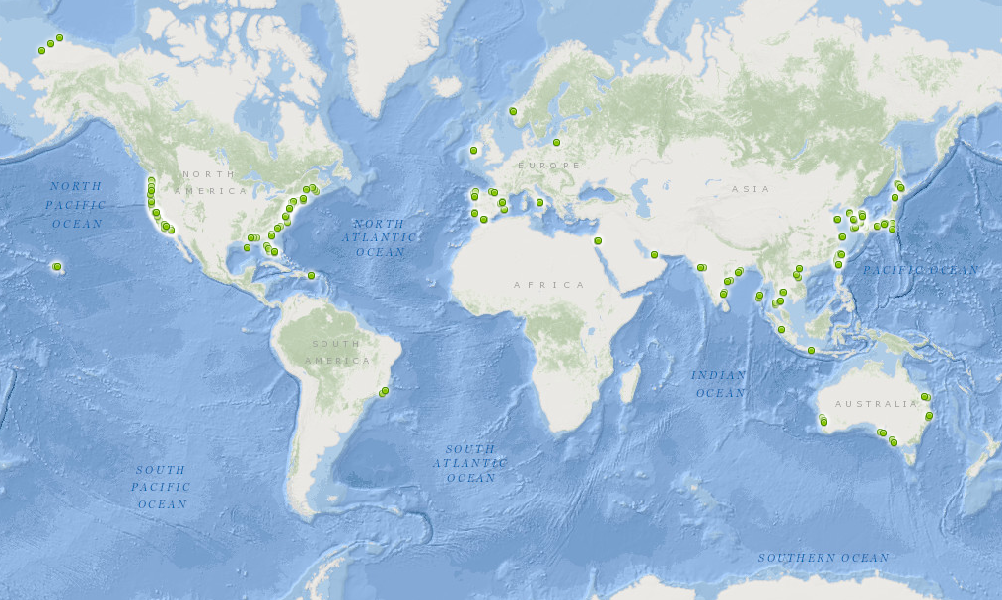
350 Radars World Wide
Region | Number | Percentage
Americas | 162 | 47%
Europe | 54 | 16%
Middle East | 7 | 2%
Asia | 122 | 35%

Slide 9
Application: Search and Rescue

Slide 10
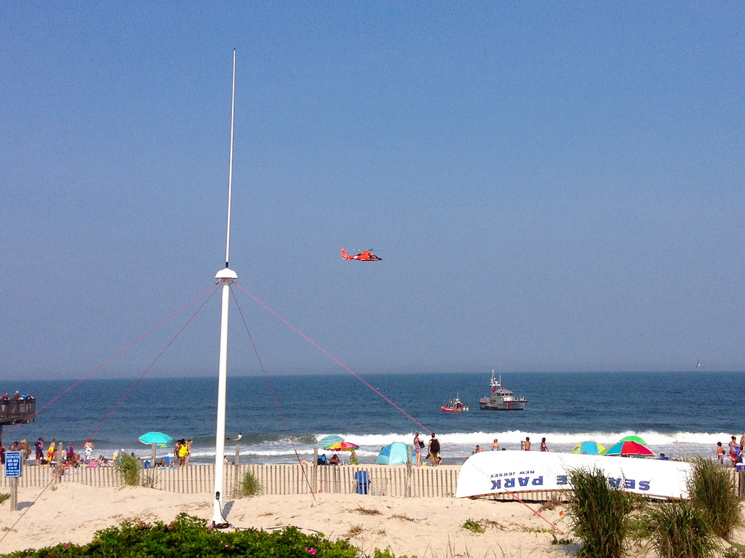
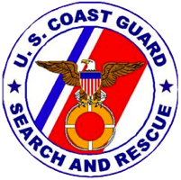
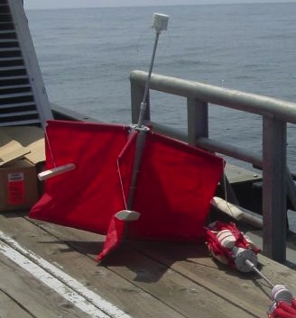
Success Stories – Making a Difference
Optimizing HF Radar for SAR using USCG Surface Drifters

Slide 11
Search and Rescue - 2004

Slide 12
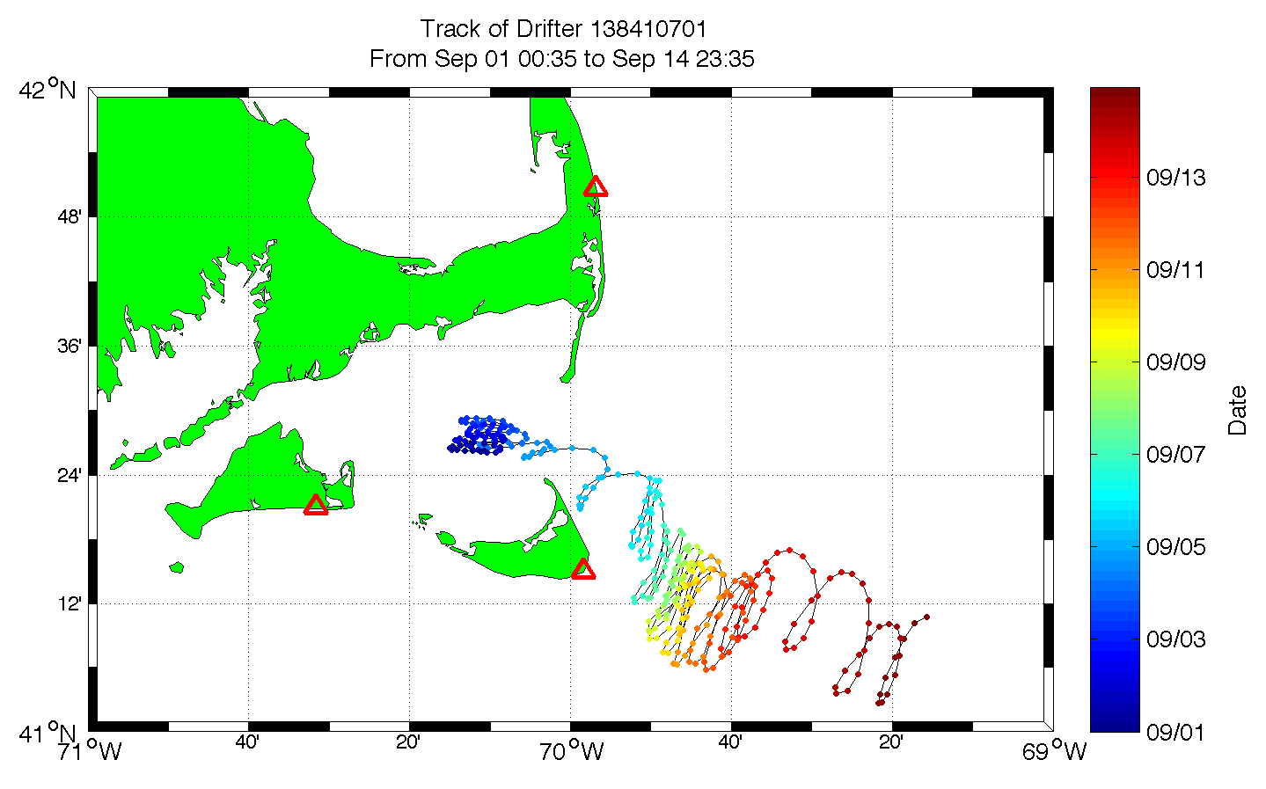

Slide 13
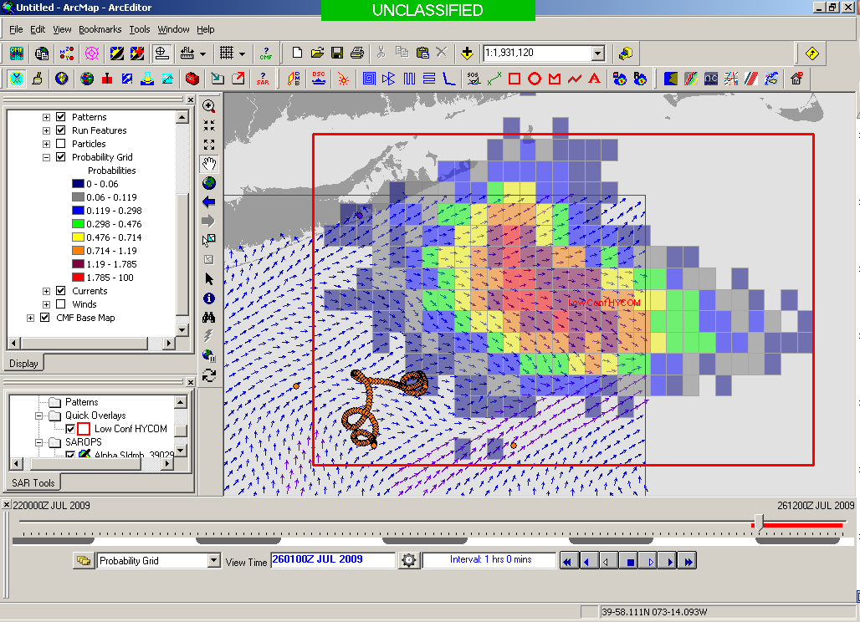
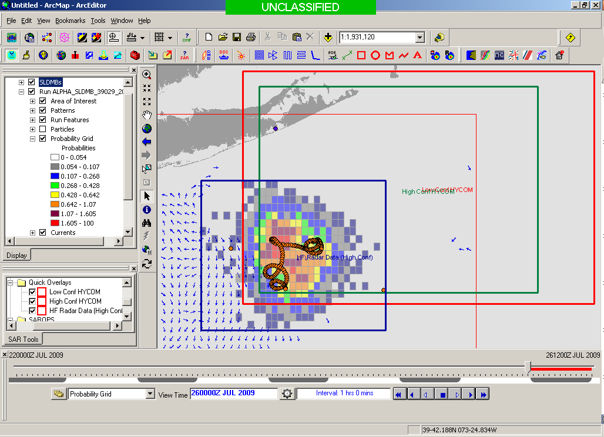
Search Area After 96 Hours
154 km
100 km
232 km
123 km
HYCOM
36,000 km²
CODAR
12,000 km²
Notes:
HYCOM (Low Conf) 48 hours

Slide 14
CONCLUSIONS
Other Applications Include
Oil Spill Modeling
Wind and Wave Measurements
Vessel Detection and Tracking

