Slide 1
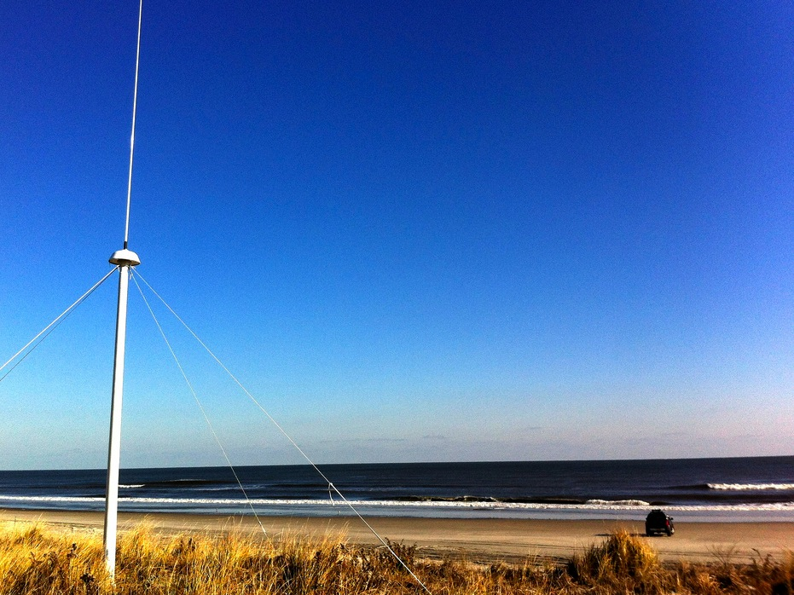






Evaluation of Environmental Data for Search and Rescue
Hugh Roarty
Scott Glenn
Art Allen
April 15, 2016
Wuhan, China

Slide 2
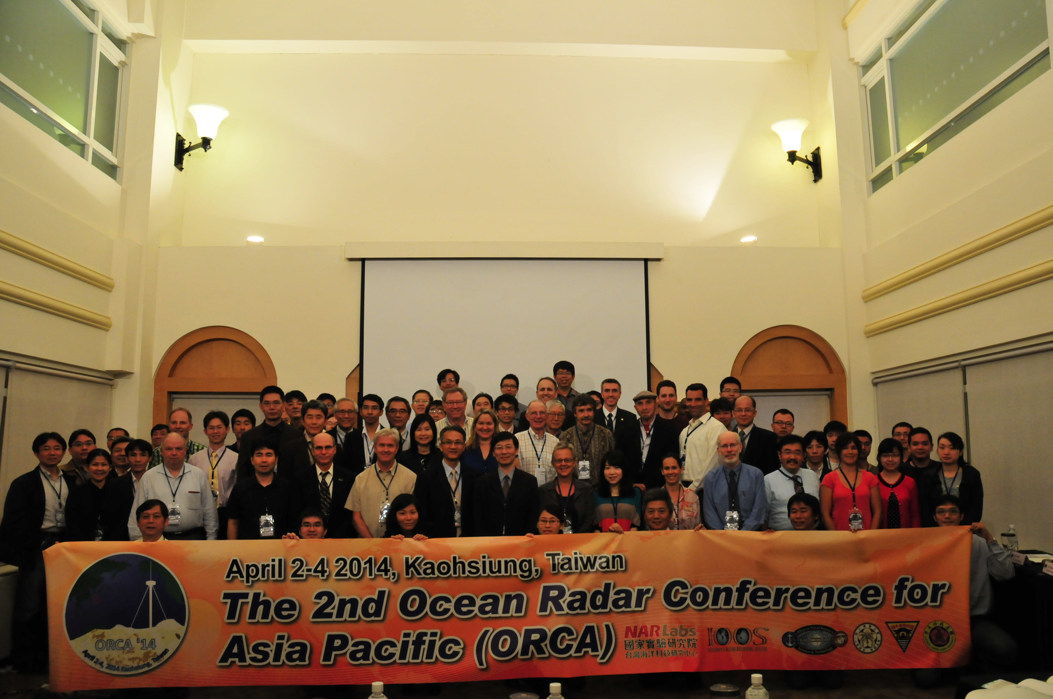


Slide 3
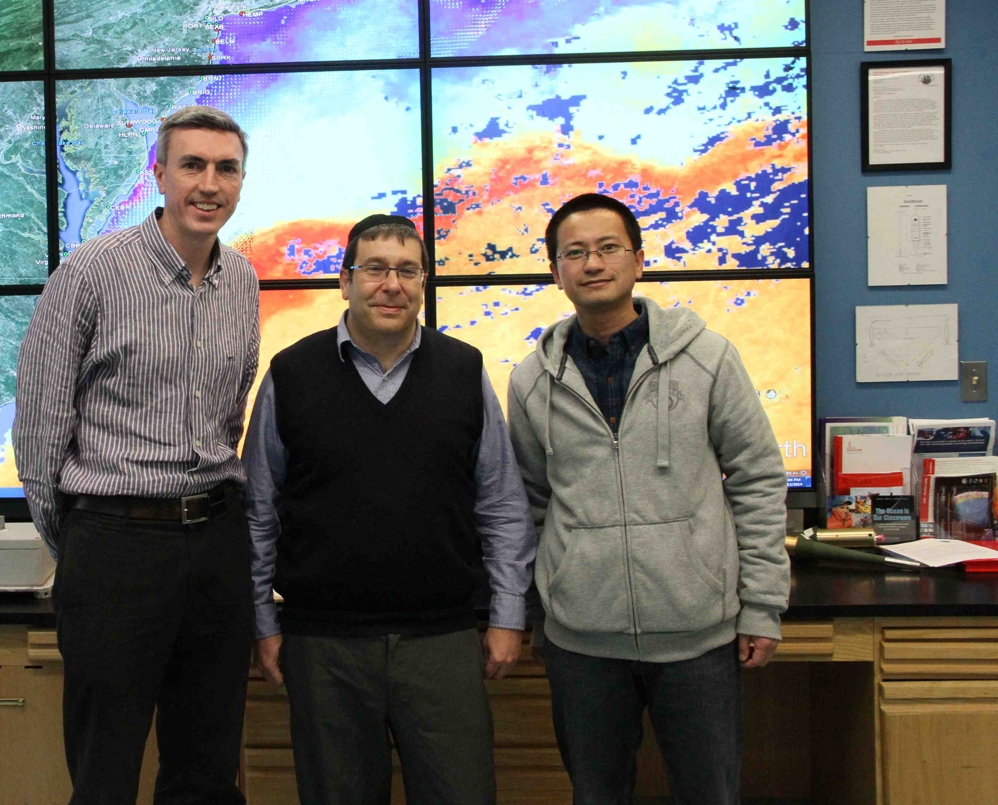
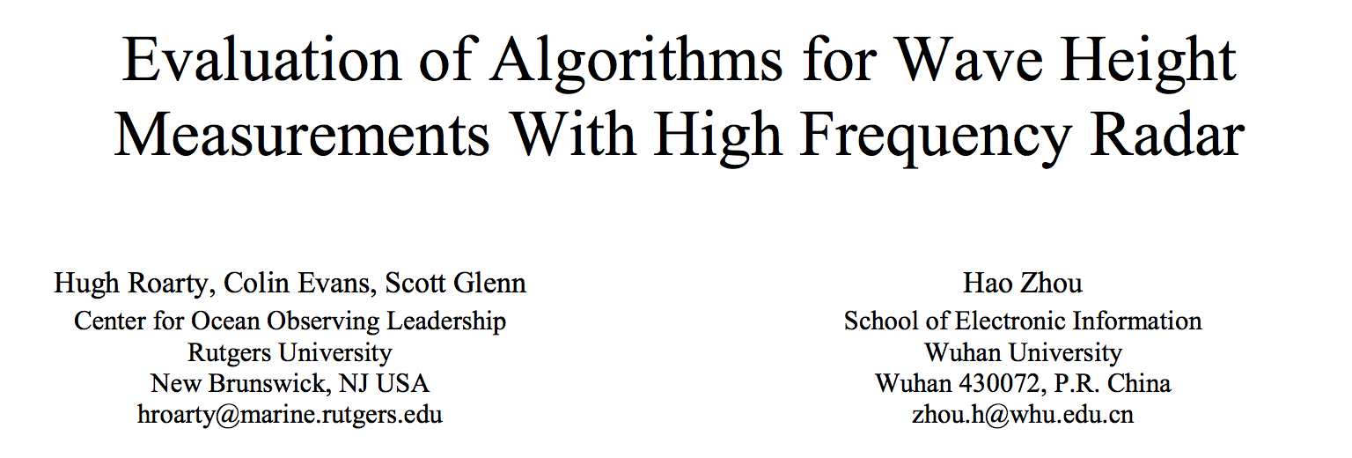
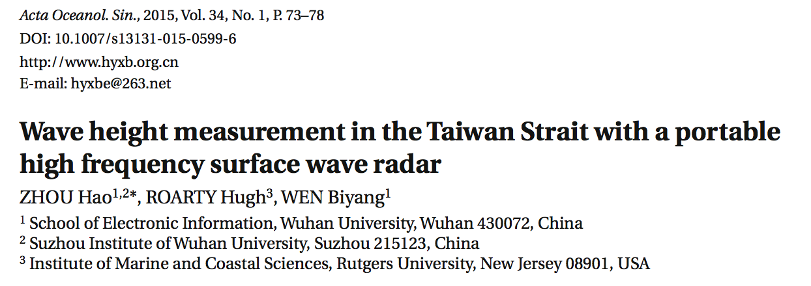
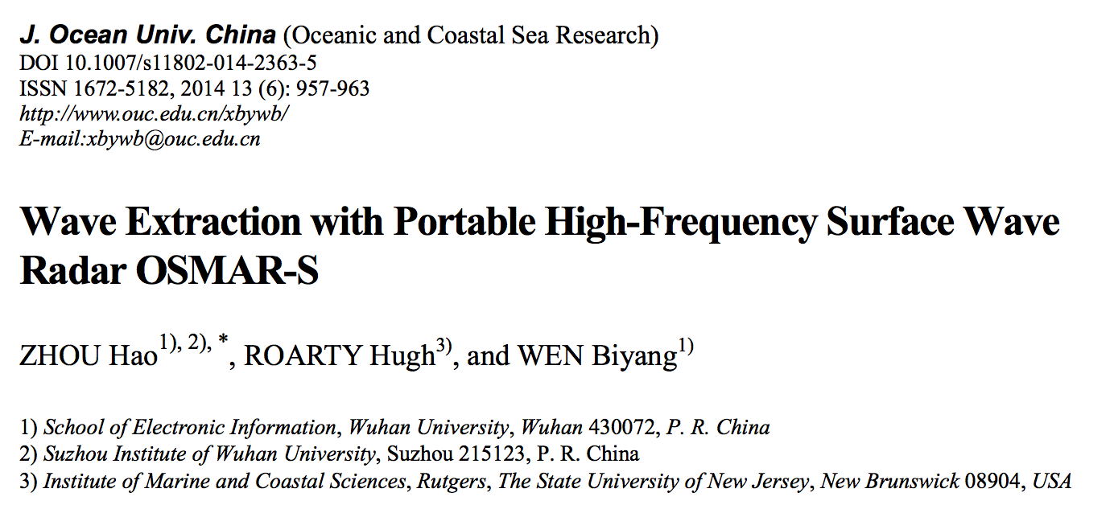

Slide 4

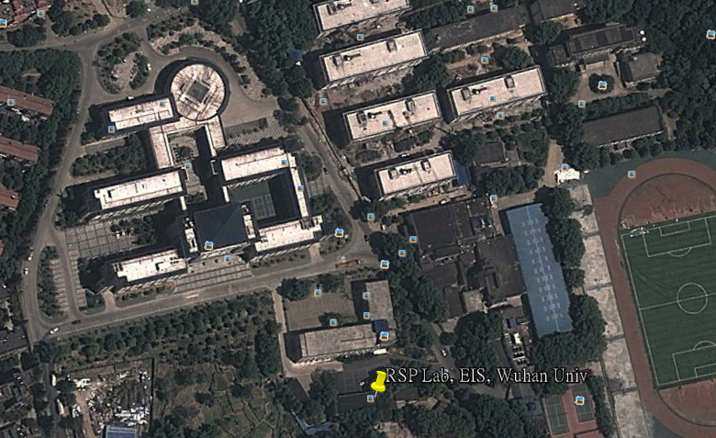

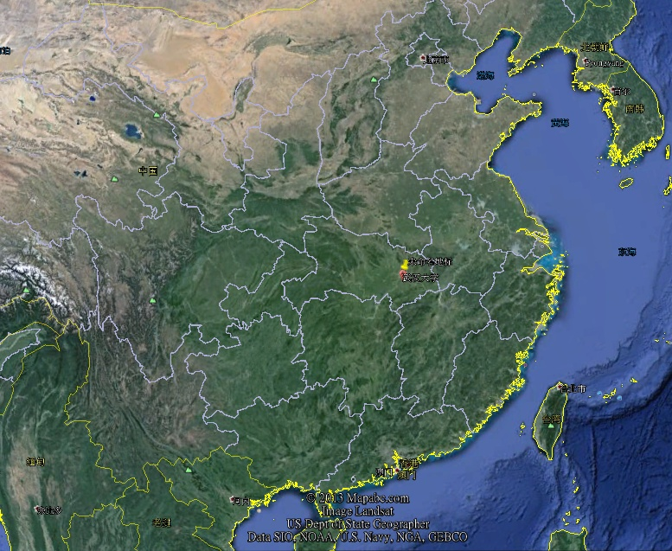
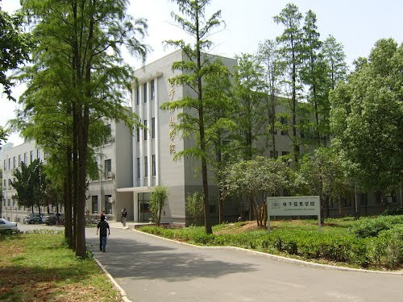
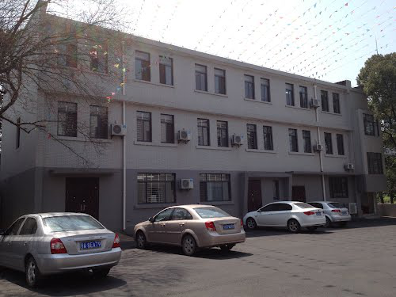
Wuhan University
The most beautiful university in China

Slide 5
Talk Outline
Introduction to MARACOOS
Introduction to High Frequency Radar
Application for Search and Rescue
Evaluating Environmental Data in SAROPS
Global HF Radar Task

Slide 6
Regional Observing System - MARACOOS

Slide 7
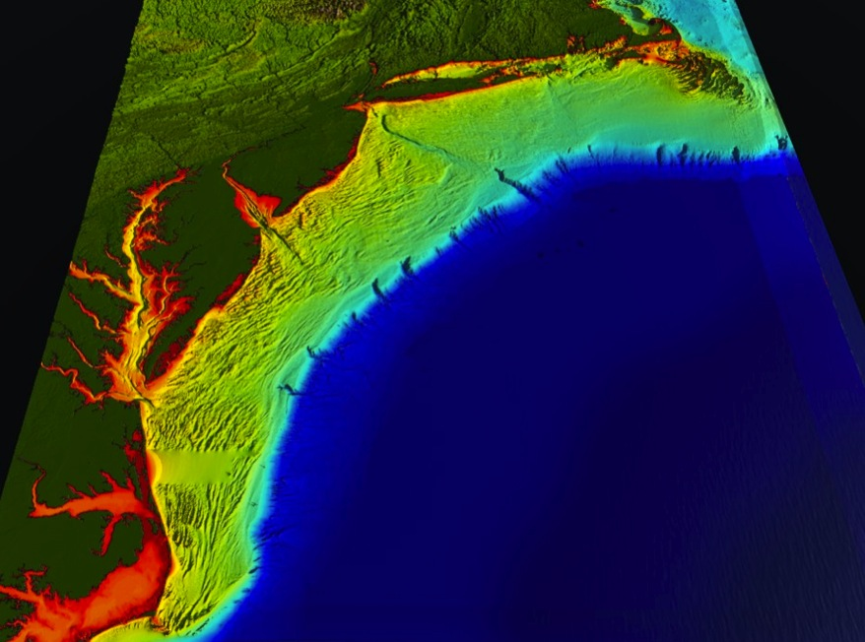
















RI
U..
Middle Atlantic
Regional Association
Coastal
Ocean Observing System
CT
Cape
Cod
NY
MA
PA
10 States - 76 Million People
1000 km Cape to Cape
NJ
MARACOOS:
A Sustained Real-time Observation & Forecast System
DE
MD
>40 PIs
>20 Institutions
>50 Members
>2000 Contacts
VA
NC
Cape
Hatteras
Notes:
7

Slide 8
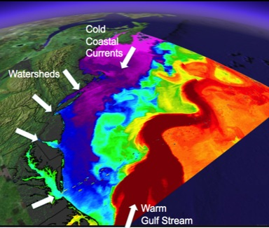
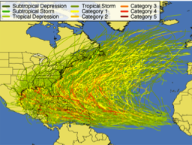
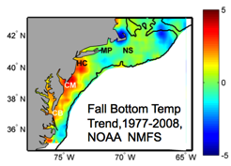
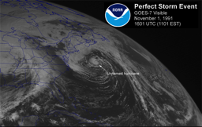
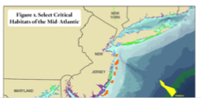
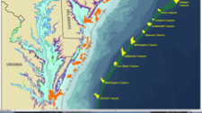
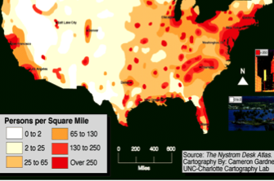
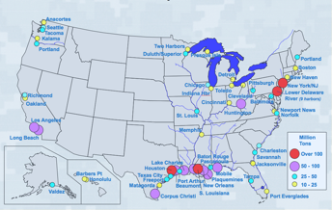
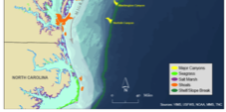
MID-ATLANTIC REGIONAL DRIVERS
Tropical Storms
Climate Change
Ocean Circulation
Critical Habitat
Northeasters
Population
Ports

Slide 9
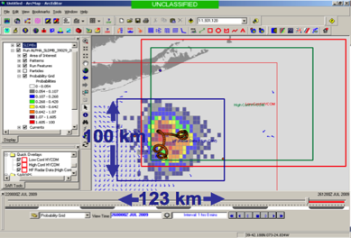
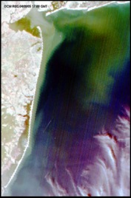
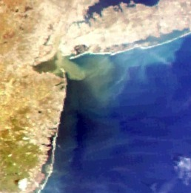
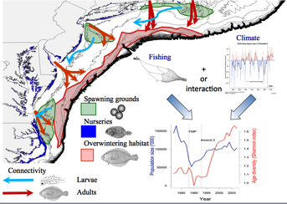
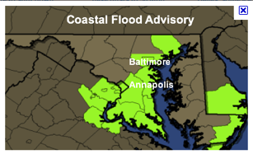
MARACOOS REGIONAL THEMES
1) Maritime Operations – Safety at Sea
3) Water Quality – a) Floatables, b) Hypoxia, c) Nutrients
2) Ecosystem Decision Support - Fisheries
5) Energy – Offshore Wind
4) Coastal Inundation - Flooding

Slide 10
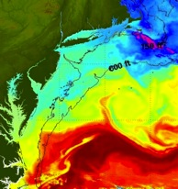
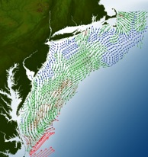
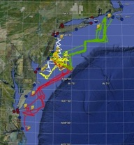
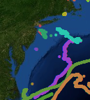
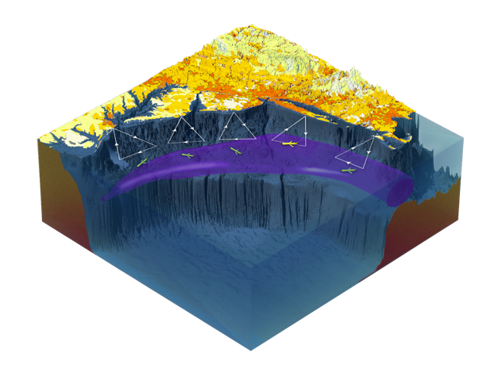

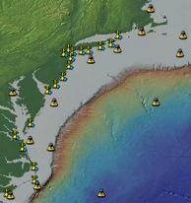
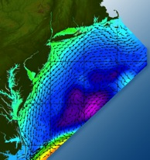

Satellites
HF-Radar
Gliders
Drifters
Population Density
To seek, discover & apply
new knowledge & understanding
of our coastal ocean
Weather Stations
Atmosphere & Ocean Forecast Ensembles
Notes:
Need to cut off cold pool in south and bend offshore
Need to experiment with dulling down the colors in the pop density. Maybe orange/tan to white like the box I put in?
Put gliders just below the lines in 3 of them, and increase their angles facing up and down randomly. I stuck in cheesy examples
I already put the shadow and 80% clear line around the two new maps in the upper right, so we are good there.

Slide 11
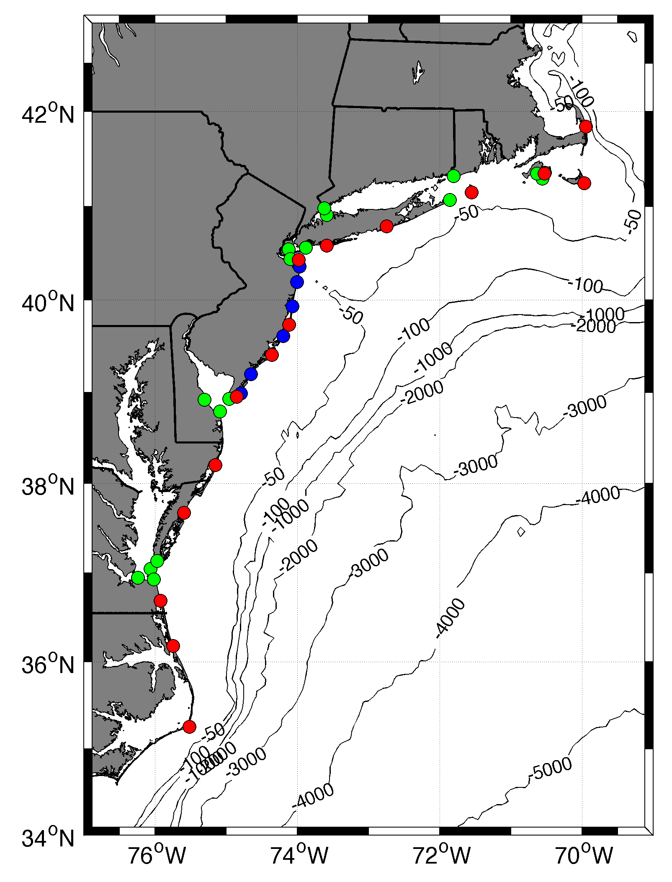









MARACOOS HF RADAR NETWORK
 | 5 MHz | 13 MHz | 25 MHz
U Mass
WHOI
U Conn
URI
Stevens
Rutgers
Delaware
ODU/CIT
UNC
10 | 17 | 8 | 17
10 organizations
42 Stations in Total

Slide 12
Introduction to High Frequency Radar

Slide 13
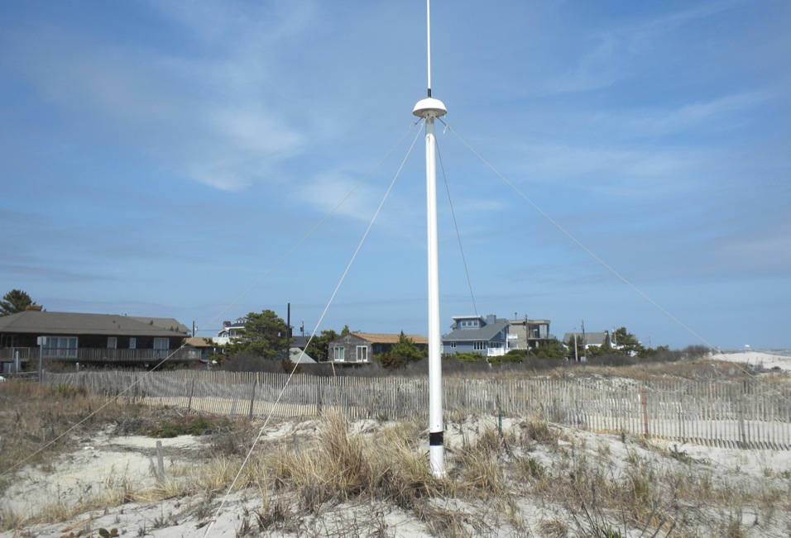
13 MHz Transmit and Receive Antenna
4 meters

Slide 14
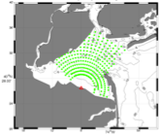
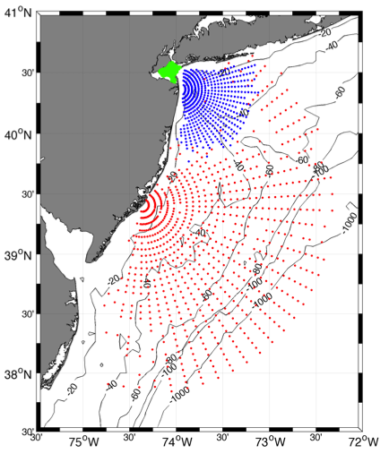
Surface Current Mapping Capability
25 MHz
Radar λ: 12 m Ocean λ: 6 m
Range: 30 km Resolution: 1 km
13 MHz
Radar λ: 23 m Ocean λ: 12 m
Range: 80 km Resolution: 3 km
05 MHz
Radar λ: 60m Ocean λ: 30 m
Range: 180 km Resolution: 6 km

Slide 15
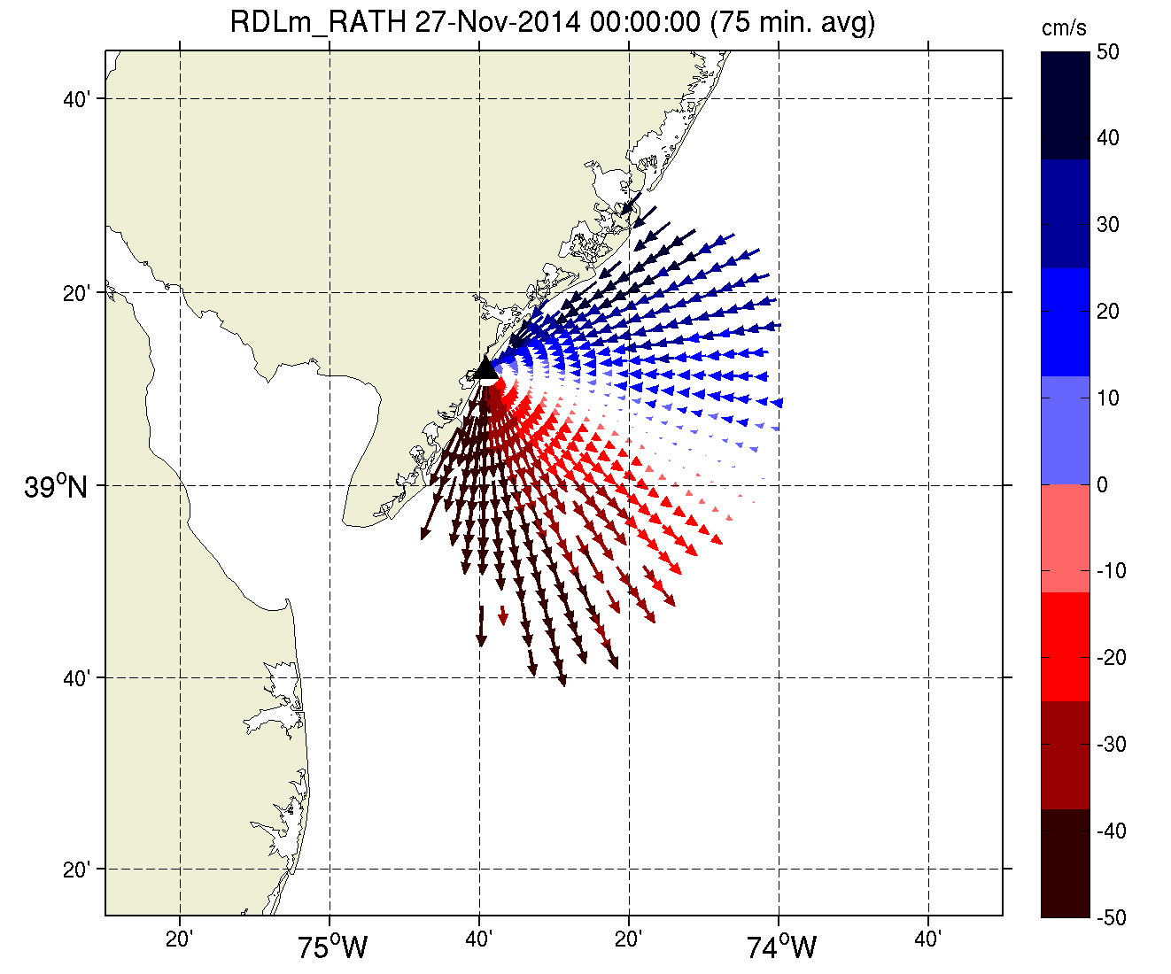
Radial Map of Currents

Slide 16
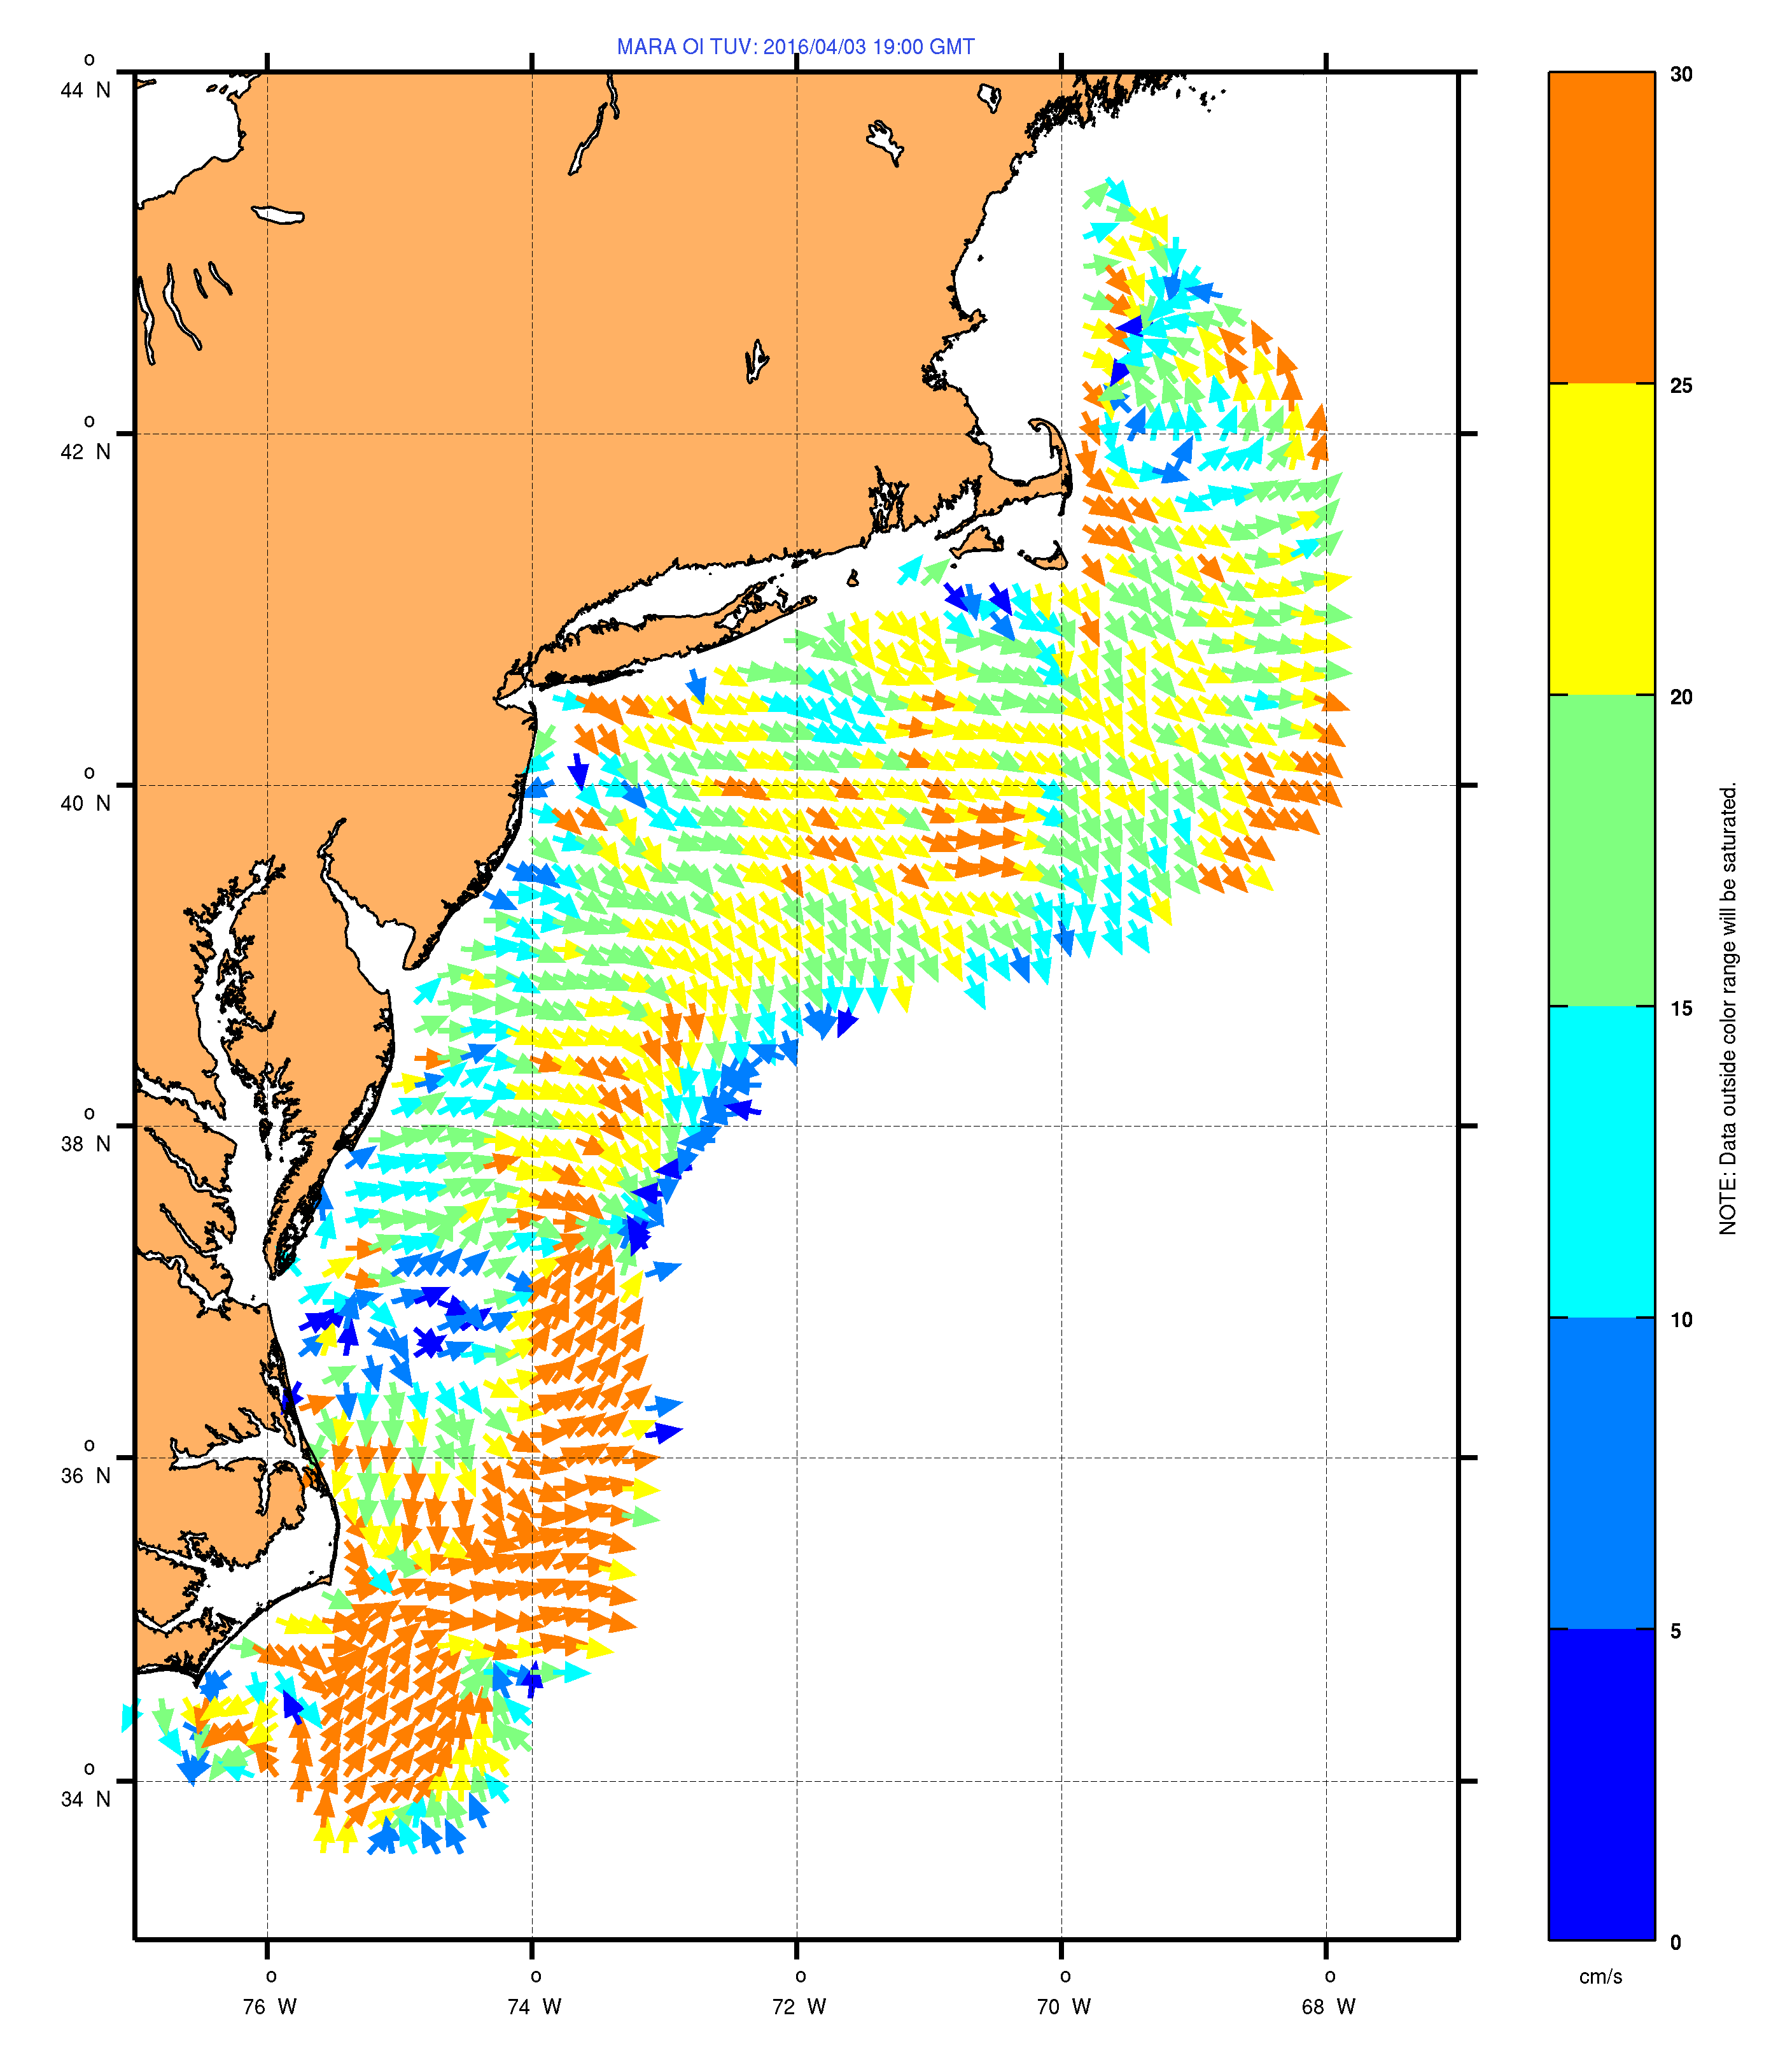
30 cm/s
April 3, 2016
24 Hour Average
25 cm/s
17 Sites
5 MHz
1000 km coastline
6 Km Spatial Resolution
20 cm/s
15 cm/s
10 cm/s
5 cm/s
0 cm/s

Slide 17
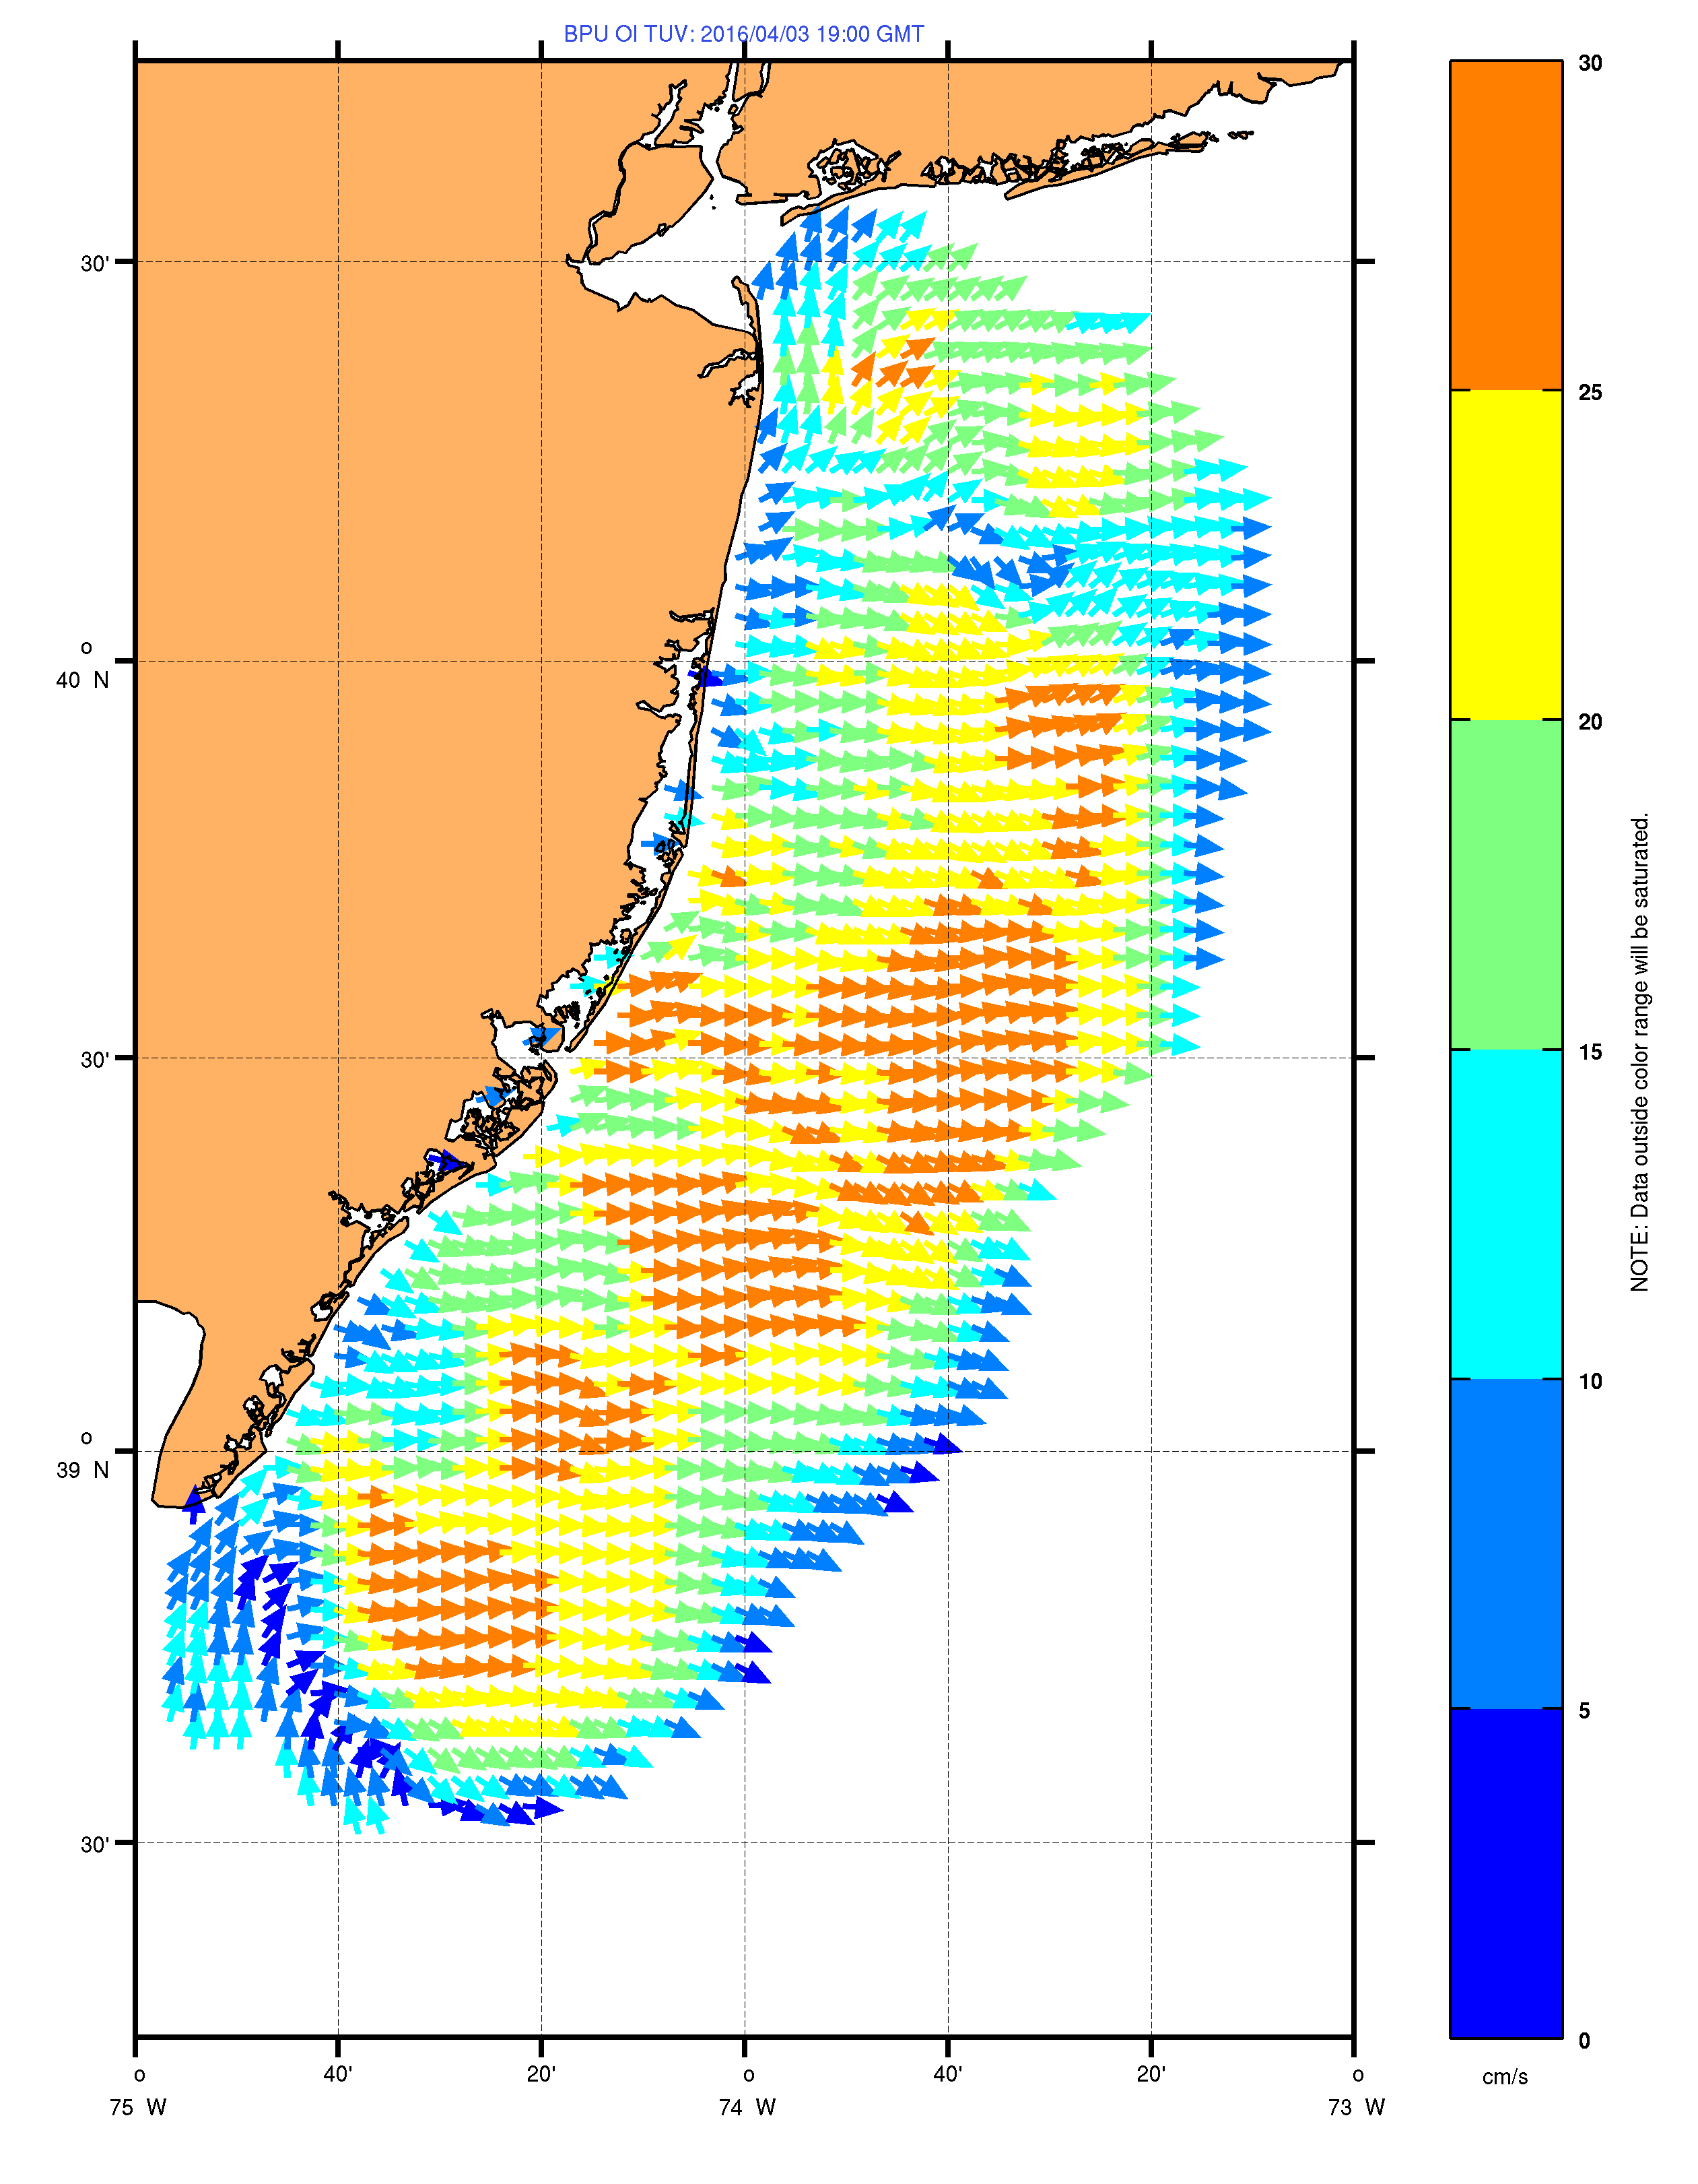
30 cm/s
25 cm/s
7 Sites
13 MHz
200 km coastline
2 Km Spatial Resolution
20 cm/s
15 cm/s
10 cm/s
5 cm/s
0 cm/s

Slide 18
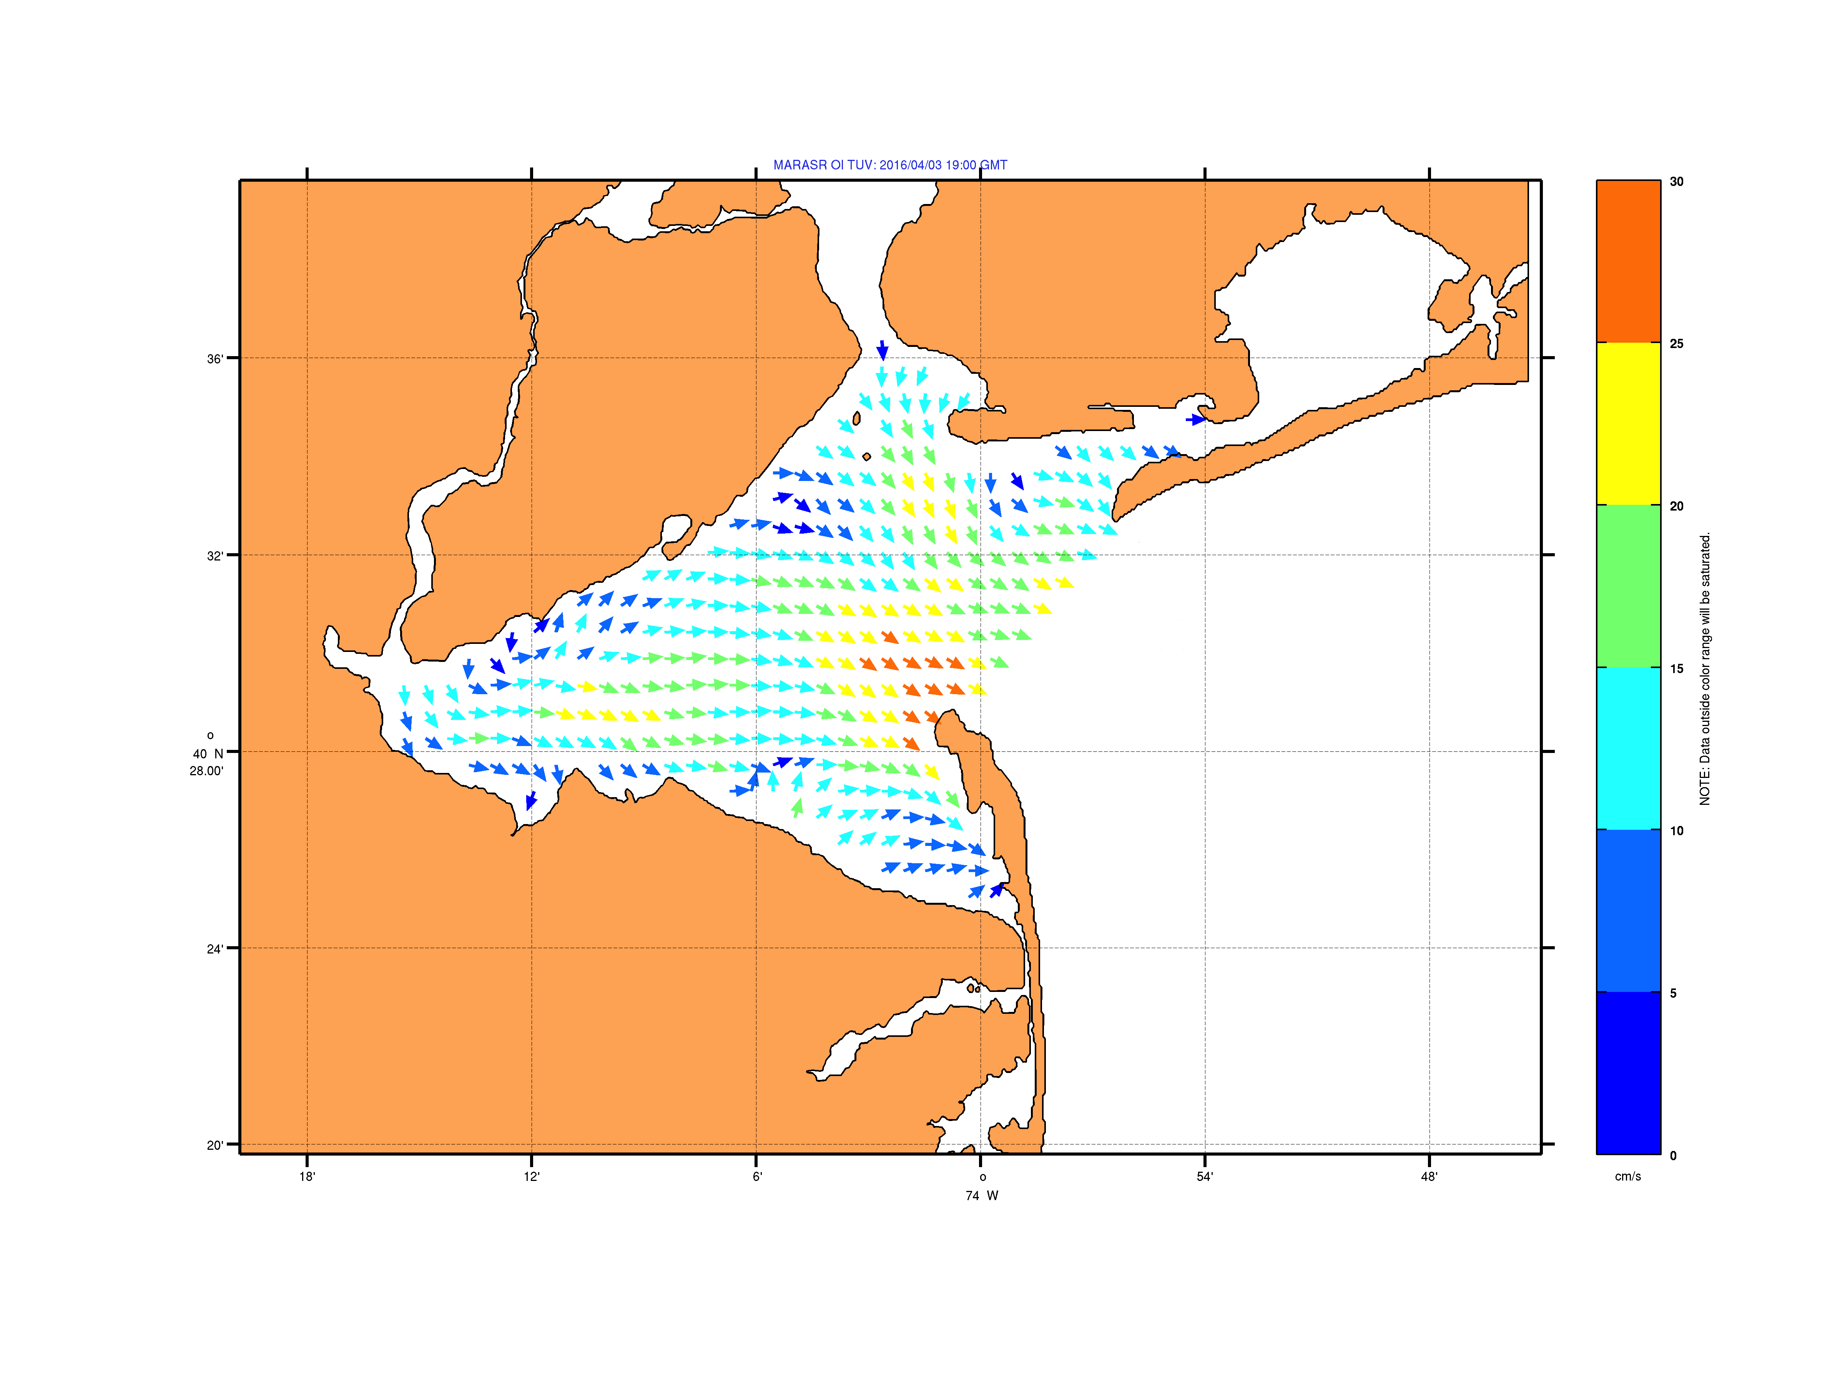
30 cm/s
25 cm/s
3 Sites
25 MHz
40 km coastline
1 Km Spatial Resolution
20 cm/s
15 cm/s
10 cm/s
5 cm/s
0 cm/s

Slide 19
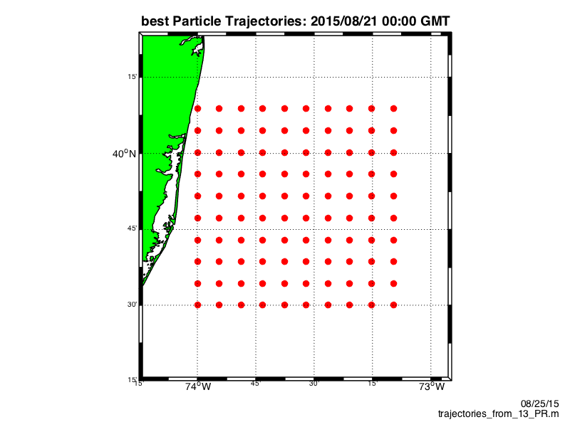


Slide 20
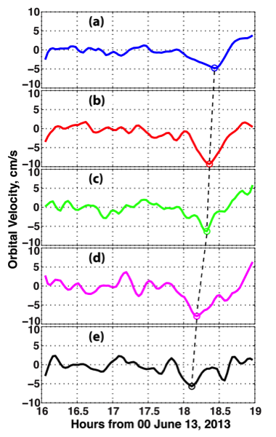

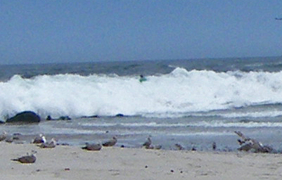
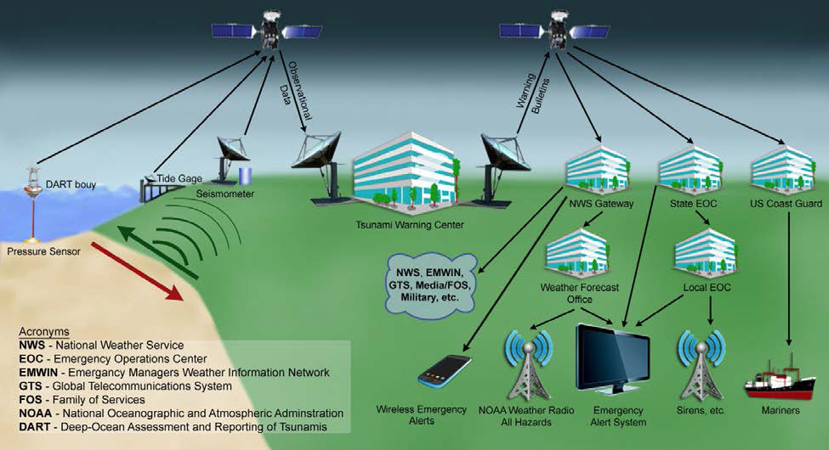
HF Radar Detects Tsunamis
6 km offshore
10 km offshore
14 km offshore
18 km offshore
Long Beach Island, NJ
22 km offshore

Slide 21

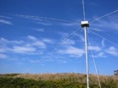


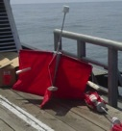
HF Radar Application
Search And Rescue
Dr. Hugh Roarty
Dr. Josh Kohut

Slide 22


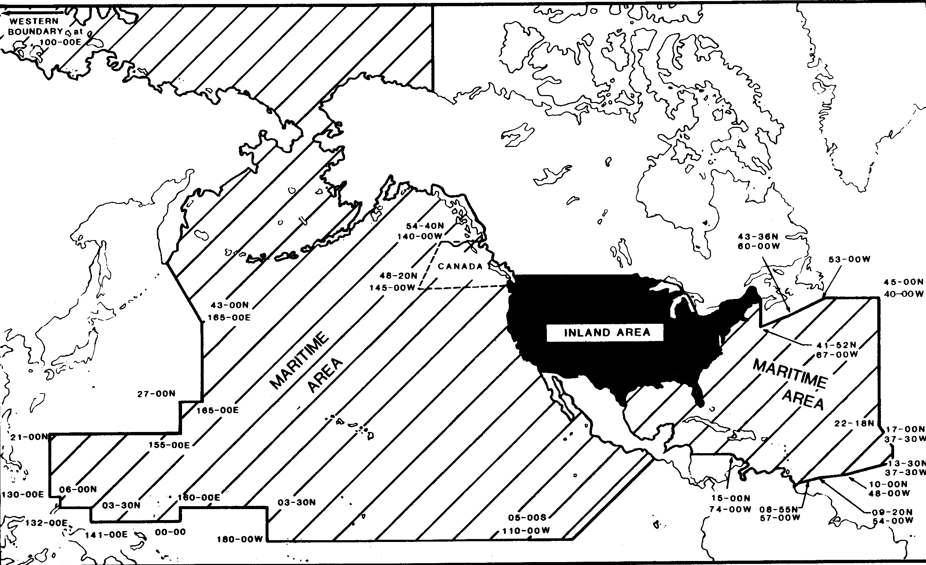
USCG
Area of Responsibility

Slide 23


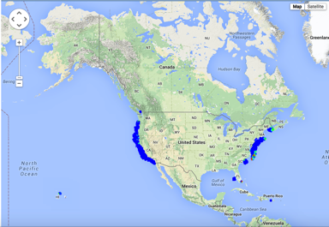
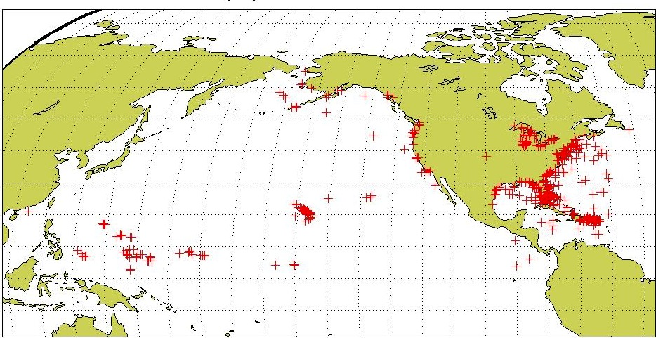
USCG Drifter Deployments
Self Locating Data Marker Buoys (SLDMB)
for Search And Rescue (SAR)
January 2006 – December 2007 (2 years)
National HF Radar Network
Most SAR cases occur in the envisioned HF Radar Network footprint
Notes:
Here are the initial deployment positions for our SLDMBs. From these records we selected only those that exceeded 4 days in length

Slide 24
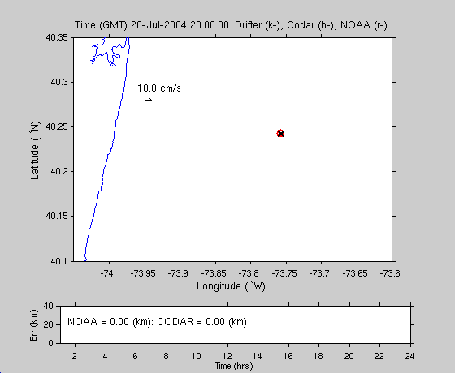


Long Range 5 MHz
Year 2005
Drifter
CODAR
NOAA

Slide 25


USCG Current Validation
Results of a 1-year blind validation study -
For every real drifter deployed at sea:
5000 Virtual Drifters Deployed in SAROPS
Search Areas compared to real drifters every 12 hours
154 km
100 km
232 km
123 km
HYCOM 96 hour Search Area
36,000 km²
HF Radar 96 hour Search Area
12,000 km²
Notes:
Here are the initial deployment positions for our SLDMBs. From these records we selected only those that exceeded 4 days in length

Slide 26
Evaluation of Environmental Data

Slide 27
National Data Requests from SAROPS
December 1, 2011 to March 15, 2014
Atmosphere
Ocean

Slide 28


HF Radar
Surface Current Maps
HYCOM
25 hour mean, March 28, 2016 18:00 UTC

Slide 29


Normalized Cumulative Lagrangian Separation
Liu and Weisberg (2011)

Slide 30

Day | Σ di | Σ loi | ss
1 | 4 | 5 | 0.2
2 | 4+3.6 | 5+14 | 0.60
3 | 4+3.6+5.1 | 5+14+24 | 0.70
Day 3
5.1
Day 2
Day 1
3.6
4
di
loi

Slide 31

Normalized Cumulative Lagrangian Separation
Liu and Weisberg (2011)

Slide 32


HF Radar
HYCOM

Slide 33

HYCOM

Slide 34

HFR

Slide 35


Slide 36


HF Radar
HYCOM
Separation (km) between actual and modeled trajectory after 48 hours

Slide 37



Trajectory prediction using HF radar surface currents: Monte Carlo simulations of prediction uncertainties
Journal of Geophysical Research: Oceans
Volume 111, Issue C12, C12005, 8 DEC 2006 DOI: 10.1029/2006JC003715
http://onlinelibrary.wiley.com/doi/10.1029/2006JC003715/full#jgrc10405-fig-0008
Notes:
(a) Separation between actual and predicted drifter position as a function of time since start of prediction, averaged over all trajectory segments that start within the nominal coverage zone for the BI region. The curves with symbols show the mean separation (dashed line and circles) and the 95th percentile separation (solid line and circles) between the real drifter and the predicted position. The dashed and solid lines show respectively the mean distance and the 95th percentile distance that the real drifter moved over the prediction time. (b) The same statistical measures averaged over all segments that both start and end within the 10% coverage zone.
IF THIS IMAGE HAS BEEN PROVIDED BY OR IS OWNED BY A THIRD PARTY, AS INDICATED IN THE CAPTION LINE, THEN FURTHER PERMISSION MAY BE NEEDED BEFORE ANY FURTHER USE. PLEASE CONTACT WILEY'S PERMISSIONS DEPARTMENT ON PERMISSIONS@WILEY.COM OR USE THE RIGHTSLINK SERVICE BY CLICKING ON THE 'REQUEST PERMISSIONS' LINK ACCOMPANYING THIS ARTICLE. WILEY OR AUTHOR OWNED IMAGES MAY BE USED FOR NON-COMMERCIAL PURPOSES, SUBJECT TO PROPER CITATION OF THE ARTICLE, AUTHOR, AND PUBLISHER.

Slide 38



Slide 40
GEO Global hf radar network

Slide 41

Global High Frequency Radar Network
Previous Meetings
England 2012
Norway 2013
Taiwan 2014
Greece 2015

Slide 42



Fourth Meeting of the Global High Frequency Radar Network
September 22-23, 2015
Heraklion, Crete, Greece

Slide 43



Slide 44

GEO, the Group on Earth Observations
An Intergovernmental group with 99 Members and 87 Participating Organizations
U.S. Department of State, Washington DC
July 31, 2003

Slide 45

Australia, China, Japan, Korea, Philippines and Taiwan are members of GEO
Notes:
GEO is a global partnership of governments and organizations that seeks to realize its Vision of “a future wherein decisions and actions for the benefit of humankind are informed by coordinated, comprehensive and sustained Earth observations.” In support of this Vision, through collective voluntary action, the GEO community is implementing a Global Earth Observation System of Systems (GEOSS) from among a great many individual Earth observation, information and processing systems.
The Global Earth Observation System of Systems 10-Year Implementation Plan, GEO, 2005, p. 5.

Slide 46
GEO Objectives
Improve and Coordinate Observation Systems
Advance Broad Open Data Policies/Practices
Foster Increased Use of EO Data and Information
Build Capacity

Slide 47
Goals for Global HF Radar Network
Increase the number of coastal radars
Ensure HFR data is available in a single standardized format in near-real-time,
Assimilate data into ocean and ecosystem models
A set of easy to use standard products
Worldwide Quality Standards
Develop emerging uses of HF radar

Slide 48





Role of Global Network
ROW

Slide 49

GEO HF Radar Portal

Slide 50

Global HF Radar Viewer

Slide 51


~350 Radars World Wide
Region | Number | Percentage
Americas | 162 | 47%
Europe | 54 | 16%
Middle East | 7 | 2%
Asia | 122 | 35%

Slide 52

ORCA Meeting Inventory

Slide 53

Global Inventory
349
Morocco
381
Philippines

Slide 54

Application Success Stories

Slide 55
Talk Outline
Introduction to MARACOOS
Introduction to High Frequency Radar
Application for Search and Rescue
Evaluating Environmental Data in SAROPS
Global HF Radar Task

Slide 56
Evaluation of Environmental Data
for Search and Rescue
THANK YOU

