Slide 1

The Mid-Atlantic Coastal Ocean Observing System:
Hurricanes
HF Radars
HFR Network
Thank You ORCA & U. Wuhan
Scott Glenn & Hugh Roarty
Rutgers University
Chad Whelan
CODAR Ocean Sensors
Academic – Industry Partnership Since 1998

Slide 2





78 Million People (1/4 of U.S.)
1000 km Cape to Cape
U..
Middle Atlantic
Regional Association
Coastal
Ocean Observing System
Cape
Cod
Stratified
Coastal Ocean Interactions with
Tropical Cyclones
Sandy
Irene
Barry
Scott Glenn, Travis Miles,
Greg Seroka, Robert Forney,
Hugh Roarty, Oscar Schofield,
Josh Kohut (Rutgers),
Yi Xu (China) & Fei Yu (China)
Nature Communications (2016)
Arthur
Cape
Hatteras
Notes:
2

Slide 3
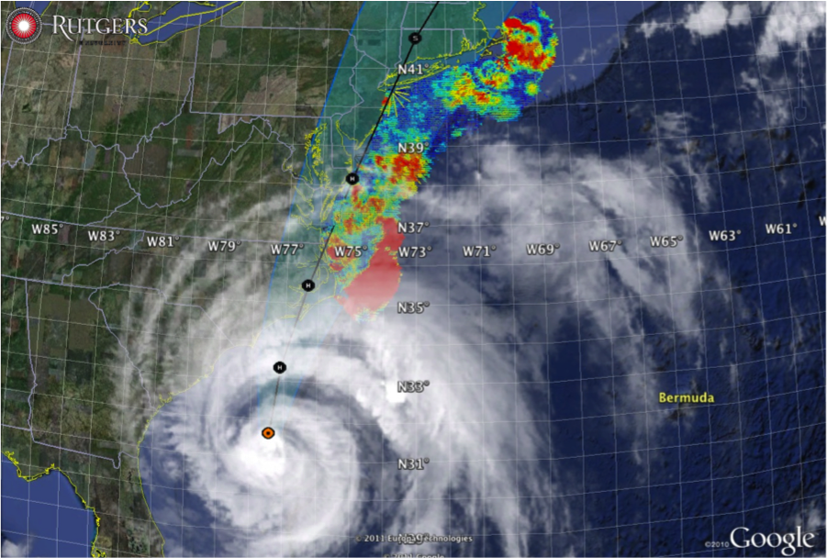

Hurricane Irene
August 28, 2011
NOAA/NHC Damage:
#7 with >$16 Billion.
Track Accurate;
Intensity Over-predicted.
Avila & Cangialosi, 2012, Tropical Cyclone Report
Hurricane Sandy
October 29, 2012
NOAA/NHC Damage:
#2 with >$68 Billion.
Track Accurate;
Surge Under-predicted.
Georgas et al., 2014, J. of Extr. Even.
Colle et al., 2015, J. Mar. Sci. & Engr.

Slide 4
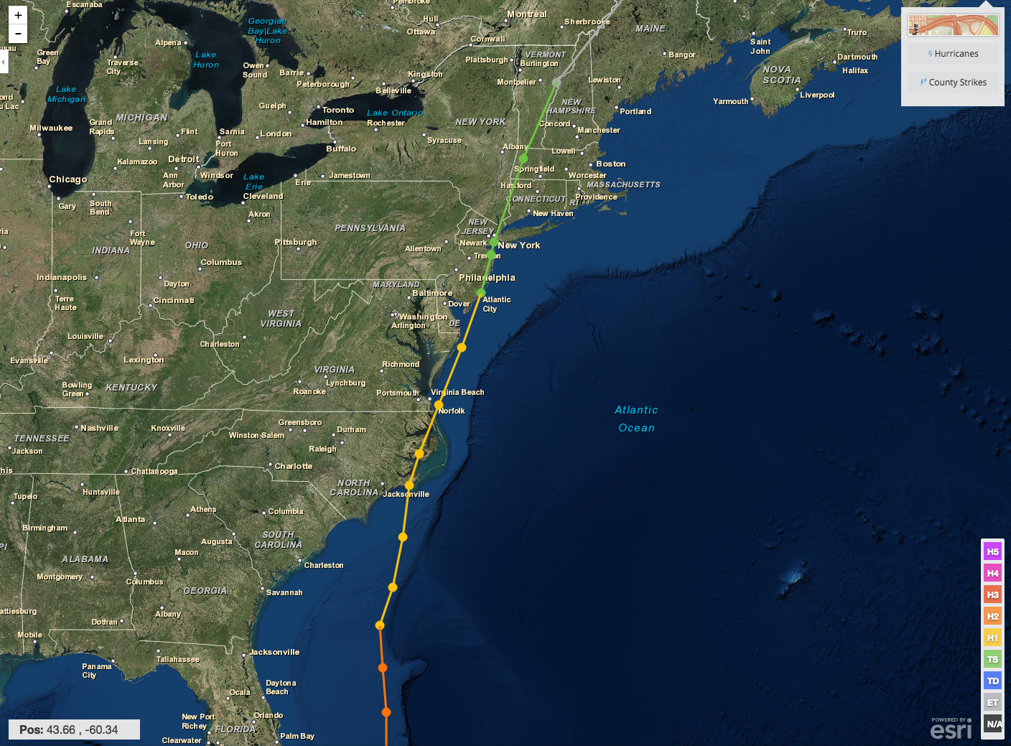
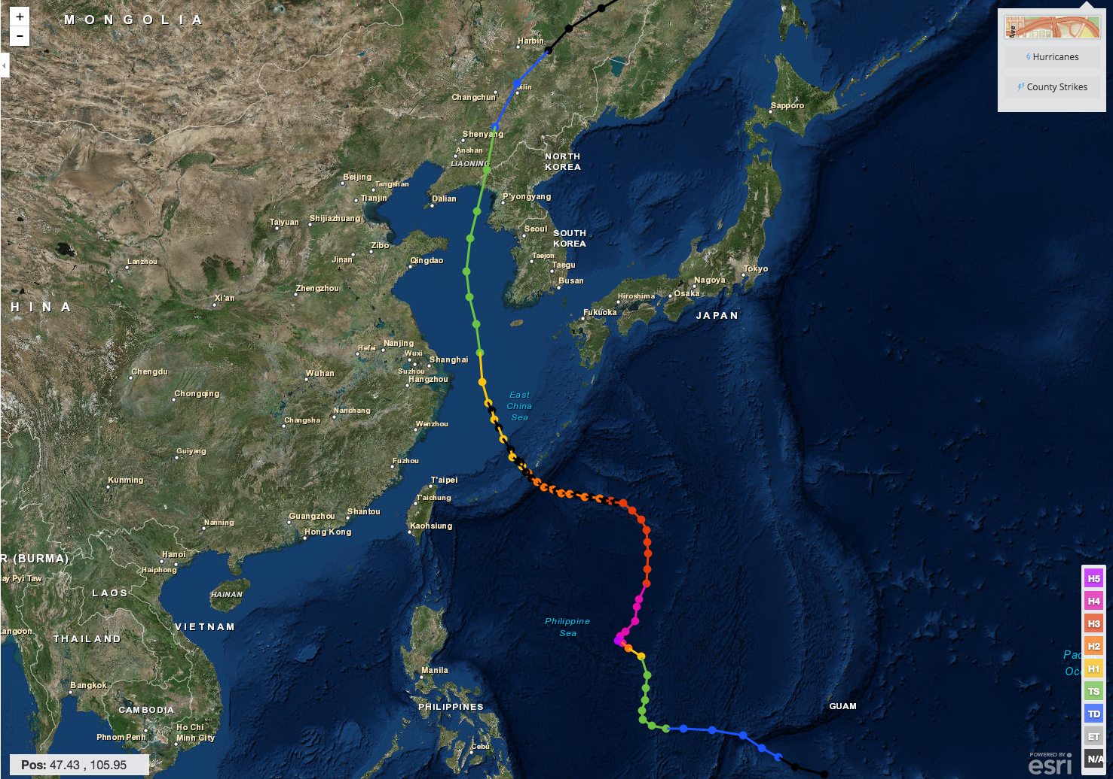
Hurricane Irene & Super-Typhoon Muifa:
What do these summer of 2011 storms have in common?
Hurricane Irene
26-29 August 2011
Super-Typhoon Muifa
26 July - 9 August 2011

Slide 5
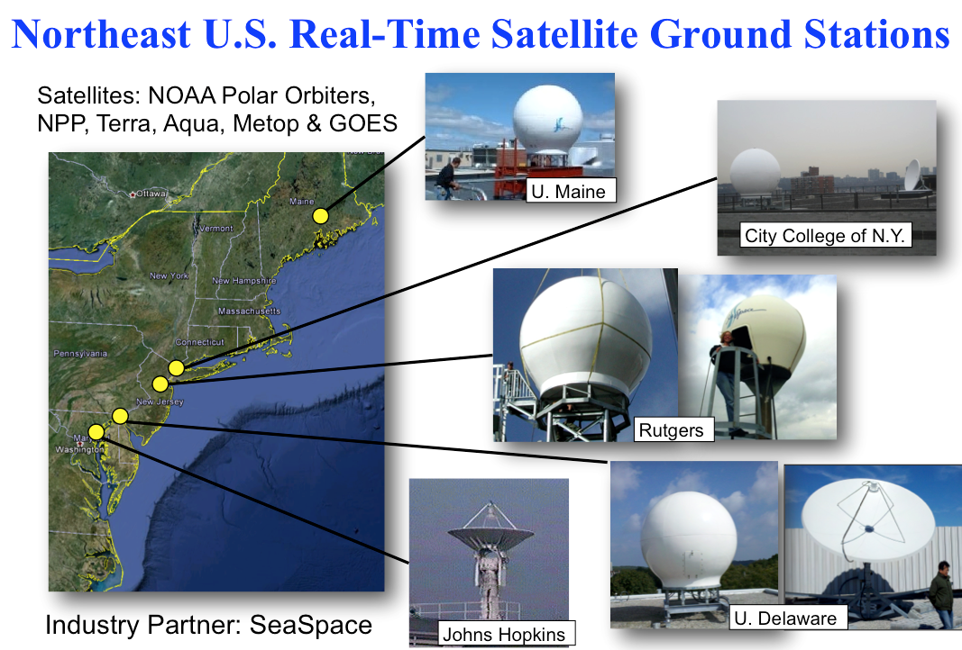
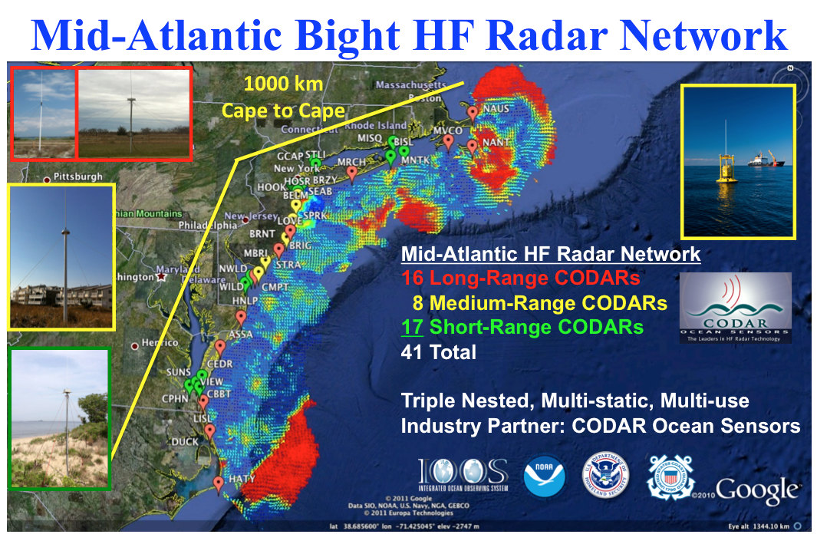
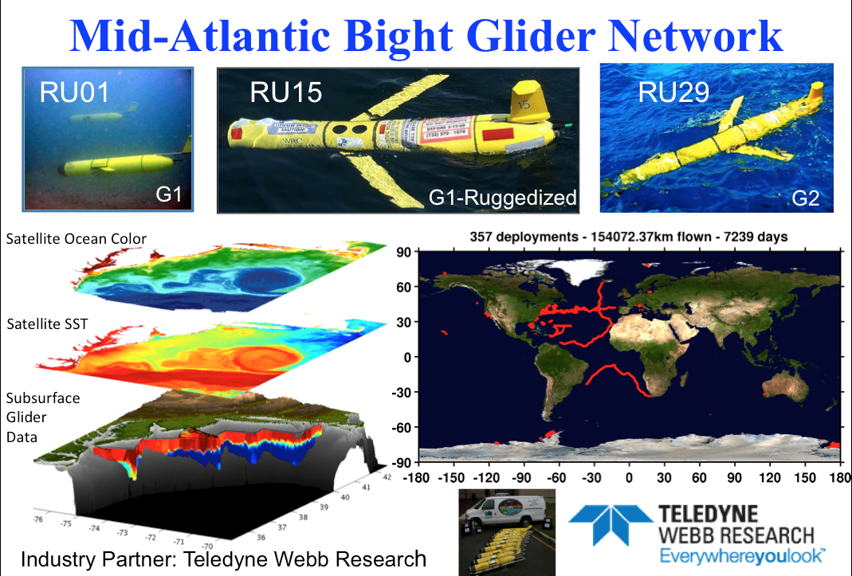
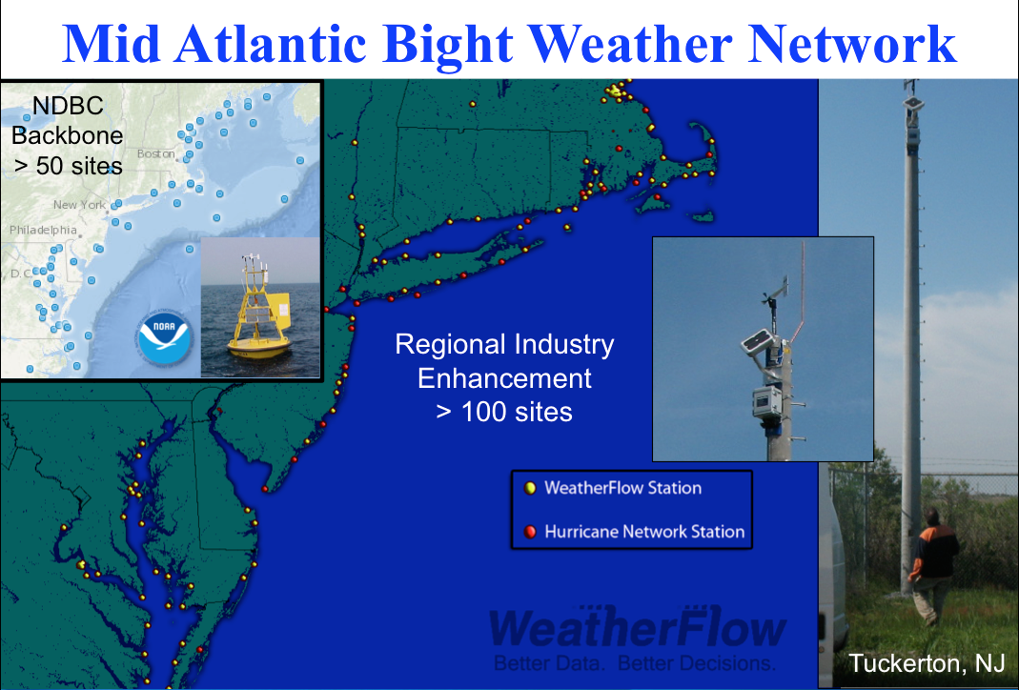
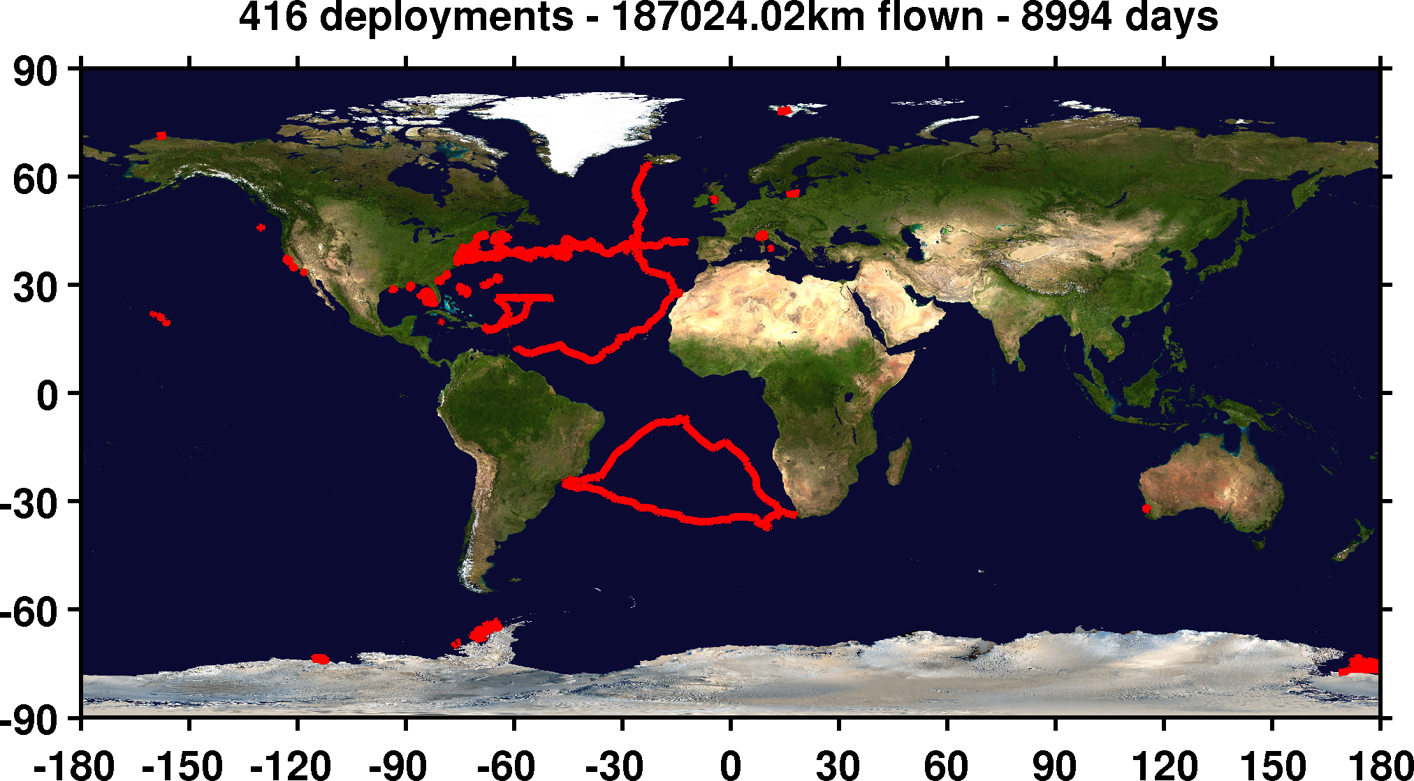
Mid-Atlantic Regional-Scale Observation Network

Slide 6
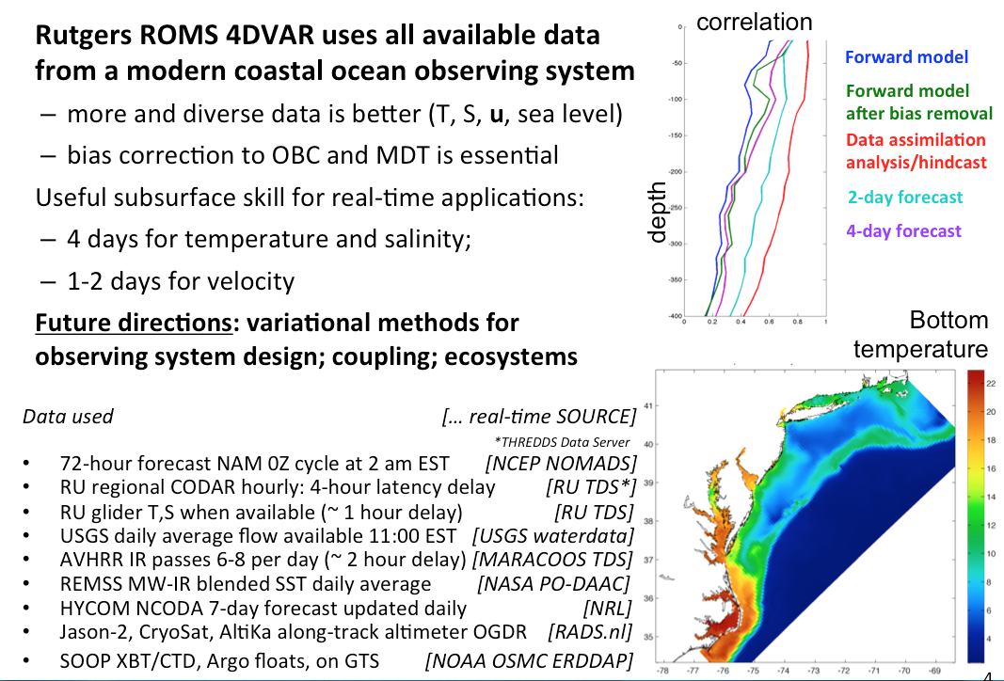
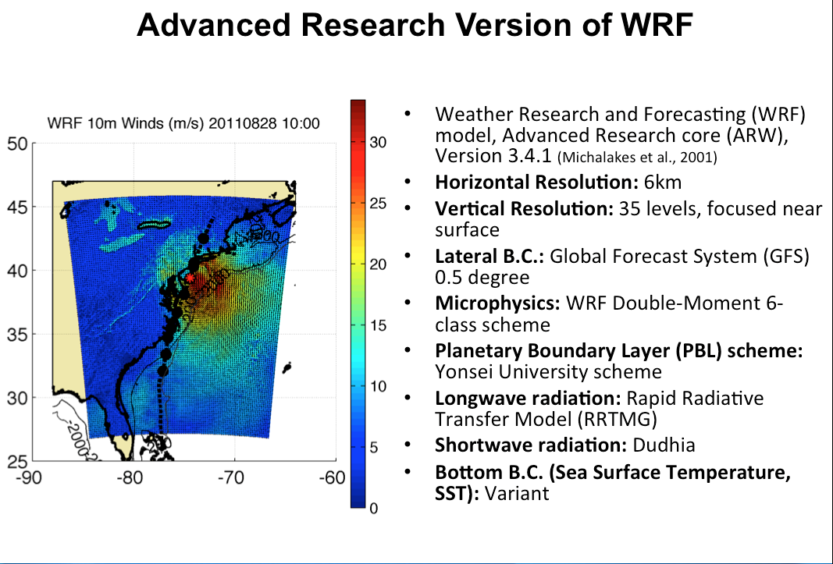

Mid-Atlantic Ensemble of Forecast Models Include:
Mid-Atlantic Operations Center @

Slide 7


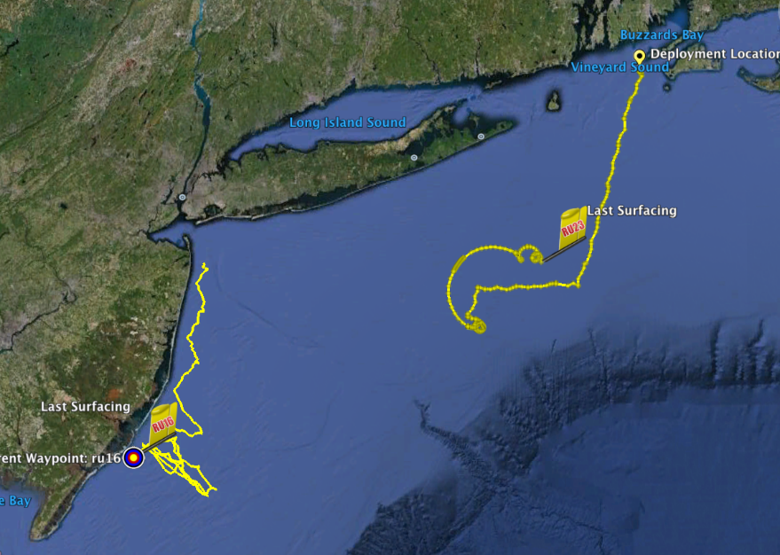
Hurricane Irene Track August 26-29 2011
Two Gliders Deployed

Slide 8
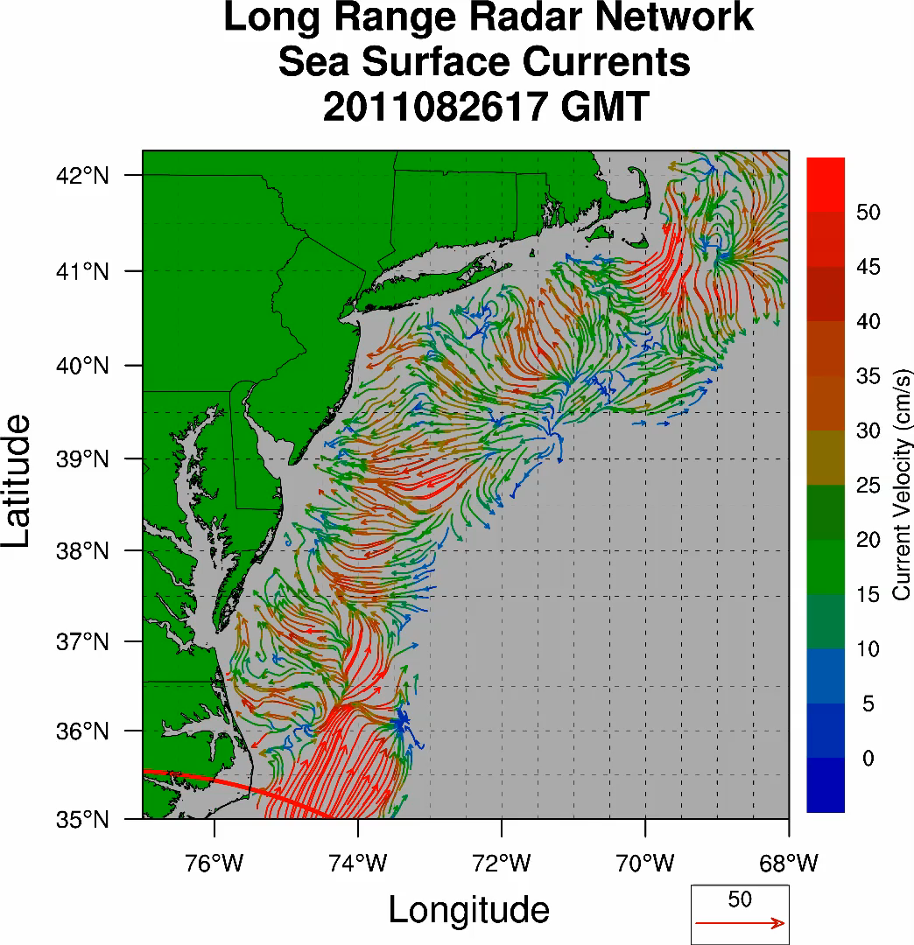
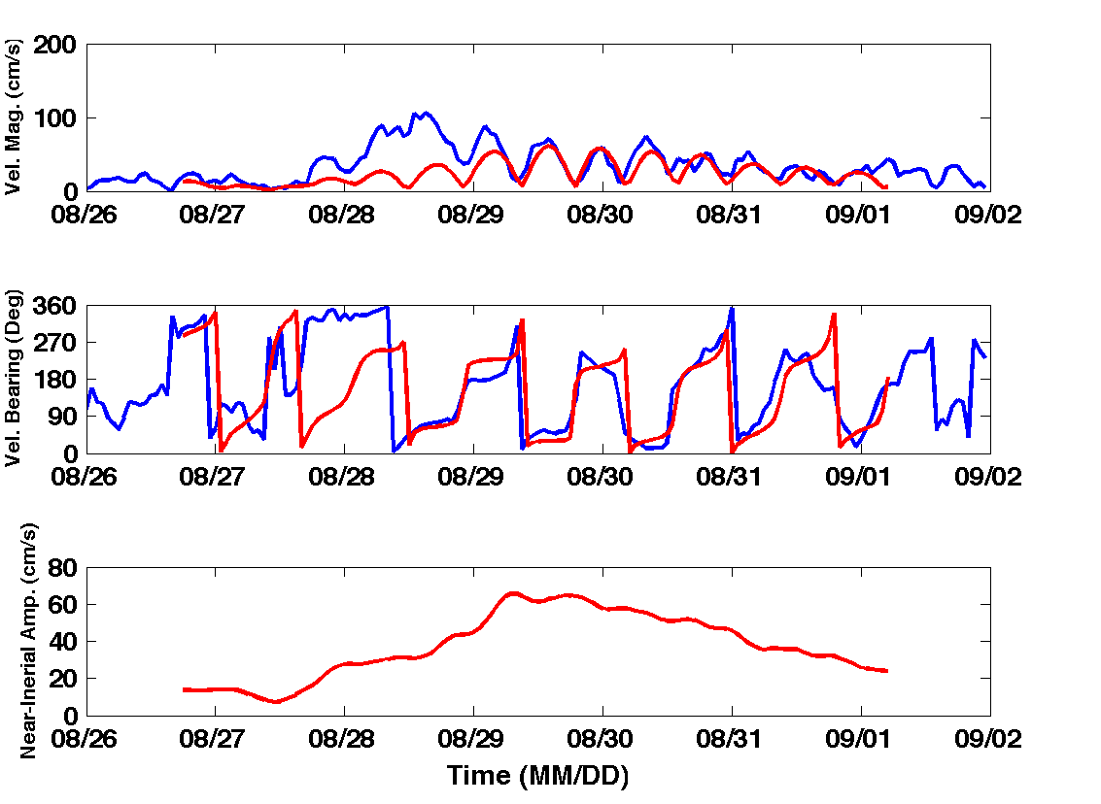
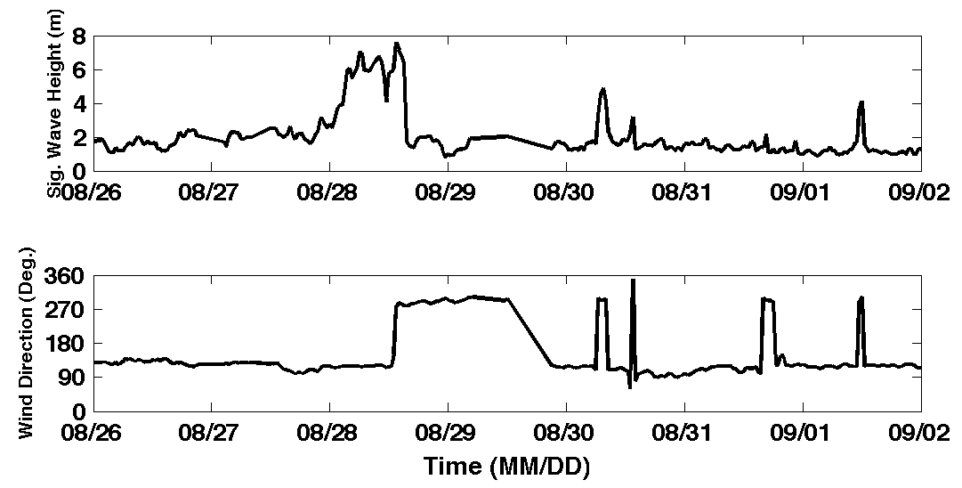
Hurricane Irene
39.5N 73W Surface Current Time Series
Total Current Near-Inertial Current
Wave & Wind Direction Time Series
Eye crosses NJ mid-day on Aug 28

Slide 9
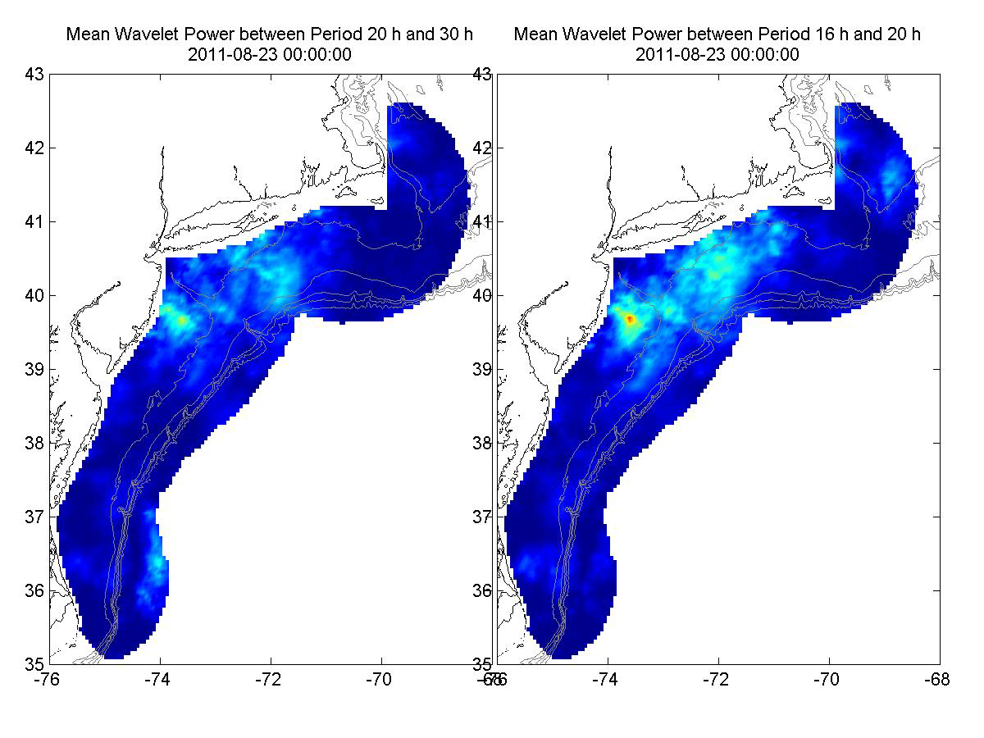
Hurricane Irene Surface Current Wavelet Analysis
Direct Wind Forcing
Inertial Response
Aug 27 Aug 28 Aug 29 Aug 30 Aug 31 Sep 01
Frontside Eye Backside Inertial Inertial Inertial

Slide 10
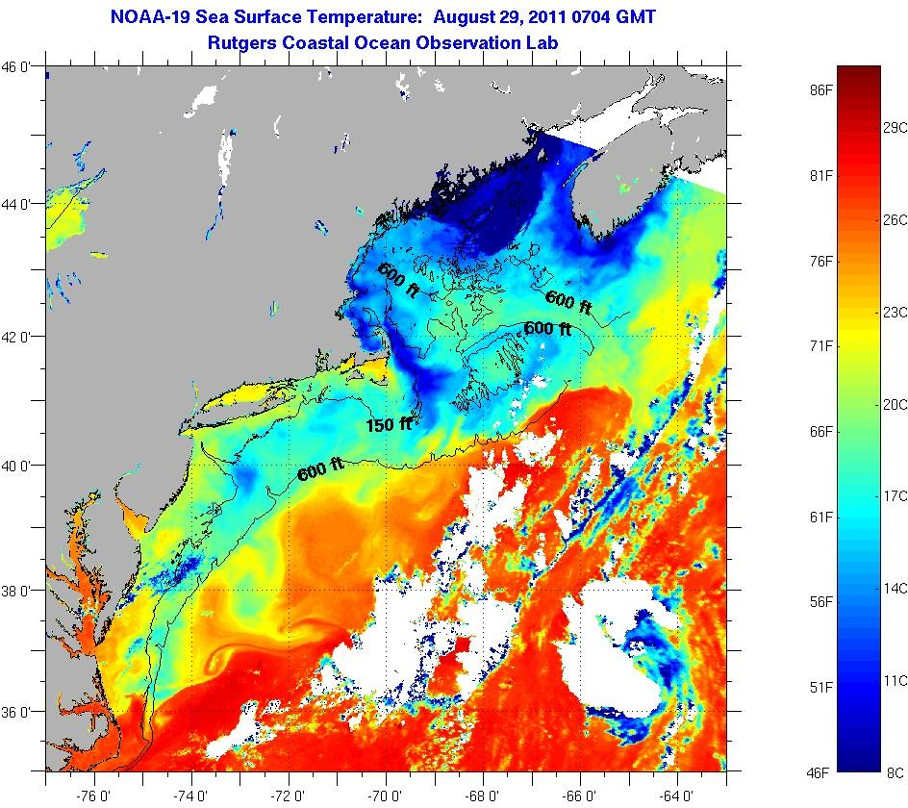
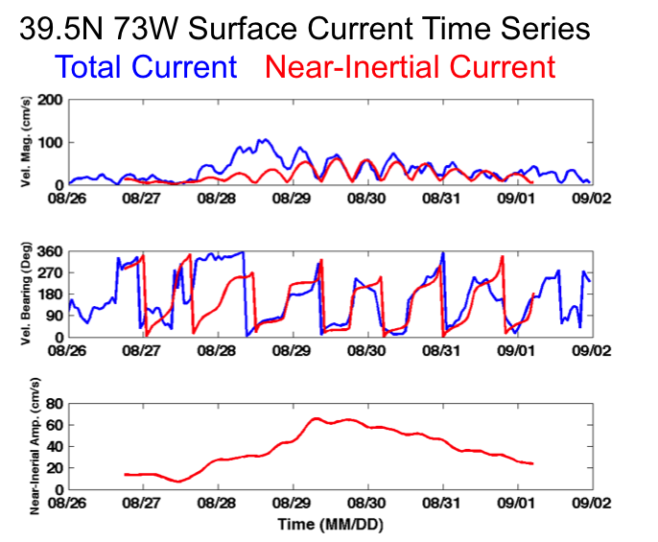
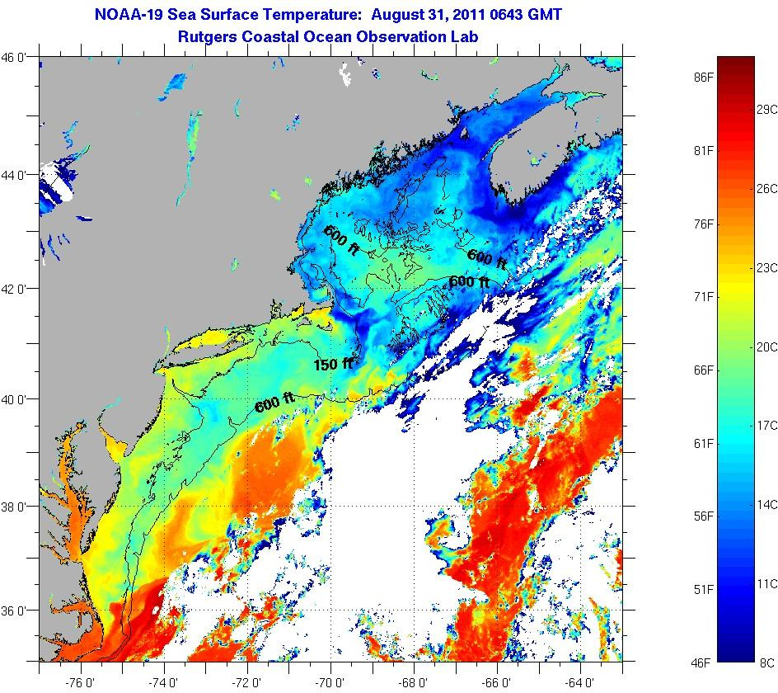
SST Response during Irene’s Inertial Tail
Significant SST cooling not observed.
In many locations SST warming observed.
August 29
SST
August 31
SST

Slide 11
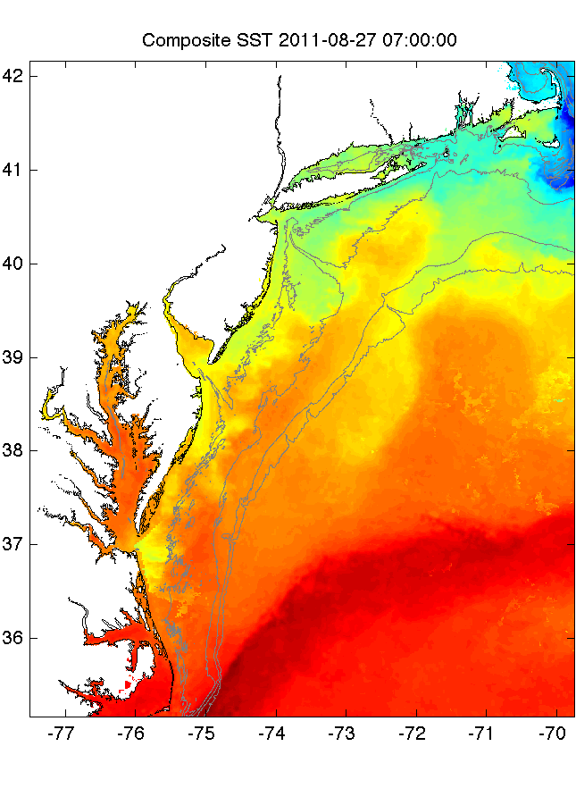
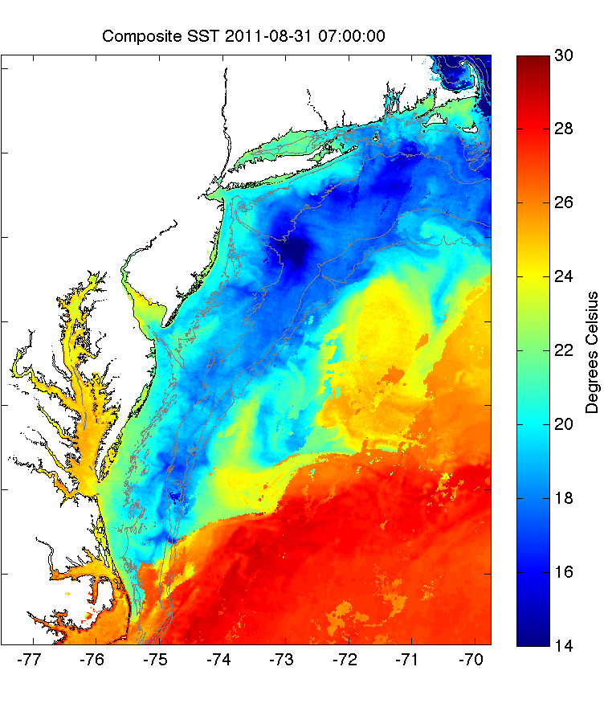
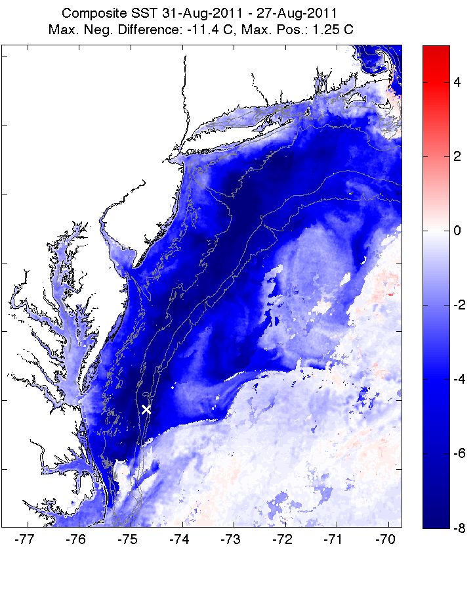
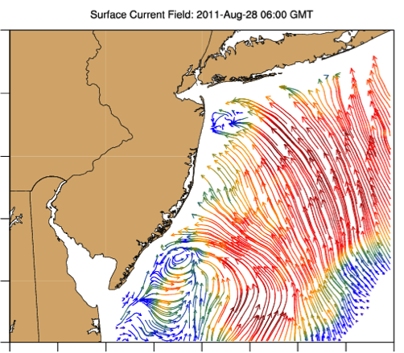
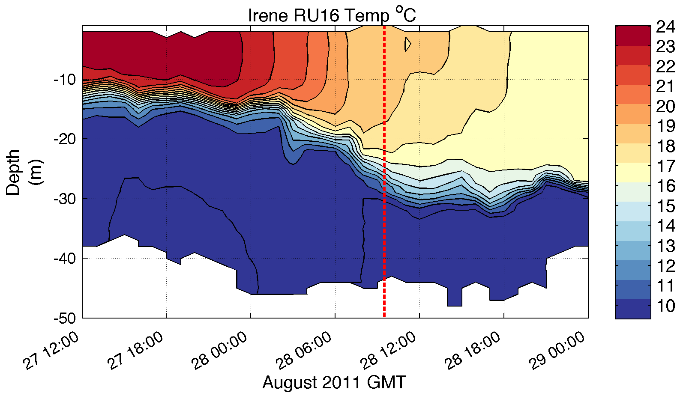
Direct Forcing Period
Pre-Irene
Post-Irene
Difference
11C max Cooling
WHAT?
Satellite
SST
WHEN? Glider Temperature
WHY?
HF Radar
Currents
Eye Passage

Slide 12
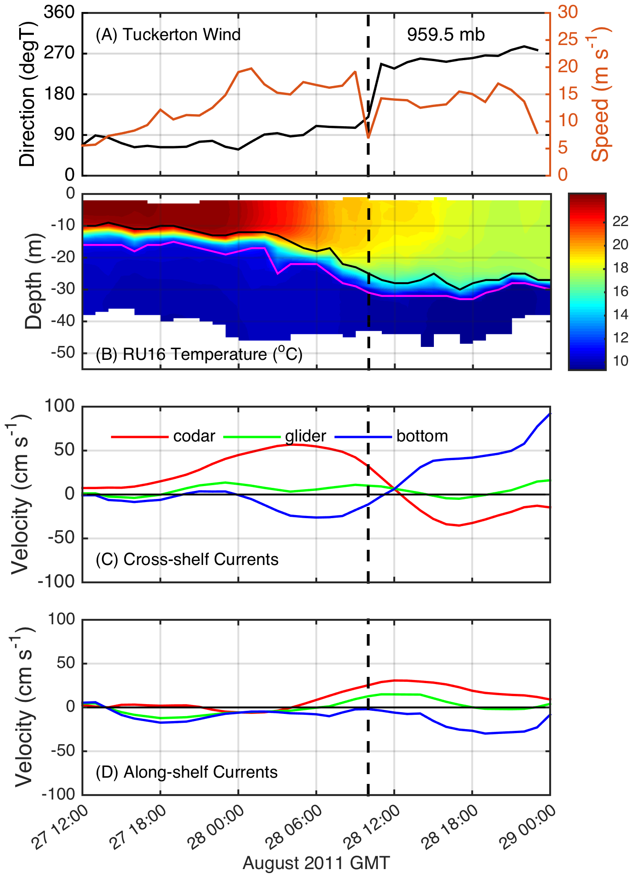
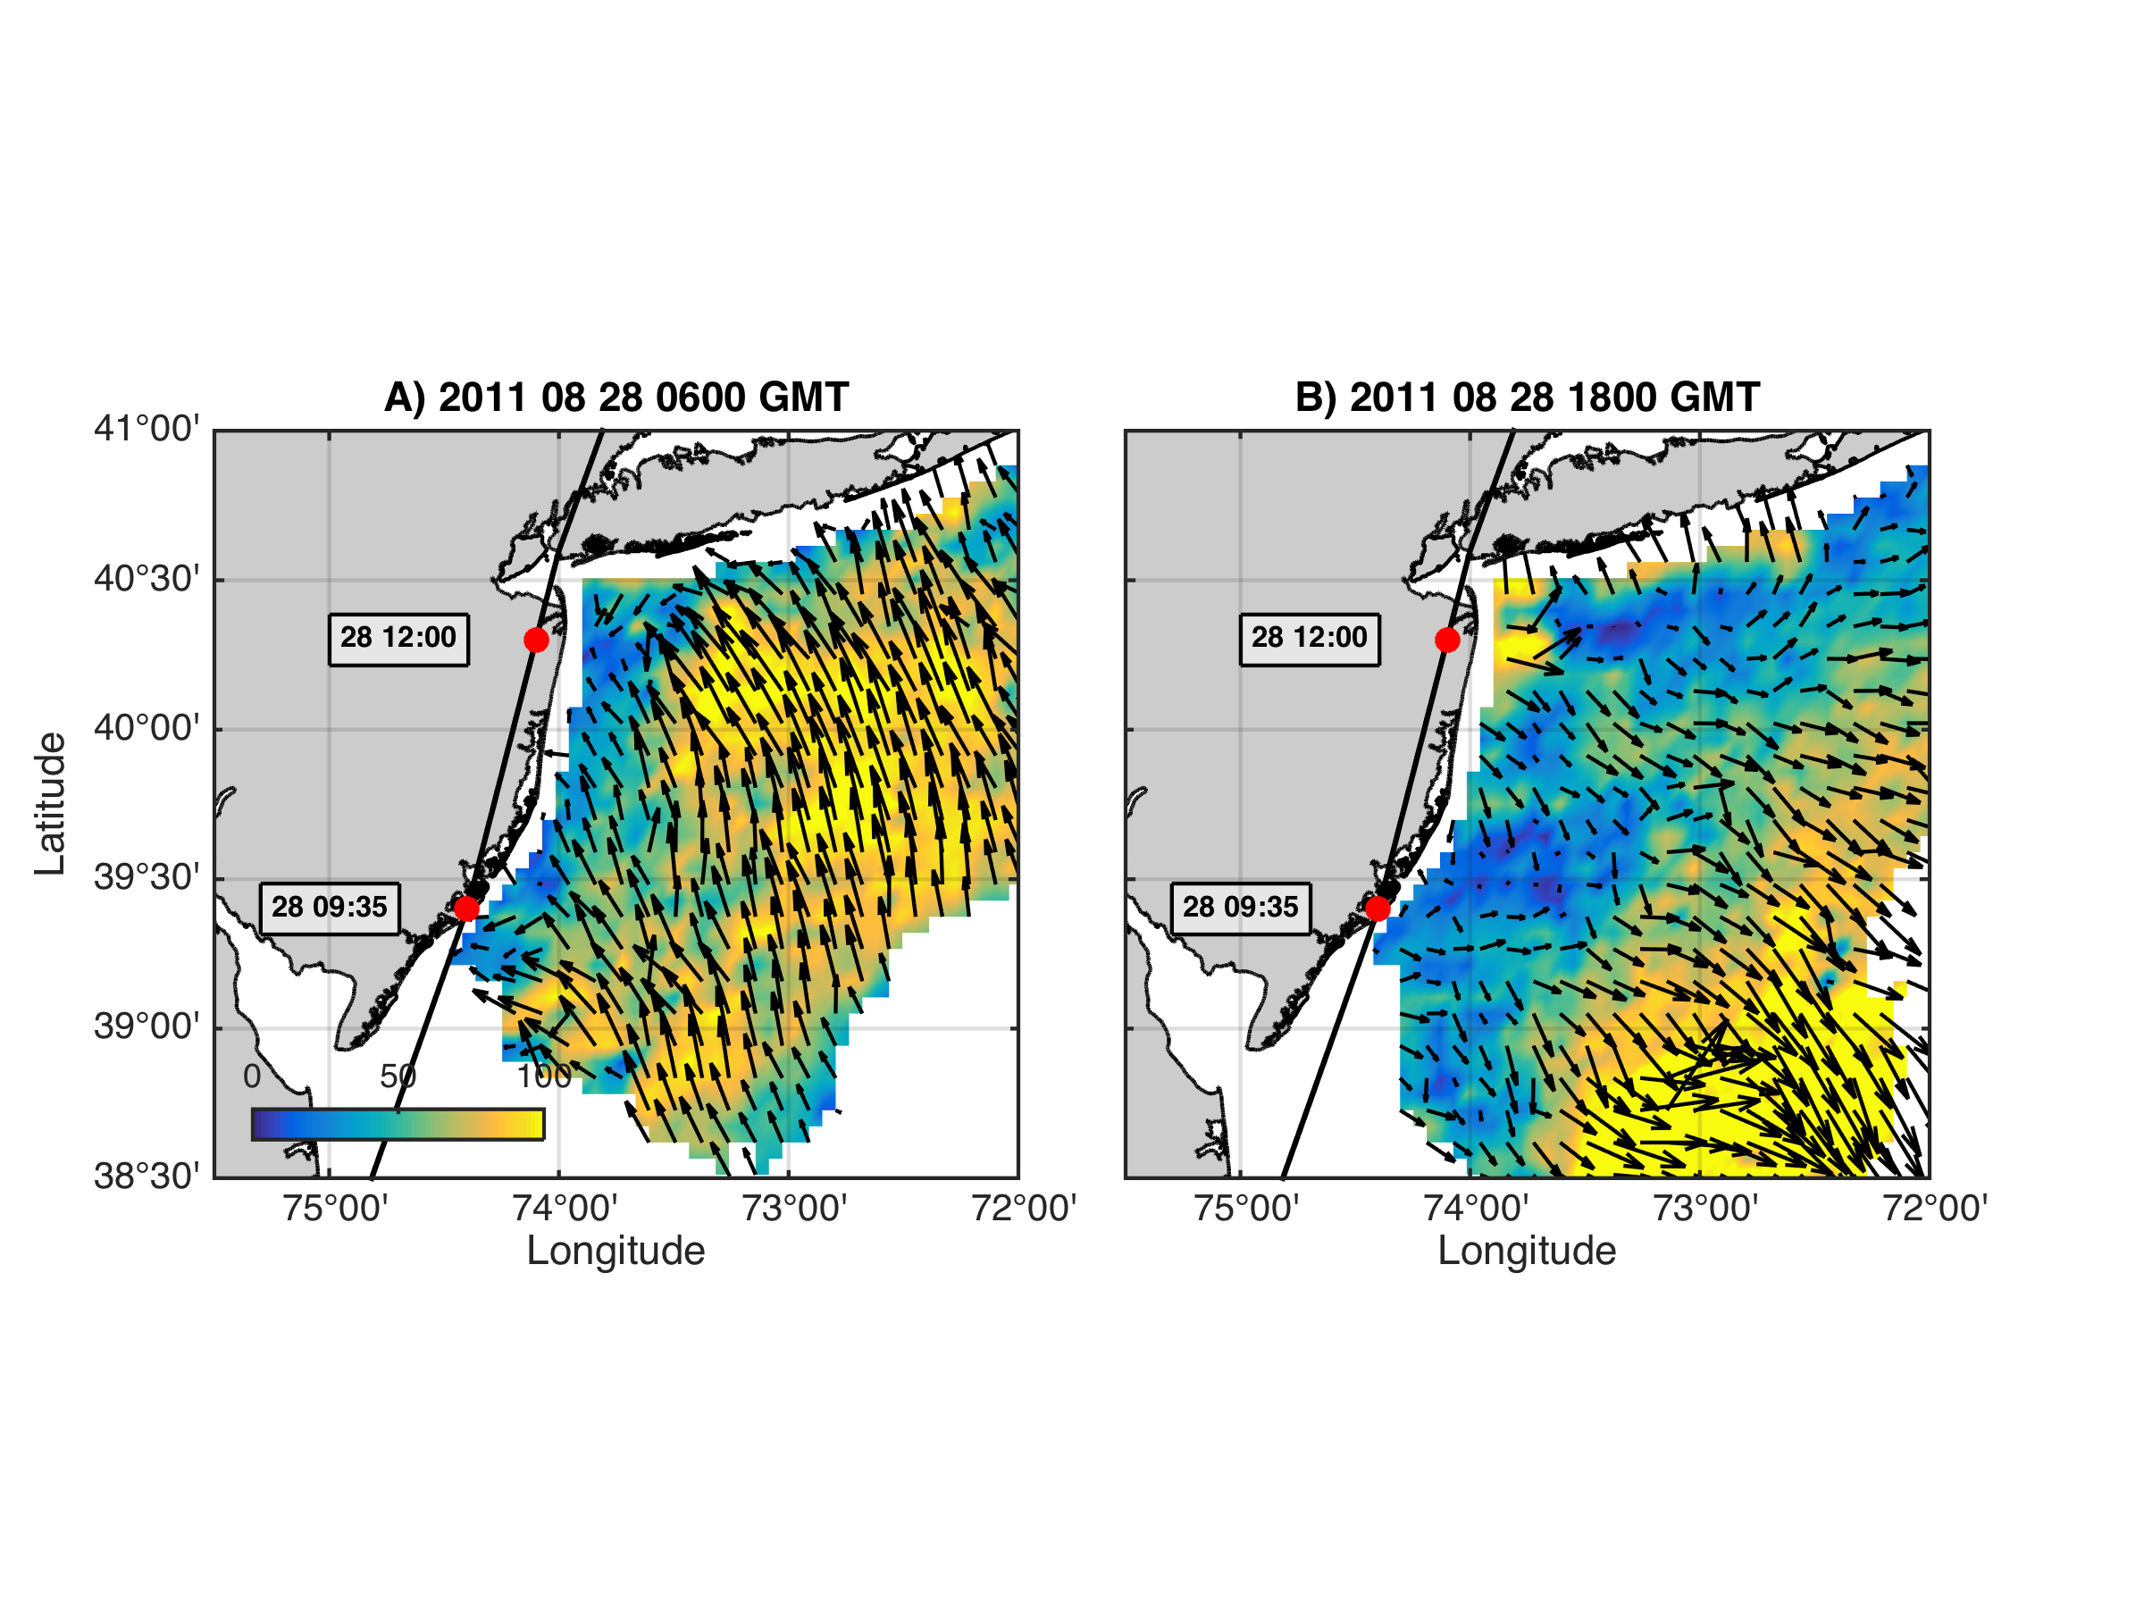
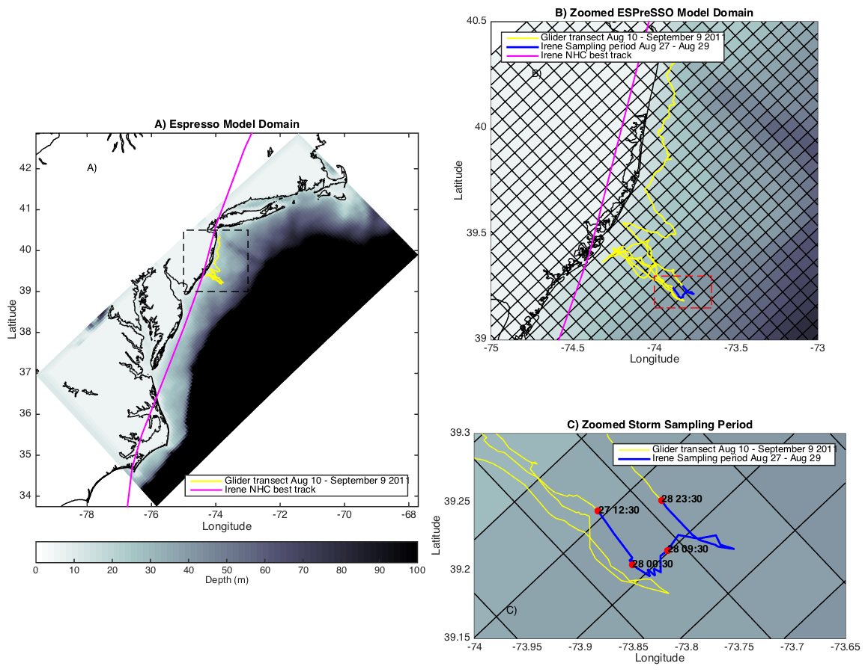
Coastal Baroclinic Circulation
HF Radar Surface Currents
Before Eye
After Eye
Before Eye After Eye
Glider Track, Model Grid
& Bathymetry
Storm Period in Blue

Slide 13
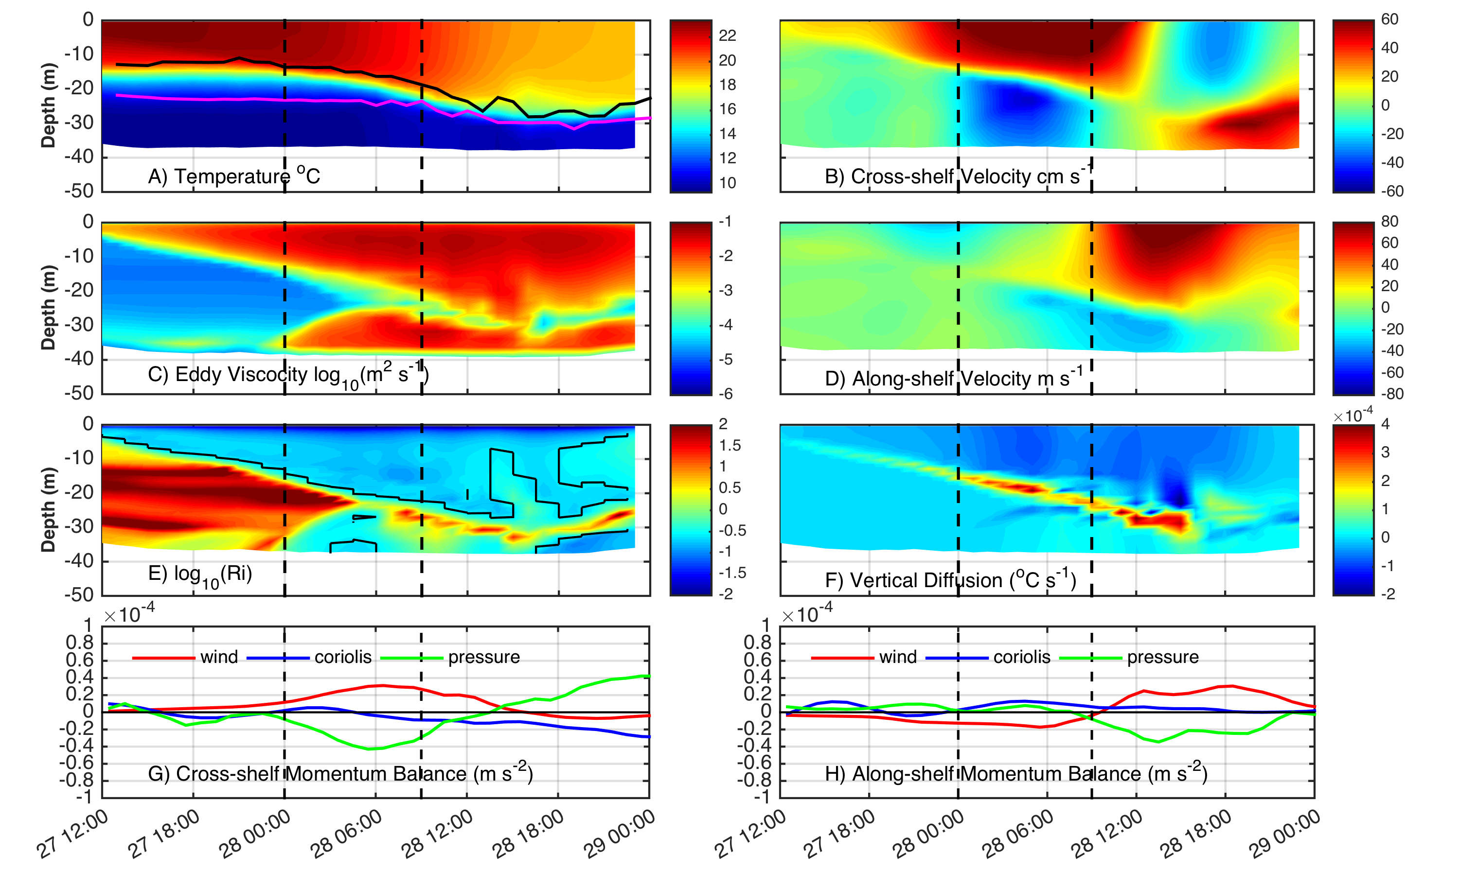
ROMS Model Results at Glider Location
Coastal Baroclinic Circulation Enhances Mixing & Cooling

Slide 14
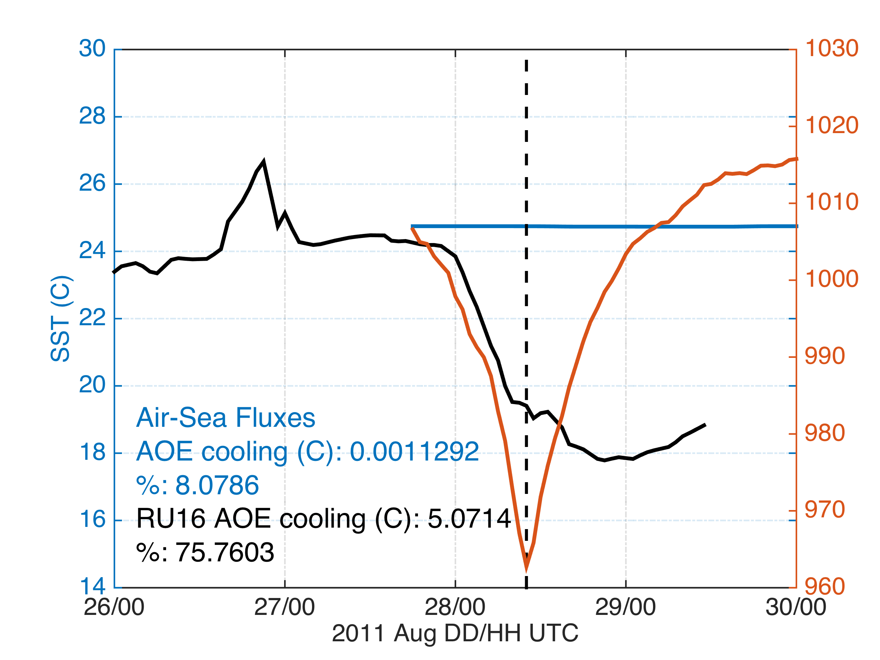
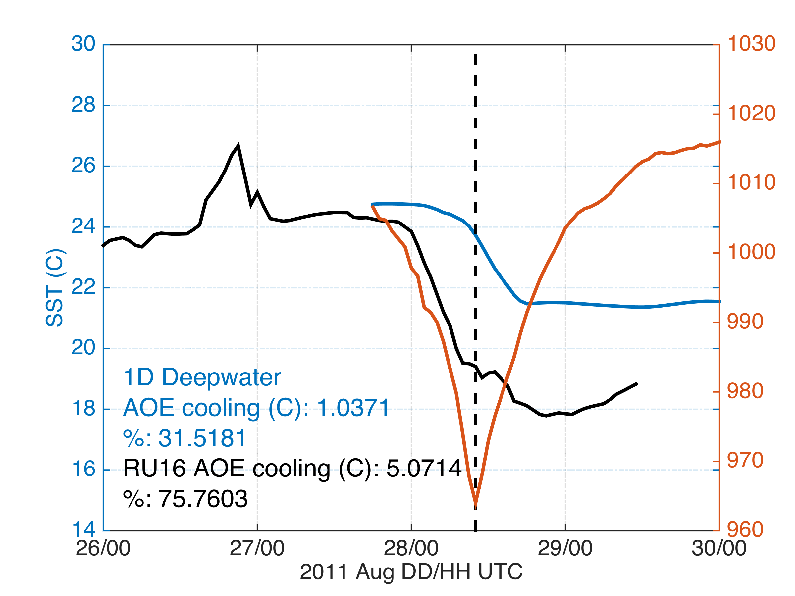
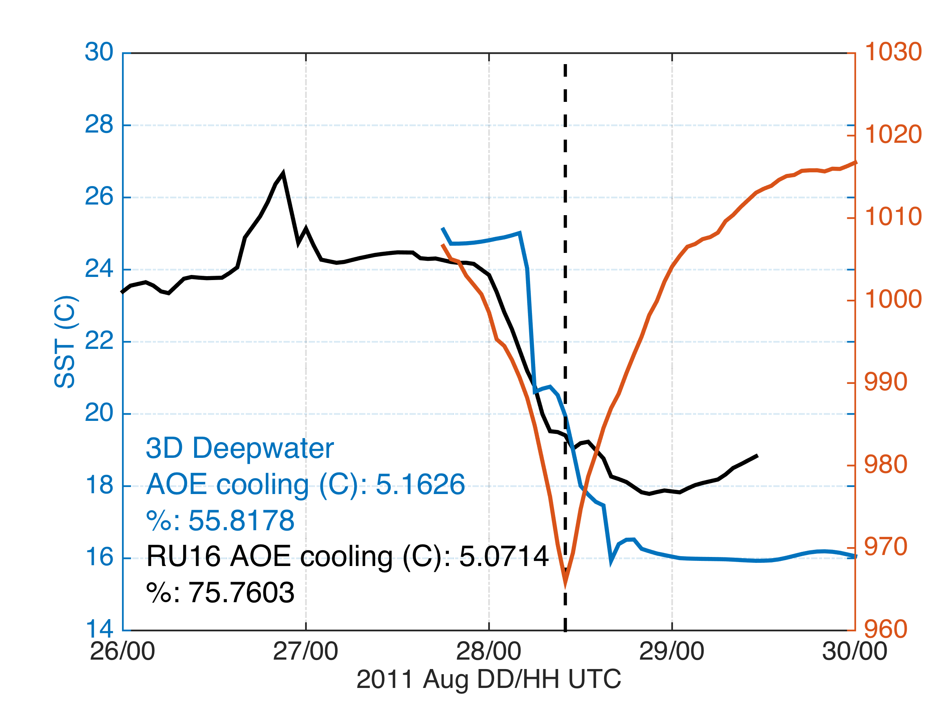
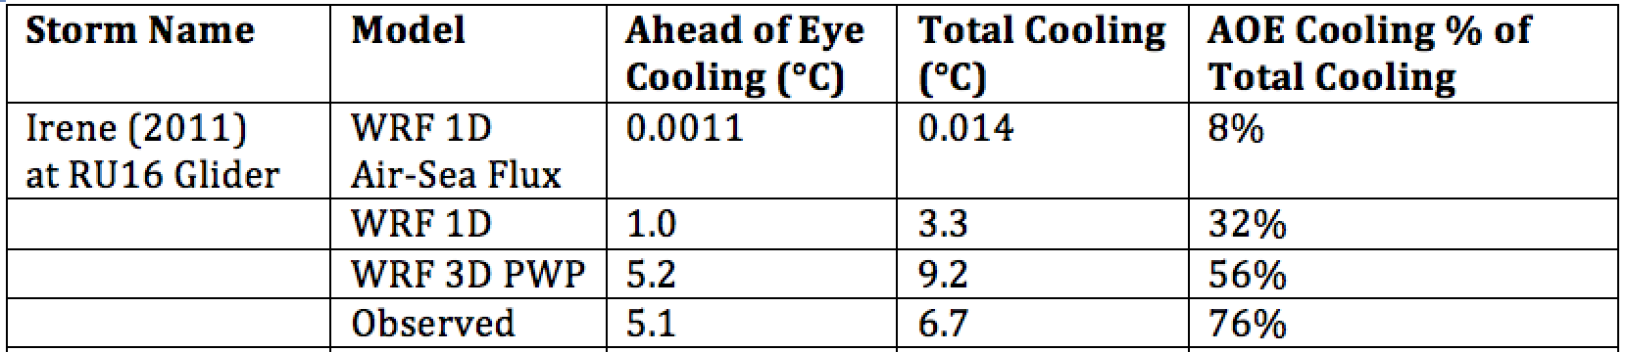
Modeled Deepwater Cooling Processes in Hurricane Irene
Air-Sea Fluxes Only
1-D Mixing
3-D PWP (Upwelling)
Storm-induced cooling in deep water is often equally distributed between the front and back half of the storm (Price et al., 1981)

Slide 15
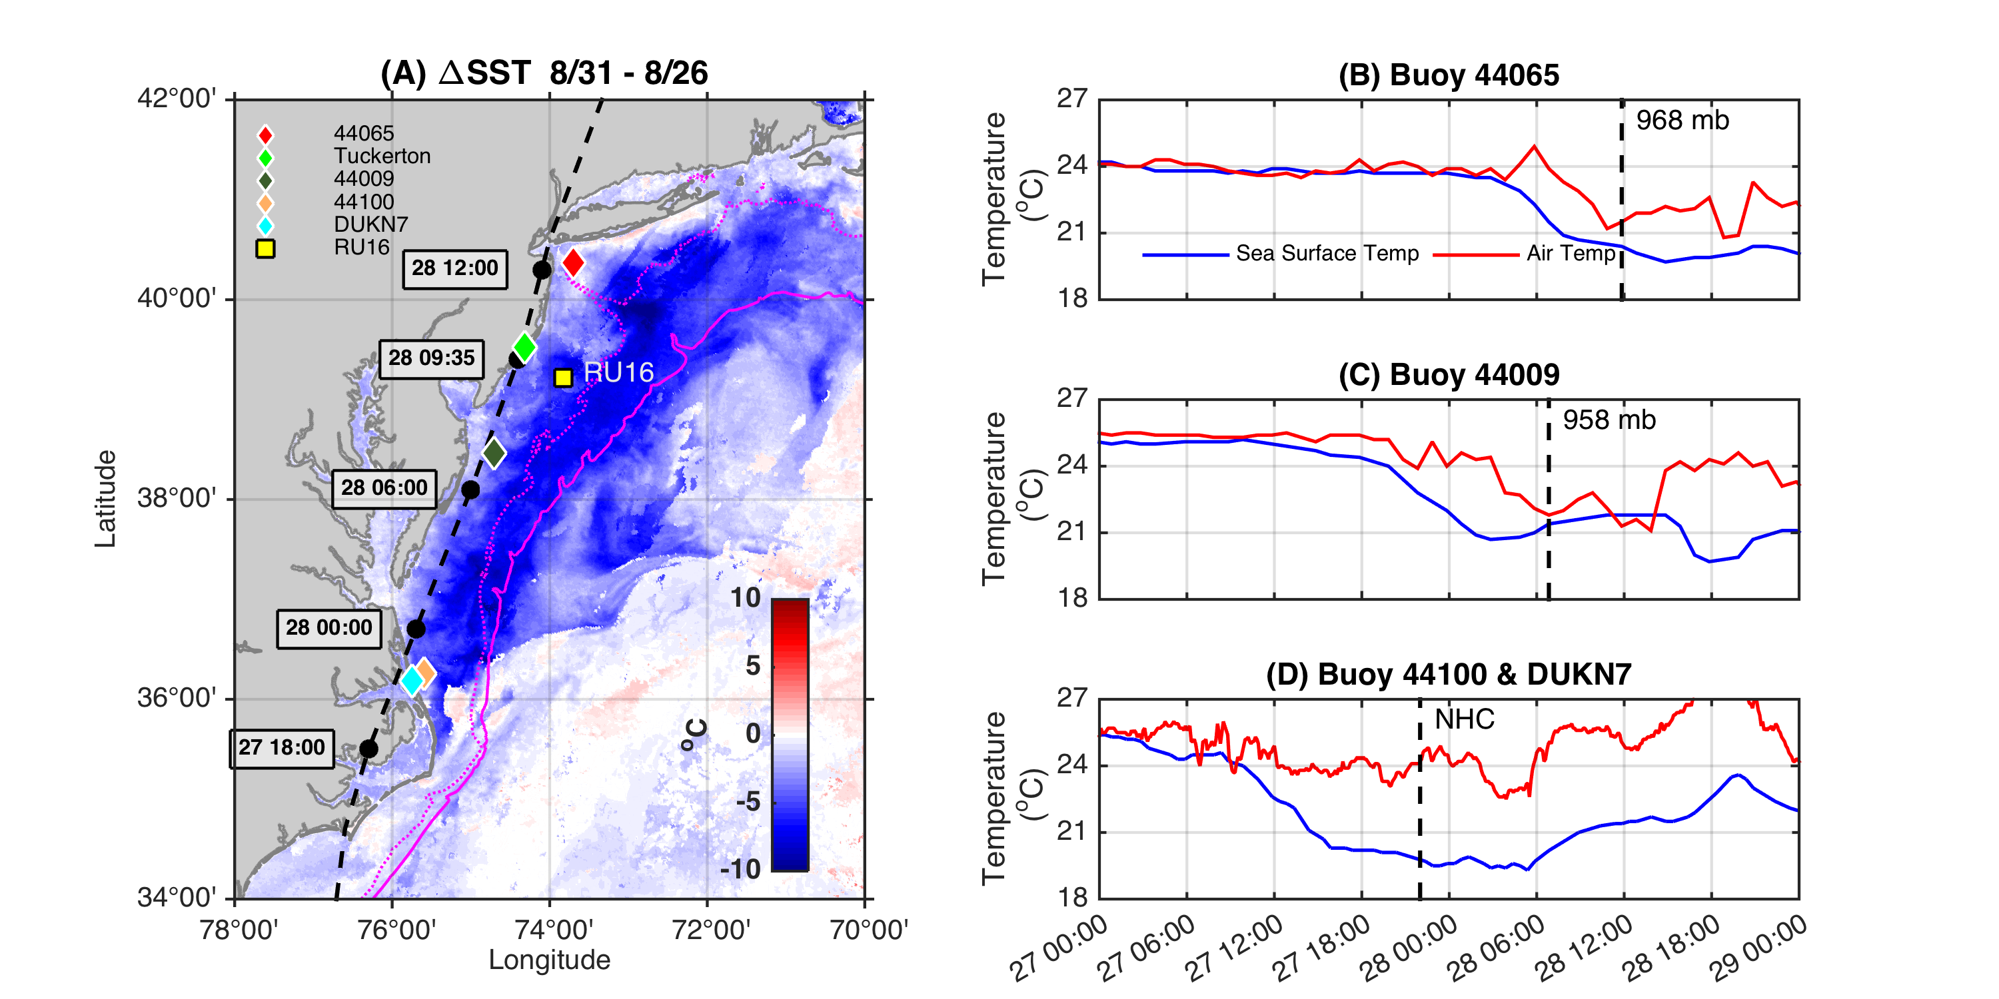
Ahead-of-Eye-Center Cooling in Irene:
Nearshore Buoy Observations
After - Before
85%
80%
94%

Slide 16
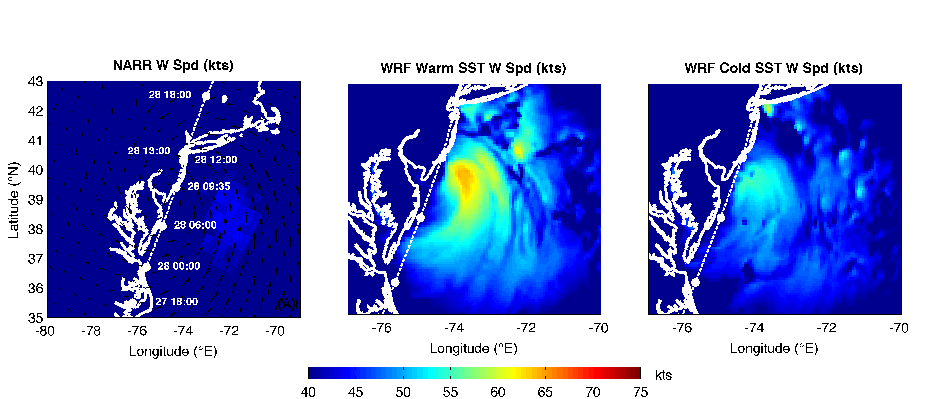
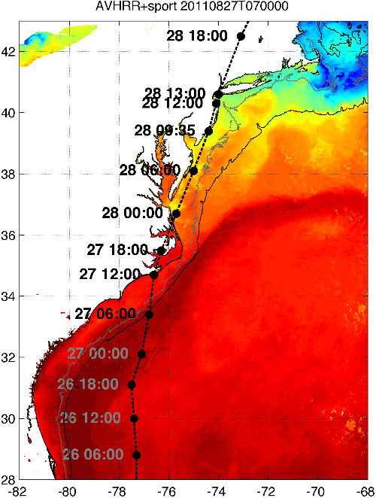
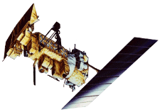

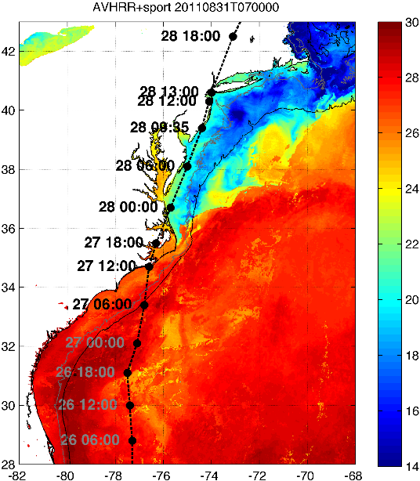

Rutgers Atmospheric Forecast Sensitivity Study
Warm Ocean
Boundary Condition
Cat 1 Hurricane
Tropical Storm
Cold Ocean
Boundary Condition
IMPACT?
>10 knots reduction in peak wind speed
Notes:
76-94% cooling ahead-of-eye
Average = 84% cooling ahead-of-eye

Slide 17
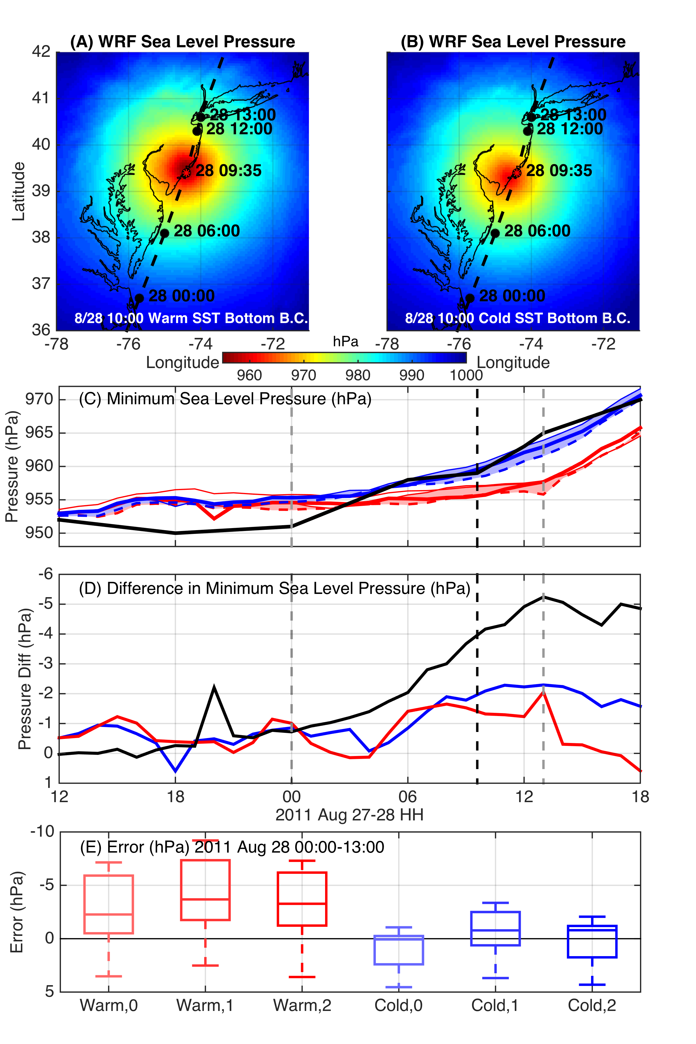
WRF Model Sensitivity Study
Over 140 model runs
Paired to compare sensitivities
Central pressure & max wind
Sensitivity to SST greatest
Seroka, Miles, Xu, Kohut, Schofield & Glenn,
Hurricane Irene Sensitivity to Stratified Coastal Ocean Cooling, In Revision, Monthly Weather Review

Slide 18
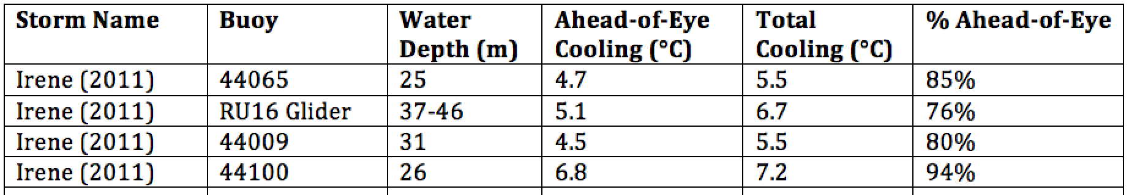
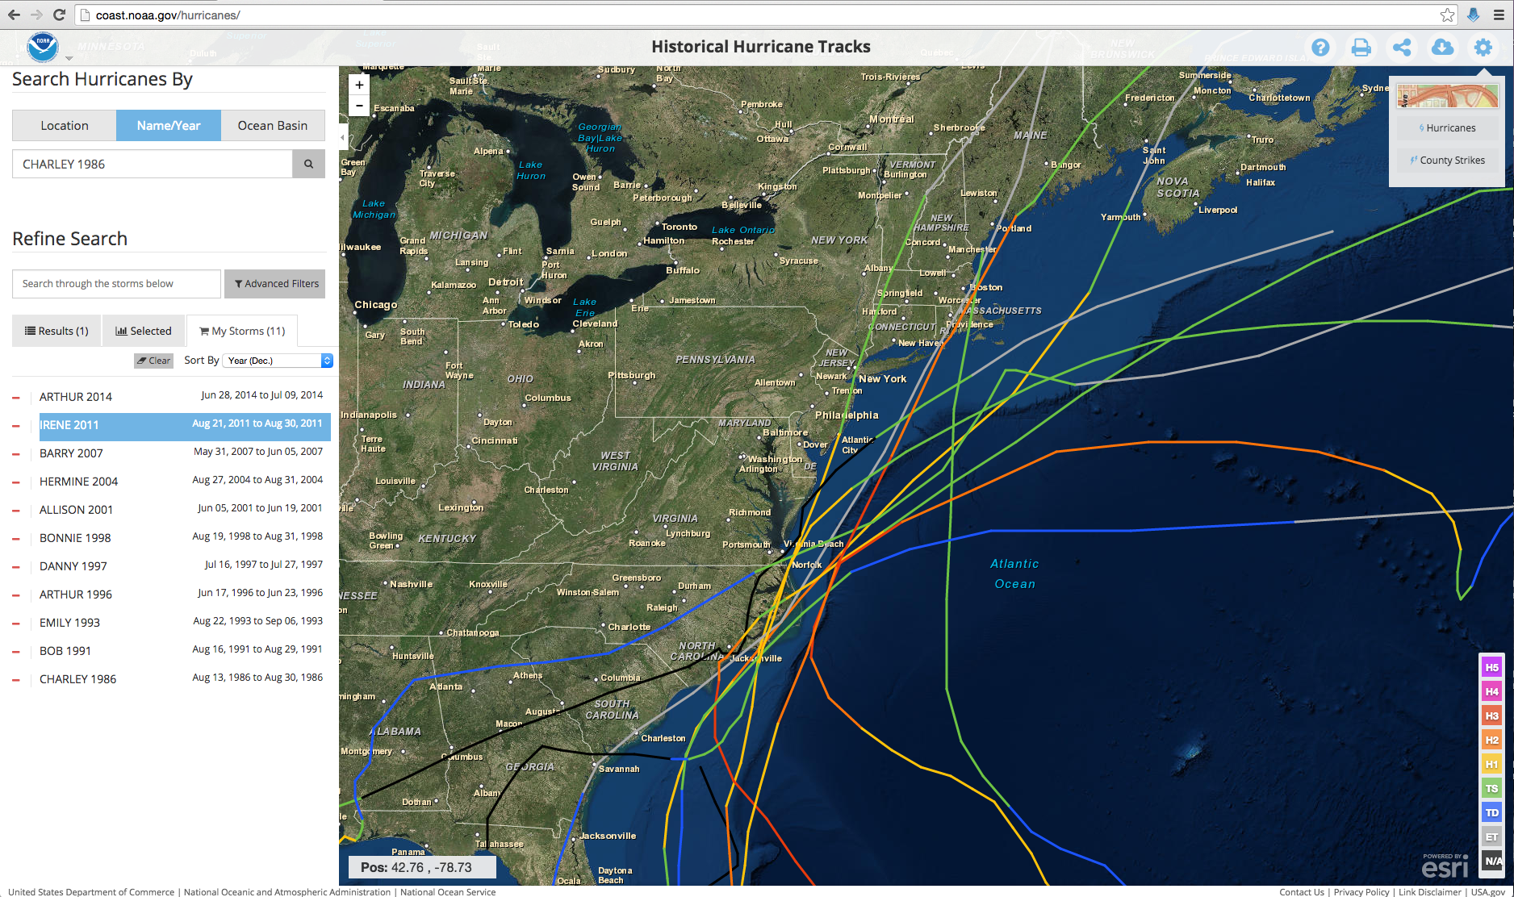
Historical Hurricanes Crossing the
Middle Atlantic Bight Continental Shelf in Stratified Season

Slide 19
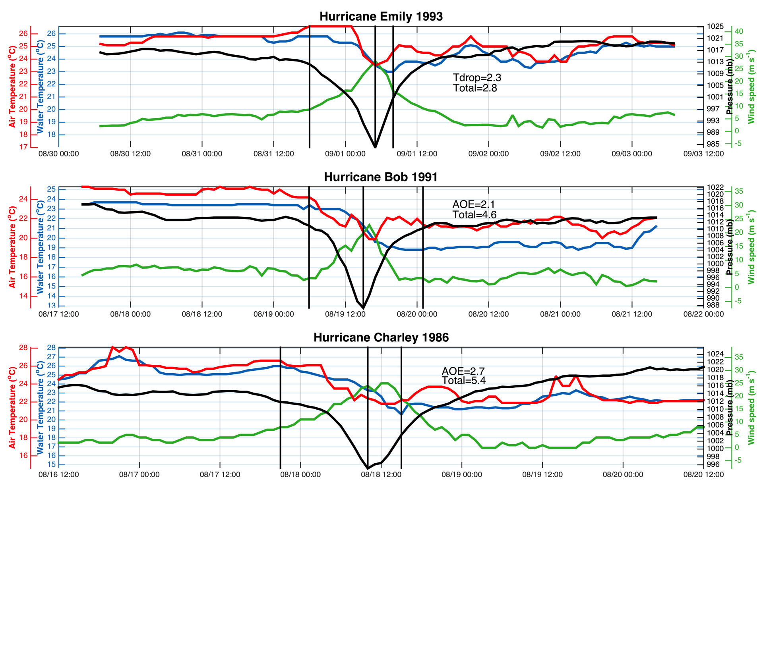
Ahead-of-Eye-
Center Cooling:
Water Temp
Air Temp
Air Press
Wind Speed
First
Three
Hurricanes
Objective criteria:
Hurricane eye over MAB continental shelf in stratified summer season (June-August)
Buoy must have air pressure, wind speed, water temperature (air temperature bonus)
First vertical line is warmest water temperature when wind speed exceeds 5 m/s
Center line is coolest temperature before pressure minimum
Last line is coolest temperature after pressure minimum & wind speed below 5 m/s

Slide 20
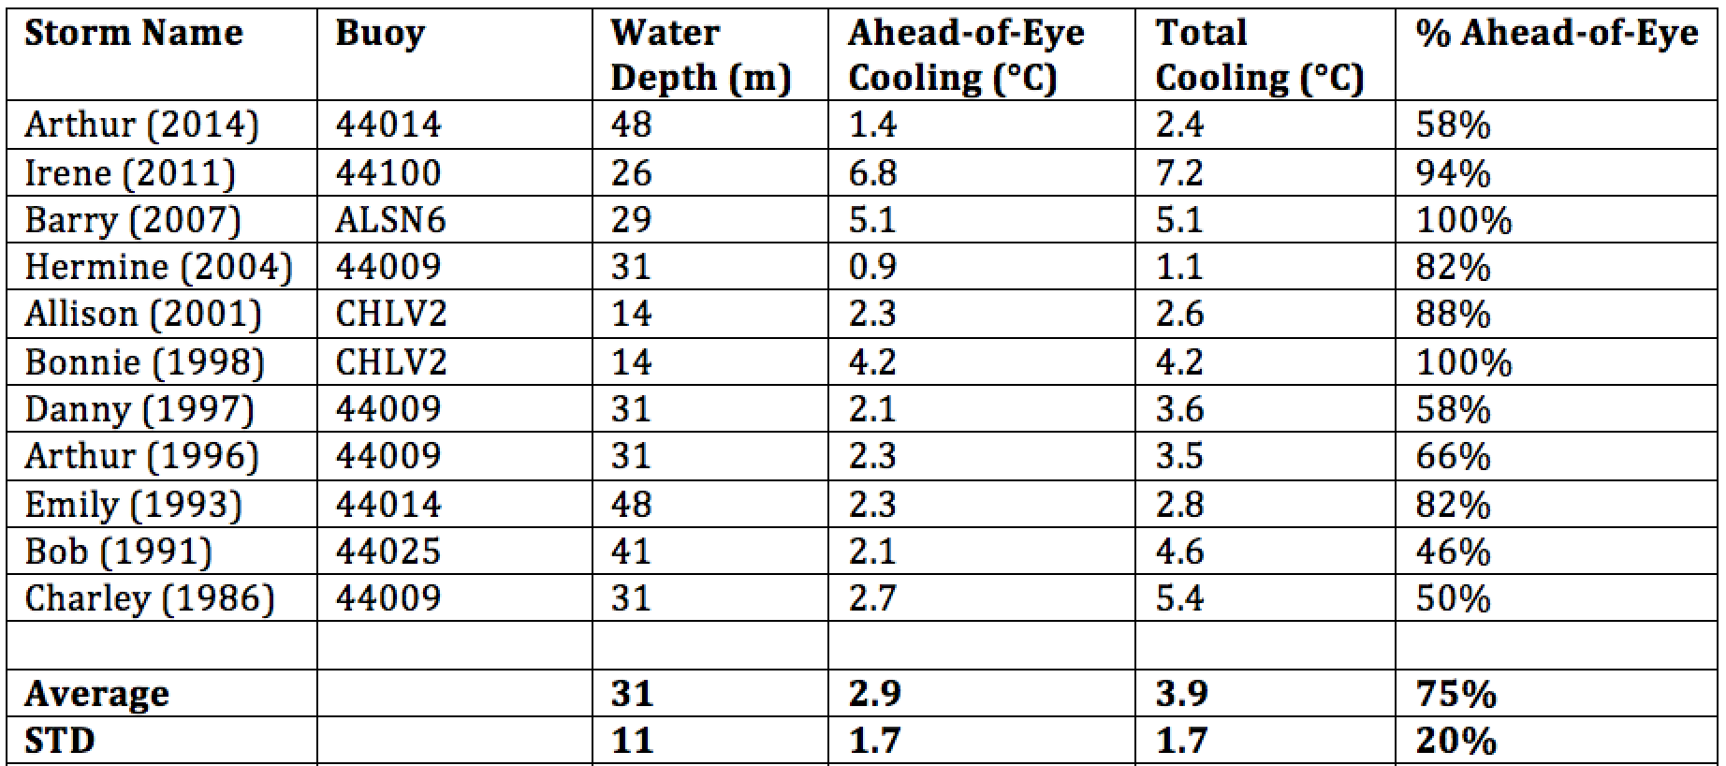
Historical Hurricanes Crossing the MAB in Stratified Season
Observed Ahead-of-Eye-Center Cooling
Storm-induced cooling in deep water is often equally distributed between the front and back half of the storm (Price et al., 1981)

Slide 21
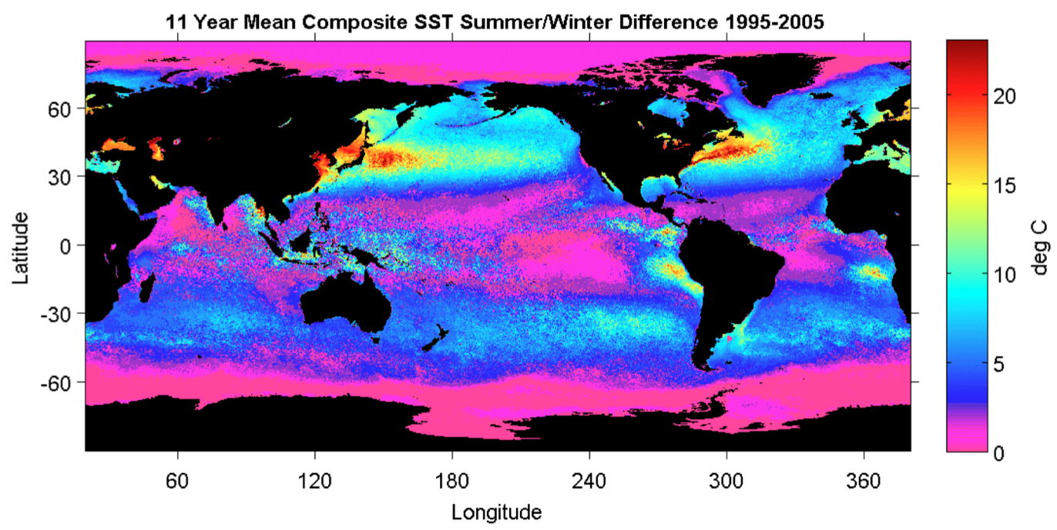
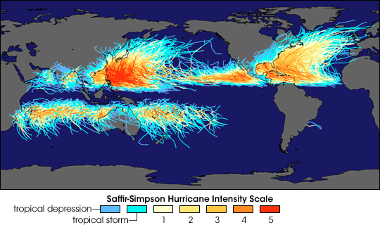
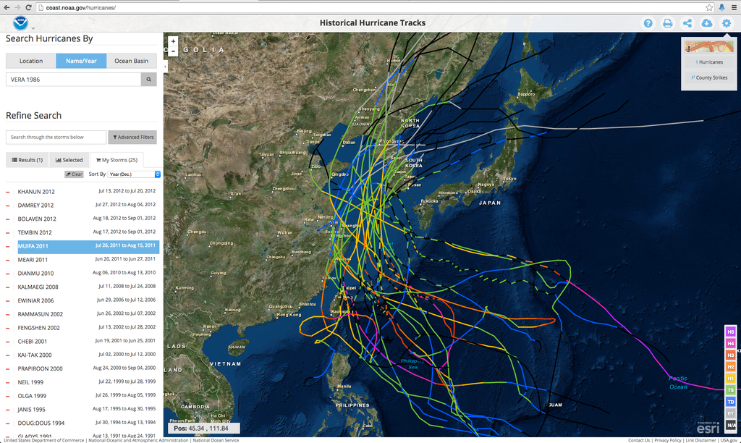
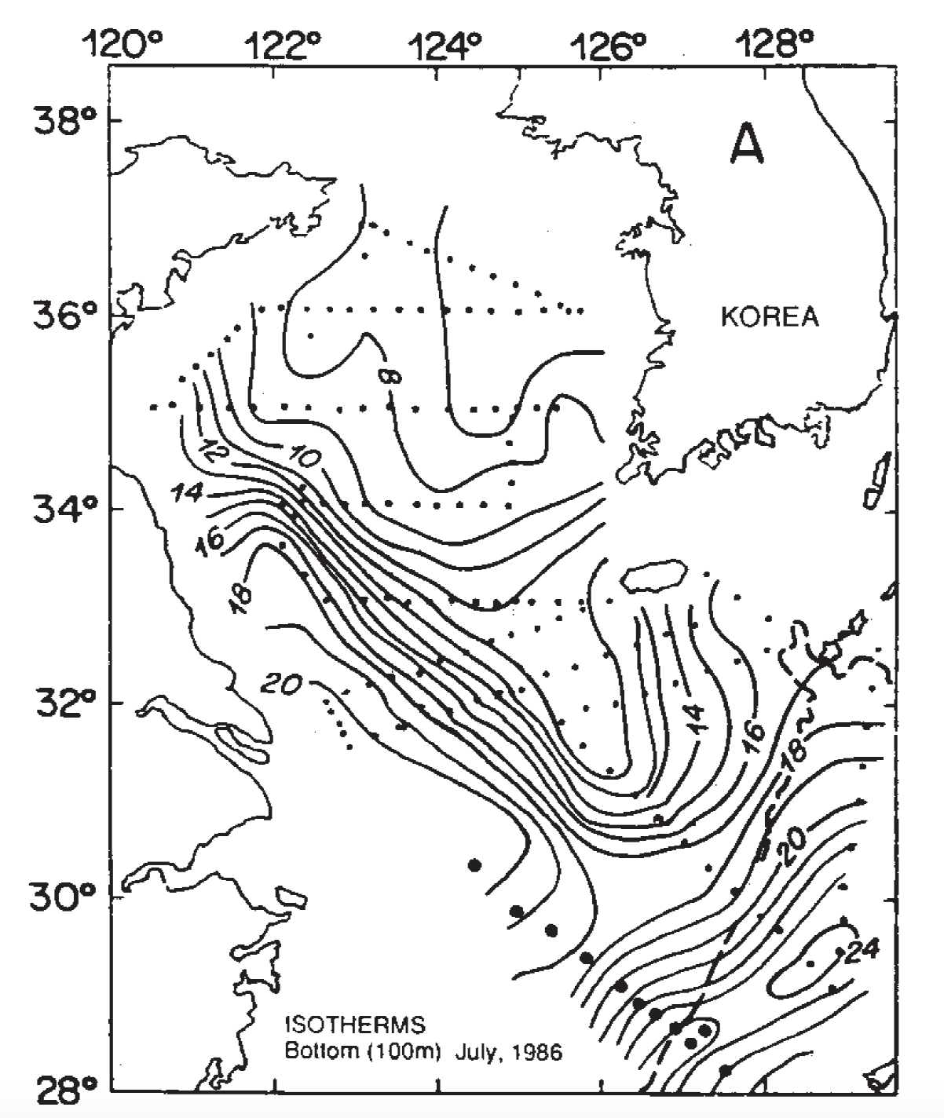
Historical Typhoons Crossing the Yellow Sea in the Stratified Season
Summer/Winter SST Difference
Ramya Ramadurai, 2009
Bottom Temp
26 Typhoons
tracked across northern East China Sea & Yellow Sea since 1985
Chen et al., CSR, 1992

Slide 22
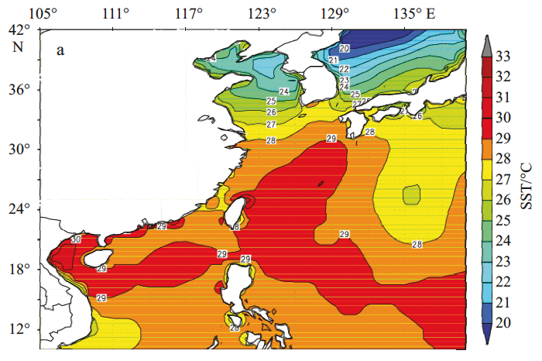
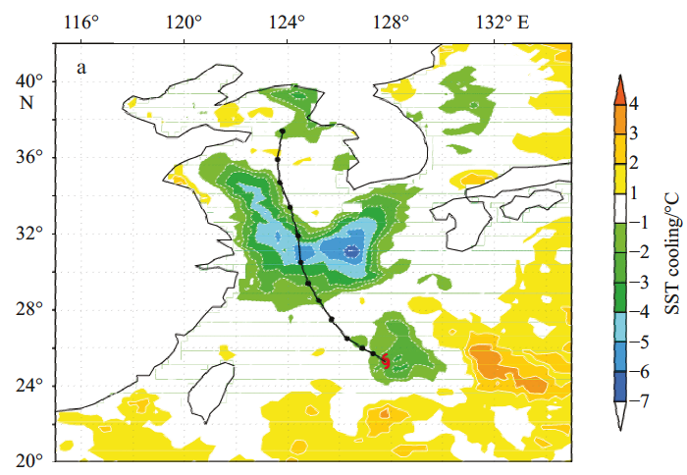
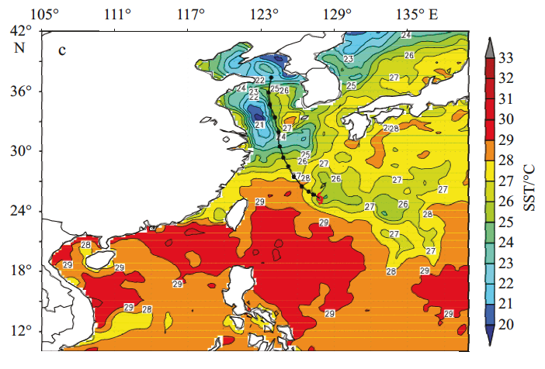
Typhoon Muifa - Total Cooling Observed by Satellite
SST
Before
Muifa
Track
SST
After
SST
Difference
Up to 7C
From: Sun, Duan, Zhu, Wu, Zhang & Huang, Acta Oceanol. Sin., 2014

Slide 23
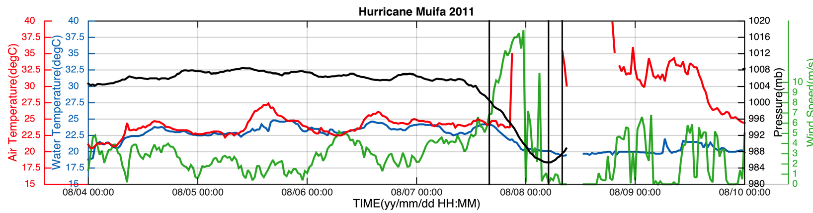
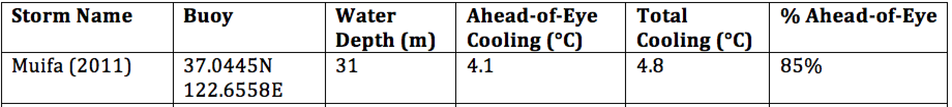
Typhoon Muifa:
Ahead-of-Eye-Center Cooling
observed by Coastal Buoy
Muifa
Track
From: Fei Yu, Institute of Oceanology, Chinese Academy of Sciences
Yi Xu, State Key Laboratory of Estuarine & Coastal Research, East China Normal University

Slide 24

Hurricane Arthur: July 3, 2014

Slide 25



Hurricane Arthur
ASCAT Winds, WRF Winds, CODAR Currents
July 4, 2014

Slide 26



Hurricane Arthur
CODAR Current Fields
Late July 4, 2014
(Before Eye)
Early July 5, 2014
(After Eye)
Late July 5, 2014
(After Eye)

Slide 27

Hurricane Sandy
October 29, 2012
See Miles et al (2015):

Slide 28



Superstorm Sandy: 2 Days Before Landfall

Slide 29

Superstorm Sandy: 1 Day Before Landfall

Slide 30

Superstorm Sandy: Morning Before Landfall

Slide 31


Keyport
Sandy
Irene
Superstorm Sandy: Landfall (20:00 Local)
Notes:
Insert Comment on recent rebuild/hurricane hardened HF Radar stations?

Slide 32

Hurricane Irene
August 26, 2011
Glenn et al., Nat. Com., 2016
Conclusion
Hurricane Sandy
October 29, 2012
Miles et al., JGR, 2015

