Slide 1

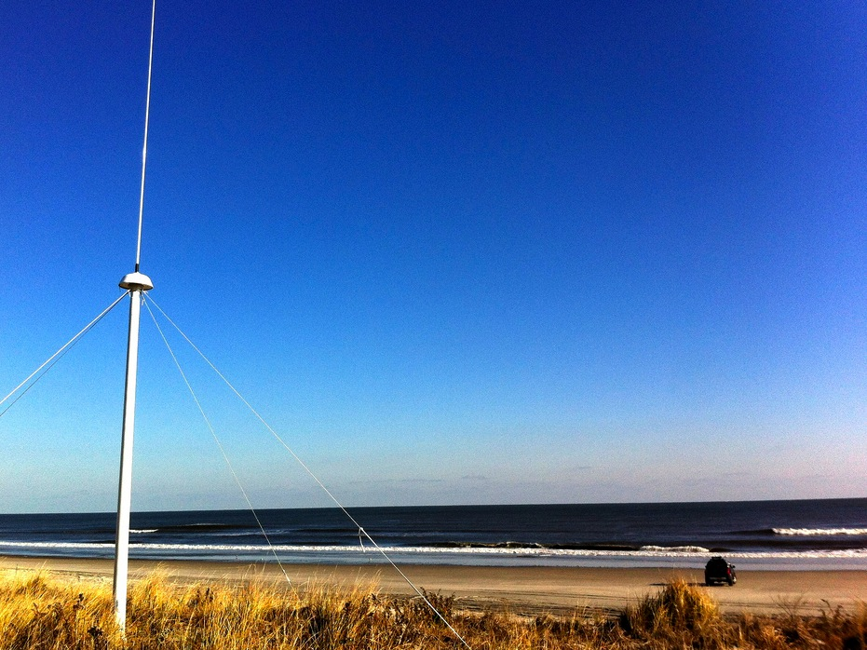





Evaluation of Environmental Data for Search and Rescue
Hugh Roarty
Scott Glenn
Art Allen
April 12, 2016
Shanghai, China

Slide 2
Talk Outline
Introduction to High Frequency Radar
Application for Search and Rescue
Evaluating Environmental Data in SAROPS

Slide 3
Introduction to High Frequency Radar

Slide 4
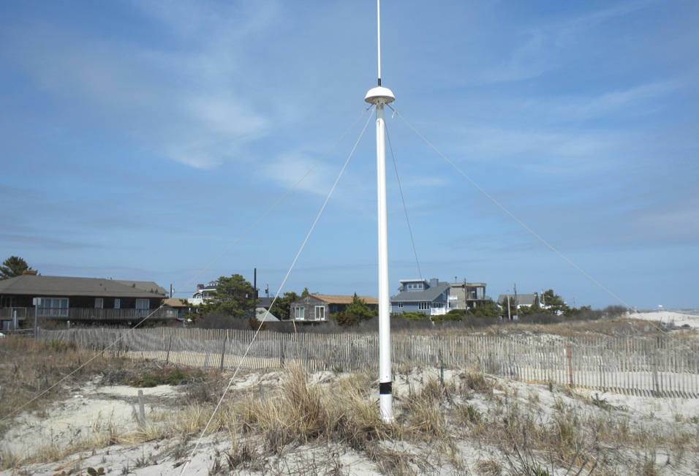
13 MHz Transmit and Receive Antenna
4 meters

Slide 5
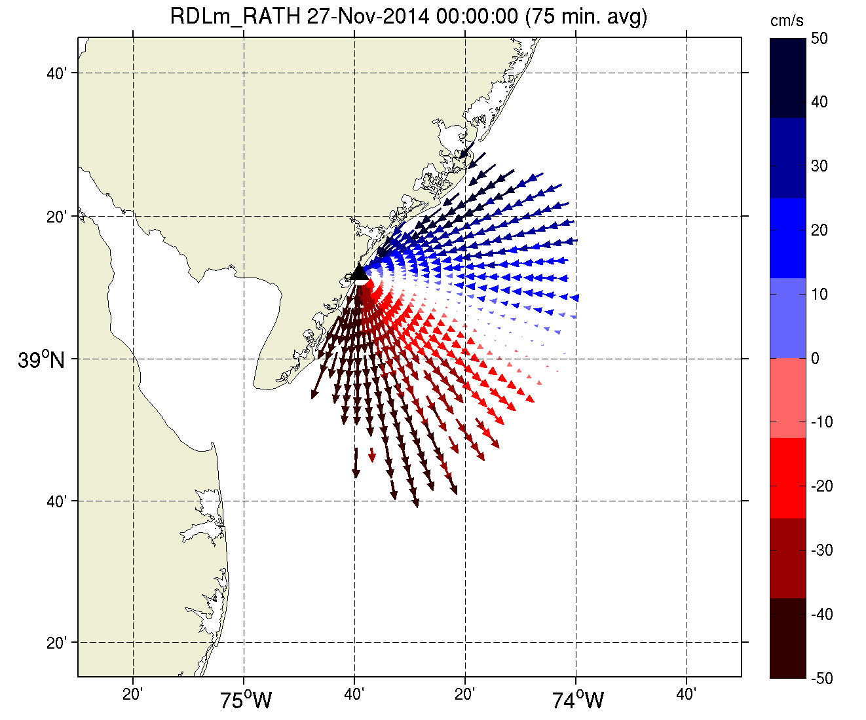
Radial Map of Currents

Slide 6
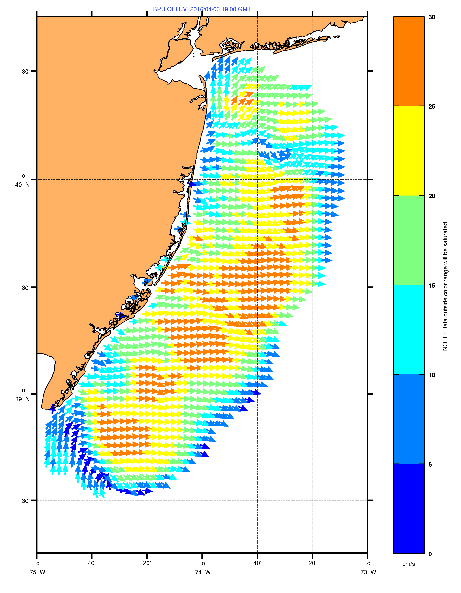
30 cm/s
April 3, 2016
24 Hour Average
25 cm/s
7 Sites
13 MHz
200 km coastline
2 Km Spatial Resolution
20 cm/s
15 cm/s
10 cm/s
5 cm/s
0 cm/s

Slide 7
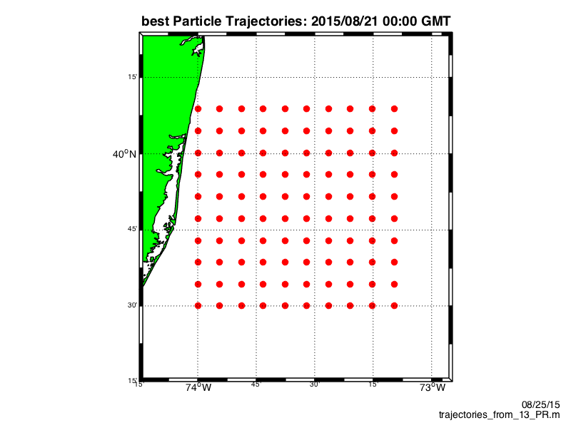


Slide 8
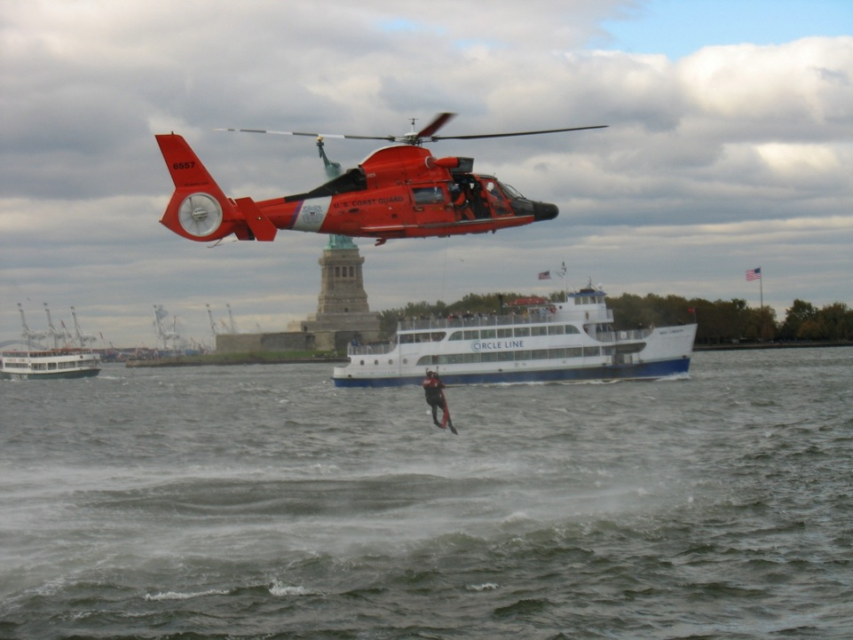
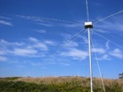


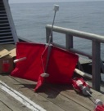
HF Radar Application
Search And Rescue
Dr. Hugh Roarty
Dr. Josh Kohut

Slide 9


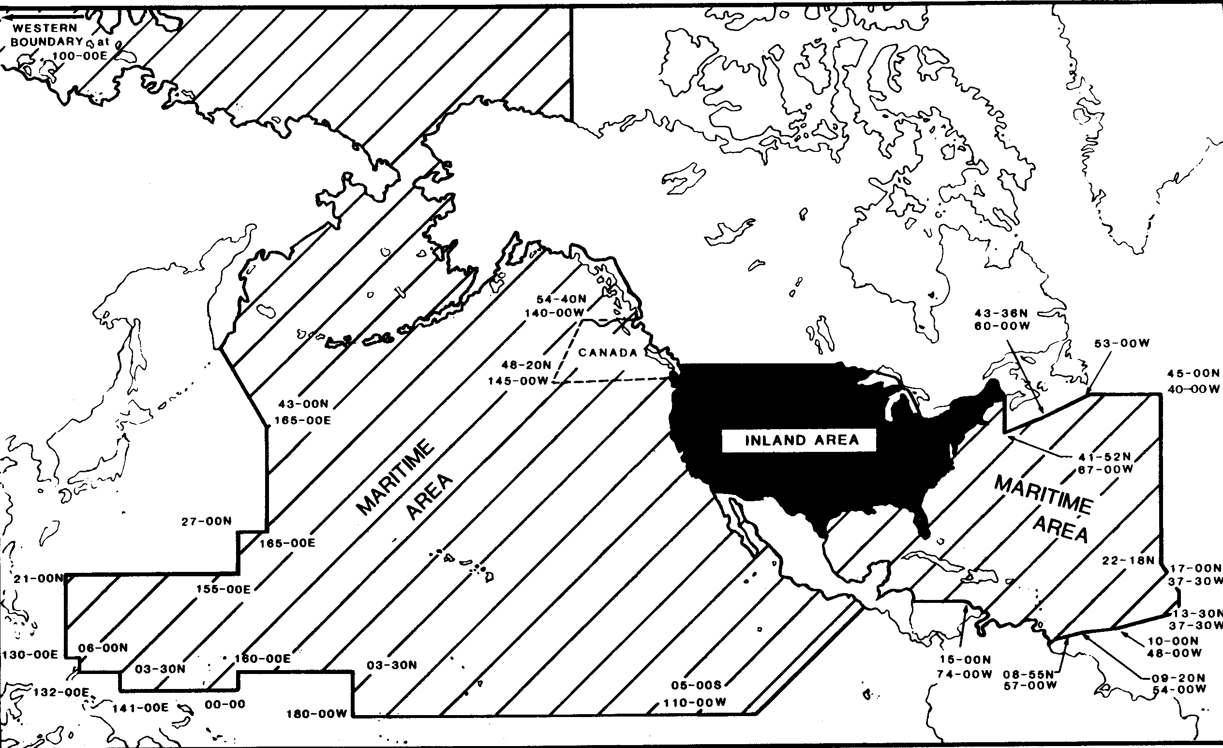
USCG
Area of Responsibility

Slide 10


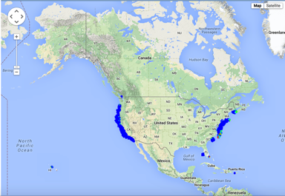
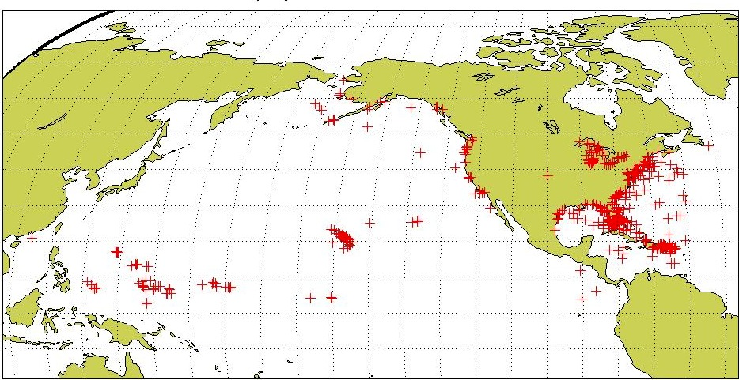
USCG Drifter Deployments
Self Locating Data Marker Buoys (SLDMB)
for Search And Rescue (SAR)
January 2006 – December 2007 (2 years)
National HF Radar Network
Most SAR cases occur in the envisioned HF Radar Network footprint
Notes:
Here are the initial deployment positions for our SLDMBs. From these records we selected only those that exceeded 4 days in length

Slide 11
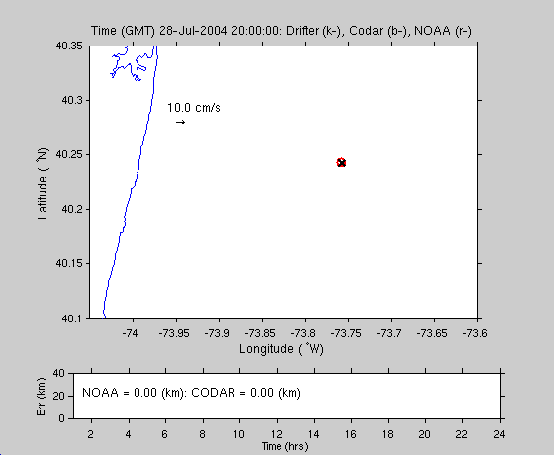
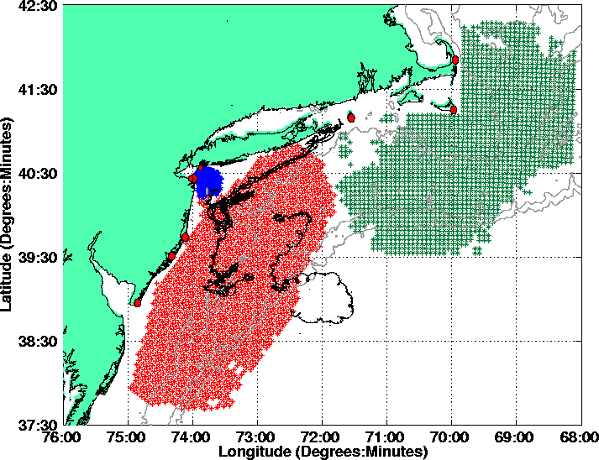

Long Range 5 MHz
Year 2005
Drifter
CODAR
NOAA

Slide 12
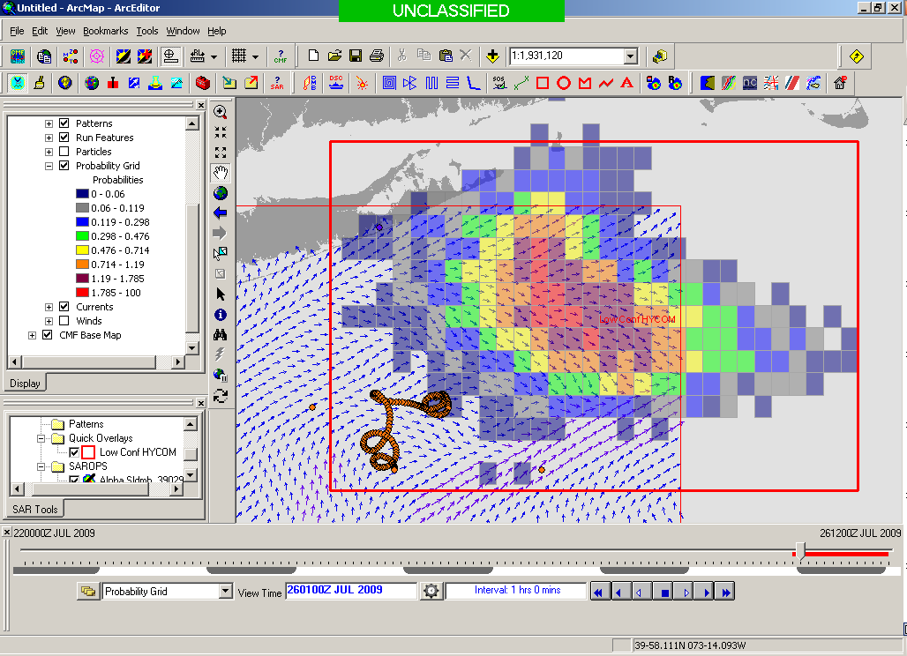
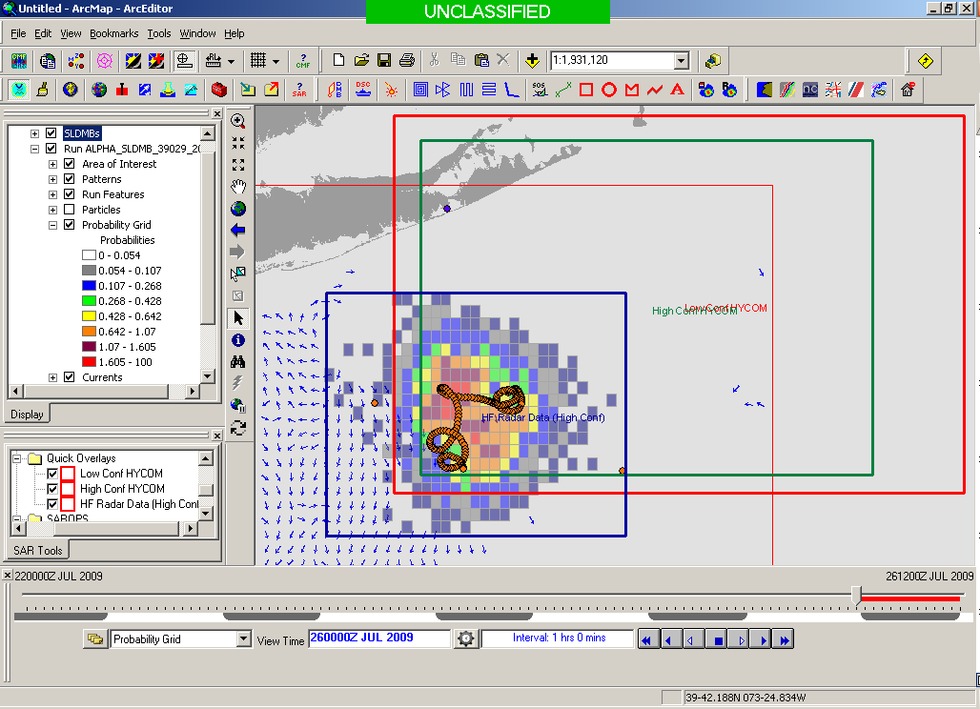
USCG Current Validation
Results of a 1-year blind validation study -
For every real drifter deployed at sea:
5000 Virtual Drifters Deployed in SAROPS
Search Areas compared to real drifters every 12 hours
154 km
100 km
232 km
123 km
HYCOM 96 hour Search Area
36,000 km²
HF Radar 96 hour Search Area
12,000 km²
Notes:
Here are the initial deployment positions for our SLDMBs. From these records we selected only those that exceeded 4 days in length

Slide 13
Evaluation of Environmental Data

Slide 14
National Data Requests from SAROPS
December 1, 2011 to March 15, 2014
Atmosphere
Ocean

Slide 15
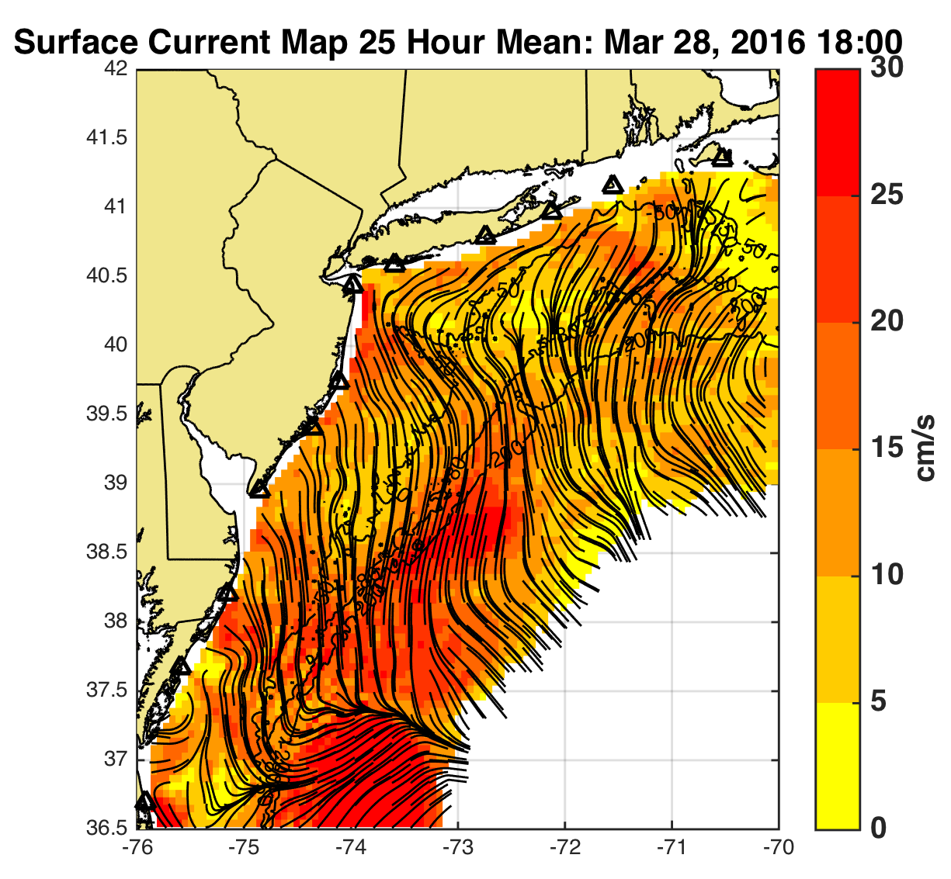
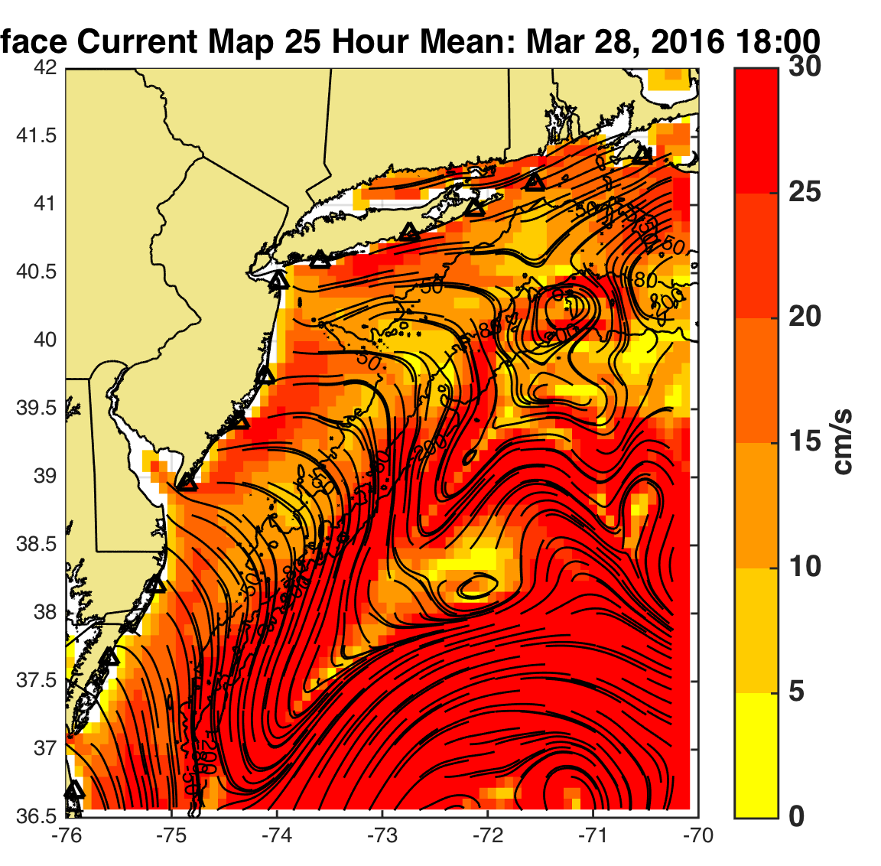
HF Radar
HYCOM
Surface Curent Maps, 25 hour mean, March 28, 2016 18:00 UTC

Slide 16
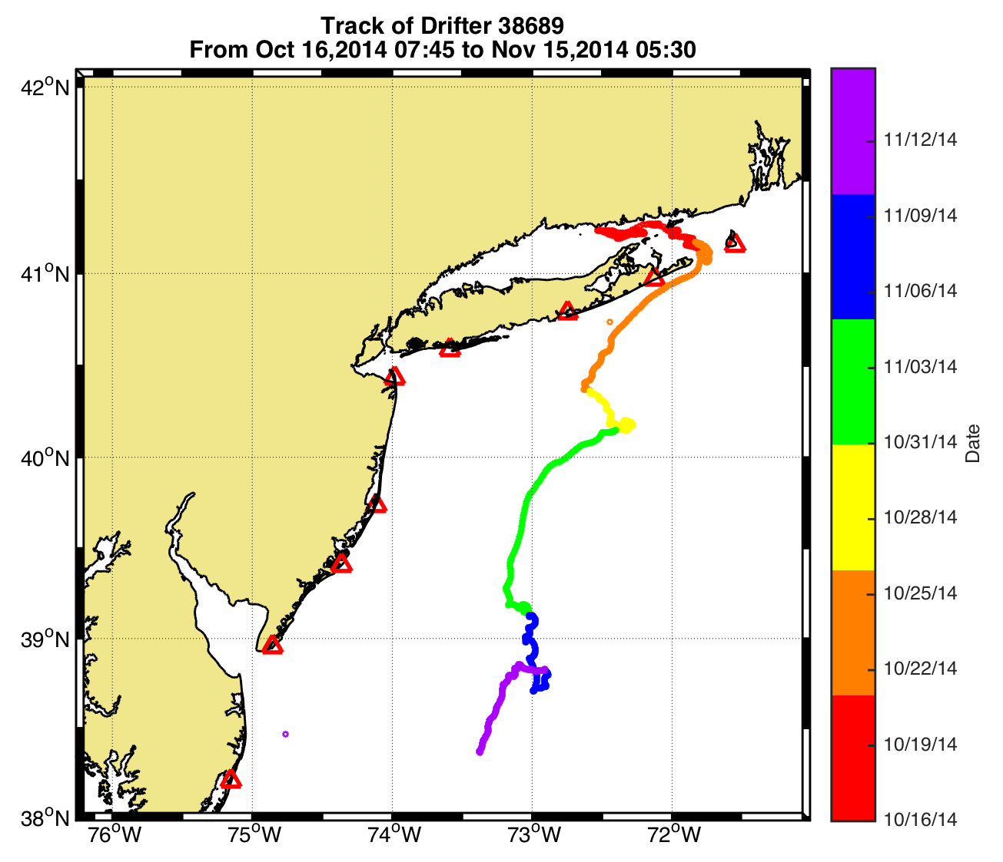
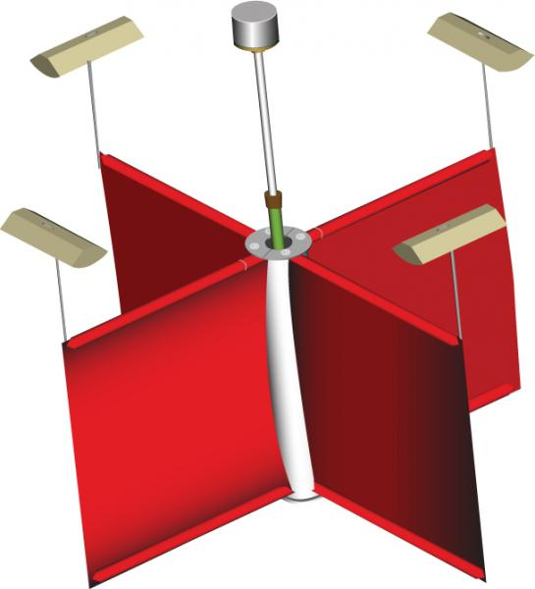
Normalized Cumulative Lagrangian Separation
Liu and Weisberg (2011)

Slide 17
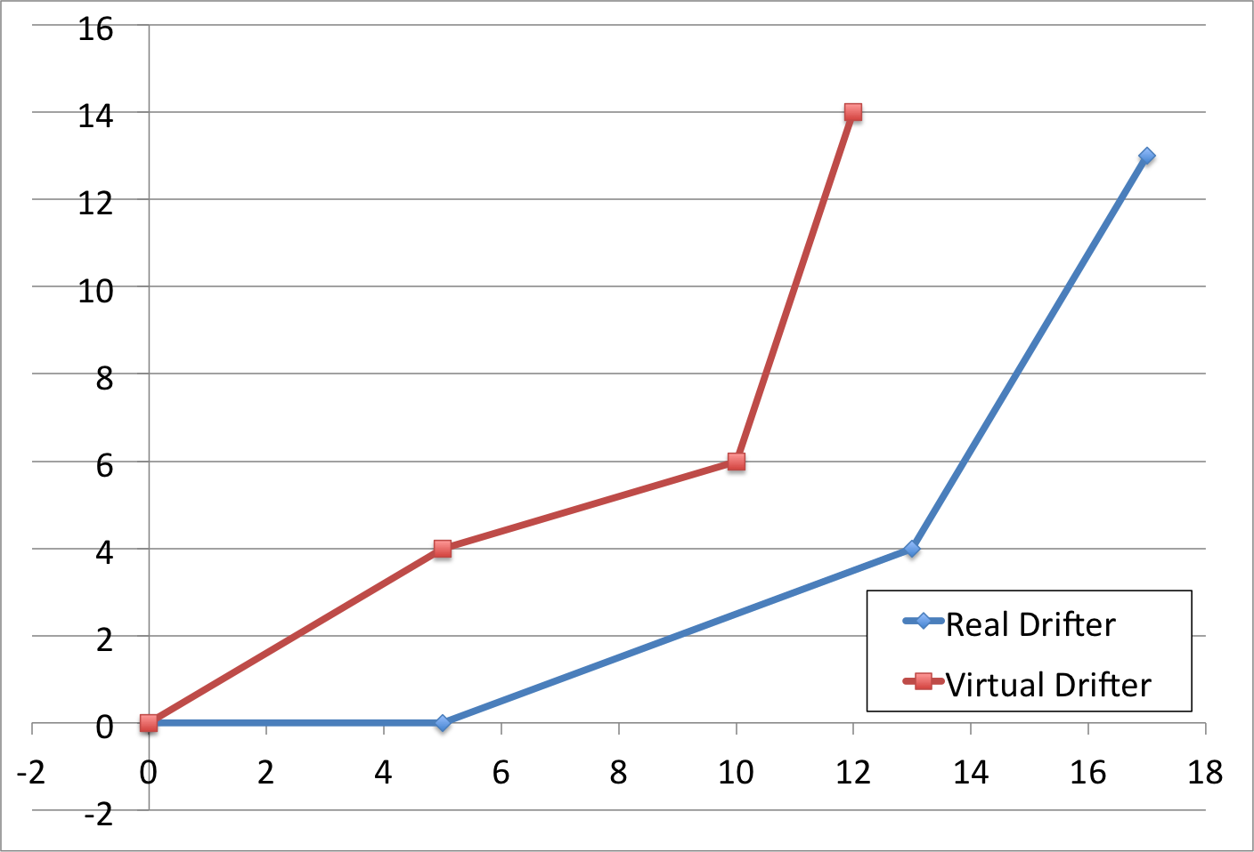
Day | Σ di | Σ loi | ss
1 | 4 | 5 | 0.2
2 | 4+3.6 | 5+14 | 0.60
3 | 4+3.6+5.1 | 5+14+24 | 0.70
Day 3
5.1
Day 2
Day 1
3.6
4
di
loi

Slide 18
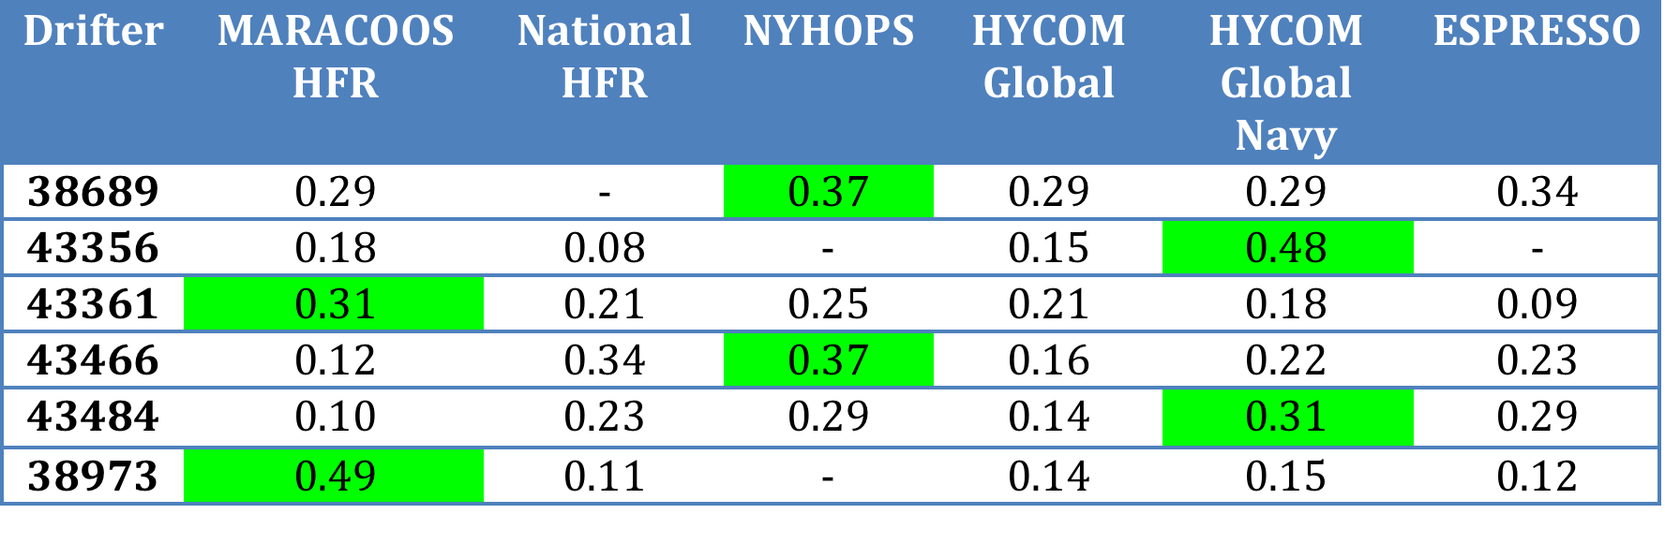
Normalized Cumulative Lagrangian Separation
Liu and Weisberg (2011)

Slide 19
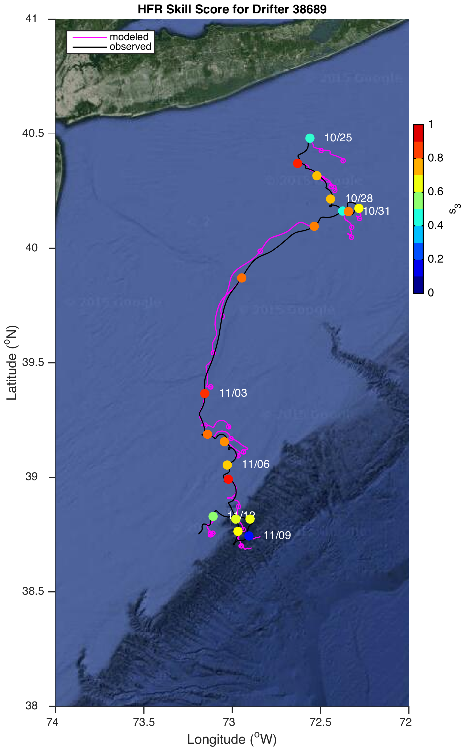
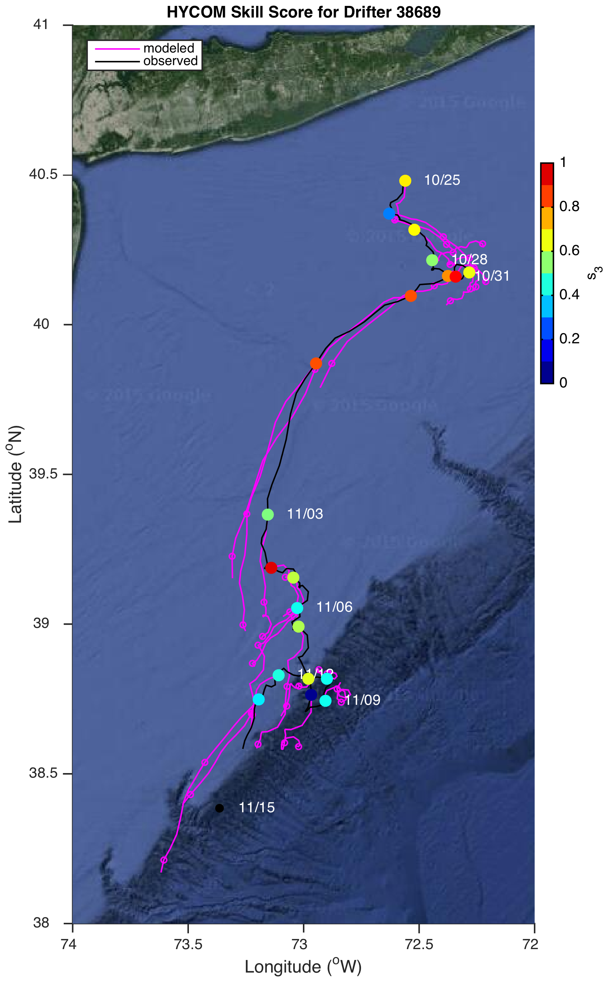
HF Radar
HYCOM

Slide 20
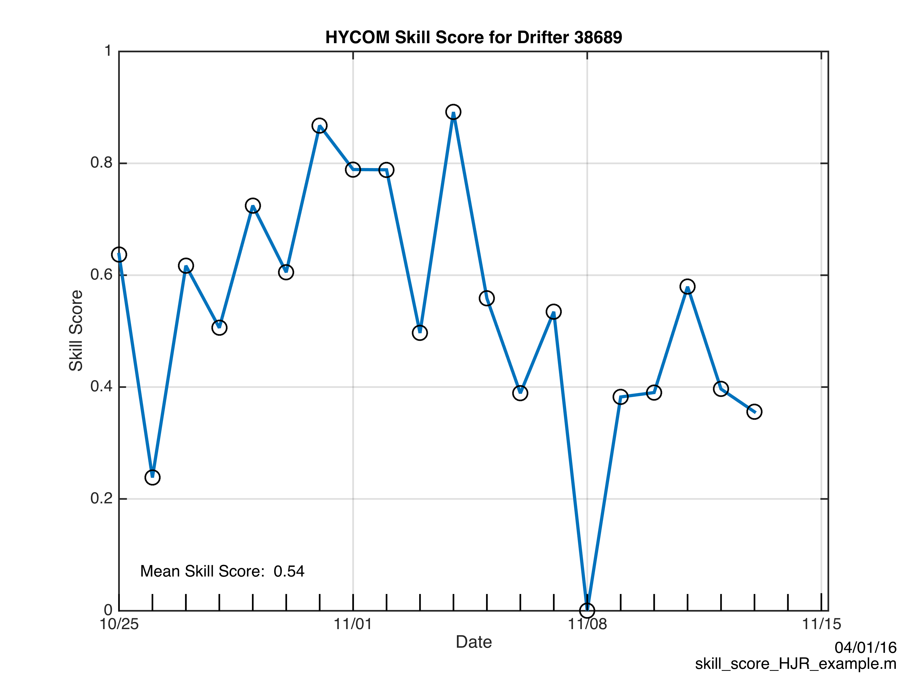
HYCOM

Slide 21
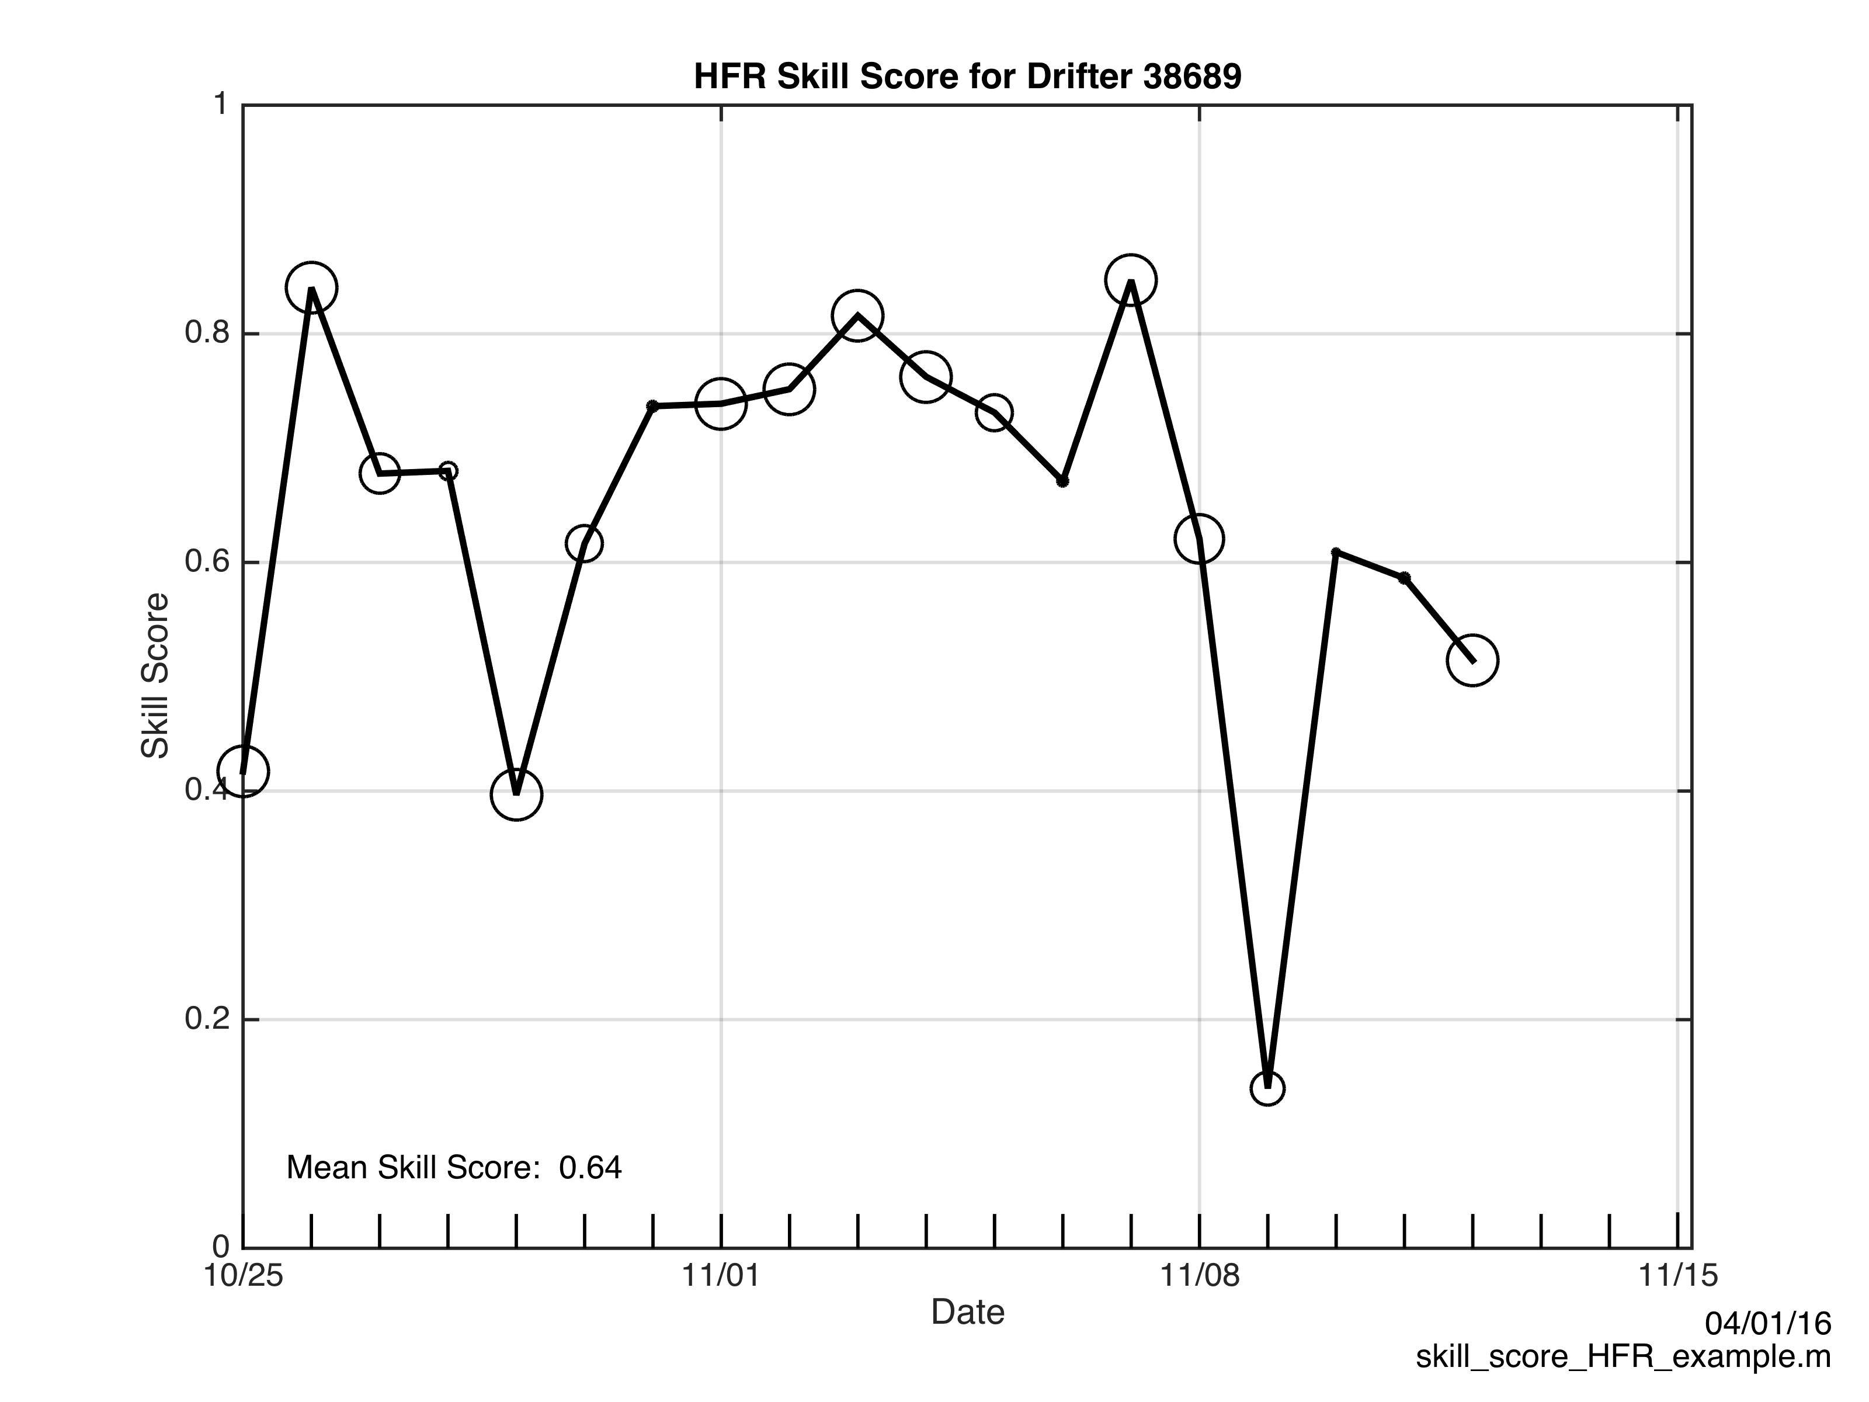
HFR

Slide 22
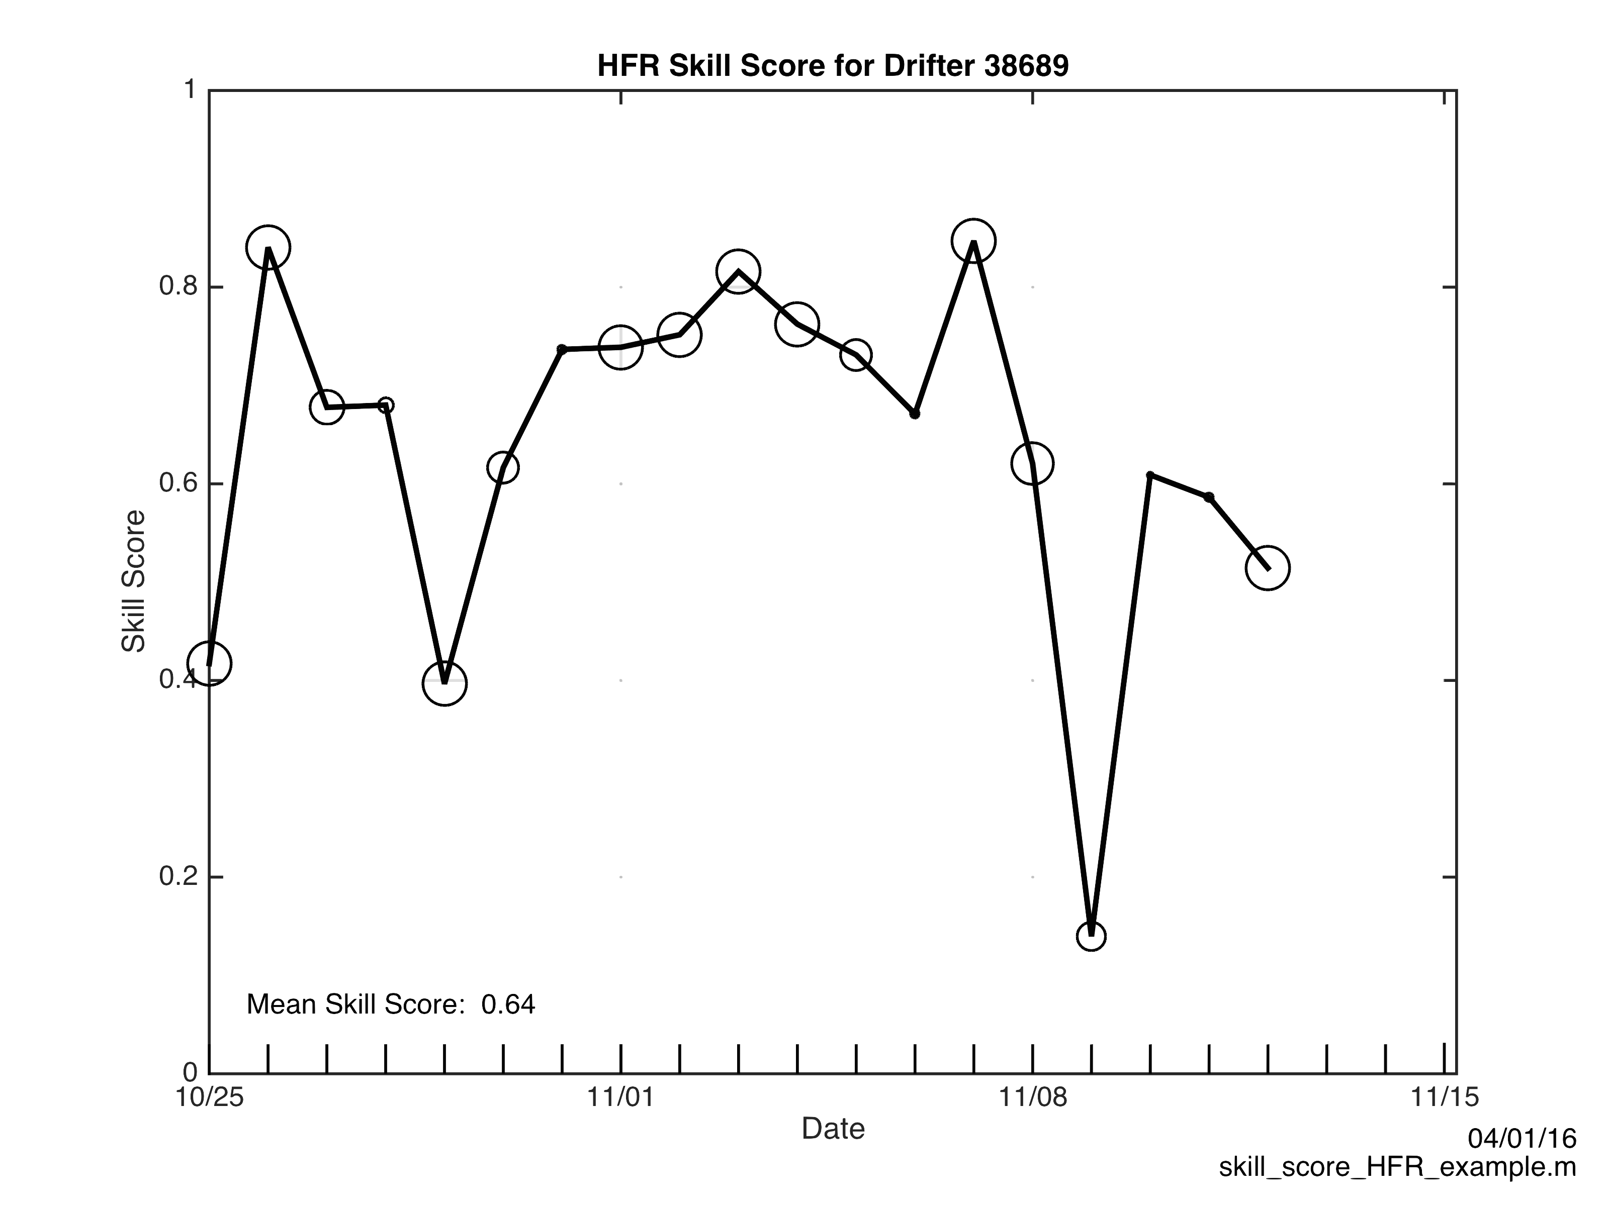

Slide 23
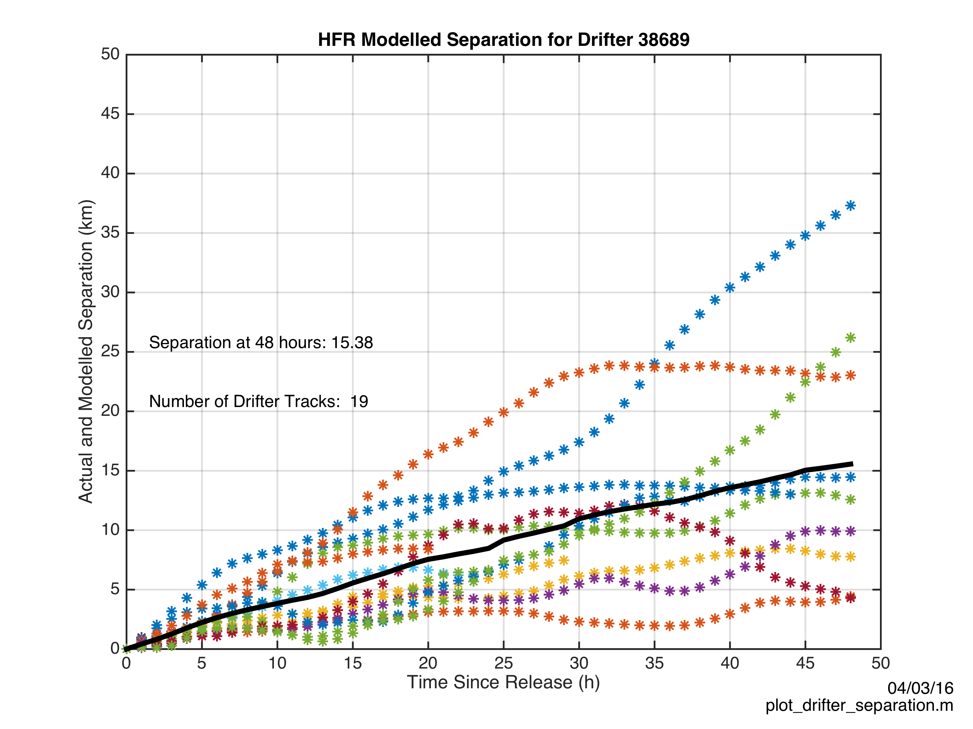
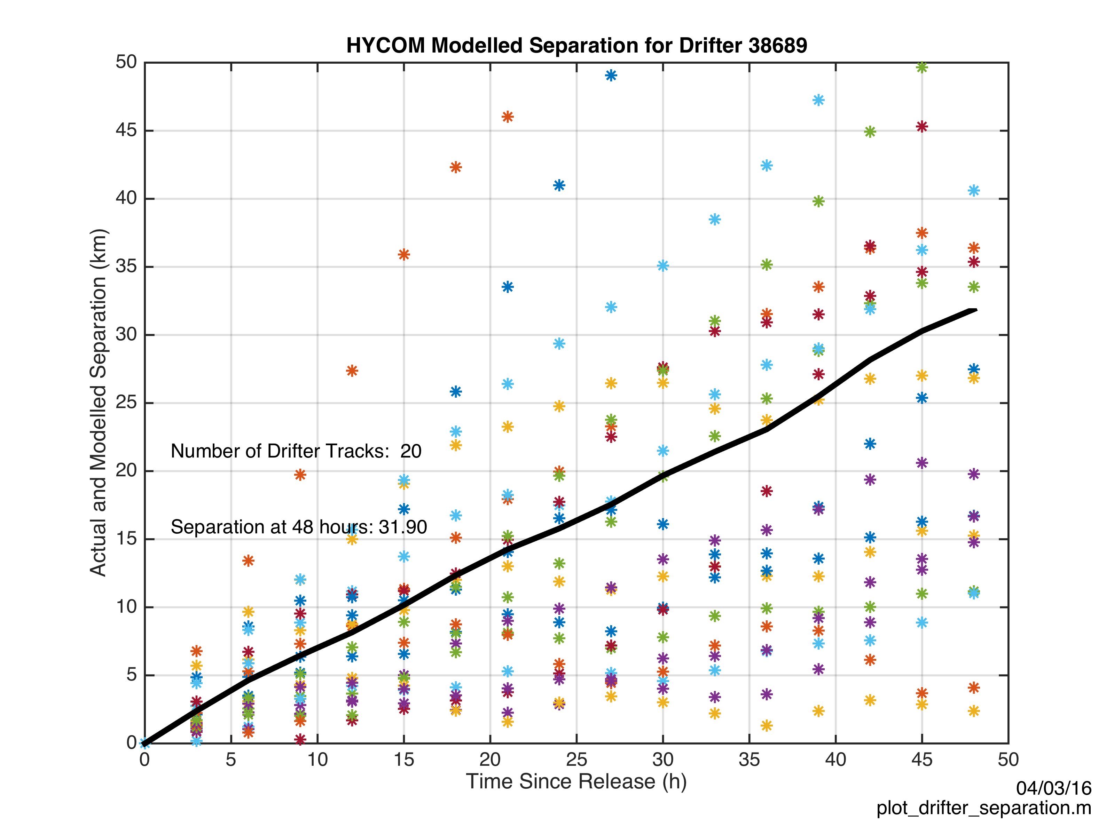
HF Radar
HYCOM
Separation (km) between actual and modeled trajectory after 48 hours

Slide 25
Talk Outline
Introduction to High Frequency Radar
Application for Search and Rescue
Evaluating Environmental Data in SAROPS

Slide 26
Observations of the Surface Circulation Over the Mid Atlantic Bight Continental Shelf
THANK YOU

