Slide 1
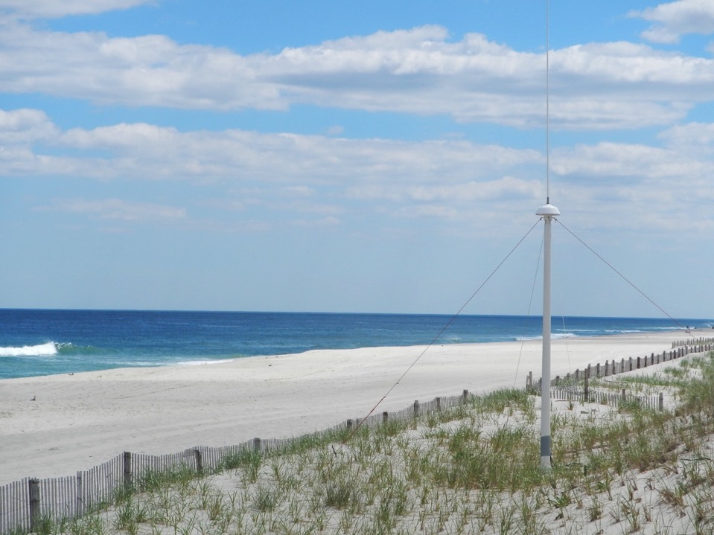



HF Radar Skill Assessment
Hugh Roarty
Rutgers University MARACOOS

Slide 2
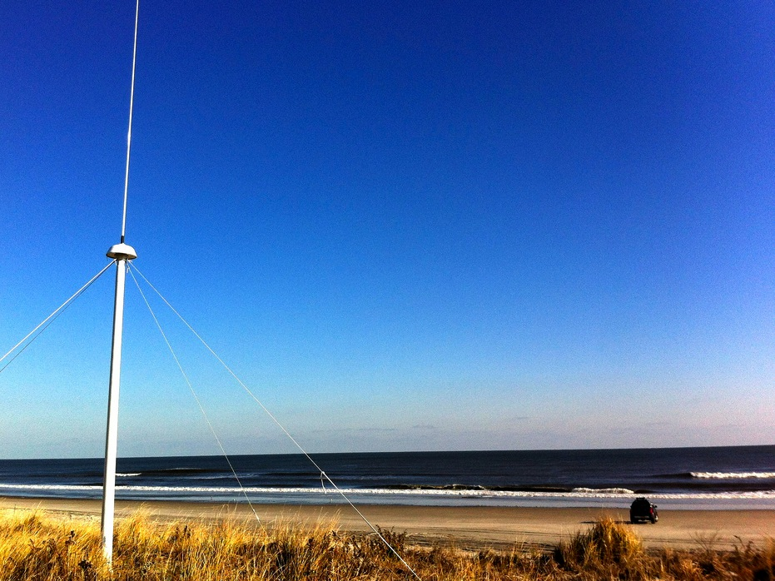
Outline
Introduction to HF Radar
Application for Search and Rescue
Assessing Skill of HFR for Search and Rescue
Radial Quality Control

Slide 3
Introduction to High Frequency Radar
INTRODUCTION TO HF RADAR

Slide 4
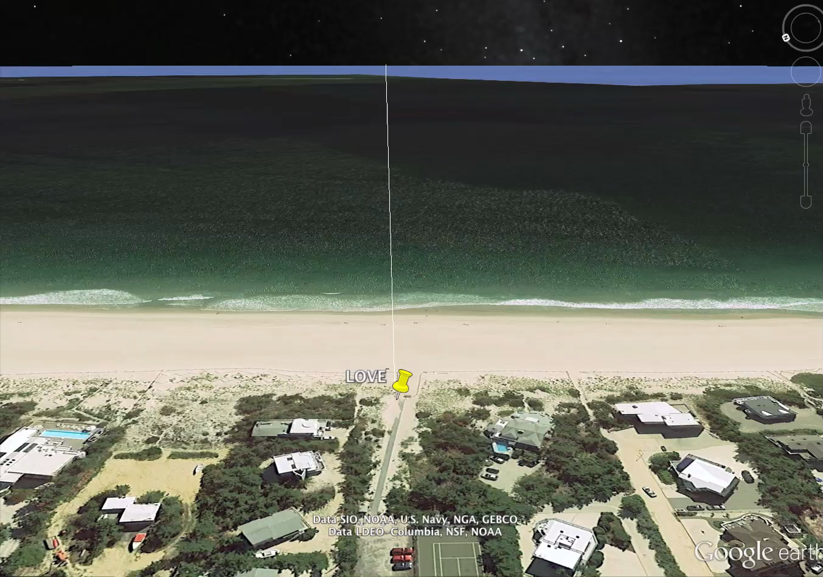

Slide 5
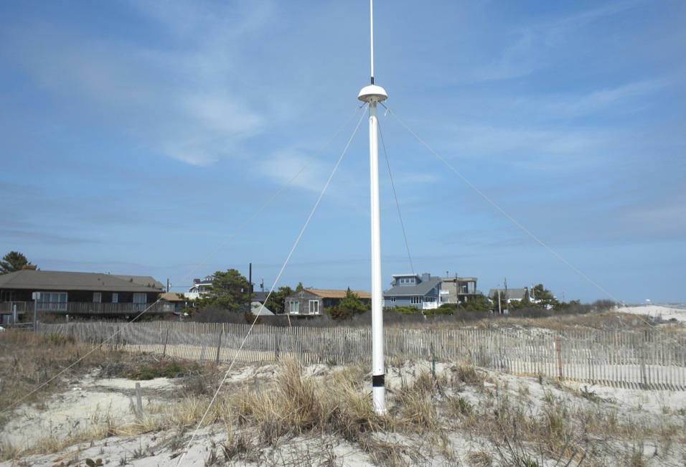
13 MHz Transmit and Receive Antenna
4 meters

Slide 6


Slide 7
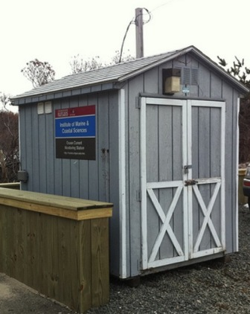
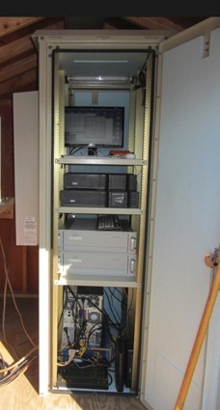
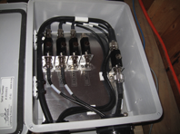
Standard CODAR Shore Site:
Shed, Enclosure, Tx/Rx, Comms, Power, GPS, AIS
monitor
computer & external hard drive
A.C. unit
UPS system
transmitter
receiver
Two lines of Communication
Shed
Enclosure
Lightning Protection

Slide 8


Freq MHz | λ meters | λ/2 meters | T seconds | C m/s
5 | 60 | 30.0 | 4.4 | 6.7
13 | 23 | 11.5 | 2.7 | 3.6
25 | 12 | 6.0 | 2.0 | 3.0
42 | 7 | 3.6 | 1.5 | 2.3
Bragg Sea Echo
λ
λ
λ/2
λ/2
A
B
C
SeaSonde Principles
SeaSonde Principles
Notes:
-The leading RADAR wave crest reflects some energy off of wave slope C
-The second RADAR wave crest passes A (with some energy lost to reflection)
-The second wave crest & the reflected energy of the leading wave crest meet at B
-The energy of the second wave crest reflected at B adds coherently with the reflected
energy of the leading wave crest.

Slide 9
Freq MHz | λ meters | λ/2 meters | T seconds | C m/s
5 | 60 | 30.0 | 4.4 | 6.7
13 | 23 | 11.5 | 2.7 | 3.6
25 | 12 | 6.0 | 2.0 | 3.0
42 | 7 | 3.6 | 1.5 | 2.3
Bragg Sea Echo
λ
λ
λ/2
λ/2
A
B
C
SeaSonde Principles
SeaSonde Principles
Notes:
-The leading RADAR wave crest reflects some energy off of wave slope C
-The second RADAR wave crest passes A (with some energy lost to reflection)
-The second wave crest & the reflected energy of the leading wave crest meet at B
-The energy of the second wave crest reflected at B adds coherently with the reflected
energy of the leading wave crest.

Slide 10
Freq MHz | λ meters | λ/2 meters | T seconds | C m/s
5 | 60 | 30.0 | 4.4 | 6.7
13 | 23 | 11.5 | 2.7 | 3.6
25 | 12 | 6.0 | 2.0 | 3.0
42 | 7 | 3.6 | 1.5 | 2.3
Bragg Sea Echo
λ
λ
λ/2
λ/2
A
B
C
SeaSonde Principles
SeaSonde Principles
Notes:
-The leading RADAR wave crest reflects some energy off of wave slope C
-The second RADAR wave crest passes A (with some energy lost to reflection)
-The second wave crest & the reflected energy of the leading wave crest meet at B
-The energy of the second wave crest reflected at B adds coherently with the reflected
energy of the leading wave crest.

Slide 11
Freq MHz | λ meters | λ/2 meters | T seconds | C m/s
5 | 60 | 30.0 | 4.4 | 6.7
13 | 23 | 11.5 | 2.7 | 3.6
25 | 12 | 6.0 | 2.0 | 3.0
42 | 7 | 3.6 | 1.5 | 2.3
Bragg Sea Echo
λ
λ
λ/2
λ/2
A
B
C
SeaSonde Principles
SeaSonde Principles
Notes:
-The leading RADAR wave crest reflects some energy off of wave slope C
-The second RADAR wave crest passes A (with some energy lost to reflection)
-The second wave crest & the reflected energy of the leading wave crest meet at B
-The energy of the second wave crest reflected at B adds coherently with the reflected
energy of the leading wave crest.

Slide 12
Freq MHz | λ meters | λ/2 meters | T seconds | C m/s
5 | 60 | 30.0 | 4.4 | 6.7
13 | 23 | 11.5 | 2.7 | 3.6
25 | 12 | 6.0 | 2.0 | 3.0
42 | 7 | 3.6 | 1.5 | 2.3
Bragg Sea Echo
λ
λ
λ/2
λ/2
A
B
C
SeaSonde Principles
SeaSonde Principles
Notes:
-The leading RADAR wave crest reflects some energy off of wave slope C
-The second RADAR wave crest passes A (with some energy lost to reflection)
-The second wave crest & the reflected energy of the leading wave crest meet at B
-The energy of the second wave crest reflected at B adds coherently with the reflected
energy of the leading wave crest.

Slide 13
Freq MHz | λ meters | λ/2 meters | T seconds | C m/s
5 | 60 | 30.0 | 4.4 | 6.7
13 | 23 | 11.5 | 2.7 | 3.6
25 | 12 | 6.0 | 2.0 | 3.0
42 | 7 | 3.6 | 1.5 | 2.3
Bragg Sea Echo
λ
λ
λ/2
λ/2
A
B
C
SeaSonde Principles
SeaSonde Principles
Notes:
-The leading RADAR wave crest reflects some energy off of wave slope C
-The second RADAR wave crest passes A (with some energy lost to reflection)
-The second wave crest & the reflected energy of the leading wave crest meet at B
-The energy of the second wave crest reflected at B adds coherently with the reflected
energy of the leading wave crest.

Slide 14
Freq MHz | λ meters | λ/2 meters | T seconds | C m/s
5 | 60 | 30.0 | 4.4 | 6.7
13 | 23 | 11.5 | 2.7 | 3.6
25 | 12 | 6.0 | 2.0 | 3.0
42 | 7 | 3.6 | 1.5 | 2.3
Bragg Sea Echo
λ
λ
λ/2
λ/2
A
B
C
SeaSonde Principles
SeaSonde Principles
Notes:
-The leading RADAR wave crest reflects some energy off of wave slope C
-The second RADAR wave crest passes A (with some energy lost to reflection)
-The second wave crest & the reflected energy of the leading wave crest meet at B
-The energy of the second wave crest reflected at B adds coherently with the reflected
energy of the leading wave crest.

Slide 15
Freq MHz | λ meters | λ/2 meters | T seconds | C m/s
5 | 60 | 30.0 | 4.4 | 6.7
13 | 23 | 11.5 | 2.7 | 3.6
25 | 12 | 6.0 | 2.0 | 3.0
42 | 7 | 3.6 | 1.5 | 2.3
Bragg Sea Echo
λ
λ
λ/2
λ/2
A
B
C
SeaSonde Principles
SeaSonde Principles
Notes:
-The leading RADAR wave crest reflects some energy off of wave slope C
-The second RADAR wave crest passes A (with some energy lost to reflection)
-The second wave crest & the reflected energy of the leading wave crest meet at B
-The energy of the second wave crest reflected at B adds coherently with the reflected
energy of the leading wave crest.

Slide 16
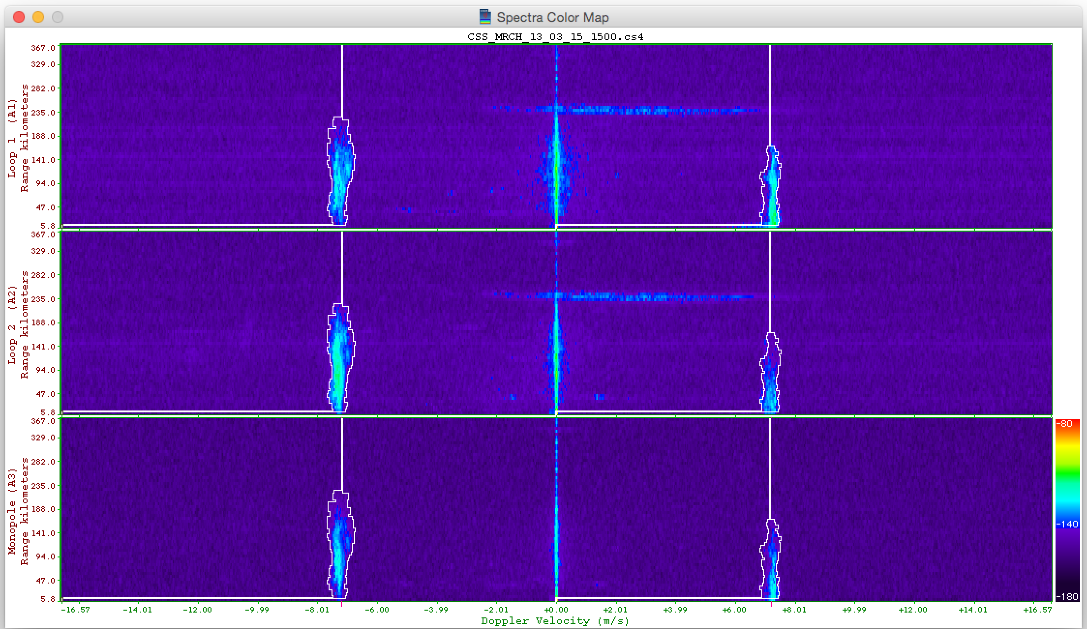

Slide 17
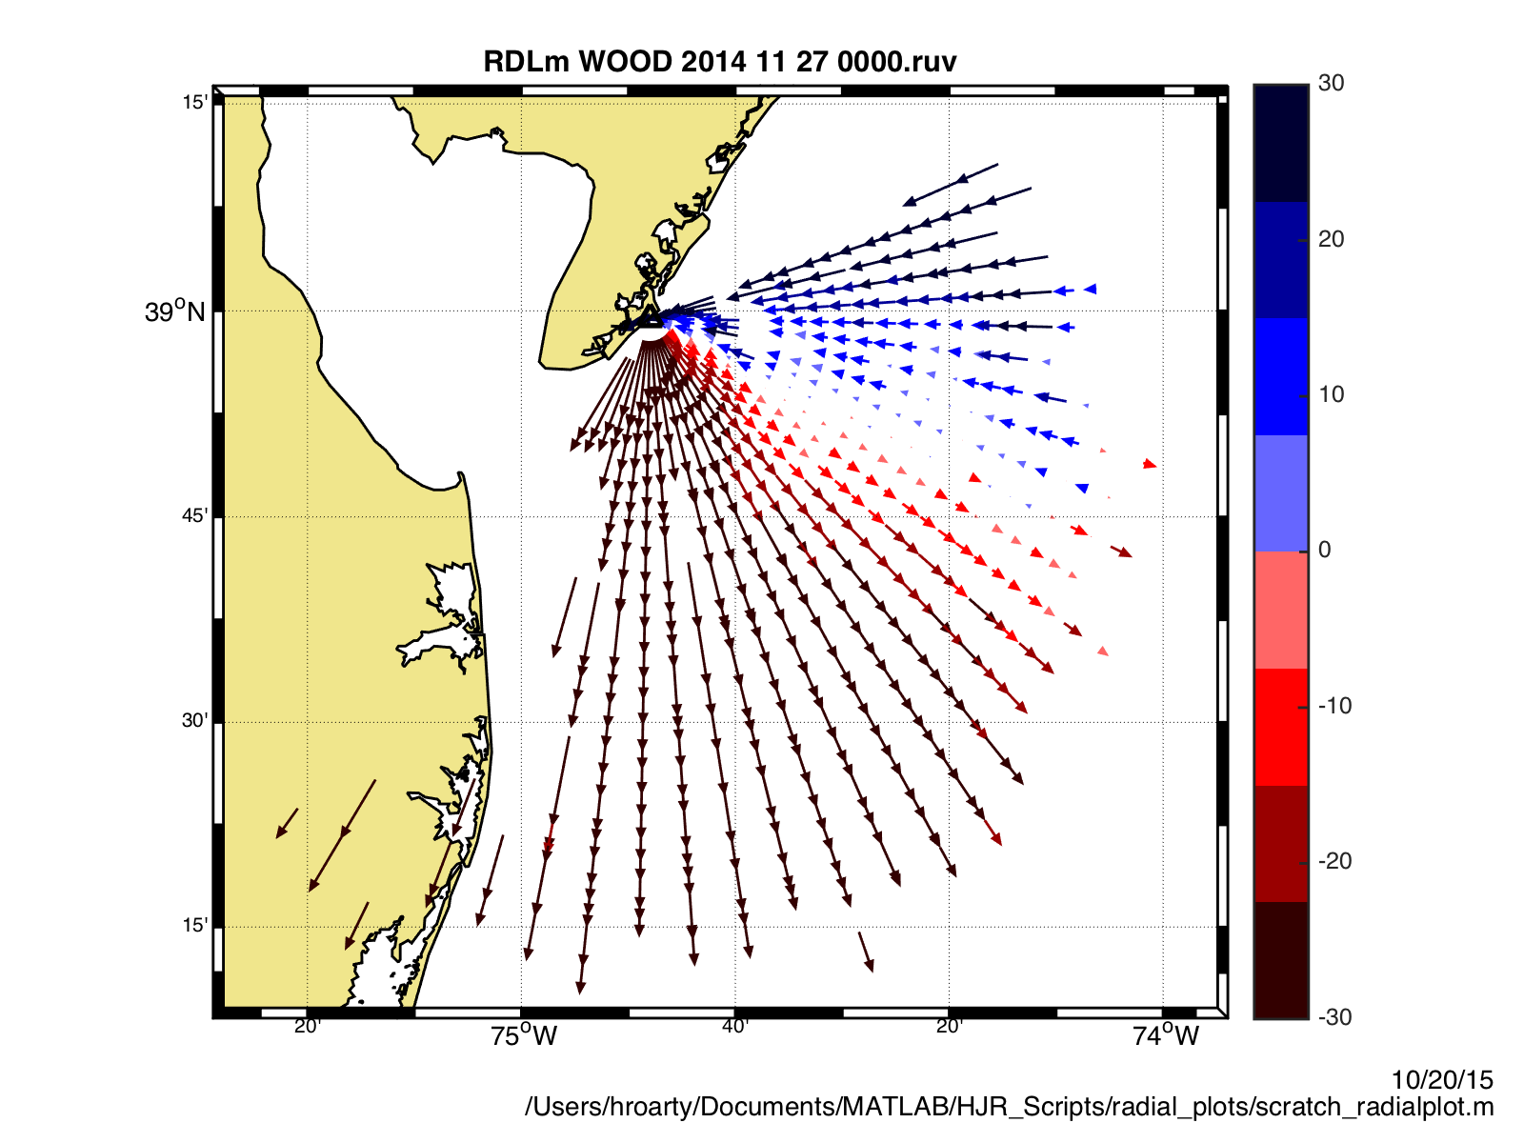
Radial Surface Currents

Slide 18
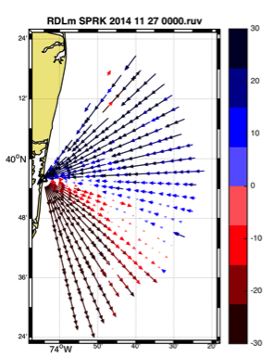
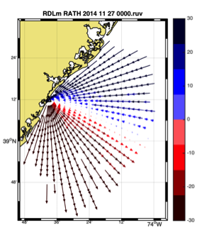
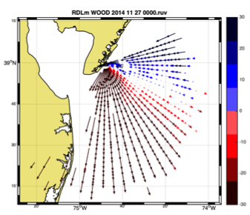
Combine Radial Velocity Measurements

Slide 19
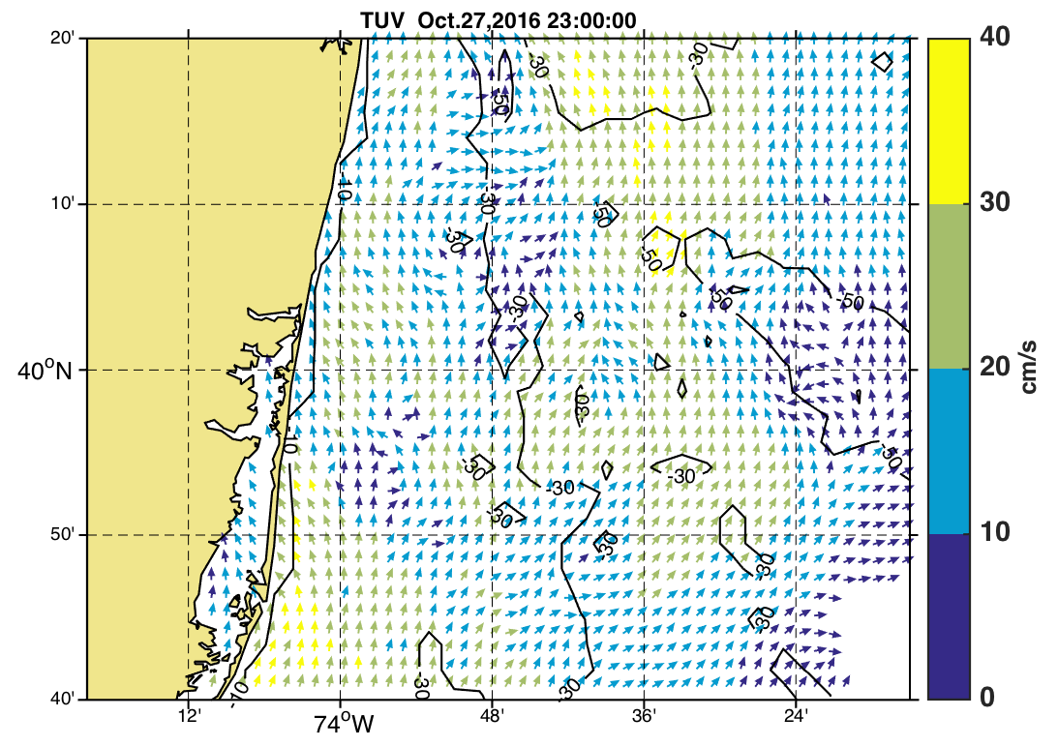
Total Vector Surface Currents: October 27, 2016 23:00 GMT
Long Branch

Slide 20
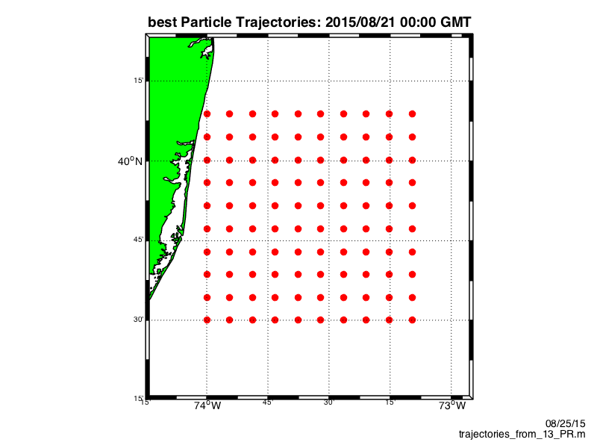


Slide 21
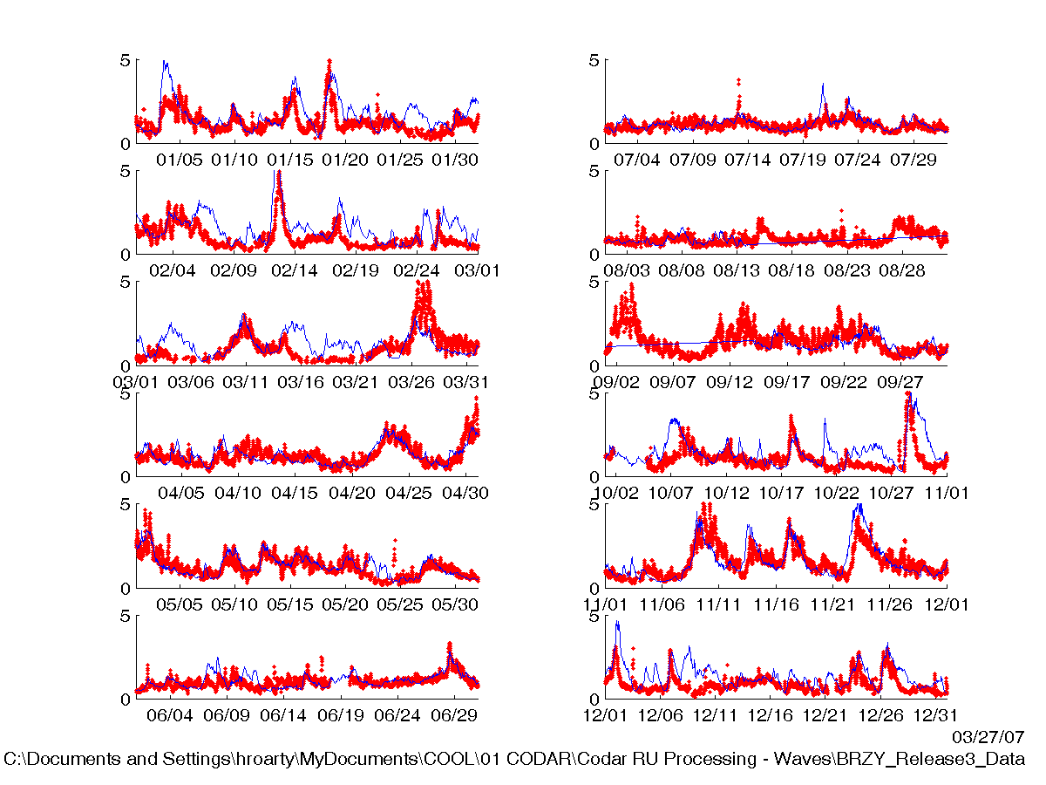
2006 Wave Comparison
25 MHZ Codar at Breezy Pt.
NOAA Buoy 44025
Significant Wave Height (m)

Slide 22
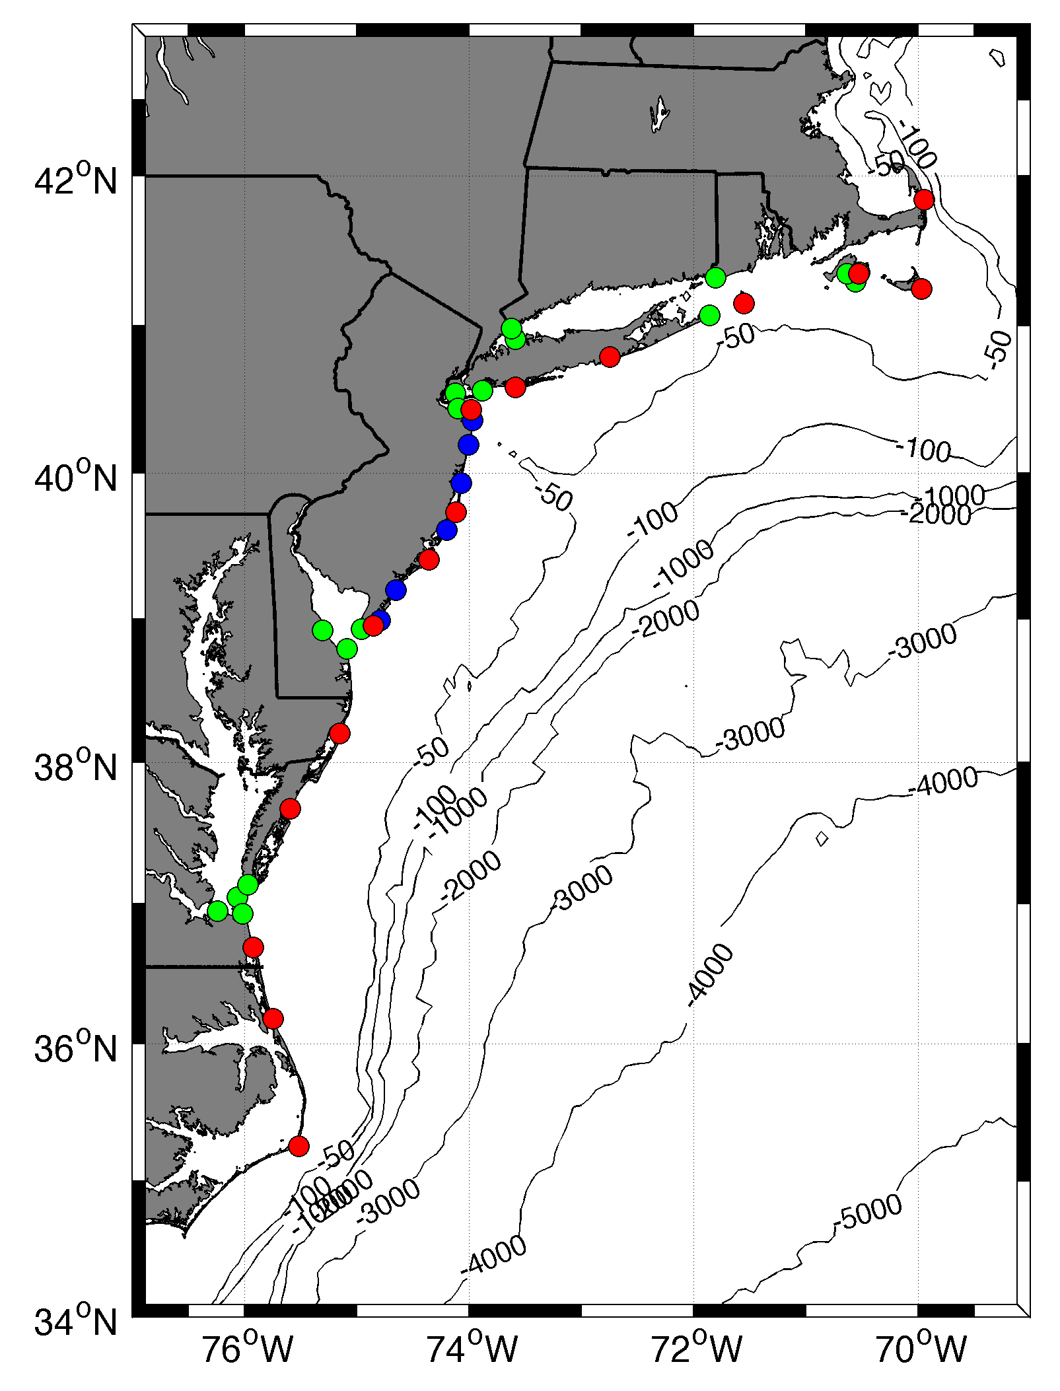










MARACOOS HF RADAR NETWORK
 | 5 MHz | 13 MHz | 25 MHz
U Mass
WHOI
U Conn
URI
Stevens
Rutgers
Delaware
ODU/CIT
UNC
9 | 17 | 8 | 17
46 Stations in Total

Slide 23


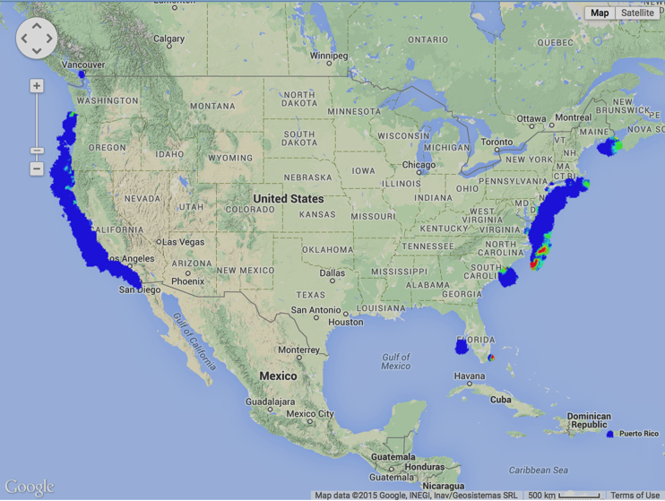
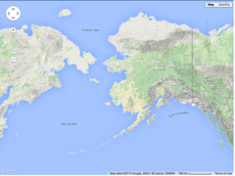
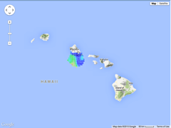
National HF Radar Network
Coverage for 20 Feb 2015
150 HF Radars Registered
121 HF Radars Reporting

Slide 24
APPLICATION FOR SEARCH AND RESCUE

Slide 25
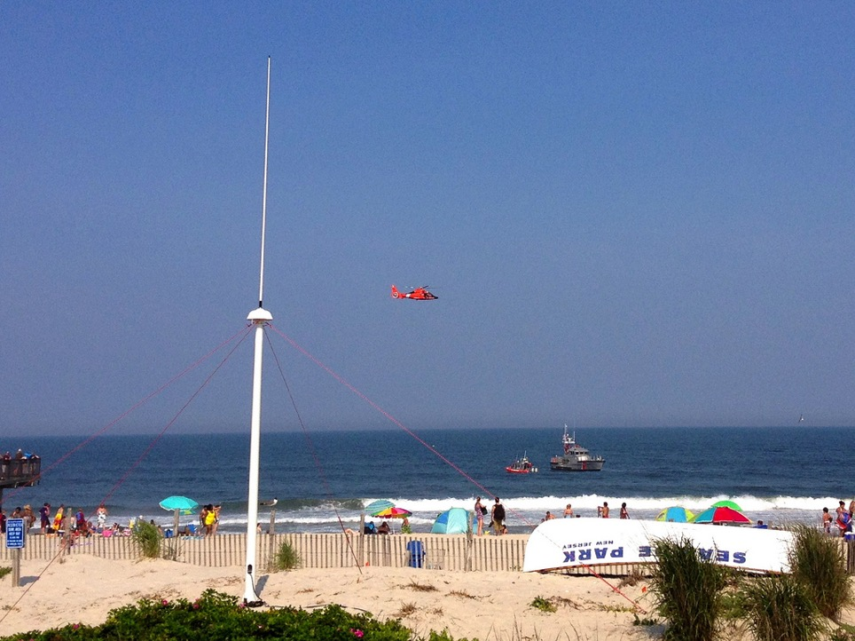



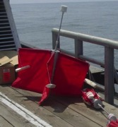
Success Stories – Making a Difference
Optimizing HF Radar for SAR using USCG Surface Drifters

Slide 26
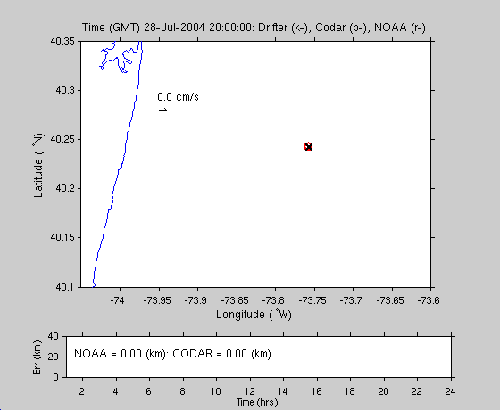

Search and Rescue - 2004

Slide 27
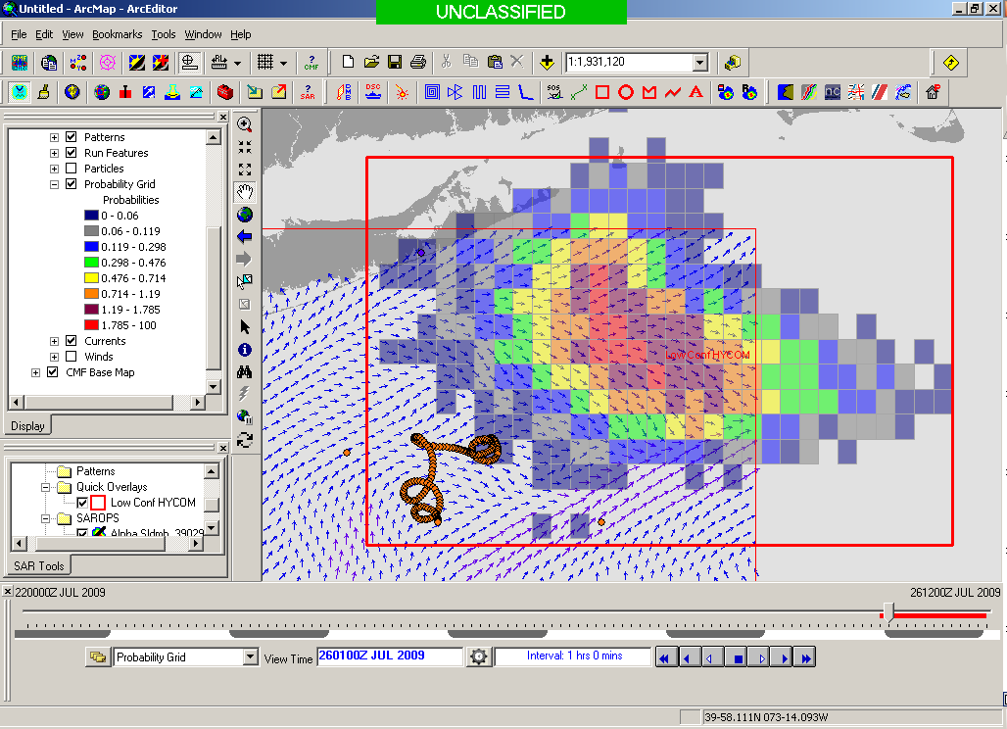
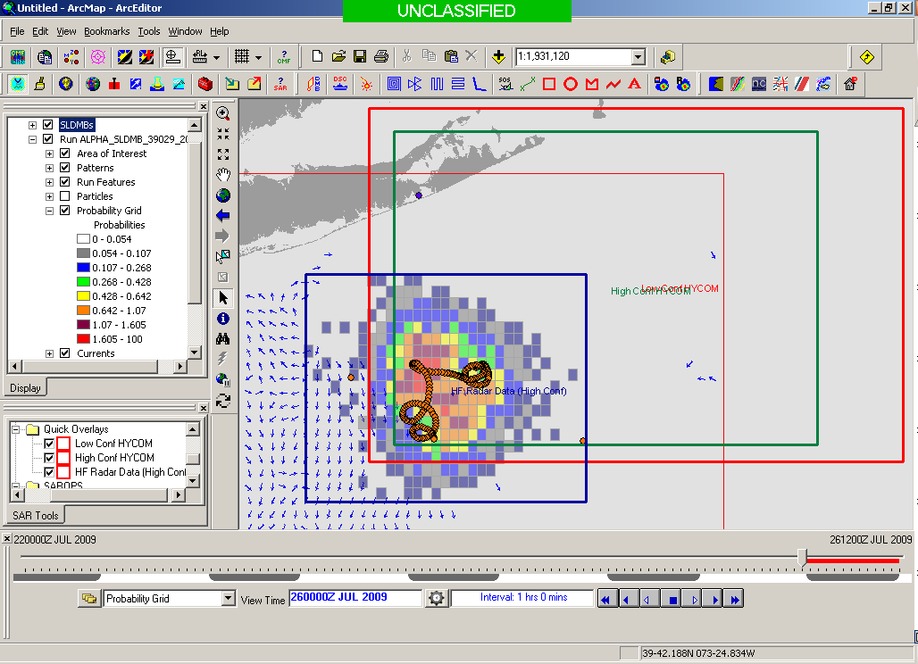
SAROPS Test Case - 2008
5000 Virtual Drifters +
1 Real Drifter (Black Line):
Search Area After 96 Hours
154 km
100 km
232 km
123 km
HyCOM
36,000 km²
HF Radar
12,000 km²
Notes:
HYCOM (Low Conf) 48 hours

Slide 28

May 4, 2009: After a year of testing, NOAA Announces on
U.S. Department of Commerce Website that
MARACOOS CODAR is Operational in SAROPS
Present Activity:
Bring all
sustained regional-scale HFR networks up to operational status in USCG SAROPS
3 West Coast Regions for
California & Oregon are ready.

Slide 29
ASSESSING SKILL OF HFR FOR SEARCH AND RESCUE

Slide 30
National Data Requests from SAROPS
December 1, 2011 to March 15, 2014
Atmosphere
Ocean

Slide 31
Drifter Deployment Locations
Cluster | Longitude | Latitude
1 | 70d 42m W | 41d 10m N | 30 m isobath south of Martha's Vineyard
2 | 70d 42m W | 40d 32m N | 70 m isobath south of Martha's Vineyard
3 | 73d 38m W | 39d 53m N | ENE of Barnegat Inlet but south of the Hudson Canyon
Planned deployment date May 10-11, 2016

Slide 32
Drifter Deployment Locations
# | Buoy Number | Date | Group | Description
1 | 43241 | 5/10/16 | 1 | MVCO 30 m isobath
2 | 43372 | 5/10/16 | 1 | MVCO 30 m isobath
3 | 38824 | 5/10/16 | 2 | MVCO 70 m isobath
4 | 43104 | 5/10/16 | 2 | MVCO 70 m isobath
5 | 43340 | 5/10/16 | 3 | NJ
6 | 43346 | 5/10/16 | 3 | NJ
7 | 43411 | 5/10/16 | 3 | NJ

Slide 33
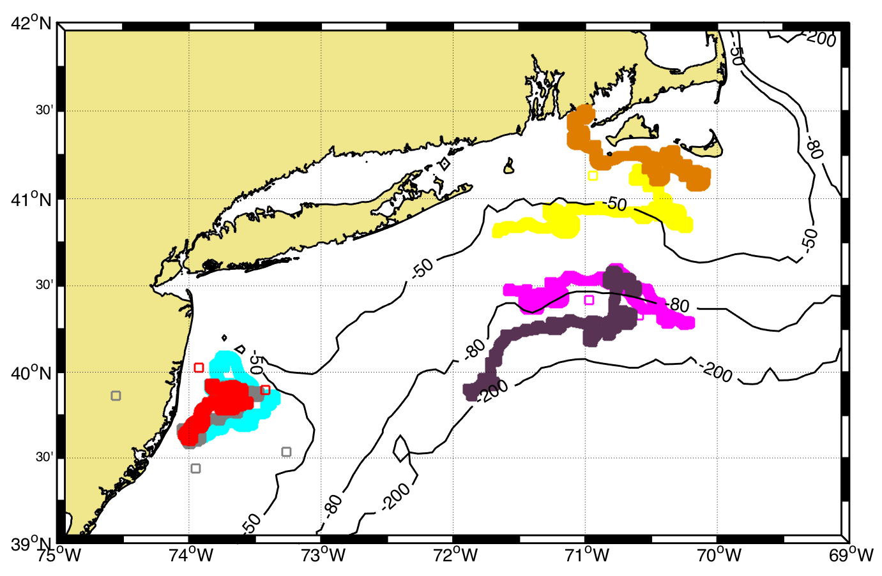
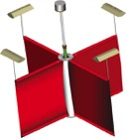
Normalized Cumulative Lagrangian Separation
Liu and Weisberg (2011)

Slide 34
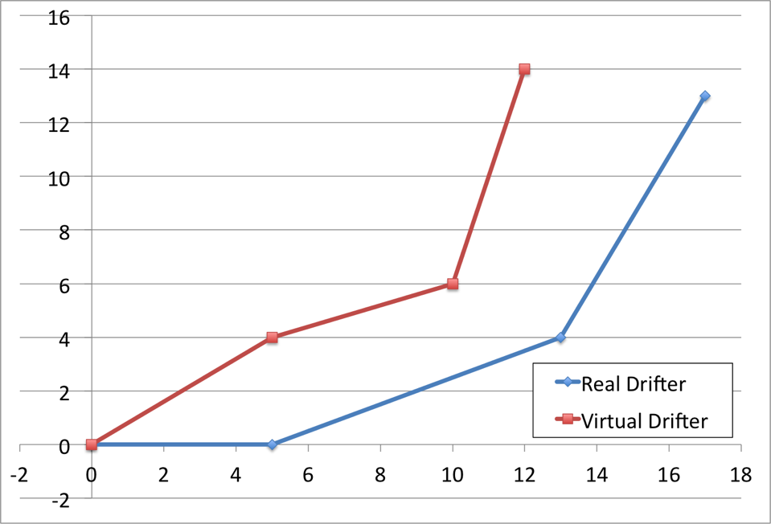
Day | Σ di | Σ loi | skill
1 | 4 | 5 | 0.2
2 | 4+3.6 | 5+14 | 0.60
3 | 4+3.6+5.1 | 5+14+24 | 0.70
Day 3
5.1
Day 2
Day 1
3.6
4
di
loi

Slide 35
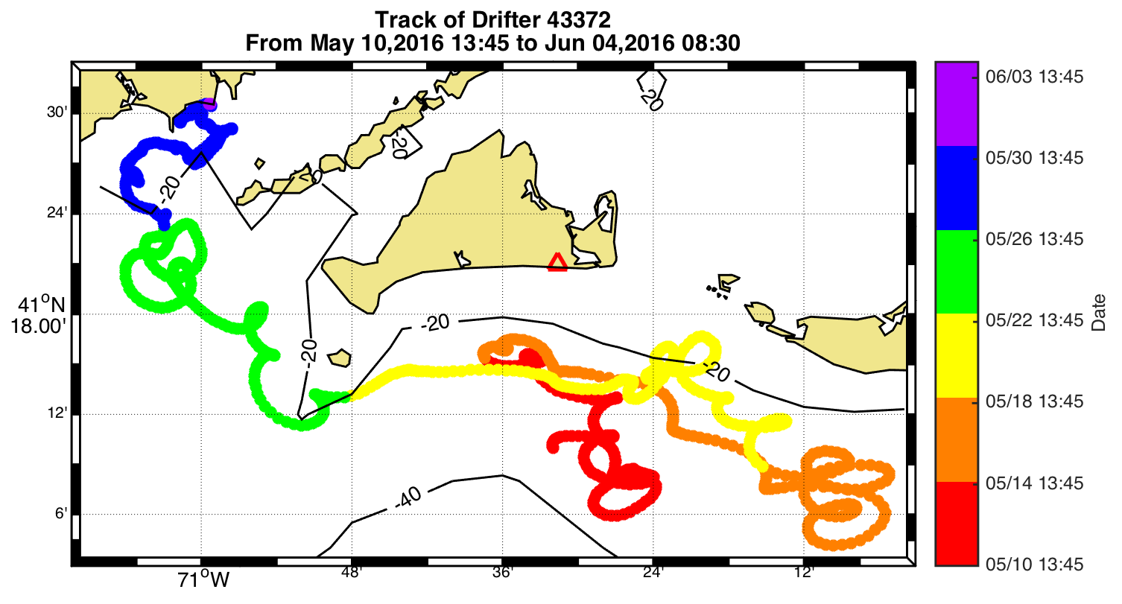

Slide 36
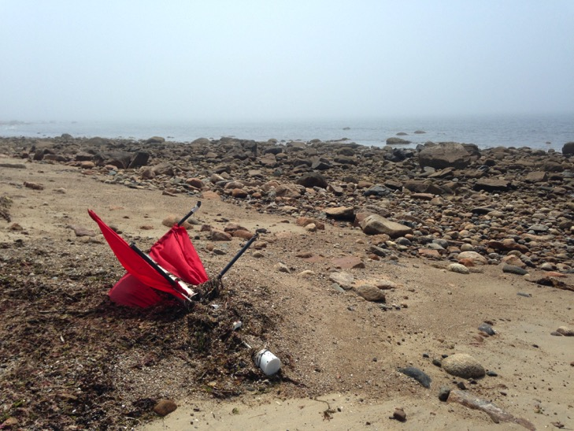
Drifter 43372 Washed Ashore South Dartmouth, MA

Slide 37
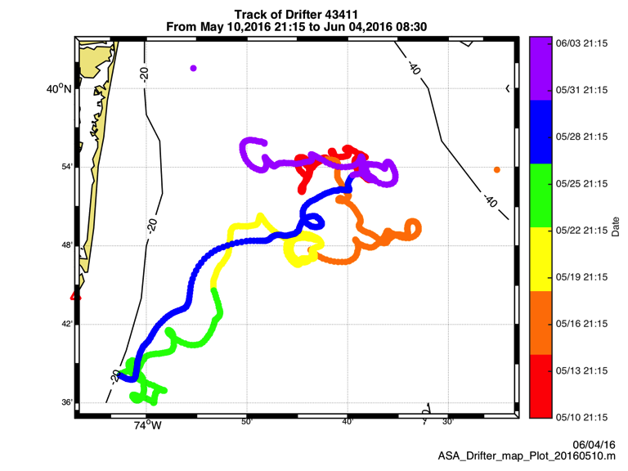

Slide 38
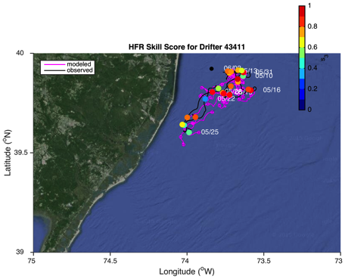
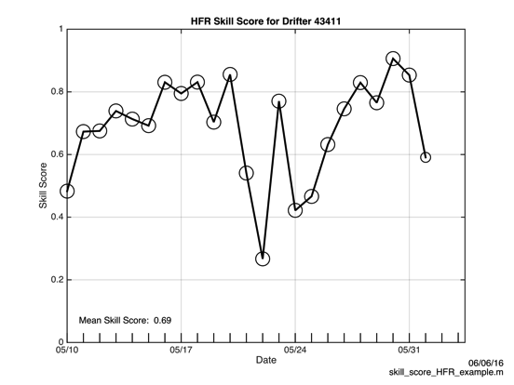
5 MHz HF Radar

Slide 39

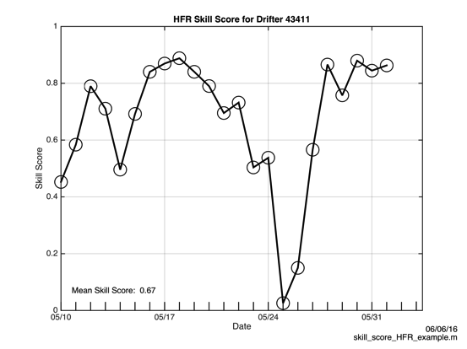
13 MHz HF Radar

Slide 40
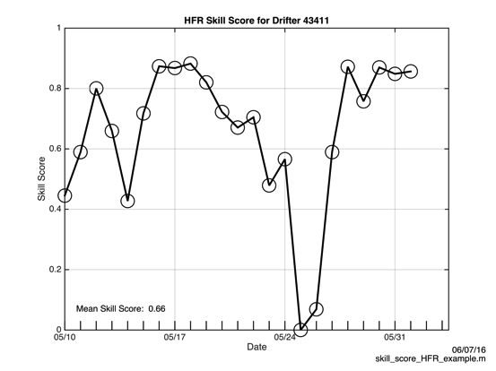

13 MHz HF Radar with QC

Slide 41
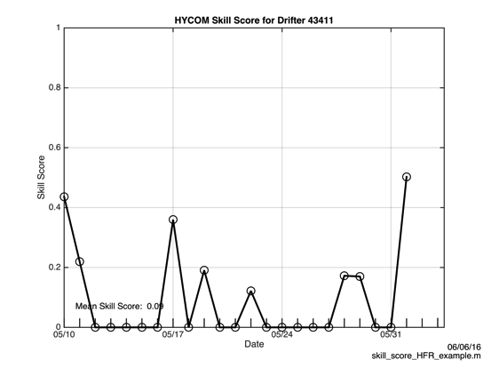
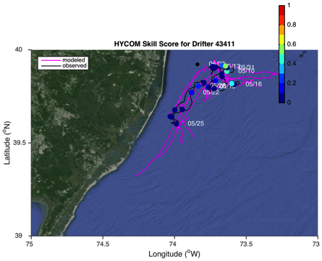
HYCOM

Slide 42
Skill Scores

Slide 43
RADIAL QUALITY CONTROL

Slide 44
Radial Surface Currents

Slide 45
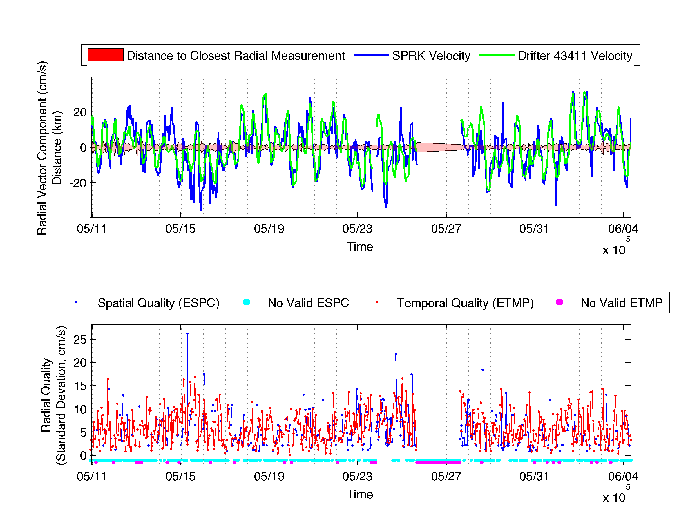

Slide 46
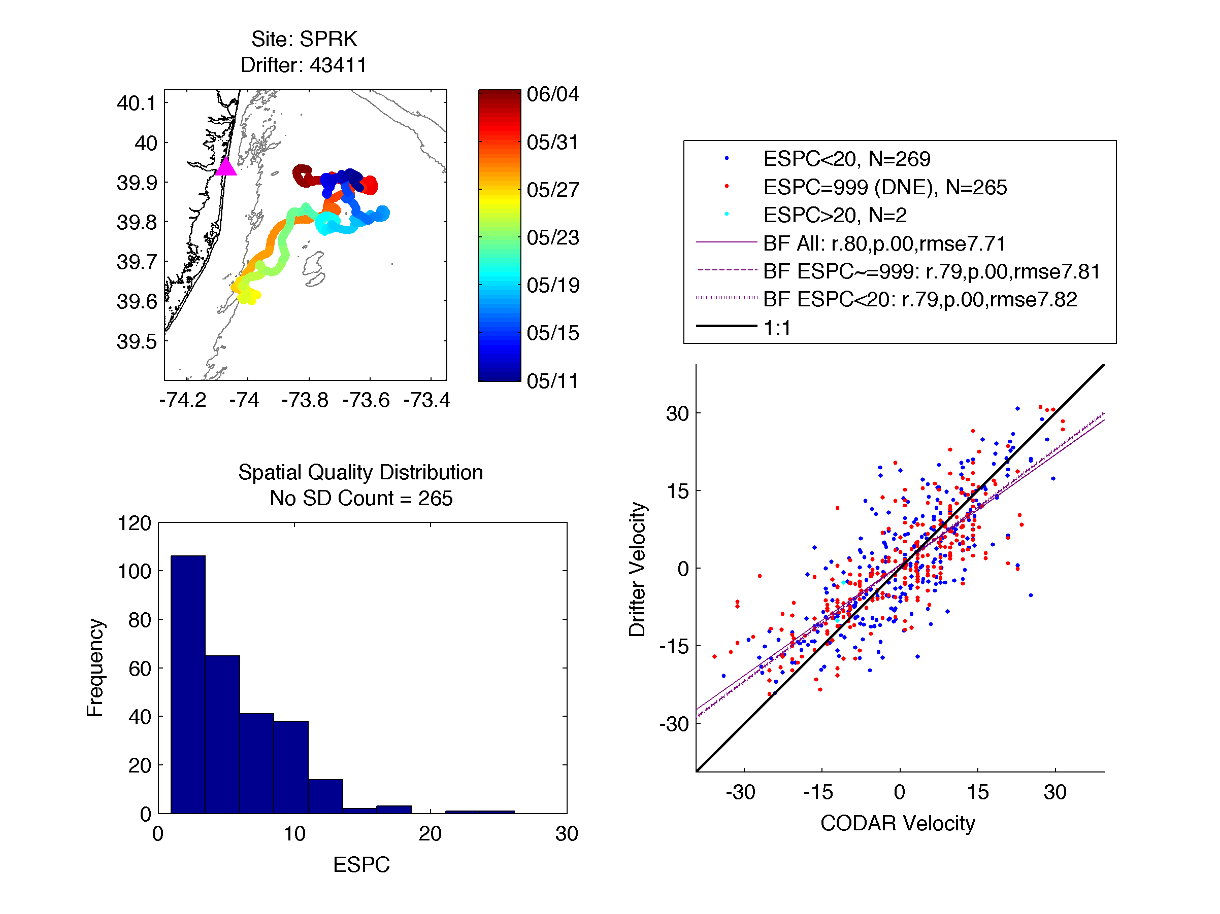

Slide 47
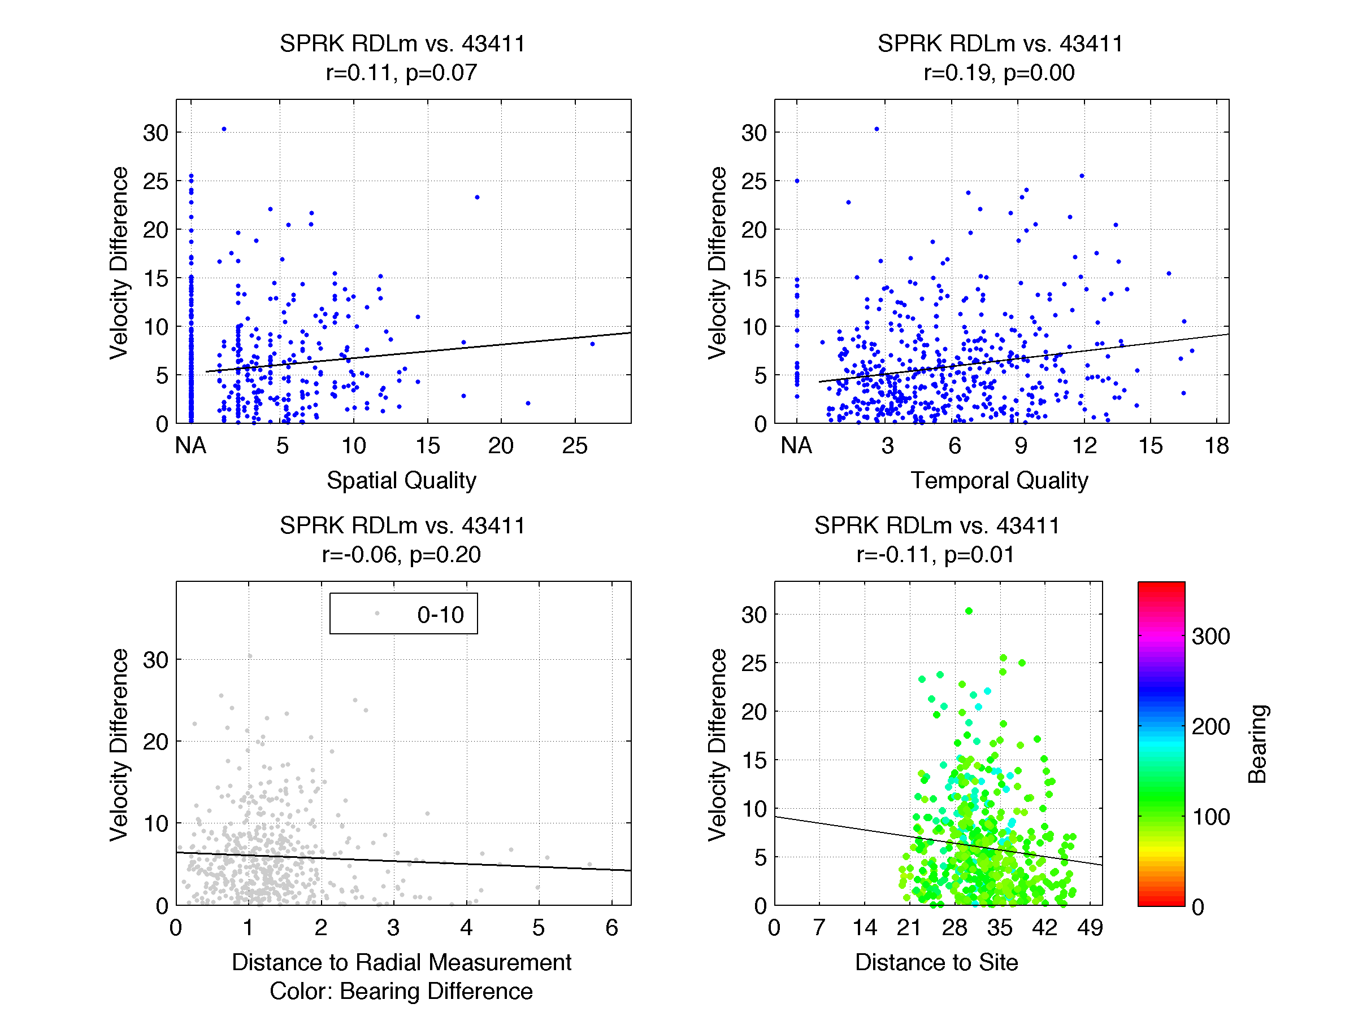

Slide 48
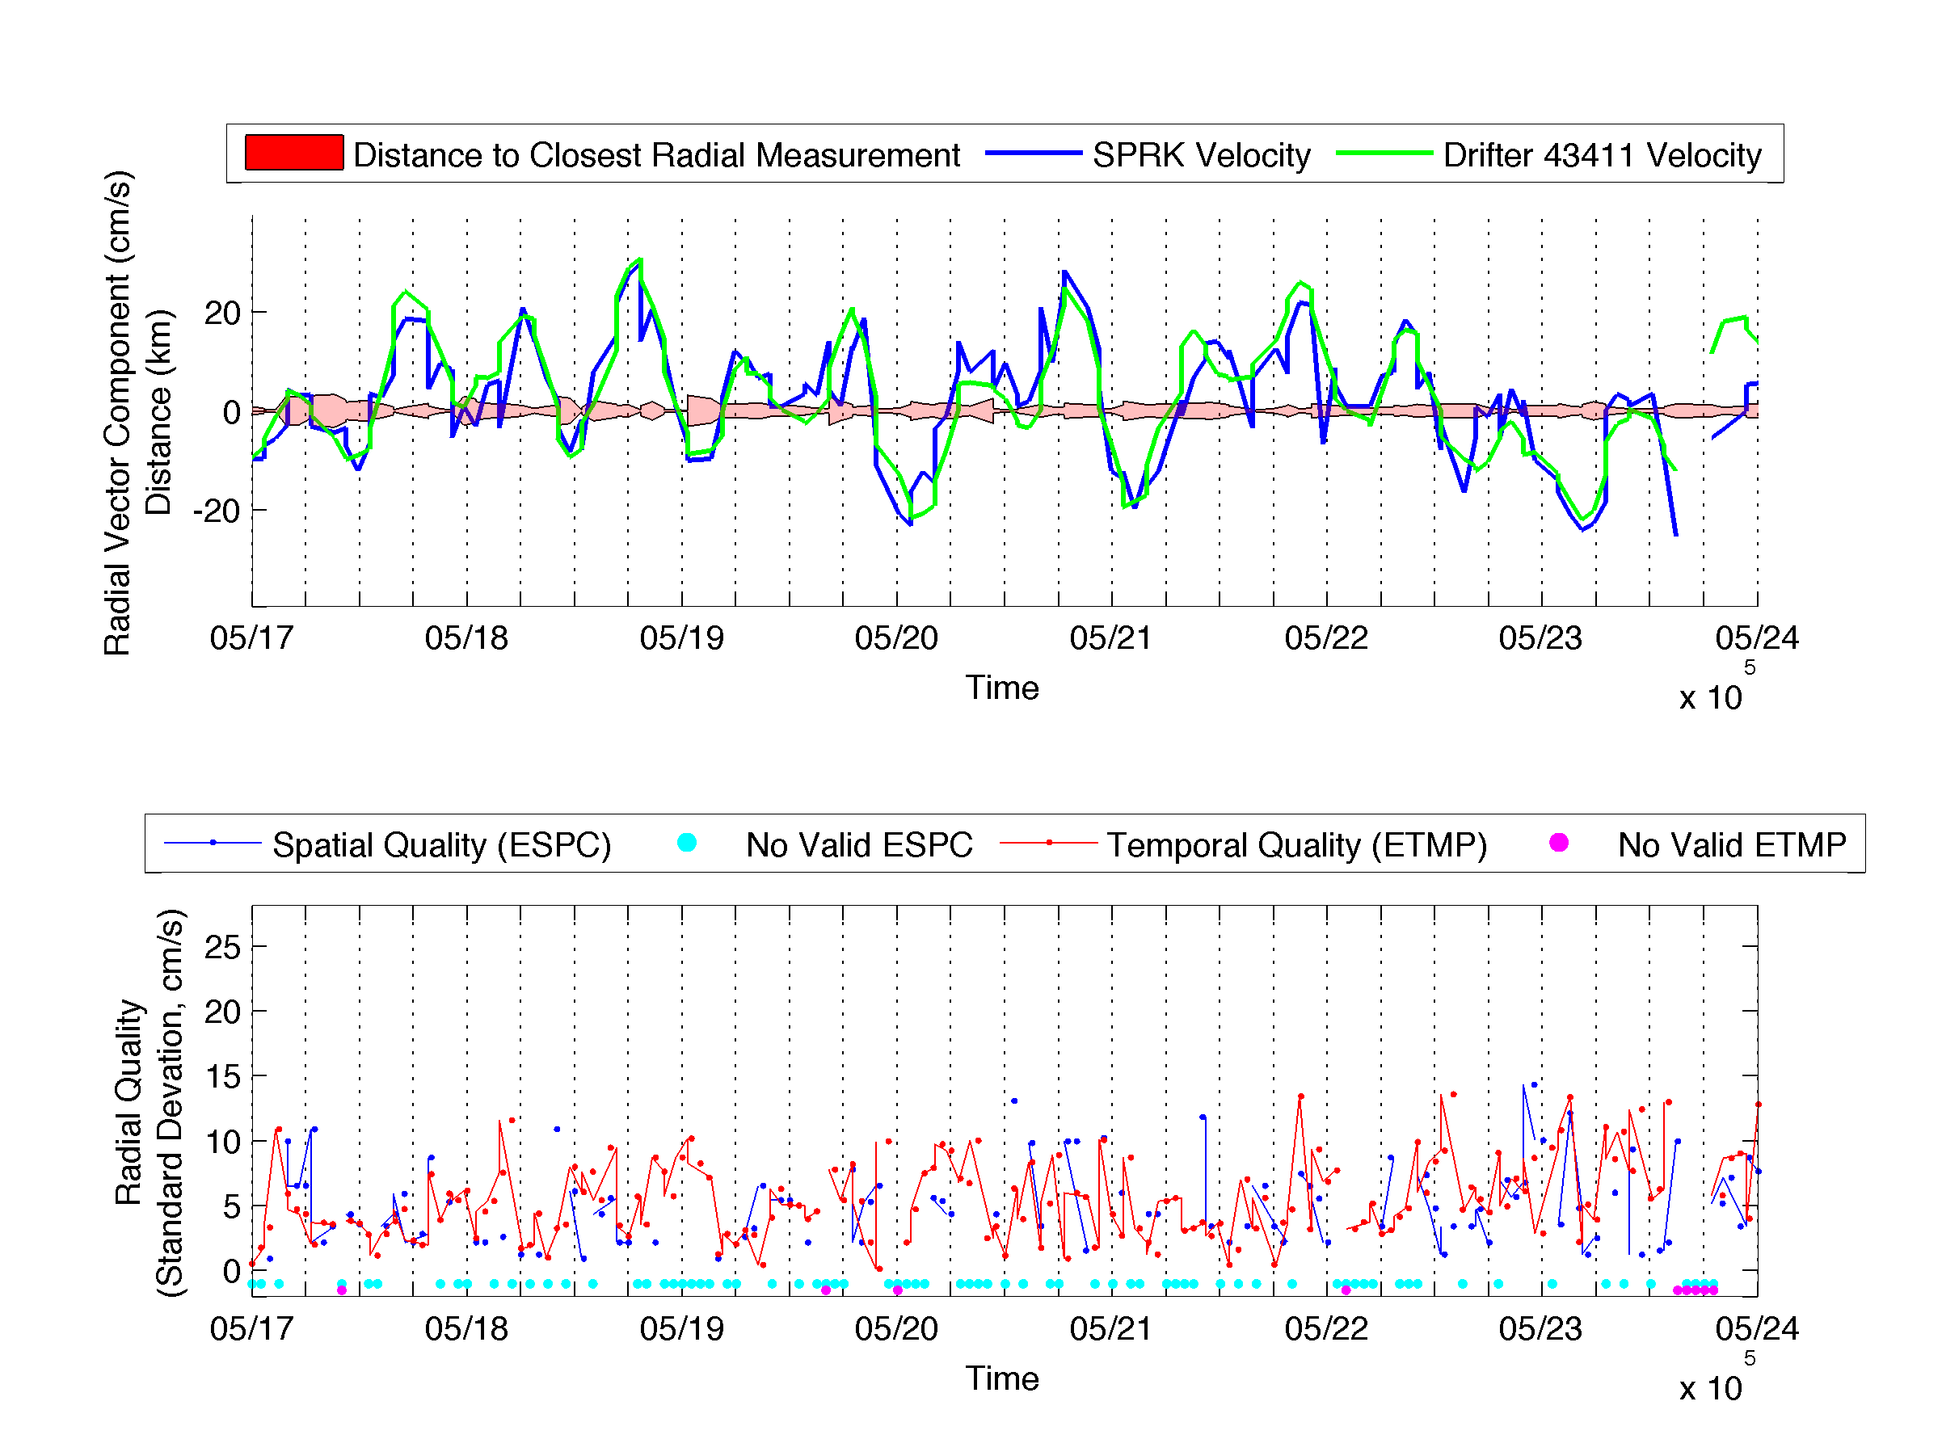

Slide 49
Outline
Introduction to HF Radar
Application for Search and Rescue
Assessing Skill of HFR for Search and Rescue
Radial Quality Control

Slide 50
HF Radar Skill Assessment
THANK YOU

